Slide 1
ECE 5984: Introduction to Machine Learning
Topics:
Supervised Learning
General Setup, learning from data
Nearest Neighbour
Readings: Barber 14 (kNN)
Dhruv Batra
Virginia Tech

Slide 2
Administrativia
New class room
GBJ 102
More space
Force-adds approved
Scholar
Anybody not have access?
Still have problems reading/submitting? Resolve ASAP.
Please post questions on Scholar Forum.
Please check scholar forums. You might not know you have a doubt.

Slide 3
Administrativia
Reading/Material/Pointers
Slides on Scholar
Scanned handwritten notes on Scholar
Readings/Video pointers on Public Website

Slide 4
Administrativia
Computer Vision & Machine Learning Reading Group
Meet: Fridays 5-6pm
Reading CV/ML conference papers
Whittemore 654

Slide 5
Plan for today
Supervised/Inductive Learning
Setup
Goal: Classification, Regression
Procedural View
Statistical Estimation View
Loss functions
Your first classifier: k-Nearest Neighbour

Slide 6
Types of Learning
Supervised learning
Training data includes desired outputs
Unsupervised learning
Training data does not include desired outputs
Weakly or Semi-supervised learning
Training data includes a few desired outputs
Reinforcement learning
Rewards from sequence of actions

Slide 7
Supervised / Inductive Learning
Given
examples of a function (x, f(x))
Predict function f(x) for new examples x
Discrete f(x): Classification
Continuous f(x): Regression
f(x) = Probability(x): Probability estimation

Slide 8
Slide Credit: Pedro Domingos, Tom Mitchel, Tom Dietterich

Slide 9
Supervised Learning
Input: x (images, text, emails…)
Output: y (spam or non-spam…)
(Unknown) Target Function
f: X → Y (the “true” mapping / reality)
Data
(x₁,y₁), (x₂,y₂), …, (x_{N},y_{N})
Model / Hypothesis Class
g: X → Y
y = g(x) = sign(w^{T}x)
Learning = Search in hypothesis space
Find best g in model class.

Slide 10
Slide Credit: Yaser Abu-Mostapha

Slide 11
Basic Steps of Supervised Learning
Set up a supervised learning problem
Data collection
Start with training data for which we know the correct outcome provided by a teacher or oracle.
Representation
Choose how to represent the data.
Modeling
Choose a hypothesis class: H = {g: X → Y}
Learning/Estimation
Find best hypothesis you can in the chosen class.
Model Selection
Try different models. Picks the best one. (More on this later)
If happy stop
Else refine one or more of the above

Slide 12
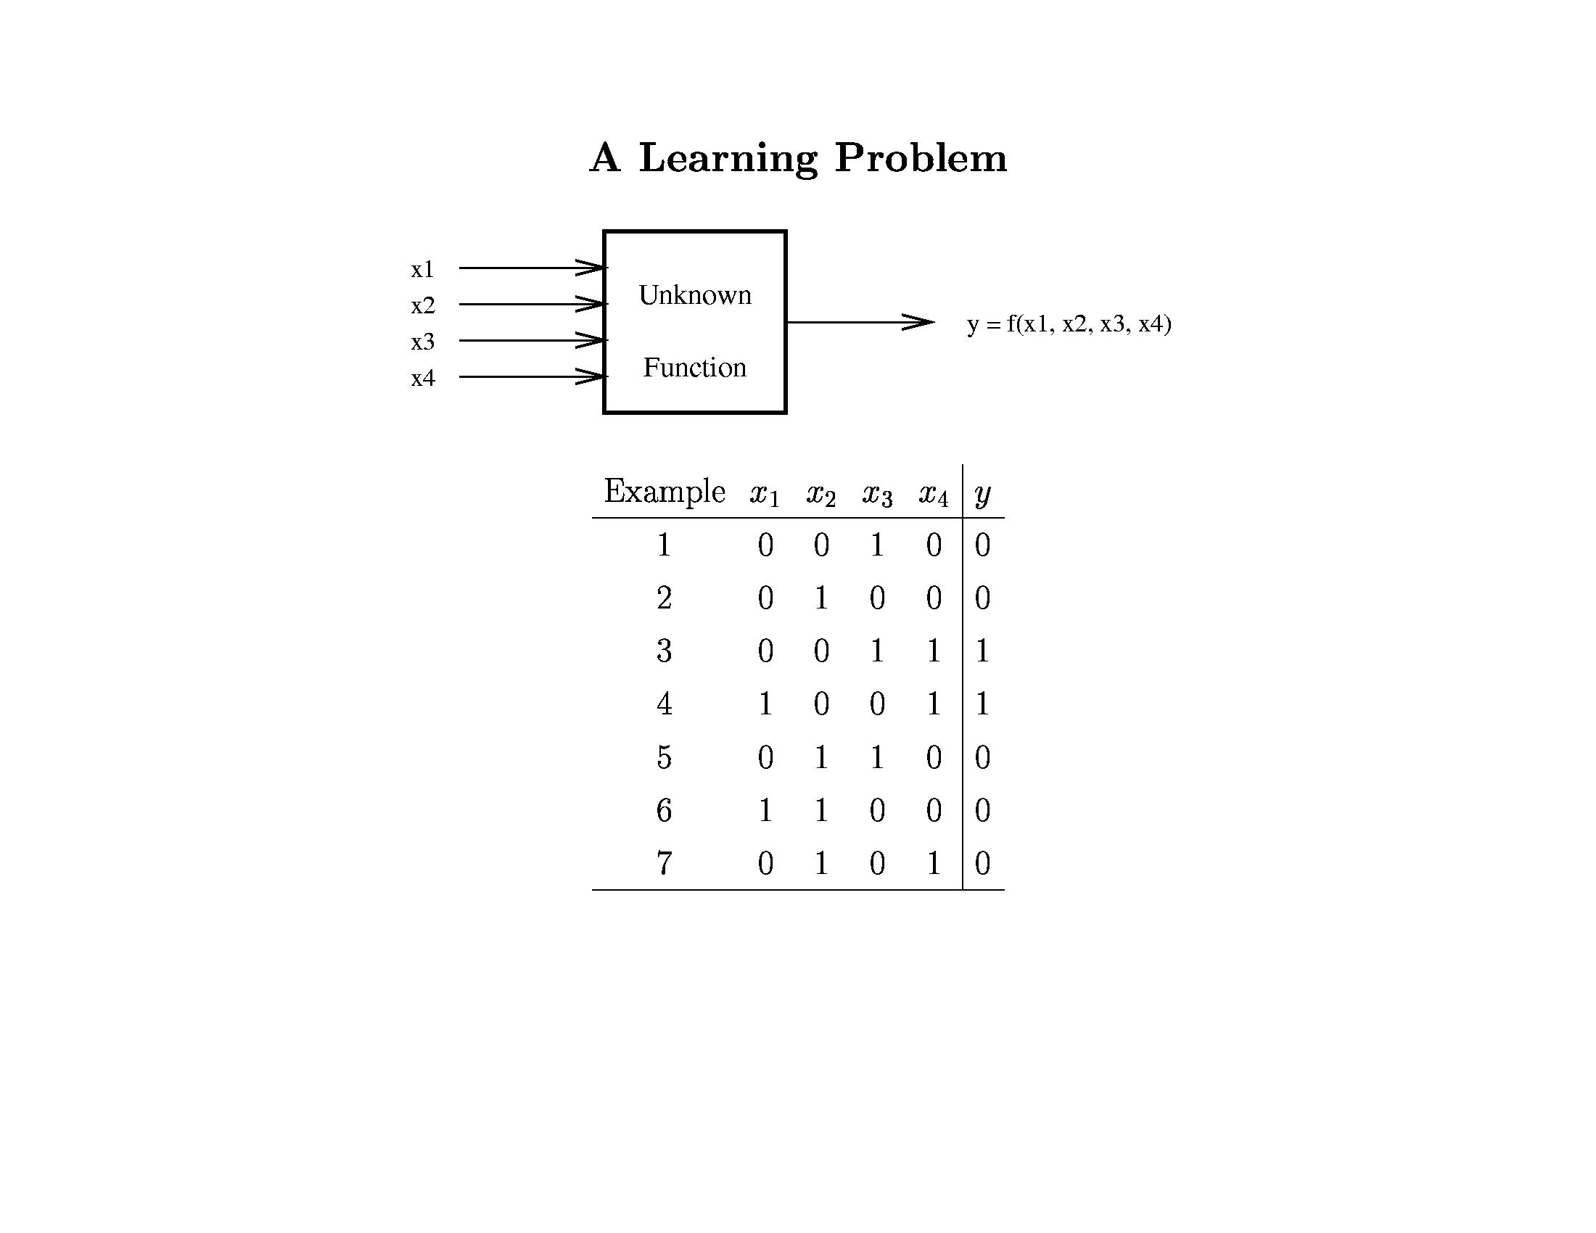
Learning is hard!
No assumptions = No learning

Slide 13
Klingon vs Mlingon Classification
Training Data
Klingon: klix, kour, koop
Mlingon: moo, maa, mou
Testing Data: kap
Which language?
Why?

Slide 14
Loss/Error Functions
How do we measure performance?
Regression:
L₂ error
Classification:
#misclassifications
Weighted misclassification via a cost matrix
For 2-class classification:
True Positive, False Positive, True Negative, False Negative
For k-class classification:
Confusion Matrix

Slide 15
Training vs Testing
What do we want?
Good performance (low loss) on training data?
No, Good performance on unseen test data!
Training Data:
{ (x₁,y₁), (x₂,y₂), …, (x_{N},y_{N}) }
Given to us for learning f
Testing Data
{ x₁, x₂, …, x_{M} }
Used to see if we have learnt anything

Slide 16
Procedural View
Training Stage:
Raw Data → x (Feature Extraction)
Training Data { (x,y) } → f (Learning)
Testing Stage
Raw Data → x (Feature Extraction)
Test Data x → f(x) (Apply function, Evaluate error)

Slide 17
Statistical Estimation View
Probabilities to rescue:
x and y are random variables
D = (x₁,y₁), (x₂,y₂), …, (x_{N},y_{N}) ~ P(X,Y)
IID: Independent Identically Distributed
Both training & testing data sampled IID from P(X,Y)
Learn on training set
Have some hope of generalizing to test set

Slide 18
Concepts
Capacity
Measure how large hypothesis class H is.
Are all functions allowed?
Overfitting
f works well on training data
Works poorly on test data
Generalization
The ability to achieve low error on new test data

Slide 19
Guarantees
20 years of research in Learning Theory oversimplified:
If you have:
Enough training data D
and H is not too complex
then probably we can generalize to unseen test data

Slide 20
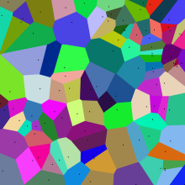
New Topic: Nearest Neighbours
Image Credit: Wikipedia

Slide 21
Synonyms
Nearest Neighbours
k-Nearest Neighbours
Member of following families:
Instance-based Learning
Memory-based Learning
Exemplar methods
Non-parametric methods

Slide 22
Nearest Neighbor is an example of…. Instance-based learning
Has been around since about 1910.
To make a prediction, search database for similar datapoints, and fit with the local points.
Assumption: Nearby points behavior similarly wrt y
x₁ y₁
x₂ y₂
x₃ y₃
.
.
x_{n} y_{n}

Slide 23
Instance/Memory-based Learning
Four things make a memory based learner:
A distance metric
How many nearby neighbors to look at?
A weighting function (optional)
How to fit with the local points?
Slide Credit: Carlos Guestrin

Slide 24
1-Nearest Neighbour
Four things make a memory based learner:
A distance metric
Euclidean (and others)
How many nearby neighbors to look at?
1
A weighting function (optional)
unused
How to fit with the local points?
Just predict the same output as the nearest neighbour.
Slide Credit: Carlos Guestrin

Slide 25
k-Nearest Neighbour
Four things make a memory based learner:
A distance metric
Euclidean (and others)
How many nearby neighbors to look at?
k
A weighting function (optional)
unused
How to fit with the local points?
Just predict the average output among the nearest neighbours.
Slide Credit: Carlos Guestrin

Slide 26
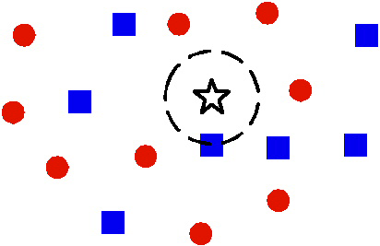
1 vs k Nearest Neighbour
Image Credit: Ying Wu

Slide 27
1 vs k Nearest Neighbour
Image Credit: Ying Wu

Slide 28
Nearest Neighbour
Demo 1
http://cgm.cs.mcgill.ca/~soss/cs644/projects/perrier/Nearest.html
Demo 2
http://www.cs.technion.ac.il/~rani/LocBoost/

Slide 29
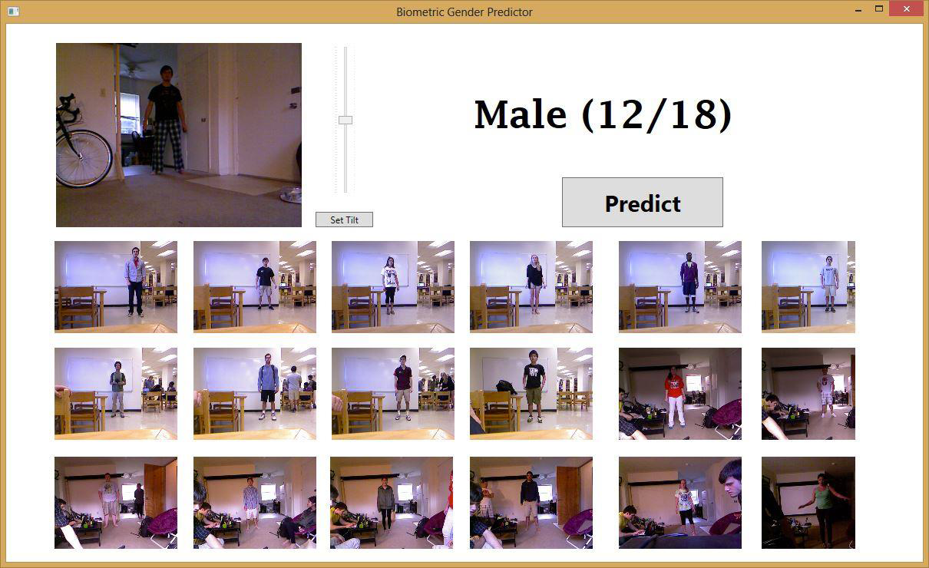
Spring 2013 Projects
Gender Classification from body proportions
Igor Janjic & Daniel Friedman, Juniors

Slide 30
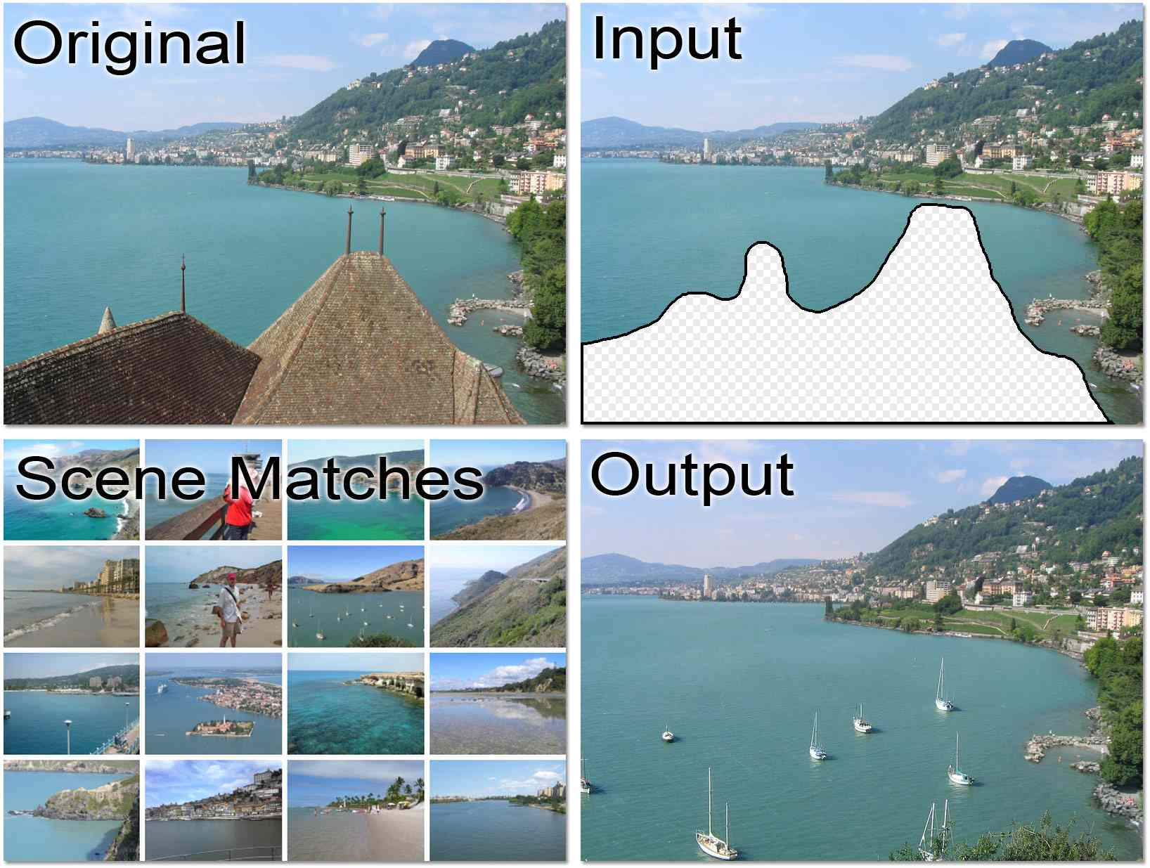
Scene Completion [Hayes & Efros, SIGGRAPH07]

Slide 31
Hays and Efros, SIGGRAPH 2007
Notes:
Now we take our gist (and mask and color image) and find it’s L2 nearest neighbors in the database of 2.3 million images.

Slide 32
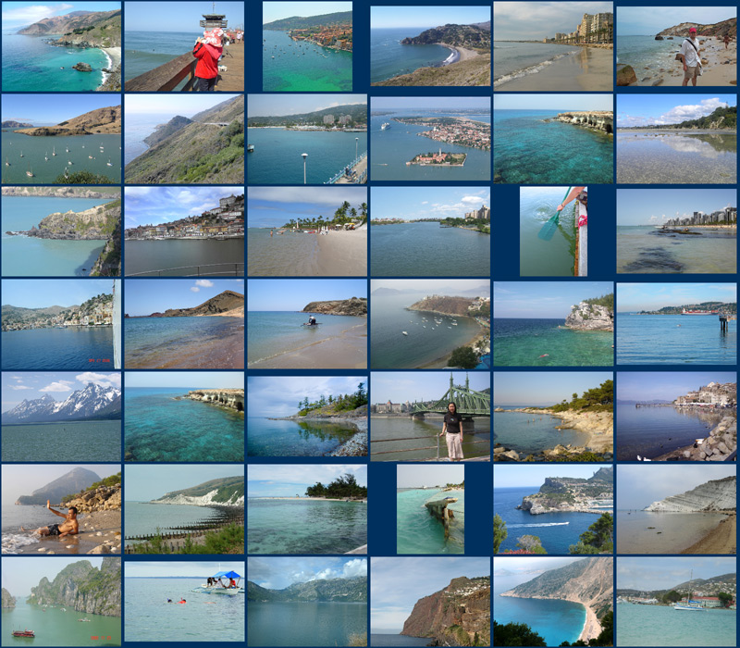
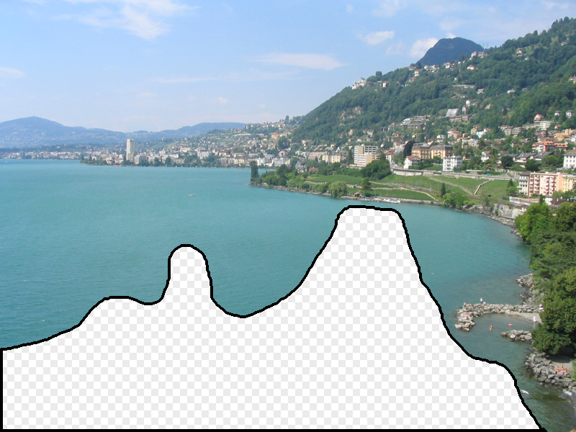
… 200 total
Hays and Efros, SIGGRAPH 2007

Slide 33
Context Matching
Hays and Efros, SIGGRAPH 2007

Slide 34
Graph cut + Poisson blending
Hays and Efros, SIGGRAPH 2007

Slide 35
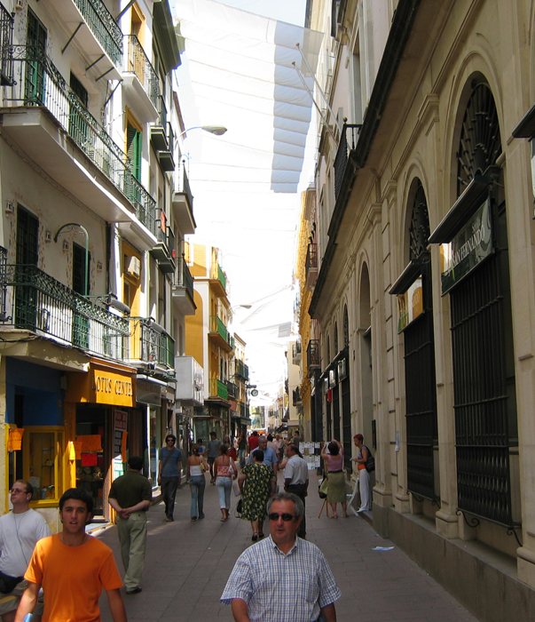
Hays and Efros, SIGGRAPH 2007
Notes:
not just for the cases where the data
needed simply isn't available in the source image (show several such examples)

Slide 36
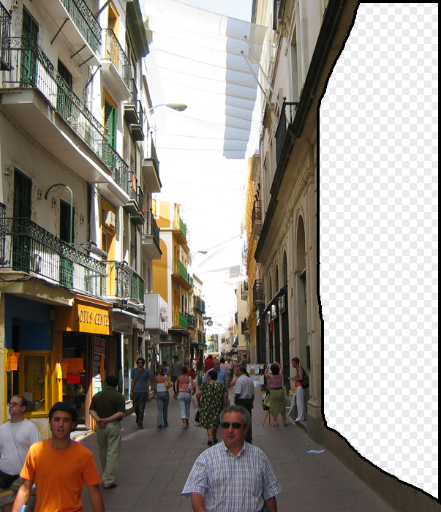
Hays and Efros, SIGGRAPH 2007
Notes:
not just for the cases where the data
needed simply isn't available in the source image (show several such examples)

Slide 37
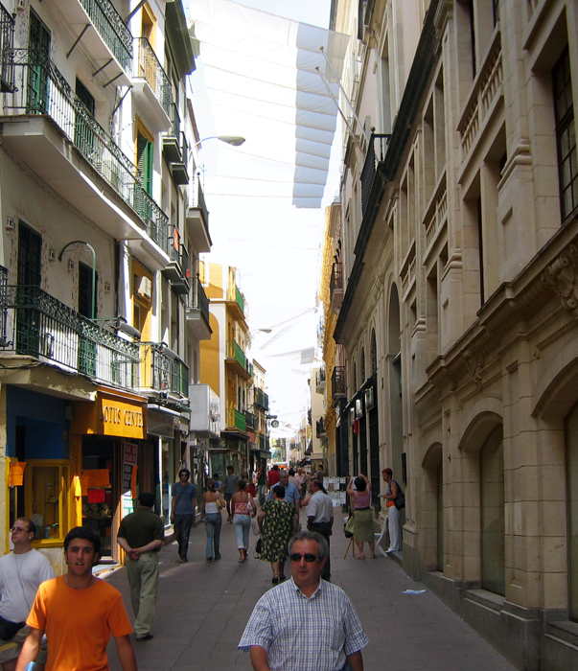
Hays and Efros, SIGGRAPH 2007
Notes:
not just for the cases where the data
needed simply isn't available in the source image (show several such examples)

Slide 38
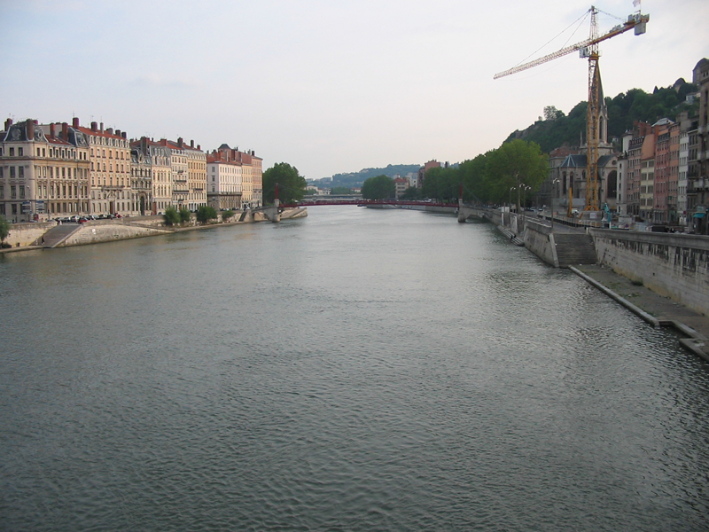
Hays and Efros, SIGGRAPH 2007

Slide 39
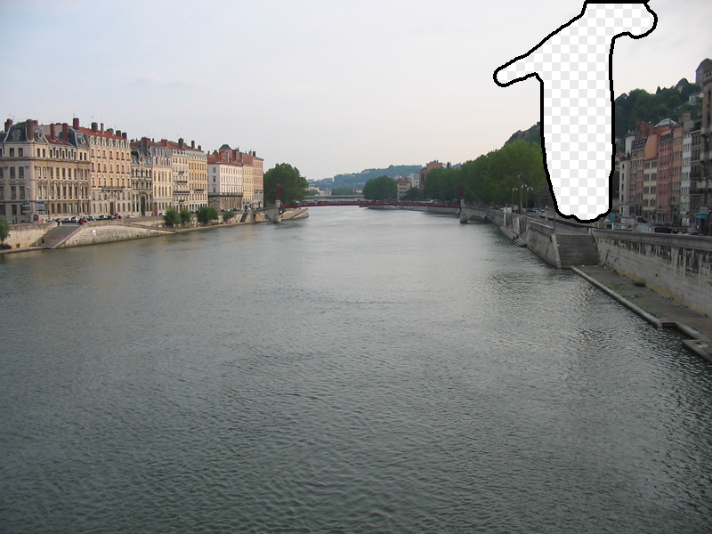
Hays and Efros, SIGGRAPH 2007

Slide 40
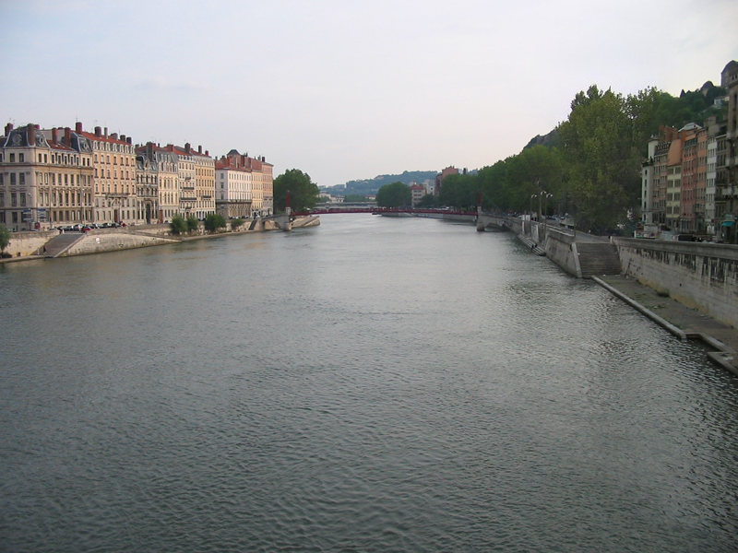
Hays and Efros, SIGGRAPH 2007

