Slide 1
ECE 5984: Introduction to
Machine Learning
Topics:
  Classification: Naïve Bayes
Readings: Barber 10.1-10.3
Dhruv Batra
Virginia Tech

Slide 2
Administrativia
HW2
  Due: Friday 03/06, 03/15, 11:55pm
  Implement linear regression, Naïve Bayes, Logistic Regression
Need a couple of catch-up lectures
  How about 4-6pm?

Slide 3
Administrativia
Mid-term
  When: March 18, class timing
  Where: In class
  Format: Pen-and-paper.
  Open-book, open-notes, closed-internet.
    No sharing.
  What to expect: mix of
    Multiple Choice or True/False questions
    “Prove this statement”
    “What would happen for this dataset?”
  Material
    Everything from beginning to class to (including) SVMs

Slide 4
New Topic:
Naïve Bayes
(your first probabilistic classifier)
x
Classification
y
Discrete

Slide 5
Error Decomposition
Approximation/Modeling Error
  You approximated reality with model
Estimation Error
  You tried to learn model with finite data
Optimization Error
  You were lazy and couldn’t/didn’t optimize to completion
Bayes Error
  Reality just sucks
  http://psych.hanover.edu/JavaTest/SDT/ROC.html

Slide 6
Classification
Learn: h:X  Y
  X – features
  Y – target classes
Suppose you know P(Y|X) exactly, how should you classify?
  Bayes classifier:
Why?
Slide Credit: Carlos Guestrin

Slide 7
Optimal classification
Theorem: Bayes classifier h_{Bayes} is optimal!
  That is
Proof:
Slide Credit: Carlos Guestrin

Slide 8
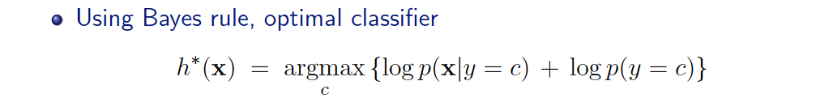
Generative vs. Discriminative
Generative Approach
  Estimate p(x|y) and p(y)
  Use Bayes Rule to predict y
Discriminative Approach
  Estimate p(y|x) directly OR
  Learn “discriminant” function h(x)

Slide 9
Generative vs. Discriminative
Generative Approach
  Assume some functional form for P(X|Y), P(Y)
  Estimate p(X|Y) and p(Y)
  Use Bayes Rule to calculate P(Y| X=x)
  Indirect computation of P(Y|X) through Bayes rule
  But, can generate a sample, P(X) = ∑_{y} P(y) P(X|y)
Discriminative Approach
  Estimate p(y|x) directly OR
  Learn “discriminant” function h(x)
  Direct but cannot obtain a sample of the data, because P(X) is not available

Slide 10
Generative vs. Discriminative
Generative:
  Today: Naïve Bayes
Discriminative:
  Next: Logistic Regression
NB & LR related to each other.

Slide 11
How hard is it to learn the optimal classifier?
Categorical Data
How do we represent these? How many parameters?
  Class-Prior, P(Y):
    Suppose Y is composed of k classes
  Likelihood, P(X|Y):
    Suppose X is composed of d binary features
Complex model → High variance with limited data!!!
Slide Credit: Carlos Guestrin

Slide 12
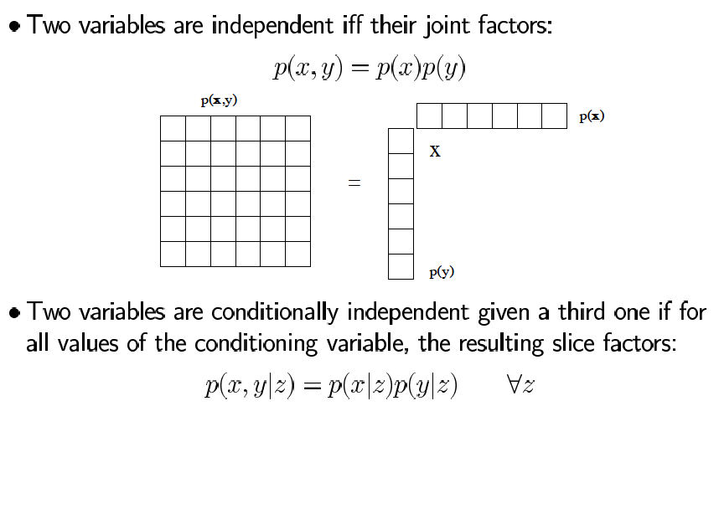
Independence to the rescue
Slide Credit: Sam Roweis

Slide 13

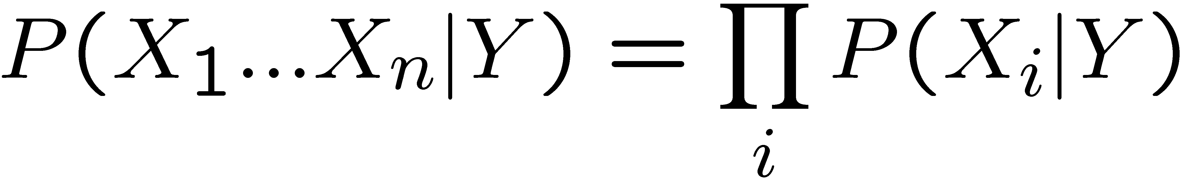
The Naïve Bayes assumption
Naïve Bayes assumption:
  Features are independent given class:
  More generally:
How many parameters now?
    Suppose X is composed of d binary features
Slide Credit: Carlos Guestrin

Slide 14
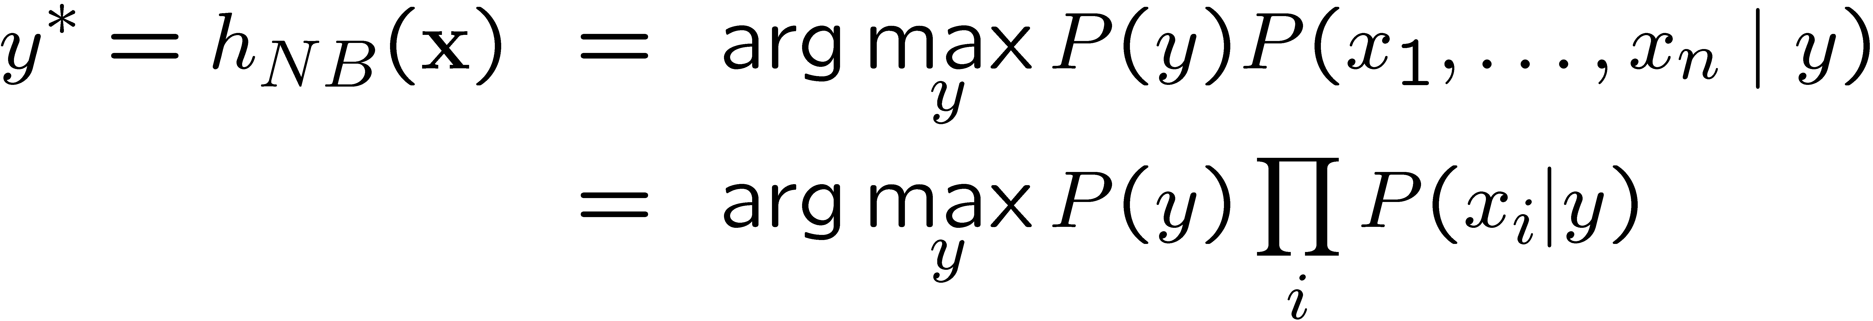
The Naïve Bayes Classifier
Given:
  Class-Prior P(Y)
  d conditionally independent features X given the class Y
  For each X_{i}, we have likelihood P(X_{i}|Y)
Decision rule:
If assumption holds, NB is optimal classifier!
Slide Credit: Carlos Guestrin

Slide 15
MLE for the parameters of NB
Given dataset
  Count(A=a,B=b) #number of examples where A=a and B=b
MLE for NB, simply:
  Class-Prior: P(Y=y) =
  Likelihood: P(X_{i}=x_{i} | Y=y) =

Slide 16
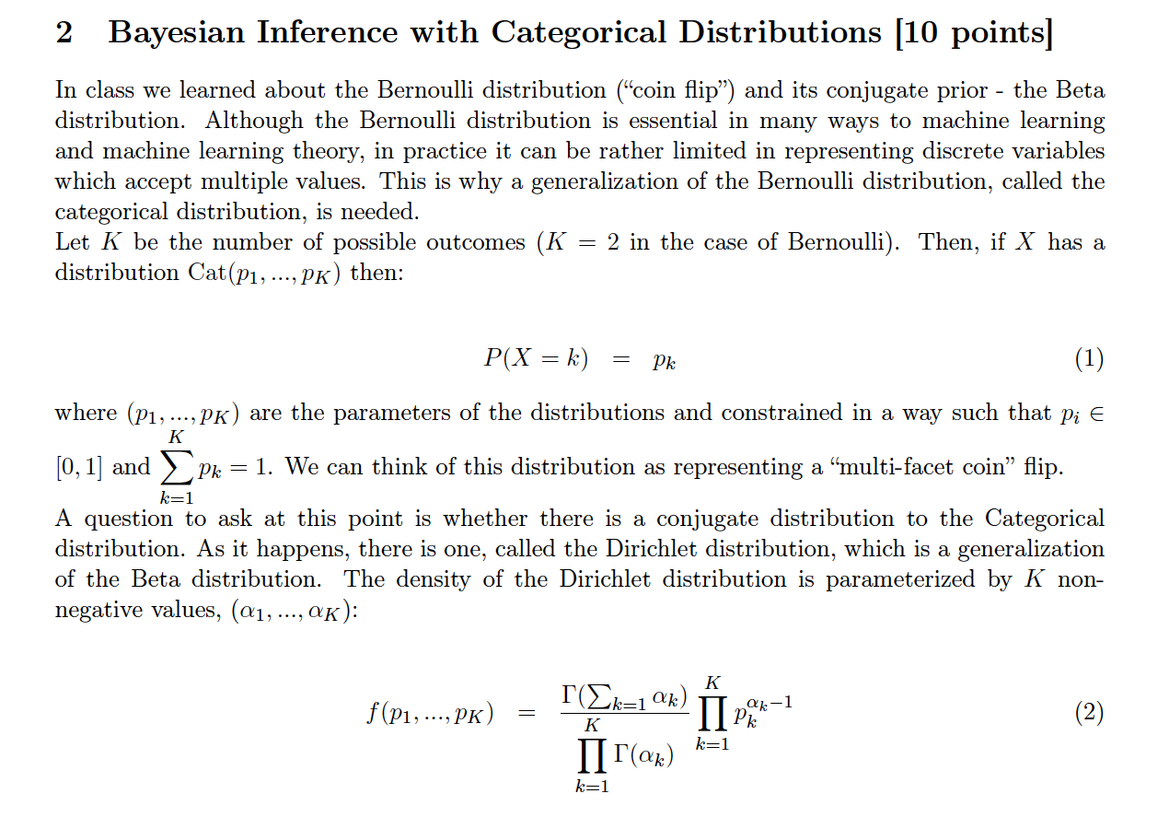
HW1

Slide 17
Naïve Bayes
In class demo
Variables
  Y = {did-not-watch superbowl, watched superbowl}
  X₁ = {domestic, international}
  X₂ = {<2 years at VT, >=2years}
Estimate
  P(Y=1)
  P(X₁=0 | Y=0), P(X₂=0 | Y=0)
  P(X₁=0 | Y=1), P(X₂=0 | Y=1)
Prediction: argmax_y P(Y=y)P(x₁|Y=y)P(x₂|Y=y)

Slide 18
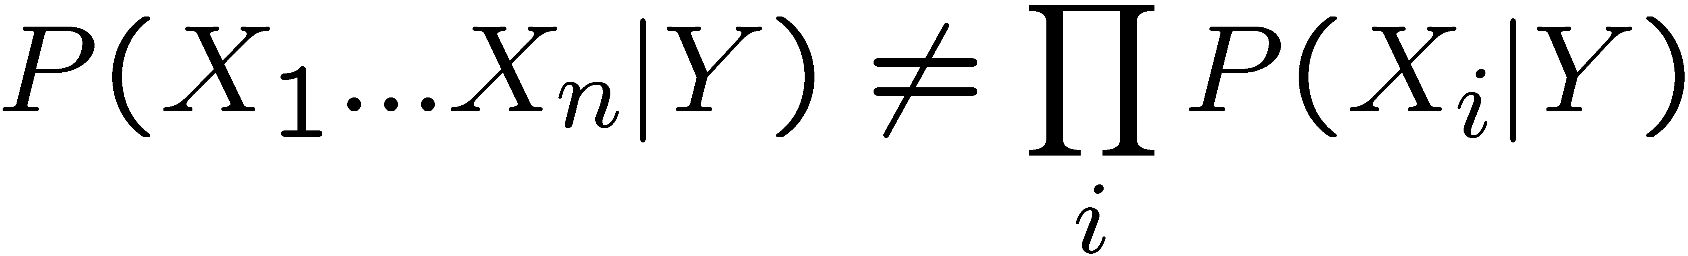
Subtleties of NB classifier 1 – Violating the NB assumption
Usually, features are not conditionally independent:
Probabilities P(Y|X) often biased towards 0 or 1
Nonetheless, NB is a very popular classifier
  NB often performs well, even when assumption is violated
  [Domingos & Pazzani ’96] discuss some conditions for good performance
Slide Credit: Carlos Guestrin

Slide 19
Subtleties of NB classifier 2 – Insufficient training data
What if you never see a training instance where X₁=a when Y=c?
  e.g., Y={NonSpamEmail}, X₁={‘Nigeria’}
  P(X₁=a | Y=c) = 0
Thus, no matter what the values X₂,…,X_{d} take:
  P(Y=c | X₁=a,X₂,…,X_{d}) = 0
What now???
Slide Credit: Carlos Guestrin

Slide 20
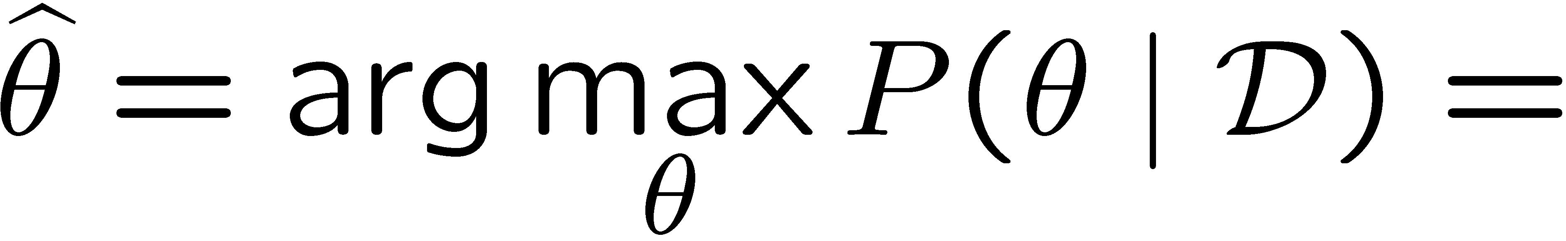
Recall MAP for Bernoulli-Beta
MAP: use most likely parameter:
Beta prior equivalent to extra flips
Slide Credit: Carlos Guestrin

Slide 21
Bayesian learning for NB parameters – a.k.a. smoothing
Prior on parameters
  Dirichlet everything!
MAP estimate
Now, even if you never observe a feature/class, posterior probability never zero
Slide Credit: Carlos Guestrin

Slide 22
Text classification
Classify e-mails
  Y = {Spam,NotSpam}
Classify news articles
  Y = {what is the topic of the article?}
Classify webpages
  Y = {Student, professor, project, …}
What about the features X?
  The text!
Slide Credit: Carlos Guestrin

Slide 23

Features X are entire document – X_{i} for i^{th} word in article
Slide Credit: Carlos Guestrin

Slide 24
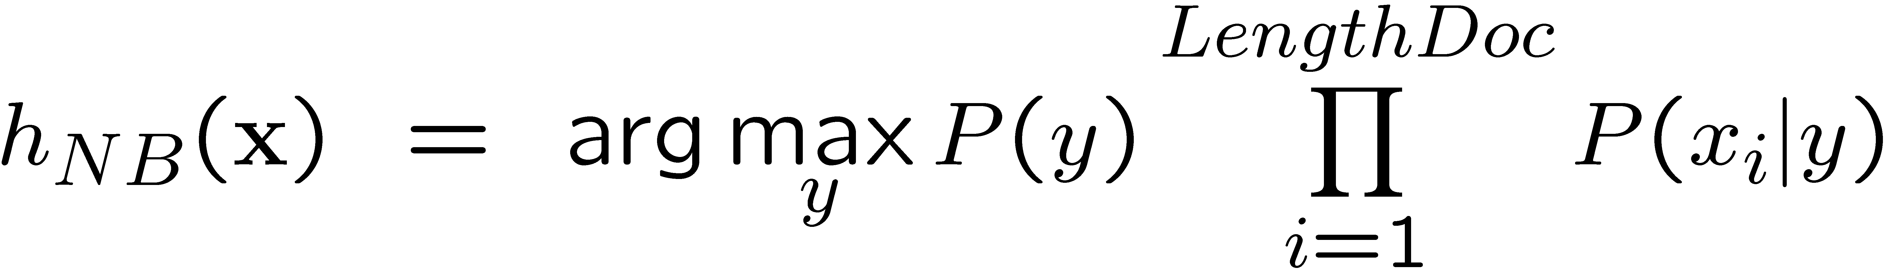
NB for Text classification
P(X|Y) is huge!!!
  Article at least 1000 words, X={X₁,…,X₁₀₀₀}
  X_{i} represents i^{th} word in document, i.e., the domain of X_{i} is entire vocabulary, e.g., Webster Dictionary (or more), 10,000 words, etc.
NB assumption helps a lot!!!
  P(X_{i}=x_{i}|Y=y) is just the probability of observing word x_{i} in a document on topic y
Slide Credit: Carlos Guestrin

Slide 25
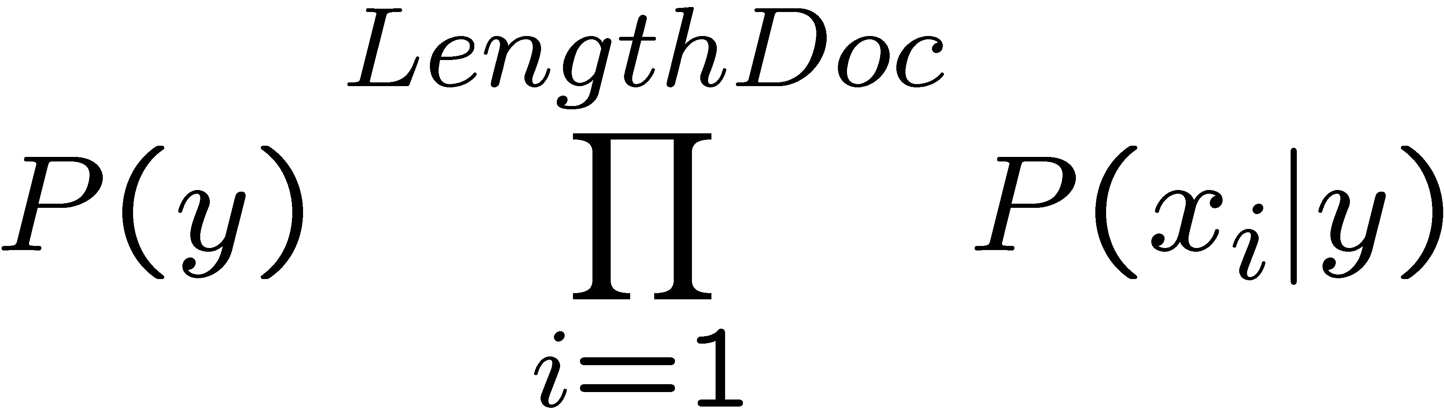
Bag of Words model
Typical additional assumption:
Position in document doesn’t matter:
P(X_{i}=a|Y=y) = P(X_{k}=a|Y=y)
  “Bag of words” model – order of words on the page ignored
  Sounds really silly, but often works very well!
When the lecture is over, remember to wake up the
person sitting next to you in the lecture room.
Slide Credit: Carlos Guestrin

Slide 26
Bag of Words model
Typical additional assumption:
Position in document doesn’t matter:
P(X_{i}=x_{i}|Y=y) = P(X_{k}=x_{i}|Y=y)
  “Bag of words” model – order of words on the page ignored
  Sounds really silly, but often works very well!
in is lecture lecture next over person remember room
sitting the the the to to up wake when you
Slide Credit: Carlos Guestrin

Slide 27

Bag of Words model
aardvark 0
about 2
all 2
Africa 1
apple 0
anxious 0
...
gas 1
...
oil 1
…
Zaire 0
Slide Credit: Carlos Guestrin

Slide 28



Object
Bag of ‘words’
Slide Credit: Fei Fei Li

Slide 29


Slide Credit: Fei Fei Li

Slide 30

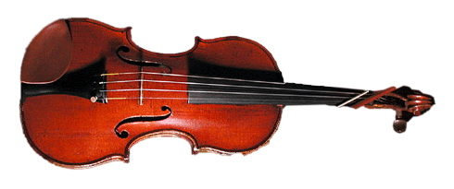
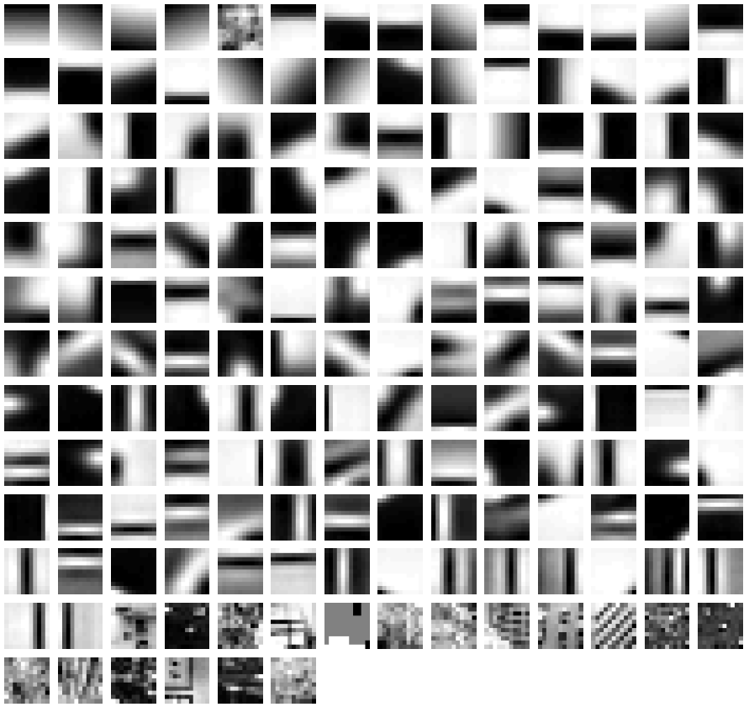
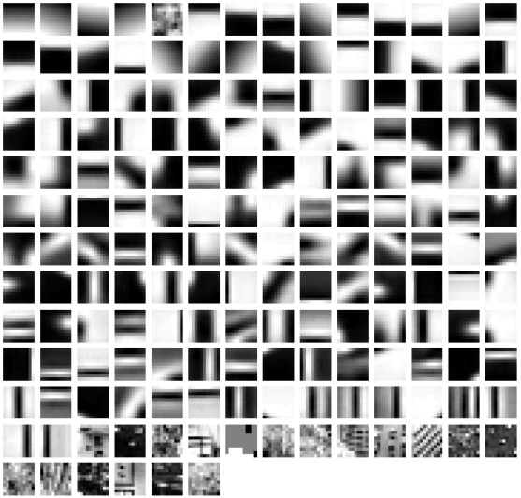


learning
recognition
codewords dictionary
feature detection
& representation
image representation
category
decision
category models
(and/or) classifiers
Slide Credit: Fei Fei Li

Slide 31
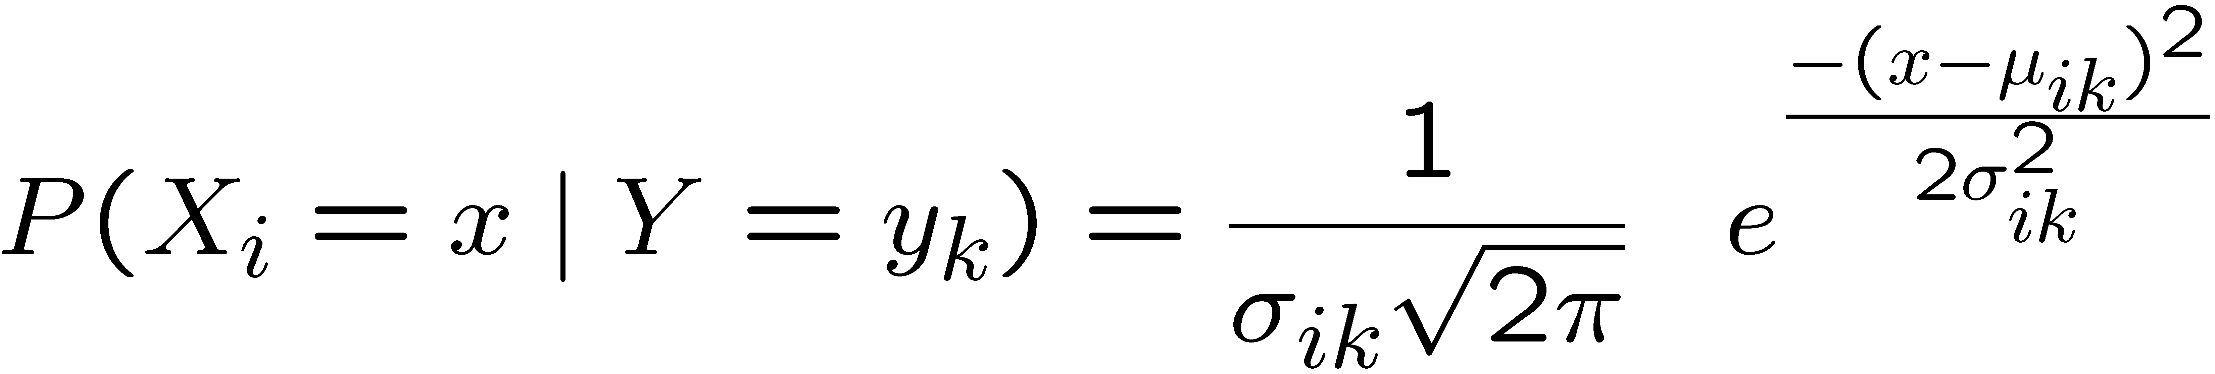
What if we have continuous X_{i} ?
Eg., character recognition: X_{i} is i^{th} pixel
Gaussian Naïve Bayes (GNB):
Sometimes assume variance
is independent of Y (i.e., σ_{i}),
or independent of X_{i} (i.e., σ_{k})
or both (i.e., σ)
Slide Credit: Carlos Guestrin

Slide 32
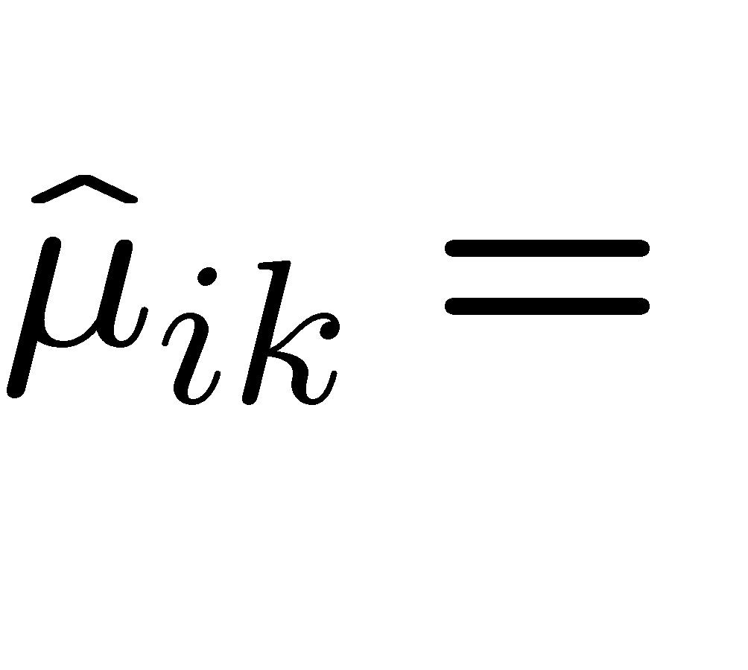
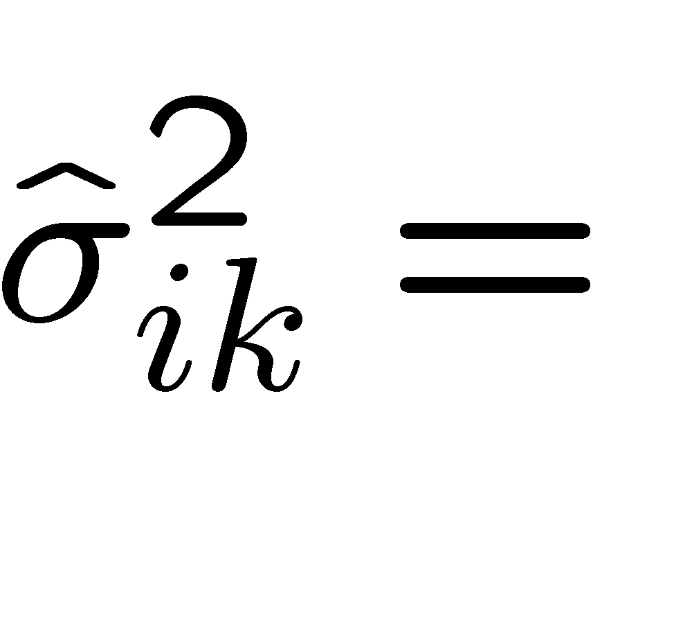
Estimating Parameters: Y discrete, X_{i} continuous
Maximum likelihood estimates:

Slide 33
What you need to know about NB
Optimal decision using Bayes Classifier
Naïve Bayes classifier
  What’s the assumption
  Why we use it
  How do we learn it
  Why is Bayesian estimation of NB parameters important
Text classification
  Bag of words model
Gaussian NB
  Features are still conditionally independent
  Each feature has a Gaussian distribution given class

Slide 34
Generative vs. Discriminative
Generative Approach
  Estimate p(x|y) and p(y)
  Use Bayes Rule to predict y
Discriminative Approach
  Estimate p(y|x) directly OR
  Learn “discriminant” function h(x)

Slide 35
Today: Logistic Regression
Main idea
  Think about a 2 class problem {0,1}
  Can we regress to P(Y=1 | X=x)?
Meet the Logistic or Sigmoid function
  Crunches real numbers down to 0-1
Model
  In regression: y ~ N(w’x, λ²)
  Logistic Regression: y ~ Bernoulli(σ(w’x))

Slide 36
Understanding the sigmoid
w₀=2, w₁=1
w₀=0, w₁=1
w₀=0, w₁=0.5
Slide Credit: Carlos Guestrin

