Slide 1
ECE 5984: Introduction to
Machine Learning
Topics:
  (Finish) Model selection
  Error decomposition
    Bias-Variance Tradeoff
  Classification: Naïve Bayes
Readings: Barber 17.1, 17.2, 10.1-10.3
Dhruv Batra
Virginia Tech

Slide 2
Administrativia
HW2
  Due: Friday 03/06, 11:55pm
  Implement linear regression, Naïve Bayes, Logistic Regression
Need a couple of catch-up lectures
  How about 4-6pm?

Slide 3
Administrativia
Mid-term
  When: March 18, class timing
  Where: In class
  Format: Pen-and-paper.
  Open-book, open-notes, closed-internet.
    No sharing.
  What to expect: mix of
    Multiple Choice or True/False questions
    “Prove this statement”
    “What would happen for this dataset?”
  Material
    Everything from beginning to class to (including) SVMs

Slide 4
Recap of last time

Slide 5
Regression

Slide 6
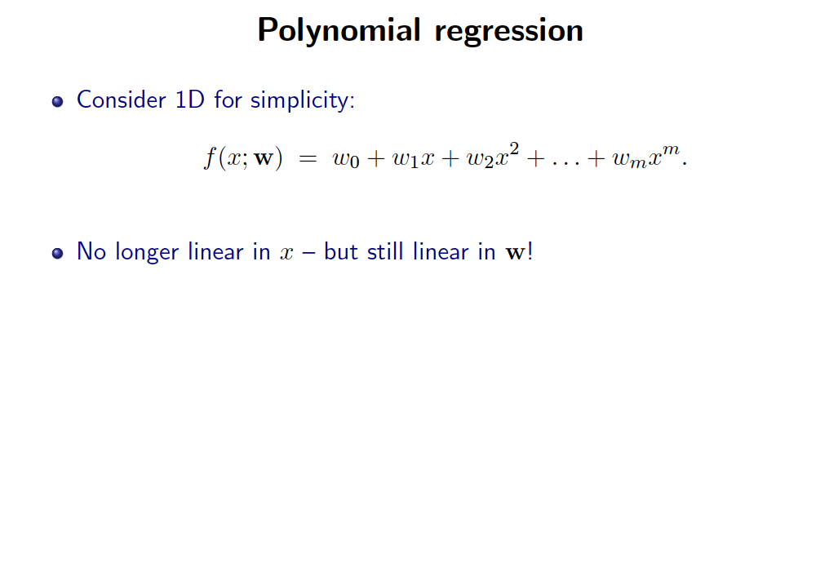
Slide Credit: Greg Shakhnarovich

Slide 7
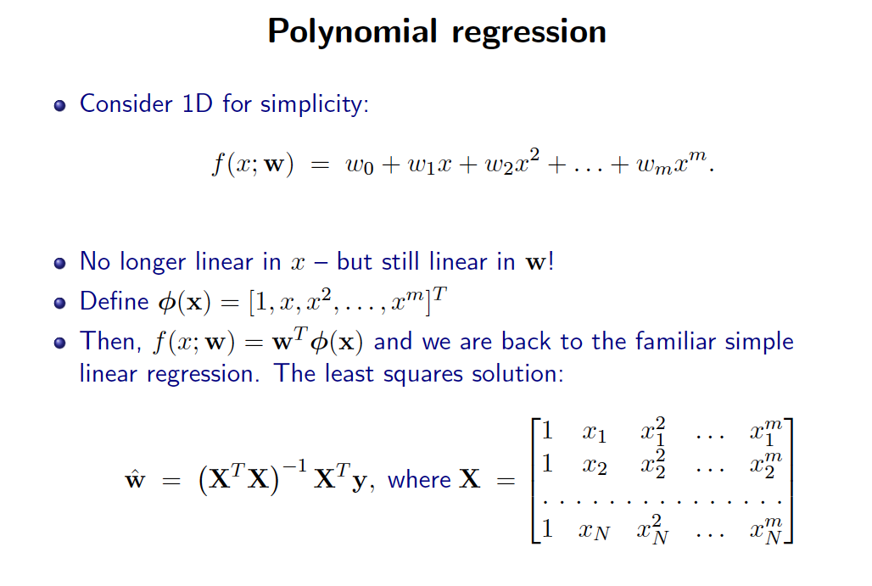
Slide Credit: Greg Shakhnarovich

Slide 8
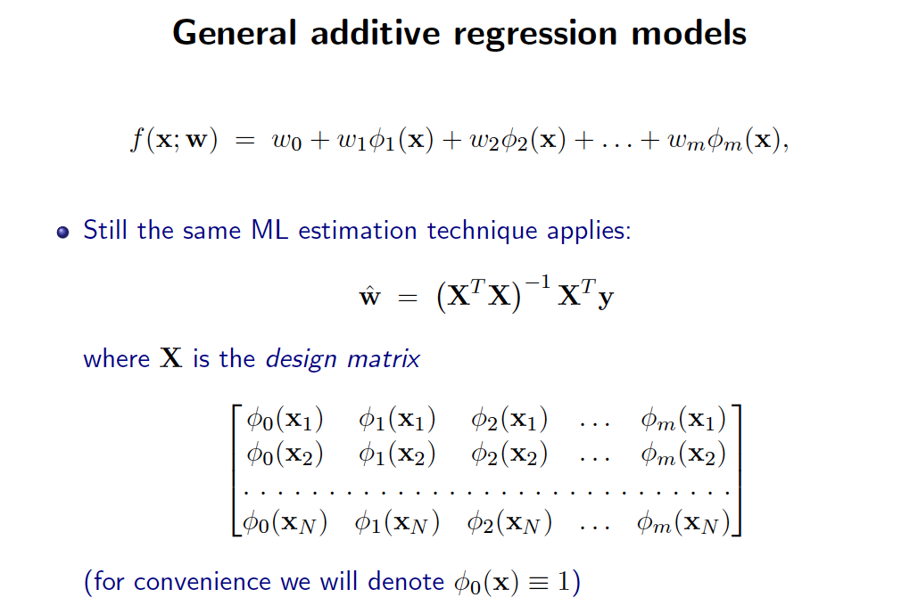
Slide Credit: Greg Shakhnarovich

Slide 9
What you need to know
Linear Regression
  Model
  Least Squares Objective
  Connections to Max Likelihood with Gaussian Conditional
  Robust regression with Laplacian Likelihood
  Ridge Regression with priors
  Polynomial and General Additive Regression

Slide 10
Plan for Today
(Finish) Model Selection
  Overfitting vs Underfitting
  Bias-Variance trade-off
    aka Modeling error vs Estimation error tradeoff
Naïve Bayes

Slide 11
New Topic: Model Selection and Error Decomposition

Slide 12
Example for Regression
Demo
  http://www.princeton.edu/~rkatzwer/PolynomialRegression/
How do we pick the hypothesis class?

Slide 13
Model Selection
How do we pick the right model class?
Similar questions
  How do I pick magic hyper-parameters?
  How do I do feature selection?

Slide 14
Errors
Expected Loss/Error
Training Loss/Error
Validation Loss/Error
Test Loss/Error
Reporting Training Error (instead of Test) is CHEATING
Optimizing parameters on Test Error is CHEATING

Slide 15
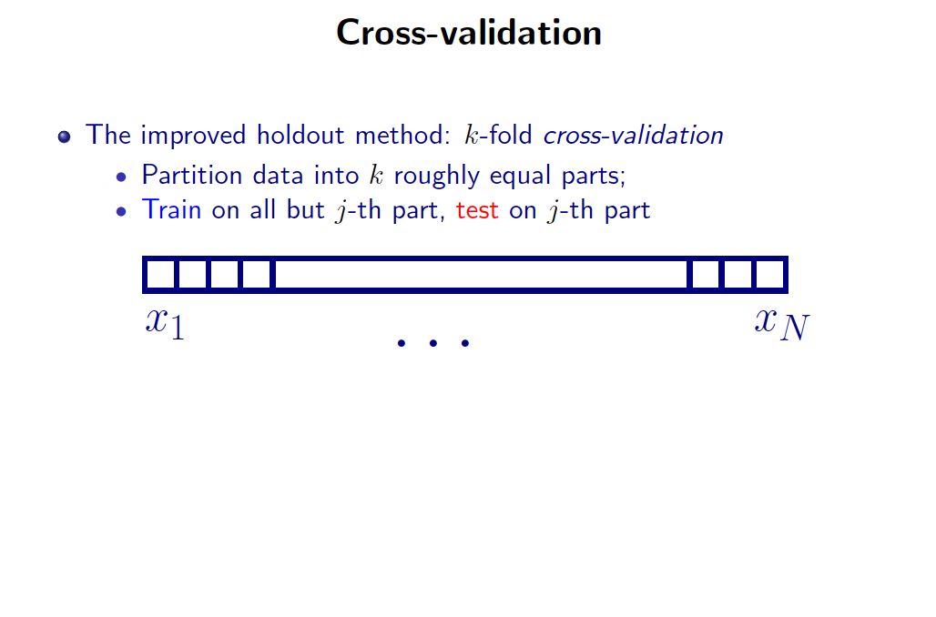
Slide Credit: Greg Shakhnarovich

Slide 16
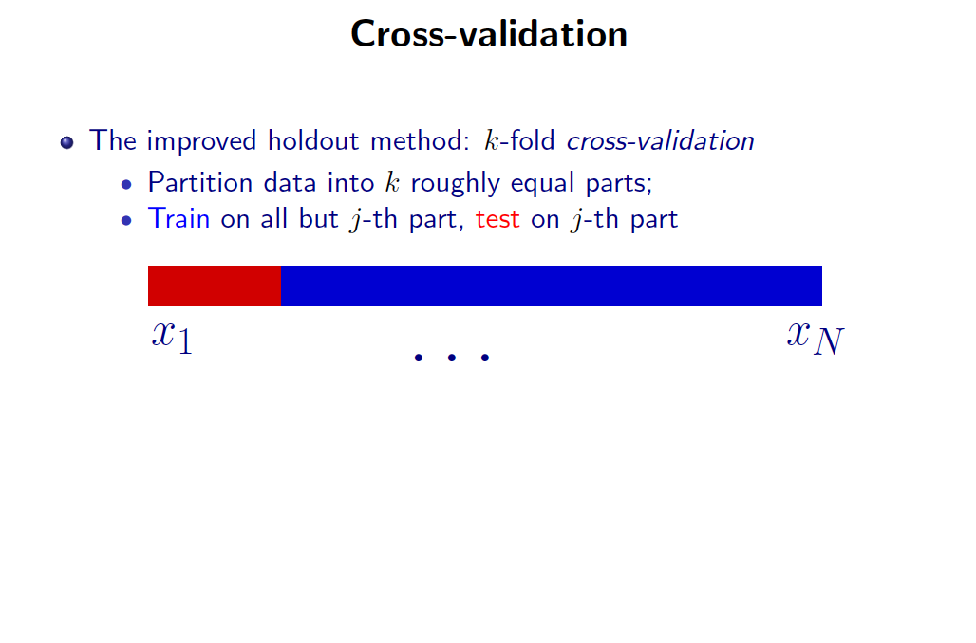
Slide Credit: Greg Shakhnarovich

Slide 17
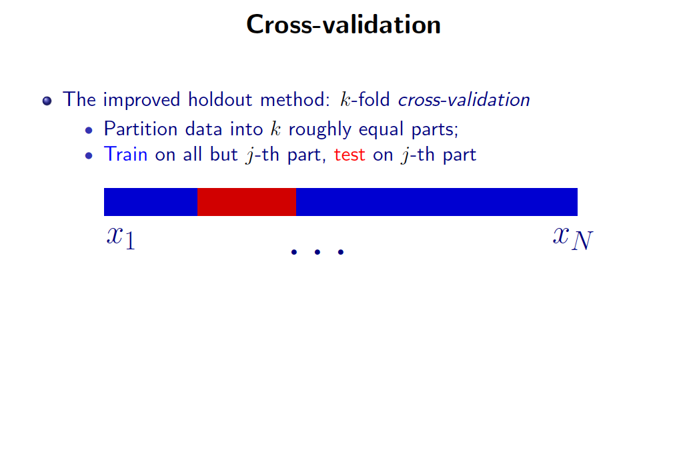
Slide Credit: Greg Shakhnarovich

Slide 18
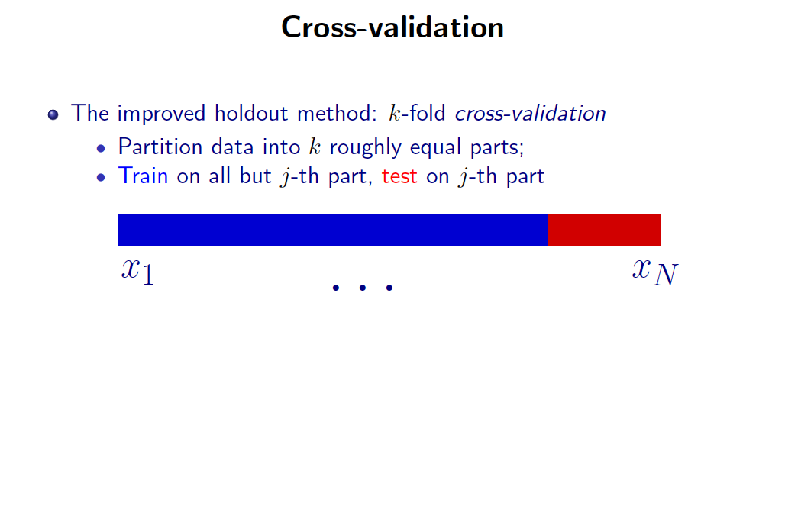
Slide Credit: Greg Shakhnarovich

Slide 19
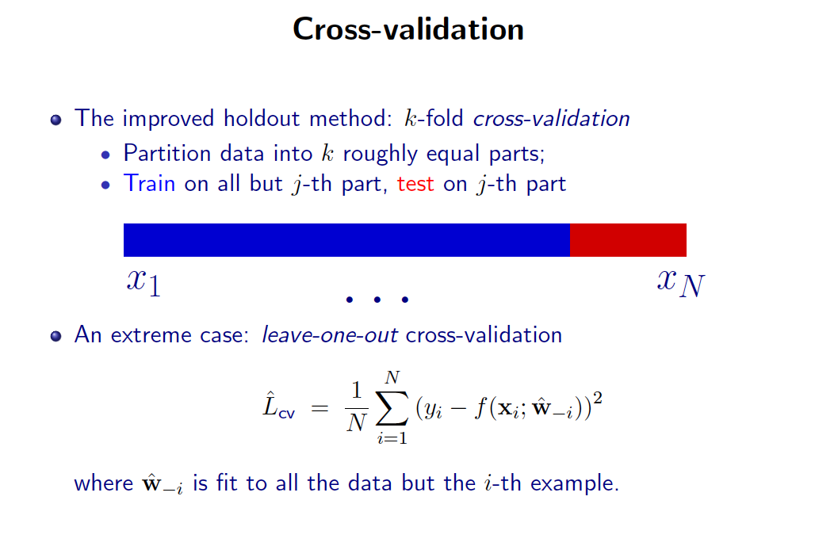
Slide Credit: Greg Shakhnarovich

Slide 20
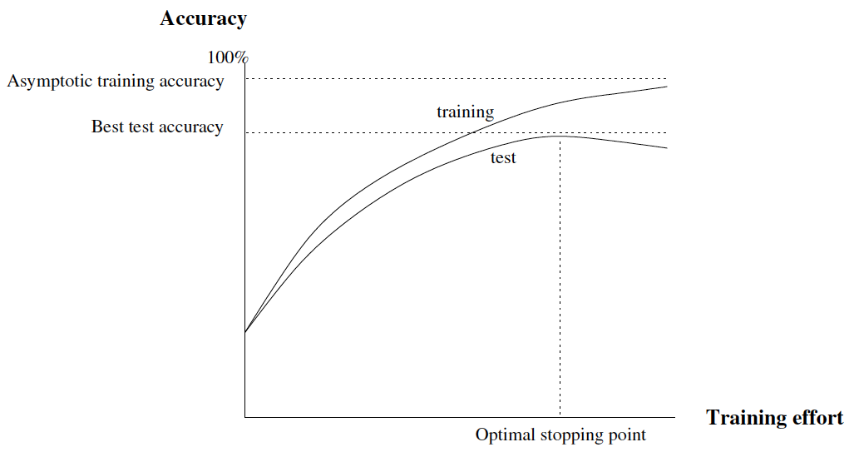
Typical Behavior
a

Slide 21
Overfitting
Overfitting: a learning algorithm overfits the training data if it outputs a solution w when there exists another solution w’ such that:
Slide Credit: Carlos Guestrin

Slide 22
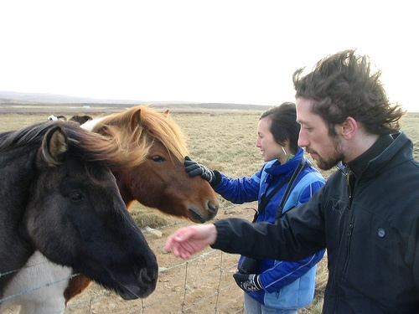
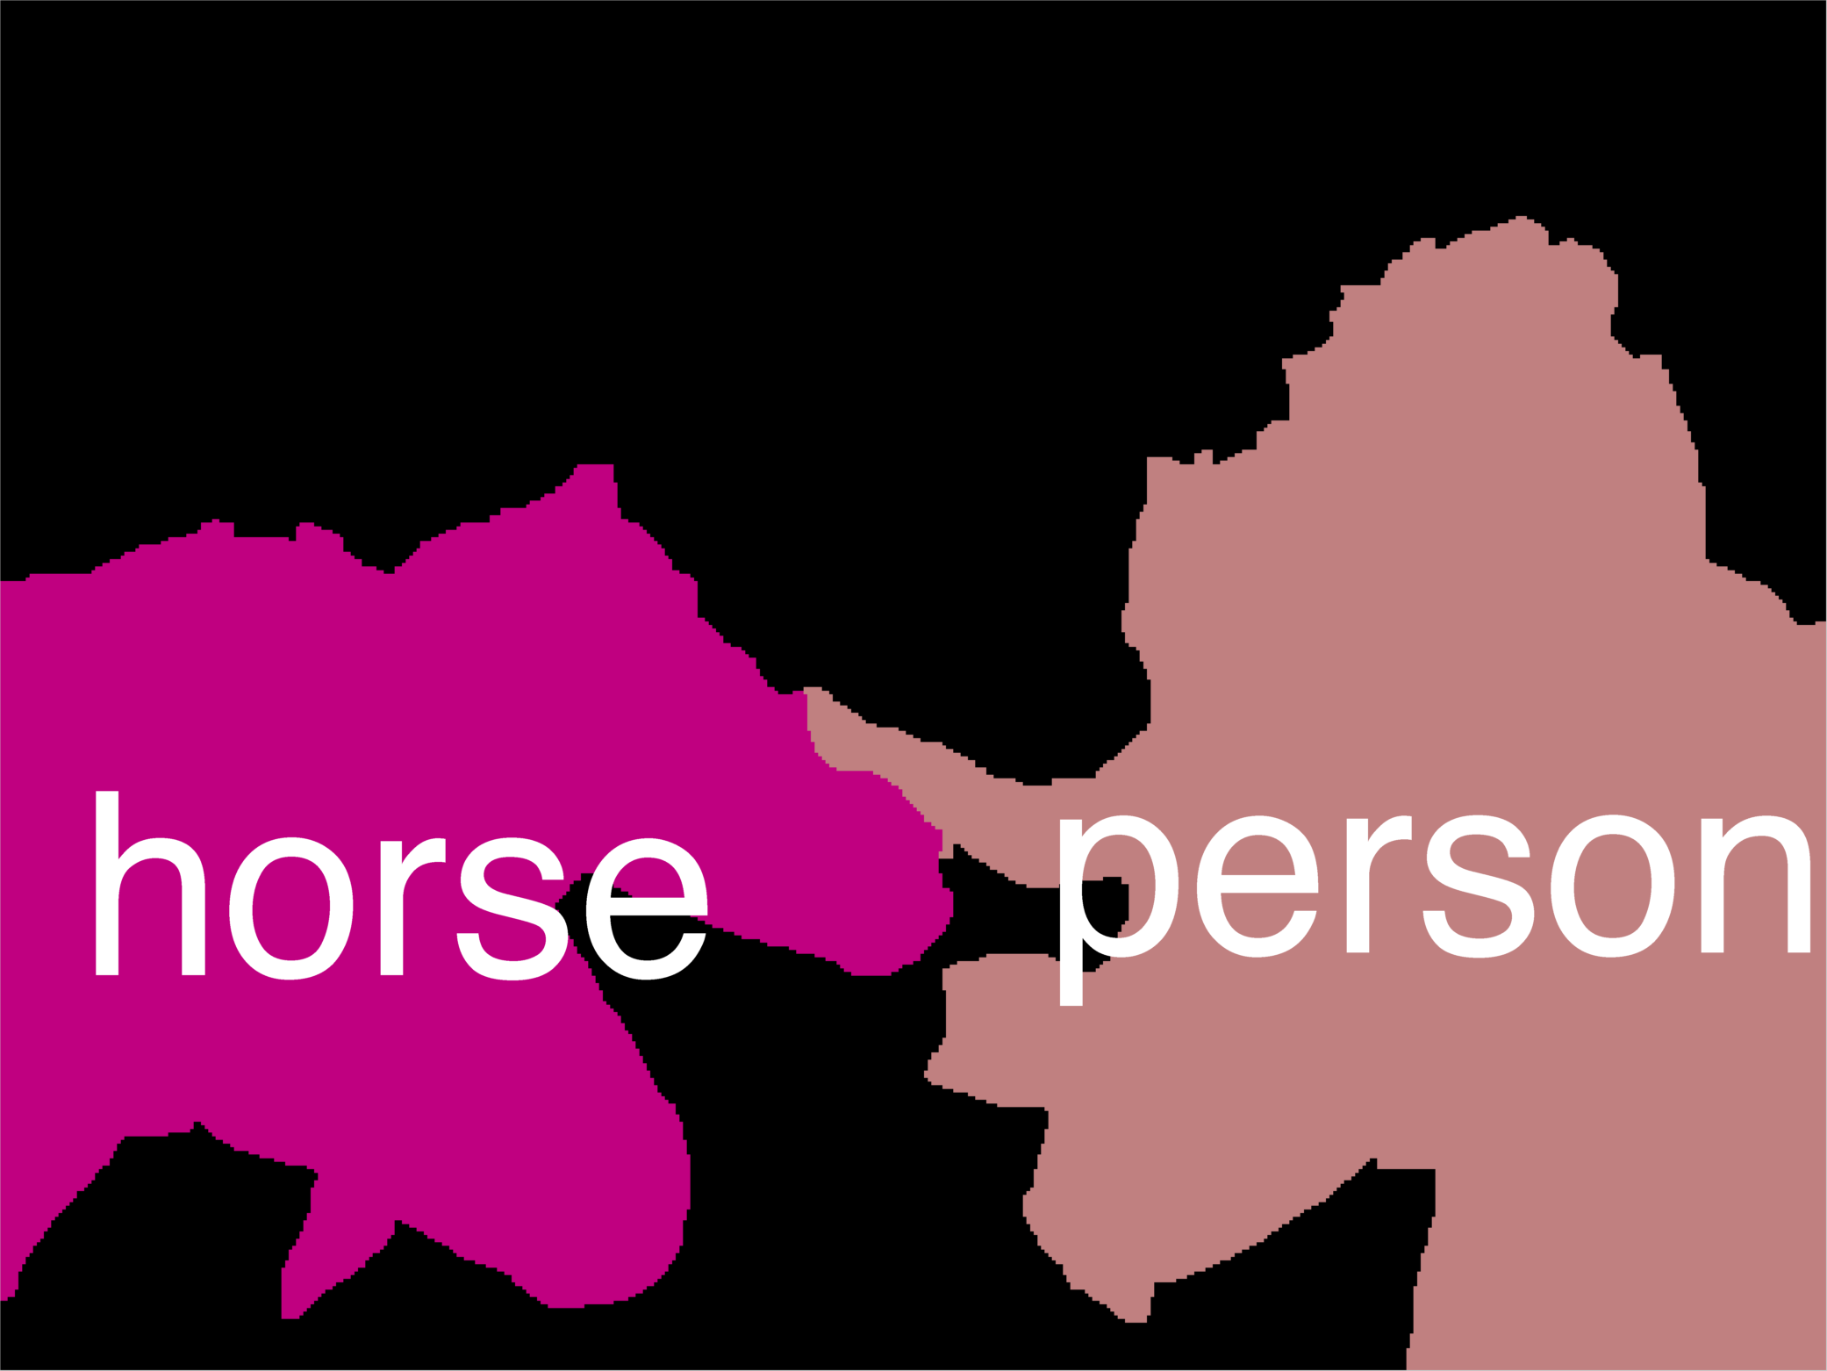
Error Decomposition
Reality
Modeling Error
model class
Estimation
Error
Optimization
Error

Slide 23
Error Decomposition
Reality
Modeling Error
Estimation
Error
Optimization
Error
model class

Slide 24
Error Decomposition
Modeling Error
Reality
model class
Higher-Order
Potentials
Estimation
Error
Optimization
Error

Slide 25
Error Decomposition
Approximation/Modeling Error
  You approximated reality with model
Estimation Error
  You tried to learn model with finite data
Optimization Error
  You were lazy and couldn’t/didn’t optimize to completion
(Next time) Bayes Error
  Reality just sucks

Slide 26
Bias-Variance Tradeoff
Bias: difference between what you expect to learn and truth
  Measures how well you expect to represent true solution
  Decreases with more complex model
Variance: difference between what you expect to learn and what you learn from a from a particular dataset
  Measures how sensitive learner is to specific dataset
  Increases with more complex model
Slide Credit: Carlos Guestrin

Slide 27
Bias-Variance Tradeoff
Matlab demo

Slide 28
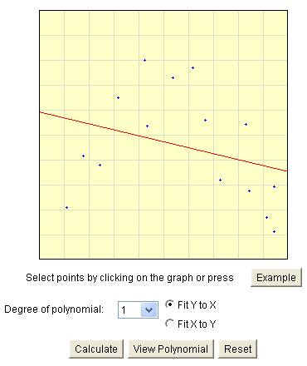
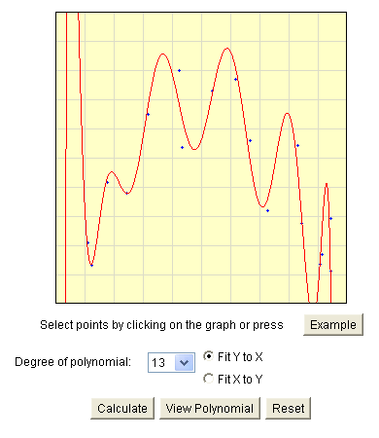
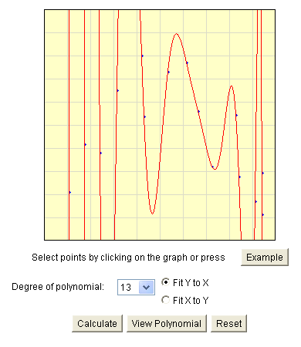
Bias-Variance Tradeoff
Choice of hypothesis class introduces learning bias
  More complex class → less bias
  More complex class → more variance
Slide Credit: Carlos Guestrin

Slide 29
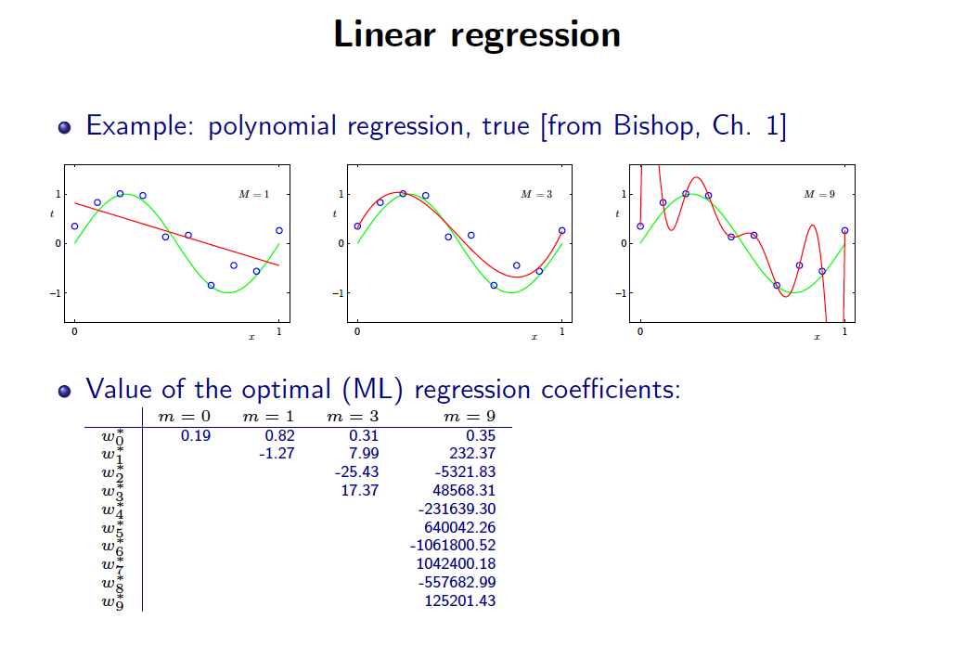
Slide Credit: Greg Shakhnarovich

Slide 30
Learning Curves
Error vs size of dataset
On board
  High-bias curves
  High-variance curves

Slide 31
Debugging Machine Learning
My algorithm does work
  High test error
What should I do?
  More training data
  Smaller set of features
  Larger set of features
  Lower regularization
  Higher regularization

Slide 32
What you need to know
Generalization Error Decomposition
  Approximation, estimation, optimization, bayes error
  For squared losses, bias-variance tradeoff
Errors
  Difference between train & test error & expected error
  Cross-validation (and cross-val error)
  NEVER EVER learn on test data
Overfitting vs Underfitting

Slide 33
New Topic:
Naïve Bayes
(your first probabilistic classifier)
x
Classification
y
Discrete

Slide 34
Classification
Learn: h:X  Y
  X – features
  Y – target classes
Suppose you know P(Y|X) exactly, how should you classify?
  Bayes classifier:
Why?
Slide Credit: Carlos Guestrin

Slide 35
Optimal classification
Theorem: Bayes classifier h_{Bayes} is optimal!
  That is
Proof:
Slide Credit: Carlos Guestrin

Slide 36
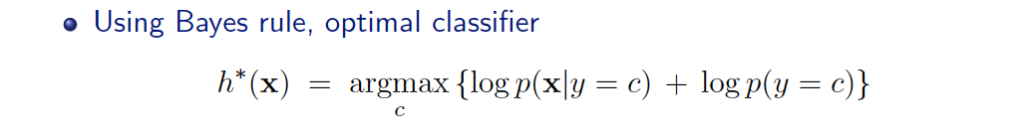
Generative vs. Discriminative
Generative Approach
  Estimate p(x|y) and p(y)
  Use Bayes Rule to predict y
Discriminative Approach
  Estimate p(y|x) directly OR
  Learn “discriminant” function h(x)

Slide 37
Generative vs. Discriminative
Generative Approach
  Assume some functional form for P(X|Y), P(Y)
  Estimate p(X|Y) and p(Y)
  Use Bayes Rule to calculate P(Y| X=x)
  Indirect computation of P(Y|X) through Bayes rule
  But, can generate a sample, P(X) = ∑_{y} P(y) P(X|y)
Discriminative Approach
  Estimate p(y|x) directly OR
  Learn “discriminant” function h(x)
  Direct but cannot obtain a sample of the data, because P(X) is not available

Slide 38
Generative vs. Discriminative
Generative:
  Today: Naïve Bayes
Discriminative:
  Next: Logistic Regression
NB & LR related to each other.

Slide 39
How hard is it to learn the optimal classifier?
Categorical Data
How do we represent these? How many parameters?
  Class-Prior, P(Y):
    Suppose Y is composed of k classes
  Likelihood, P(X|Y):
    Suppose X is composed of d binary features
Complex model → High variance with limited data!!!
Slide Credit: Carlos Guestrin

Slide 40
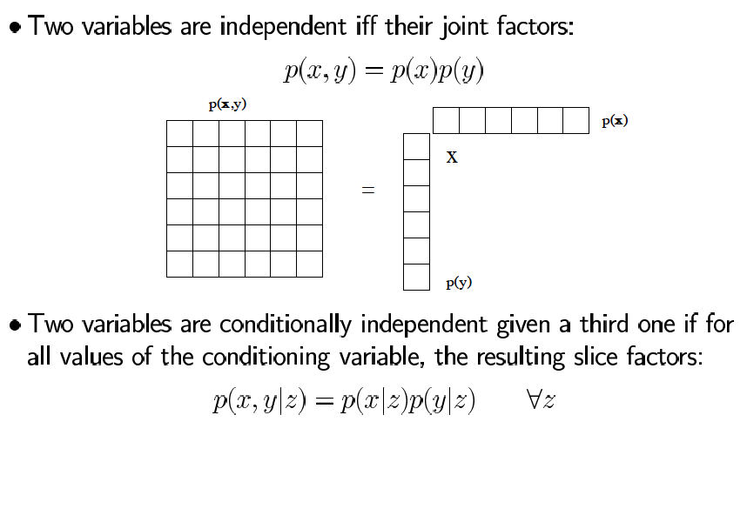
Independence to the rescue
Slide Credit: Sam Roweis

Slide 41
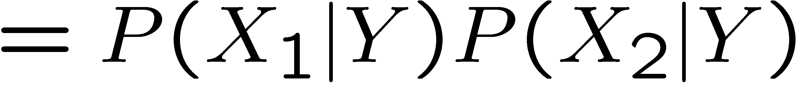
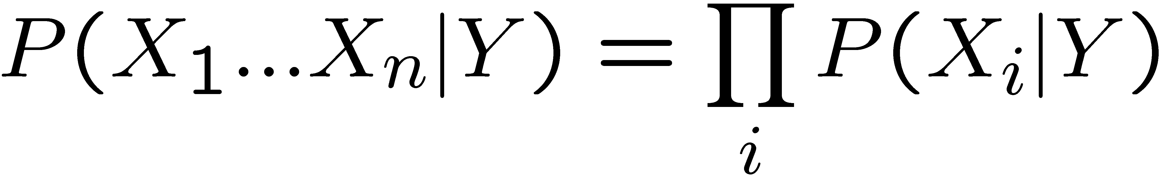
The Naïve Bayes assumption
Naïve Bayes assumption:
  Features are independent given class:
  More generally:
How many parameters now?
    Suppose X is composed of d binary features
Slide Credit: Carlos Guestrin

Slide 42
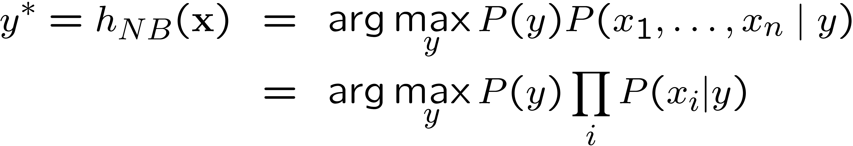
The Naïve Bayes Classifier
Given:
  Class-Prior P(Y)
  d conditionally independent features X given the class Y
  For each X_{i}, we have likelihood P(X_{i}|Y)
Decision rule:
If assumption holds, NB is optimal classifier!
Slide Credit: Carlos Guestrin

