Slide 1
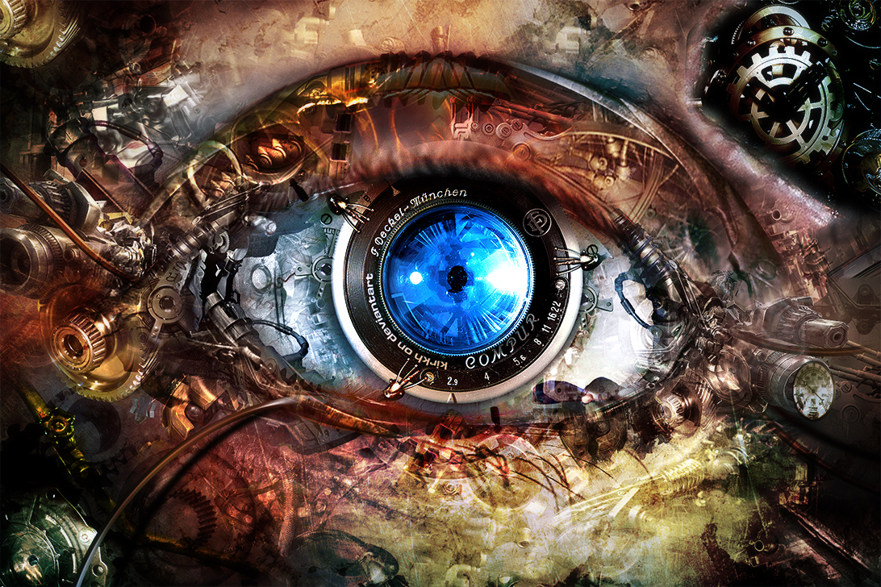
Summary and Discussion
Computer Vision
Jia-Bin Huang, Virginia Tech
Many slides from D. Hoiem

Slide 2
Administrative stuffs
Final project
  Poster (40%)
    Presentation (70%)
    Summary (30%)
  Webpage report (50%)
Final exam
  Module 1 – module 5
  Simple concept questions (18 questions)
  One letter size cheat sheet allowed (2 side)
SPOT evaluation due Dec 8th

Slide 3
Today’s class
Review of important concepts
Some important open problems
Feedback and course evaluation
Notes:
Tie together concepts that were disjoint in class. Identify some major research problems.

Slide 4
Fundamentals of Computer Vision
Light
  What an image records
Geometry
  How to relate world coordinates and image coordinates
Matching
  How to measure the similarity of two regions
Alignment
  How to align points/patches
  How to recover transformation parameters based on matched points
Grouping
  What points/regions/lines belong together?
Categorization
  What similarities are important?

Slide 5
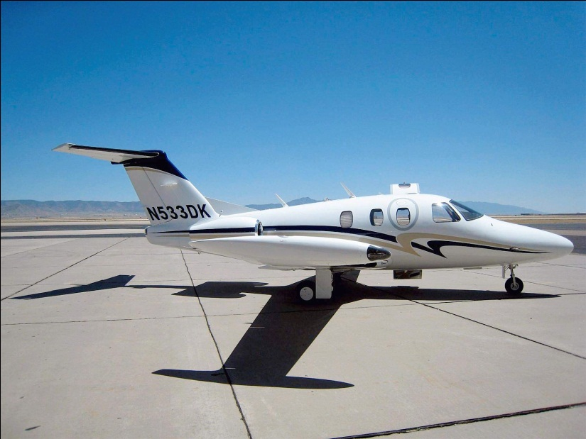
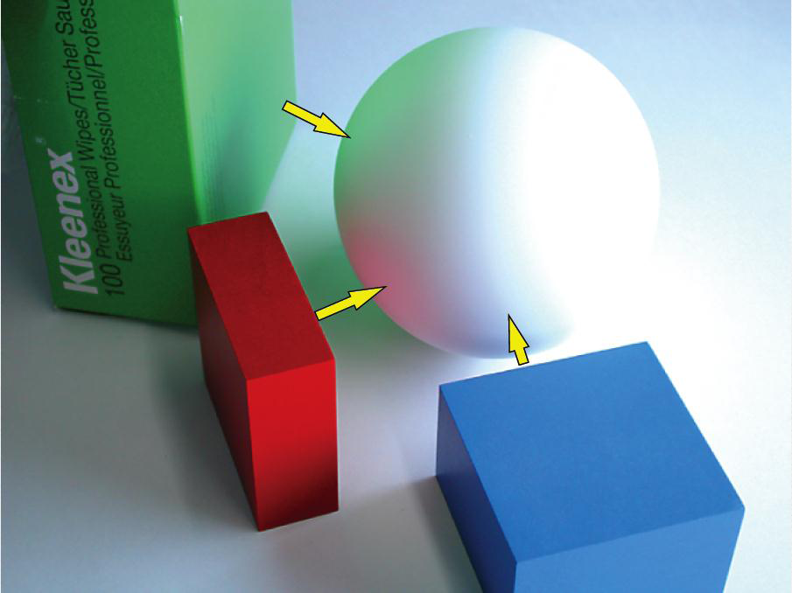
Light and Color
Shading of diffuse materials depends on albedo and orientation wrt light
  Gradients are a major cue for changes in orientation (shape)
Many materials have a specular component that directly reflects light
Reflected color depends on albedo and light color
RGB is default color space, but sometimes others (e.g., HSV, L*a*b) are more useful
Image from Koenderink

Slide 6
Geometry
x = K [R t] X
  Maps 3d point X to 2d point x
  Rotation R and translation t map into 3D camera coordinates
  Intrinsic matrix K projects from 3D to 2D
Parallel lines in 3D converge at the vanishing point in the image
  A 3D plane has a vanishing line in the image
x’^{T} F x = 0
  Points in two views that correspond to the same 3D point are related by the fundamental matrix F

Slide 7
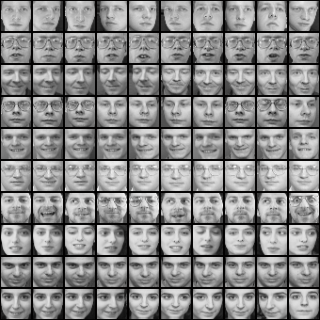

Matching
Does this patch match that patch?
  In two simultaneous views? (stereo)
  In two successive frames? (tracking, flow, SFM)
  In two pictures of the same object? (recognition)
?
?
Notes:
Add picture here

Slide 8
Matching
Representation: be invariant/robust to expected deformations but nothing else
Assume that shape does not change
  Key cue: local differences in shading (e.g., gradients)
Change in viewpoint
  Rotation invariance: rotate and/or affine warp patch according to dominant orientations
Change in lighting or camera gain
  Average intensity invariance: oriented gradient-based matching
  Contrast invariance: normalize gradients by magnitude
Small translations
  Translation robustness: histograms over small regions
But can one representation do all of this?
SIFT: local normalized histograms of
oriented gradients provides robustness to
in-plane orientation, lighting, contrast, translation
HOG: like SIFT but does not rotate to dominant orientation

Slide 9
Alignment of points
Search: efficiently align matching patches
Interest points: find repeatable, distinctive points
  Long-range matching: e.g., wide baseline stereo, panoramas, object instance recognition
  Harris: points with strong gradients in orthogonal directions (e.g., corners) are precisely repeatable in x-y
  Difference of Gaussian: points with peak response in Laplacian image pyramid are somewhat repeatable in x-y-scale
Local search
  Short range matching: e.g., tracking, optical flow
  Gradient descent on patch SSD, often with image pyramid
Windowed search
  Long-range matching: e.g., recognition, stereo w/ scanline

Slide 10


Alignment of sets
Find transformation to align matching sets of points
Geometric transformation (e.g., affine)
  Least squares fit (SVD), if all matches can be trusted
  Hough transform: each potential match votes for a range of parameters
    Works well if there are very few parameters (3-4)
  RANSAC: repeatedly sample potential matches, compute parameters, and check for inliers
    Works well if fraction of inliers is high and few parameters (4-8)
Other cases
  Thin plate spline for more general distortions
  One-to-one correspondence (Hungarian algorithm)
B₃
A₁
A₃
A₂
B₁
B₂

Slide 11
Grouping
Clustering: group items (patches, pixels, lines, etc.) that have similar appearance
  Uses: discretize continuous values; improve efficiency; summarize data
  Algorithms: k-means, agglomerative
Segmentation: group pixels into regions of coherent color, texture, motion, and/or label
  Mean-shift clustering
  Watershed
  Graph-based segmentation: e.g., MRF and graph cuts
EM, mixture models: probabilistically group items that are likely to be drawn from the same distribution, while estimating the distributions’ parameters

Slide 12




Categorization
Match objects, parts, or scenes that may vary in appearance
Categories are typically defined by human and may be related by function, cost, or other non-visual attributes
Key problem: what are important similarities?
  Can be learned from training examples
Training Labels
Training Images
Image Features
Classifier Training
Trained Classifier

Slide 13
Categorization
Representation: ideally should be compact, comprehensive, direct
Histograms of quantized interest points (SIFT, HOG), color, texture
  Typical for image or region categorization
  Degree of spatial encoding is controllable by using spatial pyramids
HOG features at specified position
  Often used for finding parts or objects

Slide 14
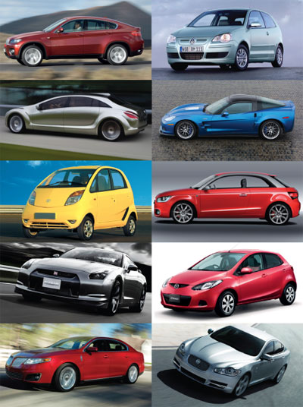
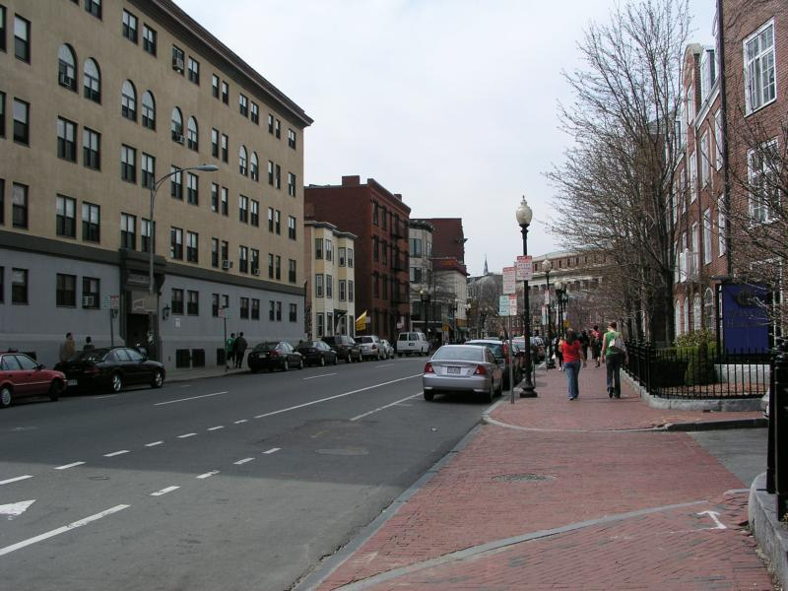
Object Categorization
Search by Sliding Window Detector
May work well for rigid objects
Key idea: simple alignment for simple deformations
Object or Background?

Slide 15

Object Categorization
Search by Parts-based model
Key idea: more flexible alignment for articulated objects
Defined by models of part appearance, geometry or spatial layout, and search algorithm

Slide 16
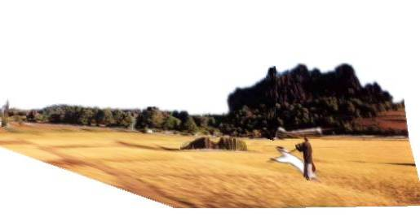
Vision as part of an intelligent system
3D Scene
Feature
Extraction
Texture
Color
Optical Flow
Stereo Disparity
Grouping
Surfaces
Bits of objects
Sense of depth
Motion patterns
Interpretation
Objects
Agents and goals
Shapes and properties
Open paths
Words
Action
Walk, touch, contemplate, smile, evade, read on, pick up, …

Slide 17
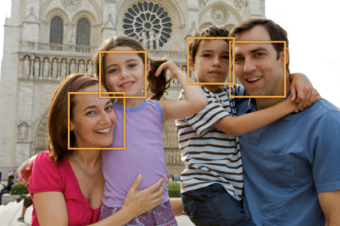
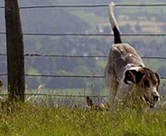
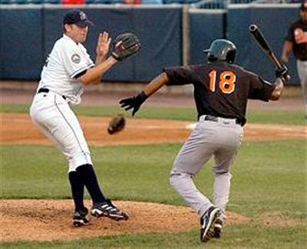
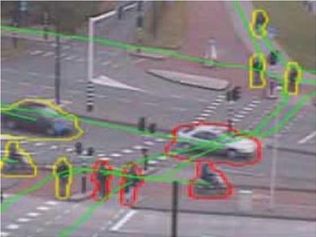
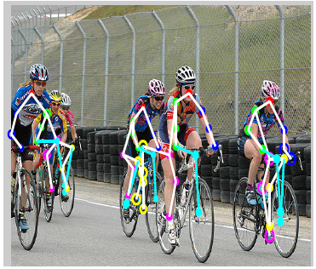
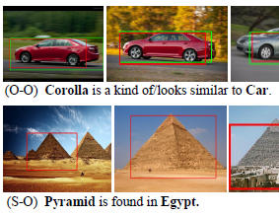
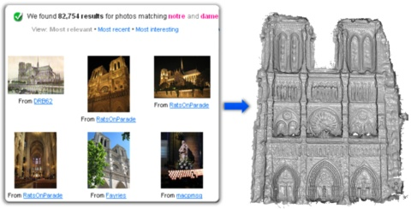
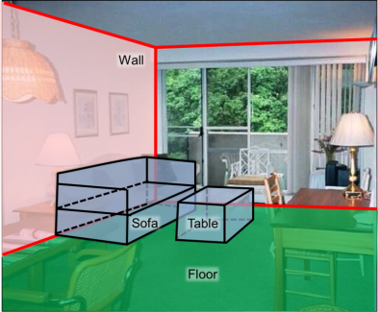
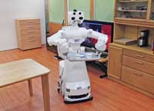
Well-Established
(patch matching)
Major Progress
(pattern matching++)
New Opportunities
(interpretation/tasks)
Face Detection/Recognition
Category Detection
Entailment/Prediction
Object Tracking / Flow
Human Pose
Life-long Learning
Multi-view Geometry
3D Scene Layout
Vision for Robots
Notes:
Key research questions are evolving from recognizing local patterns to broader scene interpretation. Some problems in vision are well-established – useful systems have existed for ten years or more, such as face detection, object tracking, and 3D reconstruction from multiple images. These involve feature extraction, local patch matching, and template matching. In the last ten year, the research focus has been on problems that require advanced signal processing but also models of individual components of the world, such as object category detection, human pose estimation, and recovering 3D scene layout from limited views. In these problems, we need to think about how to model an object category or the human body or physical surfaces in a scene. The progress in these problems, which I’ll describe, creates new opportunities to tackle problems that require broad and complex models of the world, going beyond individual objects and surfaces to reason about narratives and intention.

Slide 18
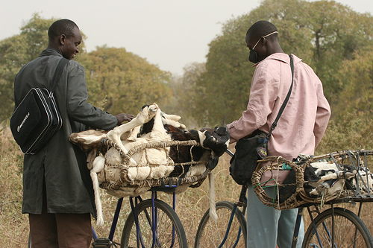
Scene Understanding =
Objects + People + Layout +
Interpretation within Task Context

Slide 19
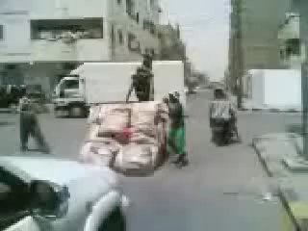
What do I see? → Why is this happening?
What is important?
What will I see?
How can we learn about the world through vision?
How do we create/evaluate vision systems that adapt to useful tasks?

Slide 20
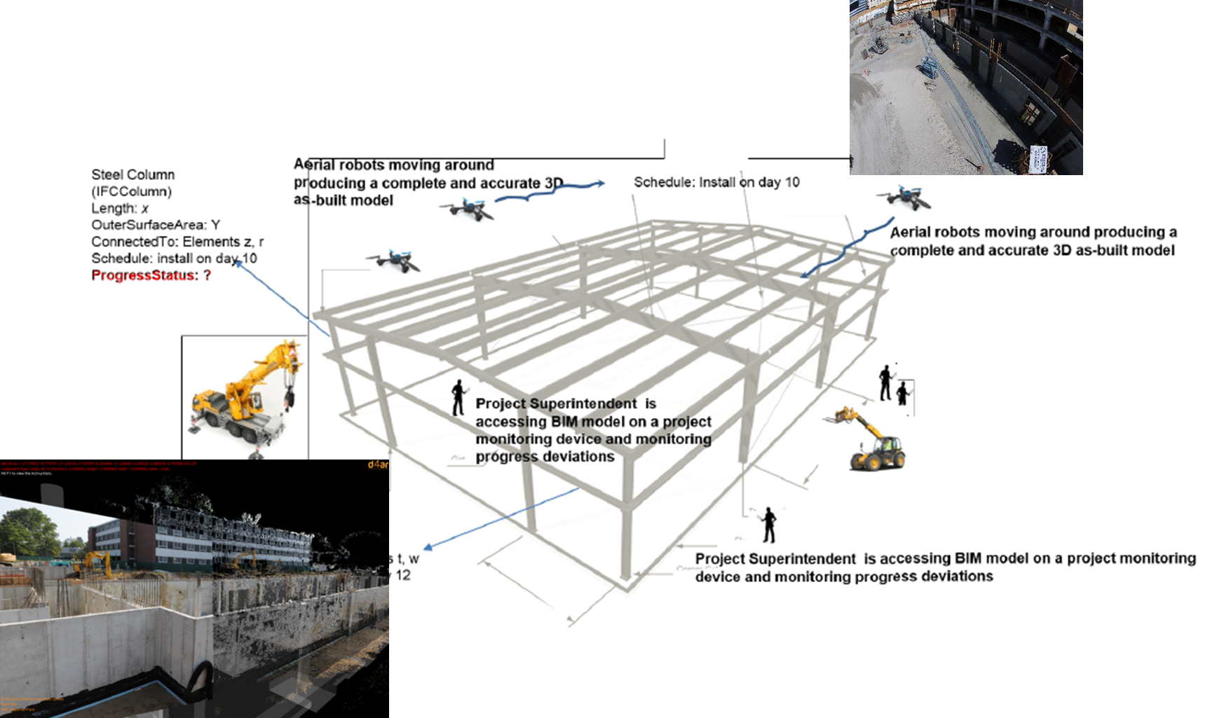
Important open problems
How can we interpret vision given structured plans of a scene?

Slide 21
Important open problems
Algorithms: works pretty well → perfect
  E.g., stereo: top of wish list from Pixar guy Micheal Kass
Good directions:
Incorporate higher level knowledge

Slide 22
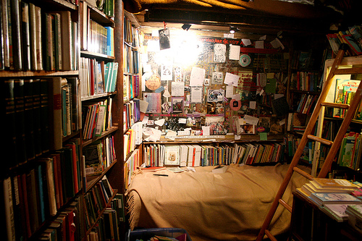
Important open problems
Spatial understanding: what is it doing? Or how do I do it?
Important questions:
What are good representations of space for navigation and interaction? What kind of details are important?
How can we combine single-image cues with multi-view cues?

Slide 23
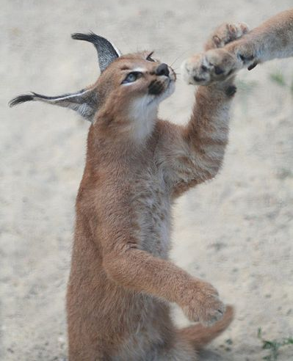
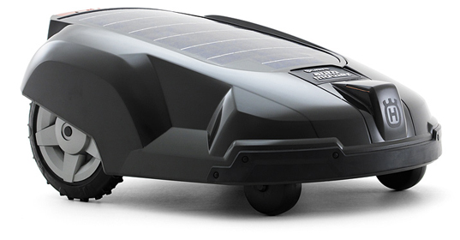
Important open problems
Object representation: what is it?
Important questions:
How can we pose recognition so that it lets us deal with new objects?
What do we want to predict or infer, and to what extent does that rely on categorization?
How do we transfer knowledge of one type of object to another?

Slide 24
Important open problems
Can we build a “core” vision system that can easily be extended to perform new tasks or even learn on its own?
  What kind of representations might allow this?
  What should be built in and what should be learned?

Slide 25
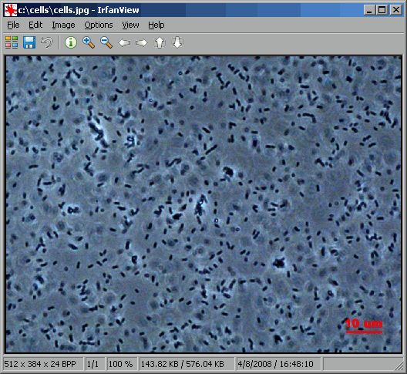
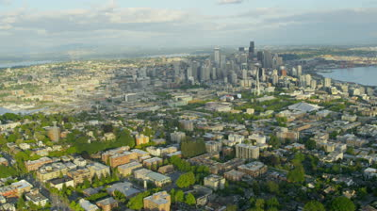
Important open problems
Vision for the masses
Analyzing social effects of green space
How to make vision systems that can quickly adapt to these thousands of visual tasks?
Counting cells

Slide 26
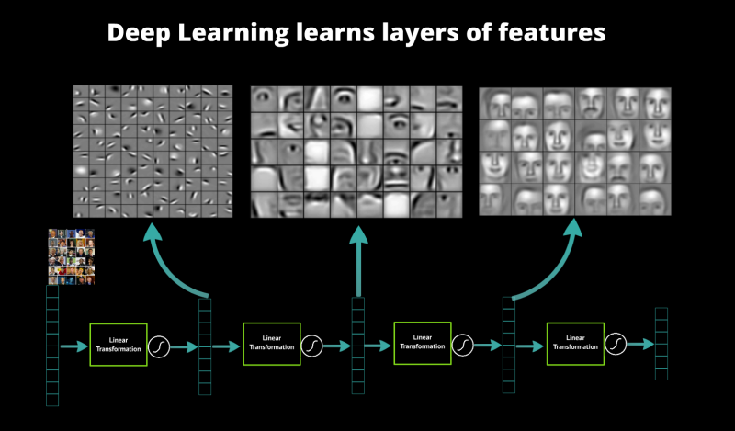
Important problems
Learning features and intermediate representations that transfer to new tasks
Figure from http://www.datarobot.com/blog/a-primer-on-deep-learning/

Slide 27
Important open problems
Almost everything is still unsolved!
  Robust 3D shape from multiple images
  Recognize objects (only faces and maybe cars is really solved, thanks to tons of data)
  Caption images/video
  Predict intention
  Object segmentation
  Count objects in an image
  Estimate pose
  Recognize actions
  ….

Slide 28
If you want to learn more…
Read lots of papers: IJCV, PAMI, CVPR, ICCV, ECCV, NIPS
Helpful topics for classes
  Classes in machine learning, pattern recognition, deep learning
  Statistics, graphical models
  Seminar-style paper-reading classes
Just implement stuff, try demos, see what works

Slide 29
Thank you!

