Slide 1
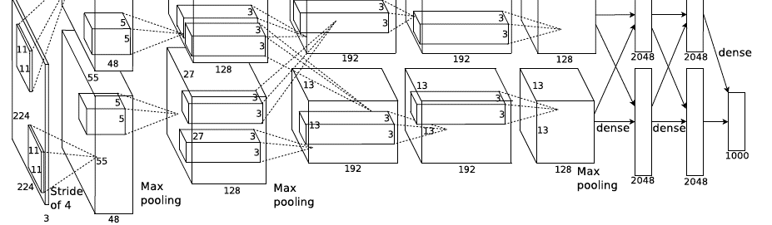
Convolutional Neural Networks
Computer Vision
Jia-Bin Huang, Virginia Tech

Slide 2
Today’s class
Overview
Convolutional Neural Network (CNN)
Understanding and Visualizing CNN
Training CNN
Notes:
Today I am going to talk about convolutional neural network for computer vision. I will start with an overview. Talk about what is a CNN. Various ways to visualize and understand CNN. Then, introduce various tricks to train a CNN. In the end, I will talk about a probabilistic interpretation of CNN.

Slide 3

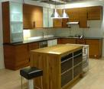
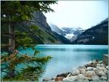

Image Categorization: Training phase
Training Images
Training
Training Labels
Image Features
Classifier Training
Trained Classifier
Notes:
Recall this image classification diagram in the previous lecture. Here we want to classify an image. We collect a dataset of examples with labels, extract some image features, train a classifier so that the prediction errors on the training images are minimized.

Slide 4
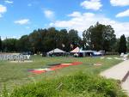
Image Categorization: Testing phase
Training Images
Training
Training Labels
Image Features
Classifier Training
Trained Classifier
Testing
Image Features
Trained Classifier
Prediction
Outdoor
Test Image
Notes:
At testing time, when given a new test image, we extract the same image features and use the trained classified for prediction.

Slide 5
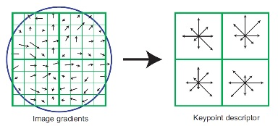
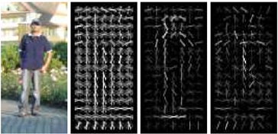
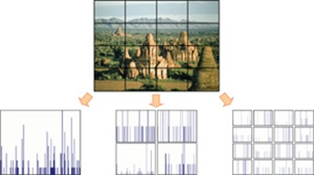
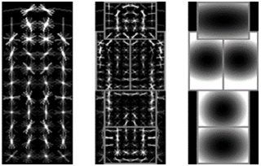
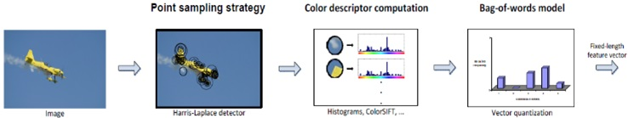
Features are the Keys
SIFT [Loewe IJCV 04]
HOG [Dalal and Triggs CVPR 05]
SPM [Lazebnik et al. CVPR 06]
DPM [Felzenszwalb et al. PAMI 10]
Color Descriptor [Van De Sande et al. PAMI 10]

Slide 6
Learning a Hierarchy of Feature Extractors
  Each layer of hierarchy extracts features from output of previous layer
  All the way from pixels → classifier
  Layers have the (nearly) same structure
  Image/video
  Labels
Image/Video
Pixels
Layer 1
Layer 2
Layer 3
Simple
Classifier
Notes:
Make clear that classic methods, e.g. convnets are purely supervised.

Slide 7
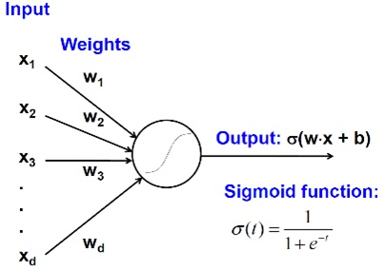
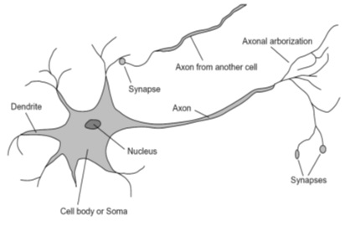
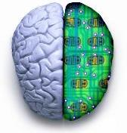
Biological neuron and Perceptrons
A biological neuron
An artificial neuron (Perceptron)
- a linear classifier

Slide 8
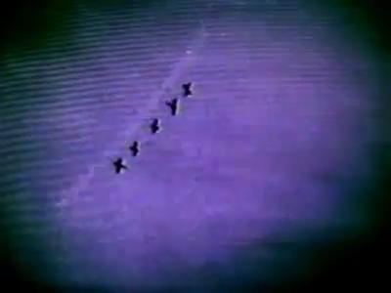
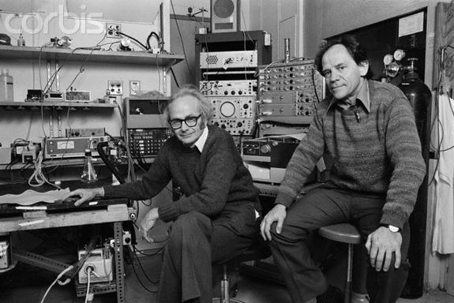
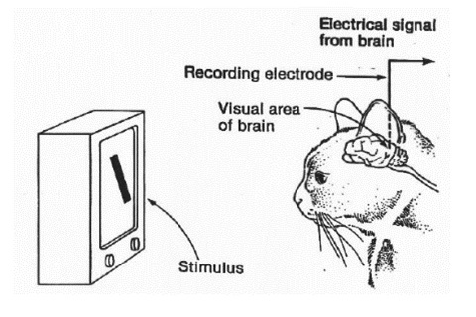
Simple, Complex and Hypercomplex cells
David H. Hubel and Torsten Wiesel
Suggested a hierarchy of feature detectors in the visual cortex, with higher level features responding to patterns of activation in lower level cells, and propagating activation upwards to still higher level cells.
David Hubel's Eye, Brain, and Vision

Slide 9
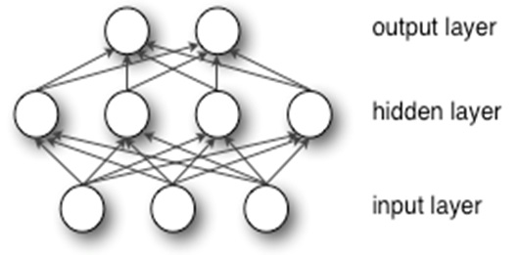
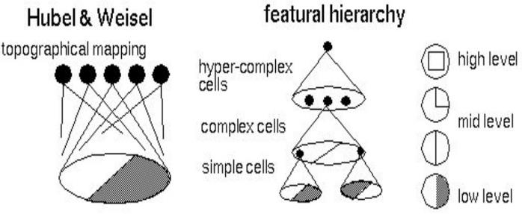
Hubel/Wiesel Architecture and Multi-layer Neural Network
Hubel and Weisel’s architecture
Multi-layer Neural Network
- A non-linear classifier

Slide 10
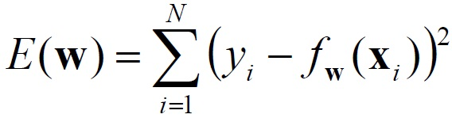
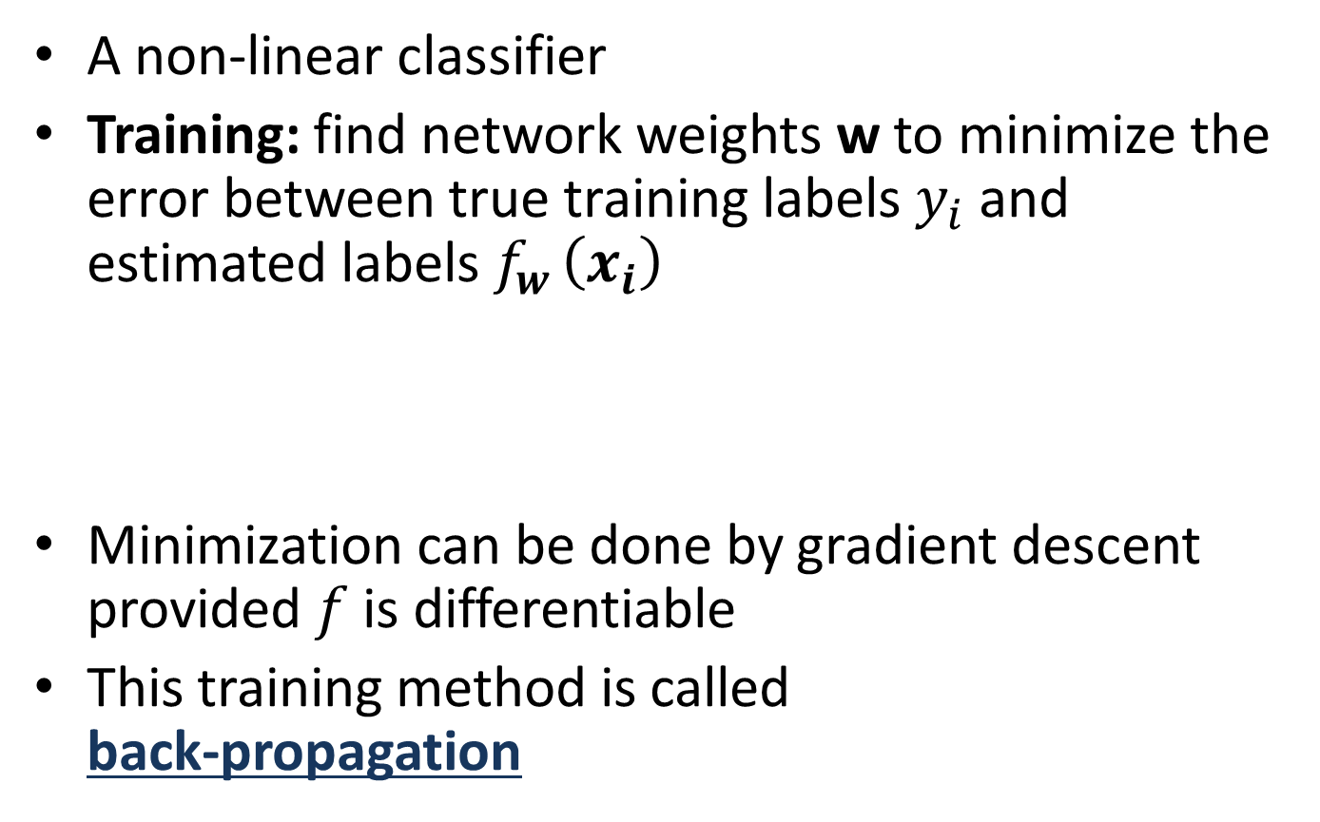
Multi-layer Neural Network
A non-linear classifier
Training: find network weights w to minimize the error between true training labels $y_{i}$and estimated labels $f_{w }\left(x_{i}\right)$
Minimization can be done by gradient descent provided $f$ is differentiable
This training method is called
back-propagation

Slide 11
Convolutional Neural Networks
Also known as CNN, ConvNet, DCN
CNN = a multi-layer neural network with
    1. Local connectivity
    2. Weight sharing

Slide 12
CNN: Local Connectivity
Hidden layer
Input layer
Global connectivity
Local connectivity
# input units (neurons): 7
# hidden units: 3
Number of parameters
  Global connectivity: 3 x 7 = 21
  Local connectivity: 3 x 3 = 9

Slide 13
CNN: Weight Sharing
Hidden layer
w₁
w₃
w₅
w₇
w₉
w₁
w₃
w₂
w₁
w₃
w₂
w₄
w₆
w₈
w₂
w₁
w₃
w₂
Input layer
Without weight sharing
With weight sharing
# input units (neurons): 7
# hidden units: 3
Number of parameters
  Without weight sharing: 3 x 3 = 9
  With weight sharing : 3 x 1 = 3

Slide 14
CNN with multiple input channels
Hidden layer
Input layer
Channel 1
Channel 2
Single input channel
Multiple input channels
Filter weights
Filter weights

Slide 15
CNN with multiple output maps
Hidden layer
Map 1
Map 2
Input layer
Single output map
Multiple output maps
Filter 1
Filter 2
Filter weights
Filter weights

Slide 16
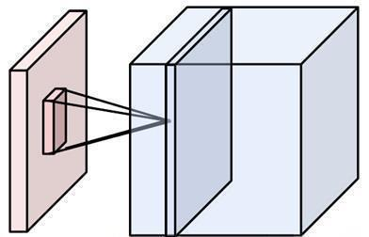
Putting them together
Local connectivity
Weight sharing
Handling multiple input channels
Handling multiple output maps
Weight sharing
Local connectivity
# input channels
# output (activation) maps
Image credit: A. Karpathy

Slide 17
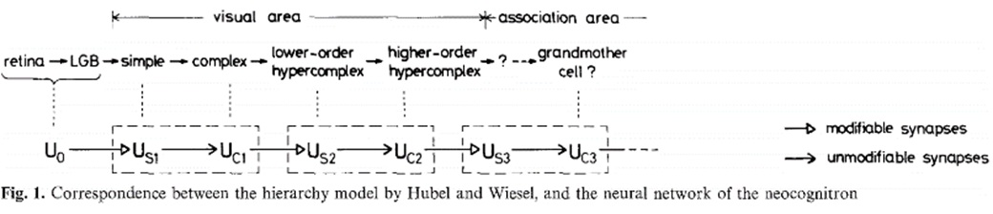
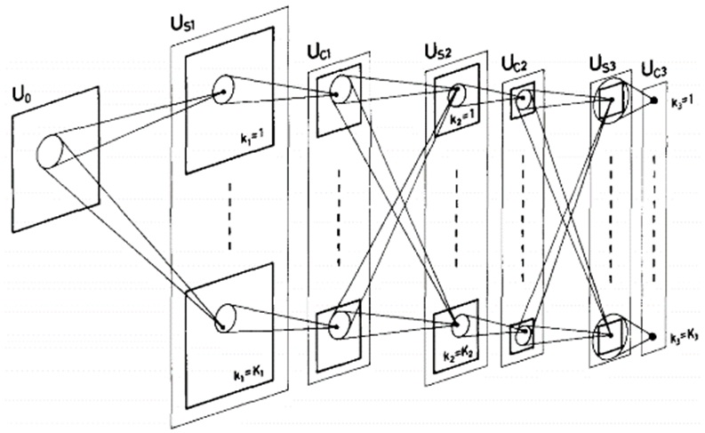
Neocognitron [Fukushima, Biological Cybernetics 1980]
Deformation-Resistant Recognition
S-cells: (simple)
- extract local features
C-cells: (complex)
- allow for positional errors

Slide 18
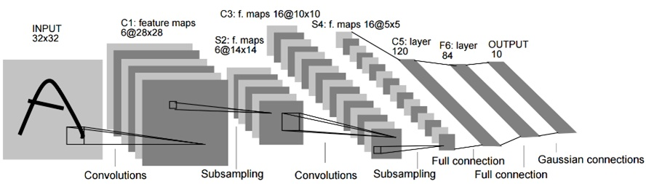
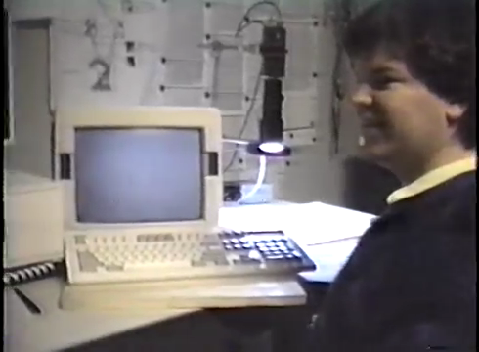
LeNet [LeCun et al. 1998]
Gradient-based learning applied to document recognition [LeCun, Bottou, Bengio, Haffner 1998]
LeNet-1 from 1993

Slide 19
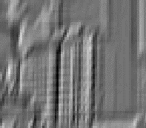


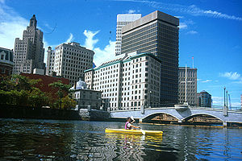
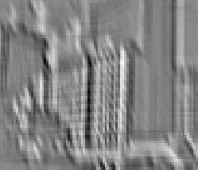
What is a Convolution?
Weighted moving sum
...
Input
Feature Activation Map
slide credit: S. Lazebnik

Slide 20
Convolutional Neural Networks
Feature maps
Normalization
Spatial pooling
Non-linearity
Convolution (Learned)
Input Image
slide credit: S. Lazebnik

Slide 21
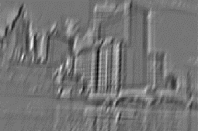

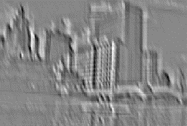
Convolutional Neural Networks
Feature maps
Normalization
Spatial pooling
Non-linearity
...
Convolution (Learned)
Input
Feature Map
Input Image
slide credit: S. Lazebnik

Slide 22
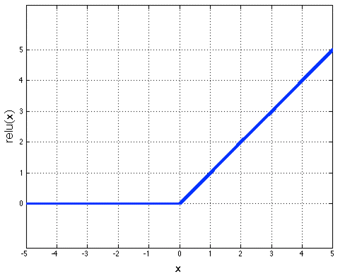
Convolutional Neural Networks
Feature maps
Normalization
Rectified Linear Unit (ReLU)
Spatial pooling
Non-linearity
Convolution (Learned)
Input Image
slide credit: S. Lazebnik

Slide 23
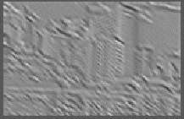

Convolutional Neural Networks
Feature maps
Normalization
  Max pooling
Spatial pooling
Non-linearity
Convolution (Learned)
Max-pooling: a non-linear down-sampling
Provide translation invariance
Input Image
slide credit: S. Lazebnik

Slide 24
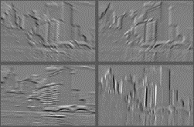
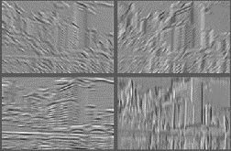
Convolutional Neural Networks
Feature maps
Normalization
Spatial pooling
Feature Maps
Feature Maps
After Contrast Normalization
Non-linearity
Convolution (Learned)
Input Image
slide credit: S. Lazebnik

Slide 25
Convolutional Neural Networks
Feature maps
Normalization
Spatial pooling
Non-linearity
Convolution (Learned)
Input Image
slide credit: S. Lazebnik

Slide 26
Engineered vs. learned features
Label
Convolutional filters are trained in a supervised manner by back-propagating
classification error
Dense
Dense
Dense
Convolution/pool
Label
Convolution/pool
Classifier
Convolution/pool
Pooling
Convolution/pool
Feature extraction
Convolution/pool
Image
Image

Slide 27
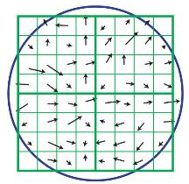

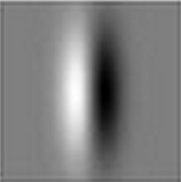
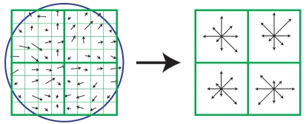
SIFT Descriptor
Lowe [IJCV 2004]
Image
Pixels
Apply gradient filters
Spatial pool
(Sum)
Feature
Vector
Normalize to unit length

Slide 28
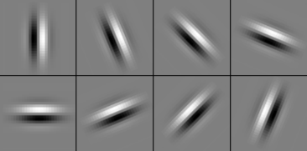
SIFT Descriptor
Lowe [IJCV 2004]
Image
Pixels
Apply
oriented filters
Spatial pool
(Sum)
Feature
Vector
Normalize to unit length
slide credit: R. Fergus

Slide 29




Spatial Pyramid Matching
Lazebnik,
Schmid,
Ponce
[CVPR 2006]
SIFT
Features
Filter with
Visual Words
Max
Multi-scale
spatial pool
(Sum)
Classifier
slide credit: R. Fergus

Slide 30
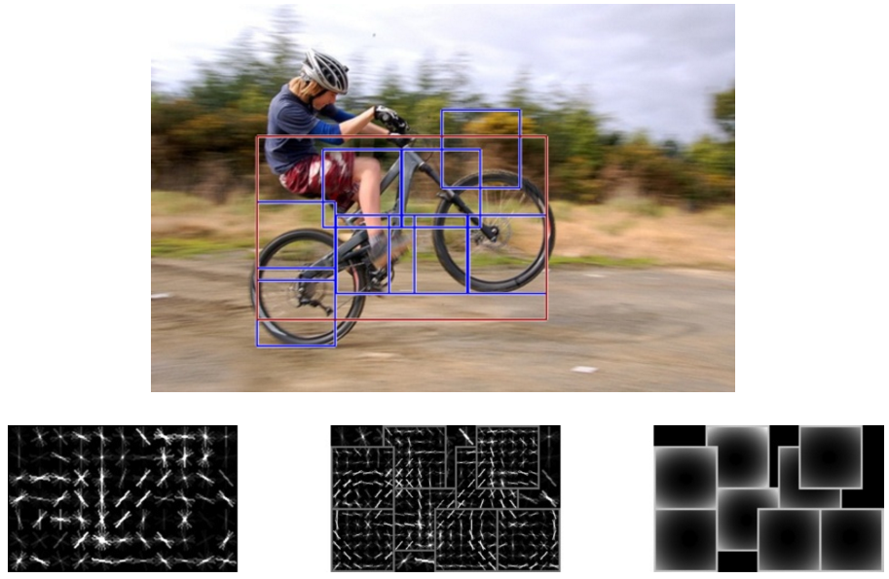
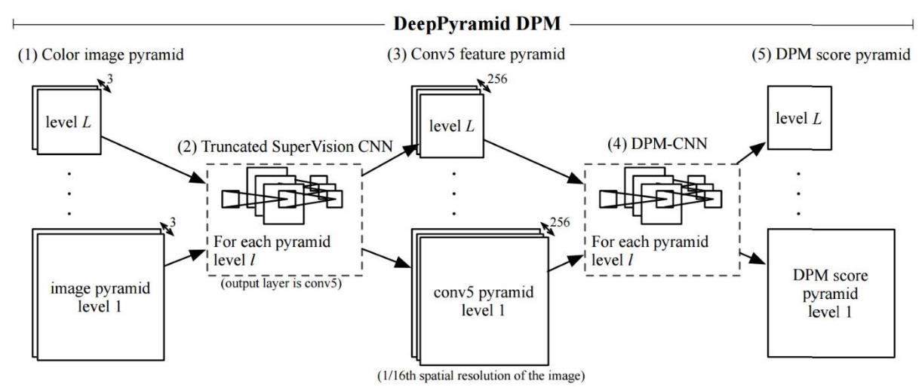
Deformable Part Model
Deformable Part Models are Convolutional Neural Networks [Girshick et al. CVPR 15]

Slide 31
AlexNet
Similar framework to LeCun’98 but:
  Bigger model (7 hidden layers, 650,000 units, 60,000,000 params)
  More data (10⁶ vs. 10³ images)
  GPU implementation (50x speedup over CPU)
    Trained on two GPUs for a week
A. Krizhevsky, I. Sutskever, and G. Hinton,
ImageNet Classification with Deep Convolutional Neural Networks, NIPS 2012
Notes:
Two-GPU architecture

Slide 32
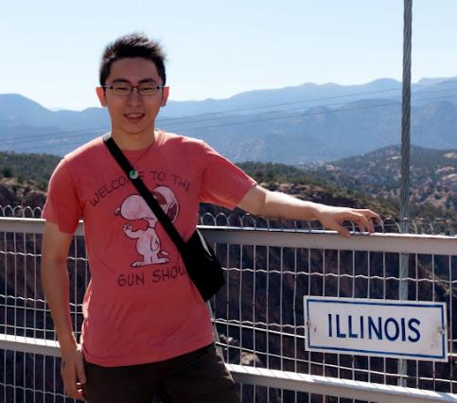
Using CNN for Image Classification
Fully connected layer Fc7
d = 4096
AlexNet
Averaging
Fixed input size: 224x224x3
Softmax Layer
“Jia-Bin”
d = 4096

Slide 33
ImageNet Challenge 2012-2014
Best non-convnet in 2012: 26.2%
Team | Year | Place | Error (top-5) | External data
SuperVision – Toronto (7 layers) | 2012 | - | 16.4% | no
SuperVision | 2012 | 1st | 15.3% | ImageNet 22k
Clarifai – NYU (7 layers) | 2013 | - | 11.7% | no
Clarifai | 2013 | 1st | 11.2% | ImageNet 22k
VGG – Oxford (16 layers) | 2014 | 2nd | 7.32% | no
GoogLeNet (19 layers) | 2014 | 1st | 6.67% | no
Human expert* |  |  | 5.1%
Team | Method | Error (top-5)
DeepImage - Baidu | Data augmentation + multi GPU | 5.33%
PReLU-nets - MSRA | Parametric ReLU + smart initialization | 4.94%
BN-Inception ensemble - Google | Reducing internal covariate shift | 4.82%
Notes:
Best non-convnet in 2012: 26.2%

Slide 34
Beyond classification
Detection
Segmentation
Regression
Pose estimation
Matching patches
Synthesis
Style transfer
and many more…

Slide 35
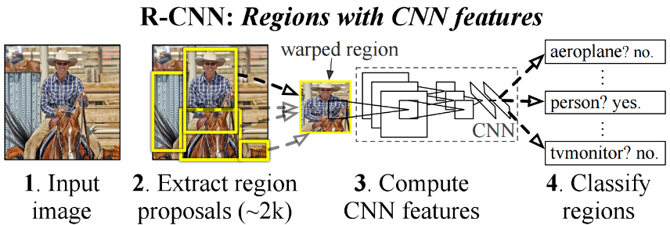
R-CNN: Regions with CNN features
Trained on ImageNet classification
Finetune CNN on PASCAL
RCNN [Girshick et al. CVPR 2014]

Slide 36
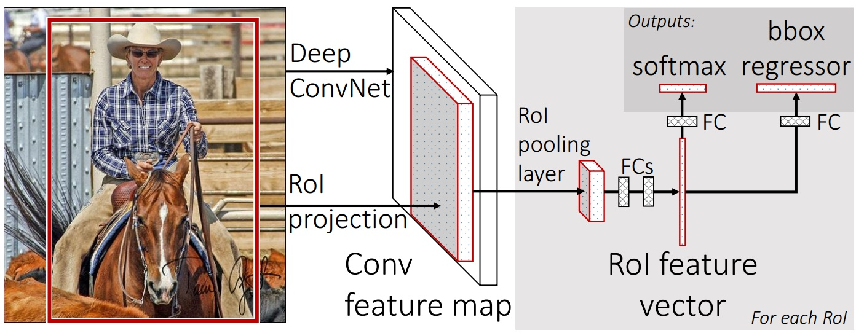
Fast R-CNN
Fast RCNN [Girshick, R 2015]
https://github.com/rbgirshick/fast-rcnn

Slide 37
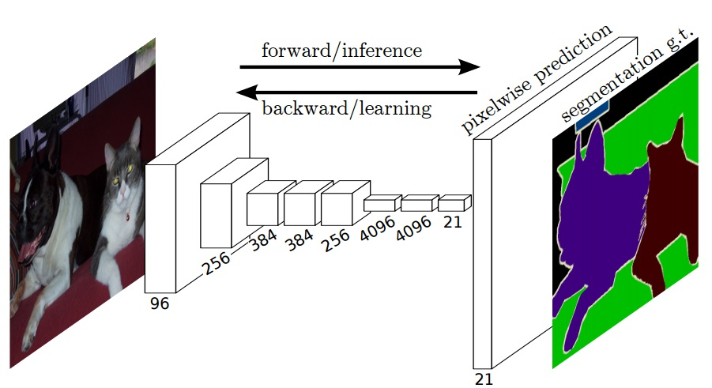
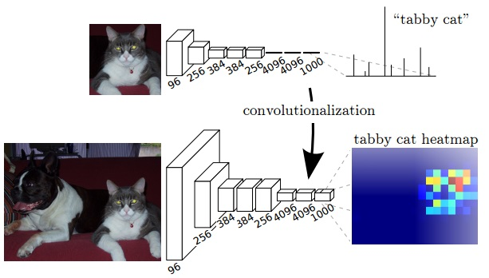
Labeling Pixels: Semantic Labels
Fully Convolutional Networks for Semantic Segmentation [Long et al. CVPR 2015]

Slide 38
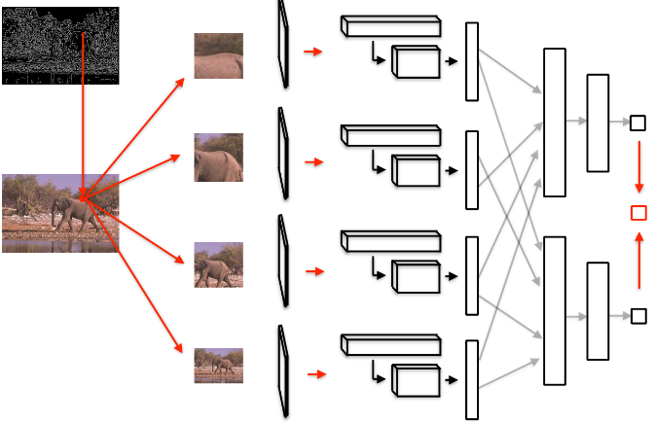
Labeling Pixels: Edge Detection
DeepEdge: A Multi-Scale Bifurcated Deep Network for Top-Down Contour Detection
[Bertasius et al. CVPR 2015]

Slide 39
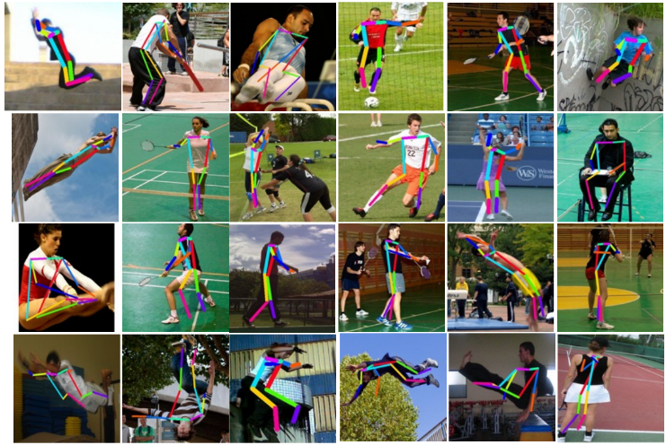
CNN for Regression
DeepPose [Toshev and Szegedy CVPR 2014]

Slide 40
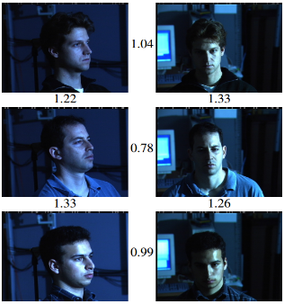
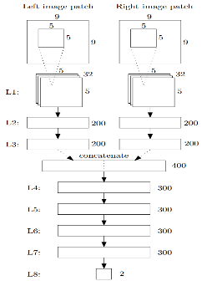
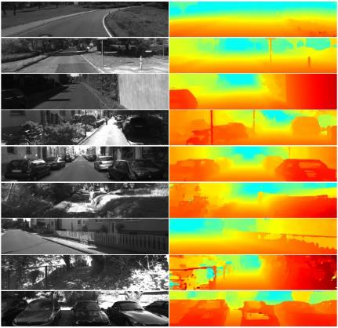
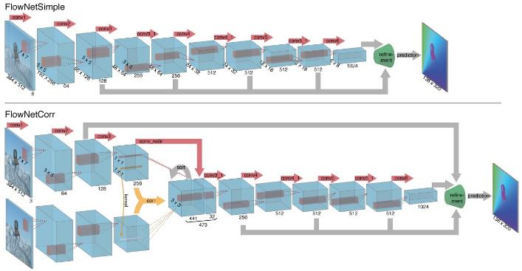

CNN as a Similarity Measure for Matching
Stereo matching [Zbontar and LeCun CVPR 2015]
Compare patch [Zagoruyko and Komodakis 2015]
FaceNet [Schroff et al. 2015]
Match ground and aerial images
[Lin et al. CVPR 2015]
FlowNet [Fischer et al 2015]

Slide 41


CNN for Online Visual Tracking
Hierarchical Convolutional Features for Visual Tracking [Ma et al. ICCV 2015]

Slide 42

CNN for Image Generation
Learning to Generate Chairs with Convolutional Neural Networks [Dosovitskiy et al. CVPR 2015]

Slide 43

Chair Morphing
Learning to Generate Chairs with Convolutional Neural Networks [Dosovitskiy et al. CVPR 2015]

Slide 44



CNN for Image Restoration/Enhancement
Super-resolution
[Dong et al. ECCV 2014]
Non-blind deconvolution
[Xu et al. NIPS 2014]
Non-uniform blur estimation
[Sun et al. CVPR 2015]

Slide 45



Style Transfer
Find an output image with
  similar activations of early layers (low-level) of source image
  similar activations of later layers (high-level) of target image
Source image
Target image
Output (deepart)
A Neural Algorithm of Artistic Style [Gatys et al. 2015]

Slide 46

Image Captioning
http://cs.stanford.edu/people/karpathy/deepimagesent/

Slide 47
Understanding and Visualizing CNN
Find images that maximize some class scores
Individual neuron activation
Visualize input pattern using deconvnet
Invert CNN features
Breaking CNNs

Slide 48

Find images that maximize some class scores
person: HOG template
Deep Inside Convolutional Networks: Visualising Image Classification Models and Saliency Maps
[Simonyan et al. ICLR Workshop 2014]

Slide 49

Individual Neuron Activation
RCNN [Girshick et al. CVPR 2014]

Slide 50

Individual Neuron Activation
RCNN [Girshick et al. CVPR 2014]

Slide 51

Individual Neuron Activation
RCNN [Girshick et al. CVPR 2014]

Slide 52

Map activation back to the input pixel space
What input pattern originally caused a given activation in the feature maps?
Visualizing and Understanding Convolutional Networks [Zeiler and Fergus, ECCV 2014]

Slide 53

Layer 1
Visualizing and Understanding Convolutional Networks [Zeiler and Fergus, ECCV 2014]

Slide 54

Layer 2
Visualizing and Understanding Convolutional Networks [Zeiler and Fergus, ECCV 2014]

Slide 55

Layer 3
Visualizing and Understanding Convolutional Networks [Zeiler and Fergus, ECCV 2014]

Slide 56

Layer 4 and 5
Visualizing and Understanding Convolutional Networks [Zeiler and Fergus, ECCV 2014]

Slide 57

Invert CNN features
Reconstruct an image from CNN features
Understanding deep image representations by inverting them
[Mahendran and Vedaldi CVPR 2015]

Slide 58


CNN Reconstruction
Reconstruction from different layers
Multiple reconstructions
Understanding deep image representations by inverting them
[Mahendran and Vedaldi CVPR 2015]

Slide 59

Breaking CNNs
Intriguing properties of neural networks [Szegedy ICLR 2014]

Slide 60

What is going on?
x
Explaining and Harnessing Adversarial Examples [Goodfellow ICLR 2015]
http://karpathy.github.io/2015/03/30/breaking-convnets/

Slide 61
What is going on?
Recall gradient descent training: modify the weights to reduce classifier error
Adversarial examples: modify the image to increase classifier error
Explaining and Harnessing Adversarial Examples [Goodfellow ICLR 2015]
http://karpathy.github.io/2015/03/30/breaking-convnets/

Slide 62
Fooling a linear classifier
Perceptron weight update: add a small multiple of the example to the weight vector:
w ← w + α x
To fool a linear classifier, add a small multiple of the weight vector to the training example:
x ← x + α w
Explaining and Harnessing Adversarial Examples [Goodfellow ICLR 2015]
http://karpathy.github.io/2015/03/30/breaking-convnets/

Slide 63

Fooling a linear classifier
http://karpathy.github.io/2015/03/30/breaking-convnets/

Slide 64

Breaking CNNs
Deep Neural Networks are Easily Fooled: High Confidence Predictions for Unrecognizable Images [Nguyen et al. CVPR 2015]

Slide 65

Images that both CNN and Human can recognize
Deep Neural Networks are Easily Fooled: High Confidence Predictions for Unrecognizable Images [Nguyen et al. CVPR 2015]

Slide 66

Direct Encoding
Deep Neural Networks are Easily Fooled: High Confidence Predictions for Unrecognizable Images [Nguyen et al. CVPR 2015]

Slide 67

Indirect Encoding
Deep Neural Networks are Easily Fooled: High Confidence Predictions for Unrecognizable Images [Nguyen et al. CVPR 2015]

Slide 68
Training Convolutional Neural Networks
Backpropagation + stochastic gradient descent with momentum
  Neural Networks: Tricks of the Trade
Dropout
Data augmentation
Batch normalization
Initialization
  Transfer learning

Slide 69


Training CNN with gradient descent
A CNN as composition of functions
$$f_{w}\left(x\right)={f_{L}(… (f}_{2}\left(f_{1}\left(x;w_{1}\right);w_{2}\right)…;w_{L})$$
Parameters
  $$w=(w_{1}, w_{2},…w_{L})$$
Empirical loss function
  $$L\left(w\right)= \frac{1}{n}\sum_{i}{l(z_{i}, f_{w}(x_{i}))}$$
Gradient descent
$$w^{t+1}=w^{t} − η_{t}\frac{∂f}{∂w}(w^{t})$$
New weight
Old weight
Learning rate
Gradient

Slide 70



An Illustrative example
$$f\left(x, y\right)=xy, \frac{∂f}{∂x}=y, \frac{∂f}{∂y}=x$$
Example: $x=4, y=−3⇒f\left(x,y\right)=−12$
Partial derivatives
$$\frac{∂f}{∂x}=−3, \frac{∂f}{∂y}=4$$
Gradient
$$∇f=[\frac{∂f}{∂x},\frac{∂f}{∂y}]$$
Example credit: Andrej Karpathy

Slide 71




$$f\left(x, y,z\right)=\left(x+y\right)z=qz$$
$$q=x+y$$
$$\frac{∂q}{∂x}=1, \frac{∂q}{∂y}=1$$
$$f=qz$$
$$\frac{∂f}{∂q}=z, \frac{∂f}{∂z}=q$$
Goal: compute the gradient
$$∇f=[\frac{∂f}{∂x},\frac{∂f}{∂y},\frac{∂f}{∂z}]$$
Example credit: Andrej Karpathy

Slide 72



$$f\left(x, y,z\right)=\left(x+y\right)z=qz$$
$$q=x+y$$
$$\frac{∂q}{∂x}=1, \frac{∂q}{∂y}=1$$
$$f=qz$$
$$\frac{∂f}{∂q}=z, \frac{∂f}{∂z}=q$$
Chain rule:
$$\frac{∂f}{∂x}= \frac{∂f}{∂q}\frac{∂q}{∂x}$$
Example credit: Andrej Karpathy

Slide 73






Backpropagation (recursive chain rule)
$$w_{1}$$
$$w_{2}$$
$$q$$
$$\frac{∂f}{∂q}$$
$$w_{n}$$
$$\frac{∂f}{∂w_{i}}=\frac{∂q}{∂w_{i}}\frac{∂f}{∂q}$$
Local gradient
Gate gradient
Can be computed during forward pass
The gate receives this during backprop

Slide 74

Dropout
Intuition: successful conspiracies
50 people planning a conspiracy
Strategy A: plan a big conspiracy involving 50 people
  Likely to fail. 50 people need to play their parts correctly.
Strategy B: plan 10 conspiracies each involving 5 people
  Likely to succeed!
Dropout: A simple way to prevent neural networks from overfitting [Srivastava JMLR 2014]

Slide 75



Dropout
Main Idea: approximately combining exponentially many different neural network architectures efficiently
Dropout: A simple way to prevent neural networks from overfitting [Srivastava JMLR 2014]

Slide 76

Data Augmentation (Jittering)
Create virtual training samples
  Horizontal flip
  Random crop
  Color casting
  Geometric distortion
Deep Image [Wu et al. 2015]

Slide 77


Parametric Rectified Linear Unit
Delving Deep into Rectifiers: Surpassing Human-Level Performance on
ImageNet Classification [He et al. 2015]

Slide 78


Batch Normalization
Batch Normalization: Accelerating Deep Network Training by
Reducing Internal Covariate Shift [Ioffe and Szegedy 2015]

Slide 79

Transfer Learning
Improvement of learning in a new task through the transfer of knowledge from a related task that has already been learned.
Weight initialization for CNN
Learning and Transferring Mid-Level Image Representations using
Convolutional Neural Networks [Oquab et al. CVPR 2014]

Slide 80


Convolutional activation features
[Donahue et al. ICML 2013]
CNN Features off-the-shelf:
an Astounding Baseline for Recognition
[Razavian et al. 2014]

Slide 81


How transferable are features in CNN?
How transferable are features in deep
neural networks [Yosinski NIPS 2014]

Slide 82


Deep Rendering Model (DRM)
A Probabilistic Theory of Deep Learning [Patel, Nguyen, and Baraniuk 2015]

Slide 83

CNN as a Max-Sum Inference
A Probabilistic Theory of Deep Learning [Patel, Nguyen, and Baraniuk 2015]

Slide 84

Model
Inference
Learning

Slide 85
Tools
Caffe
cuda-convnet2
Torch
MatConvNet
Pylearn2
TensorFlow

Slide 86
Resources
http://deeplearning.net/
  Hub to many other deep learning resources
https://github.com/ChristosChristofidis/awesome-deep-learning
  A resource collection deep learning
https://github.com/kjw0612/awesome-deep-vision
  A resource collection deep learning for computer vision
http://cs231n.stanford.edu/syllabus.html
  Nice course on CNN for visual recognition

Slide 87
Things to remember
Overview
  Neuroscience, Perceptron, multi-layer neural networks
Convolutional neural network (CNN)
  Convolution, nonlinearity, max pooling
  CNN for classification and beyond
Understanding and visualizing CNN
  Find images that maximize some class scores;
  visualize individual neuron activation, input pattern and images; breaking CNNs
Training CNN
  Dropout; data augmentation; batch normalization; transfer learning
Probabilistic interpretation
  Deep rendering model; CNN forward-propagation as max-sum inference; training as an EM algorithm

Slide 88


