Slide 1
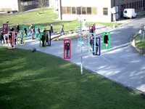
Object Tracking
Computer Vision
Jia-Bin Huang, Virginia Tech
Many slides from D. Hoiem

Slide 2
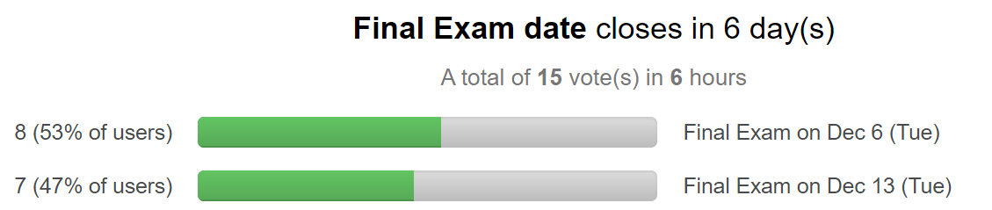
Administrative stuffs
HW 5 (Scene categorization)
  Due 11:59pm on Wed, November 16
Poll on Piazza –
When should we have the final exam?
  Dec 6
  Dec 13

Slide 3
Today’s class
Explain HW 5 in detail
Review/finish object detection
Tracking Objects
  Examples and Applications
  Overview of probabilistic tracking
  Kalman Filter
  Particle Filter

Slide 4
HW 5
Color histogram and k-nearest neighbor (kNN) classifier
Bag of visual words model and nearest neighbor classifier
Bag of visual words model and a discriminative classifier
Spatial pyramid model and a discriminative classifier

Slide 5
Review: Statistical template
Object model = log linear model of parts at fixed positions
?
+3
+2
-2
-1
-2.5
= -0.5
> 7.5
Non-object
?
+4
+1
+0.5
+3
+0.5
= 10.5
> 7.5
Object

Slide 6
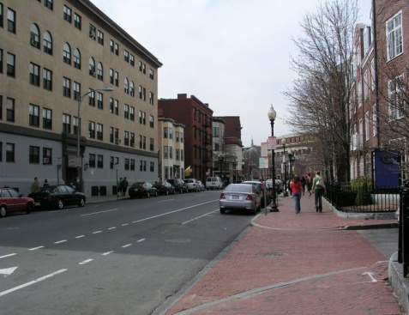
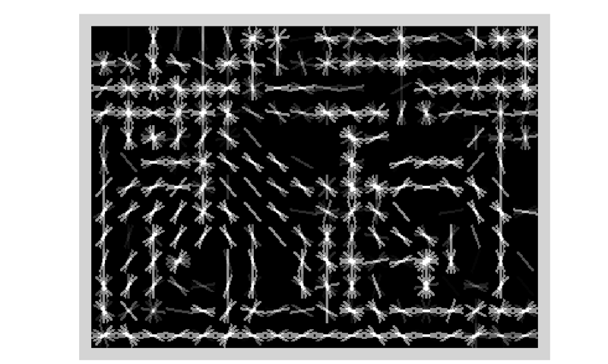
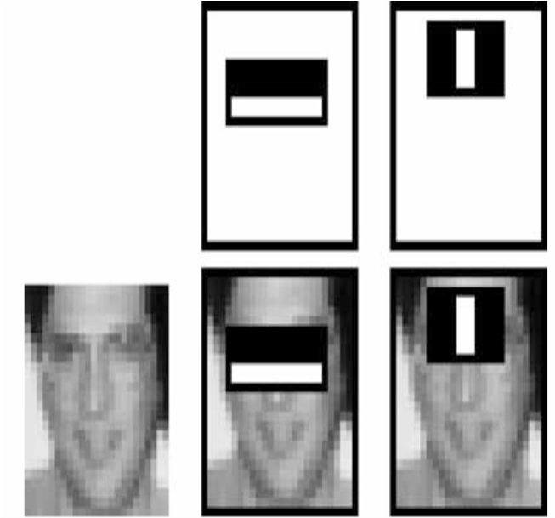
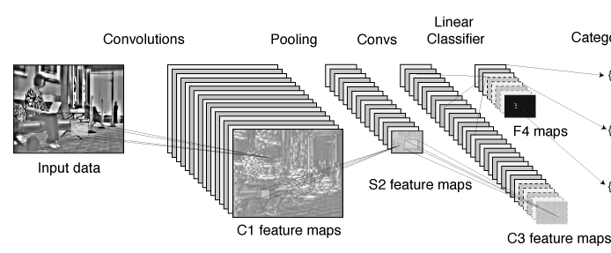
Review: Statistical templates
A. Propose Window
B. Extract Features
C. Classify
D. Post-process
SVM
Boosted stubs
Neural network
Non-max suppression
Segment or refine localization
HOG
Sliding window: scan image pyramid
Fast randomized features
Region proposals: edge/region-based, resize to fixed window
CNN features

Slide 7
Review: Part-based Models
Part
Part
Part
Star-shaped model
  Example: Deformable Parts Model
    Felzenswalb et al. 2010
Tree-shaped model
  Example: Pictorial structures
    Felzenszwalb Huttenlocher 2005
Sequential prediction models
Root
Part
Part

Slide 8
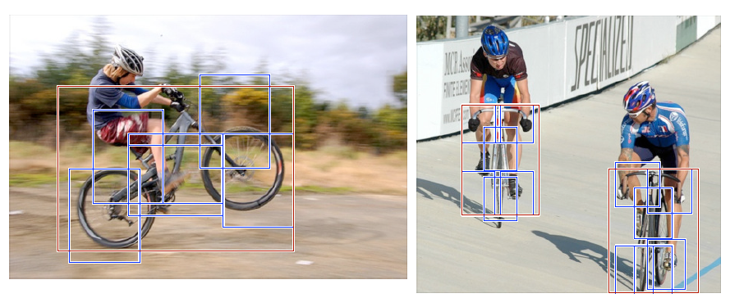
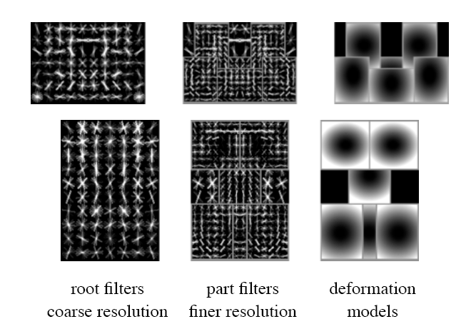
Deformable Latent Parts Model (DPM)
Detections
Template Visualization
Felzenszwalb et al. 2008, 2010

Slide 9
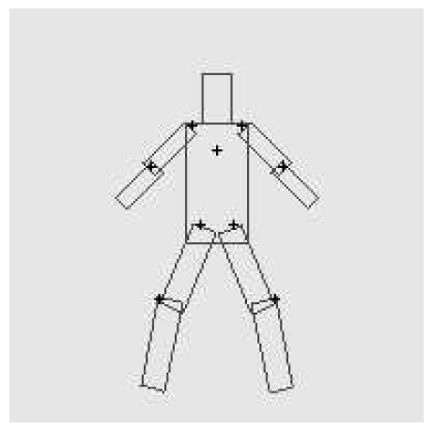
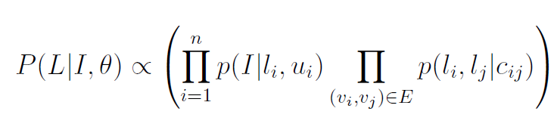
Pictorial Structures Model
Appearance likelihood
Geometry likelihood

Slide 10
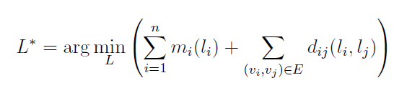
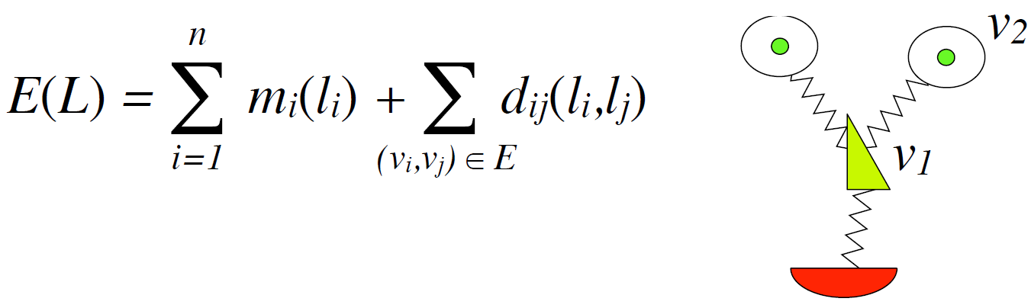
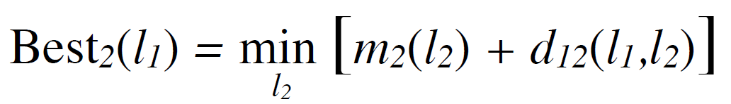
Pictorial Structures Model
Optimization is tricky but can be efficient
For each l₁, find best l₂:
Remove v₂, and repeat with smaller tree, until only a single part
For k parts, n locations per part, this has complexity of O(kn²), but can be solved in ~O(kn) using generalized distance transform

Slide 11
Tracking Objects
Goal:
Locating a moving object/part across video frames
Examples and Applications
Overview of visual tracking
Motion models: probabilistic tracking
  Kalman Filter
  Particle Filter

Slide 12
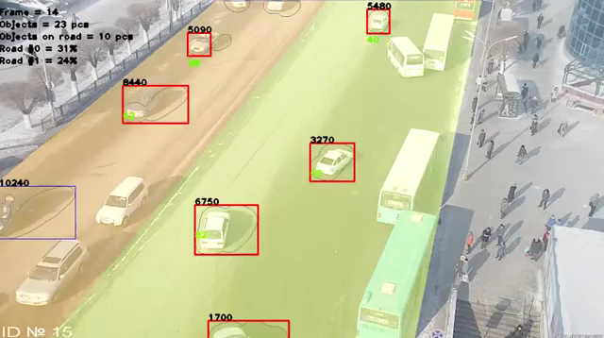
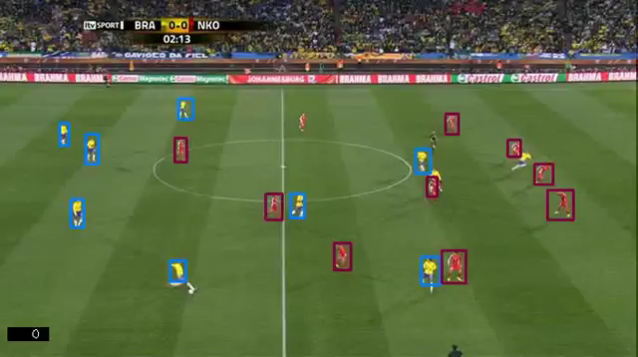
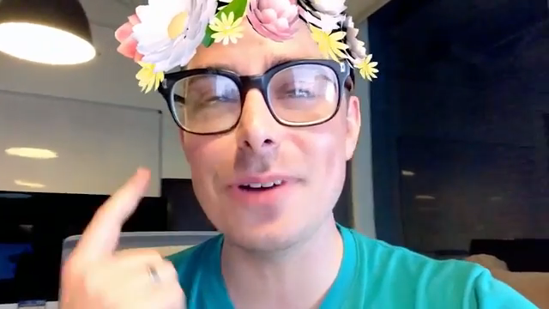
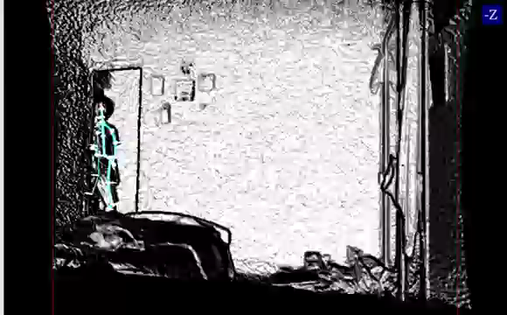
Tracking examples
Traffic
Sports
Face
Body

Slide 13
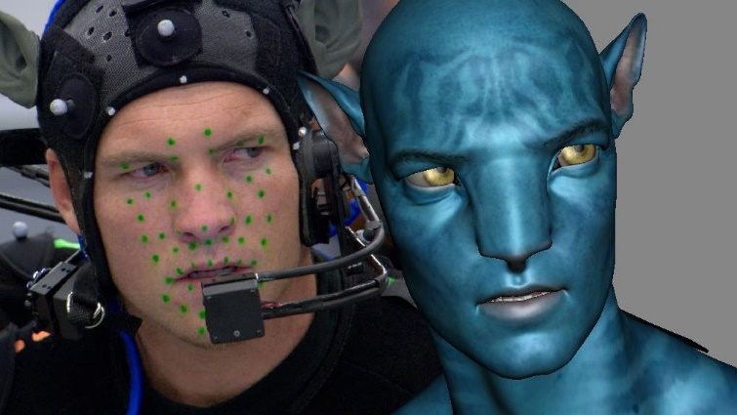
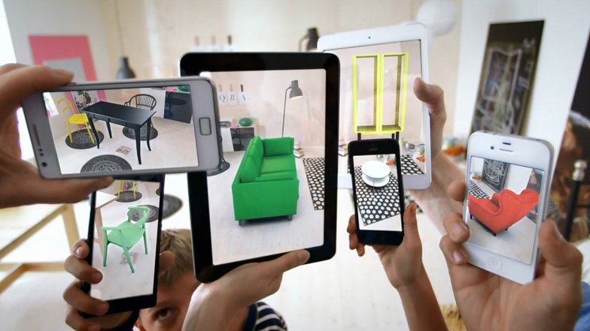
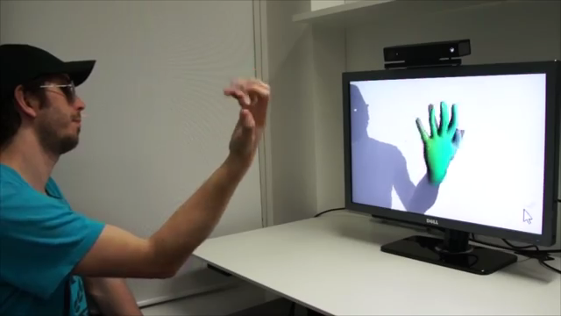
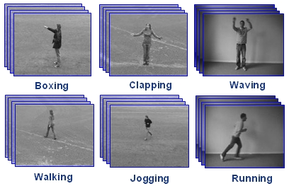
Further applications
Motion capture
Augmented Reality
Action Recognition
Security, traffic monitoring
Video Compression
Human-computer interaction
Video Summarization
Medical Screening

Slide 14
Tracking Examples
Traffic: https://www.youtube.com/watch?v=DiZHQ4peqjg
Soccer: http://www.youtube.com/watch?v=ZqQIItFAnxg
Face: http://www.youtube.com/watch?v=i_bZNVmhJ2o
Body: https://www.youtube.com/watch?v=_Ahy0Gh69-M
Eye: http://www.youtube.com/watch?v=NCtYdUEMotg
Gaze: http://www.youtube.com/watch?v=-G6Rw5cU-1c

Slide 15
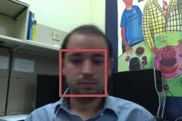
Things that make visual tracking difficult
Small, few visual features
Erratic movements, moving very quickly
Occlusions, leaving and coming back
Surrounding similar-looking objects

Slide 16
Strategies for tracking
Tracking by repeated detection
  Works well if object is easily detectable (e.g., face or colored glove) and there is only one
  Need some way to link up detections
  Best you can do, if you can’t predict motion

Slide 17
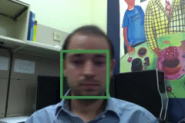
Tracking with dynamics
Key idea: Based on a model of expected motion, predict where objects will occur in next frame, before even seeing the image
  Restrict search for the object
  Measurement noise is reduced by trajectory smoothness
  Robustness to missing or weak observations

Slide 18
Strategies for tracking
Tracking with motion prediction
  Predict the object’s state in the next frame
  Kalman filtering: next state can be linearly predicted from current state (Gaussian)
  Particle filtering: sample multiple possible states of the object (non-parametric, good for clutter)

Slide 19
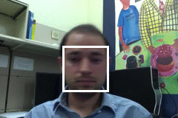
General model for tracking
state X: The actual state of the moving object that we want to estimate
  State could be any combination of position, pose, viewpoint, velocity, acceleration, etc.
observations Y: Our actual measurement or observation of state X. Observation can be very noisy
At each time t, the state changes to X_{t} and we get a new observation Y_{t}

Slide 20
Steps of tracking
Prediction: What is the next state of the object given past measurements?

Slide 21
Steps of tracking
Prediction: What is the next state of the object given past measurements?
Correction: Compute an updated estimate of the state from prediction and measurements

Slide 22
Simplifying assumptions
Only the immediate past matters
dynamics model

Slide 23
Simplifying assumptions
Only the immediate past matters
Measurements depend only on the current state
dynamics model
observation model

Slide 24
Simplifying assumptions
Only the immediate past matters
Measurements depend only on the current state
dynamics model
observation model
…
X₀
X₁
X₂
X_{t-1}
X_{t}
Y₀
Y₁
Y₂
Y_{t-1}
Y_{t}

Slide 25
Problem statement
We have models for
  Likelihood of next state given current state:
  Likelihood of observation given the state:
We want to recover, for each t:

Slide 26
Probabilistic tracking
Base case:
  Start with initial prior that predicts state in absence of any evidence: P(X₀)
  For the first frame, correct this given the first measurement: Y₀=y₀

Slide 27
Probabilistic tracking
Base case:
  Start with initial prior that predicts state in absence of any evidence: P(X₀)
  For the first frame, correct this given the first measurement: Y₀=y₀

Slide 28
Probabilistic tracking
Base case:
  Start with initial prior that predicts state in absence of any evidence: P(X₀)
  For the first frame, correct this given the first measurement: Y₀=y₀
Given corrected estimate for frame t-1:
  Predict for frame t ➔
  Observe y_{t}; Correct for frame t ➔
predict
correct

Slide 29
Prediction
Prediction involves representing
given
Law of total probability

Slide 30
Prediction
Prediction involves representing
given
Conditioning on X_{t–1}

Slide 31
Prediction
Prediction involves representing
given
Independence assumption

Slide 32
Prediction
Prediction involves representing
given
dynamics
model
corrected estimate
from previous step

Slide 33
Correction
Correction involves computing
given predicted value

Slide 34
Correction
Correction involves computing
given predicted value
Bayes’ Rule

Slide 35
Correction
Correction involves computing
given predicted value
Independence assumption
(observation y_{t} directly depends only on state X_{t})

Slide 36
Correction
Correction involves computing
given predicted value
Conditioning on X_{t}

Slide 37
Correction
Correction involves computing
given predicted value
observation
model
predicted
estimate
normalization factor

Slide 38
Summary: Prediction and correction
Prediction:
Correction:
dynamics
model
corrected estimate
from previous step
observation
model
predicted
estimate

Slide 39
The Kalman filter
Linear dynamics model: state undergoes linear transformation plus Gaussian noise
Observation model: measurement is linearly transformed state plus Gaussian noise
The predicted/corrected state distributions are Gaussian
  You only need to maintain the mean and covariance
  The calculations are easy (all the integrals can be done in closed form)

Slide 40
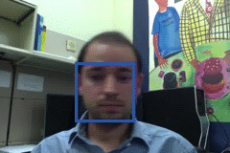
Example: Kalman Filter
Ground Truth
Observation
Correction
Next Frame
Update Location, Velocity, etc.
Prediction

Slide 41
Comparison
Ground Truth
Observation
Correction

Slide 42
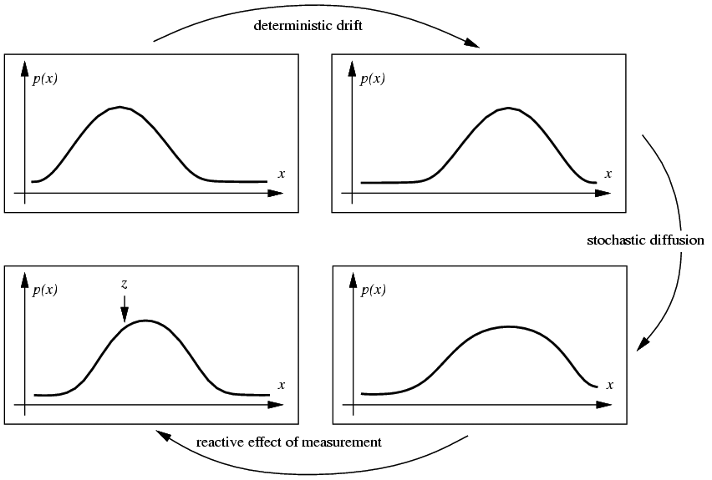
Propagation of Gaussian densities
Current state
Expected change
Decent model if there is just one object, but localization is imprecise
Uncertainty
Observation and Correction

Slide 43
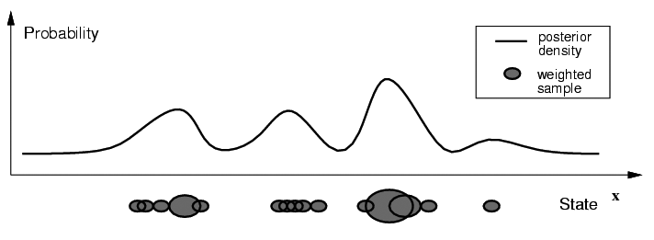
Particle filtering
Represent the state distribution non-parametrically
Prediction: Sample possible values X_{t-1} for the previous state
Correction: Compute likelihood of X_{t} based on weighted samples and P(y_{t}|X_{t})
M. Isard and A. Blake, CONDENSATION -- conditional density propagation for visual tracking, IJCV 29(1):5-28, 1998

Slide 44
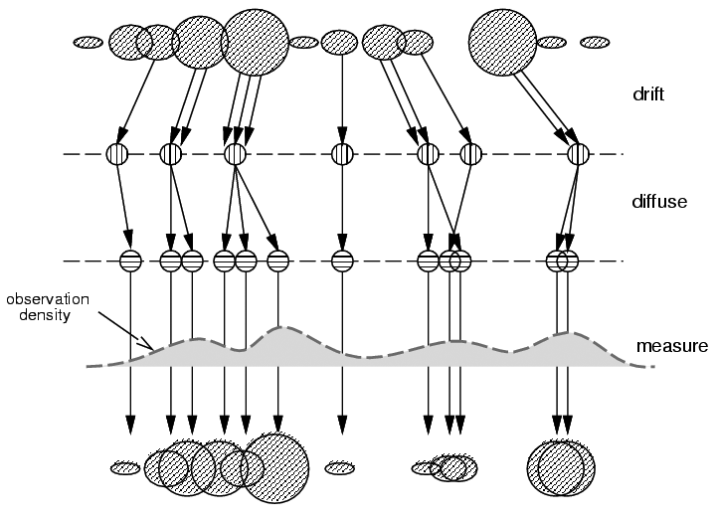
Particle filtering
Start with weighted samples from previous time step
Sample and shift according to dynamics model
Spread due to randomness; this is predicted density P(X_{t}|Y_{t-1})
Weight the samples
according to observation density
Arrive at corrected density estimate P(X_{t}|Y_{t})
M. Isard and A. Blake, CONDENSATION -- conditional density propagation for visual tracking, IJCV 29(1):5-28, 1998

Slide 45
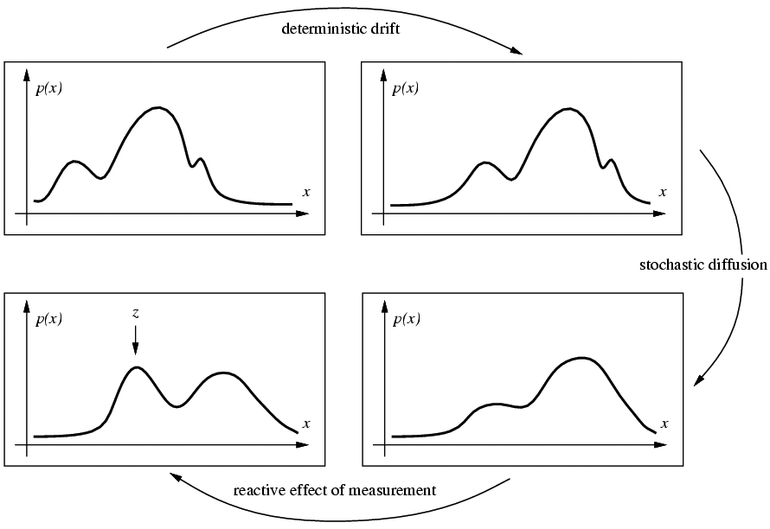
Propagation of non-parametric densities
Current state
Expected change
Good if there are multiple, confusable objects (or clutter) in the scene
Uncertainty
Observation and Correction

Slide 46

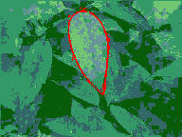
Particle filtering results
People: http://www.youtube.com/watch?v=wCMk-pHzScE
Hand: http://www.youtube.com/watch?v=tIjufInUqZM
Localization (similar model): https://www.youtube.com/watch?v=rAuTgsiM2-8
http://www.cvlibs.net/publications/Brubaker2013CVPR.pdf
Good informal explanation: https://www.youtube.com/watch?v=aUkBa1zMKv4

Slide 47
Tracking issues
Initialization
  Manual
  Background subtraction
  Detection

Slide 48
Tracking issues
Initialization
Getting observation and dynamics models
  Observation model: match a template or use a trained detector
  Dynamics model: usually specify using domain knowledge

Slide 49
Tracking issues
Initialization
Obtaining observation and dynamics model
Uncertainty of prediction vs. correction
  If the dynamics model is too strong, will end up ignoring the data
  If the observation model is too strong, tracking is reduced to repeated detection
Too strong dynamics model
Too strong observation model

Slide 50
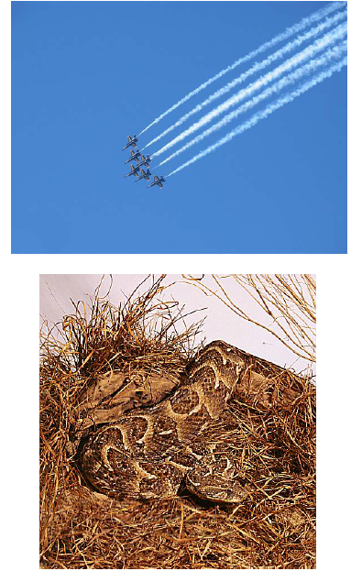
Tracking issues
Initialization
Getting observation and dynamics models
Prediction vs. correction
Data association
  When tracking multiple objects, need to assign right objects to right tracks (particle filters good for this)

Slide 51
Tracking issues
Initialization
Getting observation and dynamics models
Prediction vs. correction
Data association
Drift
  Errors can accumulate over time

Slide 52
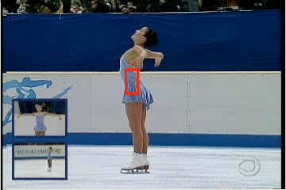
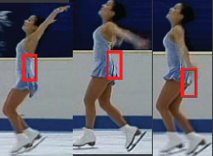
Drift
D. Ramanan, D. Forsyth, and A. Zisserman. Tracking People by Learning their Appearance. PAMI 2007.

Slide 53

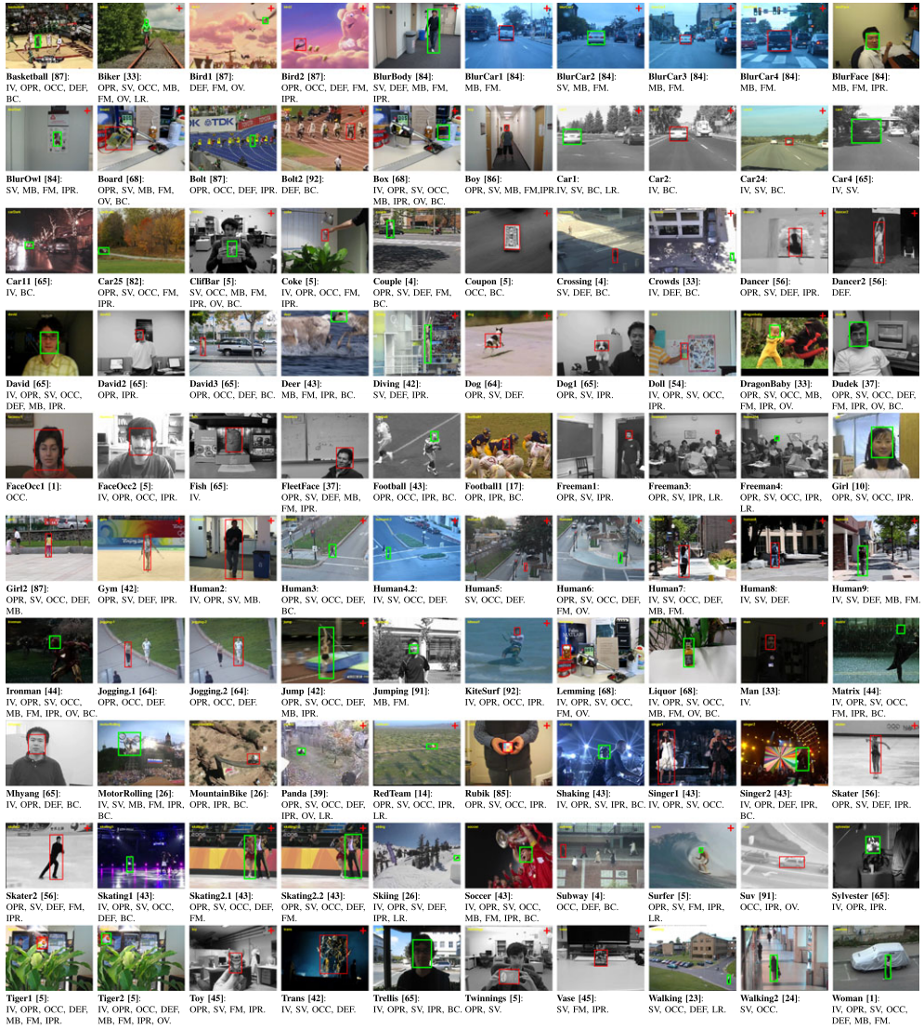
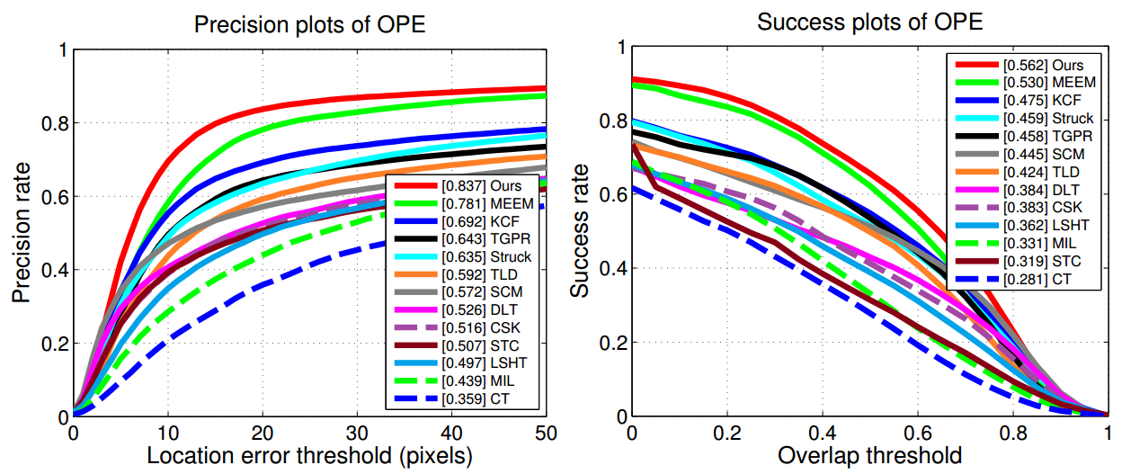
State-of-the-art object tracking
VOT 2016
Object tracking benchmark, PAMI15

Slide 54
Things to remember
Tracking objects = detection + prediction
Probabilistic framework
  Predict next state
  Update current state based on observation
Two simple but effective methods
  Kalman filters: Gaussian distribution
  Particle filters: multimodal distribution

