Slide 1
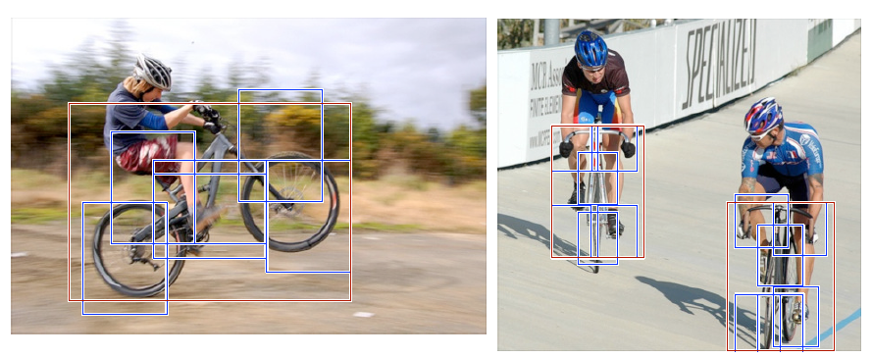
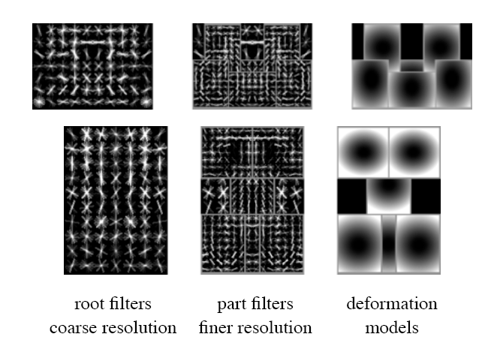
Object Detection with
Part-based Models
Computer Vision
Jia-Bin Huang, Virginia Tech
Many slides from D. Hoiem, J. Hays

Slide 2
Administrative stuffs
HW 5 (Scene categorization) is out
  Due 11:59pm on Wed, November 16
HW 3 graded
HW 4 will be out this week
Final project

Slide 3
Today’s class
Statistical template matching
  Dalal-Triggs pedestrian detector (basic concept)
  Viola-Jones detector (cascades, integral images)
  R-CNN detector (object proposals/CNN)
Deformable parts model
  Star-shaped model
  Example: Deformable Parts Model Felzenswalb et al. 2010
  Tree-shaped model
  Example: Pictorial structures Felzenszwalb Huttenlocher 2005
  Sequential prediction models

Slide 4
Review: Statistical template
Object model = log linear model of parts at fixed positions
?
+3
+2
-2
-1
-2.5
= -0.5
> 7.5
Non-object
?
+4
+1
+0.5
+3
+0.5
= 10.5
> 7.5
Object

Slide 5
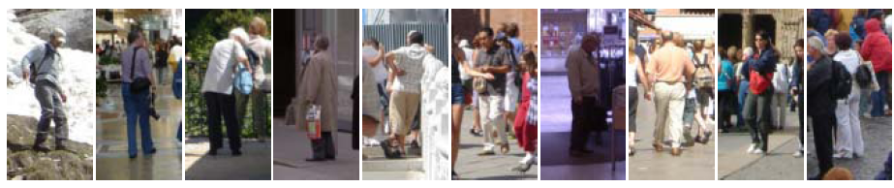
Example: Dalal-Triggs pedestrian detector
Extract fixed-sized (64x128 pixel) window at each position and scale
Compute HOG (histogram of gradient) features within each window
Score the window with a linear SVM classifier
Perform non-maxima suppression to remove overlapping detections with lower scores
Navneet Dalal and Bill Triggs, Histograms of Oriented Gradients for Human Detection, CVPR05

Slide 6

Slides by Pete Barnum
Navneet Dalal and Bill Triggs, Histograms of Oriented Gradients for Human Detection, CVPR05

Slide 7
Tested with
  RGB
  LAB
  Grayscale
Gamma Normalization and Compression
  Square root
  Log
Slightly better performance vs. grayscale
Very slightly better performance vs. no adjustment

Slide 8
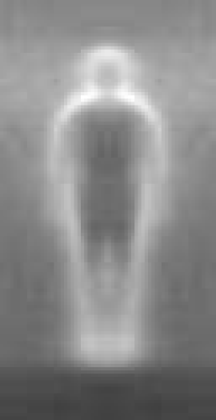

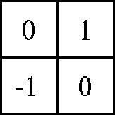

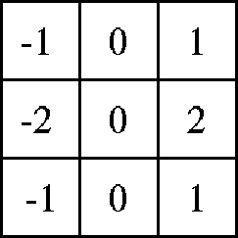

Outperforms
centered
diagonal
uncentered
cubic-corrected
Sobel
Slides by Pete Barnum
Navneet Dalal and Bill Triggs, Histograms of Oriented Gradients for Human Detection, CVPR05

Slide 9
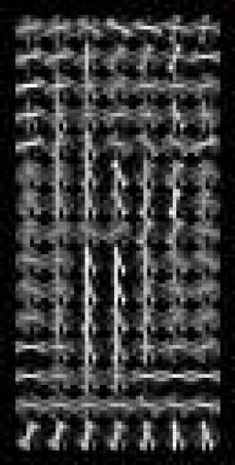
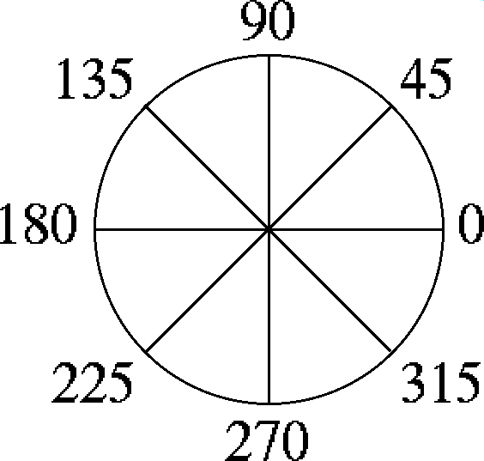

Histogram of gradient orientations
  Votes weighted by magnitude
  Bilinear interpolation between cells
Orientation: 9 bins (for unsigned angles)
Histograms in 8x8 pixel cells
Slides by Pete Barnum
Navneet Dalal and Bill Triggs, Histograms of Oriented Gradients for Human Detection, CVPR05

Slide 10
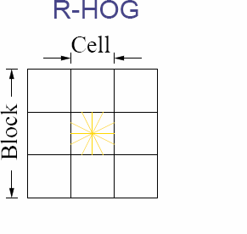
Normalize with respect to surrounding cells
Slides by Pete Barnum
Navneet Dalal and Bill Triggs, Histograms of Oriented Gradients for Human Detection, CVPR05

Slide 11
# orientations
# features = 15 x 7 x 9 x 4 = 3780
X=
# cells
# normalizations by neighboring cells
Slides by Pete Barnum
Navneet Dalal and Bill Triggs, Histograms of Oriented Gradients for Human Detection, CVPR05

Slide 12
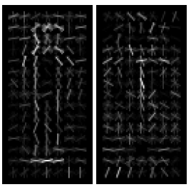
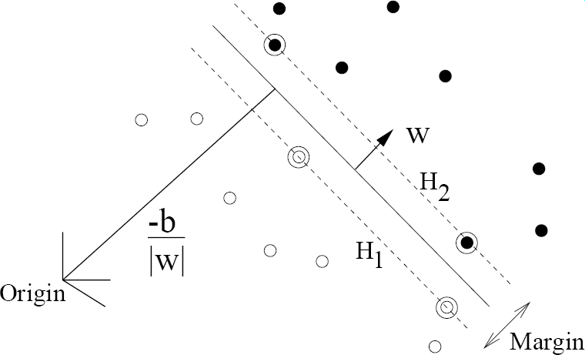
pos w
neg w
Slides by Pete Barnum
Navneet Dalal and Bill Triggs, Histograms of Oriented Gradients for Human Detection, CVPR05

Slide 13
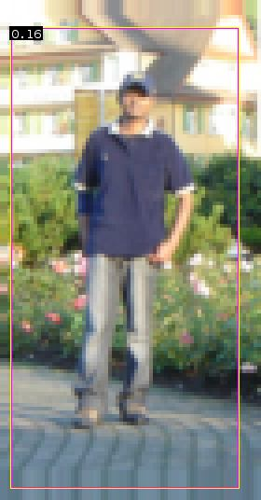


pedestrian
Slides by Pete Barnum
Navneet Dalal and Bill Triggs, Histograms of Oriented Gradients for Human Detection, CVPR05

Slide 14
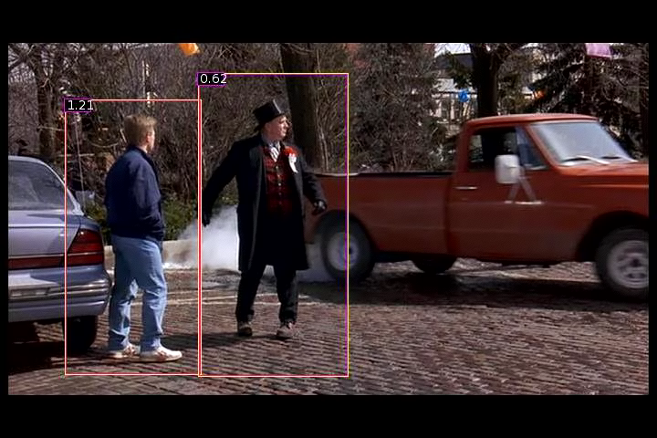
Detection examples

Slide 15
Something to think about…
Sliding window detectors work
  very well for faces
  fairly well for cars and pedestrians
  badly for cats and dogs
Why are some classes easier than others?

Slide 16
Viola-Jones sliding window detector
Fast detection through two mechanisms
Quickly eliminate unlikely windows
Use features that are fast to compute
Viola and Jones. Rapid Object Detection using a Boosted Cascade of Simple Features (2001).

Slide 17
Cascade for Fast Detection
Stage 1
H₁(x) > t₁?
Yes
Stage 2
H₂(x) > t₂?
Stage N
H_{N}(x) > t_{N}?
Yes
Choose threshold for low false negative rate
Fast classifiers early in cascade
Slow classifiers later, but most examples don’t get there
…
Pass
No
No
No
Examples
Reject
Reject
Reject

Slide 18
Features that are fast to compute
“Haar-like features”
  Differences of sums of intensity
  Thousands, computed at various positions and scales within detection window
-1
+1
Two-rectangle features
Three-rectangle features
Etc.

Slide 19
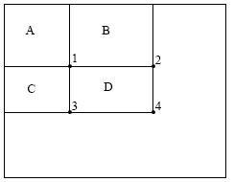
Integral Images
ii = cumsum(cumsum(im, 1), 2)
x, y
ii(x,y) = Sum of the values in the grey region
How to compute B-A?
How to compute A+D-B-C?

Slide 20

Feature selection with Adaboost
Create a large pool of features (180K)
Select features that are discriminative and work well together
  “Weak learner” = feature + threshold + parity
  Choose weak learner that minimizes error on the weighted training set
  Reweight

Slide 21
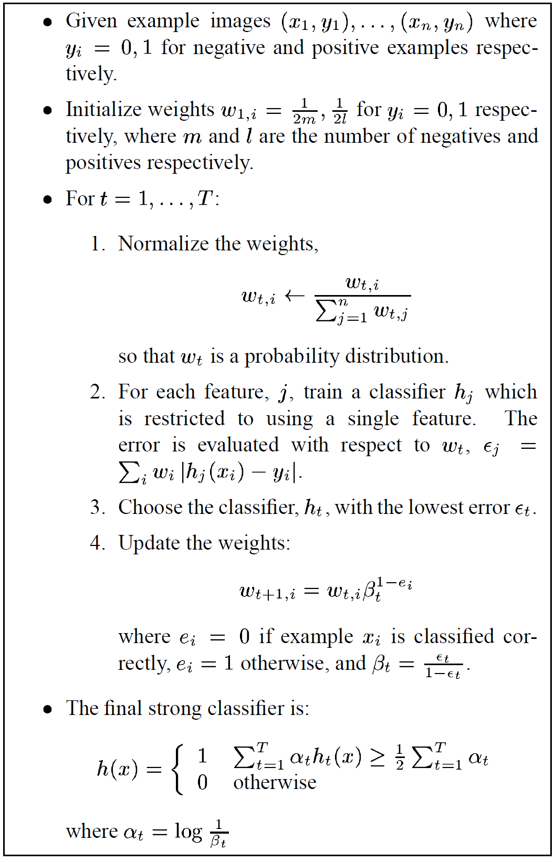
Adaboost

Slide 22
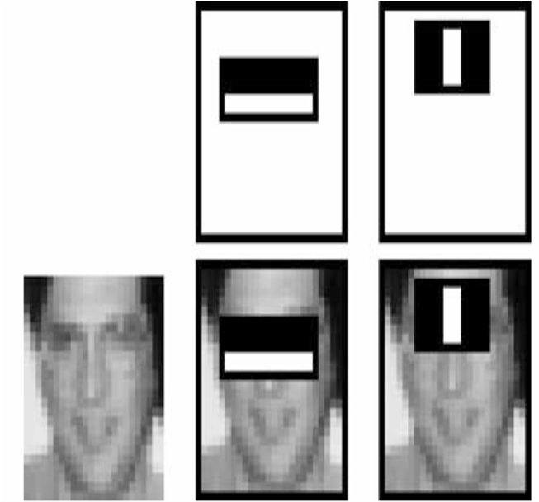
Top 2 selected features

Slide 23
Viola-Jones details
38 stages with 1, 10, 25, 50 … features
  6061 total used out of 180K candidates
  10 features evaluated on average
Training Examples
  4916 positive examples
  10000 negative examples collected after each stage
Scanning
  Scale detector rather than image
  Scale steps = 1.25 (factor between two consecutive scales)
  Translation 1*scale (# pixels between two consecutive windows)
Non-max suppression: average coordinates of overlapping boxes
Train 3 classifiers and take vote

Slide 24
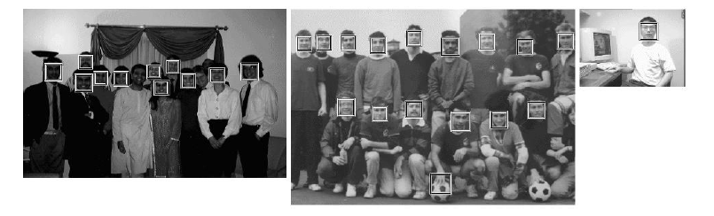
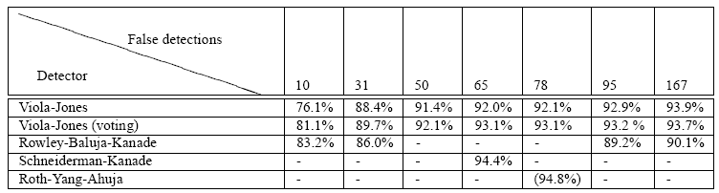
Viola Jones Results
Speed = 15 FPS (in 2001)
MIT + CMU face dataset

Slide 25
R-CNN (Girshick et al. CVPR 2014)
Replace sliding windows with “selective search” region proposals (Uijilings et al. IJCV 2013)
Extract rectangles around regions and resize to 227x227
Extract features with fine-tuned CNN (that was initialized with network trained on ImageNet before training)
Classify last layer of network features with SVM
https://people.eecs.berkeley.edu/~rbg/papers/r-cnn-cvpr.pdf

Slide 26
Sliding window vs. region proposals
Sliding window
Region proposals
Comprehensive search over position, scale (sometimes aspect, though expensive)
Typically 100K candidates
Simple
Speed boost through convolution often possible
Repeatable
Even with many candidates, may not be a good fit to object
Search over regions guided by image contours/patterns with varying aspect/size
Typically 2-10K candidates
Random (not repeatable)
Requires a preprocess (currently 1-5s)
Often requires resizing patch to fit fixed size
More likely to provide candidates with very good object fit

Slide 27
HOG Template
Statistical Template Matching
HOG: Dalal-Triggs 2005

Slide 28
Deformable Parts Model (v1-v5)
HOG Template
Better Models of Complex Categories
HOG: Dalal-Triggs 2005 DPM: Felzenszwalb et al. 2008-2012

Slide 29
R-CNN
Regionlets
Deformable Parts Model (v1-v5)
HOG Template
Key Advance: Learn effective features from massive amounts of labeled data and
adapt to new tasks with less data
Better Features
HOG: Dalal-Triggs 2005 DPM: Felzenszwalb et al. 2008-2012 Regionlets: Wang et al. 2013 R-CNN: Girshick et al. 2014

Slide 30
Mistakes are often reasonable
Confident Mistakes
Bicycle: AP = 0.73
R-CNN results

Slide 31
Mistakes are often reasonable
Horse: AP = 0.69
Confident Mistakes
R-CNN results

Slide 32
Misses are often predictable
Bicycle
Small objects, distinctive parts absent or occluded, unusual views
R-CNN results
Notes:
Predictable which objects will be missed

Slide 33
Strengths and Weaknesses of Statistical Template Approach
Strengths
Works very well for non-deformable objects: faces, cars, upright pedestrians
Fast detection
Weaknesses
Sliding window has difficulty with deformable objects (proposals works with flexible features works better)
Not robust to occlusion
Requires lots of training data

Slide 34
Tricks of the trade
Details in feature computation really matter
  E.g., normalization in Dalal-Triggs improves detection rate by 27% at fixed false positive rate
Template size
  Typical choice for sliding window is size of smallest detectable object
  For CNNs, typically based on what pretrained features are available
“Jittering” to create synthetic positive examples
  Create slightly rotated, translated, scaled, mirrored versions as extra positive examples
Bootstrapping to get hard negative examples
  Randomly sample negative examples
  Train detector
  Sample negative examples that score > -1
  Repeat until all high-scoring negative examples fit in memory

Slide 35
Influential Works in Detection
Sung-Poggio (1994, 1998) : ~2100 citations
  Basic idea of statistical template detection (I think), bootstrapping to get “face-like” negative examples, multiple whole-face prototypes (in 1994)
Rowley-Baluja-Kanade (1996-1998) : ~4200
  “Parts” at fixed position, non-maxima suppression, simple cascade, rotation, pretty good accuracy, fast
Schneiderman-Kanade (1998-2000,2004) : ~2250
  Careful feature/classifier engineering, excellent results, cascade
Viola-Jones (2001, 2004) : ~20,000
  Haar-like features, Adaboost as feature selection, hyper-cascade, very fast, easy to implement
Dalal-Triggs (2005) : ~11000
  Careful feature engineering, excellent results, HOG feature, online code
Felzenszwalb-Huttenlocher (2000): ~1600
  Efficient way to solve part-based detectors
Felzenszwalb-McAllester-Ramanan (2008,2010)? ~4000
  Excellent template/parts-based blend
Girshick-Donahue-Darrell-Malik (2014 ) ~300
  Region proposals + fine-tuned CNN features (marks significant advance in accuracy over hog-based methods)

Slide 36
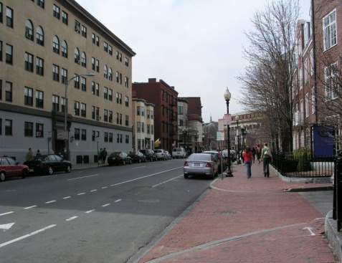
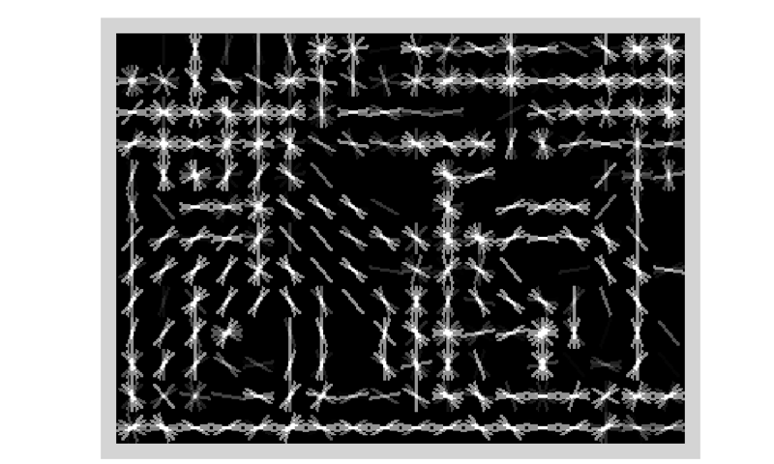
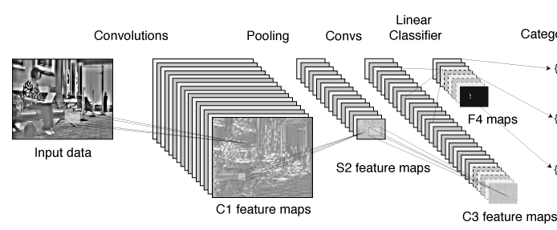
Summary: statistical templates
A. Propose Window
B. Extract Features
C. Classify
D. Post-process
SVM
Boosted stubs
Neural network
Non-max suppression
Segment or refine localization
HOG
Sliding window: scan image pyramid
Fast randomized features
Region proposals: edge/region-based, resize to fixed window
CNN features

Slide 37
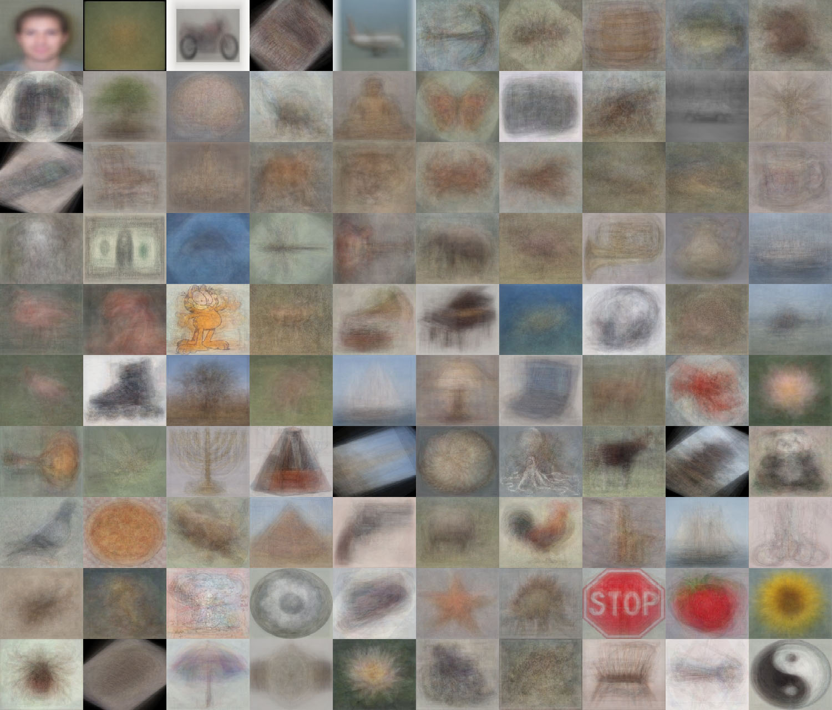
When do statistical templates make sense?
Caltech 101 Average Object Images

Slide 38
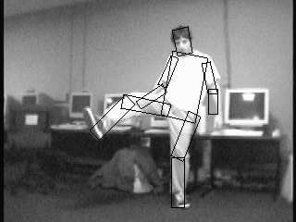
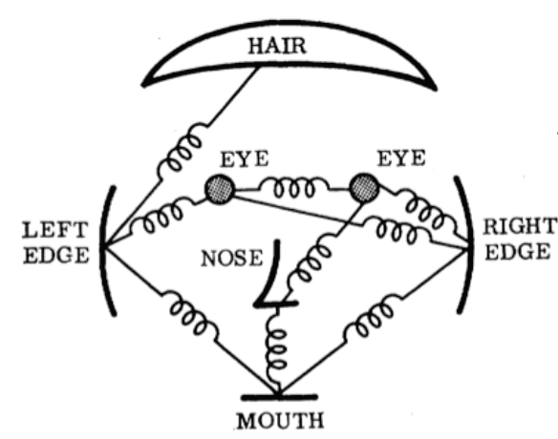
Object models:
Articulated parts model
Object is configuration of parts
Each part is detectable
Images from Felzenszwalb

Slide 39
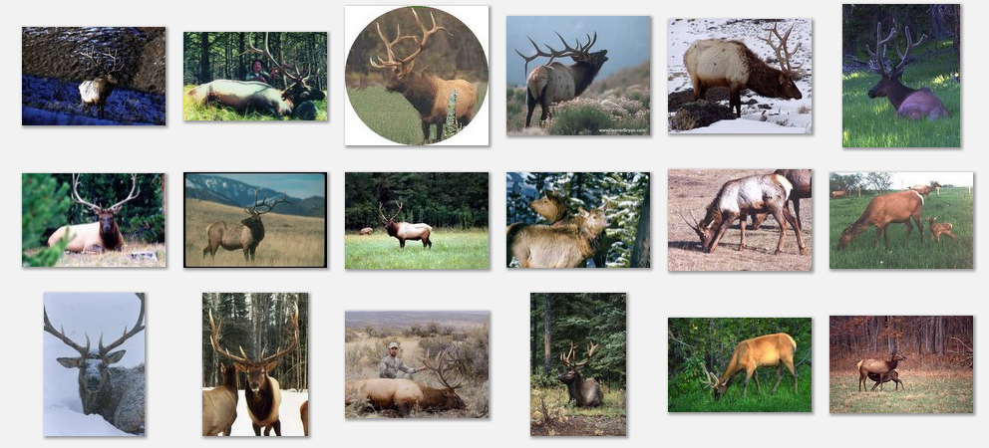
Deformable objects
Images from Caltech-256
Slide Credit: Duan Tran

Slide 40
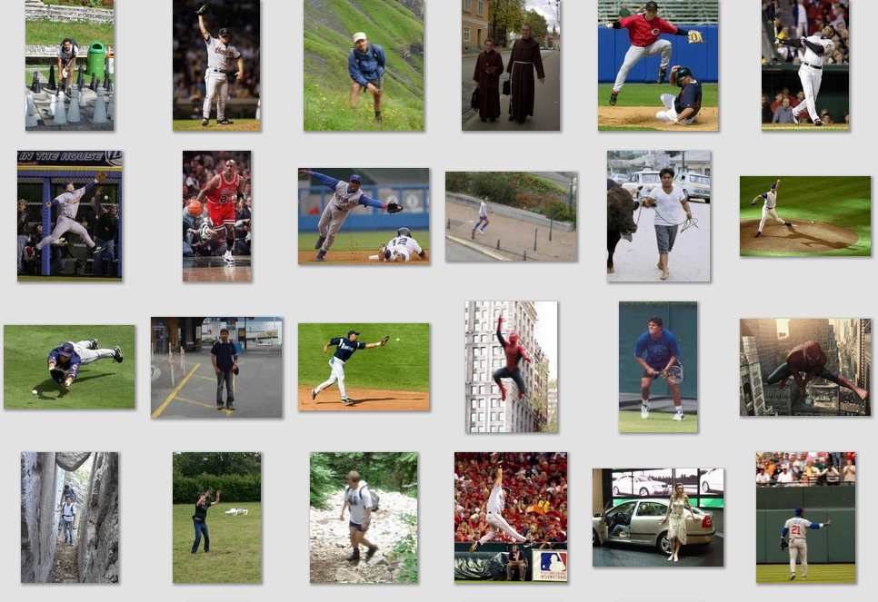
Deformable objects
Images from D. Ramanan’s dataset
Slide Credit: Duan Tran

Slide 41
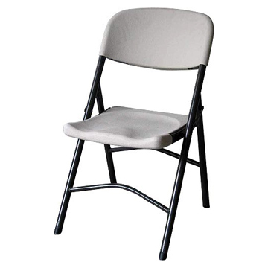
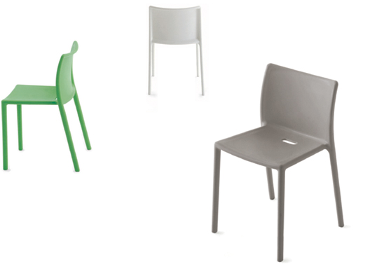
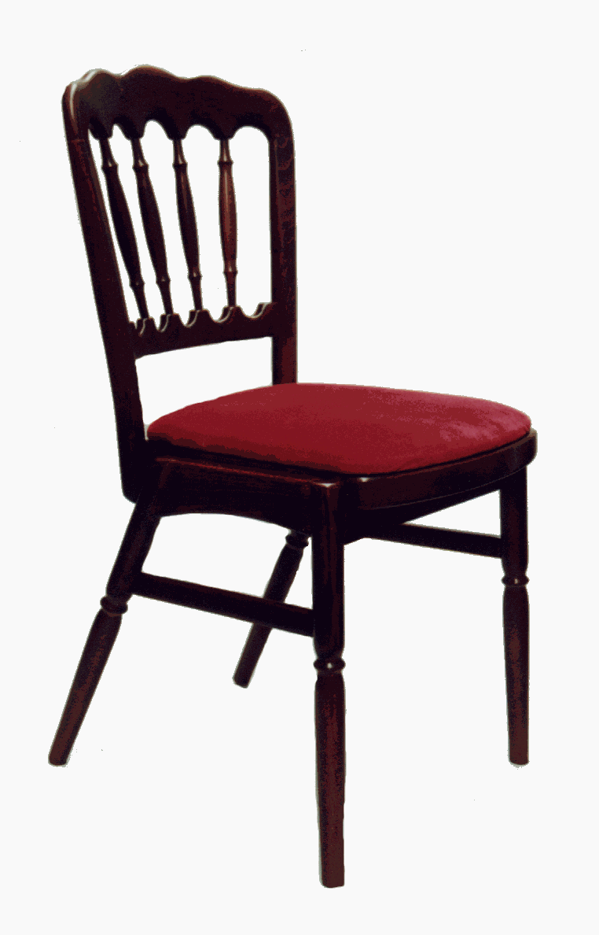
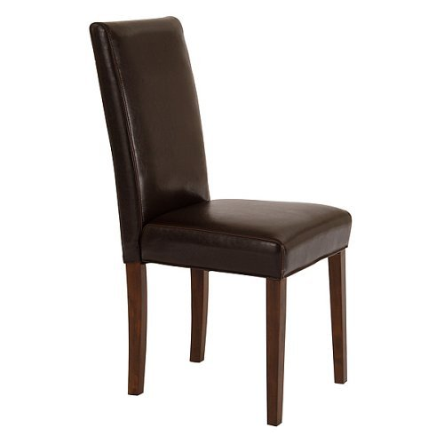
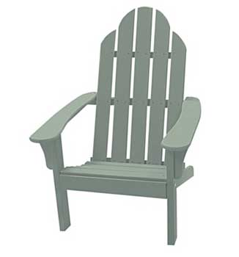
Compositional objects

Slide 42
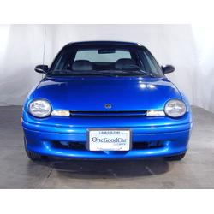
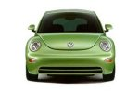
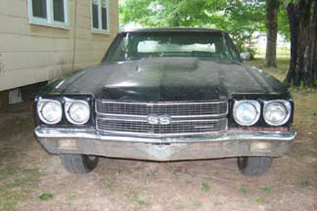
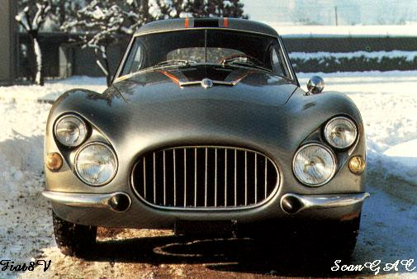
Parts-based Models
Define object by collection of parts modeled by
  Appearance
  Spatial configuration
Slide credit: Rob Fergus

Slide 43
How to model spatial relations?
One extreme: fixed template

Slide 44
How to model spatial relations?
Another extreme: bag of words
=

Slide 45
How to model spatial relations?
Star-shaped model
Part
Part
Part
Root
Part
Part

Slide 46
How to model spatial relations?
Star-shaped model
=
X
X
≈
Part
Part
Part
X
Root
Part
Part

Slide 47
How to model spatial relations?
Tree-shaped model

Slide 48
How to model spatial relations?
Many others...
O(N⁶)
O(N²)
O(N³)
O(N²)
Fergus et al. ’03
Fei-Fei et al. ‘03
Leibe et al. ’04, ‘08
Crandall et al. ‘05
Fergus et al. ’05
Crandall et al. ‘05
Felzenszwalb & Huttenlocher ‘05
Csurka ’04
Vasconcelos ‘00
Bouchard & Triggs ‘05
Carneiro & Lowe ‘06
from [Carneiro & Lowe, ECCV’06]

Slide 49
Part-based Models
Part
Part
Part
Star-shaped model
  Example: Deformable Parts Model
    Felzenswalb et al. 2010
Tree-shaped model
  Example: Pictorial structures
    Felzenszwalb Huttenlocher 2005
Sequential prediction models
Root
Part
Part

Slide 50
Deformable Latent Parts Model (DPM)
Detections
Template Visualization
Felzenszwalb et al. 2008, 2010

Slide 51
Review: Dalal-Triggs detector
.
-
= 0.16
Image Window
HOG
SVM weights (pos/neg)
score
Extract fixed-sized (64x128 pixel) window at each position and scale
Compute HOG (histogram of gradient) features within each window
Score the window with a linear SVM classifier
Perform non-maxima suppression to remove overlapping detections with lower scores

Slide 52
Deformable parts model
Root filter models coarse whole-object appearance
Part filters model finer-scale appearance of smaller patches
For each root window, part positions that maximize appearance score minus spatial cost are found
Total score is sum of scores of each filter and spatial costs
Root filter
Part filters
Spatial costs

Slide 53
DPM: computing object score
Scores from individual part detectors
Scores from root detector
With generalized distance transform, compute the maximum part score corresponding to each root position

Slide 54
DPM: mixture model
Each positive example is modeled by one of M detectors
In testing, all detectors are applied with non-max suppression

Slide 55
DPM: Training
Solve for latent parameters (root/part positions, mixture component) that maximize score and are consistent with ground truth bounding box
Add negative examples that achieve some minimum score (> 1 – delta)
Solve for SVM weights given current latent parameters and negative examples

Slide 56
Results

Slide 57
Improvement over time for HOG-based detectors
AP on PASCAL VOC 2007
DPM v4 (3 comp., left/right flip)
DPM v5
DPM v2
(2 comp., context)
DPM v3
DPM v1 (1 component, parts)
Dalal-Triggs (1 component, no parts)

Slide 58
Tree-shaped model

Slide 59
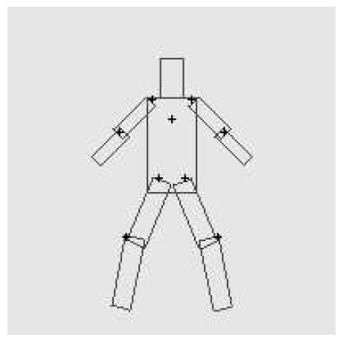
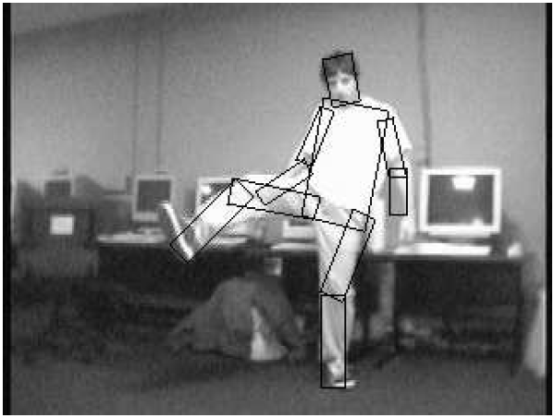
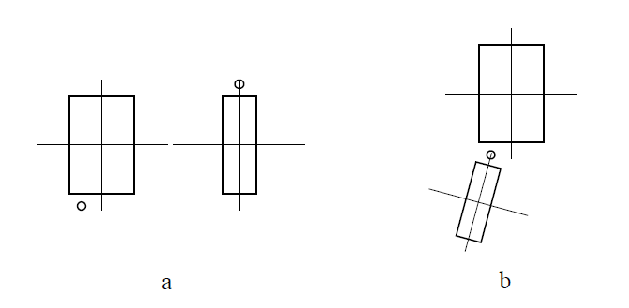
Pictorial Structures Model
Part = oriented rectangle
Spatial model = relative size/orientation
Felzenszwalb and Huttenlocher 2005
Notes:
What is the root of the tree?

Slide 60
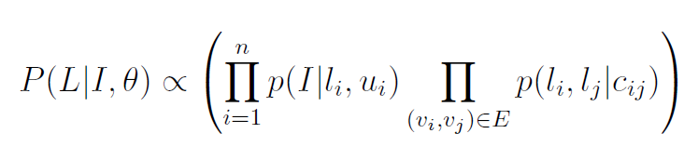
Pictorial Structures Model
Appearance likelihood
Geometry likelihood

Slide 61
Modeling the Appearance
Any appearance model could be used
  HOG Templates, etc.
  Here: rectangles fit to background subtracted binary map
Can train appearance models independently (easy, not as good) or jointly (more complicated but better)
Appearance likelihood
Geometry likelihood

Slide 62
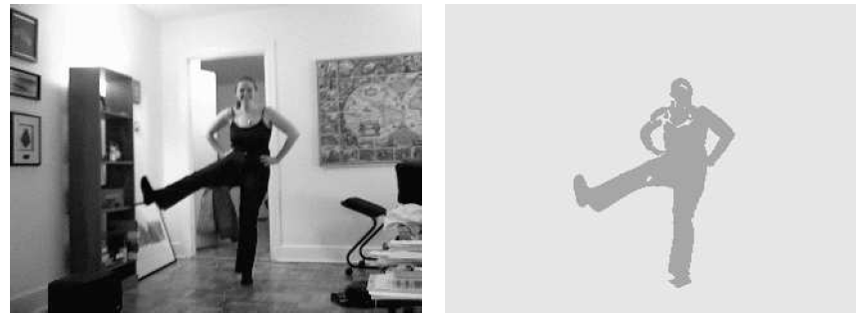
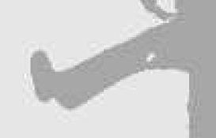
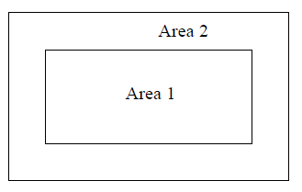
Part representation
Background subtraction

Slide 63
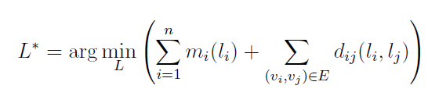
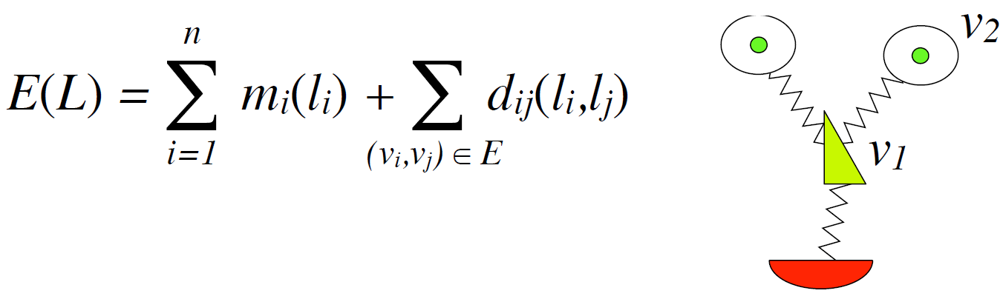
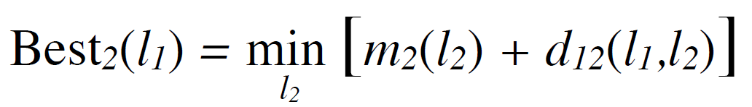
Pictorial structures model
Optimization is tricky but can be efficient
For each l₁, find best l₂:
Remove v₂, and repeat with smaller tree, until only a single part
For k parts, n locations per part, this has complexity of O(kn²), but can be solved in ~O(kn) using generalized distance transform

Slide 64
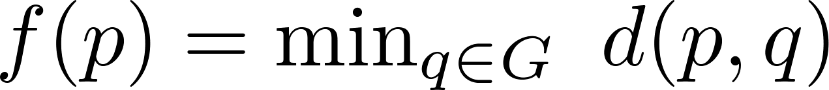
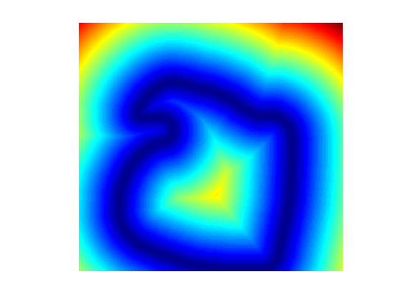
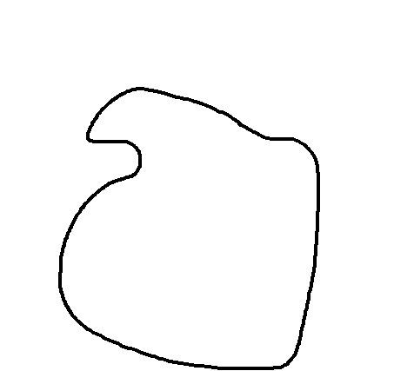
Distance Transform
For each pixel p, how far away is the nearest pixel q of set G
  G is often the set of edge pixels
G: black pixels
p₁
q₁
q₂
p₂

Slide 65
Distance Transform - Applications
Set distances – e.g. Hausdorff Distance
Image processing – e.g. Blurring
Robotics – Motion Planning
Alignment
  Edge images
  Motion tracks
  Audio warping
Deformable Part Models

Slide 66

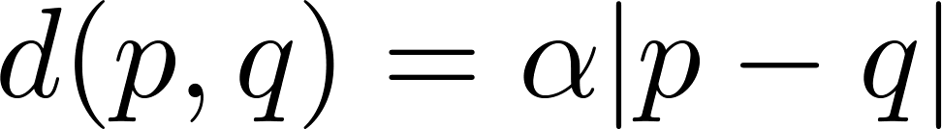
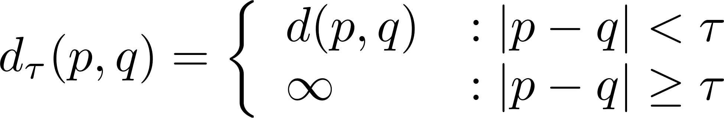
Generalized Distance Transform
Original form:
General form:
For many deformation costs,
Quadratic
Abs Diff
Min Composition
Bounded

Slide 67

Results for person matching

Slide 68

Results for person matching

Slide 69

Enhanced pictorial structures
Learn spatial prior
Color models from soft segmentation
(initialized by location priors of each part)
BMVC 2009

Slide 71
Example from Ramakrishna

Slide 72
Sequential structured prediction
Can consider pose estimation as predicting a set of related variables (called structured prediction)
  Some parts easy to find (head), some are hard (wrists)
One solution: jointly solve for most likely variables (DPM, pictorial structures)
Another solution: iteratively predict each variable based in part on previous predictions

Slide 73
Pose machines
Ramakrishna et al. ECCV 2014

Slide 77
Example results

Slide 78
General principle
“Auto-context” (Tu CVPR 2008): instead of fancy graphical models, create feature from past predictions and repredict
Can view this as an “unrolled belief propagation” (Ross et al. 2011)
Tu Bai 2010: Auto-context
Ross Munoz Hebert Bagnell 2011: Message-Passing Inference Machines

Slide 79








Many uses and variations on sequential structured prediction
Cascaded Classification Model
Closing the Loop
Scene Analysis Processes
Surface Orientation
Object/Viewpoint
Occlusion/Depth
Input Image
Hoiem Efros Hebert 2008
Intrinsic Images
Autocontext
Tu 2008
Tu Bai 2010
Heitz Gould Saxena Koller 2008
Li Kowdle Saxena Chen 2010
Notes:
141 97

Slide 80
Learning to search for landmarks
Learn to find easy landmarks (body joints) first and use them as context for harder ones
Singh et al. CVPR 2015

Slide 81
Results: best (top) to worst (bottom)

Slide 82

Convolutional Pose Machine
CVPR 2016 https://arxiv.org/pdf/1602.00134.pdf

Slide 83
Graphical models vs. structured prediction
Advantages of sequential prediction
  Simple procedures for training and inference
  Learns how much to rely on each prediction
  Can model very complex relations
Advantages of BP/graphcut/etc
  Elegant
  Relations are explicitly modeled
  Exact inference in some cases

Slide 84
Things to remember
Models can be broken down into part appearance and spatial configuration
  Wide variety of models
Efficient optimization can be tricky but usually possible
  Generalized distance transform is a useful trick
Rather than explicitly modeling contextual relations, can encode through features/classifiers

Slide 85

Next class
Visual tracking

