Slide 1
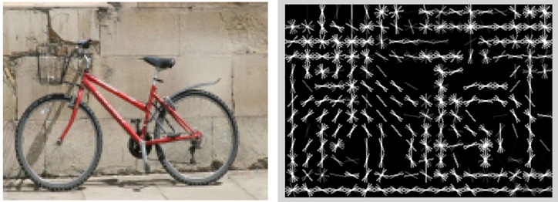
Object Detection with
Statistical Template
Computer Vision
Jia-Bin Huang, Virginia Tech
Many slides from D. Hoiem, J. Hays

Slide 2
Administrative stuffs
HW 5 is out
  Due 11:59pm on Wed, November 16
  Scene categorization
  Please start early
Final project proposal
  Feedback via emails

Slide 3
Today’s class
Review/finish supervised learning
Overview of object category detection
Statistical template matching
  Dalal-Triggs pedestrian detector (basic concept)
  Viola-Jones detector (cascades, integral images)
  R-CNN detector (object proposals/CNN)

Slide 4
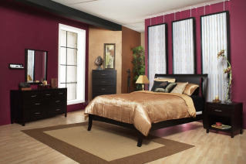
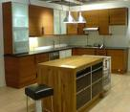
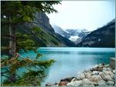

Image Categorization
Training
Training Labels
Training Images
Image Features
Classifier Training
Trained Classifier

Slide 5
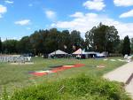
Image Categorization
Training
Training Labels
Training Images
Image Features
Classifier Training
Trained Classifier
Testing
Image Features
Trained Classifier
Prediction
Outdoor
Test Image

Slide 6
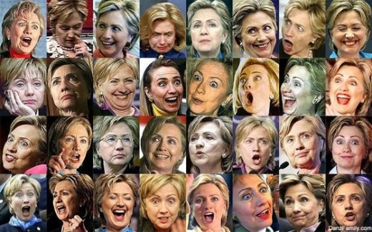

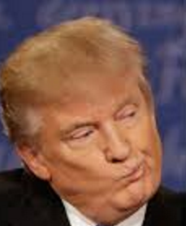
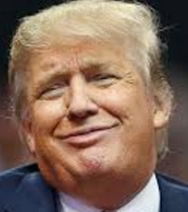


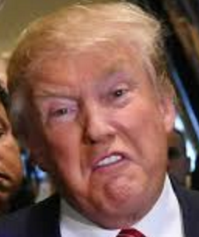






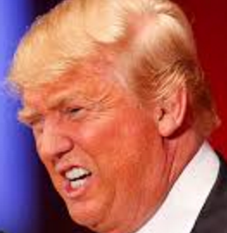
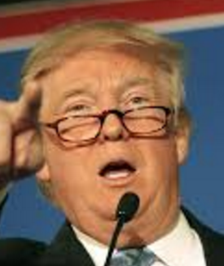

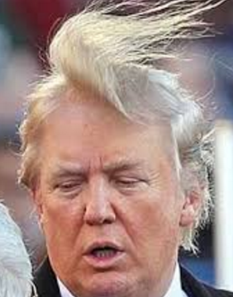



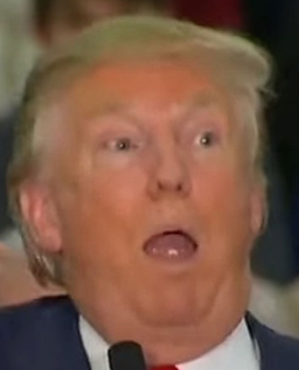
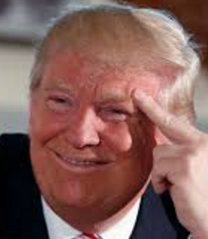







Image features: map images to feature space
Classifiers: map feature space to label space
x
x
x
x
x
x
x
x
x
o
x
o
x
o
o
x
o
o
o
x2
o
o
o
o
o
x1
x
x
x
x
x
x
x
x
x
x
x
x
x
x
x
x
x
x
o
x
o
x
o
x
o
x
o
o
x
o
o
x
o
o
o
o
o
o
x2
o
o
o
o
o
x2
o
o
o
o
o
x1
x1

Slide 7
Different types of classification
Exemplar-based: transfer category labels from examples with most similar features
  What similarity function? What parameters?
Linear classifier: confidence in positive label is a weighted sum of features
  What are the weights?
Non-linear classifier: predictions based on more complex function of features
  What form does the classifier take? Parameters?
Generative classifier: assign to the label that best explains the features (makes features most likely)
  What is the probability function and its parameters?
Note: You can always fully design the classifier by hand, but usually this is too difficult. Typical solution: learn from training examples.

Slide 8
Exemplar-based Models
Transfer the label(s) of the most similar training examples

Slide 9
K-nearest neighbor classifier
x
x
x
o
x
x
x
+
o
o
x
x
o
o
+
o
o
x2
x1

Slide 10
1-nearest neighbor
x
x
x
o
x
x
x
+
o
o
x
x
o
o
+
o
o
x2
x1

Slide 11
3-nearest neighbor
x
x
x
o
x
x
x
+
o
o
x
x
o
o
+
o
o
x2
x1

Slide 12
5-nearest neighbor
x
x
x
o
x
x
x
+
o
o
x
x
o
o
+
o
o
x2
x1

Slide 13
Using K-NN
Simple, a good one to try first
Higher K gives smoother functions
No training time (unless you want to learn a distance function)
With infinite examples, 1-NN provably has error that is at most twice Bayes optimal error

Slide 14

Discriminative classifiers
Learn a simple function of the input features that confidently predicts the true labels on the training set
Training Goals
Accurate classification of training data
Correct classifications are confident
Classification function is simple
$$y=f\left(x\right)$$

Slide 15
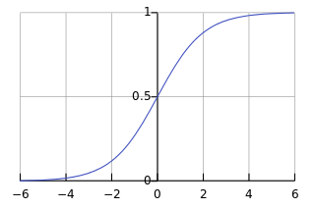
Classifiers: Logistic Regression
x
x
Objective
Parameterization
Regularization
Training
Inference
x
x
x
x
o
x
x
o
o
o
x2
o
x1
The objective function of most discriminative classifiers includes a loss term and a regularization term.

Slide 16
Using Logistic Regression
Quick, simple classifier (good one to try first)
Use L2 or L1 regularization
  L1 does feature selection and is robust to irrelevant features but slower to train

Slide 17
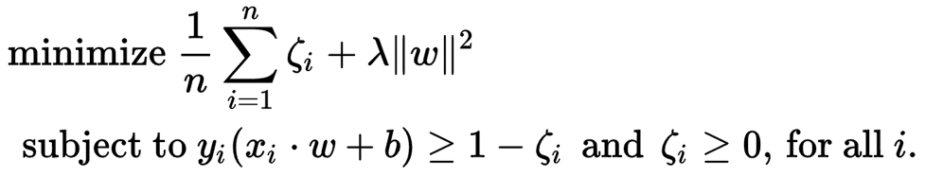
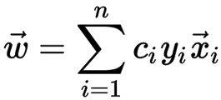

Classifiers: Linear SVM
x
x
$$w$$
o
x
x
x
x
o
x
x
o
o
o
o
x2
x1

Slide 18
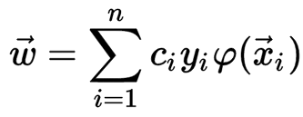
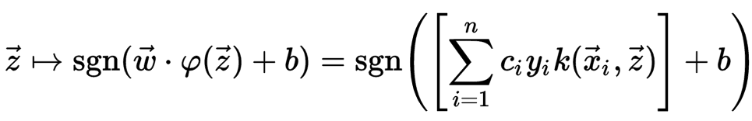
Classifiers: Kernelized SVM
x
x
o
o
o
x
x
Kernel trick:
- implicitly mapping their inputs into high-dimensional feature spaces
x
x
x
o
o
x²
o
x
x
x

Slide 19
Using SVMs
Good general purpose classifier
  Generalization depends on margin, so works well with many weak features
  No feature selection
  Usually requires some parameter tuning
Choosing kernel
  Linear: fast training/testing – start here
  RBF: related to neural networks, nearest neighbor
  Chi-squared, histogram intersection: good for histograms (but slower, esp. chi-squared)
  Can learn a kernel function

Slide 20
Classifiers: Decision Trees
x
x
x
o
x
x
x
o
x
o
x
o
o
o
o
x2
x1

Slide 21
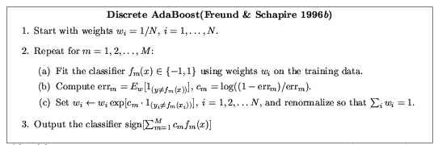
Ensemble Methods: Boosting
figure from Friedman et al. 2000

Slide 22
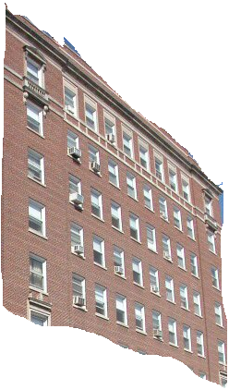
Boosted Decision Trees
High in
Image?
Gray?
Yes
No
Yes
No
Smooth?
Green?
High in
Image?
Many Long
Lines?
…
Yes
No
Yes
No
Yes
No
Yes
No
Blue?
Very High
Vanishing
Point?
Yes
No
Yes
No
Ground Vertical Sky
P(label | good segment, data)
[Collins et al. 2002]

Slide 23
Using Boosted Decision Trees
Flexible: can deal with both continuous and categorical variables
How to control bias/variance trade-off
  Size of trees
  Number of trees
Boosting trees often works best with a small number of well-designed features
Boosting “stubs” can give a fast classifier

Slide 24
Generative classifiers
Model the joint probability of the features and the labels
  Allows direct control of independence assumptions
  Can incorporate priors
  Often simple to train (depending on the model)
Examples
  Naïve Bayes
  Mixture of Gaussians for each class

Slide 25
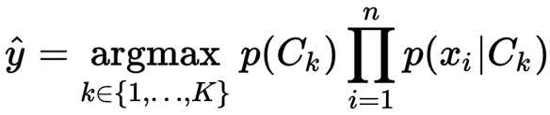
Naïve Bayes
Objective
Parameterization
Regularization
Training
Inference
Conditional independence
Inference
y
x₁
x₂
x₃

Slide 26
Using Naïve Bayes
Simple thing to try for categorical data
Very fast to train/test

Slide 27
Web-based demo
SVM
Neural Network
Random Forest

Slide 28
Many classifiers to choose from
Which is the best one?
SVM
Neural networks
Naïve Bayes
Bayesian network
Logistic regression
Randomized Forests
Boosted Decision Trees
K-nearest neighbor
RBMs
Deep networks
Etc.

Slide 29
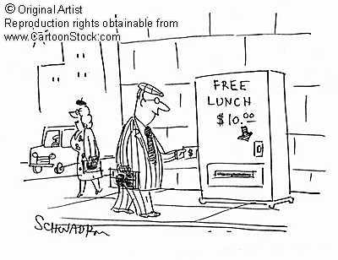
No Free Lunch Theorem
Notes:
You can only get generalization through assumptions.

Slide 30
Generalization Theory
It’s not enough to do well on the training set: we want to also make good predictions for new examples

Slide 31
Bias-Variance Trade-off
E(MSE) = noise² + bias² + variance
Error due to variance parameter estimates from training samples
Unavoidable error
Error due to incorrect assumptions
See the following for explanation of bias-variance (also Bishop’s “Neural Networks” book):
http://www.inf.ed.ac.uk/teaching/courses/mlsc/Notes/Lecture4/BiasVariance.pdf

Slide 32
Bias and Variance
Error = noise² + bias² + variance
Few training examples
Test Error
Many training examples
High Bias
Low Variance
Complexity
Low Bias
High Variance
Notes:
Note: these figures don’t work in pdf

Slide 33
Choosing the trade-off
Need validation set
Validation set is separate from the test set
Test error
Error
Training error
High Bias
Low Variance
Complexity
Low Bias
High Variance

Slide 34
Effect of Training Size
Fixed classifier
Error
Testing
Generalization Error
Training
Number of Training Examples

Slide 35

How to measure complexity?
VC dimension
Other ways: number of parameters, etc.
What is the VC dimension of a linear classifier for N-dimensional features? For a nearest neighbor classifier?
Upper bound on generalization error
Test error <=
Training error +
N: size of training set
h: VC dimension
η: 1-probability that bound holds

Slide 36
How to reduce variance?
Choose a simpler classifier
Regularize the parameters
Use fewer features
Get more training data
Which of these could actually lead to greater error?
Notes:
The simpler classifier or regularization could increase bias and lead to more error.

Slide 37
Reducing Risk of Error
Margins
x
x
x
x
x
x
o
x
x
o
o
o
o
x2
x1

Slide 38
The perfect classification algorithm
Objective function: encodes the right loss for the problem
Parameterization: makes assumptions that fit the problem
Regularization: right level of regularization for amount of training data
Training algorithm: can find parameters that maximize objective on training set
Inference algorithm: can solve for objective function in evaluation

Slide 39
Comparison
assuming x in {0 1}
Learning Objective
Training
Inference
Naïve Bayes
Logistic Regression
Gradient ascent
Linear SVM
Quadratic programming or subgradient opt.
Kernelized SVM
complicated to write
Quadratic programming
Nearest Neighbor
most similar features → same label
Record data

Slide 40
Characteristics of vision learning problems
Lots of continuous features
  E.g., HOG template may have 1000 features
  Spatial pyramid may have ~15,000 features
Imbalanced classes
  often limited positive examples, practically infinite negative examples
Difficult prediction tasks

Slide 41
When a massive training set is available
Relatively new phenomenon
  MNIST (handwritten letters) in 1990s, LabelMe in 2000s, ImageNet (object images) in 2009, …
Want classifiers with low bias (high variance ok) and reasonably efficient training
Very complex classifiers with simple features are often effective
  Random forests
  Deep convolutional networks

Slide 42
New training setup with moderate sized datasets
Training Labels
Training Images
Tune CNN features and
Neural Network classifier
Trained Classifier
Initialize CNN Features
Dataset similar to task with millions of labeled examples

Slide 43
Practical tips
Preparing features for linear classifiers
  Often helps to make zero-mean, unit-dev
  For non-ordinal features, convert to a set of binary features
Selecting classifier meta-parameters (e.g., regularization weight)
  Cross-validation: split data into subsets; train on all but one subset, test on remaining; repeat holding out each subset
    Leave-one-out, 5-fold, etc.
Most popular classifiers in vision
  SVM: linear for when fast training/classification is needed; performs well with lots of weak features
  Logistic Regression: outputs a probability; easy to train and apply
  Nearest neighbor: hard to beat if there is tons of data (e.g., character recognition)
  Boosted stumps or decision trees: applies to flexible features, incorporates feature selection, powerful classifiers
  Random forests: outputs probability; good for simple features, tons of data
  Deep networks / CNNs: flexible output; learns features; adapt existing network (which is trained with tons of data) or train new with tons of data
Always try at least two types of classifiers

Slide 44
Making decisions about data
3 important design decisions:
  1) What data do I use?
  2) How do I represent my data (what feature)?
  3) What classifier / regressor / machine learning tool do I use?
These are in decreasing order of importance
Deep learning addresses 2 and 3 simultaneously (and blurs the boundary between them).
You can take the representation from deep learning and use it with any classifier.

Slide 45
Things to remember
No free lunch: machine learning algorithms are tools
Try simple classifiers first
Better to have smart features and simple classifiers than simple features and smart classifiers
  Though with enough data, smart features can be learned
Use increasingly powerful classifiers with more training data (bias-variance tradeoff)

Slide 46
Some Machine Learning References
General
  Tom Mitchell, Machine Learning, McGraw Hill, 1997
  Christopher Bishop, Neural Networks for Pattern Recognition, Oxford University Press, 1995
Adaboost
  Friedman, Hastie, and Tibshirani, “Additive logistic regression: a statistical view of boosting”, Annals of Statistics, 2000
SVMs
  http://www.support-vector.net/icml-tutorial.pdf
Random forests
  http://research.microsoft.com/pubs/155552/decisionForests_MSR_TR_2011_114.pdf

Slide 47
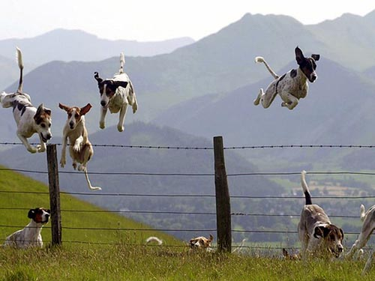
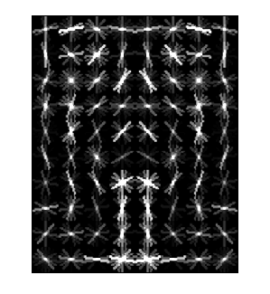
Object Category Detection
Focus on object search: “Where is it?”
Build templates that quickly differentiate object patch from background patch
Dog Model
…
Object or
Non-Object?

Slide 48
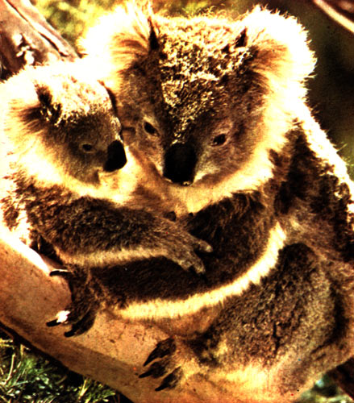
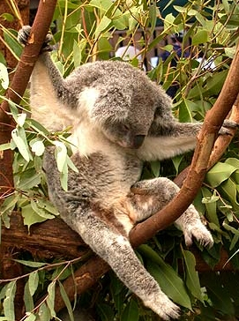
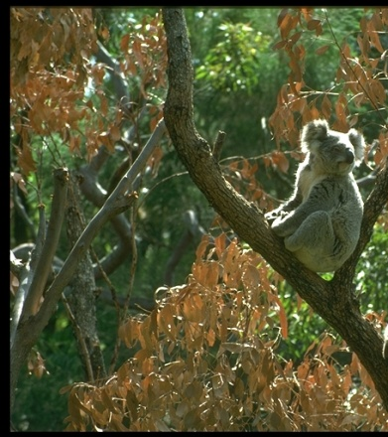

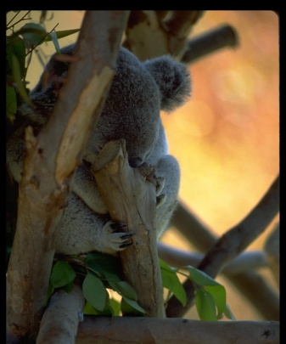
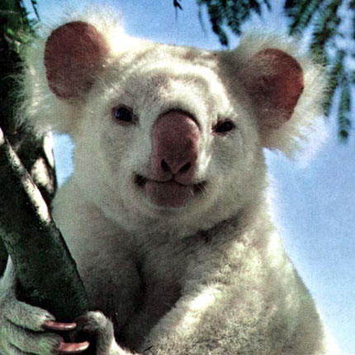
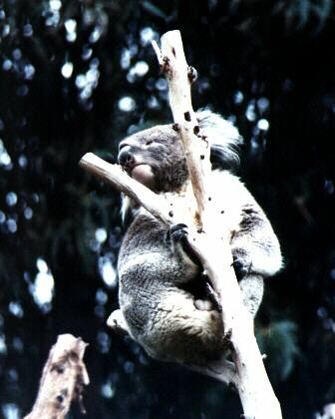
Challenges in modeling the object class
Illumination
Object pose
Clutter
Occlusions
Intra-class appearance
Viewpoint
Slide from K. Grauman, B. Leibe

Slide 49
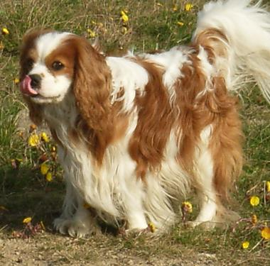
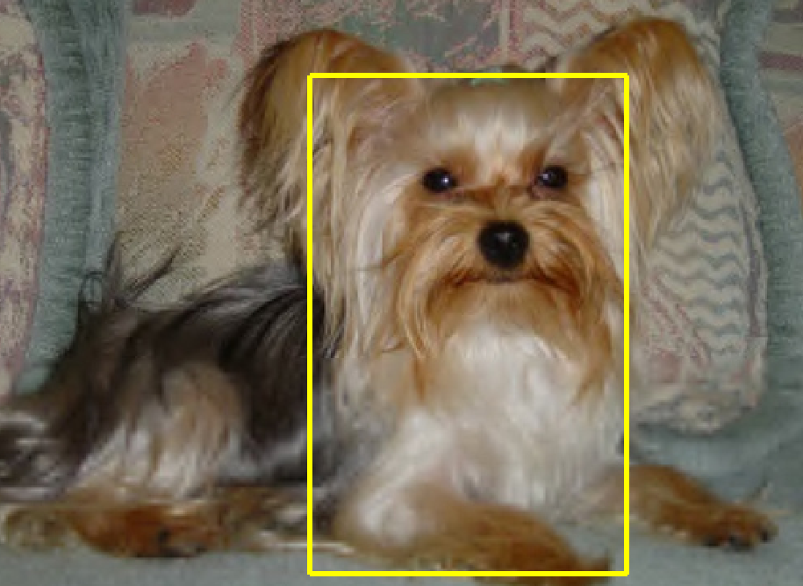
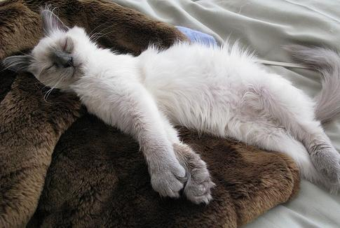
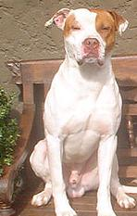
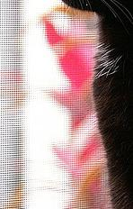

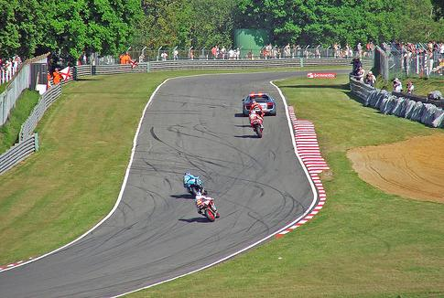

Challenges in modeling the non-object class
True Detections
Bad Localization
Confused with Similar Object
Confused with Dissimilar Objects
Misc. Background

Slide 50
General Process of Object Recognition
Specify Object Model
What are the object parameters?
Generate Hypotheses
Score Hypotheses
Resolve Detections

Slide 51
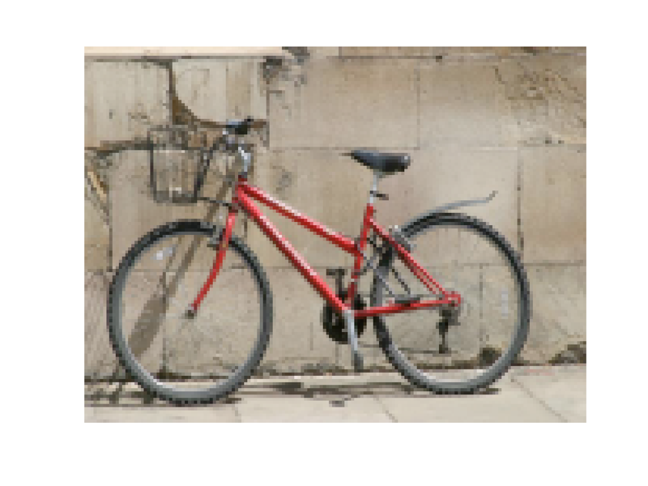
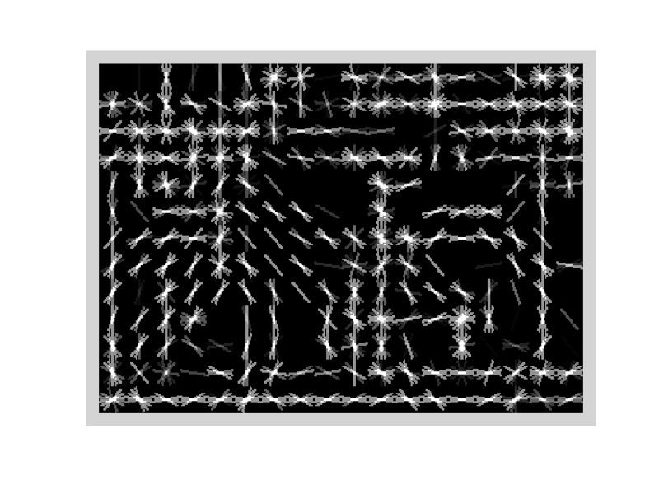
Specifying an object model
Statistical Template in Bounding Box
  Object is some (x,y,w,h) in image
  Features defined wrt bounding box coordinates
Image
Template Visualization
Images from Felzenszwalb

Slide 52
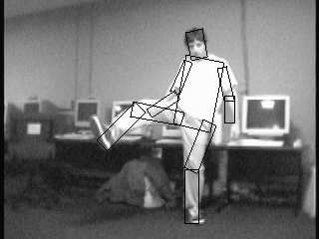
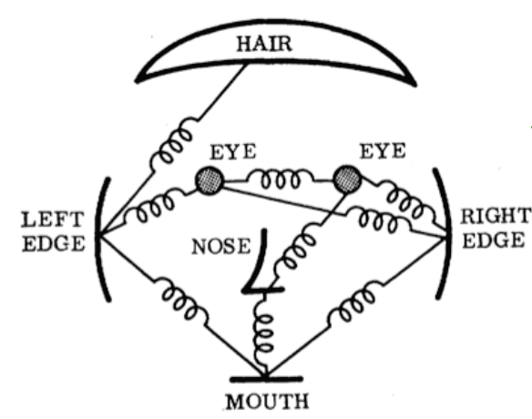
Specifying an object model
2. Articulated parts model
  Object is configuration of parts
  Each part is detectable
Images from Felzenszwalb

Slide 53
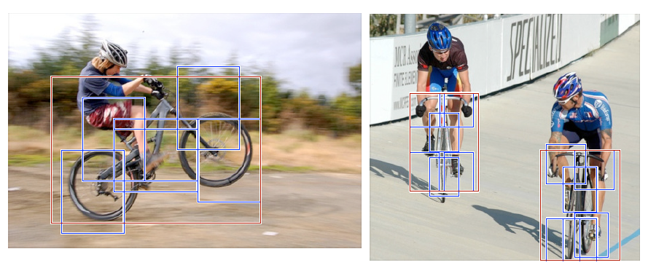
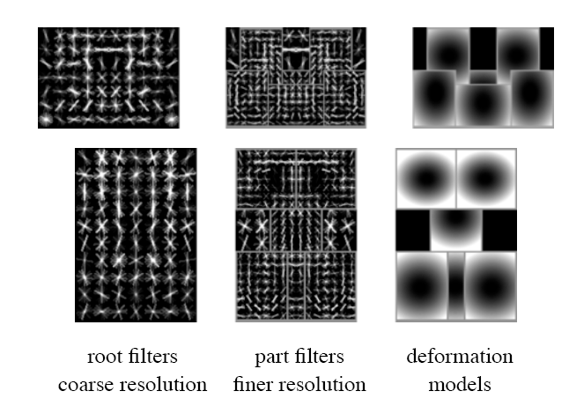
Specifying an object model
3. Hybrid template/parts model
Detections
Template Visualization
Felzenszwalb et al. 2008

Slide 54
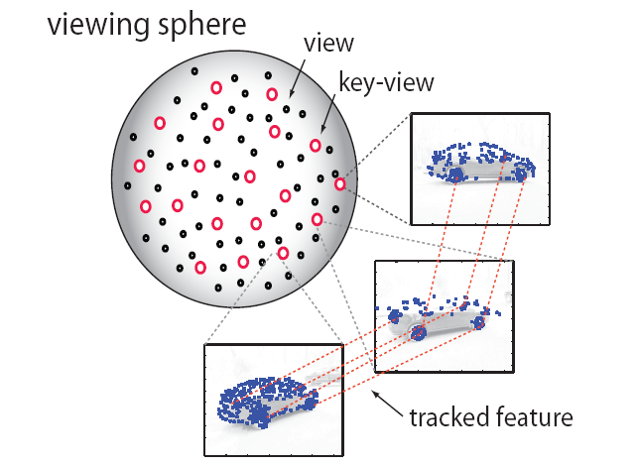
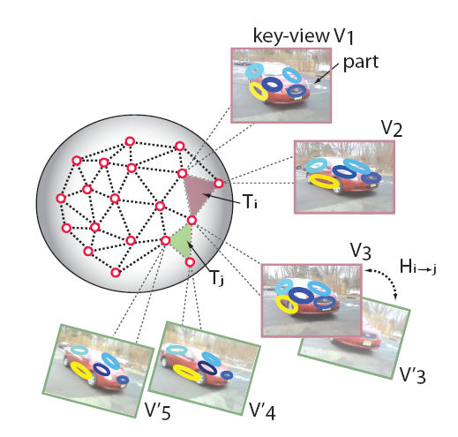
Specifying an object model
3D-ish model
Object is collection of 3D planar patches under affine transformation

Slide 55
General Process of Object Recognition
Specify Object Model
Generate Hypotheses
Propose an alignment of the model to the image
Score Hypotheses
Resolve Detections

Slide 56
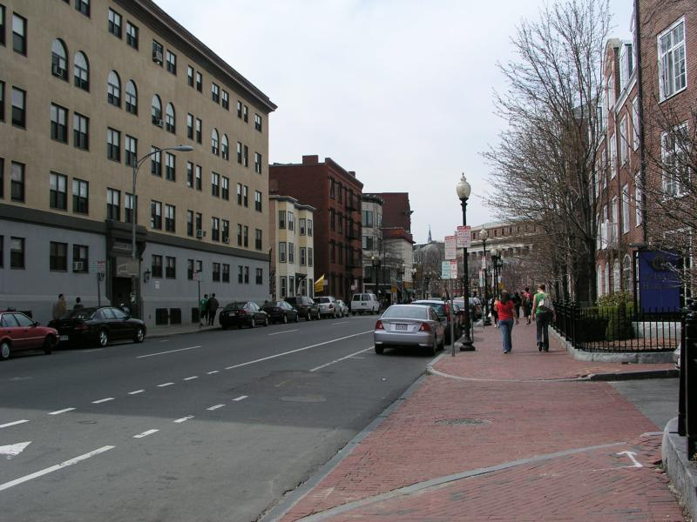
Generating hypotheses
Sliding window
  Test patch at each location and scale

Slide 57
Generating hypotheses
Sliding window
  Test patch at each location and scale

Slide 58
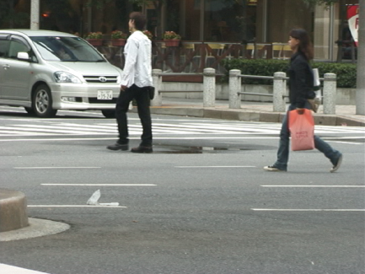
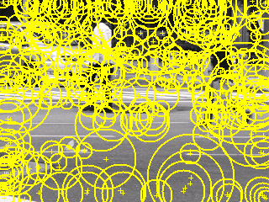
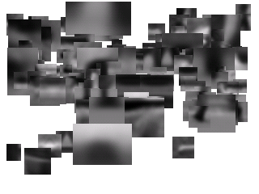
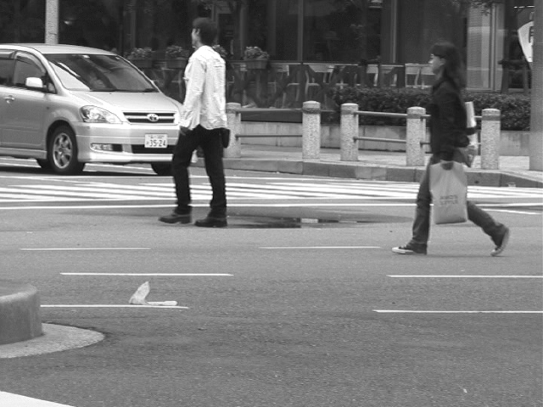
Generating hypotheses
2. Voting from patches/keypoints
Matched Codebook
Entries
Probabilistic
Voting
Interest Points
y
s
3D Voting Space
(continuous)
x
ISM model by Leibe et al.

Slide 59






Generating hypotheses
3. Region-based proposal
Endres Hoiem 2010

Slide 60
General Process of Object Recognition
Specify Object Model
Generate Hypotheses
Mainly-gradient based or CNN features, usually based on summary representation, many classifiers
Score Hypotheses
Resolve Detections

Slide 61
General Process of Object Recognition
Specify Object Model
Generate Hypotheses
Score Hypotheses
Resolve Detections
Rescore each proposed object based on whole set

Slide 62
Resolving detection scores
Non-max suppression
Score = 0.8
Score = 0.8
Score = 0.1

Slide 63



Resolving detection scores
2. Context/reasoning
meters
Hoiem et al. 2006
meters

Slide 64
Object category detection in computer vision
Goal: detect all pedestrians, cars, monkeys, etc in image

Slide 65


Basic Steps of Category Detection
Align
  E.g., choose position, scale orientation
  How to make this tractable?
Compare
  Compute similarity to an example object or to a summary representation
  Which differences in appearance are important?
Aligned
Possible Objects
Exemplar
Summary

Slide 66
Sliding window: a simple alignment solution
…
…

Slide 67

Each window is separately classified

Slide 68
Statistical Template
Object model = sum of scores of features at fixed positions
?
+3
+2
-2
-1
-2.5
= -0.5
> 7.5
Non-object
?
+4
+1
+0.5
+3
+0.5
= 10.5
> 7.5
Object

Slide 69
Design challenges
How to efficiently search for likely objects
  Even simple models require searching hundreds of thousands of positions and scales
Feature design and scoring
  How should appearance be modeled? What features correspond to the object?
How to deal with different viewpoints?
  Often train different models for a few different viewpoints
Implementation details
  Window size
  Aspect ratio
  Translation/scale step size
  Non-maxima suppression

Slide 70

Example: Dalal-Triggs pedestrian detector
Extract fixed-sized (64x128 pixel) window at each position and scale
Compute HOG (histogram of gradient) features within each window
Score the window with a linear SVM classifier
Perform non-maxima suppression to remove overlapping detections with lower scores
Navneet Dalal and Bill Triggs, Histograms of Oriented Gradients for Human Detection, CVPR05

Slide 71

Slides by Pete Barnum
Navneet Dalal and Bill Triggs, Histograms of Oriented Gradients for Human Detection, CVPR05

Slide 72
Tested with
  RGB
  LAB
  Grayscale
Gamma Normalization and Compression
  Square root
  Log
Slightly better performance vs. grayscale
Very slightly better performance vs. no adjustment

Slide 73






Outperforms
centered
diagonal
uncentered
cubic-corrected
Sobel
Slides by Pete Barnum
Navneet Dalal and Bill Triggs, Histograms of Oriented Gradients for Human Detection, CVPR05

Slide 74



Histogram of gradient orientations
  Votes weighted by magnitude
  Bilinear interpolation between cells
Orientation: 9 bins (for unsigned angles)
Histograms in 8x8 pixel cells
Slides by Pete Barnum
Navneet Dalal and Bill Triggs, Histograms of Oriented Gradients for Human Detection, CVPR05

Slide 75

Normalize with respect to surrounding cells
Slides by Pete Barnum
Navneet Dalal and Bill Triggs, Histograms of Oriented Gradients for Human Detection, CVPR05

Slide 76
# orientations
# features = 15 x 7 x 9 x 4 = 3780
X=
# cells
# normalizations by neighboring cells
Slides by Pete Barnum
Navneet Dalal and Bill Triggs, Histograms of Oriented Gradients for Human Detection, CVPR05

Slide 77


pos w
neg w
Slides by Pete Barnum
Navneet Dalal and Bill Triggs, Histograms of Oriented Gradients for Human Detection, CVPR05

Slide 78



pedestrian
Slides by Pete Barnum
Navneet Dalal and Bill Triggs, Histograms of Oriented Gradients for Human Detection, CVPR05

Slide 79

Detection examples

Slide 80
Something to think about…
Sliding window detectors work
  very well for faces
  fairly well for cars and pedestrians
  badly for cats and dogs
Why are some classes easier than others?

Slide 81
Viola-Jones sliding window detector
Fast detection through two mechanisms
Quickly eliminate unlikely windows
Use features that are fast to compute
Viola and Jones. Rapid Object Detection using a Boosted Cascade of Simple Features (2001).

Slide 82
Cascade for Fast Detection
Stage 1
H₁(x) > t₁?
Yes
Stage 2
H₂(x) > t₂?
Stage N
H_{N}(x) > t_{N}?
Yes
Choose threshold for low false negative rate
Fast classifiers early in cascade
Slow classifiers later, but most examples don’t get there
…
Pass
No
No
No
Examples
Reject
Reject
Reject

Slide 83
Features that are fast to compute
“Haar-like features”
  Differences of sums of intensity
  Thousands, computed at various positions and scales within detection window
-1
+1
Two-rectangle features
Three-rectangle features
Etc.

Slide 84

Integral Images
ii = cumsum(cumsum(im, 1), 2)
x, y
ii(x,y) = Sum of the values in the grey region
How to compute B-A?
How to compute A+D-B-C?

Slide 85

Feature selection with Adaboost
Create a large pool of features (180K)
Select features that are discriminative and work well together
  “Weak learner” = feature + threshold + parity
  Choose weak learner that minimizes error on the weighted training set
  Reweight

Slide 86

Adaboost

Slide 87

Adaboost: Immune to Overfitting?
Test error
Train error

Slide 88
Adaboost: Margin Maximizer
Test error
Train error
margin

Slide 89

Top 2 selected features

Slide 90
Viola-Jones details
38 stages with 1, 10, 25, 50 … features
  6061 total used out of 180K candidates
  10 features evaluated on average
Training Examples
  4916 positive examples
  10000 negative examples collected after each stage
Scanning
  Scale detector rather than image
  Scale steps = 1.25 (factor between two consecutive scales)
  Translation 1*scale (# pixels between two consecutive windows)
Non-max suppression: average coordinates of overlapping boxes
Train 3 classifiers and take vote

Slide 91


Viola Jones Results
Speed = 15 FPS (in 2001)
MIT + CMU face dataset

Slide 92
R-CNN (Girshick et al. CVPR 2014)
Replace sliding windows with “selective search” region proposals (Uijilings et al. IJCV 2013)
Extract rectangles around regions and resize to 227x227
Extract features with fine-tuned CNN (that was initialized with network trained on ImageNet before training)
Classify last layer of network features with SVM
http://arxiv.org/pdf/1311.2524.pdf

Slide 93
Sliding window vs. region proposals
Sliding window
Region proposals
Comprehensive search over position, scale (sometimes aspect, though expensive)
Typically 100K candidates
Simple
Speed boost through convolution often possible
Repeatable
Even with many candidates, may not be a good fit to object
Search over regions guided by image contours/patterns with varying aspect/size
Typically 2-10K candidates
Random (not repeatable)
Requires a preprocess (currently 1-5s)
Often requires resizing patch to fit fixed size
More likely to provide candidates with very good object fit

Slide 94
HOG Template
Statistical Template Matching
HOG: Dalal-Triggs 2005

Slide 95
Deformable Parts Model (v1-v5)
HOG Template
Better Models of Complex Categories
HOG: Dalal-Triggs 2005 DPM: Felzenszwalb et al. 2008-2012

Slide 96
R-CNN
Regionlets
Deformable Parts Model (v1-v5)
HOG Template
Key Advance: Learn effective features from massive amounts of labeled data and
adapt to new tasks with less data
Better Features
HOG: Dalal-Triggs 2005 DPM: Felzenszwalb et al. 2008-2012 Regionlets: Wang et al. 2013 R-CNN: Girshick et al. 2014

Slide 97
Mistakes are often reasonable
Confident Mistakes
Bicycle: AP = 0.73
R-CNN results

Slide 98
Mistakes are often reasonable
Horse: AP = 0.69
Confident Mistakes
R-CNN results

Slide 99
Misses are often predictable
Bicycle
Small objects, distinctive parts absent or occluded, unusual views
R-CNN results
Notes:
Predictable which objects will be missed

Slide 100
Strengths and Weaknesses of Statistical Template Approach
Strengths
Works very well for non-deformable objects: faces, cars, upright pedestrians
Fast detection
Weaknesses
Sliding window has difficulty with deformable objects (proposals works with flexible features works better)
Not robust to occlusion
Requires lots of training data

Slide 101
Tricks of the trade
Details in feature computation really matter
  E.g., normalization in Dalal-Triggs improves detection rate by 27% at fixed false positive rate
Template size
  Typical choice for sliding window is size of smallest detectable object
  For CNNs, typically based on what pretrained features are available
“Jittering” to create synthetic positive examples
  Create slightly rotated, translated, scaled, mirrored versions as extra positive examples
Bootstrapping to get hard negative examples
  Randomly sample negative examples
  Train detector
  Sample negative examples that score > -1
  Repeat until all high-scoring negative examples fit in memory

Slide 102
Influential Works in Detection
Sung-Poggio (1994, 1998) : ~2100 citations
  Basic idea of statistical template detection (I think), bootstrapping to get “face-like” negative examples, multiple whole-face prototypes (in 1994)
Rowley-Baluja-Kanade (1996-1998) : ~4200
  “Parts” at fixed position, non-maxima suppression, simple cascade, rotation, pretty good accuracy, fast
Schneiderman-Kanade (1998-2000,2004) : ~2250
  Careful feature/classifier engineering, excellent results, cascade
Viola-Jones (2001, 2004) : ~20,000
  Haar-like features, Adaboost as feature selection, hyper-cascade, very fast, easy to implement
Dalal-Triggs (2005) : ~11000
  Careful feature engineering, excellent results, HOG feature, online code
Felzenszwalb-Huttenlocher (2000): ~1600
  Efficient way to solve part-based detectors
Felzenszwalb-McAllester-Ramanan (2008,2010)? ~4000
  Excellent template/parts-based blend
Girshick-Donahue-Darrell-Malik (2014 ) ~300
  Region proposals + fine-tuned CNN features (marks significant advance in accuracy over hog-based methods)

Slide 103




Fails in commercial face detection
Things iPhoto thinks are faces
http://www.oddee.com/item_98248.aspx

Slide 104


Summary: statistical templates
Propose Window
Extract Features
Classify
Post-process
SVM
Boosted stubs
Neural network
Non-max suppression
Segment or refine localization
HOG
Sliding window: scan image pyramid
Fast randomized features
Region proposals: edge/region-based, resize to fixed window
CNN features

Slide 105
Things to remember
Sliding window for search
Features based on differences of intensity (gradient, wavelet, etc.)
  Excellent results require careful feature design
Boosting for feature selection
Integral images, cascade for speed
Bootstrapping to deal with many, many negative examples
Stage 1
H₁(x) > t₁?
Yes
Stage 2
H₂(x) > t₂?
…
Stage N
H_{N}(x) > t_{N}?
Yes
Pass
Examples
No
No
No
Reject
Reject
Reject

Slide 106
Next class
Part-based models and pose estimation

