Slide 1
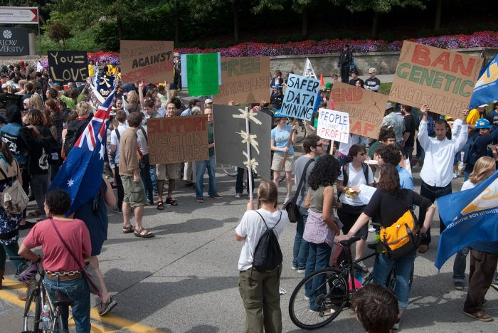
Machine Learning Crash Course
Computer Vision
Jia-Bin Huang, Virginia Tech
Many slides from D. Hoiem, J. Hays

Slide 2
Administrative stuffs
HW 4
  Due 11:59pm on Wed, November 2nd

Slide 3
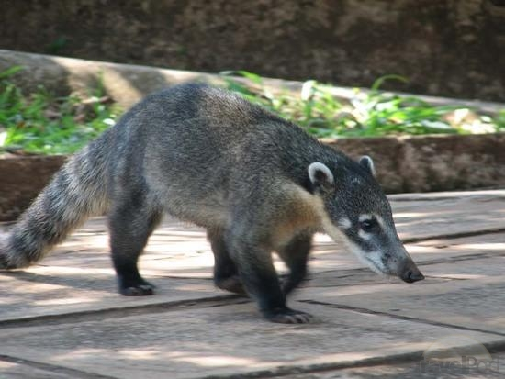
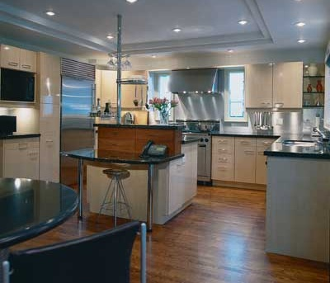
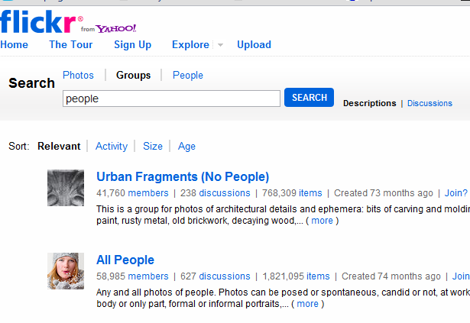
What is a category?
Why would we want to put an image in one?
Many different ways to categorize
To predict, describe, interact. To organize.
Notes:
Category is a group of items – a set. To categorize is to place into a set.
We want to define a sense of similarity, of belonging for our images. We may want to organize them or tag them or predict other things about them. We may want to categorize by event, by objects, by layout.
Animal is a coati

Slide 4
Examples of Categorization in Vision
Part or object detection
  E.g., for each window: face or non-face?
Scene categorization
  Indoor vs. outdoor, urban, forest, kitchen, etc.
Action recognition
  Picking up vs. sitting down vs. standing …
Emotion recognition
Region classification
  Label pixels into different object/surface categories
Boundary classification
  Boundary vs. non-boundary
Etc, etc.

Slide 5

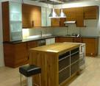
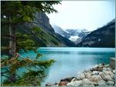

Image Categorization
Training
Training Labels
Training Images
Image Features
Classifier Training
Trained Classifier

Slide 6
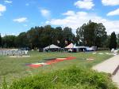
Image Categorization
Training
Training Labels
Training Images
Image Features
Classifier Training
Trained Classifier
Testing
Image Features
Trained Classifier
Prediction
Outdoor
Test Image

Slide 7
Feature design is paramount
Most features can be thought of as templates, histograms (counts), or combinations
Think about the right features for the problem
  Coverage
  Concision
  Directness

Slide 8
Today’s class: Machine Learning
Machine learning overview
Unsupervised Learning
  Dimensionality reduction
  Clustering
Supervised Learning
  Classification
  Regression

Slide 9
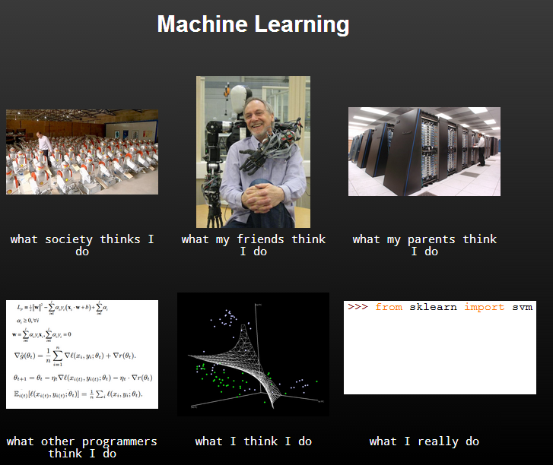

Slide 10
“If you were a current computer science student what area would you start studying heavily?”
  Answer: Machine Learning.
  “The ultimate is computers that learn”
  Bill Gates, Reddit AMA
“Machine learning is the next Internet”
  Tony Tether, Director, DARPA
“Machine learning is today’s discontinuity”
  Jerry Yang, CEO, Yahoo
Slide Credit: Pedro Domingos, Tom Mitchel, Tom Dietterich

Slide 11
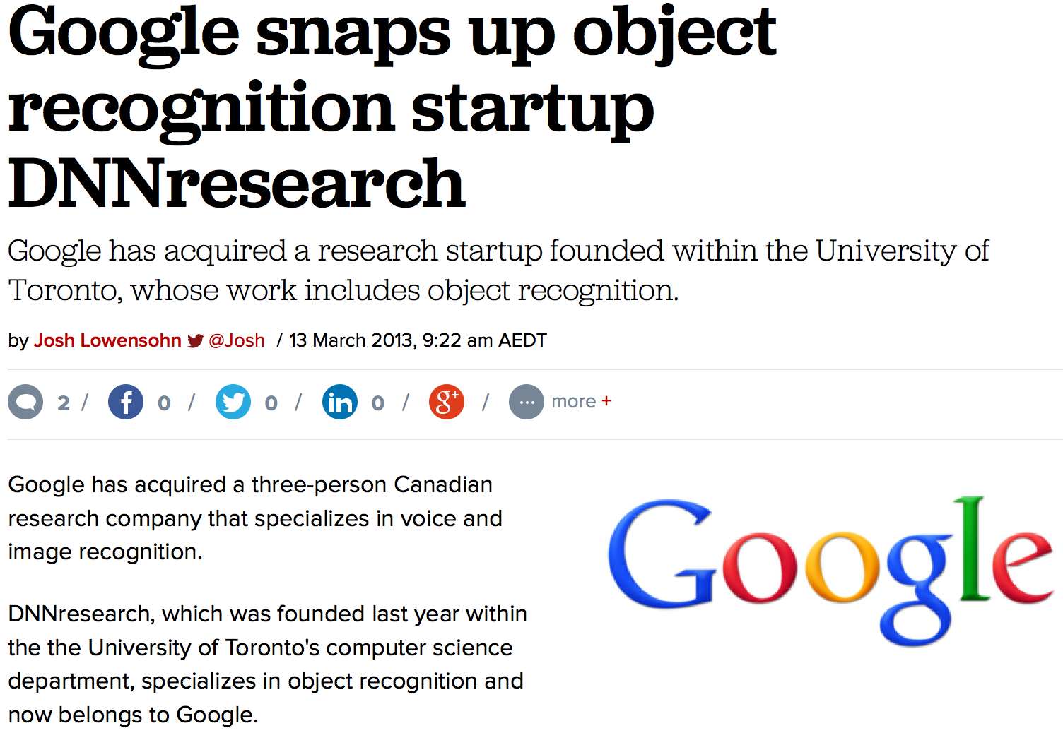
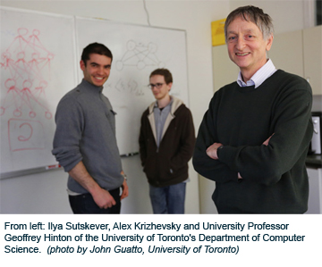
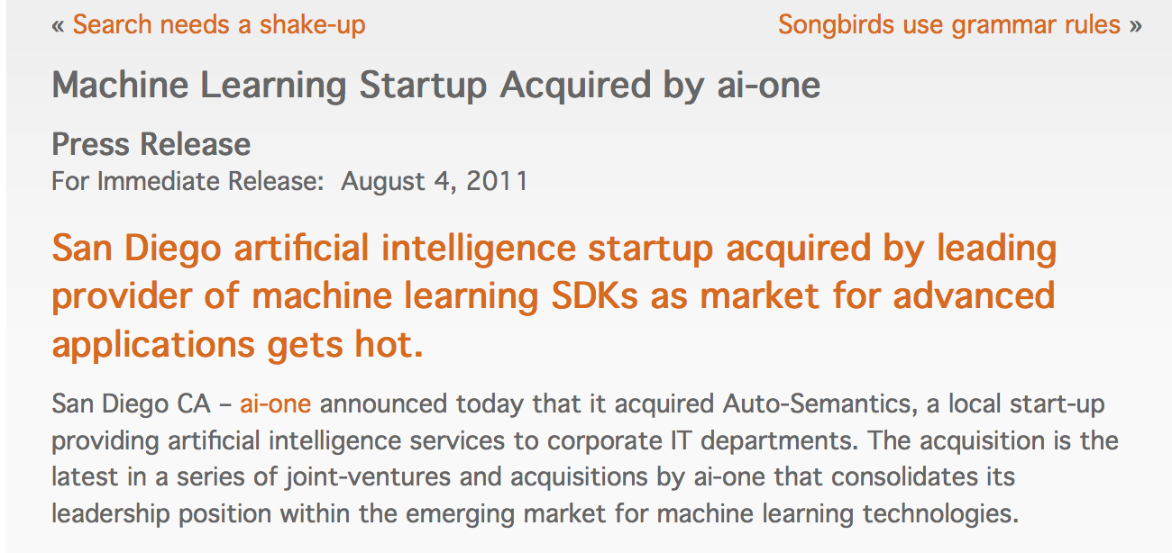
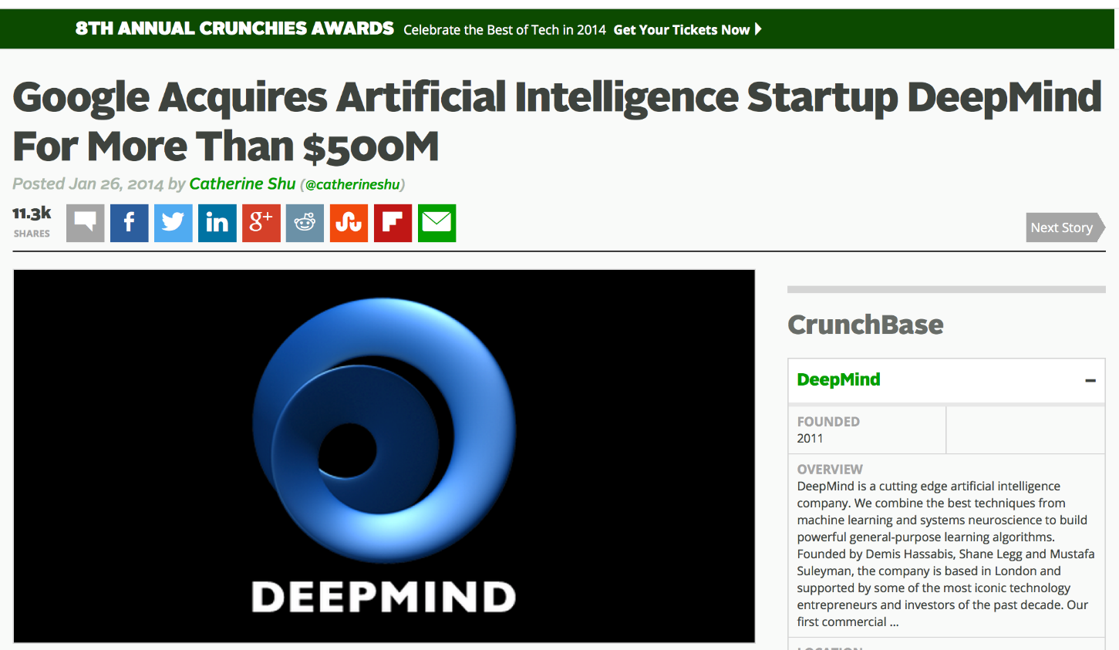
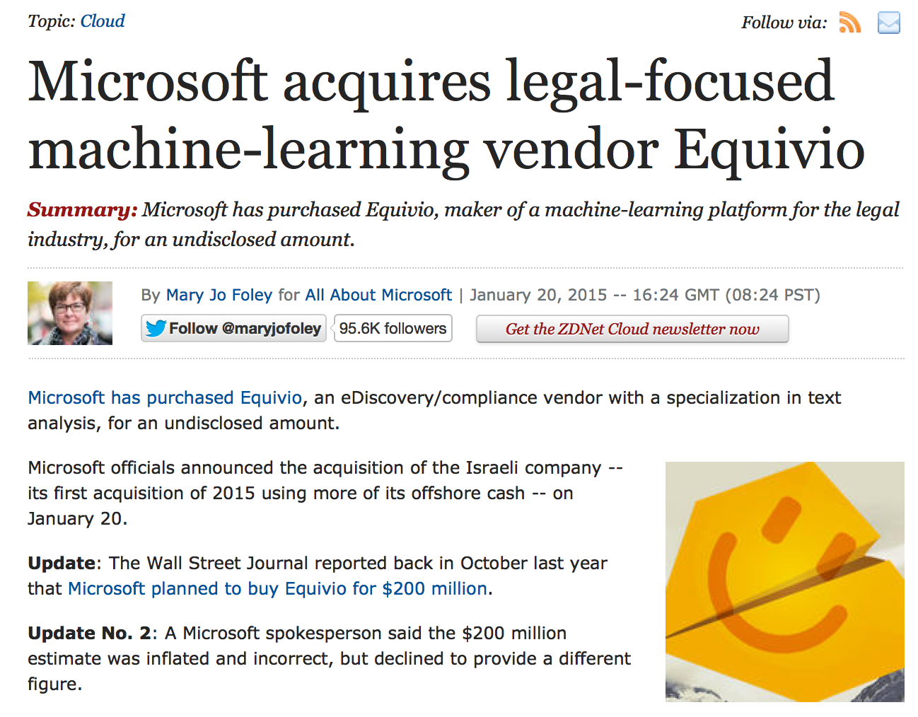

Slide 12
Machine Learning:
Making predictions or decisions from Data

Slide 13
Resources
Disclaimer:
  This overview will not cover statistical underpinnings of learning methods. We’ve looking at ML as a tool.
ML related courses at Virginia Tech
  ECE 5424 / 4424 - CS 5824 / 4824 Introduction to Machine Learning
  CS 4804 Introduction to Artificial Intelligence
  ECE 6504 Neural Networks and Deep Learning
External courses
  Machine Learning by Andrew Ng
  https://www.coursera.org/learn/machine-learning
  Learning from Data by Yaser S. Abu-Mostafa
  https://www.edx.org/course/learning-data-introductory-machine-caltechx-cs1156x

Slide 14
Impact of Machine Learning
Machine Learning is arguably the greatest export from computing to other scientific fields.

Slide 15
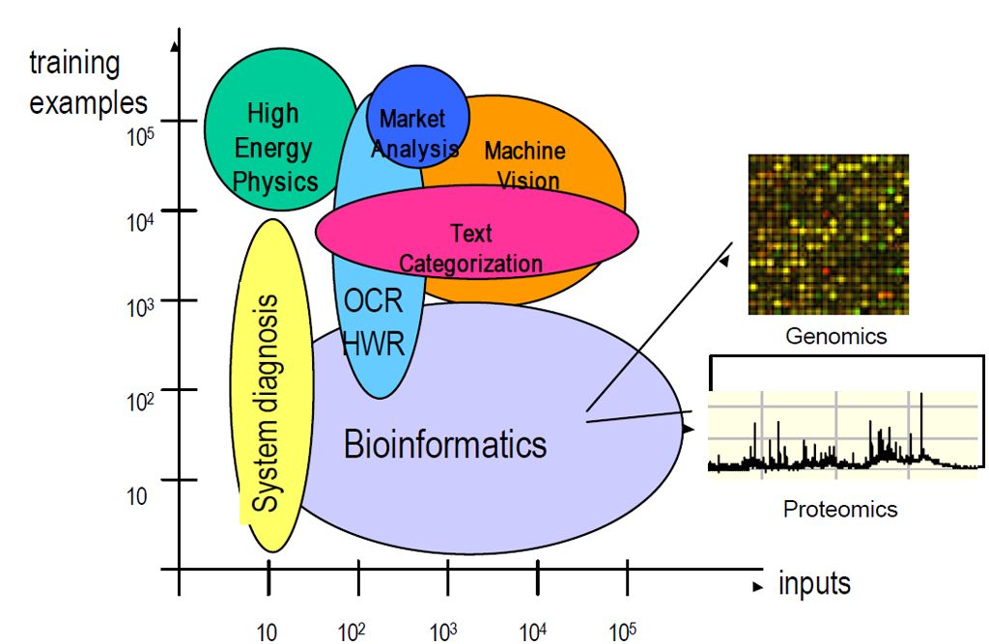
Machine Learning Applications
Slide: Isabelle Guyon

Slide 16
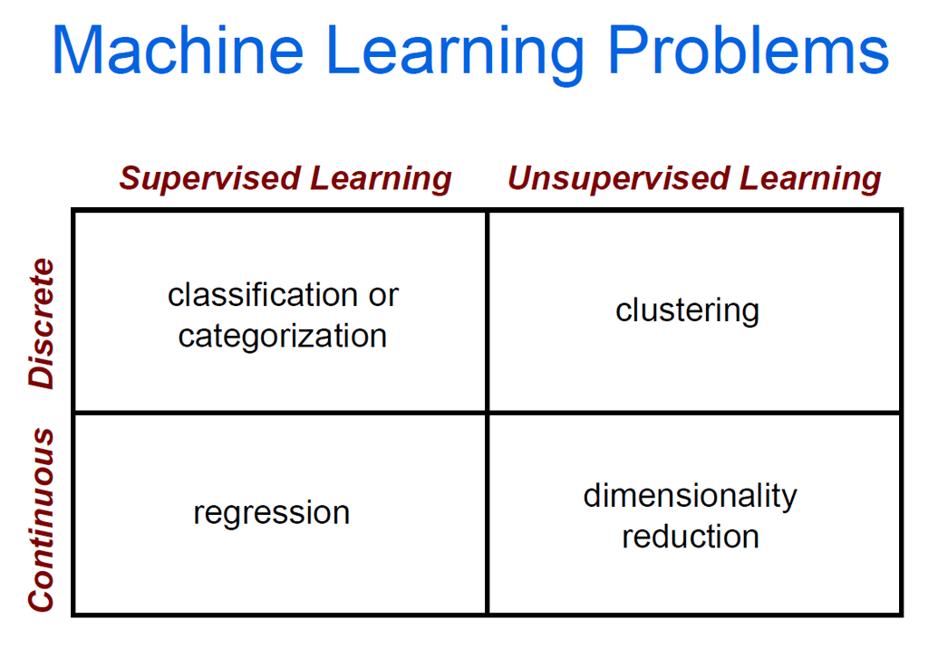

Slide 17
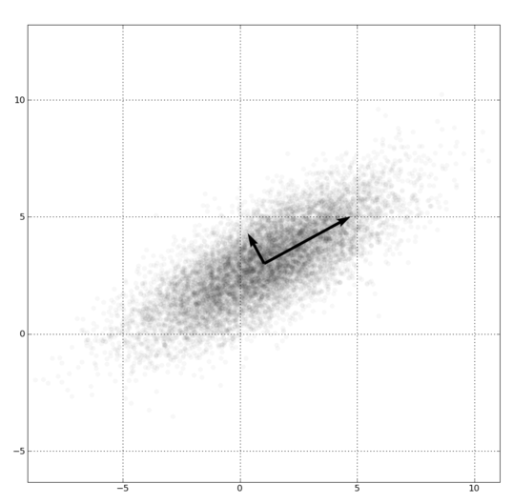
Dimensionality Reduction
PCA, ICA, LLE, Isomap
PCA is the most important technique to know. It takes advantage of correlations in data dimensions to produce the best possible lower dimensional representation based on linear projections (minimizes reconstruction error).
PCA should be used for dimensionality reduction, not for discovering patterns or making predictions. Don't try to assign semantic meaning to the bases.

Slide 18
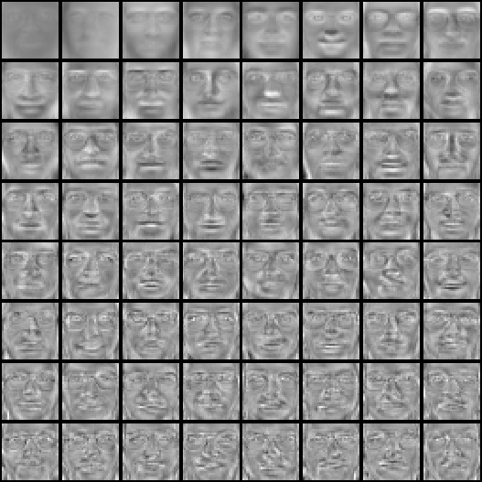

Eigenfaces example
Top eigenvectors: u₁,…u_{k}
Mean: μ

Slide 20
Clustering
Clustering:
  group together similar points and represent them with a single token
Key Challenges:
  What makes two points/images/patches similar?
  How do we compute an overall grouping from pairwise similarities?
Slide: Derek Hoiem

Slide 21
Why do we cluster?
Summarizing data
  Look at large amounts of data
  Patch-based compression or denoising
  Represent a large continuous vector with the cluster number
Counting
  Histograms of texture, color, SIFT vectors
Segmentation
  Separate the image into different regions
Prediction
  Images in the same cluster may have the same labels
Slide: Derek Hoiem

Slide 22
How do we cluster?
K-means
  Iteratively re-assign points to the nearest cluster center
Agglomerative clustering
  Start with each point as its own cluster and iteratively merge the closest clusters
Mean-shift clustering
  Estimate modes of pdf
Spectral clustering
  Split the nodes in a graph based on assigned links with similarity weights
Slide: Derek Hoiem

Slide 24



The machine learning framework
Apply a prediction function to a feature representation of the image to get the desired output:
f( ) = “apple”
f( ) = “tomato”
f( ) = “cow”
Slide credit: L. Lazebnik

Slide 25
The machine learning framework
y = f(x)
Training: given a training set of labeled examples {(x₁,y₁), …, (x_{N},y_{N})}, estimate the prediction function f by minimizing the prediction error on the training set
Testing: apply f to a never before seen test example x and output the predicted value y = f(x)
output
prediction function
Image feature
Slide credit: L. Lazebnik

Slide 26
Classifier
A classifier maps from the feature space to a label
x
x
x
x
x
x
o
x
x
o
o
o
o
x2
x1

Slide 27
Different types of classification
Exemplar-based: transfer category labels from examples with most similar features
  What similarity function? What parameters?
Linear classifier: confidence in positive label is a weighted sum of features
  What are the weights?
Non-linear classifier: predictions based on more complex function of features
  What form does the classifier take? Parameters?
Generative classifier: assign to the label that best explains the features (makes features most likely)
  What is the probability function and its parameters?
Note: You can always fully design the classifier by hand, but usually this is too difficult. Typical solution: learn from training examples.

Slide 28
One way to think about it…
Training labels dictate that two examples are the same or different, in some sense
Features and distance measures define visual similarity
Goal of training is to learn feature weights or distance measures so that visual similarity predicts label similarity
We want the simplest function that is confidently correct

Slide 29
Exemplar-based Models
Transfer the label(s) of the most similar training examples

Slide 30
K-nearest neighbor classifier
x
x
x
o
x
x
x
+
o
o
x
x
o
o
+
o
o
x2
x1

Slide 31
1-nearest neighbor
x
x
x
o
x
x
x
+
o
o
x
x
o
o
+
o
o
x2
x1

Slide 32
3-nearest neighbor
x
x
x
o
x
x
x
+
o
o
x
x
o
o
+
o
o
x2
x1

Slide 33
5-nearest neighbor
x
x
x
o
x
x
x
+
o
o
x
x
o
o
+
o
o
x2
x1

Slide 34
K-nearest neighbor
x
x
x
o
x
x
x
+
o
o
x
x
o
o
+
o
o
x2
x1

Slide 35
Using K-NN
Simple, a good one to try first
Higher K gives smoother functions
No training time (unless you want to learn a distance function)
With infinite examples, 1-NN provably has error that is at most twice Bayes optimal error

Slide 36

Discriminative classifiers
Learn a simple function of the input features that confidently predicts the true labels on the training set
Training Goals
Accurate classification of training data
Correct classifications are confident
Classification function is simple
$$y=f\left(x\right)$$

Slide 37
Classifiers: Logistic Regression
Objective
Parameterization
Regularization
Training
Inference
x
x
x
x
x
x
o
x
x
o
o
o
o
x2
x1
The objective function of most discriminative classifiers includes a loss term and a regularization term.

Slide 38
Using Logistic Regression
Quick, simple classifier (good one to try first)
Use L2 or L1 regularization
  L1 does feature selection and is robust to irrelevant features but slower to train

Slide 39
Classifiers: Linear SVM
x
x
x
o
x
x
x
o
x
x
o
o
o
o
x2
x1

Slide 40
Classifiers: Kernelized SVM
x
x
o
o
o
x
x
x
x
x
o
o
x²
o
x
x
x

Slide 41
Using SVMs
Good general purpose classifier
  Generalization depends on margin, so works well with many weak features
  No feature selection
  Usually requires some parameter tuning
Choosing kernel
  Linear: fast training/testing – start here
  RBF: related to neural networks, nearest neighbor
  Chi-squared, histogram intersection: good for histograms (but slower, esp. chi-squared)
  Can learn a kernel function

Slide 42
Classifiers: Decision Trees
x
x
x
o
x
x
x
o
x
o
x
o
o
o
o
x2
x1

Slide 43
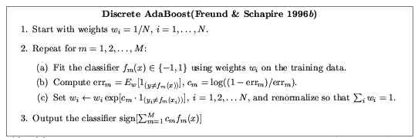
Ensemble Methods: Boosting
figure from Friedman et al. 2000

Slide 44
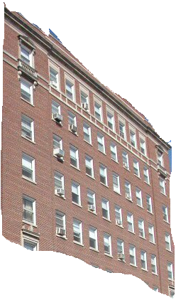
Boosted Decision Trees
High in
Image?
Gray?
Yes
No
Yes
No
Smooth?
Green?
High in
Image?
Many Long
Lines?
…
Yes
No
Yes
No
Yes
No
Yes
No
Blue?
Very High
Vanishing
Point?
Yes
No
Yes
No
Ground Vertical Sky
P(label | good segment, data)
[Collins et al. 2002]

Slide 45
Using Boosted Decision Trees
Flexible: can deal with both continuous and categorical variables
How to control bias/variance trade-off
  Size of trees
  Number of trees
Boosting trees often works best with a small number of well-designed features
Boosting “stubs” can give a fast classifier

Slide 46
Generative classifiers
Model the joint probability of the features and the labels
  Allows direct control of independence assumptions
  Can incorporate priors
  Often simple to train (depending on the model)
Examples
  Naïve Bayes
  Mixture of Gaussians for each class

Slide 47
Naïve Bayes
Objective
Parameterization
Regularization
Training
Inference
y
x₁
x₂
x₃

Slide 48
Using Naïve Bayes
Simple thing to try for categorical data
Very fast to train/test

Slide 49
Many classifiers to choose from
Which is the best one?
SVM
Neural networks
Naïve Bayes
Bayesian network
Logistic regression
Randomized Forests
Boosted Decision Trees
K-nearest neighbor
RBMs
Deep networks
Etc.

Slide 50
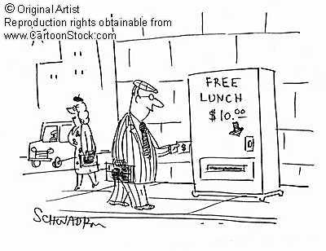
No Free Lunch Theorem
Notes:
You can only get generalization through assumptions.

Slide 51
Generalization Theory
It’s not enough to do well on the training set: we want to also make good predictions for new examples

Slide 52
Bias-Variance Trade-off
E(MSE) = noise² + bias² + variance
Error due to variance parameter estimates from training samples
Unavoidable error
Error due to incorrect assumptions
See the following for explanation of bias-variance (also Bishop’s “Neural Networks” book):
http://www.inf.ed.ac.uk/teaching/courses/mlsc/Notes/Lecture4/BiasVariance.pdf

Slide 53
Bias and Variance
Error = noise² + bias² + variance
Few training examples
Test Error
Many training examples
High Bias
Low Variance
Complexity
Low Bias
High Variance
Notes:
Note: these figures don’t work in pdf

Slide 54
Choosing the trade-off
Need validation set
Validation set is separate from the test set
Test error
Error
Training error
High Bias
Low Variance
Complexity
Low Bias
High Variance

Slide 55
Effect of Training Size
Fixed classifier
Error
Testing
Generalization Error
Training
Number of Training Examples

Slide 56

How to measure complexity?
VC dimension
Other ways: number of parameters, etc.
What is the VC dimension of a linear classifier for N-dimensional features? For a nearest neighbor classifier?
Upper bound on generalization error
Test error <=
Training error +
N: size of training set
h: VC dimension
η: 1-probability that bound holds

Slide 57
How to reduce variance?
Choose a simpler classifier
Regularize the parameters
Use fewer features
Get more training data
Which of these could actually lead to greater error?
Notes:
The simpler classifier or regularization could increase bias and lead to more error.

Slide 58
Reducing Risk of Error
Margins
x
x
x
x
x
x
o
x
x
o
o
o
o
x2
x1

Slide 59
The perfect classification algorithm
Objective function: encodes the right loss for the problem
Parameterization: makes assumptions that fit the problem
Regularization: right level of regularization for amount of training data
Training algorithm: can find parameters that maximize objective on training set
Inference algorithm: can solve for objective function in evaluation

Slide 60
Comparison
assuming x in {0 1}
Learning Objective
Training
Inference
Naïve Bayes
Logistic Regression
Gradient ascent
Linear SVM
Quadratic programming or subgradient opt.
Kernelized SVM
complicated to write
Quadratic programming
Nearest Neighbor
most similar features → same label
Record data

Slide 61
Characteristics of vision learning problems
Lots of continuous features
  E.g., HOG template may have 1000 features
  Spatial pyramid may have ~15,000 features
Imbalanced classes
  often limited positive examples, practically infinite negative examples
Difficult prediction tasks

Slide 62
When a massive training set is available
Relatively new phenomenon
  MNIST (handwritten letters) in 1990s, LabelMe in 2000s, ImageNet (object images) in 2009, …
Want classifiers with low bias (high variance ok) and reasonably efficient training
Very complex classifiers with simple features are often effective
  Random forests
  Deep convolutional networks

Slide 63
New training setup with moderate sized datasets
Training Labels
Training Images
Tune CNN features and
Neural Network classifier
Trained Classifier
Initialize CNN Features
Dataset similar to task with millions of labeled examples

Slide 64
Practical tips
Preparing features for linear classifiers
  Often helps to make zero-mean, unit-dev
  For non-ordinal features, convert to a set of binary features
Selecting classifier meta-parameters (e.g., regularization weight)
  Cross-validation: split data into subsets; train on all but one subset, test on remaining; repeat holding out each subset
    Leave-one-out, 5-fold, etc.
Most popular classifiers in vision
  SVM: linear for when fast training/classification is needed; performs well with lots of weak features
  Logistic Regression: outputs a probability; easy to train and apply
  Nearest neighbor: hard to beat if there is tons of data (e.g., character recognition)
  Boosted stumps or decision trees: applies to flexible features, incorporates feature selection, powerful classifiers
  Random forests: outputs probability; good for simple features, tons of data
  Deep networks / CNNs: flexible output; learns features; adapt existing network (which is trained with tons of data) or train new with tons of data
Always try at least two types of classifiers

Slide 65
Making decisions about data
3 important design decisions:
  1) What data do I use?
  2) How do I represent my data (what feature)?
  3) What classifier / regressor / machine learning tool do I use?
These are in decreasing order of importance
Deep learning addresses 2 and 3 simultaneously (and blurs the boundary between them).
You can take the representation from deep learning and use it with any classifier.

Slide 66
Things to remember
No free lunch: machine learning algorithms are tools
Try simple classifiers first
Better to have smart features and simple classifiers than simple features and smart classifiers
  Though with enough data, smart features can be learned
Use increasingly powerful classifiers with more training data (bias-variance tradeoff)

Slide 67
Some Machine Learning References
General
  Tom Mitchell, Machine Learning, McGraw Hill, 1997
  Christopher Bishop, Neural Networks for Pattern Recognition, Oxford University Press, 1995
Adaboost
  Friedman, Hastie, and Tibshirani, “Additive logistic regression: a statistical view of boosting”, Annals of Statistics, 2000
SVMs
  http://www.support-vector.net/icml-tutorial.pdf
Random forests
  http://research.microsoft.com/pubs/155552/decisionForests_MSR_TR_2011_114.pdf

