Slide 1
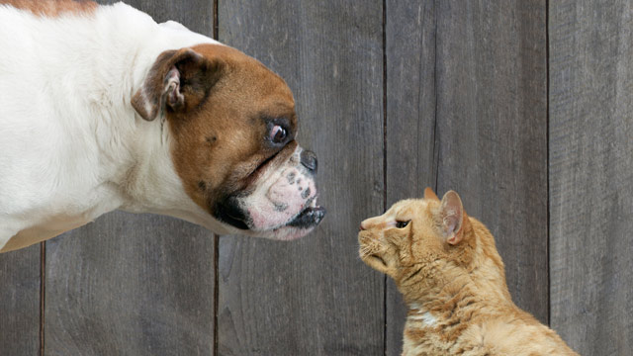
Image Features and Categorization
Computer Vision
Jia-Bin Huang, Virginia Tech

Slide 2
Administrative stuffs
Final project
  Proposal due 11:59 PM on Thursday, Oct 27
  Submit via CANVAS
  Send a copy to Jia-Bin and Akrit via email
HW 4
  Due 11:59pm on Wed, November 2nd
Happy Halloween!

Slide 3

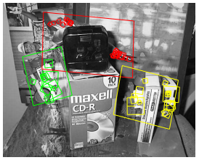
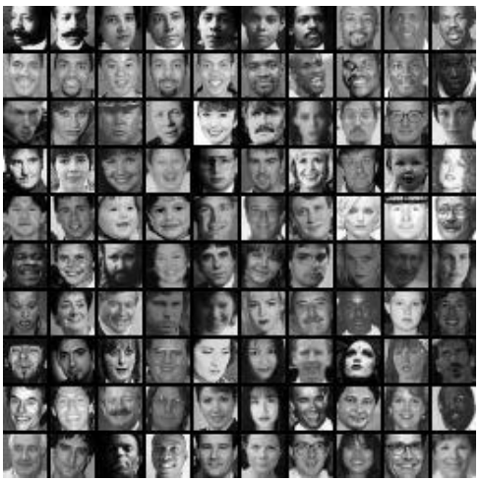
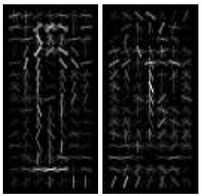
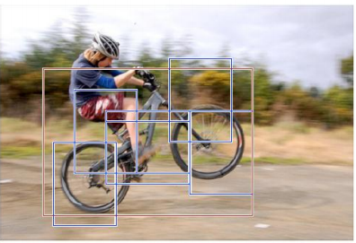

Where are we now?
Object instance recognition
Face recognition
Today: Image features and
categorization
Categorical object detection
Object tracking
Notes:
In the previous classes covered vision tasks involving recognition of particular instance
Object instance recognition is localizing particular object instance in an image
The other related task is face recognition, match one face to a particular person
Today, talking about another task, mapping images and regions to categories.
What is the difference? For example for face images, finding if the image contains John is a instance recognition task, but john is not a category.
Recognizing a face images is a male or a female is categorization task.

Slide 4


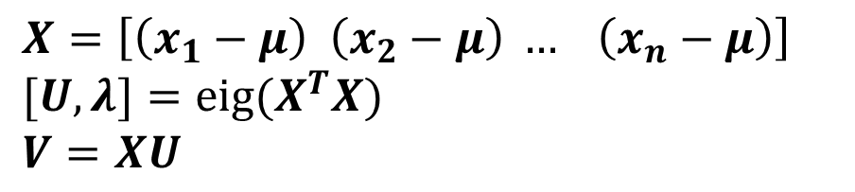
Review: Eigenfaces (PCA on face images)
Compute the principal components (“eigenfaces”) of the covariance matrix
Keep K eigenvectors with largest eigenvalues
Represent all face images in the dataset as linear combinations of eigenfaces
  Perform nearest neighbor on these coefficients
$$X=\left[\left(x_{1}−μ\right) \left(x_{2}−μ\right) … \left(x_{n}−μ\right)\right]$$
$$[U, λ]={eig(X}^{T}X)$$
$$V=XU$$
$$V=V(:, largest_eig)$$
$$Xpca=V{\left(:, {largest}_{eig}\right)}^{T}X$$
M. Turk and A. Pentland, Face Recognition using Eigenfaces, CVPR 1991

Slide 5

Review: Recognition with Fisherfaces
Use PCA to reduce dimensions to N-C dim PCA space
Compute within-class and between-class scatter matrices for PCA coefficients
Solve generalized eigenvector problem
Project to FLD subspace (c-1 dimensions)
Classify by nearest neighbor
$$W^{T}opt=W^{T}fldW^{T}pca$$
Note: x in step 2 refers to PCA coef; x in step 4 refers to original data

Slide 6
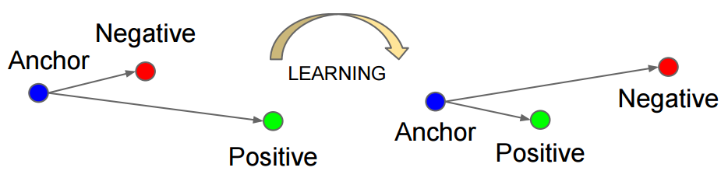
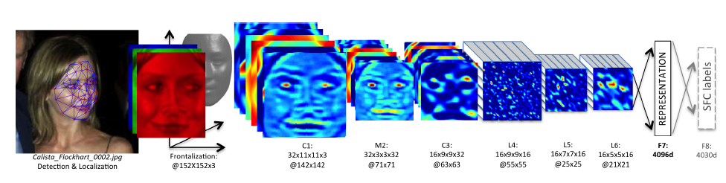
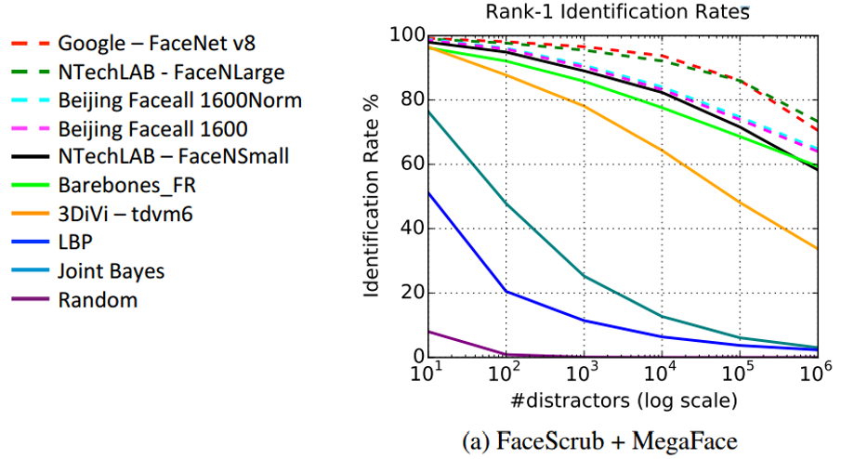
Review: recent development
Important steps
  Detect
  Align
  Represent
  Classify
FaceNet, ICCV 2015
DeepFace, CVPR 2014
MegaFace, CVPR 2016

Slide 7
Face recognition by humans
Face recognition by humans: 20 results (2005)
Slides by Jianchao Yang

Slide 8
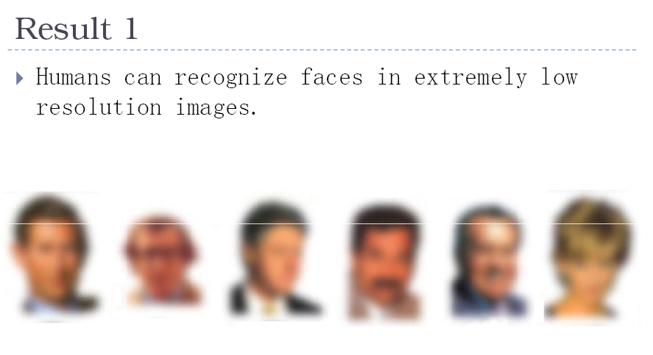

Slide 9
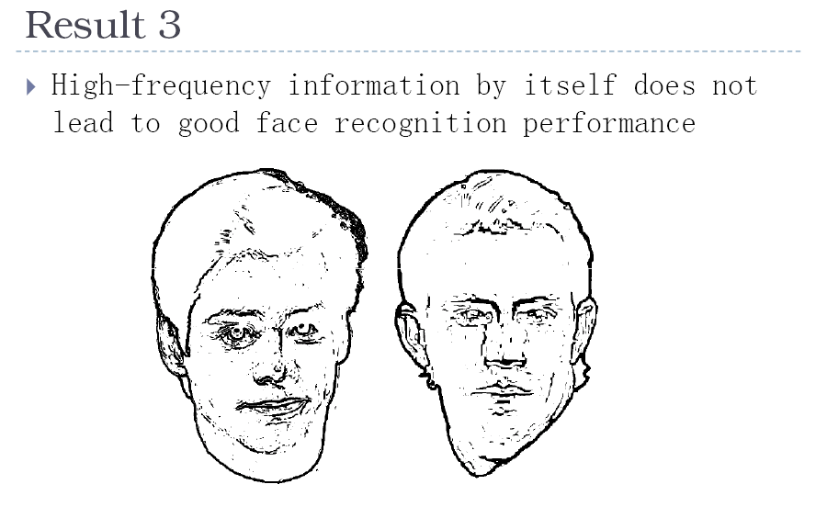

Slide 10
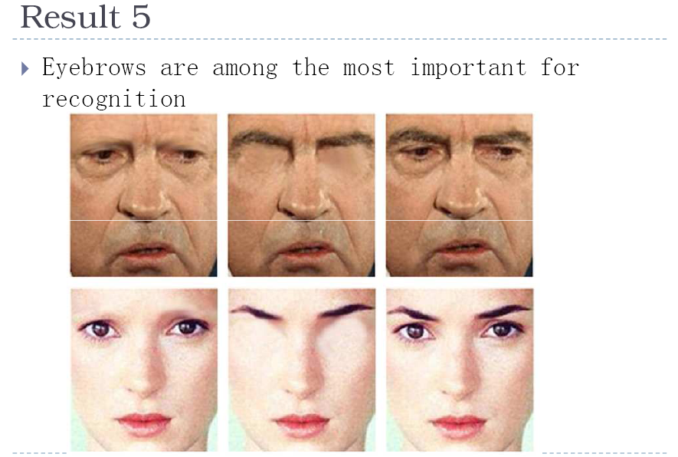

Slide 11
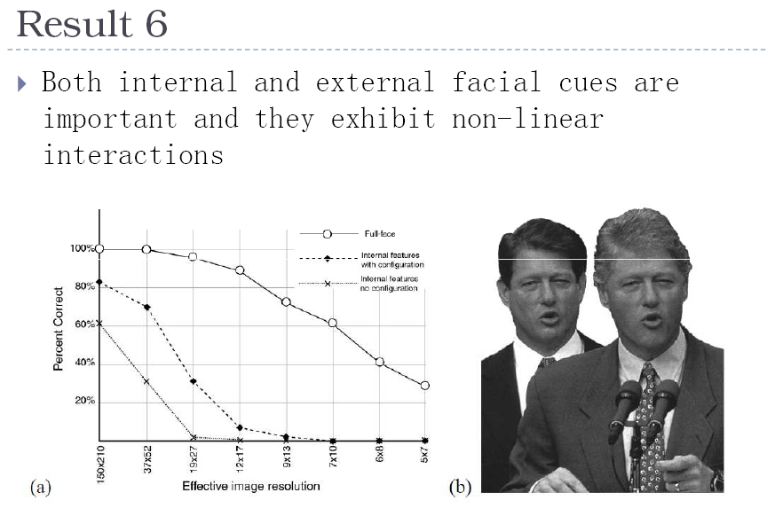

Slide 12
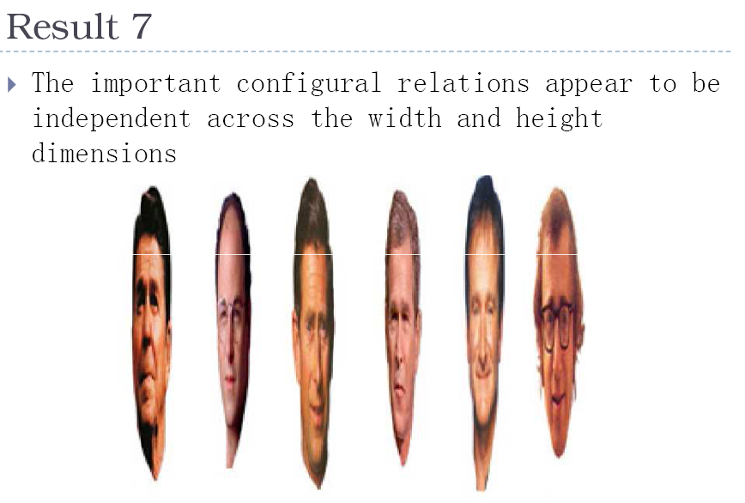

Slide 13
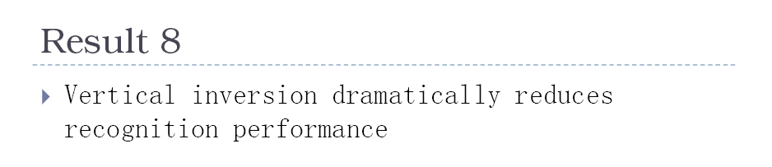
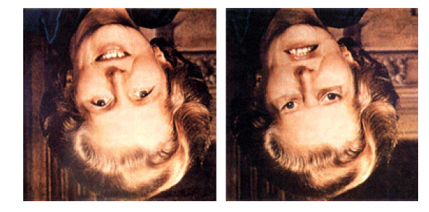
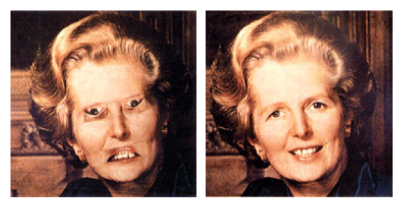

Slide 14
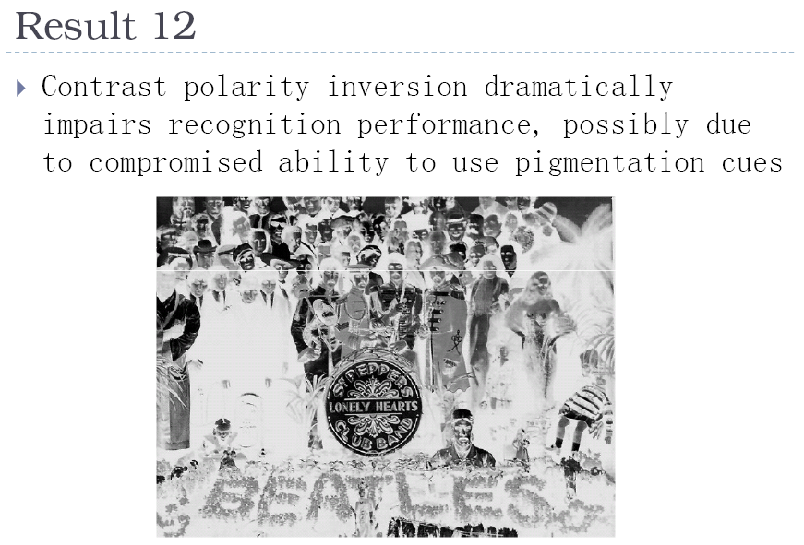


Slide 15
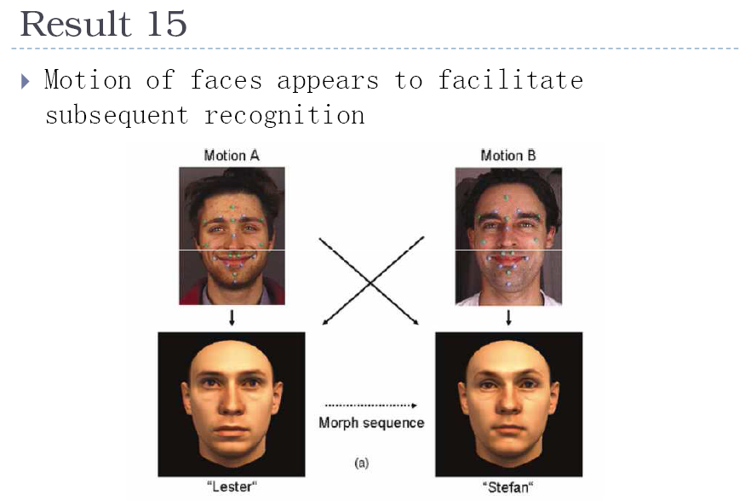

Slide 16
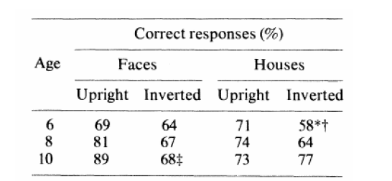
Result 17: Vision progresses from piecemeal to holistic

Slide 17
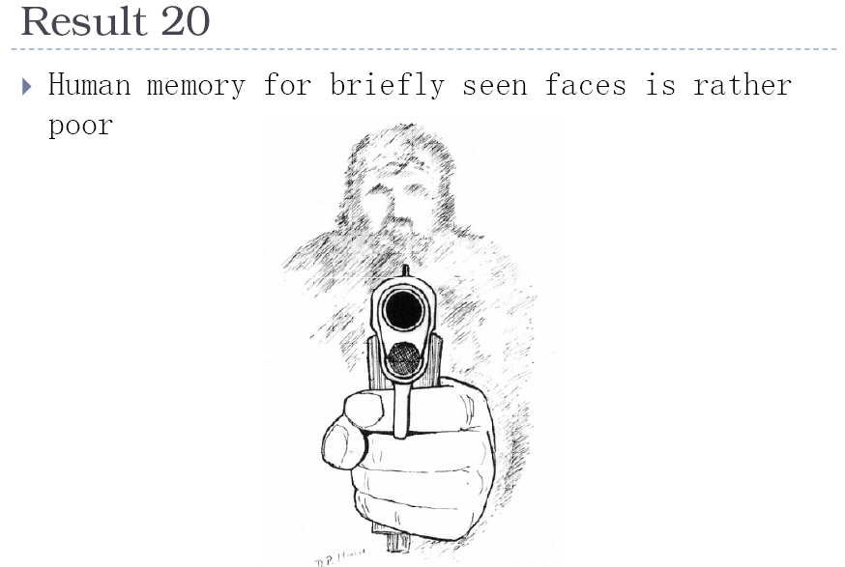

Slide 18
Today: Image features and categorization
General concepts of categorization
  Why? What? How?
Image features
  Color, texture, gradient, shape, interest points
  Histograms, feature encoding, and pooling
  CNN as feature
Image and region categorization

Slide 19
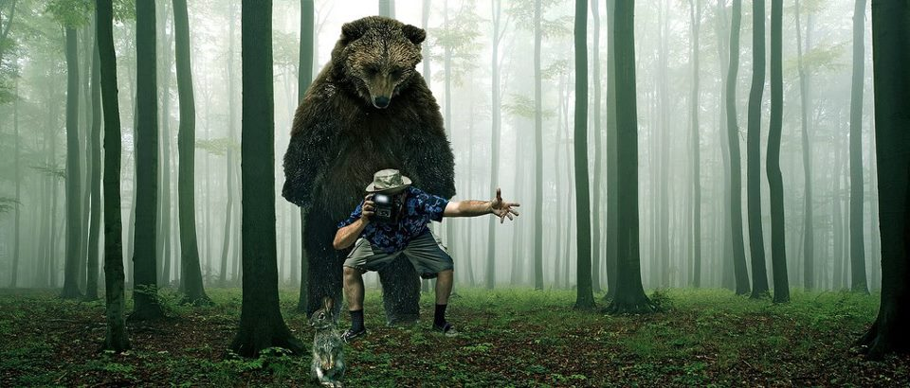
What do you see in this image?
Trees
Bear
Camera
Man
Can I put stuff in it?
Rabbit
Grass
Forest
Notes:
What do you say about this image?
So this is a forest scene, and there is a lot trees, grass on the ground, man and holding a camera looking rabbit, bear behind.
Giving out category names, doing categorization

Slide 20
Describe, predict, or interact with the object based on visual cues
Is it dangerous?
Is it alive?
How fast does it run?
Is it soft?
Does it have a tail?
Can I poke with it?
Notes:
Looking at this image, by categorizing each of the object, we infer a lot of information.
Animal alive, dangerous, how fast runs, I poke it.
Infer in man is in danger

Slide 21
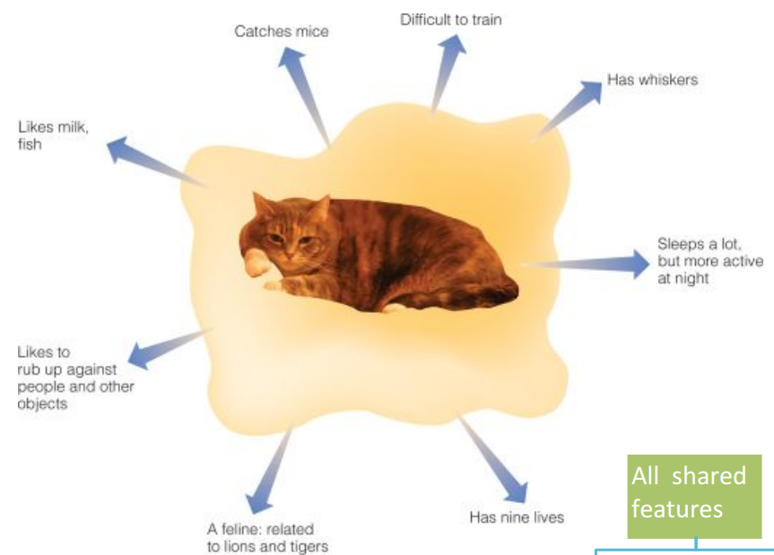
Why do we care about categories?
From an object’s category, we can make predictions about its behavior in the future, beyond of what is immediately perceived.
Pointers to knowledge
  Help to understand individual cases not previously encountered
Communication
Notes:
I think about things in categories because there are many benefit to it.
Mainly the benefit is, from categories, we can go beyond what we see and make prediction

Slide 22
Theory of categorization
How do we determine if something is a member of a particular category?
Definitional approach
Prototype approach
Exemplar approach

Slide 23
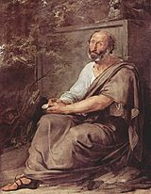
Definitional approach: classical view of categories
Plato & Aristotle
  Categories are defined by a list of properties shared by all elements in a category
  Category membership is binary
  Every member in the category is equal
  The Categories (Aristotle)
Aristotle by Francesco Hayez
Slide Credit: A. A. Efros

Slide 24
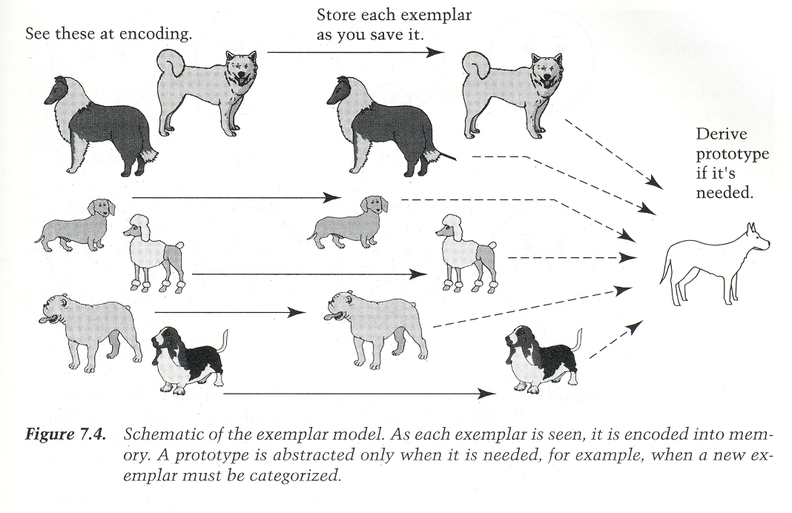
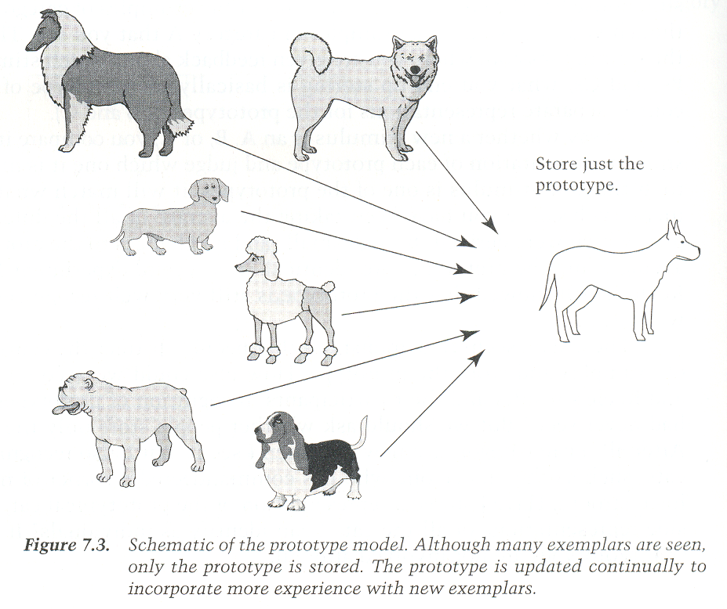
Prototype or sum of exemplars ?
Prototype Model
Exemplars Model
Category judgments are made
by comparing a new exemplar
to all the old exemplars of a category
or to the exemplar that is the most
appropriate
Category judgments are made
by comparing a new exemplar
to the prototype.
Slide Credit: Torralba
Notes:
Knowing what a category is, how do we recognize them?
One way to think about it is that I have a generic prototype of something say dog, and I compare everything to the prototype to make this decision.
The other way to think about it is I have kept in my memory a number of exemplars and I compare new things to those exemplars and make the prediction

Slide 25

Levels of categorization [Rosch 70s]
Definition of Basic Level:
Similar shape: Basic level categories are the highest-level category for which their members have similar shapes.
Similar motor interactions: … for which people interact with its members using similar motor sequences.
Common attributes: … there are a significant number
of attributes in common between pairs of members.
…
animal
Superordinate
levels
…
…
similarity
quadruped
…
Basic level
dog
cat
cow
German
shepherd
Doberman
Sub Basic Superordinate
Subordinate
level
…
“Fido”
…
Rosch et a. Principle of categorization, 1978
Notes:
So category is important but what kind of categories do we what to work with?
It turns out that philosophers have been thinking about it over thousands of years and some of recent theories about categorization is made by a research Elenor Rosch in 1976.
They found that first categories can be put into taxonomies. Dog is subcategory of animal, and German shepherd is subcategory of dog.
At higher level things share very little in common, and at lower level, things share a lot in common. a fly is very different from a dog, but german shepherd is very similar to a greyhound, but the boundary may be less clear.
So in the taxonomy tree, there is level called basic level where people are very comfortable to work with, they are like dog, cat, cow.
In this level categories still share a lot in common and the boundaries of categories are very clear.

Slide 26
Image categorization
Cat vs Dog

Slide 27
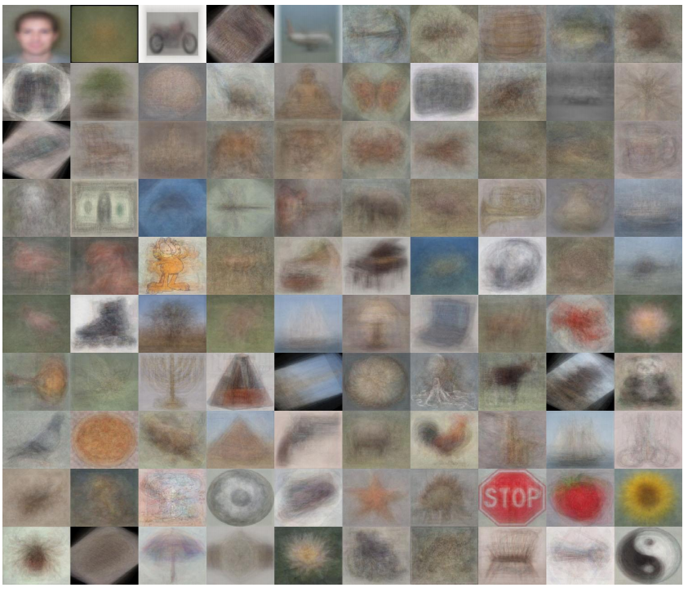
Image categorization
Object recognition
Caltech 101 Average Object Images

Slide 28
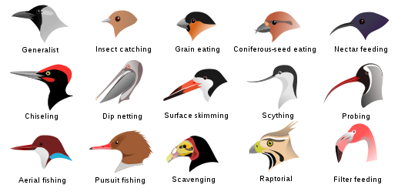
Image categorization
Fine-grained recognition
Visipedia Project

Slide 29
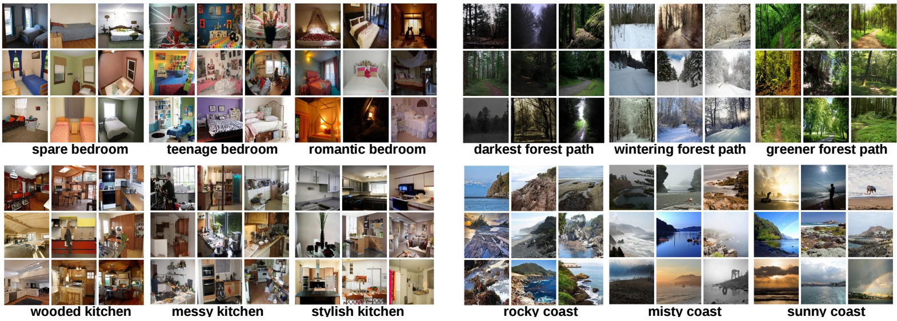
Image categorization
Place recognition
Places Database [Zhou et al. NIPS 2014]

Slide 30
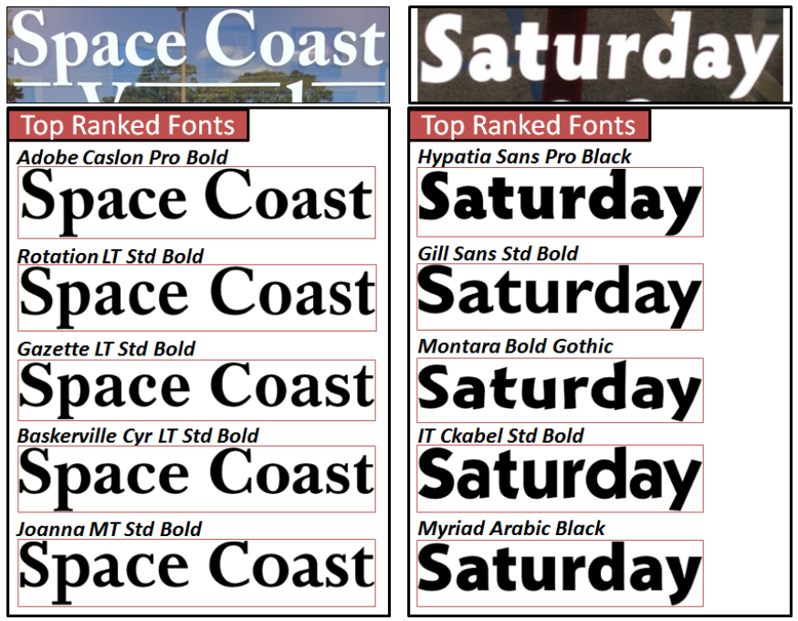
Image categorization
Visual font recognition
[Chen et al. CVPR 2014]

Slide 31
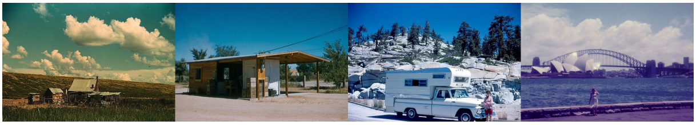
Image categorization
Dating historical photos
1940
1953
1966
1977
[Palermo et al. ECCV 2012]

Slide 32
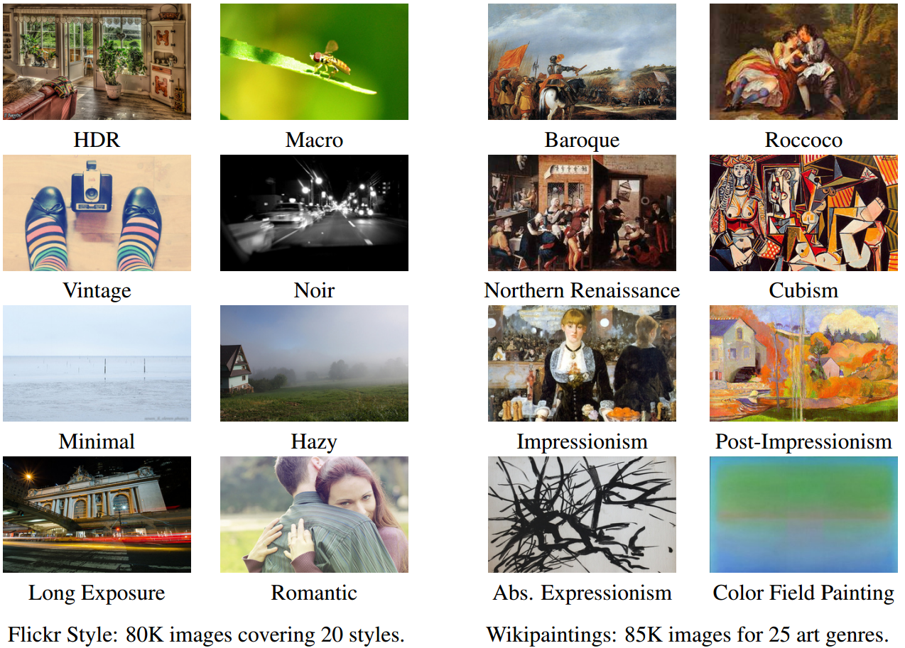
Image categorization
Image style recognition
[Karayev et al. BMVC 2014]

Slide 33
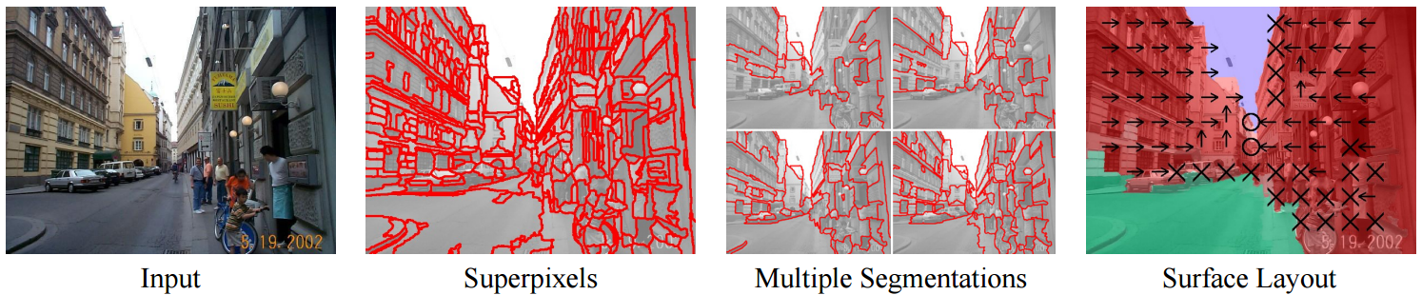
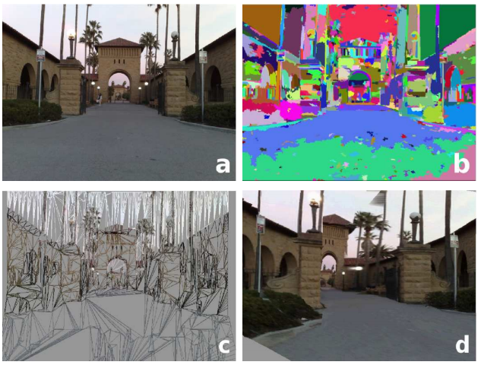
Region categorization
Layout prediction
Assign regions to orientation
Geometric context [Hoiem et al. IJCV 2007]
Assign regions to depth
Make3D [Saxena et al. PAMI 2008]

Slide 34
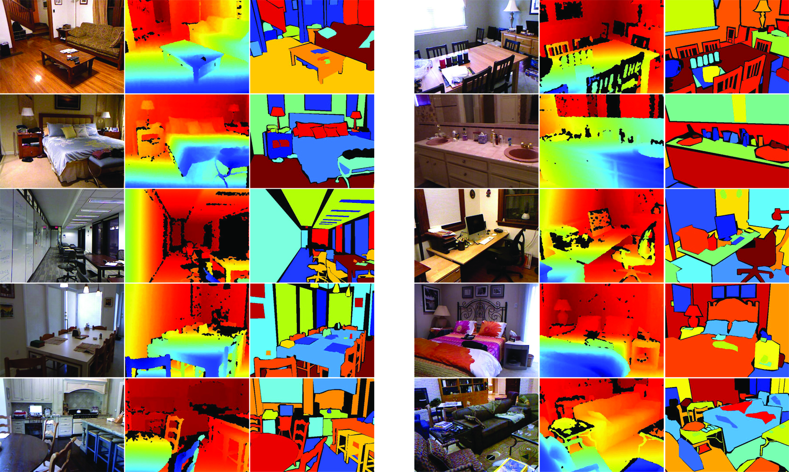
Region categorization
Semantic segmentation from RGBD images
[Silberman et al. ECCV 2012]

Slide 35
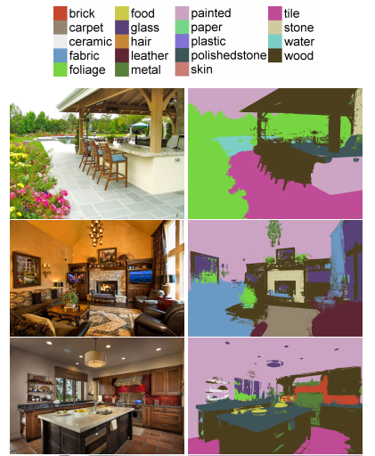
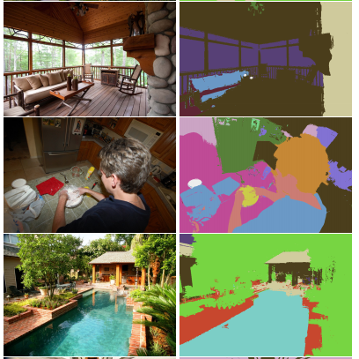
Region categorization
Material recognition
[Bell et al. CVPR 2015]

Slide 36
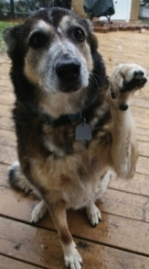
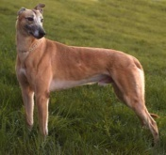
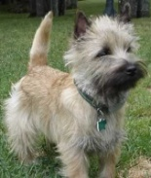
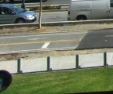

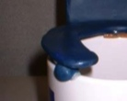
Supervised learning
LAB Histogram
x
x
x
x
x
Textons
o
x
o
x
= Category
label
o
o
HOG
o
x
Bag of SIFT
x
Examples
+
+
Image Features
Classifier
Notes:
Supervised learning
First we represent the visual appearance of our examples using some image features, we want the features to capture important visual characteristics
Then, we will build models to separate the examples from the same category from the examples that do not belong to this category

Slide 37


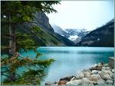

Training phase
Training Images
Training
Training Labels
Image Features
Classifier Training
Trained Classifier
Notes:
At testing time, we are given with an new image, we also represent it in terms of image features and apply the trained model to obtain the prediction

Slide 38
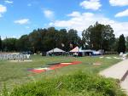
Testing phase
Training Images
Training
Training Labels
Image Features
Classifier Training
Trained Classifier
Testing
Image Features
Trained Classifier
Prediction
Outdoor
Test Image
Notes:
At testing time, we are given with an new image, we also represent it in terms of image features and apply the trained model to obtain the prediction

Slide 39
Testing phase
Training Images
Training
Training Labels
Image Features
Classifier Training
Trained Classifier
Testing
Image Features
Trained Classifier
Prediction
Outdoor
Test Image
Notes:
At testing time, we are given with an new image, we also represent it in terms of image features and apply the trained model to obtain the prediction

Slide 40






Q: What are good features for…
recognizing a beach?

Slide 41
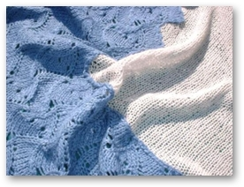
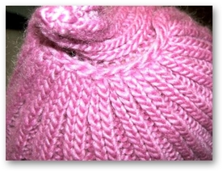
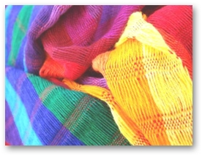
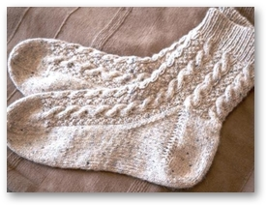
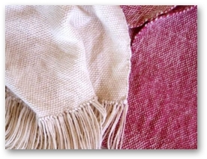
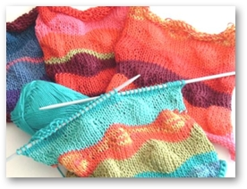
Q: What are good features for…
recognizing cloth fabric?

Slide 42






Q: What are good features for…
recognizing a mug?

Slide 43
What are the right features?
Depend on what you want to know!
Object: shape
  Local shape info, shading, shadows, texture
Scene : geometric layout
  linear perspective, gradients, line segments
Material properties: albedo, feel, hardness
  Color, texture
Action: motion
  Optical flow, tracked points
Notes:
Object: shape, shadows

Slide 44
General principles of representation
Coverage
  Ensure that all relevant info is captured
Concision
  Minimize number of features without sacrificing coverage
Directness
  Ideal features are independently useful for prediction
Notes:
To represent images using features, there is not a certain best way to represent an image.
However, there are a few guidelines that apply: 1. we want our features to capture what is relveant to our categorization task.
For example, we want to focus on material category, look at color and texture categorize the scene category, then we want to use some feature that can capture the overall layout.
2. Features to be simple, less complicated model. In the extreme case, we can directly use raw image intensity as features. But the problem is, structured, correlated and classifier would not be able to learn. Learned by classifiers
3. Correlated features, each predict different things. RGB, LAB, color. RGB and texture, different perspective.

Slide 45

Image representations
Templates
  Intensity, gradients, etc.
Histograms
  Color, texture, SIFT descriptors,
  etc.
Average of features
Image
Intensity
Gradient
template
Notes:
Genres of representation.
Template of gradients, capturing the shape, shape are cues for object
2.histogram distribution of color and texture

Slide 46

Image representations: histograms
Global histogram
- Represent distribution of features
  Color, texture, depth, …
Space Shuttle Cargo Bay
Images from Dave Kauchak
Notes:
Histograms, measure feature distribution. General representation, The feature maybe color text, depth

Slide 47
Image representations: histograms
Data samples in 2D
Feature 2
Feature 1

Slide 48
Image representations: histograms
Probability or count of data in each bin
Marginal histogram on feature 1
Feature 2
Feature 1
bin

Slide 49
Image representations: histograms
Marginal histogram on feature 2
bin
Feature 2
Feature 1

Slide 50
Image representations: histograms
Joint histogram
bin
Feature 2
Feature 1

Slide 51
Modeling multi-dimensional data
Feature 2
Feature 2
Feature 1
Feature 1
Feature 2
Feature 1
Joint histogram
Requires lots of data
Loss of resolution to
avoid empty bins
Marginal histogram
  Requires independent features
  More data/bin than
  joint histogram

Slide 52
Modeling multi-dimensional data
Clustering
Use the same cluster centers for all images
bin
Feature 2
Feature 1

Slide 53
Computing histogram distance
Histogram intersection
Chi-squared Histogram matching distance
Earth mover’s distance
(Cross-bin similarity measure)
  minimal cost paid to transform one distribution into the other
[Rubner et al. The Earth Mover's Distance as a Metric for Image Retrieval, IJCV 2000]

Slide 54
Histograms: implementation issues
Quantization
  Grids: fast but applicable only with few dimensions
  Clustering: slower but can quantize data in higher dimensions
Matching
  Histogram intersection or Euclidean may be faster
  Chi-squared often works better
  Earth mover’s distance is good for when nearby bins represent similar values
Few Bins
Need less data
Coarser representation
Many Bins
Need more data
Finer representation
Notes:
Recap on histogram
Design issue histogram how many bin grids. Fewer loss more information compact
More bins data points fine
Euclidean

Slide 55



What kind of things do we compute histograms of?
Color
Texture (filter banks or HOG over regions)
L*a*b* color space
HSV color space
Notes:
Histogram of what.
Color, RGB values LAB approximate human perception, HSV hue staturation and illumination.
Textures: texture filter response

Slide 56


What kind of things do we compute histograms of?
Histograms of descriptors
“Bag of visual words”
SIFT – [Lowe IJCV 2004]
Notes:
Histogram of distinctive interesting points.
Detect and describe, interesting point descriptor, histogram of descriptors
Bag of visual words

Slide 57

Analogy to documents
Of all the sensory impressions proceeding to the brain, the visual experiences are the dominant ones. Our perception of the world around us is based essentially on the messages that reach the brain from our eyes. For a long time it was thought that the retinal image was transmitted point by point to visual centers in the brain; the cerebral cortex was a movie screen, so to speak, upon which the image in the eye was projected. Through the discoveries of Hubel and Wiesel we now know that behind the origin of the visual perception in the brain there is a considerably more complicated course of events. By following the visual impulses along their path to the various cell layers of the optical cortex, Hubel and Wiesel have been able to demonstrate that the message about the image falling on the retina undergoes a step-wise analysis in a system of nerve cells stored in columns. In this system each cell has its specific function and is responsible for a specific detail in the pattern of the retinal image.
China is forecasting a trade surplus of $90bn (£51bn) to $100bn this year, a threefold increase on 2004's $32bn. The Commerce Ministry said the surplus would be created by a predicted 30% jump in exports to $750bn, compared with a 18% rise in imports to $660bn. The figures are likely to further annoy the US, which has long argued that China's exports are unfairly helped by a deliberately undervalued yuan. Beijing agrees the surplus is too high, but says the yuan is only one factor. Bank of China governor Zhou Xiaochuan said the country also needed to do more to boost domestic demand so more goods stayed within the country. China increased the value of the yuan against the dollar by 2.1% in July and permitted it to trade within a narrow band, but the US wants the yuan to be allowed to trade freely. However, Beijing has made it clear that it will take its time and tread carefully before allowing the yuan to rise further in value.
sensory, brain,
visual, perception,
retinal, cerebral cortex,
eye, cell, optical
nerve, image
Hubel, Wiesel
China, trade,
surplus, commerce,
exports, imports, US,
yuan, bank, domestic,
foreign, increase,
trade, value
ICCV 2005 short course, L. Fei-Fei
Notes:
Analogy Language
Bag of lexical word articles

Slide 58





















Bag of visual words
Image
patches
BoW histogram
Codewords
Notes:
Patch local shape, by quantize them, dictionary of visual word and then we patch into a codeword
Frequency distribution Visual words to represent

Slide 59
Image categorization with bag of words
Training
Extract keypoints and descriptors for all training images
Cluster descriptors
Quantize descriptors using cluster centers to get “visual words”
Represent each image by normalized counts of “visual words”
Train classifier on labeled examples using histogram values as features
Testing
Extract keypoints/descriptors and quantize into visual words
Compute visual word histogram
Compute label or confidence using classifier

Slide 60

Bag of visual words image classification
[Chatfieldet al. BMVC 2011]

Slide 61




Feature encoding
Hard/soft assignment to clusters
Histogram encoding
Kernel codebook encoding
Locality constrained encoding
Fisher encoding
[Chatfieldet al. BMVC 2011]

Slide 62



Fisher vector encoding
Fit Gaussian Mixture Models
Posterior probability
First and second order differences to cluster k
[Perronnin et al. ECCV 2010]

Slide 63


Performance comparisons
Fisher vector encoding outperforms others
Higher-order statistics helps
[Chatfieldet al. BMVC 2011]

Slide 64




But what about spatial layout?
All of these images have the same color histogram
Notes:
So far, global histogram over the whole image discard spatial information
Images contain structures and looking at a scene spatial distribution of feature we want to capture but we throw them away
Result in the fact that I can construct a very different image and still get the same histogram
This image is obvious a scene on grassland but with the noisy and gradient image on the bottom, color histogram

Slide 65

Spatial pyramid
Compute histogram in each spatial bin
Notes:
Overcome this, global, pyramid of histogram
Split into spatial bins at several levels and compute the histogram in each of them

Slide 66
Spatial pyramid
High number of features – PCA to reduce dimensionality
[Lazebnik et al. CVPR 2006]
Notes:
In more details, we still have the global histogram, but then I also have histograms computed in this 2x2 grid and histogram computed in 4x4 grid
Each of the histograms are individual normalized. They are weighted because you want each level to have equal weights, and combined together.
This spatial pyramid bag of bow is often considered as the goto feature to image categorization, works best for scenes, also works for most object.
One critism high dimensionality and you can deal with by doing PCA dimension reduction

Slide 67



Pooling
Average/max pooling
Second-order pooling
[Joao et al. PAMI 2014]
=avg/max
Source: Unsupervised Feature Learning and Deep Learning
=avg/max

Slide 68
2012 ImageNet 1K
(Fall 2012)

Slide 69

2012 ImageNet 1K (Fall 2012)

Slide 70
Shallow vs. deep learning
Label
Dense
Engineered vs. learned
features
Dense
Dense
Convolution
Label
Convolution
Classifier
Convolution
Pooling
Convolution
Feature extraction
Convolution
Image
Image

Slide 71


Gradient-Based Learning Applied to Document Recognition, LeCun, Bottou, Bengio and Haffner, Proc. of the IEEE, 1998
Imagenet Classification with Deep Convolutional Neural Networks, Krizhevsky, Sutskever, and Hinton, NIPS 2012
Slide Credit: L. Zitnick

Slide 72
GPUs
+
Data*
Gradient-Based Learning Applied to Document Recognition, LeCun, Bottou, Bengio and Haffner, Proc. of the IEEE, 1998
Imagenet Classification with Deep Convolutional Neural Networks, Krizhevsky, Sutskever, and Hinton, NIPS 2012
* Rectified activations and dropout
Slide Credit: L. Zitnick

Slide 73


Convolutional activation features
[Donahue et al. ICML 2013]
CNN Features off-the-shelf:
an Astounding Baseline for Recognition
[Razavian et al. 2014]

Slide 74



Region representation
Segment the image into superpixels
Use features to represent each image segment
Joseph Tighe and Svetlana Lazebnik
Notes:
Whole images regions
Each region, extract features, predict on that.
Features are extract within the region or the surrounding rather than global

Slide 75
Region representation
Color, texture, BoW
  Only computed within the local region
Shape of regions
Position in the image
Notes:
Color texture bag of word

Slide 76

Working with regions
Spatial support is important –
multiple segmentation
Spatial consistency – MRF smoothing
Geometric context [Hoiem et al. ICCV 2005]

Slide 77

Beyond categorization
Exemplar models [Malisiewicz and Efros NIPS09, ICCV11]
  Ask not “what is this?”, ask “what is this like” –
  Moshe Bar
A train?

Slide 78
Things to remember
Visual categorization help transfer knowledge
Image features
  Coverage, concision, directness
  Color, gradients, textures, motion, descriptors
  Histogram, feature encoding, and pooling
  CNN as features
Image/region categorization

Slide 79
Next lecture - Classifiers
Training Images
Training
Training Labels
Image Features
Classifier Training
Trained Classifier
Testing
Image Features
Trained Classifier
Prediction
Outdoor
Test Image
Notes:
At testing time, we are given with an new image, we also represent it in terms of image features and apply the trained model to obtain the prediction

