Slide 1
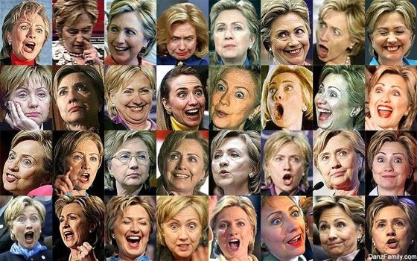
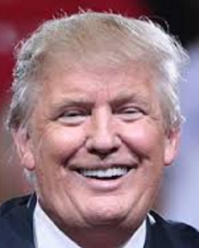
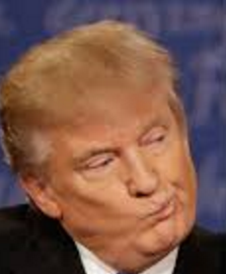
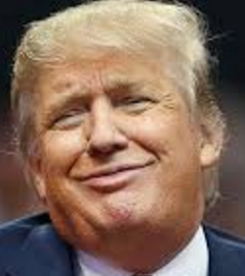
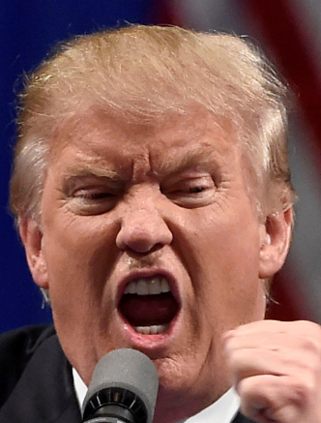
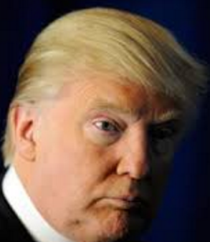
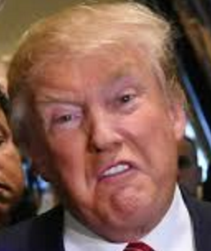
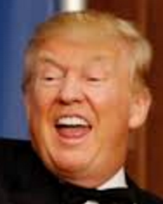
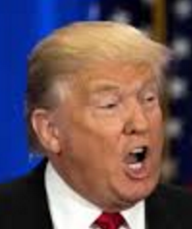
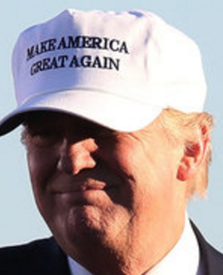
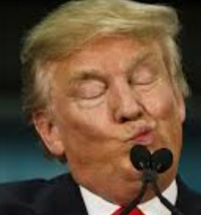
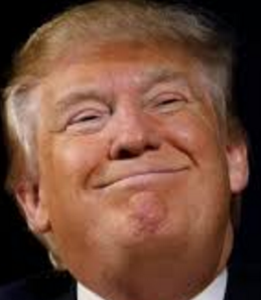
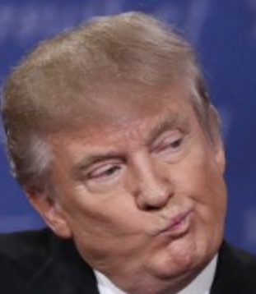
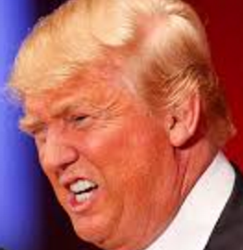
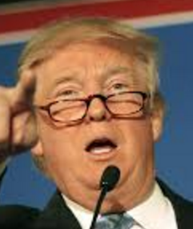
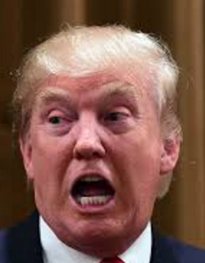
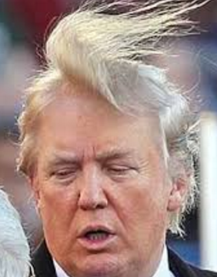
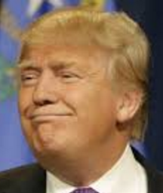
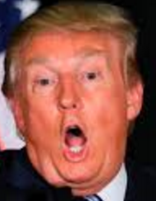
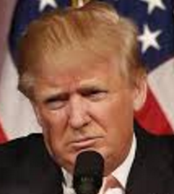
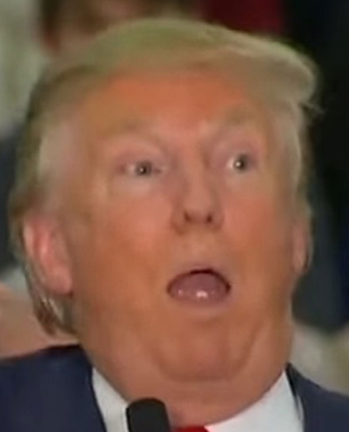
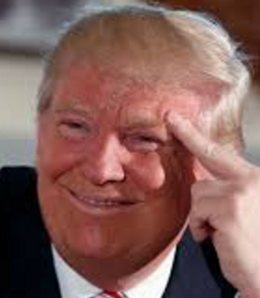
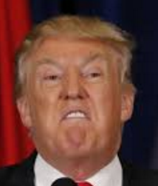
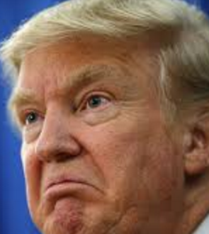
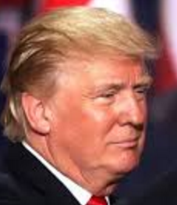
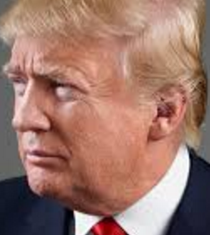
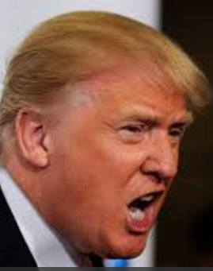
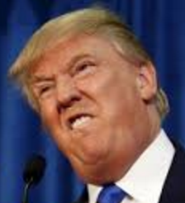
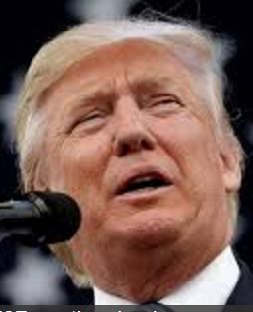
Face Recognition and
Feature Subspaces
Computer Vision
Jia-Bin Huang, Virginia Tech
Many slides from Lana Lazebnik, Silvio Savarese, Fei-Fei Li, and D. Hoiem

Slide 2
Administrative stuffs
Final project
  Proposal due Oct 27 (Thursday)
  Submit via CANVAS
  Send a copy to Jia-Bin and Akrit via email
HW 4
  Due 11:59pm on Wed, November 2nd, 2016

Slide 3
The fifth module
Face recognition
  Feature subspace: PCA and LDA
Image features and categorization
  How to extract visual representation?
Machine learning crash course
  What similarities are important?
Object detection
  Where is the object in the image?
Object tracking
  Where is the object in the next frame?

Slide 4
This class: face recognition
Two methods: “Eigenfaces” and “Fisherfaces”
  Feature subspaces: PCA and FLD
Look at results from recent vendor test
Recent method: DeepFace and FaceNet
Look at interesting findings about human face recognition

Slide 5
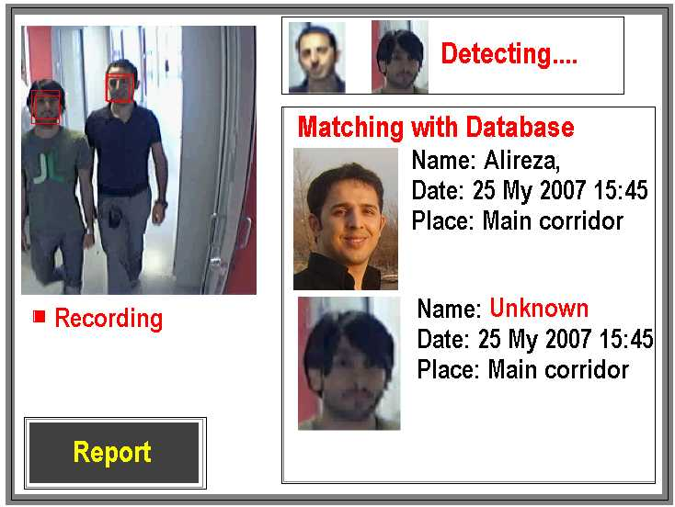
Applications of Face Recognition
Surveillance

Slide 6
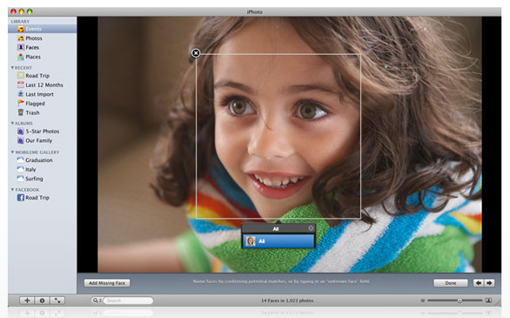
Applications of Face Recognition
Album organization: iPhoto 2009
http://www.apple.com/ilife/iphoto/

Slide 7
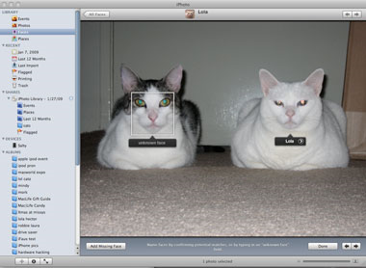
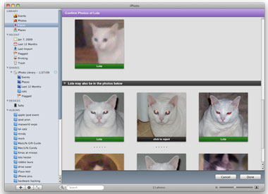
Can be trained to recognize pets!
http://www.maclife.com/article/news/iphotos_faces_recognizes_cats

Slide 8
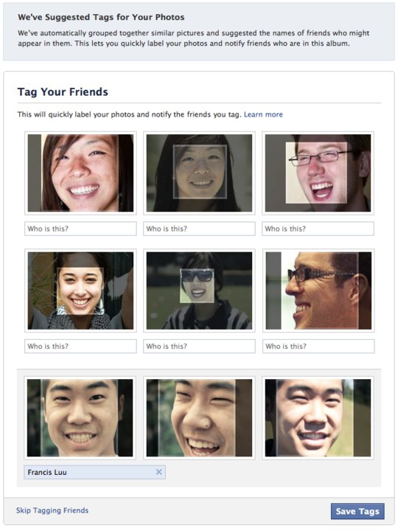
Facebook friend-tagging with auto-suggest

Slide 9
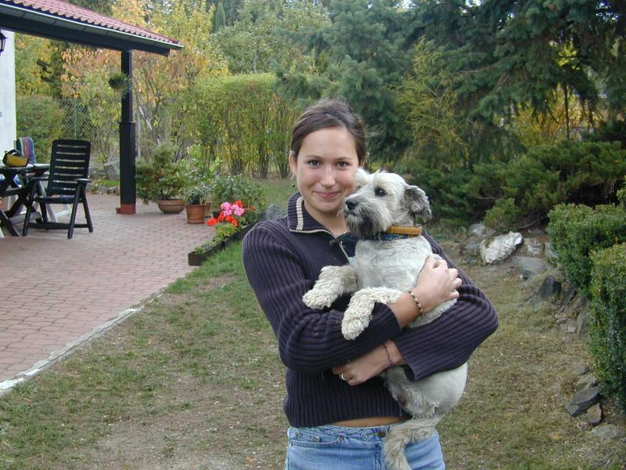

Face recognition: once you’ve detected and cropped a face, try to recognize it
Detection
Recognition
“Sally”

Slide 10
Face recognition: overview
Typical scenario: few examples per face, identify or verify test example
Why it’s hard?
  changes in expression, lighting, age, occlusion, viewpoint
Basic approaches (all nearest neighbor)
  Project into a new subspace (or kernel space) (e.g., “Eigenfaces”=PCA)
  Measure face features
  Make 3d face model, compare shape+appearance, e.g., Active Appearance Model (AAM)

Slide 11
Typical face recognition scenarios
Verification: a person is claiming a particular identity; verify whether that is true
  E.g., security
Closed-world identification: assign a face to one person from among a known set
General identification: assign a face to a known person or to “unknown”

Slide 12
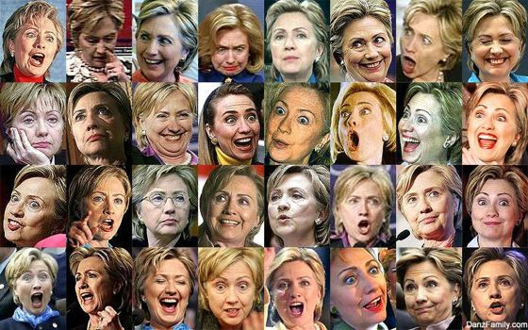
What makes face recognition hard?
Expression

Slide 13




What makes face recognition hard?
Lighting

Slide 14
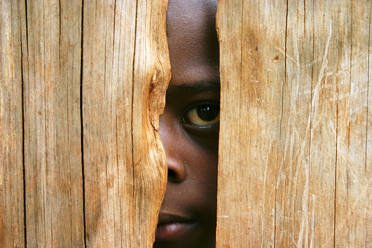
What makes face recognition hard?
Occlusion

Slide 15
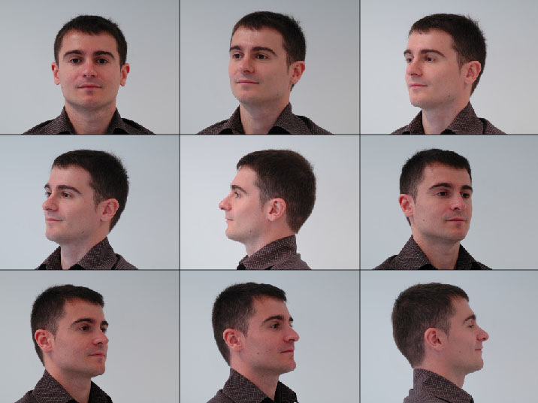
What makes face recognition hard?
Viewpoint

Slide 16
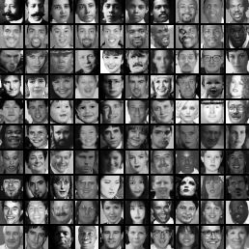
Simple idea for face recognition
Treat face image as a vector of intensities
Recognize face by nearest neighbor in database

Slide 17
The space of all face images
When viewed as vectors of pixel values, face images are extremely high-dimensional
  100x100 image = 10,000 dimensions
  Slow and lots of storage
But very few 10,000-dimensional vectors are valid face images
We want to effectively model the subspace of face images

Slide 18
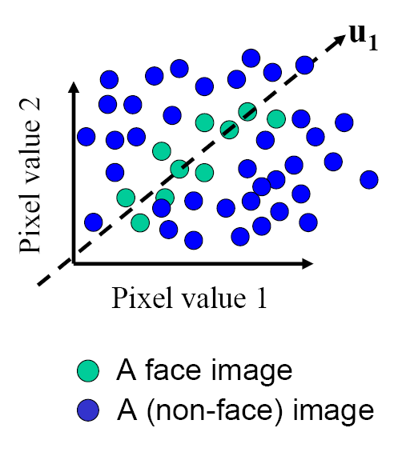
The space of all face images
Eigenface idea: construct a low-dimensional linear subspace that best explains the variation in the set of face images

Slide 19
Principal Component Analysis (PCA)
Given: N data points x₁, … ,x_{N} in R^{d}
We want to find a new set of features that are linear combinations of original ones:
u(x_{i}) = u^{T}(x_{i} – µ)
(µ: mean of data points)
Choose unit vector u in R^{d} that captures the most data variance
Forsyth & Ponce, Sec. 22.3.1, 22.3.2

Slide 20
Principal Component Analysis
Direction that maximizes the variance of the projected data:
N
Maximize
subject to ||u||=1
Projection of data point
N
1/N
Covariance matrix of data
The direction that maximizes the variance is the eigenvector associated with the largest eigenvalue of Σ (can be derived using Raleigh’s quotient or Lagrange multiplier)

Slide 21
Implementation issue
Covariance matrix is huge (M² for M pixels)
But typically # examples << M
Simple trick
  X is MxN matrix of normalized training data
  Solve for eigenvectors u of X^{T}X instead of XX^{T}
  Then Xu is eigenvector of covariance XX^{T}
  Need to normalize each vector of Xu into unit length

Slide 22
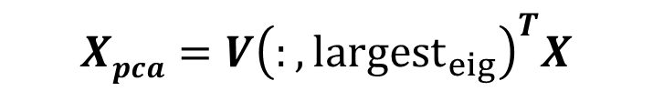

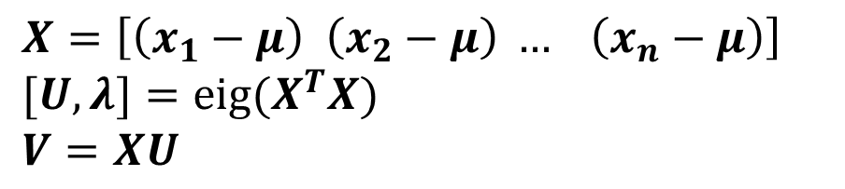
Eigenfaces (PCA on face images)
Compute the principal components (“eigenfaces”) of the covariance matrix
Keep K eigenvectors with largest eigenvalues
Represent all face images in the dataset as linear combinations of eigenfaces
  Perform nearest neighbor on these coefficients
$$X=\left[\left(x_{1}−μ\right) \left(x_{2}−μ\right) … \left(x_{n}−μ\right)\right]$$
$$[U, λ]={eig(X}^{T}X)$$
$$V=XU$$
$$V=V(:, largest_eig)$$
$$Xpca=V{\left(:, {largest}_{eig}\right)}^{T}X$$
M. Turk and A. Pentland, Face Recognition using Eigenfaces, CVPR 1991

Slide 23
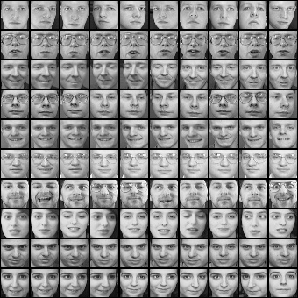
Eigenfaces example
Training images
x₁,…,x_{N}

Slide 24
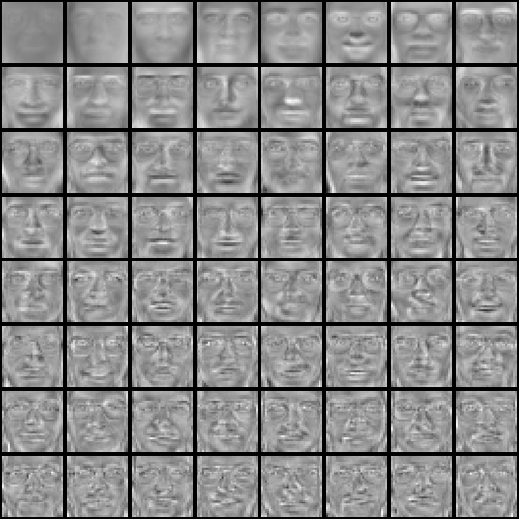
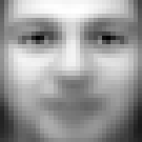
Eigenfaces example
Top eigenvectors: u₁,…u_{k}
Mean: μ

Slide 25
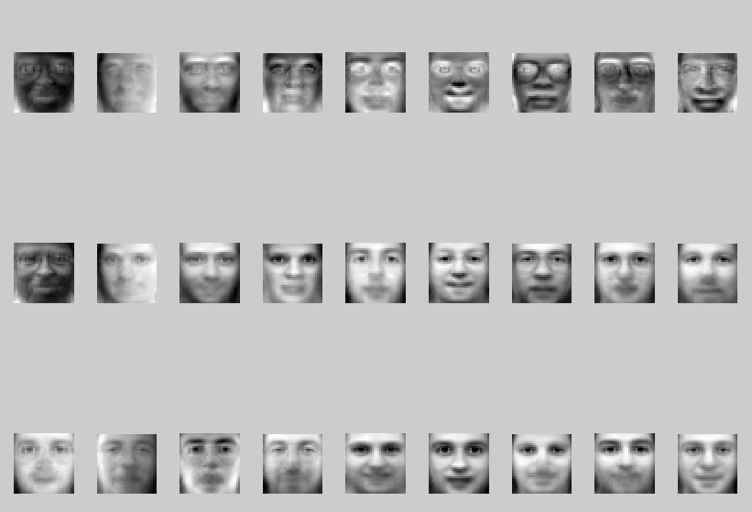
Visualization of eigenfaces
Principal component (eigenvector) u_{k}
μ + 3σ_{k}u_{k}
μ – 3σ_{k}u_{k}

Slide 26

Representation and reconstruction
Face x in “face space” coordinates:
=

Slide 27

Representation and reconstruction
Face x in “face space” coordinates:
Reconstruction:
=
=
+
^
x
=
µ + w₁u₁+w₂u₂+w₃u₃+w₄u₄+ …

Slide 28
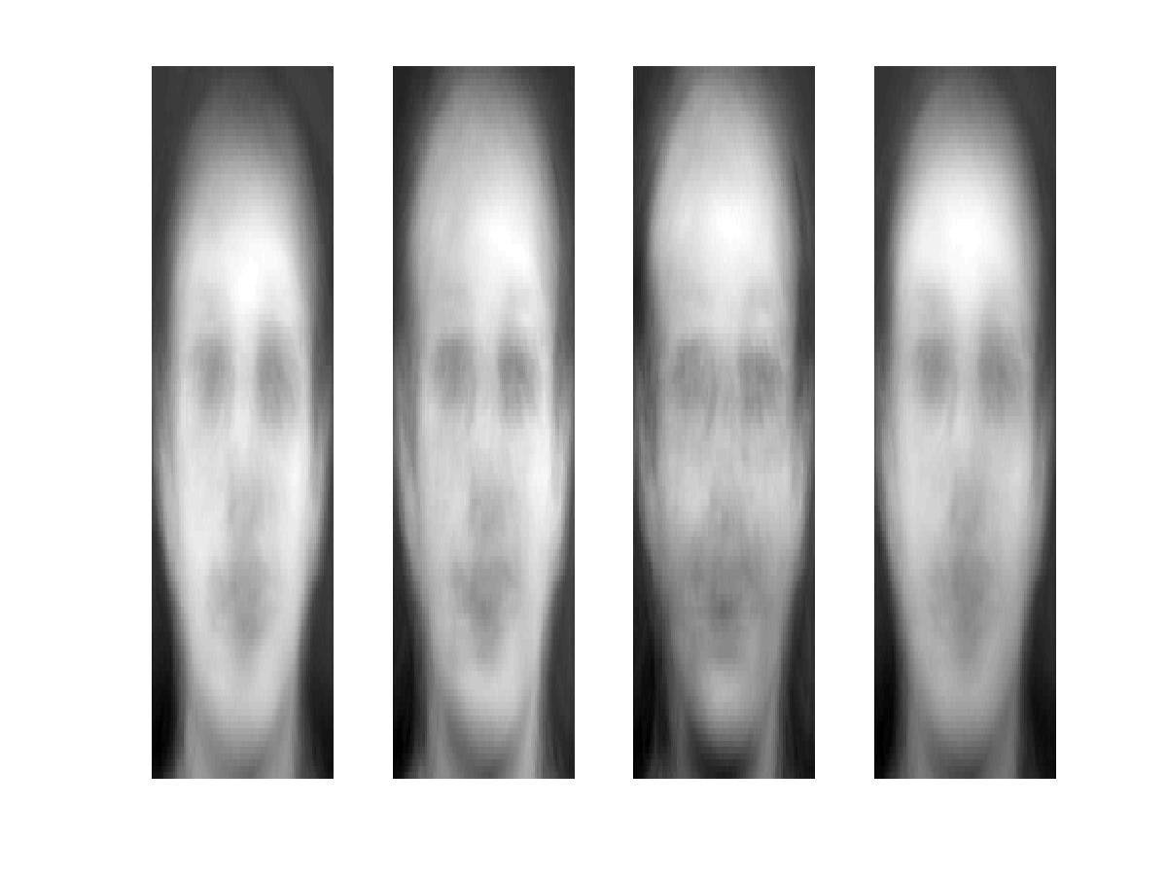
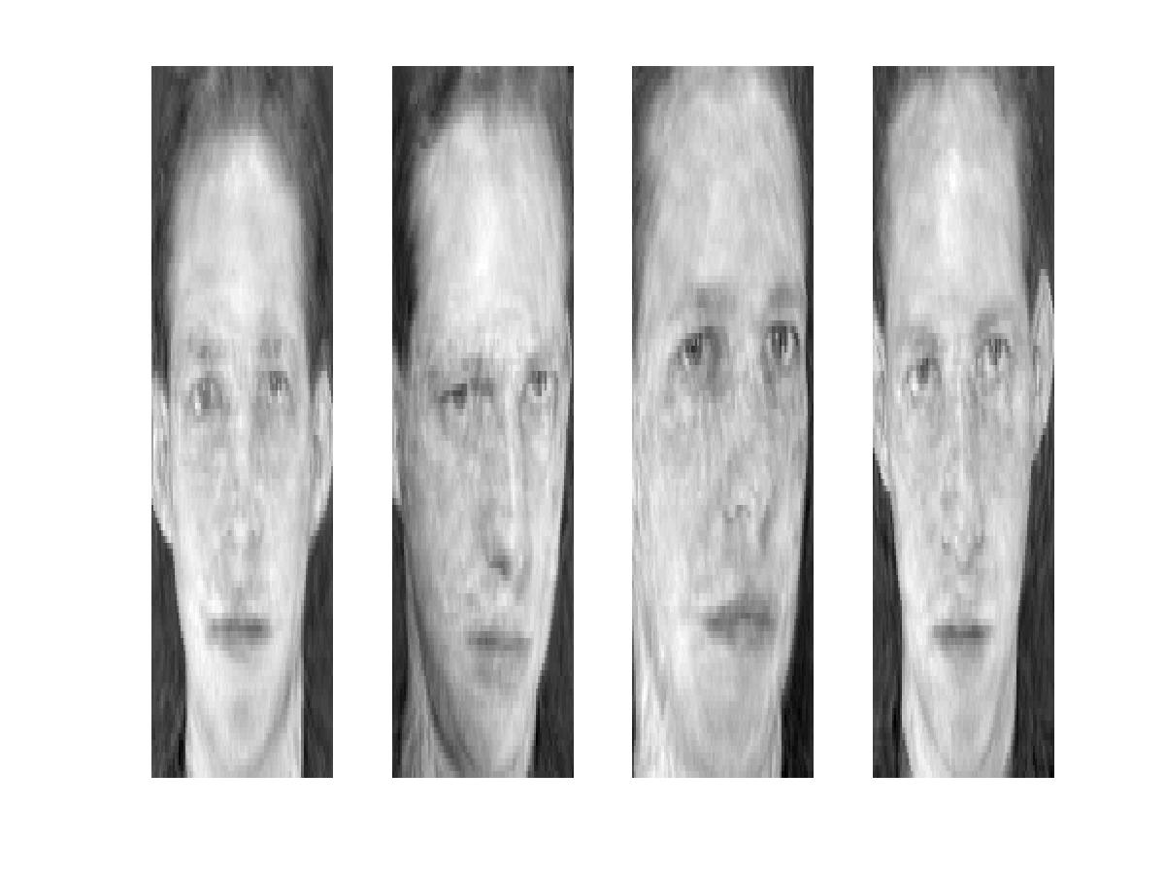
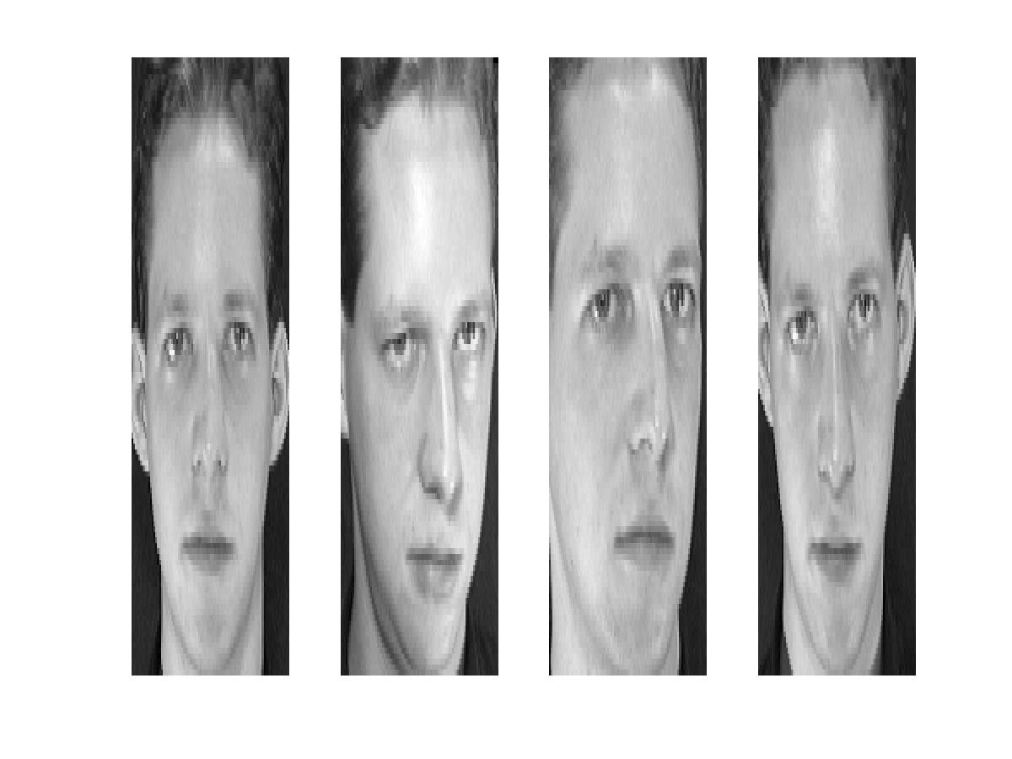
Reconstruction
P = 4
P = 200
P = 400
After computing eigenfaces using 400 face images from ORL face database

Slide 29
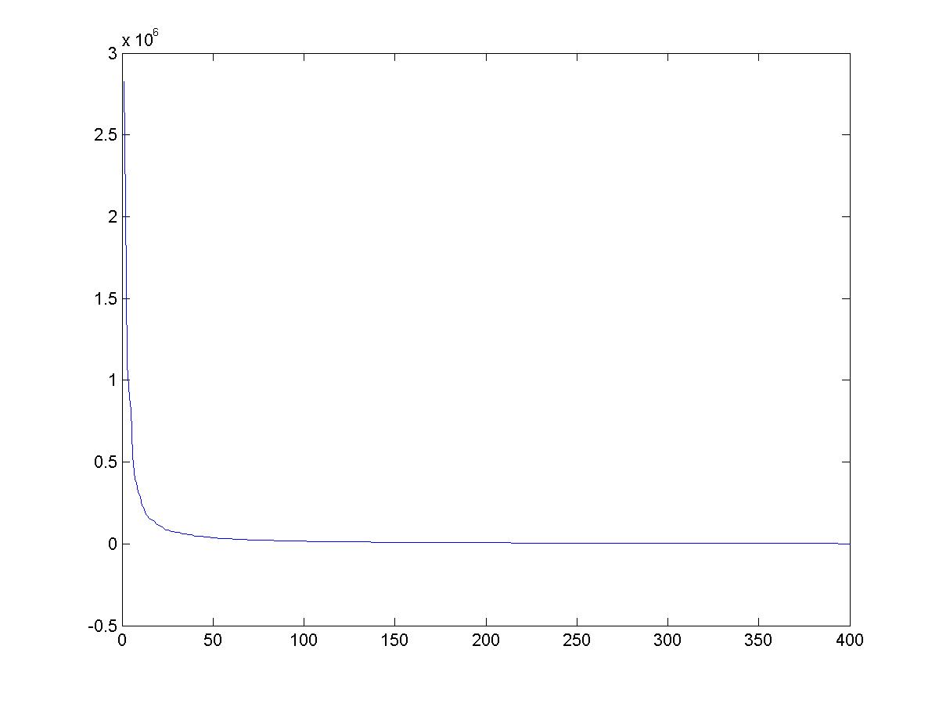
Eigenvalues (variance along eigenvectors)

Slide 30
Note
Preserving variance (minimizing MSE) does not necessarily lead to qualitatively good reconstruction.
P = 200

Slide 31
Recognition with eigenfaces
Process labeled training images (training)
Find mean µ and covariance matrix Σ
Find k principal components (eigenvectors of Σ) u₁,…u_{k}
Project each training image x_{i} onto subspace spanned by principal components:
(w_{i1},…,w_{ik}) = (u₁^{T}(x_{i} – µ), … , u_{k}^{T}(x_{i} – µ))
Given novel image x (testing)
Project onto subspace:
(w₁,…,w_{k}) = (u₁^{T}(x – µ), … , u_{k}^{T}(x – µ))
Optional: check reconstruction error x – x to determine whether image is really a face
Classify as closest training face in k-dimensional subspace
^
M. Turk and A. Pentland, Face Recognition using Eigenfaces, CVPR 1991

Slide 32
PCA
General dimensionality reduction technique
Preserves most of variance with a much more compact representation
  Lower storage requirements (eigenvectors + a few numbers per face)
  Faster matching
What are the problems for face recognition?

Slide 33


Limitations
Global appearance method: not robust to misalignment, background variation

Slide 34
Question
Would PCA on image pixels work well as a general compression technique?
P = 200

Slide 35
Limitations
The direction of maximum variance is not always good for classification

Slide 36
A more discriminative subspace: FLD
Fisher Linear Discriminants → “Fisher Faces”
PCA preserves maximum variance
FLD preserves discrimination
  Find projection that maximizes scatter between classes and minimizes scatter within classes
Reference: Eigenfaces vs. Fisherfaces, Belheumer et al., PAMI 1997

Slide 37
Illustration of the Projection
Using two classes as example:
x2
x2
x1
x1
Poor Projection
Good

Slide 38
Comparing with PCA

Slide 39
Variables
N Sample images:
c classes:
Average of each class:
Average of all data:

Slide 40
Scatter Matrices
Scatter of class i:
Within class scatter:
Between class scatter:

Slide 41
Illustration
x2
Within class scatter
x1
Between class scatter

Slide 42
Mathematical Formulation
After projection
  Between class scatter
  Within class scatter
Objective:
Solution: Generalized Eigenvectors
Rank of W_{opt} is limited
  Rank(S_{B}) <= |C|-1
  Rank(S_{W}) <= N-C

Slide 43
Illustration
x2
x1

Slide 44

Recognition with FLD
Use PCA to reduce dimensions to N-C dim PCA space
Compute within-class and between-class scatter matrices for PCA coefficients
Solve generalized eigenvector problem
Project to FLD subspace (c-1 dimensions)
Classify by nearest neighbor
$$W^{T}opt=W^{T}fldW^{T}pca$$
Note: x in step 2 refers to PCA coef; x in step 4 refers to original data

Slide 45

Results: Eigenface vs. Fisherface
Input: 160 images of 16 people
Train: 159 images
Test: 1 image
Variation in Facial Expression, Eyewear, and Lighting
With glasses
Without glasses
3 Lighting conditions
5 expressions
Reference: Eigenfaces vs. Fisherfaces, Belheumer et al., PAMI 1997

Slide 46

Eigenfaces vs. Fisherfaces
Reference: Eigenfaces vs. Fisherfaces, Belheumer et al., PAMI 1997

Slide 47
1. Identify a Specific Instance
Frontal faces
  Typical scenario: few examples per face, identify or verify test example
  What’s hard: changes in expression, lighting, age, occlusion, viewpoint
  Basic approaches (all nearest neighbor)
    Project into a new subspace (or kernel space) (e.g., “Eigenfaces”=PCA)
    Measure face features
    Make 3d face model, compare shape+appearance (e.g., AAM)

Slide 48

Large scale comparison of methods
FRVT 2006 Report
Not much (or any) information available about methods, but gives idea of what is doable

Slide 49


FVRT Challenge: interesting findings
Left: Major progress since Eigenfaces
Right: Computers outperformed humans in controlled settings (cropped frontal face, known lighting, aligned)
Humans outperform greatly in less controlled settings (viewpoint variation, no crop, no alignment, change in age, etc.)
False Rejection Rate at False Acceptance Rate = 0.001

Slide 50
FVRT Challenge
Frontal faces
  FVRT2006 evaluation: computers win!

Slide 51

FVRT Challenge
Frontal faces
  FVRT2006 evaluation: controlled illumination

Slide 52

FVRT Challenge
Frontal faces
  FVRT2006 evaluation: uncontrolled illumination

Slide 53
State-of-the-art Face Recognizers
Most recent research focuses on “faces in the wild”, recognizing faces in normal photos
  Classification: assign identity to face
  Verification: say whether two people are the same
Important steps
  Detect
  Align
  Represent
  Classify

Slide 54

DeepFace: Closing the Gap to Human-Level Performance in Face Verification
Taigman, Yang, Ranzato, & Wolf (Facebook, Tel Aviv), CVPR 2014
Following slides adapted from Daphne Tsatsoulis

Slide 55








Face Alignment
1. Detect a face and 6 fiducial markers using a support vector regressor (SVR)
2. Iteratively scale, rotate, and translate image until it aligns with a target face
3. Localize 67 fiducial points in the 2D aligned crop
4. Create a generic 3D shape model by taking the average of 3D scans from the USF Human-ID database and manually annotate the 67 anchor points
5.Fit an affine 3D-to-2D camera and use it to direct the warping of the face

Slide 56
Train DNN classifier on aligned faces
Architecture (deep neural network classifier)
Two convolutional layers (with one pooling layer)
3 locally connected and 2 fully connected layers
> 120 million parameters
Train on dataset with 4400 individuals, ~1000 images each
Train to identify face among set of possible people
Verification is done by comparing features at last layer for two faces

Slide 57
DNN Architecture: Training
Social Face Classification (SFC) dataset
  4.4 million labeled faces of 4030 people from Facebook
  Each person has 800-1200 faces
  Testing images are the most recent 5% of a person’s images (using time-stamp)
Train DNN using SFC
  Train it as a multi-class classification problem
  Test using the 5% of held-out data to find optimal parameter settings and network architecture

Slide 58



Face Verification: compare features at last layer of network for two faces
Do two input instances belong to the same class (person)?
Unsupervised Protocol
  Inner product
Restricted Protocol
  Weighted χ² distance
Unrestricted Protocol
  Siamese Network
Notes:
Different errors for different LFW benchmarks
Siamese re-trains jointly two replicas of the network for metric learning

Slide 59
Experiments: Datasets
LFW Dataset
  13,323 webphotos of 5749 celebrities divided into 6000 face pairs in 10 splits
  Performance based on mean recognition accuracy using
    A) Restricted Protocol: Only same and not-same labels are used in training
    B) Unrestricted Protocol: Given some identity information so many more training pairs can be added to the training set
    C) Unsupervised Protocol: No training whatsoever is performed on LFW images
YTF Dataset
  3425 YouTube videos of 1595 people, 5000 video pairs and 10 splits

Slide 60


Results: Labeled Faces in the Wild Dataset
Performs similarly to humans!
(note: humans would do better with uncropped faces)
Experiments show that alignment is crucial (0.97 vs 0.88) and that deep features help (0.97 vs. 0.91)

Slide 61



OpenFace (FaceNet)
FaceNet: A Unified Embedding for Face Recognition and Clustering, CVPR 2015 http://cmusatyalab.github.io/openface/

Slide 62

MegaFace Benchmark
The MegaFace Benchmark: 1 Million Faces for Recognition at Scale, CVPR 2016

Slide 63
Face recognition by humans
Face recognition by humans: 20 results (2005)
Slides by Jianchao Yang

Slide 64


Slide 65


Slide 66


Slide 67


Slide 68


Slide 69




Slide 70



Slide 71


Slide 72

Result 17: Vision progresses from piecemeal to holistic

Slide 73


Slide 74
Things to remember
PCA is a generally useful dimensionality reduction technique
  But not ideal for discrimination
FLD better for discrimination, though only ideal under Gaussian data assumptions
Computer face recognition works very well under controlled environments (since 2006)
Also starting to perform at human level in uncontrolled settings (recent progress: better alignment, features, more data)

Slide 75

Next class
Image categorization

