Slide 1
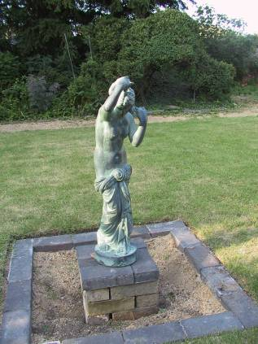
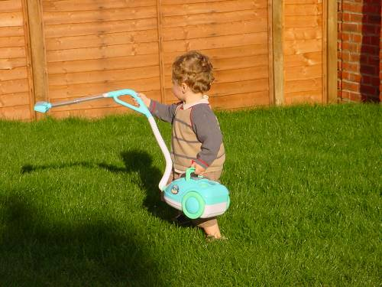
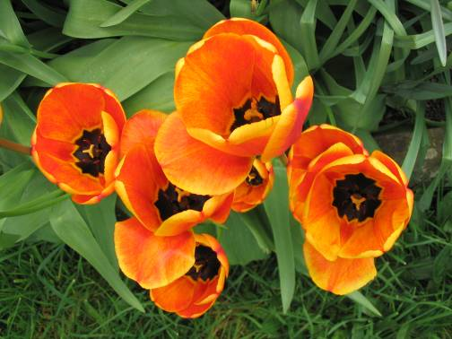
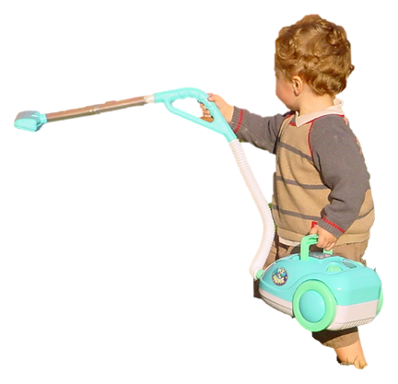
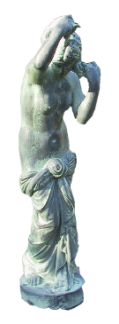

Markov Random Fields and
Segmentation with Graph Cuts
Computer Vision
Jia-Bin Huang, Virginia Tech
Many slides from D. Hoiem

Slide 2
Administrative stuffs
Final project
  Proposal due Oct 27 (Thursday)
HW 4 is out
  Due 11:59pm on Wed, November 2nd, 2016

Slide 3
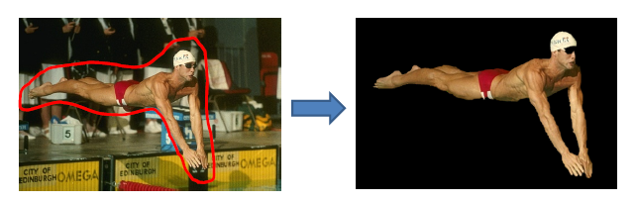
Today’s class
Review EM and GMM
Markov Random Fields
Segmentation with Graph Cuts
HW 4
i
w_{ij}
j

Slide 4
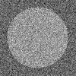
Missing Data Problems: Segmentation
Challenge: Segment the image into figure and ground without knowing what the foreground looks like in advance.
Three sub-problems:
If we had labels, how could we model the appearance of foreground and background? MLE: maximum likelihood estimation
Once we have modeled the fg/bg appearance, how do we compute the likelihood that a pixel is foreground? Probabilistic inference
How can we get both labels and appearance models at once?
Hidden data problem: Expectation Maximization
Background
Foreground

Slide 5
EM: Mixture of Gaussians
Initialize parameters
Compute likelihood of hidden variables for current parameters
Estimate new parameters for each component, weighted by likelihood
Given by normal distribution

Slide 6
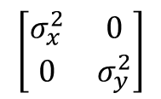


Gaussian Mixture Models: Practical Tips
Number of components
  Select by hand based on knowledge of problem
  Select using cross-validation or sample data
  Usually, not too sensitive and safer to use more components
Covariance matrix
  Spherical covariance: dimensions within each component are independent with equal variance (1 parameter but usually too restrictive)
  Diagonal covariance: dimensions within each component are not independent with difference variances (N parameters for N-D data)
  Full covariance: no assumptions (N*(N+1)/2 parameters); for high N might be expensive to do EM, to evaluate, and may overfit
  Typically use “Full” if lots of data, few dimensions; Use “Diagonal” otherwise
Can get stuck in local minima
  Use multiple restarts
  Choose solution with greatest data likelihood
$$\left[\begin{matrix}σ^{2} & 0 \\ 0 & σ^{2}\end{matrix}\right]$$
Spherical
$$\left[\begin{matrix}σ_{x}^{2} & 0 \\ 0 & σ_{y}^{2}\end{matrix}\right]$$
$$\left[\begin{matrix}a & c \\ c & b\end{matrix}\right]$$
Spherical
Diagonal
Full

Slide 7
“Hard EM”
Same as EM except compute z* as most likely values for hidden variables
K-means is an example
Advantages
  Simpler: can be applied when cannot derive EM
  Sometimes works better if you want to make hard predictions at the end
But
  Generally, pdf parameters are not as accurate as EM

Slide 8
EM Demo
GMM with images demos

Slide 9
function EM_segmentation(im, K)
x = im(:);
N = numel(x);
minsigma = std(x)/numel(x); % prevent component from getting 0 variance
% Initialize GMM parameters
prior = zeros(K, 1);
mu = zeros(K, 1);
sigma = zeros(K, 1);
prior(:) = 1/K;
minx = min(x);
maxx = max(x);
for k = 1:K
mu(k) = (0.1+0.8*rand(1))*(maxx-minx) + minx;
sigma(k) = (1/K)*std(x);
end
% Initialize P(component_i | x_i) (initial values not important)
pm = ones(N, K);
oldpm = zeros(N, K);

Slide 10
maxiter = 200;
niter = 0;
% EM algorithm: loop until convergence
while (mean(abs(pm(:)-oldpm(:)))>0.001) && (niter < maxiter)
niter = niter+1;
oldpm = pm;
% estimate probability that each data point belongs to each component
for k = 1:K
pm(:, k) = prior(k)*normpdf(x, mu(k), sigma(k));
end
pm = pm ./ repmat(sum(pm, 2), [1 K]);
% compute maximum likelihood parameters for expected components
for k = 1:K
prior(k) = sum(pm(:, k))/N;
mu(k) = sum(pm(:, k).*x) / sum(pm(:, k));
sigma(k) = sqrt( sum(pm(:, k).*(x - mu(k)).^2) / sum(pm(:, k)));
sigma(k) = max(sigma(k), minsigma); % prevent variance from going to 0
end
end

Slide 11
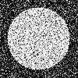
What’s wrong with this prediction?
P(foreground | image)

Slide 12
Solution:
Encode dependencies between pixels
P(foreground | image)
Normalizing constant called “partition function”
Labels to be predicted
Individual predictions
Pairwise predictions

Slide 13
Writing Likelihood as an “Energy”
-log
Cost of assignment y_{i}
Cost of pairwise assignment y_{i ,}y_{j}

Slide 14
Notes on energy-based formulation
Primarily used when you only care about the most likely solution (not the confidences)
Can think of it as a general cost function
Can have larger “cliques” than 2
  Clique is the set of variables that go into a potential function

Slide 15
Markov Random Fields
Node y_{i}: pixel label
Edge: constrained pairs
Cost to assign a label to each pixel
Cost to assign a pair of labels to connected pixels

Slide 16
Markov Random Fields
Unary potential
Example: “label smoothing” grid
0: -logP(y_{i} = 0 | data)
1: -logP(y_{i} = 1 | data)
Pairwise Potential
0 1
0 0 K
1 K 0
K>0

Slide 17
Solving MRFs with graph cuts
Source (Label 0)
Cost to assign to 1
Cost to split nodes
Cost to assign to 0
Sink (Label 1)

Slide 18
Solving MRFs with graph cuts
Source (Label 0)
Cost to assign to 1
Cost to split nodes
Cost to assign to 0
Sink (Label 1)

Slide 19
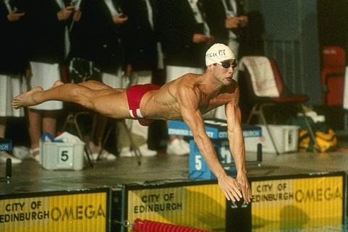
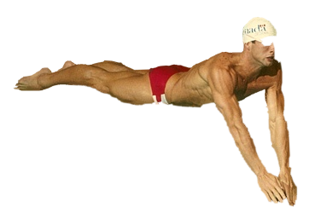
GrabCut segmentation
User provides rough indication of foreground region.
Goal: Automatically provide a pixel-level segmentation.

Slide 20
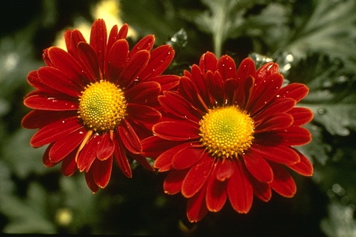
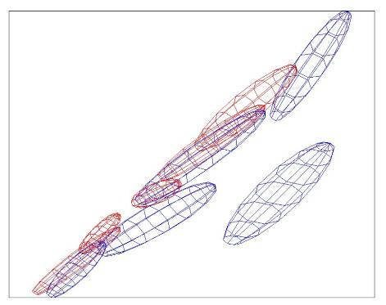
Colour Model
R
Foreground &
Background
Background
G
Gaussian Mixture Model (typically 5-8 components)
Source: Rother
Notes:
Color enbergy.
Iterations have the effect of pulling them away;
D is – log likelyhood of the GMM.

Slide 21

Graph cuts
Boykov and Jolly (2001)
Foreground (source)
Image
Min Cut
Background
(sink)
Cut: separating source and sink; Energy: collection of edges
Min Cut: Global minimal energy in polynomial time
Source: Rother
Notes:
Optimization engine we use Graph Cuts. By now everybody should know what graph cut is. IN case you missed it here is a very brief introduction.
To image. 3D view. First task to construct a graph.
All pixels on a certain scanline. Just a few of them.
Next step introduce artificial nodes. fgd and background.
Edges – contrast. Boundary is quite likely between black and white.
Min Cut - Minimum edge strength.

Slide 22

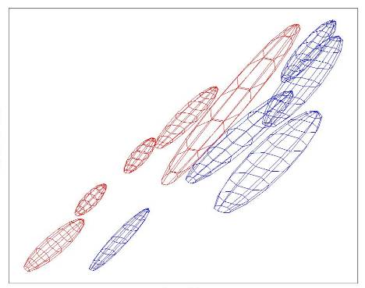
Colour Model
R
R
Foreground &
Background
Iterated graph cut
Foreground
Background
G
Background
G
Gaussian Mixture Model (typically 5-8 components)
Source: Rother
Notes:
Color energy.
Iterations have the effect of pulling them away;
D is – log likelihood of the GMM.

Slide 23
GrabCut segmentation
Define graph
  usually 4-connected or 8-connected
    Divide diagonal potentials by sqrt(2)
Define unary potentials
  Color histogram or mixture of Gaussians for background and foreground
Define pairwise potentials
Apply graph cuts
Return to 2, using current labels to compute foreground, background models

Slide 24
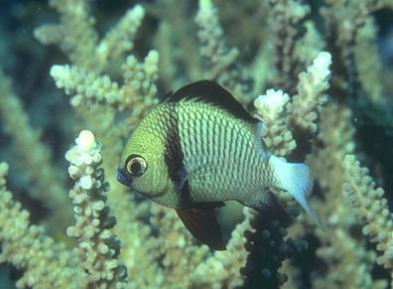
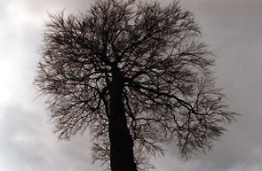
What is easy or hard about these cases for graphcut-based segmentation?

Slide 25

Easier examples
GrabCut – Interactive Foreground Extraction 10
Notes:
Moderately straightforward examples- after the user input automnatically

Slide 26
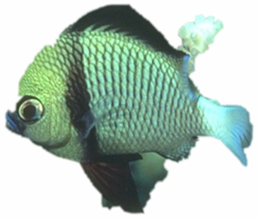

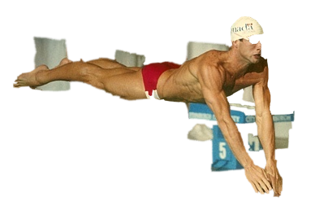
More difficult Examples
Camouflage &
Low Contrast
Fine structure
Harder Case
Initial Rectangle
Initial
Result
GrabCut – Interactive Foreground Extraction 11
Notes:
You might wonder when does it fail. 4 cases. Low contrats – an edge not good visible

Slide 27
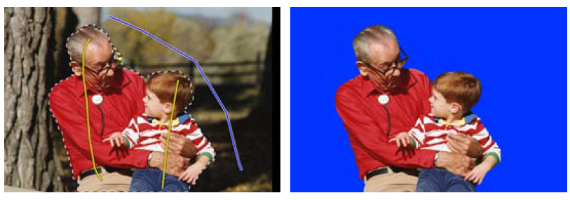
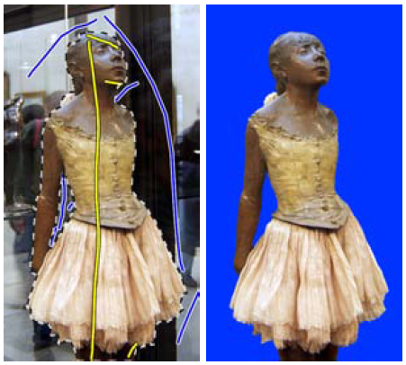
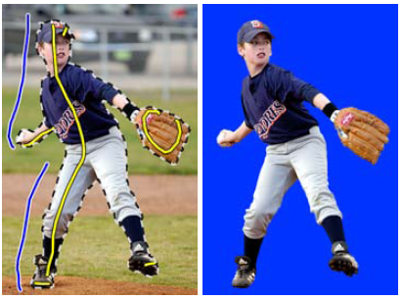
Lazy Snapping (Li et al. SG 2004)

Slide 28
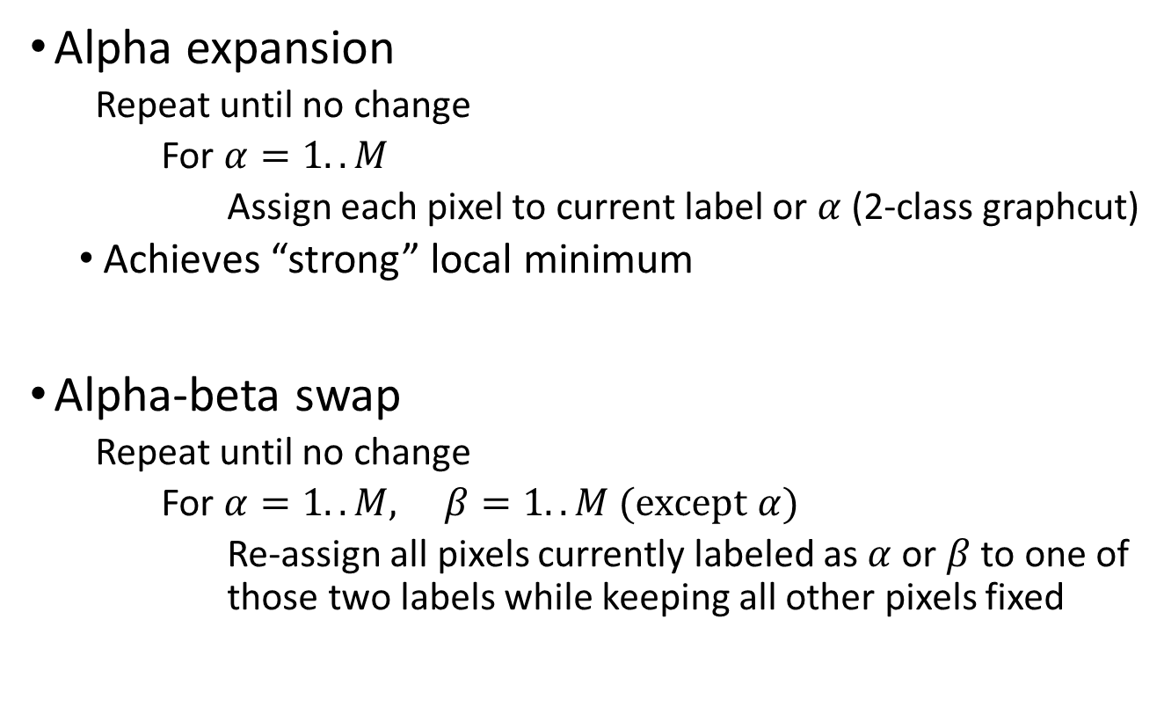
Graph cuts with multiple labels
Alpha expansion
  Repeat until no change
    For $α=1..M$
      Assign each pixel to current label or $α$ (2-class graphcut)
  Achieves “strong” local minimum
Alpha-beta swap
  Repeat until no change
    For $α=1..M, β=1..M (except α)$
      Re-assign all pixels currently labeled as $α$or $β$ to one of those two labels while keeping all other pixels fixed

Slide 29
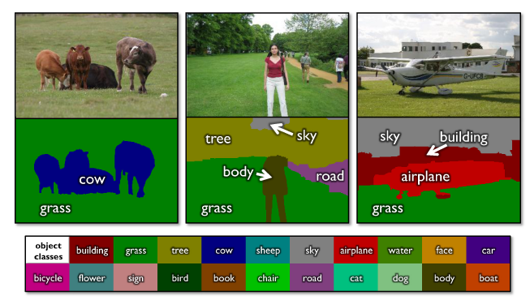
Using graph cuts for recognition
TextonBoost (Shotton et al. 2009 IJCV)

Slide 30
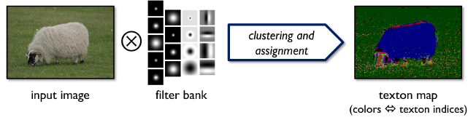
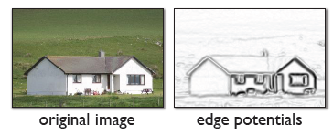
Using graph cuts for recognition
Unary Potentials
from classifier
(note: edge potentials are from input image also; this is illustration from paper)
Alpha Expansion Graph Cuts
TextonBoost (Shotton et al. 2009 IJCV)

Slide 31
Limitations of graph cuts
Associative: edge potentials penalize different labels
If not associative, can sometimes clip potentials
Graph cut algorithm applies to only 2-label problems
  Multi-label extensions are not globally optimal (but still usually provide very good solutions)
Must satisfy

Slide 32
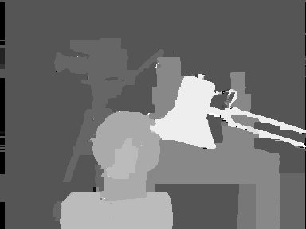
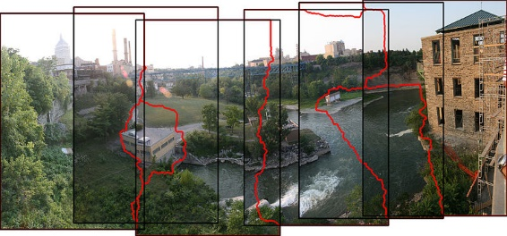
Graph cuts: Pros and Cons
Pros
  Very fast inference
  Can incorporate data likelihoods and priors
  Applies to a wide range of problems
Cons
  Not always applicable (associative only)
  Need unary terms (not used for bottom-up segmentation, for example)
Use whenever applicable
(stereo, image labeling, recognition)
stereo
stitching
recognition

Slide 33
More about MRFs/CRFs
Other common uses
  Graph structure on regions
  Encoding relations between multiple scene elements
Inference methods
  Loopy BP or BP-TRW
    Exact for tree-shaped structures
    Approximate solutions for general graphs
    More widely applicable and can produce marginals but often slower

Slide 34
Further reading and resources
Graph cuts
  http://www.cs.cornell.edu/~rdz/graphcuts.html
  Classic paper: What Energy Functions can be Minimized via Graph Cuts? (Kolmogorov and Zabih, ECCV '02/PAMI '04)
Belief propagation
  Yedidia, J.S.; Freeman, W.T.; Weiss, Y., "Understanding Belief Propagation and Its Generalizations”, Technical Report, 2001: http://www.merl.com/publications/TR2001-022/
Comparative study
  Szeliski et al. A comparative study of energy minimization methods for markov random fields with smoothness-based priors, PAMI 2008
  Kappes et al. A comparative study of modern inference techniques for discrete energy minimization problems, CVPR 2013

Slide 35
HW 4 Part 1: SLIC (Achanta et al. PAMI 2012)
http://infoscience.epfl.ch/record/177415/files/Superpixel_PAMI2011-2.pdf
Initialize cluster centers on pixel grid in steps S
  - Features: Lab color, x-y position
Move centers to position in 3x3 window with smallest gradient
Compare each pixel to cluster center within 2S pixel distance and assign to nearest
Recompute cluster centers as mean color/position of pixels belonging to each cluster
Stop when residual error is small

Slide 36
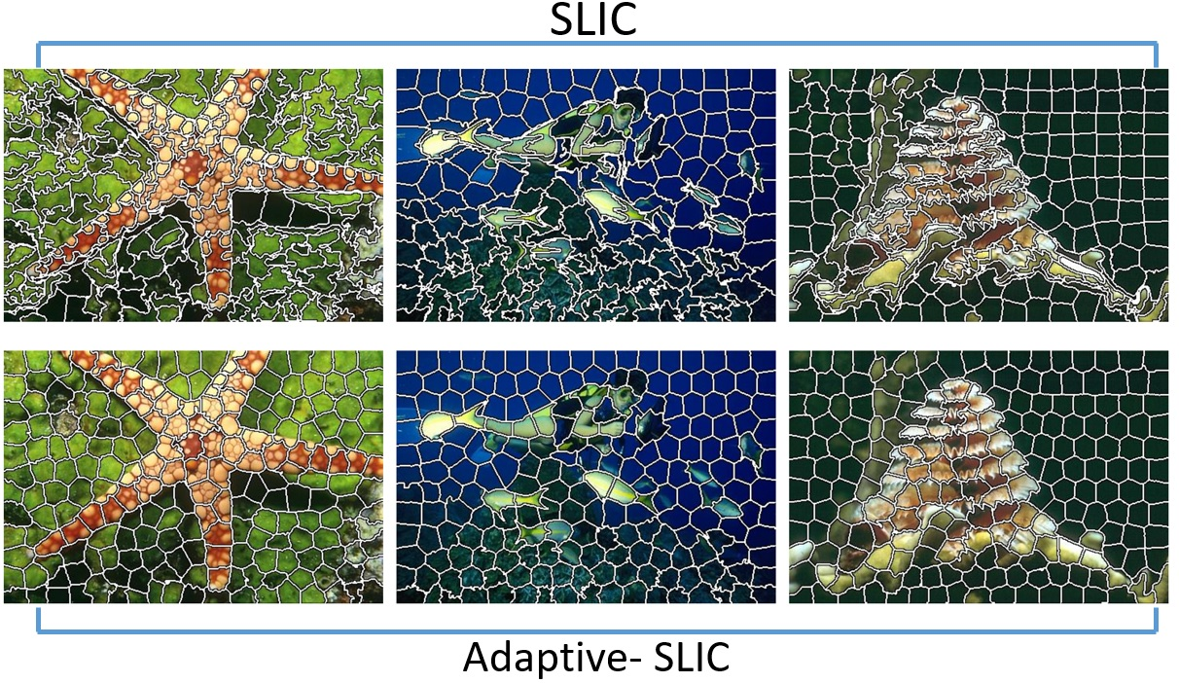
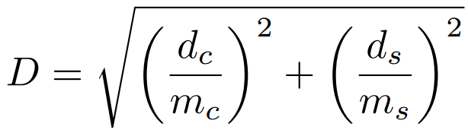
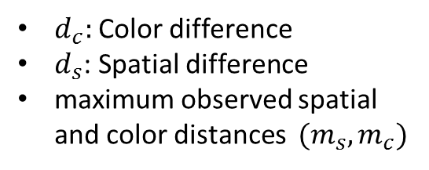
HW 4 Part 1: SLIC – Graduate credits
(up to 15 points) Improve your results on SLIC
  Color space, gradient features, edges
(up to 15 points) Implement Adaptive-SLIC
$d_{c}:$Color difference
$d_{s}$: Spatial difference
maximum observed spatial and color distances $(m_{s}, m_{c})$

Slide 37
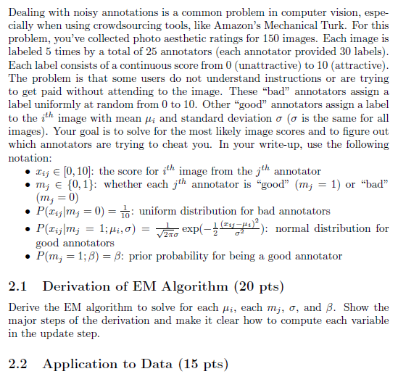
HW 4 Part 2: EM algorithm
The false scores come from a uniform distribution
The true scores for each image have a Gaussian distribution
Annotators are always “bad” or always “good”
The “good/bad” label of each annotator is the missing data

Slide 38
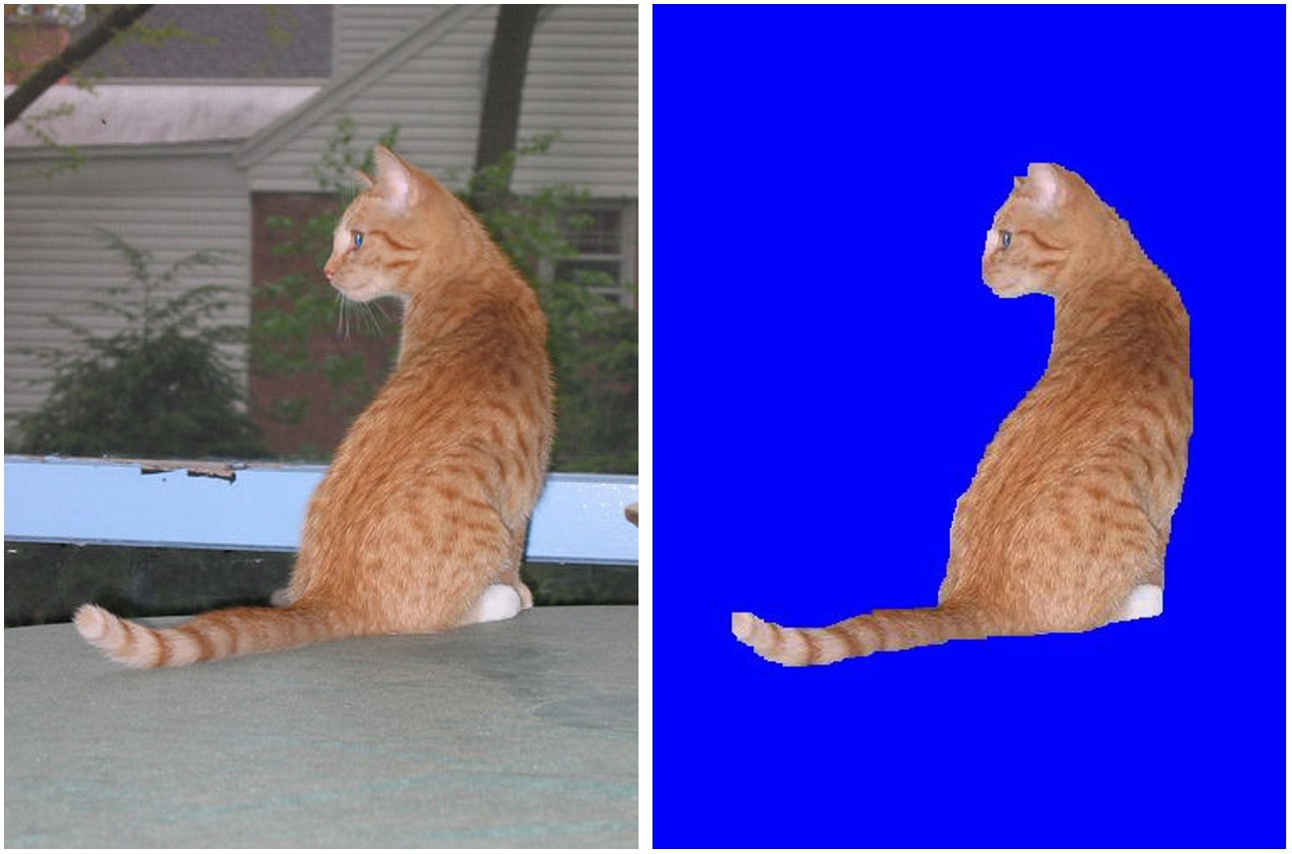
HW 4 Part 3: GraphCut
Define unary potential
Define pairwise potential
  Contrastive term
Solve segementation using graph-cut
  Read GraphCut.m

Slide 39
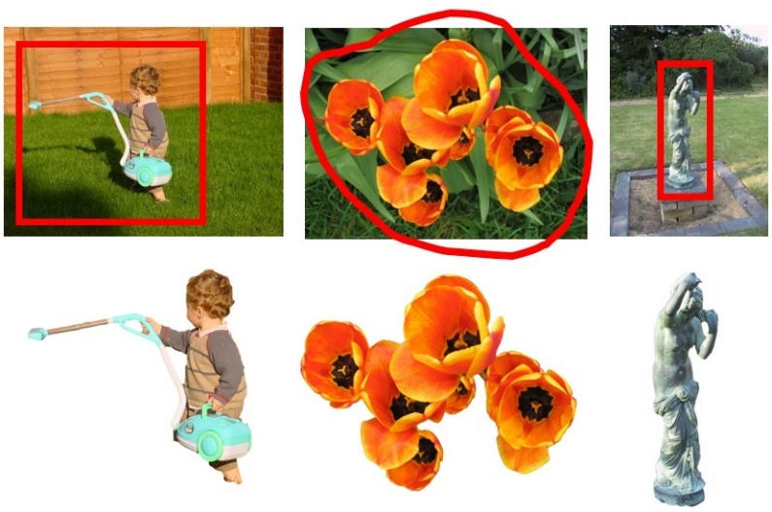
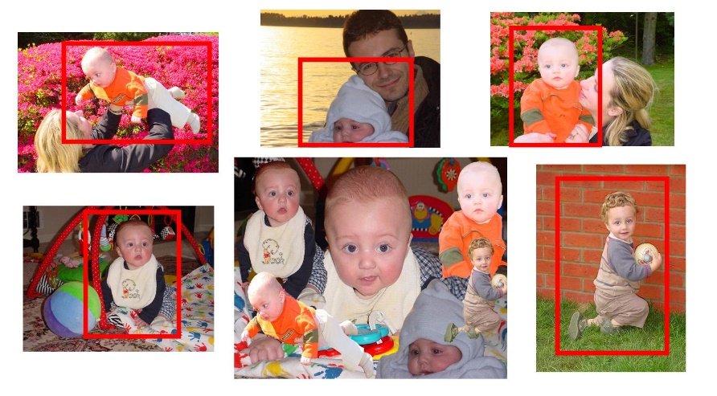
HW 4 Part 3: GraphCut –
Graduate credits
(up to 15 points) try two more images
(up to 10 points) image composition

Slide 40
Things to remember
Markov Random Fields
  Encode dependencies between pixels
Likelihood as energy
Segmentation with Graph Cuts
i
w_{ij}
j

Slide 41
Next module: Object Recognition
Face recognition
Image categorization
Machine learning
Object category detection
Tracking objects

