Slide 1
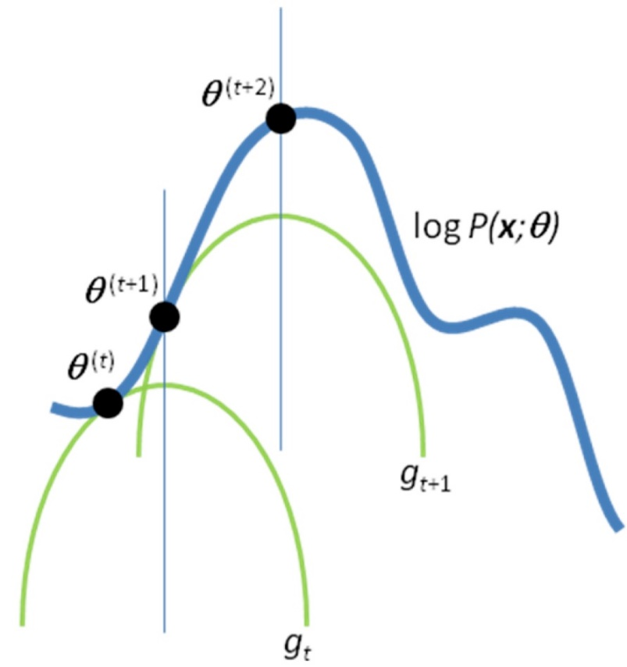
Hidden Variables, the EM Algorithm, and Mixtures of Gaussians
Computer Vision
Jia-Bin Huang, Virginia Tech
Many slides from D. Hoiem

Slide 2
Administrative stuffs
Final project
  proposal due Oct 27 (Thursday)
Tips for final project
  Set up several milestones
  Think about how you are going to evaluate
  Demo is highly encouraged
HW 4 out tomorrow

Slide 3
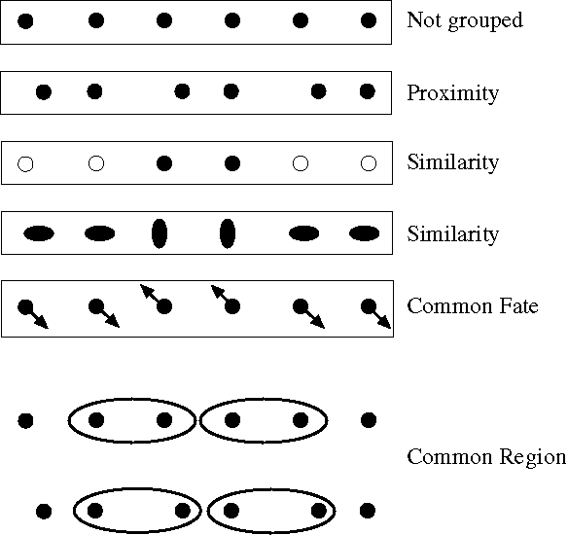
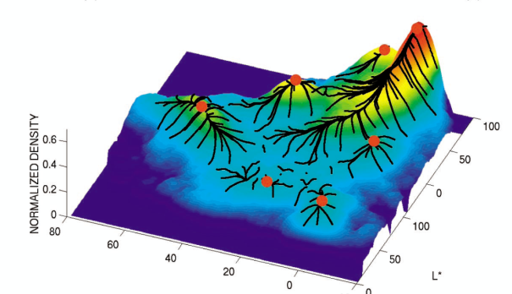
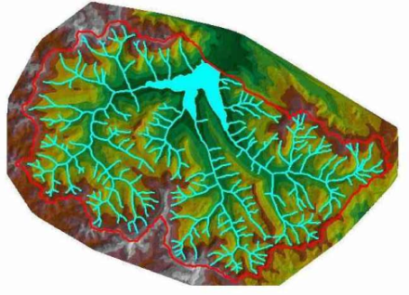
Review: Image Segmentation
Gestalt cues and principles of organization
Uses of segmentation
  Efficiency
  Provide feature supports
  Propose object regions
  Want the segmented object
Mean-shift segmentation
  Good general-purpose segmentation method
  Generally useful clustering, tracking technique
Watershed segmentation
  Good for hierarchical segmentation
  Use in combination with boundary prediction

Slide 4
HW 4: SLIC (Achanta et al. PAMI 2012)
http://infoscience.epfl.ch/record/177415/files/Superpixel_PAMI2011-2.pdf
Initialize cluster centers on pixel grid in steps S
  - Features: Lab color, x-y position
Move centers to position in 3x3 window with smallest gradient
Compare each pixel to cluster center within 2S pixel distance and assign to nearest
Recompute cluster centers as mean color/position of pixels belonging to each cluster
Stop when residual error is small
+ Fast 0.36s for 320x240
+ Regular superpixels
+ Superpixels fit boundaries
- May miss thin objects
- Large number of superpixels

Slide 5
Today’s Class
Examples of Missing Data Problems
  Detecting outliers (HW 4, problem 2)
  Latent topic models
  Segmentation (HW 4, problem 3)
Background
  Maximum Likelihood Estimation
  Probabilistic Inference
Dealing with “Hidden” Variables
  EM algorithm, Mixture of Gaussians
  Hard EM

Slide 6

Missing Data Problems: Outliers
You want to train an algorithm to predict whether a photograph is attractive. You collect annotations from Mechanical Turk. Some annotators try to give accurate ratings, but others answer randomly.
Challenge: Determine which people to trust and the average rating by accurate annotators.
Annotator Ratings
10
8
9
2
8
Photo: Jam343 (Flickr)

Slide 7
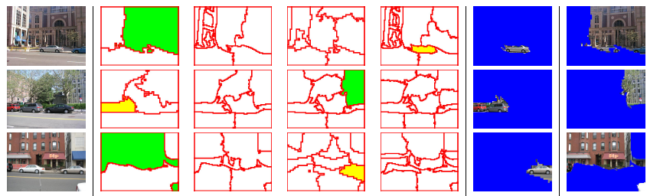
Missing Data Problems: Object Discovery
You have a collection of images and have extracted regions from them. Each is represented by a histogram of “visual words”.
Challenge: Discover frequently occurring object categories, without pre-trained appearance models.
http://www.robots.ox.ac.uk/~vgg/publications/papers/russell06.pdf

Slide 8
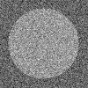
Missing Data Problems: Segmentation
You are given an image and want to assign foreground/background pixels.
Challenge: Segment the image into figure and ground without knowing what the foreground looks like in advance.
Foreground
Background

Slide 9
Missing Data Problems: Segmentation
Challenge: Segment the image into figure and ground without knowing what the foreground looks like in advance.
Three steps:
If we had labels, how could we model the appearance of foreground and background?
  Maximum Likelihood Estimation
Once we have modeled the fg/bg appearance, how do we compute the likelihood that a pixel is foreground?
  Probabilistic Inference
How can we get both labels and appearance models at once?
  Expectation-Maximization (EM) Algorithm

Slide 10
Maximum Likelihood Estimation
If we had labels, how could we model the appearance of foreground and background?
Background
Foreground

Slide 11
Maximum Likelihood Estimation
data
parameters

Slide 12
Maximum Likelihood Estimation
Gaussian Distribution
Notes:
Assume data is i.i.d., take log, and solve using partial derivatives.

Slide 13
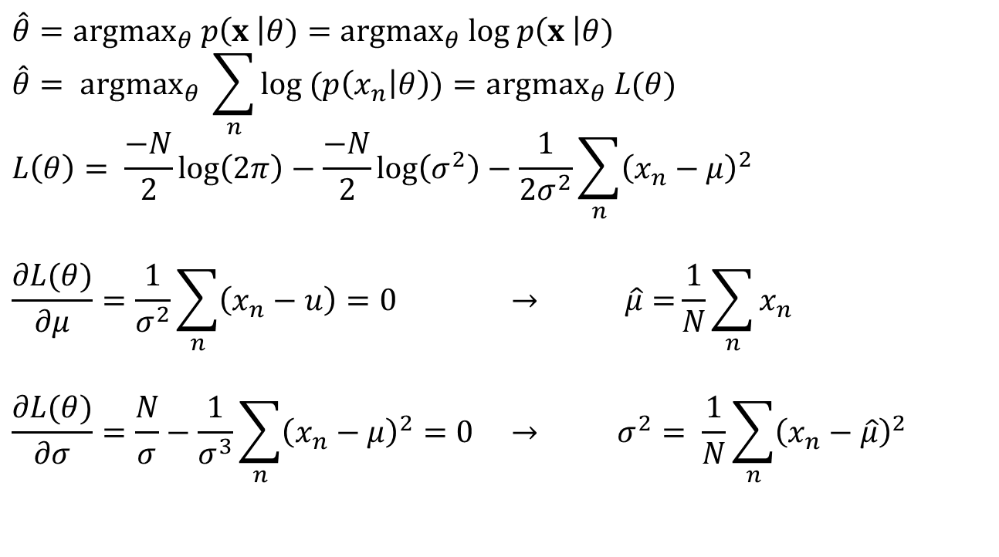
Maximum Likelihood Estimation
Gaussian Distribution
Log-Likelihood
$$\hat{θ}={argmax}_{θ} p\left(x \right|θ)={argmax}_{θ} log p\left(x \right|θ)$$
$$\hat{θ}= {argmax}_{θ} \sum_{n}{log (p\left(x_{n} | θ\right))}={argmax}_{θ} L(θ)$$
$$L\left(θ\right)= \frac{−N}{2}log\left(2π\right)−\frac{−N}{2}log\left(σ^{2}\right)−\frac{1}{2σ^{2}}\sum_{n}{{\left(x_{n}−μ\right)}^{2}}$$
$$\frac{∂L(θ)}{∂μ}=\frac{1}{σ^{2}}\sum_{n}{\left(x_{n}−u\right)=0 → \hat{μ}=}\frac{1}{N}\sum_{n}{x_{n}}$$
$$\frac{∂L(θ)}{∂σ}=\frac{N}{σ}−\frac{1}{σ^{3}}\sum_{n}{{\left(x_{n}−μ\right)}^{2}=0} → σ^{2}= \frac{1}{N}\sum_{n}{{\left(x_{n}−\hat{μ}\right)}^{2} }$$

Slide 14
Maximum Likelihood Estimation
Gaussian Distribution

Slide 15
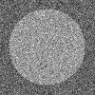

Example: MLE
Parameters used to Generate
fg: mu=0.6, sigma=0.1
bg: mu=0.4, sigma=0.1
im
labels
>> mu_fg = mean(im(labels))
mu_fg = 0.6012
>> sigma_fg = sqrt(mean((im(labels)-mu_fg).^2))
sigma_fg = 0.1007
>> mu_bg = mean(im(~labels))
mu_bg = 0.4007
>> sigma_bg = sqrt(mean((im(~labels)-mu_bg).^2))
sigma_bg = 0.1007
>> pfg = mean(labels(:));

Slide 16
Probabilistic Inference
2. Once we have modeled the fg/bg appearance, how do we compute the likelihood that a pixel is foreground?
Background
Foreground

Slide 17
Probabilistic Inference
Compute the likelihood that a particular model generated a sample
component or label

Slide 18

Probabilistic Inference
Compute the likelihood that a particular model generated a sample
component or label
Conditional probability
$$P\left(A | B\right)= \frac{P(A,B)}{P(B)}$$

Slide 19
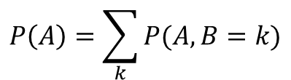
Probabilistic Inference
Compute the likelihood that a particular model generated a sample
component or label
Marginalization
$$P\left(A\right)=\sum_{k}{P(A, B=k)}$$

Slide 20

Probabilistic Inference
Compute the likelihood that a particular model generated a sample
component or label
Joint distribution
$$P\left(A,B\right)=P\left(B\right)P(A|B)$$

Slide 21
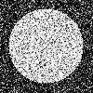
Example: Inference
Learned Parameters
fg: mu=0.6, sigma=0.1
bg: mu=0.4, sigma=0.1
im
>> pfg = 0.5;
>> px_fg = normpdf(im, mu_fg, sigma_fg);
>> px_bg = normpdf(im, mu_bg, sigma_bg);
>> pfg_x = px_fg*pfg ./ (px_fg*pfg + px_bg*(1-pfg));
p(fg | im)

Slide 22
Dealing with Hidden Variables
3. How can we get both labels and appearance parameters at once?
Background
Foreground

Slide 23
Mixture of Gaussians
mixture component
component model parameters
component prior

Slide 24
Mixture of Gaussians
With enough components, can represent any probability density function
  Widely used as general purpose pdf estimator

Slide 25
Segmentation with Mixture of Gaussians
Pixels come from one of several Gaussian
components
  We don’t know which pixels come from which components
  We don’t know the parameters for the components
Problem:
Estimate the parameters of the
Gaussian Mixture Model.
What would you do?

Slide 26
Simple solution
Initialize parameters
Compute the probability of each hidden variable given the current parameters
Compute new parameters for each model, weighted by likelihood of hidden variables
Repeat 2-3 until convergence

Slide 27
Mixture of Gaussians: Simple Solution
Initialize parameters
Compute likelihood of hidden variables for current parameters
Estimate new parameters for each model, weighted by likelihood

Slide 28
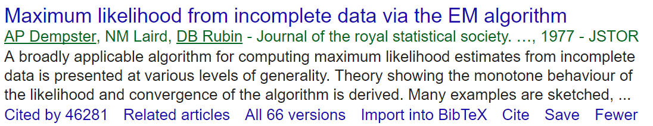
Expectation Maximization (EM) Algorithm
Goal:
Log of sums is intractable
Jensen’s Inequality
for concave functions f(x)
(so we maximize the lower bound!)
See here for proof: www.stanford.edu/class/cs229/notes/cs229-notes8.ps

Slide 29
Expectation Maximization (EM) Algorithm
Goal:
E-step: compute
M-step: solve
Notes:
The expectation is a lower bound on the marginal probability of x

Slide 30
Expectation Maximization (EM) Algorithm
log of expectation of P(x|z)
Goal:
E-step: compute
M-step: solve
expectation of log of P(x|z)
Notes:
The expectation is a lower bound on the marginal probability of x

Slide 31
EM for Mixture of Gaussians - derivation
E-step:
M-step:

Slide 32
EM for Mixture of Gaussians
E-step:
M-step:

Slide 33




EM algorithm - derivation
http://lasa.epfl.ch/teaching/lectures/ML_Phd/Notes/GP-GMM.pdf

Slide 34
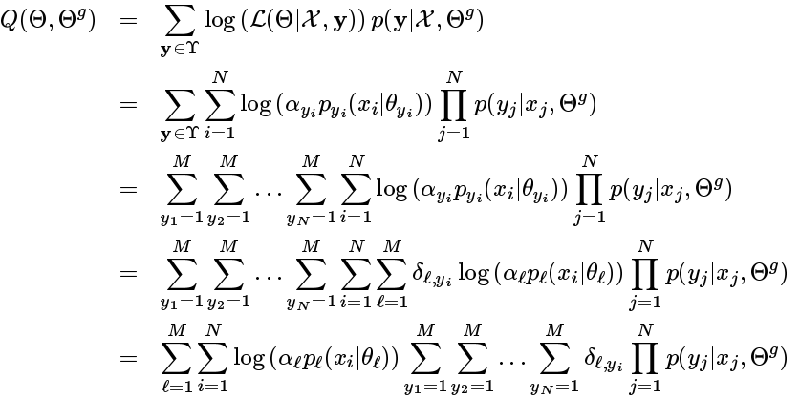

EM algorithm – E-Step

Slide 35
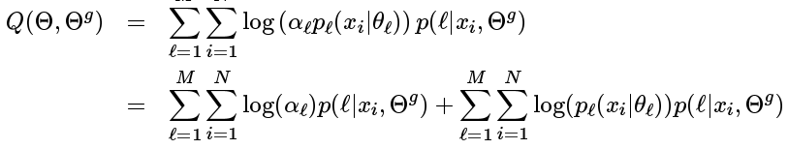
EM algorithm – E-Step

Slide 36



EM algorithm – M-Step

Slide 37
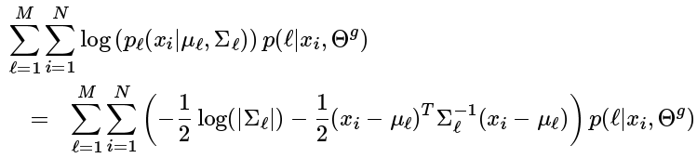



EM algorithm – M-Step
Take derivative with respect to $μ_{l}$

Slide 38


EM algorithm – M-Step
Take derivative with respect to $\sum_{l}^{−1}{}$

Slide 39
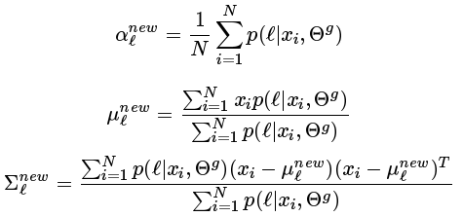
EM Algorithm for GMM

Slide 40
EM Algorithm
Maximizes a lower bound on the data likelihood at each iteration
Each step increases the data likelihood
  Converges to local maximum
Common tricks to derivation
  Find terms that sum or integrate to 1
  Lagrange multiplier to deal with constraints

Slide 41

Convergence of EM Algorithm

Slide 42
EM Demos
Mixture of Gaussian demo
Simple segmentation demo

Slide 43
“Hard EM”
Same as EM except compute z* as most likely values for hidden variables
K-means is an example
Advantages
  Simpler: can be applied when cannot derive EM
  Sometimes works better if you want to make hard predictions at the end
But
  Generally, pdf parameters are not as accurate as EM

Slide 44
Missing Data Problems: Outliers
You want to train an algorithm to predict whether a photograph is attractive. You collect annotations from Mechanical Turk. Some annotators try to give accurate ratings, but others answer randomly.
Challenge: Determine which people to trust and the average rating by accurate annotators.
Annotator Ratings
10
8
9
2
8
Photo: Jam343 (Flickr)

Slide 45
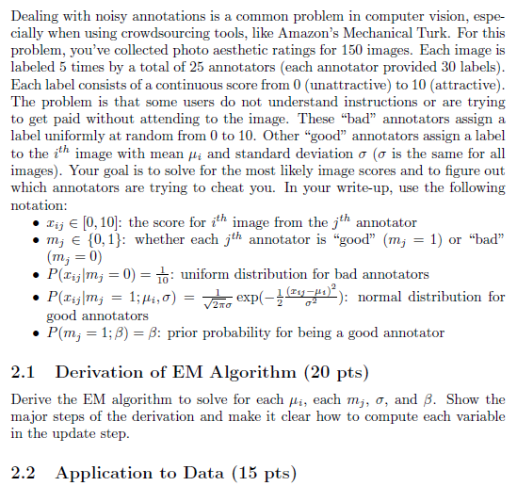
HW 4, problem 2
The false scores come from a uniform distribution
The true scores for each image have a Gaussian distribution
Annotators are always “bad” or always “good”
The “good/bad” label of each annotator is the missing data

Slide 46
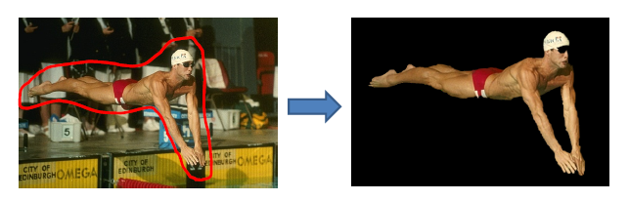
Next class
MRFs and Graph-cut Segmentation
Think about your final projects (if not done already)

