Slide 1
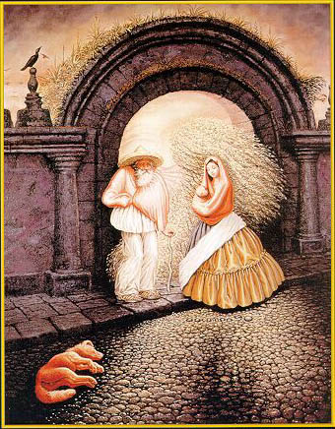
Image Segmentation
Computer Vision
Jia-Bin Huang, Virginia Tech
Many slides from D. Hoiem

Slide 2
Administrative stuffs
HW 3 due 11:59 PM, Oct 17 (Monday)
Final project proposal due Oct 27 (Thursday)
Will hold office hour this Friday

Slide 3
Today’s class
Review/finish Structure from motion
  Multi-view stereo
Segmentation and grouping
  Gestalt cues
  By clustering (k-means, mean-shift)
  By boundaries (watershed)
  By graph (merging , graph cuts)
  By labeling (MRF) <- Next Thursday
Superpixels and multiple segmentations

Slide 4
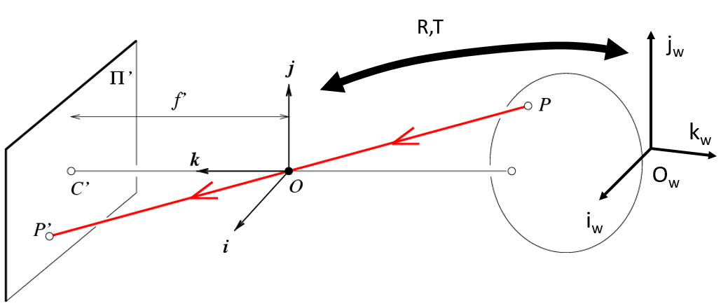
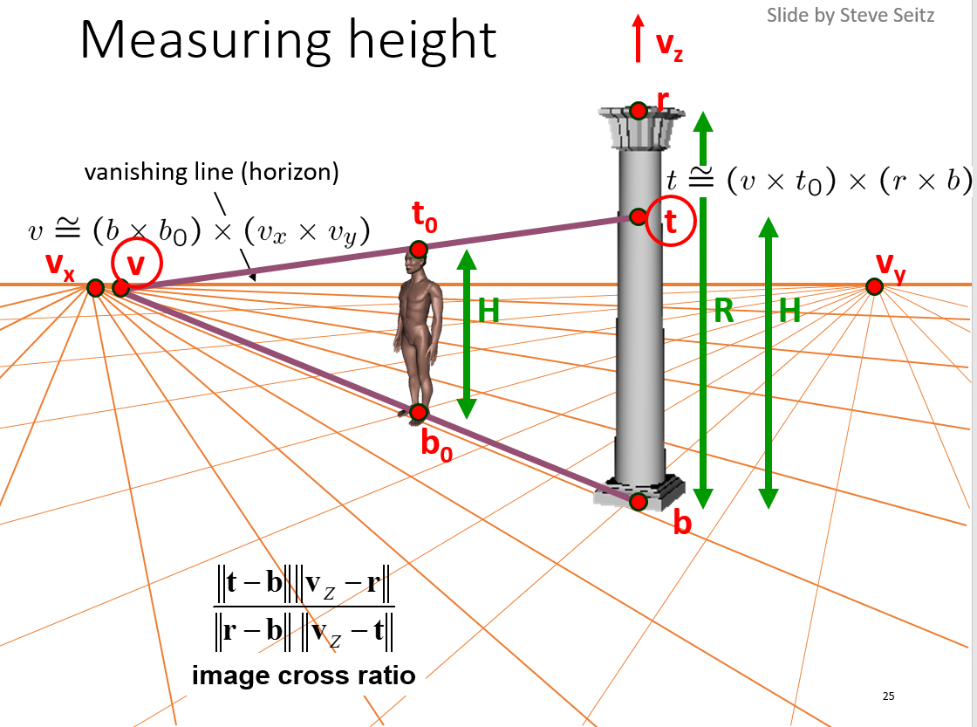







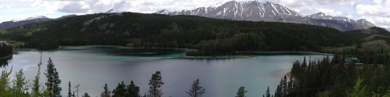
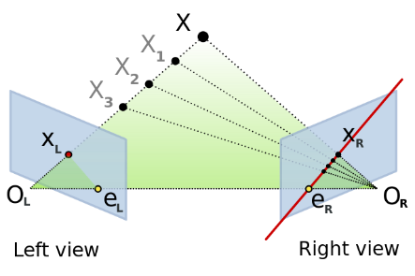
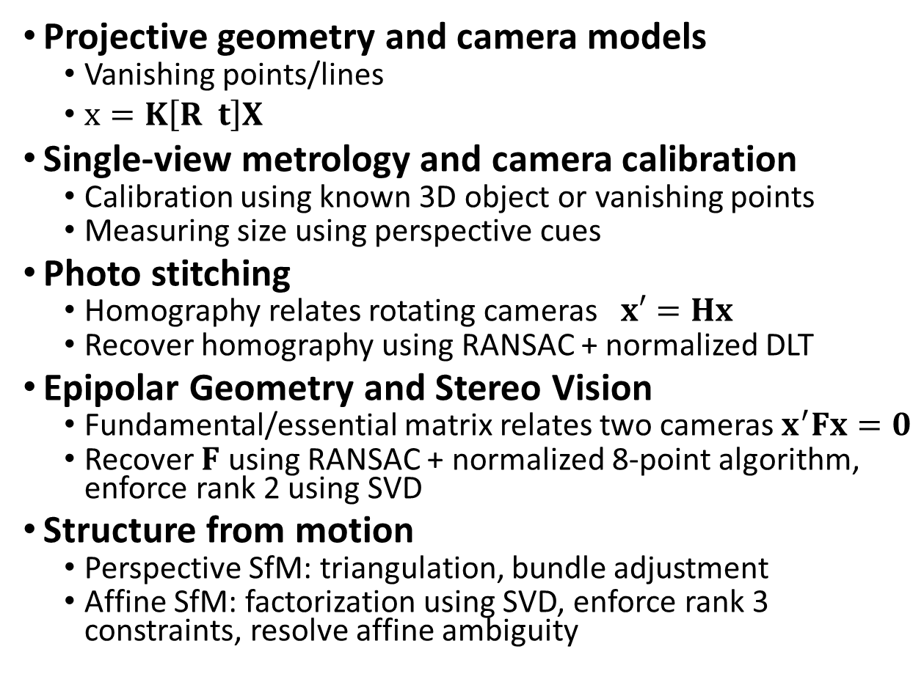
Perspective and 3D Geometry
Projective geometry and camera models
  Vanishing points/lines
  $x=K\left[R t\right]X$
Single-view metrology and camera calibration
  Calibration using known 3D object or vanishing points
  Measuring size using perspective cues
Photo stitching
  Homography relates rotating cameras $x′=Hx$
  Recover homography using RANSAC + normalized DLT
Epipolar Geometry and Stereo Vision
  Fundamental/essential matrix relates two cameras $x^{′}Fx=0$
  Recover $F$ using RANSAC + normalized 8-point algorithm, enforce rank 2 using SVD
Structure from motion
  Perspective SfM: triangulation, bundle adjustment
  Affine SfM: factorization using SVD, enforce rank 3 constraints, resolve affine ambiguity
X_{j}
x_{1j}
x_{3j}
P₁
x_{2j}
P₂
P₃

Slide 5
Review: Projective structure from motion
Given: m images of n fixed 3D points
x_{ij} = P_{i} X_{j} , i = 1,… , m, j = 1, … , n
Problem: estimate m projection matrices P_{i} and n 3D points X_{j} from the mn corresponding 2D points x_{ij}
X_{j}
x_{1j}
x_{3j}
x_{2j}
P₁
P₃
P₂
Slides: Lana Lazebnik

Slide 6
Review: Affine structure from motion
Given: m images and n tracked features x_{ij}
For each image i, center the feature coordinates
Construct a 2m × n measurement matrix D:
  Column j contains the projection of point j in all views
  Row i contains one coordinate of the projections of all the n points in image i
Factorize D:
  Compute SVD: D = U W V^{T}
  Create U₃ by taking the first 3 columns of U
  Create V₃ by taking the first 3 columns of V
  Create W₃ by taking the upper left 3 × 3 block of W
Create the motion (affine) and shape (3D) matrices:
  A = U₃W₃^{½} and S = W₃^{½} V₃^{T}
Eliminate affine ambiguity
  Solve L = CC^{T} using metric constraints
  Solve C using Cholesky decomposition
  Update A and X: A = AC, S = C⁻¹S
Source: M. Hebert

Slide 7
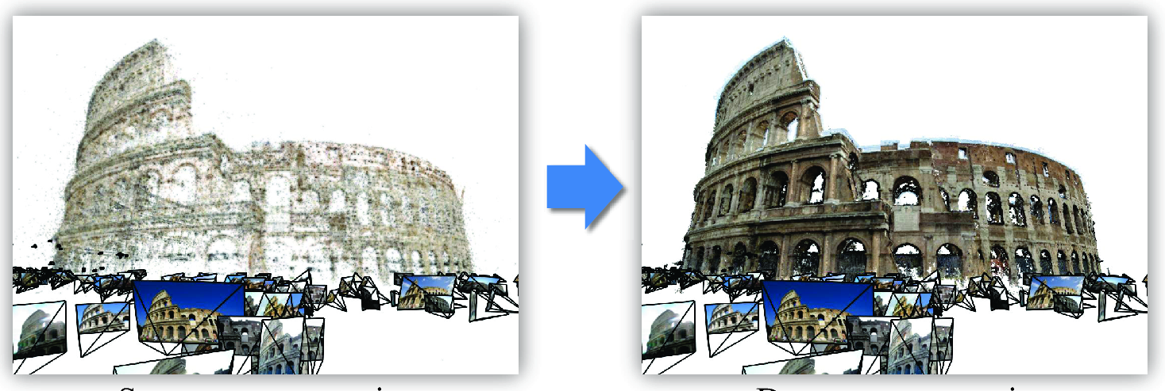
Multi-view stereo

Slide 8
Multi-view stereo
Generic problem formulation: given several images of the same object or scene, compute a representation of its 3D shape
“Images of the same object or scene”
  Arbitrary number of images (from two to thousands)
  Arbitrary camera positions (special rig, camera network
  or video sequence)
  Calibration may be known or unknown
“Representation of 3D shape”
  Depth maps
  Meshes
  Point clouds
  Patch clouds
  Volumetric models
  ….

Slide 9
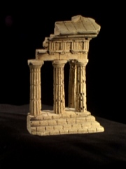
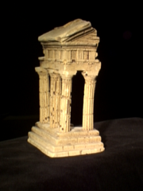
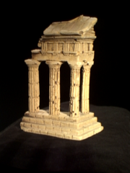
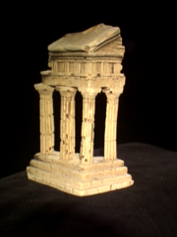
Multi-view stereo: Basic idea
Source: Y. Furukawa

Slide 10
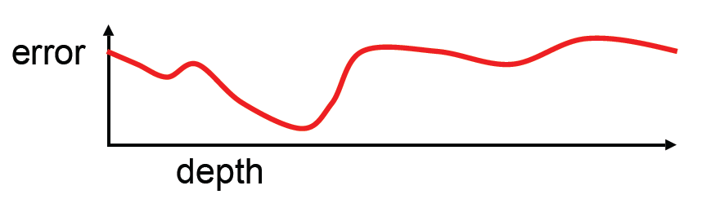
Multi-view stereo: Basic idea
Source: Y. Furukawa

Slide 11
Multi-view stereo: Basic idea
Source: Y. Furukawa

Slide 12
Multi-view stereo: Basic idea
Source: Y. Furukawa

Slide 13
Plane Sweep Stereo
input image
input image
reference camera
Sweep family of planes at different depths w.r.t. a reference camera
  For each depth, project each input image onto that plane
  This is equivalent to a homography warping each input image into the reference view
What can we say about the scene points that are at the right depth?
R. Collins. A space-sweep approach to true multi-image matching. CVPR 1996.

Slide 14
Plane Sweep Stereo
Scene surface
Sweeping plane
Image 2
Image 1

Slide 15
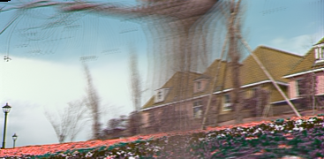
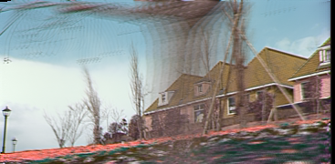
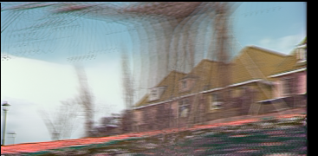
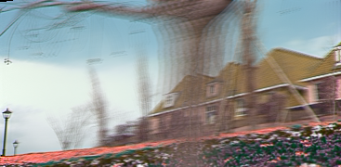
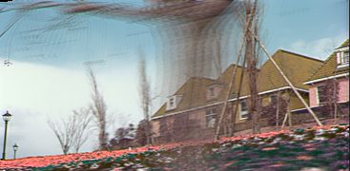
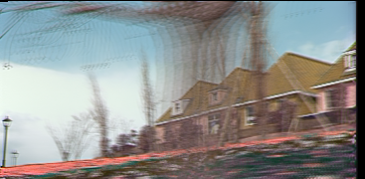
Plane Sweep Stereo
For each depth plane
  For each pixel in the composite image stack, compute the variance
For each pixel, select the depth that gives the lowest variance
Can be accelerated using graphics hardware
R. Yang and M. Pollefeys. Multi-Resolution Real-Time Stereo on Commodity Graphics Hardware, CVPR 2003

Slide 16
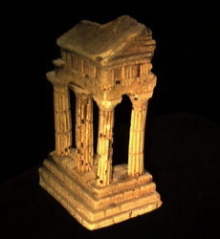
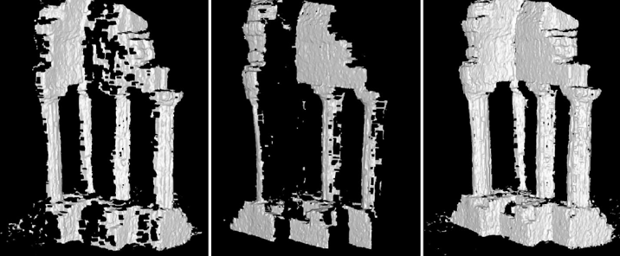
Merging depth maps
Given a group of images, choose each one as reference and compute a depth map w.r.t. that view using a multi-baseline approach
Merge multiple depth maps to a volume or a mesh (see, e.g., Curless and Levoy 96)
Map 1
Map 2
Merged

Slide 17
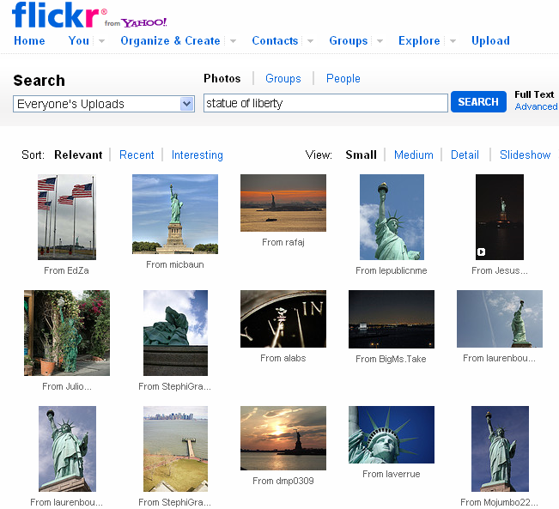
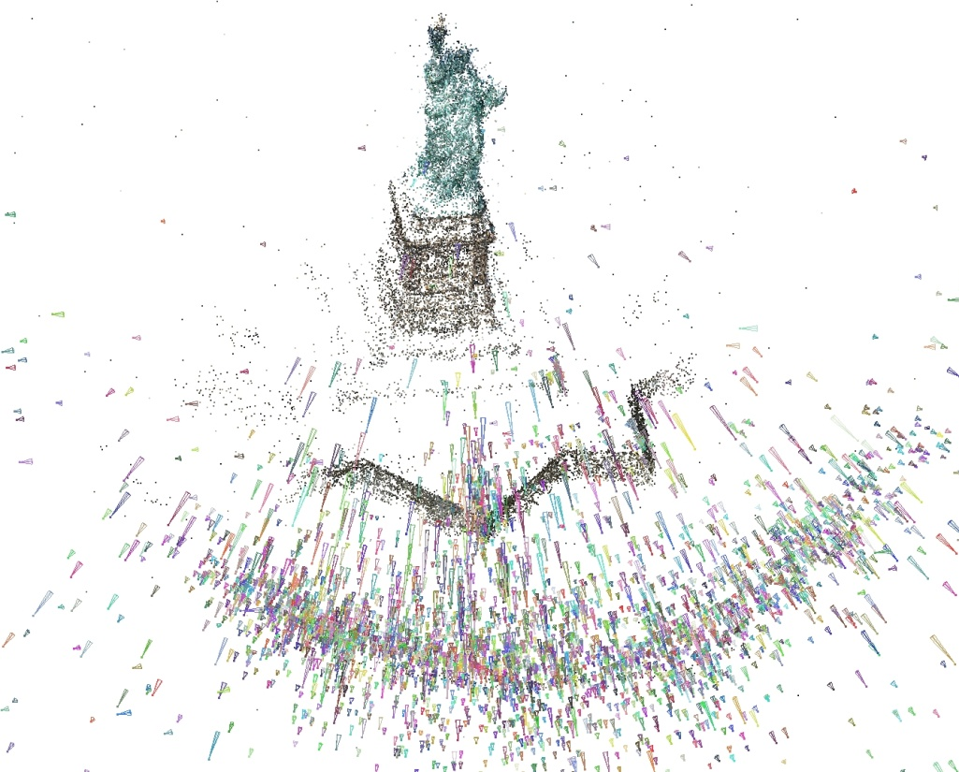
Stereo from community photo collections
Need structure from motion to recover unknown camera parameters
Need view selection to find good groups of images on which to run dense stereo

Slide 18
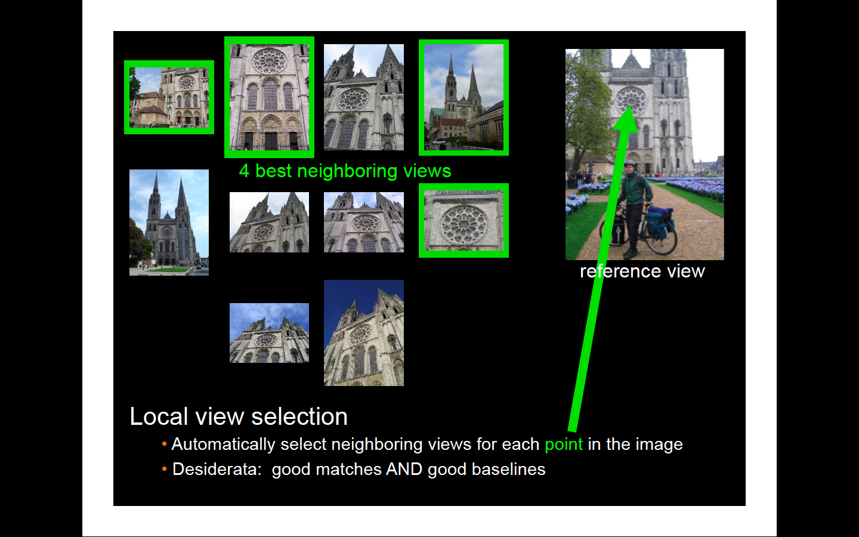

Slide 19
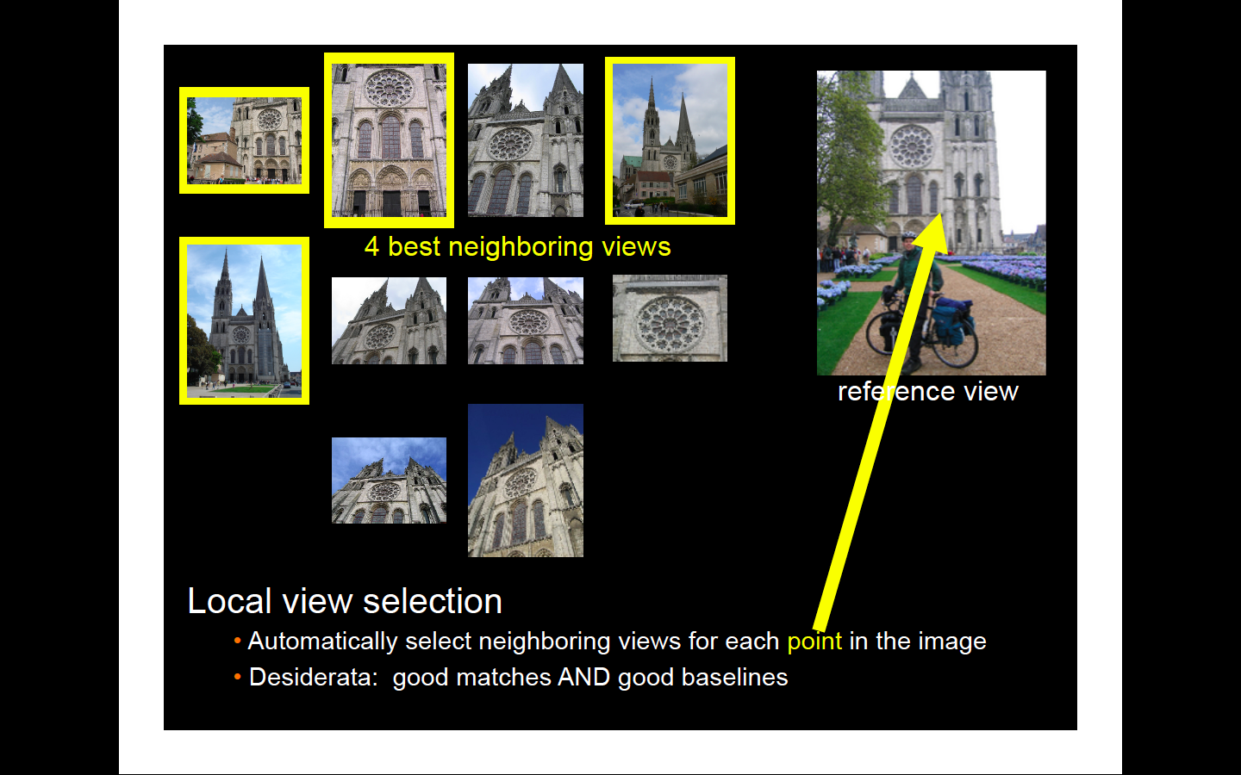

Slide 20
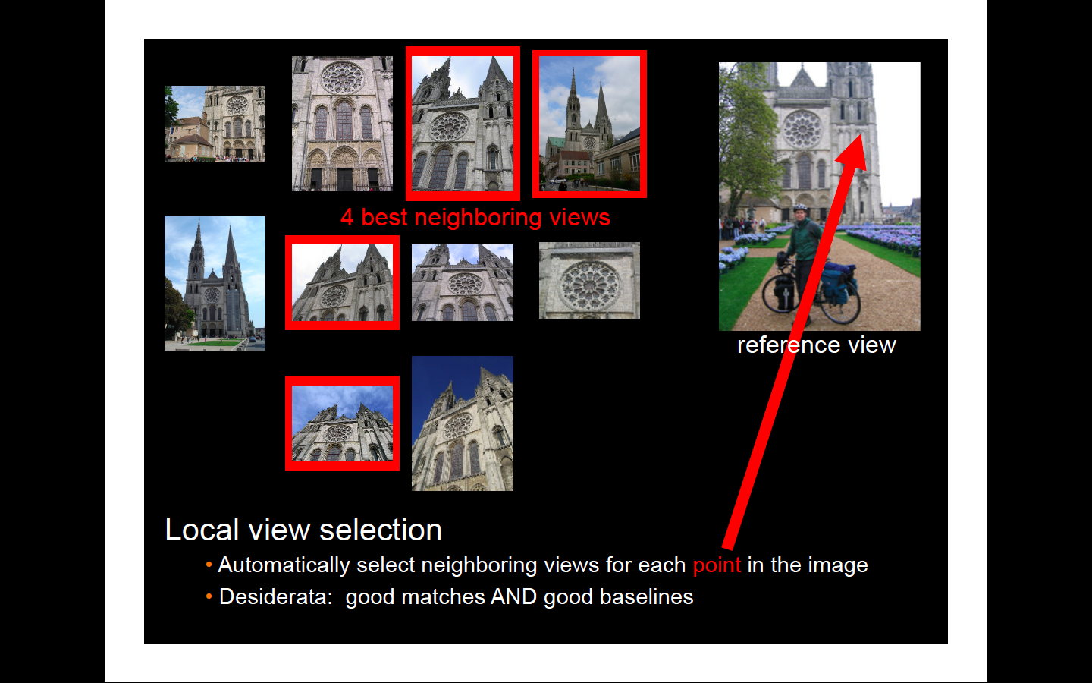

Slide 21
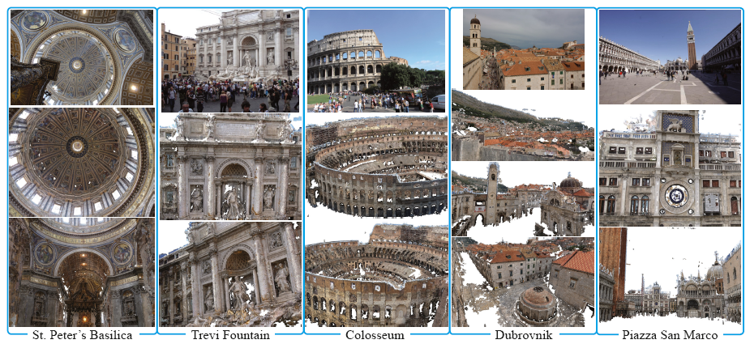
Towards Internet-Scale Multi-View Stereo
YouTube video, high-quality video
Yasutaka Furukawa, Brian Curless, Steven M. Seitz and Richard Szeliski, Towards Internet-scale Multi-view Stereo,CVPR 2010.

Slide 22
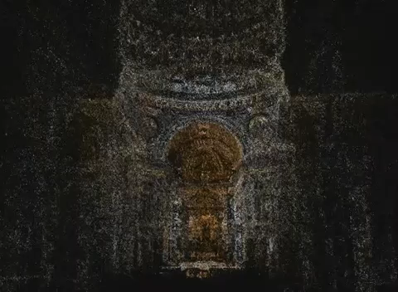
Internet-Scale Multi-View Stereo

Slide 23
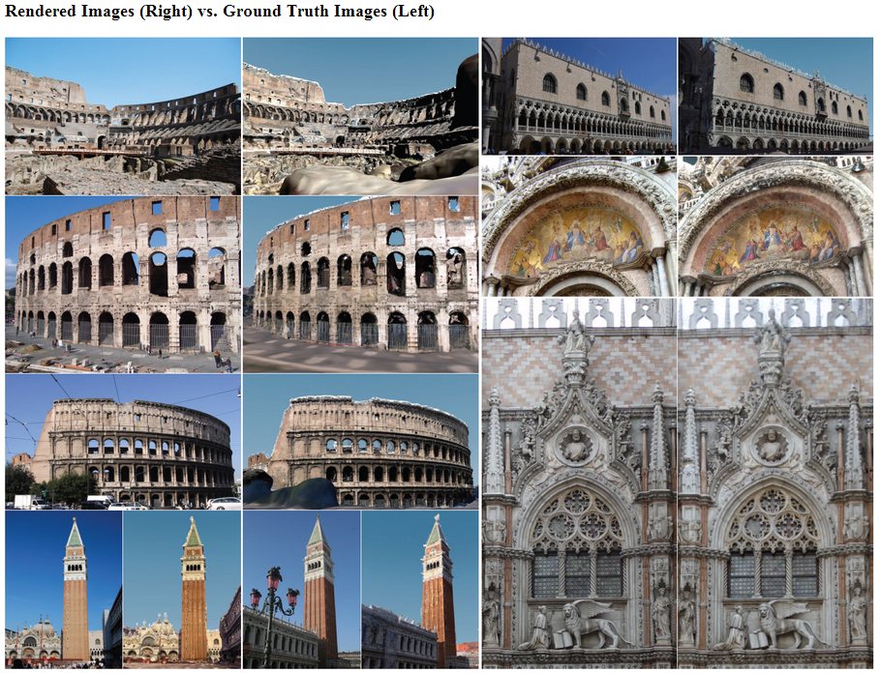
The Visual Turing Test for Scene Reconstruction
Q. Shan, R. Adams, B. Curless, Y. Furukawa, and S. Seitz, "The Visual Turing Test for Scene Reconstruction," 3DV 2013.
Notes:
Abstract: We present the first large scale system for capturing and rendering relightable scene reconstructions from massive unstructured photo collections taken under different illumination conditions and viewpoints. We combine photos taken from many sources, Flickr-based ground-level imagery, oblique aerial views, and streetview, to recover models that are significantly more complete and detailed than previously demonstrated. We demonstrate the ability to match both the viewpoint and illumination of arbitrary input photos, enabling a Visual Turing Test in which photo and rendering are viewed side-by-side and the observer has to guess which is which. While we cannot yet fool human perception, the gap is closing.

Slide 24
The Reading List
“A computer algorithm for reconstructing a scene from two images”, Longuet-Higgins, Nature 1981
“Shape and motion from image streams under orthography:
A factorization method.” C. Tomasi and T. Kanade, IJCV, 9(2):137-154, November 1992
“In defense of the eight-point algorithm”, Hartley, PAMI 1997
“An efficient solution to the five-point relative pose problem”, Nister, PAMI 2004
“Accurate, dense, and robust multiview stereopsis”, Furukawa and Ponce, CVPR 2007
“Photo tourism: exploring image collections in 3d”, ACM SIGGRAPH 2006
“Building Rome in a day”, Agarwal et al., ICCV 2009
https://www.youtube.com/watch?v=kyIzMr917Rc, 3D Computer Vision: Past, Present, and Future

Slide 25
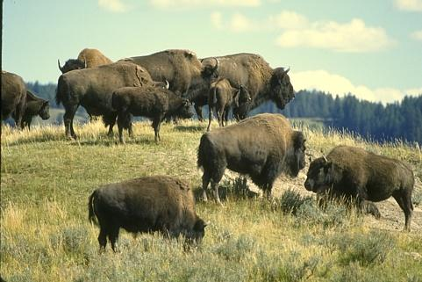
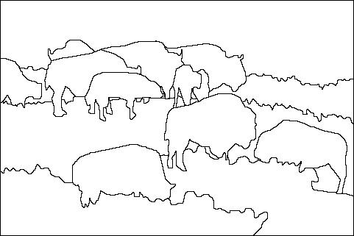
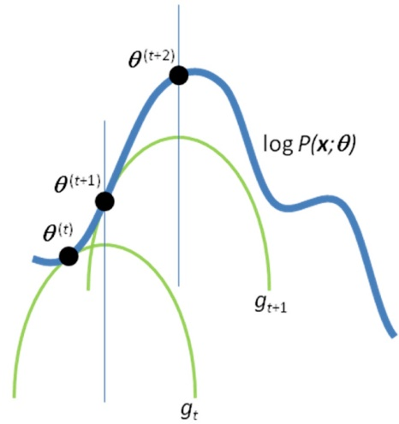
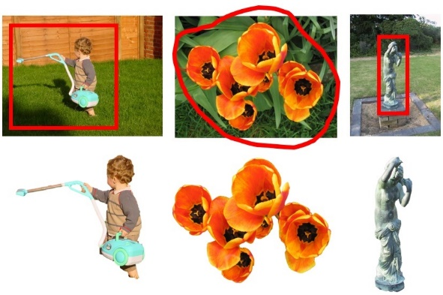
Grouping and Segmentation
Image Segmentation
  Which pixels belong together?
Hidden Variables, the EM Algorithm, and Mixtures of Gaussians
  How to handle missing data?
MRFs and Segmentation with Graph Cut
  How do we solve image labeling problems?

Slide 26
How many people?

Slide 27
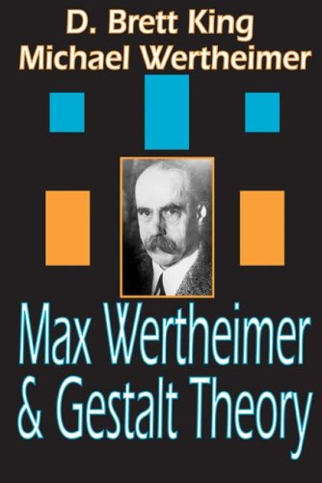
Gestalt psychology or gestaltism
German: Gestalt - "form" or "whole”
Berlin School, early 20th century
Kurt Koffka, Max Wertheimer, and Wolfgang Köhler
View of brain:
whole is more than the sum of its parts
holistic
parallel
analog
self-organizing tendencies
Slide from S. Saverese

Slide 28
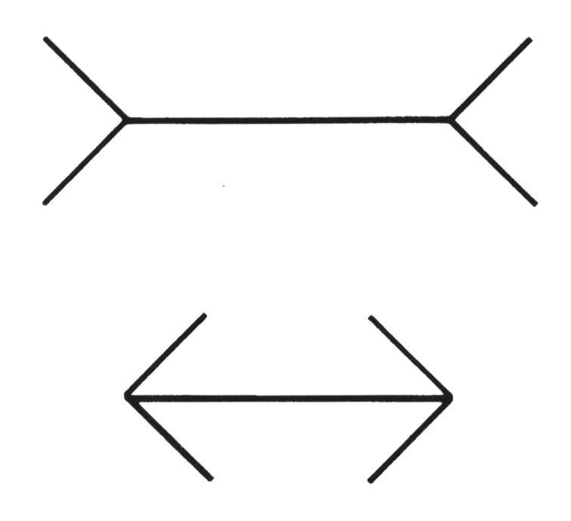
Gestaltism
The Muller-Lyer illusion
Notes:
The famous Muller-Lyer illusion; the point is that the horizontal bar has properties that come only from its membership in
a group (it looks shorter in the lower picture, but is actually the same size) and that these properties can’t be discounted--- you can’t look at this figure and ignore the arrowheads and thereby make the two bars seem to be the same size.

Slide 29
We perceive the interpretation, not the senses
Notes:
In one experiment, children from rural Zambia were less susceptible to the illusion.

Slide 30
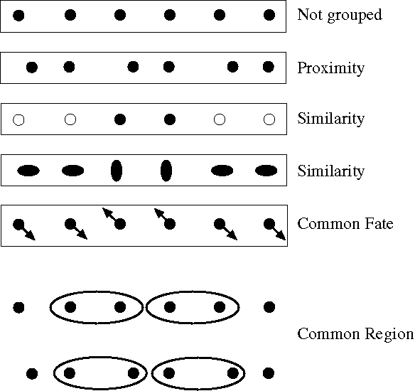
Principles of perceptual organization
From Steve Lehar: The Constructive Aspect of Visual Perception
Notes:
Some criteria that tend to cause tokens to be grouped.

Slide 31
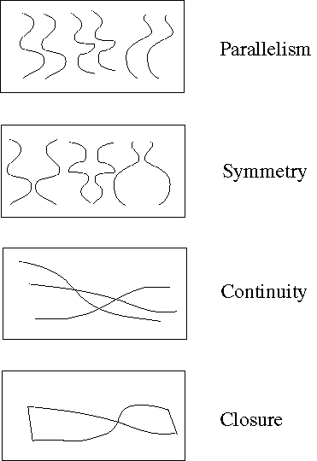
Principles of perceptual organization
Notes:
More such

Slide 32
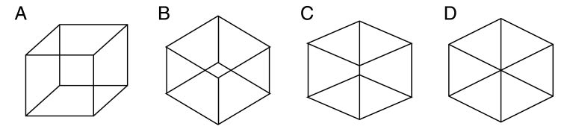
Gestaltists do not believe in coincidence

Slide 33
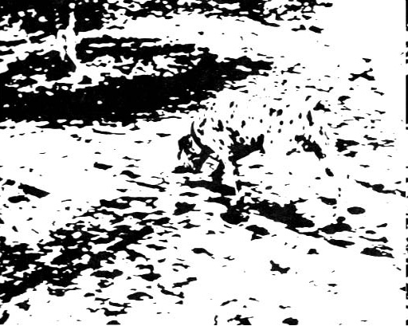
Emergence

Slide 34
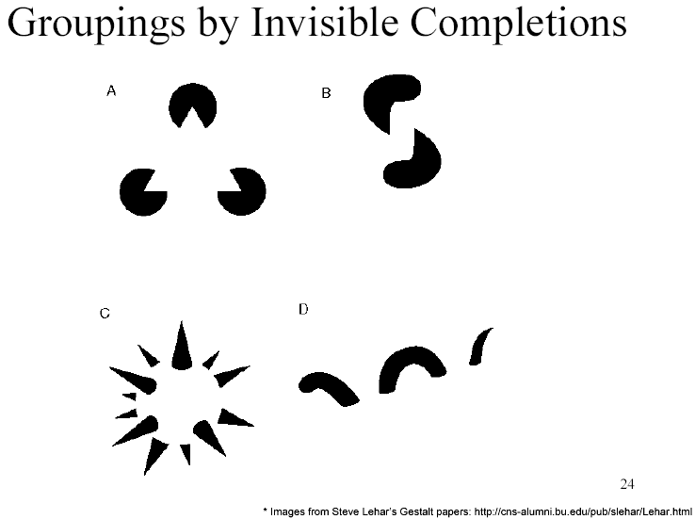
Grouping by invisible completion
From Steve Lehar: The Constructive Aspect of Visual Perception

Slide 35
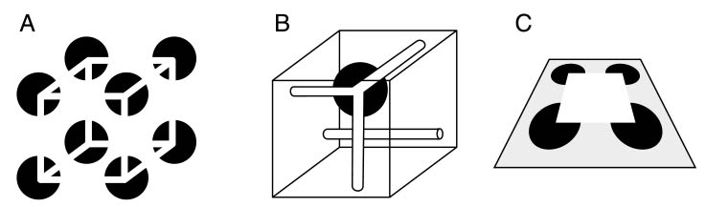
Grouping involves global interpretation
From Steve Lehar: The Constructive Aspect of Visual Perception

Slide 36
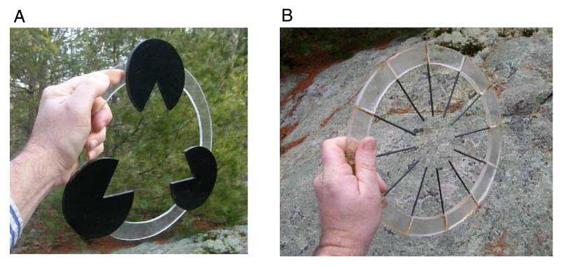
Grouping involves global interpretation
From Steve Lehar: The Constructive Aspect of Visual Perception

Slide 37
Gestalt cues
Good intuition and basic principles for grouping
Basis for many ideas in segmentation and occlusion reasoning
Some (e.g., symmetry) are difficult to implement in practice

Slide 38
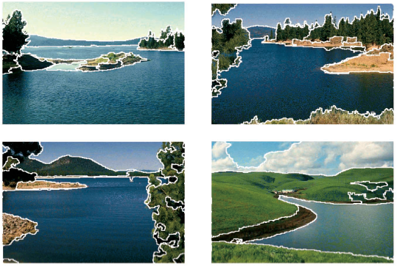
Image segmentation
Goal: Group pixels into meaningful or perceptually similar regions

Slide 39
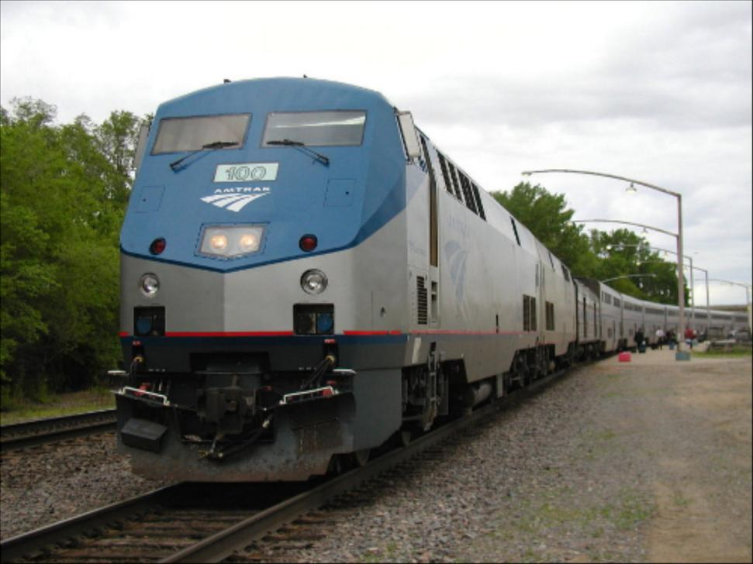
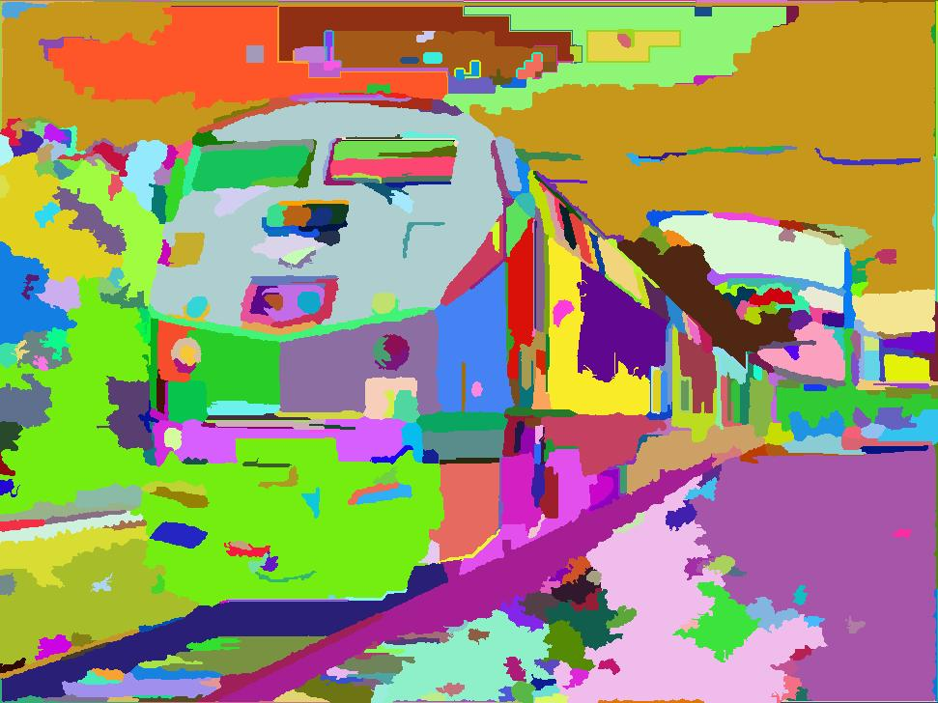
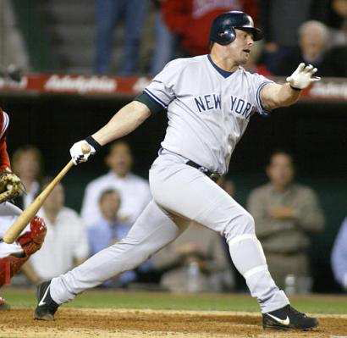
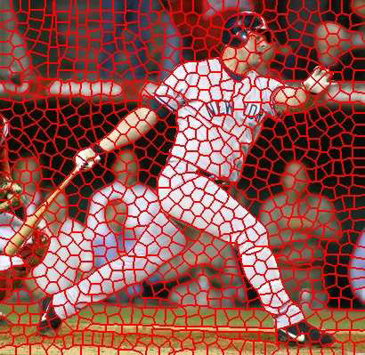
Segmentation for efficiency: “superpixels”
[Felzenszwalb and Huttenlocher 2004]
[Shi and Malik 2001]
[Hoiem et al. 2005, Mori 2005]

Slide 40
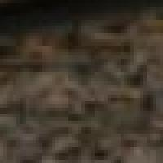
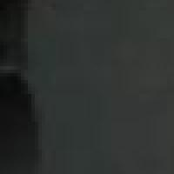
Segmentation for feature support
50x50 Patch
50x50 Patch

Slide 41
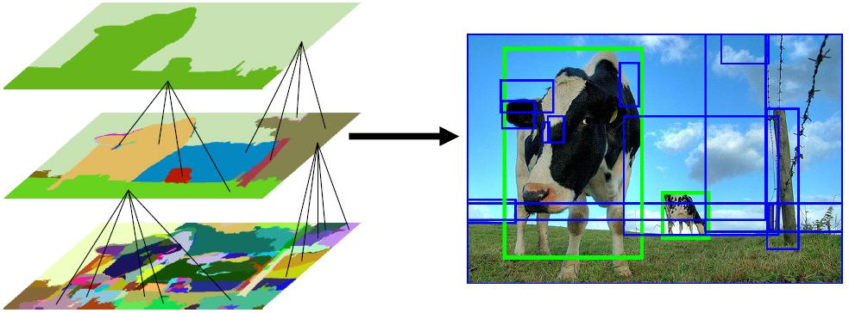
Segmentation for object proposals
“Selective Search” [Sande, Uijlings et al. ICCV 2011, IJCV 2013]
[Endres Hoiem ECCV 2010, IJCV 2014]

Slide 42
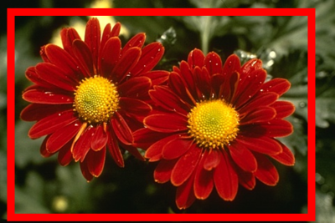



Segmentation as a result
Rother et al. 2004

Slide 43

Major processes for segmentation
Bottom-up: group tokens with similar features
Top-down: group tokens that likely belong to the same object
[Levin and Weiss 2006]

Slide 44
Segmentation using clustering
Kmeans
Mean-shift

Slide 45

Feature Space
Source: K. Grauman

Slide 46
K-means algorithm
Partition the data into K sets S = {S₁, S₂, … S_{K}} with corresponding centers μ_{i}
Partition such that variance in each partition is as low as possible

Slide 47
K-means algorithm
Partition the data into K sets S = {S₁, S₂, … S_{K}} with corresponding centers μ_{i}
Partition such that variance in each partition is as low as possible

Slide 48
K-means algorithm
Initialize K centers μ_{i} (usually randomly)
Assign each point x to its nearest center:
Update cluster centers as the mean of its members
Repeat 2-3 until convergence (t = t+1)

Slide 49
function C = kmeans(X, K)
% Initialize cluster centers to be randomly sampled points
[N, d] = size(X);
rp = randperm(N);
C = X(rp(1:K), :);
lastAssignment = zeros(N, 1);
while true
% Assign each point to nearest cluster center
bestAssignment = zeros(N, 1);
mindist = Inf*ones(N, 1);
for k = 1:K
for n = 1:N
dist = sum((X(n, :)-C(k, :)).^2);
if dist < mindist(n)
mindist(n) = dist;
bestAssignment(n) = k;
end
end
end
% break if assignment is unchanged
if all(bestAssignment==lastAssignment), break; end;
% Assign each cluster center to mean of points within it
for k = 1:K
C(k, :) = mean(X(bestAssignment==k, :));
end
end

Slide 50



K-means clustering using intensity alone and color alone
Image
Clusters on intensity
Clusters on color
Notes:
I gave each pixel the mean intensity or mean color of its cluster --- this is basically just vector quantizing the image intensities/colors. Notice that there is no requirement that clusters be spatially localized and they’re not.

Slide 51

K-Means pros and cons
Pros
  Simple and fast
  Easy to implement
Cons
  Need to choose K
  Sensitive to outliers
Usage
  Rarely used for pixel segmentation

Slide 52

Mean shift segmentation
D. Comaniciu and P. Meer, Mean Shift: A Robust Approach toward Feature Space Analysis, PAMI 2002.
Versatile technique for clustering-based segmentation

Slide 53



Mean shift algorithm
Try to find modes of this non-parametric density

Slide 54

Kernel density estimation
Kernel
Estimated density
Data (1-D)

Slide 55


Kernel density estimation
Kernel density estimation function
Gaussian kernel

Slide 56
Mean shift
Region of
interest
Center of
mass
Mean Shift
vector
Slide by Y. Ukrainitz & B. Sarel

Slide 57
Mean shift
Region of
interest
Center of
mass
Mean Shift
vector
Slide by Y. Ukrainitz & B. Sarel

Slide 58
Mean shift
Region of
interest
Center of
mass
Mean Shift
vector
Slide by Y. Ukrainitz & B. Sarel

Slide 59
Mean shift
Region of
interest
Center of
mass
Mean Shift
vector
Slide by Y. Ukrainitz & B. Sarel

Slide 60
Mean shift
Region of
interest
Center of
mass
Mean Shift
vector
Slide by Y. Ukrainitz & B. Sarel

Slide 61
Mean shift
Region of
interest
Center of
mass
Mean Shift
vector
Slide by Y. Ukrainitz & B. Sarel

Slide 62
Mean shift
Region of
interest
Center of
mass
Slide by Y. Ukrainitz & B. Sarel

Slide 63
Computing the Mean Shift
Simple Mean Shift procedure:
Compute mean shift vector
Translate the Kernel window by m(x)
Slide by Y. Ukrainitz & B. Sarel

Slide 64
Real Modality Analysis

Slide 65

Attraction basin
Attraction basin: the region for which all trajectories lead to the same mode
Cluster: all data points in the attraction basin of a mode
Slide by Y. Ukrainitz & B. Sarel

Slide 66

Attraction basin

Slide 67
Mean shift clustering
The mean shift algorithm seeks modes of the given set of points
  Choose kernel and bandwidth
  For each point:
    Center a window on that point
    Compute the mean of the data in the search window
    Center the search window at the new mean location
    Repeat (b,c) until convergence
  Assign points that lead to nearby modes to the same cluster

Slide 68

Segmentation by Mean Shift
Compute features for each pixel (color, gradients, texture, etc); also store each pixel’s position
Set kernel size for features K_{f} and position K_{s}
Initialize windows at individual pixel locations
Perform mean shift for each window until convergence
Merge modes that are within width of K_{f} and K_{s}

Slide 69




Mean shift segmentation results
http://www.caip.rutgers.edu/~comanici/MSPAMI/msPamiResults.html

Slide 70
http://www.caip.rutgers.edu/~comanici/MSPAMI/msPamiResults.html

Slide 71
Mean-shift: other issues
Speedups
  Binned estimation – replace points within some “bin” by point at center with mass
  Fast search of neighbors – e.g., k-d tree or approximate NN
  Update all windows in each iteration (faster convergence)
Other tricks
  Use kNN to determine window sizes adaptively
Lots of theoretical support
  D. Comaniciu and P. Meer, Mean Shift: A Robust Approach toward Feature Space Analysis, PAMI 2002.

Slide 72
Mean shift pros and cons
Pros
  Good general-purpose segmentation
  Flexible in number and shape of regions
  Robust to outliers
  General mode-finding algorithm (useful for other problems such as finding most common surface normals)
Cons
  Have to choose kernel size in advance
  Not suitable for high-dimensional features
When to use it
  Oversegmentation
  Multiple segmentations
  Tracking, clustering, filtering applications
    D. Comaniciu, V. Ramesh, P. Meer: Real-Time Tracking of Non-Rigid Objects using Mean Shift, Best Paper Award, IEEE Conf. Computer Vision and Pattern Recognition (CVPR'00), Hilton Head Island, South Carolina, Vol. 2, 142-149, 2000

Slide 73
Mean-shift reading
Nicely written mean-shift explanation (with math)
http://saravananthirumuruganathan.wordpress.com/2010/04/01/introduction-to-mean-shift-algorithm/
  Includes .m code for mean-shift clustering
Mean-shift paper by Comaniciu and Meer
http://www.caip.rutgers.edu/~comanici/Papers/MsRobustApproach.pdf
Adaptive mean shift in higher dimensions
http://mis.hevra.haifa.ac.il/~ishimshoni/papers/chap9.pdf

Slide 74
Superpixel algorithms
Goal: divide the image into a large number of regions, such that each regions lie within object boundaries
Examples
  Watershed
  Felzenszwalb and Huttenlocher graph-based
  Turbopixels
  SLIC

Slide 75

Watershed algorithm

Slide 76




Watershed segmentation
Image
Gradient
Watershed boundaries

Slide 77
Meyer’s watershed segmentation
Choose local minima as region seeds
Add neighbors to priority queue, sorted by value
Take top priority pixel from queue
  If all labeled neighbors have same label, assign that label to pixel
  Add all non-marked neighbors to queue
Repeat step 3 until finished (all remaining pixels in queue are on the boundary)
Matlab: seg = watershed(bnd_im)
Meyer 1991

Slide 78


Simple trick
Use Gaussian or median filter to reduce number of regions

Slide 79
Watershed usage
Use as a starting point for hierarchical segmentation
  Ultrametric contour map (Arbelaez 2006)
Works with any soft boundaries
  Pb (w/o non-max suppression)
  Canny (w/o non-max suppression)
  Etc.

Slide 80
Watershed pros and cons
Pros
  Fast (< 1 sec for 512x512 image)
  Preserves boundaries
Cons
  Only as good as the soft boundaries (which may be slow to compute)
  Not easy to get variety of regions for multiple segmentations
Usage
  Good algorithm for superpixels, hierarchical segmentation

Slide 81




Felzenszwalb and Huttenlocher: Graph-Based Segmentation
    http://www.cs.brown.edu/~pff/segment/
+ Good for thin regions
+ Fast
+ Easy to control coarseness of segmentations
+ Can include both large and small regions
- Often creates regions with strange shapes
- Sometimes makes very large errors

Slide 82

Turbo Pixels: Levinstein et al. 2009
http://www.cs.toronto.edu/~kyros/pubs/09.pami.turbopixels.pdf
Tries to preserve boundaries like watershed but to produce more regular regions

Slide 83
SLIC (Achanta et al. PAMI 2012)
http://infoscience.epfl.ch/record/177415/files/Superpixel_PAMI2011-2.pdf
Initialize cluster centers on pixel grid in steps S
  - Features: Lab color, x-y position
Move centers to position in 3x3 window with smallest gradient
Compare each pixel to cluster center within 2S pixel distance and assign to nearest
Recompute cluster centers as mean color/position of pixels belonging to each cluster
Stop when residual error is small
+ Fast 0.36s for 320x240
+ Regular superpixels
+ Superpixels fit boundaries
- May miss thin objects
- Large number of superpixels

Slide 84
Choices in segmentation algorithms
Oversegmentation
  Watershed + Structure random forest
  Felzenszwalb and Huttenlocher 2004
    http://www.cs.brown.edu/~pff/segment/
  SLIC
  Turbopixels
  Mean-shift
Larger regions (object-level)
  Hierarchical segmentation (e.g., from Pb)
  Normalized cuts
  Mean-shift
  Seed + graph cuts (discussed later)

Slide 85
Multiple segmentations
When creating regions for pixel classification or object detection, don’t commit to one partitioning
Strategies:
  Hierarchical segmentation
    Occlusion boundaries hierarchy: Hoiem et al. IJCV 2011 (uses trained classifier to merge)
    Pb+watershed hierarchy: Arbeleaz et al. CVPR 2009
    Selective search: FH + agglomerative clustering
    Superpixel hierarchy
  Vary segmentation parameters
    E.g., multiple graph-based segmentations or mean-shift segmentations
  Region proposals
    Propose seed superpixel, try to segment out object that contains it
    (Endres Hoiem ECCV 2010, Carreira Sminchisescu CVPR 2010)

Slide 86


Things to remember
Gestalt cues and principles of organization
Uses of segmentation
  Efficiency
  Better features
  Propose object regions
  Want the segmented object
Mean-shift segmentation
  Good general-purpose segmentation method
  Generally useful clustering, tracking technique
Watershed segmentation
  Good for hierarchical segmentation
  Use in combination with boundary prediction

