Slide 1
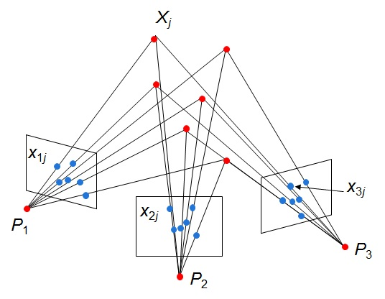
Structure from Motion
Computer Vision
Jia-Bin Huang, Virginia Tech
Many slides from S. Seitz, N Snavely, and D. Hoiem

Slide 2
Administrative stuffs
HW 3 due 11:59 PM, Oct 17 (Monday)
Top alignment results
  Mengyu Song (5.03)
    second moment ellipse + ICP
  Badour AlBahar (5.41)
    Tested the original image, multiple initializations
  Sujay Yadawadkar (6.989)
    Iterative closest point with affine transformation
Feedback
  Detailed discussions on HW assignment
  More generous on hints

Slide 3
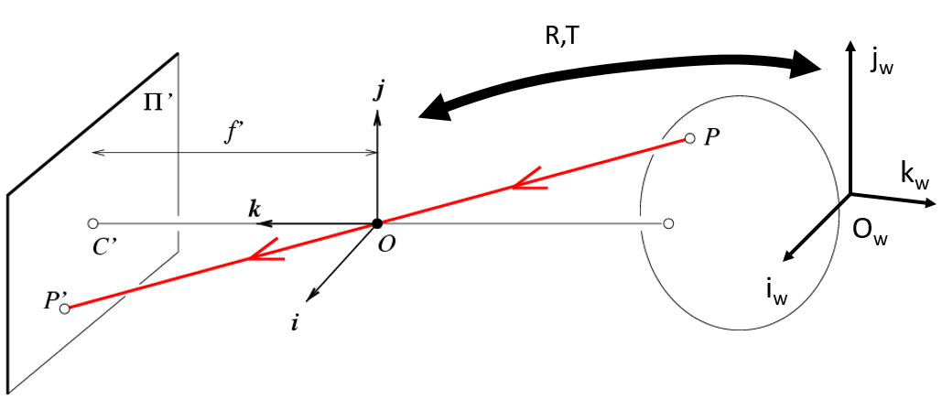
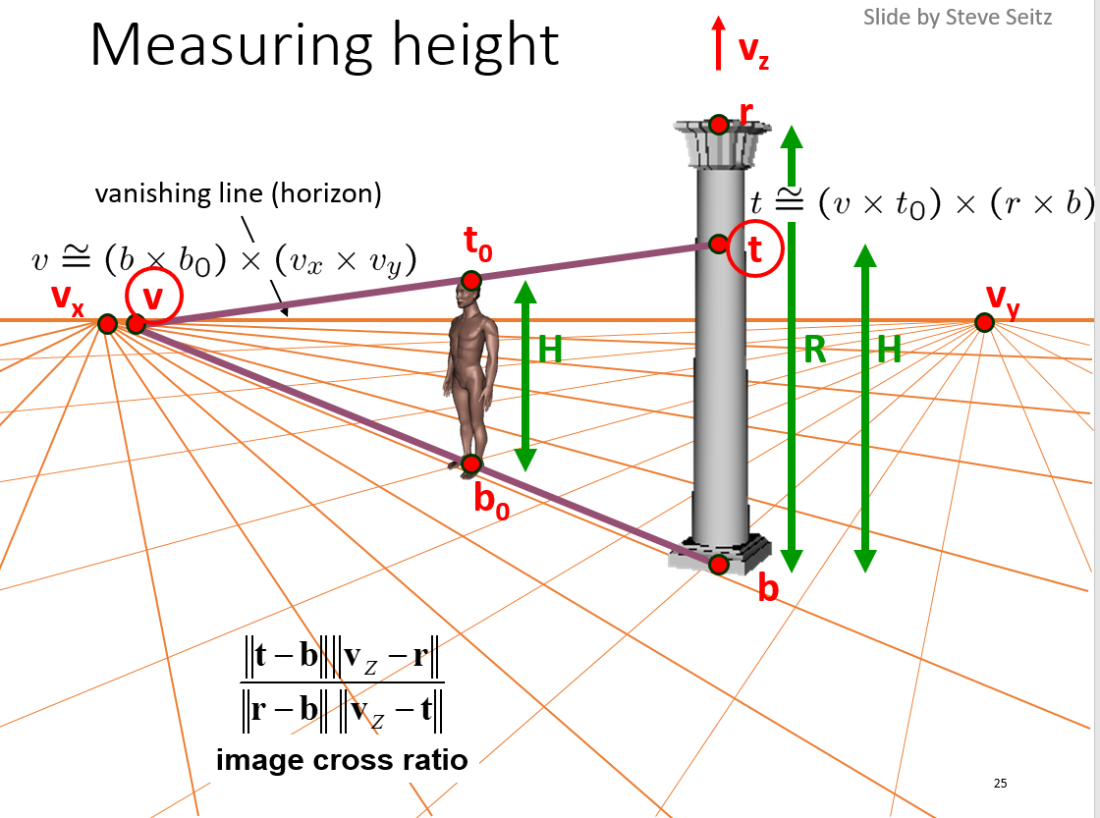







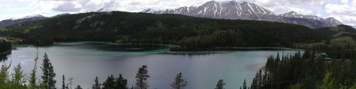
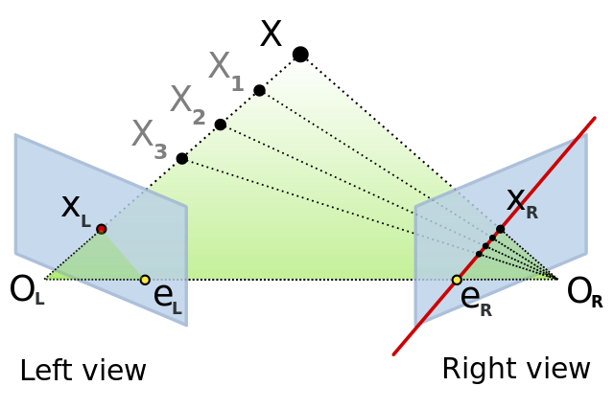
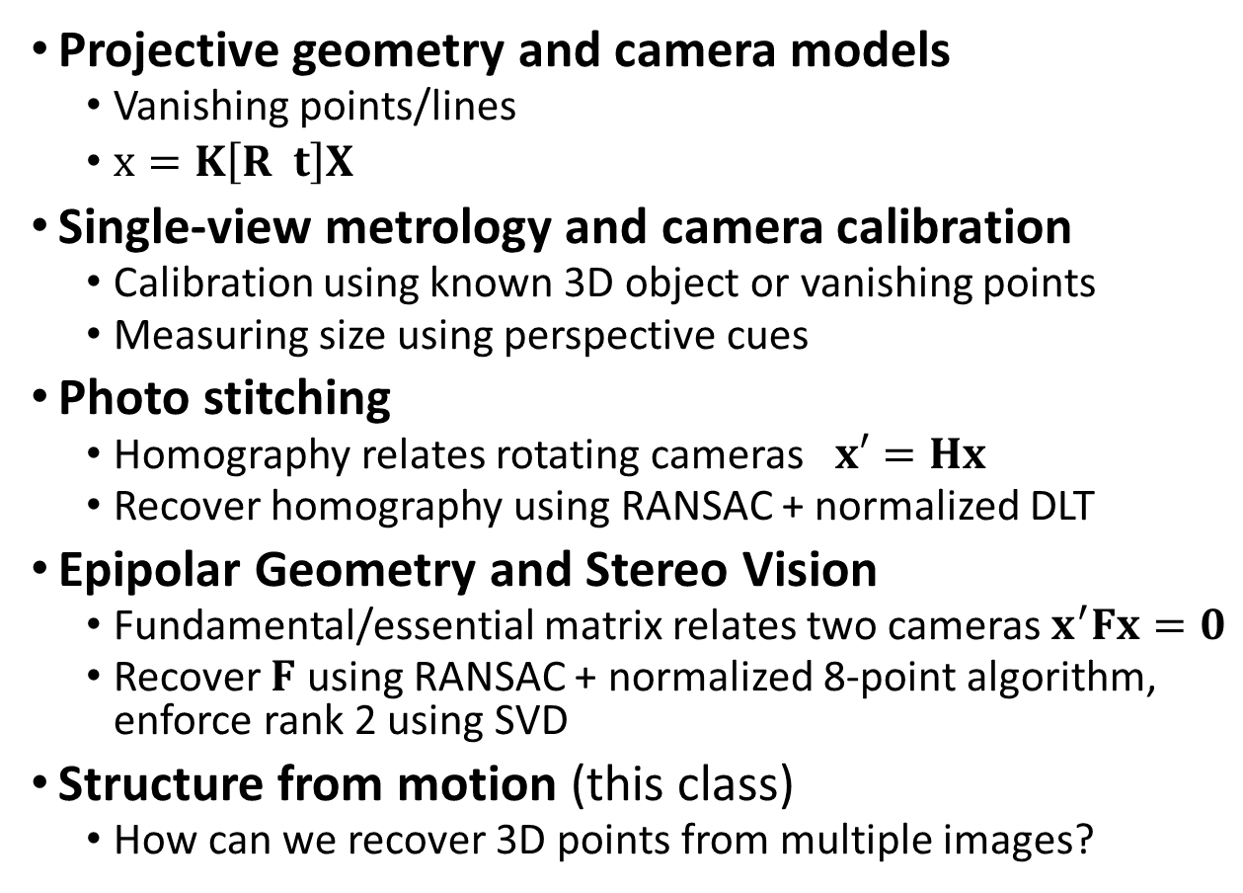
Perspective and 3D Geometry
Projective geometry and camera models
  Vanishing points/lines
  $x=K\left[R t\right]X$
Single-view metrology and camera calibration
  Calibration using known 3D object or vanishing points
  Measuring size using perspective cues
Photo stitching
  Homography relates rotating cameras $x′=Hx$
  Recover homography using RANSAC + normalized DLT
Epipolar Geometry and Stereo Vision
  Fundamental/essential matrix relates two cameras $x^{′}Fx=0$
  Recover $F$ using RANSAC + normalized 8-point algorithm, enforce rank 2 using SVD
Structure from motion (this class)
  How can we recover 3D points from multiple images?

Slide 4
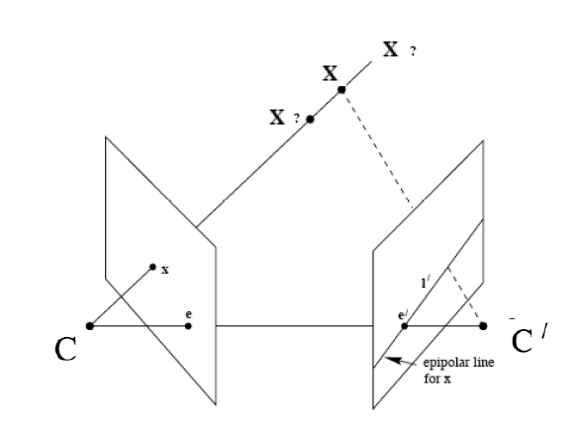
Recap: Epipoles
Point x in left image corresponds to epipolar line l’ in right image
Epipolar line passes through the epipole (the intersection of the cameras’ baseline with the image plane

Slide 5



Recap: Fundamental Matrix
Fundamental matrix maps from a point in one image to a line in the other
If x and x’ correspond to the same 3d point X:

Slide 6
Recap: Automatic Estimation of F
Assume we have matched points x x’ with outliers
8-Point Algorithm for Recovering F
Correspondence Relation
Normalize image coordinates
RANSAC with 8 points
  Randomly sample 8 points
  Compute F via least squares
  Enforce by SVD
  Repeat and choose F with most inliers
De-normalize:

Slide 7
Recap
We can get projection matrices P and P’ up to a projective ambiguity (see HZ p. 255-256)
Code:
function P = vgg_P_from_F(F)
[U,S,V] = svd(F);
e = U(:,3);
P = [-vgg_contreps(e)*F e];
See HZ p. 255-256

Slide 8
This class: Structure from Motion
Projective structure from motion
Affine structure from motion
HW 3
Multi-view stereo (optional)

Slide 9
Structure [ˈstrək(t)SHər]:
3D Point Cloud of the Scene
Motion [ˈmōSH(ə)n]:
Camera Location and Orientation
Structure from Motion (SfM)
Get the Point Cloud from Moving Cameras

Slide 10
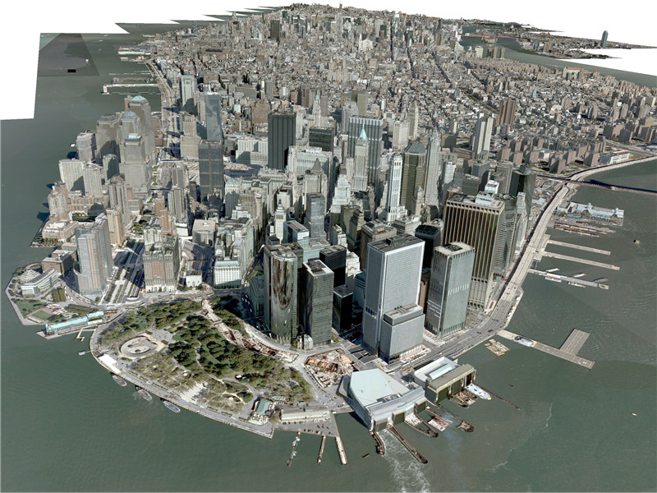
SfM Applications – 3D Modeling
http://www.3dcadbrowser.com/download.aspx?3dmodel=40454

Slide 11
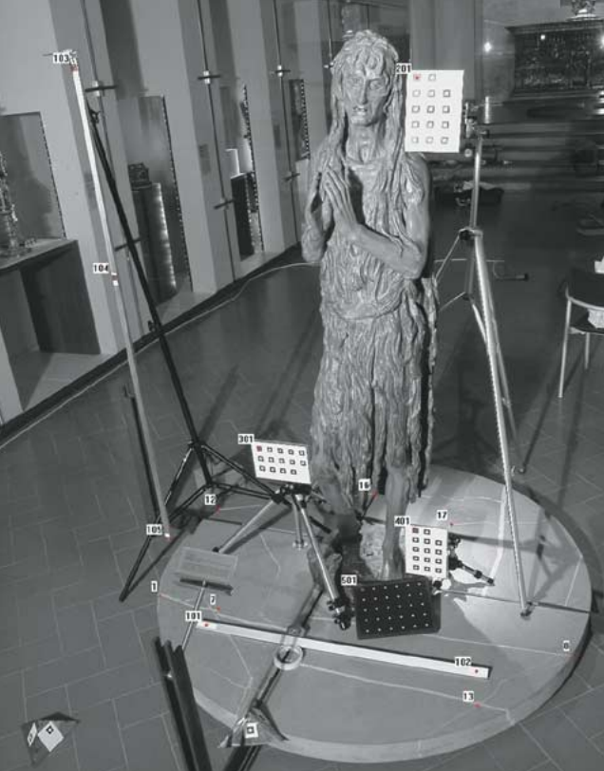
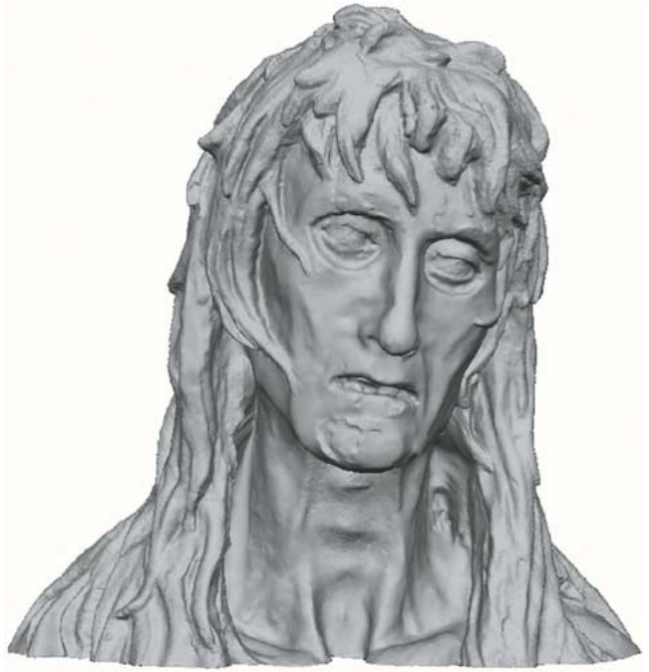
SfM Applications – Surveying cultural heritage structure analysis
Guidi et al. High-accuracy 3D modeling of cultural heritage, 2004

Slide 12
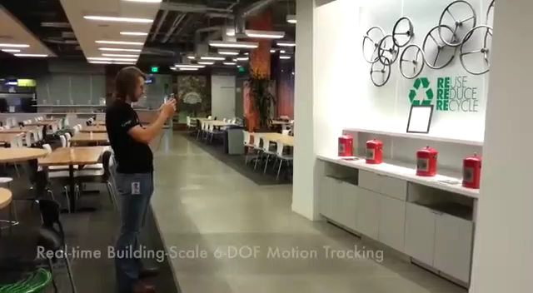
SfM Applications –
Robot navigation and mapmaking
https://www.youtube.com/watch?v=1HhOmF22oYA

Slide 13
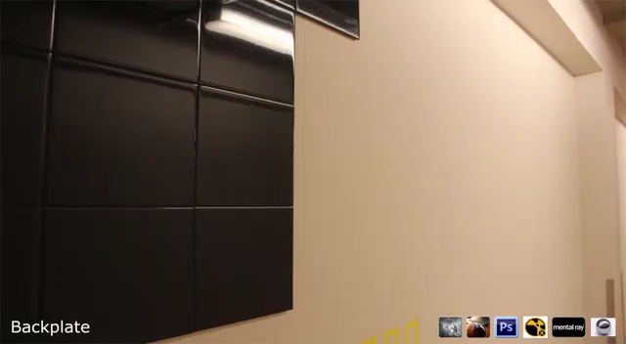
SfM Applications – Visual effect (matchmove)
https://www.youtube.com/watch?v=bK6vCPcFkfk

Slide 14
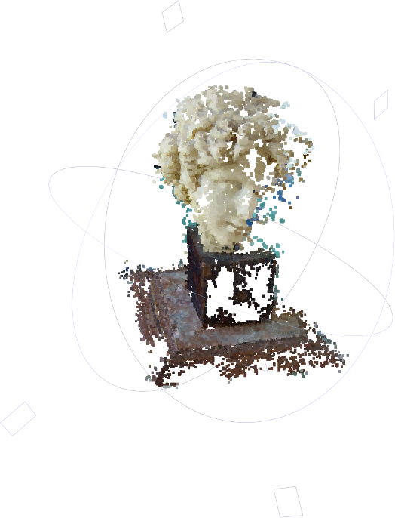
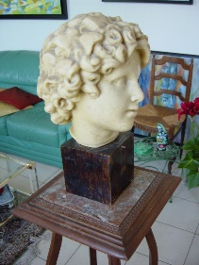
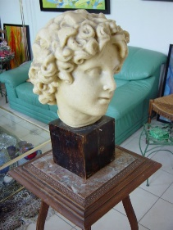
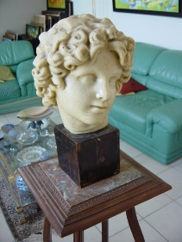
Steps
Images → Points: Structure from Motion
Points → More points: Multiple View Stereo
Points → Meshes: Model Fitting
Meshes → Models: Texture Mapping
Images → Models: Image-based Modeling
+
=
+
+
=
Slide credit: J. Xiao

Slide 15
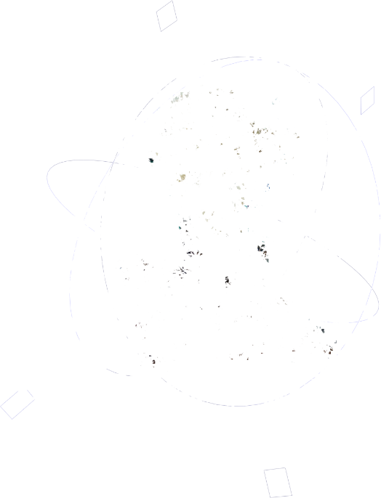
Steps
Images → Points: Structure from Motion
Points → More points: Multiple View Stereo
Points → Meshes: Model Fitting
Meshes → Models: Texture Mapping
Images → Models: Image-based Modeling
+
=
+
+
=
Slide credit: J. Xiao

Slide 16
Steps
Images → Points: Structure from Motion
Points → More points: Multiple View Stereo
Points → Meshes: Model Fitting
Meshes → Models: Texture Mapping
Images → Models: Image-based Modeling
+
=
+
+
+
=
Slide credit: J. Xiao

Slide 17
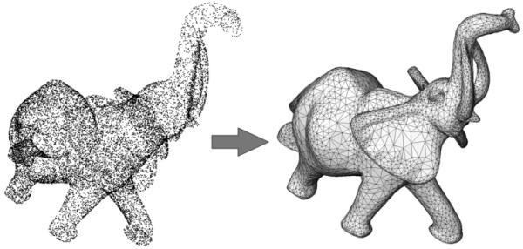
Steps
Images → Points: Structure from Motion
Points → More points: Multiple View Stereo
Points → Meshes: Model Fitting
Meshes → Models: Texture Mapping
Images → Models: Image-based Modeling
+
=
Slide credit: J. Xiao

Slide 18
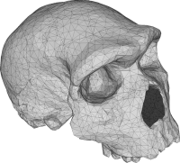
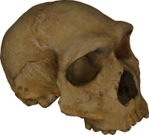
Steps
Images → Points: Structure from Motion
Points → More points: Multiple View Stereo
Points → Meshes: Model Fitting
Meshes → Models: Texture Mapping
Images → Models: Image-based Modeling
+
=
Slide credit: J. Xiao

Slide 19
Steps
Images → Points: Structure from Motion
Points → More points: Multiple View Stereo
Points → Meshes: Model Fitting
Meshes → Models: Texture Mapping
Images → Models: Image-based Modeling
+
=
Example: https://photosynth.net/
Slide credit: J. Xiao

Slide 20
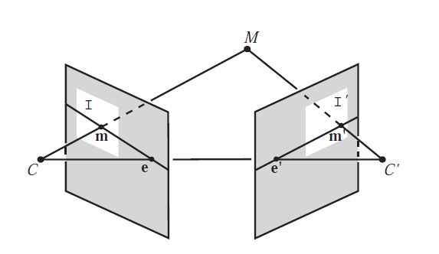
Triangulation: Linear Solution
Generally, rays C→x and C’→x’ will not exactly intersect
Can solve via SVD, finding a least squares solution to a system of equations
X
x
x'
Further reading: HZ p. 312-313

Slide 21
Triangulation: Linear Solution
Given P, P’, x, x’
Precondition points and projection matrices
Create matrix A
[U, S, V] = svd(A)
X = V(:, end)
Pros and Cons
Works for any number of corresponding images
Not projectively invariant
Code: http://www.robots.ox.ac.uk/~vgg/hzbook/code/vgg_multiview/vgg_X_from_xP_lin.m

Slide 22
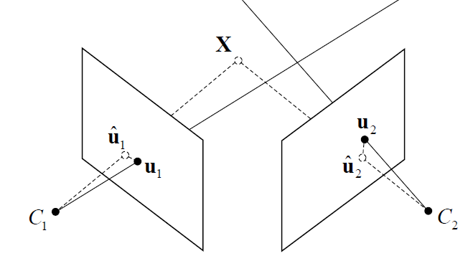
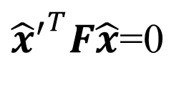




Triangulation: Non-linear Solution
Minimize projected error while satisfying
${{\hat{x}}^{′}}^{T}F\hat{x}$=0
$$cost\left(X\right)=dist{\left(x,\hat{x}\right)}^{2}+dist{\left(x′,\hat{x}′\right)}^{2}$$
$$x′$$
$$\hat{x}$$
$$x$$
$${\hat{x}}^{′}$$
Figure source: Robertson and Cipolla (Chpt 13 of Practical Image Processing and Computer Vision)

Slide 23
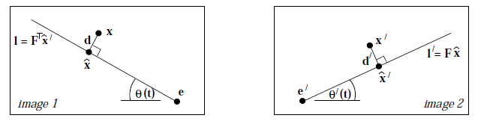

Triangulation: Non-linear Solution
Minimize projected error while satisfying
Solution is a 6-degree polynomial of t, minimizing
${{\hat{x}}^{′}}^{T}F\hat{x}$=0
$$cost\left(X\right)=dist{\left(x,\hat{x}\right)}^{2}+dist{\left(x′,\hat{x}′\right)}^{2}$$
Further reading: HZ p. 318

Slide 24
Projective structure from motion
Given: m images of n fixed 3D points
x_{ij} = P_{i} X_{j} , i = 1,… , m, j = 1, … , n
Problem: estimate m projection matrices P_{i} and n 3D points X_{j} from the mn corresponding 2D points x_{ij}
X_{j}
x_{1j}
x_{3j}
x_{2j}
P₁
P₃
Slides from Lana Lazebnik
P₂

Slide 25
Projective structure from motion
Given: m images of n fixed 3D points
x_{ij} = P_{i} X_{j} , i = 1,… , m, j = 1, … , n
Problem:
  Estimate unknown m projection matrices P_{i} and n 3D points X_{j}
  from the known mn corresponding points x_{ij}
With no calibration info, cameras and points can only be recovered up to a 4x4 projective transformation Q:
X → QX, P → PQ⁻¹
We can solve for structure and motion when
2mn >= 11m + 3n – 15
For two cameras, at least 7 points are needed
DoF in P_{i}
DoF in X_{j}
Up to 4x4 projective tform Q

Slide 26
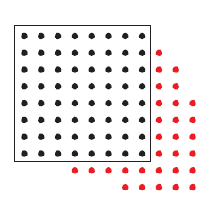
Sequential structure from motion
Initialize motion (calibration) from two images using fundamental matrix
Initialize structure by triangulation
For each additional view:
  Determine projection matrix of new camera using all the known 3D points that are visible in its image – calibration/resectioning
points
cameras

Slide 27
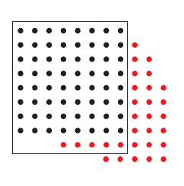
Sequential structure from motion
Initialize motion from two images using fundamental matrix
Initialize structure by triangulation
For each additional view:
  Determine projection matrix of new camera using all the known 3D points that are visible in its image – calibration
  Refine and extend structure: compute new 3D points,
  re-optimize existing points that are also seen by this camera – triangulation
points
cameras

Slide 28
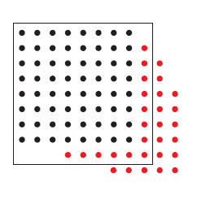
Sequential structure from motion
Initialize motion from two images using fundamental matrix
Initialize structure by triangulation
For each additional view:
  Determine projection matrix of new camera using all the known 3D points that are visible in its image – calibration
  Refine and extend structure: compute new 3D points, re-optimize existing points that are also seen by this camera – triangulation
Refine structure and motion: bundle adjustment
points
cameras

Slide 29
Bundle adjustment
Non-linear method for refining structure and motion
Minimizing reprojection error
X_{j}
Theory:
The Levenberg–Marquardt algorithm
Practice:
The Ceres-Solver from Google
P₁X_{j}
x_{1j}
x_{3j}
P₃X_{j}
P₂X_{j}
x_{2j}
P₁
P₃
P₂

Slide 30
Auto-calibration
Auto-calibration: determining intrinsic camera parameters directly from uncalibrated images
For example, we can use the constraint that a moving camera has a fixed intrinsic matrix
  Compute initial projective reconstruction and find 3D projective transformation matrix Q such that all camera matrices are in the form P_{i} = K [R_{i} | t_{i}]
Can use constraints on the form of the calibration matrix, such as zero skew

Slide 31
Summary so far
From two images, we can:
  Recover fundamental matrix F
  Recover canonical camera projection matrix P and P’ from F
  Estimate 3D positions (if K is known) that correspond to each pixel
For a moving camera, we can:
  Initialize by computing F, P, X for two images
  Sequentially add new images, computing new P, refining X, and adding points
  Auto-calibrate assuming fixed calibration matrix to upgrade to similarity transform

Slide 32
Recent work in SfM
Reconstruct from many images by efficiently finding subgraphs
  http://www.cs.cornell.edu/projects/matchminer/ (Lou et al. ECCV 2012)
Improving efficiency of bundle adjustment or
    http://vision.soic.indiana.edu/projects/disco/ (Crandall et al. ECCV 2011)
    http://imagine.enpc.fr/~moulonp/publis/iccv2013/index.html (Moulin et al. ICCV 2013)
(best method with software available; also has good overview of recent methods)
Reconstruction of Cornell (Crandall et al. ECCV 2011)

Slide 33
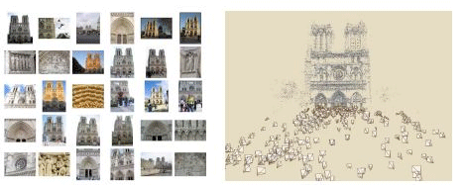
Photo synth
Noah Snavely, Steven M. Seitz, Richard Szeliski, "Photo tourism: Exploring photo collections in 3D," SIGGRAPH 2006
http://photosynth.net/

Slide 34
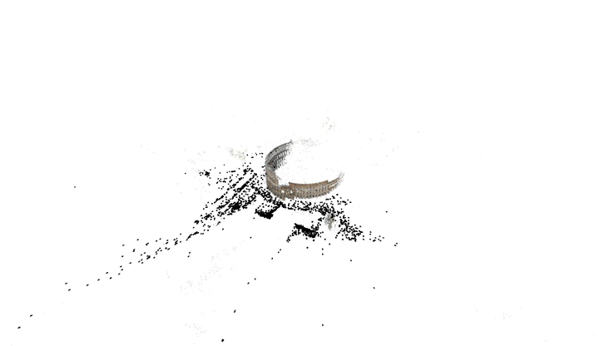
3D from multiple images
Building Rome in a Day: Agarwal et al. 2009

Slide 35
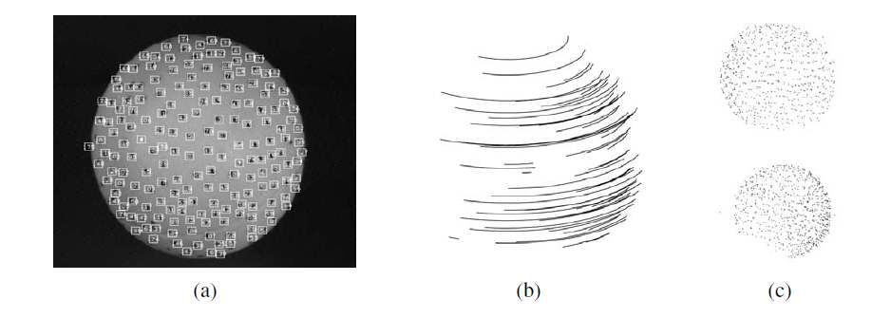
Structure from motion under orthographic projection
3D Reconstruction of a Rotating Ping-Pong Ball
Reasonable choice when
  Change in depth of points in scene is much smaller than distance to camera
  Cameras do not move towards or away from the scene
C. Tomasi and T. Kanade. Shape and motion from image streams under orthography:
A factorization method. IJCV, 9(2):137-154, November 1992.

Slide 36

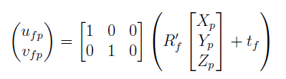
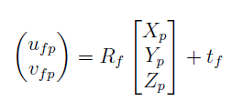

Orthographic projection for rotated/translated camera
x
a₂
a₁
X

Slide 37
Affine structure from motion
Affine projection is a linear mapping + translation in in homogeneous coordinates
We are given corresponding 2D points (x) in several frames
We want to estimate the 3D points (X) and the affine parameters of each camera (A)
x
a₂
X
Projection of
world origin
a₁

Slide 38
Step 1: Simplify by getting rid of t: shift to centroid of points for each camera
2d normalized point
(observed)
3d normalized point
Linear (affine) mapping
Notes:
Makes our world coordinates at the center of the object

Slide 39
Suppose we know 3D points and affine camera parameters …
then, we can compute the observed 2d positions of each point
3D Points (3xn)
Camera Parameters (2mx3)
2D Image Points (2mxn)

Slide 40
Affine structure from motion
Centering: subtract the centroid of the image points
For simplicity, assume that the origin of the world coordinate system is at the centroid of the 3D points
After centering, each normalized point x_{ij} is related to the 3D point X_{i} by
Notes:
Center to get rid of the “b” in “x = AX + b”

Slide 41
Affine structure from motion
Given: m images of n fixed 3D points:
x_{ij} = A_{i} X_{j} + b_{i} , i = 1,… , m, j = 1, … , n
Problem: use the mn correspondences x_{ij} to estimate m projection matrices A_{i} and translation vectors b_{i},
and n points X_{j}
The reconstruction is defined up to an arbitrary affine transformation Q (12 degrees of freedom):
We have 2mn knowns and 8m + 3n unknowns (minus 12 dof for affine ambiguity)
Thus, we must have 2mn >= 8m + 3n – 12
For two views, we need four point correspondences

Slide 42
What if we instead observe corresponding 2d image points?
Can we recover the camera parameters and 3d points?
cameras (2 m)
points (n)
What rank is the matrix of 2D points?
Notes:
The measurement matrix D = MS must have rank 3!

Slide 43
Affine structure from motion
Let’s create a 2m × n data (measurement) matrix:
points (3 × n)
cameras
(2 m × 3)
The measurement matrix D = MS must have rank 3!
C. Tomasi and T. Kanade. Shape and motion from image streams under orthography:
A factorization method. IJCV, 9(2):137-154, November 1992.

Slide 44
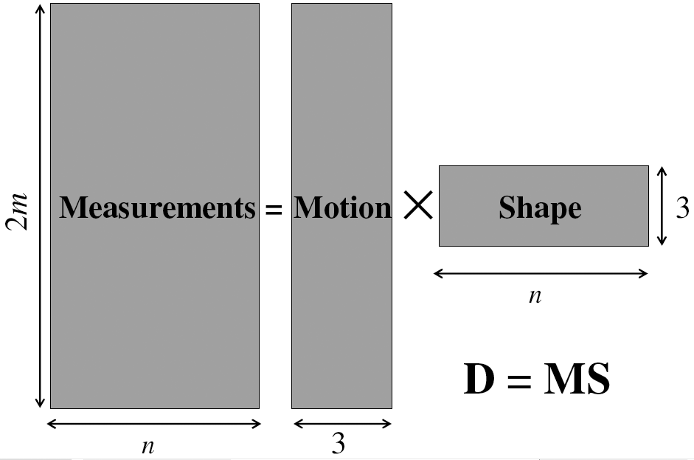
Factorizing the measurement matrix
AX
Source: M. Hebert

Slide 45
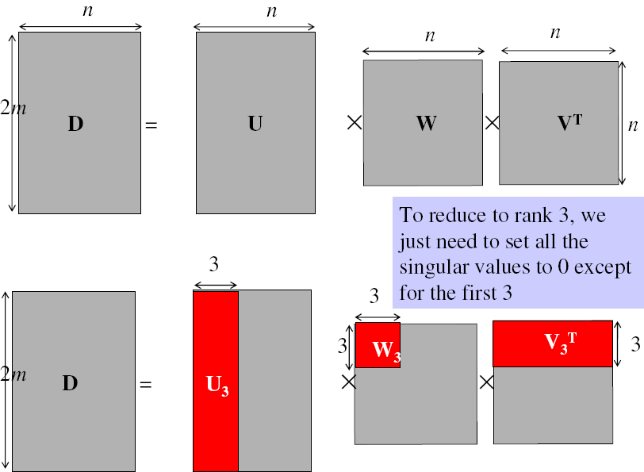
Factorizing the measurement matrix
Singular value decomposition of D:
Source: M. Hebert

Slide 46
Factorizing the measurement matrix
Singular value decomposition of D:
Source: M. Hebert

Slide 47
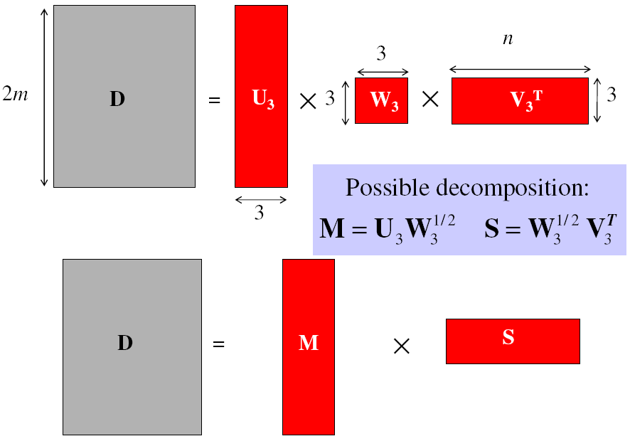
Factorizing the measurement matrix
Obtaining a factorization from SVD:
Source: M. Hebert

Slide 48
Factorizing the measurement matrix
Obtaining a factorization from SVD:
Source: M. Hebert

Slide 49
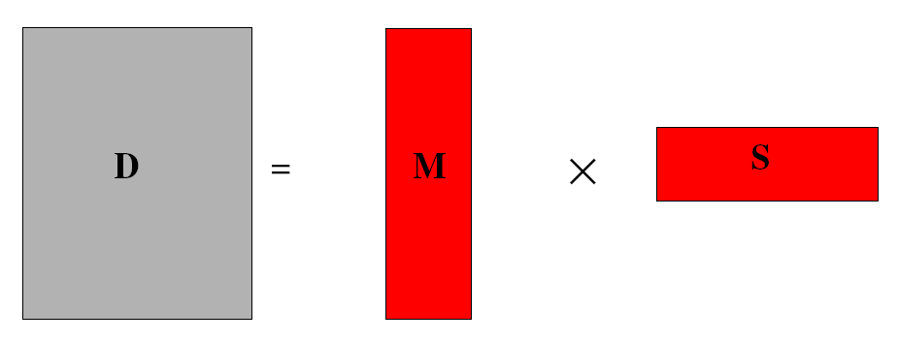
Affine ambiguity
The decomposition is not unique. We get the same D by using any 3×3 matrix C and applying the transformations A → AC, X →C⁻¹X
That is because we have only an affine transformation and we have not enforced any Euclidean constraints (like forcing the image axes to be perpendicular, for example)
Source: M. Hebert

Slide 50
Eliminating the affine ambiguity
Orthographic: image axes are perpendicular and of unit length
a₁ · a₂ = 0
x
|a₁|² = |a₂|² = 1
a₂
a₁
X
Source: M. Hebert

Slide 51
Solve for orthographic constraints
Three equations for each image i
Solve for L = CC^{T}
Recover C from L by Cholesky decomposition:
L = CC^{T}
Update A and X: A = AC, X = C⁻¹X
where
~
~

Slide 52


How to solve L = CC^{T} ?
$$\left[a b c\right]\left[\begin{matrix}L_{11} & L_{21} & L_{31} \\ L_{12} & L_{22} & L_{32} \\ L_{13} & L_{23} & L_{33}\end{matrix}\right]\left[\begin{aligned}d \\ e \\ f\end{aligned}\right]=k$$
$$\left[ad bd cd ae be ce af bf cf\right]\left[\begin{aligned}L_{11} \\ L_{12} \\ L_{13} \\ L_{21} \\ L_{22} \\ L_{23} \\ L_{31} \\ L_{32} \\ L_{33}\end{aligned}\right]=k$$
reshape([a b c]’*[d e f], [1, 9])

Slide 53
Algorithm summary
Given: m images and n tracked features x_{ij}
For each image i, center the feature coordinates
Construct a 2m × n measurement matrix D:
  Column j contains the projection of point j in all views
  Row i contains one coordinate of the projections of all the n points in image i
Factorize D:
  Compute SVD: D = U W V^{T}
  Create U₃ by taking the first 3 columns of U
  Create V₃ by taking the first 3 columns of V
  Create W₃ by taking the upper left 3 × 3 block of W
Create the motion (affine) and shape (3D) matrices:
  A = U₃W₃^{½} and S = W₃^{½} V₃^{T}
Eliminate affine ambiguity
  Solve L = CC^{T} using metric constraints
  Solve C using Cholesky decomposition
  Update A and X: A = AC, S = C⁻¹S
Source: M. Hebert

Slide 54
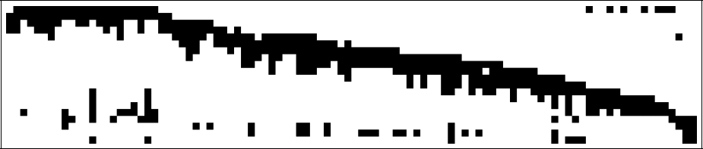
Dealing with missing data
So far, we have assumed that all points are visible in all views
In reality, the measurement matrix typically looks something like this:
One solution:
  solve using a dense submatrix of visible points
  Iteratively add new cameras
cameras
points

Slide 55
Reconstruction results
C. Tomasi and T. Kanade. Shape and motion from image streams under orthography:
A factorization method. IJCV, 9(2):137-154, November 1992.

Slide 56
Further reading
Short explanation of Affine SfM: class notes from Lischinksi and Gruber
http://www.cs.huji.ac.il/~csip/sfm.pdf
Clear explanation of epipolar geometry and projective SfM
  http://mi.eng.cam.ac.uk/~cipolla/publications/contributionToEditedBook/2008-SFM-chapters.pdf

Slide 57
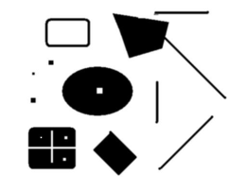
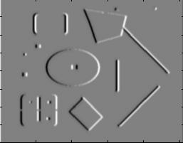
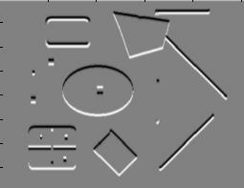
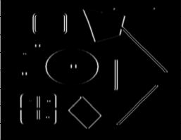
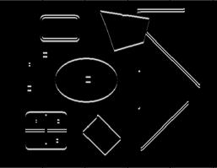
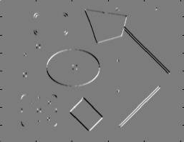
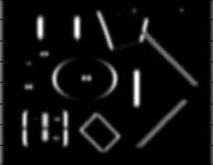
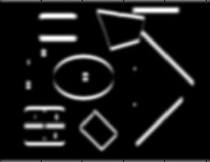
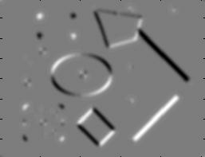
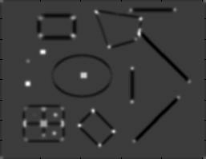
Review of Affine SfM from Interest Points
Detect interest points (e.g., Harris)
I_{x}
I_{y}
1. Image derivatives
I_{x}²
I_{y}²
I_{x}I_{y}
2. Square of derivatives
3. Gaussian
filter g(σ_{I})
g(I_{x}²)
g(I_{y}²)
g(I_{x}I_{y})
4. Cornerness function – both eigenvalues are strong
5. Non-maxima suppression
har

Slide 58
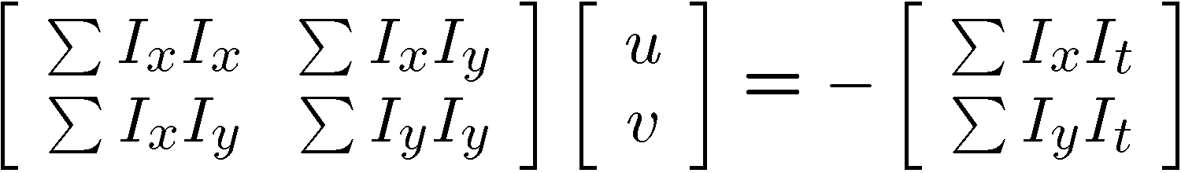
Review of Affine SfM from Interest Points
2. Correspondence via Lucas-Kanade tracking
Original (x,y) position
  Initialize (x’,y’) = (x,y)
  Compute (u,v) by
  Shift window by (u, v): x’=x’+u; y’=y’+v;
  Recalculate I_{t}
  Repeat steps 2-4 until small change
    Use interpolation for subpixel values
I_{t} = I(x’, y’, t+1) - I(x, y, t)
2nd moment matrix for feature patch in first image
displacement

Slide 59
Review of Affine SfM from Interest Points
3. Get Affine camera matrix and 3D points using Tomasi-Kanade factorization
Solve for orthographic constraints

Slide 60



HW 3 – Part 1-A. Vanishing points
% Load the image
im = imread(‘new_classroom_building.jpg’);
% Manually select at least three lines
(press q to stop)
vp = getVanishingPoint(im);
lines – [3 x N], N >= 3
line equation (a, b, c): au + bv + c = 0
Problem: Solving the VPs using lines
1. Find points at the intersections of each pair of lines. Take the mean as your VP.
  -> less accurate
2. Find a point that minimizes the sum of the distances to the lines. Solve for VP using A\b;
$$\left[\begin{aligned}\begin{matrix}a_{1} & b_{1} \\ a_{2} & b_{2}\end{matrix} \\ a_{3} b_{3}\end{aligned}\right]\left[\begin{aligned}u \\ v\end{aligned}\right]=\left[\begin{aligned}−1 \\ −1 \\ −1\end{aligned}\right]$$
3. Maximum likelihood estimate to minimize averaged angular differences (L-M)
Write-up
Plot the VPs and the lines used to estimate them on the image plane.
Specify the three VPs (u,v) in the image plane
Plot the ground horizon line and specify its normalized parameters: au + bv + c = 0

Slide 61







HW 3 – Part 1-B. Finding K
VPs = [vp1, vp2, vp3] - [3 x 3]
Unknown camera parameters $f,{ u}_{0}, v_{0}$
$$K =\left[\begin{matrix}f & 0 & u_{0} \\ 0 & f & v_{0} \\ 0 & 0 & 1\end{matrix}\right]$$
Problem: Solving intrinsic matrix K
Orthogonality constraints
$$X_{i}^{⊤}X_{j}=0$$
$$K^{−1}=\left[\begin{matrix}\frac{1}{f} & 0 & −\frac{u_{0}}{f} \\ 0 & \frac{1}{f} & −\frac{v_{0}}{f} \\ 0 & 0 & 1\end{matrix}\right]$$
VP (3D)
VP (2D)
$$X_{i}=R^{−1}K^{−1}p_{i}$$
$$p_{i}^{⊤}{\left(K^{−1}\right)}^{⊤}{(K}^{−1})p_{j}=0$$
Approach 1:
Closed-form solution: solve ${ u}_{0}, v_{0}$ first and then solve f
Approach 2:
Use numerical solver, e.g., fsolve
Write-up
Show the process of finding camera focal length and optical center
Report the estimated camera focal length (f) and optical center (u0, v0).

Slide 62

HW 3 – Part 1-C. Finding R
VPs = [vp1, vp2, vp3] - [3 x 3]
Problem: Solving rotation matrix R
Rotation matrix $R=\left[r_{1} r_{2} r_{3}\right]$
$$p_{i}=KRX_{i}$$
Set directions of vanishing points
$$X_{1}={\left[1,0, 0\right]}^{⊤}$$
$$X_{2}={\left[0,1, 0\right]}^{⊤}$$
$$X_{3}={\left[0,0, 1\right]}^{⊤}$$
$$p_{1}=Kr_{1}$$
$$p_{2}=Kr_{2}$$
$$p_{3}=Kr_{3}$$
  Special properties of R
    inv(R)=R^{T}
    Each row and column of R has unit length
Write-up
Describe how to compute the camera’s rotation matrix.
Compute the rotation matrix for this image, vertical VP = [0, 1, 0],
the right-most VP=[1,0,0], left-most VP = [0, 0, 1].

Slide 63



HW 3 – Part 1-D. Single-view metrology
Problem: Estimate the height of building, tractor, and camera
Height of sign = 1.65m
image cross ratio
$$r$$
$$b$$
Write-up
Turn in an illustration that shows the horizon line, and the lines and measurements used to estimate the heights of the building, tractor, and camera.
Report the estimated heights of the building, tractor, and camera in meters.

Slide 64


HW 3 – Part 2 Epipolar Geometry
Problem: recover F from matches with outliers
load matches.mat
[c1, r1] – 477 x 2
[c2, r2] – 500 x 2
matches – 252 x 2
matches(:,1): matched point in im1
matches(:,2): matched point in im2
Write-up:
Describe what test you used for deciding inlier vs. outlier.
Display the estimated fundamental matrix F after normalizing to unit length
Plot the outlier keypoints with green dots on top of the first image plot(x, y, '.g');
Plot the corresponding epipolar lines

Slide 65

Distance of point to epipolar line
l=Fx=[a b c]
.
x
.
x‘=[u v 1]
$$d\left(l,x^{′}\right)=\frac{|au+bv+c|}{\sqrt{a^{2}+b^{2}}}$$

Slide 66


HW 3 – Part 3 Affine SfM
Problem: recover motion and structure
load tracks.mat
track_x – [500 x 51]
track_y - [500 x 51]
Use plotSfM(A, S) to diplay motion and shape
A – [2m x 3] motion matrix
S – [3 x n]

Slide 67
HW 3 – Part 3 Affine SfM
Eliminate affine ambiguity
where
Solve for L = CC^{T}
  L = reshape(A\b, [3,3]); % A - 3m x 9, b – 3m x 1
Recover C from L by Cholesky decomposition: L = CC^{T}
Update A and X: A = AC, X = C⁻¹X

Slide 68

Multi-view stereo

Slide 69
Multi-view stereo
Generic problem formulation: given several images of the same object or scene, compute a representation of its 3D shape
“Images of the same object or scene”
  Arbitrary number of images (from two to thousands)
  Arbitrary camera positions (special rig, camera network
  or video sequence)
  Calibration may be known or unknown
“Representation of 3D shape”
  Depth maps
  Meshes
  Point clouds
  Patch clouds
  Volumetric models
  ….

Slide 70




Multi-view stereo: Basic idea
Source: Y. Furukawa

Slide 71

Multi-view stereo: Basic idea
Source: Y. Furukawa

Slide 72
Multi-view stereo: Basic idea
Source: Y. Furukawa

Slide 73
Multi-view stereo: Basic idea
Source: Y. Furukawa

Slide 74
Plane Sweep Stereo
input image
input image
reference camera
Sweep family of planes at different depths w.r.t. a reference camera
  For each depth, project each input image onto that plane
  This is equivalent to a homography warping each input image into the reference view
What can we say about the scene points that are at the right depth?
R. Collins. A space-sweep approach to true multi-image matching. CVPR 1996.

Slide 75
Plane Sweep Stereo
Scene surface
Sweeping plane
Image 2
Image 1

Slide 76






Plane Sweep Stereo
For each depth plane
  For each pixel in the composite image stack, compute the variance
For each pixel, select the depth that gives the lowest variance
Can be accelerated using graphics hardware
R. Yang and M. Pollefeys. Multi-Resolution Real-Time Stereo on Commodity Graphics Hardware, CVPR 2003

Slide 77


Merging depth maps
Given a group of images, choose each one as reference and compute a depth map w.r.t. that view using a multi-baseline approach
Merge multiple depth maps to a volume or a mesh (see, e.g., Curless and Levoy 96)
Map 1
Map 2
Merged

Slide 78


Stereo from community photo collections
Need structure from motion to recover unknown camera parameters
Need view selection to find good groups of images on which to run dense stereo

Slide 79


Slide 80


Slide 81


Slide 82

Towards Internet-Scale Multi-View Stereo
YouTube video, high-quality video
Yasutaka Furukawa, Brian Curless, Steven M. Seitz and Richard Szeliski, Towards Internet-scale Multi-view Stereo,CVPR 2010.

Slide 83

Internet-Scale Multi-View Stereo

Slide 84

The Visual Turing Test for Scene Reconstruction
Q. Shan, R. Adams, B. Curless, Y. Furukawa, and S. Seitz, "The Visual Turing Test for Scene Reconstruction," 3DV 2013.
Notes:
Abstract: We present the first large scale system for capturing and rendering relightable scene reconstructions from massive unstructured photo collections taken under different illumination conditions and viewpoints. We combine photos taken from many sources, Flickr-based ground-level imagery, oblique aerial views, and streetview, to recover models that are significantly more complete and detailed than previously demonstrated. We demonstrate the ability to match both the viewpoint and illumination of arbitrary input photos, enabling a Visual Turing Test in which photo and rendering are viewed side-by-side and the observer has to guess which is which. While we cannot yet fool human perception, the gap is closing.

Slide 85
The Reading List
“A computer algorithm for reconstructing a scene from two images”, Longuet-Higgins, Nature 1981
“Shape and motion from image streams under orthography:
A factorization method.” C. Tomasi and T. Kanade, IJCV, 9(2):137-154, November 1992
“In defense of the eight-point algorithm”, Hartley, PAMI 1997
“An efficient solution to the five-point relative pose problem”, Nister, PAMI 2004
“Accurate, dense, and robust multiview stereopsis”, Furukawa and Ponce, CVPR 2007
“Photo tourism: exploring image collections in 3d”, ACM SIGGRAPH 2006
“Building Rome in a day”, Agarwal et al., ICCV 2009
https://www.youtube.com/watch?v=kyIzMr917Rc, 3D Computer Vision: Past, Present, and Future

Slide 86

Next class
Grouping and Segmentation

