Slide 1
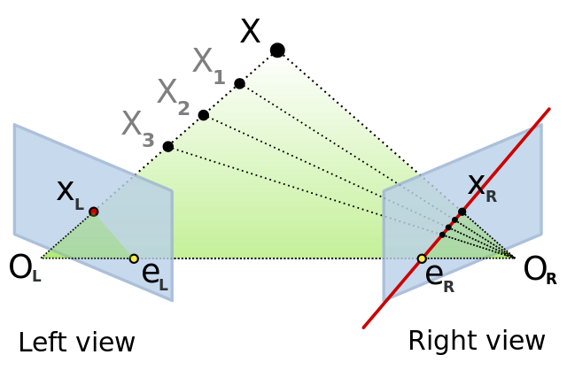
Epipolar Geometry and Stereo Vision
Computer Vision
Jia-Bin Huang, Virginia Tech
Many slides from S. Seitz and D. Hoiem

Slide 2
Last class: Image Stitching
Two images with rotation/zoom but no translation
.
X
x
x'
f
f'

Slide 3
This class: Two-View Geometry
Epipolar geometry
  Relates cameras from two positions
Stereo depth estimation
  Recover depth from two images

Slide 4
Depth from Stereo
Goal: recover depth by finding image coordinate x’ that corresponds to x
X
X
x
z
x
x’
x'
f
f
C
Baseline
B
C’

Slide 5
Depth from Stereo
Goal: recover depth by finding image coordinate x’ that corresponds to x
Sub-Problems
  Calibration: How do we recover the relation of the cameras (if not already known)?
  Correspondence: How do we search for the matching point x’?
X
x
x'

Slide 6
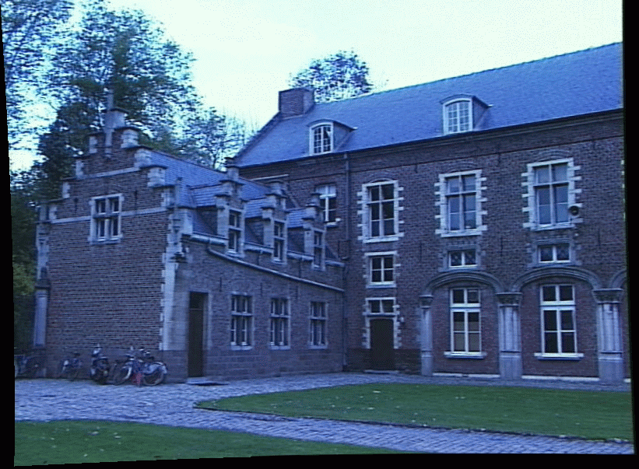
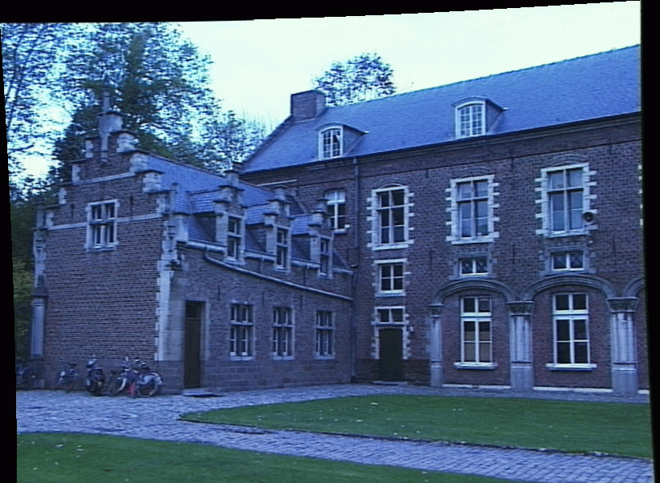
Correspondence Problem
x
?
We have two images taken from cameras with different intrinsic and extrinsic parameters
How do we match a point in the first image to a point in the second? How can we constrain our search?

Slide 7
Key idea: Epipolar constraint

Slide 8
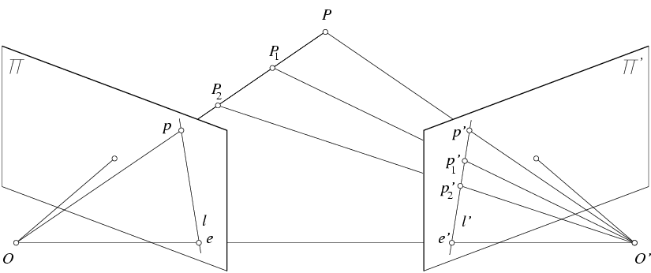
Key idea: Epipolar constraint
X
X
X
x
x’
x’
x’
Potential matches for x have to lie on the corresponding line l’.
Potential matches for x’ have to lie on the corresponding line l.

Slide 9
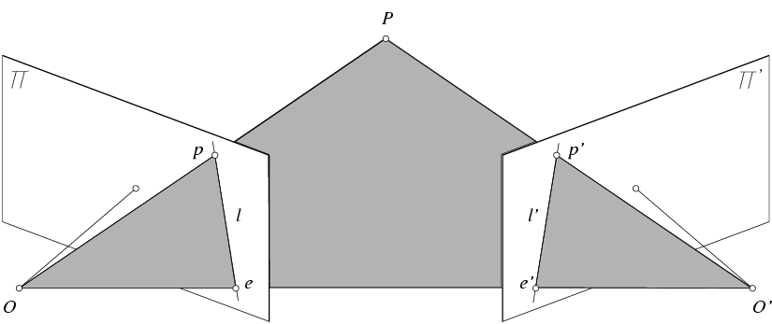
Epipolar geometry: notation
X
x
x’
Baseline – line connecting the two camera centers
Epipoles
= intersections of baseline with image planes
= projections of the other camera center
Epipolar Plane – plane containing baseline (1D family)

Slide 10
Epipolar geometry: notation
X
x
x’
Baseline – line connecting the two camera centers
Epipoles
= intersections of baseline with image planes
= projections of the other camera center
Epipolar Plane – plane containing baseline (1D family)
Epipolar Lines - intersections of epipolar plane with image
planes (always come in corresponding pairs)

Slide 11
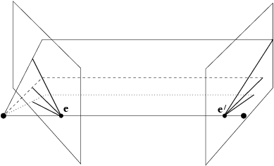
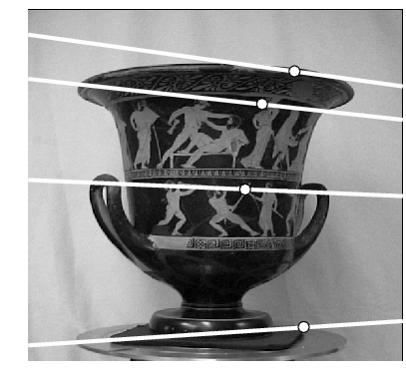
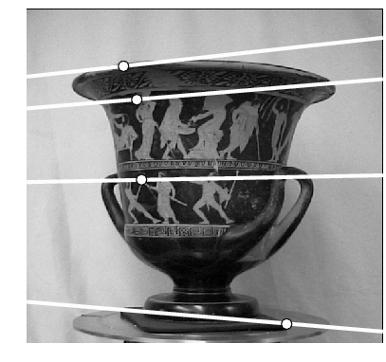
Example: Converging cameras

Slide 12
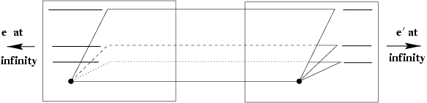
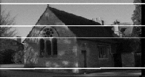
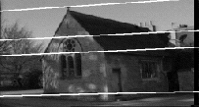
Example: Motion parallel to image plane

Slide 13
Example: Forward motion
What would the epipolar lines look like if the camera moves directly forward?

Slide 14
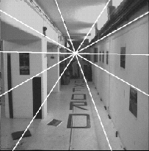
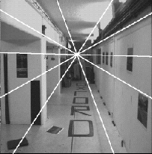
Example: Forward motion
e’
e
Epipole has same coordinates in both images.
Points move along lines radiating from e: “Focus of expansion”

Slide 15
Epipolar constraint: Calibrated case
X
x
x’
Given the intrinsic parameters of the cameras:
  Convert to normalized coordinates by pre-multiplying all points with the inverse of the calibration matrix; set first camera’s coordinate system to world coordinates
3D scene point
Homogeneous 2d point (3D ray towards X)
2D pixel coordinate (homogeneous)
3D scene point in 2nd camera’s 3D coordinates

Slide 16
Epipolar constraint: Calibrated case
X
x
x’
Given the intrinsic parameters of the cameras:
  Convert to normalized coordinates by pre-multiplying all points with the inverse of the calibration matrix; set first camera’s coordinate system to world coordinates
  Define some R and t that relate X to X’ as below
for some scale factor

Slide 17





Epipolar constraint: Calibrated case
X
x
x’
$$\hat{x}$$
$${\hat{x}}^{′}$$
(because $\hat{x}, R{\hat{x}}^{′},$ and $t$ are co-planar)
$$t×\hat{x}=t×\left(R {\hat{x}}^{′}+t\right)=t×(R {\hat{x}}^{′})$$
$$\hat{x}⋅\left(t×\hat{x}\right)=\hat{x}\left[ t×\left(R {\hat{x}}^{′}\right)\right]=0$$
Notes:
X’ is X in the second camera’s coordinate system
We can identify the non-homogeneous 3D vectors X and X’ with the homogeneous coordinate vectors x and x’ of the projections of the two points into the two respective images

Slide 18


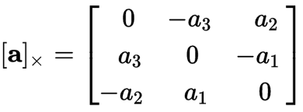

Essential matrix
X
x
x’
Essential Matrix
(Longuet-Higgins, 1981)
Notes:
[t]_{x} is the skew symmetric matrix of t

Slide 19
Properties of the Essential matrix
X
x
x’
Drop ^ below to simplify notation
E x’ is the epipolar line associated with x’ (l = E x’)
E^{T}x is the epipolar line associated with x (l’ = E^{T}x)
E e’ = 0 and E^{T}e = 0
E is singular (rank two)
E has five degrees of freedom
  (3 for R, 2 for t because it’s up to a scale)
Skew-symmetric matrix

Slide 20
Epipolar constraint: Uncalibrated case
X
x
x’
If we don’t know K and K’, then we can write the epipolar constraint in terms of unknown normalized coordinates:

Slide 21
The Fundamental Matrix
Without knowing K and K’, we can define a similar relation using unknown normalized coordinates
Fundamental Matrix
(Faugeras and Luong, 1992)

Slide 22
Properties of the Fundamental matrix
X
x
x’
F x’ is the epipolar line associated with x’ (l = F x’)
F^{T}x is the epipolar line associated with x (l’ = F^{T}x)
F e’ = 0 and F^{T}e = 0
F is singular (rank two): det(F)=0
F has seven degrees of freedom: 9 entries but defined up to scale, det(F)=0

Slide 23
Estimating the Fundamental Matrix
8-point algorithm
  Least squares solution using SVD on equations from 8 pairs of correspondences
  Enforce det(F)=0 constraint using SVD on F
7-point algorithm
  Use least squares to solve for null space (two vectors) using SVD and 7 pairs of correspondences
  Solve for linear combination of null space vectors that satisfies det(F)=0
Minimize reprojection error
  Non-linear least squares
Note: estimation of F (or E) is degenerate for a planar scene.

Slide 24
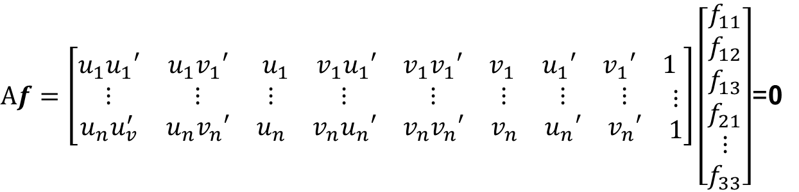
8-point algorithm
Solve a system of homogeneous linear equations
  Write down the system of equations
$$uu^{′}f_{11}+uv^{′}f_{12}+uf_{13}+vu^{′}f_{21}+vv^{′}f_{22}+vf_{23}+u^{′}f_{31}+v^{′}f_{32}+f_{33}=0$$
$Af=\left[\begin{matrix}u_{1}u_{1}′ & u_{1}v_{1}′ & \begin{matrix}u_{1} & v_{1}u_{1}′ & \begin{matrix}v_{1}v_{1}′ & v_{1} & \begin{matrix}u_{1}′ & v_{1}′ & 1\end{matrix}\end{matrix}\end{matrix} \\ \begin{matrix}⋮ \\ u_{n}u_{v}^{′}\end{matrix} & \begin{matrix}⋮ \\ u_{n}v_{n}′\end{matrix} & \begin{matrix}\begin{matrix}⋮ \\ u_{n}\end{matrix} & \begin{matrix}⋮ \\ v_{n}u_{n}′\end{matrix} & \begin{matrix}\begin{matrix}⋮ \\ v_{n}v_{n}′\end{matrix} & \begin{matrix}⋮ \\ v_{n}\end{matrix} & \begin{matrix}\begin{matrix}⋮ \\ u_{n}′\end{matrix} & \begin{matrix}⋮ \\ v_{n}′\end{matrix} & \begin{matrix}⋮ \\ 1\end{matrix}\end{matrix}\end{matrix}\end{matrix}\end{matrix}\right]\left[\begin{matrix}f_{11} \\ f_{12} \\ \begin{aligned}f_{13} \\ f_{21} \\ ⋮ \\ f_{33}\end{aligned}\end{matrix}\right]$=0

Slide 25
8-point algorithm
Solve a system of homogeneous linear equations
  Write down the system of equations
  Solve f from Af=0 using SVD
Matlab:
[U, S, V] = svd(A);
f = V(:, end);
F = reshape(f, [3 3])’;

Slide 26
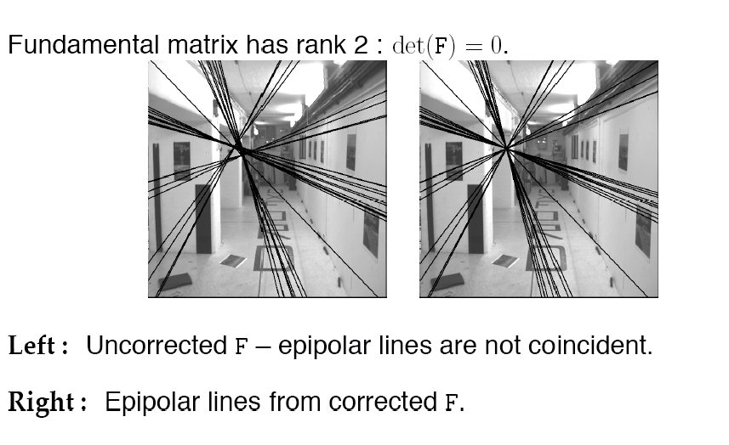
Need to enforce singularity constraint

Slide 27
8-point algorithm
Solve a system of homogeneous linear equations
  Write down the system of equations
  Solve f from Af=0 using SVD
Resolve det(F) = 0 constraint using SVD
Matlab:
[U, S, V] = svd(A);
f = V(:, end);
F = reshape(f, [3 3])’;
Matlab:
[U, S, V] = svd(F);
S(3,3) = 0;
F = U*S*V’;

Slide 28

8-point algorithm
Solve a system of homogeneous linear equations
  Write down the system of equations
  Solve f from Af=0 using SVD
Resolve det(F) = 0 constraint by SVD
Notes:
Use RANSAC to deal with outliers (sample 8 points)
  How to test for outliers?
Solve in normalized coordinates
  mean=0
  standard deviation ~= (1,1,1)
  just like with estimating the homography for stitching
$${|x}^{′}F x |<threshold?$$
Notes:
Test for outliers by computing distance from epipolar line to corresponding point (NOT by taking square of x^{T}Fx’)

Slide 29
Comparison of homography estimation and the 8-point algorithm
Assume we have matched points x x’ with outliers
Homography (No Translation)
Fundamental Matrix (Translation)
Correspondence Relation
Normalize image coordinates
RANSAC with 4 points
  Solution via SVD
De-normalize:
Correspondence Relation
Normalize image coordinates
RANSAC with 8 points
  Initial solution via SVD
  Enforce by SVD
De-normalize:

Slide 30
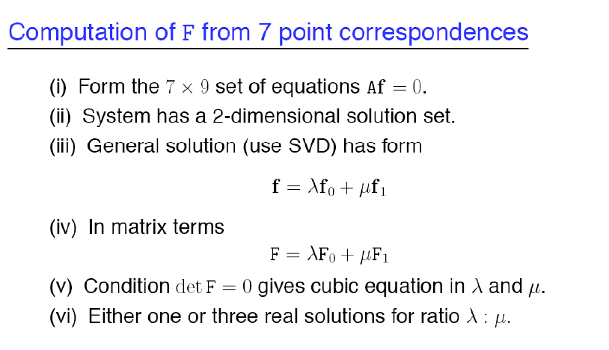
7-point algorithm
Faster (need fewer points) and could be more robust (fewer points), but also need to check for degenerate cases

Slide 31
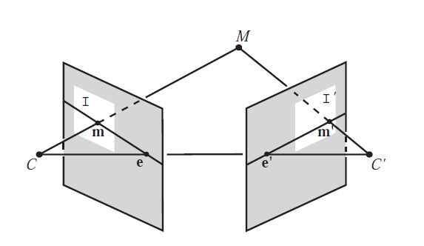
“Gold standard” algorithm
Use 8-point algorithm to get initial value of F
Use F to solve for P and P’ (discussed later)
Jointly solve for 3d points X and F that minimize the squared re-projection error
X
x
x'
See Algorithm 11.2 and Algorithm 11.3 in HZ (pages 284-285) for details

Slide 32
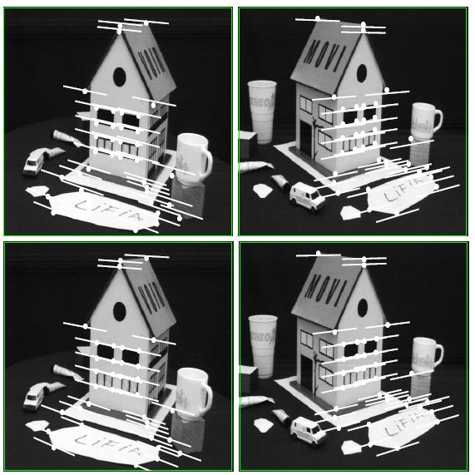
Comparison of estimation algorithms
 | 8-point | Normalized 8-point | Nonlinear least squares
Av. Dist. 1 | 2.33 pixels | 0.92 pixel | 0.86 pixel
Av. Dist. 2 | 2.18 pixels | 0.85 pixel | 0.80 pixel

Slide 33
We can get projection matrices P and P’ up to a projective ambiguity
K’*rotation
K’*translation
Code:
function P = vgg_P_from_F(F)
[U,S,V] = svd(F);
e = U(:,3);
P = [-vgg_contreps(e)*F e];
See HZ p. 255-256
If we know the intrinsic matrices (K and K’), we can resolve the ambiguity

Slide 34
From epipolar geometry to camera calibration
Estimating the fundamental matrix is known as “weak calibration”
If we know the calibration matrices of the two cameras, we can estimate the essential matrix: E = K^{T}FK’
The essential matrix gives us the relative rotation and translation between the cameras, or their extrinsic parameters

Slide 35

Let’s recap…
Fundamental matrix song

Slide 36
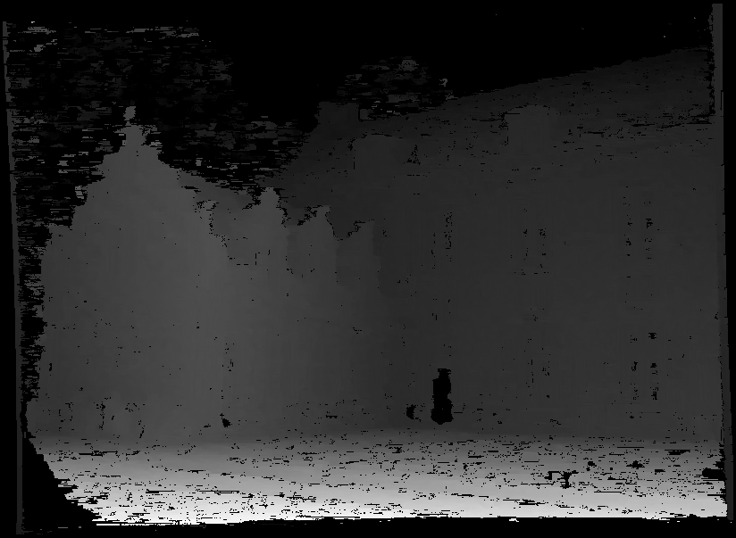
Moving on to stereo…
Fuse a calibrated binocular stereo pair to produce a depth image
image 1
image 2
Dense depth map
Many of these slides adapted from Steve Seitz and Lana Lazebnik

Slide 37
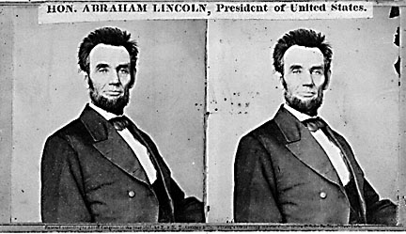
Basic stereo matching algorithm
For each pixel in the first image
  Find corresponding epipolar line in the right image
  Search along epipolar line and pick the best match
  Triangulate the matches to get depth information
Simplest case: epipolar lines are scanlines
  When does this happen?

Slide 38
Simplest Case: Parallel images
Image planes of cameras are parallel to each other and to the baseline
Camera centers are at same height
Focal lengths are the same

Slide 39
Simplest Case: Parallel images
Image planes of cameras are parallel to each other and to the baseline
Camera centers are at same height
Focal lengths are the same
Then, epipolar lines fall along the horizontal scan lines of the images

Slide 40
Simplest Case: Parallel images
Epipolar constraint:
R = I t = (T, 0, 0)
x
x’
t
The y-coordinates of corresponding points are the same

Slide 41
Depth from disparity
X
z
x
x’
f
f
O
Baseline
B
O’
Disparity is inversely proportional to depth.

Slide 42
Stereo image rectification

Slide 43
Stereo image rectification
Reproject image planes onto a common plane parallel to the line between camera centers
Pixel motion is horizontal after this transformation
Two homographies (3x3 transform), one for each input image reprojection
C. Loop and Z. Zhang. Computing Rectifying Homographies for Stereo Vision. IEEE Conf. Computer Vision and Pattern Recognition, 1999.

Slide 44
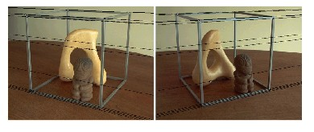
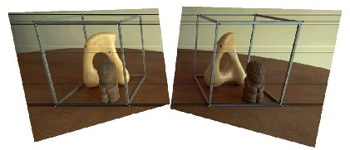
Rectification example

Slide 45
Basic stereo matching algorithm
If necessary, rectify the two stereo images to transform epipolar lines into scanlines
For each pixel x in the first image
  Find corresponding epipolar scanline in the right image
  Search the scanline and pick the best match x’
  Compute disparity x-x’ and set depth(x) = fB/(x-x’)

Slide 46
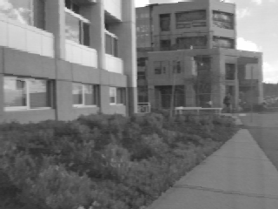
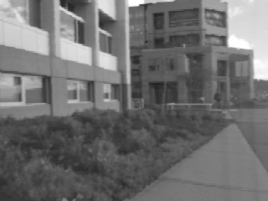
Correspondence search
Left
Right
scanline
Matching cost
disparity
Slide a window along the right scanline and compare contents of that window with the reference window in the left image
Matching cost: SSD or normalized correlation

Slide 47
Correspondence search
Left
Right
scanline
SSD

Slide 48
Correspondence search
Left
Right
scanline
Norm. corr

Slide 49
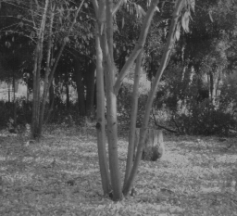
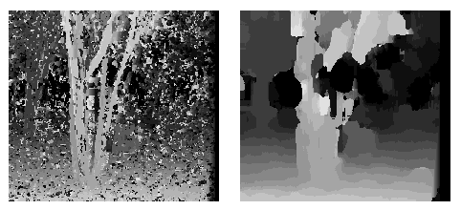
Effect of window size
W = 3
W = 20
Smaller window
  + More detail
  More noise
Larger window
  + Smoother disparity maps
  Less detail
  Fails near boundaries
Notes:
smaller window: more detail, more noise
bigger window: less noise, more detail

Slide 50

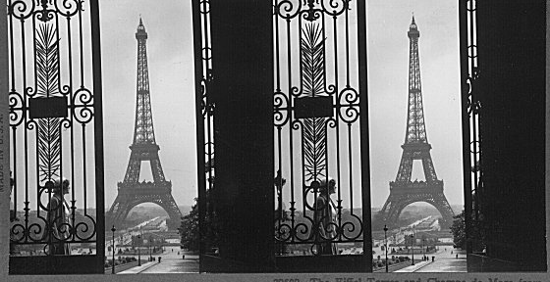
Failures of correspondence search
Textureless surfaces
Occlusions, repetition
Non-Lambertian surfaces, specularities

Slide 51
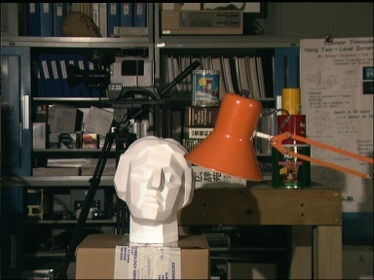
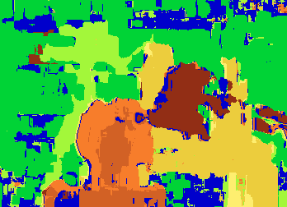

Results with window search
Data
Window-based matching
Ground truth

Slide 52
How can we improve window-based matching?
So far, matches are independent for each point
What constraints or priors can we add?

Slide 53
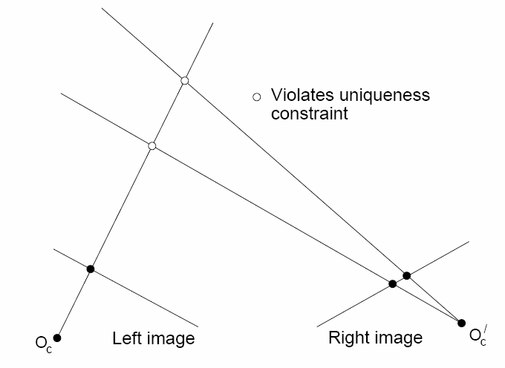
Stereo constraints/priors
Uniqueness
  For any point in one image, there should be at most one matching point in the other image

Slide 54
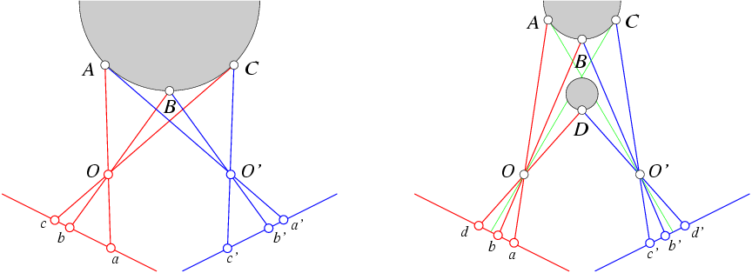
Stereo constraints/priors
Uniqueness
  For any point in one image, there should be at most one matching point in the other image
Ordering
  Corresponding points should be in the same order in both views

Slide 55
Stereo constraints/priors
Uniqueness
  For any point in one image, there should be at most one matching point in the other image
Ordering
  Corresponding points should be in the same order in both views
Ordering constraint doesn’t hold

Slide 56
Priors and constraints
Uniqueness
  For any point in one image, there should be at most one matching point in the other image
Ordering
  Corresponding points should be in the same order in both views
Smoothness
  We expect disparity values to change slowly (for the most part)

Slide 57
Stereo matching as energy minimization
I₁
I₂
D
W₁(i )
W₂(i+D(i ))
D(i )
Energy functions of this form can be minimized using graph cuts
  Y. Boykov, O. Veksler, and R. Zabih, Fast Approximate Energy Minimization via Graph Cuts, PAMI 2001

Slide 58
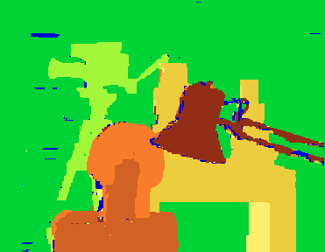
Many of these constraints can be encoded in an energy function and solved using graph cuts
Before
Graph cuts
Ground truth
  Y. Boykov, O. Veksler, and R. Zabih, Fast Approximate Energy Minimization via Graph Cuts, PAMI 2001
    For the latest and greatest: http://www.middlebury.edu/stereo/

Slide 59
Things to remember
Epipolar geometry
  Epipoles are intersection of baseline with image planes
  Matching point in second image is on a line passing through its epipole
  Fundamental matrix maps from a point in one image to a line (its epipolar line) in the other
  Can solve for F given corresponding points (e.g., interest points)
  Can recover canonical camera matrices from F (with projective ambiguity)
Stereo depth estimation
  Estimate disparity by finding corresponding points along scanlines
  Depth is inverse to disparity

Slide 60
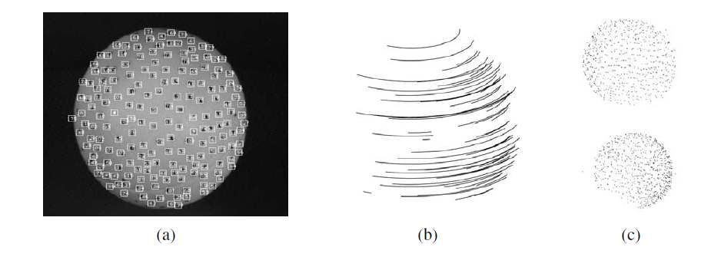
Next class: structure from motion

