Slide 1
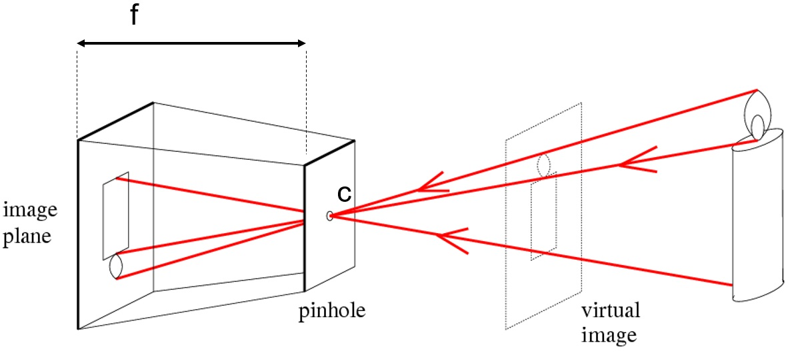
Projective Geometry and
Camera Models
Computer Vision
Jia-Bin Huang, Virginia Tech
Many slides from S. Seitz and D. Hoiem

Slide 2
Administrative stuffs
HWs
  HW 1 is back
  HW 2 due 11:59 PM on Oct 3rd.
  Frequently asked questions for HW 2
  HW 3 should be out by the end of this week
Think about your final projects
  work in groups of 2-4
  should evince independent effort to learn about a new topic, try something new, or apply to an application of interest
  Proposals will be due Oct 27

Slide 3
Top edge methods – average F-score
Subhashree (0.673)
  Canny for different channels with oriented filters
Shruti Phadke (0.66)
  Simple Gradient, colour channel splitting
Ben Zhao (0.658)
  Oriented Elongated Gaussian
Excellent HW 1 report:
Badour AlBahar

Slide 4
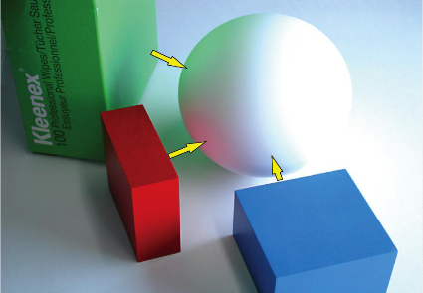
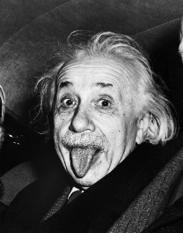

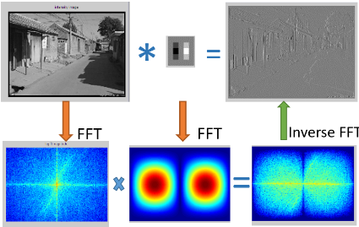



Review: Interpreting Intensity
Light and color
  What an image records
Filtering in spatial domain
  Filtering = weighted sum of neighboring pixels
  Smoothing, sharpening, measuring texture
Filtering in frequency domain
  Filtering = change frequency of the input image
  Denoising, sampling, image compression
Image pyramid and template matching
  Filtering = a way to find a template
  Image pyramids for coarse-to-fine search and multi-scale detection
Edge detection
  Canny edge = smooth -> derivative -> thin -> threshold -> link
  Finding straight lines, binary image analysis

Slide 5
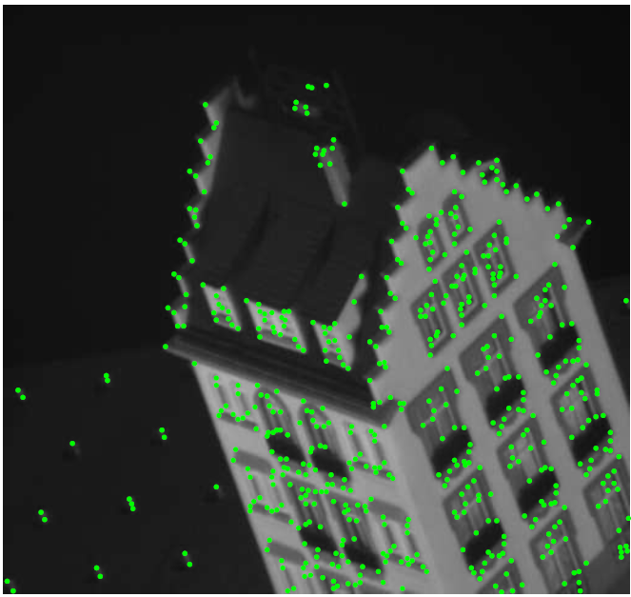
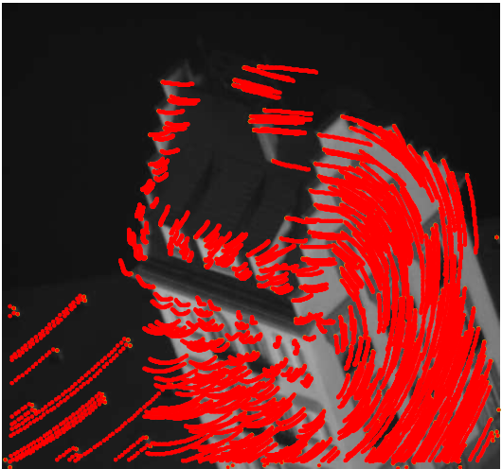
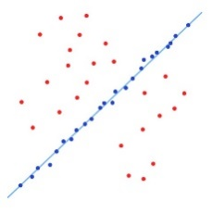
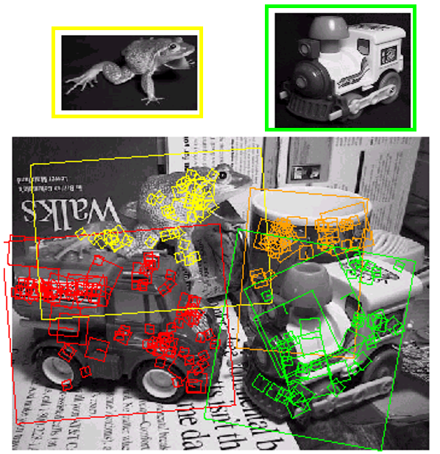
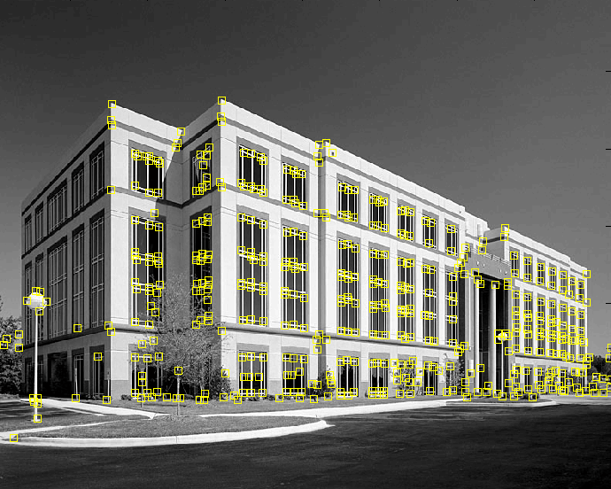
Review: Correspondence and Alignment
Interest points
  Find distinct and repeatable points in images
  Harris-> corners, DoG -> blobs
  SIFT -> feature descriptor
Feature tracking and optical flow
  Find motion of a keypoint/pixel over time
  Lucas-Kanade:
    brightness consistency, small motion, spatial coherence
  Handle large motion:
    iterative update + pyramid search
Fitting and alignment
  find the transformation parameters that
  best align matched points
Object instance recognition
  Keypoint-based object instance recognition and search

Slide 6
Perspective and 3D Geometry
Projective geometry and camera models
  What’s the mapping between image and world coordiantes?
Single view metrology and camera calibration
  How can we measure the size of 3D objects in an image?
  How can we estimate the camera parameters?
Photo stitching
  What’s the mapping from two images taken without camera translation?
Epipolar Geometry and Stereo Vision
  What’s the mapping from two images taken with camera translation?
Structure from motion
  How can we recover 3D points from multiple images?

Slide 7
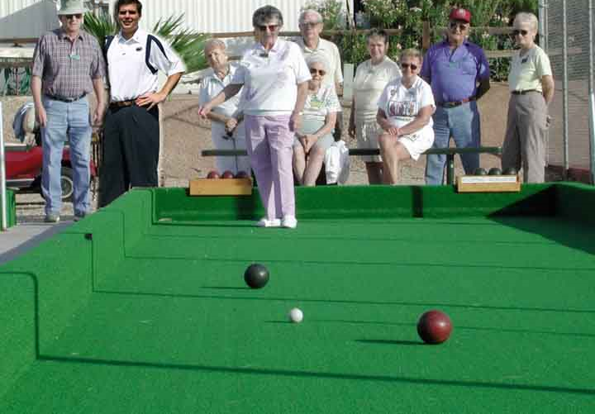
Next two classes:
Single-view Geometry
How tall is this woman?
How high is the camera?
What is the camera rotation?
What is the focal length of the camera?
Which ball is closer?

Slide 8
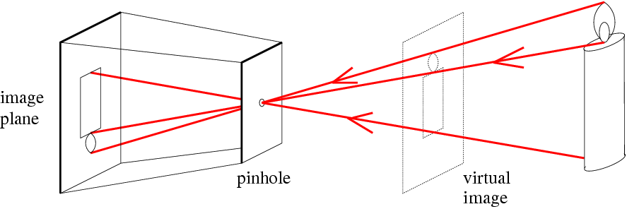
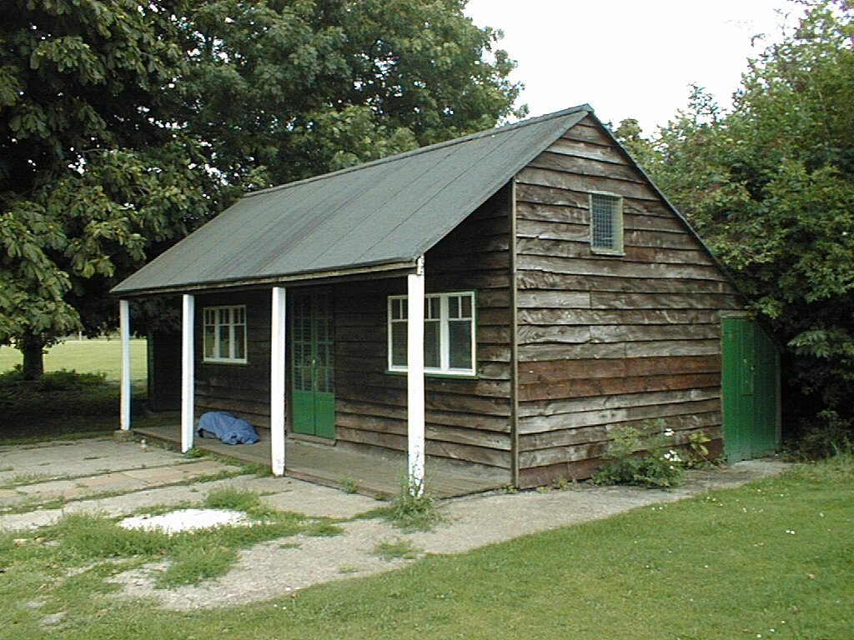
Today’s class
Mapping between image and world coordinates
Pinhole camera model
Projective geometry
  Vanishing points and lines
Projection matrix
Vertical vanishing
point
(at infinity)
Vanishing
line
Vanishing
point
Vanishing
point

Slide 9
Image formation
Let’s design a camera
  Idea 1: put a piece of film in front of an object
  Do we get a reasonable image?
Slide source: Seitz

Slide 10
Pinhole camera
Idea 2: add a barrier to block off most of the rays
  This reduces blurring
  The opening known as the aperture
Slide source: Seitz
Notes:
Q: How does this transform the image? A: It gets inverted

Slide 11
Pinhole camera
f
c
f = focal length
c = center of the camera
Figure from Forsyth

Slide 12
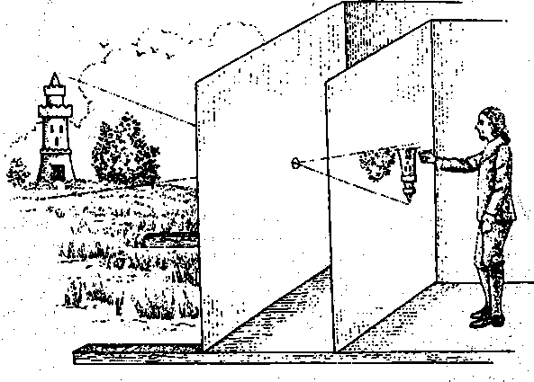
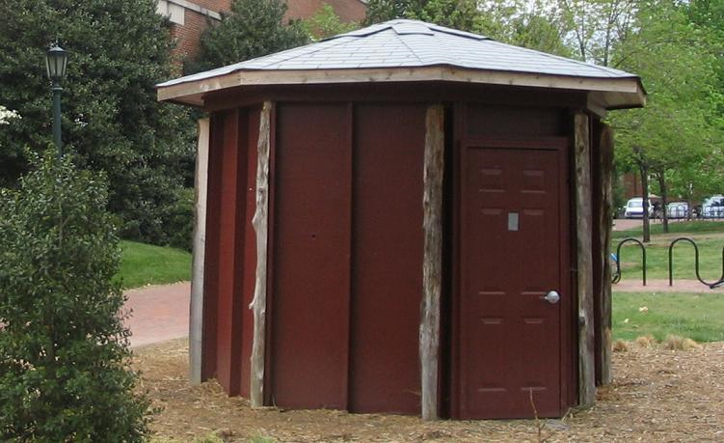
Camera obscura: the pre-camera
First idea: Mo-Ti, China (470BC to 390BC)
First built: Alhazen, Iraq/Egypt (965 to 1039AD)
Illustration of Camera Obscura
Freestanding camera obscura at UNC Chapel Hill
Photo by Seth Ilys
Notes:
Alhazen was born in Basra, moved to Egypt. Proposed to the king to control the Nile with a dam. Realized he couldn’t do it and feigned madness until the king died. During that time, he wrote the book of optics.

Slide 13
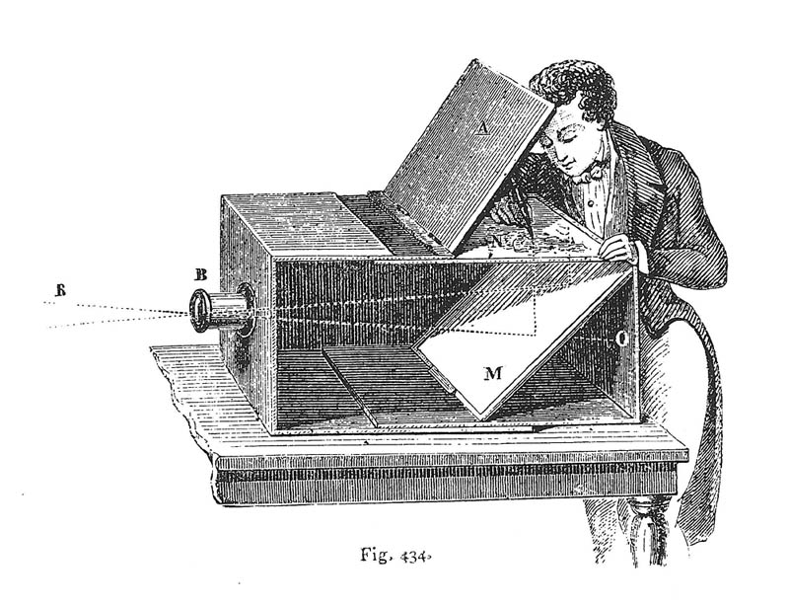
Camera Obscura used for Tracing
Lens Based Camera Obscura, 1568

Slide 14
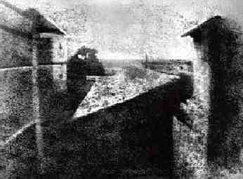
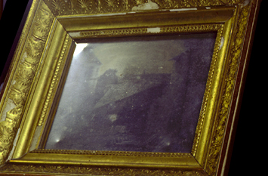
First Photograph
Oldest surviving photograph
  Took 8 hours on pewter plate
Photograph of the first photograph
Joseph Niepce, 1826
Stored at UT Austin
Niepce later teamed up with Daguerre, who eventually created Daguerrotypes

Slide 15
Dimensionality Reduction Machine (3D to 2D)
3D world
2D image
Figures © Stephen E. Palmer, 2002

Slide 16
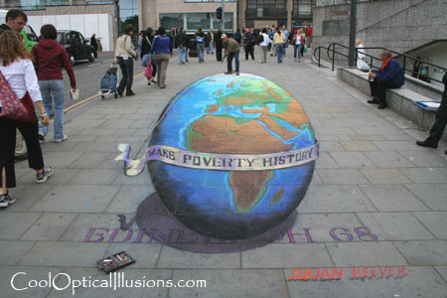
Projection can be tricky…
Slide source: Seitz

Slide 17
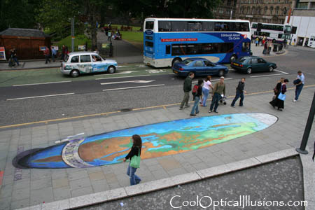
Projection can be tricky…
Slide source: Seitz
Making of 3D sidewalk art: http://www.youtube.com/watch?v=3SNYtd0Ayt0

Slide 18
Projective Geometry
What is lost?
Length
Who is taller?
Which is closer?

Slide 19
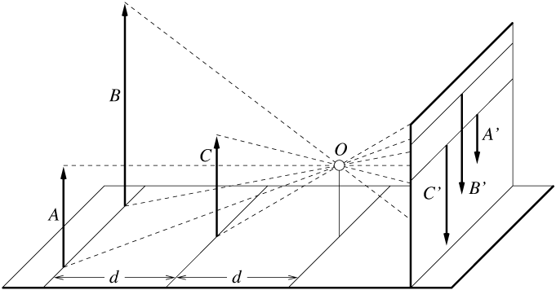
Length is not preserved
A’
C’
B’
Figure by David Forsyth

Slide 20
Projective Geometry
What is lost?
Length
Angles
Parallel?
Perpendicular?

Slide 21
Projective Geometry
What is preserved?
Straight lines are still straight

Slide 22
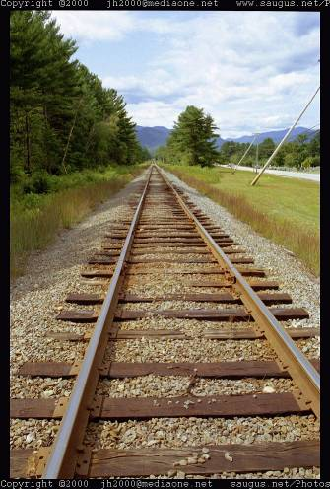
Vanishing points and lines
Parallel lines in the world intersect in the image at a “vanishing point”
Notes:
Go to board, sketch out various properties of vanishing points/lines

Slide 23
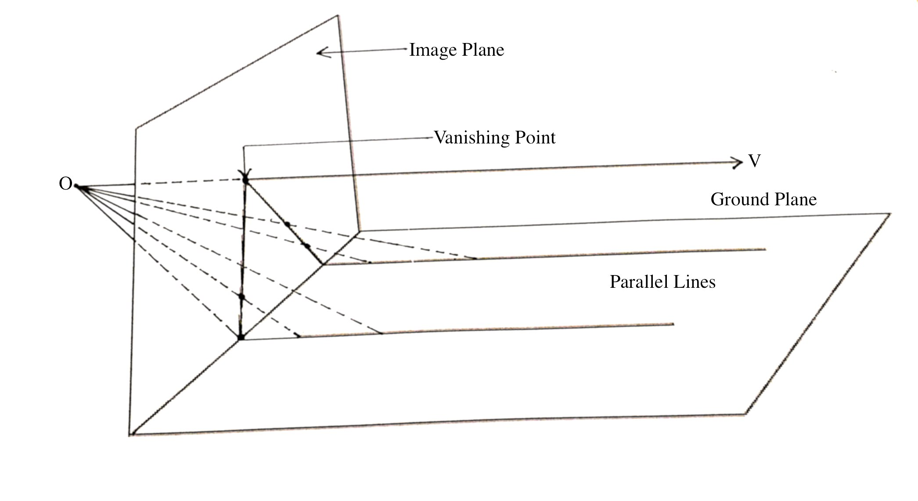
Vanishing points

Slide 24
Vanishing points and lines
Vanishing Point
Vanishing Point
o
o
Vanishing Line
The projections of parallel 3D lines intersect at a vanishing point
The projection of parallel 3D planes intersect at a vanishing line
If a set of parallel 3D lines are also parallel to a particular plane, their vanishing point will lie on the vanishing line of the plane
Not all lines that intersect are parallel
Vanishing point <-> 3D direction of a line
Vanishing line <-> 3D orientation of a surface
Notes:
Go to board, sketch out various properties of vanishing points/lines
Parallel lines intersect at a point
The intersection of red lines and blue lines form a parallelogram
Sets of parallel lines on the same plane form a vanishing line
Sets of parallel planes form a vanishing line
Not all lines that intersect are parallel

Slide 25
Vanishing points and lines
Vertical vanishing
point
(at infinity)
Vanishing
line
Vanishing
point
Vanishing
point
Slide from Efros, Photo from Criminisi

Slide 26
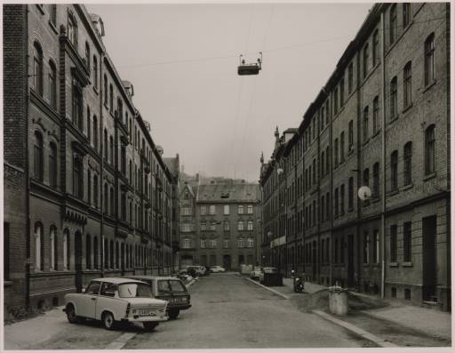
Vanishing points and lines
Photo from online Tate collection
Notes:
Where are the vanishing points? Do buildings on left and buildings on right have the same vanishing line? Which way is the camera tilted?

Slide 27
Note on estimating vanishing points
Use multiple lines for better accuracy
… but lines will not intersect at exactly the same point in practice
One solution: take mean of intersecting pairs
… bad idea!
Instead, minimize angular differences
Notes:
Go to board, sketch out various properties of vanishing points/lines

Slide 28

Vanishing objects

Slide 29
Projection: world coordinates→image coordinates
.
Optical Center (u₀, v₀)
.
.
Y
f
Z
X
.
v
Camera Center (t_{x}, t_{y}, t_{z})
u

Slide 30
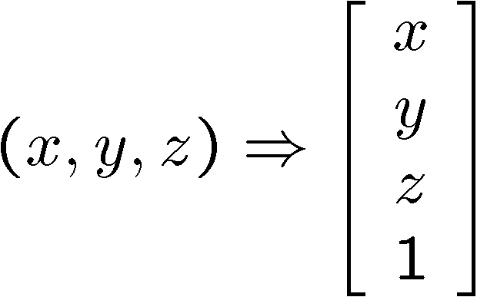
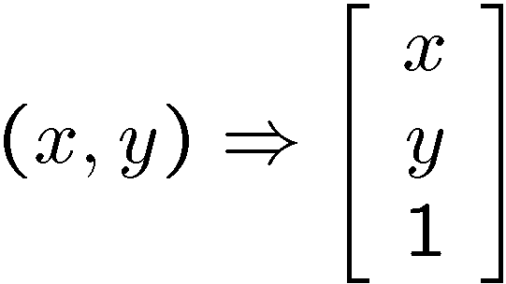
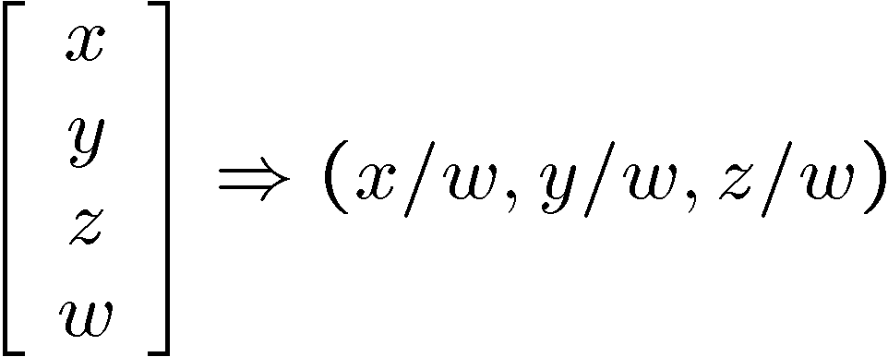
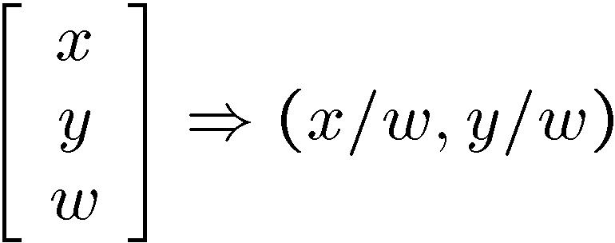
Homogeneous coordinates
Is this a linear transformation?
  no—division by z is nonlinear
Converting to homogeneous coordinates
homogeneous image
coordinates
homogeneous scene
coordinates
Converting from homogeneous coordinates
Notes:
Append coordinate with value 1; proportional coordinate system

Slide 31
Homogeneous coordinates
Invariant to scaling
Point in Cartesian is ray in Homogeneous
Homogeneous Coordinates
Cartesian Coordinates
Notes:
Q: Suppose we have a point in Cartesian coordinates. What is that in homogeneous coordinates? A: a ray

Slide 32






Basic geometry in homogeneous coordinates
Append 1 to pixel coordinate to get homogeneous coordinate
Line equation:
Line given by cross product of two points
Intersection of two lines given by cross product of the lines
Three points lies on the same line
Three lines intersect at the same point
$$line_{i}^{⊤}p=0$$
$$au+bv+c=0$$
$$line_{i}={\left[a b c\right]}^{⊤}$$
$$line_{ij}=p_{i}×p_{j}$$
$$p_{k}^{⊤}\left(p_{i}×p_{j}\right)=0$$
$${line}_{k}^{⊤}\left({line}_{i}×{line}_{j}\right)=0$$

Slide 33
Another problem solved by homogeneous coordinates
Intersection of parallel lines
  Cartesian: (Inf, Inf)
  Homogeneous: (1, 1, 0)
  Cartesian: (Inf, Inf)
Homogeneous: (1, 2, 0)
Notes:
Parallel lines intersect at different infinities

Slide 34
Interlude: where can this be useful?

Slide 35
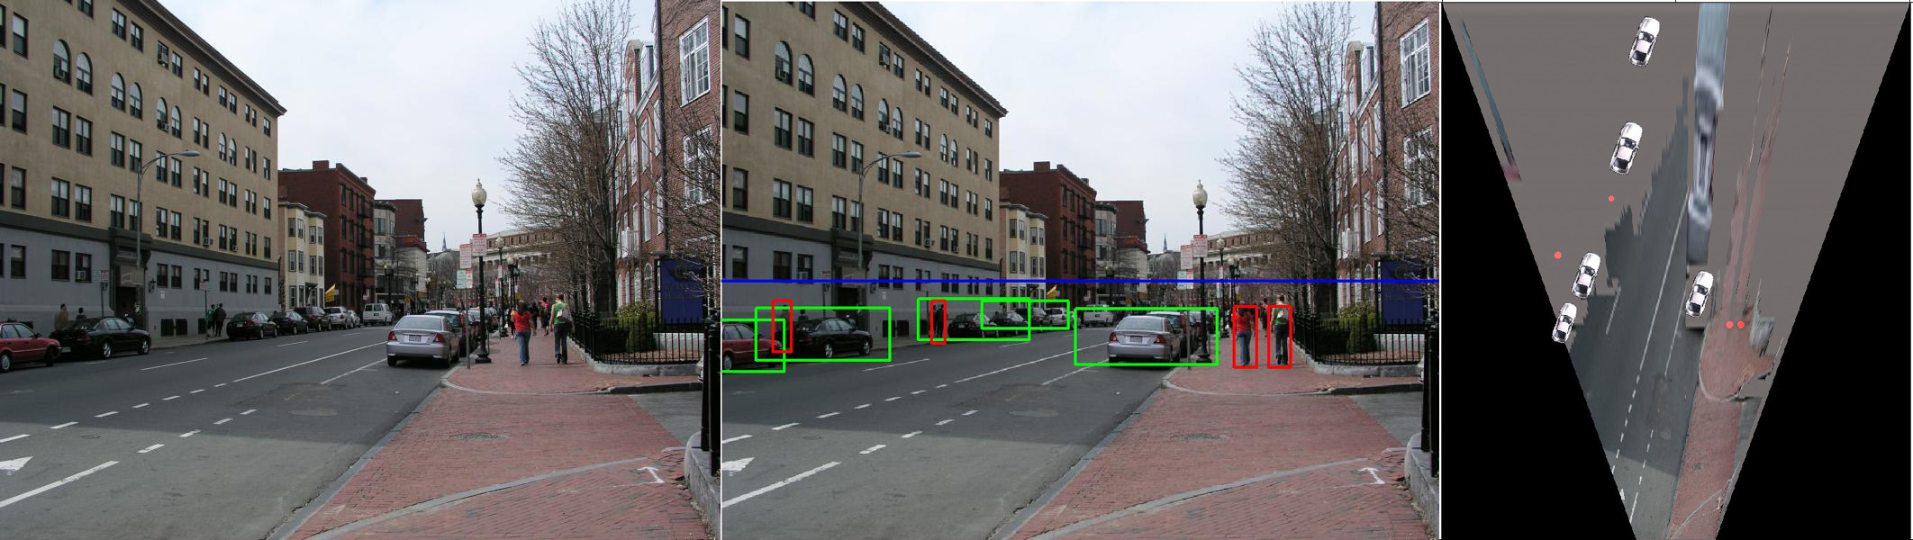
Applications
Object Recognition (CVPR 2006)

Slide 36
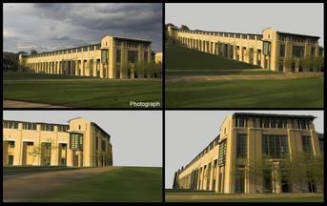
Applications
Single-view reconstruction (SIGGRAPH 2005)

Slide 37
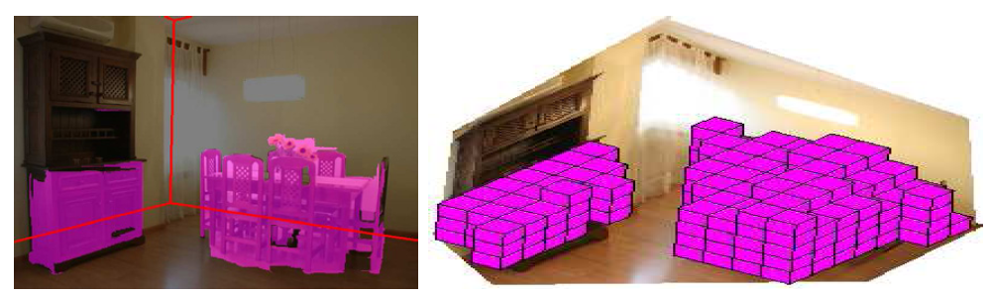
Applications
Getting spatial layout in indoor scenes (ICCV 2009)

Slide 38
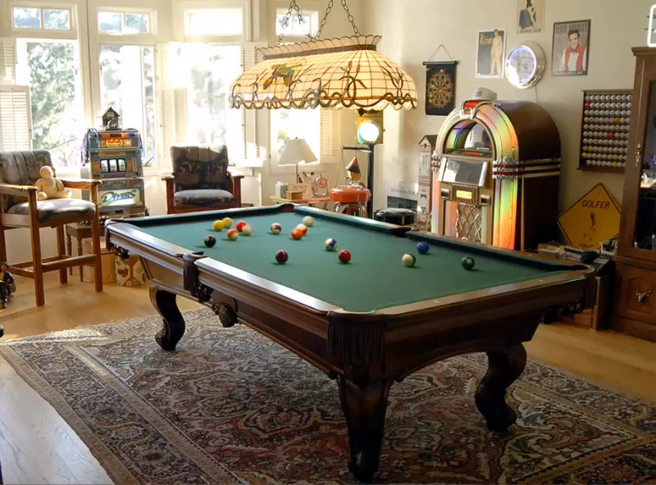
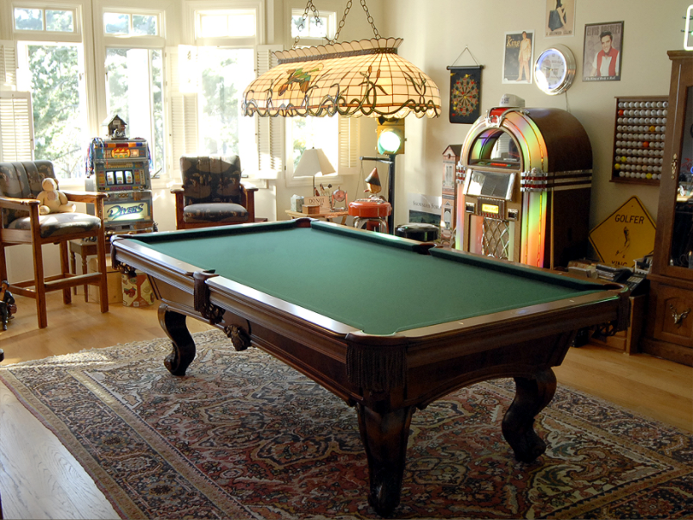
Applications
Inserting synthetic objects into images: http://vimeo.com/28962540

Slide 39
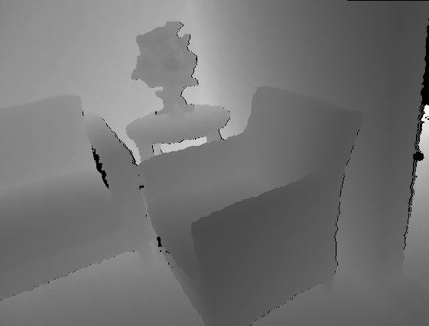

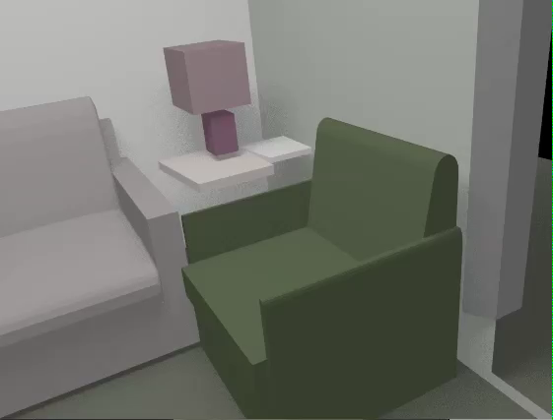
Applications
Creating detailed and complete 3D scene models from a single view

Slide 40
Perspective Projection Matrix
Projection is a matrix multiplication using homogeneous coordinates
divide by the third coordinate
In practice: lots of coordinate transformations…
World to
camera coord.
trans. matrix
(4x4)
3D
point
(4x1)
2D
point
(3x1)
Camera to
pixel coord.
trans. matrix
(3x3)
Perspective
projection matrix
(3x4)
=

Slide 41
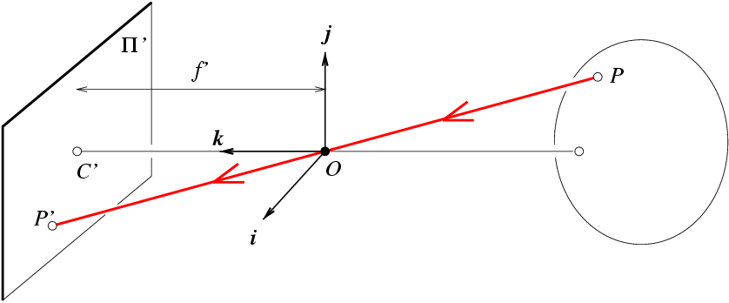
Projection matrix
Slide Credit: Saverese
R,T
j_{w}
k_{w}
O_{w}
i_{w}
x: Image Coordinates: (u,v,1)
K: Intrinsic Matrix (3x3)
R: Rotation (3x3)
t: Translation (3x1)
X: World Coordinates: (X,Y,Z,1)
Notes:
We can use homogeneous coordinates to write camera matrix in linear form.

Slide 42
Projection matrix
Intrinsic Assumptions
Unit aspect ratio
Optical center at (0,0)
No skew
Extrinsic Assumptions
No rotation
Camera at (0,0,0)
K
Slide Credit: Saverese
Notes:
Work through equations for u and v on board

Slide 43
Remove assumption: known optical center
Intrinsic Assumptions
Unit aspect ratio
No skew
Extrinsic Assumptions
No rotation
Camera at (0,0,0)

Slide 44
Remove assumption: square pixels
Intrinsic Assumptions
No skew
Extrinsic Assumptions
No rotation
Camera at (0,0,0)

Slide 45
Remove assumption: non-skewed pixels
Intrinsic Assumptions
Extrinsic Assumptions
No rotation
Camera at (0,0,0)
Note: different books use different notation for parameters

Slide 46
Oriented and Translated Camera
R
j_{w}
t
k_{w}
O_{w}
i_{w}

Slide 47
Allow camera translation
Intrinsic Assumptions
Extrinsic Assumptions
No rotation

Slide 48
3D Rotation of Points
Slide Credit: Saverese
Rotation around the coordinate axes, counter-clockwise:
p’
γ
y
p
z

Slide 49
Allow camera rotation

Slide 50
Degrees of freedom
5
6
Notes:
How many known points are needed to estimate this?

Slide 51
Vanishing Point = Projection from Infinity

Slide 52
Scaled Orthographic Projection
Special case of perspective projection
  Object dimensions are small compared to distance to camera
  Also called “weak perspective”
Image
World
Slide by Steve Seitz

Slide 53
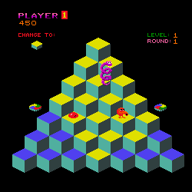
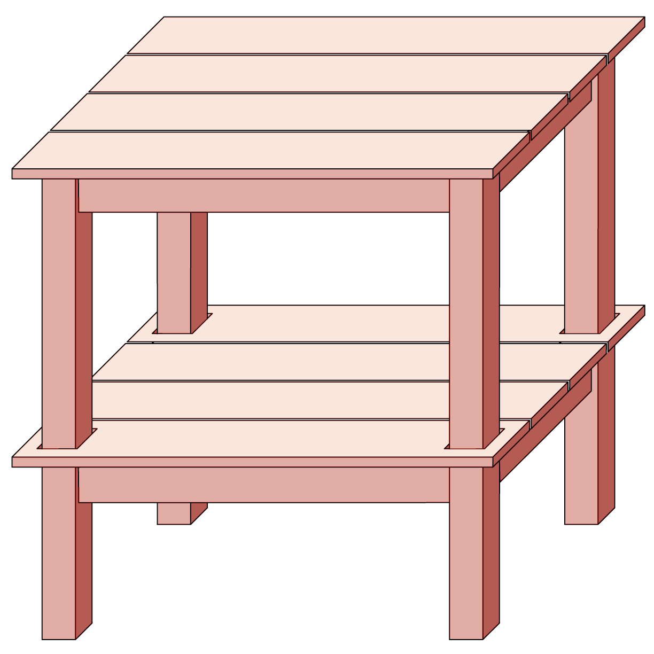
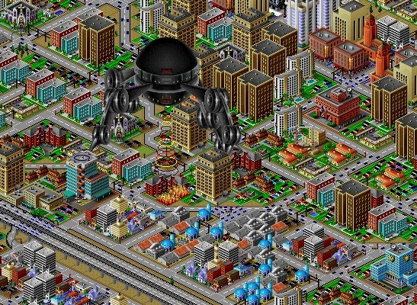
Orthographic Projection - Examples

Slide 54

Orthographic Projection - Examples

Slide 55
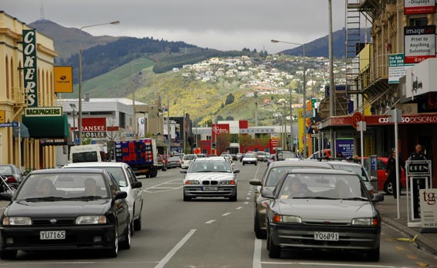
Applications in object detection
Far field: object appearance doesn’t change as objects translate
Near field: object appearance changes as objects translate

Slide 56
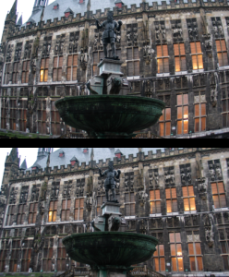
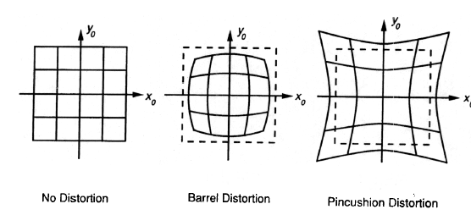
Beyond Pinholes: Radial Distortion
Common in wide-angle lenses or for special applications (e.g., security)
Creates non-linear terms in projection
Usually handled by through solving for non-linear terms and then correcting image
Corrected Barrel Distortion
Image from Martin Habbecke

Slide 57
Things to remember
Vertical vanishing
point
(at infinity)
Vanishing points and vanishing lines
Pinhole camera model and camera projection matrix
Homogeneous coordinates
Vanishing
line
Vanishing
point
Vanishing
point

Slide 58
Next class
Applications of camera model and projective geometry
Recovering the camera intrinsic and extrinsic parameters from an image
Measuring size in the world
Projecting from one plane to another

