Slide 1
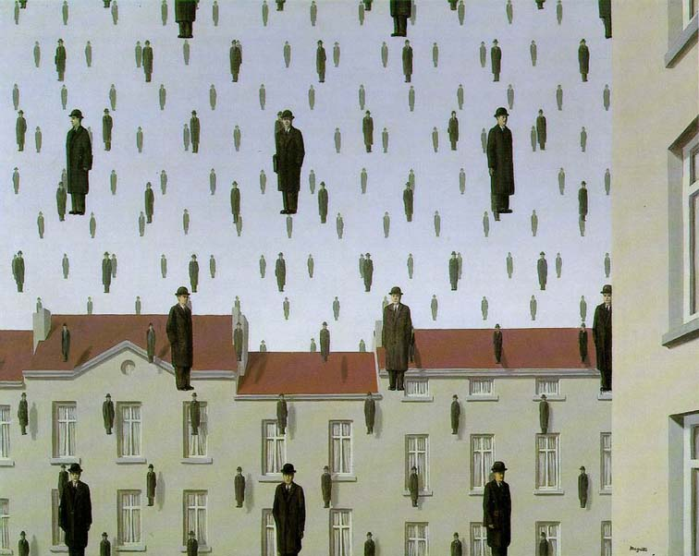
Image Pyramids and Applications
Computer Vision
Jia-Bin Huang, Virginia Tech
Golconda, René Magritte, 1953

Slide 2
Administrative stuffs
HW 1 posted, due 11:59 PM Sept 19
Anonymous feedback from students
Repeat students’ questions and answers
Turn on some light in the classroom
Post frequently asked questions for HWs

Slide 3
Previous class: Image Filtering
Sometimes it makes sense to think of images and filtering in the frequency domain
Fourier analysis
Can be faster to filter using FFT for large images (N logN vs. N² for auto-correlation)
Images are mostly smooth
Basis for compression
Remember to low-pass before sampling

Slide 4
Spatial domain
*
=
FFT
FFT
Inverse FFT
=
Frequency domain

Slide 5
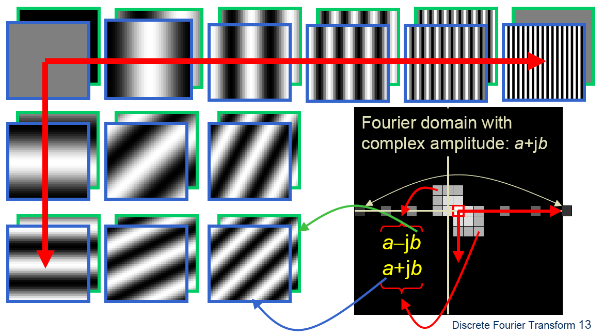
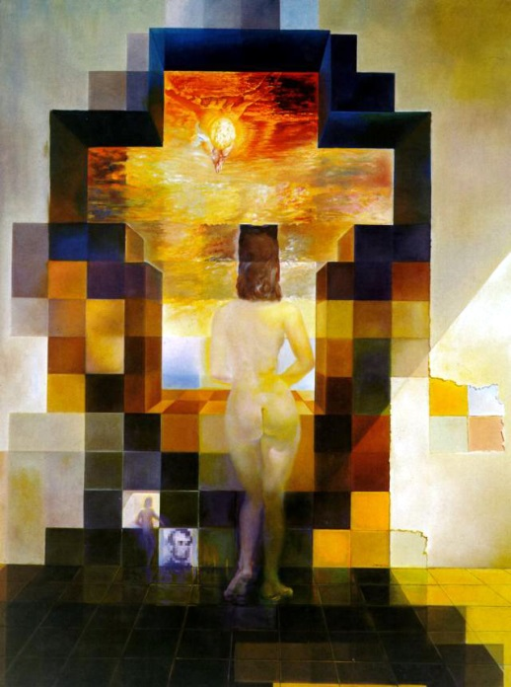
Fourier Transform
Teases away fast vs. slow changes in the image.
Image as a sum of basis images
Slide credit: A Efros

Slide 6
Extension to 2D
in Matlab, check out: imagesc(log(abs(fftshift(fft2(im)))));

Slide 7
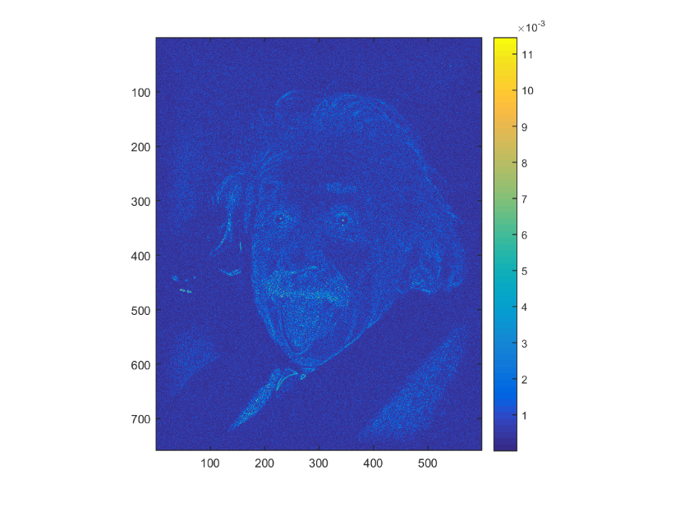
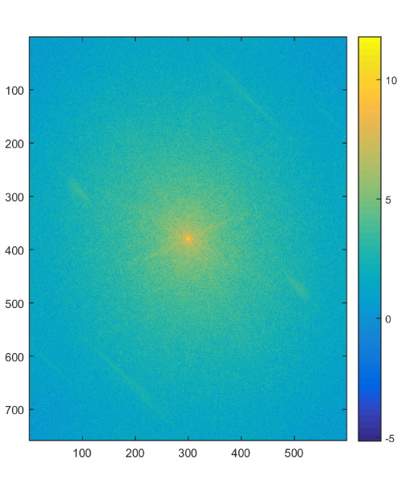
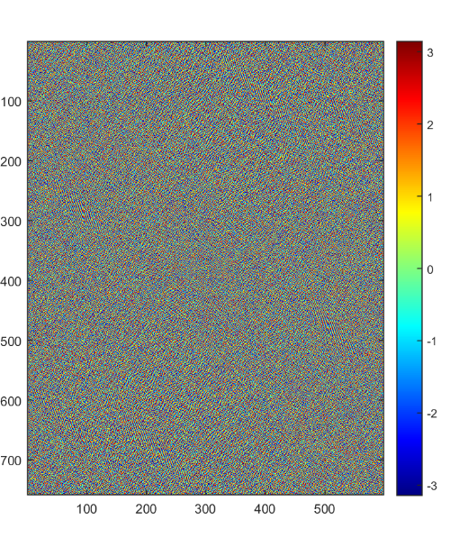
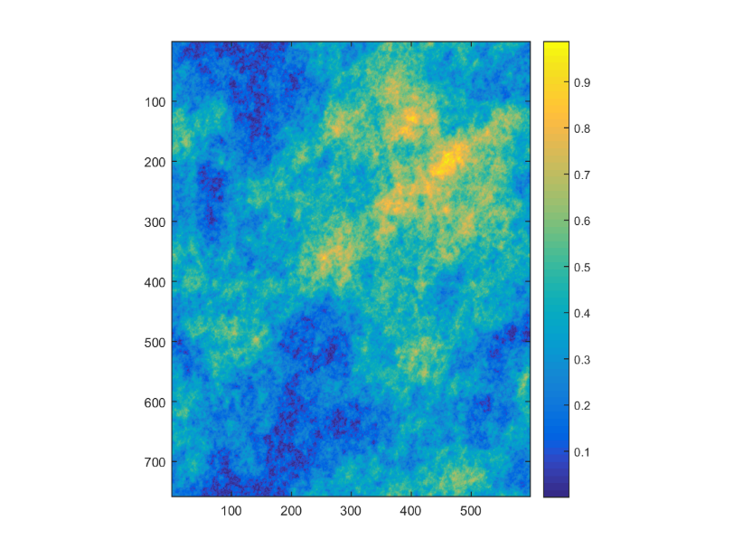
Phase vs. Magnitude
Use random
magnitude
Inverse FFT
Intensity image
FFT
Use random
phase
Inverse FFT
Magnitude
Phase

Slide 8
Today’s class
Template matching
Image Pyramids
Compression
Introduction to HW1

Slide 9
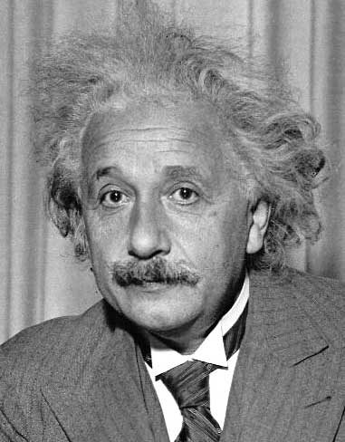
Template matching
Goal: find in image
Main challenge: What is a good similarity or distance measure between two patches? D() , )
Correlation
Zero-mean correlation
Sum Square Difference
Normalized Cross Correlation

Slide 10
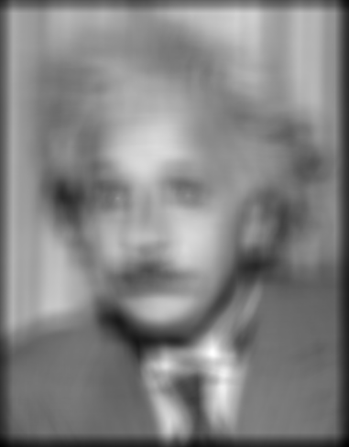
Matching with filters
Goal: find in image
Method 0: filter the image with eye patch
f = image
g = filter
What went wrong?
Input
Filtered Image
Notes:
Problem: response is stronger for higher intensity

Slide 11
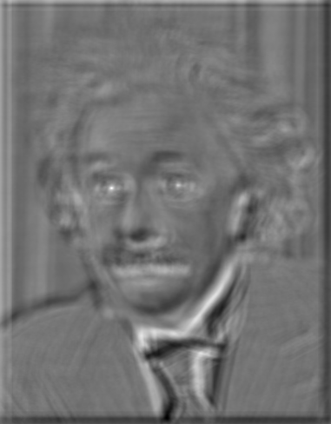
Matching with filters
Goal: find in image
Method 1: filter the image with zero-mean eye
mean of template g
True detections
False detections
Input
Filtered Image (scaled)
Thresholded Image
Notes:
Likes bright pixels where filters are above average, dark pixels where filters are below average. Problems: response is sensitive to gain/contrast, pixels in filter that are near the mean have little effect, does not require pixel values in image to be near or proportional to values in filter.

Slide 12
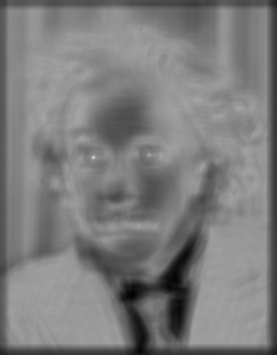
Matching with filters
Goal: find in image
Method 2: Sum of squared differences (SSD)
True detections
Input
1- sqrt(SSD)
Thresholded Image
Notes:
Problem: SSD sensitive to average intensity

Slide 13
Matching with filters
Can SSD be implemented with linear filters?
Constant
Filtering with g
Filtering with box filter

Slide 14
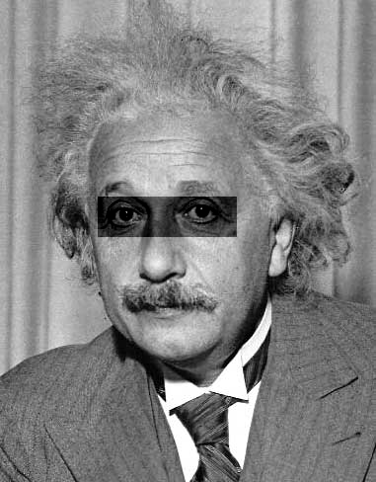
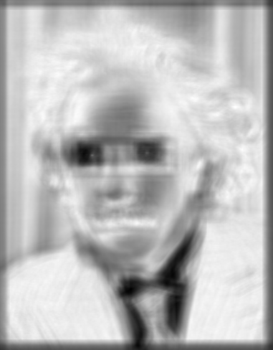
Matching with filters
Goal: find in image
Method 2: SSD
What’s the potential downside of SSD?
Input
1- sqrt(SSD)
Notes:
Problem: SSD sensitive to average intensity

Slide 15
Matching with filters
Goal: find in image
Method 3: Normalized cross-correlation
mean template
mean image patch
Matlab: normxcorr2(template, im)
Notes:
Invariant to mean and scale of intensity

Slide 16
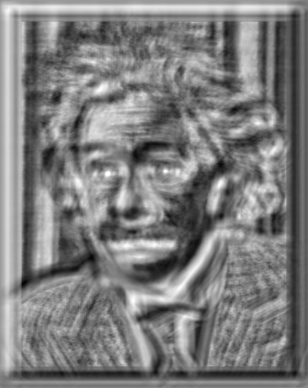
Matching with filters
Goal: find in image
Method 3: Normalized cross-correlation
True detections
Input
Normalized X-Correlation
Thresholded Image

Slide 17
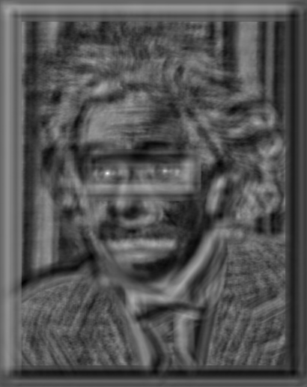
Matching with filters
Goal: find in image
Method 3: Normalized cross-correlation
True detections
Input
Normalized X-Correlation
Thresholded Image

Slide 18
Q: What is the best method to use?
A: Depends
Zero-mean filter: fastest but not a great matcher
SSD: next fastest, sensitive to overall intensity
Normalized cross-correlation: slowest, invariant to local average intensity and contrast

Slide 19
Q: What if we want to find larger or smaller eyes?
A: Image Pyramid

Slide 20
Review of Sampling
Gaussian
Filter
Image
Low-Pass Filtered Image
Sub-sample
Low-Res Image

Slide 21
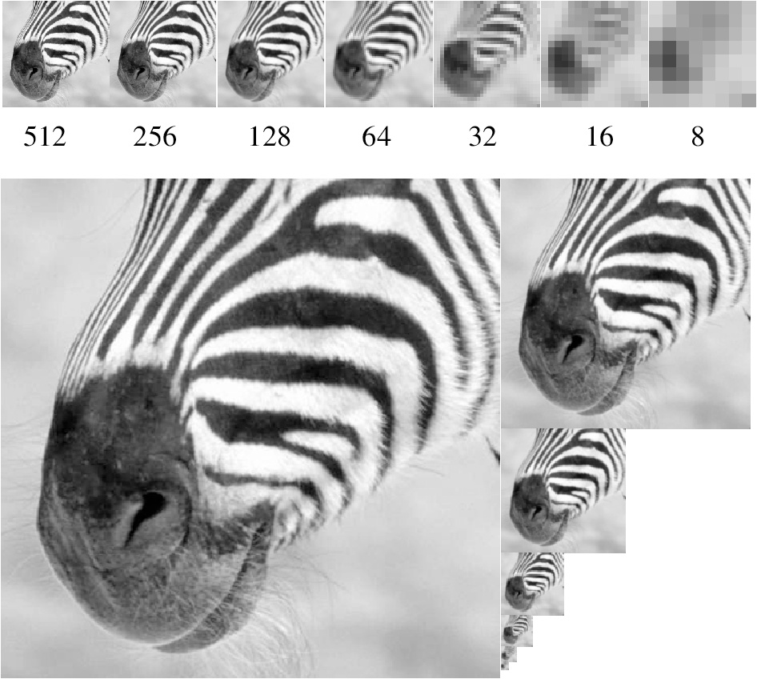
Gaussian pyramid
Source: Forsyth

Slide 22
Template Matching with Image Pyramids
Input: Image, Template
Match template at current scale
Downsample image
In practice, scale step of 1.1 to 1.2
Repeat 1-2 until image is very small
Take responses above some threshold, perhaps with non-maxima suppression

Slide 23
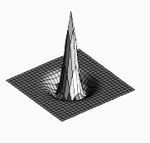
Laplacian filter
unit impulse
Gaussian
Laplacian of Gaussian
Source: Lazebnik

Slide 24
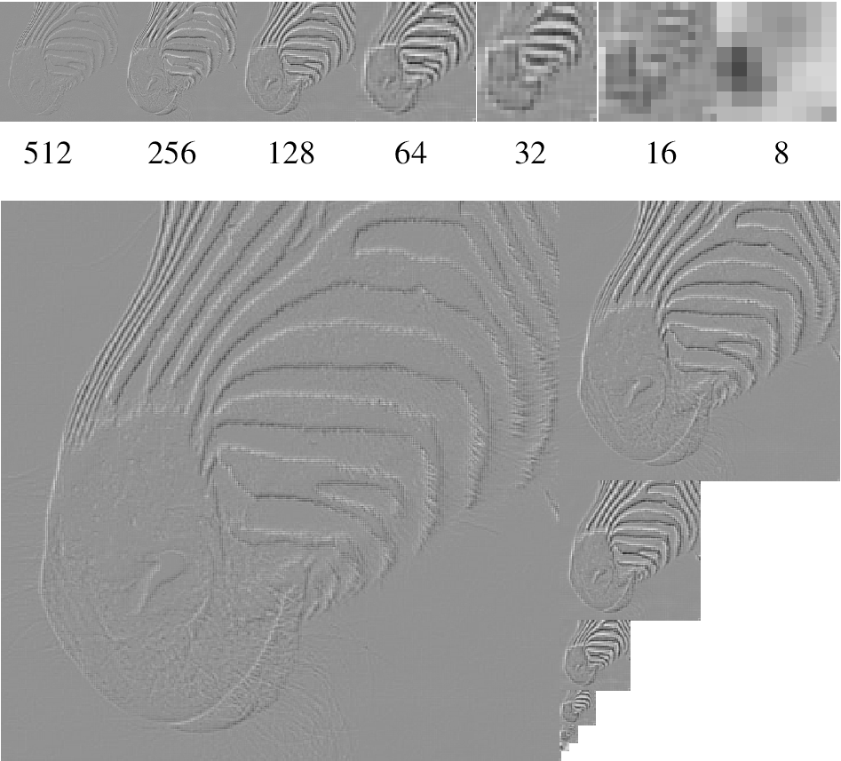
Laplacian pyramid
Source: Forsyth

Slide 25
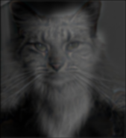
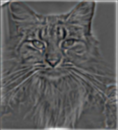
Creating the Gaussian/Laplacian Pyramid
Image = G₁
Smooth, then downsample
G₂
Downsample (Smooth(G₁))
Downsample (Smooth(G₂))
G₃
…
G_{N} = L_{N}
G₁ - Smooth(Upsample(G₂))
L₁
L₂
L₃
G₃ - Smooth(Upsample(G₄))
G₂ - Smooth(Upsample(G₃))
Use same filter for smoothing in each step (e.g., Gaussian with $σ=2$)
Downsample/upsample with “nearest” interpolation

Slide 26
Hybrid Image in Laplacian Pyramid
High frequency → Low frequency

Slide 27
Reconstructing image from Laplacian pyramid
Image =
L₁ + Smooth(Upsample(G₂))
G₂ = L₂ + Smooth(Upsample(G₃))
G₃ = L₃ + Smooth(Upsample(L₄))
L₄
L₁
L₂
L₃
Use same filter for smoothing as in desconstruction
Upsample with “nearest” interpolation
Reconstruction will be lossless

Slide 28
Major uses of image pyramids
Object detection
Scale search
Features
Detecting stable interest points
Course-to-fine registration
Compression

Slide 29
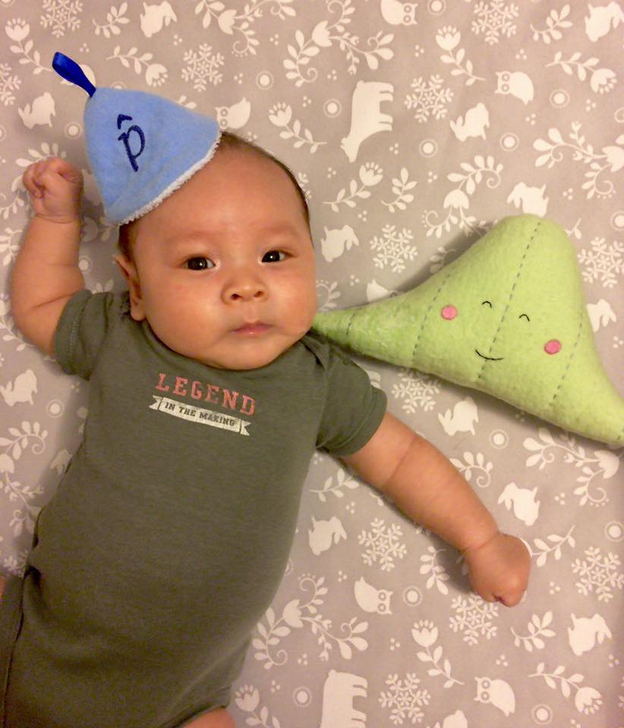

Slide 32
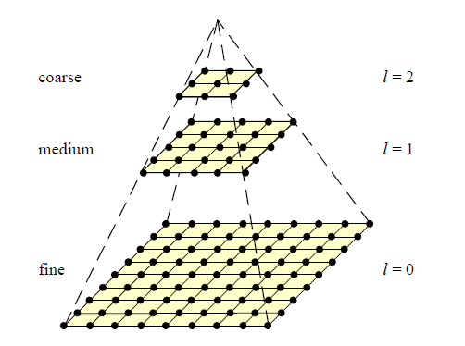
Coarse-to-fine Image Registration
Compute Gaussian pyramid
Align with coarse pyramid
Successively align with finer pyramids
Search smaller range
Why is this faster?
Are we guaranteed to get the same result?

Slide 33
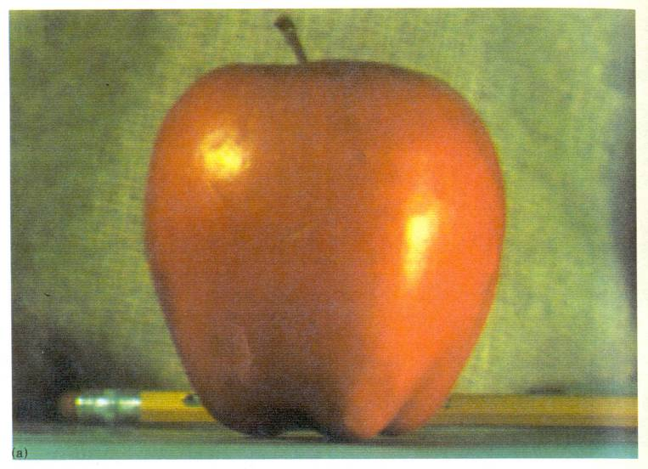
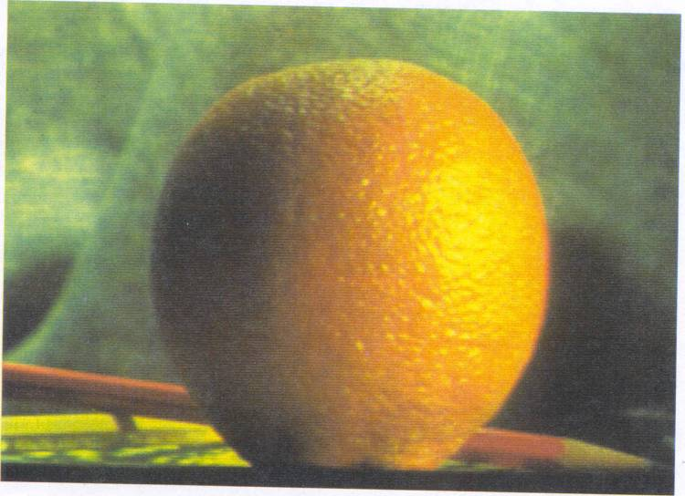
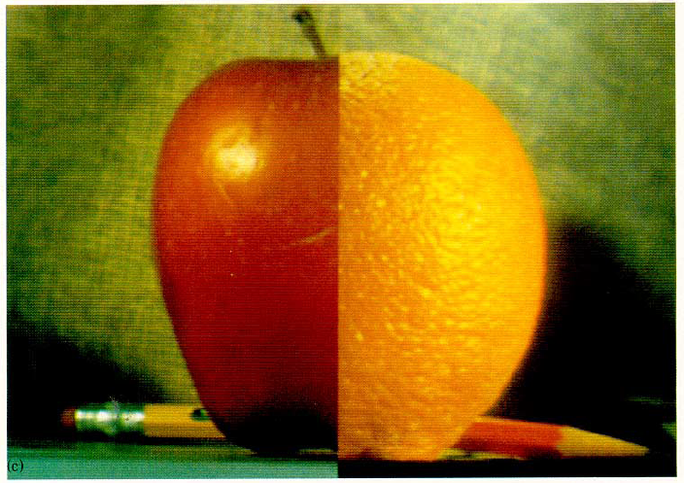
Applications: Pyramid Blending

Slide 34
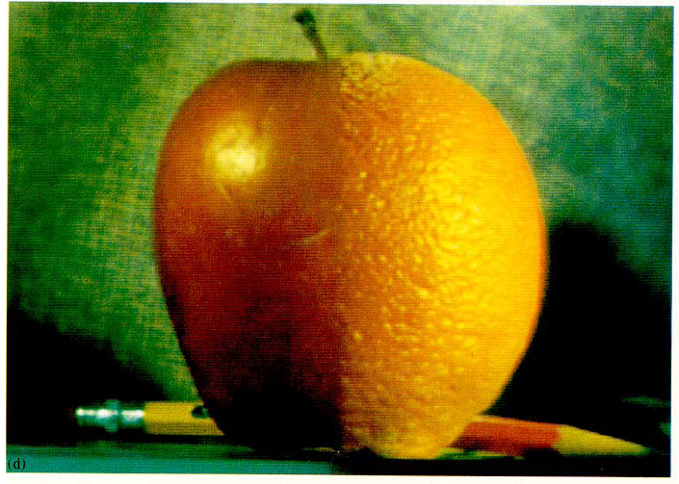
Applications: Pyramid Blending

Slide 35
Pyramid Blending
At low frequencies, blend slowly
At high frequencies, blend quickly
1
0
1
0
1
0
Left pyramid
blend
Right pyramid

Slide 36
Image representation
Pixels:
great for spatial resolution, poor access to frequency
Fourier transform:
great for frequency, not for spatial info
Pyramids/filter banks:
balance between spatial and frequency information

Slide 37
Compression
How is it that a 4MP image (12000KB) can be compressed to 400KB without a noticeable change?

Slide 38
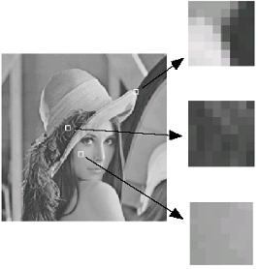
Lossy Image Compression (JPEG)
Block-based Discrete Cosine Transform (DCT)
Slides: Efros

Slide 39
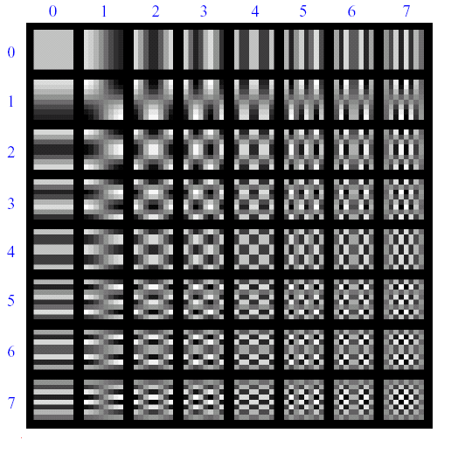
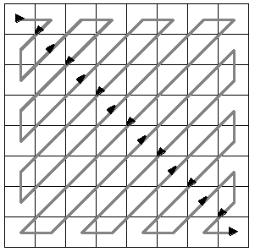
Using DCT in JPEG
The first coefficient B(0,0) is the DC component, the average intensity
The top-left coeffs represent low frequencies, the bottom right – high frequencies

Slide 40
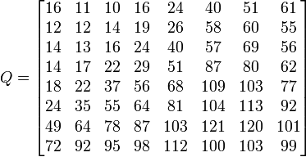
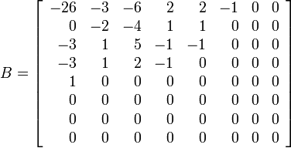
Image compression using DCT
Quantize
More coarsely for high frequencies (which also tend to have smaller values)
Many quantized high frequency values will be zero
Encode
Can decode with inverse dct
Filter responses
Quantization table
Quantized values

Slide 41
JPEG Compression Summary
Convert image to YCrCb
Subsample color by factor of 2
People have bad resolution for color
Split into blocks (8x8, typically), subtract 128
For each block
Compute DCT coefficients
Coarsely quantize
Many high frequency components will become zero
Encode (e.g., with Huffman coding)
http://en.wikipedia.org/wiki/YCbCr
http://en.wikipedia.org/wiki/JPEG

Slide 42
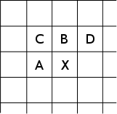
Lossless compression (PNG)
Predict that a pixel’s value based on its upper-left neighborhood
Store difference of predicted and actual value
Pkzip it (DEFLATE algorithm)

Slide 43
Three views of image filtering
Image filters in spatial domain
Filter is a mathematical operation on values of each patch
Smoothing, sharpening, measuring texture
Image filters in the frequency domain
Filtering is a way to modify the frequencies of images
Denoising, sampling, image compression
Templates and Image Pyramids
Filtering is a way to match a template to the image
Detection, coarse-to-fine registration

Slide 44
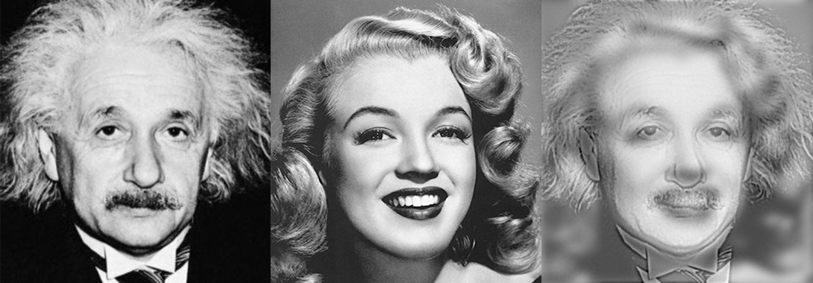
HW 1 – Hybrid Image
Hybrid image =
Low-Freq( Image A ) + Hi-Freq( Image B )

Slide 45
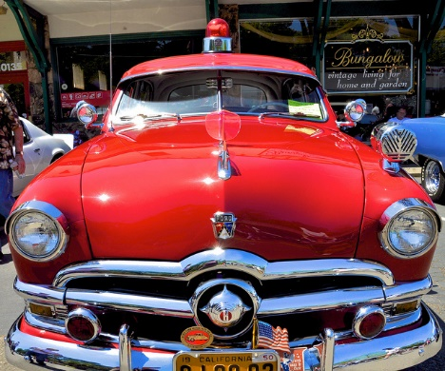
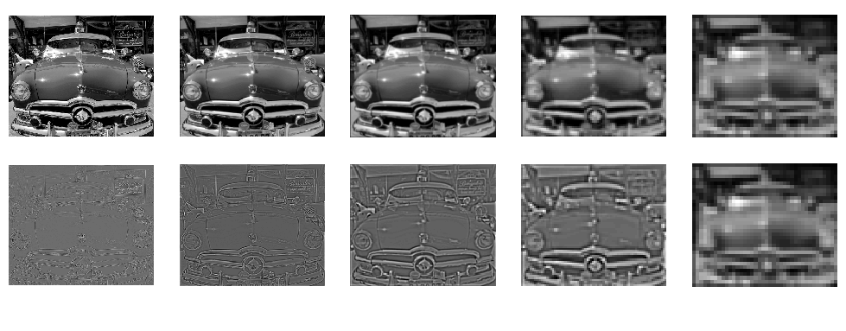
HW 1 – Image Pyramid

Slide 46
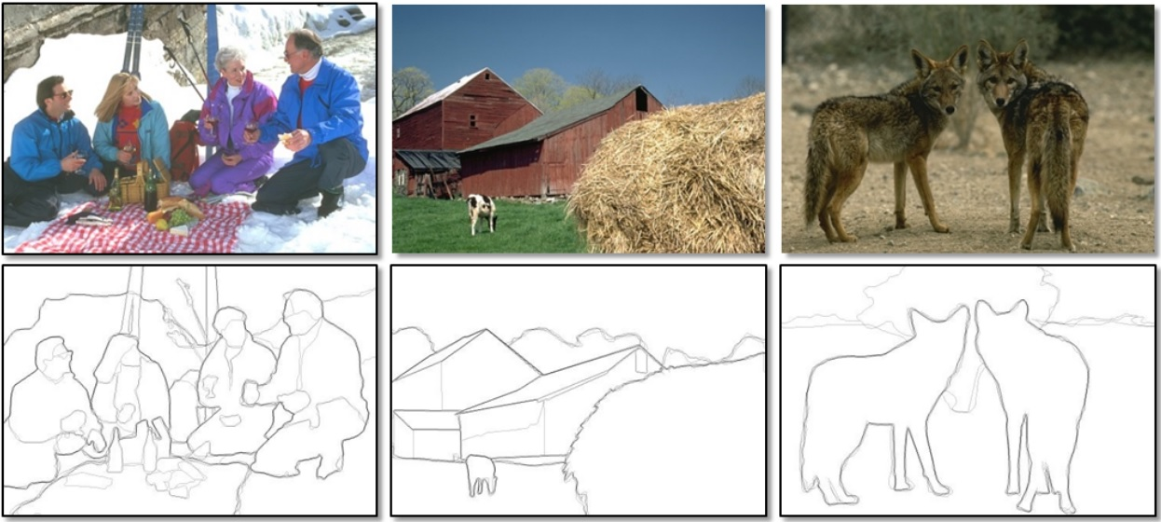
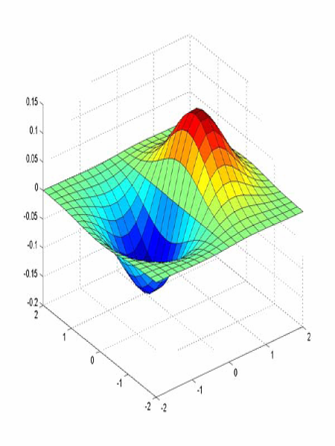
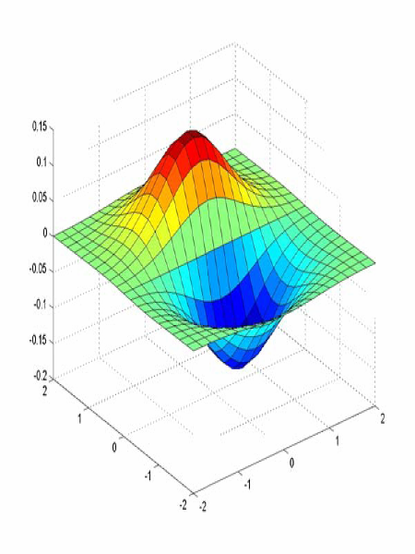
HW 1 – Edge Detection
Derivative of Gaussian filters
x-direction
y-direction

Slide 47
Things to remember
Template matching (SSD or Normxcorr2)
SSD can be done with linear filters, is sensitive to overall intensity
Gaussian pyramid
Coarse-to-fine search, multi-scale detection
Laplacian pyramid
More compact image representation
Can be used for compositing in graphics
Compression
In JPEG, coarsely quantize high frequencies

Slide 48
Thank you
See you this Thursday
Next class:
Edge detection

