Slide 1
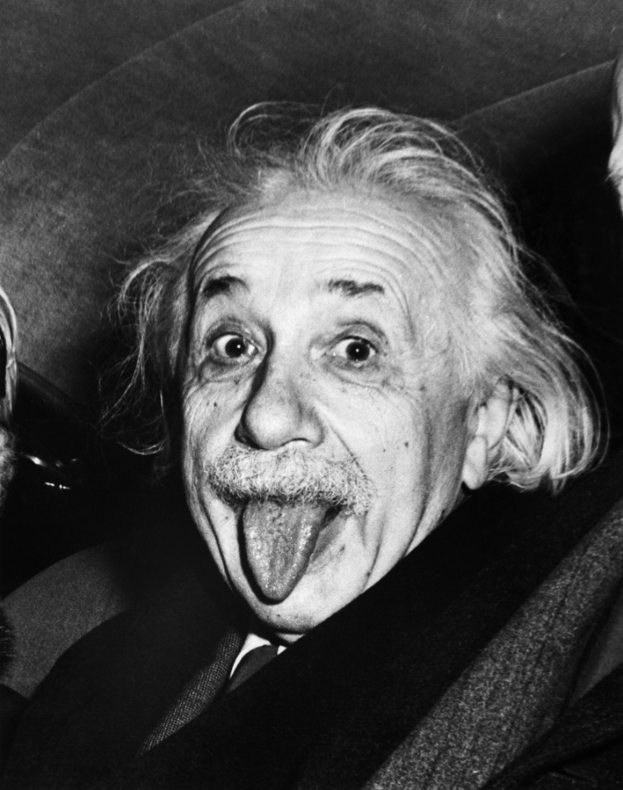

Image Filtering in Spatial domain
Computer Vision
Jia-Bin Huang, Virginia Tech

Slide 2
Administrative stuffs
Any questions?
Office hours - Jia-Bin (440 Whittemore Hall )
  Friday at 11 AM - 12 PM (this week only)
  Friday at 3:00 – 4:00 PM (lectures, HW discussions)
  Friday at 4:00 – 5:00 PM (final project discussions)
Office hours - Akrit (264 Whittemore Hall)
  Wed at 10:30 AM – 11:30 AM
MATLAB tutorial session by Akrit
  Friday 3-4 PM, Whittemore Hall 340A
  Bring your laptop with MATLAB installed

Slide 3
Previous class: Light and Color
Reflection models
  diffuse/specular reflectance, albedo
  Surface orientation and light intensity
Color vision
  physics of light, trichromacy, color consistency, color spaces (RGB, HSV, Lab)
Object cast light and shadows to each other
Interpret images from local differences

Slide 4
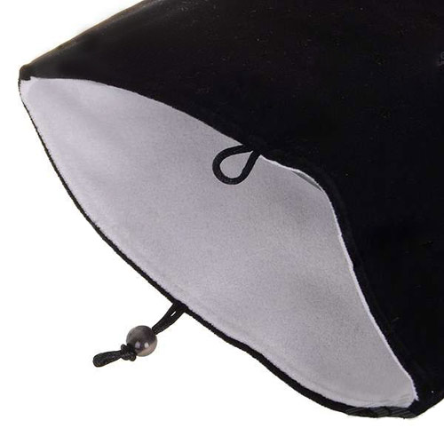
Reflection models
Albedo: fraction of light that is reflected
  Determines color (amount reflected at each wavelength)
Very low albedo (hard to see shape)
Higher albedo
Slide credit: Derek Hoiem

Slide 5
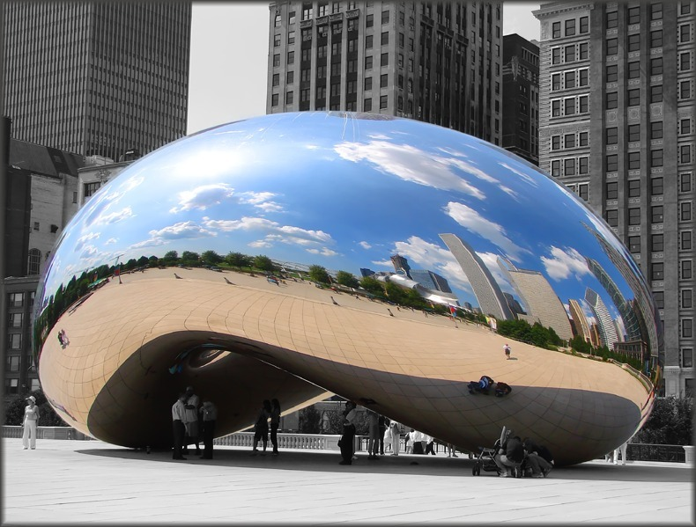
Reflection models
Specular reflection: mirror-like
  Light reflects at incident angle
  Reflection color = incoming light color
Slide credit: Derek Hoiem

Slide 6
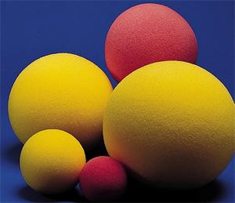
Reflection models
Diffuse reflection
  Light scatters in all directions (proportional to cosine with surface normal)
  Observed intensity is independent of viewing direction
  Reflection color depends on light color and albedo
Slide credit: Derek Hoiem

Slide 7
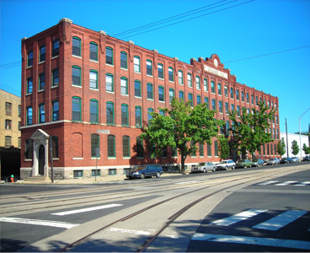
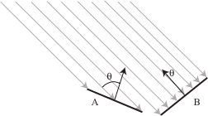

Surface orientation and light intensity
Amount of light that hits surface from distant point source depends on angle between surface normal and source
1
2
$$I\left(x\right)=ρ\left(x\right)\left(S⋅N(x)\right)$$
prop to cosine of relative angle
Slide credit: Derek Hoiem

Slide 8

Application: Photometric Stereo
Assume:
  A Lambertian object
  A local shading model (each point on a surface receives light only from sources visible at that point)
  A set of known light source directions
  A set of pictures of an object, obtained in exactly the same camera/object configuration but using different sources
  Orthographic projection
Goal: reconstruct object shape and albedo
S₂
S_{n}
S₁
???
Slide credit: S. Lazebnik
F&P 2nd ed., sec. 2.2.4

Slide 9
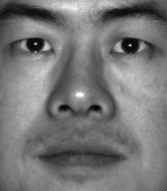
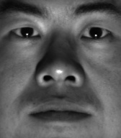
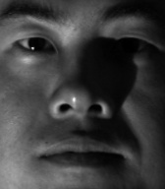
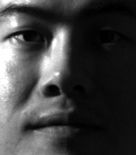
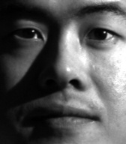

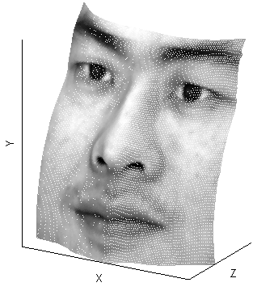
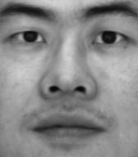
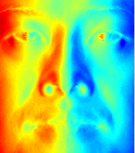
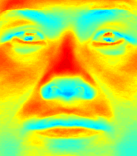
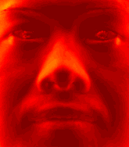
Example
Input
…
Recovered surface model
Recovered Albedo
Recovered normal field
x
y
z
Slide credit: S. Lazebnik

Slide 10

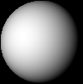




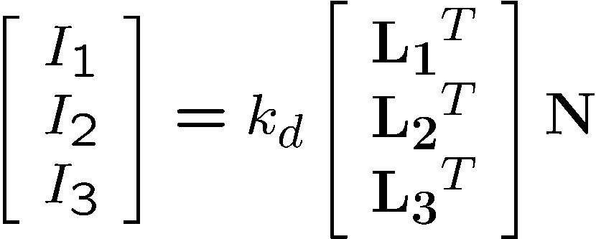
Photometric Stereo
N
L₃
L₂
L₁
V
Can write this as a matrix equation:
Slide credit: N. Snavely

Slide 11
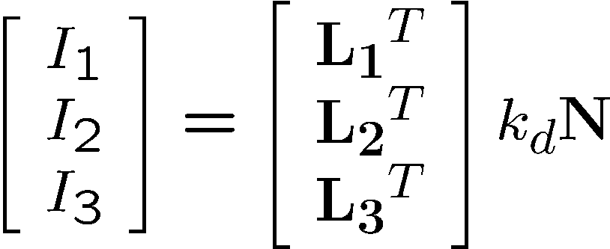







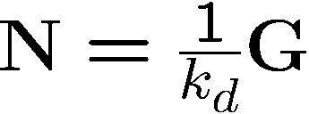
Solving the equations
Intensity
(Known)
Light direction
(Known)
Albedo x Surface normal
(Unknown)
How do we get the albedo and surface normal from G?
Slide credit: N. Snavely

Slide 12
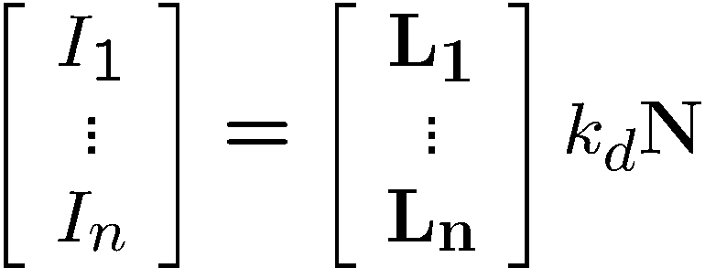
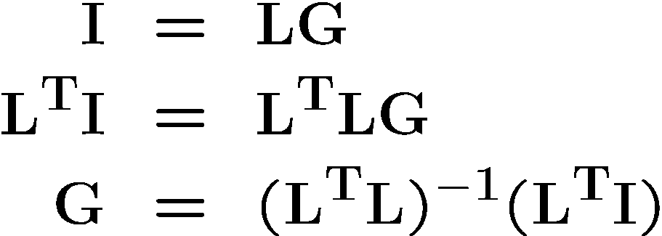
More than three lights
Get better results by using more lights
Least squares solution:
In MATLAB
G = L\I;
Solve for N, k_{d} as before
What’s the size of L^{T}L?
Slide credit: N. Snavely

Slide 13
Next three classes: three views of filtering
Image filters in spatial domain
  Filter is a mathematical operation on values of each patch
  Smoothing, sharpening, measuring texture
Image filters in the frequency domain
  Filtering is a way to modify the frequencies of images
  Denoising, sampling, image compression
Templates and Image Pyramids
  Filtering is a way to match a template to the image
  Detection, coarse-to-fine registration
Slide credit: Derek Hoiem

Slide 14
Today’s class
Pixels and image filtering
Application: representing textures
Denoising and non-linear image filtering

Slide 15

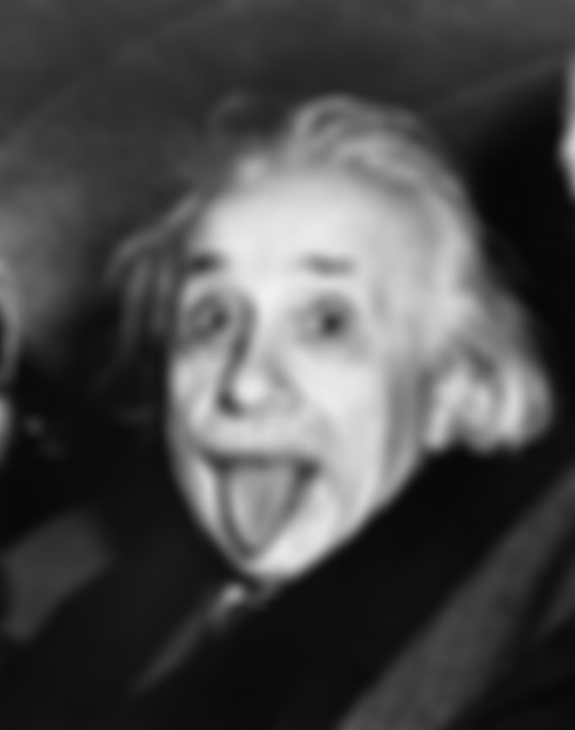
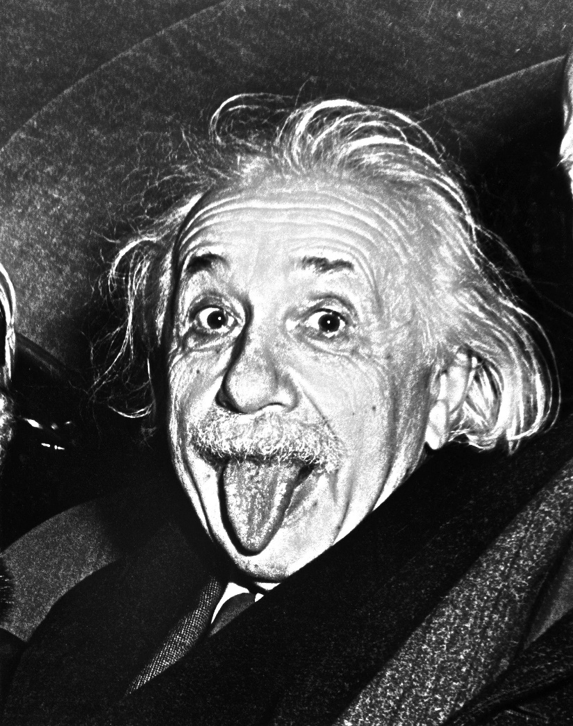
Why should we care?
Input
Smoothing
Sharpening
https://en.wikipedia.org/wiki/Albert_Einstein_in_popular_culture#/media/File:Einstein_tongue.jpg

Slide 16
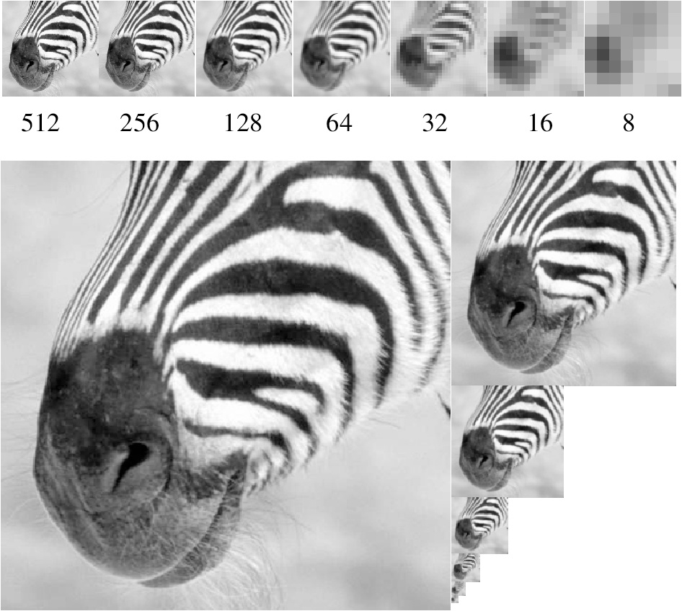
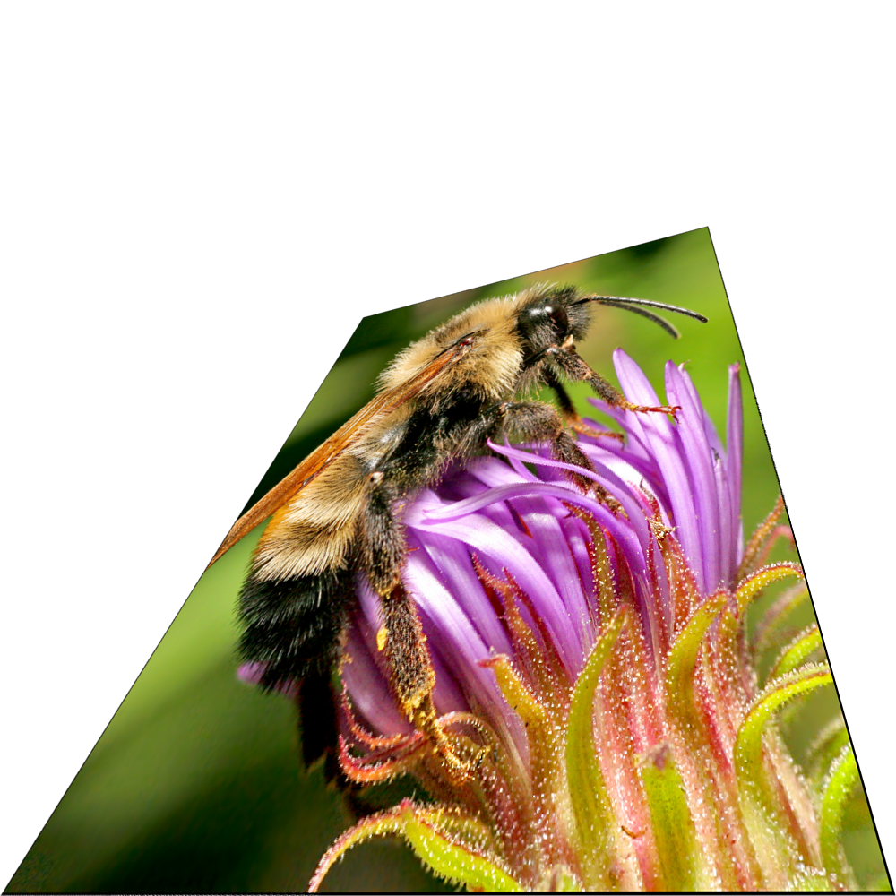
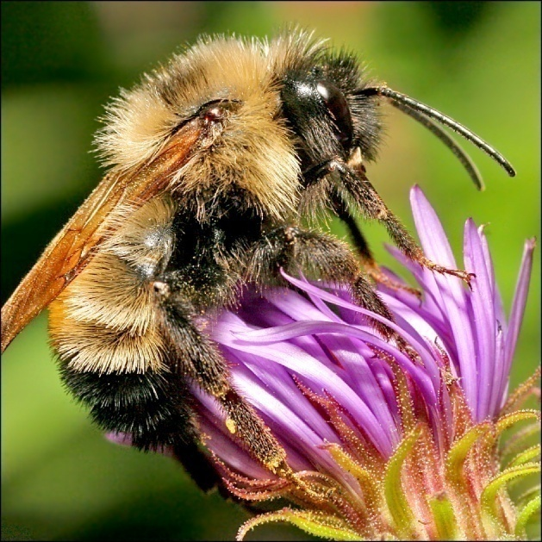
Why should we care?
Image Pyramid
Image interpolation/resampling
Source: D Forsyth
Source: N Snavely

Slide 17
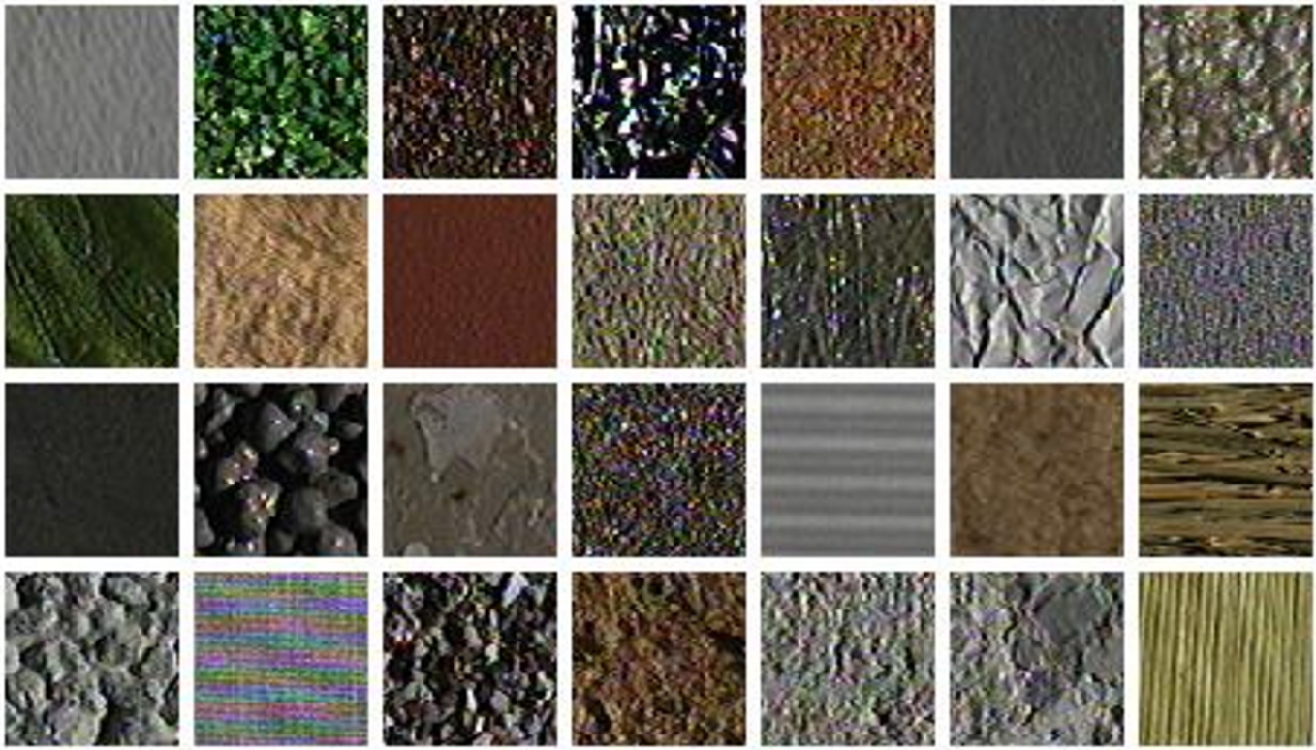
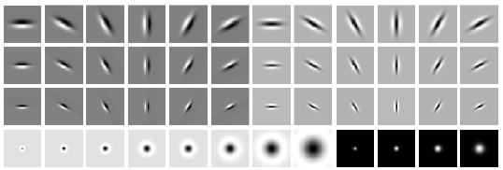
Why should we care?
LM filter bank. Code here
Representing textures with filter banks

Slide 18
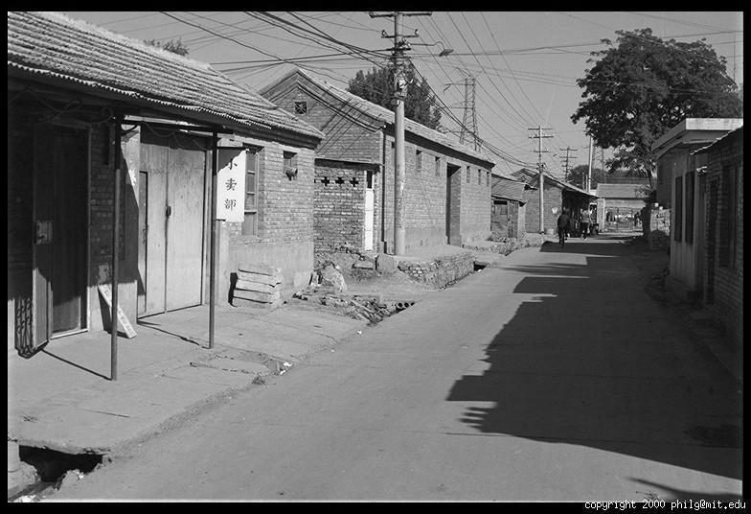
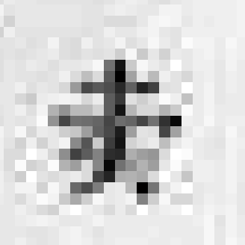
The raster image (pixel matrix)
0.92 | 0.93 | 0.94 | 0.97 | 0.62 | 0.37 | 0.85 | 0.97 | 0.93 | 0.92 | 0.99
0.95 | 0.89 | 0.82 | 0.89 | 0.56 | 0.31 | 0.75 | 0.92 | 0.81 | 0.95 | 0.91
0.89 | 0.72 | 0.51 | 0.55 | 0.51 | 0.42 | 0.57 | 0.41 | 0.49 | 0.91 | 0.92
0.96 | 0.95 | 0.88 | 0.94 | 0.56 | 0.46 | 0.91 | 0.87 | 0.90 | 0.97 | 0.95
0.71 | 0.81 | 0.81 | 0.87 | 0.57 | 0.37 | 0.80 | 0.88 | 0.89 | 0.79 | 0.85
0.49 | 0.62 | 0.60 | 0.58 | 0.50 | 0.60 | 0.58 | 0.50 | 0.61 | 0.45 | 0.33
0.86 | 0.84 | 0.74 | 0.58 | 0.51 | 0.39 | 0.73 | 0.92 | 0.91 | 0.49 | 0.74
0.96 | 0.67 | 0.54 | 0.85 | 0.48 | 0.37 | 0.88 | 0.90 | 0.94 | 0.82 | 0.93
0.69 | 0.49 | 0.56 | 0.66 | 0.43 | 0.42 | 0.77 | 0.73 | 0.71 | 0.90 | 0.99
0.79 | 0.73 | 0.90 | 0.67 | 0.33 | 0.61 | 0.69 | 0.79 | 0.73 | 0.93 | 0.97
0.91 | 0.94 | 0.89 | 0.49 | 0.41 | 0.78 | 0.78 | 0.77 | 0.89 | 0.99 | 0.93

Slide 19
Image filtering
Image filtering: for each pixel, compute function of local neighborhood and output a new value
  Same function applied at each position
  Output and input image are typically the same size
10
5
3
Some function
4
5
1
7
1
1
7
Local image data
Modified image data
Slide Credit: L. Zhang

Slide 20
Image filtering
Linear filtering
  function is a weighted sum/difference of pixel values
Really important!
  Enhance images
    Denoise, smooth, increase contrast, etc.
  Extract information from images
    Texture, edges, distinctive points, etc.
  Detect patterns
    Template matching
10
5
3
0
0
0
4
6
1
0
0.5
0
8
1
1
8
0
1
0.5
Local image data
kernel
Modified image data
Slide credit: Derek Hoiem

Slide 21
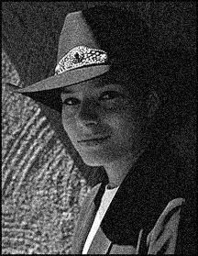
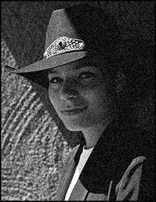

Question: Noise reduction
Given a camera and a still scene, how can you reduce noise?
Take lots of images and average them!
What’s the next best thing?
Source: S. Seitz
Notes:
Answer: take lots of images, average them

Slide 22
First attempt at a solution
Let’s replace each pixel with an average of all the values in its neighborhood
Assumptions:
  Expect pixels to be like their neighbors
  Expect noise processes to be independent from pixel to pixel
Slide credit: Kristen Grauman

Slide 23

Example: box filter
1
1
1
1
1
1
1
1
1
Slide credit: David Lowe

Slide 24
Image filtering
1
1
1
1
1
1
1
1
1
0 | 0 | 0 | 0 | 0 | 0 | 0 | 0 | 0 | 0
0 | 0 | 0 | 0 | 0 | 0 | 0 | 0 | 0 | 0
0 | 0 | 0 | 90 | 90 | 90 | 90 | 90 | 0 | 0
0 | 0 | 0 | 90 | 90 | 90 | 90 | 90 | 0 | 0
0 | 0 | 0 | 90 | 90 | 90 | 90 | 90 | 0 | 0
0 | 0 | 0 | 90 | 0 | 90 | 90 | 90 | 0 | 0
0 | 0 | 0 | 90 | 90 | 90 | 90 | 90 | 0 | 0
0 | 0 | 0 | 0 | 0 | 0 | 0 | 0 | 0 | 0
0 | 0 | 90 | 0 | 0 | 0 | 0 | 0 | 0 | 0
0 | 0 | 0 | 0 | 0 | 0 | 0 | 0 | 0 | 0
 | 0
Slide credit: S. Seitz
Notes:
ones, divide by 9

Slide 25
Image filtering
1
1
1
1
1
1
1
1
1
0 | 0 | 0 | 0 | 0 | 0 | 0 | 0 | 0 | 0
0 | 0 | 0 | 0 | 0 | 0 | 0 | 0 | 0 | 0
0 | 0 | 0 | 90 | 90 | 90 | 90 | 90 | 0 | 0
0 | 0 | 0 | 90 | 90 | 90 | 90 | 90 | 0 | 0
0 | 0 | 0 | 90 | 90 | 90 | 90 | 90 | 0 | 0
0 | 0 | 0 | 90 | 0 | 90 | 90 | 90 | 0 | 0
0 | 0 | 0 | 90 | 90 | 90 | 90 | 90 | 0 | 0
0 | 0 | 0 | 0 | 0 | 0 | 0 | 0 | 0 | 0
0 | 0 | 90 | 0 | 0 | 0 | 0 | 0 | 0 | 0
0 | 0 | 0 | 0 | 0 | 0 | 0 | 0 | 0 | 0
 | 0 | 10
0 | 0 | 0 | 0 | 0 | 0 | 0 | 0 | 0 | 0
0 | 0 | 0 | 0 | 0 | 0 | 0 | 0 | 0 | 0
0 | 0 | 0 | 90 | 90 | 90 | 90 | 90 | 0 | 0
0 | 0 | 0 | 90 | 90 | 90 | 90 | 90 | 0 | 0
0 | 0 | 0 | 90 | 90 | 90 | 90 | 90 | 0 | 0
0 | 0 | 0 | 90 | 0 | 90 | 90 | 90 | 0 | 0
0 | 0 | 0 | 90 | 90 | 90 | 90 | 90 | 0 | 0
0 | 0 | 0 | 0 | 0 | 0 | 0 | 0 | 0 | 0
0 | 0 | 90 | 0 | 0 | 0 | 0 | 0 | 0 | 0
0 | 0 | 0 | 0 | 0 | 0 | 0 | 0 | 0 | 0
Slide credit: S. Seitz
Notes:
ones, divide by 9

Slide 26
Image filtering
1
1
1
1
1
1
1
1
1
0 | 0 | 0 | 0 | 0 | 0 | 0 | 0 | 0 | 0
0 | 0 | 0 | 0 | 0 | 0 | 0 | 0 | 0 | 0
0 | 0 | 0 | 90 | 90 | 90 | 90 | 90 | 0 | 0
0 | 0 | 0 | 90 | 90 | 90 | 90 | 90 | 0 | 0
0 | 0 | 0 | 90 | 90 | 90 | 90 | 90 | 0 | 0
0 | 0 | 0 | 90 | 0 | 90 | 90 | 90 | 0 | 0
0 | 0 | 0 | 90 | 90 | 90 | 90 | 90 | 0 | 0
0 | 0 | 0 | 0 | 0 | 0 | 0 | 0 | 0 | 0
0 | 0 | 90 | 0 | 0 | 0 | 0 | 0 | 0 | 0
0 | 0 | 0 | 0 | 0 | 0 | 0 | 0 | 0 | 0
 | 0 | 10 | 20
0 | 0 | 0 | 0 | 0 | 0 | 0 | 0 | 0 | 0
0 | 0 | 0 | 0 | 0 | 0 | 0 | 0 | 0 | 0
0 | 0 | 0 | 90 | 90 | 90 | 90 | 90 | 0 | 0
0 | 0 | 0 | 90 | 90 | 90 | 90 | 90 | 0 | 0
0 | 0 | 0 | 90 | 90 | 90 | 90 | 90 | 0 | 0
0 | 0 | 0 | 90 | 0 | 90 | 90 | 90 | 0 | 0
0 | 0 | 0 | 90 | 90 | 90 | 90 | 90 | 0 | 0
0 | 0 | 0 | 0 | 0 | 0 | 0 | 0 | 0 | 0
0 | 0 | 90 | 0 | 0 | 0 | 0 | 0 | 0 | 0
0 | 0 | 0 | 0 | 0 | 0 | 0 | 0 | 0 | 0
Slide credit: S. Seitz
Notes:
ones, divide by 9

Slide 27
Image filtering
1
1
1
1
1
1
1
1
1
0 | 0 | 0 | 0 | 0 | 0 | 0 | 0 | 0 | 0
0 | 0 | 0 | 0 | 0 | 0 | 0 | 0 | 0 | 0
0 | 0 | 0 | 90 | 90 | 90 | 90 | 90 | 0 | 0
0 | 0 | 0 | 90 | 90 | 90 | 90 | 90 | 0 | 0
0 | 0 | 0 | 90 | 90 | 90 | 90 | 90 | 0 | 0
0 | 0 | 0 | 90 | 0 | 90 | 90 | 90 | 0 | 0
0 | 0 | 0 | 90 | 90 | 90 | 90 | 90 | 0 | 0
0 | 0 | 0 | 0 | 0 | 0 | 0 | 0 | 0 | 0
0 | 0 | 90 | 0 | 0 | 0 | 0 | 0 | 0 | 0
0 | 0 | 0 | 0 | 0 | 0 | 0 | 0 | 0 | 0
 | 0 | 10 | 20 | 30
0 | 0 | 0 | 0 | 0 | 0 | 0 | 0 | 0 | 0
0 | 0 | 0 | 0 | 0 | 0 | 0 | 0 | 0 | 0
0 | 0 | 0 | 90 | 90 | 90 | 90 | 90 | 0 | 0
0 | 0 | 0 | 90 | 90 | 90 | 90 | 90 | 0 | 0
0 | 0 | 0 | 90 | 90 | 90 | 90 | 90 | 0 | 0
0 | 0 | 0 | 90 | 0 | 90 | 90 | 90 | 0 | 0
0 | 0 | 0 | 90 | 90 | 90 | 90 | 90 | 0 | 0
0 | 0 | 0 | 0 | 0 | 0 | 0 | 0 | 0 | 0
0 | 0 | 90 | 0 | 0 | 0 | 0 | 0 | 0 | 0
0 | 0 | 0 | 0 | 0 | 0 | 0 | 0 | 0 | 0
Slide credit: S. Seitz
Notes:
ones, divide by 9

Slide 28
Image filtering
1
1
1
1
1
1
1
1
1
0 | 0 | 0 | 0 | 0 | 0 | 0 | 0 | 0 | 0
0 | 0 | 0 | 0 | 0 | 0 | 0 | 0 | 0 | 0
0 | 0 | 0 | 90 | 90 | 90 | 90 | 90 | 0 | 0
0 | 0 | 0 | 90 | 90 | 90 | 90 | 90 | 0 | 0
0 | 0 | 0 | 90 | 90 | 90 | 90 | 90 | 0 | 0
0 | 0 | 0 | 90 | 0 | 90 | 90 | 90 | 0 | 0
0 | 0 | 0 | 90 | 90 | 90 | 90 | 90 | 0 | 0
0 | 0 | 0 | 0 | 0 | 0 | 0 | 0 | 0 | 0
0 | 0 | 90 | 0 | 0 | 0 | 0 | 0 | 0 | 0
0 | 0 | 0 | 0 | 0 | 0 | 0 | 0 | 0 | 0
 | 0 | 10 | 20 | 30 | 30
Slide credit: S. Seitz
Notes:
ones, divide by 9

Slide 29
Image filtering
1
1
1
1
1
1
1
1
1
0 | 0 | 0 | 0 | 0 | 0 | 0 | 0 | 0 | 0
0 | 0 | 0 | 0 | 0 | 0 | 0 | 0 | 0 | 0
0 | 0 | 0 | 90 | 90 | 90 | 90 | 90 | 0 | 0
0 | 0 | 0 | 90 | 90 | 90 | 90 | 90 | 0 | 0
0 | 0 | 0 | 90 | 90 | 90 | 90 | 90 | 0 | 0
0 | 0 | 0 | 90 | 0 | 90 | 90 | 90 | 0 | 0
0 | 0 | 0 | 90 | 90 | 90 | 90 | 90 | 0 | 0
0 | 0 | 0 | 0 | 0 | 0 | 0 | 0 | 0 | 0
0 | 0 | 90 | 0 | 0 | 0 | 0 | 0 | 0 | 0
0 | 0 | 0 | 0 | 0 | 0 | 0 | 0 | 0 | 0
 | 0 | 10 | 20 | 30 | 30
?
Slide credit: S. Seitz
Notes:
ones, divide by 9

Slide 30
Image filtering
1
1
1
1
1
1
1
1
1
0 | 0 | 0 | 0 | 0 | 0 | 0 | 0 | 0 | 0
0 | 0 | 0 | 0 | 0 | 0 | 0 | 0 | 0 | 0
0 | 0 | 0 | 90 | 90 | 90 | 90 | 90 | 0 | 0
0 | 0 | 0 | 90 | 90 | 90 | 90 | 90 | 0 | 0
0 | 0 | 0 | 90 | 90 | 90 | 90 | 90 | 0 | 0
0 | 0 | 0 | 90 | 0 | 90 | 90 | 90 | 0 | 0
0 | 0 | 0 | 90 | 90 | 90 | 90 | 90 | 0 | 0
0 | 0 | 0 | 0 | 0 | 0 | 0 | 0 | 0 | 0
0 | 0 | 90 | 0 | 0 | 0 | 0 | 0 | 0 | 0
0 | 0 | 0 | 0 | 0 | 0 | 0 | 0 | 0 | 0
 | 0 | 10 | 20 | 30 | 30
 |  |  |  | 50
?
Slide credit: S. Seitz
Notes:
ones, divide by 9

Slide 31
Image filtering
1
1
1
1
1
1
1
1
1
0 | 0 | 0 | 0 | 0 | 0 | 0 | 0 | 0 | 0
0 | 0 | 0 | 0 | 0 | 0 | 0 | 0 | 0 | 0
0 | 0 | 0 | 90 | 90 | 90 | 90 | 90 | 0 | 0
0 | 0 | 0 | 90 | 90 | 90 | 90 | 90 | 0 | 0
0 | 0 | 0 | 90 | 90 | 90 | 90 | 90 | 0 | 0
0 | 0 | 0 | 90 | 0 | 90 | 90 | 90 | 0 | 0
0 | 0 | 0 | 90 | 90 | 90 | 90 | 90 | 0 | 0
0 | 0 | 0 | 0 | 0 | 0 | 0 | 0 | 0 | 0
0 | 0 | 90 | 0 | 0 | 0 | 0 | 0 | 0 | 0
0 | 0 | 0 | 0 | 0 | 0 | 0 | 0 | 0 | 0
 | 0 | 10 | 20 | 30 | 30 | 30 | 20 | 10
 | 0 | 20 | 40 | 60 | 60 | 60 | 40 | 20
 | 0 | 30 | 60 | 90 | 90 | 90 | 60 | 30
 | 0 | 30 | 50 | 80 | 80 | 90 | 60 | 30
 | 0 | 30 | 50 | 80 | 80 | 90 | 60 | 30
 | 0 | 20 | 30 | 50 | 50 | 60 | 40 | 20
 | 10 | 20 | 30 | 30 | 30 | 30 | 20 | 10
 | 10 | 10 | 10 | 0 | 0 | 0 | 0 | 0
Slide credit: S. Seitz

Slide 32
Box Filter
What does it do?
Replaces each pixel with an average of its neighborhood
Achieve smoothing effect (remove sharp features)
1
1
1
1
1
1
1
1
1
Slide credit: David Lowe

Slide 33
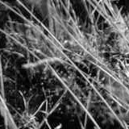
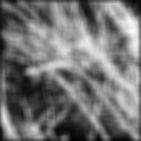
Smoothing with box filter

Slide 34
Properties of smoothing filters
Smoothing
  Values positive
  Sum to 1 → constant regions same as input
  Amount of smoothing proportional to mask size
  Remove “high-frequency” components; “low-pass” filter
Slide credit: Kristen Grauman

Slide 35
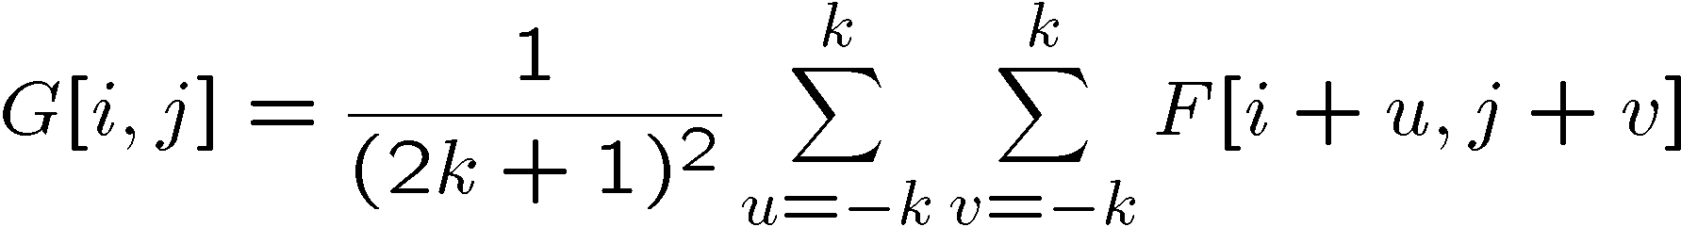
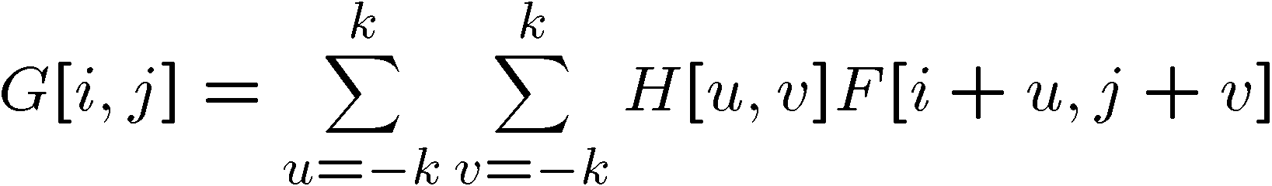
Correlation filtering
Say the averaging window size is 2k+1 x 2k+1:
Attribute uniform weight to each pixel
Loop over all pixels in neighborhood around image pixel F[i,j]
Now generalize to allow different weights depending on neighboring pixel’s relative position:
Non-uniform weights
Slide credit: Kristen Grauman

Slide 36

Correlation filtering
This is called cross-correlation, denoted
Filtering an image: replace each pixel with a linear combination of its neighbors.
The filter “kernel” or “mask” H[u,v] is the prescription for the weights in the linear combination.
Slide credit: Kristen Grauman

Slide 37



Filtering an impulse signal
What is the result of filtering the impulse signal (image) F with the arbitrary kernel H?
0 | 0 | 0 | 0 | 0 | 0 | 0
0 | 0 | 0 | 0 | 0 | 0 | 0
0 | 0 | 0 | 0 | 0 | 0 | 0
0 | 0 | 0 | 1 | 0 | 0 | 0
0 | 0 | 0 | 0 | 0 | 0 | 0
0 | 0 | 0 | 0 | 0 | 0 | 0
0 | 0 | 0 | 0 | 0 | 0 | 0
a | b | c
d | e | f
g | h | i
?
Slide credit: Kristen Grauman

Slide 38
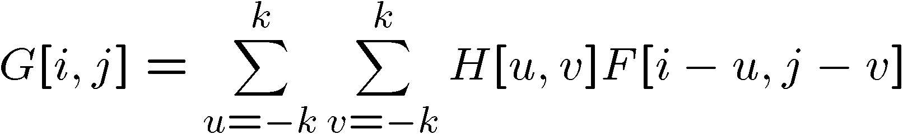
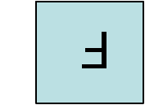

Convolution
Convolution:
  Flip the filter in both dimensions (bottom to top, right to left)
  Then apply cross-correlation
F
H
Notation for convolution operator
Slide credit: Kristen Grauman

Slide 39
Convolution vs. correlation
Convolution
  G=filter2(H,F); or
  G=imfilter(F,H);
Cross-correlation
  G=conv2(H,F);
For a Gaussian or box filter, how will the outputs differ?
If the input is an impulse signal, how will the outputs differ?
Slide credit: Kristen Grauman

Slide 40
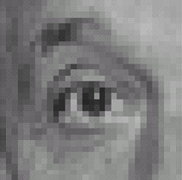
Practice with linear filters
0
0
0
?
0
1
0
0
0
0
Original
Slide credit: David Lowe (UBC)

Slide 41
Practice with linear filters
0
0
0
0
1
0
0
0
0
Original
Filtered
(no change)
Slide credit: David Lowe (UBC)

Slide 42
Practice with linear filters
0
0
0
?
0
0
1
0
0
0
Original
Slide credit: David Lowe (UBC)

Slide 43
Practice with linear filters
0
0
0
0
0
1
0
0
0
Original
Shifted left
By 1 pixel
Slide credit: David Lowe (UBC)

Slide 44
Practice with linear filters
0
0
0
-
1
1
1
?
0
2
0
1
1
1
0
0
0
1
1
1
(Note that filter sums to 1)
Original
Slide credit: David Lowe (UBC)

Slide 45
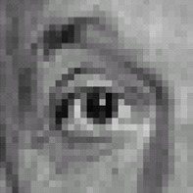
Practice with linear filters
0
0
0
-
1
1
1
0
2
0
1
1
1
0
0
0
1
1
1
Original
Sharpening filter
  Accentuates differences with local average
Slide credit: David Lowe (UBC)

Slide 46
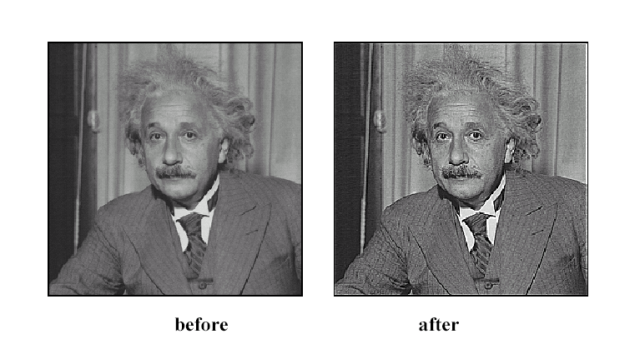
Sharpening
Slide credit: David Lowe (UBC)

Slide 47
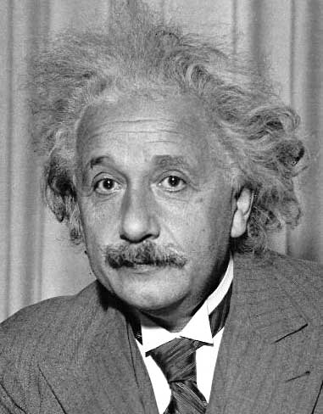
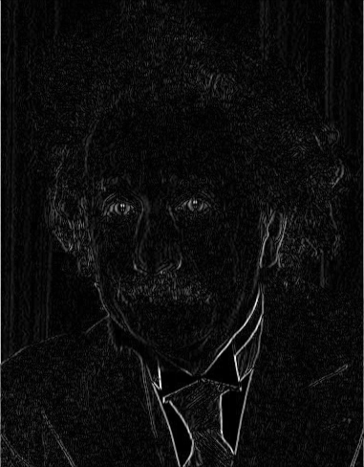
Other filters
1
0
-1
2
0
-2
1
0
-1
Sobel
Vertical Edge
(absolute value)

Slide 48
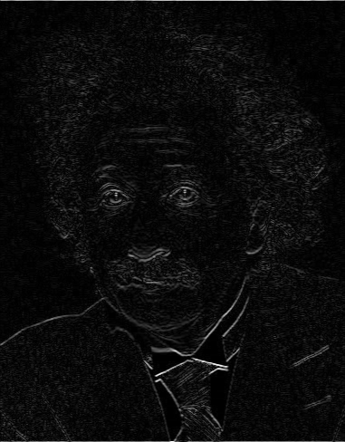
Other filters
1
2
1
0
0
0
-1
-2
-1
Sobel
Horizontal Edge
(absolute value)

Slide 49
Basic gradient filters
Horizontal Gradient
Vertical Gradient
0
0
0
0
-1
0
-1
0
1
-1
0
1
0
0
0
or
0
0
0
0
1
0
or
-1
0
1

Slide 50
Questions
Write as filtering operations, plus some pointwise operations: +, -, .*,>
Sum of four adjacent neighbors plus 1
Sum of squared values of 3x3 windows around each pixel:
Center pixel value is larger than the average of the pixel values to the left and right:

Slide 51
Key properties of linear filters
Linearity:
filter(f₁ + f₂) = filter(f₁) + filter(f₂)
Shift invariance: same behavior regardless of pixel location
filter(shift(f)) = shift(filter(f))
Any linear, shift-invariant operator can be represented as a convolution
Source: S. Lazebnik

Slide 52
More properties
Commutative: a * b = b * a
  Conceptually no difference between filter and signal
Associative: a * (b * c) = (a * b) * c
  Often apply several filters one after another: (((a * b₁) * b₂) * b₃)
  This is equivalent to applying one filter: a * (b₁ * b₂ * b₃)
Distributes over addition: a * (b + c) = (a * b) + (a * c)
Scalars factor out: ka * b = a * kb = k (a * b)
Identity: unit impulse e = [0, 0, 1, 0, 0],
a * e = a
Source: S. Lazebnik

Slide 53
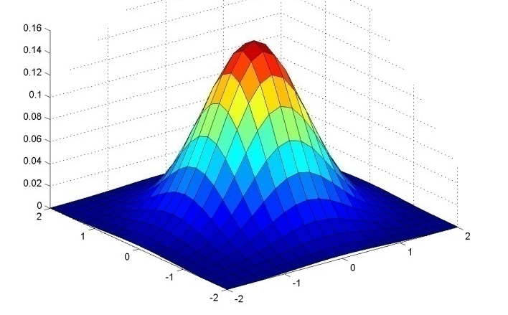
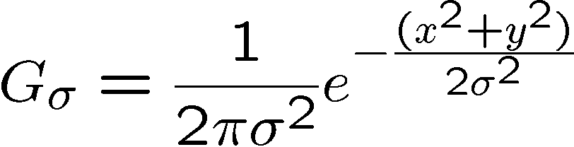
Important filter: Gaussian
Spatially-weighted average
0.003 0.013 0.022 0.013 0.003
0.013 0.059 0.097 0.059 0.013
0.022 0.097 0.159 0.097 0.022
0.013 0.059 0.097 0.059 0.013
0.003 0.013 0.022 0.013 0.003
5 x 5, σ = 1
Slide credit: Christopher Rasmussen

Slide 54

Smoothing with Gaussian filter

Slide 55
Smoothing with box filter

Slide 56
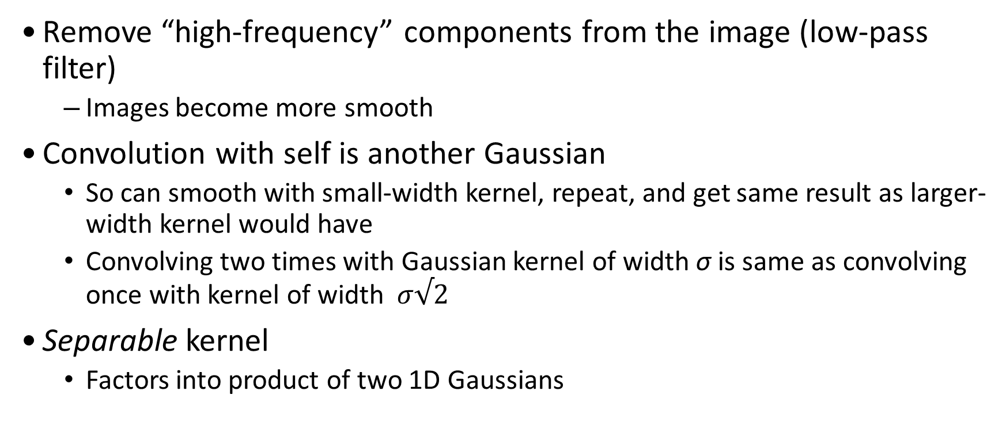
Gaussian filters
Remove “high-frequency” components from the image (low-pass filter)
  Images become more smooth
Convolution with self is another Gaussian
  So can smooth with small-width kernel, repeat, and get same result as larger-width kernel would have
  Convolving two times with Gaussian kernel of width σ is same as convolving once with kernel of width $σ√2$
Separable kernel
  Factors into product of two 1D Gaussians
Slide credit: Kristen Grauman
Notes:
Linear vs. quadratic in mask size

Slide 57
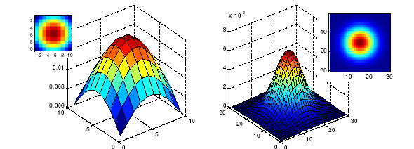
Gaussian filters
What parameters matter here?
Size of kernel or mask
  Note, Gaussian function has infinite support, but discrete filters use finite kernels
σ = 5 with 10 x 10 kernel
σ = 5 with 30 x 30 kernel
Slide credit: Kristen Grauman

Slide 58
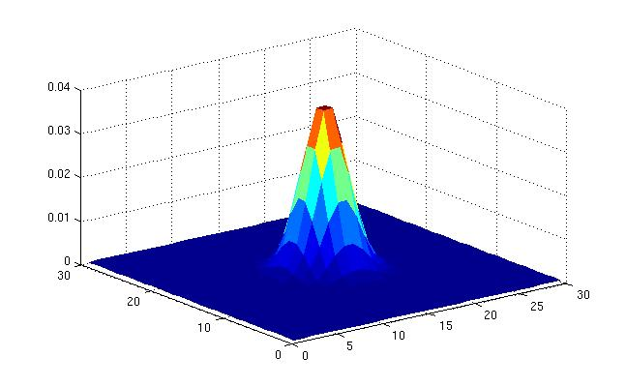



Gaussian filters
What parameters matter here?
Variance of Gaussian: determines extent of smoothing
σ = 2 with 30 x 30 kernel
σ = 5 with 30 x 30 kernel
Slide credit: Kristen Grauman

Slide 59

Separability of the Gaussian filter
Source: D. Lowe

Slide 60



Separability example
2D filtering
(center location only)
The filter factors
into a product of 1D
filters:
Perform filtering
along rows:
*
=
Followed by filtering
along the remaining column:
*
=
Source: K. Grauman

Slide 61
Separability
Why is separability useful in practice?
Separability means that a 2D convolution can be reduced to two 1D convolutions (one among rows and one among columns)
What is the complexity of filtering an n×n image with an m×m kernel?
  O(n² m²)
What if the kernel is separable?
  O(n² m)

Slide 62
Some practical matters

Slide 63
Practical matters
How big should the filter be?
Values at edges should be near zero ← important!
Rule of thumb for Gaussian: set filter half-width to about 3 σ

Slide 64













Practical matters
What about near the edge?
  the filter window falls off the edge of the image
  need to extrapolate
  methods:
    clip filter (black)
    wrap around
    copy edge
    reflect across edge
Source: S. Marschner

Slide 65
Practical matters
  methods (MATLAB):
    clip filter (black): imfilter(f, g, 0)
    wrap around: imfilter(f, g, ‘circular’)
    copy edge: imfilter(f, g, ‘replicate’)
    reflect across edge: imfilter(f, g, ‘symmetric’)
Source: S. Marschner

Slide 66
Practical matters
What is the size of the output?
MATLAB: filter2(g, f, shape)
  shape = ‘full’: output size is sum of sizes of f and g
  shape = ‘same’: output size is same as f
  shape = ‘valid’: output size is difference of sizes of f and g
full
same
valid
g
g
g
g
f
f
f
g
g
g
g
g
g
g
g
Source: S. Lazebnik

Slide 67

Application: Representing Texture
Source: Forsyth

Slide 68




Texture and Material
http://www-cvr.ai.uiuc.edu/ponce_grp/data/texture_database/samples/

Slide 69



Texture and Orientation
http://www-cvr.ai.uiuc.edu/ponce_grp/data/texture_database/samples/

Slide 70


Texture and Scale
http://www-cvr.ai.uiuc.edu/ponce_grp/data/texture_database/samples/

Slide 71
What is texture?
Regular or stochastic patterns caused by bumps, grooves, and/or markings

Slide 72
How can we represent texture?
Compute responses of blobs and edges at various orientations and scales

Slide 73

Overcomplete representation: filter banks
orientations
scales
“Edges”
“Bars”
“Spots”
Code for filter banks: www.robots.ox.ac.uk/~vgg/research/texclass/filters.html

Slide 74


Filter banks
Process image with each filter and keep responses (or squared/abs responses)

Slide 75
How can we represent texture?
Measure responses of blobs and edges at various orientations and scales
Idea 1: Record simple statistics (e.g., mean, std.) of absolute filter responses

Slide 76






Can you match the texture to the response?
Filters
A
B
1
2
C
3
Mean abs responses

Slide 77

Representing texture by mean abs response
Filters
Mean abs responses

Slide 78
Representing texture
Idea 2: take vectors of filter responses at each pixel and cluster them, then take histograms (more on this in coming weeks)

Slide 79
Denoising and Nonlinear Image Filtering
Salt and pepper noise: contains random occurrences of black and white pixels
Impulse noise: contains random occurrences of white pixels
Gaussian noise: variations in intensity drawn from a Gaussian normal distribution
Source: S. Seitz

Slide 80

Gaussian noise
Mathematical model: sum of many independent factors
Good for small standard deviations
Assumption: independent, zero-mean noise
Source: M. Hebert

Slide 81


Reducing Gaussian noise
Smoothing with larger standard deviations suppresses noise, but also blurs the image

Slide 82

Reducing salt-and-pepper noise
3x3
5x5
7x7
What’s wrong with the results?

Slide 83

Alternative idea: Median filtering
A median filter operates over a window by selecting the median intensity in the window
Is median filtering linear?
Source: K. Grauman
Notes:
Linearity of median filter: try filter([0 0 0; 0 1 0; 0 0 0] + [1 1 1; 1 1 2; 2 2 2])

Slide 84
Median filter
Is median filtering linear?
Let’s try filtering

Slide 85

Median filter
What advantage does median filtering have over Gaussian filtering?
  Robustness to outliers
Source: K. Grauman

Slide 86

Median filter
Salt-and-pepper noise
Median filtered
MATLAB: medfilt2(image, [h w])
Source: M. Hebert

Slide 87

Gaussian vs. median filtering
3x3
5x5
7x7
Gaussian
Median

Slide 88

Other non-linear filters
Weighted median (pixels further from center count less)
Clipped mean (average, ignoring few brightest and darkest pixels)
Bilateral filtering (weight by spatial distance and intensity difference)
Bilateral filtering
Image:
http://vision.ai.uiuc.edu/?p=1455

Slide 89


Bilateral Filters
Edge preserving: weights similar pixels more
Original
Gaussian
Bilateral
spatial
similarity (e.g., intensity)
Carlo Tomasi, Roberto Manduchi, Bilateral Filtering for Gray and Color Images, ICCV, 1998.

Slide 90


Guided Image Filters
Bilateral filters
Guided filters
B = imguidedfilter(A,G);
Kaiming He, Jian Sun, Xiaou Tang, Guided Image Filtering. PAMI 2013

Slide 91


Take-home messages
Linear filtering is sum of dot product at each position
  Can smooth, sharpen, translate (among many other uses)
Gaussian filters
  Low pass filters, separability, variance
Attend to details:
  filter size, extrapolation, cropping
Application: representing textures
Noise models and nonlinear image filters
1
1
1
1
1
1
1
1
1

Slide 92

Thank you
Next class: Image Filters in
Frequency Domain

