Slide 1
ECE 5424: Introduction to
Machine Learning
Topics:
  (Finish) Expectation Maximization
  Principal Component Analysis (PCA)
Readings: Barber 15.1-15.4
Stefan Lee
Virginia Tech

Slide 2
Project Poster
Poster Presentation:
  Dec 6th 1:30-3:30pm
  Goodwin Hall Atrium
  Print poster (or bunch of slides)
    Fedex, Library, ECE support, CS support
  Format:
    Portrait, 2 feet (width) x 36 inches (height)
    See https://filebox.ece.vt.edu/~f16ece5424/project.html
Submit poster as PDF by Dec 6th 1:30pm
  Makes up the final portion of your project grade
Best Project Prize!

Slide 3
Final Exam
Dec 14th in class (DURH 261); 2:05 - 4:05 pm
Content:
  Almost completely about material since the midterm
    SVM, Neural Networks, Descision Trees, Ensemble Techniques, K-means, EM (today), Factor Analysis (Thrusday)
  True/False (explain your choice like last time)
  Multiple Choice
  Some ‘Prove this’
  Some ‘What would happen with algorithm A on this dataset”

Slide 4
Homework & Grading
HW3 & HW4 should be graded this week
Will release solutions this week as well

Slide 5
Recap of Last Time

Slide 6
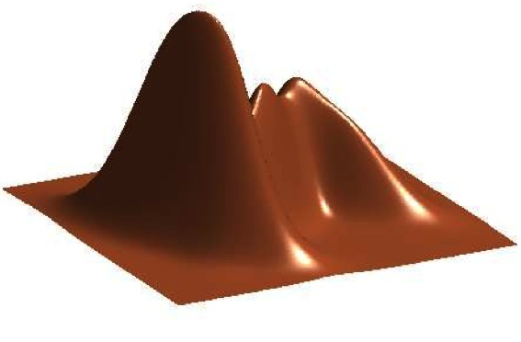
GMM
Figure Credit: Kevin Murphy

Slide 7
EM
Expectation Maximization [Dempster ‘77]
Often looks like “soft” K-means
Extremely general
Extremely useful algorithm
  Essentially THE goto algorithm for unsupervised learning
Plan
  EM for learning GMM parameters
  EM for general unsupervised learning problems

Slide 8
EM for Learning GMMs
Simple Update Rules
  E-Step: estimate P(z_{i} = j | x_{i})
  M-Step: maximize full likelihood weighted by posterior

Slide 9
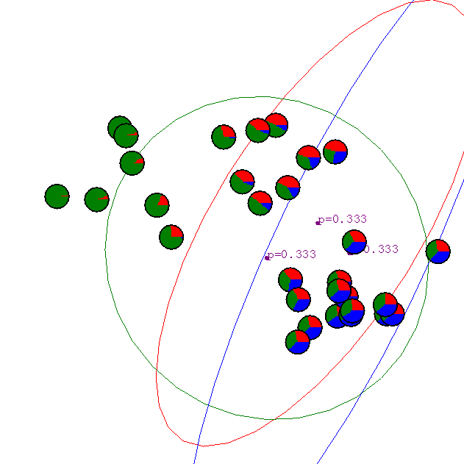
Gaussian Mixture Example: Start
Slide Credit: Carlos Guestrin

Slide 10
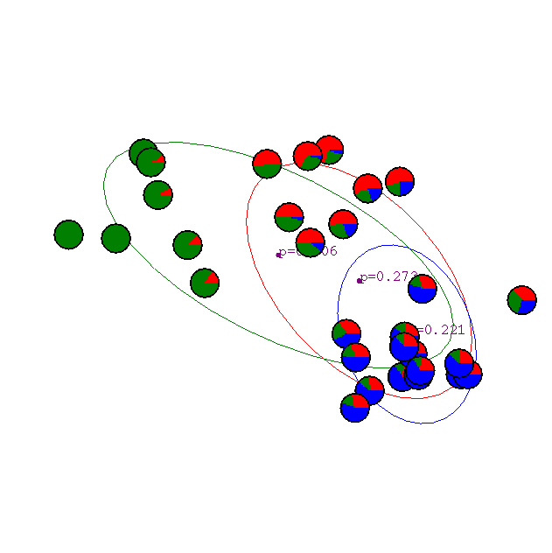
After 1st iteration
Slide Credit: Carlos Guestrin

Slide 11

After 2nd iteration
Slide Credit: Carlos Guestrin

Slide 12

After 3rd iteration
Slide Credit: Carlos Guestrin

Slide 13

After 4th iteration
Slide Credit: Carlos Guestrin

Slide 14

After 5th iteration
Slide Credit: Carlos Guestrin

Slide 15

After 6th iteration
Slide Credit: Carlos Guestrin

Slide 16

After 20th iteration
Slide Credit: Carlos Guestrin

Slide 17
General Mixture Models
P(x | z) | P(z) | Name
Gaussian | Categorial | GMM
Multinomial | Categorical | Mixture of Multinomials
Categorical | Dirichlet | Latent Dirichlet Allocation

Slide 18
The general learning problem with missing data
Marginal likelihood – x is observed, z is missing:

Slide 19
Applying Jensen’s inequality

Slide 20
Convergence of EM
Define potential function F(θ,Q):
EM corresponds to coordinate ascent on F
  Thus, maximizes lower bound on marginal log likelihood

Slide 21
EM is coordinate ascent
E-step: Fix θ^{(t)}, maximize F over Q:
  “Realigns” F with likelihood:
Notes:
3rd step goes to ll because the log P(x_i | theta) can go out of the sum

Slide 22
EM is coordinate ascent
M-step: Fix Q^{(t)}, maximize F over θ
Corresponds to weighted dataset:
  <x₁,z=1> with weight Q^{(t+1)}(z=1|x₁)
  <x₁,z=2> with weight Q^{(t+1)}(z=2|x₁)
  <x₁,z=3> with weight Q^{(t+1)}(z=3|x₁)
  <x₂,z=1> with weight Q^{(t+1)}(z=1|x₂)
  <x₂,z=2> with weight Q^{(t+1)}(z=2|x₂)
  <x₂,z=3> with weight Q^{(t+1)}(z=3|x₂)
  …

Slide 23
EM Intuition

Slide 24
What you should know
K-means for clustering:
  algorithm
  converges because it’s coordinate ascent
EM for mixture of Gaussians:
  How to “learn” maximum likelihood parameters (locally max. like.) in the case of unlabeled data
EM is coordinate ascent
Remember, E.M. can get stuck in local minima, and empirically it DOES
General case for EM
Slide Credit: Carlos Guestrin

Slide 25
Tasks
x
Classification
y
Discrete
x
Regression
y
Continuous
x
Clustering
c
Discrete ID
x
Dimensionality
Reduction
z
Continuous

Slide 26
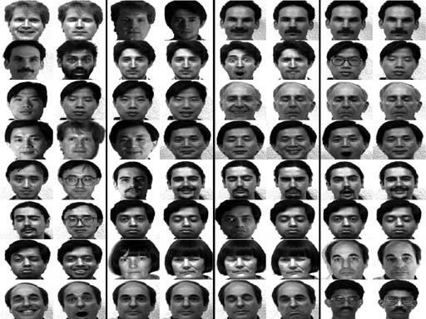
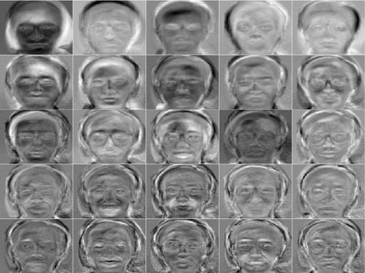
New Topic: PCA

Slide 27
Synonyms
Principal Component Analysis
Karhunen–Loève transform
Eigen-Faces
Eigen-<Insert-your-problem-domain>
PCA is a Dimensionality Reduction Algorithm
Other Dimensionality Reduction algorithms
  Linear Discriminant Analysis (LDA)
  Independent Component Analysis (ICA)
  Local Linear Embedding (LLE)
  …

Slide 28
Dimensionality reduction
Input data may have thousands or millions of dimensions!
  e.g., images have 5M pixels

Slide 29
Dimensionality reduction
Input data may have thousands or millions of dimensions!
  e.g., images have 5M pixels
Dimensionality reduction:
represent data with fewer dimensions
  easier learning – fewer parameters
  visualization – hard to visualize more than 3D or 4D
  discover “intrinsic dimensionality” of data
    high dimensional data that is truly lower dimensional

Slide 30
PCA / KL-Transform
De-correlation view
  Make features uncorrelated
  No projection yet
Max-variance view:
  Project data to lower dimensions
  Maximize variance in lower dimensions
Synthesis / Min-error view:
  Project data to lower dimensions
  Minimize reconstruction error
All views lead to same solution

Slide 31
Basic PCA algorithm
Center data (subtract mean)
Estimate covariance
Find eigenvectors and values of covariance
Principle components: choose k eigenvectors with highest corresponding values

Slide 32
Video
https://youtu.be/pSRA8GpWIrA?t=162

Slide 33
Video
What if the dimension is high?
  Covariance matrix is d x d
  For high d, Eigen decomposition is very slow… O(d³)
Use Singular Value Decomposition (SVD)
  finds k-eigenvectors
  great implementations O(N²d)

Slide 34
PCA Problem #1
Only removed linear dependencies
Correlation Cov(x,y) / (var(x), var(y))

Slide 35
PCA Problem #2
Direction of maximum variance may not be use for classification
See Linear Discriminate Analysis (if you have labels)

Slide 36
What you need to know
Dimensionality Reduction
  why and when its important
    visualization
    compression
    faster learning
Principle Component Analysis
  KL Transform view
    Notes have reconstruction error and max variance views too
  Relationship to covariance matrix and eigenvectors
  using SVD for PCA

Slide 37
Machine Learning Lectures are Over
Basics of Statistical Learning
  Loss functions, MLE, MAP, Bayesian estimation, bias-variance tradeoff, regularization, cross-validation
Supervised Learning
  Nearest neighbor, Naïve Bayes, Logistic Regression, Neural Networks, Support Vector Machines, Kernels, Decision Trees
  Ensemble methods: bagging and boosting
Unsupervised Learning
  Clustering/Density estimation: k-means, GMMs, EM
  Dimensionality Reduction: PCA (with SVD)

Slide 38
What is Left?
Poster Session
  Dec 6th 1:30-3:30pm in Goodwin Hall Atrium
Final Exam
  Dec 14th in class (DURH 261); 2:05 - 4:05 pm
A Sincere Thank You

