Slide 1
ECE 5424: Introduction to Machine Learning
Topics:
SVM
Lagrangian Duality
(Maybe) SVM dual & kernels
Readings: Barber 17.5
Stefan Lee
Virginia Tech

Slide 2
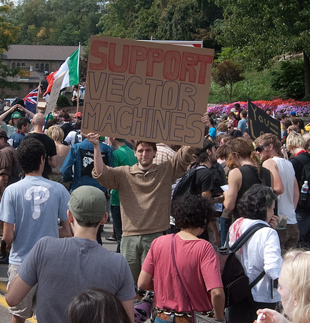
Recap of Last Time

Slide 3
Image Courtesy: Arthur Gretton

Slide 4
Image Courtesy: Arthur Gretton

Slide 5
Image Courtesy: Arthur Gretton

Slide 6
Image Courtesy: Arthur Gretton

Slide 7
Generative vs. Discriminative
Generative Approach (Naïve Bayes)
Estimate p(x|y) and p(y)
Use Bayes Rule to predict y
Discriminative Approach
Estimate p(y|x) directly (Logistic Regression)
Learn “discriminant” function f(x) (Support Vector Machine)

Slide 8
SVMs are Max-Margin Classifiers
w.x + b = +1
w.x + b = 0
w.x + b = -1
x⁺
x⁻
Maximize this while getting examples correct.

Slide 9
Last Time
Hard-Margin SVM Formulation
$\min_{w,b}{ w}^{T}w$ $$s.t. \left(w^{T}x_{j}+b\right)y_{j}≥1, ∀j$$
Soft-Margin SVM Formulation
$\min_{w,b}{ w}^{T}w+C\sum_{i}{ξ_{i}}$ $$s.t. \left(w^{T}x_{j}+b\right)y_{j}≥1−,ξ_{j} ∀j \\ ξ_{j}≥0, ∀j$$

Slide 10
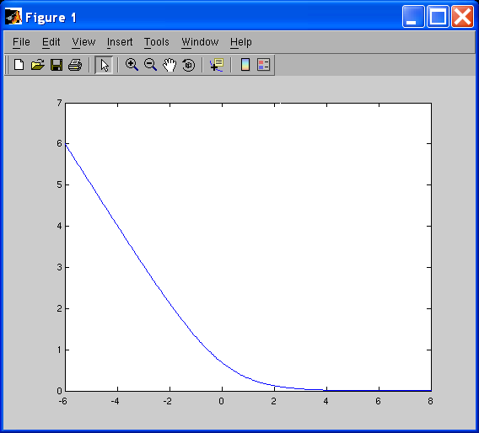
Last Time
Can rewrite as a hinge loss $\min_{w,b}{\frac{1}{2}w^{T}w+C \sum_{i}{h(y_{i}(w^{T}x_{i}+b)}}$
SVM: Hinge Loss
LR: Logistic Loss

Slide 11
Today
I want to show you how useful SVMs really are by explaining the Kernel trick but to do that….
…. we need to talk about Lagrangian Duality

Slide 12
Constrained Optimization
How do I solve these sorts of problems:
$$\min_{w}{f\left(w\right)} \\ s.t. h_{1}\left(w\right)=0 \\ ⋮ \\ h_{k}\left(w\right)=0 \\ g_{1}\left(w\right)≤0 \\ ⋮ \\ g_{m}\left(w\right)≤0$$

Slide 13
Introducing the Lagrangian
Lets assume we have this problem
$$\min_{w}{f\left(w\right)} \\ s.t. h\left(w\right)=0 \\ g\left(w\right)≤0$$
Define the Lagrangian function:
$$L\left(w, β,α\right)=f\left(w\right)+βh\left(w\right)+αg\left(w\right) \\ s.t. α≥0$$
Where $β$ and $α$ are called Lagrange Multipliers
(or dual variables)

Slide 14
Gradient of Lagrangian
$$L\left(w, β,α\right)=f\left(w\right)+βh\left(w\right)+αg\left(w\right)$$
$$\frac{δL}{δα}=g\left(w\right)=0$$
$$\frac{δL}{δβ}=h\left(w\right)=0$$
$$\frac{δL}{δw}=\frac{δf(w)}{δw}+β\frac{δh(w)}{δw}+α\frac{δg(w)}{δw}=0$$
This will find critical points in the constrained function.

Slide 15
Building Intuition
$$L\left(w, β,α\right)=f\left(w\right)+βh\left(w\right)$$
$$\frac{δL}{δw}=\frac{δf(w)}{δw}+β\frac{δh(w)}{δw}=0$$
$$\frac{δf(w)}{δw}=−β\frac{δh(w)}{δw}$$

Slide 16
Geometric Intuition
Image Credit: Wikipedia

Slide 17
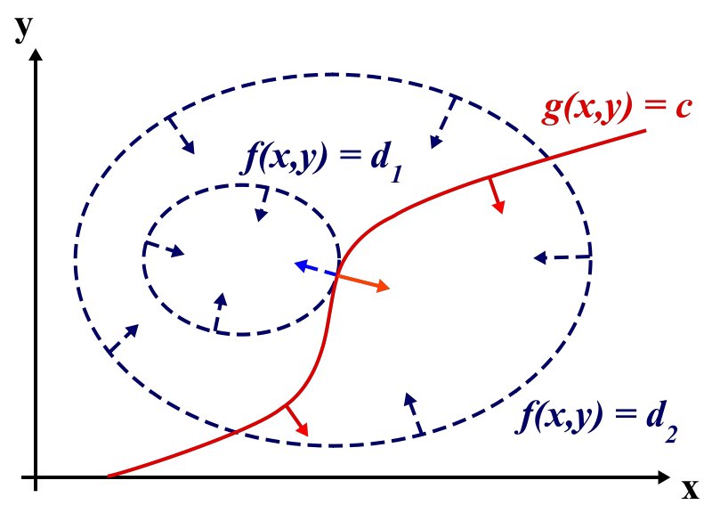
Geometric Intuition
h
Image Credit: Wikipedia

Slide 18
A simple example
Minimize f(x,y) = x + y s.t. x² + y² = 1
L(x,y, $β$) = x + y + $β$(x² + y² – 1)
$\frac{δL}{δx}=1+2βx=0$, $\frac{δL}{δx}=1+2βy=0$ $\frac{δL}{δΒ}=x^{2}+y^{2}−1=0$
$x=y=\frac{1}{2β}→\frac{2}{4β^{2}}=1 →β= ±\sqrt{2}$
Makes $x=y=±$ $\frac{\sqrt{2}}{2}$

Slide 19
Why go through this trouble?
Often solutions derived from the Lagrangian form are easier to solve
Sometimes they offer some useful intuition about the problem
It builds character.

Slide 20
Lagrangian Duality
More formally on overhead
Starring a game-theoretic interpretation, the duality gap, and KKT conditions.

