Slide 1
Transfer Learning
Delasa Aghamirzaie, Abraham Lama Salomon
Deep Learning for Perception
9/15/2015

Slide 2
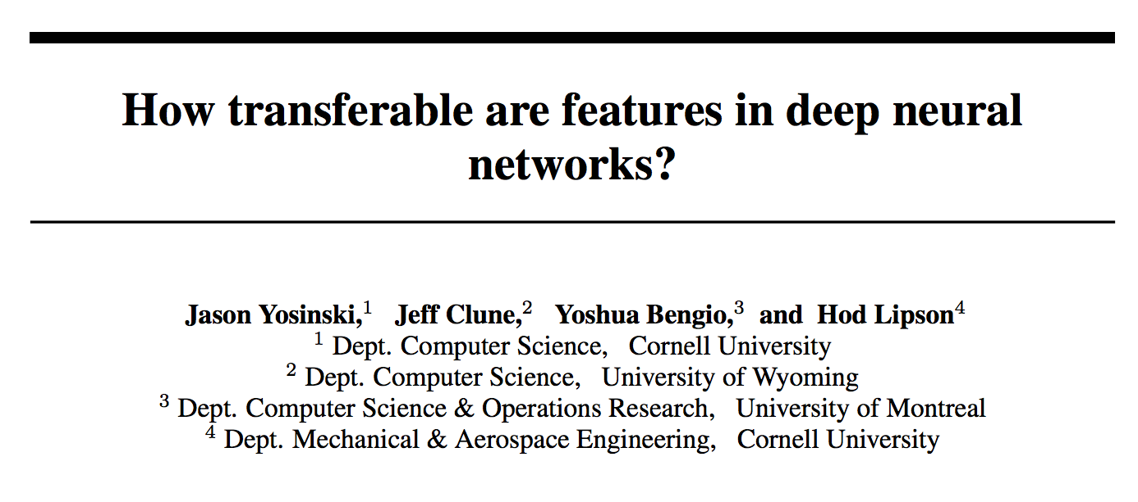
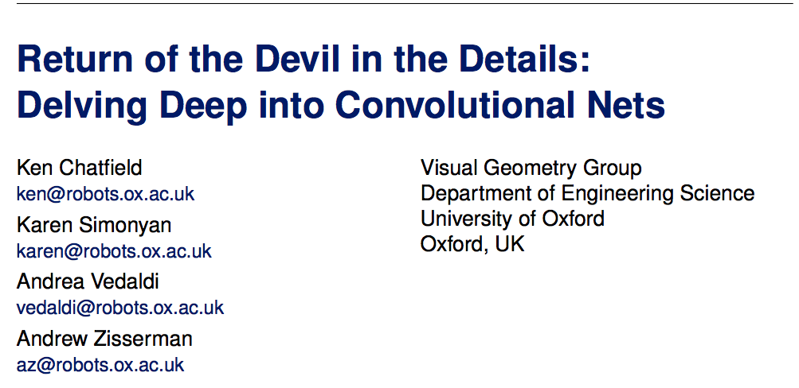
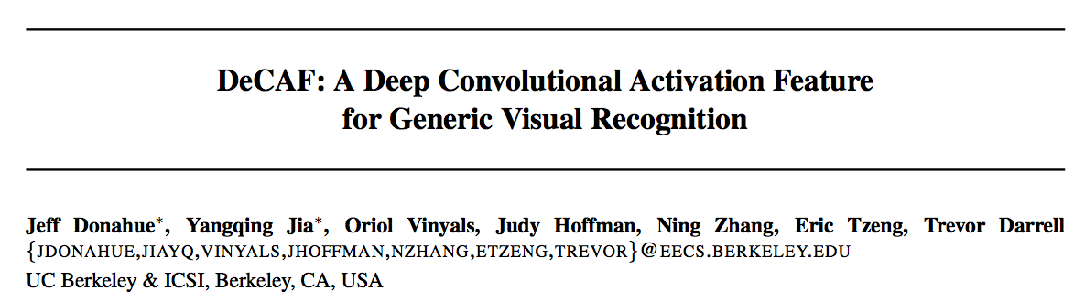
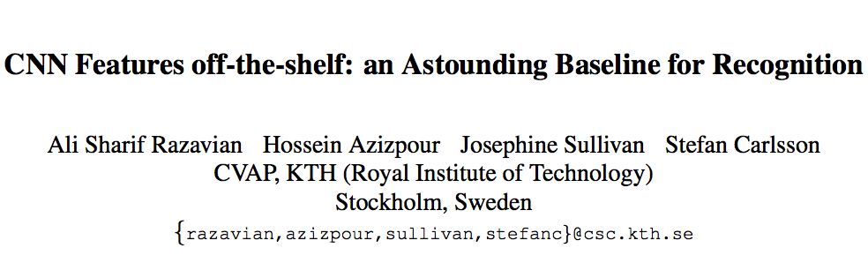
Outline

Slide 3
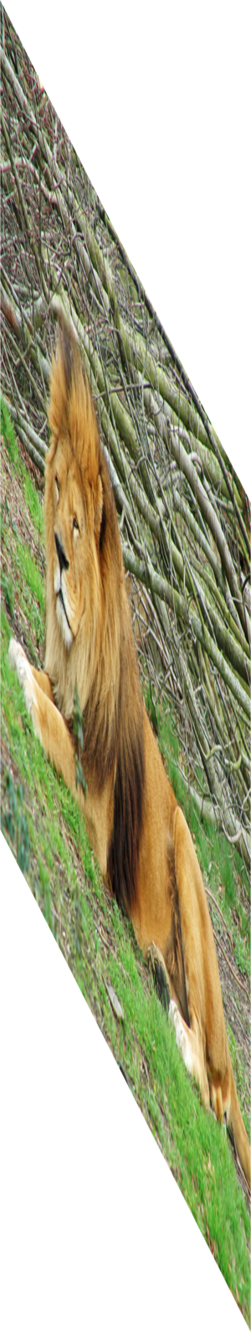
Convolutional Neural Networks: AlexNet
Lion
Image
labels
Krizhevsky, Sutskever, Hinton — NIPS 2012
Notes:
Successful training of a very large CNN on imagenet data to predict one of the thousand classes.
We know these models are working

Slide 4



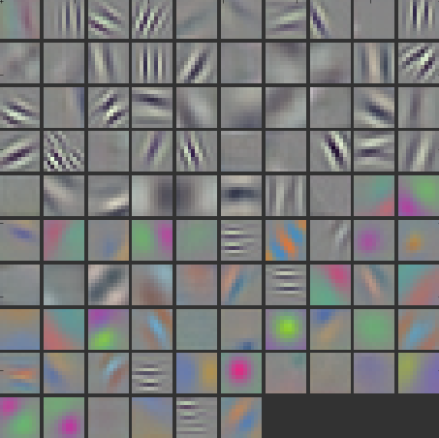
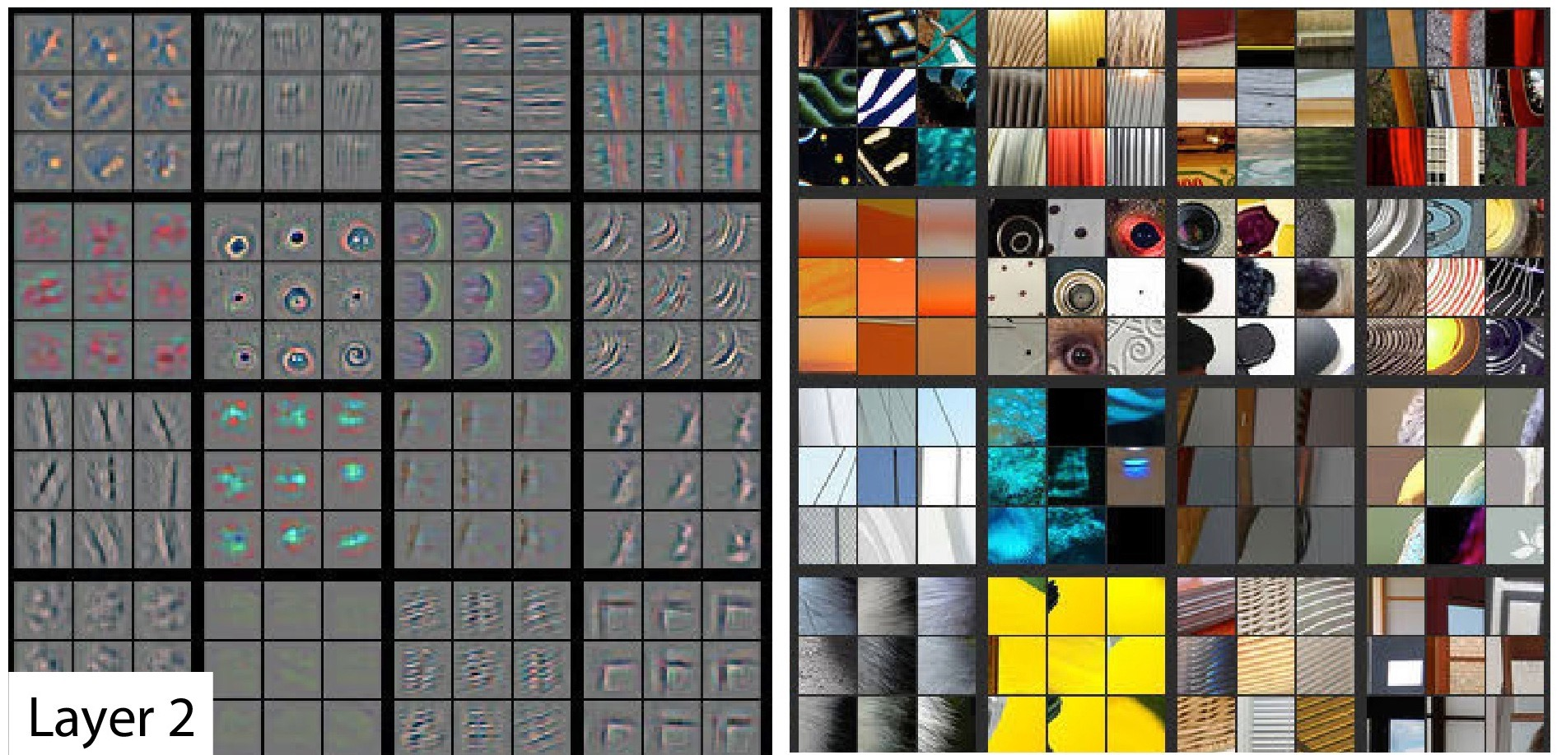
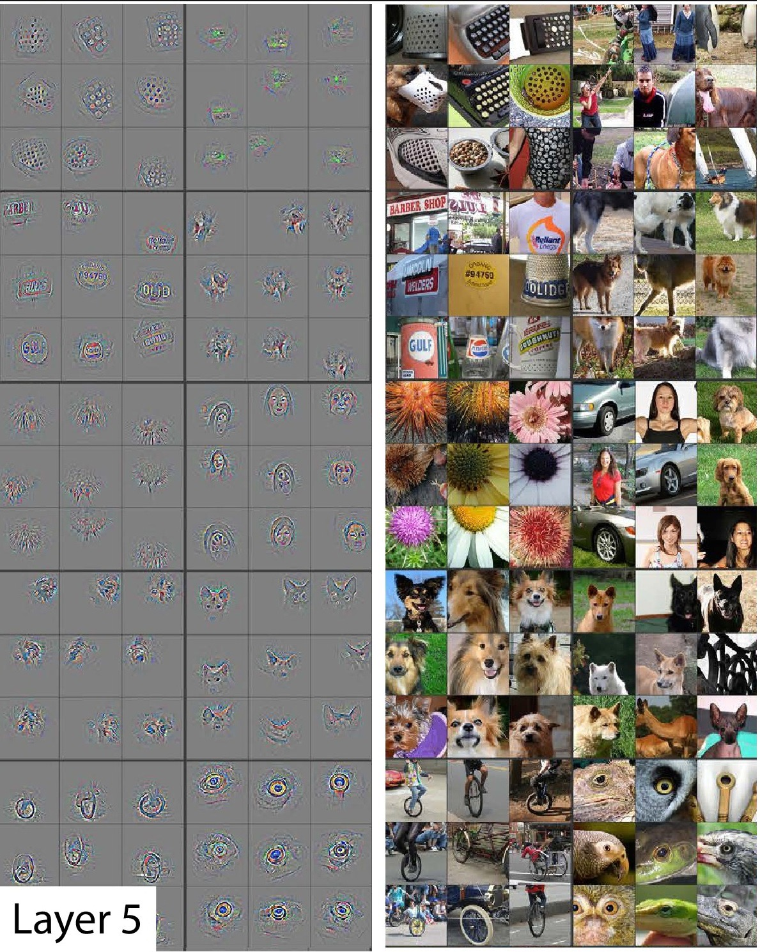
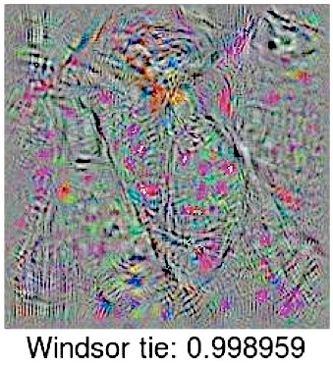
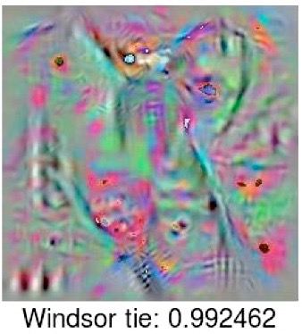
Layer 1
Filter (Gabor and color blobs)
Layer 2
Layer 5
Last
Layer
Zeiler et al.
arXiv 2013, ECCV 2014
Nguyen et al.
arXiv 2014
Gabor filter: linear filters used for edge detection with similar orientation representations to the human visual system
Notes:
clear THAT they work, but not as clear WHY or HOW.
WHAT’s going on in the middle?
LET’S think about what we DO KNOW.
It does not matter what dataset you use or what task you are training on, the first layer is always a gabor filter.
To find patches of images that cause high activation: deconvulutional neural network

Slide 5

general
Main idea of this paper:
Quantify the general to specific transition
by using transfer learning.
??
??
??
Lion
specific
Layer number
Notes:
At the beginning layers we learn features that are general. At the last layers, we learn features that are specific to the target task. The question is how this transition occurs. Quantify the transition using transfer learning. Specific to tasks,

Slide 6
Transfer Learning Overview
Defining transfer learning
How it works
Frozen weights
Fine tuning
Selffer
Fine tuner
Transfer
Figure for demonstrating how backprop woks
Input A
Task A
Layer n
Transfer
AnB: Frozen Weights
Back-propagation
Task B
Input B
Task B
Back-propagation
AnB⁺: Fine-tuning

Slide 7




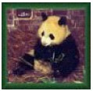


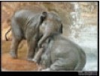
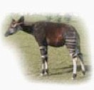
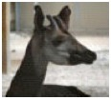
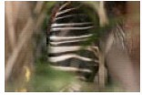
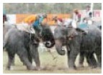
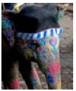


ImageNet
dataset
A
500 Classes
dataset
B
1000 Classes
500 Classes
Deng et al., 2009
Notes:
okapi

Slide 8
A Images
A Labels
Train using Caffe framework (Jia et al.)
500 Classes

Slide 9
A Images
A Labels
Train using Caffe framework (Jia et al.)
500 Classes
Notes:
train using the Caffe

Slide 10
A Images
A Labels
Train using Caffe framework (Jia et al.)
500 Classes

Slide 11
baseA
A Images
baseB
B Images

Slide 12
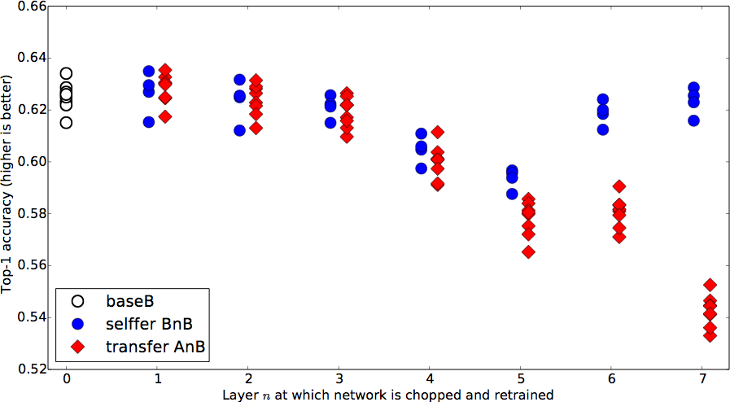
Notes:
Each point is average accuracy over validation set. Variants because of different 500 classes.

Slide 13
A Images
A Labels

Slide 14
B Images
B Labels
Hypothesis: if transferred features are specific to task A, performance drops. Otherwise the performance should be the same.

Slide 15

transfer
AnB
Compare to
B Images
B Labels
baseB

Slide 16
Notes:
FIRST layers generic for this A / B combination
OVERALL drop by the end is not large! (MANY RELATED CATEGORIES)
CURIOUS BUMP IN MIDDLE

Slide 17
B Images
B Labels

Slide 18
B Images
B Labels

Slide 19
selffer
BnB
B Images
B Labels

Slide 20
Notes:
When you chop half of the network, randomly initialize the rest of the network, keep the weights frozen, u have optimization issues. A so

Slide 21
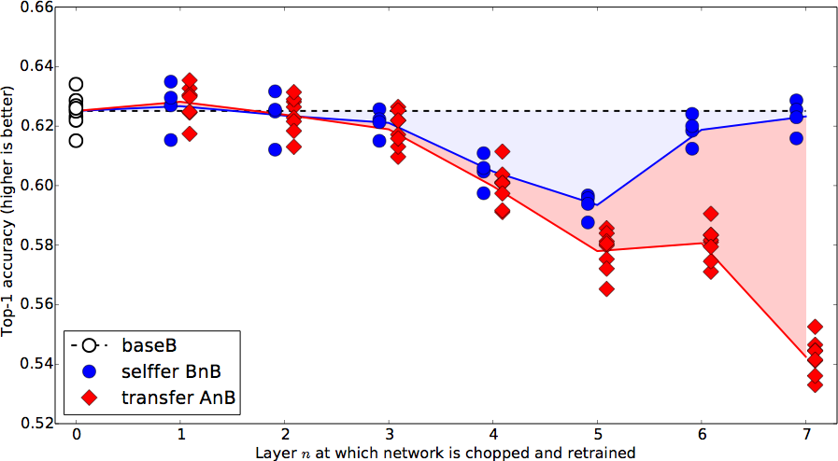

Slide 22
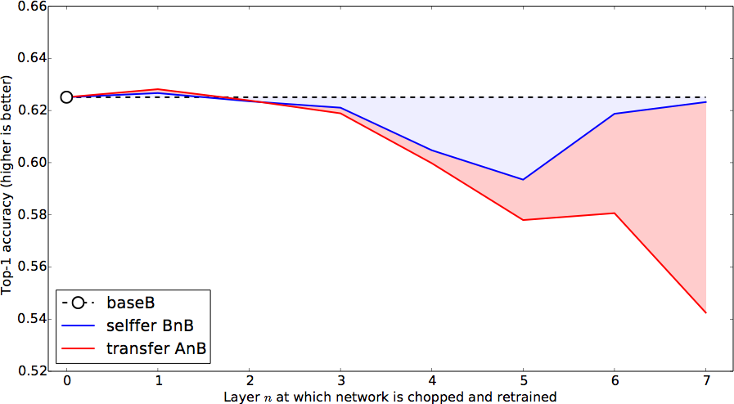
Performance drops due to...
Fragile
co-adaptation
Representation
specificity
Notes:
Not previously shown

Slide 23
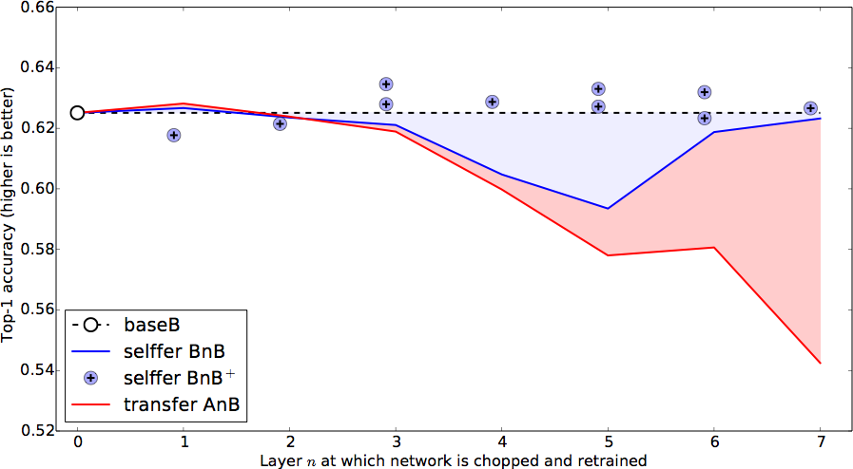
Notes:
Not previously shown

Slide 24
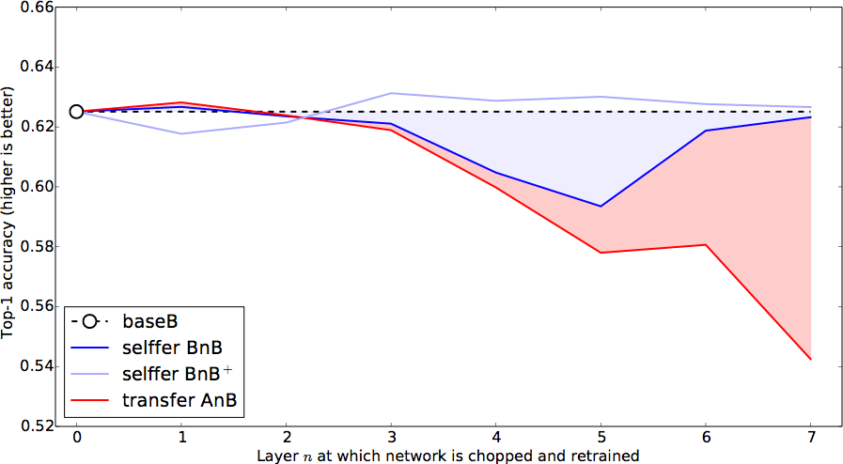
Notes:
Not previously shown

Slide 25
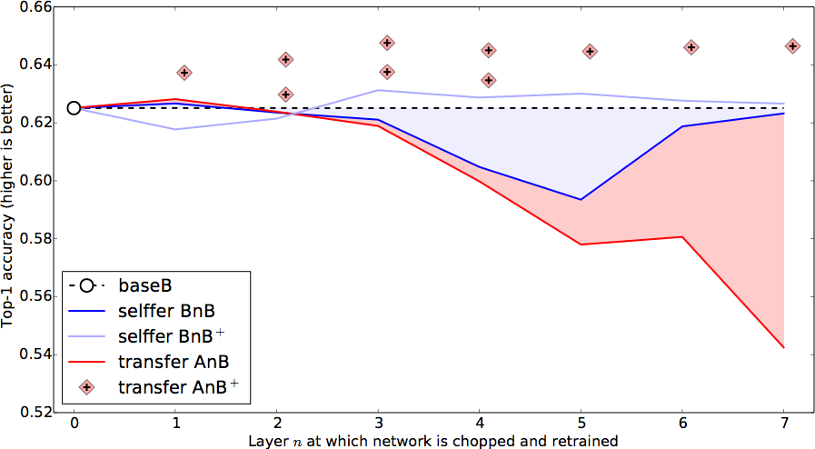
Notes:
Not previously shown

Slide 26
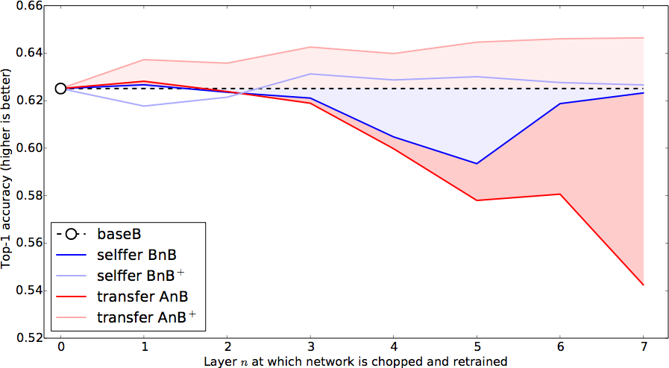
Notes:
Not previously shown

Slide 27
Transfer + fine-tuning improves generalization
Notes:
Not previously shown

Slide 28
ImageNet has many related categories...
Dataset A: random
Dataset B: random
gecko
garbage truck
toucan
fire truck
radiator
binoculars
baseball
lion
panther
bookshop
rabbit
gorilla

Slide 29
ImageNet has many related categories...
Dataset A: man-made
Dataset B: natural
garbage truck
gorilla
fire truck
gecko
radiator
toucan
baseball
rabbit
binoculars
panther
bookshop
lion

Slide 30
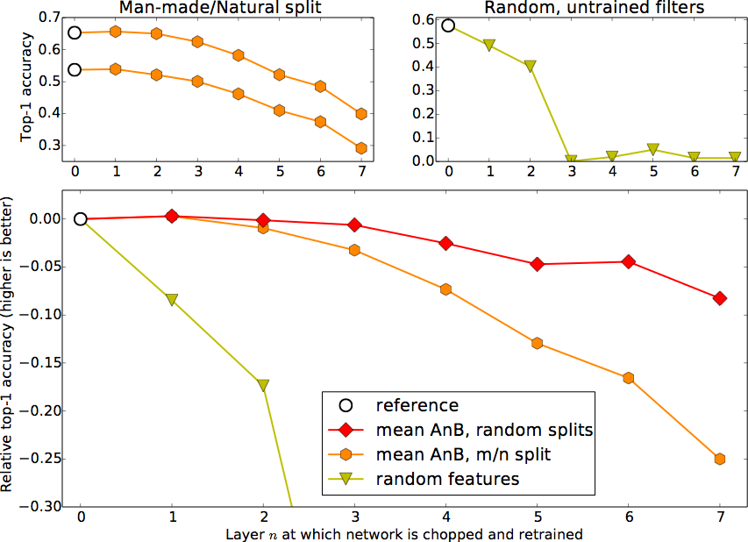
Similar A/B

Slide 31
Similar A/B
Dissimilar A/B

Slide 32
Similar A/B
Random
(Jarret et al. 2009)
Dissimilar A/B

Slide 33
Conclusions
fine-tuning helps
co-adaptation
specificity
Measure general to specific transition layer by layer
Transferability governed by:
  lost co-adaptations
  specificity
  difference between base and target dataset
Fine-tuning helps even on large target dataset
Notes:
In top-5 accuracy you give yourself credit for having the right answer if the right answer appears in your top five guesses.

Slide 34

DeCAF: A Deep Convolutional Activation Feature
for Generic Visual Recognition
Jeff Donahue, Yangqing Jia, Oriol Vinyals, Judy Hoffman, Ning Zhang, Eric Tzeng and Trevor Darrell
Yangqing Jia, author of Caffe and its precursor DeCAF.

Slide 35
Problem:
performance with conventional visual representations had reached a plateau.
Solution:
discover effective representations that capture salient semantics for a given task.
can deep architectures do this?

Slide 36
Why Deep Models:
deep architectures should be able to capture salient aspects of a given domain [Krizhevsky NIPS 2012][Singh ECCV 2012].
perform better than traditional hand-engineered representations
[Le CVPR 2011]
Had been applied to large-scale visual recognition tasks
However:
with limited training data, fully-supervised deep architectures generally overfit
many visual recognition challenges have tasks with few training examples

Slide 37
Approach:
Train a Deep convolutional model in a fully supervised setting using Krizhevsky method and ImageNet database.
[Krizhevsky NIPS 2012].
Extract various features from the network
Evaluate the efficacy of these features on generic vision tasks
Questions:
Do features extracted from the CNN generalize the other datasets ?
How does performance vary with network depth?
How does performance vary with network architecture?

Slide 38
Adopted Network:
Deep CNN architecture proposed by Krizhevsky [Krizhevsky NIPS 2012].
  5 convolutional layers (with pooling and ReLU)
  3 fully-connected layers
  won ImageNet Large Scale Visual recognition Challenge 2012
  top-1 validation error rate of 40.7%
follow architecture and training protocol with two differences
  input 256 x 256 images rather than 224 x 224 images
  no data augmentation trick

Slide 39
Qualitatively and Quantitatively Feedback:
Comparison with GIST features [Oliva & Torralba, 2001] and LLC features [Wang at al., 2010]
Use of t-SNE algorithm [van der Maaten & Hilton, 2008]
Use of ILSVRC-2012 validation set to avoid overfitting (150,000 photographs)
Use of SUN-397 dataset to evaluate how dataset bias affects results

Slide 40
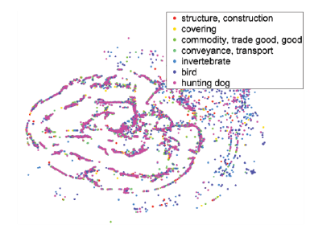
Feature Generalization and Visualization
T-SNE Algorithm
t-SNE feature visualizations on the ILSVRC-2012 validation set
LLC Features
GIST Features
DeCAF
We visualize features in the following way: we run the t- SNE algorithm (van der Maaten & Hinton, 2008) to find a 2-dimensional embedding of the high- imensional feature space, and plot them as points colored depending on their
semantic category in a particular hierarchy.
LLC FEATURES

Slide 41
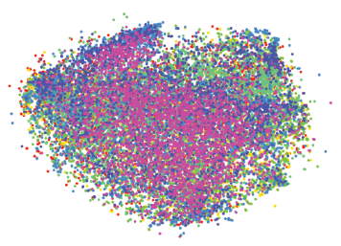
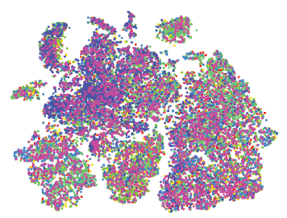
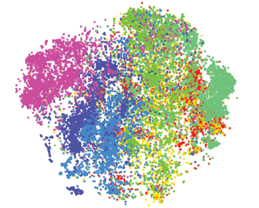
LLC FEATURES
DeCAF₁ FEATURES
This is compatible with common deep
learning knowledge that the first layers learn “low-level”
features, whereas the latter layers learn semantic or “highlevel”
features.
Furthermore, other features such as GIST
or LLC fail to capture the semantic difference in the image
GIST FEATURES
DeCAF₆ FEATURES

Slide 42
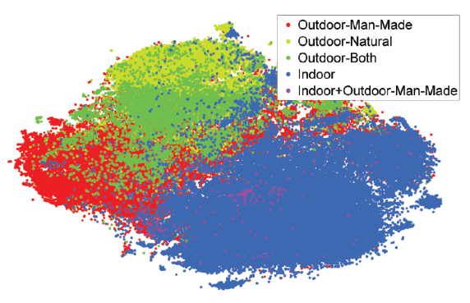
DeCAF₆ features trained on ILSVRC-2012 generalized to SUN-397 when considering semantic groupings of labels
SUN-397: Large-scale scene recognition from abbey to zoo.
(899 categories and 130,519 images)

Slide 43
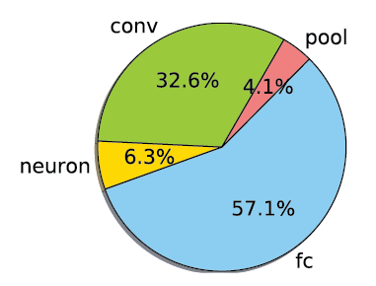
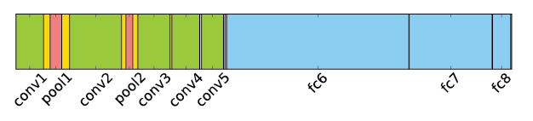
Computational Time
Break-down of the computation time analyzed using the decaf framework.
The convolution and fully-connected layers take most of the time to run, which is understandable as they involve large matrix-matrix multiplications6.

Slide 44
Experimental Comparison Feedback
Not evaluation of features from any earlier layers in the CNN
  do not contain rich semantic representation
Results on multiple datasets to evaluate the strength of DeCAF for
  basic object recognition (Caltech-101)
  domain adaptation (Office)
  fine-grained recognition (Caltech-UCSD)
  scene recognition (SUN-397)

Slide 45
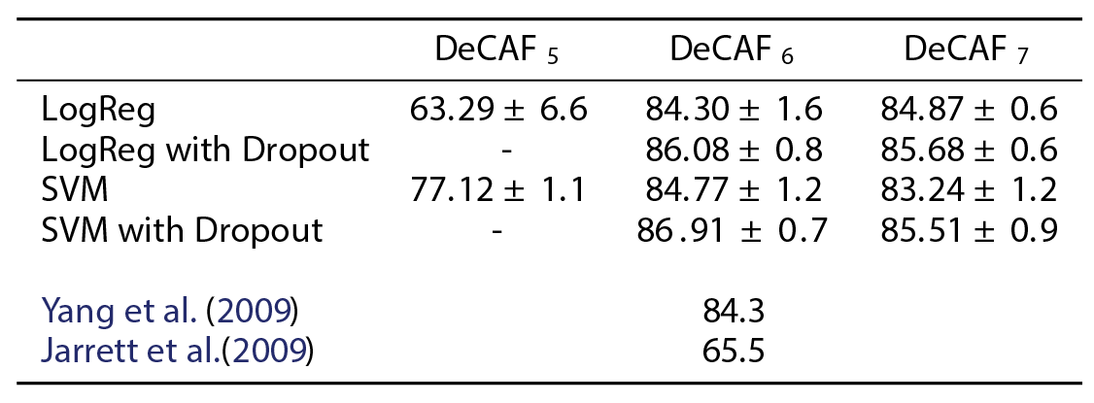
Experiments: Object Recognition
Caltech-101
Compared also with the two-layers convolutional network of Jarret et al (2009)

Slide 46
Experiments: Domain Adaptation
Office dataset (Saenko et al., 2010), which has 3 domains:
  Amazon: images taken from amazon.com
  Webcam and Dslr: images taken in office environment using a webcam or SLR camera

Slide 47
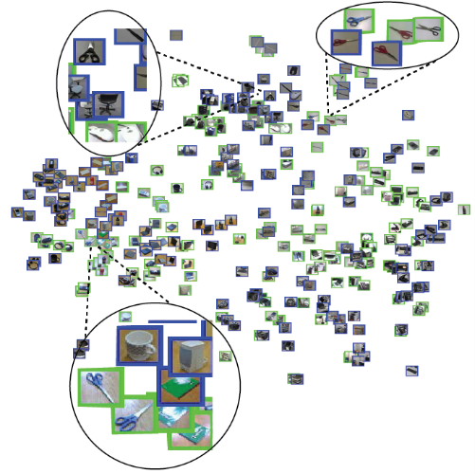
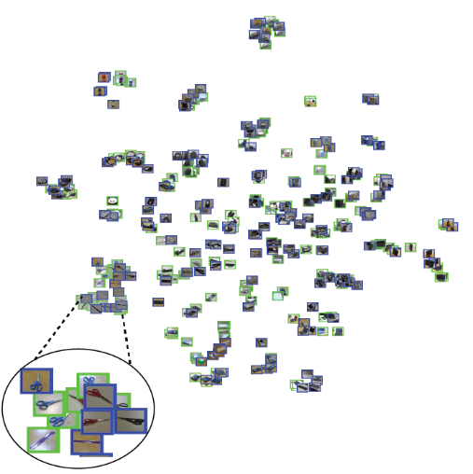
Experiments: Domain Adaptation
DeCAF robust to resolution changes
DeCAF provides better category clustering than SURF
DeCAF clusters same category instances across domains
The dataset contains three domains: Amazon, which consists of product images taken from amazon.com; and Webcam and Dslr, which consists of images taken in an office environment using a webcam or digital SLR camera, respectively.
DeCAF₆ FEATURES
GIST FEATURES

Slide 48
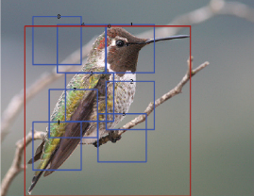

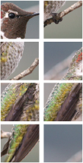
Experiments: Subcategory Recognition
Fine grained recognition involves recognizing subclasses of the same object class such as different bird species, dog breeds, flower types, etc.
Caltech-UCSD birds dataset
First adopt ImageNet-like pipeline, DeCAF6 and a multi-class logistic regression
Second adopt deformable part descriptors (DPD) method [Zhang et al., 2013]

Slide 49
Experiments: Scene Recognition
Goal: classify the scene of the entire image
SUN-397 large-scale scene recognition database
Outperforms Xiao ed al. (2010), the current state-of-the-art method
DeCAF demonstrate
the ability to generalize to other tasks
- representational power as compared to traditional hand-engineered features

Slide 50
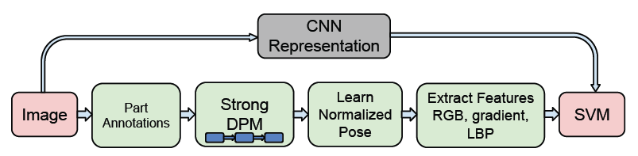
Are the features extracted by a deep network could be exploited for a wide variety of vision tasks?
CNN representation replaces pipelines of service-oriented architecture (s.o.a) methods and achieve better results.

Slide 51
OverFeat: publicly available trained CNN, with a structure that follows Krizhevsky et al. Trained for image classification of ImageNet ILSVRC 2013
(1.2 million images, 1000 categories).
The features extracted from the OverFeat network were used as a generic image representation
The CNN features used are trained only using ImageNet data, while the simple classifiers are trained using images specific to the task’s dataset.

Slide 52
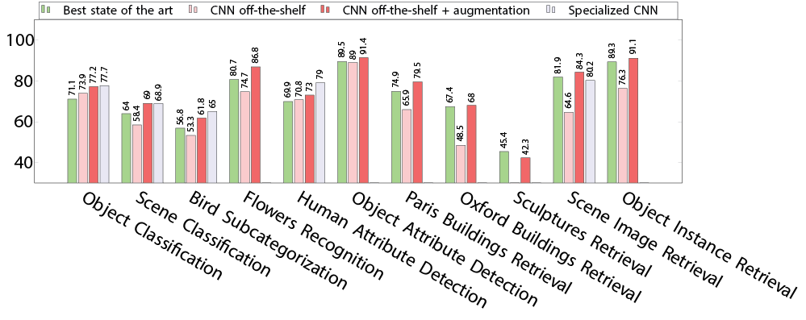

Slide 53
Experimental Comparison Feedback
Results on multiple different recognition tasks:
  visual classification (Pascal VOC 2007, MIT-67 )
  fine-grained recognition (Caltech-UCSD, Oxford 102)
  attribute detection (UIUC 64, H3D dataset)
  visual image retrieval (Oxford5k, Paris6k, Sculptures6k, Holidays and Ukbench)

Slide 54
Visual Classification
The feature vector is L2 normalized to unit length for all the experiments.
The 4096 dimensional feature vector was used in combination with a Support Vector Machine (SVM) to solve different classification tasks (CNN-SVM).
The training set was augmented by adding cropped and rotated samples (CNNaug+ SVM).

Slide 55
Visual Classification
Databases:
Pascal VOC 2007 for object image classification. Pascal VOC 2007 contains 10000 images of 20 classes including animals, handmade and natural objects.
MIT-67 indoor scenes for scene recognition. The MIT scenes dataset has 15620
images of 67 indoor scene classes.
In contrast to object detection, object image classification requires no localization of the objects.

Slide 56
Visual Classification
Pascal VOC 2007 Image Classification Results compared to other methods which also use training data outside VOC. The CNN representation is not tuned for the Pascal VOC dataset

Slide 57
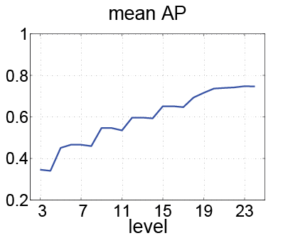
Visual Classification
Evolution of the mean image classification AP (average precision) over PASCAL VOC 2007 classes as we use a deeper representation from the OverFeat CNN trained on the ILSVRC dataset.
Intuitively one could reason that the
learnt weights for the deeper layers could become more specific
to the images of the training dataset and the task it is
trained for. We observed the
same trend in the individual class plots. The subtle drops in
the mid layers (e.g. 4, 8, etc.) is due to the “ReLU” layer
which half-rectifies the signals. Although this will help the
non-linearity of the trained model in the CNN, it does not
help if immediately used for classification.

Slide 58
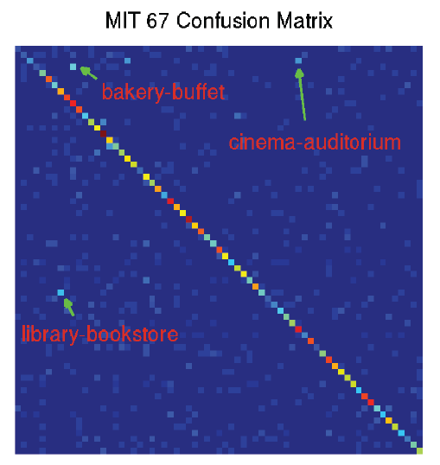
Visual Classification
Confusion matrix for the MIT-67 indoor dataset. Some of the off-diagonal confused classes have been annotated, these particular cases could be hard even for a human to distinguish.

Slide 59
Visual Classification
Results of MIT 67 Scene Classification
Using a CNN off-the-shelf representation with linear SVMs training significantly outperforms a majority of the baselines.
The performance is measured by the average classification accuracy of different classes (mean of the confusion matrix diagonal).

Slide 60
Fine Grained Recognition
Results on CUB 200-2011 Bird dataset.

Slide 61
Fine Grained Recognition
Results on the Oxford 102 Flowers dataset

Slide 62
Attribute Detection
An attribute is a semantic or abstract quality which different instances/categories share.
Databases:
UIUC 64 object attributes dataset. There are 3 categories of attributes in this dataset:
  shape (e.g. is 2D boxy)
  part (e.g. has head)
  material (e.g. is furry).
H3D dataset which defines 9 attributes for a subset of the person images from Pascal VOC 2007. The attributes range from “has glasses” to “is male”.

Slide 63
Attribute Detection
UIUC 64 object attribute dataset results
H3D Human Attributes dataset results.

Slide 64
Visual Image Retrieval
The result of object retrieval on 5 datasets

Slide 65
Image Representation:
Shallow Features: handcrafted classical representations.
  Improved Fisher Vector (IFV).
Deep Features: CNN based representations.

Slide 66
Comparison:
ConvNet based feature representations with different pre-trained network architectures and different learning heuristics.

Slide 67
CNN-F Network (Fast Architecture)
Similar to Krizhevsky et al. (ILSVRC-2012 winner)
Fast processing is ensured by the 4 pixel stride in the first convolutional layer

Slide 68
CNN-M Network (Medium Architecture)
Similar to Zeiler & Fergus (ILSVRC-2013 winner)
Smaller receptive window size + stride in conv1

Slide 69
CNN-S Network (Slow Architecture)
Similar to Overfeat ‘accurate’ network (ICLR 2014)
Smaller stride in in conv2

Slide 70
VGG Very Deep Network
Simonyan & Zisserman (ICLR 2015)
Smaller receptive window size + stride, and deeper

Slide 72
Data Augmentation:
Given pre-trained ConvNet, augmentation applied at test time

Slide 73
Data Augmentation:

Slide 74
Data Augmentation:

Slide 75
Fine-tuning:
TN-CLS
TN-RNK
TN-CLS – classification loss
TN-RNK – ranking loss

Slide 76
Evolution of Performance on PASCAL VOC-2007 over the recent years

Slide 77
Key points:
We can learn features to perform semantic visual discrimination tasks using simple linear classifiers
CNN features tend to cluster images into interesting semantic categories on which the network was never explicitly trained.
Performance improves across a spectrum of visual recognition tasks.
Data augmentation helps a lot, both for deep and shallow features.
Fine tuning makes a difference, and should use ranking loss where appropriate.

Slide 78
CloudCV
CloudCV DeCAF Server
http://www.cloudcv.org/decaf-server/

Slide 79

Questions

