Slide 1
Convolutional Neural Networks (Application in Object and Scene Recognition)
Harsh Agrawal
(Sept 8th, 2015)
ECE: 6504, Deep Learning For Perception

Slide 2
Contents
Y. LeCun, L. Bottou, Y. Bengio and P. Haffner, Gradient-Based Learning Applied to Document Recognition, Proceedings of the IEEE, 86(11):2278-2324, November 1998
Alex Krizhevsky, Ilya Sutskever, Geoffrey Hinton, ImageNet Classification with Deep Convolutional Neural Networks, NIPS 2012
Bolei Zhou, Agata Lapedriza, Jianxiong Xiao, Antonio Torralba, Aude Oliva, Learning Deep Features for Scene Recognition using Places Database, NIPS 2014
Bolei Zhou, Aditya Khosla, Agata Lapedriza, Aude Oliva, Antonio Torralba, Object Detectors Emerge In Deep Scene CNNs, ICLR 2015
Notes:
I will discussing 4 papers today. I will briefly talk about LeNet paper that was one of the first attempts at using CNN for Digit Recognition. After that I will talk about the Classification with Deep Convolutional Neural Network which was a revolutionary paper that used deeper CNN and trained on a very large dataset ImageNet for classification. Then I will talk about using CNN for Scene recognition, and how a CNN trained for scene recognition task can be used for object localization without explicit object supervision.
The main theme of these papers and my presentation today is that “ hand designed features” can be advantageously replaced by a careful designed learning machinery. And in the process strange (for a lack of better word) things happen like object detectors emerge while training a CNN for scene classification.
A quick disclaimer: During the dry-run, I took almost an hour to finish my presentation and since we don’t have that much time, I will be forced to skip some fine grained details that will not be fully important to get a good overall idea about these papers.

Slide 3
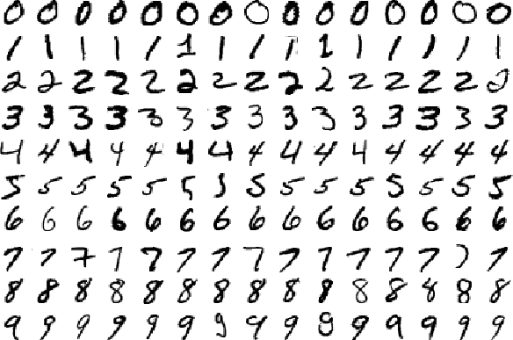
A bit of history: Convolutional Networks for OCR
Task: Correctly recognize the image of hand-written digits.
Dataset: MNIST ( 28*28 image), 60000 Training samples, 10000 Test.

Slide 4
A bit of history:
Gradient-based learning applied to document recognition [LeCun, Bottou, Bengio, Haffner 1998]
Three key ideas: Local Receptive Fields (Filters), Shared Weights, Sub-sampling(Pooling).
Slide Credits: Aarti Singh, CMU
Notes:
This architecture combines three ideas to provide some degree of scale, shift and distortion invariance.
These ideas are : Local Receptive Fields ( Filters), Shared Weights , Sub-Sampling

Slide 5
LeNet 5, Overview
Input: 32x32 pixel image.
Largest character is 20x20 (All important info should be in the center of the receptive field of the highest level feature detectors) ▪
Black and White pixel values are normalized: E.g. White = -0.1, Black =1.175 (Mean of pixels = 0, Std of pixels =1)
Slide Credits: Aarti Singh, CMU
Notes:
The input is a 32 x 32 pixel image which is significantly larger than the largest character ( 20 x 20 pixels) centered in a 28 * 28 field. It is desirable that potentially distinctive features such as corners, stroke end points are in the center of the receptive field.
The image is also normalized such that black pixels correspond to 1.175, and white pixels are -0.1 which makes the image roughly zero mean and variance of 1 which helps in accelerated learning.

Slide 6
LeNet 5, Layer C1
C1: Convolutional layer with 6 feature maps of size 28x28. C1_{k} (k=1…6)
Formula for output size = (N – F + 2P) / S + 1
N: input size, F: size of the filter, P: Padding, S: Stride
Each unit of C1 has a 5x5 receptive field in the input layer. ▪
(5*5+1)*6=156 parameters to learn
Connections: 28*28*(5*5+1)*6=122304
If it was fully connected we had (32*32+1)*(28*28)*6 = 4,821,600 parameters
Slide Credits: Aarti Singh, CMU
Notes:
Layer C1 is a convolution layer with 6 feature maps. Each unit is connected to a 5x5 neighbourhood in the input layer. The size is 28 * 28 which prevents the connections from falling of the boundary.
Its important to note here that the number of parameters that you need to learn in a convolution layer is really small compared to a fully connected layer. 156 instead of 4.8 M if the conv. Layer was replaced by the fully connected layer.

Slide 7
LeNet 5, Layer S2
S2: Subsampling layer with 6 feature maps of size 14x14 2x2 non overlapping receptive fields in C1 Layer
Averages the input, multiplies by a coefficient and adds a bias.
Both these coefficient and bias are learnt.
S2: 6*2=12 trainable parameters.
Connections: 14*14*(2*2+1)*6=5880
Slide Credits: Aarti Singh, CMU
Notes:
Sub sampling layer is similar to a max pooling layer, but LeNet used a different type of sub sampling instead of a max pool. The four inputs to a unit is averaged , multiplied by a trainable coefficient and adds a trainable bias.
Successive layers of convolutions and pooling results in increasing the number of feature maps, and decreasing the spatial resolution.

Slide 8
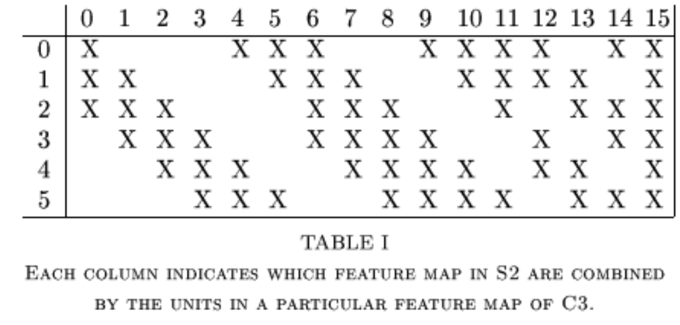
LeNet 5, Layer C3
C3: Convolutional layer with 16 feature maps of size 10x10
Each unit in C3 is connected to several! 5x5 receptive fields at identical locations in S2
Layer C3: 1516 trainable parameters. Connections: 151600
Slide Credits: Aarti Singh, CMU
Notes:
This convolution layer is a little different from C1 because each unit in C3 is connected to several feature maps of S2. Note that there is some structure to how the connections are formed. From 0-6, you have groups of 3 being connected. Then you have four and finally you have all the connections.
Why not connect every feature map in C3 to every feature map in S2 – two reasons, first you want the number of parameters to be reasonable.
Secondly, it breaks the symmetry of a fulyl connected layer. The feature maps are forced to calculate different ( but complementary) features because they get different input.

Slide 9
LeNet 5, Layer S4
S4: Subsampling layer with 16 feature maps of size 5x5
Each unit in S4 is connected to the corresponding 2x2 receptive field at C3
Layer S4: 16*2=32 trainable parameters.
Connections: 5*5*(2*2+1)*16=2000
Slide Credits: Aarti Singh, CMU

Slide 10
LeNet 5, Layer C5
C5: Fully connected layer with 120 feature maps of size 1x1
Each unit in C5 is connected to all 16 5x5 receptive fields in S4
Layer C5: 120*(16*25+1) = 48120 trainable parameters and connections (Fully connected)
Slide Credits: Aarti Singh, CMU

Slide 11
LeNet 5, Layer F6
Layer F6: 84 fully connected units. 84*(120+1)=10164 trainable parameters and connections.
Output layer: 10RBF (One for each digit) 84=7x12, stylized image
Weight update: Backpropagation
Slide Credits: Aarti Singh, CMU
Notes:
Euclidean Radial Basis Function ( Which essentially computes the difference between output vector and the parameter vector which is designed by hand. Most people use

Slide 12
Results on MNIST Dataset
LeNet achieves 0.8% error rate on test set.
SVM got 1.1%, a slightly modified version known as V-SVM got 0.8% but the computation cost is very high. It is almost twice as expensive as LeNet
LeNet was trained for 2-3 days on CPU ( 200 Mhz processor)
Currently it can be trained in less than 30 minutes.

Slide 13
Classification Task
The goal is to recognize objects present in an image.

Slide 14
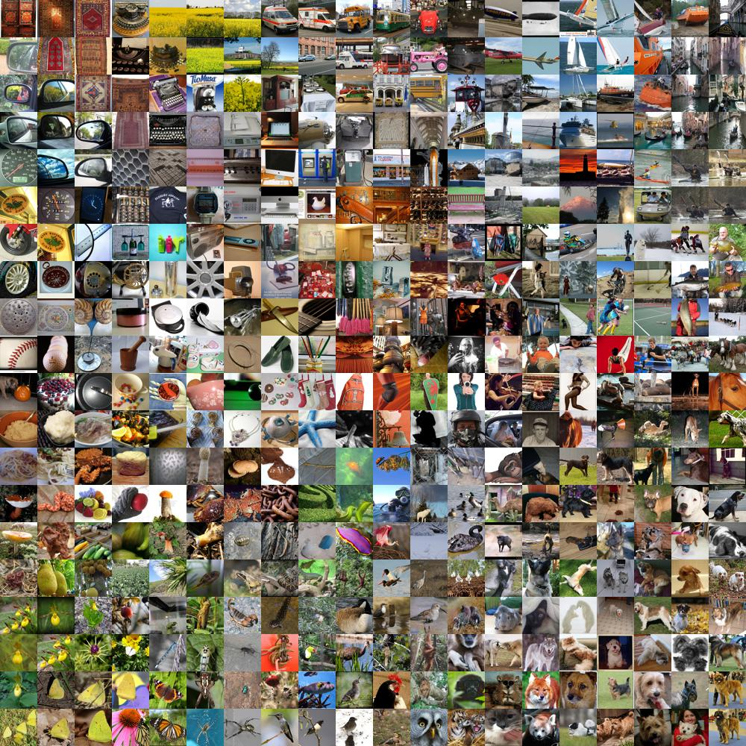
ImageNet
Over 15M labeled high resolution images.
Roughly 22K categories
Collected from web and labeled by Amazon Mechanical Turk.
http://image-net.org
Picture Credits: Andrej Karpathy

Slide 15
ImageNet Large Scale Visual Recognition Challenge ( ILSVRC)
Annual competition of image classification at large scale.
1.2M training images in 1K categories.
50K validation images, 150K testing images.
Classification: make 1 (Top-1 error) /5 (Top-5 error) guesses about the image. label.

Slide 16
ILSVRC
Slide Credits: CS231B, Stanford University

Slide 17
AlexNet (Supervision)
Similar framework to LeCun’98 but,
Bigger model (7 hidden layers, 650,000 units, 60,000,000 params)
More data (10⁶ vs. 10³ images)
GPU implementation (50x speedup over CPU)
Trained on two GPUs for a week
Better regularization for training (DropOut)

Slide 18
Architecture – Overview
5 Convolutional Layers
1000 way
softmax
3 Fully Connected Layers

Slide 19
Architecture - Overview
48
128
192
192
128
55
27
3
13
13
13
3
3
2048
2048
3
227
55
3
3
13
11
27
13
13
11
227
55
27
13
13
13
5
1000
5
13
3
55
27
13
13
2048
2048
Input
48
128
192
192
128
Notes:
The architecture in a “hopefully” more easy to understand figure. The yellow line in the middle shows that the upper half was trained on GPU 1 and the lower half on GPU 2. These are only the convolutional layers and the pooling and the normalization layer will be described in a couple of slides.

Slide 20
Architecture - Overview
55*55*96 = 290,400 neurons, each having 11*11*3=363 weights + 1 bias
290400 * 364 = 105,705,600 parameters in first layer alone if fully connected.
48
128
192
192
128
55
27
3
13
13
13
3
3
2048
2048
3
227
55
3
3
13
11
27
13
13
11
227
55
27
13
13
13
5
1000
5
13
3
55
27
13
13
2048
2048
48
128
192
192
128
Notes:
Number of parameters now would be 364 * 96
num_output: 96 kernel_size: 11 stride: 4

Slide 21
Architecture - Overview
Refer to: https://github.com/BVLC/caffe/blob/master/models/bvlc_alexnet/deploy.prototxt
for layer details.
48
128
192
192
128
55
27
3
13
13
13
3
3
2048
2048
3
22
55
3
3
13
11
27
13
13
11
227
55
27
13
13
13
5
1000
5
13
3
55
27
13
13
2048
2048
48
128
192
192
128
Notes:
The second convolutional layer takes as input the (response-normalized
and pooled) output of the first convolutional layer and filters it with 256 kernels of size 5 ⇥ 5 ⇥ 48 .
The third, fourth, and fifth convolutional layers are connected to one another without any intervening
pooling or normalization layers. The third convolutional layer has 384 kernels of size 3 ⇥ 3 ⇥ 256 connected to the (normalized, pooled) outputs of the second convolutional layer. The fourth
convolutional layer has 384 kernels of size 3 ⇥ 3 ⇥ 192 , and the fifth convolutional layer has 256
kernels of size 3 ⇥ 3 ⇥ 192 . The fully-connected layers have 4096 neurons each.
layer { name: "pool1" type: "Pooling" bottom: "norm1" top: "pool1" pooling_param { pool: MAX kernel_size: 3 stride: 2 }}
layer { name: "conv2" type: “convolution_param { num_output: 256 pad: 2 kernel_size: 5 group: 2 }}

Slide 22
Architecture - Overview
Top-1 and Top-5 error rates decreases by 1.7% and 1.2% respectively, comparing to the net trained with one GPU and half neurons
Intra GPU Connections
Inter GPU Connections
GPU #1
GPU #2
Notes:
With 1.2 million training images, we can train a network which is too big for just one GPU and since current GPUs are particularly well-suited to cross-GPU parallelization, as they are able to read from and write to one another’s memory directly, without going through host machine memory. The parallelization
scheme that we employ essentially puts half of the kernels (or neurons) on each GPU, with one
additional trick: the GPUs communicate only in certain layers. This means that, for example, the
kernels of layer 3 take input from all kernel maps in layer 2. However, kernels in layer 4 take input
only from those kernel maps in layer 3 which reside on the same GPU.
This scheme reduces our top-1 and top-5 error rates by 1.7% and 1.2%, respectively, as compared with a net with half as many
kernels in each convolutional layer trained on one GPU. The two-GPU net takes slightly less time
to train than the one-GPU net2

Slide 23
Architecture - Overview
Convolution Layer
+ ReLU
Local Contrast Norm.
Fully Connected
Layer
Pooling
Notes:
This layer shows more fine grained detail of the architecture. Every convolution layer is followed by ReLU activation. Some Layers like Layer 1 and Layer 2 have normalization layer which I will ta about in more detail in the next few slides.
Some layers like Layer 1, Layer 2 and Layer 5 have a pooling or a sum sampling layer which reduces the spatial resolution and the motivation remains the same, that we want to control the number of parameters and once the feature has been learnt, its position does not matter too much.

Slide 24
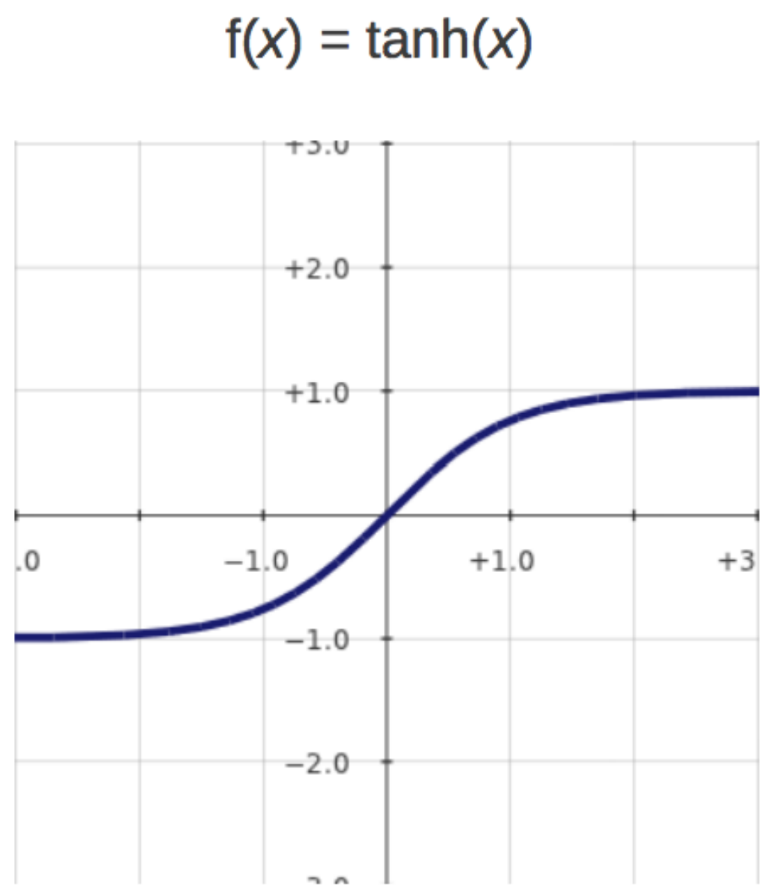
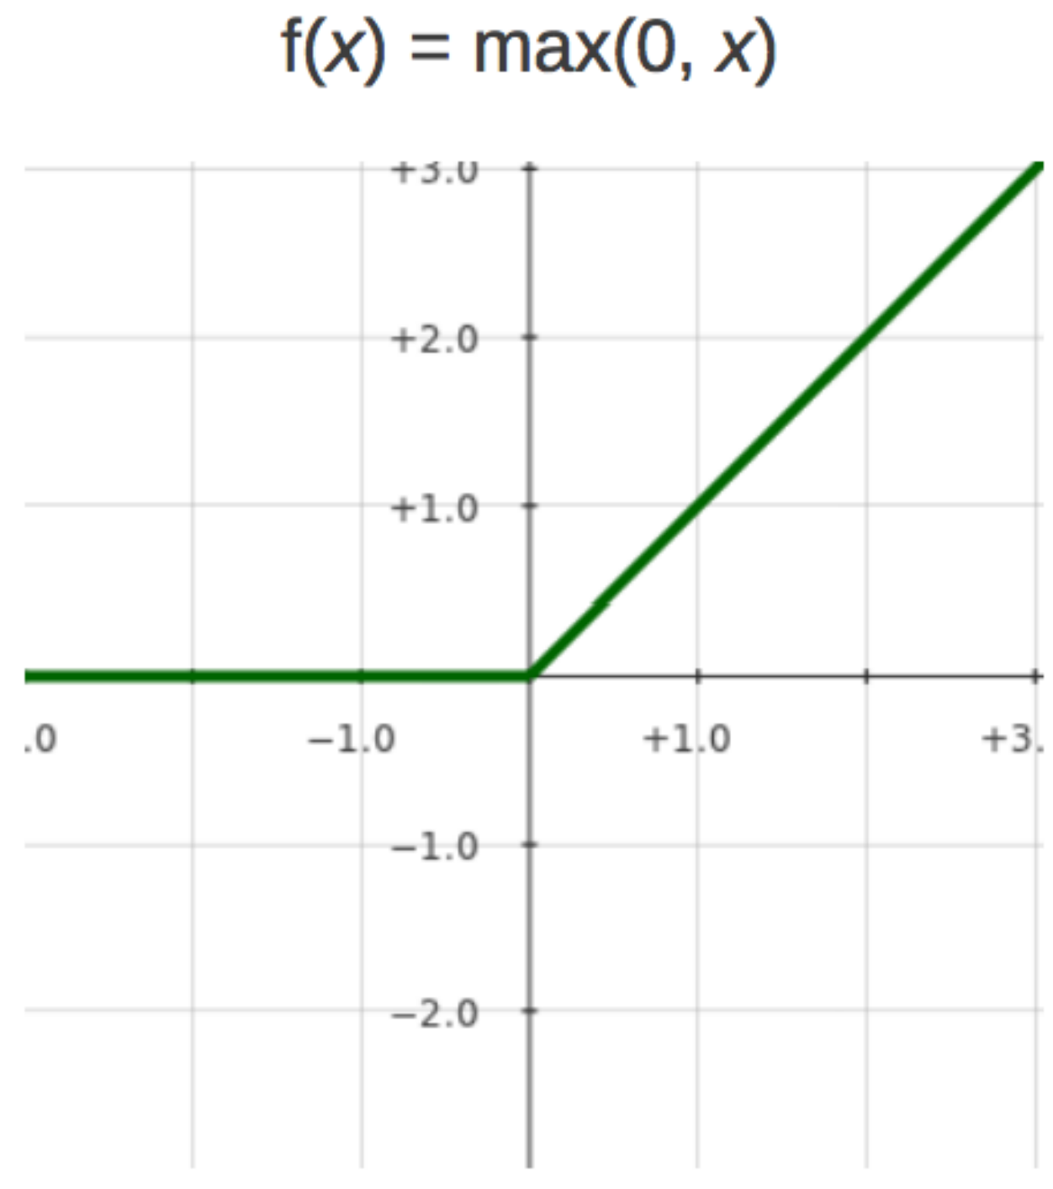
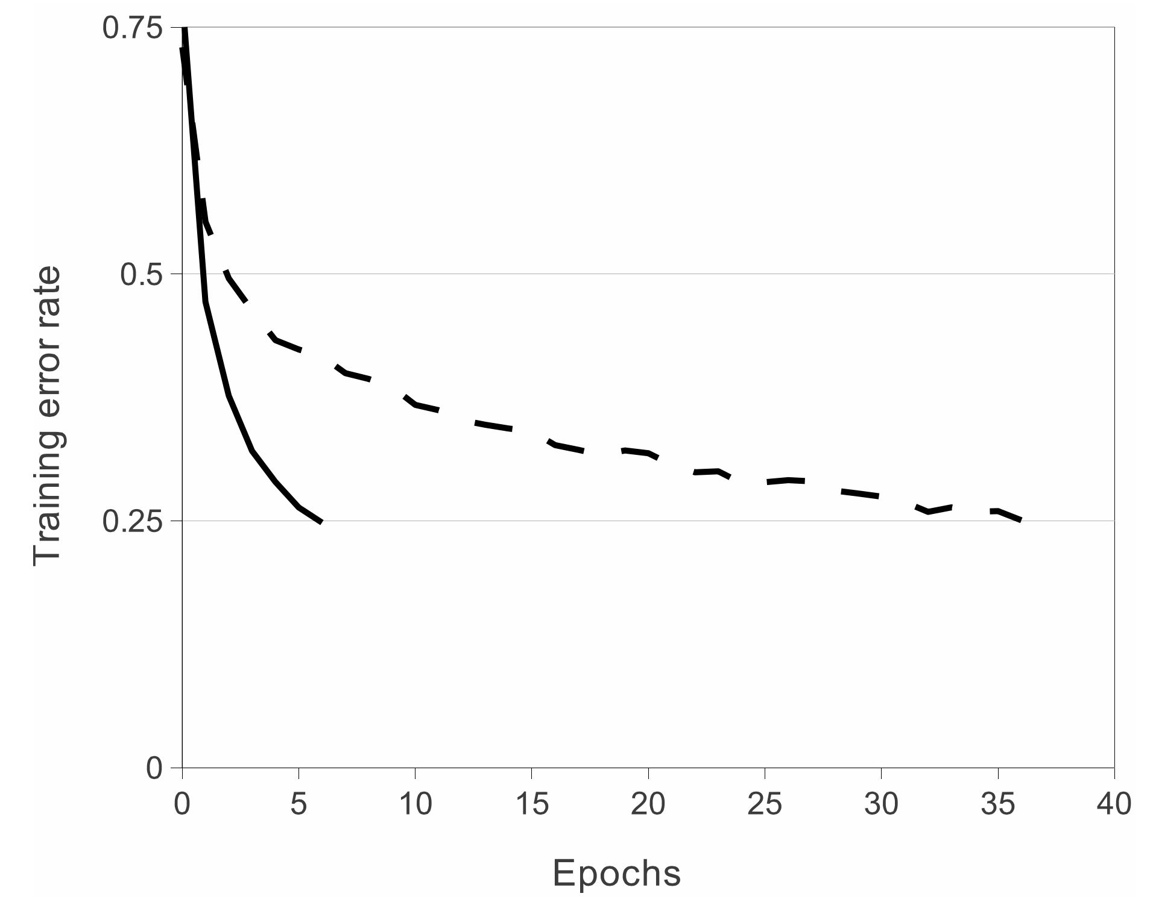
ReLU Nonlinearity
Standard way to model a neuron
$f\left(x\right)=tanh⁡(x)$
$f\left(x\right)= {\left(1+e^{−x}\right)}^{−1}$
Very slow to train.
Non-saturating nonlinerity: Rectified Linear Units (ReLU)
$f\left(x\right)=max⁡(0,x)$
Quick to train.
ReLU
Tanh
With a four layer CNN, ReLU reaches 25% error rate six times faster than Tanh on CIFAR-10
Notes:
The standard way to model a neuron’s output f as a function of its input x is with f(x) = tanh(x) or f(x) = (1 + ex)1. In terms of training time with gradient descent, these saturating nonlinearities are much slower than the non-saturating nonlinearity f(x) = max(0,x). Following Nair and Hinton [20], we refer to neurons with this nonlinearity as Rectified Linear Units (ReLUs).

Slide 25
Local Response Normalization
ReLUs don’t need input normalization.
Following normalization scheme helps generalization
Response normalization reduces top-1 and top-5 error rates by 1.4% and 1.2% respectively.
k, n, ⍺, β are hyper-parameters which are determined using validation set.
The paper had: k=2, n=5, ⍺=10⁻⁴, β=-.75
Response
normalized
activity
Activity of a neuron computed by applying
kernel i position (x,y) and then applying the
ReLU nonlinearity.
Slide Credits: CS231B, Stanford University
Notes:
ReLUs have the desirable property that they do not require input normalization to prevent them from saturating. If at least some training examples produce a positive input to a ReLU, learning will happen in that neuron. However, we still find that the following local normalization scheme aids generalization.
the sum runs over n “adjacent” kernel maps at the same spatial position, and N is the total
number of kernels in the layer.
This sort of response normalization implements a form of lateral inhibition
inspired by the type found in real neurons, creating competition for big activities amongst neuron
outputs computed using different kernels.

Slide 26
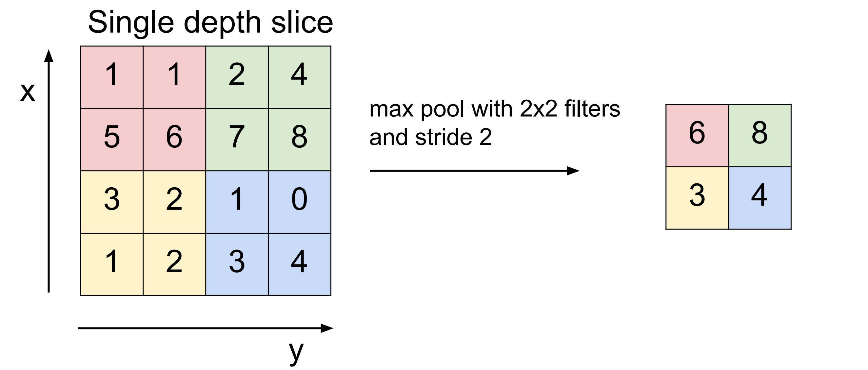
Max Pooling
Convenience Layer: Makes the representation smaller and more manageable without loosing too much information.
Input Volume of size [W1 * H1 * D1], receptive fields F*F, and stride S
Output Volume [W2 * H2 * D1]
W2 = (W1 – F) /S + 1, H2 = (H1 – F) /S +1
Notes:
Just takes the max of the 2 * 2 region of the input.

Slide 27
Overlapping Pooling
If we have set stride less than f (field) then we obtain overlapping pooling.
Specifically in AlexNet: s=2; z=3
Reduces the top-1 and top-5 error rates by 0.4% and 0.3% respectively.
Notes:
In AlexNet there is a different type of pooling that has
They observed that during training that models with overlapping pooling find it slightly more difficult to overfit.
been used. If the size of the receptive field is greater than the stride then we get overlapping pooling.

Slide 28
Data Augmentation
Easiest way to reduce overfitting on image data is to artificially enlarge the dataset using label-preserving transformations
Two forms of data augmentation:
Image Translation and Horizontal Reflection.
Changing RGB intensities.
Notes:
Neural network has 60

Slide 29
Data Augmentation: Type #1
Image translation by randomly extracting 224 x 224 patches from the 256 X 256 images.
Horizontal reflections of these 224 x 224 patches.
Dataset increased by factor of 2048 though the resulting training examples are highly inter-dependent.
At test time: 5 224 x 224 patches ( four corners and one center patch) and their horizontal patches are used.
Averaging the predictions made by the softmax layer.
Slide Credits: CS231B, Stanford University

Slide 30
Data Augmentation: Type #2
Changing RGB intensities:
Perform PCA on the set of RGB values throughout the training set.
Add multiples of principle components
P_{i} and $λ$_{i} are the ith eigenvector and eigenvalue of the 3x3 covariance matrix.
$α$_{i} is the random variable.
Slide Credits: CS231B, Stanford University

Slide 31
Averaging big deep neural nets is hard
Each net takes a long time to learn
At test time, we don’t want to run lots of different large neural nets.
Everyone who wins competitions does it by averaging/boosting models.
Random Forest
AdaBoost
Credits: Geoffrey E. Hinton, NIPS 2012
Notes:
Combining the predictions of many different models is a very successful way to reduce test errors [1, 3], but it appears to be too expensive for big neural networks that already take several days to train. There is, however, a very efficient version of model combination that only costs about a factor of two during training. The recently-introduced technique, called “dropout” [10]

Slide 32
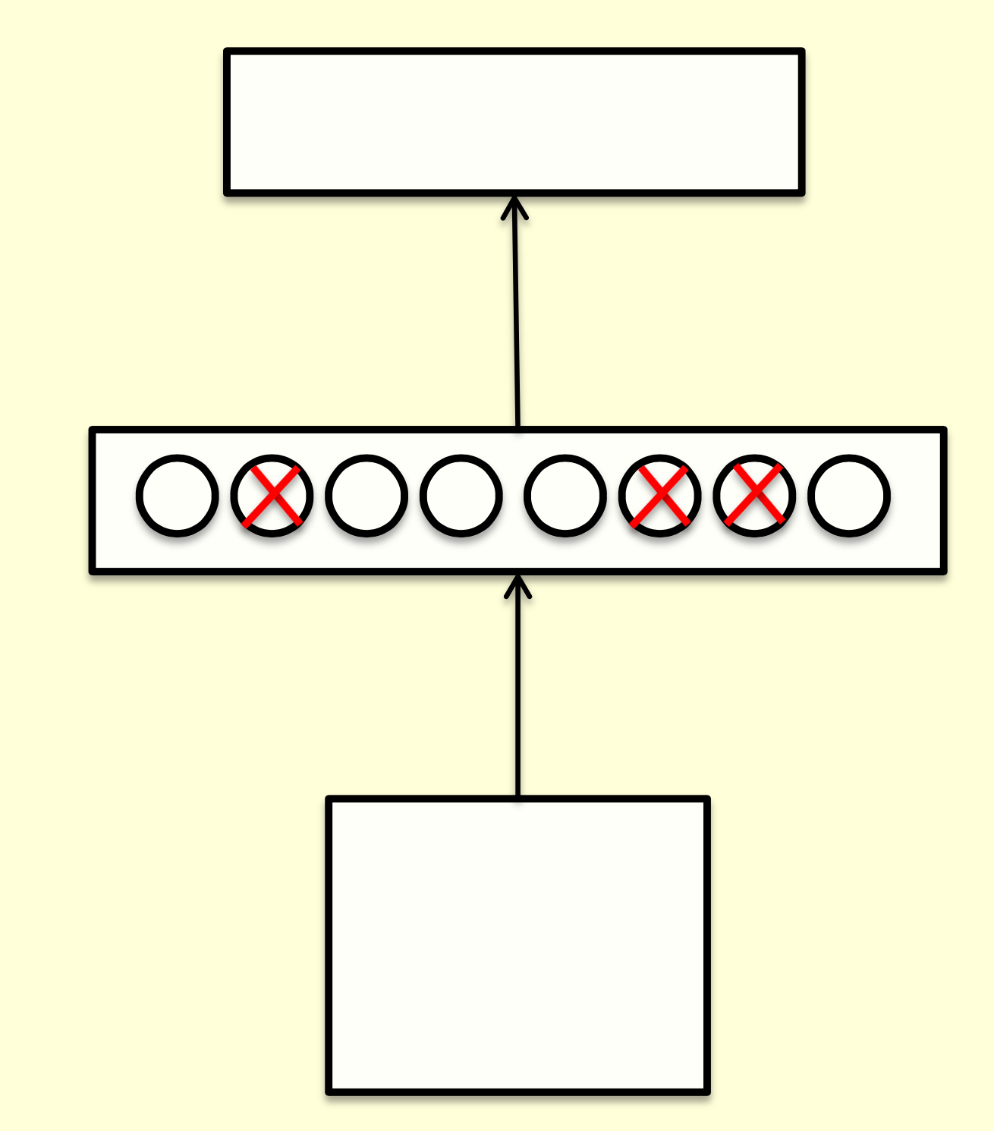
Dropouts : An efficient way to average many large neural nets
Consider a neural net with one hidden layer.
Each time we present a training example, we randomly omit each hidden unit with probability 0.5.
Equivalent to randomly sampling from $2^{h}$ different units.
All architectures share weights.
Credits: Geoffrey E. Hinton, NIPS 2012
Notes:
We will read about Dropouts on Thursday , when Xiao and Peng will discuss dropouts in more detail.

Slide 33
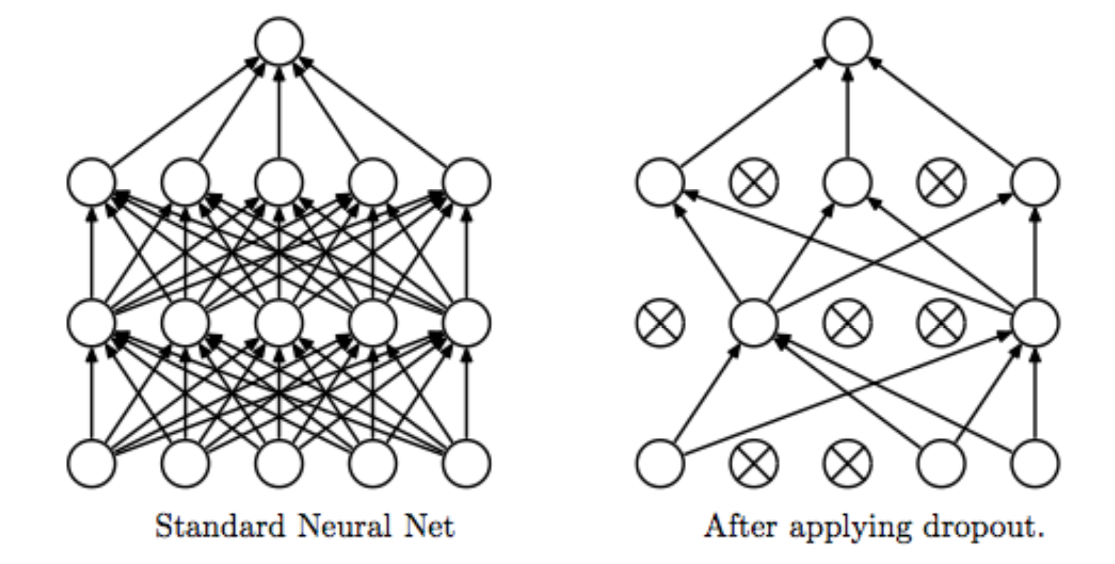
Dropouts as form of model averaging
We sample from $2^{h}$ models i.e. only a few of the models ever get trained. They only get one training example
Due to sharing of weights, the model is strongly regularized.
Pulls the weights towards what other models want.
Better than L2 and L1 that pull weights towards zero.
Credits: Geoffrey E. Hinton, NIPS 2012
Figure Credit: Srivastava et al.

Slide 34
What do we do at test time?
We could sample many different architectures and take the geometric mean of their output distributions.
Faster way would be to use all the hidden units but after halving their outgoing weights.
In case of single hidden layer , this is equivalent to the geometric mean of the predictions of all models.
For multiple layers, it’s a pretty good approximation and its fast.
Credits: Geoffrey E. Hinton, NIPS 2012
Notes:
At NIPS, Geff Hinton joked how this approximation shows his deep respect for Mathematics.

Slide 35
How well does dropout work?
If your deep neural net is significantly overfitting, it will reduce the number of errors by a lot.
If not overfitting, use a bigger one
# of parameters >> # training examples.
Synapses are cheaper than experiences.
Credits: Geoffrey E. Hinton, NIPS 2012

Slide 36
Stochastic Gradient Descent Learning
Batch Size: 128
The training took 5 to 6 days on two NVIDIA GTX 580 3GB GPUs
Momentum ( damping parameter)
Learning rate
Weight decay
Gradient of Loss w.r.t weight.
(Averaged over batch)
Notes:
The model was trained using stochastic gradient descent with a batch size of 128 examples, momentum of 0.9, and weight decay of 0.0005. The authors found that this small amount of weight decay was important for the model to learn. In other words, weight decay here is not merely a regularizer: it reduces the model’s training error.
The weights were initialized from a zero-mean Gaussian distribution with standard de- viation 0.01. the bias in the second, fourth, and fifth convolutional layers, as well as in the fully-connected hidden layers, were initialized with the constant 1. This initialization accelerates the early stages of learning by providing the ReLUs with positive inputs. neuron biases in the remaining layers were initilizaed with the constant 0.
They used an equal learning rate for all layers, which they adjusted manually throughout training. The heuristic which they followed was to divide the learning rate by 10 when the validation error rate stopped improving with the current learning rate. The learning rate was initialized at 0.01 and
reduced three times prior to termination. We trained the network for roughly 90 cycles through the training set of 1.2 million images, which took five to six days on two NVIDIA GTX 580 3GB GPUs.
Each cycle is one full pass over the training data. Also called epoch!

Slide 37
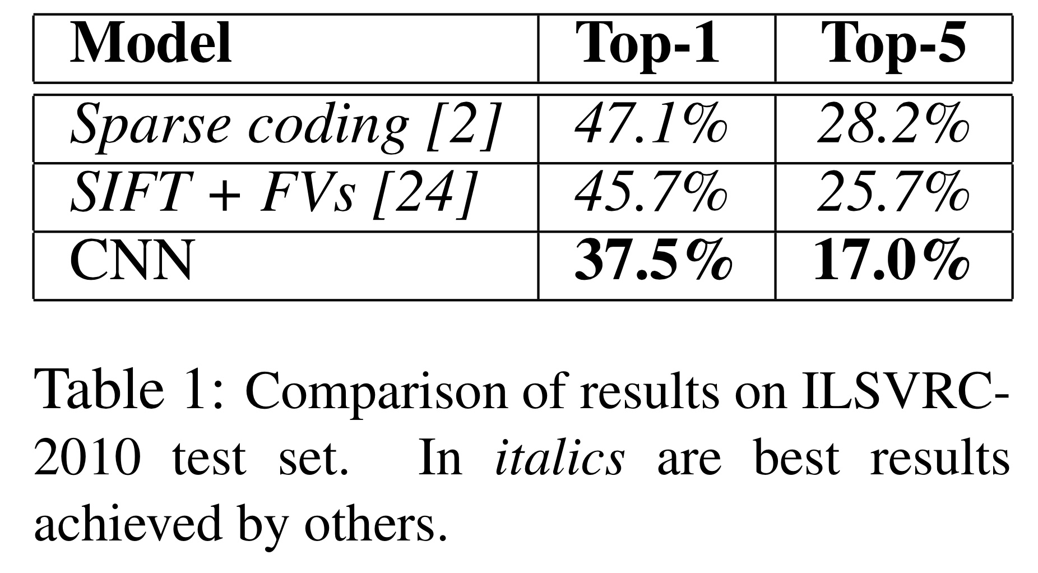
Results: ILSVRC – 2010

Slide 38
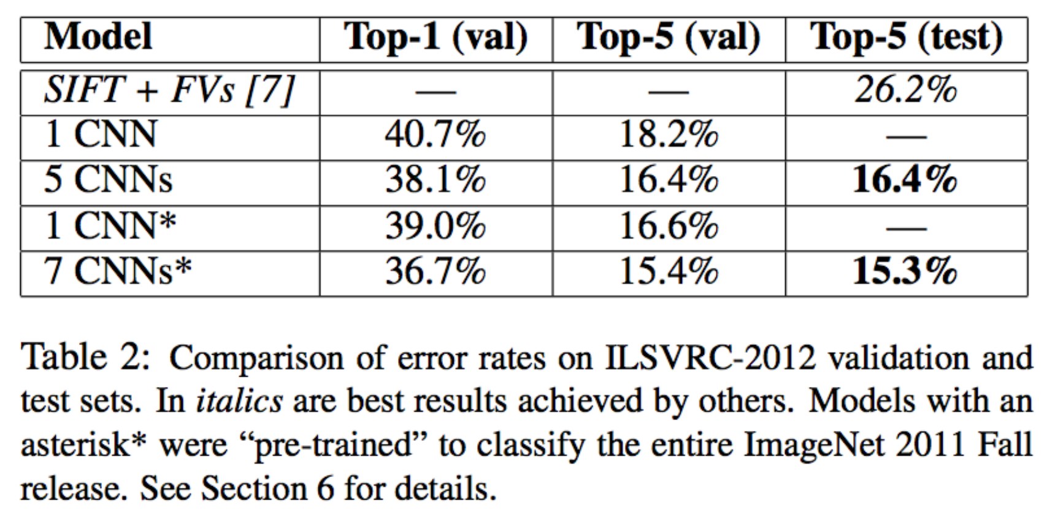
Results: ILSVRC - 2012
1CNN*: Training 1 CNN, with an extra sixth convolutional layer over the last pooling layer to classify the entire ImageNet Fall 2011 release and then fine-tuning it on ILSVRC-2012.
7CNN*: Averaging 5CNN + two CNNs pretrained on Fall 2011 release.
Notes:
The CNN described in this paper achieves a top-5 error rate of 18.2%. Averaging the predictions of five similar CNNs gives an error rate of 16.4%. Training one CNN, with an extra sixth con- volutional layer over the last pooling layer, to classify the entire ImageNet Fall 2011 release (15M images, 22K categories), and then “fine-tuning” it on ILSVRC-2012 gives an error rate of 16.6%. Averaging the predictions of two CNNs that were pre-trained on the entire Fall 2011 re- lease with the aforementioned five CNNs gives an error rate of 15.3%. The second-best con- test entry achieved an error rate of 26.2% with an approach that averages the predictions of sev- eral classifiers trained on Feature Vectorss computed from different types of densely-sampled features [7].

Slide 39
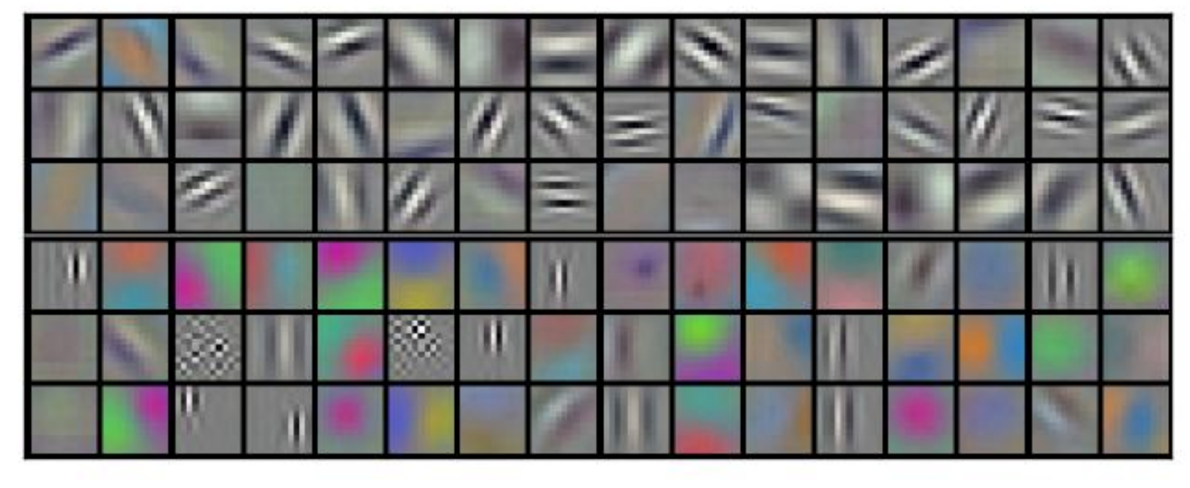
First Convolutional Layer
96 convolutional kernels of size 11×11×3 learned by the first convolutional layer on the 224×224×3 input images.
The top 48 kernels were learned on GPU1 while the bottom 48 kernels were learned on GPU2
Notes:
This figure shows the convolutional kernels learned by the network’s two data-connected layers. The network has learned a variety of frequency- and orientation-selective kernels, as well as various col- ored blobs. Notice the specialization exhibited by the two GPUs, a result of the restricted connec- tivity

Slide 40
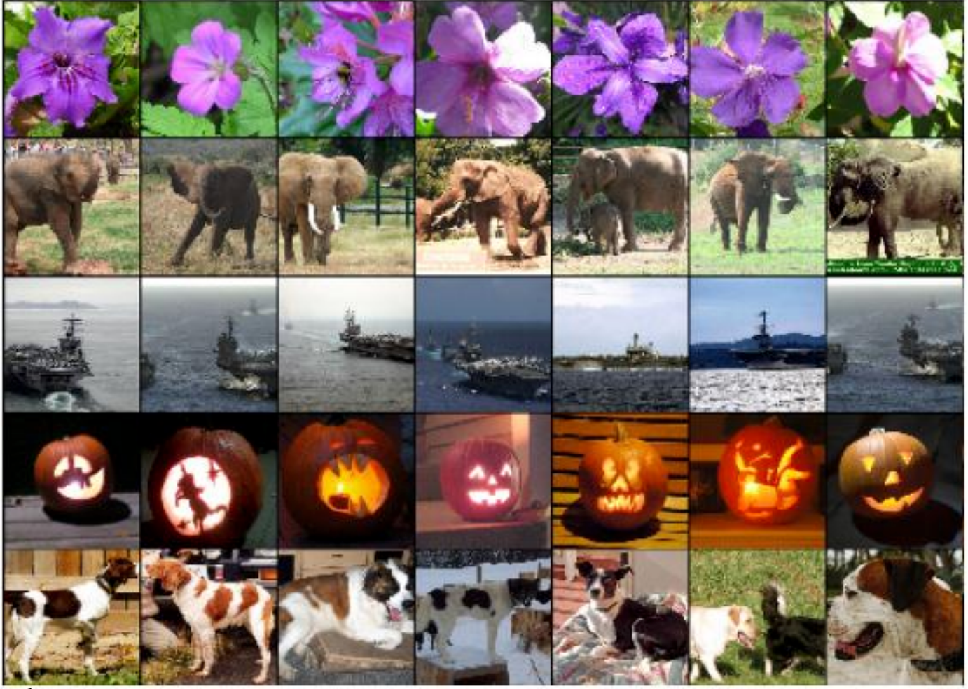
Result: Image Similarity
six training images that produce feature vectors in the last hidden layer with the smallest Euclidean distance from the feature vector for the test image.
Notes:
Another way to evaluate the network’s visual knowledge is to consider the feature activations induced by an image at the last, 4096-dimensional hidden layer. If two images produce feature activation vectors with a small Euclidean separation, we can say that the higher levels of the neural network consider them to be similar. Figure 4 shows five images from the test set and the six images from the training set that are most similar to each of them according to this measure. Notice that at the pixel level, the retrieved training images are generally not close in L2 to the query images in the first column. For example, the retrieved dogs and elephants appear in a variety of poses.

Slide 41
CloudCV Demo
http://cloudcv.org/classify

Slide 42
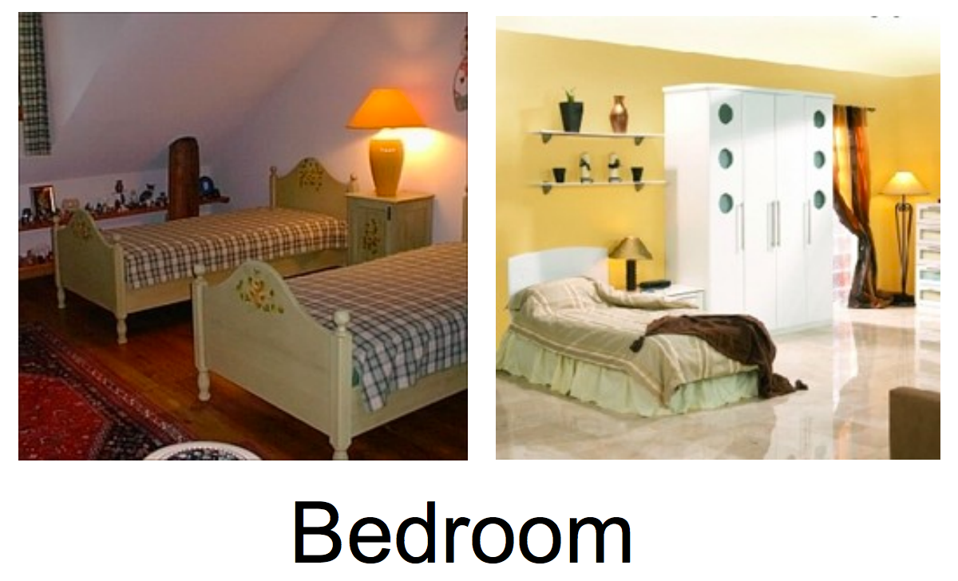
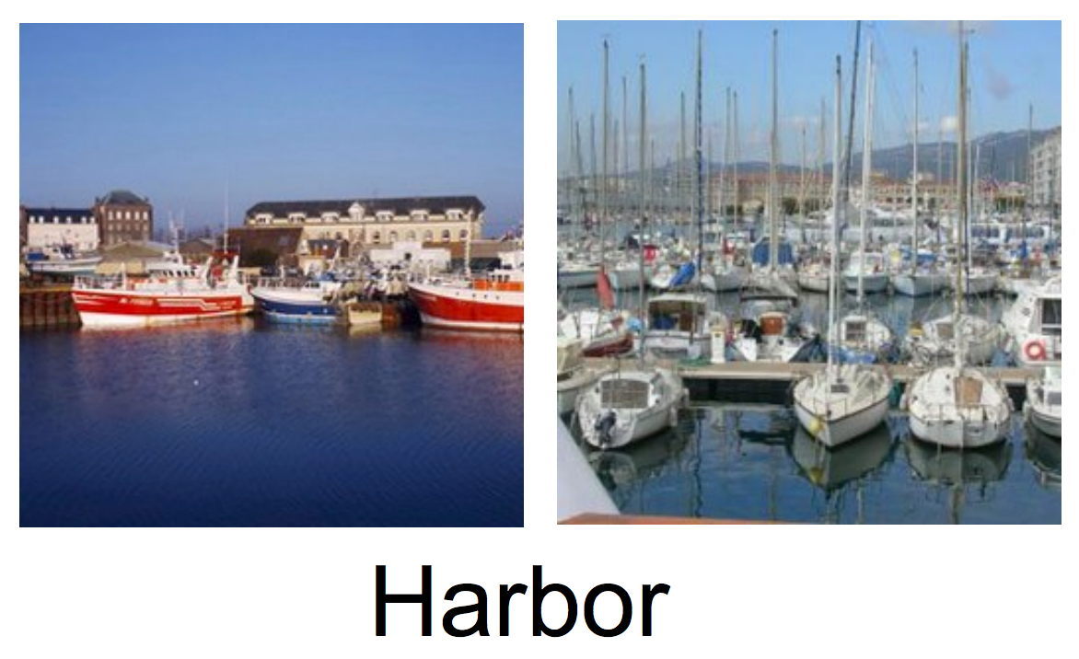
Scene Recognition – Another hallmark task for computer Vision
Given an image, predict which place we are in
Credits: Antonio Torralba, CVPR Workshop
Notes:
We have seen how to use CNNs for OCR, and Object Classification. Another hallmark task for computer vision is

Slide 43
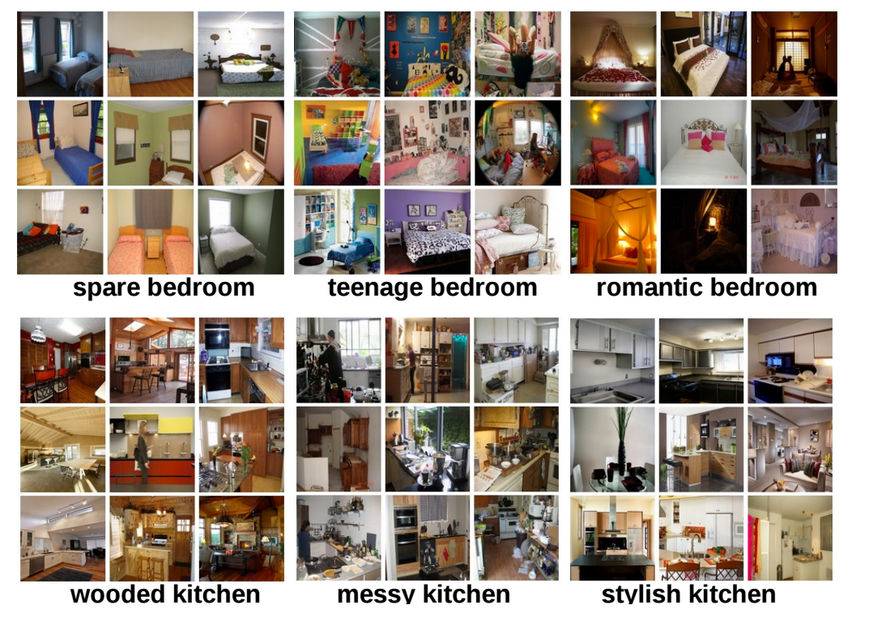
Places205 – Scene Centric Database
To learn deep features for scene recognition, we require a scene-centric database as big as ImageNet.
Places205 contains 205 categories, 2,448,873 images
Each category contains atleast 5000 images.
Past Datasets:
SUN397: 397 scene categories, atleast 100 images each, total 108,754 images.
Indoor67: 67 categories, 15620 images.
Credits: Antonio Torralba, CVPR Workshop

Slide 44
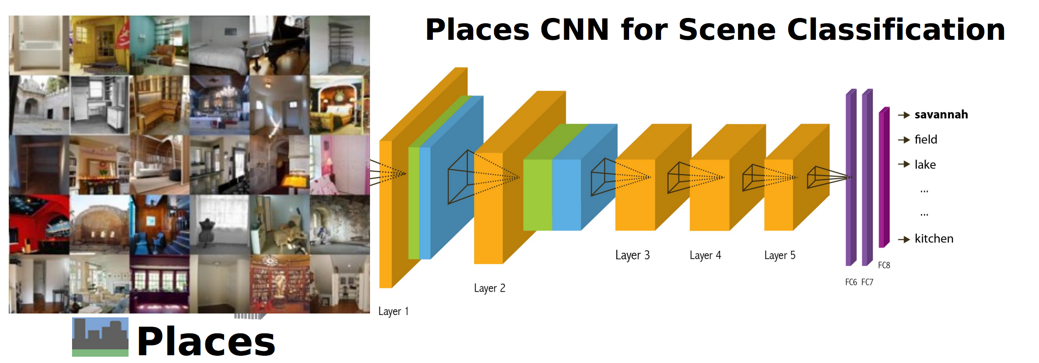
Training CNN for Scene Recognition
Training Set: Places205, 2.5M images for 205 categories
Validation Set: 100 images for every category. 20,500 total.
Test Set: 200 images for every category. 41,000 total.
Places CNN: Similar to Caffe Reference Net.
Took about 6 days to finish 30,000 iterations on a single Tesla K40.
Credits: Antonio Torralba, CVPR Workshop

Slide 45
Experiments and Results
Top-5 error for Places 205 and SUN 205 test set is 18.9% and 8.1% respectively
Notes:
ImageNet CNN is the Caffe reference net CNN ( AlexNet CNN with normalization and pooling layer swapped) trained on ImageNet.
Then you took the fc7 ( last fully connected layer) and what you get is a vector of length 4096, you take that as a feature and learn a simple classifier like SVM.

Slide 46
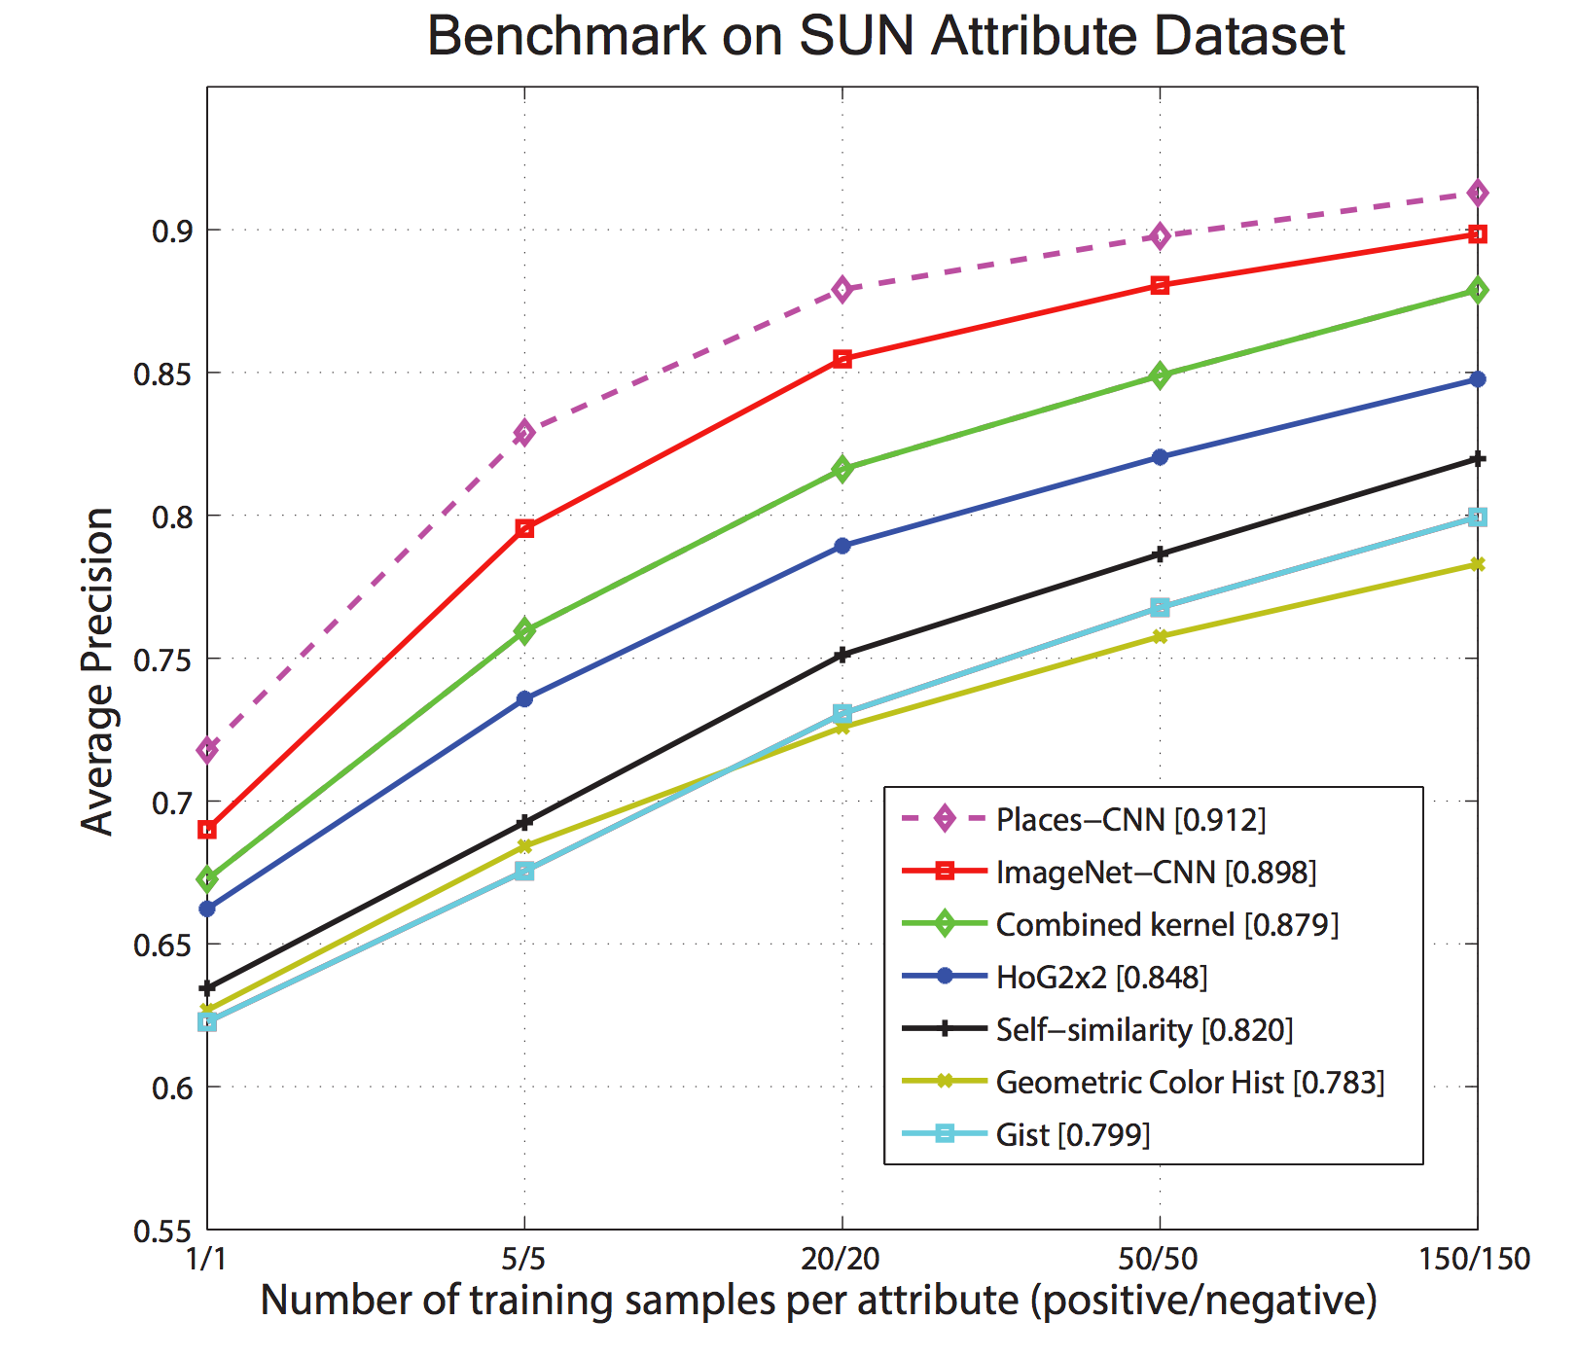
Experiments and Results
Notes:
A more exhaustive evaluation on the other benchmarks. You can see that the purple dotted line ( places CNN) beats all the other methods by a significant margin.
The last 6 lines correspond to classifiers using hand-designed features such as Dense SIFT, texton, GIST etc.

Slide 47
Object Detectors emerge in CNN trained for Scenes
This paper shows that object detectors emerge inside a CNN trained for scene classification, without any object supervision
Credits: Antonio Torralba, CVPR Workshop
Notes:
The paper shows that if you train a CNN for the task of scene classification, then object detectors will also emerge inside a CNN, and therefore you can use such a CNN for scene classification and object localization in one forward pass.
Importantly, the emergence of object detectors inside the CNN suggests that a single network can support recognition at several levels of abstraction (e.g., edges, texture, objects, and scenes) without needing multiple outputs or a collection of networks.
A number of works have focused on understanding the representation learned by CNNs which we will read about later in the course. When training a CNN to distinguish different object classes, it is unclear what the underlying representation should be. Objects have often been described using part-based representations where parts can be shared across objects,. However what those parts should be is unclear.
For a face, these parts may be eye, nose etc. But these are functional parts with words associated with it, for visual recognition, the object parts that matter might be different.
In case of scenes, it is a little more clearer
Scene categories are defined by the objects they contain and, to some extent, by the spatial configuration of those objects. For instance, the important parts of a bedroom are the bed, a side table, a lamp, a cabinet, as well as the walls, floor and ceiling. Objects represent therefore a distributed code for scenes

Slide 48
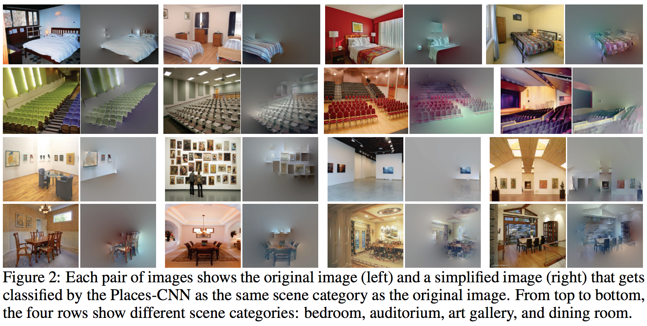
Uncovering the CNN representation
Remove segments iteratively, until misclassification.
Some objects are crucial for recognizing scenes.
Credits: Antonio Torralba, CVPR Workshop
Notes:
: given an image that is correctly classified by the network, we want to simplify this image such that it keeps as little visual information as possible while still having a high classification score for the same category.
This led to some interesting observations: for bedrooms, the minimal representations retained the bed in 87% of the cases. Other objects kept in bedrooms were wall (28%) and window (21%).

Slide 49
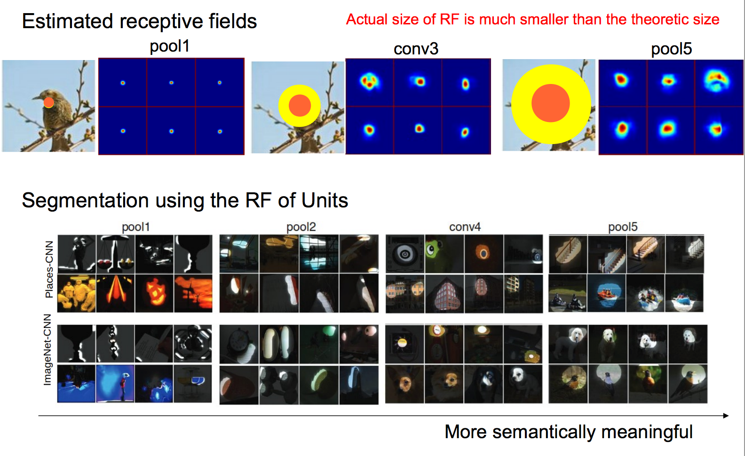
Estimating the receptive field
Credits: Antonio Torralba, CVPR Workshop
Notes:
As input, we use an image set of 200k images with a roughly equal distribution of scenes and objects (similar to Sec. 2). Then, we select the top K images with the highest activations for the given unit.
For each of the K images, we now want to identify exactly which regions of the image lead to the high unit activations. To do this, we replicate each image many times with small random occluders (image patches of size 11×11) at different locations in the image. Specifically, we generate occluders in a dense grid with a stride of 3. This results in about 5000 occluded images per original image. We now feed all the occluded images into the same network and record the change in activation as compared to using the original image. If there is a large discrepancy, we know that the given patch is important and vice versa. This allows us to build a discrepancy map for each image. Finally, to consolidate the information from the K images, we center the discrepancy map around the spatial location of the unit that caused the maximum activation for the given image. Then we average the re-centered discrepancy maps to generate the final RF.

Slide 50
Annotating the semantics of the units.
Credits: Antonio Torralba, CVPR Workshop
Notes:
we found the exact RFs of units and observed that activation regions tended to become more semantically meaningful with increasing depth of layers. In this section, our goal is to understand and quantify the precise semantics learned by each unit.
In order to do this, we ask workers on Amazon Mechanical Turk (AMT) to identify the common theme or concept that exists between the top scoring segmentations for each unit.
1) identify the concept, or semantic theme given by the set of 60 images e.g., car, blue, vertical lines, etc, (2) mark the set of images that do not fall into this theme, and (3) categorize the concept provided in (1) to one of 6 semantic groups ranging from low-level to high-level: simple elements and colors (e.g., horizontal lines, blue), materials and textures (e.g., wood, square grid), regions ans surfaces (e.g., road, grass), object parts (e.g., head, leg), objects (e.g., car, person), and scenes (e.g., kitchen, corridor).

Slide 51
Annotating the semantics of unit.
Credits: Antonio Torralba, CVPR Workshop

Slide 52
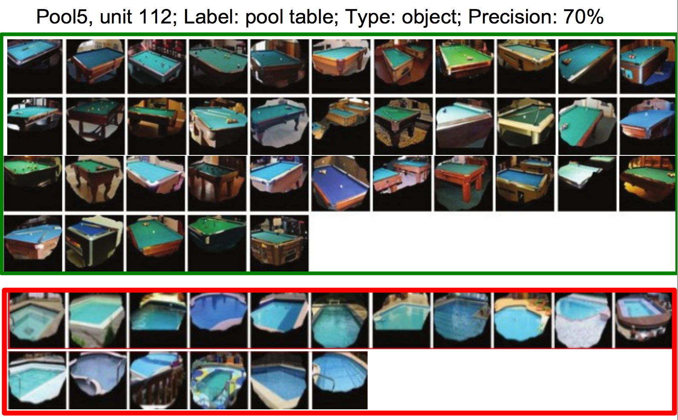
Annotating the semantics of unit.
Credits: Antonio Torralba, CVPR Workshop

Slide 53
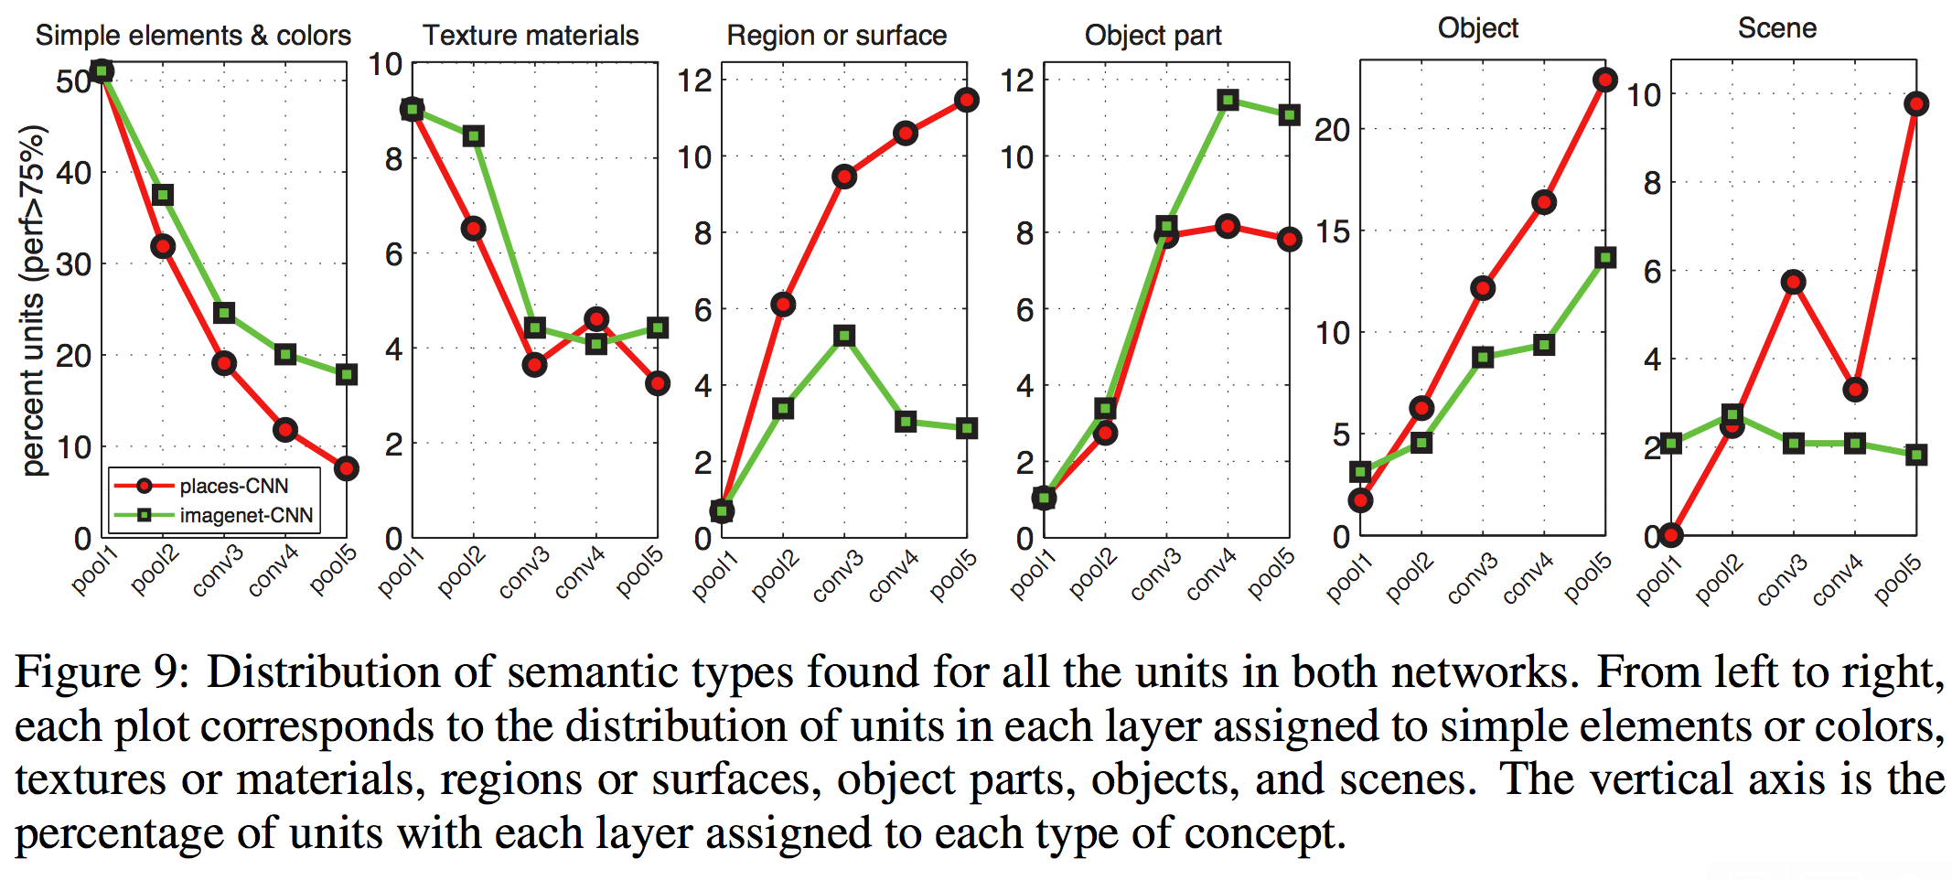
Annotating the semantics of unit.
Credits: Antonio Torralba, CVPR Workshop

Slide 54
Annotating the semantics of unit.
Object Detectors appear without any object supervision!
Credits: Antonio Torralba, CVPR Workshop

Slide 55
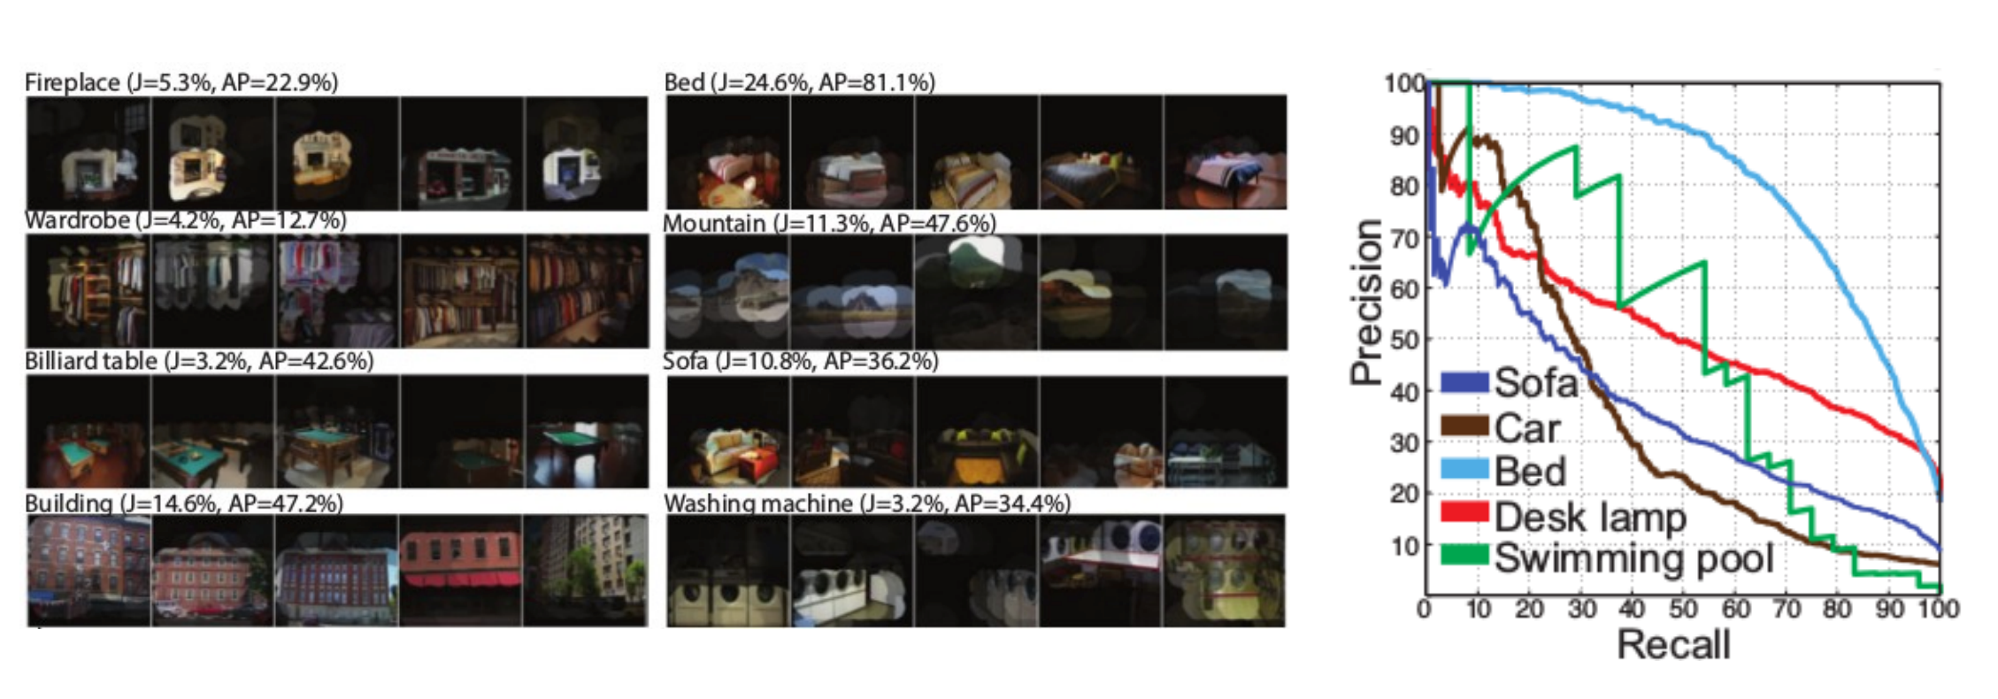
Evaluation on the SUN Database
Evaluating the performance on the emerged object detectors.
The performance of many units is high, which provides strong evidence that they are indeed detecting those objects.
Credits: Antonio Torralba, CVPR Workshop

Slide 56
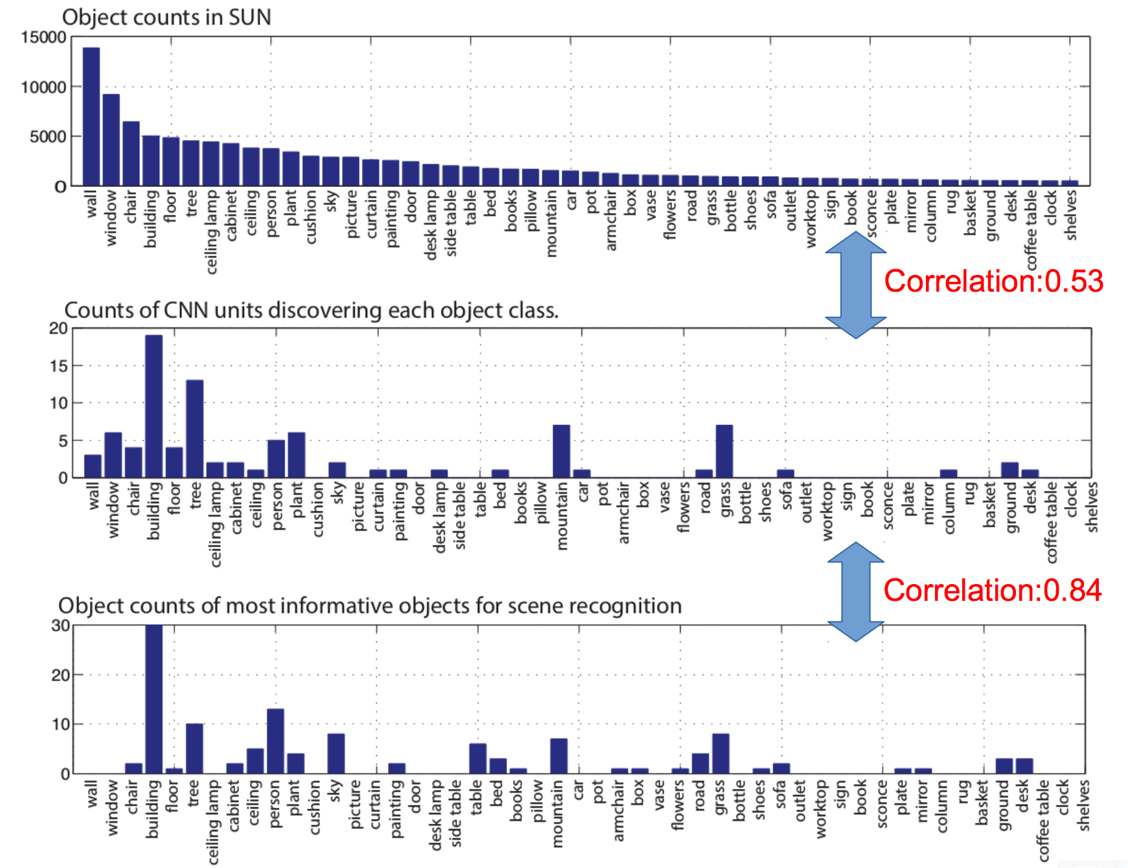
Evaluation on the SUN Database
Credits: Antonio Torralba, CVPR Workshop
Notes:
Why do objects emerge?
One possibility is that the objects that emerge in pool5 correspond to the most frequent ones in the database. Fig. 12(a) shows the sorted distribution of object counts in the SUN database which follows Zipf’s law. Fig. 12(b) shows the counts of units found in pool5 for each object class (same sorting as in Fig. 12(a)). The correlation between object frequency in the database and object frequency discovered by the units in pool5 is 0.54. Another possibility is that the objects that emerge are the objects that allow discriminating among scene categories. To measure the set of discriminant objects we used the ground truth in the SUN database to measure the classification performance achieved by each object class for scene classification. Then we count how many times each object class appears as the most informative one. This measures the number of scene categories a particular object class is the most useful for. The counts are shown in Fig. 12(c). Note the similarity between Fig. 12(b) and Fig. 12(c). The correlation is 0.84 indicating that the network is automatically identifying the most discriminative object categories to a large extent.

Slide 57
Thank you!
Fun Google+ post that I found very amusing regarding Alex Krizhevsky’s talk at ECCV Workshop https://plus.google.com/+YannLeCunPhD/posts/JBBFfv2XgWM
“Learning Representations”
people
Computer Vision
Experts
Notes:
Sheriff, Buzz Lightyaer
This image nicely sums up why should we be taking this class. ☺

