Slide 1
Weight Uncertainty in Neural Networks
Charles Blundell, Julien Cornebise, Koray Kavukcuoglu, Daan Wierstra
Presented by Michael Cogswell

Slide 2
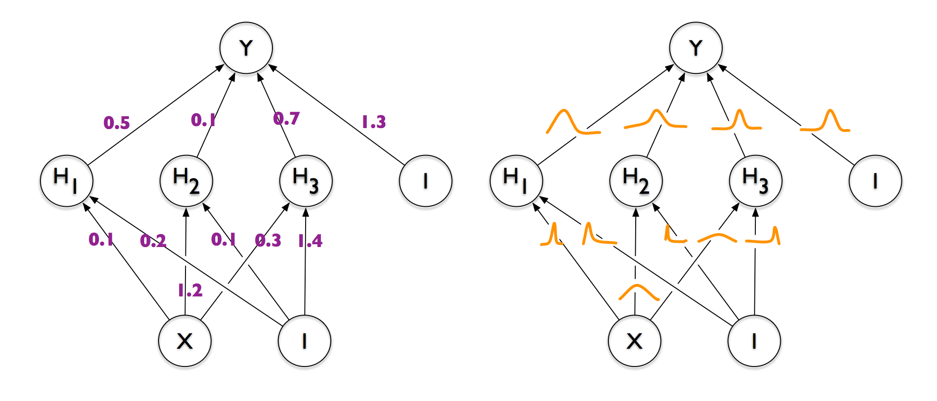
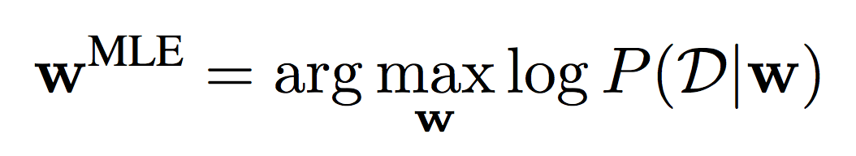
Point Estimates of Network Weights
MLE

Slide 3
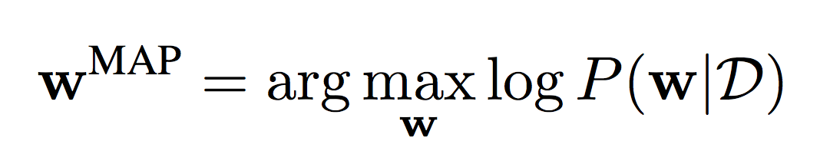
Point Estimates of Neural Networks
MAP

Slide 4
A Distribution over Neural Networks
Ideal Test Distribution

Slide 5
Approximate

Slide 6
Why?
Regularization
Understand network uncertainty
Cheap Model Averaging
Exploration in Reinforcement Learning (Contextual Bandit)

Slide 7
Outline
Variational Approximation
Gradients for All
The Prior and the Posterior
An Algorithm
Experiments
(Setting)
(Contribution)
(Details)
(Results)

Slide 8
Outline
Variational Approximation
Gradients for All
The Posterior and the Prior
An Algorithm
Experiments
(Setting)
(Contribution)
(Details)
(Results)

Slide 9
Computing the Distribution
This is defined…
(Bayes Rule)
…but intractable.

Slide 10
Variational Approximation
Gaussian
Gaussian
Gaussian
Gaussian
Notes:
\theta are the parameters of the gaussians

Slide 11
Variational Approximation

Slide 12
Objective

Slide 13
Why?
Minimum Description Length

Slide 14
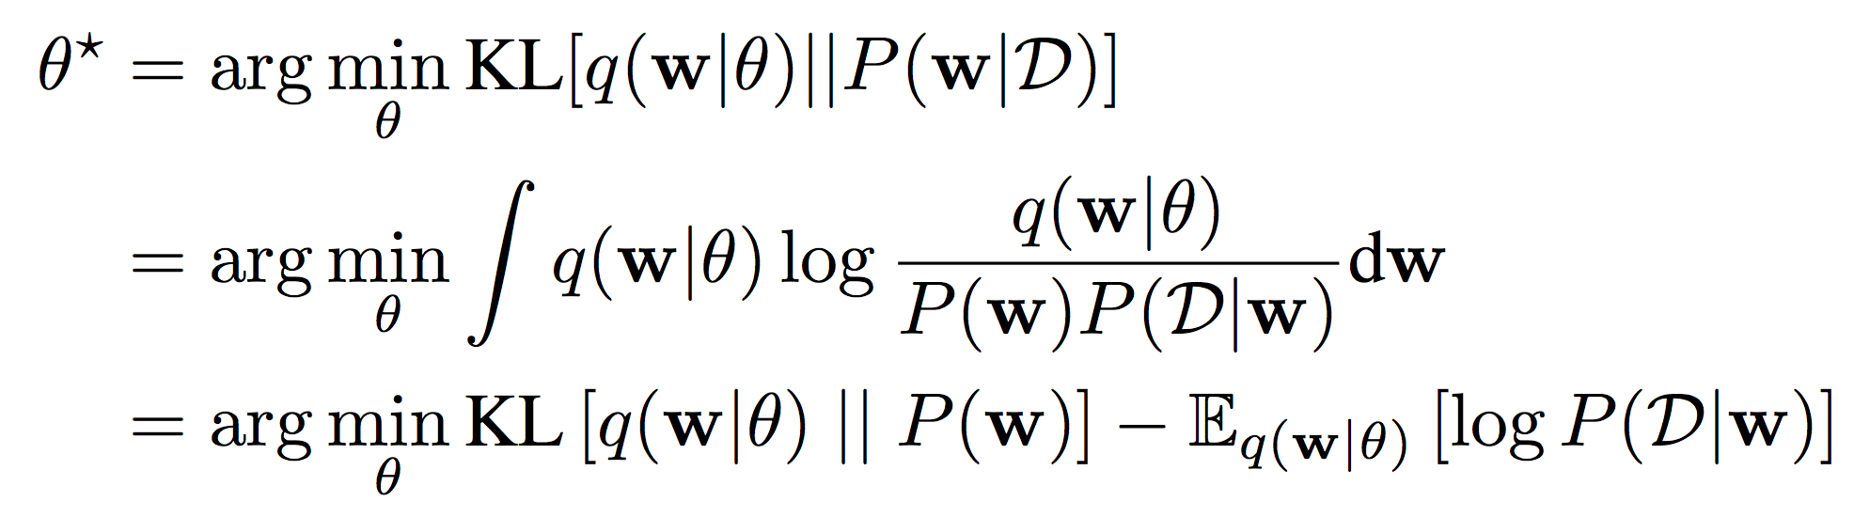
Another Expression for
Complexity Cost
Likelihood Cost

Slide 15
Minimum Description Length
bits to describe w given prior
bits to transfer targets given inputs by encoding them with a network
Honkela and Volpa, 2004; Hinton and Van Camp, 1993; Graves 2011

Slide 16
Outline
Variational Approximation
Gradients for All
The Posterior and the Prior
An Algorithm
Experiments
(Setting)
(Contribution)
(Details)
(Results)

Slide 17
Goal

Slide 18
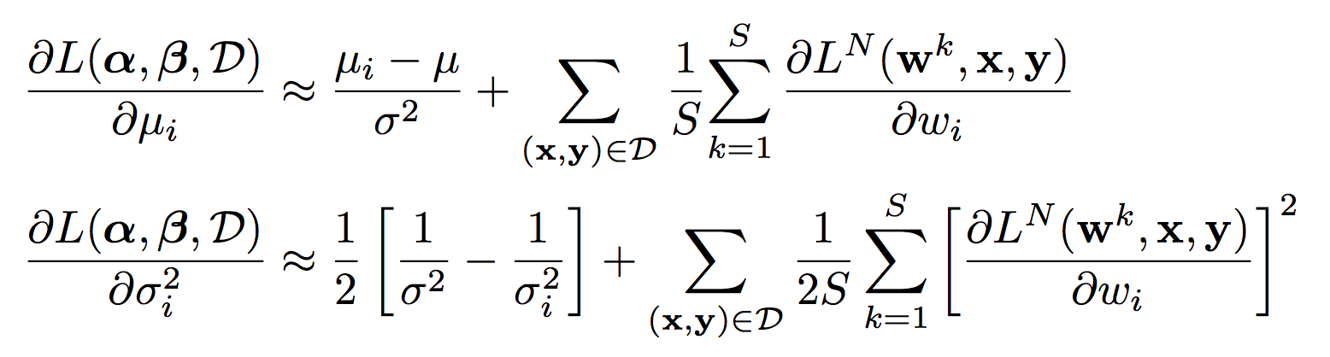
Previous Approach (Graves, NIPS 2011)
Directly approximate
  for each Prior/Posterior
e.g., Gaussians:

Slide 19
Previous Approach (Graves, NIPS 2011)
Directly approximate
  for each Prior/Posterior
Potentially Biased!

Slide 20
Re-parameterization

Slide 21
Unbiased Gradients

Slide 22
Outline
Variational Approximation
Gradients for All
The Posterior and the Prior
An Algorithm
Experiments
(Setting)
(Contribution)
(Details)
(Results)

Slide 23
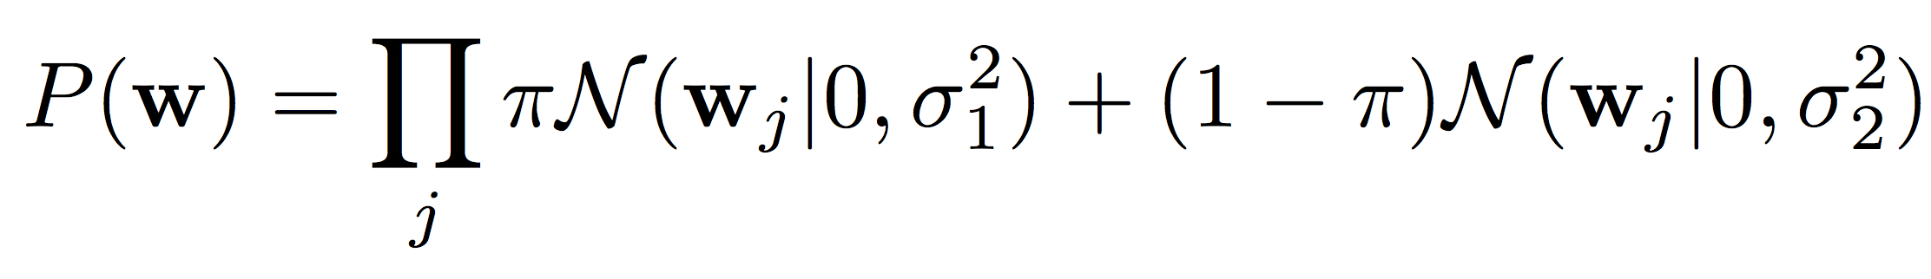
The Prior – Scale Mixture of Gaussians
Don’t have to derive a specific approximation of
Just need

Slide 24
The Posterior – Independent Gaussians

Slide 25
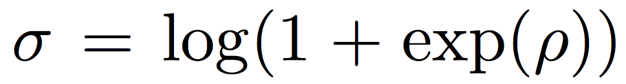
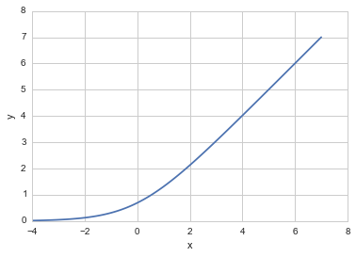
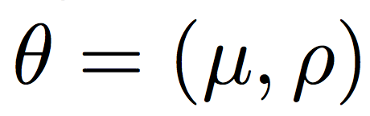
The Posterior – Re-Parameterization
learn

Slide 26
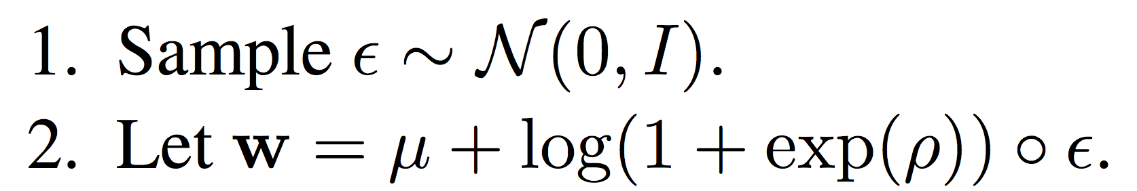
The Posterior – Sampling with Noise

Slide 27
Outline
Variational Approximation
Gradients for All
The Posterior and the Prior
An Algorithm
Experiments
(Setting)
(Contribution)
(Details)
(Results)

Slide 28
Learning
Sample w
Compute update with sampled w

Slide 29
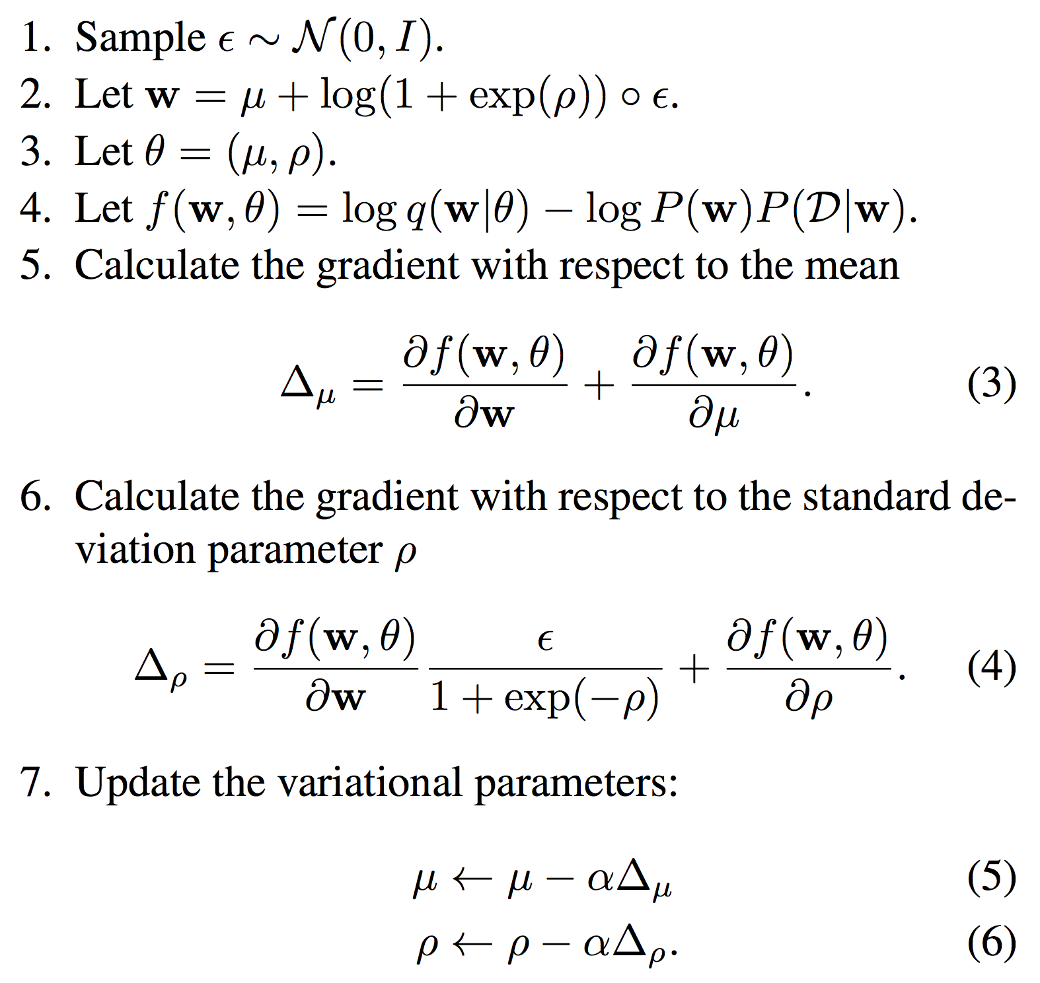
(Sample)
(Update)

Slide 30
(Sample)
(Update)

Slide 31
Outline
Variational Approximation
Gradients for All
The Posterior and the Prior
An Algorithm
Experiments
(Setting)
(Contribution)
(Details)
(Results)

Slide 32
MNIST Classification

Slide 33
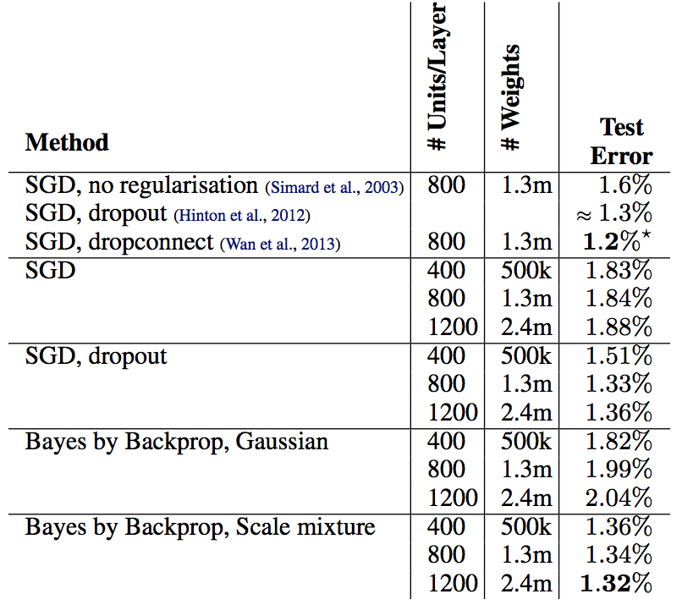
MNIST Test Error

Slide 34
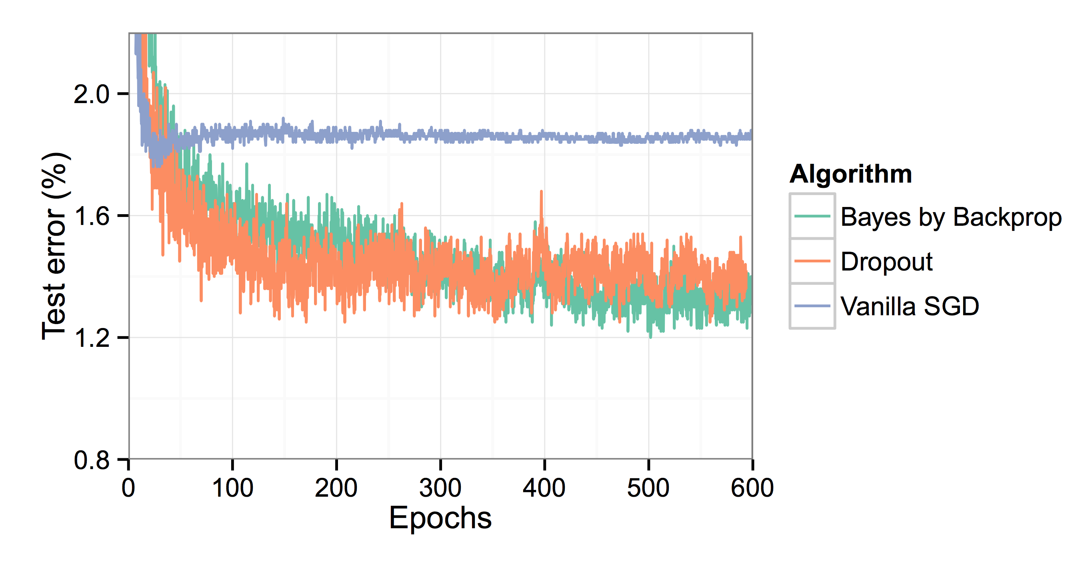
Convergence Rate

Slide 35
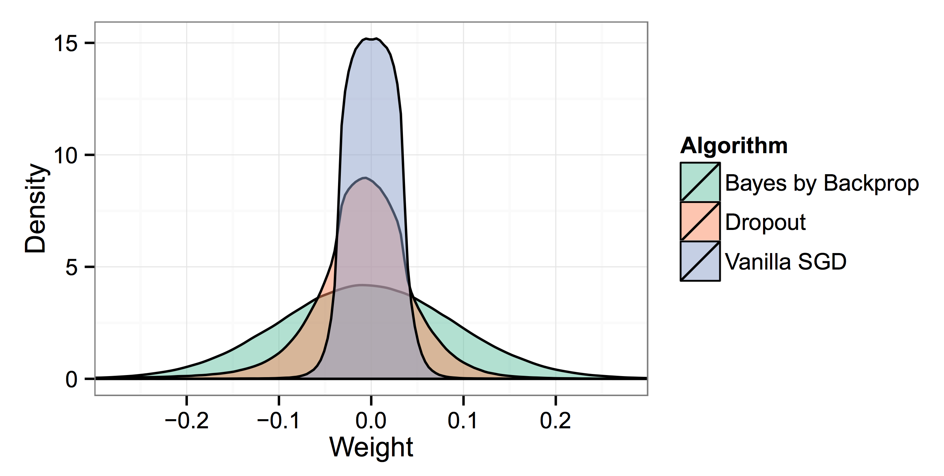
Weight Histogram
Notes:
Note that vanilla SGD looks like a gaussian, so a gaussian prior isn’t a bad idea.

Slide 36
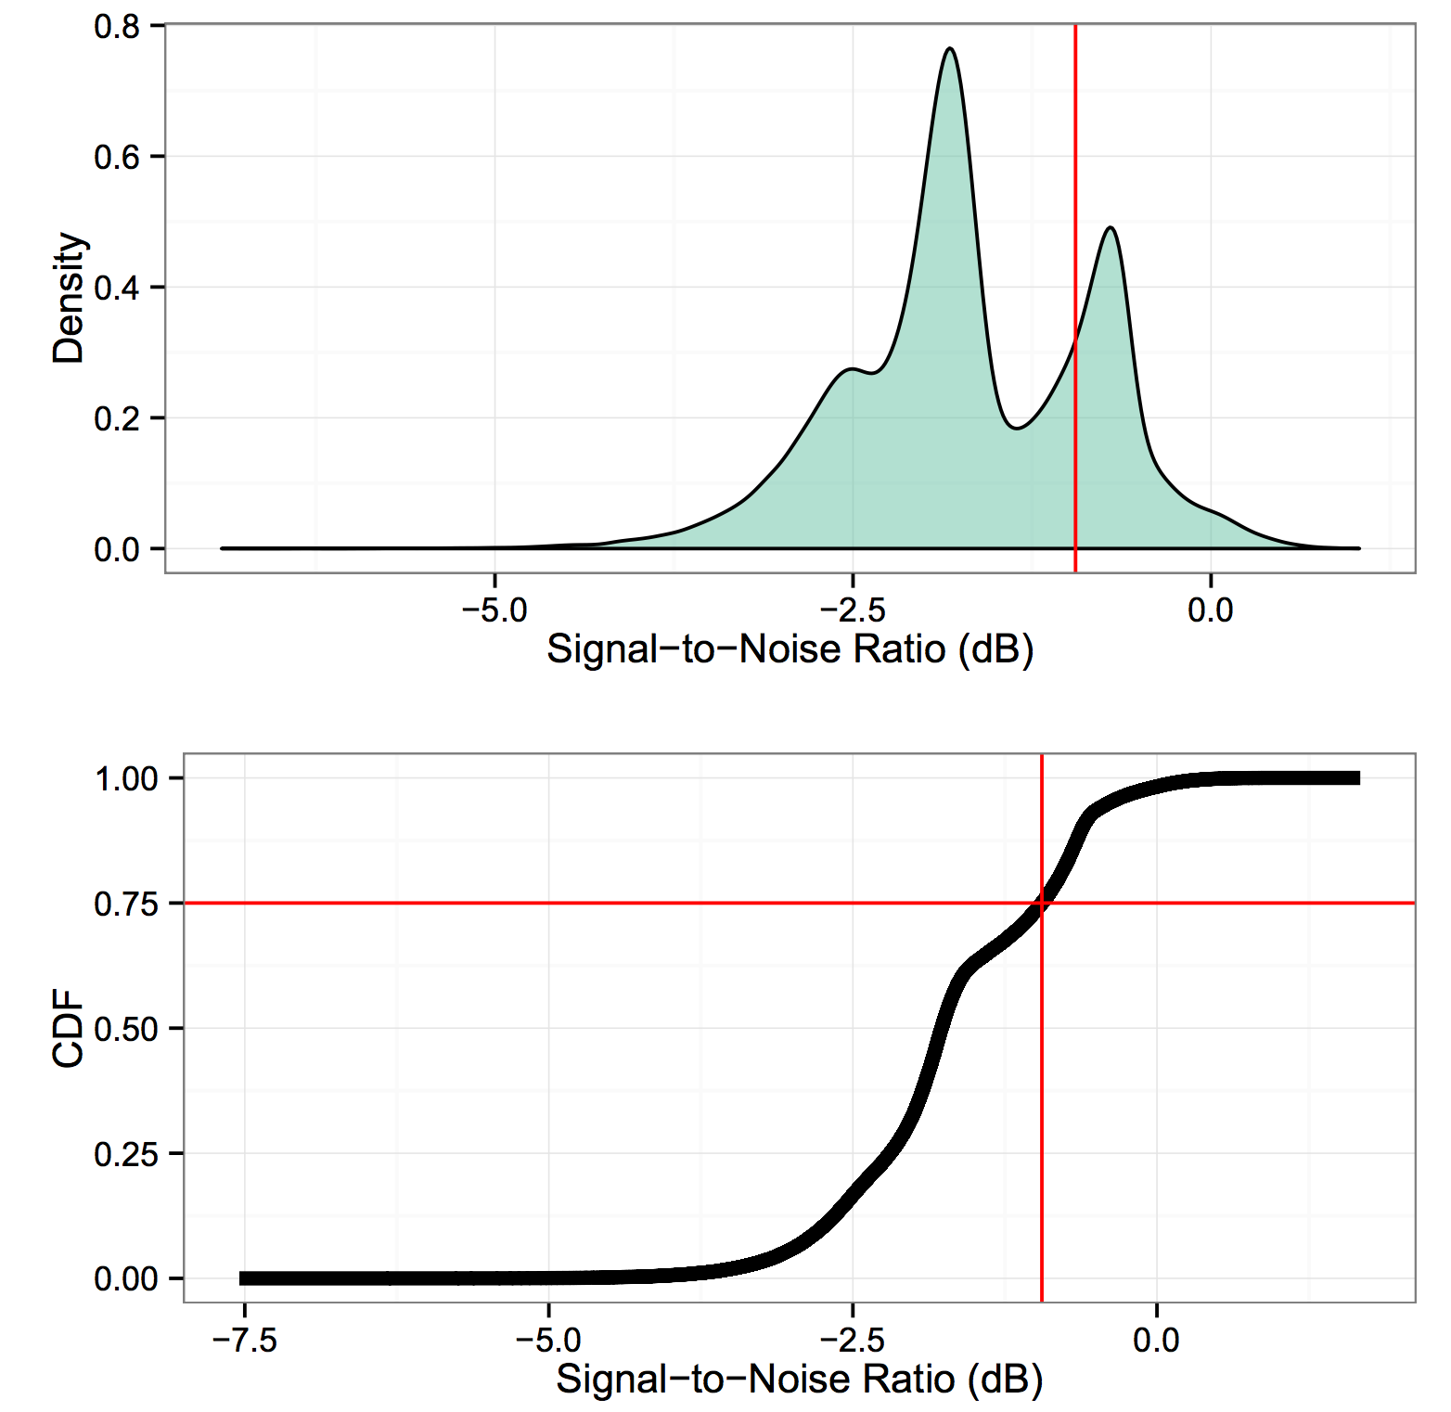
Signal to Noise Ratio
Each weight is one data point
Notes:
Note that vanilla SGD looks like a gaussian, so a gaussian prior isn’t a bad idea.

Slide 37
Weight Pruning
0
0
0
0
0

Slide 38
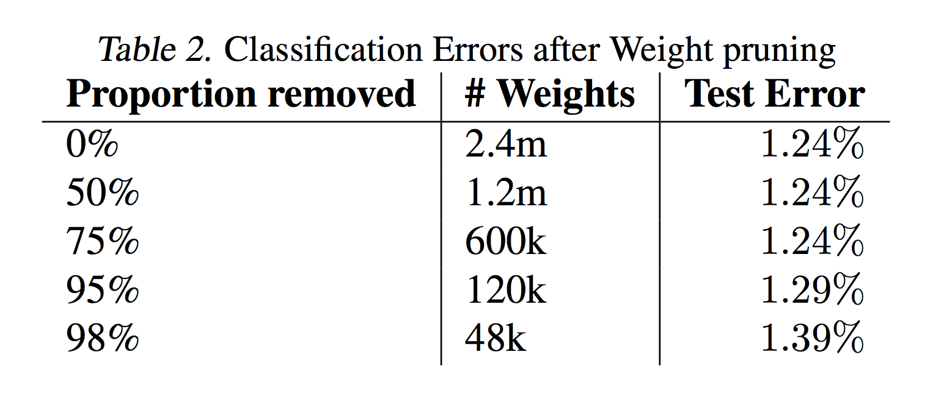
Weight Pruning
Peak 1
Peak 2

Slide 39
Regression

Slide 40
Does uncertainty in weights lead to uncertainty in outputs?

Slide 41
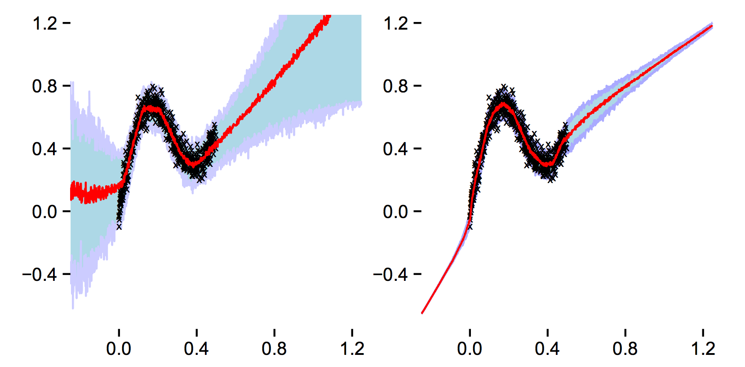
Bayes by Backprop
Standard NN
Notes:
Blue and purple shading indicates quartiles… red is median… black crosses are training data

Slide 42
Exploration in Bandit Problems

Slide 43
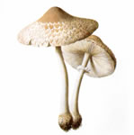
UCI Mushroom Dataset
22 Attributes
8124 Examples
Actions:
  “edible” e E[reward] = 5
  “unknown” u E[r] = 0
  “poisonous” p E[r] = -15
Image: https://archive.ics.uci.edu/ml/datasets/Mushroom

Slide 44
Classification vs Contextual Bandit
Classification
Contextual Bandit
P(y=e)
P(y=u)
P(y=p)
E[r]
NN
NN
X
X
e
u
p
Notes:
One output per class vs one input per class (w/ reward output)
Cross Entropy naturally judges all predictions

Slide 45
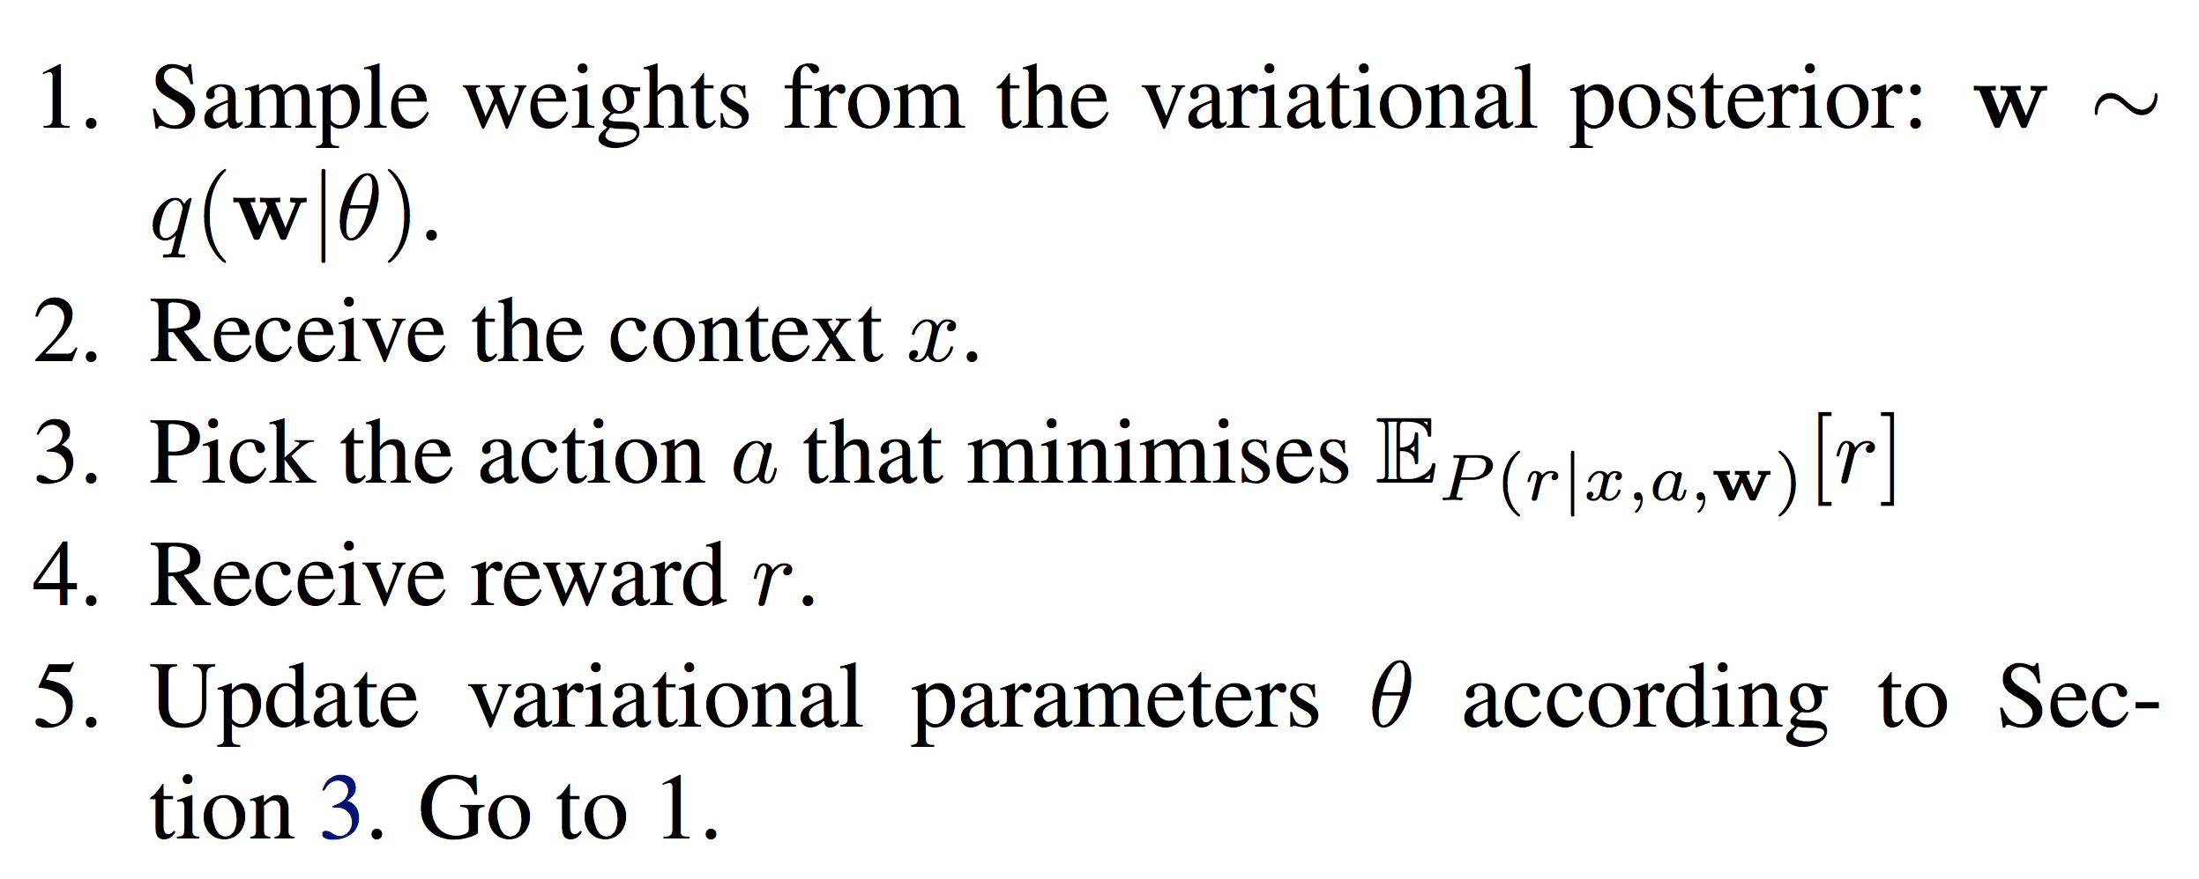
Thompson Sampling

Slide 46
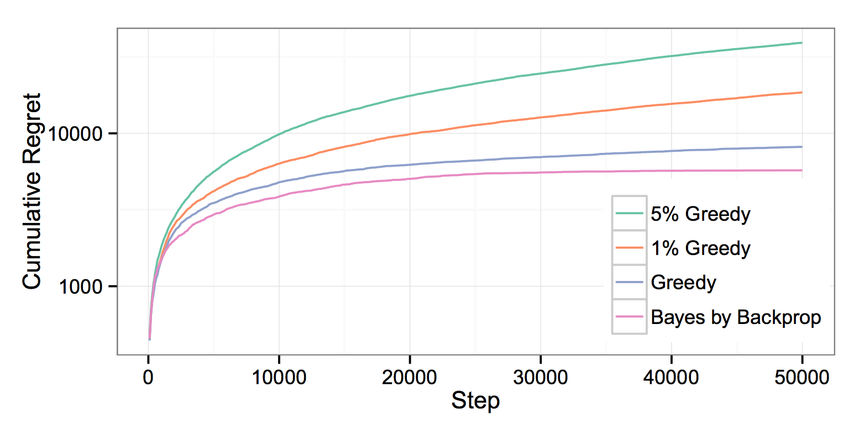
Contextual Bandit Results
Notes:
Greedy does not explore for 1000 steps
Bayes by Backprop explores

Slide 47
Conclusion
Somewhat general procedure for approximating NN posterior
Unbiased gradients
Could help with RL

Slide 48
Next: Dropout as a GP

