Slide 1
ECE 6504: Deep Learning for Perception
Topics:
LSTMs (intuition and variants)
[Abhishek:] Lua / Torch Tutorial
Dhruv Batra
Virginia Tech

Slide 2
Administrativia
HW3
Out today
Due in 2 weeks
Please please please please please start early
https://computing.ece.vt.edu/~f15ece6504/homework3/

Slide 3
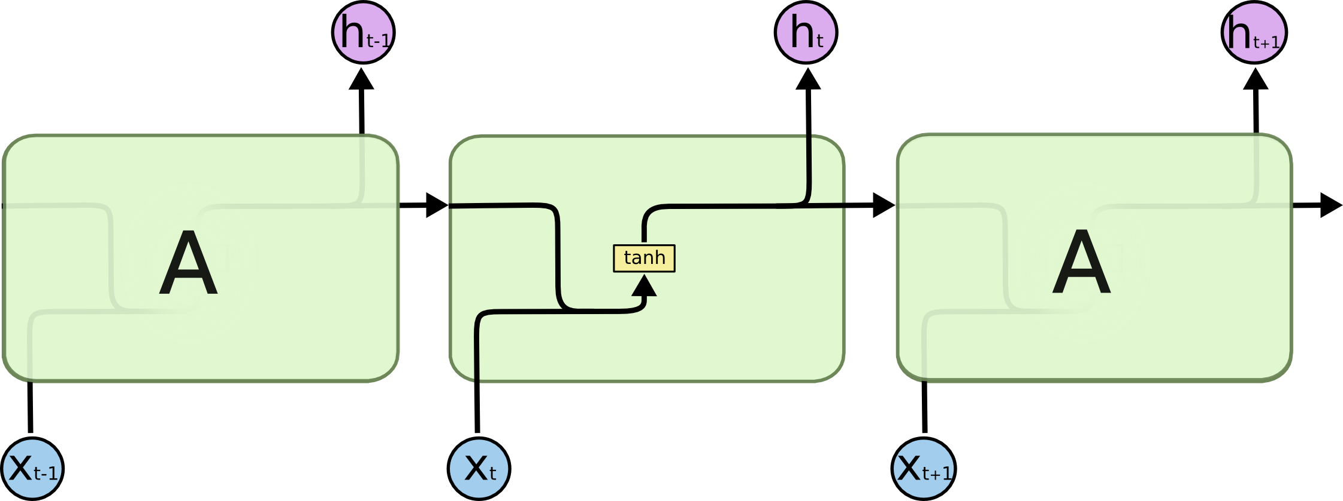
RNN
Basic block diagram
Image Credit: Christopher Olah (http://colah.github.io/posts/2015-08-Understanding-LSTMs/)

Slide 4
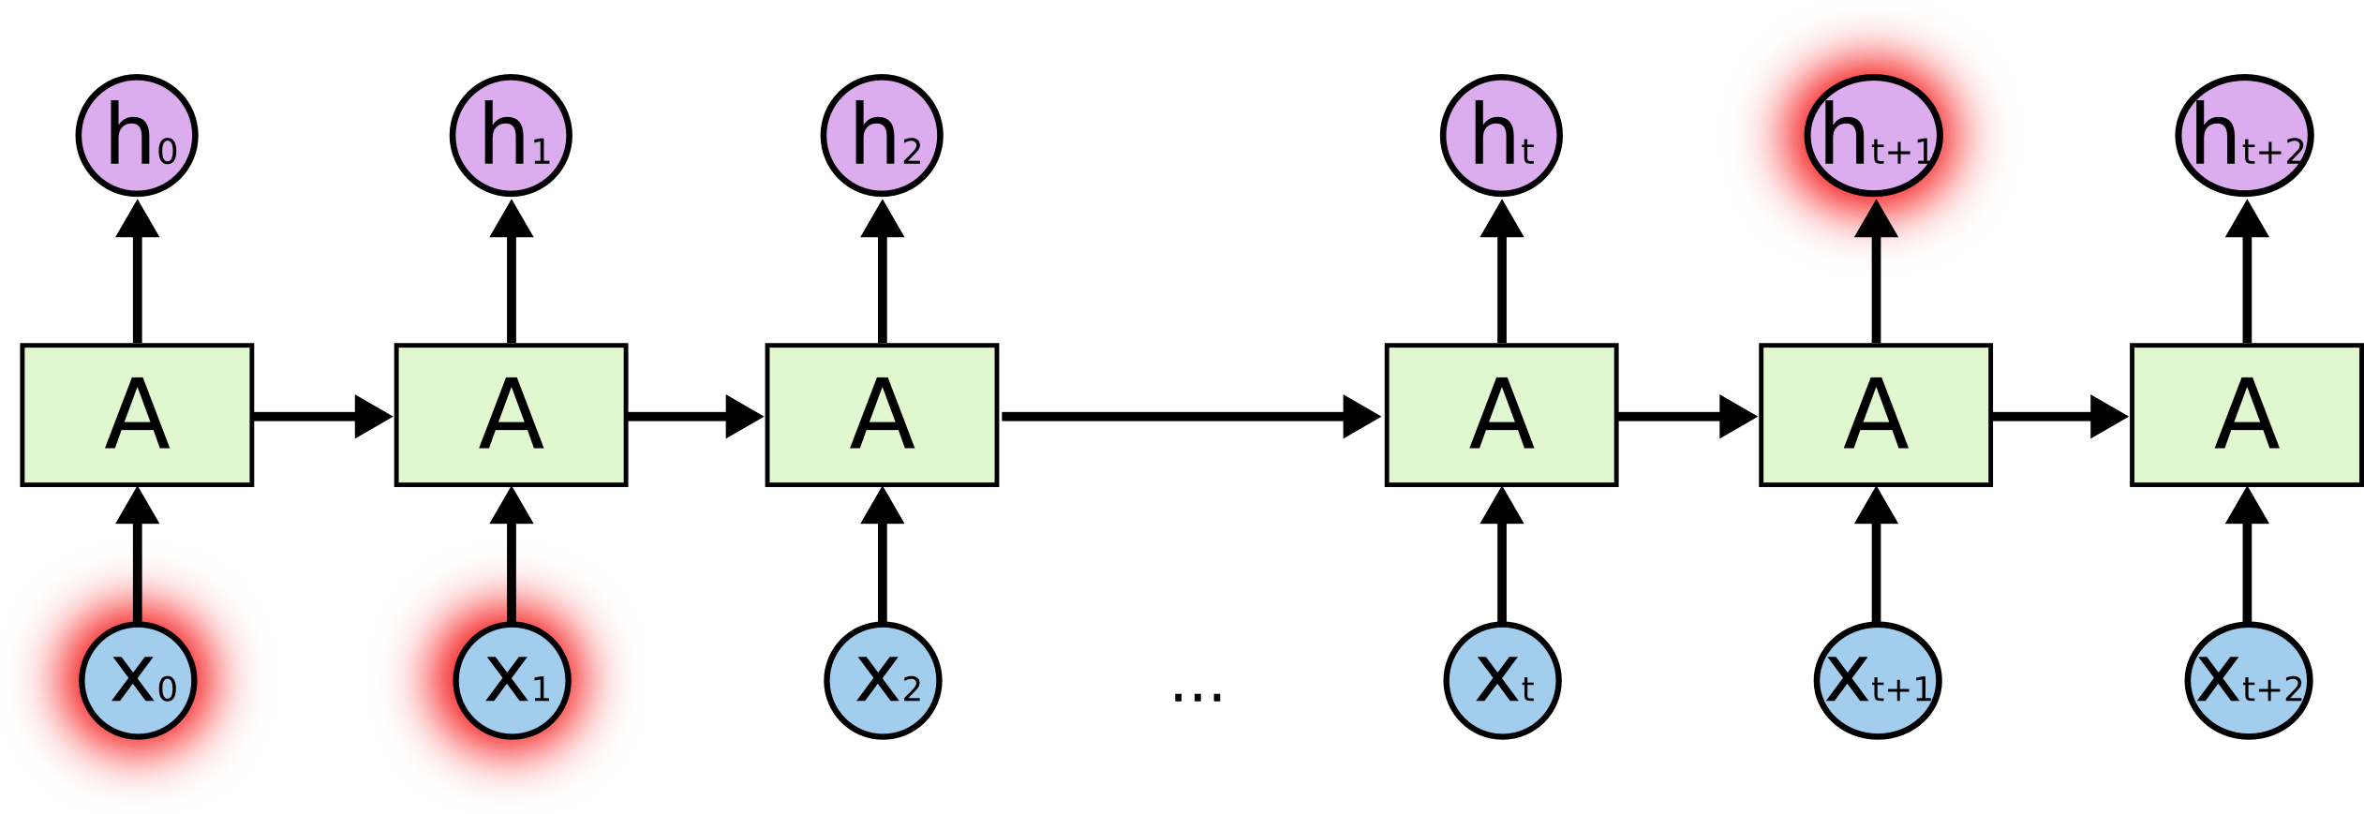
Key Problem
Learning long-term dependencies is hard
Image Credit: Christopher Olah (http://colah.github.io/posts/2015-08-Understanding-LSTMs/)

Slide 5
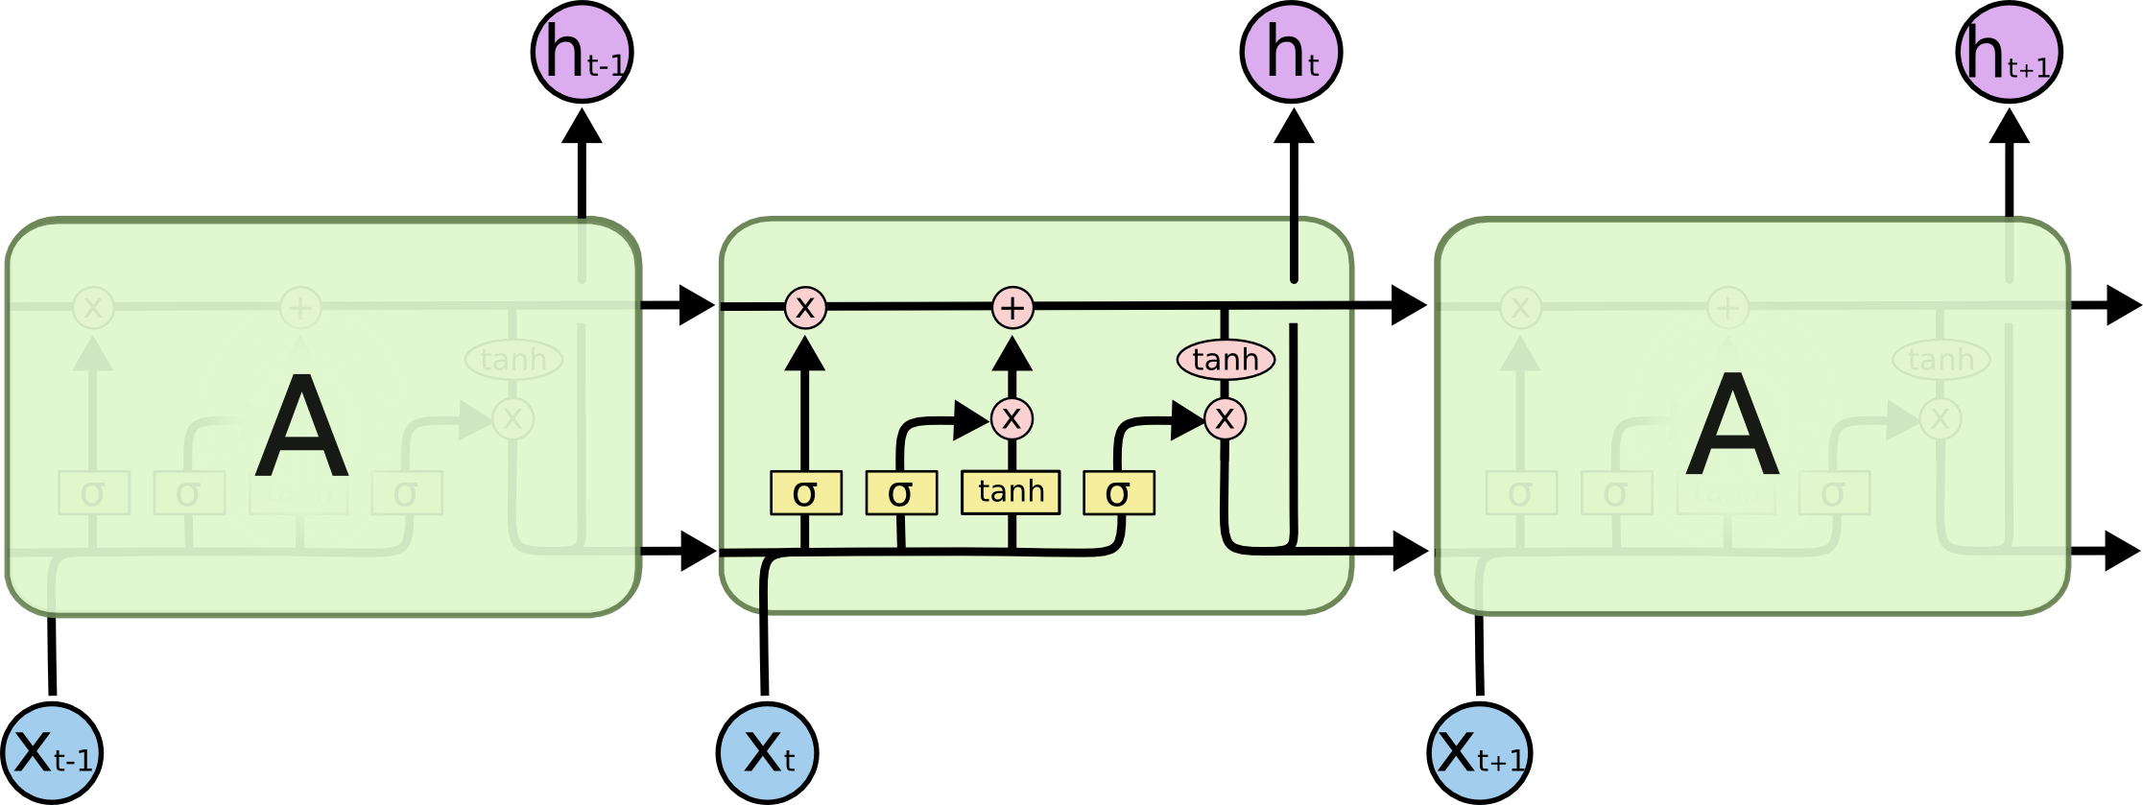
Meet LSTMs
How about we explicitly encode memory?
Image Credit: Christopher Olah (http://colah.github.io/posts/2015-08-Understanding-LSTMs/)

Slide 6
LSTMs Intuition: Memory
Cell State / Memory
Image Credit: Christopher Olah (http://colah.github.io/posts/2015-08-Understanding-LSTMs/)

Slide 7
LSTMs Intuition: Forget Gate
Should we continue to remember this “bit” of information or not?
Image Credit: Christopher Olah (http://colah.github.io/posts/2015-08-Understanding-LSTMs/)

Slide 8
LSTMs Intuition: Input Gate
Should we update this “bit” of information or not?
If so, with what?
Image Credit: Christopher Olah (http://colah.github.io/posts/2015-08-Understanding-LSTMs/)

Slide 9
LSTMs Intuition: Memory Update
Forget that + memorize this
Image Credit: Christopher Olah (http://colah.github.io/posts/2015-08-Understanding-LSTMs/)

Slide 10
LSTMs Intuition: Output Gate
Should we output this “bit” of information to “deeper” layers?
Image Credit: Christopher Olah (http://colah.github.io/posts/2015-08-Understanding-LSTMs/)

Slide 11
LSTMs Intuition: Output Gate
Should we output this “bit” of information to “deeper” layers?
Image Credit: Christopher Olah (http://colah.github.io/posts/2015-08-Understanding-LSTMs/)

Slide 12
LSTMs
A pretty sophisticated cell
Image Credit: Christopher Olah (http://colah.github.io/posts/2015-08-Understanding-LSTMs/)

Slide 13
LSTM Variants #1: Peephole Connections
Let gates see the cell state / memory
Image Credit: Christopher Olah (http://colah.github.io/posts/2015-08-Understanding-LSTMs/)

Slide 14
LSTM Variants #2: Coupled Gates
Only memorize new if forgetting old
Image Credit: Christopher Olah (http://colah.github.io/posts/2015-08-Understanding-LSTMs/)

Slide 15
LSTM Variants #3: Gated Recurrent Units
Changes:
No explicit memory; memory = hidden output
Z = memorize new and forget old
Image Credit: Christopher Olah (http://colah.github.io/posts/2015-08-Understanding-LSTMs/)

Slide 16
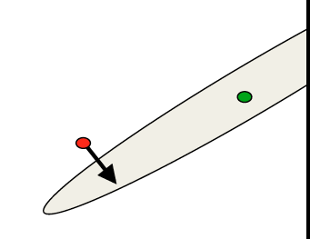
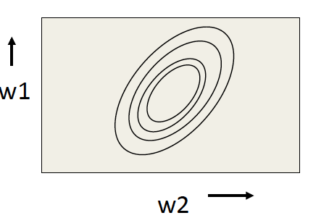
RMSProp Intuition
Gradients ≠ Direction to Opt
Gradients point in the direction of steepest ascent locally
Not where we want to go long term
Mismatch gradient magnitudes
magnitude large = we should travel a small distance
magnitude small = we should travel a large distance
Image Credit: Geoffrey Hinton

Slide 17
RMSProp Intuition
Keep track of previous gradients to get an idea of magnitudes over batch
Divide by this accumulate

