Slide 1
Fooling ConvNets
and
Adversarial Examples
ECE 6504 Deep Learning for Perception
Presented by: Aroma Mahendru

Slide 2
Presentation Overview
Intriguing properties of neural networks Christian Szegedy, Wojciech Zaremba, Ilya Sutskever, Joan Bruna, Dumitru Erhan, Ian Goodfellow, Rob Fergus
Deep Neural Networks are Easily Fooled: High Confidence Predictions for Unrecognizable Images Anh Nguyen, Jason Yosinski, Jeff Clune
Deep Dreams Alexander Mordvintsev, Christopher Olah, Mike Tyka

Slide 3
Intriguing Properties of Neural Networks
Szegedy et al., ICLR 2014

Slide 4
Intriguing Findings
No distinction between individual high level units and their random linear combinations.
Network can misclassify an image if we apply certain specific hardly perceptible perturbations to the image.
These distorted images or adversarial examples generalize fairly well even with different hyper-parameters as well as datasets.

Slide 5
Experimental setup
1. Fully connected layers with softmax model trained on MNIST dataset– “FC”
2. Krizhevsky et al. architecture trained on ImageNet dataset- “AlexNet”
3. UNsupervised trained network trained on 10M Image samples from Youtube- “QuocNet”

Slide 6
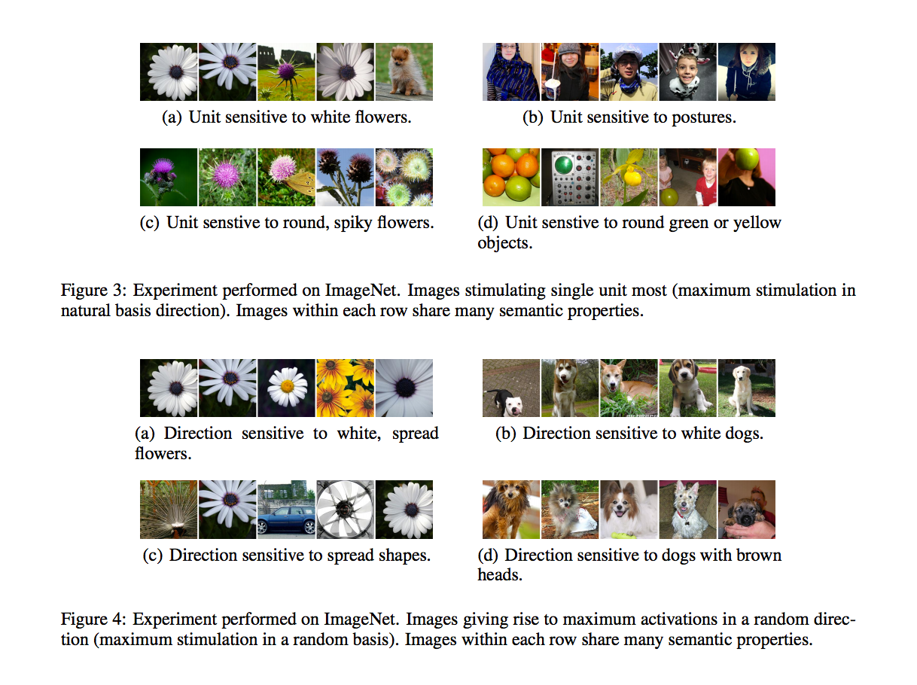
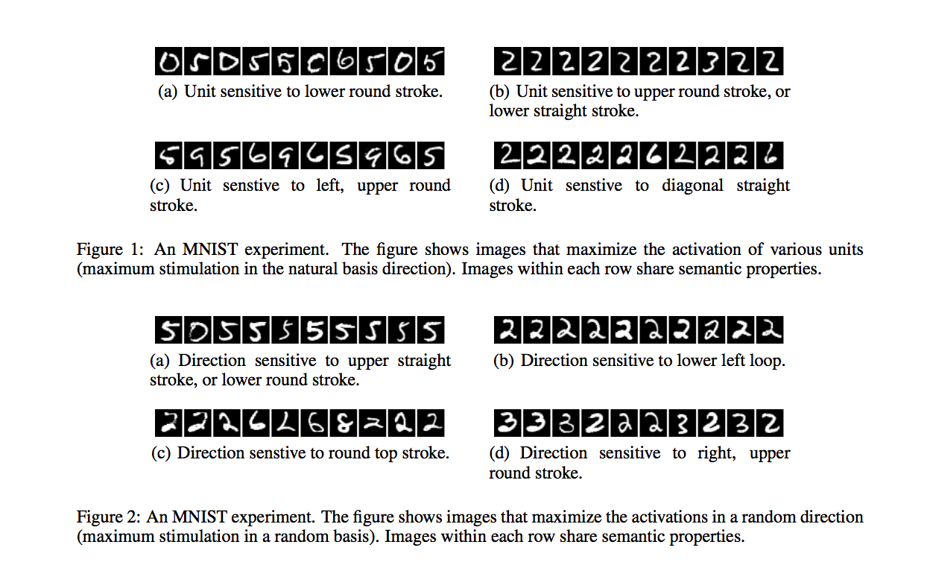
Interpretation of Higher Units
Notes:
Images that maximize activations in basis direction, image that maximize activations in random directions
Images in both cases are quite similar the space of these units rather than individual units contain the semantic information
This suggests that the natural basis is not better than a random basis for inspecting the properties
of φ(x). This puts into question the notion that neural networks disentangle variation factors across
coordinates.

Slide 7
Generating Adversarial Examples
Changing an image, originally correctly classified in a way imperceptible to human eyes, can cause a net to label the image as something else entirely.
Notes:
Deep Neural
Networks learn input-output mappings that are
discontinuous to a significant extent.

Slide 8
Generating Adversarial Examples
Notes:
Deep Neural
Networks learn input-output mappings that are
discontinuous to a significant extent.
L-BFGS an optmization algorithm like gradient descent

Slide 9
Adversarial Examples
Notes:
Deep Neural
Networks learn input-output mappings that are
discontinuous to a significant extent.

Slide 10
Cross Generalization over hyperparameters
Notes:
The general conclusion is that adversarial examples
tend to stay hard even for models trained with different hyperparameters. Although the autoencoder
based version seems most resilient to adversarial examples, it is not fully immune either.

Slide 11
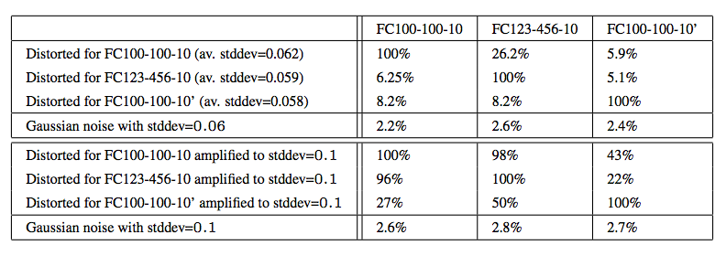
Cross Generalization over datasets
Notes:
The intriguing conclusion is
that the adversarial examples remain hard for models trained even on a disjoint training set, although
their effectiveness decreases considerably

Slide 12
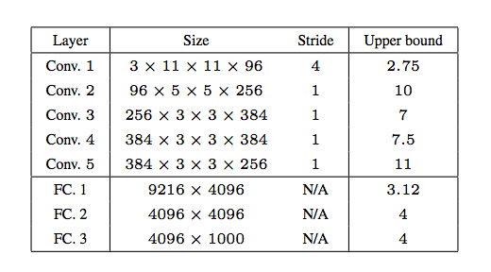
Spectral Analysis of Instability
Notes:
The instability of φ(x) can be
explained by inspecting the upper Lipschitz constant of each layer
large bounds do not automatically as we see in the paper is function of their weights
translate into existence of adversarial examples; however, small bounds guarantee that no such examples
can appear.

Slide 13
Why adversarial examples exist?
In discriminative models, decision boundary is loose. Data points occupy much less space than what is assigned to them.
Generative models would not be easily fooled.

Slide 14
Why adversarial examples exist?
Adversarial examples can be explained as a property of high-dimensional dot products.
They are a result of models being too linear, rather than too nonlinear.
The generalization of adversarial examples across different models can be explained as a result of adversarial perturbations being highly aligned with the weight vectors of a model and different models learning similar functions when trained to perform the same task.
Goodfellow et al., ICLR 2015
Notes:
Too non linear, low regularization, insufficient averaging

Slide 15
Deep Neural Networks Are Easily Fooled: High Confidence Predictions for Unrecognizable Images
Nguyen et al., CVPR15

Slide 16
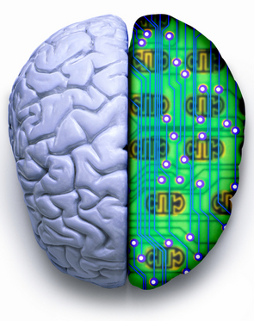
Human vs. Computer Object Recognition
Given the near-human ability of DNNs to classify objects, what differences remain between human and computer vision?
Slide credit : Bella Fadida Specktor

Slide 17
Summary
https://youtu.be/M2IebCN9Ht4

Slide 18
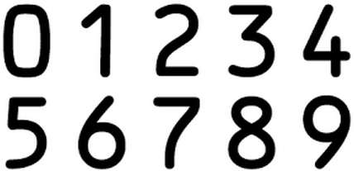
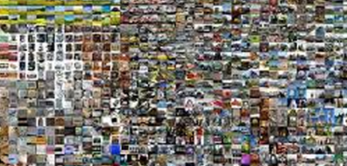
Experimental setup
1. LeNet model trained on MNIST dataset– “MNIST DNN”
2. AlexNet DNN trained on ImageNet dataset- ”ImageNet DNN” (larger dataset, bigger network)
Slide credit : Bella Fadida Specktor

Slide 19
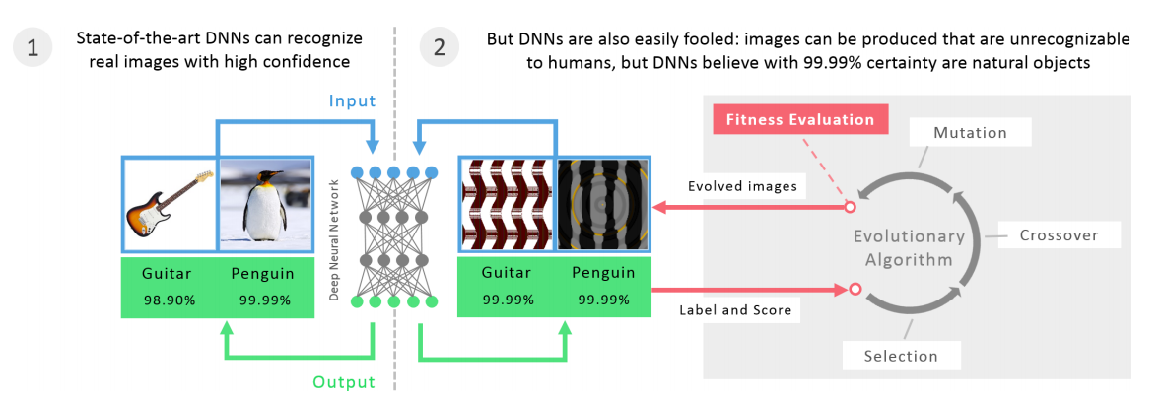
Evolution Algorithms (EA)
Notes:
one or a small set of objective function
MAP Elite : simultaneously evolve a population that contains individuals that score well on many classes. MAP-Elites works by keeping the best individual found so far for each objective. Random image -> mutation/crossover -> updates champions if has higher score
.

Slide 20
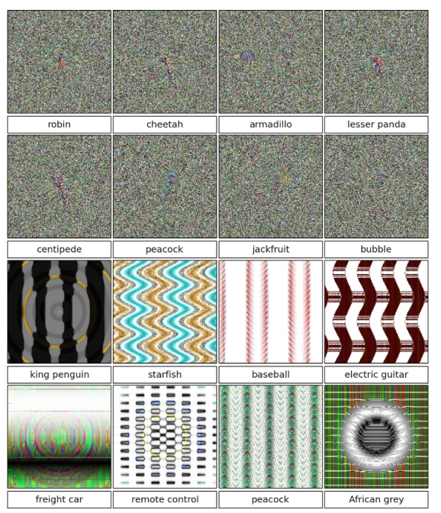
Direct Encoding
Grayscale values for MNIST, HSV values for ImageNet. Each pixel value is initialized with uniform random noise within the [0, 255] range. Those numbers are independently mutated.
Slide credit : Bella Fadida Specktor
Notes:
first by determining which numbers are mutated, via a rate that starts at 0.1 (each number has a 10% chance of being chosen to be mutated) and drops by half every 1000 generations. The numbers chosen to be mutated are then altered via the polynomial mutation operator [8] with a fixed mutation strength of 15

Slide 21
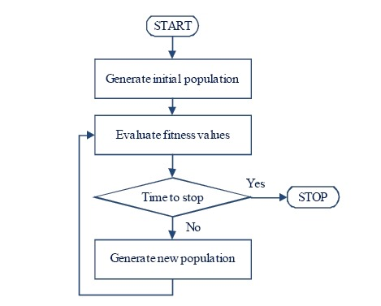
Direct Encoding
Random Grayscale Images
Mutate/Crossover
pixels directly
Notes:
first by determining which numbers are mutated, via a rate that starts at 0.1 (each number has a 10% chance of being chosen to be mutated) and drops by half every 1000 generations. The numbers chosen to be mutated are then altered via the polynomial mutation operator [8] with a fixed mutation strength of 15

Slide 22
CPNN (Compositional Pattern-Producing Network) Encoding
This encoding is more likely to produce “Regular” images – e.g. contains symmetry and repetition
Similar to ANNs, but with different nonlinear functions.
Slide credit : Bella Fadida Specktor
Notes:
each image is a CPNN, pertubations are made by changing network topology, activation functions, weights
idea is that CPNN evolve images which are similarly recognized by humans and DNNs
sine, linear, gaussian

Slide 23
CPNN (Compositional Pattern-Producing Network) Encoding
CPNN with no hidden layers
Changing CPNN parameters
Notes:
each image is a CPNN, pertubations are made by changing network topology, activation functions, weights
idea is that CPNN evolve images which are similarly recognized by humans and DNNs
sine, linear, gaussian

Slide 24
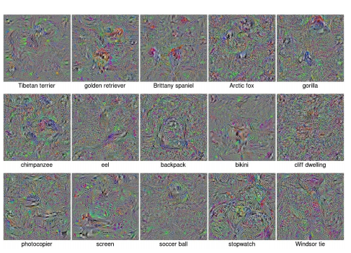
Fooling images via Gradient Ascent
Following the direction of gradient of the posterior probability for a specific class
Notes:
Calculating the gradient of the posterior probability for a specific class — here, a softmax output unit of the DNN — with respect to the input image using backprop, and then following the gradient to increase a chosen unit’s activation.

Slide 25
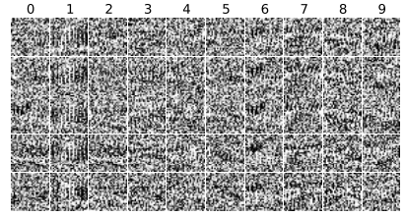
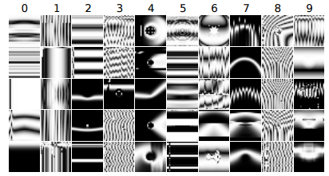
Results – MNIST
In less than 50 generations, each run of evolution produces unrecognizable images classified by MNIST DNNs with ≥ 99.99% confidence.
MNIST DNNs labelled unrecognizable images as digits with 99.99% confidence after only a few generations.
Slide credit : Bella Fadida Specktor
Notes:
By 200 generations, median confidence is 99.99%.

Slide 26
Results – ImageNet Dataset
Directly encoded EA
CPNN Encoding
Even after 20,000 generations, evolution failed to produce high-confidence images for many categories, but produced images with ≥ 99% confidence for 45 categories. 21.59% Median Confidence
Many images with DNN confidence scores ≥99.99%, but that are unrecognizable. After 5000 generations, Median Confidence score is 88.11%, similar to that for natural images
Slide credit : Bella Fadida Specktor
Notes:
smaller dataset could lead to overfitting. in some cases if target class was told one might relate the features
Dogs and cats are overrepresented in Image net, more images, less overfitting, less fooling
Another explanation is DNN find it hard to get images that score high in say one specific dog category

Slide 27
CPNN Encoding on ImageNet
Evolution produces images which has most discriminative features of a class.
Notes:
Diversity is interesting coz it’s shown that class label can be changed by imperceptible changes to the image. second paper
evolution produced images high scoring for all the classes,
some classes are closely related so images produced are similar

Slide 28
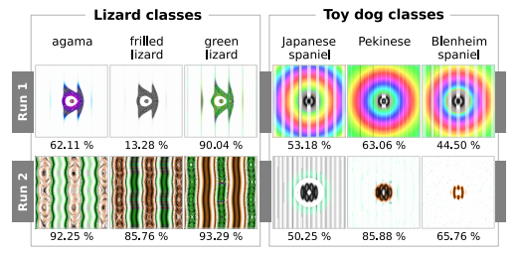
CPNN Encoding on ImageNet
Many images are related to each other phylogenetically, which leads evolution to produce similar images for closely related categories.
Different runs of evolution produce different image types.
Slide credit : Bella Fadida Specktor
Notes:
More than one discriminative features. More ways to fool the net.

Slide 29
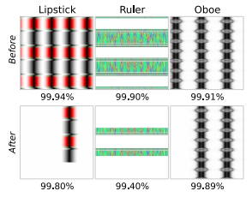
Repetition Ablation Study
To test whether repetition improves the confidence scores, some of the repeated elements were ablated.
In many images, ablation leaded to a small performance drop
Notes:
extra copies make DNNs more confident. Thus DNNs tend to focus on low-mid level features rather the global structure.

Slide 30
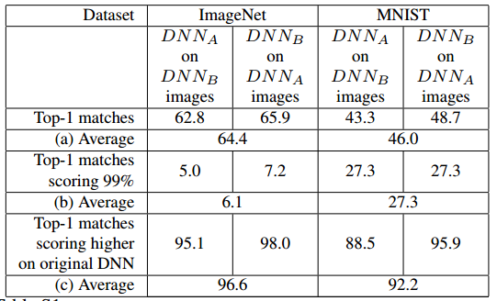
Do different DNNs learn the same discriminative features?
Slide credit : Bella Fadida Specktor
Notes:
which means that mostly they do

Slide 31
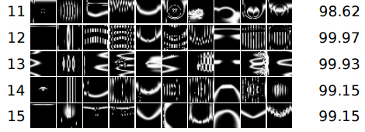
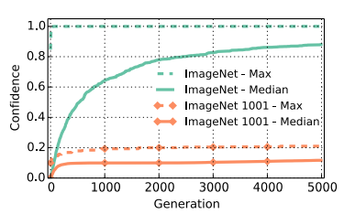
Adding “Fooling Images” class
It is easier to learn to tell CPPN images apart from natural images than it is to tell CPPN images from MNIST digits.
Slide credit : Bella Fadida Specktor
Notes:
an extra class to the DNN . the class of fooling images
also retrained model learns features specific of CPPN

Slide 32
DeepDream
Google, Inc.
Notes:
How to fool a network? We were essentially looking at what a deep net ‘sees’ in a n class ?

Slide 33
What is a deep dream?
Simply feed the network an arbitrary image or photo and let the network analyze the picture.
Pick a layer and ask the network to enhance whatever it detects
DNN “hallucinates” various low/high level features depending upon which layers is picked

Slide 34
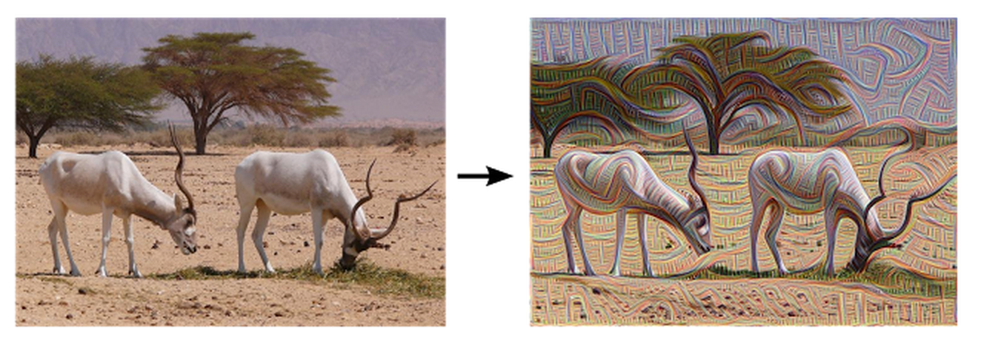
What is a deep dream?
Notes:
Too non linear, low regularization, insufficient averaging

Slide 35
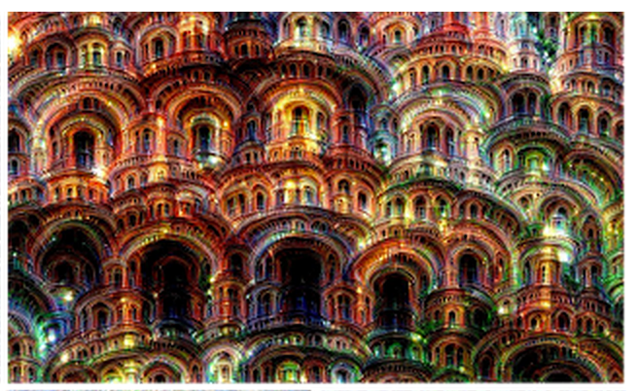
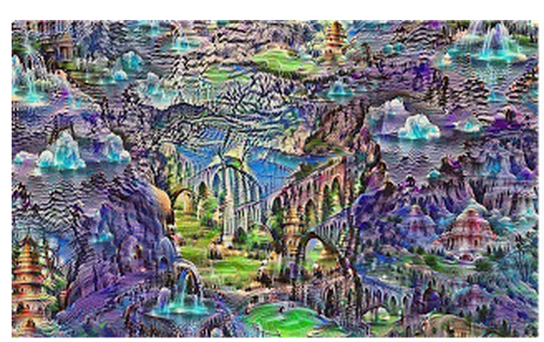
What is a deep dream?
Notes:
The algorithm is iteratively applied on its own outputs and apply some zooming after each iteration, we can get an endless stream of new impressions.
We can even start this process from a random-noise image, so that the result becomes purely the result of the neural network.

Slide 36
Setup
GoogLeNet trained on ImageNet dataset

Slide 37
Producing Dreams
It is just a gradient ascent process that tries to maximize the L2 norm of activations of a particular DNN layer. Here are a few simple tricks that were useful for getting good images:
offset image by a random jitter
normalize the magnitude of gradient ascent steps
apply ascent across multiple scales (octaves)

Slide 38
Controlling Dreams
The optimization objective can be tweaked to improve the generated image diversity.
For example, instead of maximizing the L2-norm of current image activations,maximize the dot-products between activations of current image, and their matching correspondences from the guide image.

Slide 39
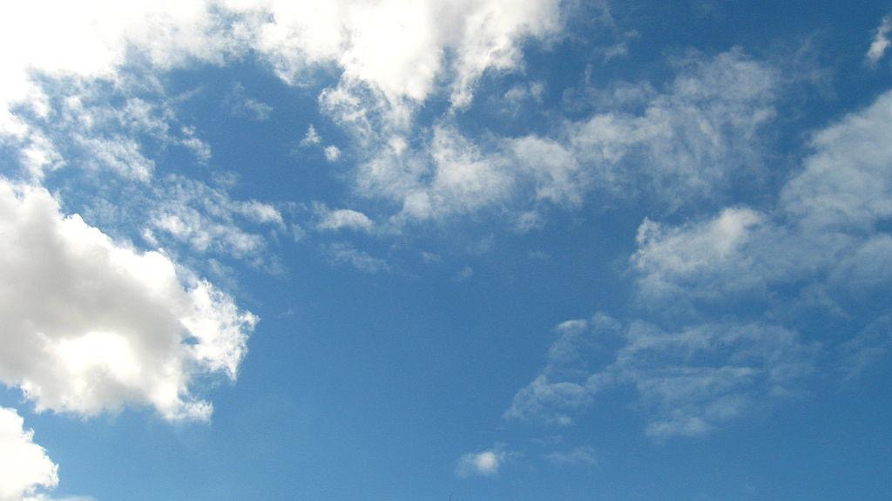
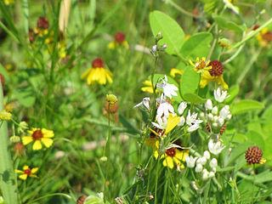
Controlling Dreams

Slide 40
Controlling Dreams

Slide 41
Links
https://github.com/google/deepdream/
http://deepdreamgenerator.com/

Slide 42
Thanks!

