Slide 1
Human-in-the-loop
ECE6504
Xiao Lin

Slide 2
Outline
Paper 1: Bird Classification
Paper 2: Object Detection
Paper 3: Co-segmentation
Summary

Slide 3
Visual Recognition with Humans in the Loop
Steve Branson, Catherine Wah, Florian Schroff, Boris Babenko, Peter Welinder, Pietro Perona, Serge Belongie
Part of the Visipedia project
In “Human Computation and Computer Vision” by James Hays, Brown University
Slides from Brian O’Neil

Slide 4
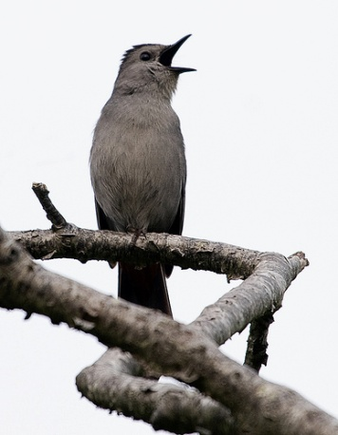
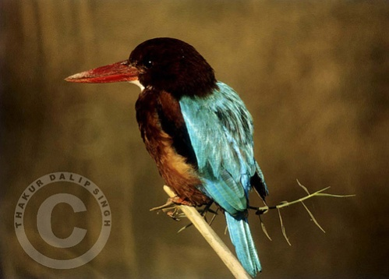
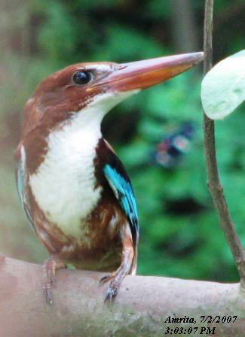
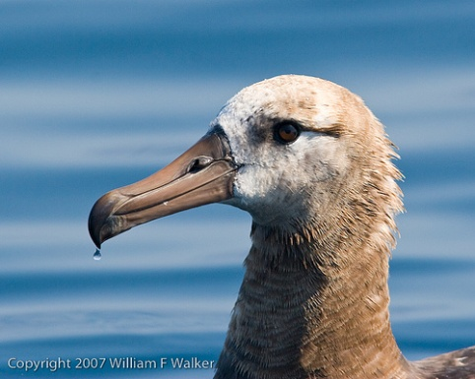
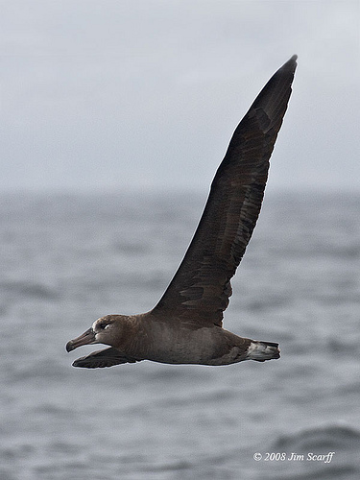
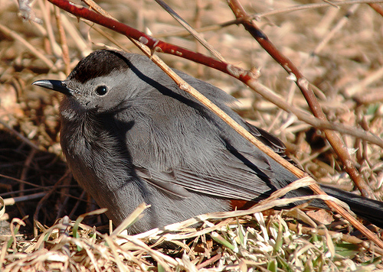
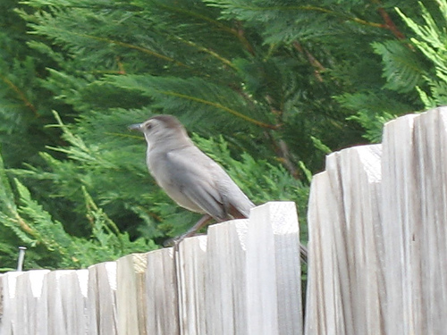
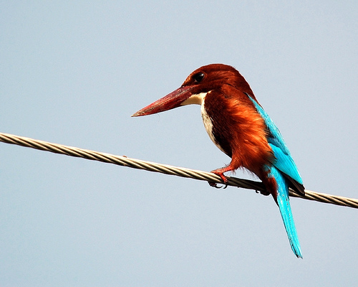
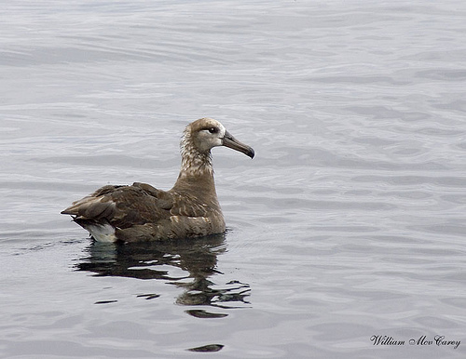
The Dataset: Birds-200
6033 images of 200 species

Slide 5
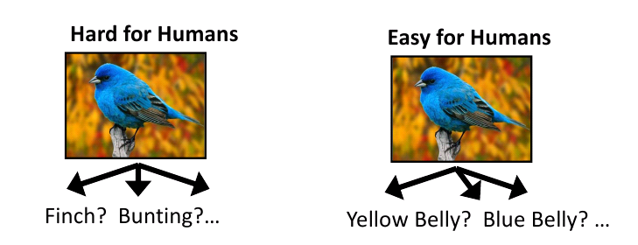
Motivation
Semantic feature extraction difficult for computers.
Require expertise and memorization
Combine strengths to solve this problem.
Modified by Xiao Lin
Notes:
Visual recognition approaches typically tackle (A): Fully autonomous recognition on relatively easy datsets.
(B) Is hard for non-expert humans. Also difficult for computers: State of the art 28-45% on fine-scale data.
(C) Human capacity to extract salient visual features is amazing and natural.

Slide 6
Motivation
Human
Find features
Computer
Ask for features and update class probability
Modified by Xiao Lin

Slide 7
System Overview: 20 Questions
Use computer vision to predict the probabilities of classes as the prior probabilities
Ask the user a series of discriminative visual questions to make the classification.
Steepest descend on entropy

Slide 8
System Overview: 20 Questions
Entropy
Measures “uncertainty”

Slide 9
Some definitions:
Set of possible questions
Possible answers to question i
Possible confidence in answer i (Guessing, Probably, Definitely)
User response
History of user responses at time t

Slide 10
Question selection
Seek the question that gives the maximum information gain (entropy reduction) given the image and the set of previous user responses.
Probability of obtaining
Response u_{i} given the image
And response history
Entropy when response is
Added to history
Entropy before response is added.
where

Slide 11
Incorporating vision
Bayes Rule
A visual recognition algorithm outputs a probability distribution across all classes that is used as the prior.
A posterior probability is then computed based on the probability of obtaining a particular response history given each class.

Slide 12
Modeling user responses
Assume that the questions are answered independently.
Required for posterior computation
Required for information gain
computation

Slide 13
Implementation
Assembled 25 visual questions encompassing 288 visual attributes extracted from www.whatbird.com
Mechanical Turk users asked to answer questions and provide confidence scores.
Down weight “guessing”

Slide 14
User Responses.

Slide 15
Visual recognition
Any vision system that can output a probability distribution across classes will work.
Authors used Andrea Vedaldis’s code.
Color/gray SIFT
VQ geometric blur
1 v All SVM
Authors added full image color histograms and VQ color histograms

Slide 16
Results
Average number of questions to make ID reduced from 11.11 to 6.43
Method allows CV to handle the easy cases, consulting with users only on the more difficult cases.

Slide 17
Key Observations
Visual recognition reduces labor over a pure “20 Q” approach.
Visual recognition improves performance over a pure “20 Q” approach. (69% vs 66%)
User input dramatically improves recognition results. (66% vs 19%)

Slide 18
Outline
Paper 1: Bird Classification
Paper 2: Object Detection
Paper 3: Co-segmentation
Summary

Slide 19
Large-Scale Live Active Learning: Training Object Detectors with Crawled Data and Crowds
Sudheendra Vijayanarasimhan, Kristen Grauman
University of Texas at Austin
http://vision.cs.utexas.edu/projects/livelearning/

Slide 20
Motivation
Goal
Object detection
Approach: Live learning
Jump out of the sandbox datasets
Tune classifiers “automatically”

Slide 21
Motivation
Train classifier
Collect images from Flickr
Find uncertain windows
Close to classification boundary
Ask a question
Generate MTurk tasks
Human labeling

Slide 22
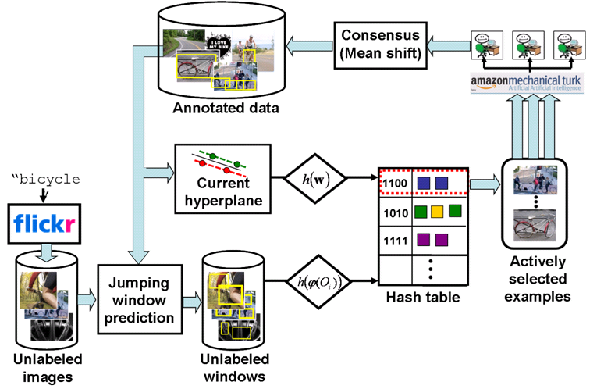
System Overview

Slide 23
System Overview
Linear Classification: fast
Jumping Window Prediction: less windows
Hashing: accelerate candidate selection
Annotation Collection

Slide 24
System Overview
Fast!
The system need to work with humans closely
A naïve approach
Kernel-based classification: Very slow for training/candidate selection
Dense sampling of windows: 3M images x700k windows/imageComplete nearest neighbor: 3M images x700k windows/image

Slide 25
System Overview
Linear Classification: fast
Jumping Window Prediction: less windows
Hashing: accelerate candidate selection
Annotation Collection

Slide 26
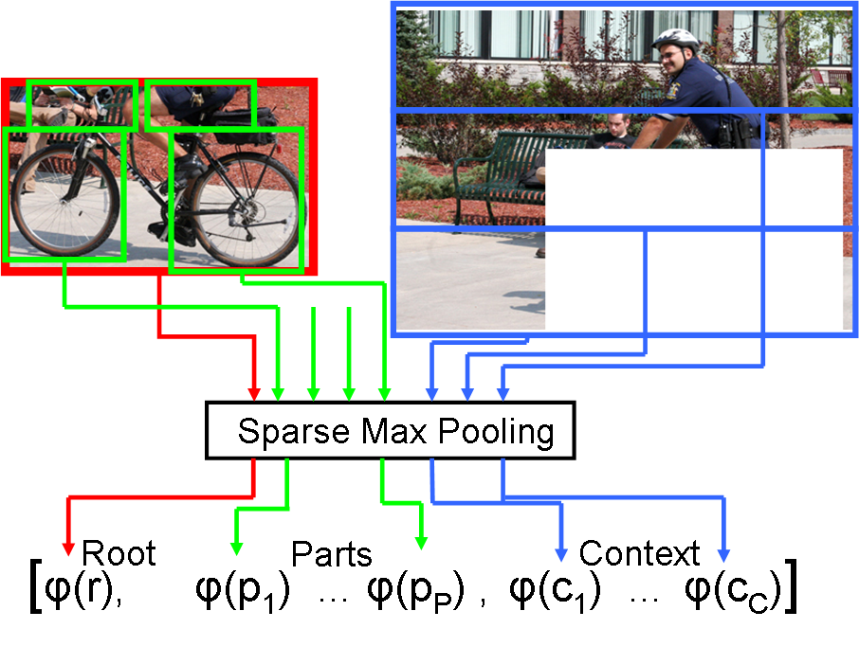
Linear Classification
Part-based model
Dense multi-scale SIFT
Sparse max pooling

Slide 27
Linear Classification
For each box
SIFT features
Sparse coding (ICA etc.)
Max over all components

Slide 28
Jumping Window Prediction
(v, g, W)
Higher priority for (v, g) pairs that often show up

Slide 29
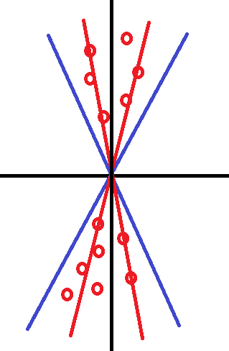
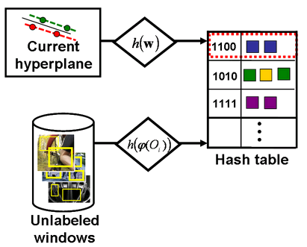
Hashing

Slide 30
Hashing
Find the nearest window to the hyperplane
Issue request for top T images
Less than 0.1% of the total examples

Slide 31
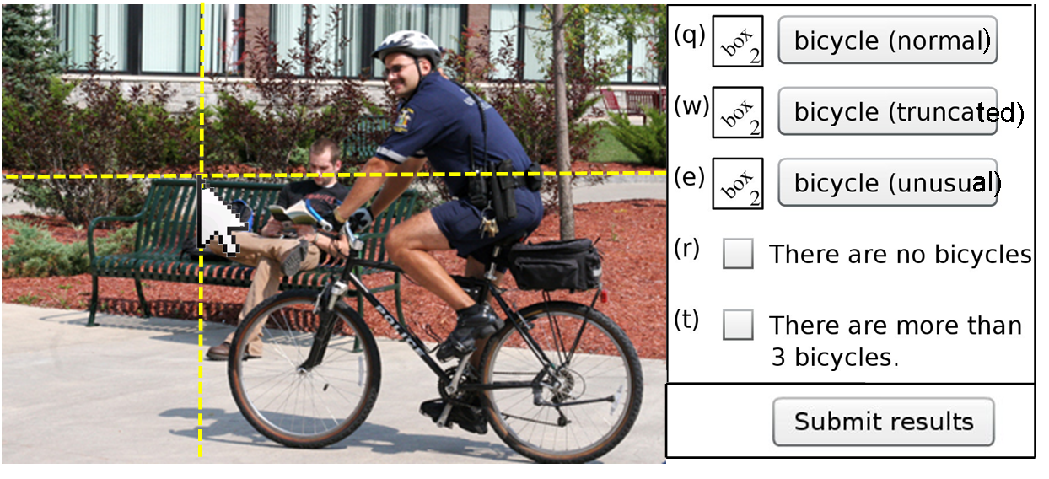
Annotation Collection
Normal, truncated, unusual or not present

Slide 32
Annotation Collection
10 requests per image
Mean shift clustering
Clusters with more than half of annotators
Largest mean overlap

Slide 33
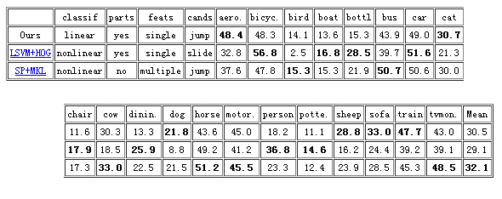
Results
Detector
PASCAL VOC 2007

Slide 34
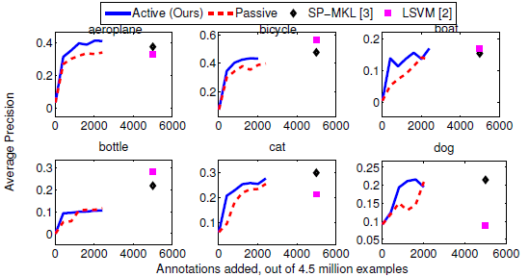
Results
Active vs. Passive learning
Active>Passive
Save on number of windows

Slide 35
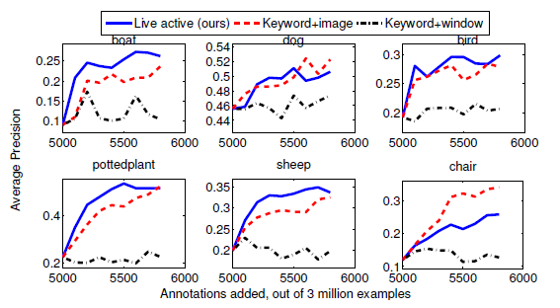
Results
Live learning

Slide 36
Outline
Paper 1: Bird Classification
Paper 2: Object Detection
Paper 3: Co-segmentation
Summary

Slide 37
iCoseg: Interactive Co-segmentation with Intelligent Scribble Guidance
Dhruv Batra¹, Adarsh Kowdle², Devi Parikh³,
Jiebo Luo⁴, Tsuhan Chen²
Carnegie Mellon Univerity¹, Cornell University² ,Toyota Technological Institute at Chicago (TTIC)³, Eastman Kodak Company⁴

Slide 38
Motivation
Background/Foreground Interactive segmentation
Rother, Carsten, Vladimir Kolmogorov, and Andrew Blake. "Grabcut: Interactive foreground extraction using iterated graph cuts." ACM Transactions on Graphics (TOG). Vol. 23. No. 3. ACM, 2004.

Slide 39
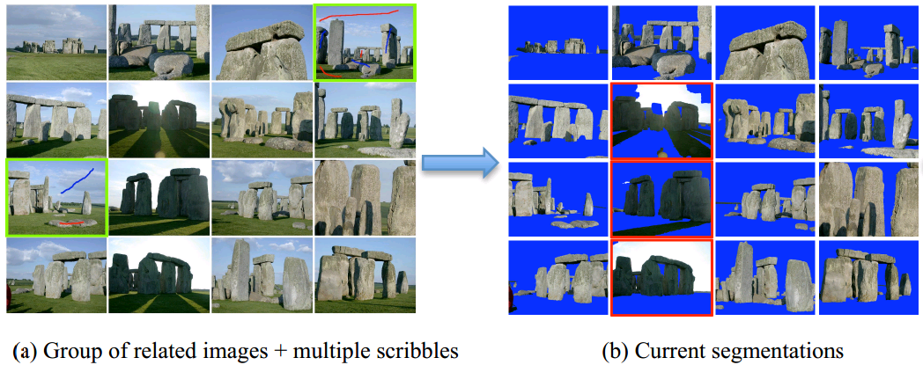
Motivation
Scribble-based co-segmentation

Slide 40
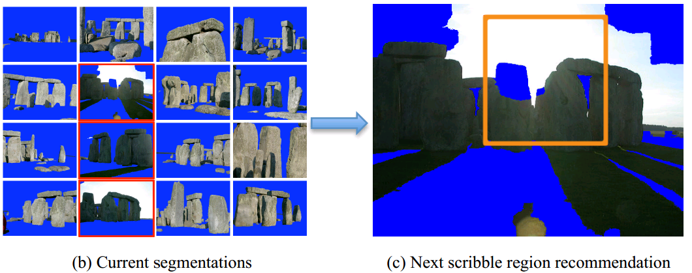
Motivation
Scribble guidance
Too many images!

Slide 41
System Overview
Obtain scribbles
Update energy model
Update segmentation
Calculate recommendation map
Unary appearance model
Superpixel distance model
Graph energy minimization
Logistic regression of cues

Slide 42
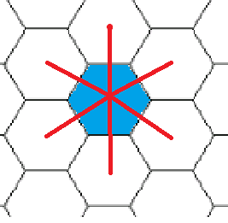
Energy Model
Unary term
Foreground/background likelihood
Learn GMMf, GMMb
Pairwise Term
Smoothness
Learn Dij (Batra et. al. 2008)
D. Batra, R. Sukthankar, and T. Chen. Semi-supervised clustering
via learnt codeword distances. In BMVC, 2008.

Slide 43
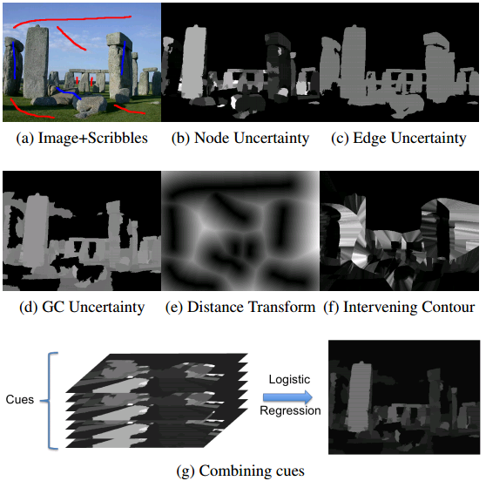
Recommendation Cues
Single Image

Slide 44
Recommendation Cues
Image-level cues
Segment size: Pforeground, Pbackground
Codeword distribution over images: Diversity of superpixels

Slide 45
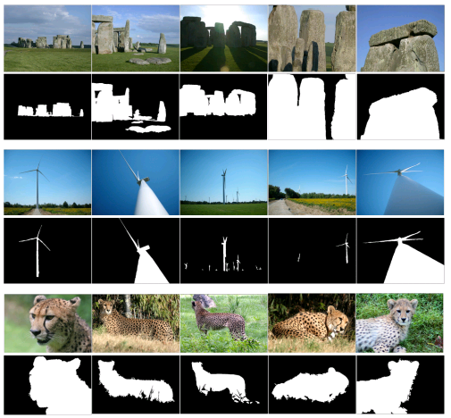
iCoseg Dataset

Slide 46
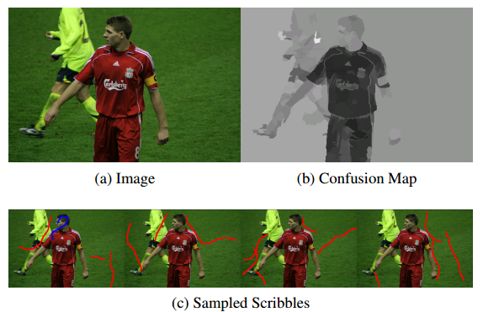
Experiments
Simulated scribbles

Slide 47
Experiments
User study

Slide 48
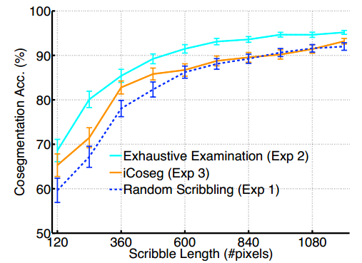
Experiments
User study
 | Time per iteration
Random | NA
iCoseg | 14.2s
Exhaustive | 20.2s

Slide 49
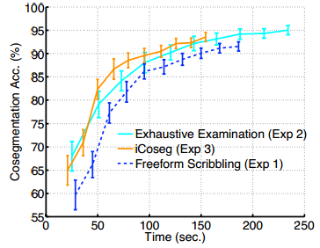
Experiments
User study
Dhruv Batra, Adarsh Kowdle, Devi Parikh, Jeibo Luo and Tsuhan Chen. "Interactively Co-segmentating Topically Related Images with Intelligent Scribble Guidance", International Journal of Computer Vision (IJCV)

Slide 50
Outline
Paper 1: Bird Classification
Paper 2: Object Detection
Paper 3: Co-segmentation
Summary

Slide 51
Summary
 | Bird Classification | Object Detection | Co-segmentation
Goal | Classification | Object Detection | Segmentation
Human input | At test time | At training time | At training time
Suggestion strategy | Greedy | Greedy | Greedy
Advantage of human in the loop | Much better attributes | Live learning | Shorter length/time of scribbling
Interface | Cell phone App Amazon MTurk | Amazon MTurk | Java GUI

Slide 52
Experiments
Interactive segmentation
20Q

