Slide 1
Languages and Images
Virginia Tech
ECE 6504
2013/04/25
Stanislaw Antol

Slide 2
A More Holistic Approach to Computer Vision
Language is another rich source of information
Linking to language can help computer vision
  Learning priors about images (e.g., captions)
  Learning priors about objects (e.g., object descriptions)
  Learning priors about scenes (e.g., properties, objects)
  Search: text->image or image->text
  More natural interface between humans and ML algorithms

Slide 3
Outline
Motivation of Topic
Paper 1: Beyond Nouns
Paper 2: Every Picture Tells a Story
Paper 3: Baby Talk
Pass to Abhijit for experimental work

Slide 4
Beyond Nouns
Exploiting Prepositions and Comparative Adjectives for Learning Visual Classifiers
Abhinav Gupta and Larry S. Davis
University of Maryland, College Park
Slide Credit: Abhinav Gupta
Notes:
4

Slide 5
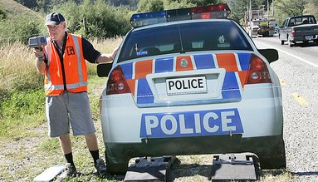
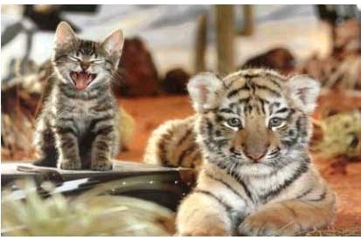
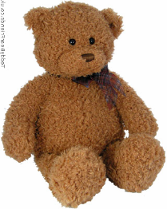


What This Paper is About
Richer linguistic descriptions of images makes learning of object appearance models from weakly labeled images more reliable.
Constructing visually-grounded models for parts of speech other than nouns provides contextual models that make labeling new images more reliable.
So, this talk is about simultaneous learning of object appearance models and context models for scene analysis.
Larger (B, A)
car
officer
road
A
A
B
cat
A
B
B
A officer on the left of car checks the speed of other cars on the road.
tiger
Bear
Water
Field
Larger (A, B)
Above (A, B)
Larger (tiger, cat)
Slide Credit: Abhinav Gupta
Notes:
Prepositions are carriers of Context

Slide 6
What this talk is about
Prepositions – A preposition usually indicates the temporal, spatial or logical relationship of its object to the rest of the sentence
The most common prepositions in English are "about," "above," "across," "after," "against," "along," "among," "around," "at," "before," "behind," "below," "beneath," "beside," "between," "beyond," "but," "by," "despite," "down," "during," "except," "for," "from," "in," "inside," "into," "like," "near," "of," "off," "on," "onto," "out," "outside," "over," "past," "since," "through," "throughout," "till," "to," "toward," "under," "underneath," "until," "up," "upon," "with," "within," and "without” where indicated in bold are the ones (the vast majority) that have clear utility for the analysis of images and video.
Comparative adjectives and adverbs– relating to color, size, movement- “larger”, “smaller”, “taller”, “heavier”, “faster”………
This paper addresses how visually grounded (simple) models for prepositions and comparative adjectives can be acquired and utilized for scene analysis.
Slide Credit: Abhinav Gupta

Slide 7
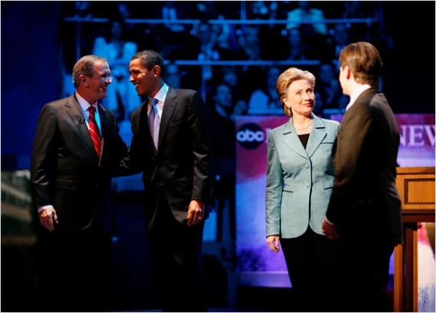
Learning Appearances – Weakly Labeled Data
Problem: Learning Visual Models for Objects/Nouns
Weakly Labeled Data
  Dataset of images with associated text or captions
Before the start of the debate, Mr. Obama and Mrs. Clinton met with the moderators, Charles Gibson, left, and George Stephanopoulos, right, of ABC News.
A officer on the left of car checks the speed of other cars on the road.
Slide Credit: Abhinav Gupta

Slide 8
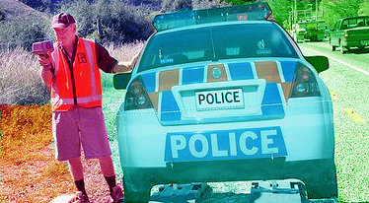
Captions - Bag of Nouns
A
officer
on the left of
car
checks the speed of other cars on the
road.
Learning Classifiers involves establishing correspondence.
road
car
car
officer
road
officer
Slide Credit: Abhinav Gupta

Slide 9
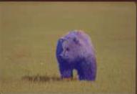
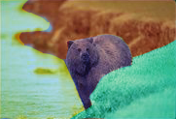



Correspondence - Co-occurrence Relationship
Water
Water
Field
Field
Bear
Bear
Bear
Bear
M-step
E-step
Learn Appearances
Bear
Water
Field
Slide Credit: Abhinav Gupta

Slide 10
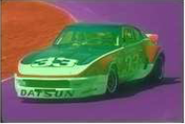
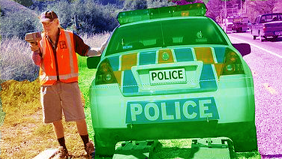
Co-occurrence Relationship (Problems)
Car
Car
Car
Road
Road
Road
Road
Road
Road
Car
Car
Road
Road
Car
Road
Car
Car
Car
Hypothesis 1
Hypothesis 2
Slide Credit: Abhinav Gupta

Slide 11
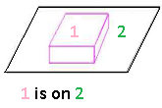
Beyond Nouns – Exploit Relationships
A
officer
on the left of
car
checks the speed of other cars on the
road.
On (car, road)
Left (officer, car)
car officer road
Use annotated text to extract nouns and relationships between nouns.
Constrain the correspondence problem using the relationships
Car
More Likely
Road
On (Car, Road)
Road
Less Likely
Car
Slide Credit: Abhinav Gupta

Slide 12
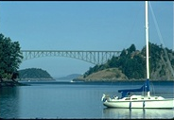

Beyond Nouns - Overview
Learn classifiers for both Nouns and Relationships simultaneously.
  Classifiers for Relationships based on differential features.
Learn priors on possible relationships between pairs of nouns
  Leads to better Labeling Performance
sky
water
above (sky , water)
above (water , sky)
water
sky
Slide Credit: Abhinav Gupta

Slide 13
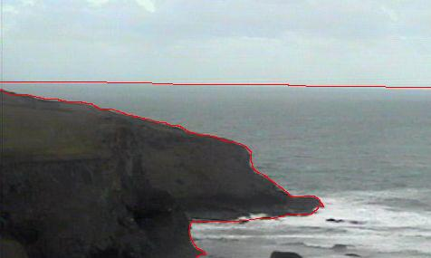
Representation
Each image is first segmented into regions.
Regions are represented by feature vectors based on:
  Appearance (RGB, Intensity)
  Shape (Convexity, Moments)
Models for nouns are based on features of the regions
Relationship models are based on differential features:
  Difference of avg. intensity
  Difference in location
Assumption: Each relationship model is based on one differential feature for convex objects. Learning models of relationships involves feature selection.
Each image is also annotated with nouns and a few relationships between those nouns.
A
B
B below A
A
B
Slide Credit: Abhinav Gupta

Slide 14
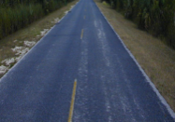
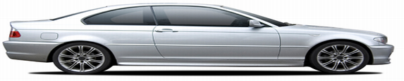
Learning the Model – Chicken Egg Problem
Learning models of nouns and relationships requires solving the correspondence problem.
To solve the correspondence problem we need some model of nouns and relationships.
Chicken-Egg Problem: We treat assignment as missing data and formulate an EM approach.
Assignment Problem
Learning Problem
Road
Car
Road
Car
On (car, road)
Slide Credit: Abhinav Gupta

Slide 15

EM Approach- Learning the Model
E-Step: Compute the noun assignment for a given set of object and relationship models from previous iteration ( ).
M-Step: For the noun assignment computed in the E-step, we find the new ML parameters by learning both relationship and object classifiers.
For initialization of the EM approach, we can use any image annotation approach with localization such as the translation based model described in [1].
[1] Duygulu, P., Barnard, K., Freitas, N., Forsyth, D.: Object recognition as machine translation: Learning a lexicon for a fixed image vocabulary. ECCV (2002)
Slide Credit: Abhinav Gupta

Slide 16
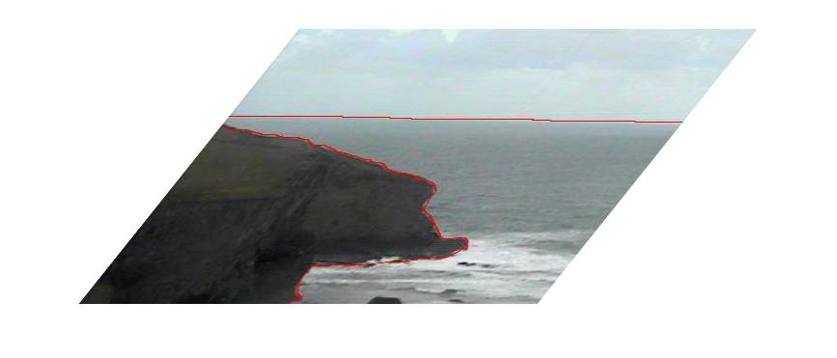
Inference Model
Image segmented into regions.
Each region represented by a noun node.
Every pair of noun nodes is connected by a relationship edge whose likelihood is obtained from differential features.
n₂
r¹²
r²³
n₁
r¹³
n₃
Slide Credit: Abhinav Gupta

Slide 17
Experimental Evaluation – Corel 5k Dataset
Evaluation based on Corel5K dataset [1].
Used 850 training images with tags and manually labeled relationships.
Vocabulary of 173 nouns and 19 relationships.
We use the same segmentations and feature vector as [1].
Quantitative evaluation of training based on 150 randomly chosen images.
Quantitative evaluation of labeling algorithm (testing) was based on 100 test images.
Slide Credit: Abhinav Gupta

Slide 18
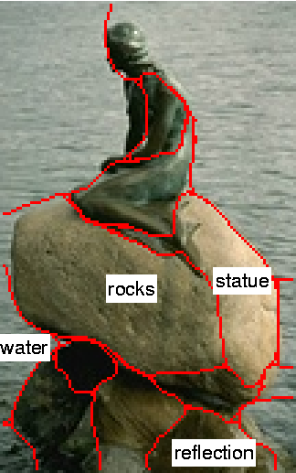
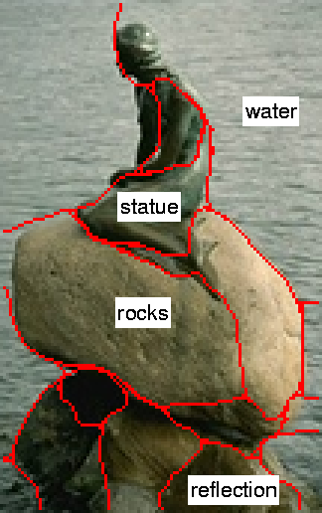
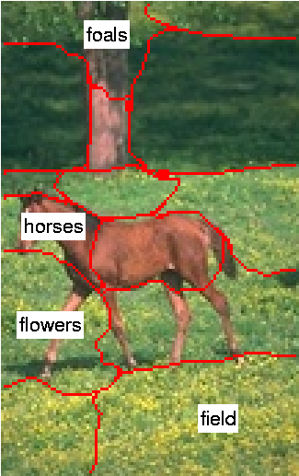
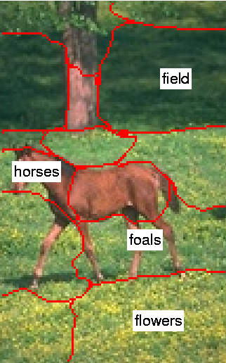
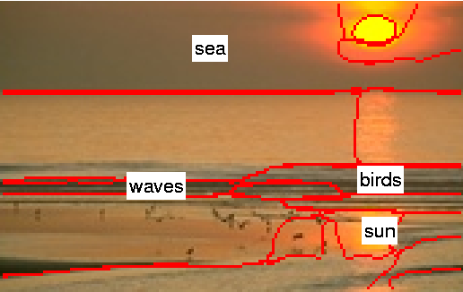
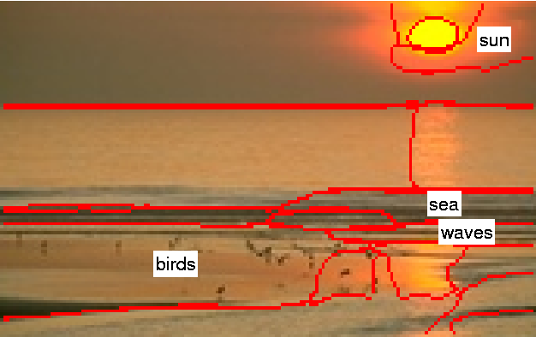
Resolution of Correspondence Ambiguities
Evaluate the performance of our approach for resolution of correspondence ambiguities in training dataset.
Evaluate performance in terms of two measures [2]:
  Range Semantics
    Counts the “percentage” of each word correctly labeled by the algorithm
    ‘Sky’ treated the same as ‘Car’
  Frequency Correct
    Counts the number of regions correctly labeled by the algorithm
    ‘Sky’ occurs more frequently than ‘Car’
below(birds,sun) above(sun, sea) brighter(sun,sea) below(waves,sun)
above(statue,rocks);
ontopof(rocks, water); larger(water,statue)
below(flowers,horses); ontopof(horses,field); below(flowers,foals)
Duygulu et. al [1]
Our Approach
[1] Duygulu, P., Barnard, K., Freitas, N., Forsyth, D.: Object recognition as machine translation: Learning a lexicon for a fixed image vocabulary. ECCV (2002)
[2] Barnard, K., Fan, Q., Swaminathan, R., Hoogs, A., Collins, R., Rondot, P., Kaufold, J.: Evaluation of localized semantics: data, methodology and experiments. Univ. of Arizona, TR-2005 (2005)
Slide Credit: Abhinav Gupta

Slide 19
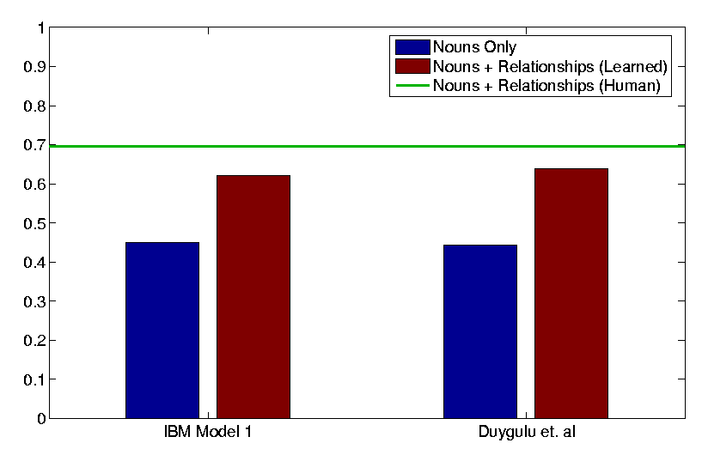
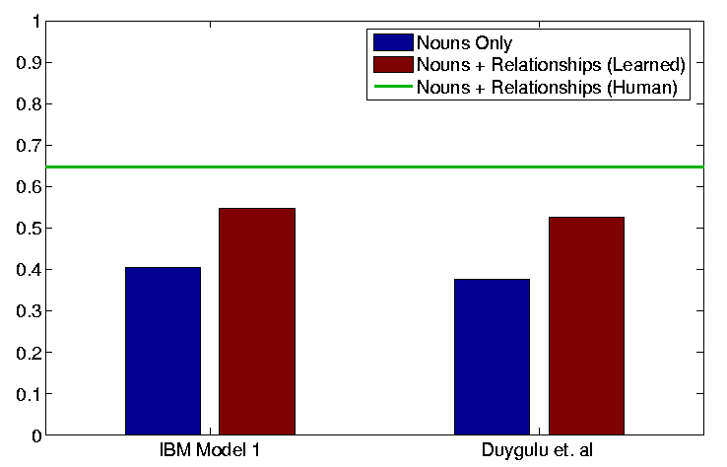
Resolution of Correspondence Ambiguities
Compared the performance with IBM Model 1[3] and Duygulu et. al[1]
Show importance of prepositions and comparators by bootstrapping our EM-algorithm.
(a) Frequency Correct
(b) Semantic Range
Slide Credit: Abhinav Gupta

Slide 20
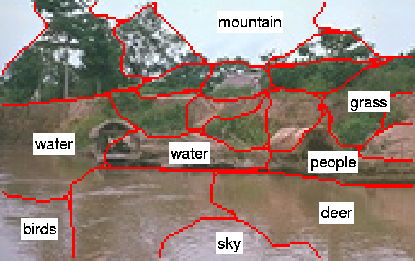
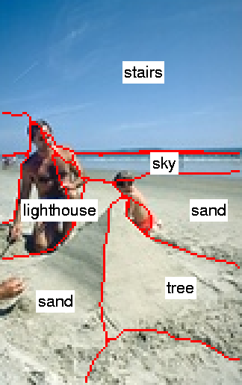
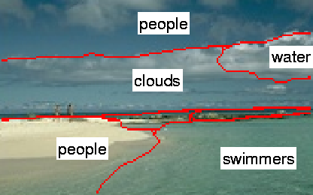
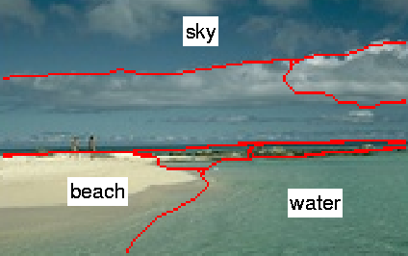
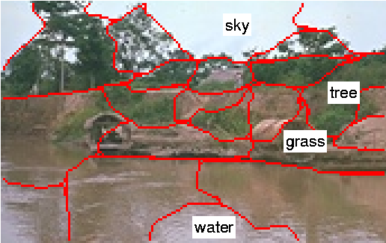
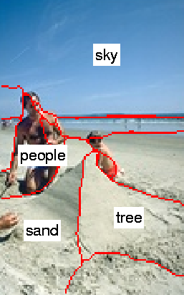
Examples of labeling test images
Duygulu (2002)
Our Approach
Slide Credit: Abhinav Gupta

Slide 21
Evaluation of labeling test images
Evaluate the performance of labeling based on annotation from Corel5K dataset
Set of Annotations from Ground Truth from Corel
Set of Annotations provided by the algorithm
Choose detection thresholds to make the number of missed labels approximately equal for two approaches, then compare labeling accuracy
Slide Credit: Abhinav Gupta

Slide 22
Precision-Recall
 | Recall |  | Precision
 | [1] | Ours | [1] | Ours
Water | 0.79 | 0.90 | 0.57 | 0.67
Grass | 0.70 | 1.00 | 0.84 | 0.79
Clouds | 0.27 | 0.27 | 0.76 | 0.88
Buildings | 0.25 | 0.42 | 0.68 | 0.80
Sun | 0.57 | 0.57 | 0.77 | 1.00
Sky | 0.60 | 0.93 | 0.98 | 1.00
Tree | 0.66 | 0.75 | 0.7 | 0.75
Slide Credit: Abhinav Gupta

Slide 23
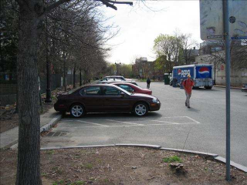

Limitations and Future Work
Assumes One-One relationship between nouns and image segments.
  Too much reliance on image segmentation
Can these relationships help in improving segmentation ?
Use Multiple Segmentations and choose the best segment.
On (car, road)
Left (tree, road)
Above (sky, tree)
Larger (Road, Car)
road
Tree
Car
Slide Credit: Abhinav Gupta

Slide 24
Conclusions
Richer natural language descriptions of images make it easier to build appearance models for nouns.
Models for prepositions and adjectives can then provide us contextual models for labeling new images.
Effective man/machine communication requires perceptually grounded models of language.
Only accounts for objects, if only we can extend…
Slide Credit: Abhinav Gupta

Slide 25
Every Picture Tells a Story
Generating Sentences from Images
Ali Farhadi¹, Mohsen Hejrati², Mohammad Amin Sadeghi², Peter Young¹, Cyrus Rashtchian¹, Julia Hockenmaier¹, David Forsyth¹
¹ University of Illinois, Urbana-Champaign
² Institute for Studies in Theoretical Physics and Mathematics
Notes:
25

Slide 26
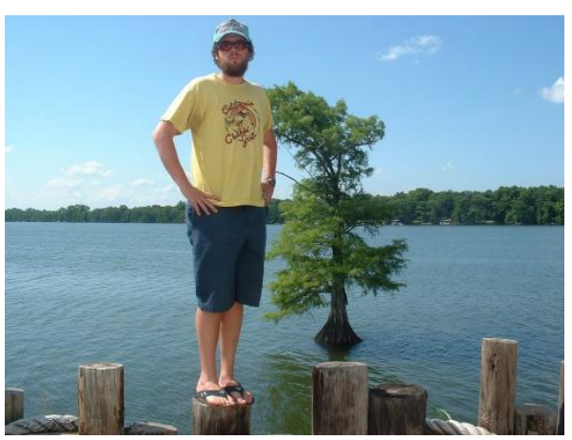
Motivation
Retrieve/generate sentences to describe images
Retrieve images to represent sentences
“A tree in water and a boy with a beard.”

Slide 27
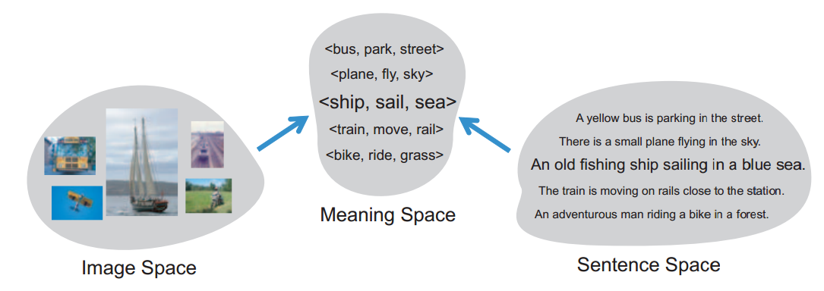
Main Idea
Images and text are very different representations, but can have same meaning
Convert each to a common ‘meaning space’
  Allows for easy comparisons
  Text-to-Image and Image-to-Text in same framework
For simplicity, <object, action, scene> triplet

Slide 28
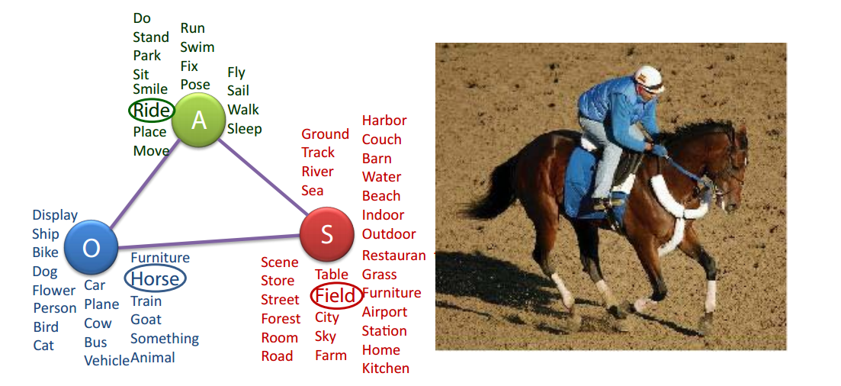
Meaning as Markov Random Field
Simple meaning model leads to small MRF
  In paper, ~10K different triplets possible (23 objects, 16 actions, 29 scenes)

Slide 29
Image Node Potentials: Image Features
Object: Felzenszwalb’s deformable parts
Action: Hoiem’s classification responses
Scene: Gist-based classification
Train SVM to build likelihood for each word, which can represent image
Used in combination with…

Slide 30
Image Node Potentials: Node Features
Average of image node features when matched image features are nearest neighbor clustered
Average of sentence node features when matched image features are nearest neighbor clustered
Average of image node features when matched image node features are nearest neighbor clustered
Average of sentence node features when matched image node features are nearest neighbor clustered

Slide 31
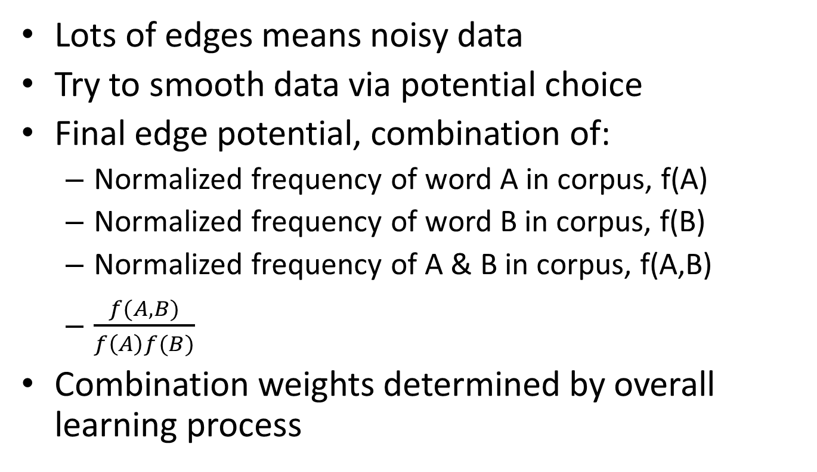
Image Edge Potentials
Lots of edges means noisy data
Try to smooth data via potential choice
Final edge potential, combination of:
  Normalized frequency of word A in corpus, f(A)
  Normalized frequency of word B in corpus, f(B)
  Normalized frequency of A & B in corpus, f(A,B)
  $\frac{f(A,B)}{f\left(A\right)f(B)}$
Combination weights determined by overall learning process

Slide 32
Sentence Scores
Lin Similarity Measure (objects and scenes)
  “Semantic distance” between words
  Based on WordNet synsets
Action Co-occurrence Score
  Downloaded Flickr photos and captions
  Searched verb pairs appearing in different captions for a given image
  Finds verbs that are the same or occur together

Slide 33
Sentence Node Potentials
Sentence node feature: similarity of each object, scene, and action from a sentence
1. Average of sentence node feature for other 4 sentences for an image
2. Average of k-nearest neighbors of sentence node features (1) for a given node
3. Average of k-nearest neighbors of image node features of images from 2’s clustering
4. Average of sentence node features of ref. sentences for the nearest neighbors in 2
5. Sentence node feature for reference sentence

Slide 34
Sentence Edge Potentials
Equivalent to Image Edge Potentials

Slide 35
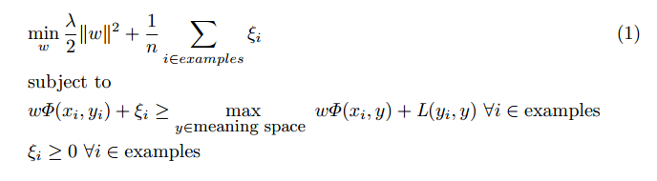
Learning
Stochastic subgradient descent method to minimize:
ξ: slack variables
λ: “tradeoff” (between regularization and slack)
Φ: “feature functions” (i.e., MRF potentials)
w: weights
x_{i}: ith image
y_{i}: ith “structure label” for ith image
Try to learn mapping parameters for all nodes and edges

Slide 36
Matching
Given meaning triplet (image or sentence), need a way to compare it to others
Smallest Image rank + Sentence rank?
  Too simple and probably very noisy
More complex score:
  1. Get top k ranking triplets from sentences and find each one’s rank as image triplet
  2. Get top k ranking triplets from images and find each one’s rank as sentence triplet
  3. sum(sum(inverserank(1.)) + sum(inverserank(2.)))

Slide 37
Evaluation Metrics
Tree-F1 measure: accuracy and specificity of taxonomy tree
  Average of three precision to recall ratios
    Recall punishes extra detail
BLUE measure: Is triplet logical?
  Check if exists in their corpus
    Simplistic
    False negatives

Slide 38
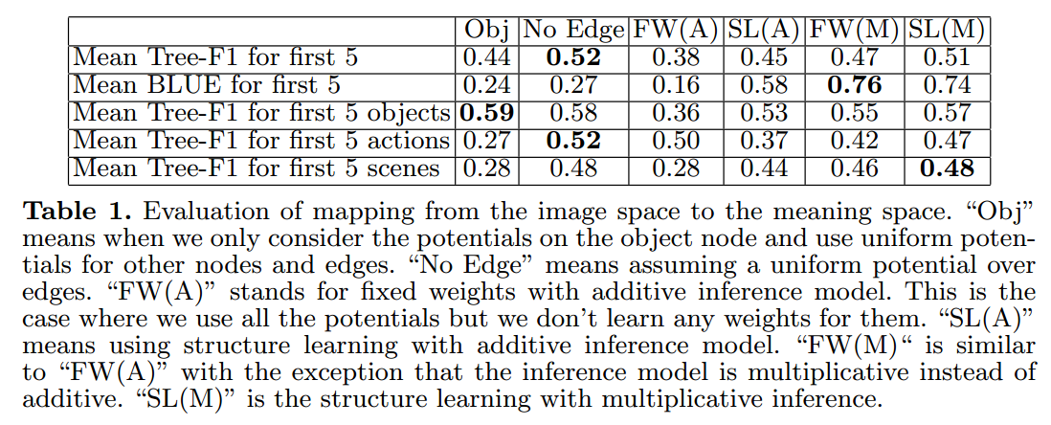
Image to Meaning Evaluation

Slide 39
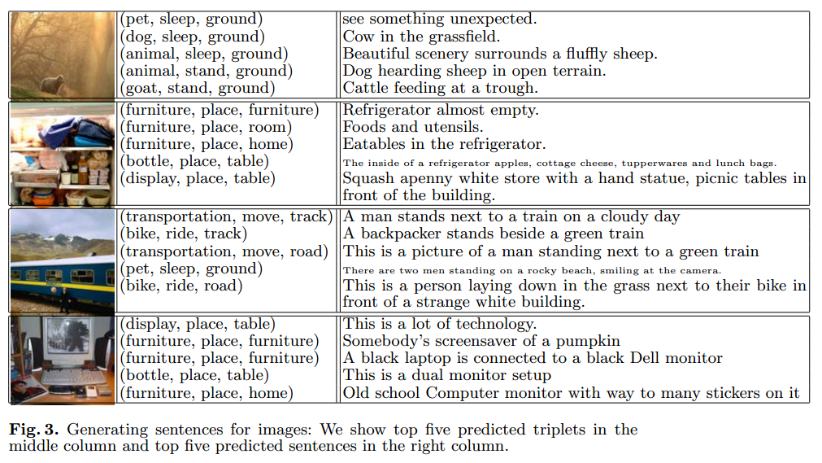
Annotation Evaluation
Each generated sentence judged by human (1,2,3)
Average of (10*number images) sentences score is 2.33
Average of 1.48 sentences (of the 10) got a 1
Average of 3.80 sentences (of the 10) got a 2
208/400 with at least one 1
354/400 with at least one 2

Slide 40
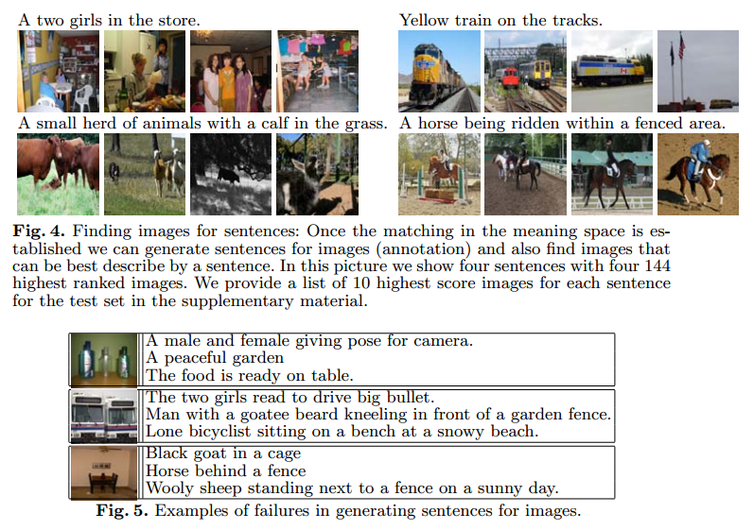
Retrieval Evaluation

Slide 41
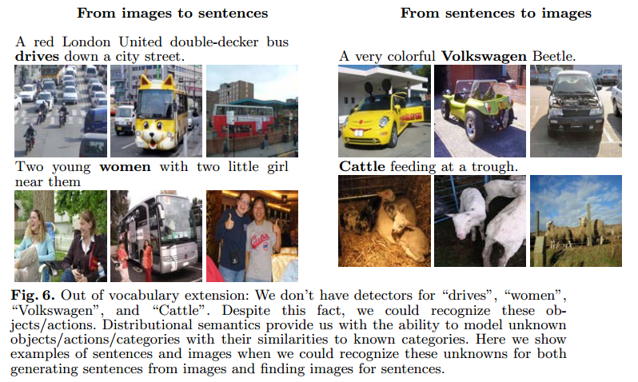
Dealing with Unknowns

Slide 42
Conclusions
I think it’s a reasonable idea
Meaning model too simple
  Limits kinds of images
Sentence database seems weak
  Downfall of using Mechanical Turk too loosely
Results aren’t super convincing
Not actually generating sentences….

Slide 43
Baby Talk
Understanding and Generating Image Descriptions
Girish Kulkarni, Visruth Premraj, Sagnik Dhar, Siming Li, Yejin Choi, Alexander C Berg, Tamara L Berg
Stony Brook University
Notes:
43

Slide 44
Motivation
Automatically describe images
  Use for news sites, etc.
  Help blind people navigate the Internet
Previous work fails to generate sentences unique to image

Slide 45
Approach
Like “Beyond Nouns,” uses prepositions, not actions
Utilize recent work in attributes
Create CRF based on objects/stuff, attributes, and prepositions, then extract sentences

Slide 46
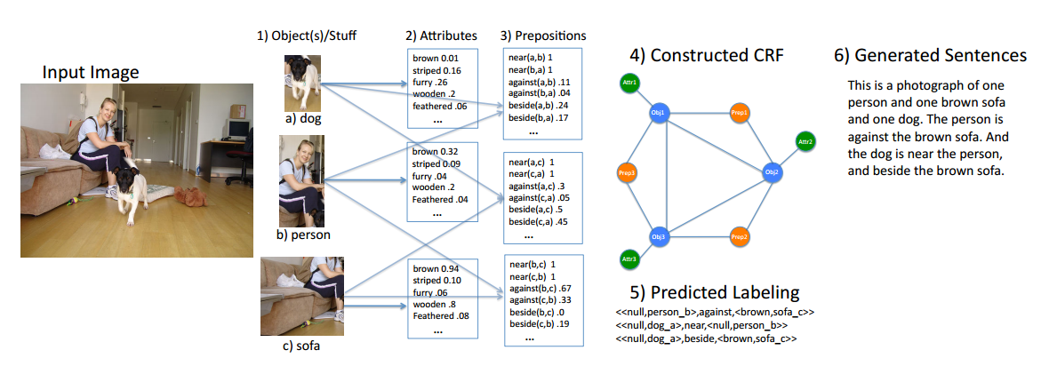
System Flow of Approach

Slide 47
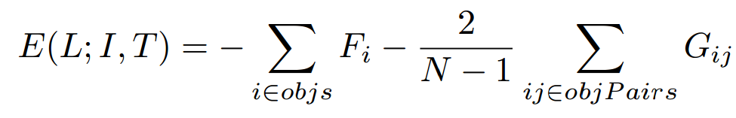
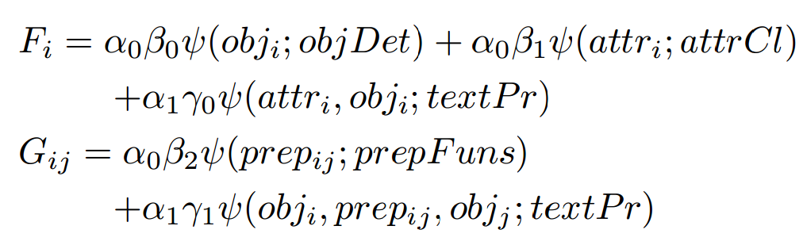
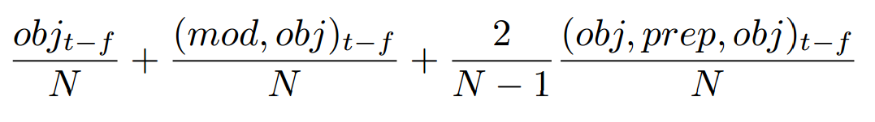
CRF Model
Learning Score Function
How are energy and scoring related?

Slide 48
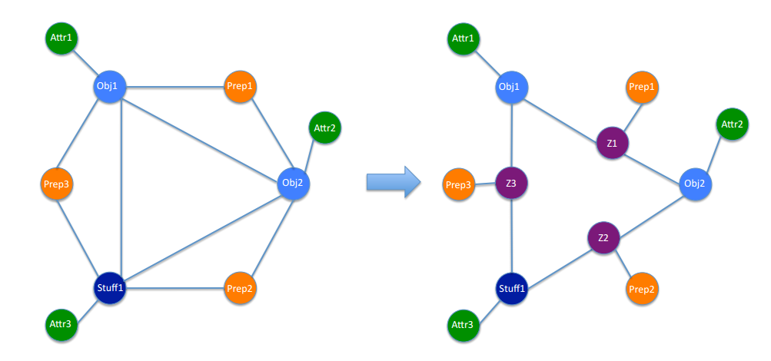

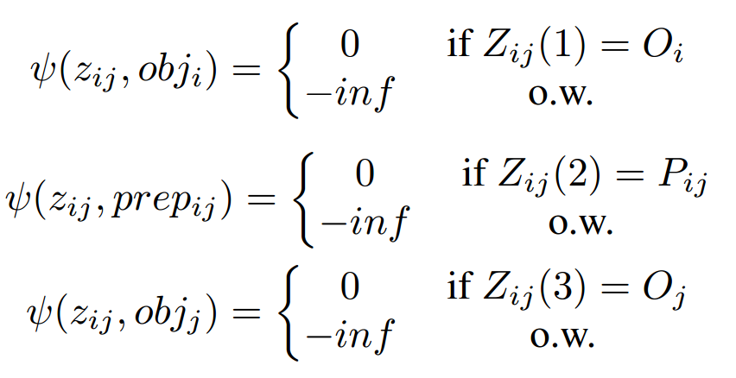

Removing Trinary Potential
Most CRF code accepts unary and binary, so they convert their model

Slide 49
Image Potentials
  Felzenszwalb deformable-parts for objects
  “Low-level feature” classifier for stuff
  Train attribute classifiers with undisclosed features
  Define prepositional functions that are evaluated on objects

Slide 50

Text Potentials
Text potentials, and split into two parts,
is a prior from Flickr description mining
is a prior from Google queries (to provide more data for ones where Flickr mining was not successful

Slide 51
Sentence Generation
Extract (set of) <modified object, preposition, modified object> triplets
Decoding Method
  Use simple N-gram model to add gluing words
Template Method
  Develop language model from text and utilize patterns with triplet substitution

Slide 52
Experiments
Used Wikipedia for language model training
Used UIUC PASCAL sentences to evaluate
  Trained on 153 images
  Tested on remaining 847 images

Slide 53
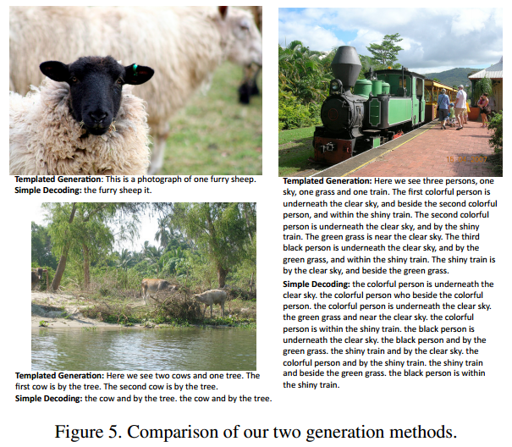
Comparison of Two Generation Schemes
Decoding are bad sentences, even if identification correct
Templated results looks pretty good
More elaborate images, more elaborate descriptions

Slide 54
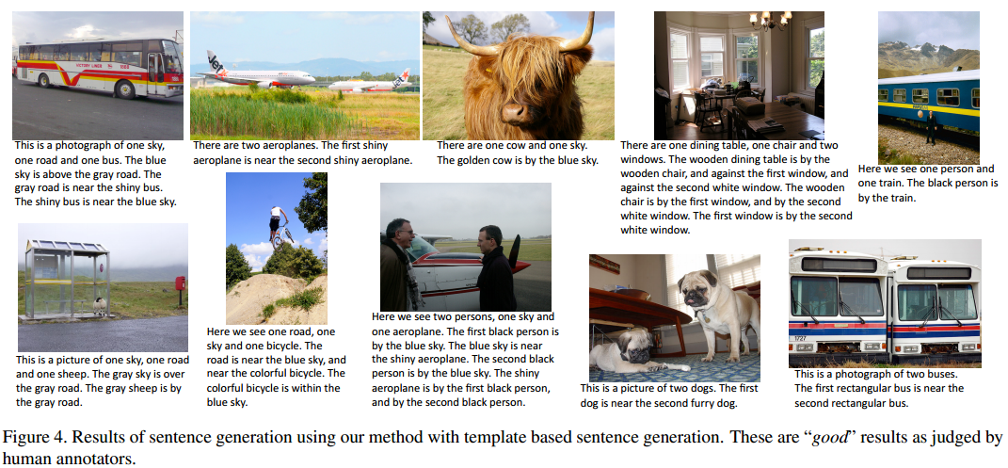
Good (Templated) Output Examples

Slide 55
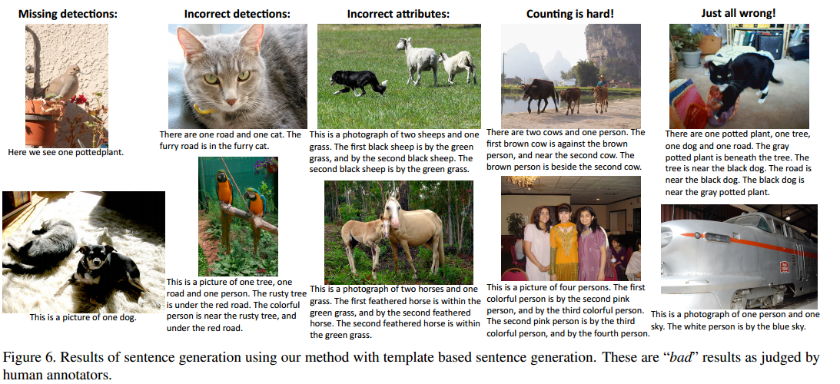
Bad (Templated) Output Examples

Slide 56
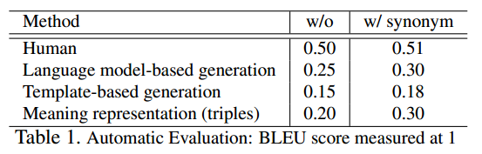
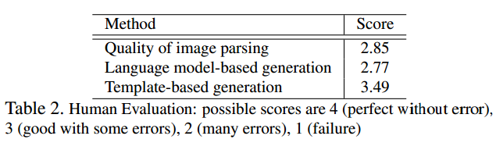

Quantitative Results
BLEU results make template seem worse
Human evaluation show much more reasonable results
No trend with respect to number of objects

Slide 57
Conclusions
Template-based approach seems to work reasonable well (especially compared to previous work)
Now very clear that there needs to be a better metric
Would have been interesting if they removed potentials and tested it

Slide 58
Thank You
And now to Abhijit

