Slide 1
Holistic Scene Understanding
Virginia Tech
ECE6504
2013/02/26
Stanislaw Antol

Slide 2
What Does It Mean?
Computer vision parts extensively developed; less work done on their integration
Potential benefit of different components compensating/helping other components
Notes:
Give examples of how certain components help others

Slide 3
Outline
Gaussian Mixture Models
Conditional Random Fields
Paper 1 Overview
Paper 2 Overview
My Experiment

Slide 4
Gaussian Mixture
Where P(X | C_{i}) is the PDF of class j, evaluated at X, P( C_{j} ) is the prior probability for class j, and P(X) is the overall PDF, evaluated at X.
Where w_{k} is the weight of the k-th Gaussian G_{k} and the weights sum to one. One such PDF model is produced for each class.
Where M_{k} is the mean of the Gaussian and V_{k} is the covariance matrix of the Gaussian..
Slide credit: Kuei-Hsien

Slide 5
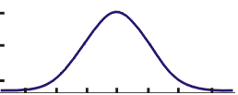
Composition of Gaussian Mixture
Class 1
G1,w1
G2,w2
G3,w3
G5.w5
Variables: μ_{i}, V_{i}, w_{k}
We use EM (estimate-maximize) algorithm to approximate this variables. One can use k-means to initialize.
G4,w4
Slide credit: Kuei-Hsien

Slide 6
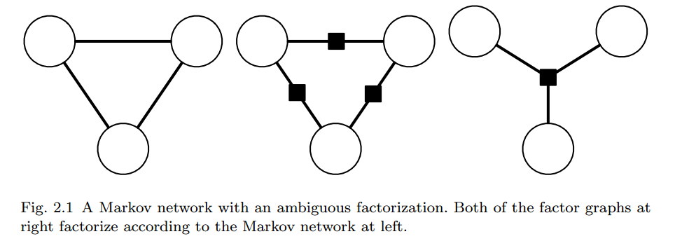
Background on CRFs
Figure from: “An Introduction to Conditional Random Fields” by C. Sutton and A. McCallum

Slide 7
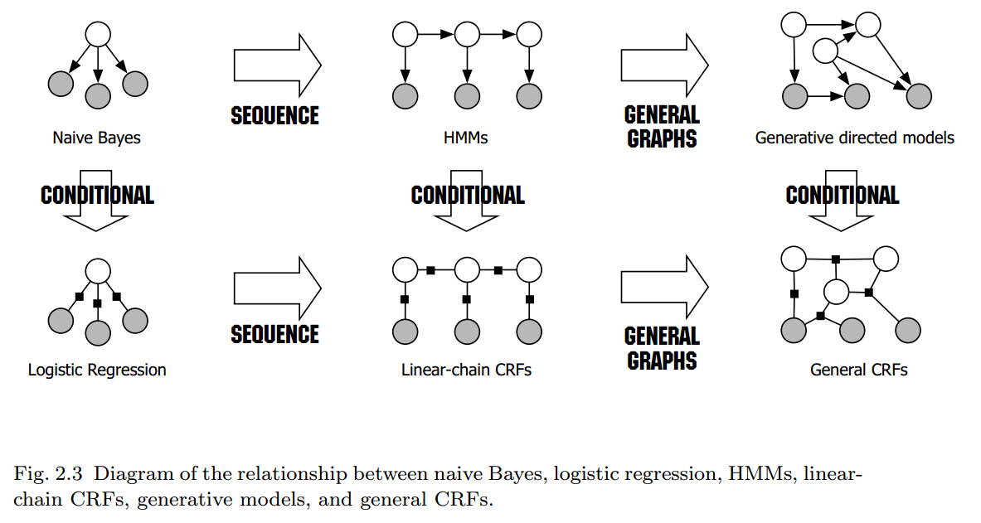
Background on CRFs
Figure from: “An Introduction to Conditional Random Fields” by C. Sutton and A. McCallum

Slide 8
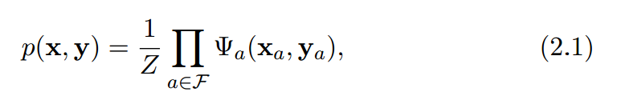
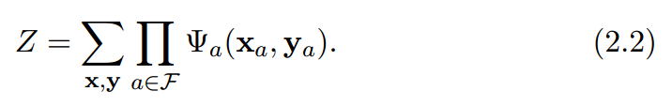
Background on CRFs
Equations from: “An Introduction to Conditional Random Fields” by C. Sutton and A. McCallum

Slide 9
Paper 1
“TextonBoost: Joint Appearance, Shape, and Context Modeling for Multi-class Object Recognition and Segmentation”
  J. Shotton, J. Winn, C. Rother, and A. Criminisi

Slide 10
Introduction
Simultaneous recognition and segmentation
  Explain every pixel (dense features)
  Appearance + shape + context
  Class generalities + image specifics
Contributions
  New low-level features
  New texture-based discriminative model
  Efficiency and scalability
Example Results
Slide credit: J. Shotton
Notes:
Don’t agree with “efficiency and scalability”

Slide 11
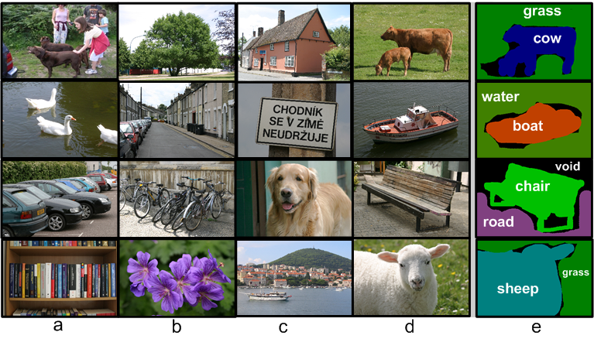
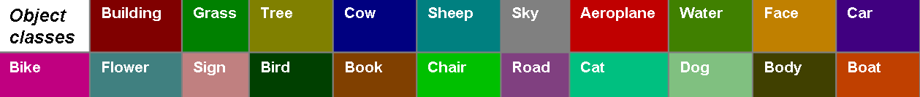
Image Databases
MSRC 21-Class Object Recognition Database
  591 hand-labelled images ( 45% train, 10% validation, 45% test )
Corel ( 7-class ) and Sowerby ( 7-class ) [He et al. CVPR 04]
Slide credit: J. Shotton
Notes:
Point out colour coding

Slide 12
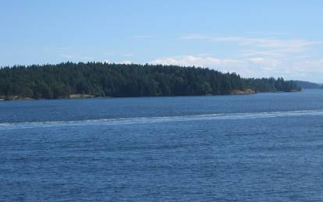
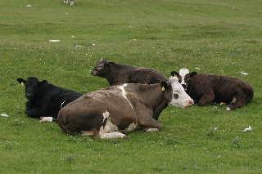
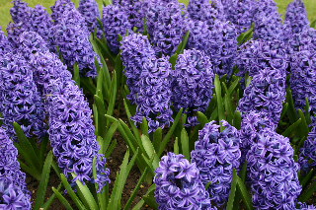
Sparse vs Dense Features
Successes using sparse features, e.g.
  [Sivic et al. ICCV 2005], [Fergus et al. ICCV 2005], [Leibe et al. CVPR 2005]
But…
  do not explain whole image
  cannot cope well with all object classes
We use dense features
  ‘shape filters’
  local texture-based image descriptions
Cope with
  textured and untextured objects, occlusions,
  whilst retaining high efficiency
problem images
for sparse features?
Slide credit: J. Shotton

Slide 13
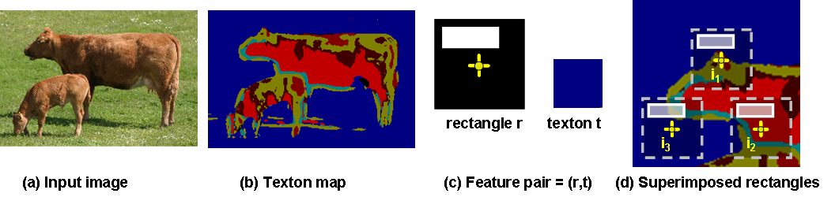
Textons
Shape filters use texton maps [Varma & Zisserman IJCV 05]
  [Leung & Malik IJCV 01]
Compact and efficient characterisation of local texture

Clustering
Input image
Texton map
Colours ⬄ Texton Indices
Filter Bank
Slide credit: J. Shotton
Notes:
BUILD UPON TEXTONS (capturing appearance)
convolve 17-D filter bank (composed of gaussians, dogs, logs) with all training images
responses are clustered with K-means
each pixel is assigned a texton number
400 texton indexes

Slide 14
Shape Filters
up to 200 pixels
(
,
)
Pair:
Feature responses v(i, r, t)
Large bounding boxes enable
long range interactions
Integral images
v(i₁, r, t) = a
rectangle r
texton t
v(i₂, r, t) = 0
v(i₃, r, t) = a/2
appearance context
Slide credit: J. Shotton
Notes:
count of texton instances under offset rectangle at position i
Bottom right example shows how we capture appearance context

Slide 15
Shape as Texton Layout
(
,
)
t₀
(r₁, t₁) =
t₁
t₂
(
,
)
t₃
t₄
(r₂, t₂) =
texton map
ground truth
texton map
feature response image
v(i, r₁, t₁)
feature response image
v(i, r₂, t₂)
Slide credit: J. Shotton
Notes:
Why are they called shape filters?
Textons capture local appearance.
Local layout of textured regions (shape) – relative positions of textures – distinguish between two different texton maps

Slide 16
Shape as Texton Layout
(
)
,
t₀
(r₁, t₁) =
t₁
t₂
(
,
)
t₃
t₄
(r₂, t₂) =
texton map
ground truth
texton map
summed response images
v(i, r₁, t₁) + v(i, r₂, t₂)
texton map
summed response images
v(i, r₁, t₁) + v(i, r₂, t₂)
Slide credit: J. Shotton
Notes:
For illustration in this toy example we’ve added responses.
In fact they are combined in a boosted classifier…

Slide 17
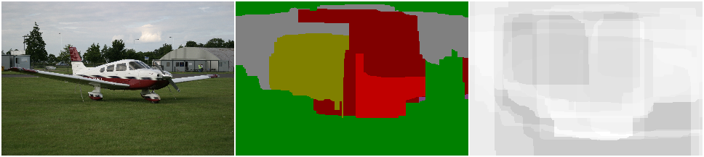
Joint Boosting for Feature Selection
Boosted classifier provides bulk segmentation/recognition only
Edge accurate segmentation will be provided by CRF model
30 rounds
1000 rounds
2000 rounds
test image
inferred segmentation
colour = most likely label
confidence
white = low confidence
black = high confidence
Using Joint Boost: [Torralba et al. CVPR 2004]
Slide credit: J. Shotton

Slide 18
Accurate Segmentation?
Boosted classifier alone
  effectively recognises objects
  but not sufficient for pixel-perfect segmentation
Conditional Random Field (CRF)
  jointly classifies all pixels whilst
  respecting image edges
boosted classifier
+ CRF
Slide credit: J. Shotton
Notes:
Intuition as to why crf improves things – incorporate other cues

Slide 19
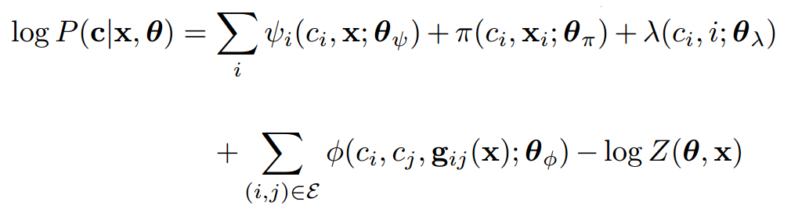
Conditional Random Field Model
Log conditional probability of
class labels c given
image x and learned parameters θ
Slide credit: J. Shotton

Slide 20

Conditional Random Field Model
shape-texture potentials
jointly across all pixels
Shape-texture potentials
  broad intra-class appearance distribution
  log boosted classifier
  parameters θ_{ψ} learned offline
shape-texture potentials
Slide credit: J. Shotton
Notes:
Explain i, psi is strong classifier learned by boosting

Slide 21
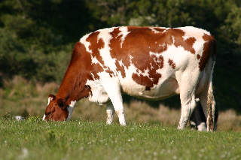
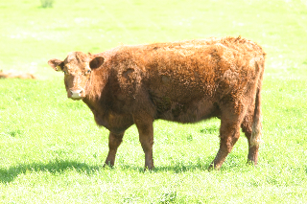
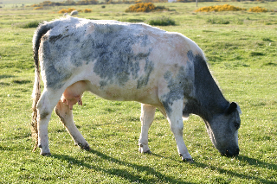
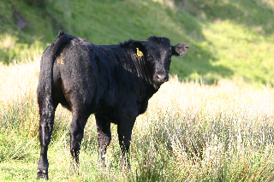
Conditional Random Field Model
colour potentials
Colour potentials
  compact appearance distribution
  Gaussian mixture model
  parameters θ_{π} learned at test time
intra-class
appearance variations
Slide credit: J. Shotton
Notes:
Use cow examples…

Slide 22

Conditional Random Field Model
location potentials
Capture prior on absolute image location
tree
sky
road
Slide credit: J. Shotton
Notes:
More influence if highly constrained dataset

Slide 23
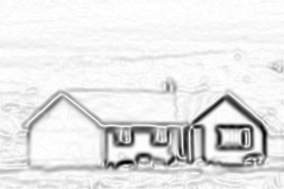
Conditional Random Field Model
sum over neighbouring pixels
edge potentials
Potts model
  encourages neighbouring pixels to have same label
Contrast sensitivity
  encourages segmentation to
  follow image edges
image edge map
Slide credit: J. Shotton

Slide 24
Conditional Random Field Model
partition function
(normalises distribution)
For details of potentials and learning, see paper
Slide credit: J. Shotton

Slide 25
CRF Inference
shape-texture
colour
location
edge
Find most probable labelling
  maximizing
Slide credit: J. Shotton

Slide 26
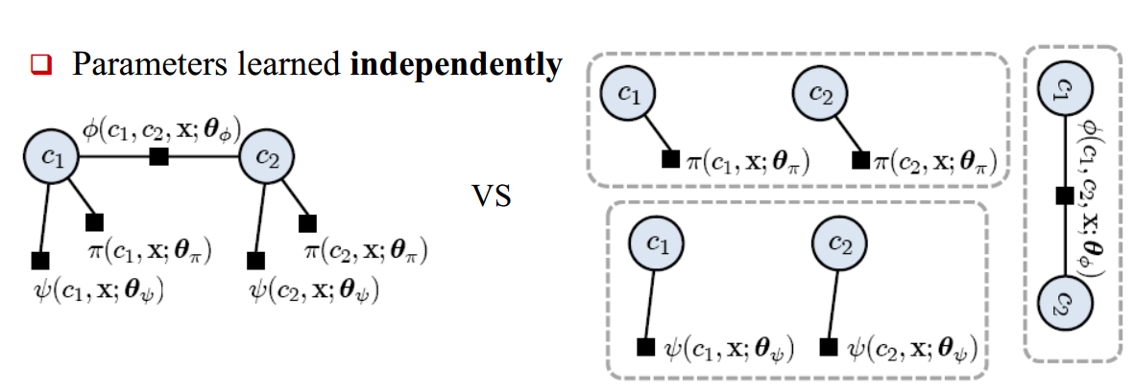
Learning
Slide credit: Daniel Munoz

Slide 27
Results on 21-Class Database
building
Slide credit: J. Shotton

Slide 28
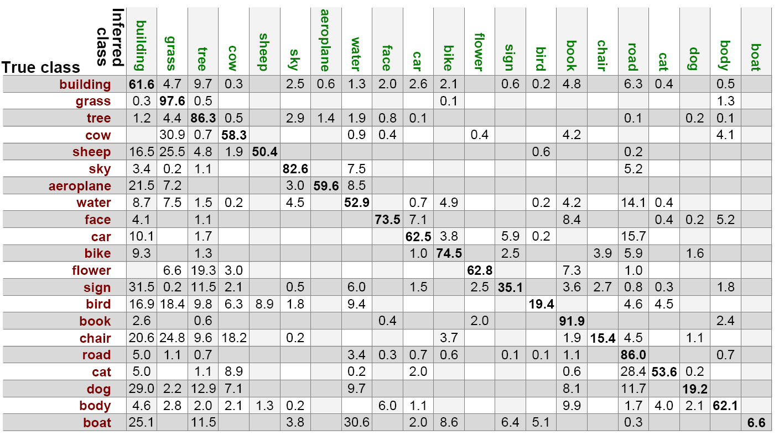
Segmentation Accuracy
Overall pixel-wise accuracy is 72.2%
  ~15 times better than chance
Confusion matrix:
Slide credit: J. Shotton
Notes:
not enough training data?

Slide 29
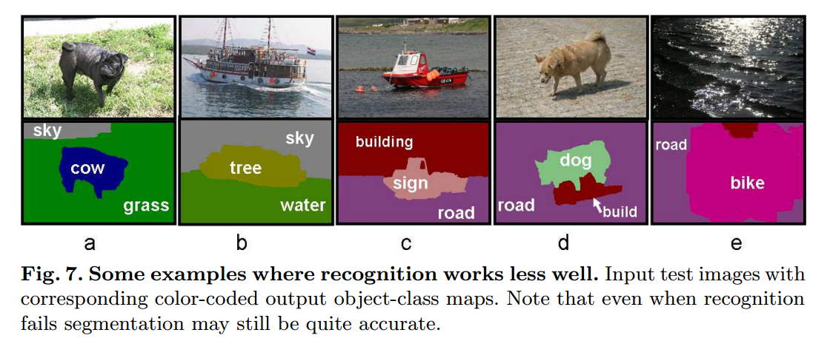
Some Failures
Slide credit: J. Shotton

Slide 30
Effect of Model Components
shape-texture
+ edge
+ colour & location
Shape-texture potentials only: 69.6%
+ edge potentials: 70.3%
+ colour potentials: 72.0%
+ location potentials: 72.2%
pixel-wise
segmentation
accuracies
Slide credit: J. Shotton
Notes:
while low numerical increase since all on the border, large perceptual improvement

Slide 31
Comparison with [He et al. CVPR 04]
Our example results:
 | Accuracy |  | Speed ( Train - Test )
 | Sowerby | Corel | Sowerby | Corel
Our CRF model | 88.6% | 74.6% | 20 mins - 1.1 secs | 30 mins - 2.5 secs
He et al. mCRF | 89.5% | 80.0% | 1 day - 30 secs | 1 day - 30 secs
Shape-texture potentials only | 85.6% | 68.4%
He et al. unary classifier only | 82.4% | 66.9%
Slide credit: J. Shotton

Slide 32
Paper 2
“Describing the Scene as a Whole: Joint Object Detection, Scene Classification, and Semantic Segmentation”
  Jian Yao, Sanja Fidler, and Raquel Urtasun

Slide 33
Motivation
Holistic scene understanding:
  Object detection
  Semantic segmentation
  Scene classification
Extends idea behind TextonBoost
  Adds scene classification, object-scene compatibility, and more

Slide 34
Main idea
Create a holistic CRF
  General framework to easily allow additions
  Utilize other work as components of CRF
  Perform CRF, not on pixels, but segments and other higher-level values

Slide 35
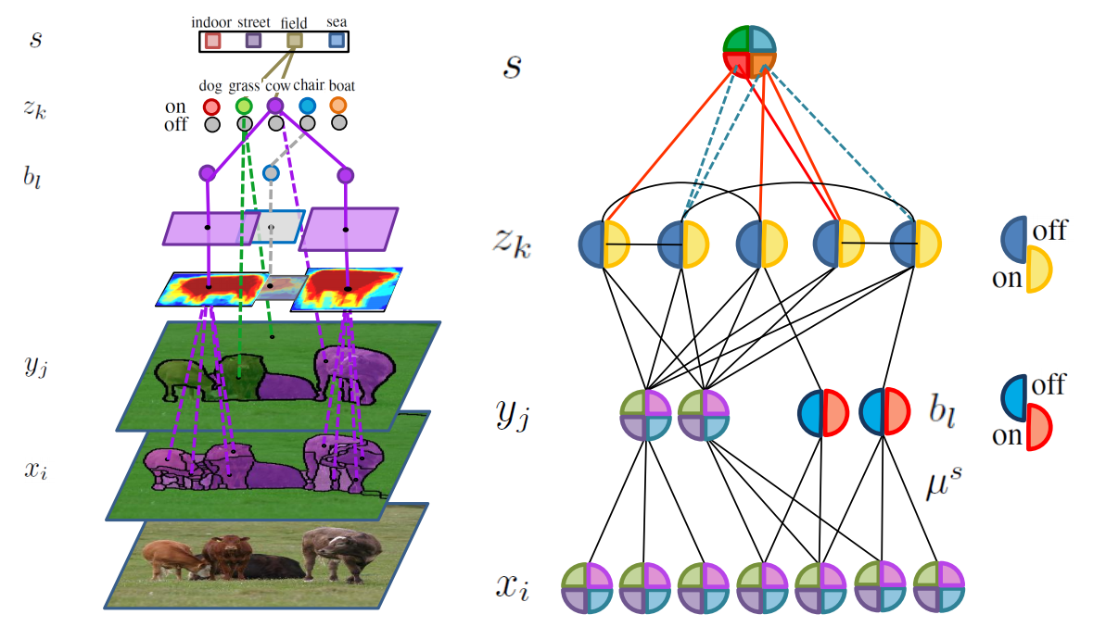
Holistic CRF (HCRF) Model
Notes:
Let’s try to understand how everything fits into this model.

Slide 36





HCRF Pre-cursors
Use own scene classification, one-vs-all SVM classifier using SIFT, colorSIFT, RGB histograms, and color moment invariants, to produce scenes
Use [5] for object detection (over-detection), b_{l}
Use [5] to help create object masks, μ^{s}
Use [20] at two different K₀ watershed threshold values to generate segments and super-segments, x_{i}, y_{j}, respectively

Slide 37
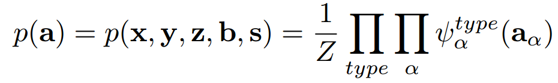

HCRF
Connection of potentials and their HCRF

Slide 38
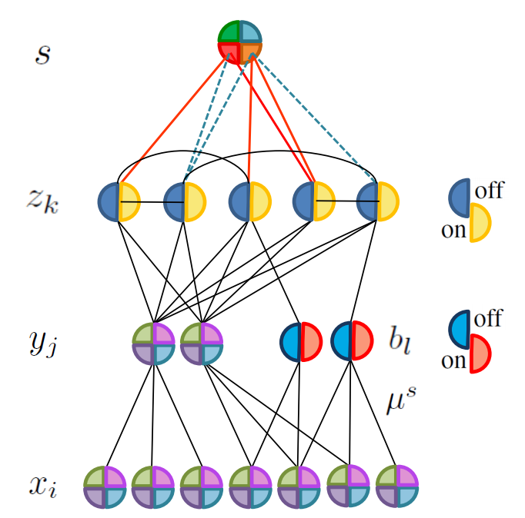
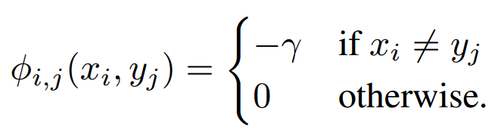
Segmentation Potentials
TextonBoost averaging

Slide 39
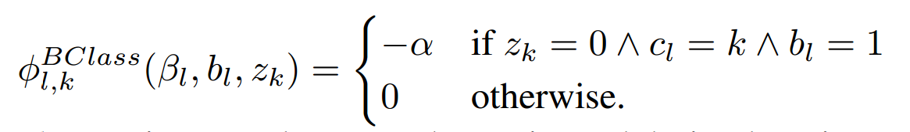
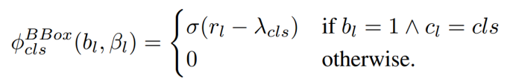
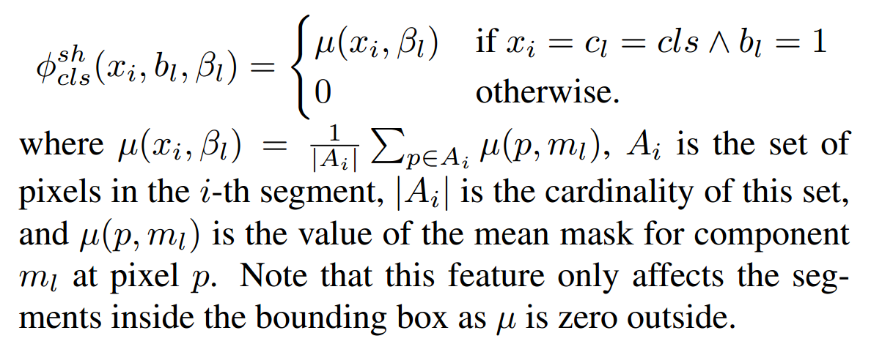
Object Reasoning Potentials

Slide 40
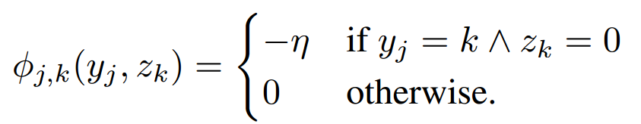
Class Presence Potentials
Chow-Liu algorithm
Is class k in image?

Slide 41

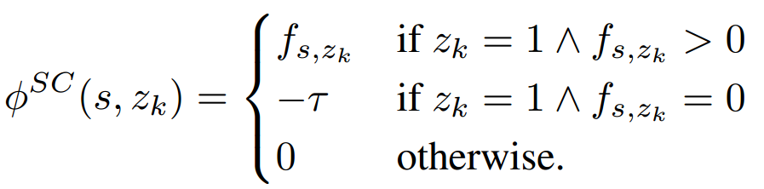
Scene Potentials
Their classification technique

Slide 42
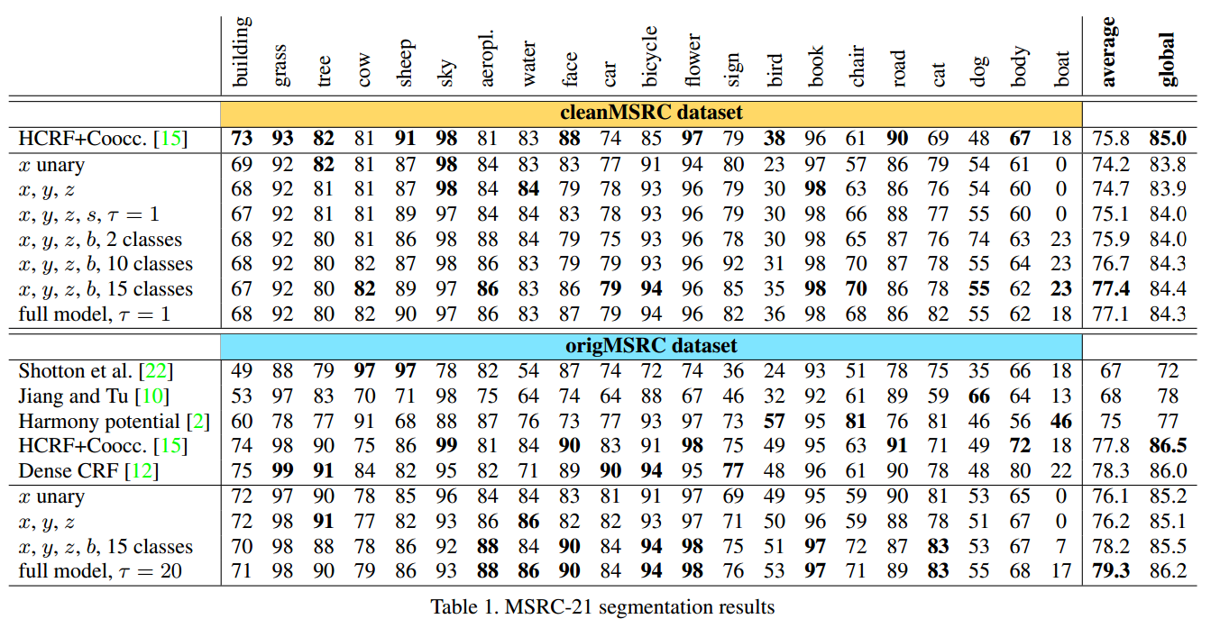
Experimental Results
Notes:
origMSRC show better results than competitors
cleanMSRC results slightly worse (due to having to be more accurate), but not compared to other methods, so impossible to tell if doing well

Slide 43
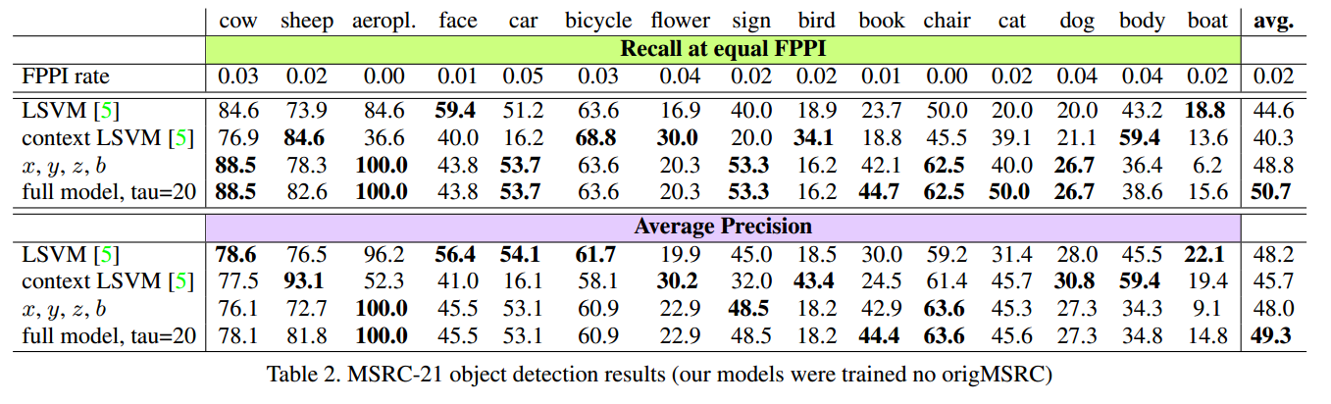
Experimental Results
Notes:
Not many comparisons…
Seems to do much better for recall, not as good for precision
100% on aeroplane? Seems like very challenging task.

Slide 44
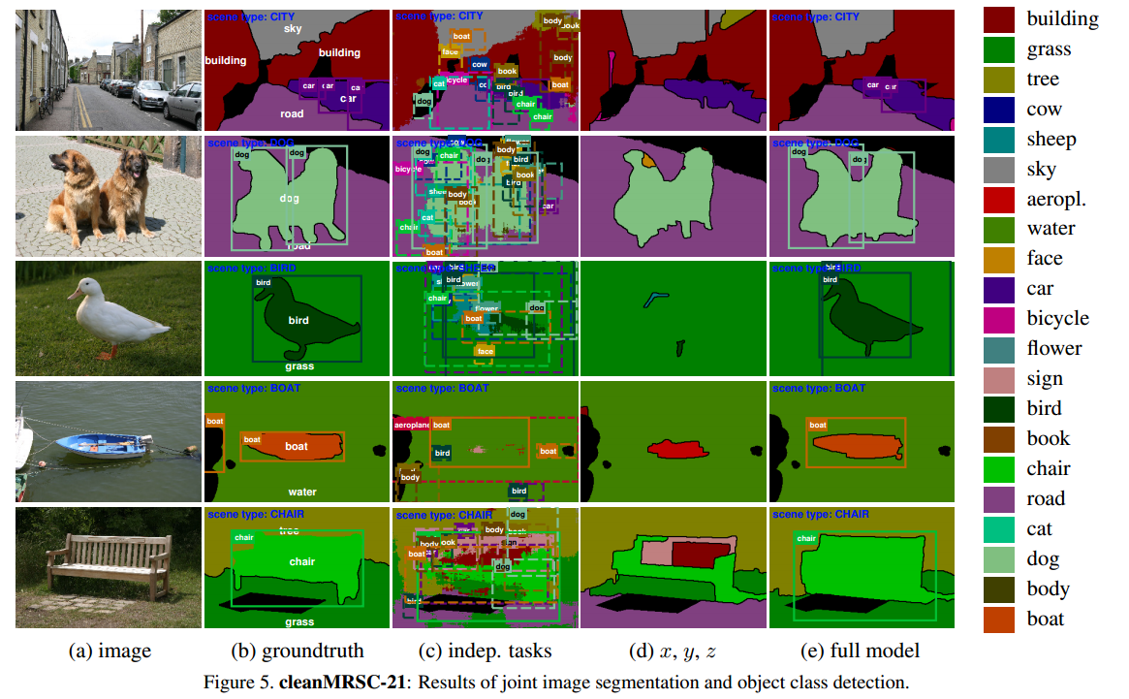
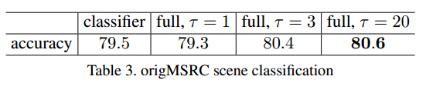
Experimental Results
Notes:
I’m a little suspicious about scene classification, as it seems like “chair” and “boat” and other objects are also scenes…
Otherwise, pretty good

Slide 45
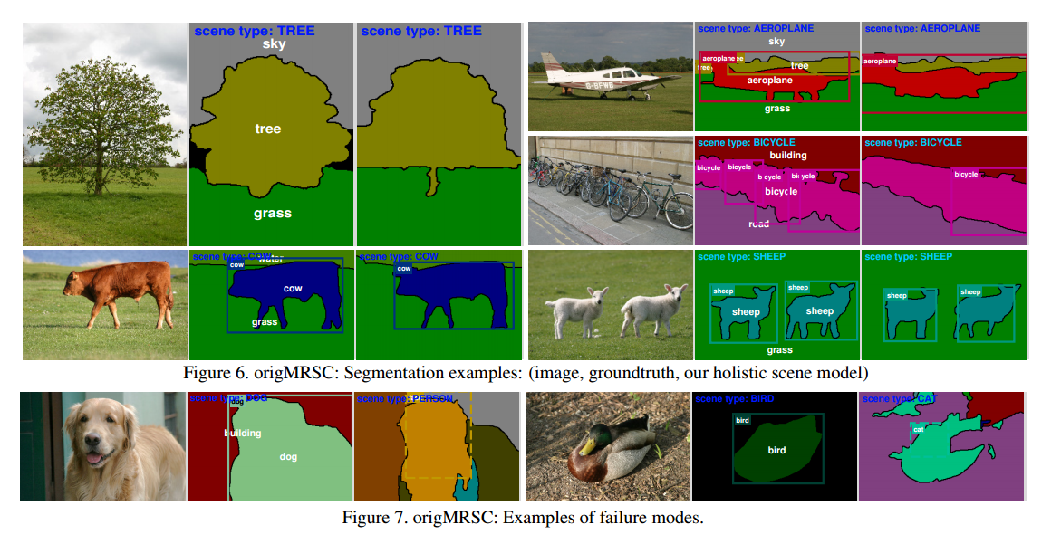
Experimental Results

Slide 46
My (TextonBoost) Experiment
Despite statement, HCRF code not available
TextonBoost only partially available
  Only code prior to CRF released
  Expects a very rigid format/structure for images
    PASCAL VOC2007 wouldn’t run, even with changes
    MSRCv2 was able to run (actually what they used)
  No results processing, just segmented images

Slide 47
My Experiment
Run code on the (same) MSRCv2 dataset
  Default parameters, except boosting rounds
    Wanted to look at effects up until 1000 rounds; compute up to 900
    Limited time; only got output for values up to 300
Evaluate relationship between boosting rounds and segmentation accuracy

Slide 48
Experimental Advice
Remember to compile in Release mode
  Classification seems to be ~3 times faster
  Training took 26 hours, maybe less if in Release
Take advantage of multi-core CPU, if possible
  Single-threaded program not utilizing much RAM, so started running two classifications together

Slide 49
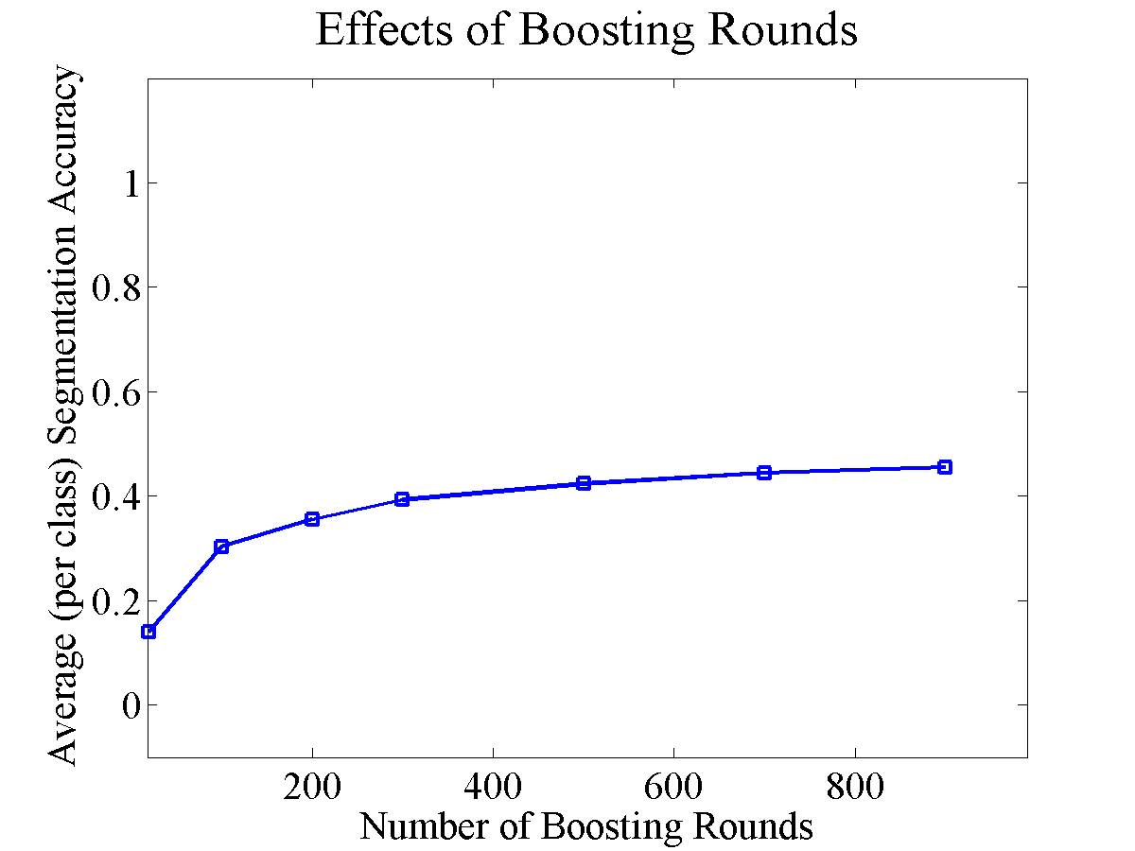
Experimental Results
Notes:
Still not getting close to their 70% range with 5000 rounds.

Slide 50
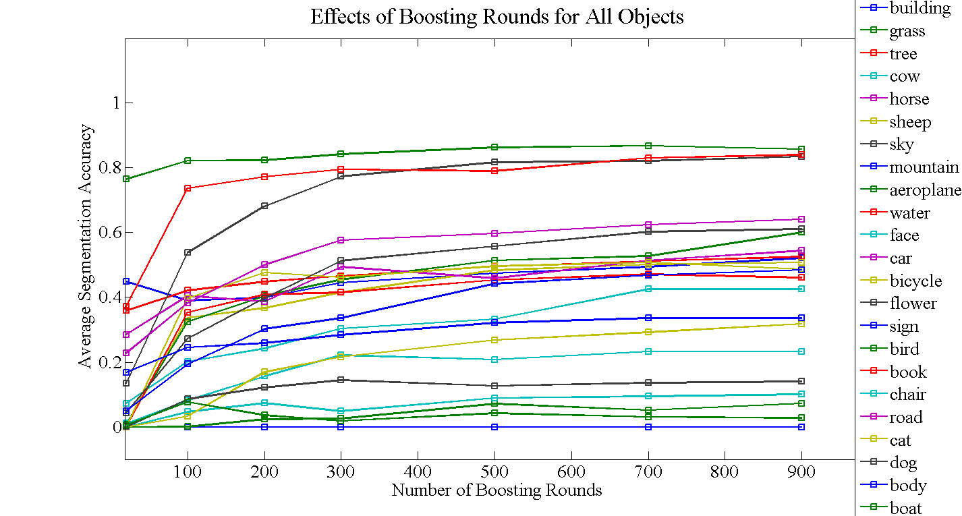
Experimental Results
Notes:
Seems to not be improving towards the end, but we know it should be. (For individual curves, look after the end of presentation.)

Slide 51
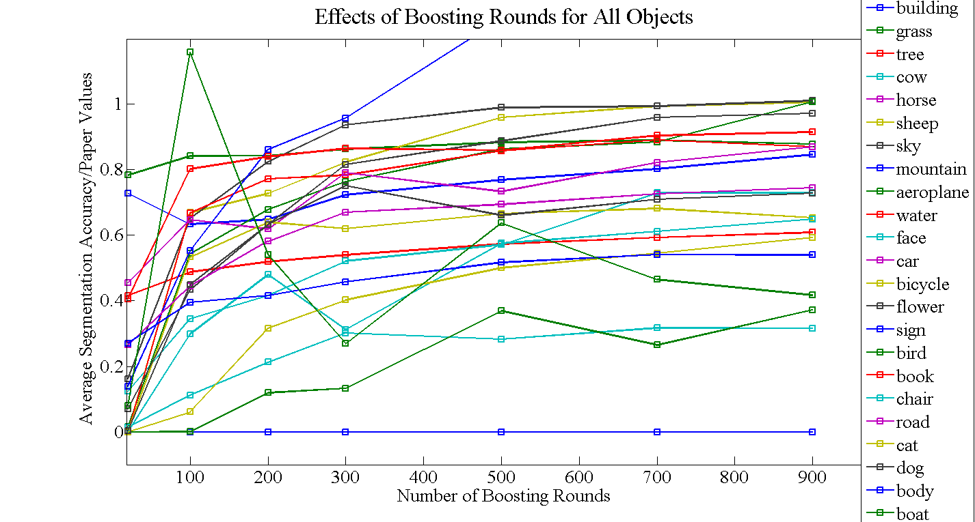
Experimental Results
Notes:
If we reached paper values, lines would go to 1.0, but we still seem to be a bit off (Note: I did not ignore classes that they didn’t do the processing for.)

Slide 52
Thank you for your time.
Any more questions?

Slide 53
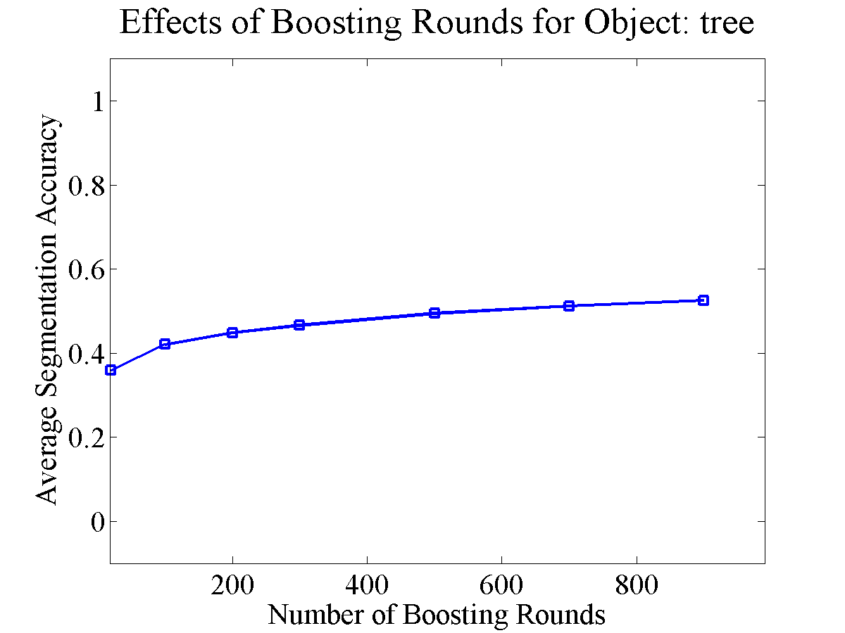
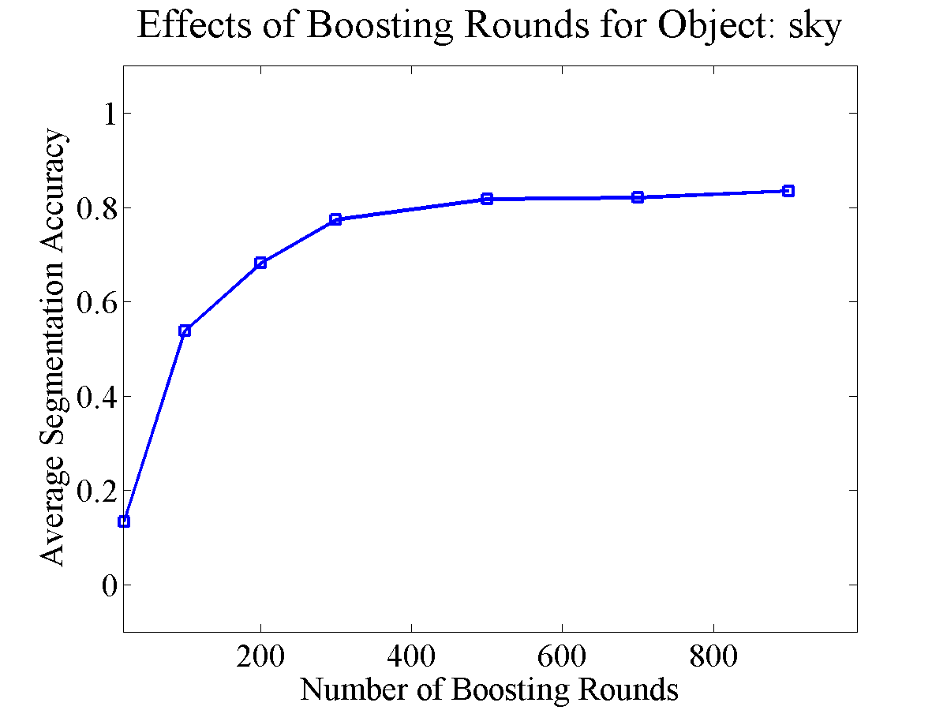
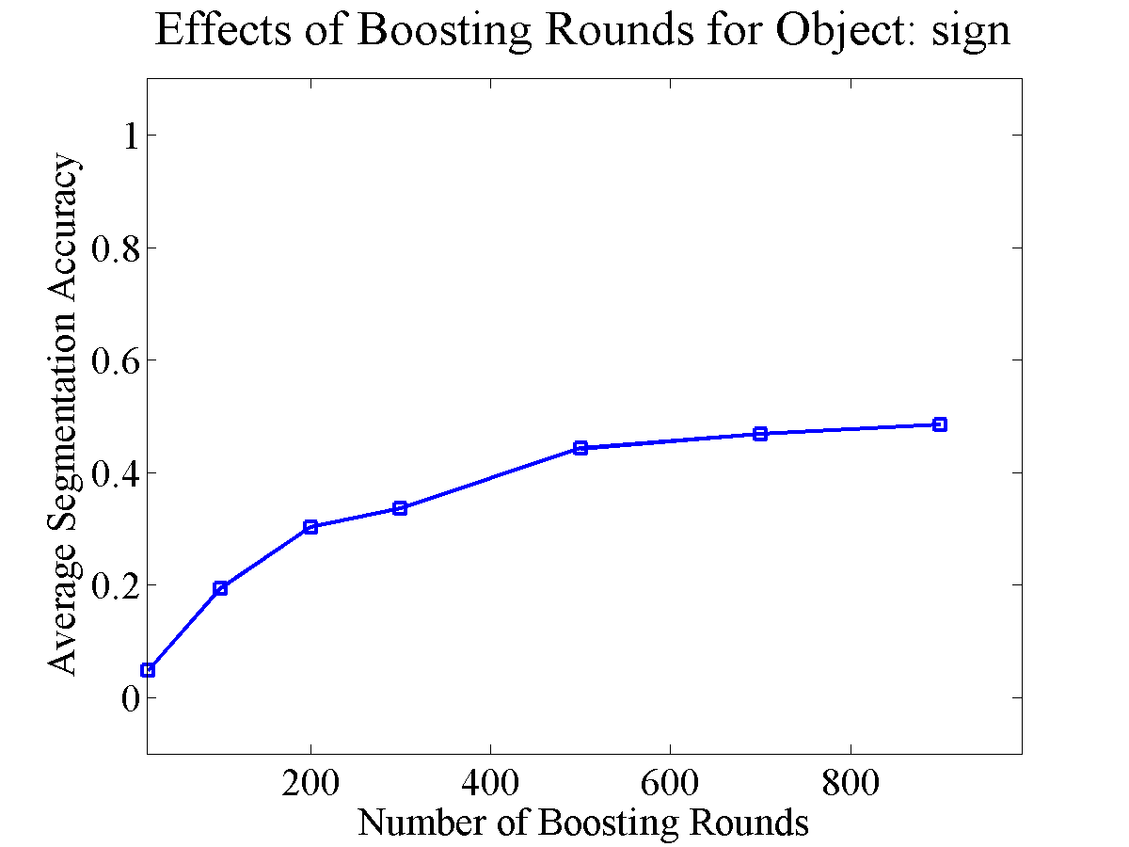
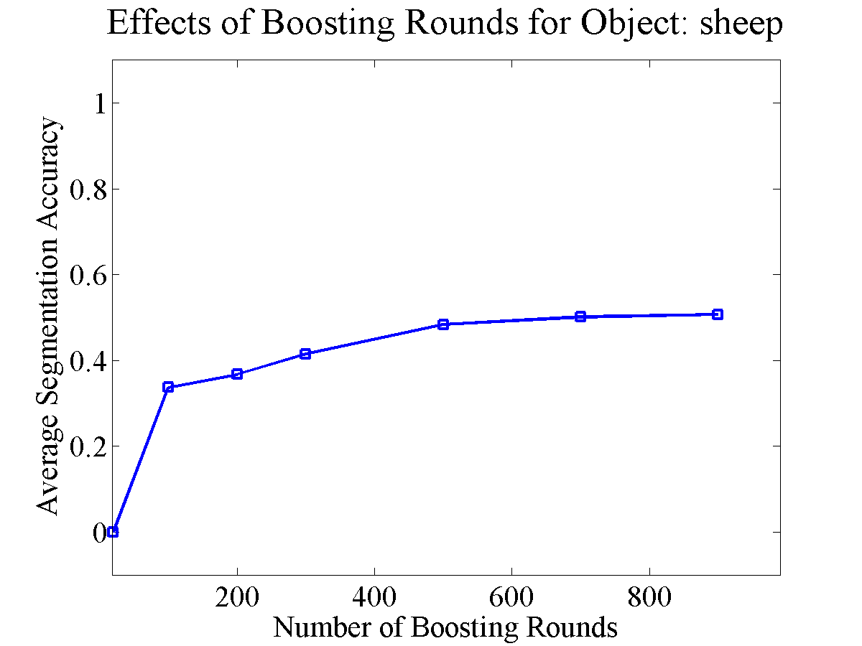
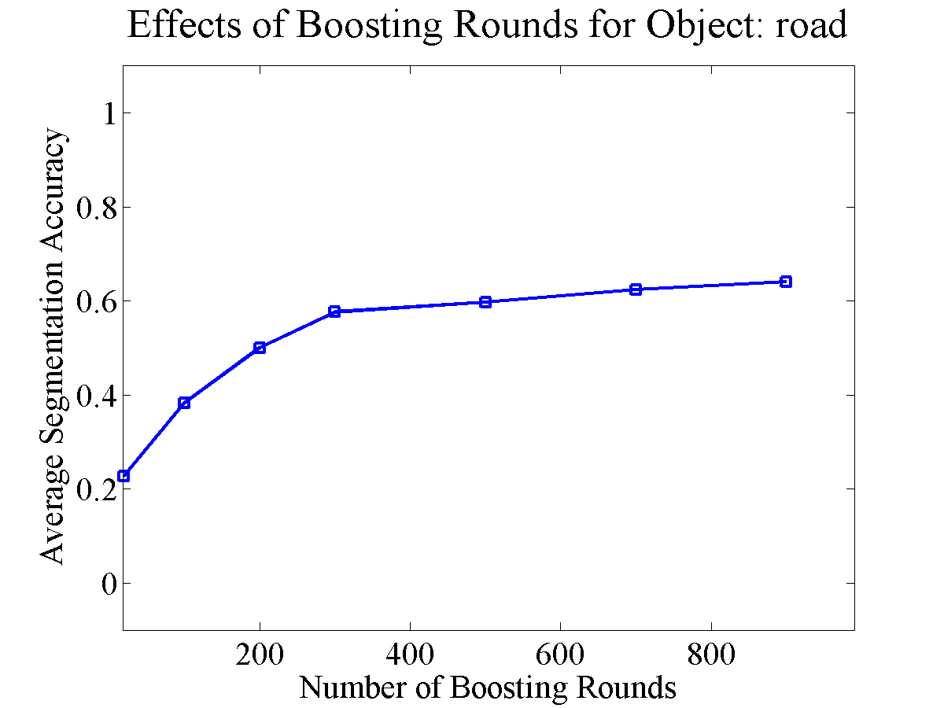
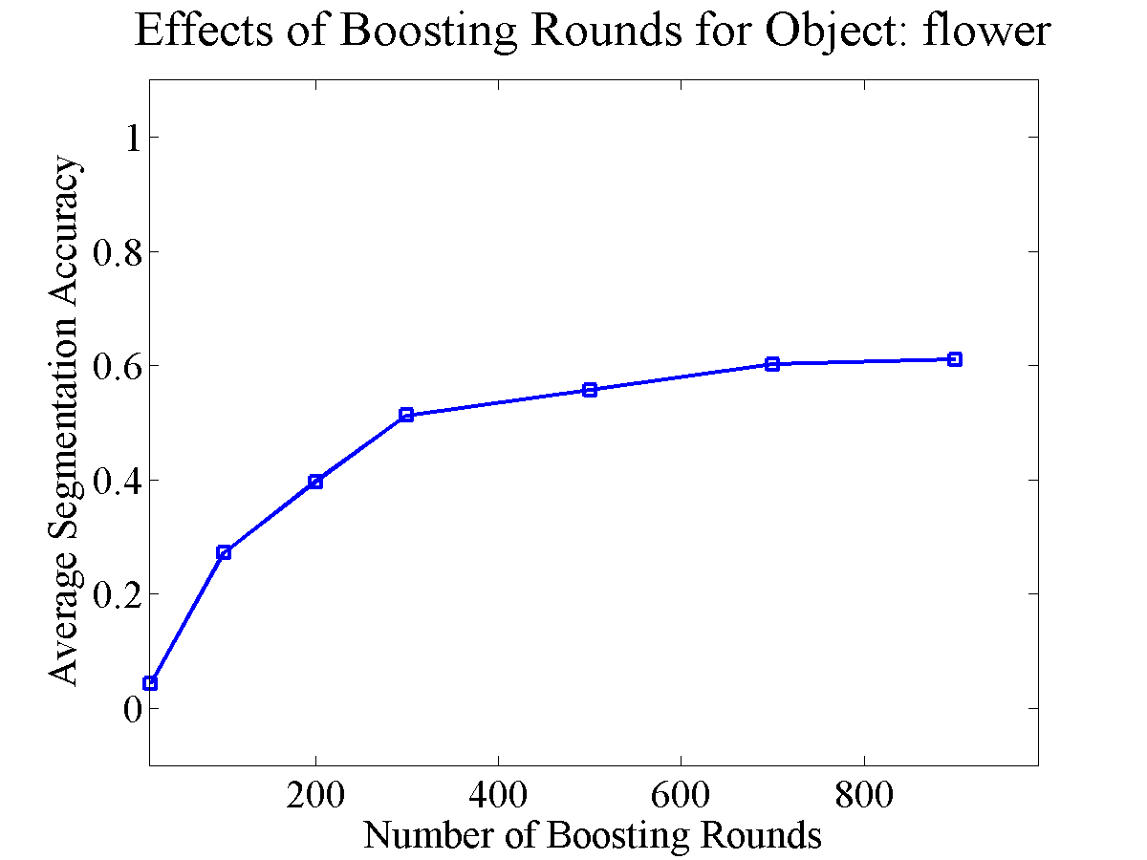
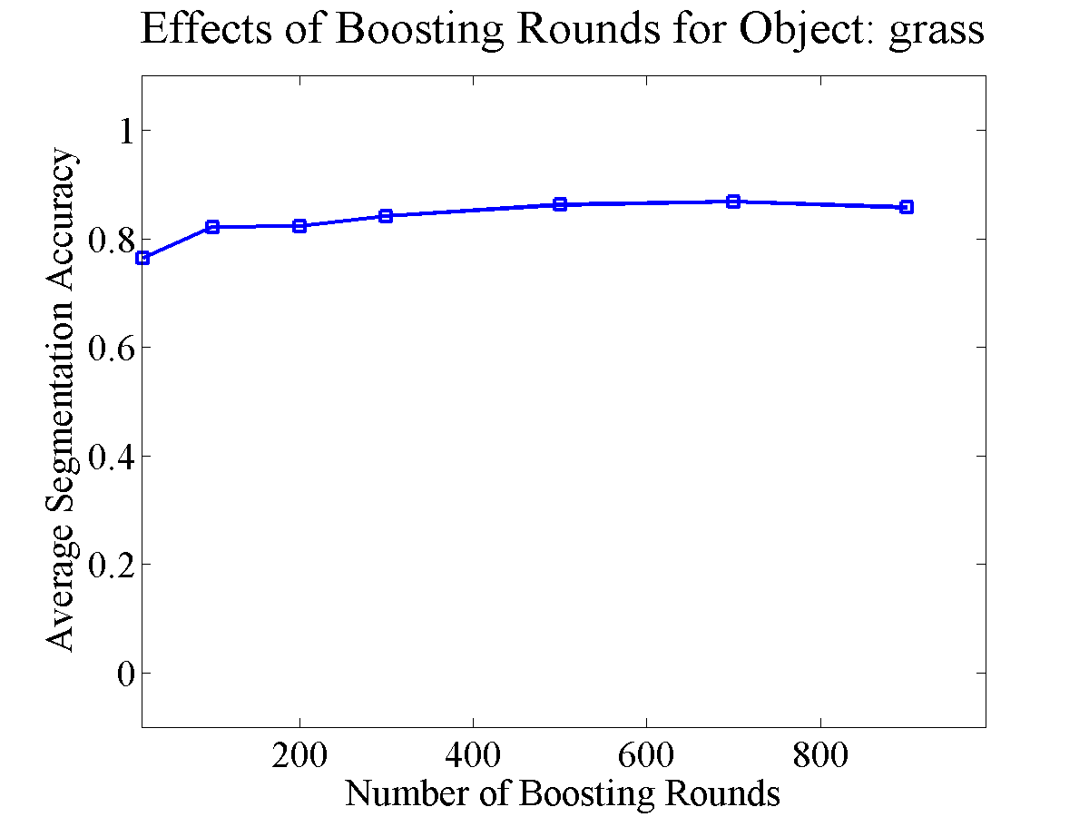
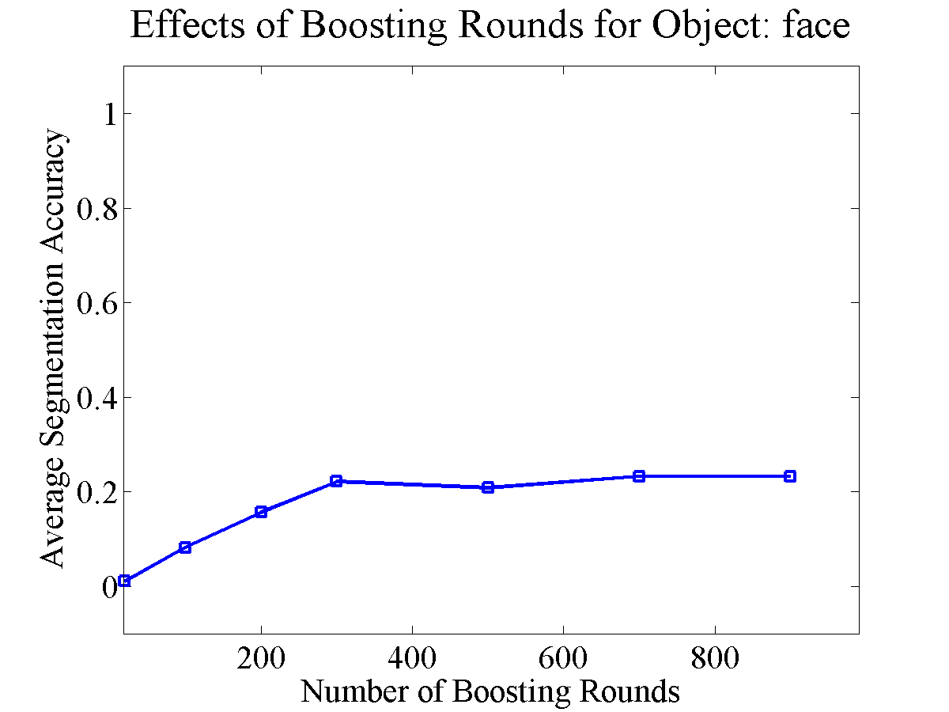
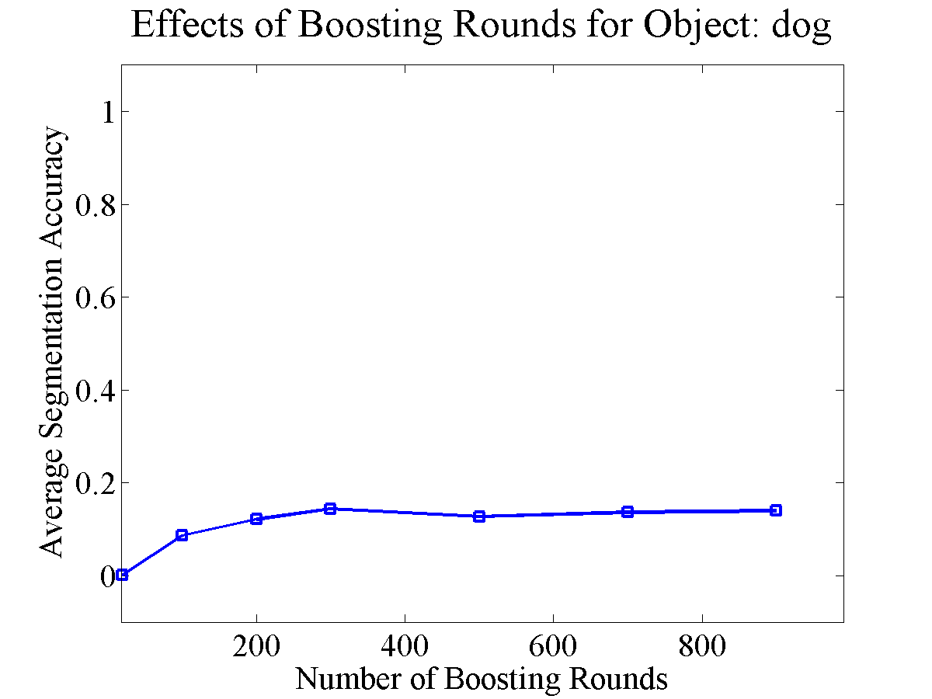

Slide 54
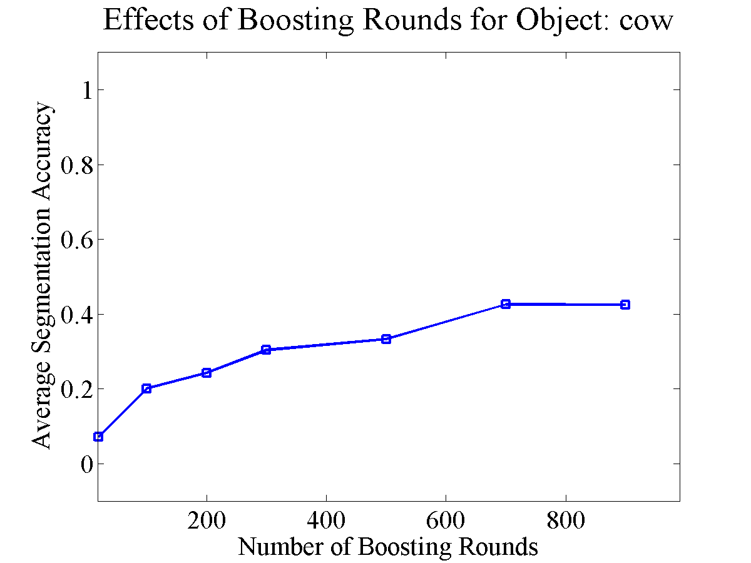
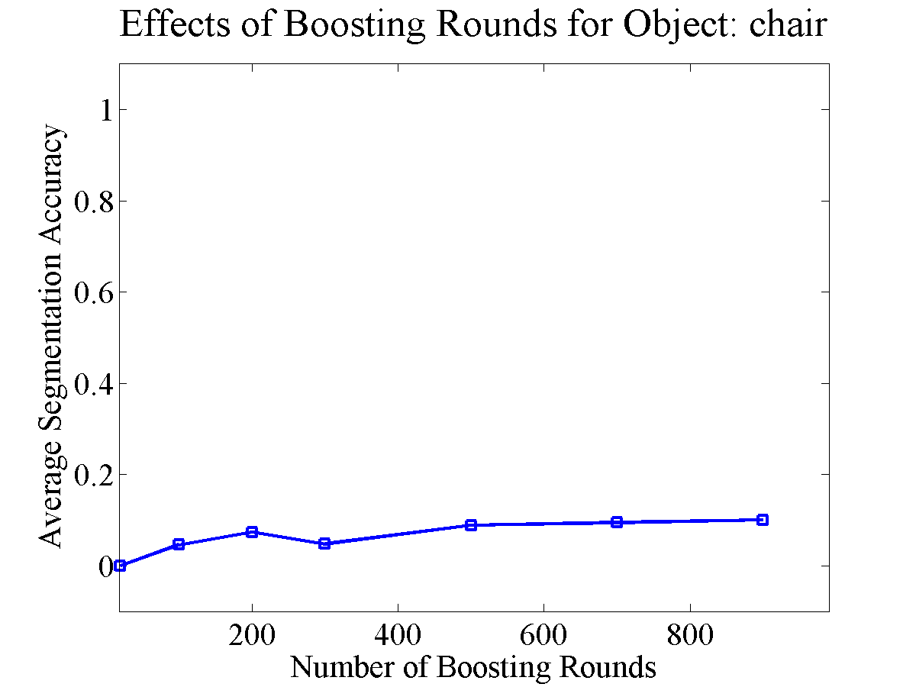
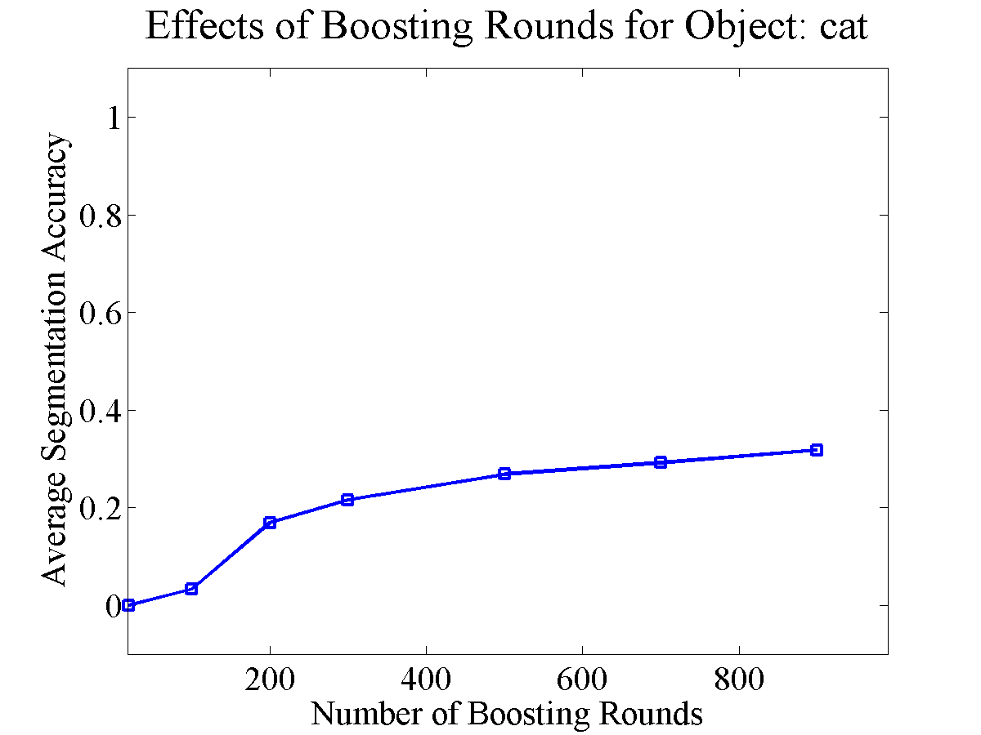







Slide 55




