Slide 1
Groups of objects
Presented By
Sherin Aly

Slide 2

























Object Recognition
Parts, Poselets, Attributes
Scenes
Huge literature, For example:
[Oliva, Torralba 2001],
[SUN 2010], …
Huge literature, For example:
[Fergus, Perona, Zisserman2003],
[Bourdev, Malik2009], …
Courtesy: Ali Farhadi
Recognition using Visual Phrases , CVPR 2011

Slide 3


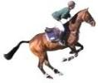


















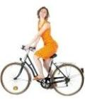






What are the right quanta of Recognition?
Courtesy: Ali Farhadi
Recognition using Visual Phrases , CVPR 2011

Slide 4
Recognition using
Visual Phrases
Amin Sadeghi
Ali Farhadi

Slide 5
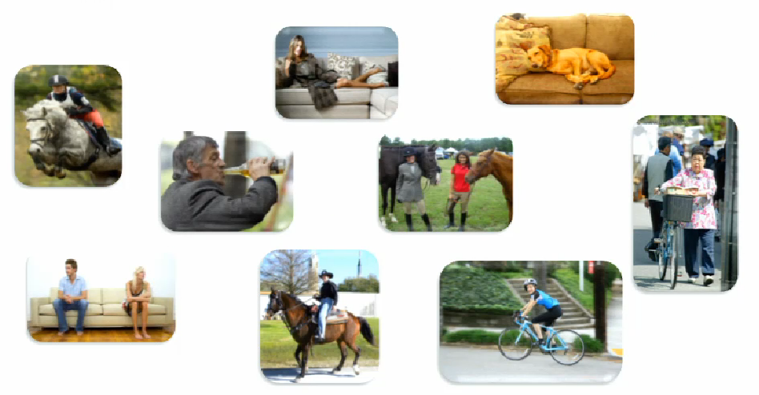

Visual Phrases
Or 1 Object and action
2 objects 1 action
Courtesy: Ali Farhadi
Visual phrase: corresponds to chunk of meaning bigger than a word

Slide 6
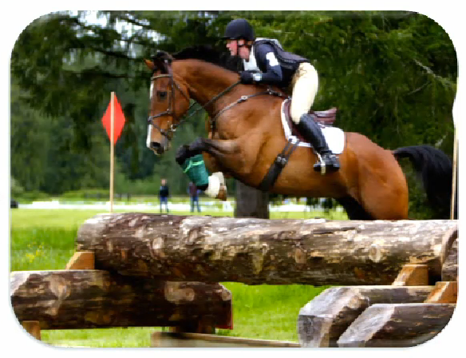
Semantically Speaking
Courtesy: Ali Farhadi

Slide 7
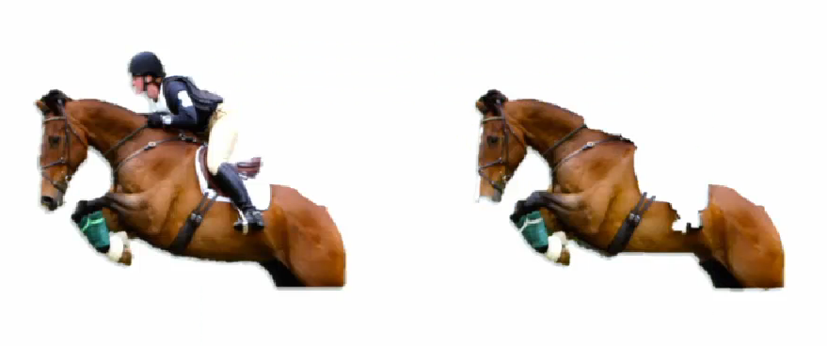
Semantically Speaking
Courtesy: Ali Farhadi

Slide 8
practically Speaking
Courtesy: Ali Farhadi

Slide 9
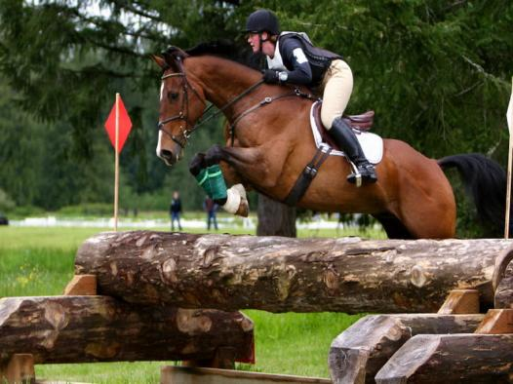
Practically Speaking
Person
Horse
[Desai, Ramanan, Fowlkes ICCV09 , Gupta, Davis, ECCV08]
Recognition using Visual Phrases , CVPR 2011

Slide 10

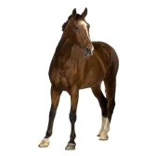
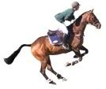
Participating in Phrases Profoundly affects the appearance of objects
- Easier to detect
- Give more information in
a single detection
we ignored a very important phenomena which is the appearance of objects may profoundly changes when participate in a relationship
- Participating in make detecting them as one entity make it much easier
- So it is really a good idea to build a detector for person riding a horse directly like a single object detector.
Courtesy: Ali Farhadi

Slide 11
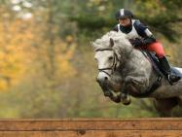

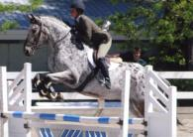
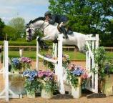
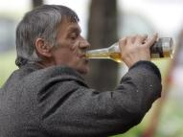
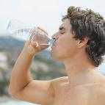
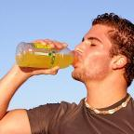
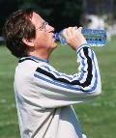

Visual Phrases
very characteristic appearance
Courtesy: Ali Farhadi

Slide 12
Adding Visual Phrases to
The Vocabulary of Recognition
Learn to detect visual phrases
    Person riding horse, dog lying on sofa
Potential Concerns:
  Combinatorial number of visual phrases
    Not all possible combinations of words make a visual phrase
      Few
      Very frequent
  Lack of training data
    No need for several training examples (characteristic appearance)
    Visual phrases are less complex, easy to detect
Courtesy: Ali Farhadi
Recognition using Visual Phrases , CVPR 2011

Slide 13
Phrasal Recognition Dataset
Individual Objects that are well studied
      Pascal Objects
      person, bike, car, dog, horse, bottle, sofa, and chair
Visual Phrases
      person riding horse; - person sitting on sofa;
      person sitting on chair; -person lying on sofa;
      person lying on beach; -person riding bicycle;
      horse and rider jumping; -person next to horse;
      person next to bicycle; -bicycle next to car;
      person jumping; -person next to car;
      dog lying on sofa; -dog running;
      dog jumping; -person running;
      person drinking from a bottle
Courtesy: Ali Farhadi
Recognition using Visual Phrases , CVPR 2011

Slide 14
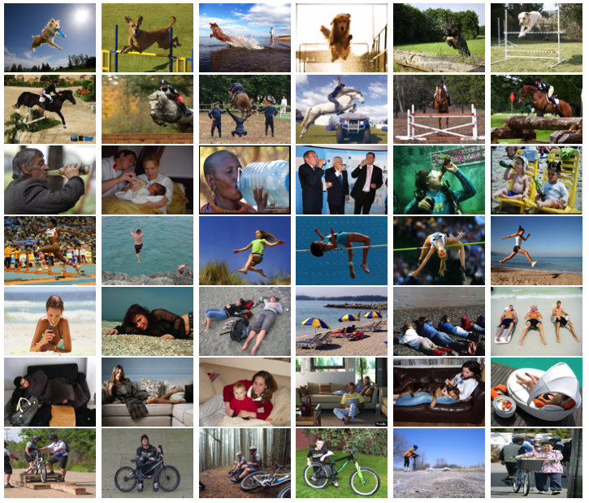
8 Objects
from Pascal
17 visual phrases
2769 images
(822 negative images)
~120 example per
category
5067 Bounding Box
examples:
1796 visual phrases
+
3271 objects
Recognition using Visual Phrases , CVPR 2011

Slide 15
Training the Detectors
Visual Phrases:
  Deformable part models [Felzenszwalb et al. 2010 v.4]
  On Phrasal Recognition Dataset
  50 examples per visual phrase
Objects:
  State of the art detectors
    v 4.0 of deformable part models
    Trained on thousands of examples
    heavily fine tuned
  Train deformable part models on Phrasal Recognition dataset
Courtesy: Ali Farhadi

Slide 16
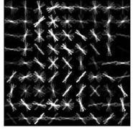
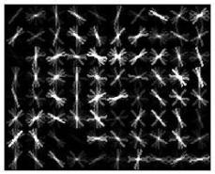
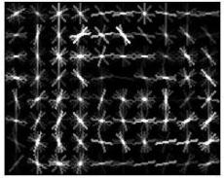
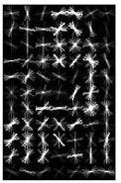
Appearance Models
Person riding horse
Person riding bicycle
Person drinking from bottle
Person next to car
Person sitting on chair
- Many of visual phrase detectors have accurately learned the phrase.
- This is mainly due to the fact that often the appearance of visual phrases has
limited variance comparing to the objects in the phrase.
Felzenszwalb et.al detectors [2010]
Recognition using Visual Phrases , CVPR 2011

Slide 17

Visual Phrase Detectors
Recognition using Visual Phrases , CVPR 2011

Slide 18

Visual Phrase Detectors
Recognition using Visual Phrases , CVPR 2011

Slide 19
Baseline
Baseline:
  Upper bound on how well one can detect a visual phrase by detecting participating objects
Fine tune the baseline to perform as best as it could potentially do
Unfair Advantages to the baseline
Recognition using Visual Phrases , CVPR 2011

Slide 20
Training the Detectors
Visual Phrases:
  Deformable part models [Felzenszwalb et al. 2010 v.4]
  On Phrasal Recognition Dataset
  50 examples per visual phrase
Objects:
  State of the art detectors
    V 4.0 of deformable part models
    Trained on thousands of examples
    Heavily fine tuned
  Train deformable part models on Phrasal Recognition dataset
  Run baseline with 2 sets of detectors
Recognition using Visual Phrases , CVPR 2011

Slide 21
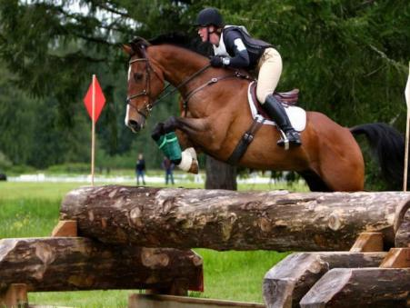
Baseline: From Detected Objects to Visual Phrase Detections
Min(C1,C2)
Max(C1,C2)
Mean(C1,C2)
Regress(C1,C2)
1. Extend the bounding
boxes of the overlapping
responses
2. compute average
of the confidences
3. PR curves
C1
C2
Recognition using Visual Phrases , CVPR 2011

Slide 22
Quantitative Results
Recognition using Visual Phrases , CVPR 2011

Slide 23
Average Precision

Slide 24
Multiple Independent Detectors
Recognition using Visual Phrases , CVPR 2011

Slide 25
Single Detectors are Misleading
Non-Maximum Suppression
Context Rescoring [Felzenszwalb et al. 2010]
Pairwise Relations [Desai, Ramanan, Fowlkes ICCV09]
Poselets and Actions [Maji, et al. CVPR2011]
Sentences [Farhadi et al. ECCV2010]
Baby Talk [Kulkarni et al. CVPR2011]
Recognition using Visual Phrases , CVPR 2011

Slide 26
Discourage Predictions
Encourage Predictions
Recognition using Visual Phrases , CVPR 2011

Slide 27
Decoding Multiple Detectors
Recognition using Visual Phrases , CVPR 2011

Slide 28

Problem settings
1
1
0
0
0
0
0
0
0
0
The problem with this approach is that one needs to greedily search the space of labels
Recognition using Visual Phrases , CVPR 2011

Slide 29
Feature representation
well designed feature representations should make it unnecessary to account for pairwise interactions
All detectors should be aware of responses of other detectors in a vicinity
Recognition using Visual Phrases , CVPR 2011

Slide 30
Feature Design
Spatial
relationships
Best Blue
Best Yellow
Above
Best Red
Best Blue
Best Yellow
Beside
Best Red
Best Blue
Best Yellow
Below
Position
Scale
confidence
Best Red
Recognition using Visual Phrases , CVPR 2011

Slide 31

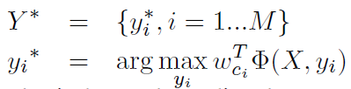
Decoding
A Max margin structure Learning
Generates features
Recognition using Visual Phrases , CVPR 2011

Slide 32
Before and After
Before Decoding
After Decoding
Recognition using Visual Phrases , CVPR 2011

Slide 33
Before and After
Before Decoding
After Decoding
Recognition using Visual Phrases , CVPR 2011

Slide 34
Phrasal Recognition Helps Object Recognition
Decoding Methods | Bicycle | Bottle | Car | Chair | Dog | Horse | Person | Sofa
Felzenszwalb detectors with CR | 0.434 | 0.429 | 0.329 | 0.213 | 0.316 | 0.438 | 0.295 | 0.204
Our Decoding With Phrases | 0.457 | 0.435 | 0.344 | 0.227 | 0.335 | 0.485 | 0.302 | 0.260
Our Decoding without Phrases | 0.437 | 0.434 | 0.330 | 0.216 | 0.329 | 0.440 | 0.297 | 0.218
Numbers are AP
Recognition using Visual Phrases , CVPR 2011

Slide 35
Including Visual Phrases to the vocabulary of Recognition helps Recognizing Objects
Decoding Methods | Bicycle | Bottle | Car | Chair | Dog | Horse | Person | Sofa
Felzenszwalb detectors with CR | 0.434 | 0.429 | 0.329 | 0.213 | 0.316 | 0.438 | 0.295 | 0.204
Our Decoding without Phrases | 0.437 | 0.434 | 0.330 | 0.216 | 0.329 | 0.440 | 0.297 | 0.218
Our Decoding With Phrases | 0.457 | 0.435 | 0.344 | 0.227 | 0.335 | 0.485 | 0.302 | 0.260
Numbers are AP
Recognition using Visual Phrases , CVPR 2011

Slide 36
Our Decoding Method Outperforms Context Rescaling
Decoding Methods | Bicycle | Bottle | Car | Chair | Dog | Horse | Person | Sofa
Felzenszwalb detectors with CR | 0.434 | 0.429 | 0.329 | 0.213 | 0.316 | 0.438 | 0.295 | 0.204
Our Decoding without Phrases | 0.437 | 0.434 | 0.330 | 0.216 | 0.329 | 0.440 | 0.297 | 0.218
Our Decoding With Phrases | 0.457 | 0.435 | 0.344 | 0.227 | 0.335 | 0.485 | 0.302 | 0.260
Numbers are AP
Recognition using Visual Phrases , CVPR 2011

Slide 37
Pairwise Decoding
Decoding Methods | Bicycle | Bottle | Car | Chair | Dog | Horse | Person | Sofa
Felzenszwalb detectors with CR | 0.434 | 0.429 | 0.329 | 0.213 | 0.316 | 0.438 | 0.295 | 0.204
Our Decoding without Phrases | 0.437 | 0.434 | 0.330 | 0.216 | 0.329 | 0.440 | 0.297 | 0.218
Desai, Ramanan, Fowlkes ICCV09 | 0.431 | 0.425 | 0.191 | 0.225 | 0.297 | 0.475 | 0.204 | 0.167
Our Decoding With Phrases | 0.457 | 0.435 | 0.344 | 0.227 | 0.335 | 0.485 | 0.302 | 0.260
Desai, Ramanan, Fowlkes ICCV09 With Phrases | 0.449 | 0.435 | 0.228 | 0.217 | 0.316 | 0.462 | 0.286 | 0.204
Numbers are AP
Recognition using Visual Phrases , CVPR 2011

Slide 38
Visual Phrases Help in Pairwise Decoding
Decoding Methods | Bicycle | Bottle | Car | Chair | Dog | Horse | Person | Sofa
Felzenszwalb detectors with CR | 0.434 | 0.429 | 0.329 | 0.213 | 0.316 | 0.438 | 0.295 | 0.204
Desai, Ramanan, Fowlkes ICCV09 | 0.431 | 0.425 | 0.191 | 0.225 | 0.297 | 0.475 | 0.204 | 0.167
Desai, Ramanan, Fowlkes ICCV09 With Phrases | 0.449 | 0.435 | 0.228 | 0.217 | 0.316 | 0.462 | 0.286 | 0.204
Our Decoding without Phrases | 0.437 | 0.434 | 0.330 | 0.216 | 0.329 | 0.440 | 0.297 | 0.218
Our Decoding With Phrases | 0.457 | 0.435 | 0.344 | 0.227 | 0.335 | 0.485 | 0.302 | 0.260
Numbers are AP
Recognition using Visual Phrases , CVPR 2011

Slide 39
Our Decoding Outperforms Pairwise Decoding
Decoding Methods | Bicycle | Bottle | Car | Chair | Dog | Horse | Person | Sofa
Felzenszwalb detectors with CR | 0.434 | 0.429 | 0.329 | 0.213 | 0.316 | 0.438 | 0.295 | 0.204
Desai, Ramanan, Fowlkes ICCV09 | 0.431 | 0.425 | 0.191 | 0.225 | 0.297 | 0.475 | 0.204 | 0.167
Desai, Ramanan, Fowlkes ICCV09 With Phrases | 0.449 | 0.435 | 0.228 | 0.217 | 0.316 | 0.462 | 0.286 | 0.204
Our Decoding without Phrases | 0.437 | 0.434 | 0.330 | 0.216 | 0.329 | 0.440 | 0.297 | 0.218
Our Decoding With Phrases | 0.457 | 0.435 | 0.344 | 0.227 | 0.335 | 0.485 | 0.302 | 0.260
Numbers are AP
Recognition using Visual Phrases , CVPR 2011

Slide 40
Conclusion
Visual Phrases
    Bigger than objects and smaller than scenes
    Substantial gain in understanding images
Phrasal recognition help object recognition
    Including visual phrases to the vocabulary of recognition
    Decoding
What should we recognize
    Semantic spectrum of the elements of recognition
    Opportunism can be a principle
Recognition using Visual Phrases , CVPR 2011

Slide 41
Contribution
Introducing visual phrases as categories for recognition
Introducing a novel dataset for phrasal recognition
The state of the art methods of modeling interactions
A decoding algorithm
Performance results in multi-class object recognition

Slide 42
Possible extension
learning the visual phrases in an unsupervised way, instead of the manually labeled visual phrases in the database.
Also, a possible extension to their encoder is to expand the idea to constraints in the 3D space, with incorporating features guided by the basic rules of visibility and occupancy
Enhance the recognition rate by incorporating the images captions in the learning process

Slide 43
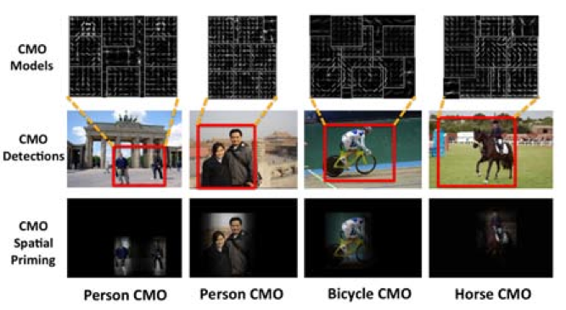
Contextual Meta-Objects
Learning the visual phrases in an unsupervised way
Congcong Li, Devi Parikh, Tsuhan Chen, ICCV 2011

Slide 44
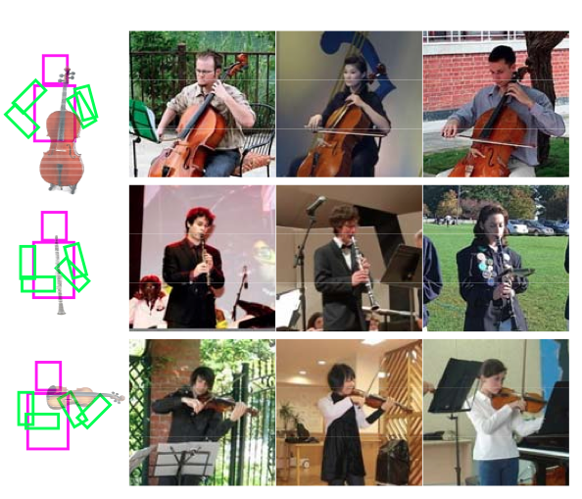
Human Object Interaction
Bangpeng Yao, Li Fei-Fei, PAMI 2012

Slide 45
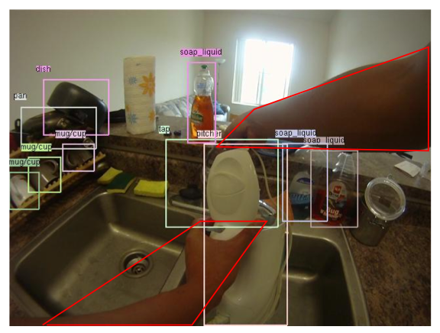
Daily Activities in First Person Cameras
Hamed Pirsiavash, Deva Ramanan, CVPR 2012

Slide 46
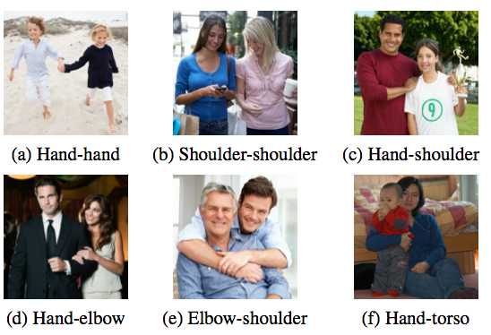
Proxemics in Personal Photos
Simon Baker, Anitha Kannan, Deva Ramanan, CVPR 2012

Slide 47
Describing Images using Natural Language
Amin Saeghi, David Forsyth

Slide 48
Automatic Discovery of Groups of Objects for Scene Understanding
Congcong Li, Devi Parikh, and Tsuhan Chen

Slide 49
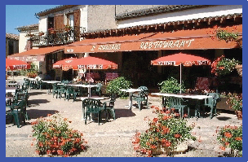
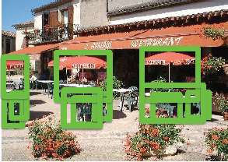
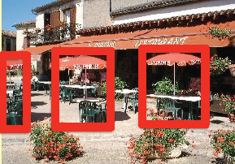
Motivation
How would we understand an image?
Scene?
Objects?
Group of Objects!
Outdoor Restaurant
3 Picnic‐umbrellas,
3 Tables,6 Chairs
3 Sets of picnic‐umbrella,
table & chairs
Note that this description demonstrates a natural grouping of objects in the scene.
This is not natural
Objects interact with each other

Slide 50
Objects interaction
These interactions may be of various forms such as:
  spatial relationships,
  physical support,
  actions being performed by a subject on an object, etc.
The key observation is that all these interactions manifest themselves as predictable visual patterns in the image.
detecting these structured visual patterns themselves is an important step

Slide 51
Group of Objects!
Detecting the groups of objects can help improve detection of the participating objects.
It significantly boosts the performance of an umbrella detector
3 Sets of picnic‐umbrella,
table & chairs
Groups of objects: composites of two or more objects which have mutually consistent spatial, scale, and view point relationships.
Problem: It is NOT feasible to manually compile a list of all possible groups with arbitrary number of participating objects!

Slide 52
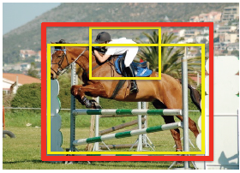
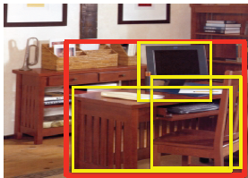
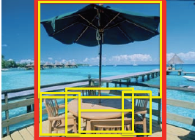
Contributions
Modeling a full spectrum of arbitrary high‐order object interactions for deeper scene understanding
Automatically discovering groups from images annotated only with object labels
Improving object detection and scene recognition performance on a variety of datasets: UIUC phrasal, PASCAL VOC07, SUN09, MIT indoor
More reliable contexual signal
Pair-wise 3rd order Higher order

Slide 53
Main approach
They employ a Hough-transform like mechanism
Apply it to the novel task of discovering groups of objects from images annotated with object categories.
We extend Zhang et al. proposed translation based “offset space” to a more complex transform space that also incorporates scale and viewpoint.
We also propose a soft voting scheme to be robust to quantization artifacts in this transform space.

Slide 54
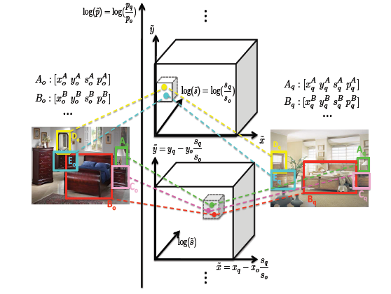
Approach: step 1
Find common object patterns between every image‐pair through a 4‐dimensional transform space
2nd-order pattern
They constructed a transform that describes the location, scale, and viewpoint changes that this correspondence induces
Employ a straightforward clustering algorithm to cluster all the discovered patterns to generate a set of groups G.
3rd-order pattern

Slide 55
But..
The above approach as described is sensitive to the quantization of the transform space;
Insisting that all participating objects in a group should be present in every instantiation of the group in images is not realistic.

Slide 56
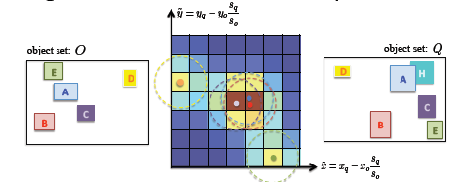
Solving quantization issue
Soft voting: alleviate the effect of hard quantization
Each object correspondence vote for neighboring bins weighted by a 4-D gaussian filter witha standard-deviation of 1
use non-maximum suppression to find the locations of the peaks.

Slide 57
Find the groups
Each object correspondence is assigned to the peak it contributes to the most.
A peak that gets n object assignments corresponds to a nth-order pattern.
After finding the cooccuring patterns, we apply the same clustering algorithm to find groups.

Slide 58
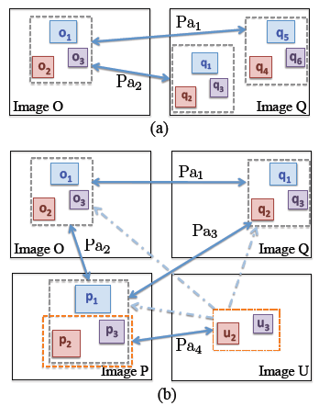
Approach: step 2
“Post processing”
Clustering patterns into groups.
Assume transitivity between patterns.
Allow missing participating objects: lower‐order groups instantiations are merged with corresponding higher‐order group instantiations

Slide 59
Approach: step 3
“Training group detectors”
Generate a bounding box for each instantiation of the group: the smallest box that encompasses all participating objects including the missing object.
Utilize any off‐the‐shelf object detection method to train group detectors.
They used the deformable part‐based model

Slide 60
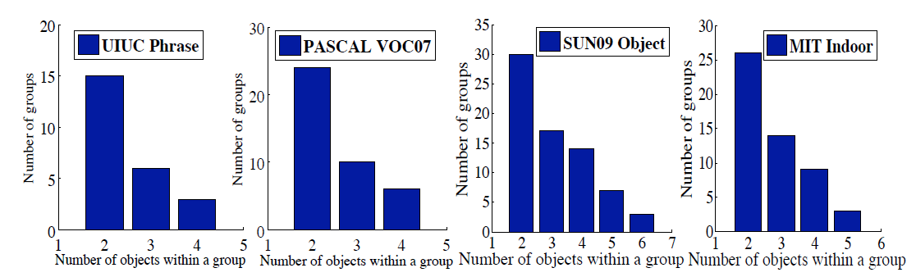
Results

Slide 61
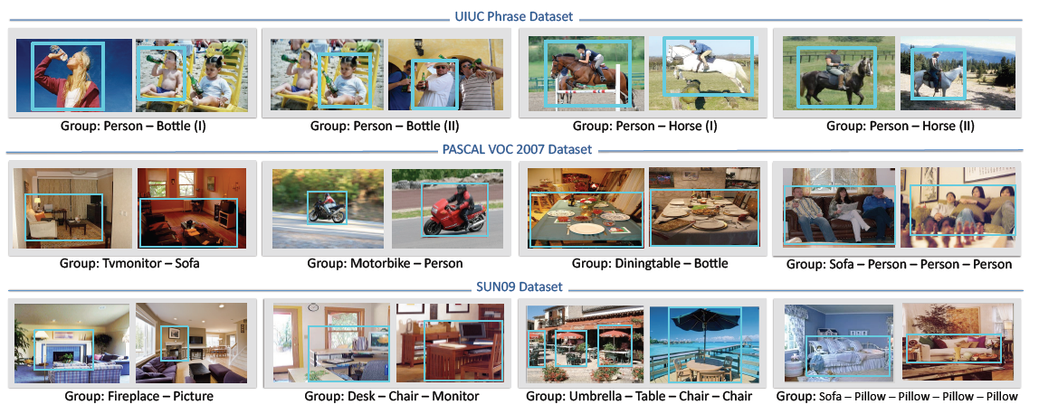
Results

Slide 62
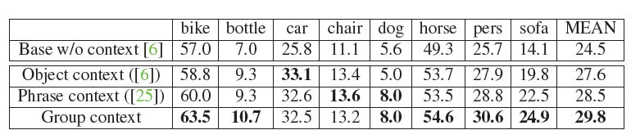
Results
“object detection improvement”
Average precision (AP) for all 8 categories in UIUC phrase dataset, mean AP across all categories. Methods: Baseline without context;
Object context (rescoring using other objects);
Phrase context (rescoring using the manually defined phrases);
Group context (rescoring using our automatically discovered object groups).

Slide 63
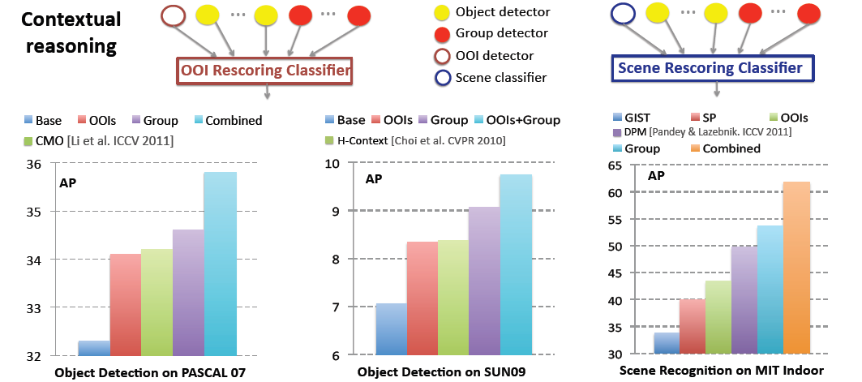
Results

Slide 64
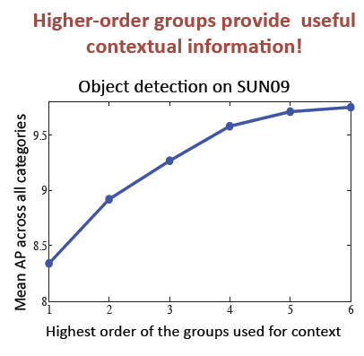

Slide 65
Time for Experiment ☺

Slide 66
So..
Using Objects concurrence, Can we detect Scene Class?
  Yes

Slide 67
Experiment Setup
Dataset Used:
  SUN 2012 Object Detection Benchmark
  http://groups.csail.mit.edu/vision/SUN/
  Total 16,873 images
  I used: 285 images for 7 classes
    abbey
    Access road
    airport
    auditorium
    attic
    bar
    bathroom
  Applied auto-Optimized SVM
    Training: 139 images
    Testing: 146 images

Slide 68
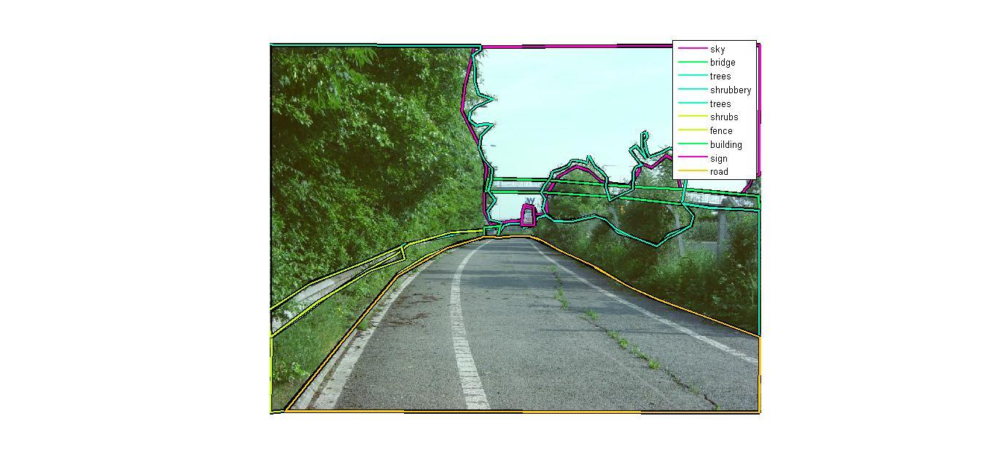
    Access road

Slide 69
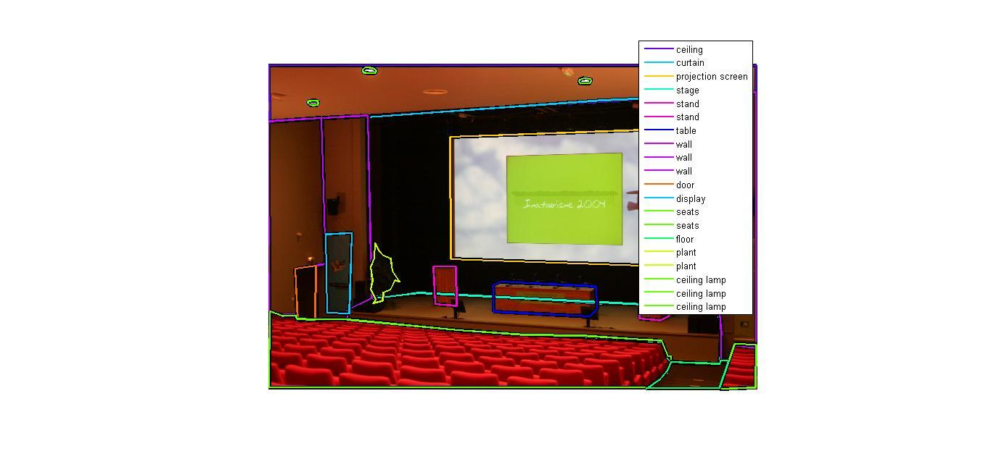
auditorium

Slide 70
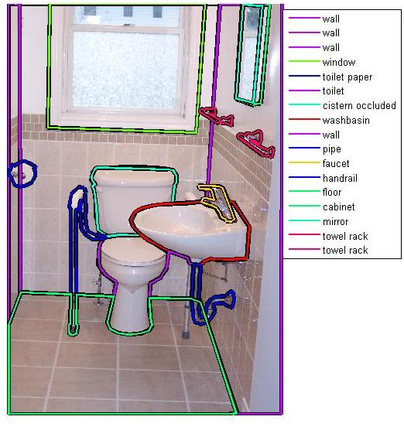
bathroom

Slide 71
Finding Most Concurrence Groups
Sample groups
cabinet occluded | cup | 'hanger
coffee table | seat crop | seats crop
'water fountain'
'dvd' | 'music system' | 'portable fridge' | 'television crop'
'brush occluded' | 'radiator crop' | 'side table crop' | 'towel occluded'
'boats' | 'sea water' | 'tomb'
'box stands' | 'fax machine' | 'gate'
-Using Ncut for clustering
Then SVM for Scene Class Recognition
Trying for different No of Groups, 100, 150, 200, and250

Slide 72
Experiment
No of Groups | Accuracy
100 | 24.65 %
150 | 37.67 %
200 | 33.56 %
250 | 24.65 %

Slide 73
Acknowledgement
Dr. Devi Parikh
Amin Sadeghi

Slide 74
Thank You ☺

