Slide 1
Pose
Abhijit Sarkar

Slide 2
Pose
An attitude or posture of the body, or of a part of the body, esp. one deliberately assumed, or in which a figure is placed for effect, or for artistic purposes.
A configuration of body parts such as head, torso, arms and legs arranged in 3D space
The resulting appearance, a 2D image created for a viewer, or a camera
[Bourdev & Malik, ICCV09]

Slide 3
Application
Surveillance
Head pose for Drowsiness
Gaming
3-D reconstruction
Movie
Action Recognition
Segmentation

Slide 4
Challenges
Viewing Variability
Pose Variability
Self occlusion, clothing
High Degree of Freedom

Slide 5
Tree-shaped model
Deformable objects
Slide credit: Rob Fergus

Slide 6
Agenda
Poselet – L. Bourdev and J. Malik. ICCV 2009
Real time pose recognition - J. Shotton, A. Fitzgibbon, M. Cook, T. Sharp, M. Finocchio, R. Moore, A. Kipman and A. Blake. CVPR 2011
Experiments
Current Scenario
Conclusion

Slide 7
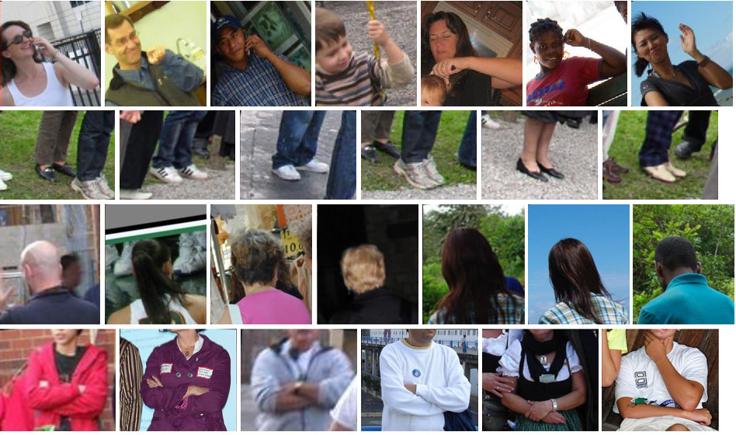
Poselets
Poselets capture part of the pose from a given viewpoint
[Bourdev & Malik, ICCV09]
Notes:
So the idea is to have a large number of these parts, which we call poselets. So even difficult examples can be found because a few of these poselets can be triggered.
But there is one problem: In the case face detector, someone had to manually crop out thousands of faces to be able to train a classifier. In our case we have unlimited number of poselets, so we cannot have such a manual step.

Slide 8
Poselets
Examples may differ visually but have common semantics
[Bourdev & Malik, ICCV09]
Notes:
So the idea is to have a large number of these parts, which we call poselets. So even difficult examples can be found because a few of these poselets can be triggered.
But there is one problem: In the case face detector, someone had to manually crop out thousands of faces to be able to train a classifier. In our case we have unlimited number of poselets, so we cannot have such a manual step.

Slide 9
Poselets
But how are we going to create training examples of poselets?
[Bourdev & Malik, ICCV09]
Notes:
So the idea is to have a large number of these parts, which we call poselets. So even difficult examples can be found because a few of these poselets can be triggered.
But there is one problem: In the case face detector, someone had to manually crop out thousands of faces to be able to train a classifier. In our case we have unlimited number of poselets, so we cannot have such a manual step.

Slide 10
Good Poselet
It should be easy to find the poselet given the input image.
Poselet should be tightly clustered in both appearance and configuration space
H3D dataset
Key point Distribution

Slide 11
How do we train a poselet?
[Bourdev & Malik, ICCV09]

Slide 12
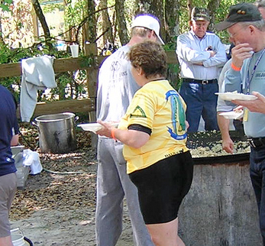
Finding correspondences at training time
Given part of a human pose
How do we find a similar pose configuration in the training set?
[Bourdev & Malik, ICCV09]

Slide 13
Finding correspondences at training time
Left Shoulder
Left Hip
We use keypoints to annotate the joints, eyes, nose, etc. of people
[Bourdev & Malik, ICCV09]

Slide 14
Finding correspondences at training time
Residual Error
[Bourdev & Malik, ICCV09]

Slide 15
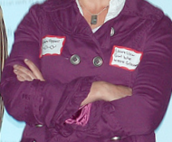
Training poselet classifiers
Residual Error:
0.15
0.20
0.10
0.85
0.15
0.35
Given a seed patch
Find the closest patch for every other person
Sort them by residual error
Threshold them
[Bourdev & Malik, ICCV09]

Slide 16
Training poselet classifiers
Given a seed patch
Find the closest patch for every other person
Sort them by residual error
Threshold them
Use them as positive training examples to train a linear SVM with HOG features
[Bourdev & Malik, ICCV09]

Slide 17
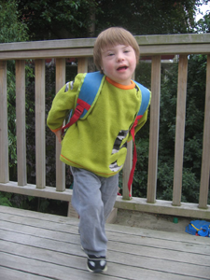
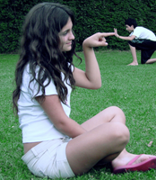
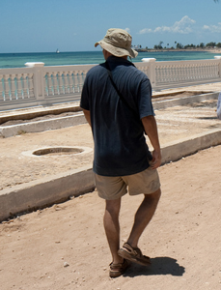
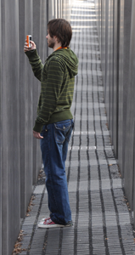
Which poselets should we train?
Choose thousands of random windows, generate poselet candidates, train linear SVMs
Select a small set of poselets that are:
Individually effective
Complementary
[Bourdev & Malik, ICCV09]

Slide 18
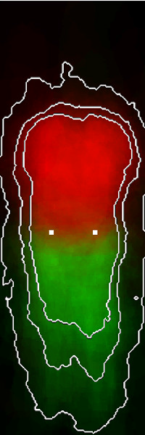
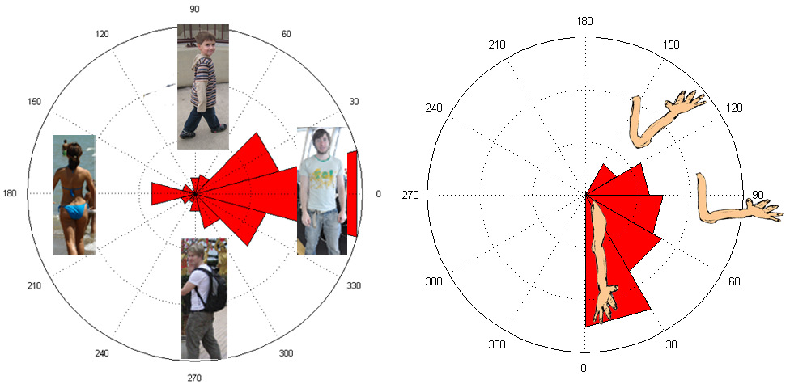
Training
Train with different view
Different orientation
[Bourdev & Malik, ICCV09]

Slide 19
Poselets website
http://eecs.berkeley.edu/~lbourdev/poselets
The set of published poselet papers
H3D data set + Matlab tools
Java3D annotation tool + video tutorial
Matlab code to detect people using poselets
Our latest trained poselets
[Bourdev & Malik, ICCV09]

Slide 20
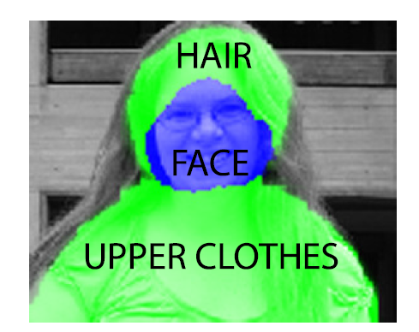
Segmentation
[Bourdev & Malik, ICCV09]

Slide 21
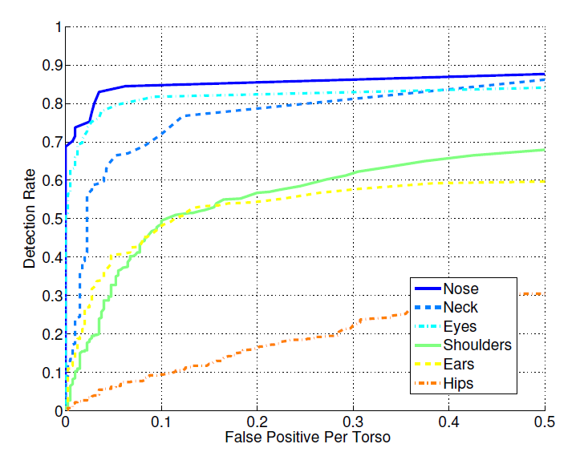
Results
[Bourdev & Malik, ICCV09]

Slide 22
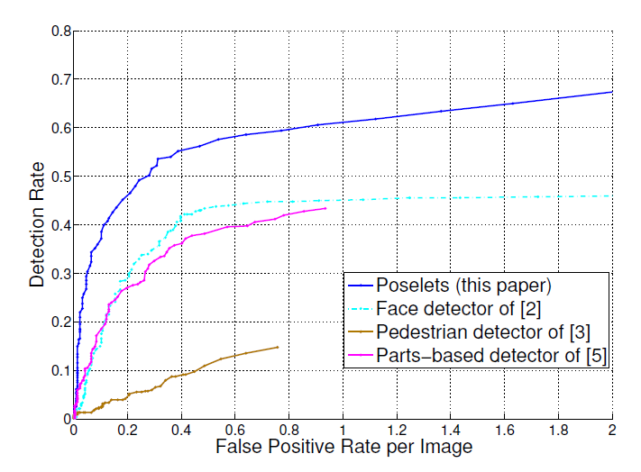
Results
[Bourdev & Malik, ICCV09]

Slide 23
Experiments
Fancy dresses
Poselet in clutter
Poselet in varied illumination
testing by varying the resolution
Multiple people in the same images
Non human

Slide 25
Success - Shadow

Slide 26
Success

Slide 27
Success

Slide 29
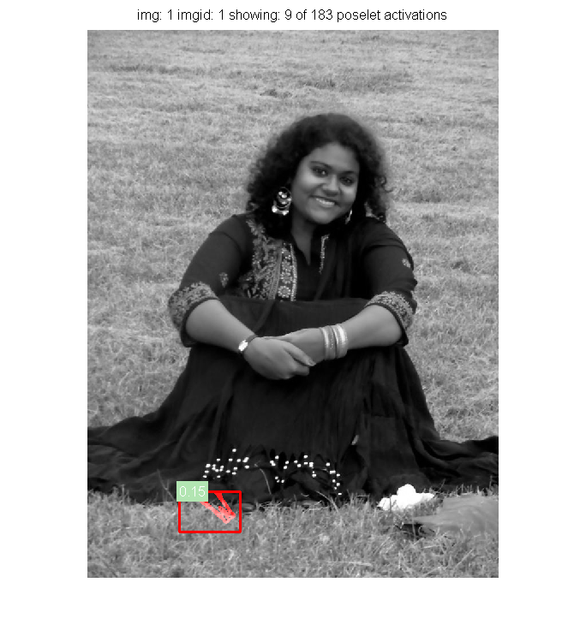

Slide 33
Torso - fault

Slide 38
Discussion
Poselet is a novel idea to include
Works prety good for some favorable cases
Has limitations in dress, low resolution, multi people case

Slide 39
Features
Predict 3D positions of body joints from a single depth image
Runs 200 fps
invariant to pose, body shape, clothing

Slide 40
The mission
Auto-initialize a tracking algorithm & recover from failures
All human poses, shapes & sizes
Limited compute budget
super-real time on Xbox 360 to allow games to run concurrently

Slide 41
The approach: body part recognition
right hand
left shoulder
neck
Depth Image
right elbow
RGB image
IR Depth Measurement

Slide 42
The Kinect pose estimation pipeline
Efficiency -> Simple for GPU
Robustness -> No relience on Tracking
capture depth image & remove bg
infer body parts
per pixel
cluster pixels to
hypothesize body joint positions
fit model &
track skeleton

Slide 43
input depth
inferred body parts
front view
side view
top view
inferred joint positions
no tracking or smoothing

Slide 44
Key Contribution
Body Parts Intermediate Represenation
Use to localize the joints of interests
Massive varied dataset
1 million training set
State of the art Accuracy
Despite no use of temporal information
Extremely Fast
5ms per frame on Xbox 360 GPU

Slide 45
Kinect Depth Camera
Works in Low light
Person stands out from Backgound
Calibrated
Uniform texture
Shadows

Slide 46
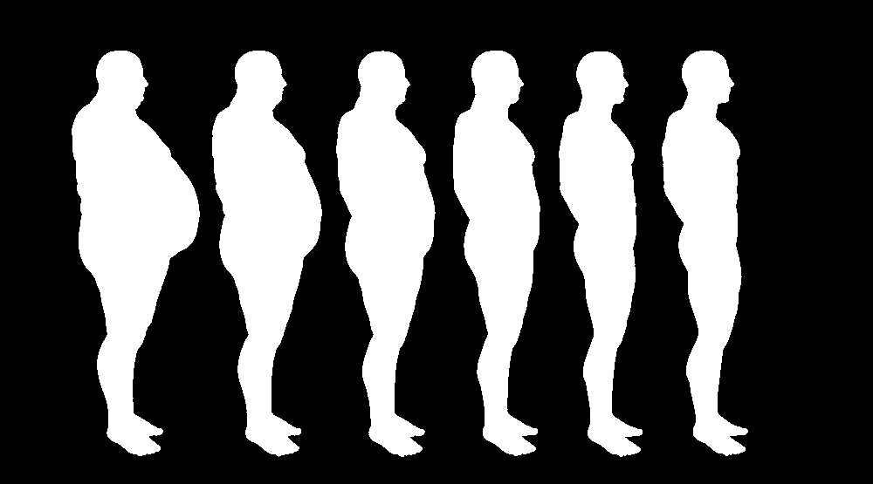
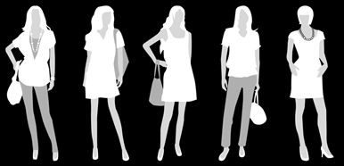
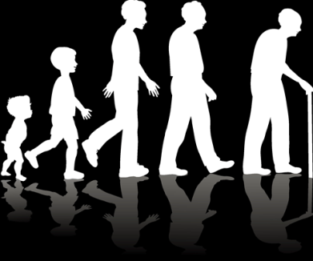
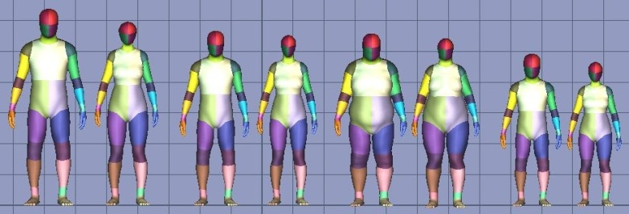
Synthetic training data
Record mocap 500k frames distilled to 100k poses
Retarget to several models
Render (depth, body parts) pairs

Slide 47
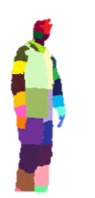
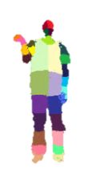
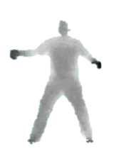
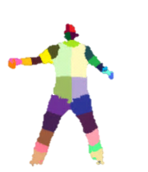
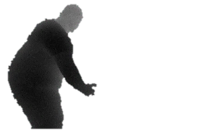
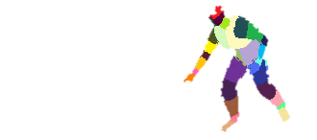
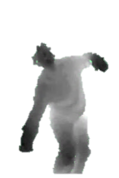
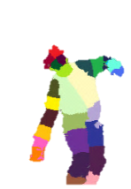
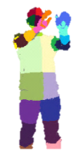
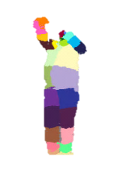
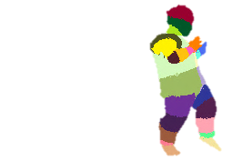
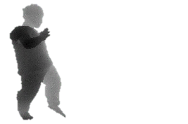
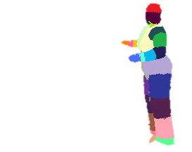
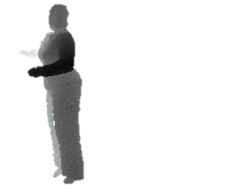
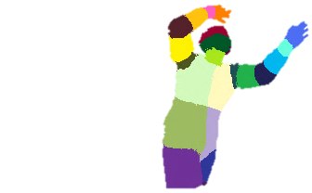
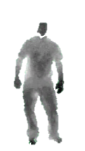
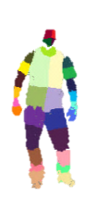
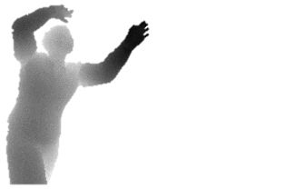
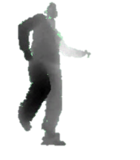
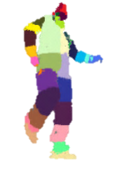
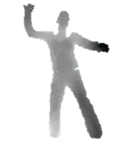
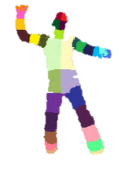
Synthetic vs real data
synthetic
(train & test)
real (test)

Slide 48
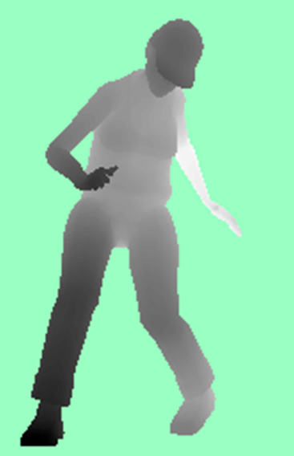
Fast depth image features
input
depth image
Depth comparisons
very fast to compute
Δ
Δ
x
Δ
Δ
x
x
x
image
depth
offset depth
Δ
Δ
feature response
$$f\left(I, \text{x}\right)=d_{I}\left(\text{x}\right)−d_{I}(\text{x}+Δ)$$
x
x
image coordinate
$$Δ=\frac{v}{d_{I}\left(\text{x}\right)}$$
scales inversely with depth
Background pixels d = large constant

Slide 49
The Basics: Is The Grass Wet?
world state
is it raining?
no
yes
is the sprinkler on?
P(wet)
= 0.95
no
yes
P(wet) = 0.1
P(wet) = 0.9

Slide 50
The Basics: Binary Decision Trees
feature vector $\text{v}∈ℝ^{N}$
split functions $f_{n}\left(\text{v}\right) :ℝ^{N}→ℝ$
thresholds $t_{n}∈ℝ$
classifications P_{n}(c)
leaf nodes
v
split nodes
1
≥
2
3
<
4
5
6
7
<
8
9
10
11
12
13
≥
14
15
16
17
category c

Slide 51
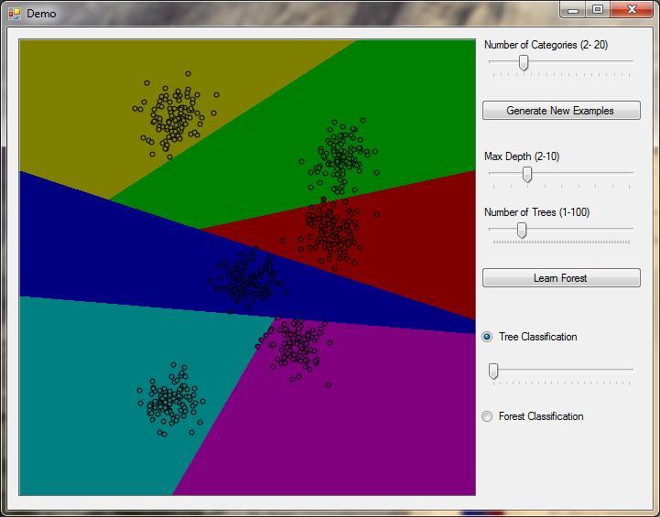
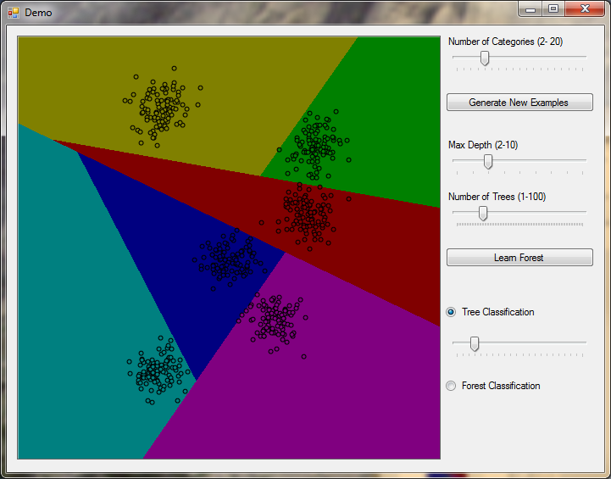
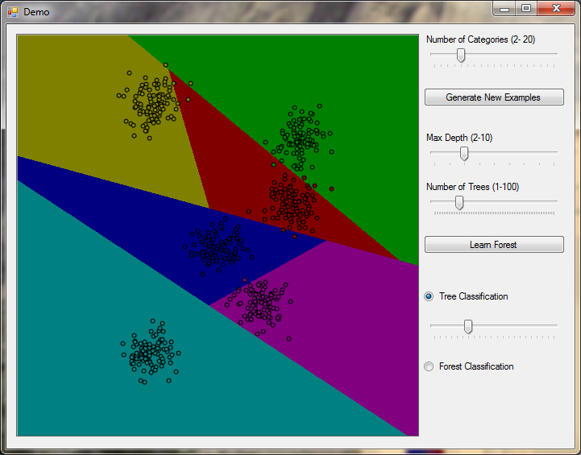
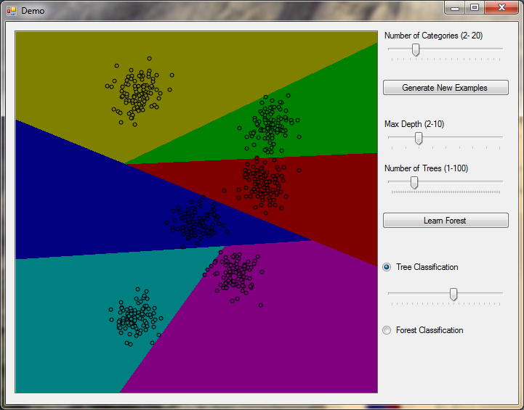
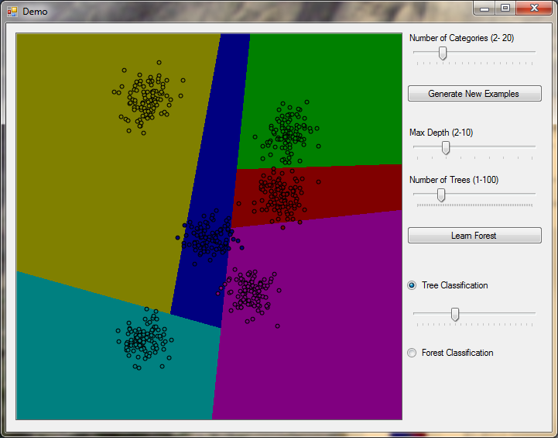
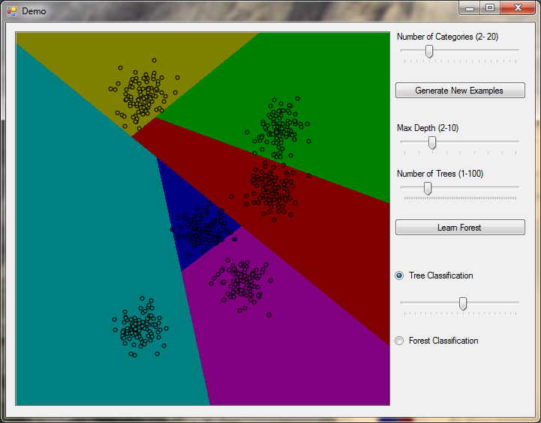
Toy Forest Classification Demo
Different trees within a forest can give rise to very different decision boundaries,
none of which is particularly good on its own.

Slide 52
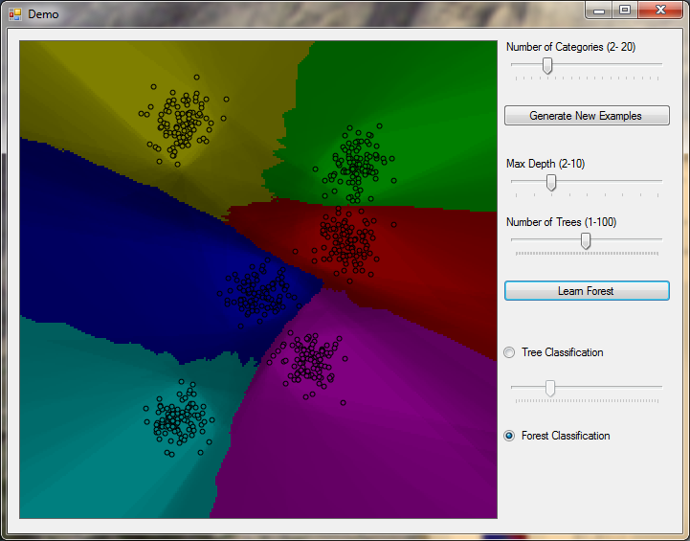
Toy Forest Classification Demo
But averaging together many trees in a forest can result in decision boundaries
that look very sensible, and are even quite close to the max margin classifier.
(Shading represents entropy – darker is higher entropy).

Slide 53
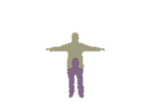
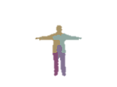
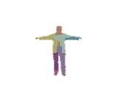
Depth of trees
input depth
ground truth parts
inferred parts (soft)
depth 1
depth 2
depth 3
depth 4
depth 5
depth 6
depth 7
depth 8
depth 9
depth 10
depth 11
depth 12
depth 13
depth 14
depth 15
depth 16
depth 17
depth 18

Slide 54
Depth of trees
synthetic test data
real test data

Slide 55
Number of training images
NB trees fixed
to maximum depth 20

Slide 56
Number of trees
ground truth
inferred body parts (most likely)
1 tree
3 trees
6 trees

Slide 57
Feature window size
31
63
129
195
260
ground truth

Slide 58
Body parts to joint hypotheses
1
2
Define 3D world space density
Mean shift for mode detection
3. hypothesize body joints
…

Slide 59
input depth
inferred body parts
front view
side view
top view
inferred joint positions
no tracking or smoothing

Slide 60
Joint prediction accuracy

Slide 61
Joint prediction accuracy

Slide 62
Summary
Frame-by-frame gives robustness
Body parts representation for efficiency
Fast, simple machine learning
Significant engineering to scale to a massive, varied training data set

Slide 64
Other Works

Slide 65
Interesting links
http://research.microsoft.com/apps/video/default.aspx?id=155251
http://techtalks.tv/talks/real-time-human-pose-recognition-in-parts-from-single-depth-images/54235/
http://eng.au.dk/fileadmin/DJF/ENG/PDF-filer/Tekniske_rapporter/Technical_Report_ECE-TR-6-samlet.pdf
http://www.youtube.com/watch?v=x2FimkptxIk

Slide 66
Thanks
Acknowlegements
Dr. Jamie Shotton
Dr. Lubomir Bourdev
Dr. Devi Parikh

