Slide 1
Object Detection
Abhijit Sarkar

Slide 2
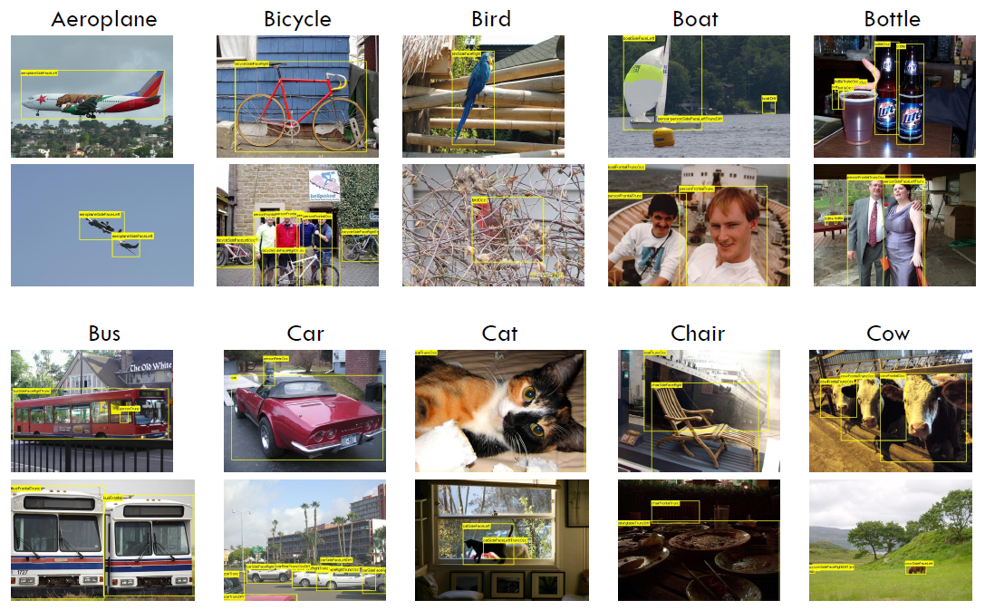
The Question
What Objects are there?
Where are those objects?
Slide Credit : Ross Girshik

Slide 3
Application
Semantic image and video search
Human Computer Interaction (Kinect)
Automotive safety
Camera face detection
Surveillance
Image and video editing
Medical Imaging
…
Slide Credit : Ross Girshik

Slide 4
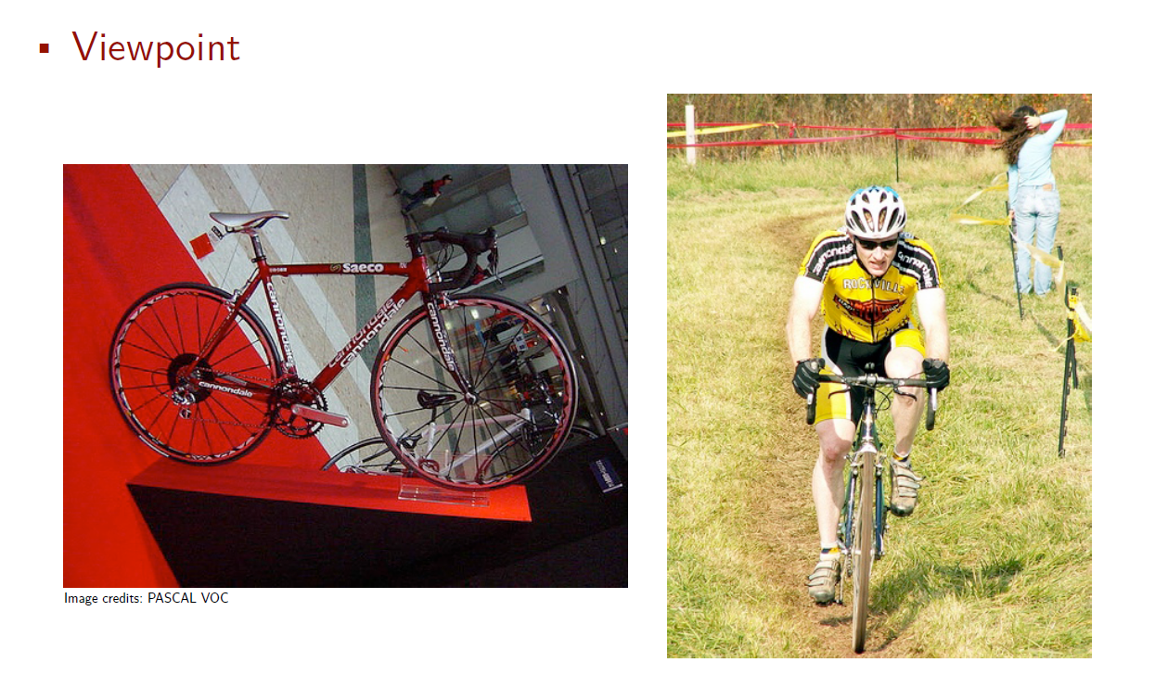
Slide Credit : Ross Girshik

Slide 5
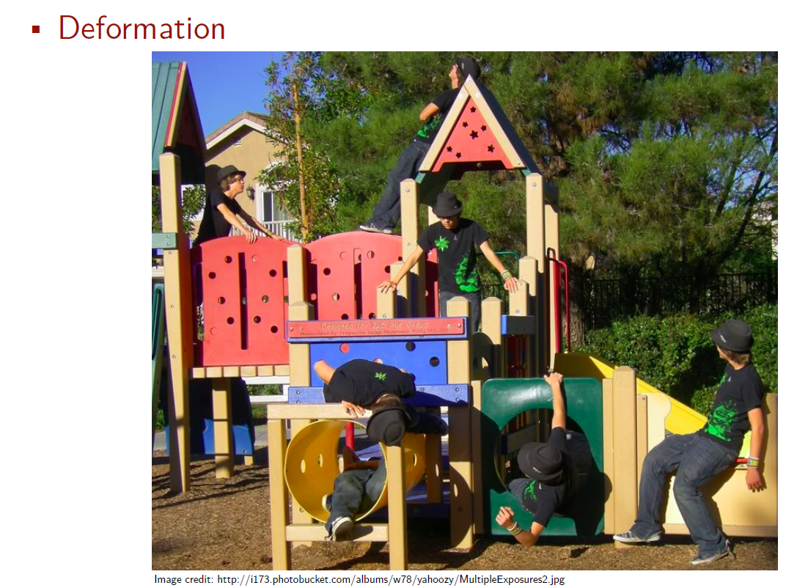
Challenges
Slide Credit : Ross Girshik

Slide 6
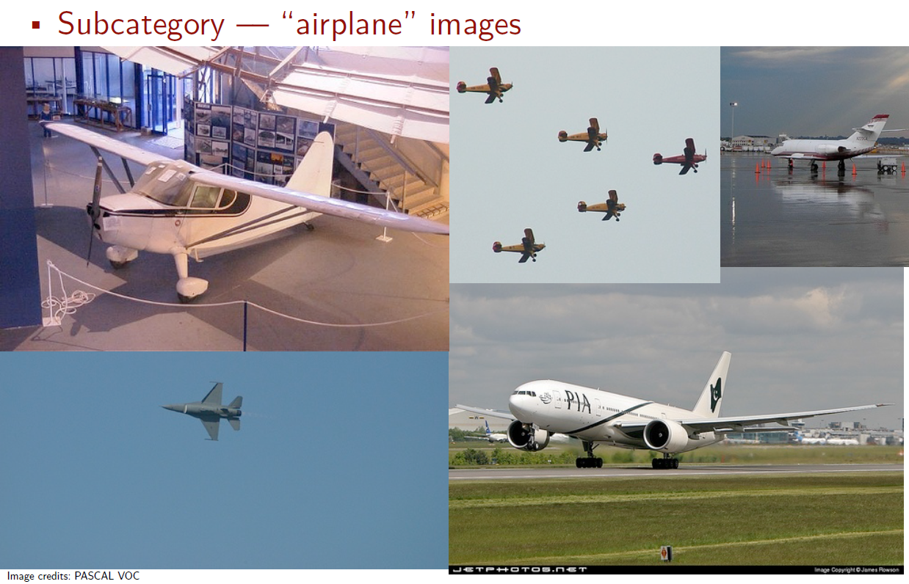
Challenges
Slide Credit : Ross Girshik

Slide 7
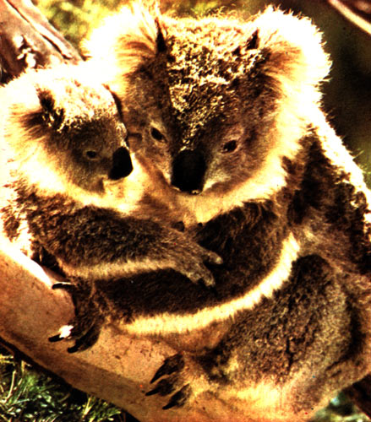
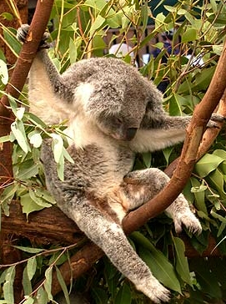


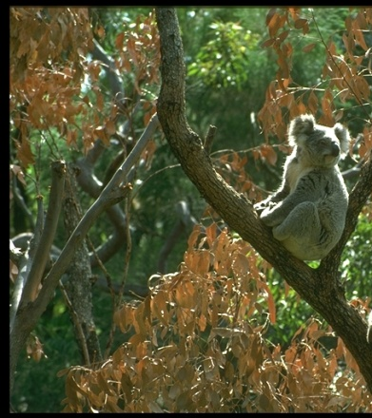
Challenges
Illumination
Object pose
Occlusions
Clutter
Slide from K. Grauman, B. Leibe

Slide 8
Agenda
Face Detection – P. Viola and M. Jones. CVPR 2001
Pedestrian detection – N. Dalal and B. Triggs. CVPR 2005
Deformable Part Model - P. Felzenszwalb, D. McAllester and D. Ramanan. CVPR 2008.
Diagnosing Error in Object Detectors - D. Hoiem, Y. Chodpathumwan and Q. Dai. ECCV 2012.
Current research scenario
Conclusion

Slide 9
Viola Jones face detection algorithm

Slide 10

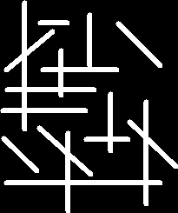

Viola Jones face detection algorithm
Haar features | Integral Image | Adaboost | Cascading
Basic introduction to edge detection
Convolution Kernel
Output image(right) has high intensity at pixels where the convolution kernel pixel pattern matches perfectly with the input image.
Slide credit : Qing Chen

Slide 11
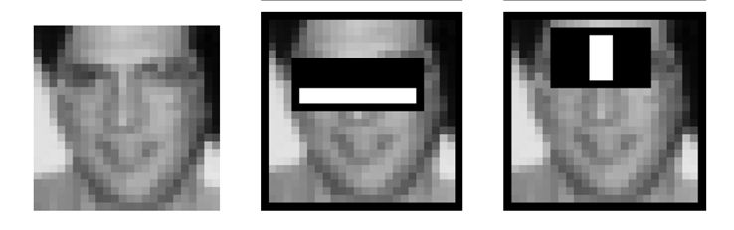
Features that are fast to compute
“Haar-like features”
  Differences of sums of intensity
  Thousands, computed at various positions and scales within detection window
-1
+1
Two-rectangle features
Three-rectangle features
Etc.
Slide credit : Qing Chen

Slide 12
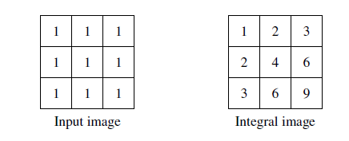
Viola Jones face detection algorithm
Haar features | Integral Image | Adaboost | Cascading
Viola jones algorithm uses a 24x24 window as the base window size to start evaluating these features in any given image.
Very high computation burden
In an integral image the value at pixel (x,y) is the sum of pixels above and to the left of (x,y)
Sum above and to left
Slide credit : Qing Chen

Slide 13
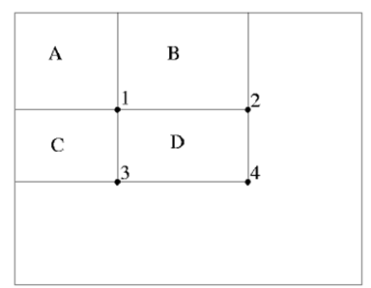
Viola Jones face detection algorithm
Haar features | Integral Image | Adaboost | Cascading
Integral image allows for the calculation of sum of all pixels inside any given rectangle using only four values at the corners of the rectangle.
Integral image
Sum of all pixels in
D = 1+4-(2+3)
= A+(A+B+C+D)-(A+C+A+B)
= D
Slide taken from a presentation by Qing Chen, Discover Lab, University of Ottawa

Slide 14
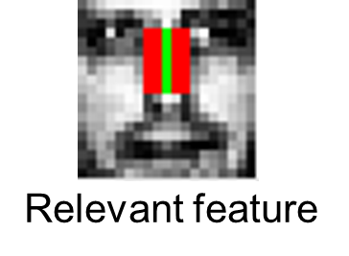
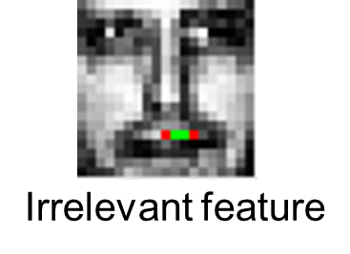
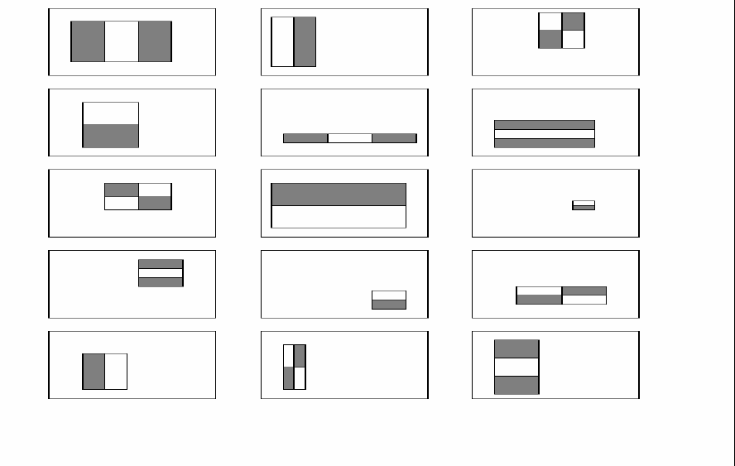
Viola Jones face detection algorithm
Haar features | Integral Image | Adaboost | Cascading
As stated previously there can be approximately 160,000 + feature values within a detector at 24x24 base resolution which need to be calculated. But it is to be understood that only few set of features will be useful among all these features to identify a face.
All Features
Slide credit : Qing Chen

Slide 15

Viola Jones face detection algorithm
Haar features | Integral Image | Adaboost | Cascading
Adaboost is a machine learning algorithm which helps in finding only the best features among all these 160,000+ features.
These features are also called as weak classifiers. Adaboost constructs a strong classifier as a linear combination of these weak classifiers.
Strong classifier
Weak classifier
Stage 1
H₁(x) > t₁?
Yes
Stage 2
H₂(x) > t₂?
Stage N
H_{N}(x) > t_{N}?
Yes
…
Pass
No
No
No
Examples
Reject
Reject
Reject
Slide credit : Qing Chen

Slide 16
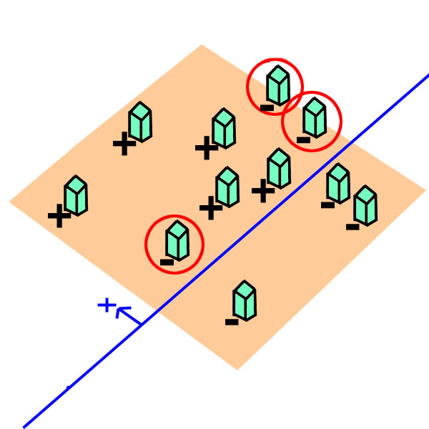
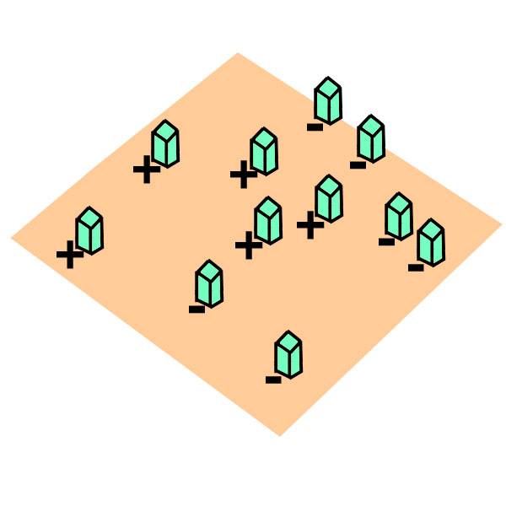
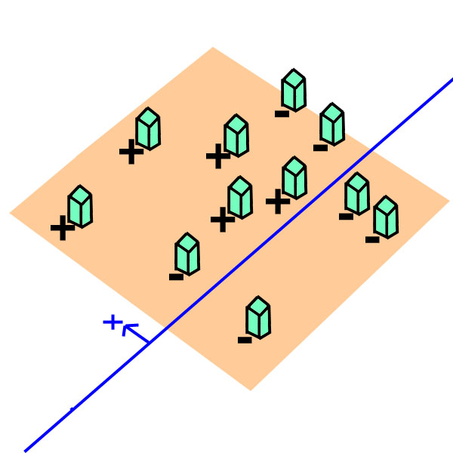
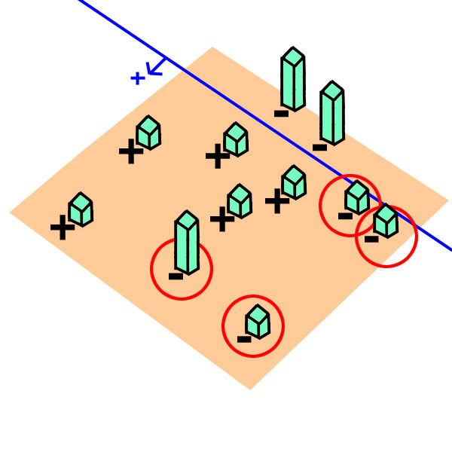
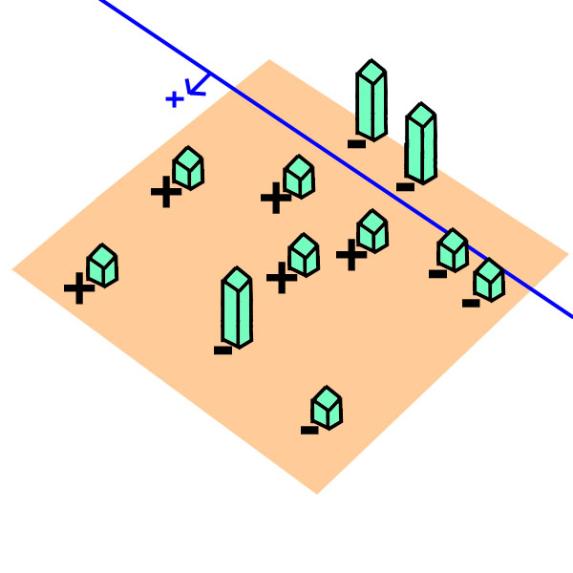
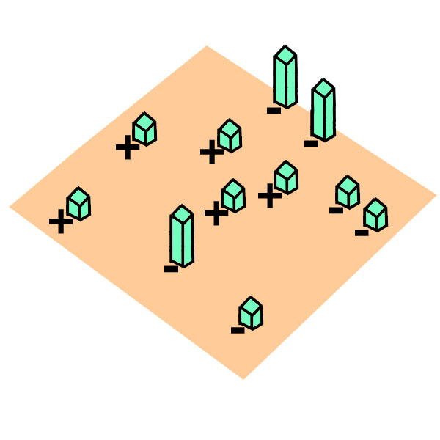
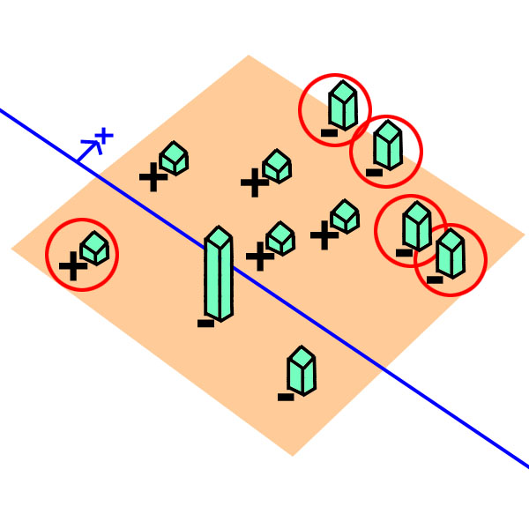
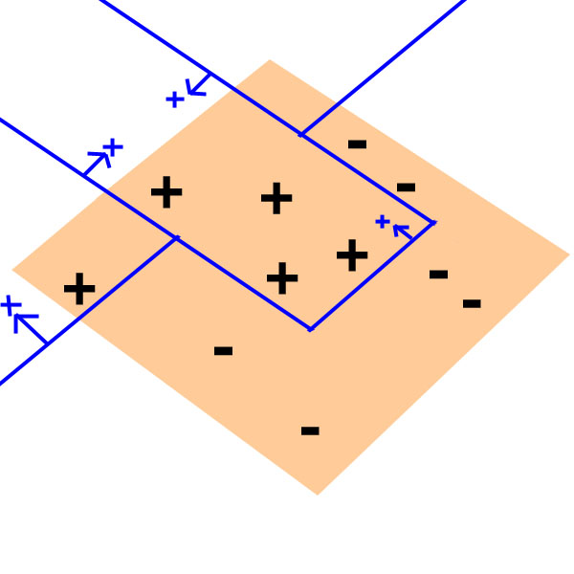
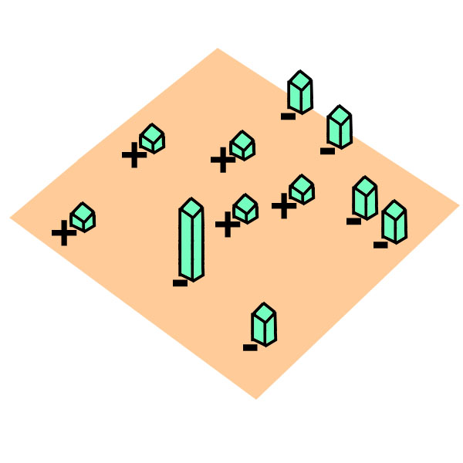
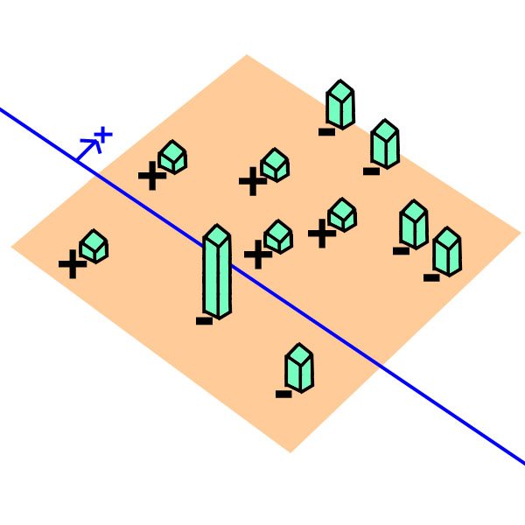
Viola Jones face detection algorithm
Haar features | Integral Image | Adaboost | Cascading
AdaBoost starts with a uniform distribution of “weights” over training examples.
Select the classifier with the lowest weighted error (i.e. a “weak” classifier)
Increase the weights on the training examples that were misclassified.
(Repeat)
At the end, carefully make a linear combination of the weak classifiers obtained at all iterations.
Slide taken from a presentation by Qing Chen, Discover Lab, University of Ottawa
Notes:
לספר לאנשים מה הם רואים
כל Weak classifier ממושקל (a) לפי ההצלחה שלו בפני עצמו.
ה Classifier החזק מנצחי לפי Weighted majority של המשקלים הללו.
מידע נוסף
לצירוף הלינארי בסוף הם קוראים Perceptron.

Slide 17







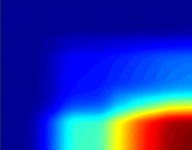

Training phase
Haar features | Integral Image | Adaboost | Cascading
Testing phase
Cascade trainer
Classifier cascade framework
Training
Set
(sub-windows)
Integral
Representation
Strong Classifier 1
(cascade stage 1)
Feature
computation
Strong Classifier 2
(cascade stage 2)
AdaBoost
Feature Selection
Strong Classifier N
(cascade stage N)
FACE IDENTIFIED
Slide courtesy: Kostantina Palla, University of Edinburgh
Notes:
בשר המאמר מתחיל בעצם עכשיו – עד עכשיו הדגמה.

Slide 18
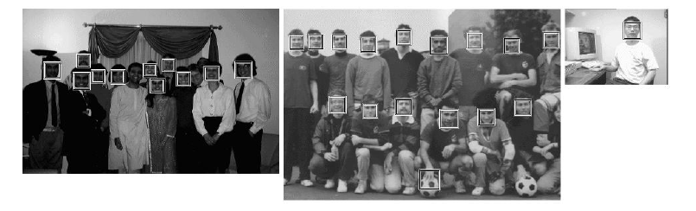
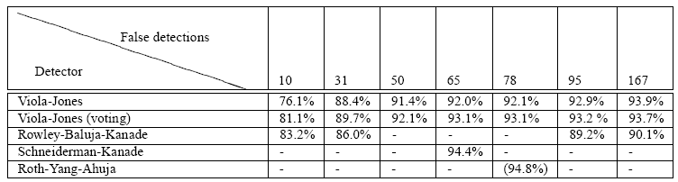
Viola Jones Results
Speed = 15 FPS (in 2001)
MIT + CMU face dataset

Slide 19
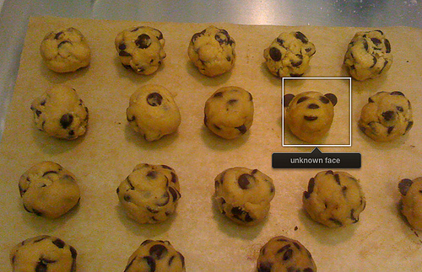

Slide 20
Strengths and Weaknesses of Statistical Template Approach
Strengths
Works very well for non-deformable objects: faces, cars, upright pedestrians
Fast detection
Quickly eliminate unlikely windows
Use features that are fast to compute
Choose threshold for low false negative rate
Weaknesses
Not so well for highly deformable objects
Not robust to occlusion
Requires lots of training data – 7 days of training

Slide 21
Dalal and Trigg – Pedestrian detection

Slide 22
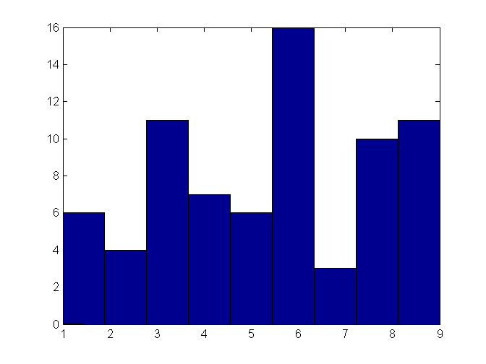

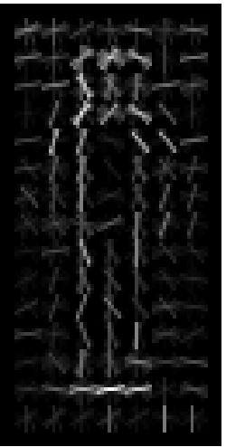
64
16 X 16
2 X 2 blocks
Concatenate the Hist
Determine the dominant direction
128
Quantize the gradient orientation in bins
0-20-40- … -180
Slides by Pete Barnum
Navneet Dalal and Bill Triggs, Histograms of Oriented Gradients for Human Detection, CVPR05

Slide 23
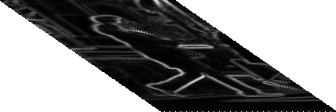
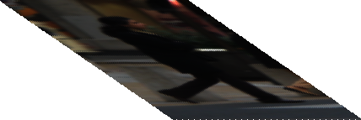

Descriptor Processing Chain
Object/Non-object
Linear SVM
[ ..., ..., ..., ...]
Collect HOGs over detection window
Contrast normalize over overlapping spatial cells
Weighted vote in spatial & orientation cells
Compute gradients
Gamma compression
Image Window
Slide Credit : Navneet Dalal, Bill Triggs
Notes:
Let me start with an overview of the encoding scheme algorithm. Don’t say anything think of phrase that a cell would activate neuron.
Why normalize…
We want invariance to color… so gradient information is necessary and we through away color information
The problem in detecting human is that appearance and pose changes lot. We want invariance to small movements. So spatial binning is required. David Lowe’s SIFT features are very good in describing people. But key here is because of different clothng, there are no interest points. Using the lessons learned from it, we do orientation binning.
One can put a linear SVM at this stage. But I will show that it is a bad idea. We want contrast normalization.
One may ask why we need overlapping. It is the same information being copied over, but key is with different normalization. Overlapping helps encode same information in multiple ways and brings invariance to small displacements of silhouttes.
We call it HOG.
Actual implementation differs bit. We perform steps 1—3 over the whole image.

Slide 24

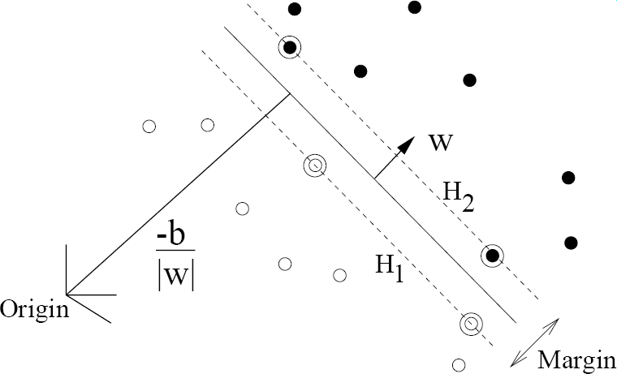
Overall Architecture
Learning Phase
Create normalised training data set
Encode images into feature vectors
Learn binary classifier
Object/Non-object decision
Slide Credit : Navneet Dalal, Bill Triggs, Derek Hoiem

Slide 25
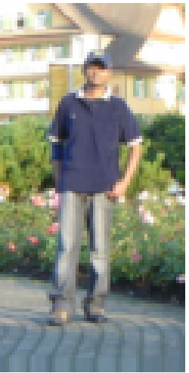
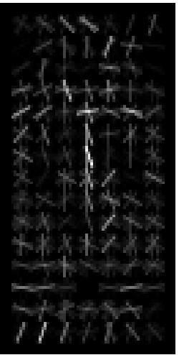
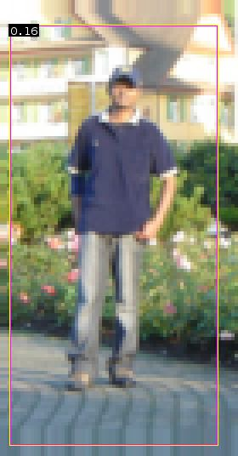
Overall Architecture
Detection Phase
Scan image at all scales and locations
Run classifier to obtain object/non-object decisions
Test Image
Fuse multiple detections in 3-D position & scale space
Object detections with bounding boxes
Weighted pos wts
Weighted neg wts
Picture Credit : Navneet Dalal, Bill Triggs

Slide 26
Video
http://lear.inrialpes.fr/pubs/2005/DT05/

Slide 27
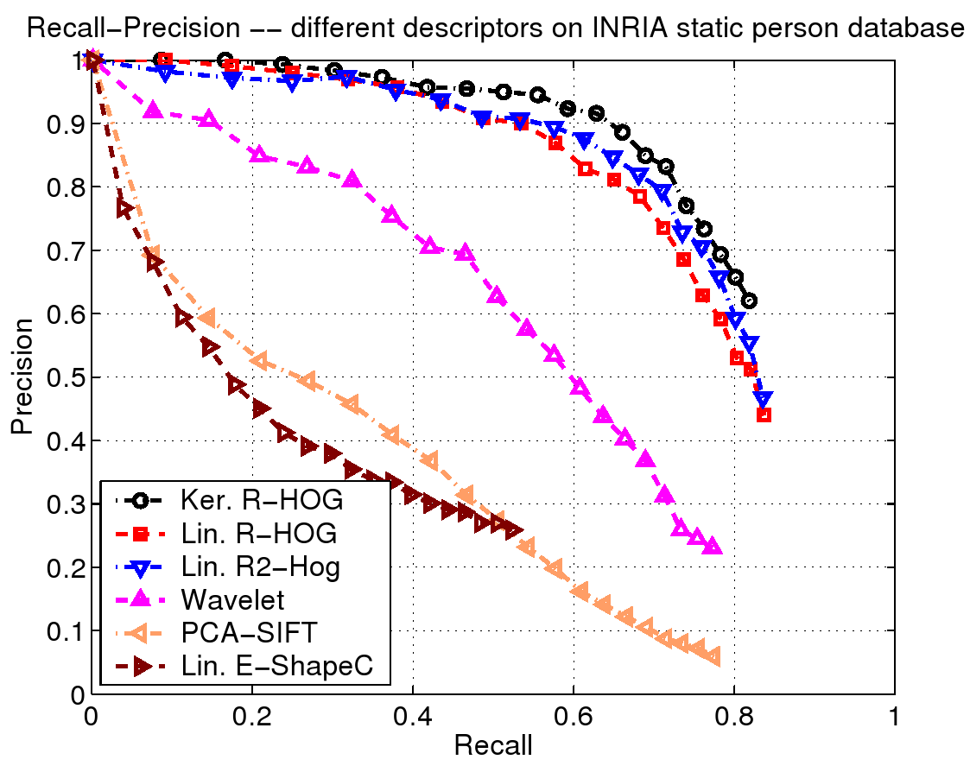
Overall Performance
Recall-precision on INRIA person database
R/C-HOG have 1-2 order lower false positives than other descriptors
Slide Credit : Navneet Dalal, Bill Triggs

Slide 28
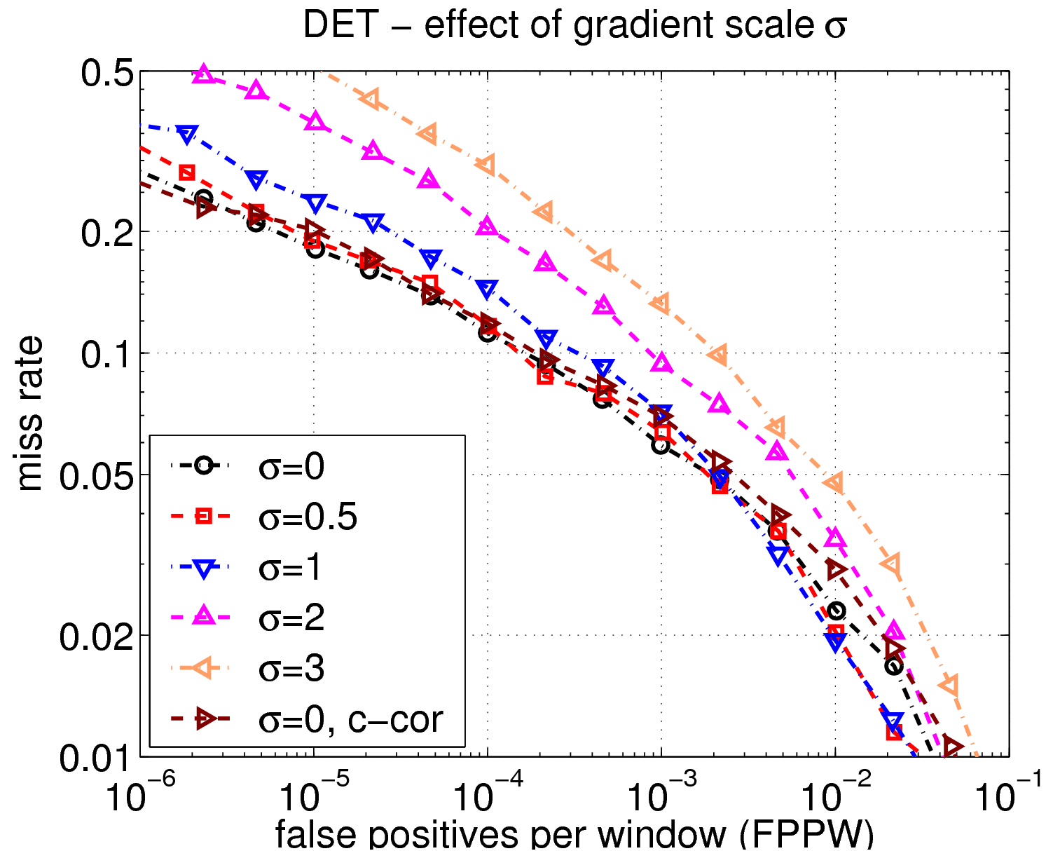
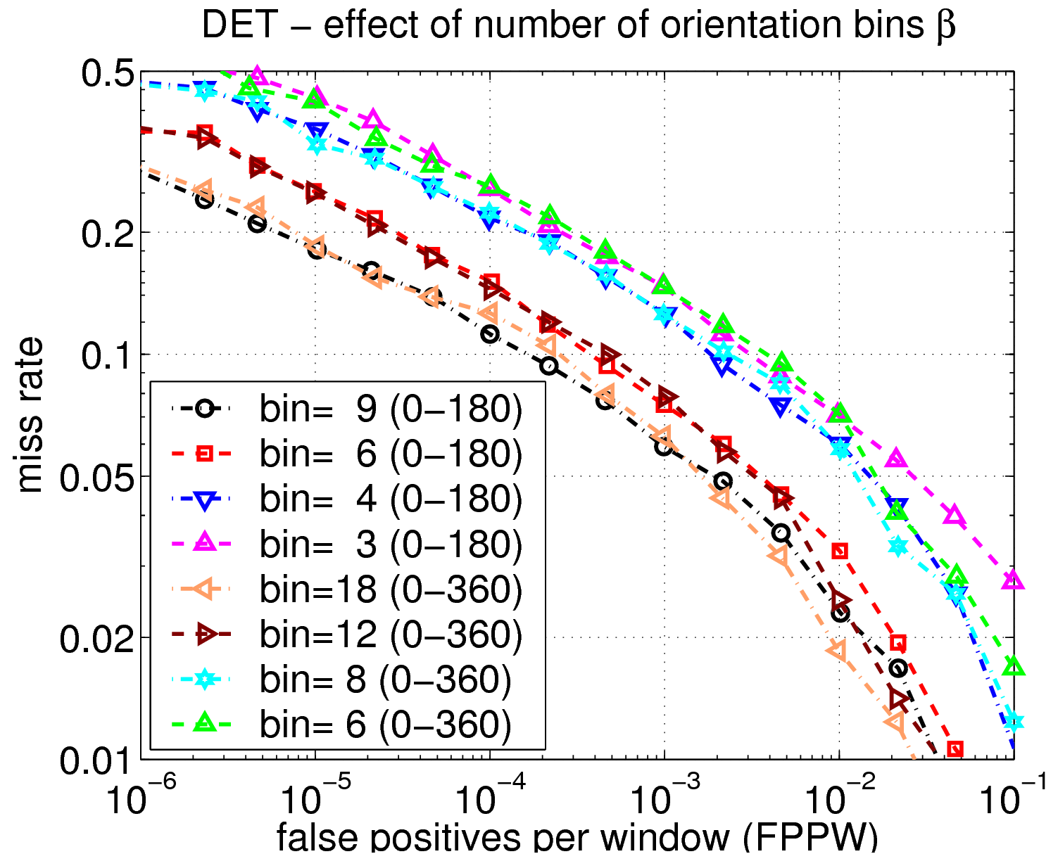
Effect of Parameters
Gradient smoothing, σ
Orientation bins, β
Using simple smoothed gradients and many orientations helps!
Gradient scale 3→ 0 ⇒ false positives drop by 10 times
Orientation bins 45˚→ 20˚ ⇒ false positives drop by 10 times
Slide Credit : Navneet Dalal, Bill Triggs

Slide 29
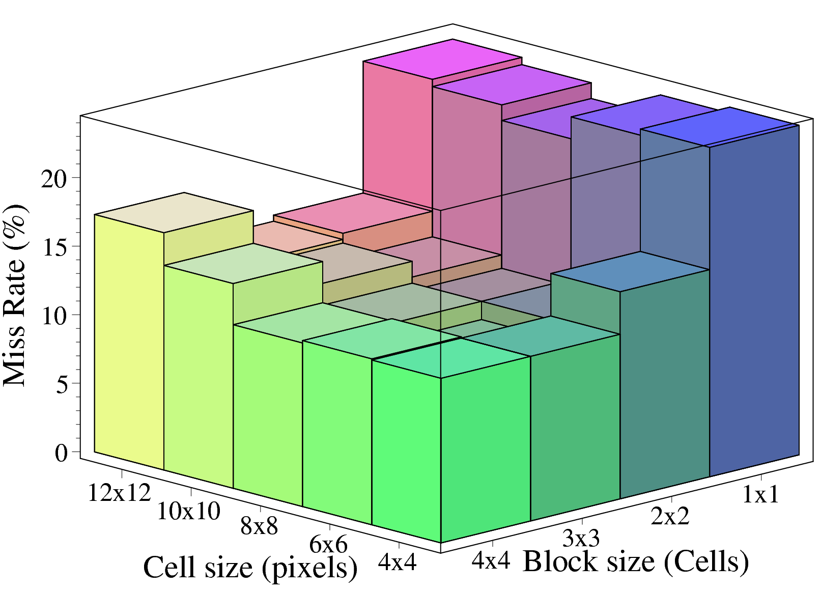

Effect of Block and Cell Size
64
128
Trade off between need for local spatial invariance and need for finer spatial resolution
Slide Credit : Navneet Dalal, Bill Triggs

Slide 30
Discussion
Simple
Useful even for noisy images
Robust detection
Real time detection
Limitations for deformable objects
Occlusion

Slide 31
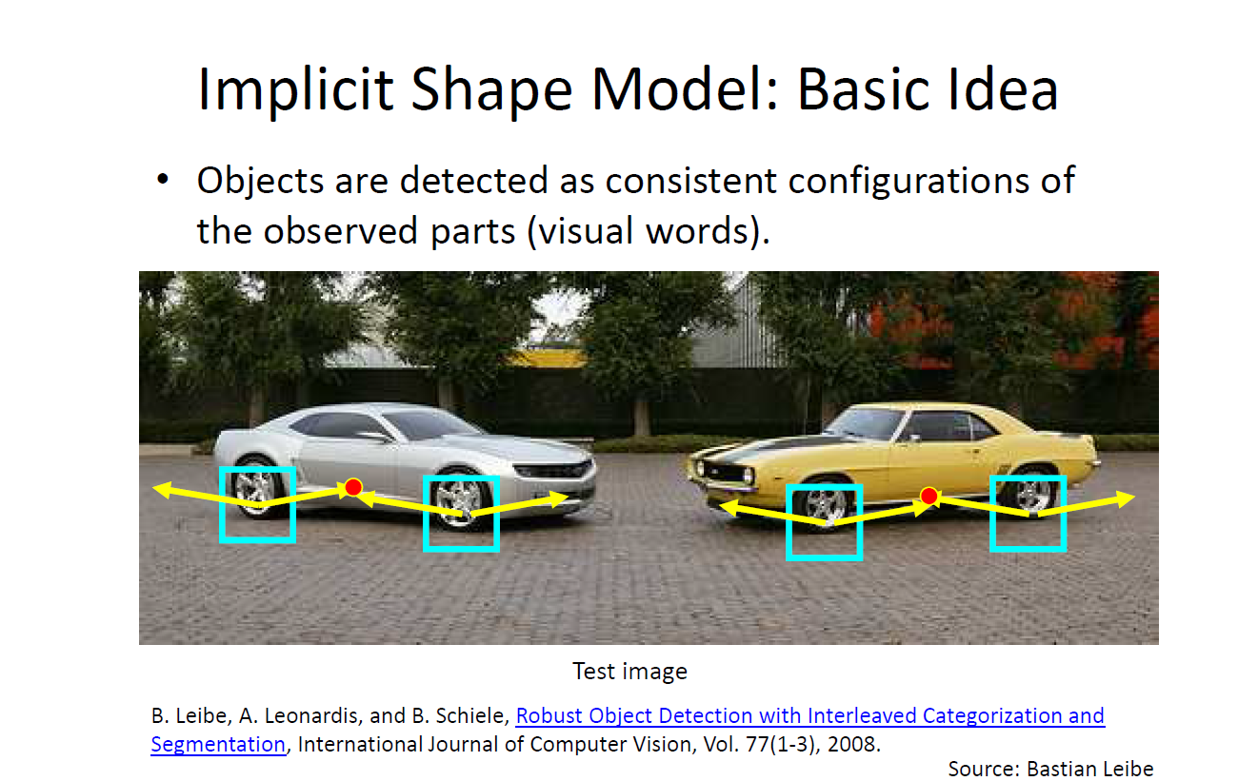
Consumer application: iPhoto 2009
Things iPhoto thinks are faces

Slide 32
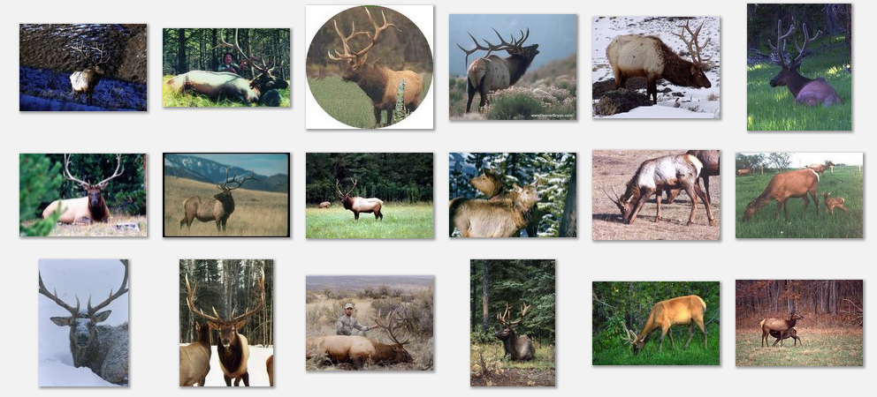
Deformable objects
Images from Caltech-256
Slide Credit: Duan Tran

Slide 33
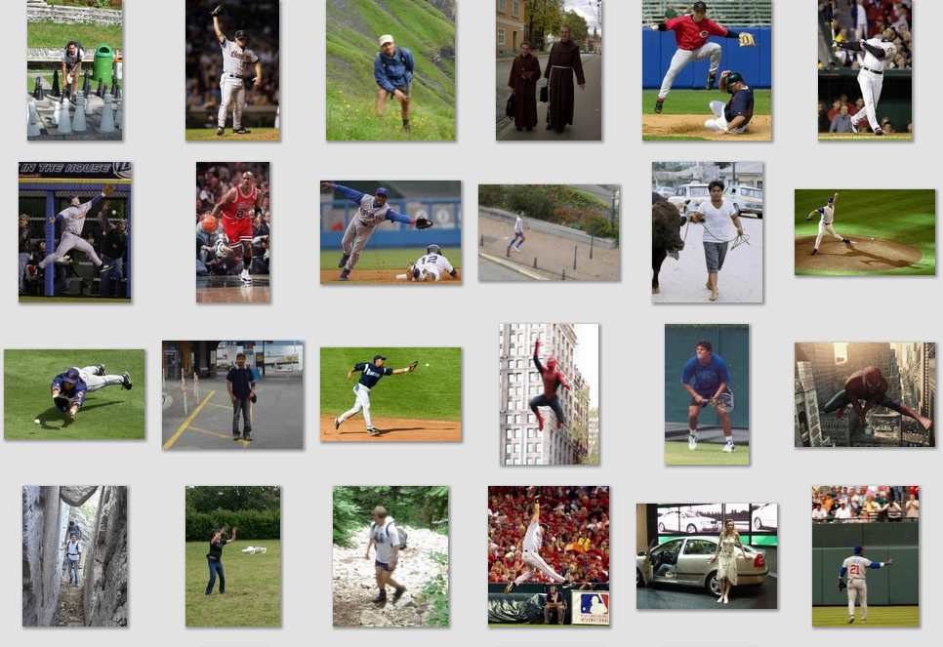
Deformable objects
Images from D. Ramanan’s dataset
Slide Credit: Duan Tran

Slide 34
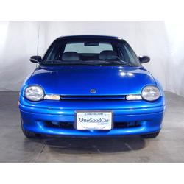
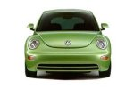
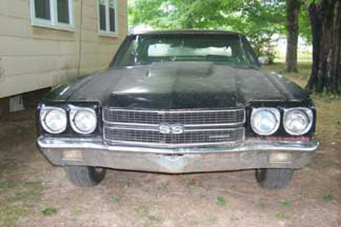
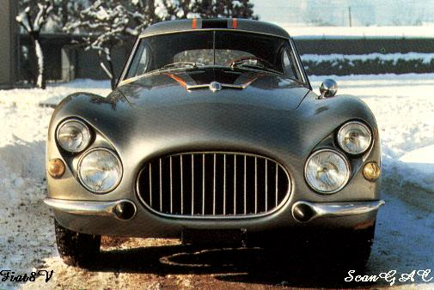
Parts-based Models
Define object by collection of parts modeled by
  Appearance
  Spatial configuration
Slide credit: Rob Fergus

Slide 35
How to model spatial relations?
One extreme: fixed template
Slide credit: Rob Fergus

Slide 36
How to model spatial relations?
Another extreme: bag of words
=
Slide credit: Rob Fergus

Slide 37
How to model spatial relations?
Star-shaped model
Part
Part
Part
Root
Part
Part
Slide credit: Rob Fergus

Slide 38
How to model spatial relations?
Star-shaped model
=
X
X
≈
Part
Part
Part
X
Root
Part
Part
Slide credit: Rob Fergus

Slide 39
How to model spatial relations?
Tree-shaped model
Slide credit: Rob Fergus

Slide 40
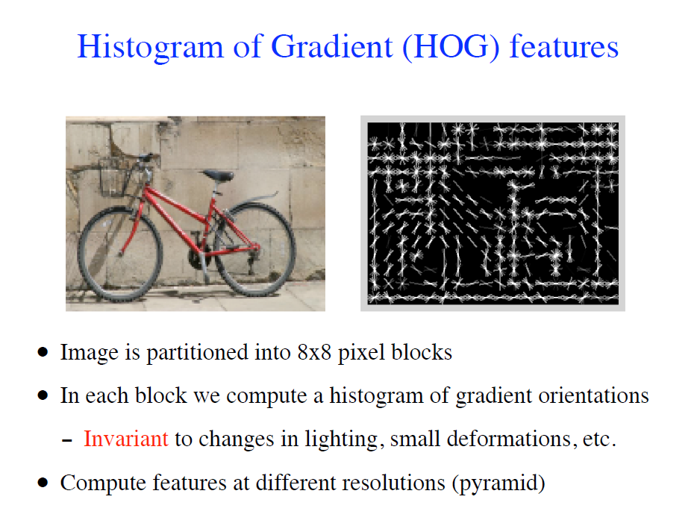

Slide 41
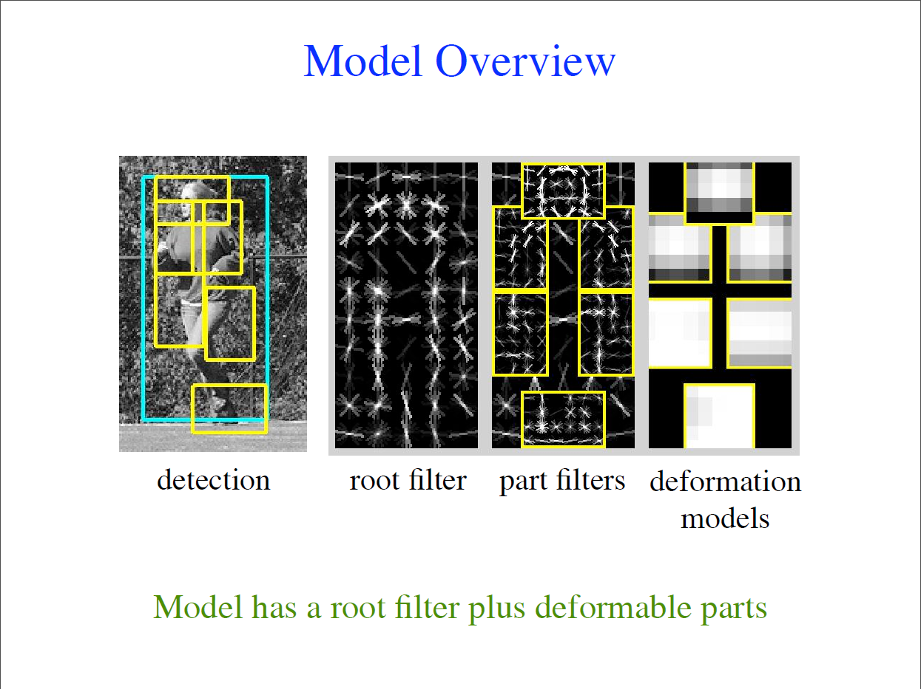
Slide credit : P. F. Felzenszwalb

Slide 42
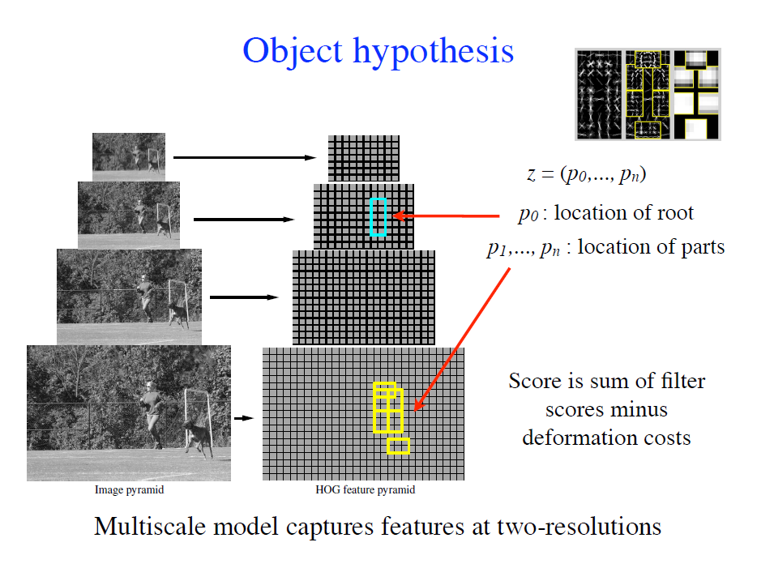

Slide 43

Slide credit : P. F. Felzenszwalb

Slide 44

Slide credit : P. F. Felzenszwalb

Slide 45

Slide credit : P. F. Felzenszwalb

Slide 46
General Process of Object Detection
Specify Object Model
What are the object parameters?
Generate Hypotheses
Resolve Detections
Slide credit : Derek Hoiem

Slide 47



Specifying an object model
Images from Felzenszwalb

Slide 48
General Process of Object Recognition
Specify Object Model
Generate Hypotheses
Propose an alignment of the model to the image
Resolve Detections
Slide credit : Derek Hoiem

Slide 49

Generating hypotheses
Sliding window
  Test patch at each location and scale
Slide credit : Derek Hoiem

Slide 50
Generating hypotheses
Sliding window
  Test patch at each location and scale
Slide credit : Derek Hoiem

Slide 51
General Process of Object Recognition
Specify Object Model
Generate Hypotheses
Resolve Detections
Rescore each proposed object based on whole set
Slide credit : Derek Hoiem

Slide 52

Resolving detection scores
Non-max suppression
Context based
Hoiem et al. 2006
Slide credit : Derek Hoiem

Slide 53

Slide credit : PASCAL 2012

Slide 54

Grammar of Object Recognition
Slide credit : PASCAL 2012

Slide 55














Object detection is a collection of problems
Intra-class Variation for “Airplane”
Occlusion
Shape
Viewpoint
Distance
Slide credit : Derek Hoiem
Notes:
Object category detection is really a collection of problems. You have to organize instances and learn sets of appearance models that are robust to occlusion and encode variations due to viewpoint, distance, and different object examples.
Object detection is a complex problem. Categories are hetergeneous: examples from the same category may look quite different from each other. Variations are due to different object examples, viewpoint, distance, and occlusion. At the same time, non-objects may fit the object appearance model due to random background textures, semantically similar objects, dissimilar objects
, involving differ a collection of objects with varying viewpoint, distance, and degrees of occlusion

Slide 56
Object detection is a collection of problems
Confusing Distractors for “Airplane”
Similar Categories
Dissimilar Categories
Localization Error
Background
Slide credit : Derek Hoiem
Notes:
Varied examples of the object category must be differentiated from various distractors: random background textures, semantically similar objects, dissimilar objects, or misaligned examples.

Slide 57











Top false positives: Airplane (DPM)
AP = 0.36
1
5
3
4
27
37
Background
27%
Localization
29%
Other Objects
11%
Similar Objects
33%
Bird, Boat, Car
30
6
2
33
Impact of Removing/Fixing FPs
7
Slide credit : Derek Hoiem
Notes:
Animate.

Slide 58











Top false positives: Dog (DPM)
AP = 0.03
1
6
16
Localization
17%
2
4
5
Background
23%
Other Objects
10%
Similar Objects
50%
Person, Cat, Horse
8
3
9
22
Impact of Removing/Fixing FPs
10
Slide credit : Derek Hoiem

Slide 59
Top false positives: Dog (MKL)
Background
4%
AP = 0.17
Other Objects
5%
Localization
17%
Impact of Removing/Fixing FPs
Similar Objects
74%
Cow, Person, Sheep, Horse
Top 5 FP
Slide credit : Derek Hoiem
Notes:
Most promising directions for improvement vary by detector and can be discovered with analysis

Slide 60


Summary of False Positive Analysis
DPM v4
(FGMR 2010)
MKL
(Vedaldi et al. 2009)
Slide credit : Derek Hoiem
Notes:
Both: biggest improvement through localization error. For animals and vehicles, small improvement by removing false positives due to background and dissimilar objects. The MKL detector makes more reasonable mistakes on animals than the DPM detector.

Slide 61
Acknowledgement
Dr. Derek Hoiem
Dr. Ross Grishik
Dr. K Grauman
PASCAL
Dr. P Felzenszwalb
Dr. Rob Fergus
Dr. Duan Tran
Dr. Navneet Dalal
Dr. Kostantina Palla
Dr. Devi Parikh

Slide 62
Useful links
http://research.microsoft.com/apps/video/default.aspx?id=104158
http://www.youtube.com/watch?v=0Zib1YEE4LU
http://www.youtube.com/watch?v=WfdYYNamHZ8

Slide 63
Questions

Slide 64
Thank you

