Slide 1
ECE 5984: Introduction to Machine Learning
Topics:
(Finish) Nearest Neighbour
Readings: Barber 14 (kNN)
Dhruv Batra
Virginia Tech

Slide 2
Administrativia
HW0
Graded. Grades available on Scholar.
Everyone passed.
Some are on the border. Please come see me.
Solutions available Wed.
HW1
Out today
Due on Sunday 02/15, 11:55pm
Please please please please please start early
Implement K-NN
Kaggle Competition
Bonus points for best performing entries.
Bonus points for beating the instructor/TA.
http://inclass.kaggle.com/c/VT-ECE-Machine-Learning-HW1

Slide 3
Recap from last time

Slide 4
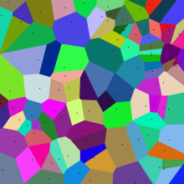
Nearest Neighbours
Image Credit: Wikipedia

Slide 5
Instance/Memory-based Learning
Four things make a memory based learner:
A distance metric
How many nearby neighbors to look at?
A weighting function (optional)
How to fit with the local points?
Slide Credit: Carlos Guestrin

Slide 6
1-Nearest Neighbour
Four things make a memory based learner:
A distance metric
Euclidean (and others)
How many nearby neighbors to look at?
1
A weighting function (optional)
unused
How to fit with the local points?
Just predict the same output as the nearest neighbour.
Slide Credit: Carlos Guestrin

Slide 7
1-NN for Regression
Here, this is the closest datapoint
Here, this is the closest datapoint
Here, this is the closest datapoint
Here, this is the closest datapoint
y
x
Figure Credit: Carlos Guestrin

Slide 8
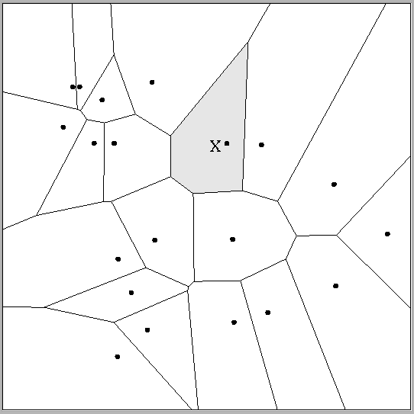
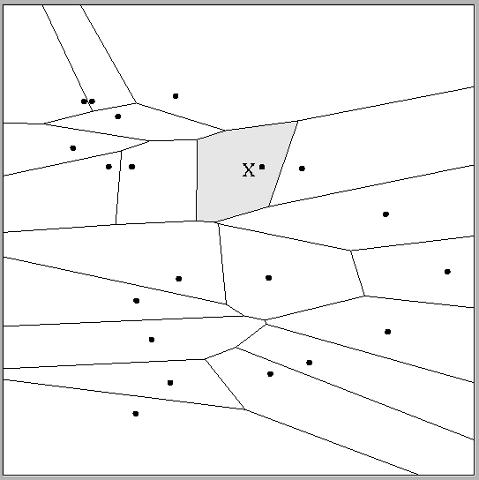
Multivariate distance metrics
Suppose the input vectors x₁, x₂, …x_{N} are two dimensional:
x₁ = ( x₁₁ , x₁₂ ) , x₂ = ( x₂₁ , x₂₂ ) , …x_{N} = ( x_{N1} , x_{N2} ).
One can draw the nearest-neighbor regions in input space.
 | Dist(x_{i},x_{j}) =(x_{i1} – x_{j1})²+(3x_{i2} – 3x_{j2})²
Dist(x_{i},x_{j}) = (x_{i1} – x_{j1})² + (x_{i2} – x_{j2})²
The relative scalings in the distance metric affect region shapes
Slide Credit: Carlos Guestrin

Slide 9
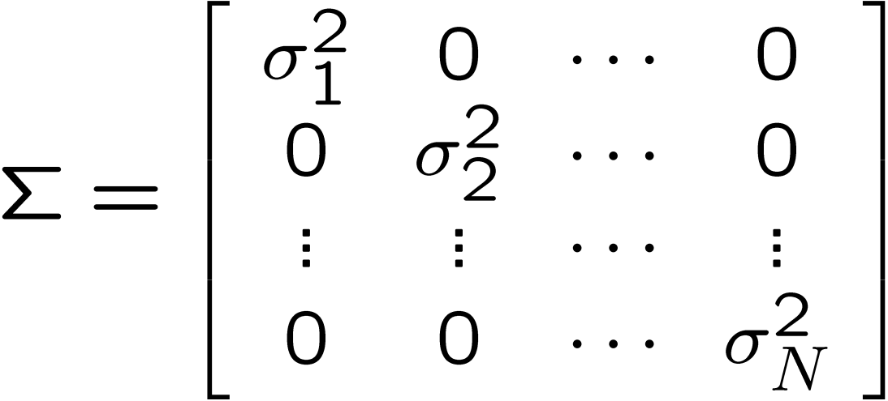
Euclidean distance metric
Or equivalently,
where
A
Slide Credit: Carlos Guestrin

Slide 10
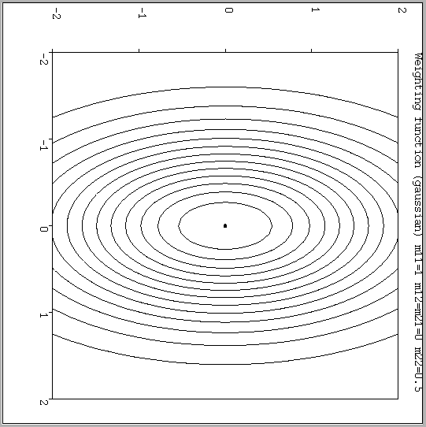
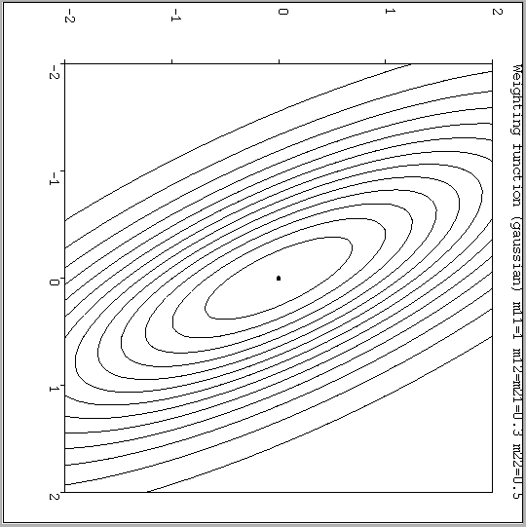
Notable distance metrics (and their level sets)
Scaled Euclidian (L₂)
Mahalanobis (non-diagonal A)
Slide Credit: Carlos Guestrin

Slide 11
Minkowski distance
Image Credit: By Waldir (Based on File:MinkowskiCircles.svg) [CC BY-SA 3.0 (http://creativecommons.org/licenses/by-sa/3.0)], via Wikimedia Commons

Slide 12
Notable distance metrics (and their level sets)
Scaled Euclidian (L₂)
L₁ norm (absolute)
Mahalanobis (non-diagonal A)
Slide Credit: Carlos Guestrin
L_{inf} (max) norm

Slide 13
Plan for today
(Finish) Nearest Neighbour
Kernel Classification/Regression
Curse of Dimensionality

Slide 14
Weighted k-NNs
Neighbors are not all the same

Slide 15
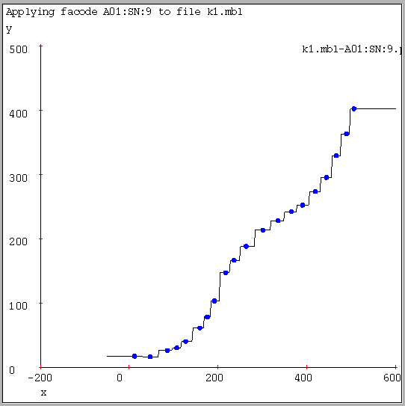
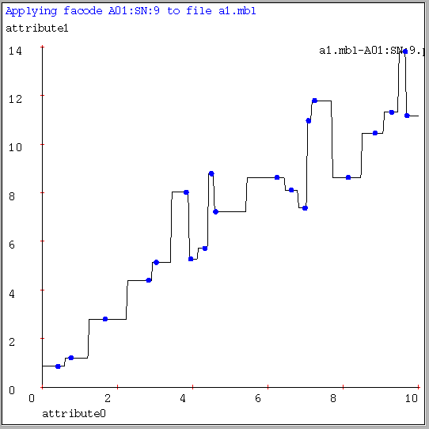
1-NN for Regression
Often bumpy (overfits)
Figure Credit: Andrew Moore

Slide 16
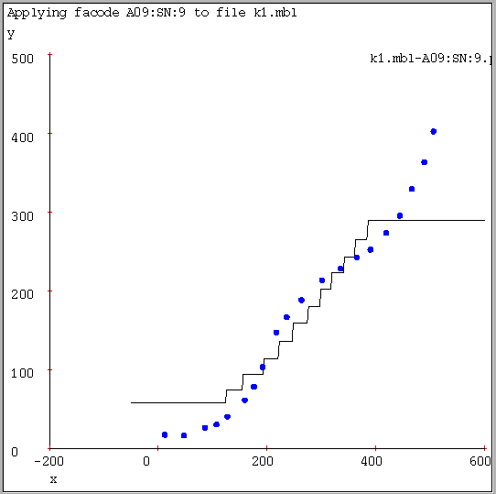
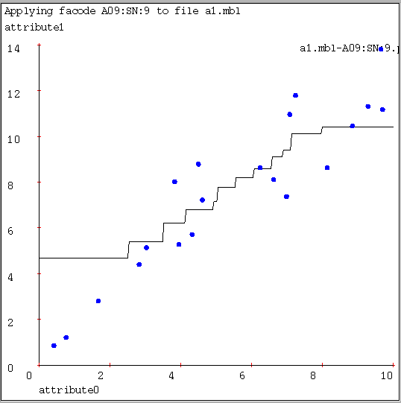
9-NN for Regression
Often bumpy (overfits)
Figure Credit: Andrew Moore

Slide 17
Kernel Regression/Classification
Four things make a memory based learner:
A distance metric
Euclidean (and others)
How many nearby neighbors to look at?
All of them
A weighting function (optional)
w_{i} = exp(-d(x_{i}, query)² / σ²)
Nearby points to the query are weighted strongly, far points weakly. The σ parameter is the Kernel Width. Very important.
How to fit with the local points?
Predict the weighted average of the outputs
predict = Σw_{i}y_{i} / Σw_{i}
Slide Credit: Carlos Guestrin

Slide 18
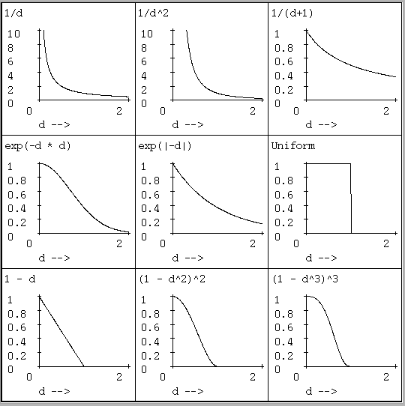
Weighting/Kernel functions
w_{i} = exp(-d(x_{i}, query)² / σ²)
(Our examples use Gaussian)
Slide Credit: Carlos Guestrin

Slide 19
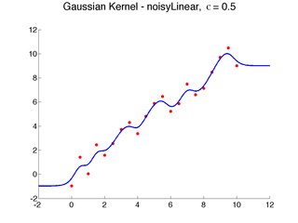
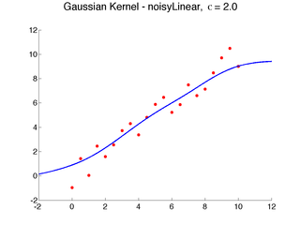
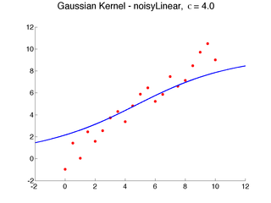
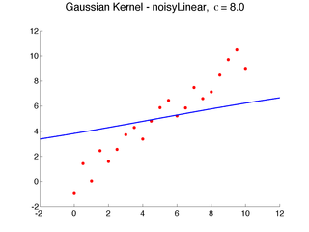
Effect of Kernel Width
What happens as σ→inf?
What happens as σ→0?
Image Credit: Ben Taskar

Slide 20
Problems with Instance-Based Learning
Expensive
No Learning: most real work done during testing
For every test sample, must search through all dataset – very slow!
Must use tricks like approximate nearest neighbour search
Doesn’t work well when large number of irrelevant features
Distances overwhelmed by noisy features
Curse of Dimensionality
Distances become meaningless in high dimensions
(See proof in next lecture)

Slide 21
Curse of Dimensionality
Consider: Sphere of radius 1 in d-dims
Consider: an outer ε-shell in this sphere
What is ?

Slide 22
Curse of Dimensionality

Slide 23
What you need to know
k-NN
Simplest learning algorithm
With sufficient data, very hard to beat “strawman” approach
Picking k?
Kernel regression/classification
Set k to n (number of data points) and chose kernel width
Smoother than k-NN
Problems with k-NN
Curse of dimensionality
Irrelevant features often killers for instance-based approaches
Slow NN search: Must remember (very large) dataset for prediction

Slide 24
What you need to know
Key Concepts (which we will meet again)
Supervised Learning
Classification/Regression
Loss Functions
Statistical Estimation
Training vs Testing Data
Hypothesis Class
Overfitting, Generalization

