Slide 1
ECE 5984: Introduction to
Machine Learning
Topics:
  (Finish) Expectation Maximization
  Principal Component Analysis (PCA)
Readings: Barber 15.1-15.4
Dhruv Batra
Virginia Tech

Slide 2
Administrativia
Poster Presentation:
  May 8 1:30-4:00pm
  310 Kelly Hall: ICTAS Building
  Print poster (or bunch of slides)
  Format:
    Portrait
    Make 1 dimen = 36in
    Board size = 30x40
  Less text, more pictures.
Best Project Prize!

Slide 3
Administrativia
Final Exam
  When: May 11 7:45-9:45am
  Where: In class
  Format: Pen-and-paper.
  Open-book, open-notes, closed-internet.
    No sharing.
  What to expect: mix of
    Multiple Choice or True/False questions
    “Prove this statement”
    “What would happen for this dataset?”
  Material
    Everything!
    Focus on the recent stuff.
    Exponentially decaying weights? Optimal policy?

Slide 4
Recap of Last Time

Slide 5
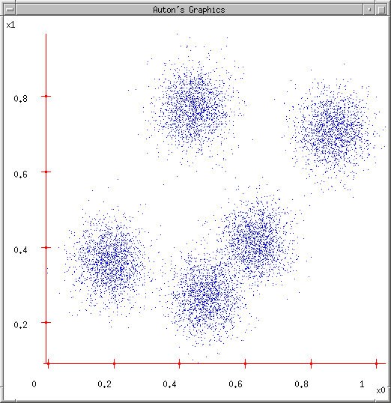
K-means
Ask user how many clusters they’d like. (e.g. k=5)
Randomly guess k cluster Center locations
Each datapoint finds out which Center it’s closest to.
Each Center finds the centroid of the points it owns…
…and jumps there
…Repeat until terminated!
Slide Credit: Carlos Guestrin

Slide 6
K-means as Co-ordinate Descent
Optimize objective function:
Fix μ, optimize a (or C)
  Assignment Step
Fix a (or C), optimize μ
  Recenter Step
Slide Credit: Carlos Guestrin

Slide 7
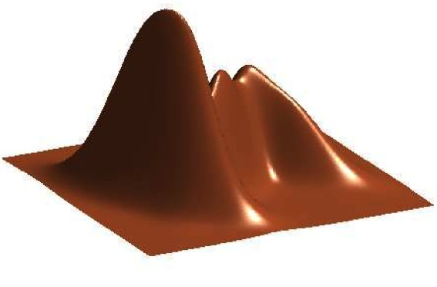
GMM
Figure Credit: Kevin Murphy

Slide 8
K-means vs GMM
K-Means
  http://home.deib.polimi.it/matteucc/Clustering/tutorial_html/AppletKM.html
GMM
  http://www.socr.ucla.edu/applets.dir/mixtureem.html

Slide 9
EM
Expectation Maximization [Dempster ‘77]
Often looks like “soft” K-means
Extremely general
Extremely useful algorithm
  Essentially THE goto algorithm for unsupervised learning
Plan
  EM for learning GMM parameters
  EM for general unsupervised learning problems

Slide 10
EM for Learning GMMs
Simple Update Rules
  E-Step: estimate P(z_{i} = j | x_{i})
  M-Step: maximize full likelihood weighted by posterior

Slide 11
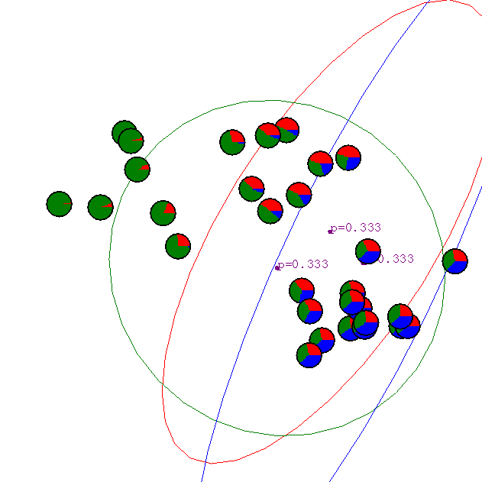
Gaussian Mixture Example: Start
Slide Credit: Carlos Guestrin

Slide 12
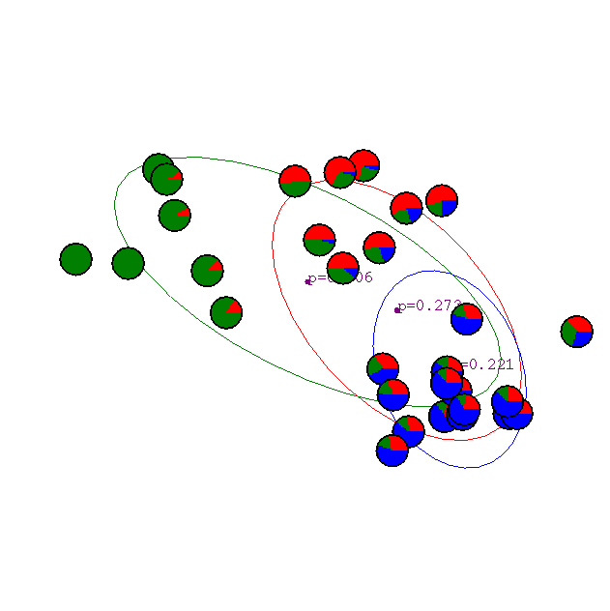
After 1st iteration
Slide Credit: Carlos Guestrin

Slide 13

After 2nd iteration
Slide Credit: Carlos Guestrin

Slide 14

After 3rd iteration
Slide Credit: Carlos Guestrin

Slide 15

After 4th iteration
Slide Credit: Carlos Guestrin

Slide 16

After 5th iteration
Slide Credit: Carlos Guestrin

Slide 17

After 6th iteration
Slide Credit: Carlos Guestrin

Slide 18

After 20th iteration
Slide Credit: Carlos Guestrin

Slide 19
General Mixture Models
P(x | z) | P(z) | Name
Gaussian | Categorial | GMM
Multinomial | Categorical | Mixture of Multinomials
Categorical | Dirichlet | Latent Dirichlet Allocation

Slide 20
Mixture of Bernoullis

Slide 21
The general learning problem with missing data
Marginal likelihood – x is observed, z is missing:

Slide 22
Applying Jensen’s inequality
Use: log ∑_{z} P(z) f(z) ≥ ∑_{z} P(z) log f(z)

Slide 23
Convergence of EM
Define potential function F(θ,Q):
EM corresponds to coordinate ascent on F
  Thus, maximizes lower bound on marginal log likelihood

Slide 24
EM is coordinate ascent
E-step: Fix θ^{(t)}, maximize F over Q:
  “Realigns” F with likelihood:

Slide 25
EM is coordinate ascent
M-step: Fix Q^{(t)}, maximize F over θ
Corresponds to weighted dataset:
  <x₁,z=1> with weight Q^{(t+1)}(z=1|x₁)
  <x₁,z=2> with weight Q^{(t+1)}(z=2|x₁)
  <x₁,z=3> with weight Q^{(t+1)}(z=3|x₁)
  <x₂,z=1> with weight Q^{(t+1)}(z=1|x₂)
  <x₂,z=2> with weight Q^{(t+1)}(z=2|x₂)
  <x₂,z=3> with weight Q^{(t+1)}(z=3|x₂)
  …

Slide 26
EM Intuition

Slide 27
What you should know
K-means for clustering:
  algorithm
  converges because it’s coordinate ascent
EM for mixture of Gaussians:
  How to “learn” maximum likelihood parameters (locally max. like.) in the case of unlabeled data
EM is coordinate ascent
Remember, E.M. can get stuck in local minima, and empirically it DOES
General case for EM
Slide Credit: Carlos Guestrin

Slide 28
Tasks
x
Classification
y
Discrete
x
Regression
y
Continuous
x
Clustering
c
Discrete ID
x
Dimensionality
Reduction
z
Continuous

Slide 29
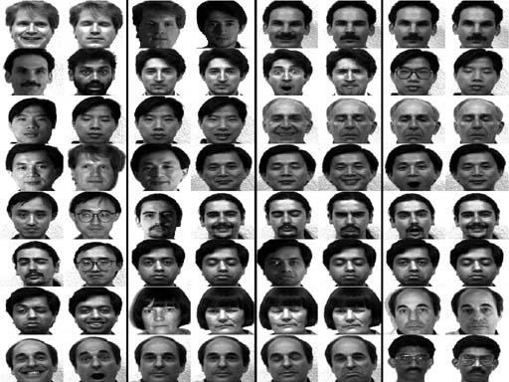
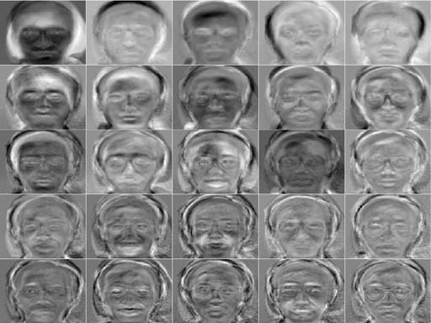
New Topic: PCA

Slide 30
Synonyms
Principal Component Analysis
Karhunen–Loève transform
Eigen-Faces
Eigen-<Insert-your-problem-domain>
PCA is a Dimensionality Reduction Algorithm
Other Dimensionality Reduction algorithms
  Linear Discriminant Analysis (LDA)
  Independent Component Analysis (ICA)
  Local Linear Embedding (LLE)
  …

Slide 31
Dimensionality reduction
Input data may have thousands or millions of dimensions!
  e.g., images have 5M pixels
Dimensionality reduction:
represent data with fewer dimensions
  easier learning – fewer parameters
  visualization – hard to visualize more than 3D or 4D
  discover “intrinsic dimensionality” of data
    high dimensional data that is truly lower dimensional

Slide 32
Dimensionality Reduction
Demo
  http://lcn.epfl.ch/tutorial/english/pca/html/
  http://setosa.io/ev/principal-component-analysis/

Slide 33
PCA / KL-Transform
De-correlation view
  Make features uncorrelated
  No projection yet
Max-variance view:
  Project data to lower dimensions
  Maximize variance in lower dimensions
Synthesis / Min-error view:
  Project data to lower dimensions
  Minimize reconstruction error
All views lead to same solution

