Slide 1
ECE 5984: Introduction to
Machine Learning
Topics:
  Decision/Classification Trees
Readings: Murphy 16.1-16.2; Hastie 9.2
Dhruv Batra
Virginia Tech

Slide 2
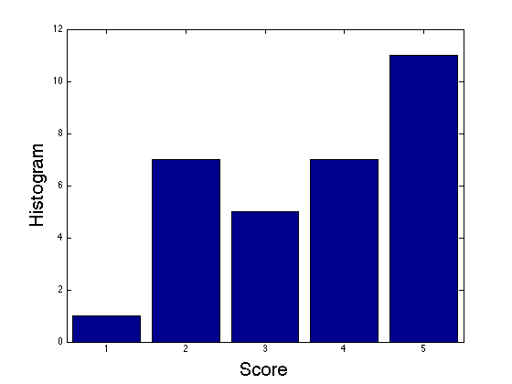
Project Proposals Graded
Mean 3.6/5 = 72%

Slide 3
Administrativia
Project Mid-Sem Spotlight Presentations
  Friday: 5-7pm, 3-5pm Whittemore 654 457A
  5 slides (recommended)
  4 minute time (STRICT) + 1-2 min Q&A
  Tell the class what you’re working on
  Any results yet?
  Problems faced?
  Upload slides on Scholar

Slide 4
Recap of Last Time

Slide 5
Convolution Explained
http://setosa.io/ev/image-kernels/
https://github.com/bruckner/deepViz

Slide 6
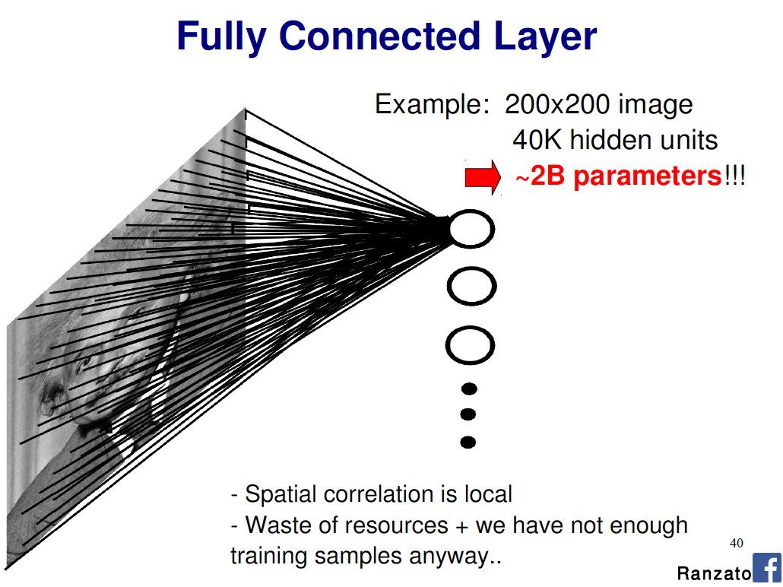
Slide Credit: Marc'Aurelio Ranzato

Slide 7
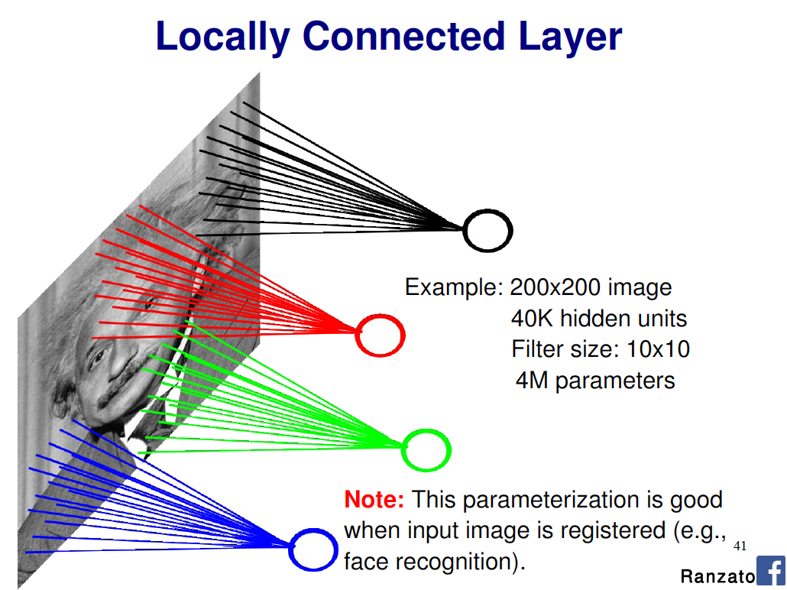
Slide Credit: Marc'Aurelio Ranzato

Slide 8
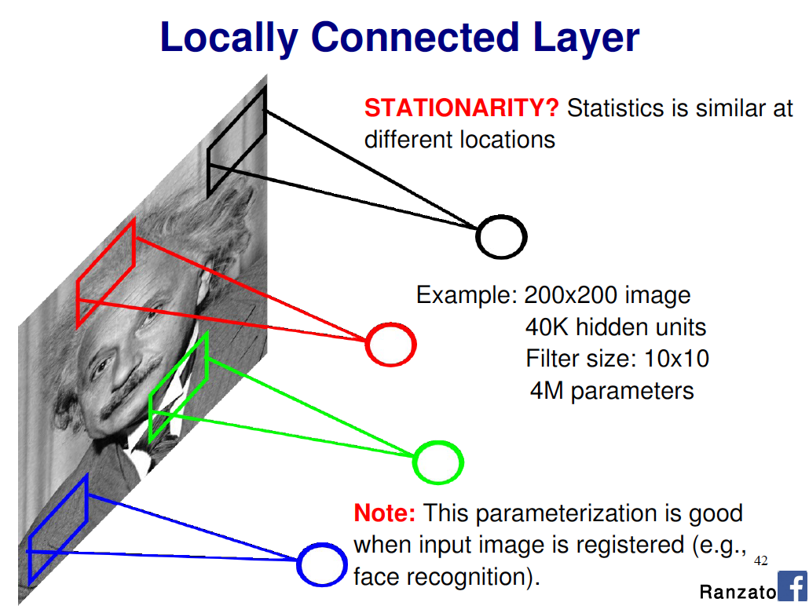
Slide Credit: Marc'Aurelio Ranzato

Slide 9
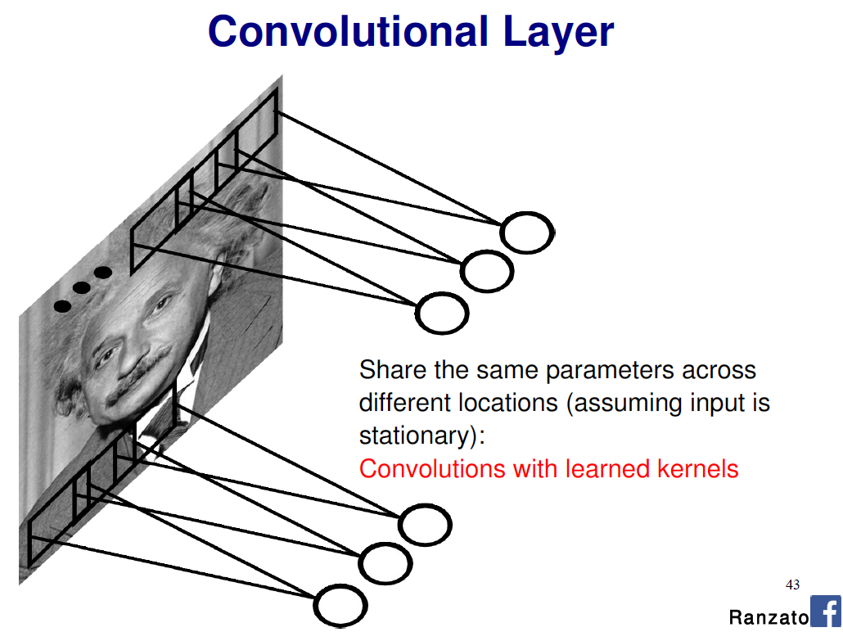
Slide Credit: Marc'Aurelio Ranzato

Slide 10
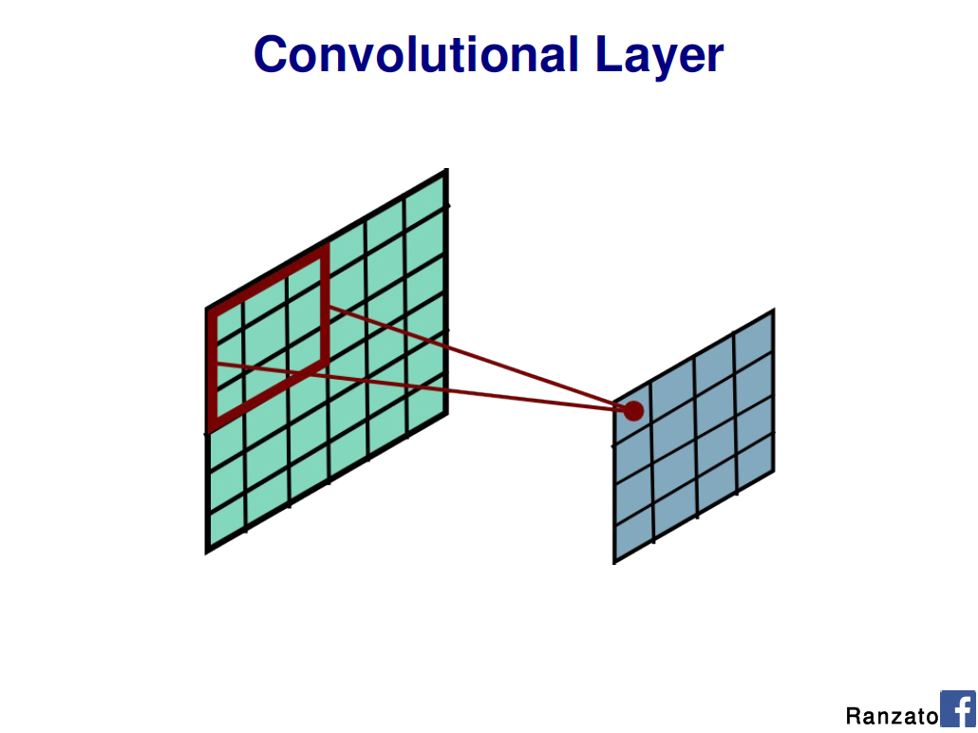
Slide Credit: Marc'Aurelio Ranzato

Slide 11
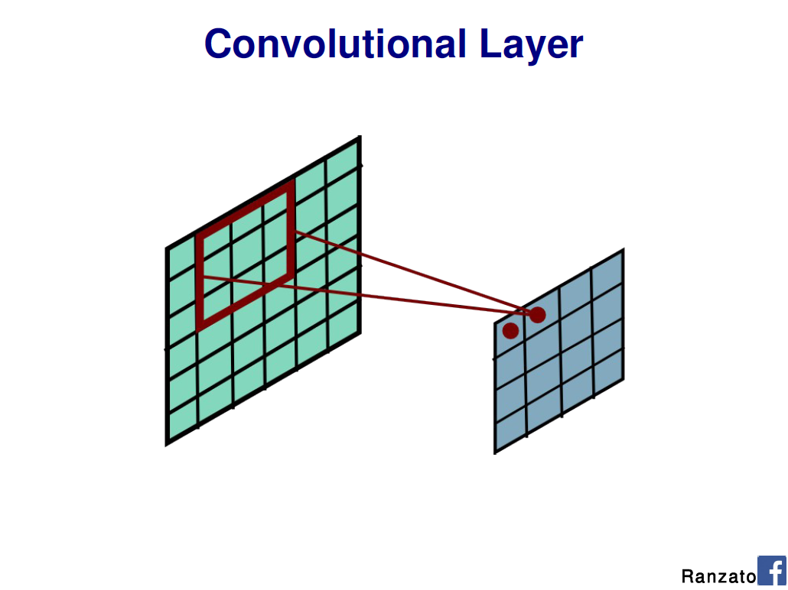
Slide Credit: Marc'Aurelio Ranzato

Slide 12
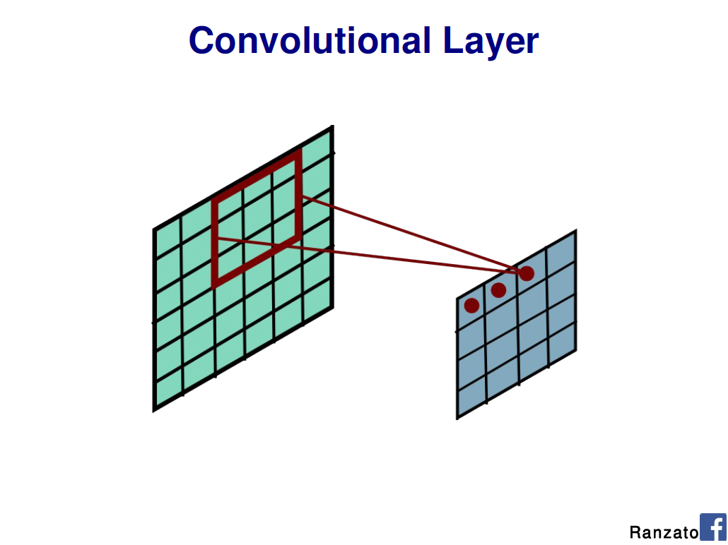
Slide Credit: Marc'Aurelio Ranzato

Slide 13
Slide Credit: Marc'Aurelio Ranzato

Slide 14
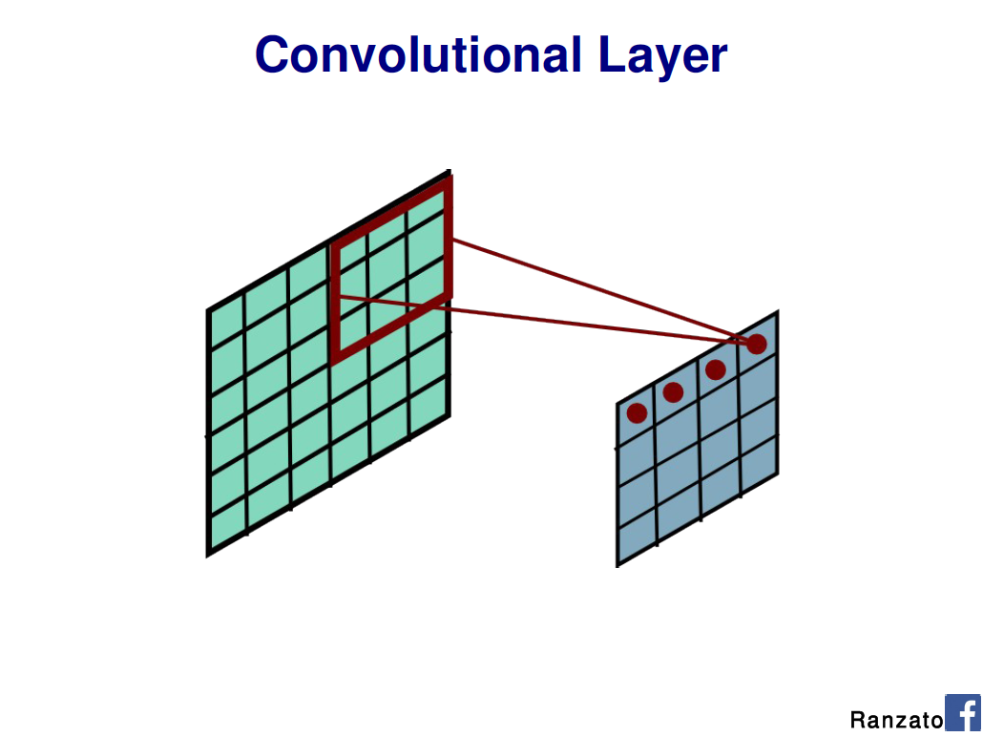
Slide Credit: Marc'Aurelio Ranzato

Slide 15

Slide Credit: Marc'Aurelio Ranzato

Slide 16
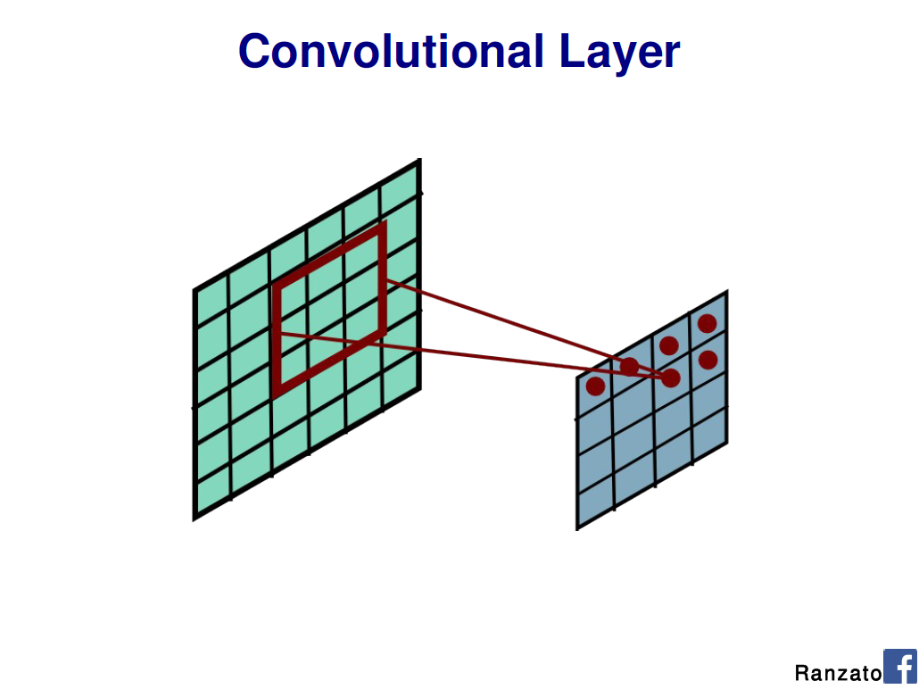
Slide Credit: Marc'Aurelio Ranzato

Slide 17

Slide Credit: Marc'Aurelio Ranzato

Slide 18
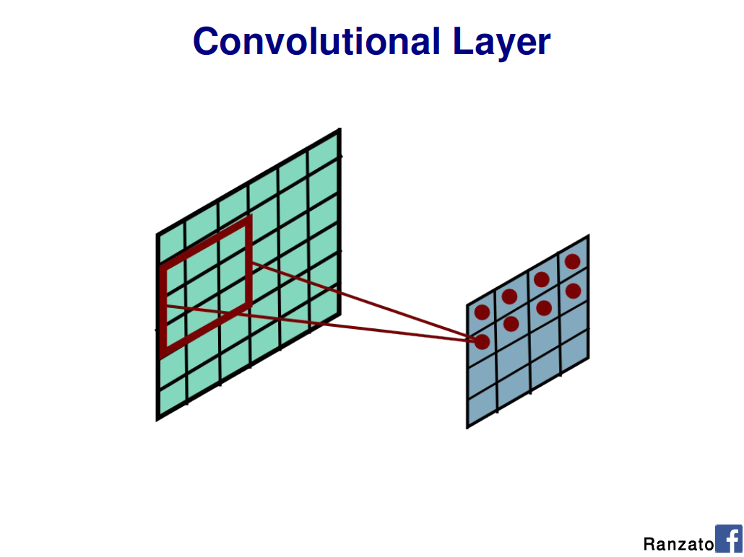
Slide Credit: Marc'Aurelio Ranzato

Slide 19
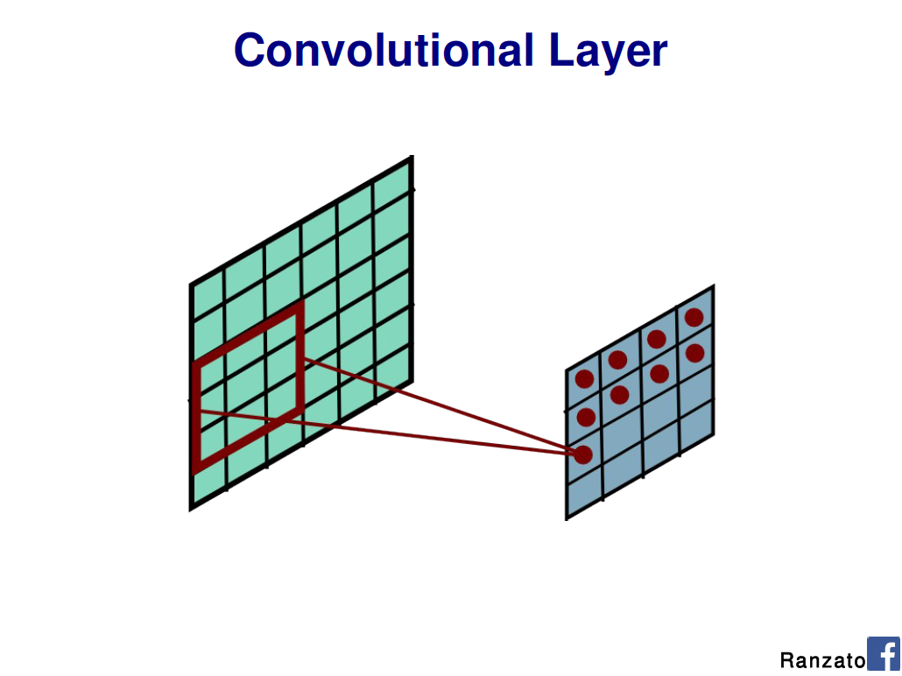
Slide Credit: Marc'Aurelio Ranzato

Slide 20
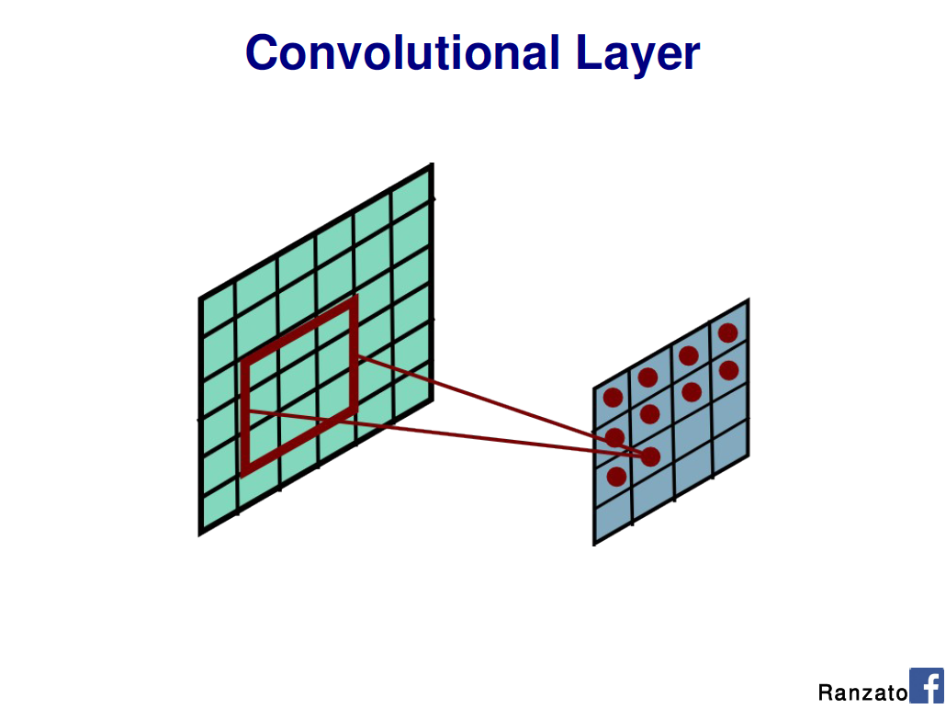
Slide Credit: Marc'Aurelio Ranzato

Slide 21
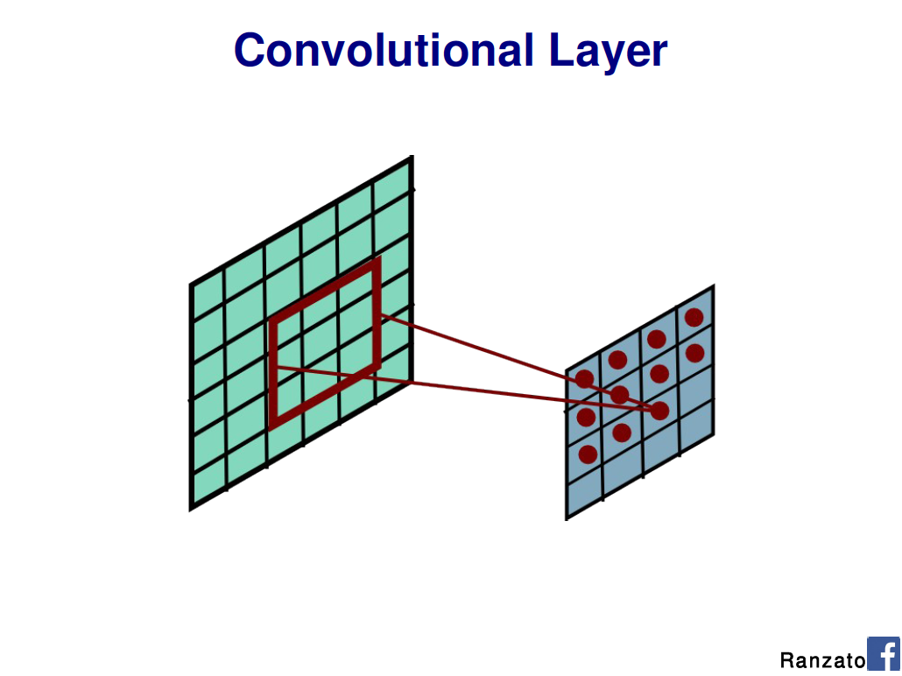
Slide Credit: Marc'Aurelio Ranzato

Slide 22
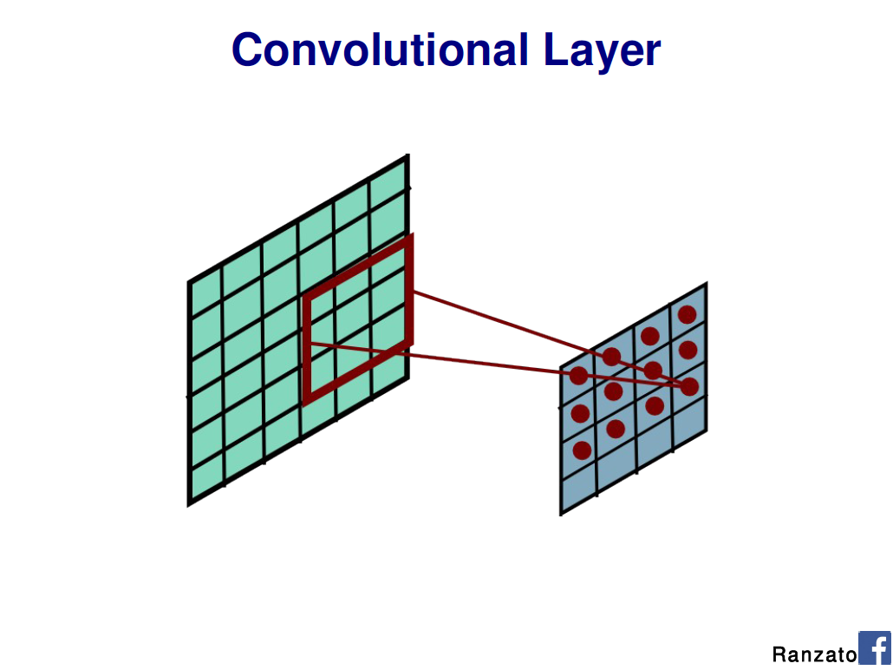
Slide Credit: Marc'Aurelio Ranzato

Slide 23
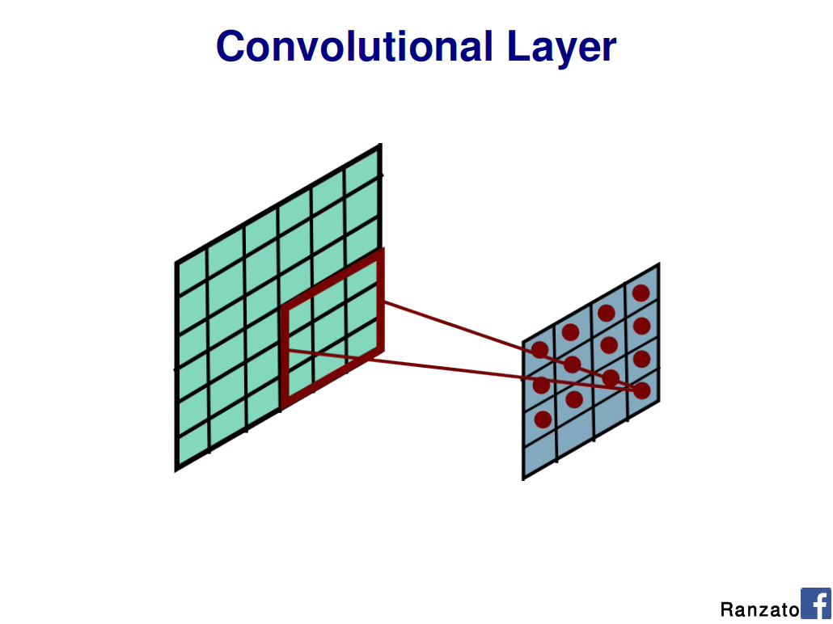
Slide Credit: Marc'Aurelio Ranzato

Slide 24

Slide Credit: Marc'Aurelio Ranzato

Slide 25
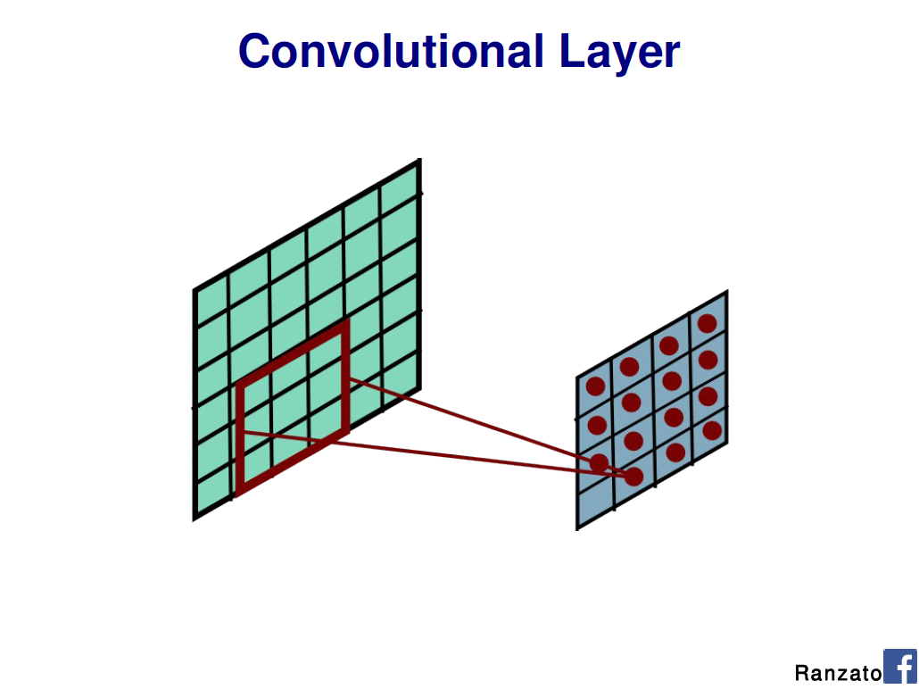
Slide Credit: Marc'Aurelio Ranzato

Slide 26
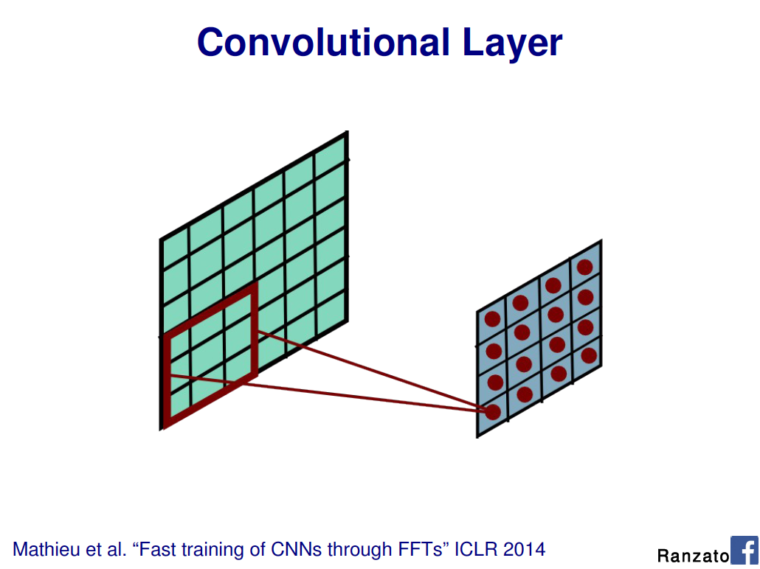
Slide Credit: Marc'Aurelio Ranzato

Slide 27
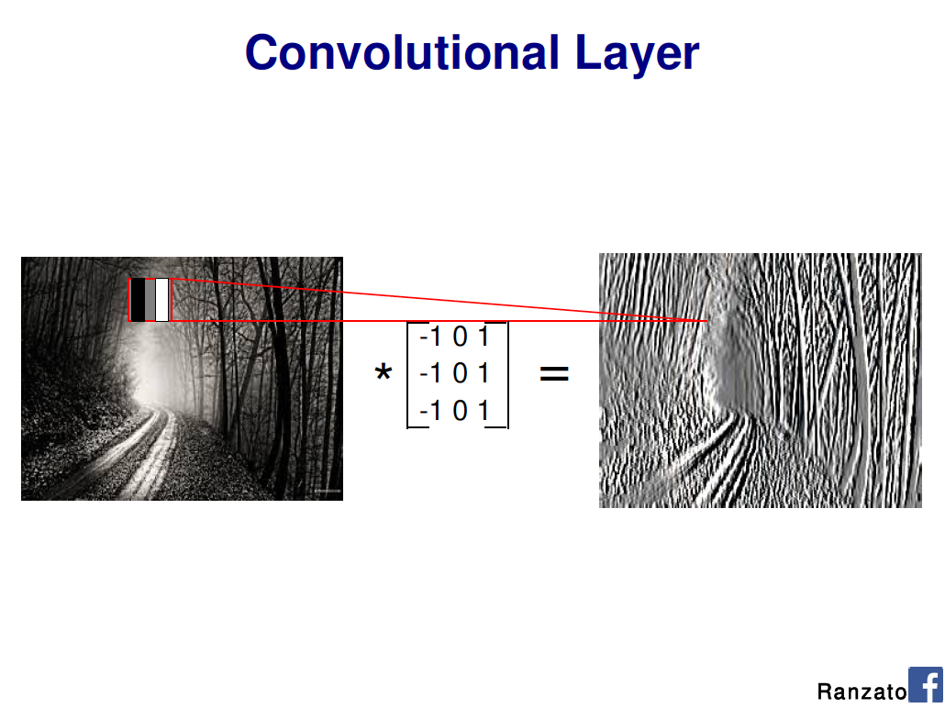
Slide Credit: Marc'Aurelio Ranzato

Slide 28
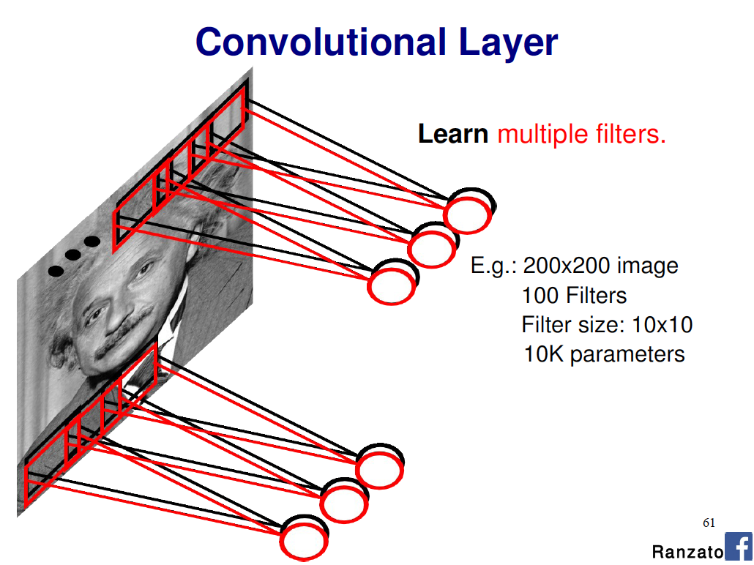
Slide Credit: Marc'Aurelio Ranzato

Slide 29
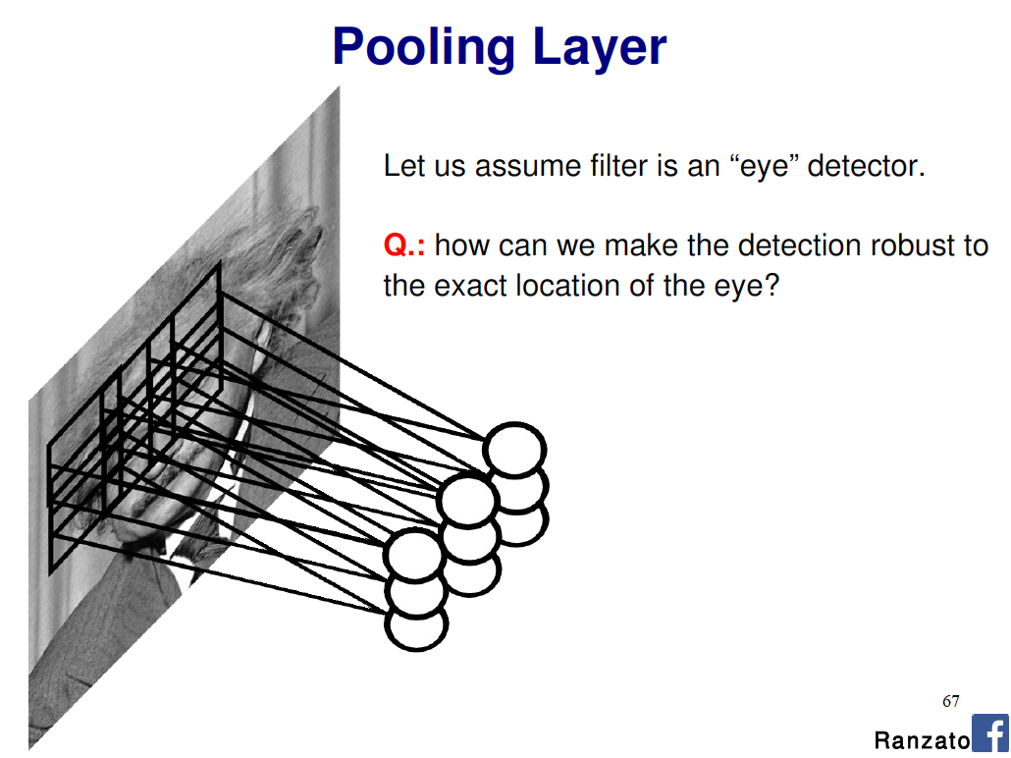
Slide Credit: Marc'Aurelio Ranzato

Slide 30
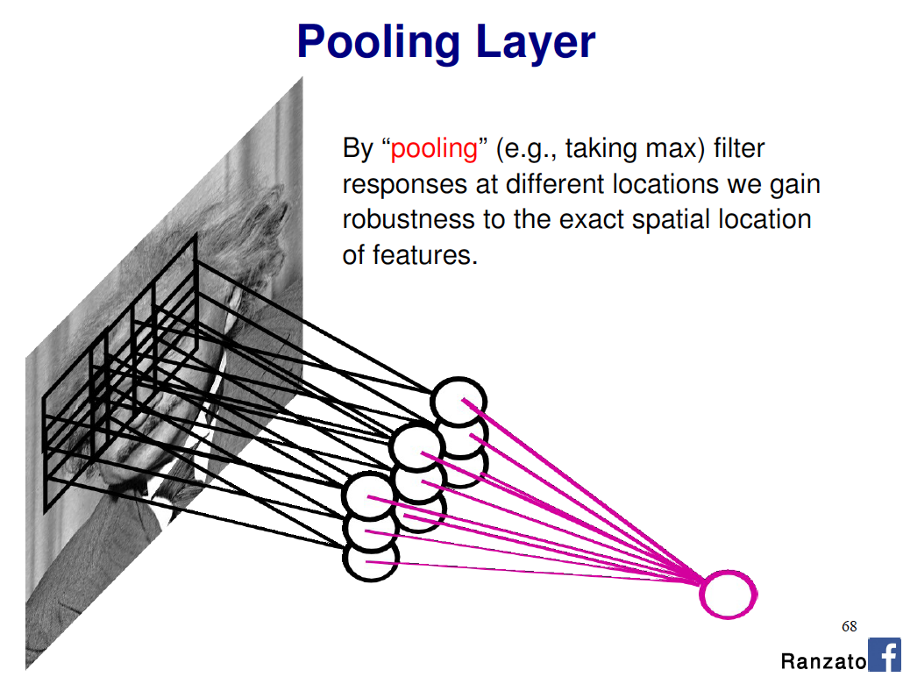
Slide Credit: Marc'Aurelio Ranzato

Slide 31
Convolutional Nets
Example:
  http://yann.lecun.com/exdb/lenet/index.html
Image Credit: Yann LeCun, Kevin Murphy

Slide 32
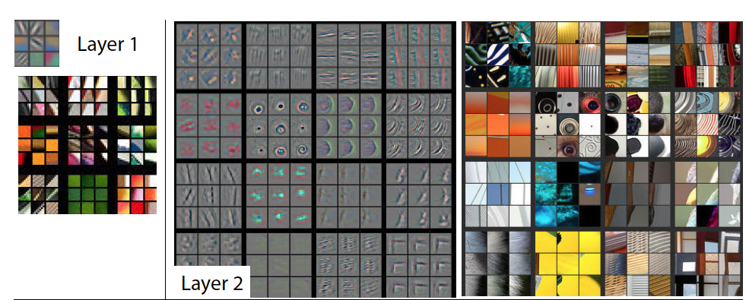
Visualizing Learned Filters
Figure Credit: [Zeiler & Fergus ECCV14]

Slide 33
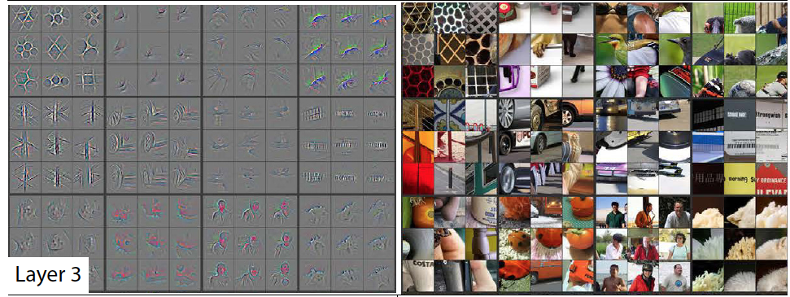
Visualizing Learned Filters
Figure Credit: [Zeiler & Fergus ECCV14]

Slide 34
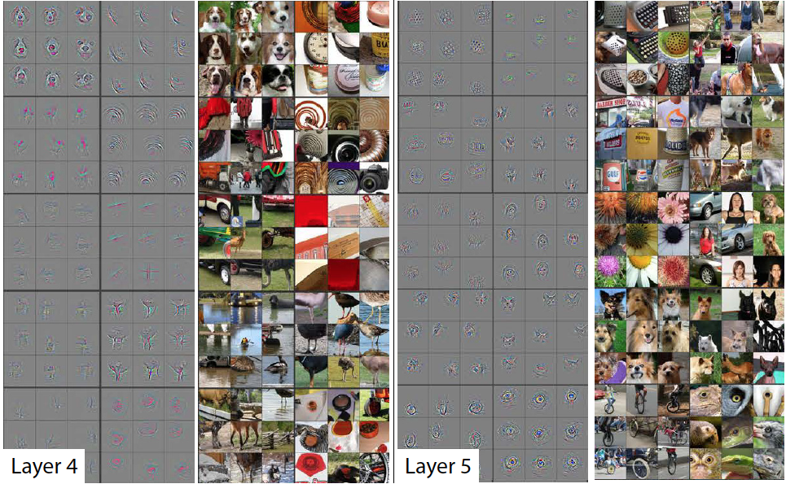
Visualizing Learned Filters
Figure Credit: [Zeiler & Fergus ECCV14]

Slide 35
Addressing non-linearly separable data – Option 1, non-linear features
Choose non-linear features, e.g.,
  Typical linear features: w₀ + ∑_{i} w_{i} x_{i}
  Example of non-linear features:
    Degree 2 polynomials, w₀ + ∑_{i} w_{i} x_{i} + ∑_{ij} w_{ij} x_{i} x_{j}
Classifier h_{w}(x) still linear in parameters w
  As easy to learn
  Data is linearly separable in higher dimensional spaces
  Express via kernels
Slide Credit: Carlos Guestrin

Slide 36
Addressing non-linearly separable data – Option 2, non-linear classifier
Choose a classifier h_{w}(x) that is non-linear in parameters w, e.g.,
  Decision trees, neural networks, …
More general than linear classifiers
But, can often be harder to learn (non-convex/concave optimization required)
Often very useful (outperforms linear classifiers)
In a way, both ideas are related
Slide Credit: Carlos Guestrin

Slide 37
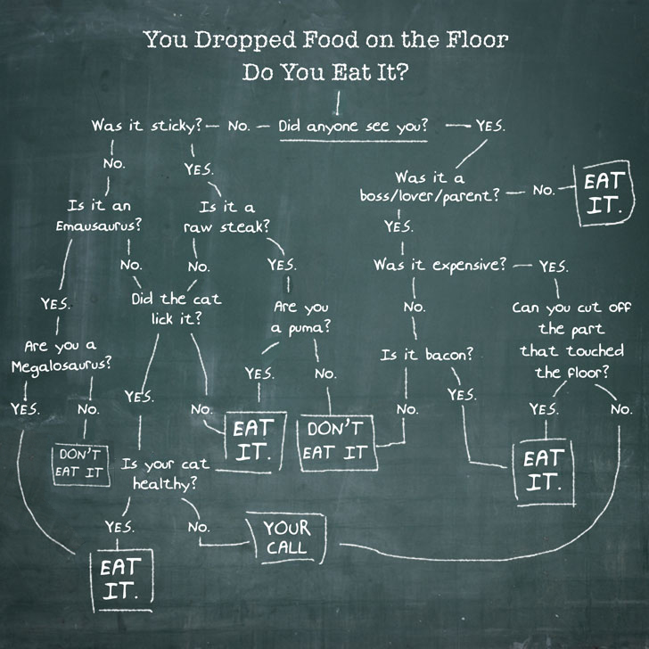
New Topic: Decision Trees

Slide 38
Synonyms
Decision Trees
Classification and Regression Trees (CART)
Algorithms for learning decision trees:
  ID3
  C4.5
Random Forests
  Multiple decision trees

Slide 39
Decision Trees
Demo
  http://www.cs.technion.ac.il/~rani/LocBoost/

Slide 40

Pose Estimation
Random Forests!
  Multiple decision trees
  http://youtu.be/HNkbG3KsY84

Slide 41
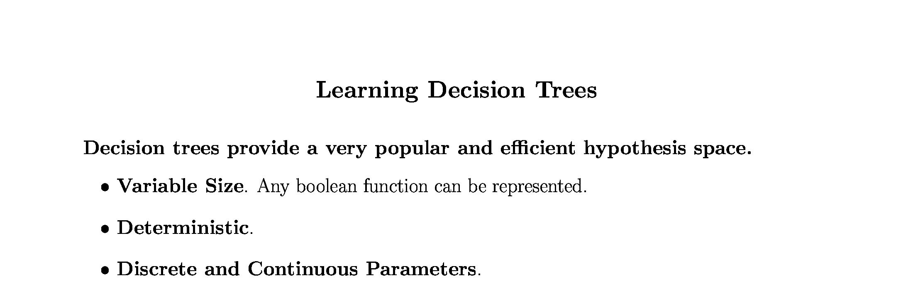
Slide Credit: Pedro Domingos, Tom Mitchel, Tom Dietterich

Slide 42
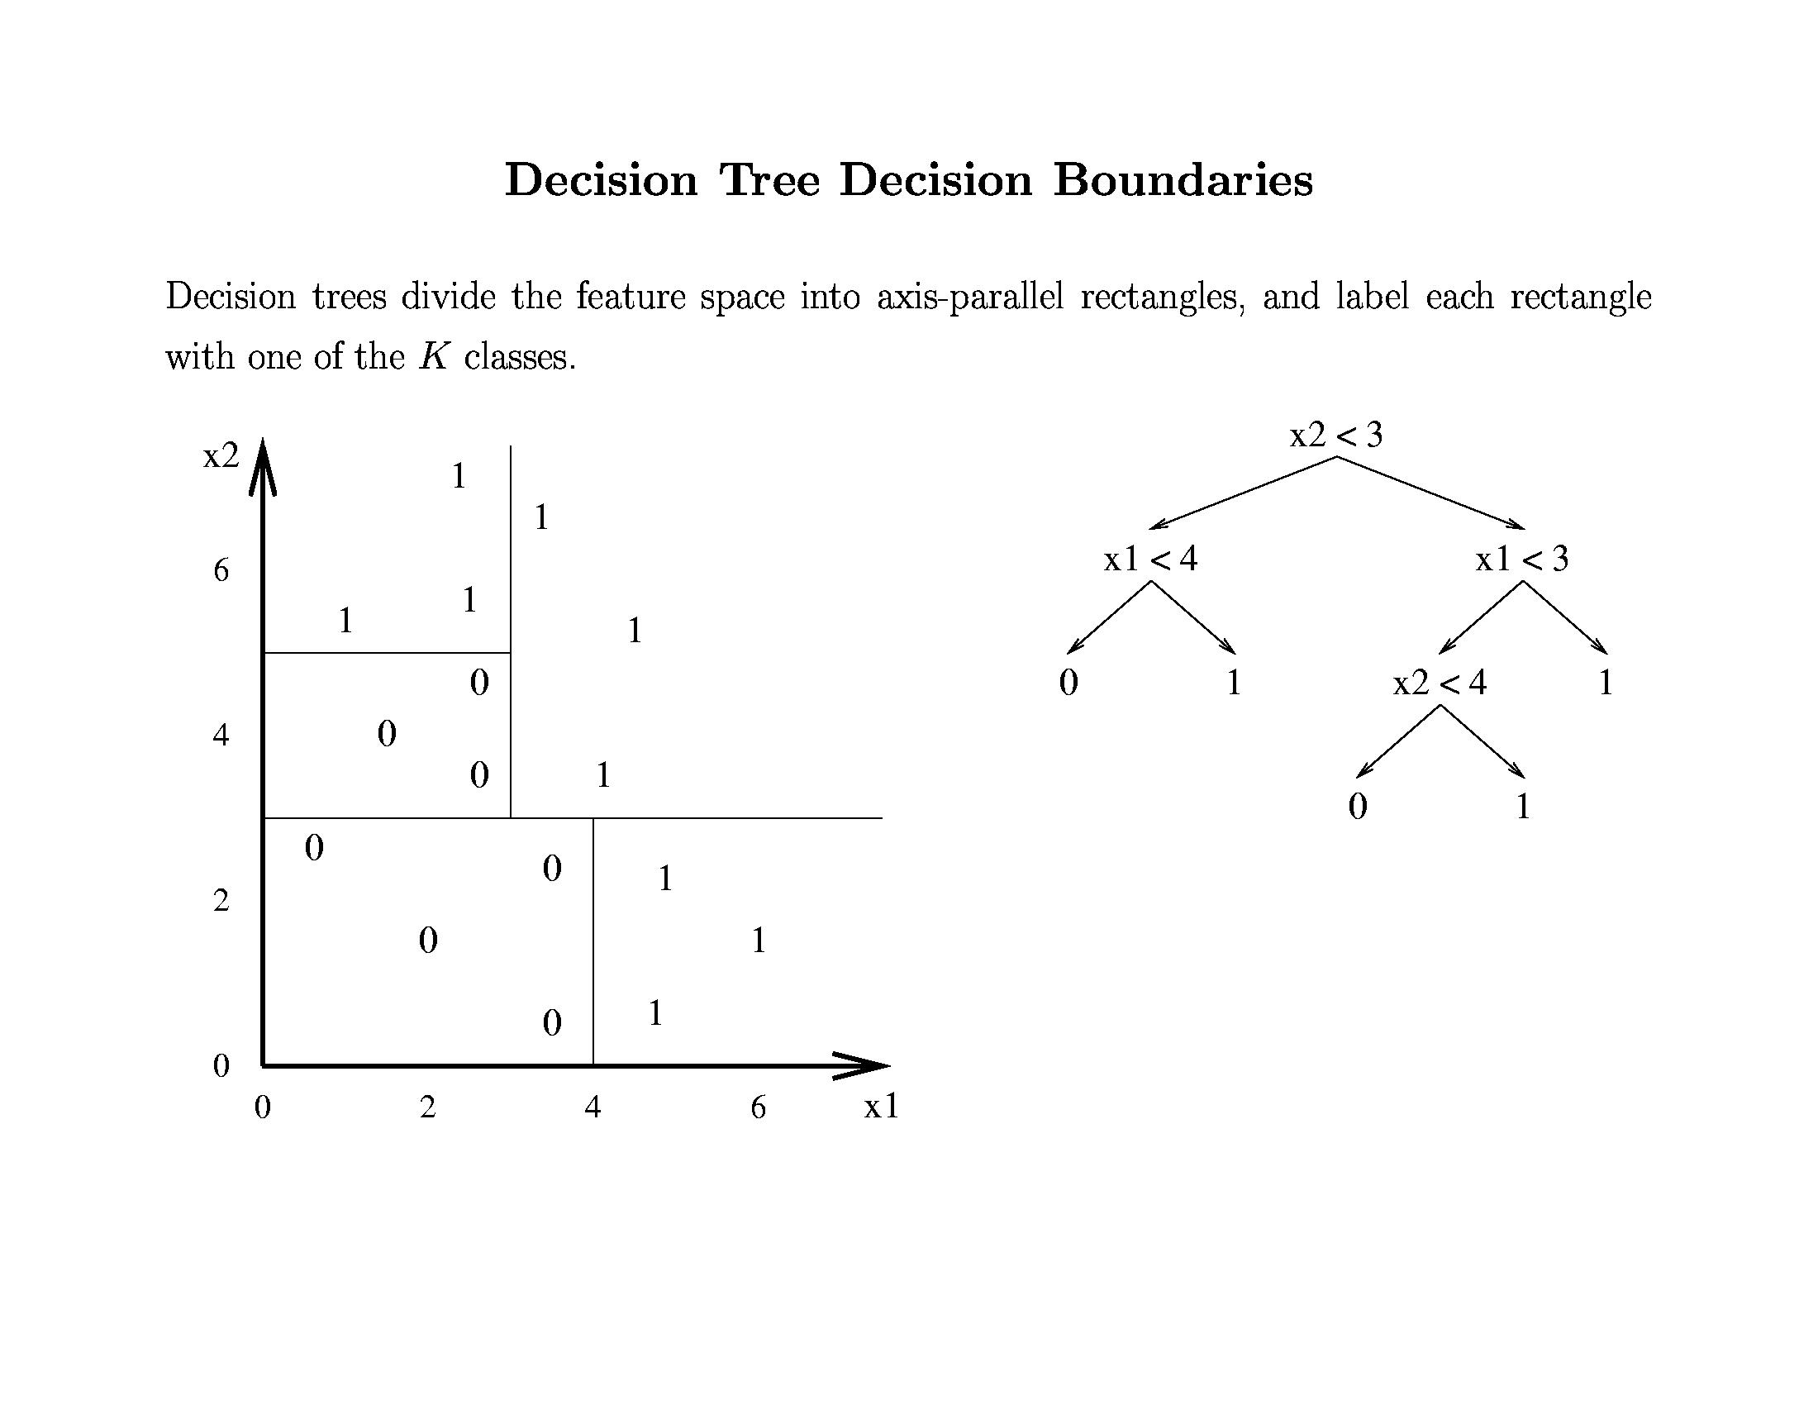
Slide Credit: Pedro Domingos, Tom Mitchel, Tom Dietterich

Slide 43
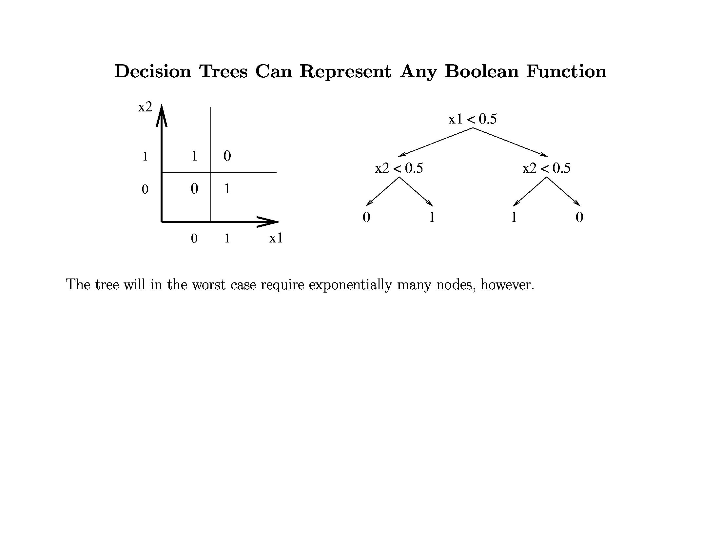
Slide Credit: Pedro Domingos, Tom Mitchel, Tom Dietterich

Slide 44
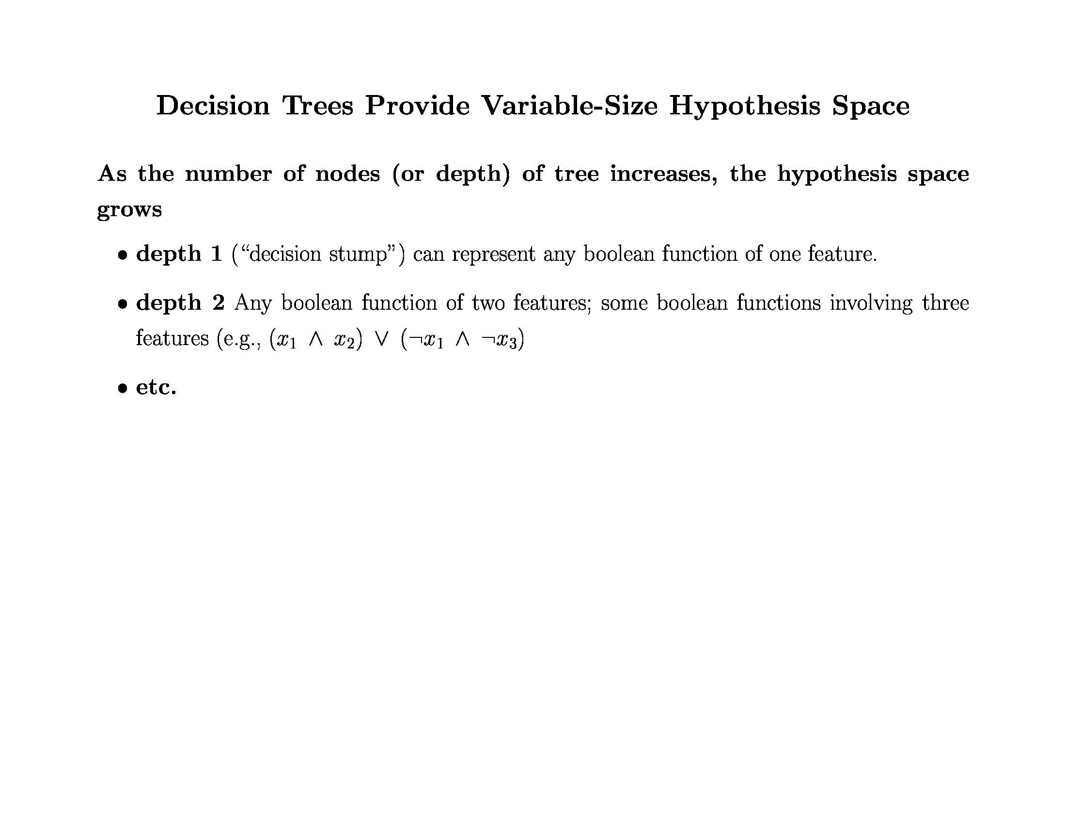
Slide Credit: Pedro Domingos, Tom Mitchel, Tom Dietterich

Slide 45
A small dataset: Miles Per Gallon
Suppose we want to predict MPG
40 Records
From the UCI repository (thanks to Ross Quinlan)
Slide Credit: Carlos Guestrin

Slide 46
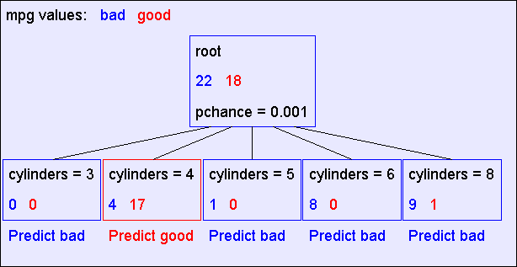
A Decision Stump
Slide Credit: Carlos Guestrin

Slide 47
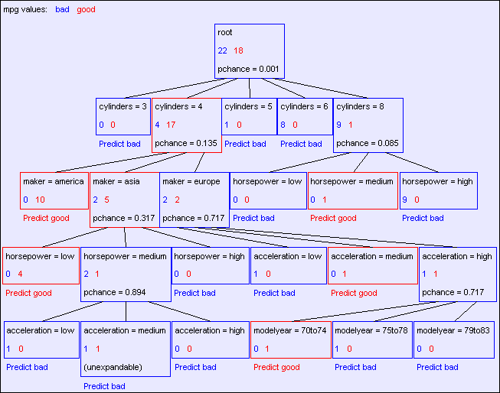
The final tree
Slide Credit: Carlos Guestrin

Slide 48
Comments
Not all features/attributes need to appear in the tree.
A features/attribute X_{i} may appear in multiple branches.
On a path, no feature may appear more than once.
  Not true for continuous features. We’ll see later.
Many trees can represent the same concept
But, not all trees will have the same size!
  e.g., Y = (A^B) ∨ (¬A^C) (A and B) or (not A and C)

Slide 49
Learning decision trees is hard!!!
Learning the simplest (smallest) decision tree is an NP-complete problem [Hyafil & Rivest ’76]
Resort to a greedy heuristic:
  Start from empty decision tree
  Split on next best attribute (feature)
  Recurse
    “Iterative Dichotomizer” (ID3)
    C4.5 (ID3+improvements)
Slide Credit: Carlos Guestrin

Slide 50
Recursion Step
Records in which cylinders = 4
Records in which cylinders = 5
Take the
Original
Dataset..
And partition it according
to the value of the attribute we split on
Records in which cylinders = 6
Records in which cylinders = 8
Slide Credit: Carlos Guestrin

Slide 51
Recursion Step
Build tree from
These records..
Build tree from
These records..
Build tree from
These records..
Build tree from
These records..
Records in which cylinders = 8
Records in which cylinders = 6
Records in which cylinders = 4
Records in which cylinders = 5
Slide Credit: Carlos Guestrin

Slide 52
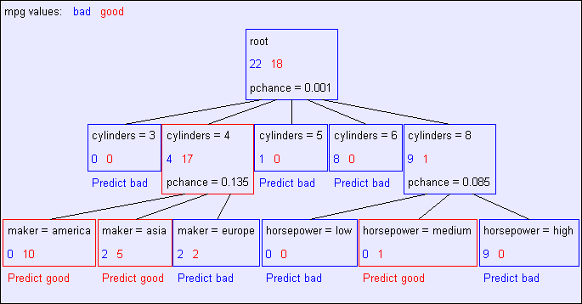
Second level of tree
Recursively build a tree from the seven records in which there are four cylinders and the maker was based in Asia
(Similar recursion in the other cases)
Slide Credit: Carlos Guestrin

Slide 53
The final tree
Slide Credit: Carlos Guestrin

Slide 54
Choosing a good attribute
X₁ | X₂ | Y
T | T | T
T | F | T
T | T | T
T | F | T
F | T | T
F | F | F
F | T | F
F | F | F
Slide Credit: Carlos Guestrin

Slide 55
Measuring uncertainty
Good split if we are more certain about classification after split
  Deterministic good (all true or all false)
  Uniform distribution bad
1
0.5
0
P(Y=F | X₁= T) = 0 | P(Y=T | X₁= T) = 1
F T
1
0.5
0
P(Y=F | X₂=F) = 1/2 | P(Y=T | X₂=F) = 1/2
F T

Slide 56
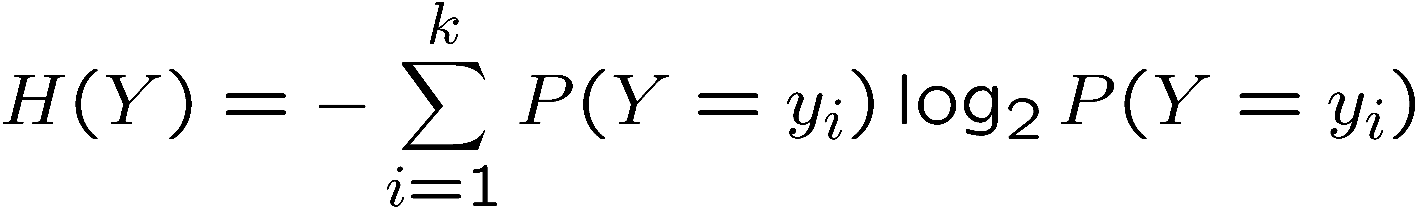
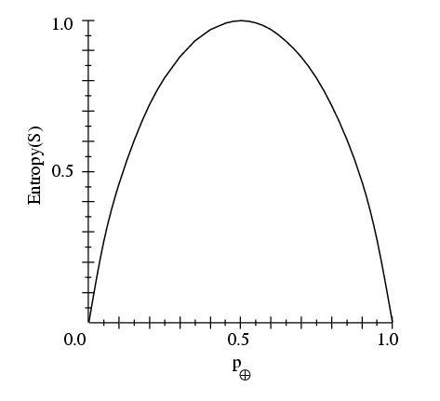
Entropy
Entropy H(X) of a random variable Y
More uncertainty, more entropy!
Information Theory interpretation: H(Y) is the expected number of bits needed to encode a randomly drawn value of Y (under most efficient code)
Slide Credit: Carlos Guestrin

Slide 57
Information gain
Advantage of attribute – decrease in uncertainty
  Entropy of Y before you split
  Entropy after split
    Weight by probability of following each branch, i.e., normalized number of records
Information gain is difference
  (Technically it’s mutual information; but in this context also referred to as information gain)
Slide Credit: Carlos Guestrin

Slide 58
Learning decision trees
Start from empty decision tree
Split on next best attribute (feature)
  Use, for example, information gain to select attribute
  Split on
Recurse
Slide Credit: Carlos Guestrin

Slide 59
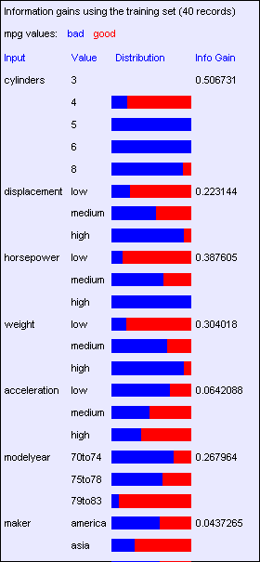
Look at all the information gains…
Suppose we want to predict MPG
Slide Credit: Carlos Guestrin

Slide 60
When do we stop?

Slide 61
Base Case One
Don’t split a node if all matching records have the same output value
Slide Credit: Carlos Guestrin

Slide 62
Base Case Two: No attributes can distinguish
Don’t split a node if none of the attributes can create multiple non-empty children
Slide Credit: Carlos Guestrin

Slide 63
Base Cases
Base Case One: If all records in current data subset have the same output then don’t recurse
Base Case Two: If all records have exactly the same set of input attributes then don’t recurse
Slide Credit: Carlos Guestrin

Slide 64
Base Cases: An idea
Base Case One: If all records in current data subset have the same output then don’t recurse
Base Case Two: If all records have exactly the same set of input attributes then don’t recurse
Proposed Base Case 3:
If all attributes have zero information gain then don’t recurse
Is this a good idea?
Slide Credit: Carlos Guestrin

Slide 65
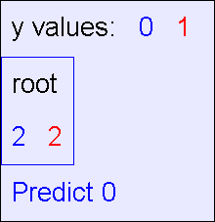
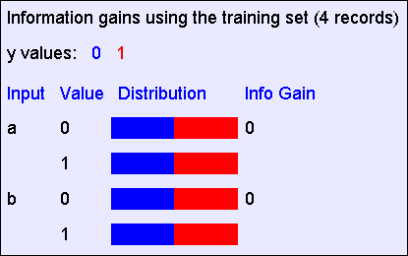
The problem with Base Case 3
y = a XOR b
The resulting decision tree:
The information gains:
Slide Credit: Carlos Guestrin

Slide 66
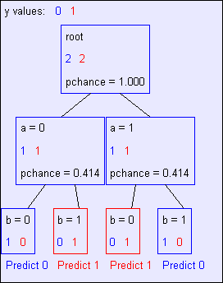
If we omit Base Case 3:
y = a XOR b
The resulting decision tree:
Slide Credit: Carlos Guestrin

