Slide 1
ECE 5984: Introduction to
Machine Learning
Topics:
  Neural Networks
    Backprop
Readings: Murphy 16.5
Dhruv Batra
Virginia Tech

Slide 2
Administrativia
HW3
  Due: in 2 weeks
  You will implement primal & dual SVMs
  Kaggle competition: Higgs Boson Signal vs Background classification
  https://inclass.kaggle.com/c/2015-Spring-vt-ece-machine-learning-hw3
  https://www.kaggle.com/c/higgs-boson

Slide 3
Administrativia
Project Mid-Sem Spotlight Presentations
  Friday: 5-7pm, 3-5pm Whittemore 654
  5 slides (recommended)
  4 minute time (STRICT) + 1-2 min Q&A
  Tell the class what you’re working on
  Any results yet?
  Problems faced?
  Upload slides on Scholar

Slide 4
Recap of Last Time

Slide 5
Not linearly separable data
Some datasets are not linearly separable!
  http://www.eee.metu.edu.tr/~alatan/Courses/Demo/AppletSVM.html

Slide 6
Addressing non-linearly separable data – Option 1, non-linear features
Choose non-linear features, e.g.,
  Typical linear features: w₀ + ∑_{i} w_{i} x_{i}
  Example of non-linear features:
    Degree 2 polynomials, w₀ + ∑_{i} w_{i} x_{i} + ∑_{ij} w_{ij} x_{i} x_{j}
Classifier h_{w}(x) still linear in parameters w
  As easy to learn
  Data is linearly separable in higher dimensional spaces
  Express via kernels
Slide Credit: Carlos Guestrin

Slide 7
Addressing non-linearly separable data – Option 2, non-linear classifier
Choose a classifier h_{w}(x) that is non-linear in parameters w, e.g.,
  Decision trees, neural networks,…
More general than linear classifiers
But, can often be harder to learn (non-convex optimization required)
Often very useful (outperforms linear classifiers)
In a way, both ideas are related
Slide Credit: Carlos Guestrin

Slide 8
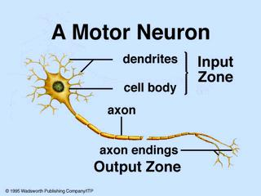
Biological Neuron

Slide 9
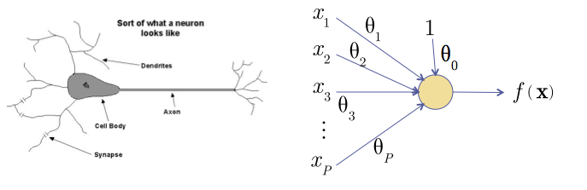
Recall: The Neuron Metaphor
Neurons
  accept information from multiple inputs,
  transmit information to other neurons.
Multiply inputs by weights along edges
Apply some function to the set of inputs at each node
Slide Credit: HKUST

Slide 10
Types of Neurons
Linear Neuron
Logistic Neuron
Potentially more. Require a convex
loss function for gradient descent training.
Perceptron
Slide Credit: HKUST

Slide 11
Limitation
A single “neuron” is still a linear decision boundary
What to do?
Idea: Stack a bunch of them together!

Slide 12
Multilayer Networks
Cascade Neurons together
The output from one layer is the input to the next
Each Layer has its own sets of weights
Slide Credit: HKUST

Slide 13
Universal Function Approximators
Theorem
  3-layer network with linear outputs can uniformly approximate any continuous function to arbitrary accuracy, given enough hidden units [Funahashi ’89]

Slide 14
Plan for Today
Neural Networks
  Parameter learning
  Backpropagation

Slide 15
Forward Propagation
On board

Slide 16
Feed-Forward Networks
Predictions are fed forward through the network to classify
Slide Credit: HKUST

Slide 17
Feed-Forward Networks
Predictions are fed forward through the network to classify
Slide Credit: HKUST

Slide 18
Feed-Forward Networks
Predictions are fed forward through the network to classify
Slide Credit: HKUST

Slide 19
Feed-Forward Networks
Predictions are fed forward through the network to classify
Slide Credit: HKUST

Slide 20
Feed-Forward Networks
Predictions are fed forward through the network to classify
Slide Credit: HKUST

Slide 21
Feed-Forward Networks
Predictions are fed forward through the network to classify
Slide Credit: HKUST

Slide 22
Gradient Computation
First let’s try:
  Single Neuron for Linear Regression
  Single Neuron for Logistic Regresion

Slide 23
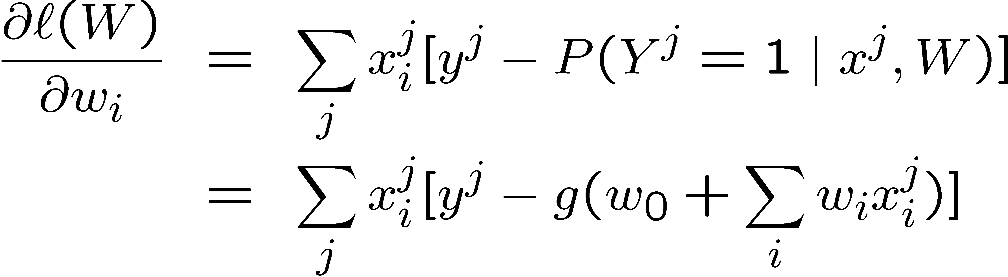
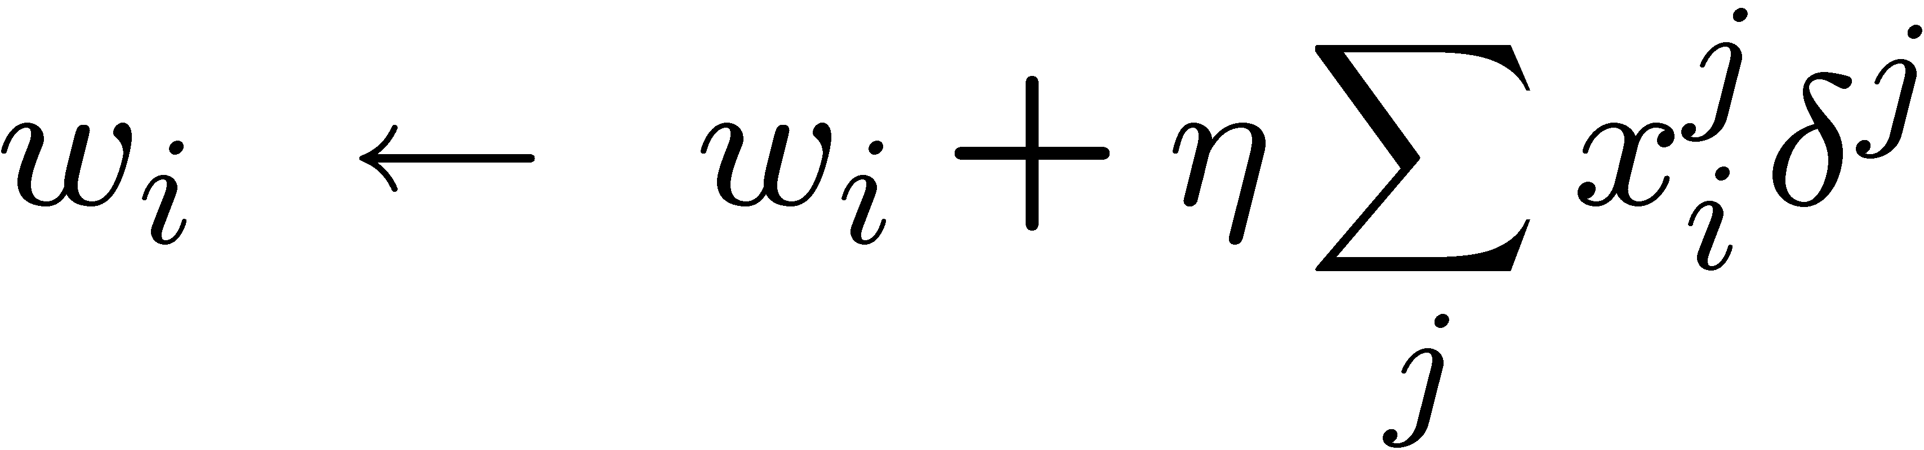
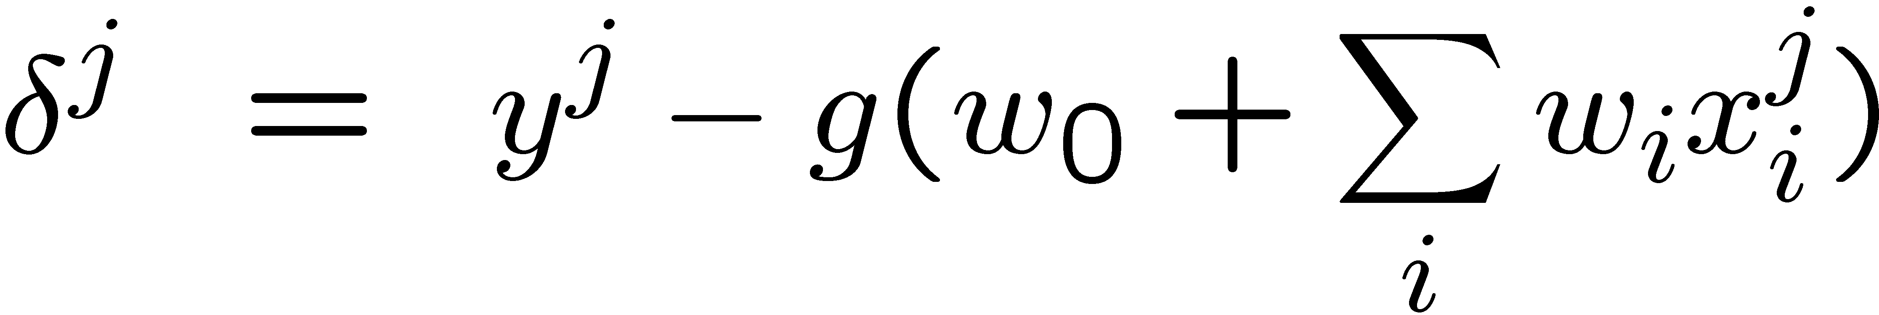
Logistic regression
Learning rule – MLE:
Slide Credit: Carlos Guestrin

Slide 24
Gradient Computation
First let’s try:
  Single Neuron for Linear Regression
  Single Neuron for Logistic Regresion
Now let’s try the general case
Backpropagation!
  Really efficient

Slide 25
Neural Nets
Best performers on OCR
  http://yann.lecun.com/exdb/lenet/index.html
NetTalk
  Text to Speech system from 1987
  http://youtu.be/tXMaFhO6dIY?t=45m15s
Rick Rashid speaks Mandarin
  http://youtu.be/Nu-nlQqFCKg?t=7m30s

Slide 26
Neural Networks
Demo
  http://neuron.eng.wayne.edu/bpFunctionApprox/bpFunctionApprox.html

Slide 27
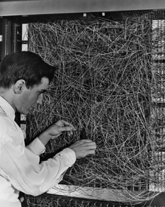
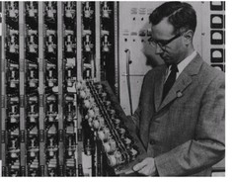
Historical Perspective

Slide 28
Convergence of backprop
Perceptron leads to convex optimization
  Gradient descent reaches global minima
Multilayer neural nets not convex
  Gradient descent gets stuck in local minima
  Hard to set learning rate
  Selecting number of hidden units and layers = fuzzy process
  NNs had fallen out of fashion in 90s, early 2000s
  Back with a new name and significantly improved performance!!!!
    Deep networks
      Dropout and trained on much larger corpus
Slide Credit: Carlos Guestrin

Slide 29
Overfitting
Many many many parameters
Avoiding overfitting?
  More training data
  Regularization
  Early stopping

Slide 30
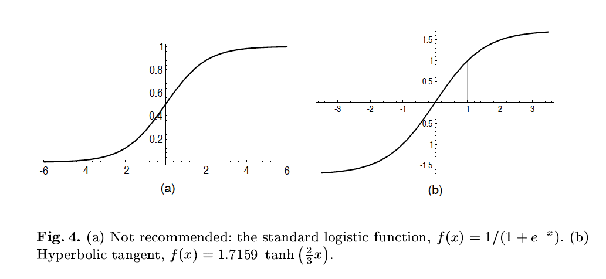
A quick note
Image Credit: LeCun et al. ‘98

Slide 31
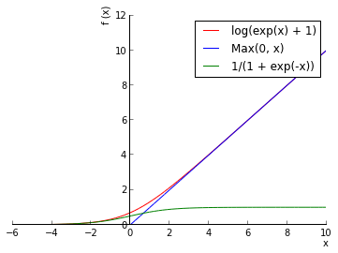
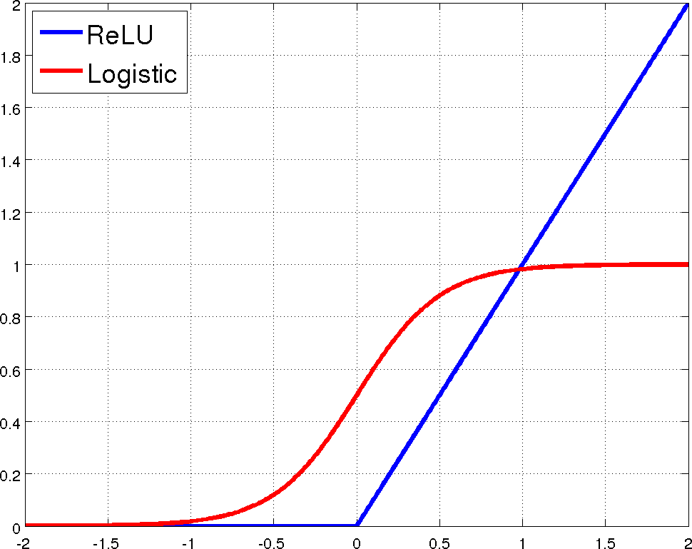
Rectified Linear Units (ReLU)

Slide 32
Convolutional Nets
Basic Idea
  On board
  Assumptions:
    Local Receptive Fields
    Weight Sharing / Translational Invariance / Stationarity
  Each layer is just a convolution!
Image Credit: Chris Bishop

Slide 33
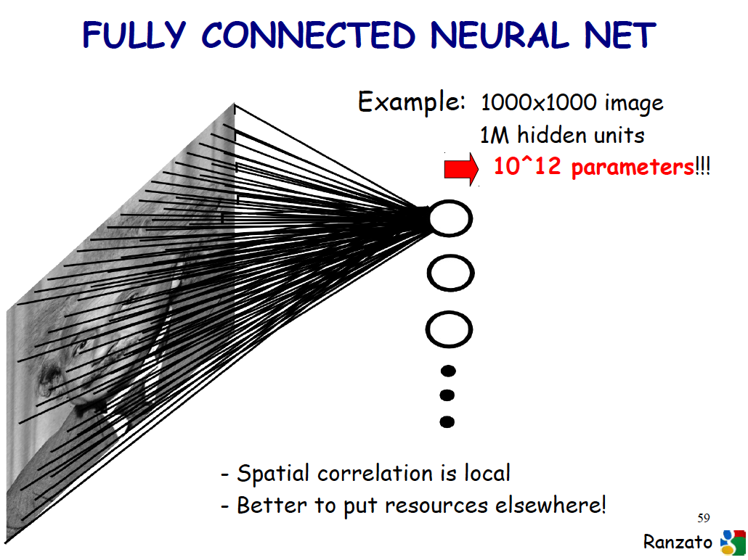
Slide Credit: Marc'Aurelio Ranzato

Slide 34
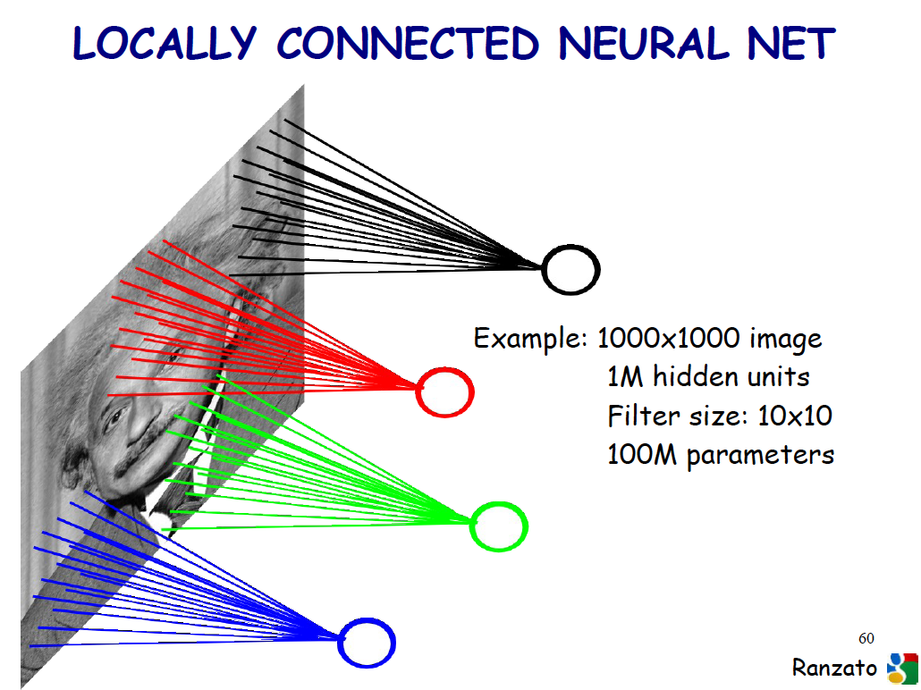
Slide Credit: Marc'Aurelio Ranzato

Slide 35
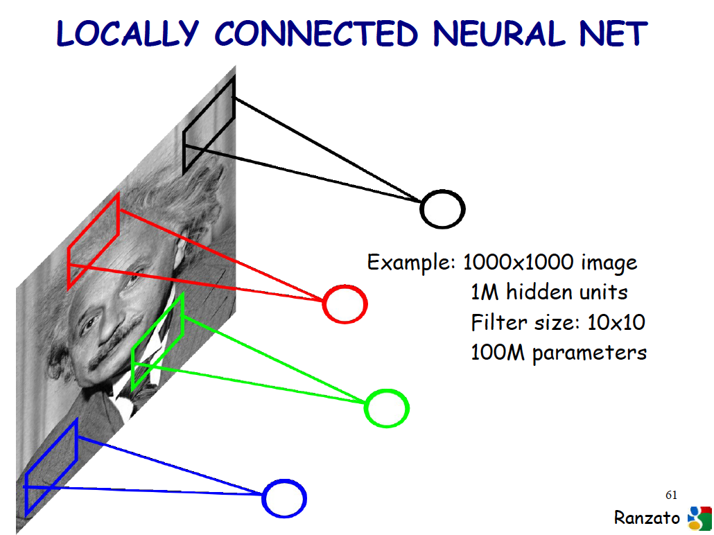
Slide Credit: Marc'Aurelio Ranzato

Slide 36
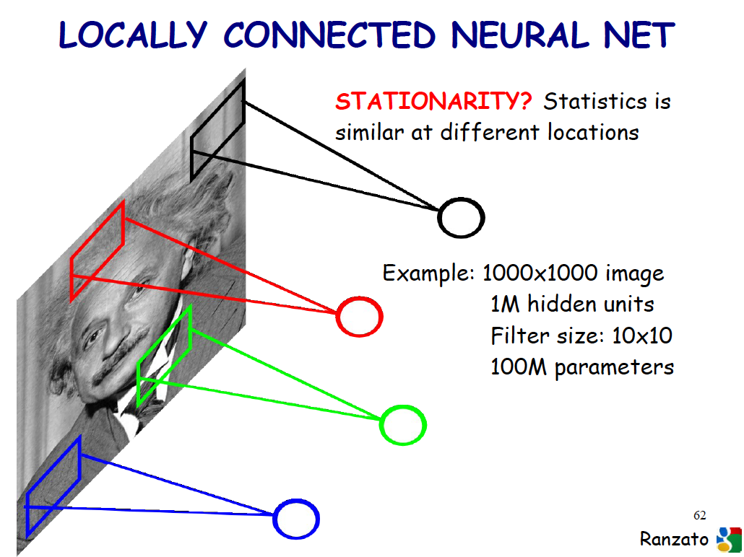
Slide Credit: Marc'Aurelio Ranzato

Slide 37
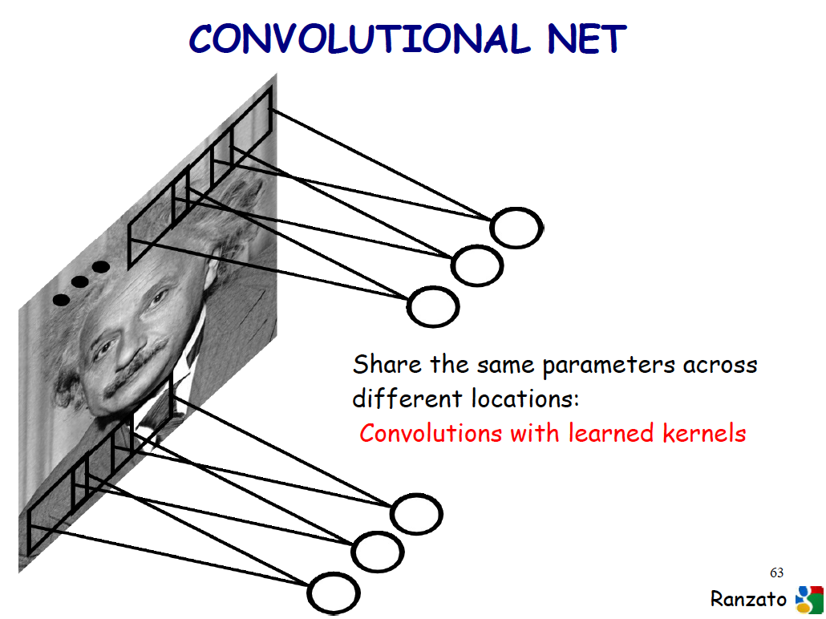
Slide Credit: Marc'Aurelio Ranzato

Slide 38
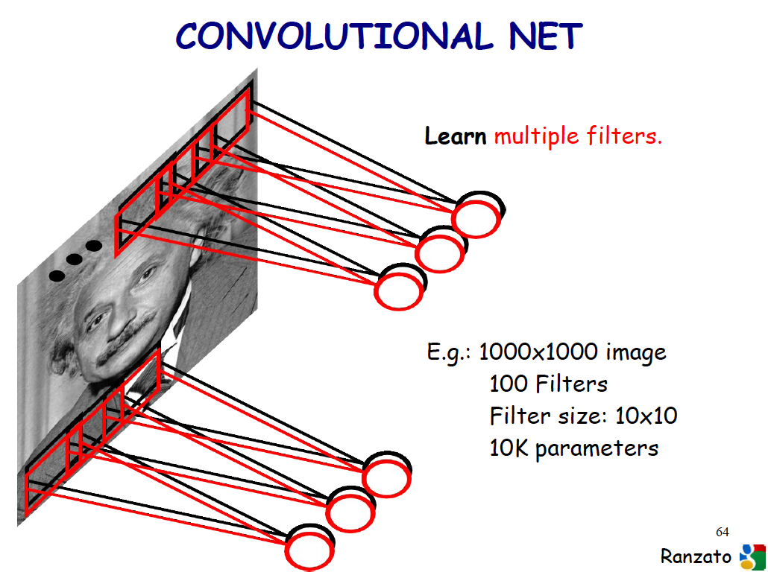
Slide Credit: Marc'Aurelio Ranzato

Slide 39
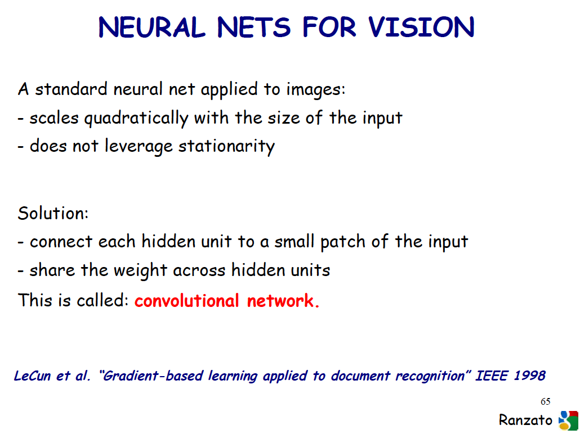
Slide Credit: Marc'Aurelio Ranzato

Slide 40
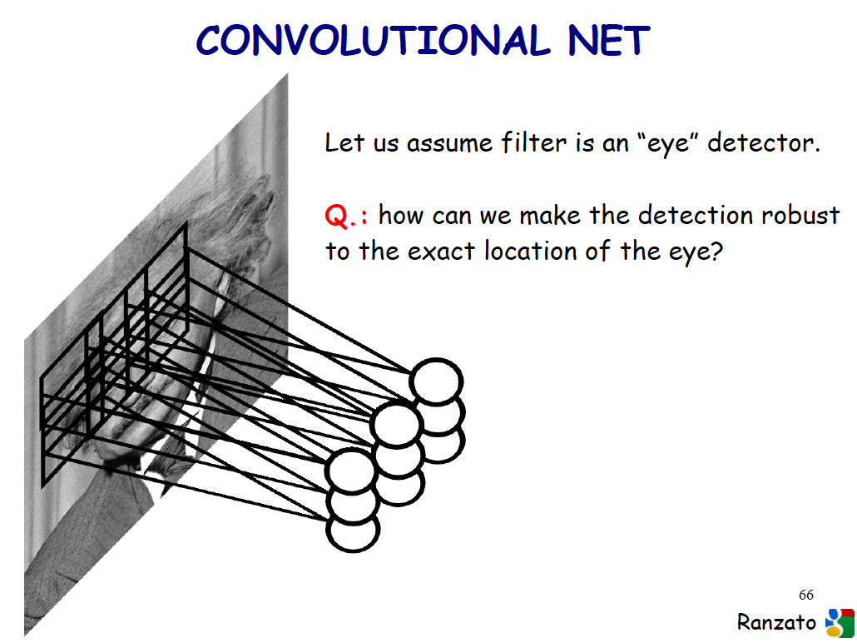
Slide Credit: Marc'Aurelio Ranzato

Slide 41
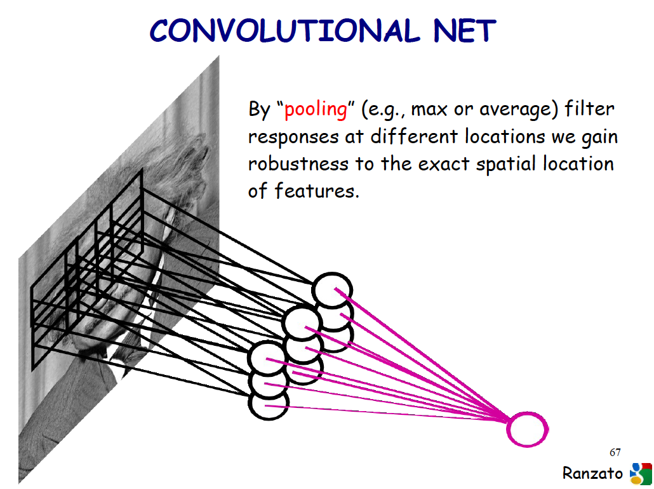
Slide Credit: Marc'Aurelio Ranzato

Slide 42
Convolutional Nets
Example:
  http://yann.lecun.com/exdb/lenet/index.html
Image Credit: Yann LeCun, Kevin Murphy

Slide 43
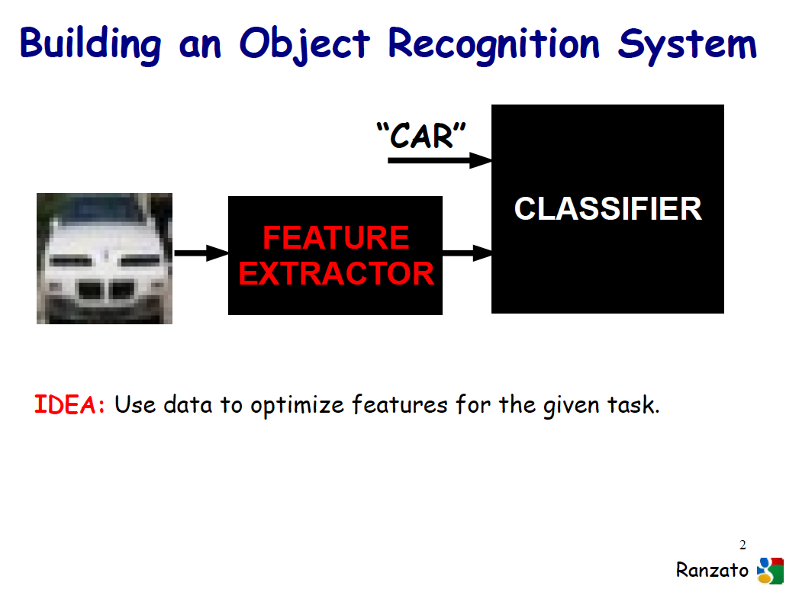
Slide Credit: Marc'Aurelio Ranzato

Slide 44
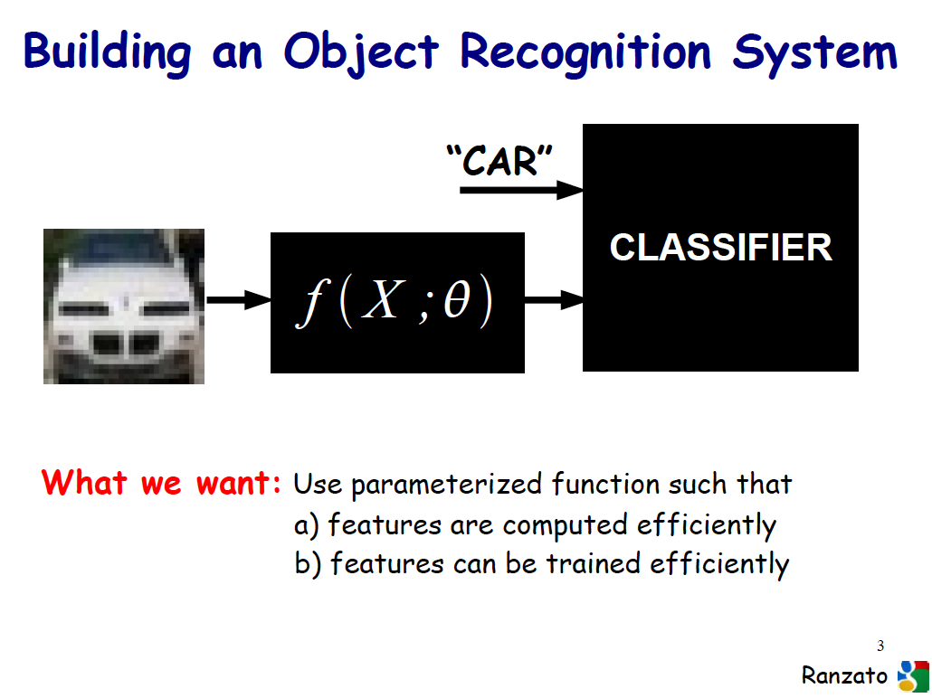
Slide Credit: Marc'Aurelio Ranzato

Slide 45
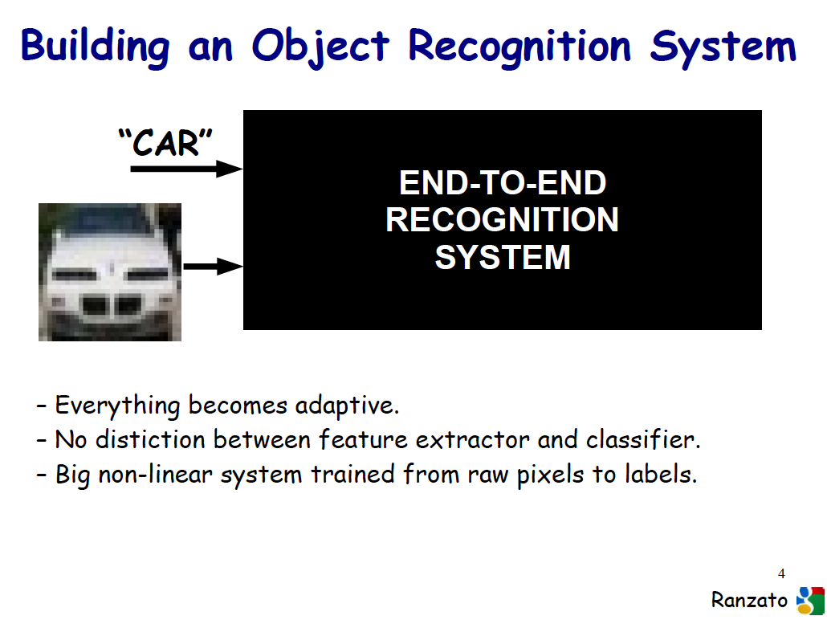
Slide Credit: Marc'Aurelio Ranzato

Slide 46
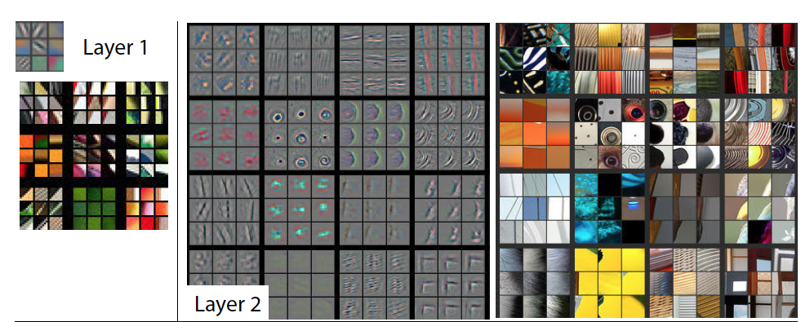
Visualizing Learned Filters
Figure Credit: [Zeiler & Fergus ECCV14]

Slide 47
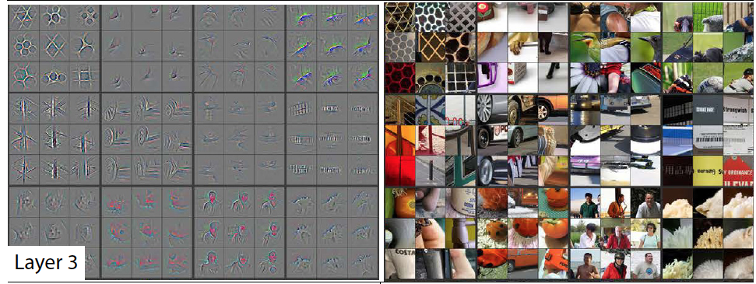
Visualizing Learned Filters
Figure Credit: [Zeiler & Fergus ECCV14]

Slide 48
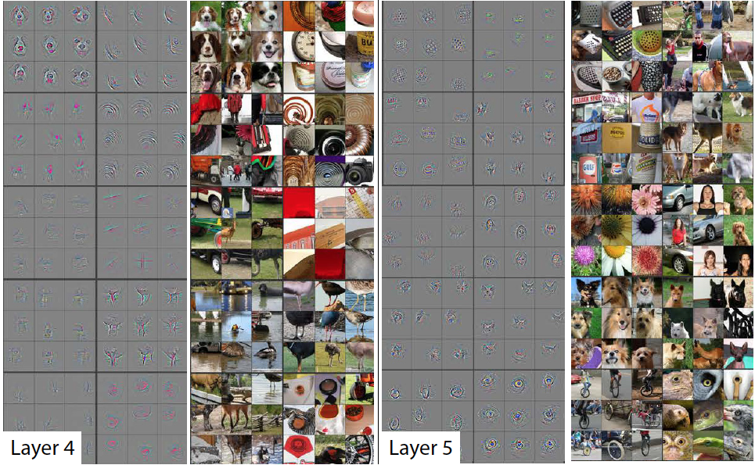
Visualizing Learned Filters
Figure Credit: [Zeiler & Fergus ECCV14]

Slide 49
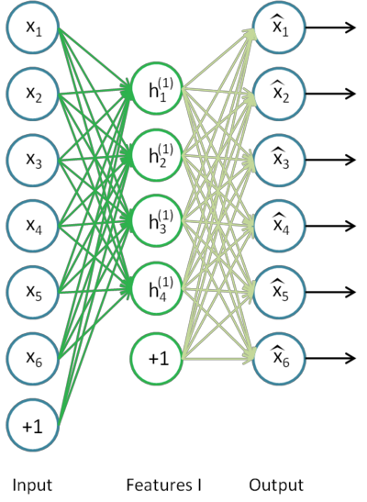
Autoencoders
Goal
  Compression: Output tries to predict input
Image Credit: http://ufldl.stanford.edu/wiki/index.php/Stacked_Autoencoders

Slide 50
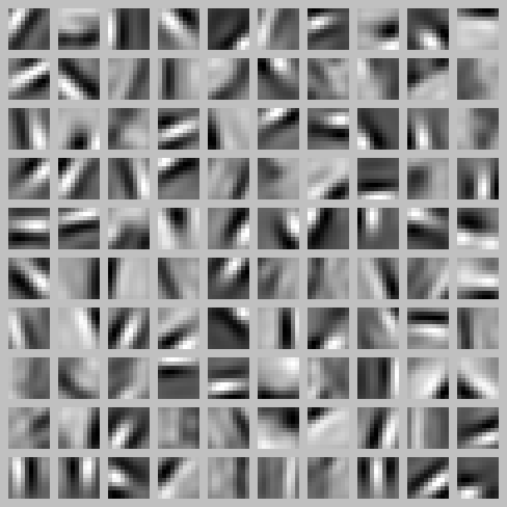
Autoencoders
Goal
  Learns a low-dimensional “basis” for the data
Image Credit: Andrew Ng

Slide 51
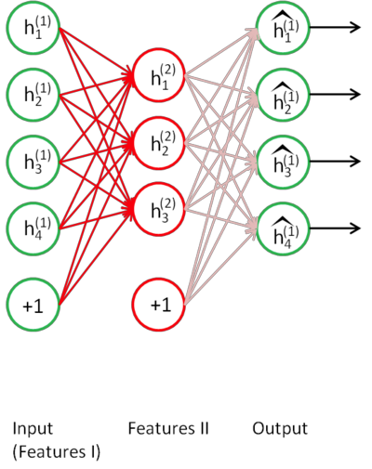
Stacked Autoencoders
How about we compress the low-dim features more?
Image Credit: http://ufldl.stanford.edu/wiki/index.php/Stacked_Autoencoders

Slide 52
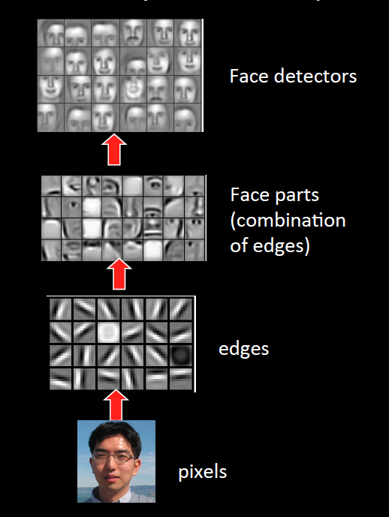
Sparse DBNs
[Lee et al. ICML ‘09]
Figure courtesy: Quoc Le

Slide 53
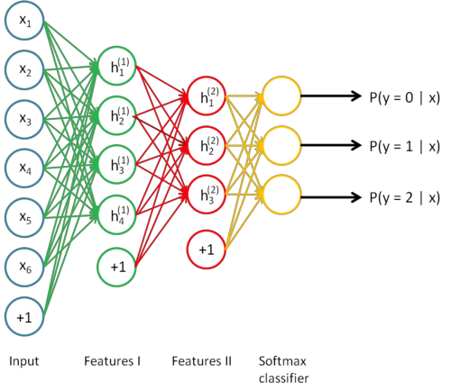
Stacked Autoencoders
Finally perform classification with these low-dim features.
Image Credit: http://ufldl.stanford.edu/wiki/index.php/Stacked_Autoencoders

Slide 54
What you need to know about neural networks
Perceptron:
  Representation
  Derivation
Multilayer neural nets
  Representation
  Derivation of backprop
  Learning rule
  Expressive power

