Slide 1
ECE 5984: Introduction to
Machine Learning
Topics:
  SVM
    SVM dual & kernels
    Multi-class SVMs
Readings: Barber 17.5
Dhruv Batra
Virginia Tech

Slide 2
Lagrangian Duality
On paper

Slide 3
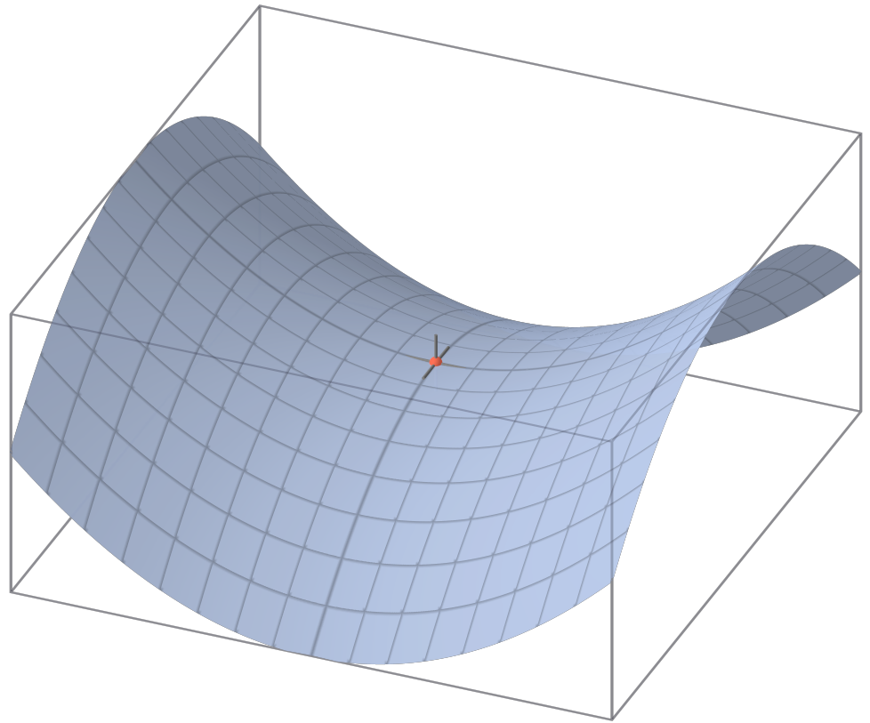
Saddle Points
Slide Credit: Wikipedia

Slide 4
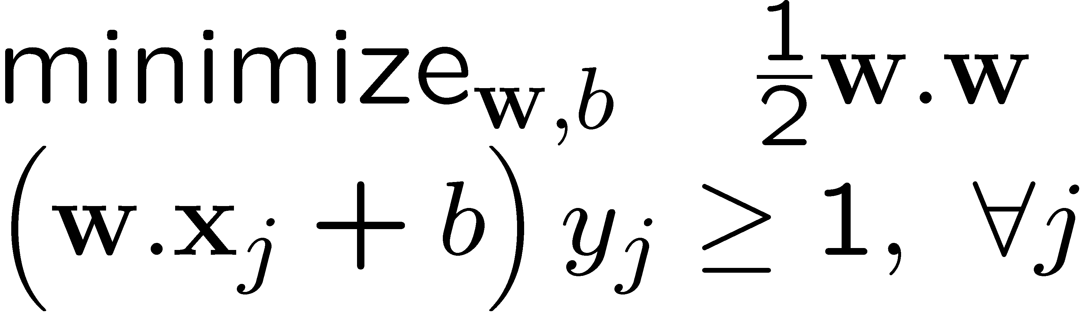
Dual SVM derivation (1) – the linearly separable case
Slide Credit: Carlos Guestrin

Slide 5
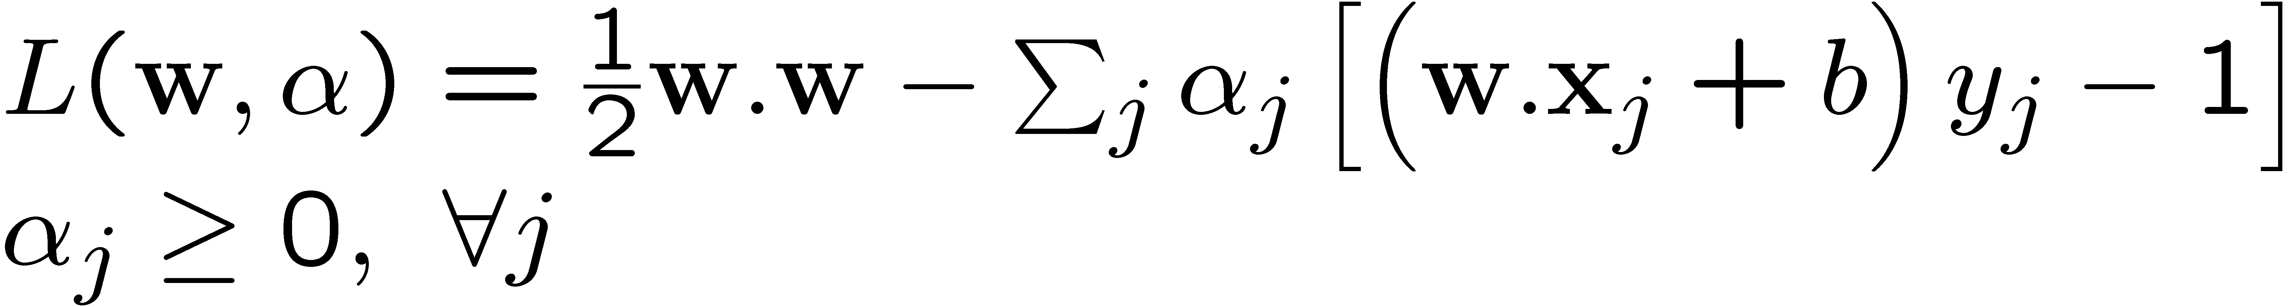
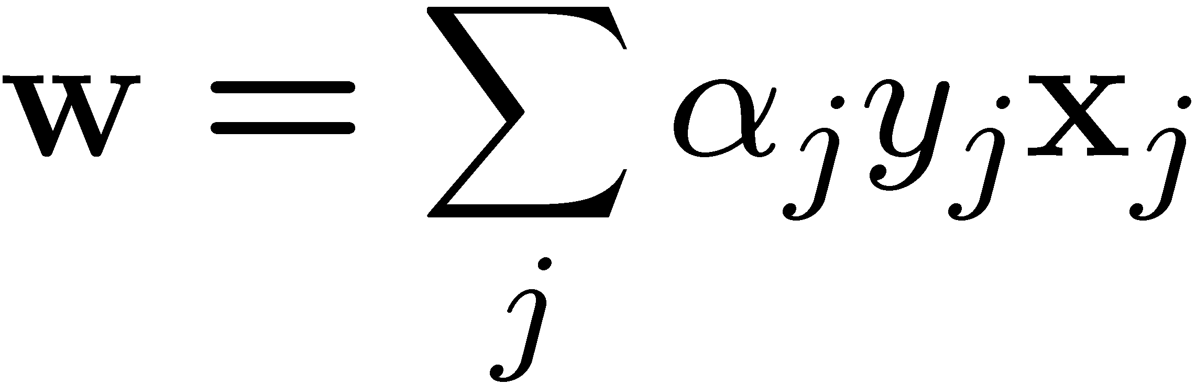
Dual SVM derivation (1) – the linearly separable case
Slide Credit: Carlos Guestrin

Slide 6
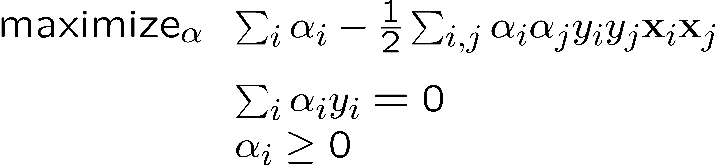
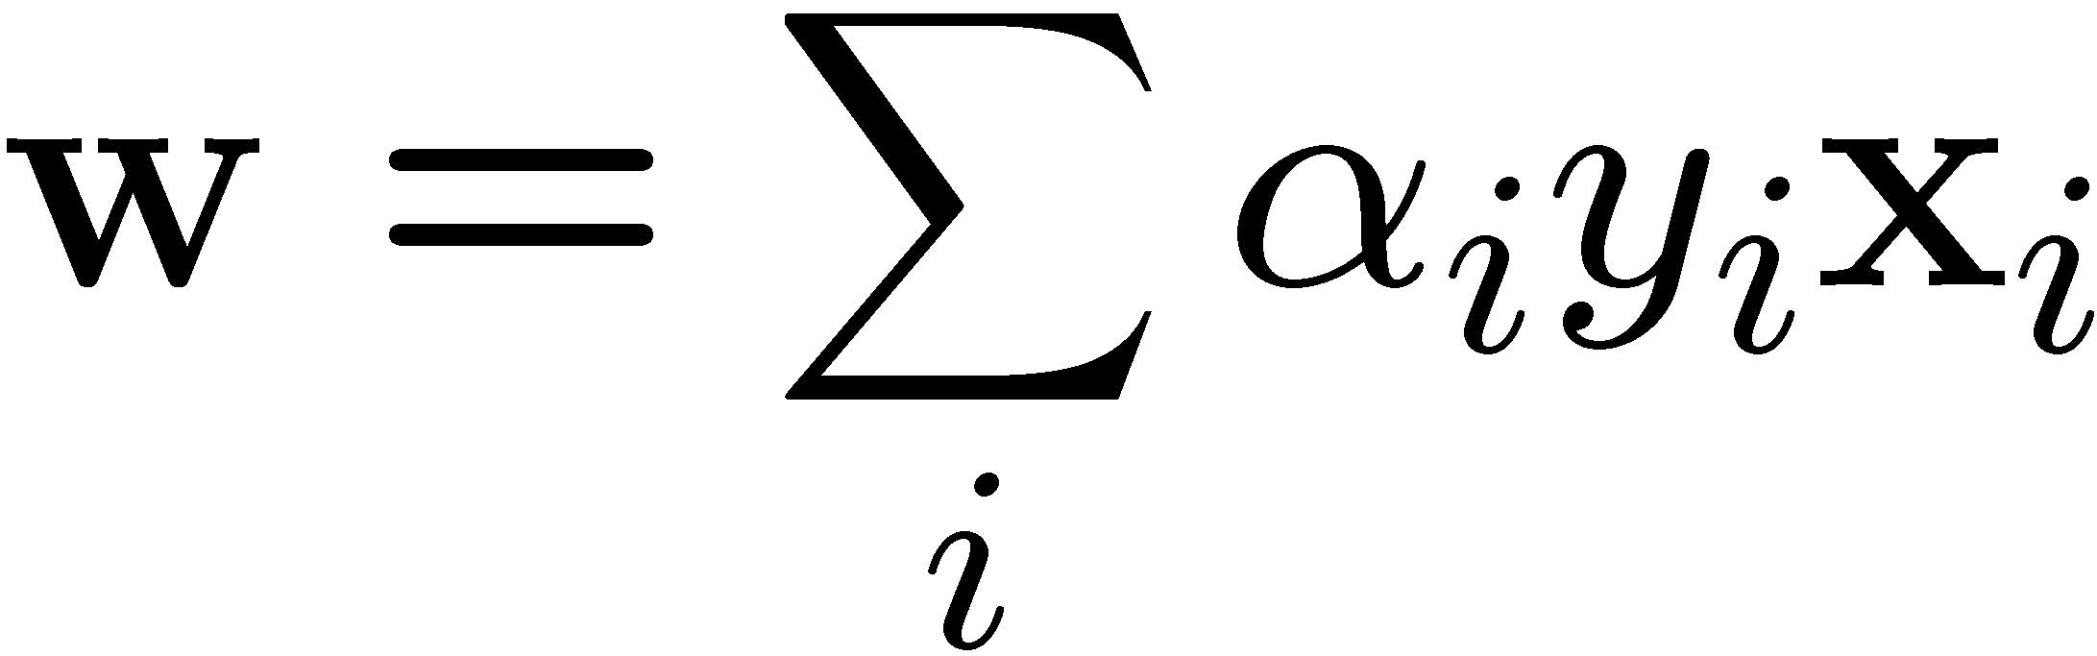
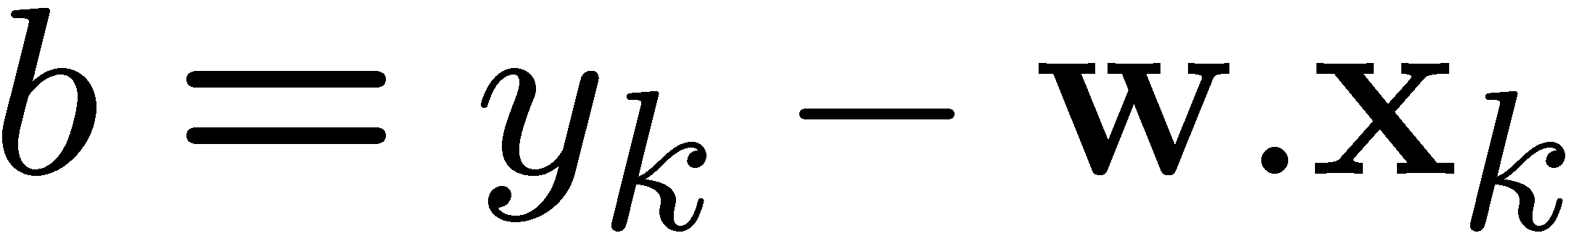
Dual SVM formulation – the linearly separable case
Slide Credit: Carlos Guestrin

Slide 7
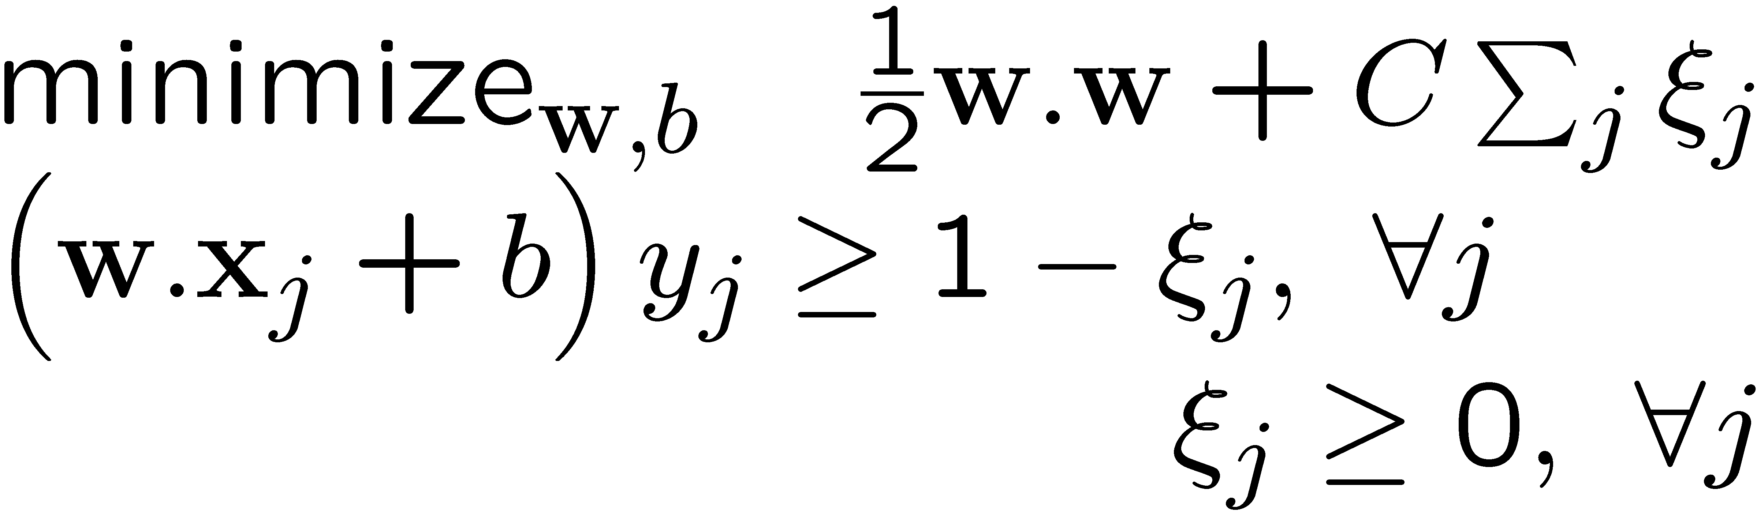
Dual SVM formulation – the non-separable case
Slide Credit: Carlos Guestrin

Slide 8
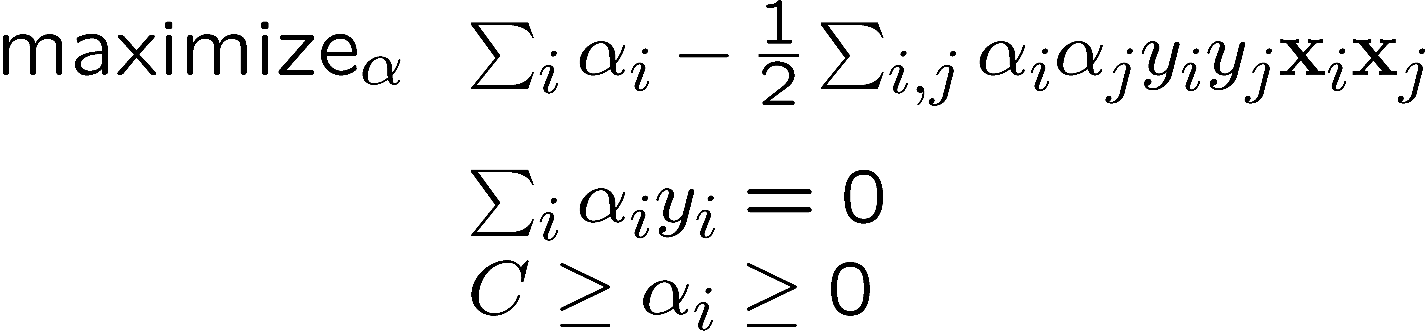
Dual SVM formulation – the non-separable case
Slide Credit: Carlos Guestrin

Slide 9
Why did we learn about the dual SVM?
Builds character!
Exposes structure about the problem
There are some quadratic programming algorithms that can solve the dual faster than the primal
The “kernel trick”!!!
Slide Credit: Carlos Guestrin

Slide 10
Dual SVM interpretation: Sparsity
w.x + b = +1
w.x + b = 0
w.x + b = -1
margin 2γ
Slide Credit: Carlos Guestrin

Slide 11
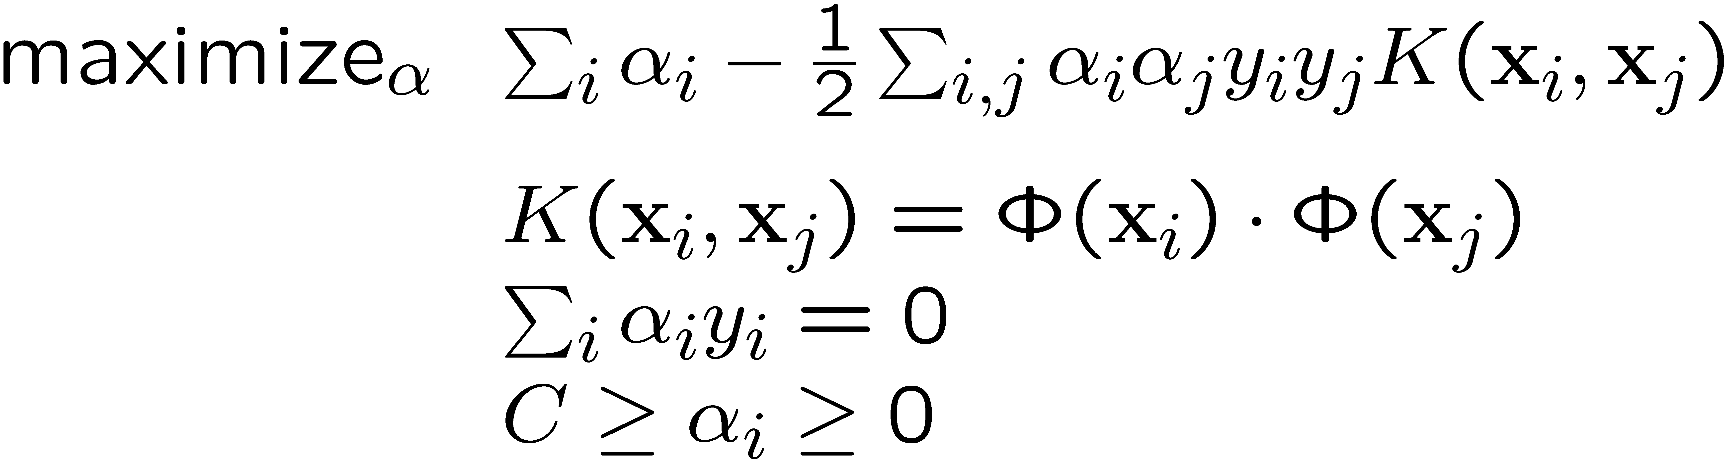
Dual formulation only depends on dot-products, not on w!

Slide 12
Dot-product of polynomials
Vector of Monomials of degree m
Slide Credit: Carlos Guestrin

Slide 13
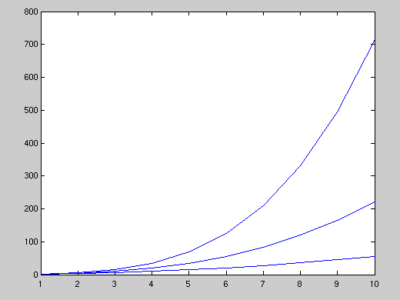
Higher order polynomials
d – input features
m – degree of polynomial
m=4
number of monomial terms
grows fast!
m = 6, d = 100
D = about 1.6 billion terms
m=3
m=2
number of input dimensions (d)
Slide Credit: Carlos Guestrin

Slide 14
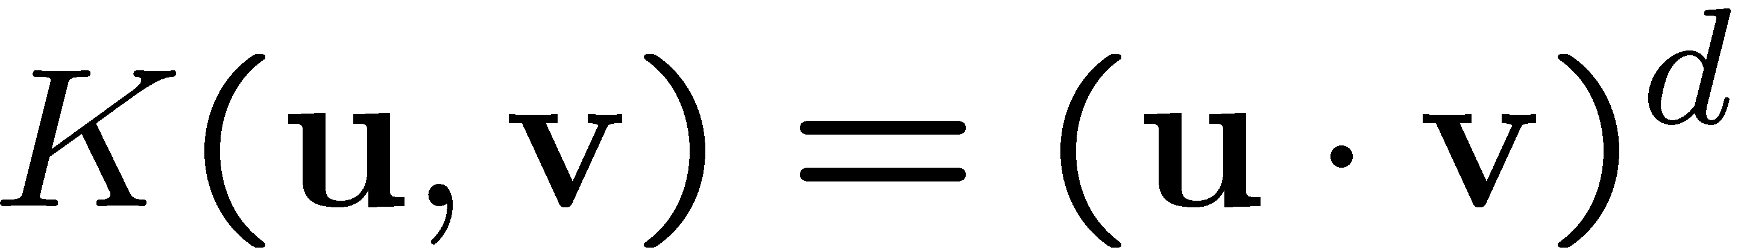
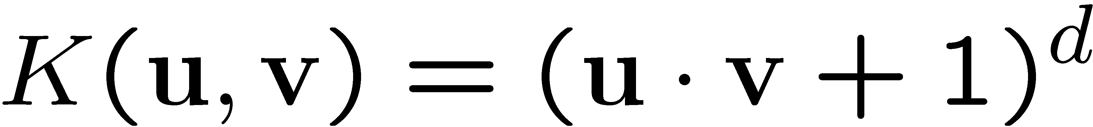
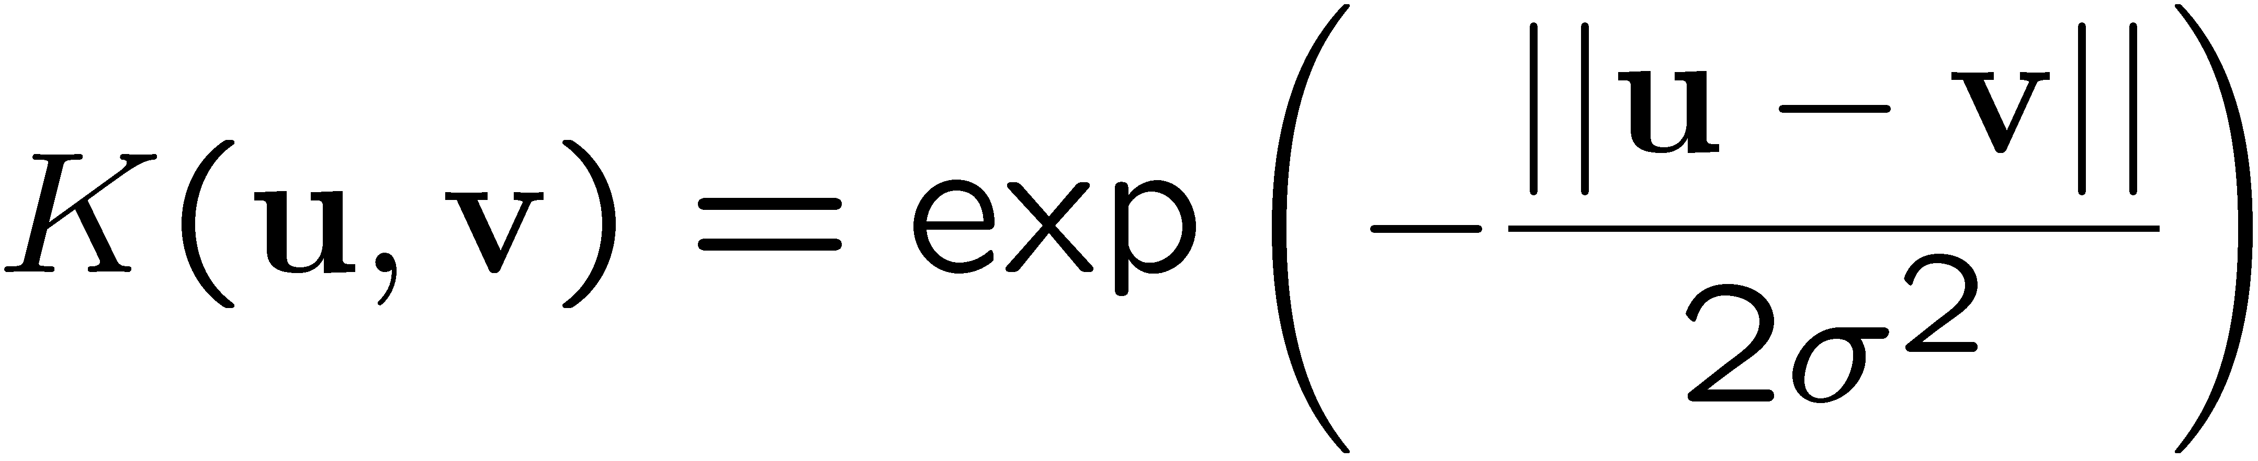
Common kernels
Polynomials of degree d
Polynomials of degree up to d
Gaussian kernel / Radial Basis Function
Sigmoid
2
Slide Credit: Carlos Guestrin

Slide 15
Kernel Demo
Demo
  http://www.eee.metu.edu.tr/~alatan/Courses/Demo/AppletSVM.html

Slide 16
What is a kernel?
k: X x X → R
Any measure of “similarity” between two inputs
Mercer Kernel / Positive Semi-Definite Kernel
  Often just called “kernel”

Slide 17
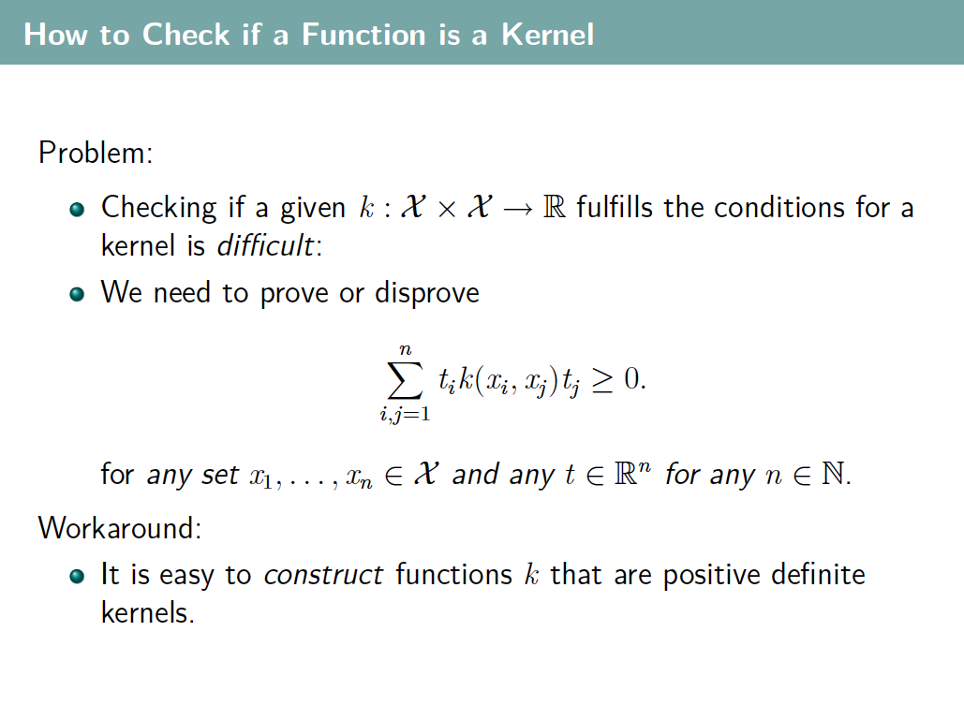
Slide Credit: Blaschko & Lampert

Slide 18
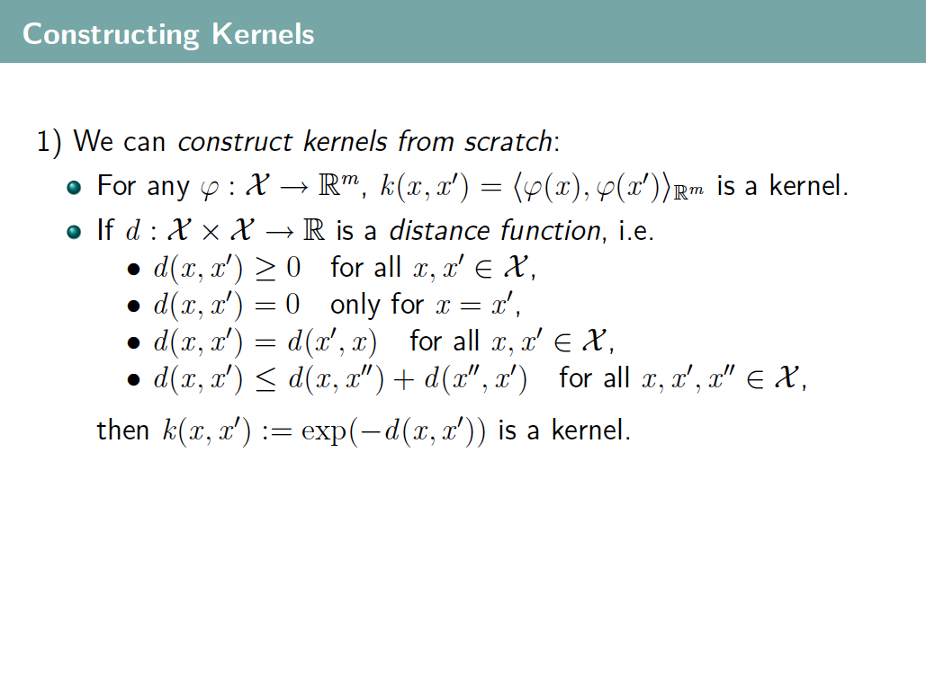
Slide Credit: Blaschko & Lampert

Slide 19
Slide Credit: Blaschko & Lampert

Slide 20
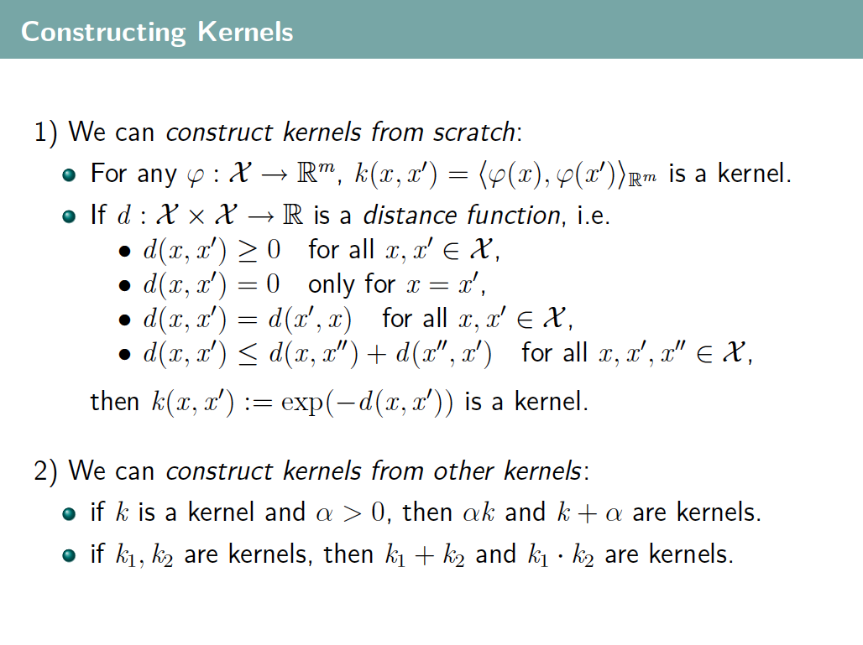
Slide Credit: Blaschko & Lampert

Slide 21
Finally: the “kernel trick”!
Never represent features explicitly
  Compute dot products in closed form
Constant-time high-dimensional dot-products for many classes of features
Very interesting theory – Reproducing Kernel Hilbert Spaces
Slide Credit: Carlos Guestrin

Slide 22
Kernels in Computer Vision
Features x = histogram (of color, texture, etc)
Common Kernels
  Intersection Kernel
  Chi-square Kernel

Slide 23
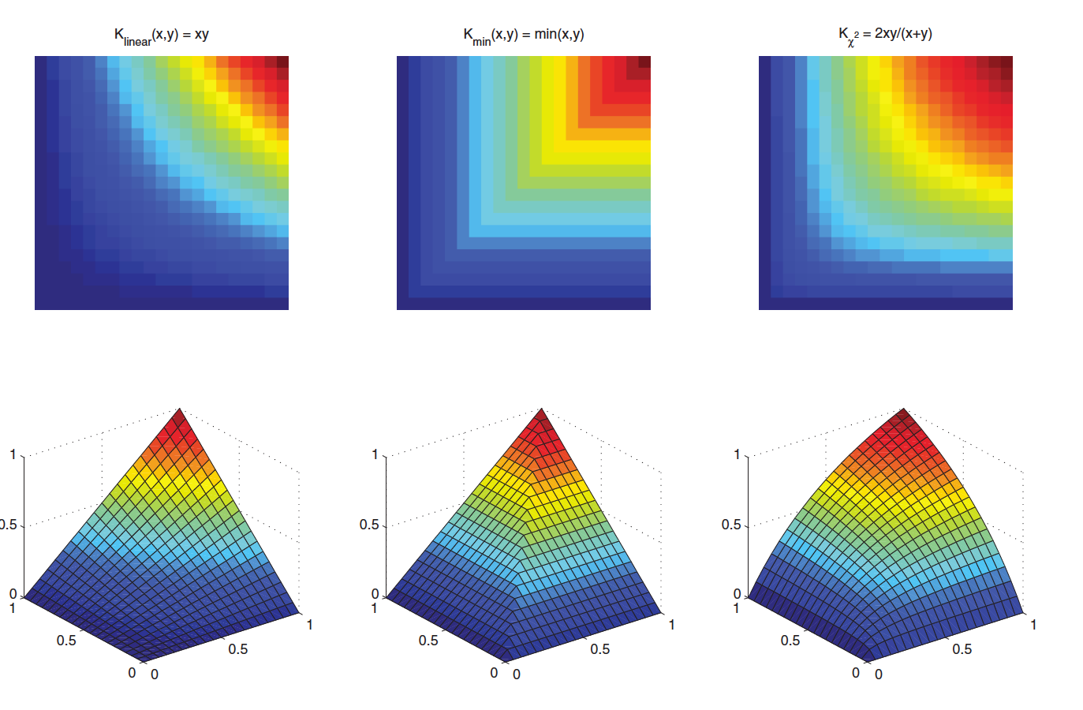
Image Credit: Subhransu Maji

Slide 24
What about at classification time
For a new input x, if we need to represent Φ(x), we are in trouble!
Recall classifier: sign(w.Φ(x)+b)
Using kernels we are fine!
Slide Credit: Carlos Guestrin

Slide 25
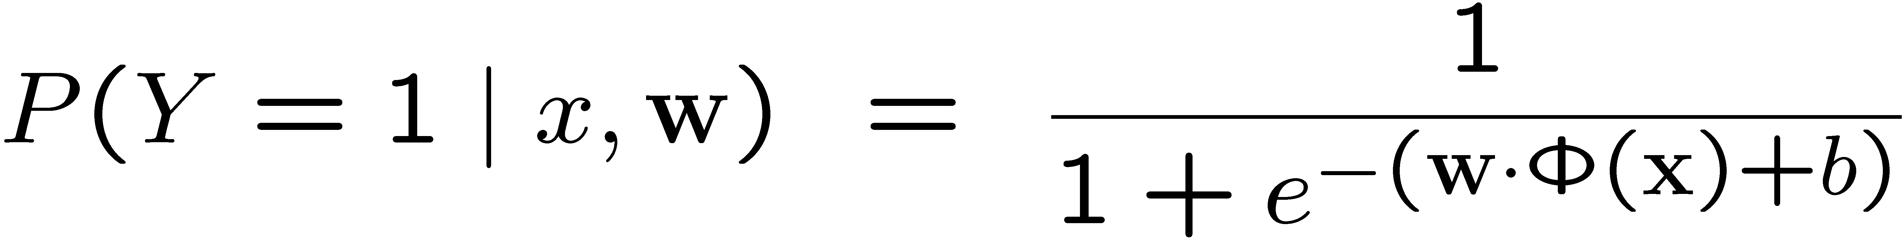
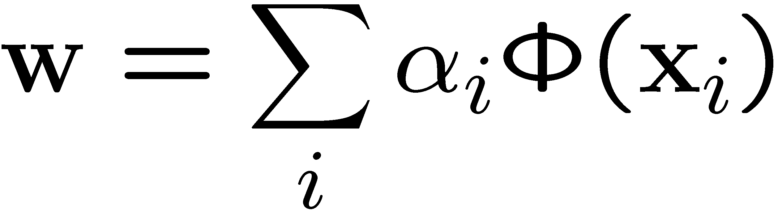
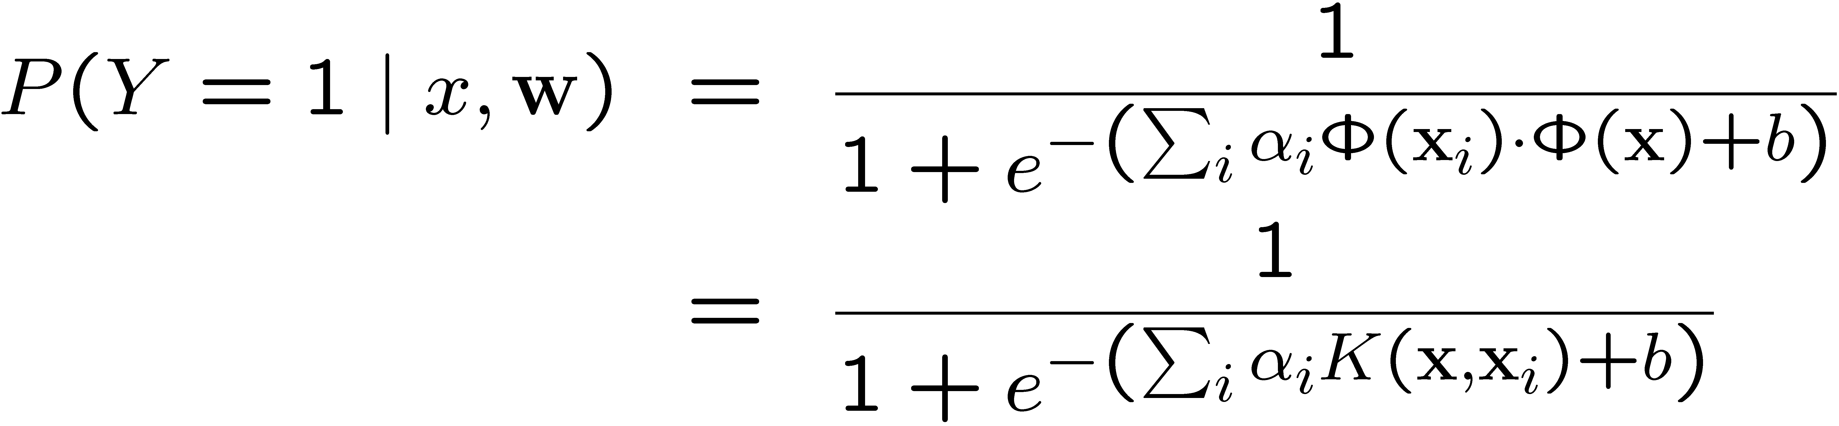
Kernels in logistic regression
Define weights in terms of support vectors:
Derive simple gradient descent rule on α_{i}

Slide 26

Kernels
Kernel Logistic Regression
Kernel Least Squares
Kernel PCA …

