Slide 1
ECE 5984: Introduction to
Machine Learning
Topics:
  Classification: Logistic Regression
  NB & LR connections
Readings: Barber 17.4
Dhruv Batra
Virginia Tech

Slide 2
Administrativia
HW2
  Due: Friday 03/06, 03/15, 11:55pm
  Implement linear regression, Naïve Bayes, Logistic Regression
Need a couple of catch-up lectures
  How about 4-6pm?

Slide 3
Recap of last time

Slide 4
Naïve Bayes
(your first probabilistic classifier)
x
Classification
y
Discrete

Slide 5
Classification
Learn: h:X  Y
  X – features
  Y – target classes
Suppose you know P(Y|X) exactly, how should you classify?
  Bayes classifier:
Why?
Slide Credit: Carlos Guestrin

Slide 6
Error Decomposition
Approximation/Modeling Error
  You approximated reality with model
Estimation Error
  You tried to learn model with finite data
Optimization Error
  You were lazy and couldn’t/didn’t optimize to completion
Bayes Error
  Reality just sucks
  http://psych.hanover.edu/JavaTest/SDT/ROC.html

Slide 7
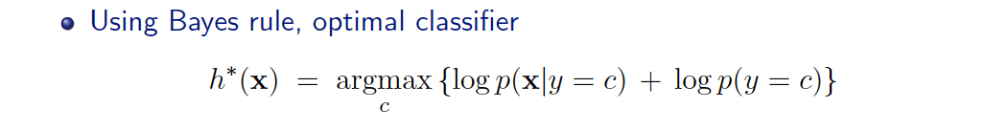
Generative vs. Discriminative
Generative Approach (Naïve Bayes)
  Estimate p(x|y) and p(y)
  Use Bayes Rule to predict y
Discriminative Approach
  Estimate p(y|x) directly (Logistic Regression)
  Learn “discriminant” function h(x) (Support Vector Machine)

Slide 8

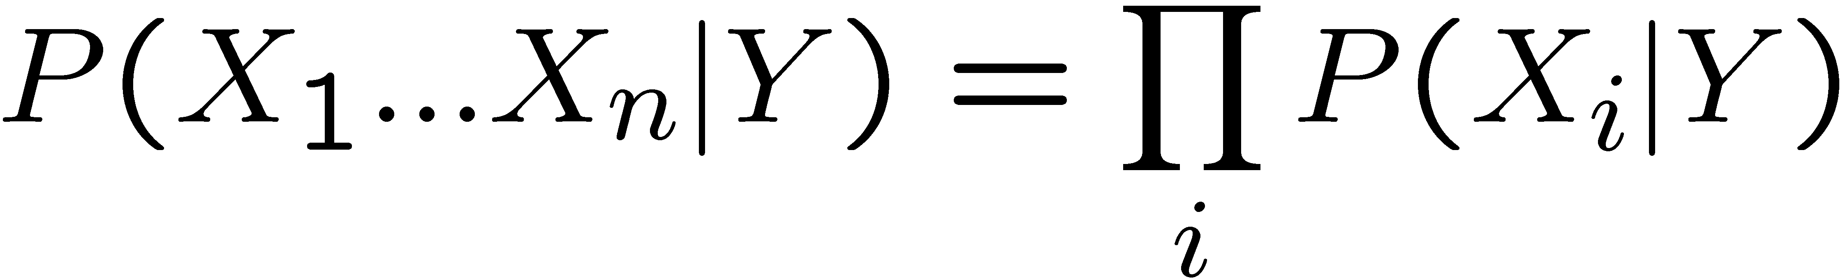
The Naïve Bayes assumption
Naïve Bayes assumption:
  Features are independent given class:
  More generally:
How many parameters now?
    Suppose X is composed of d binary features
Slide Credit: Carlos Guestrin

Slide 9
Generative vs. Discriminative
Generative Approach (Naïve Bayes)
  Estimate p(x|y) and p(y)
  Use Bayes Rule to predict y
Discriminative Approach
  Estimate p(y|x) directly (Logistic Regression)
  Learn “discriminant” function h(x) (Support Vector Machine)

Slide 10
Today: Logistic Regression
Main idea
  Think about a 2 class problem {0,1}
  Can we regress to P(Y=1 | X=x)?
Meet the Logistic or Sigmoid function
  Crunches real numbers down to 0-1
Model
  In regression: y ~ N(w’x, λ²)
  Logistic Regression: y ~ Bernoulli(σ(w’x))

Slide 11
Understanding the sigmoid
w₀=2, w₁=1
w₀=0, w₁=1
w₀=0, w₁=0.5
Slide Credit: Carlos Guestrin

Slide 12
Logistic Regression – a Linear classifier
Demo
  http://www.cs.technion.ac.il/~rani/LocBoost/

Slide 13
Visualization
Slide Credit: Kevin Murphy

Slide 14
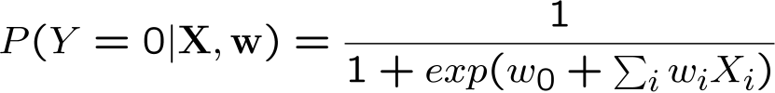
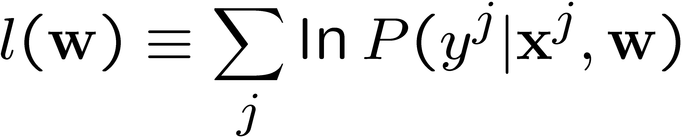
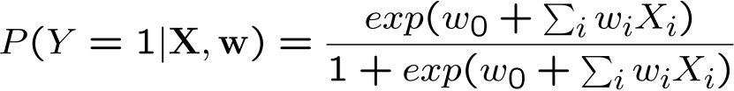
Expressing Conditional Log Likelihood
Slide Credit: Carlos Guestrin

Slide 15
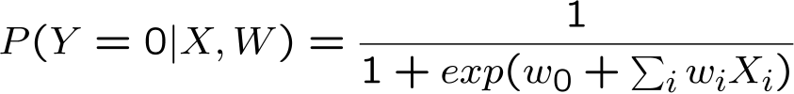
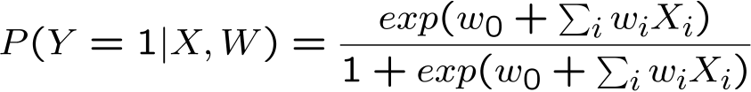
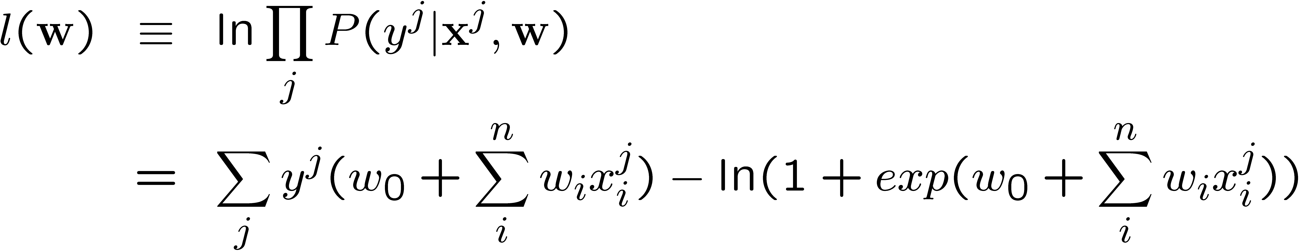
Maximizing Conditional Log Likelihood
Bad news: no closed-form solution to maximize l(w)
Good news: l(w) is concave function of w!
Slide Credit: Carlos Guestrin

Slide 16
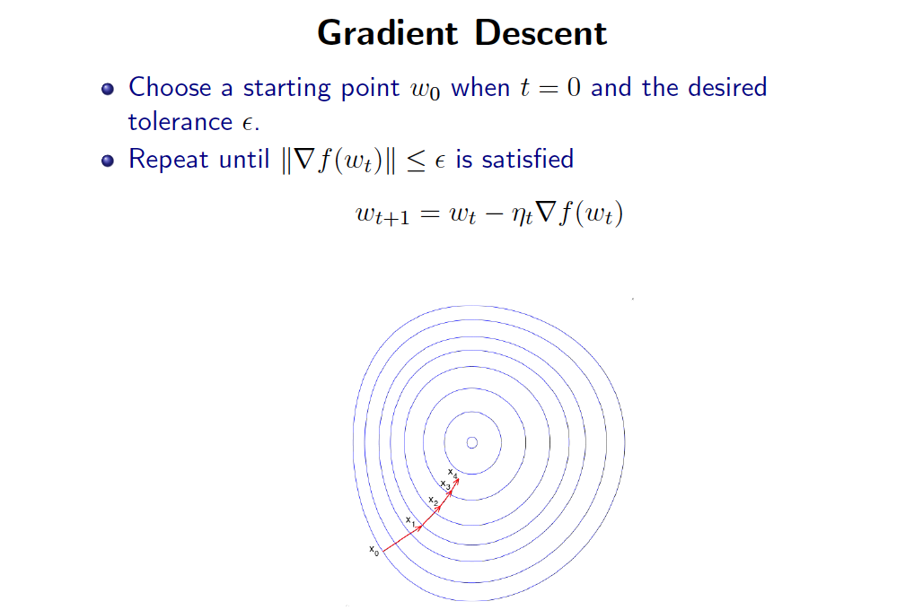
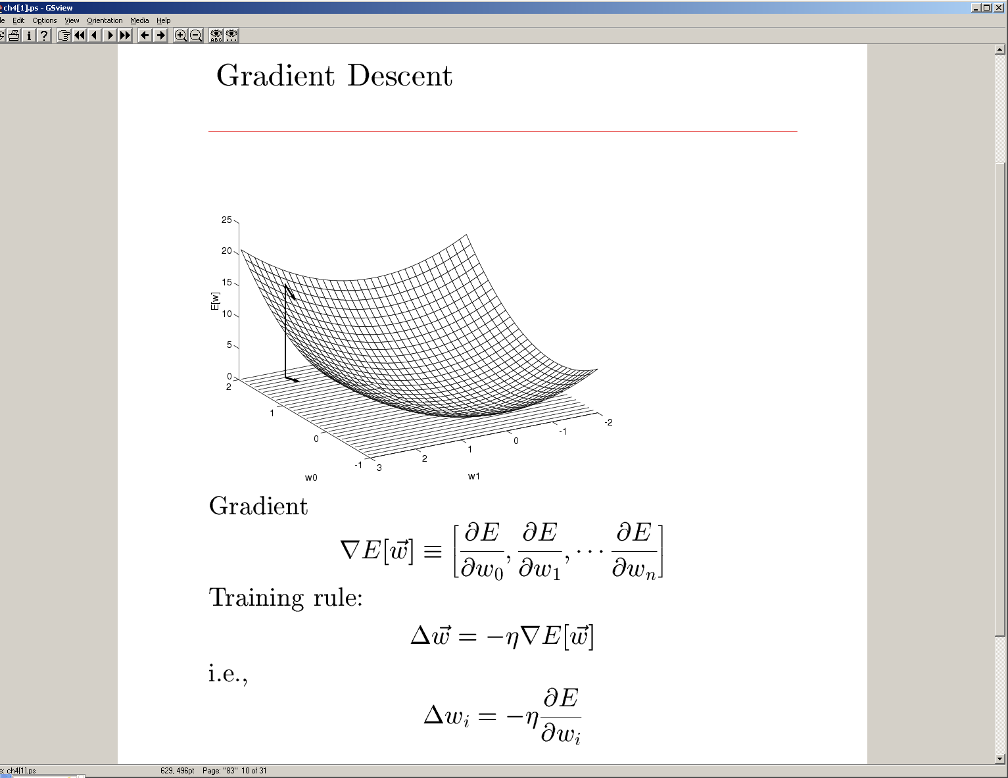
Slide Credit: Greg Shakhnarovich

Slide 17
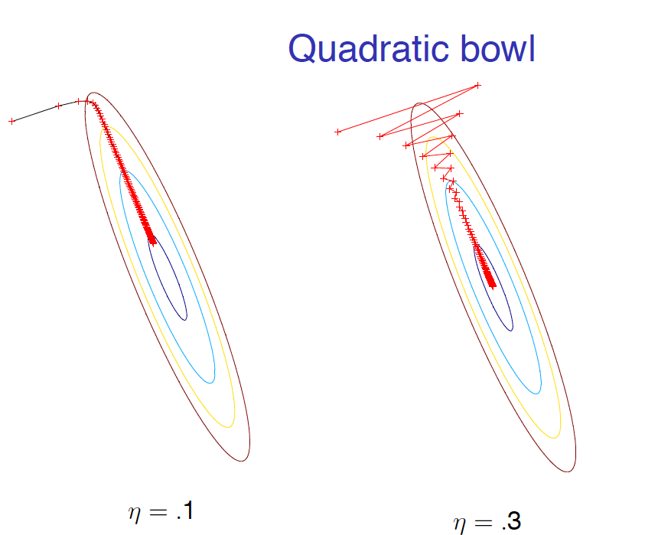
Careful about step-size
Slide Credit: Nicolas Le Roux

Slide 18
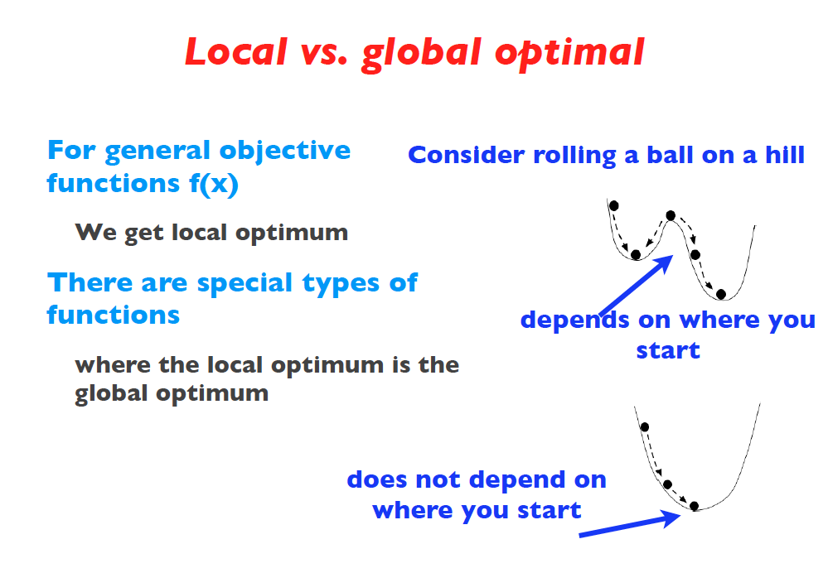
Slide Credit: Fei Sha

Slide 19
When does it work?

Slide 20
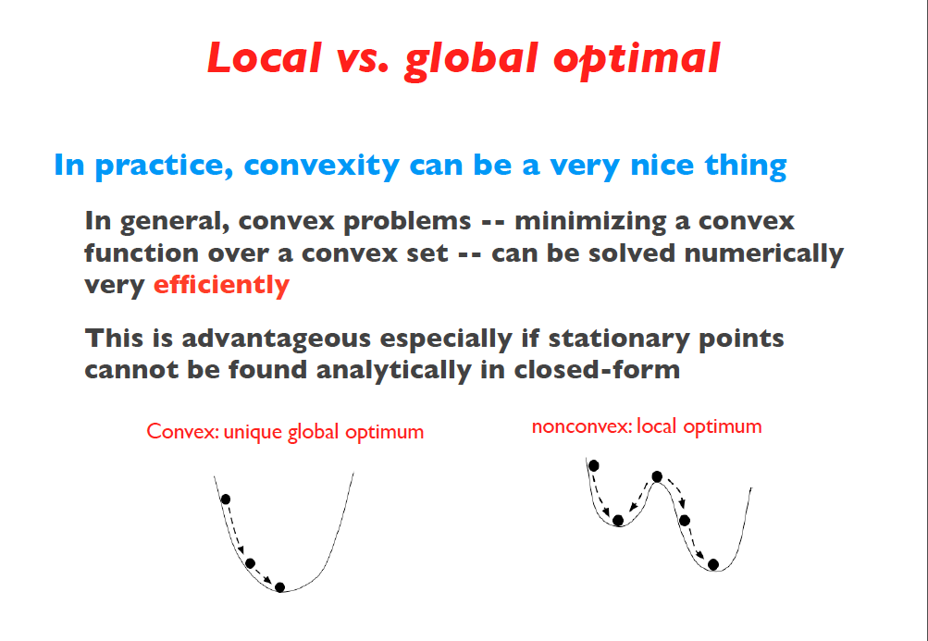
Slide Credit: Fei Sha

Slide 21
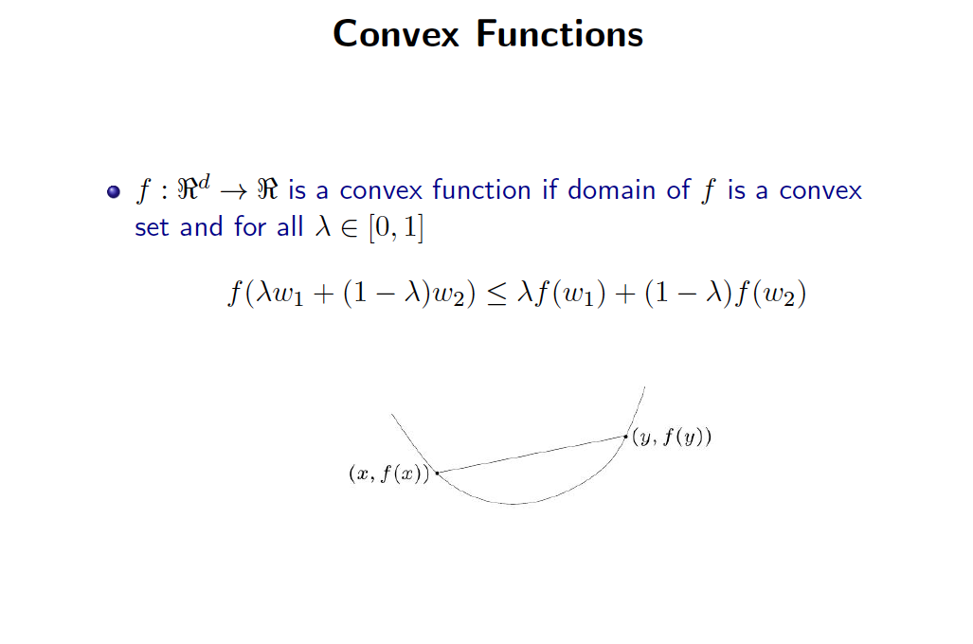
Slide Credit: Greg Shakhnarovich

Slide 22
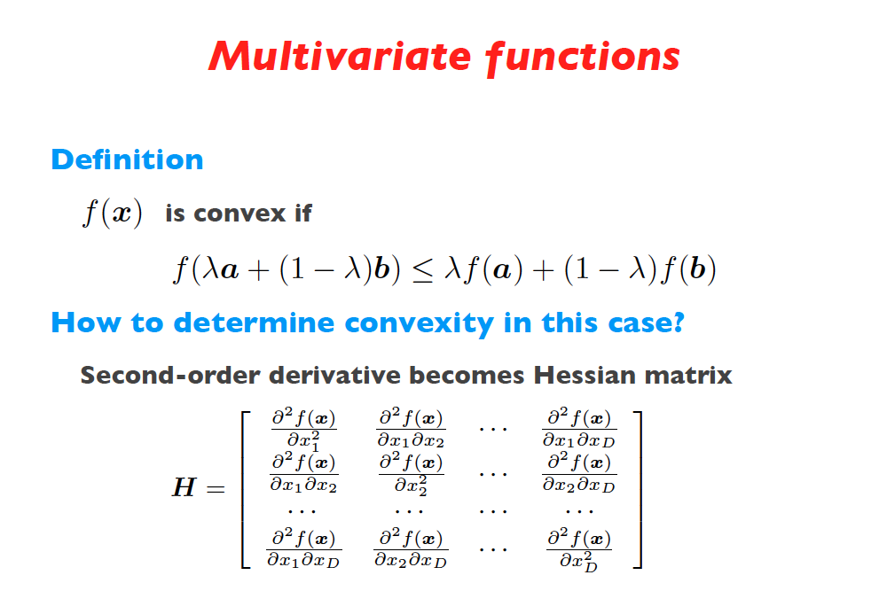
Slide Credit: Fei Sha

Slide 23
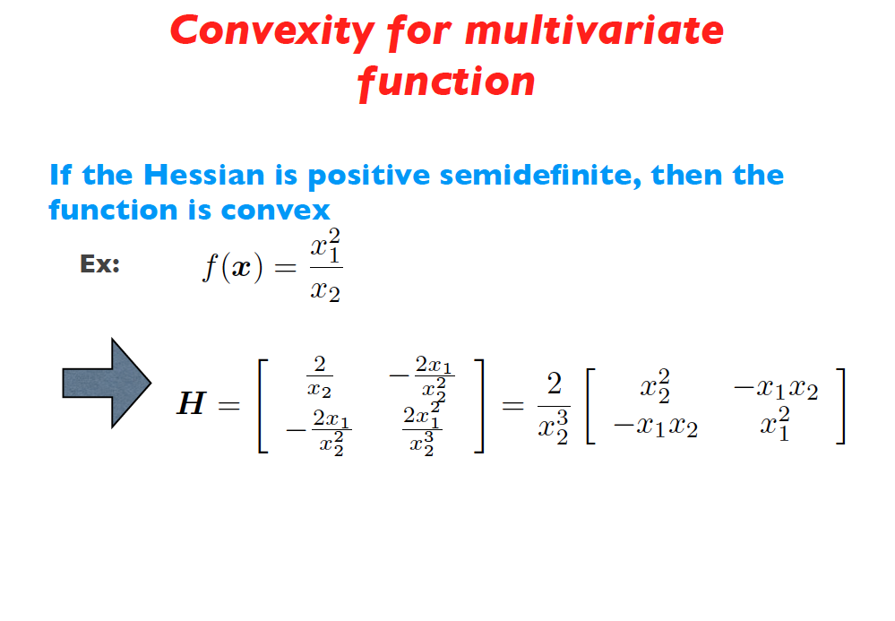
Slide Credit: Fei Sha

Slide 24
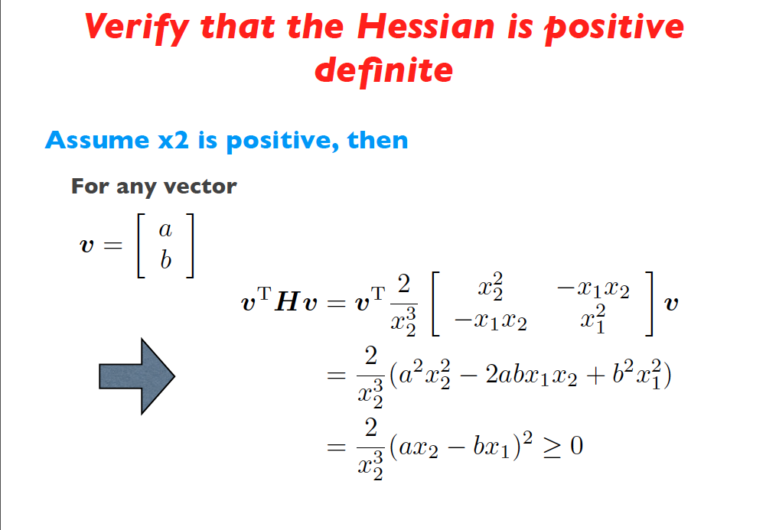
Slide Credit: Fei Sha

Slide 25
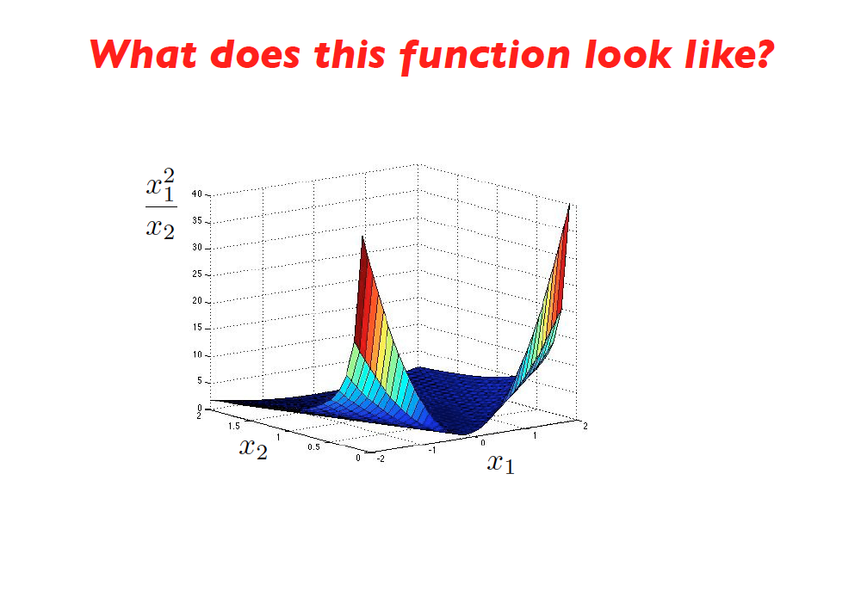
Slide Credit: Fei Sha

Slide 26
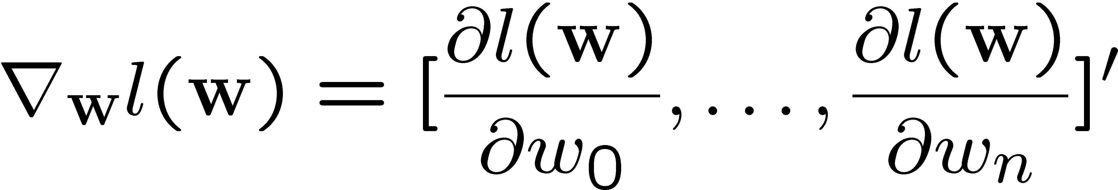

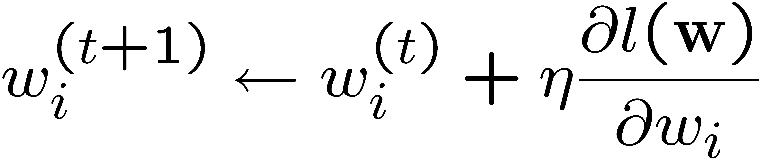
Optimizing concave function – Gradient ascent
Conditional likelihood for Logistic Regression is concave
→ Find optimum with gradient ascent
Gradient:
Learning rate, η>0
Update rule:
Slide Credit: Carlos Guestrin

Slide 27
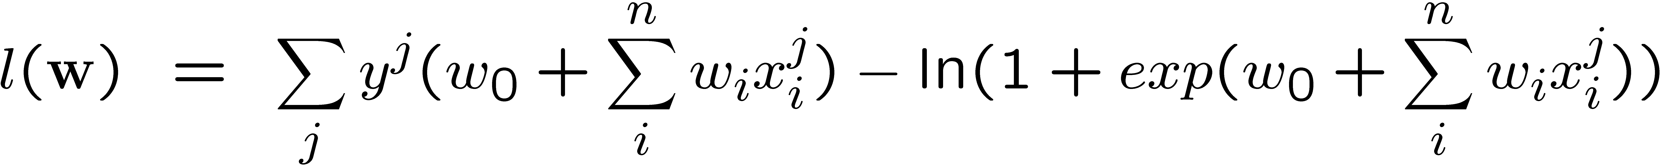
Maximize Conditional Log Likelihood:
Gradient ascent
Slide Credit: Carlos Guestrin

Slide 28
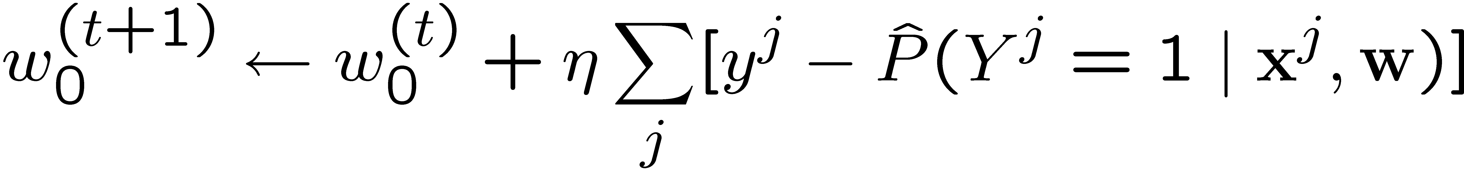
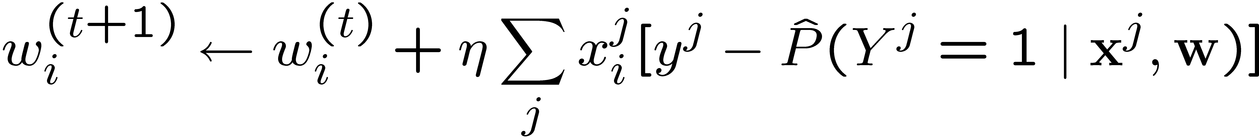
Gradient Ascent for LR
Gradient ascent algorithm: iterate until change < ε
For i=1,…,n,
repeat
Slide Credit: Carlos Guestrin

Slide 29
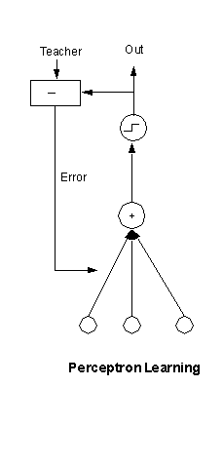

Slide 30
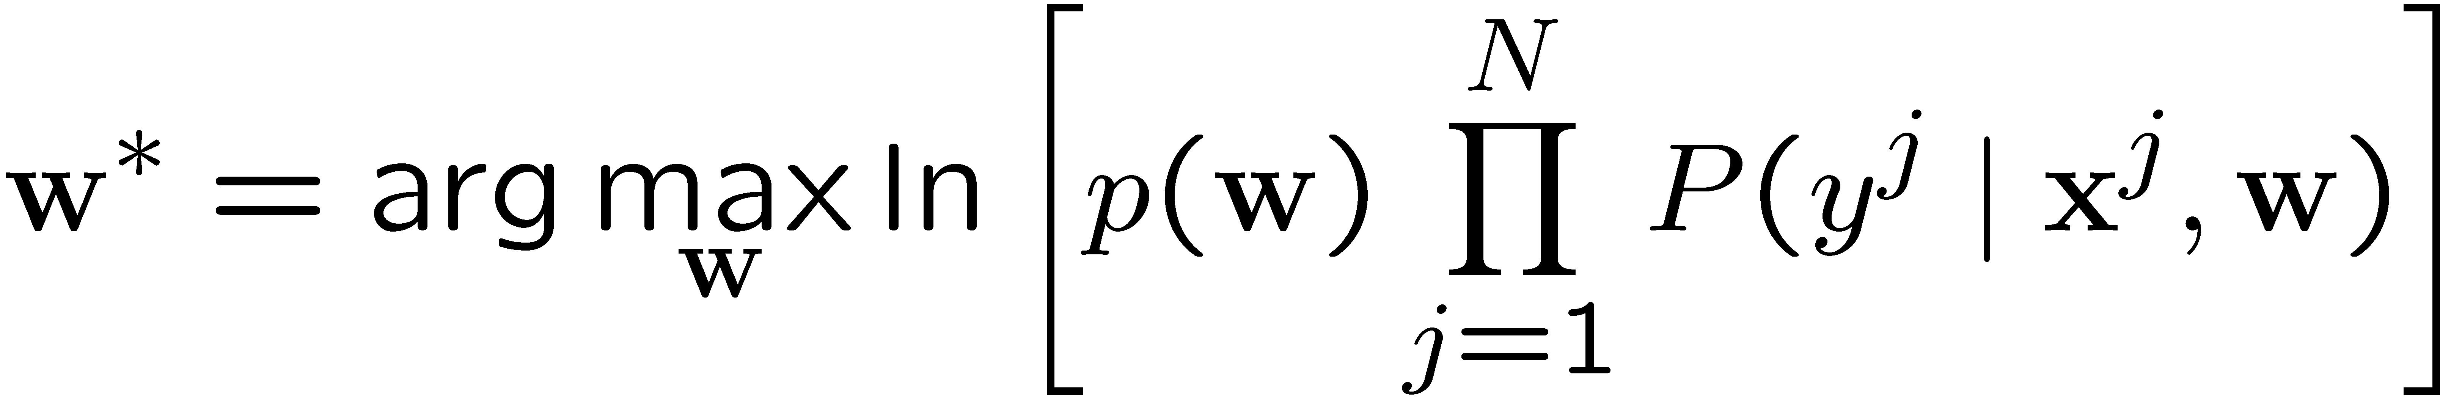
That’s all M(C)LE. How about M(C)AP?
One common approach is to define priors on w
  Normal distribution, zero mean, identity covariance
  “Pushes” parameters towards zero
Corresponds to Regularization
  Helps avoid very large weights and overfitting
  More on this later in the semester
MAP estimate
Slide Credit: Carlos Guestrin

Slide 31
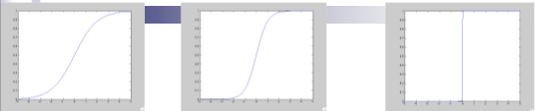
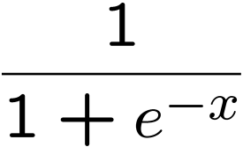
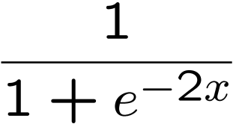
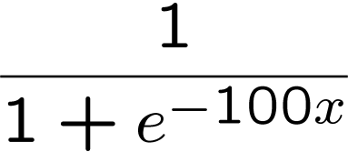
Large parameters → Overfitting
If data is linearly separable, weights go to infinity
Leads to overfitting
Penalizing high weights can prevent overfitting
Slide Credit: Carlos Guestrin

Slide 32
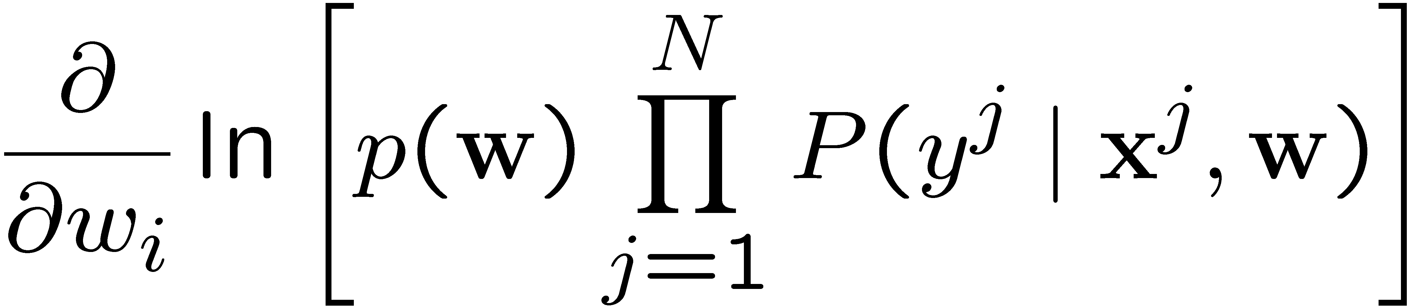
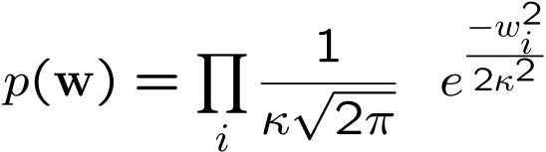
Gradient of M(C)AP
Slide Credit: Carlos Guestrin

Slide 33
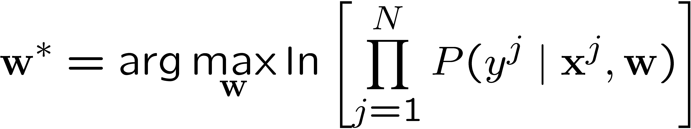
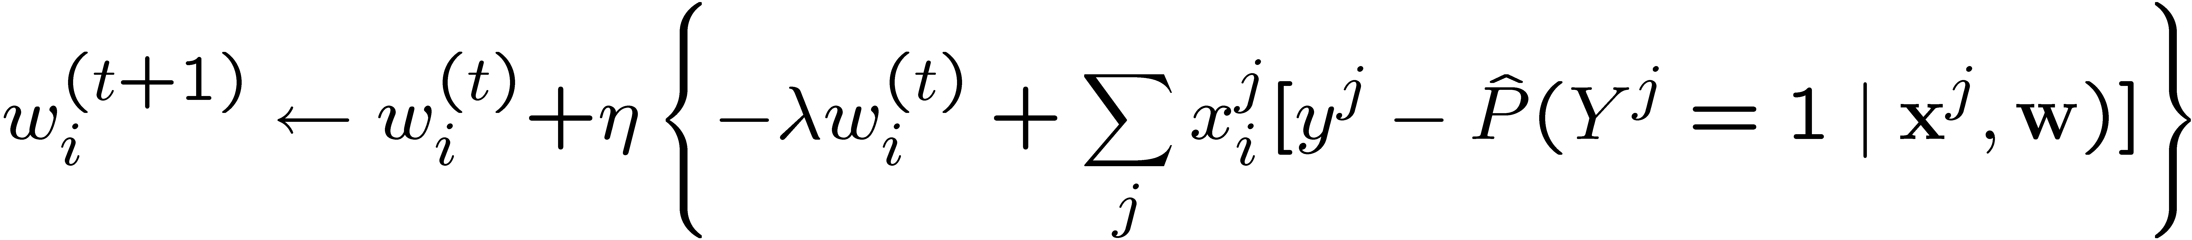
MLE vs MAP
Maximum conditional likelihood estimate
Maximum conditional a posteriori estimate
Slide Credit: Carlos Guestrin

Slide 34
HW2 Tips
Naïve Bayes
  Train_NB
    Implement “factor_tables” -- |X_{i}| x |Y| matrices
    Prior |Y| x 1 vector
    Fill entries by counting + smoothing
  Test_NB
    argmax_y P(Y=y) P(X_{i}=x_{i})…
  TIP: work in log domain
Logistic Regression
  Use small step-size at first
  Make sure you maximize log-likelihood not minimize it
  Sanity check: plot objective

Slide 35
Finishing up:
Connections between NB & LR

Slide 36
Logistic regression vs Naïve Bayes
Consider learning f: X → Y, where
  X is a vector of real-valued features, <X1 … Xd>
  Y is boolean
Gaussian Naïve Bayes classifier
  assume all X_{i} are conditionally independent given Y
  model P(X_{i} | Y = k) as Gaussian N(μ_{ik},σ_{i})
  model P(Y) as Bernoulli(θ,1-θ)
What does that imply about the form of P(Y|X)?
Cool!!!!
Slide Credit: Carlos Guestrin

Slide 37
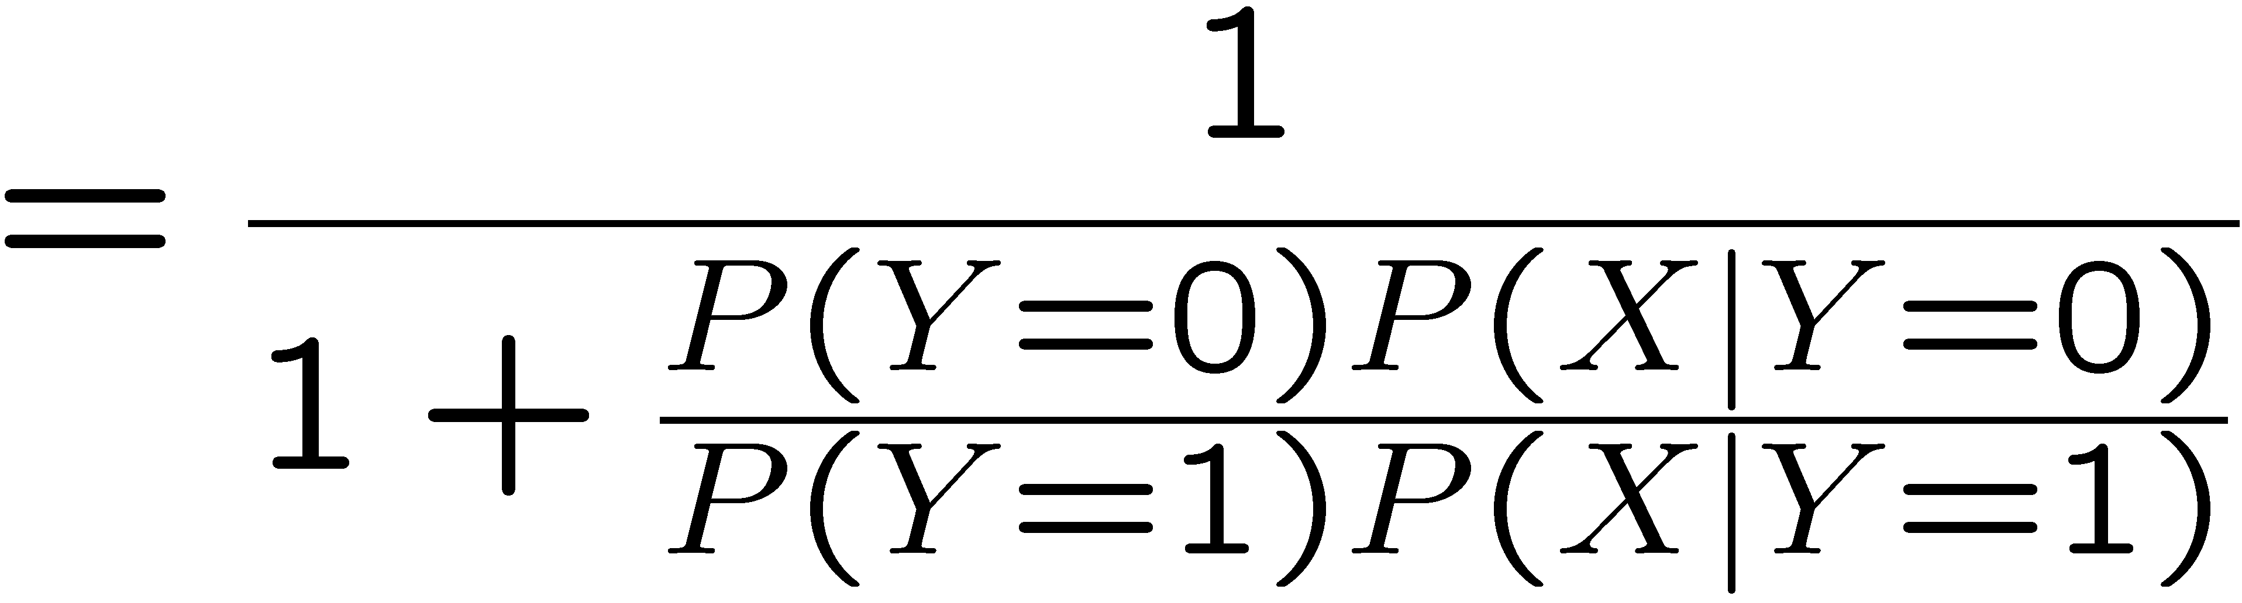
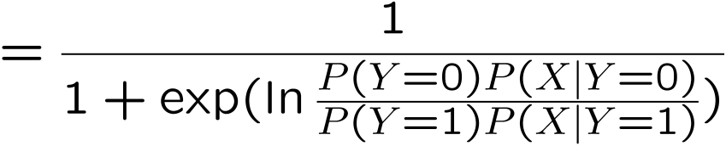
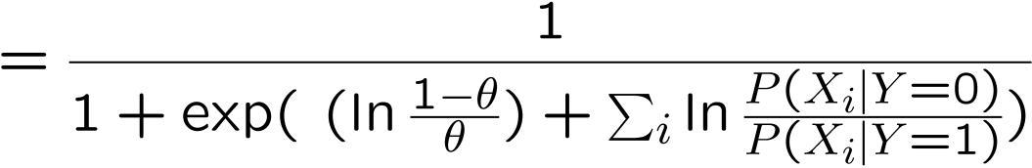
Derive form for P(Y|X) for continuous X_{i}
Slide Credit: Carlos Guestrin

Slide 38
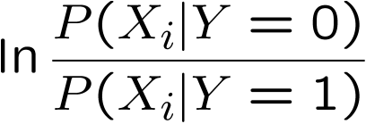
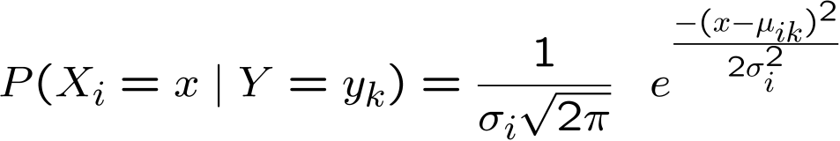
Ratio of class-conditional probabilities
Slide Credit: Carlos Guestrin

Slide 39
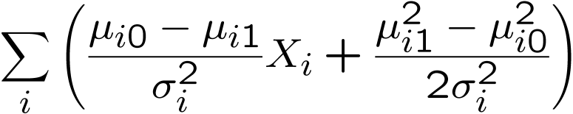
Derive form for P(Y|X) for continuous X_{i}
Slide Credit: Carlos Guestrin

Slide 40
Gaussian Naïve Bayes vs Logistic Regression
Set of Gaussian
Naïve Bayes parameters
(feature variance
independent of class label)
Set of Logistic
Regression parameters
Not necessarily
Representation equivalence
  But only in a special case!!! (GNB with class-independent variances)
But what’s the difference???
LR makes no assumptions about P(X|Y) in learning!!!
Loss function!!!
  Optimize different functions → Obtain different solutions
Slide Credit: Carlos Guestrin

Slide 41
Naïve Bayes vs Logistic Regression
Consider Y boolean, Xi continuous, X=<X1 ... Xd>
Number of parameters:
  NB: 4d +1 (or 3d+1)
  LR: d+1
Estimation method:
  NB parameter estimates are uncoupled
  LR parameter estimates are coupled
Slide Credit: Carlos Guestrin

Slide 42
G. Naïve Bayes vs. Logistic Regression 1
[Ng & Jordan, 2002]
Generative and Discriminative classifiers
Asymptotic comparison
(# training examples → infinity)
  when model correct
    GNB (with class independent variances) and
    LR produce identical classifiers
  when model incorrect
    LR is less biased – does not assume conditional independence
      therefore LR expected to outperform GNB
Slide Credit: Carlos Guestrin

Slide 43
G. Naïve Bayes vs. Logistic Regression 2
[Ng & Jordan, 2002]
Generative and Discriminative classifiers
Non-asymptotic analysis
  convergence rate of parameter estimates,
  d = # of attributes in X
    Size of training data to get close to infinite data solution
    GNB needs O(log d) samples
    LR needs O(d) samples
  GNB converges more quickly to its (perhaps less helpful) asymptotic estimates
Slide Credit: Carlos Guestrin

Slide 44
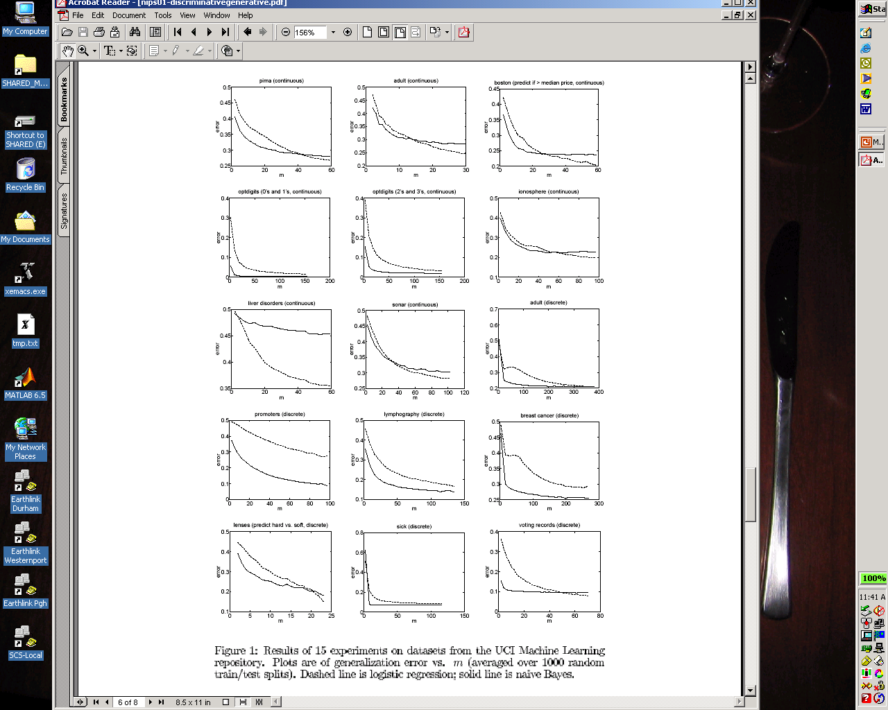
Some experiments from UCI data sets
Naïve bayes
Logistic Regression

Slide 45
What you should know about LR
Gaussian Naïve Bayes with class-independent variances representationally equivalent to LR
  Solution differs because of objective (loss) function
In general, NB and LR make different assumptions
  NB: Features independent given class assumption on P(X|Y)
  LR: Functional form of P(Y|X), no assumption on P(X|Y)
LR is a linear classifier
  decision rule is a hyperplane
LR optimized by conditional likelihood
  no closed-form solution
  Concave → global optimum with gradient ascent
  Maximum conditional a posteriori corresponds to regularization
Convergence rates
  GNB (usually) needs less data
  LR (usually) gets to better solutions in the limit
Slide Credit: Carlos Guestrin

