Slide 1
ECE 6504: Deep Learning for Perception
Topics:
Deconvolution
Dhruv Batra
Virginia Tech

Slide 2
Administrativia
HW2
Out today
Due in 2 weeks
Please please please please please start early
https://computing.ece.vt.edu/~f15ece6504/homework2/
Project Proposal
Due: Oct 2, 11:59pm
webpage

Slide 3
Project
Groups of 1-3
we prefer teams of 1 or 2
Deliverables:
Project proposal: webpage with abstract + picture + goals
Final report: webpage with results

Slide 4
Proposal
Webpage
Necessary Information:
Project title
Project idea.
This should be approximately two paragraphs.
Data set details
Ideally existing dataset. No data-collection projects.
Software
Which libraries will you use?
What will you write?
Papers to read.
Include 1-3 relevant papers. You will probably want to read at least one of them before submitting your proposal.
Teammate
Will you have a teammate? If so, what’s the break-down of labor? Maximum team size is 3 students.
Mid-sem Milestone
What will you complete by the project milestone due date? Experimental results of some kind are expected here.

Slide 5
Project
Main categories
Application/Survey
Compare a bunch of existing algorithms on a new application domain of your interest
Formulation/Development
Formulate a new model or algorithm for a new or old problem
Theory
Theoretically analyze an existing algorithm
Rules
Should fit in “Deep Learning”
Can apply DL to your own research.
Must be done this semester.
OK to combine with other class-projects
Must declare to both course instructors
Must have explicit permission from BOTH instructors
Must have a sufficient ML component

Slide 6
Plan for Today
Deconvolution
1D with Toeplitz Matrix
2D deconv intuition

Slide 7
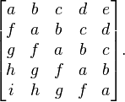
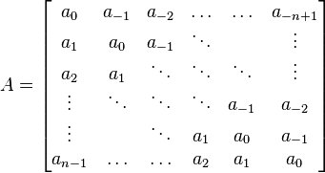
Toeplitz Matrix
Diagonals are constants
A_{ij} = a_{i-j}

Slide 8
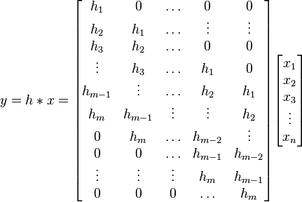
Why do we care?
(Discrete) Convolution = Matrix Multiplication
with Toeplitz Matrices

Slide 9
"Convolution of box signal with itself2" by Convolution_of_box_signal_with_itself.gif: Brian Ambergderivative work: Tinos (talk) - Convolution_of_box_signal_with_itself.gif. Licensed under CC BY-SA 3.0 via Commons - https://commons.wikimedia.org/wiki/File:Convolution_of_box_signal_with_itself2.gif#/media/File:Convolution_of_box_signal_with_itself2.gif

