Slide 1
ECE 6504: Deep Learning for Perception
Topics:
  Toeplitz Matrix
  1x1 Convolution
    AKA How to run a ConvNet on arbitrary sized images
Dhruv Batra
Virginia Tech

Slide 2
Plan for Today
Toeplitz Matrix
1x1 Convolution
  AKA How to run a ConvNet on arbitrary sized images

Slide 3
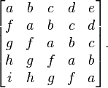
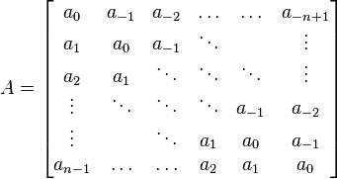
Toeplitz Matrix
Diagonals are constants
A_{ij} = a_{i-j}

Slide 4
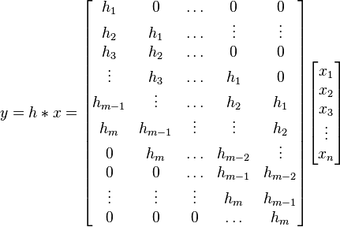
Why do we care?
(Discrete) Convolution = Matrix Multiplication
  with Toeplitz Matrices

Slide 5
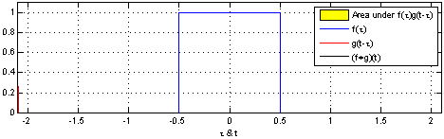
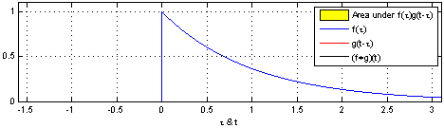
"Convolution of box signal with itself2" by Convolution_of_box_signal_with_itself.gif: Brian Ambergderivative work: Tinos (talk) - Convolution_of_box_signal_with_itself.gif. Licensed under CC BY-SA 3.0 via Commons - https://commons.wikimedia.org/wiki/File:Convolution_of_box_signal_with_itself2.gif#/media/File:Convolution_of_box_signal_with_itself2.gif

Slide 6
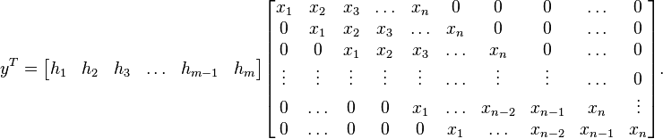
Why do we care?
Two way of writing the same thing

Slide 7
Plan for Today
Toeplitz Matrix
1x1 Convolution
  AKA How to run a ConvNet on arbitrary sized images

Slide 8

Convolutional Nets
  a
Image Credit: Yann LeCun, Kevin Murphy

Slide 9
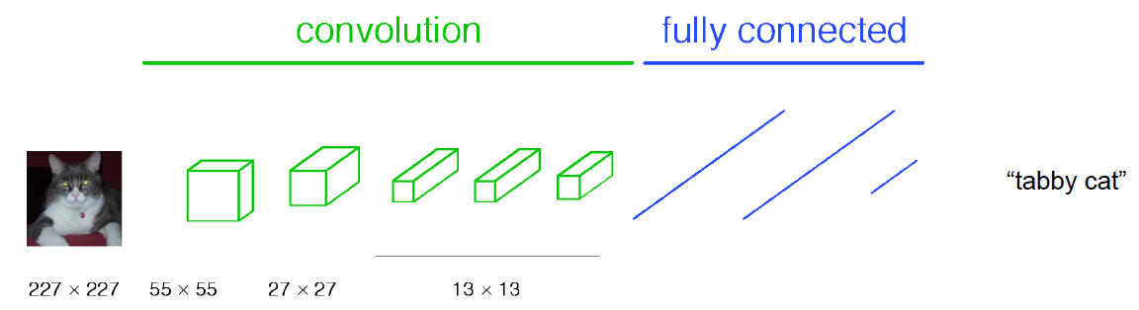
Classical View
Figure Credit: [Long, Shelhamer, Darrell CVPR15]

Slide 10
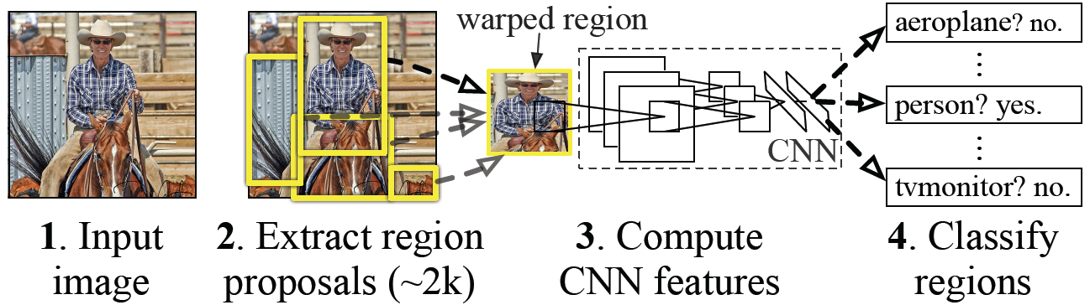
Classical View = Inefficient

Slide 11
Classical View
Figure Credit: [Long, Shelhamer, Darrell CVPR15]

Slide 12
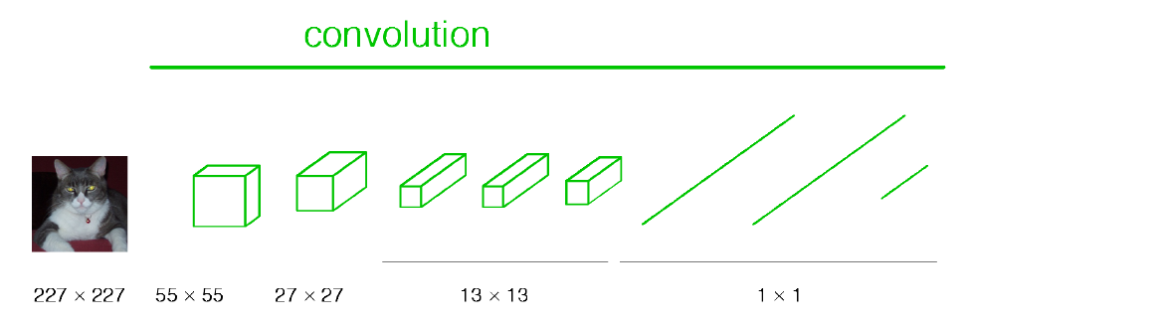
Re-interpretation
Just squint a little!
Figure Credit: [Long, Shelhamer, Darrell CVPR15]

Slide 13
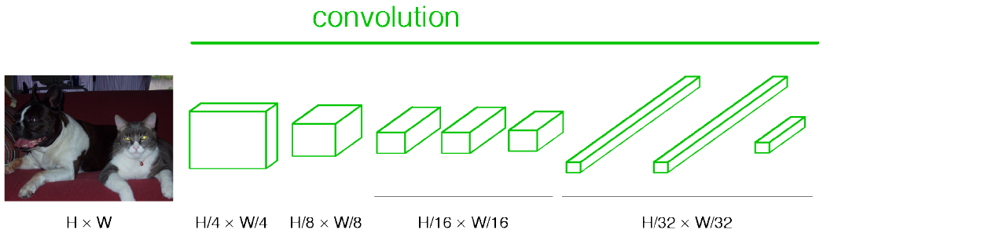
“Fully Convolutional” Networks
Can run on an image of any size!
Figure Credit: [Long, Shelhamer, Darrell CVPR15]

Slide 14
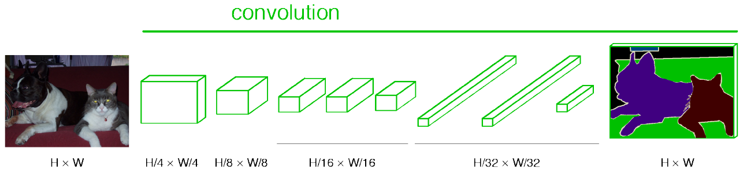
“Fully Convolutional” Networks
Up-sample to get segmentation maps
Figure Credit: [Long, Shelhamer, Darrell CVPR15]

Slide 15
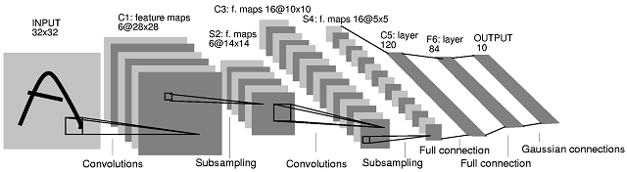
Note: After several stages of convolution-pooling, the spatial resolution is greatly reduced (usually to about 5x5) and the number of feature maps is large (several hundreds depending on the application).
It would not make sense to convolve again (there is no translation invariance and support is too small). Everything is vectorized and fed into several fully connected layers.
If the input of the fully connected layers is of size Nx5x5, the first fully connected layer can be seen as a conv. layer with 5x5 kernels.
The next fully connected layer can be seen as a conv. layer with 1x1 kernels.
Slide Credit: Marc'Aurelio Ranzato

Slide 16
H hidden units /
Hx1x1 feature maps
NxMxM, M small
Fully conn. layer /
Conv. layer (H kernels of size NxMxM)
Slide Credit: Marc'Aurelio Ranzato

Slide 17
K hidden units /
Kx1x1 feature maps
H hidden units /
Hx1x1 feature maps
NxMxM, M small
Fully conn. layer /
Conv. layer (H kernels of size NxMxM)
Fully conn. layer /
Conv. layer (K kernels of size Hx1x1)
Slide Credit: Marc'Aurelio Ranzato

Slide 18
Viewing fully connected layers as convolutional layers enables efficient use of convnets on bigger images (no need to slide windows but unroll network over space as needed to re-use computation).
TRAINING TIME
Input
Image
CNN
TEST TIME
Input
Image
Input
Image
CNN
y
x
Slide Credit: Marc'Aurelio Ranzato

Slide 19
Viewing fully connected layers as convolutional layers enables efficient use of convnets on bigger images (no need to slide windows but unroll network over space as needed to re-use computation).
TRAINING TIME
Input
Image
CNN
TEST TIME
CNNs work on any image size!
Input
Image
CNN
y
x
Unrolling is order of magnitudes more eficient than sliding windows!
Slide Credit: Marc'Aurelio Ranzato

Slide 20
Benefit of this thinking
Mathematically elegant
Efficiency
  Can run network on arbitrary image
  Without multiple crops
Dimensionality Reduction!
  Can use 1x1 convolutions to reduce feature maps

