Slide 1
Deeper is Better
Latha Pemula

Slide 2
Many attempts to improve Krizhevsky et al(2012) architecture.
Tuning various design parameters
But what really works?
Lets find out…

Slide 3
VGG NET
Sought out to investigate the effect of depth in large scale image recognition
Fix other parameters of architecture, and steadily increase depth
First place in localization(25.3% error), second in classification(7.3% error) in ILSVRC 2014 using ensemble of 7 networks
Outperforms Szegedy et.al(GoogLeNet) interms of single network classification accuracy(7.1% vs 7.9%)

Slide 4
Fixed configuration:
Convolutional Layers: 8 to 16
Fully Connected Layers: 3
Stride: 1
ReLu: Follow all hidden layers
Max-Pooling: 2x2 window
LRN: No perceived improvement in performance so not used
Padding: s/t spatial resolution is preserved.
#Convolutional filters: Starting from 64, double after each max-pooling layer until 512
Filter sizes: 3x3, 1x1

Slide 5
architecture

Slide 6
3x3 filters:
To enable deeper architectures
Minimum size required for learning concepts of horizontal, vertical, blob.
Less parameters for same receptive field.
Receptive field for stack of 3 3x3 filters = 1 7x7
With C input and output channels :
1 layer 3x3 filter: $\#params=3^{2}C^{2}$ ; $grows as { O(n}^{2})$
3 Layers of 3x3 filters : $\#params$ $={3∗(3}^{2}C^{2})$ = 27$C^{2}$
1 layer 7x7 filter: $\#params=7^{2}C^{2}$= 49$C^{2}$
Added advantage:
More ReLus
Regularization.
0 | -1 | 0
-1 | 4 | -1
0 | -1 | 0

Slide 7
1x1 filters
Increase non-linearity w/o affecting receptive field
When #ip channels == #op channels: Projection onto space of same dimension
Another perspective: Fully connected with weight sharing
Used in Network In Network and GoogLeNet

Slide 8
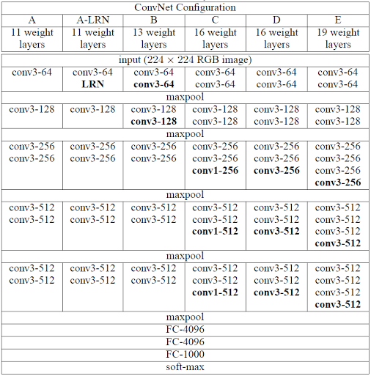
TABLe credit:Very Deep Convolutional Networks for Large-Scale Image Recognition, ICLR2015

Slide 9
Shallow config:A
Random initializations for Configuration A
Initialize the first four convolutional layers and last 3 fully connected layers with these weights for deeper architectures.
Other layers are randomly initialized from normal distribution with 0 mean and ${10}^{−2}$ variance
Bias initialized to 0

Slide 10
Training
Multinomial logistic regression objective using mini-batch gradient descent with momentum
Batch size: 256
Regularizer: 5$x{10}^{−4}$
Momentum: 0.9
Learning rate: ${10}^{−2}$ decrease by factor of 10 when val accuracy stops improving
Learning stopped after 74 epochs.
Early convergence:
Implicit Regularization using small filters
Pre-initialization of certain layers

Slide 11
Training
Fixed 224x224. Randomly cropped from isotropically rescaled images.
Data augmentation : random horizontal flipping and RGB colour shift
Training Scale S. Each training image is rescaled s/t shortest dimension=S and random 224x224 crops are extracted
Two fixed Scales:
S= 256, S=384
Variable scale:
Training set augmentation by scale jittering
Sample S randomly in range [Smin, Smax]; Smin = 256, Smax= 512
Multiscale models are trained by finetuning all layers of a single scale model

Slide 13
Testing
Testing Scale: Q
Each test image scaled isotropically s/t smallest side is Q
Single scale evaluation: Q =S
Multiscale evaluation:Try different Qs for a single S
Multi-crop evaluation
Dense Evaluation
Densely apply the network over the images
FC layers converted to convolutional layers
FC-1000: 4096x1000 params into 1000 filters size 1x1x4096
Spatial pooling to obtain scores for 1000 classes

Slide 14
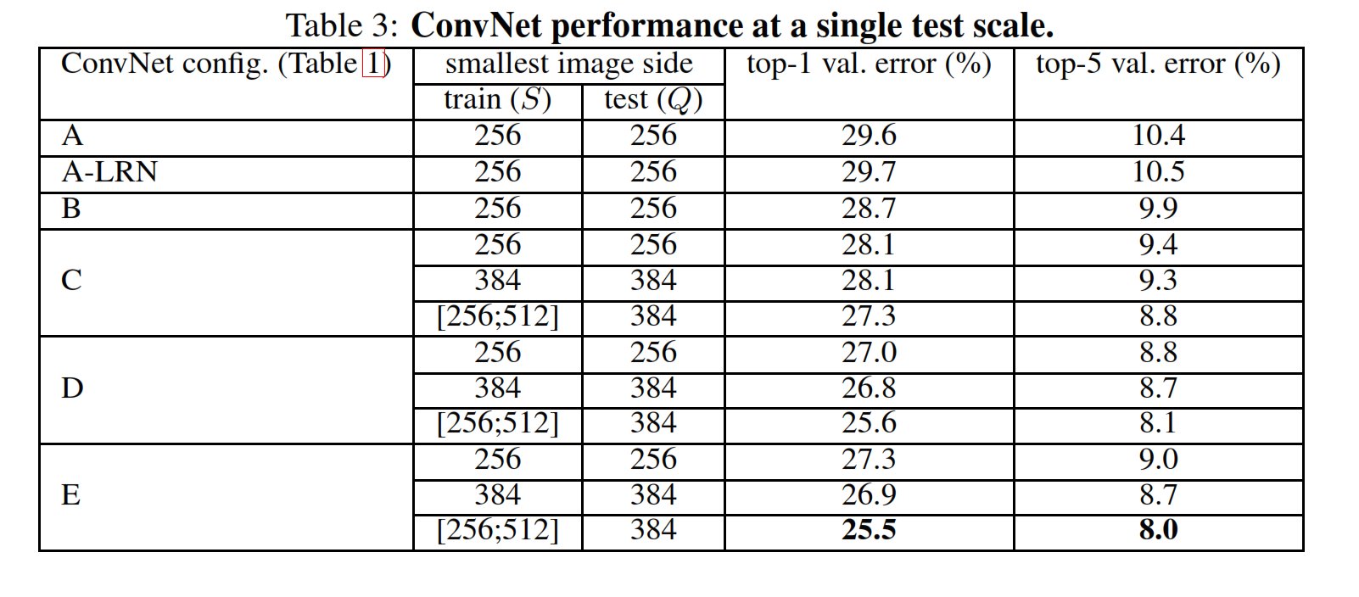
Experiments:Single Scale Evaluation
Q=S for fixed scale training
Q=0.5(Smin+Smax) for jittered scale
TABLe credit:Very Deep Convolutional Networks for Large-Scale Image Recognition, ICLR2015

Slide 15
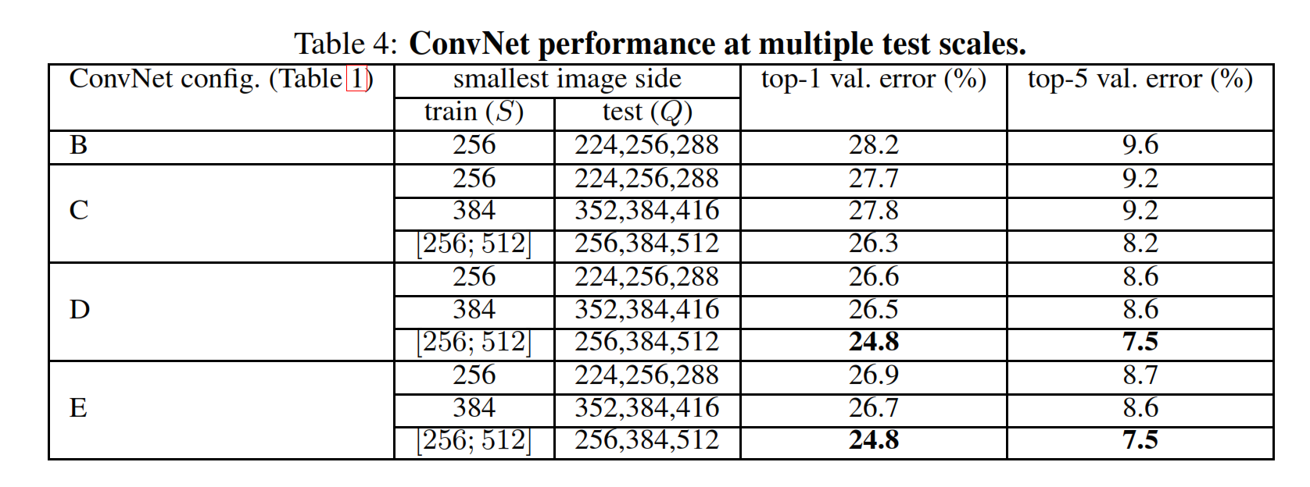
Multiscale evaluation
Scale jittering at test time
Fixed S: Q= {S-32, S, S+32}
S [Smin, Smax] : Q = {Smin, 0.5(Smin,Smax), Smax}
Multi crop : 50 crops per scale(5x5 grid and 2 flips). 150 crops 3 scales
TABLe credit:Very Deep Convolutional Networks for Large-Scale Image Recognition, ICLR2015

Slide 16
Observations
Scale jittering at test leads to better performance
Scale jittering at training is better than fixed S at training

Slide 17
Multi-crop vs dense evaluation
Dense evaluation avoids recomputation for each crop
Multicrop performs slightly better than dense evaluation
Multi-crop is Complementary to dense-evaluation perhaps due to different boundary conditions
TABLe credit:Very Deep Convolutional Networks for Large-Scale Image Recognition, ICLR2015

Slide 18
Ensembles
Ensemble of 7 networks has error 7.3% error
Ensemble of two-best performing multiscale models reduce test error to 7%
Best performing single model 7.1% error
Best results with ensemble of only 2 models 6.8% error

Slide 19
Observations:
LRN does not improve performance
Classification error decreases with increases ConvNet depth
Important to capture more spatial context(config D vs C)
Deepnets with small filters outperform shallow networks with large filters
Shallow version of B: 2 layers of 3x3 replaced with single 5x5 performs worse
Error rate saturated at 19 layers
Scale jittering at training helps capturing multiscale statistics and leads to better performance

Slide 20
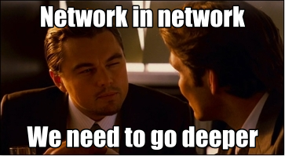
Network In Network
Slide credit:Google Inc

Slide 21
Basis
The convolutional filter in CNN is Generalized Linear Model(GLM).
Implicitly assumes that latent concepts are linearly seperable
Data for same concept often lives nonlinear manifold.
To compensate, GLMs learn over complete set of filters to cover all variations of latent concepts
Imposes burden on higher layers to extract a concept from all these variations.
Better to abstract away lower concepts earlier

Slide 22
Hence GLMs replaced with “Micro Network” structure in NINs.
Here the “Micro Network” is multilayer perceptron(MLP).
2 layer perceptron is a universal function approximator.
Neural network hence trainable by backprop
Deep model itself enabling feature re-use
Compare with Maxout Networks: piecewise linear approximator. Can approximate any convex function.

Slide 23
Slide credit:Learning&Vision group, NUS Singapore

Slide 24
architecture
Slide credit:Learning&Vision group, NUS Singapore

Slide 25
Global Average pooling
Global average pooling layer produces spatial average of featuremaps as confidence of categories
Correspondence between feature maps and categories preserved. More meaningful and interpretable.
No parameters(compared to fully connected layers) . Prevents overfitting
Robust to spatial translations of input

Slide 26
Experiments
3 stacked MLPconv layers each followed by spatial maxooling
Dropout on all but last mlpconv layers
Mini batches of size 128, decrease learning rate by factor of 10 when no improvement in val accuracy
Repeat until learning rate is 1% initial value

Slide 27
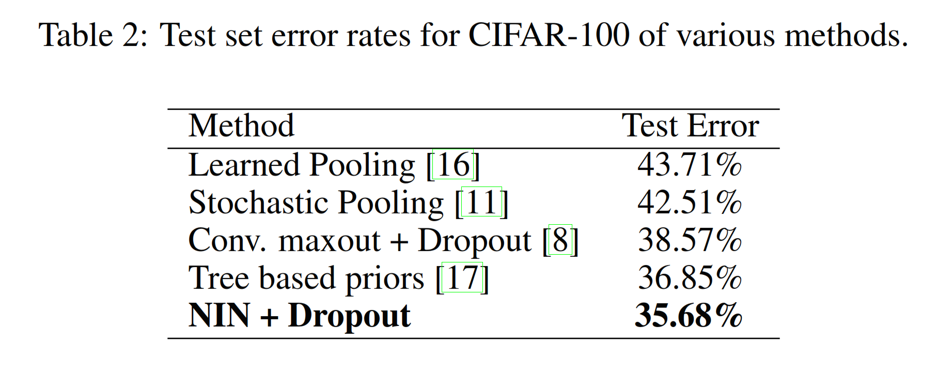
Results
TABLe credit:Network in Network, ICLR2014

Slide 28
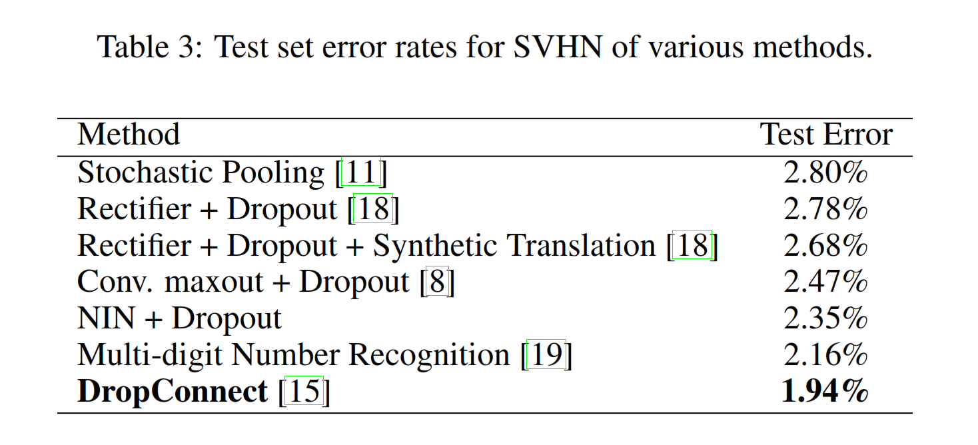
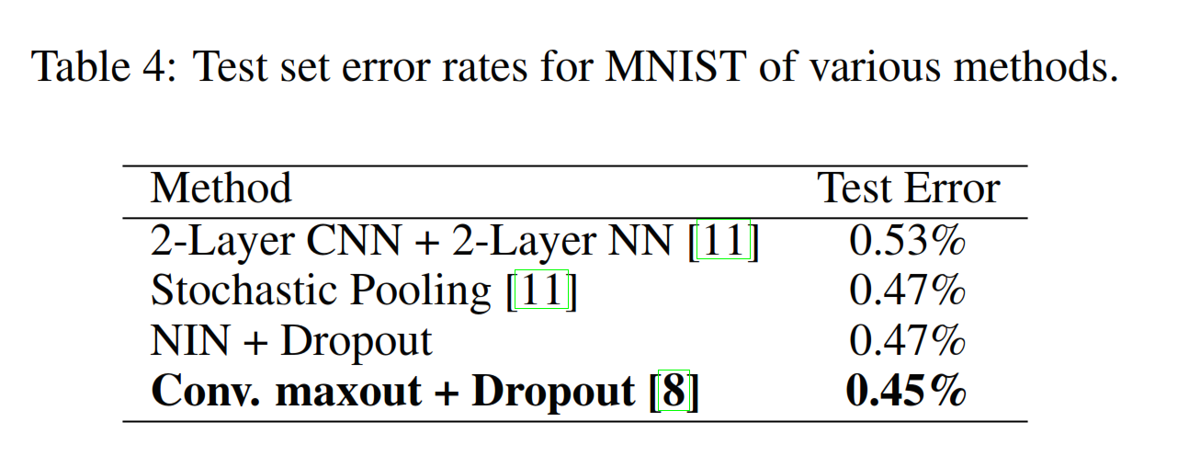
Results
TABLe credit:Network in Network, ICLR2014

Slide 29
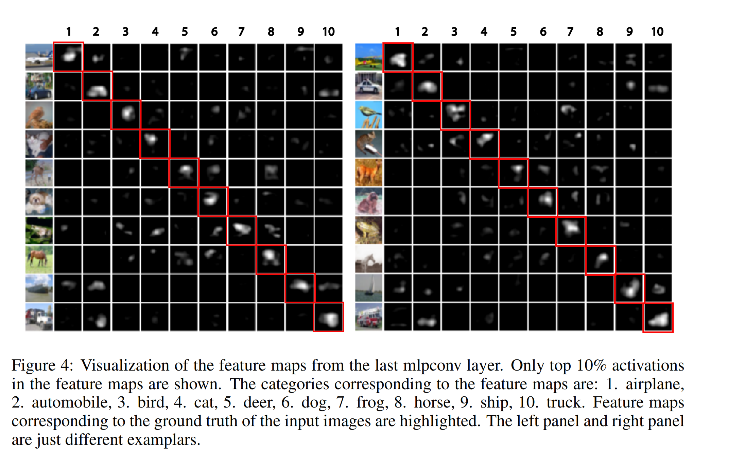
Picture credit:Network in Network, ICLR2014

Slide 30
Highlights of NIN
Build micro-neural networks with more complex structures to abstract the data within the receptive fields
Micro neural network: multilayer perceptron, a potent function approximator
Global average pooling over feature maps in classification layers, easier to interpret and less prone to overfitting compared to fully connected layers

Slide 31
GOoglenet
Slide credit:Google Inc

Slide 32
GoogLeNet
Power and Memory use considerations are important for practical use.
Image data is mostly sparse and clustered.
Aurora et. Al:
“If probability distribution of dataset is representable by a large, very sparse deep neural network, then optimal network topology can be constructed layer by layer by analyzing correlation statistics of activations of last layer and clustering neurons with highly correlated outputs”
Hebbian Principle:
“Neurons that fire together, wire together”

Slide 33
Computation infrastructures are inefficient for non uniform sparse data structures
Overhead of lookups and cache misses
Numerical libraries providing extremely fast dense matrix multiplication with parallel computing
Clustering sparse matrices into relatively dense submatrices provide good performance for sparce matrix computations

Slide 34
Optimal local sparse structure using available dense components
To capture dense clusters : 1x1 convolutions
More spatially spread out clusters captured by 3x3 and 5x5.
Pooling layer: Generally improves performance.
Outputs of all these are concatenated and passed to next layer
Give rise to the (naive) “Inception Module”

Slide 35
In images, correlations tend to be local
Slide credit:Google Inc

Slide 36
Cover very local clusters by 1x1 convolutions
number of filters
1x1
Slide credit:Google Inc

Slide 37
Less spread out correlations
number of filters
1x1
Slide credit:Google Inc

Slide 38
Cover more spread out clusters by 3x3 convolutions
number of filters
1x1
3x3
Slide credit:Google Inc

Slide 39
Cover more spread out clusters by 5x5 convolutions
number of filters
1x1
3x3
Slide credit:Google Inc

Slide 40
Cover more spread out clusters by 5x5 convolutions
number of filters
1x1
5x5
3x3
Slide credit:Google Inc

Slide 41
A heterogeneous set of convolutions
number of filters
1x1
3x3
5x5
Slide credit:Google Inc

Slide 42
Naive idea (does not work!)
Filter concatenation
1x1 convolutions
3x3 convolutions
5x5 convolutions
3x3 max pooling
Previous layer
Slide credit:Google Inc

Slide 43
#Output channels = #input channels(from pooling layer) + #(1x1 filters) + #(3x3 filters) + #(5x5 filters)
The output channels(and hence computations) will blow up eventually!
Solution:
Aggregate/compress the information using dimensionality reduction.
1x1 convolutions as a way of projecting the filters onto a different space
Used before 3x3 and 5x5 filters to aggregate information so these filters can operate on fewer channels.
In addition provide additional ReLu layers

Slide 44
Inception module
Filter concatenation
3x3 convolutions
5x5 convolutions
1x1 convolutions
1x1 convolutions
1x1 convolutions
1x1 convolutions
3x3 max pooling
Previous layer
Slide credit:Google Inc

Slide 45
Given large depth, abillity to backprop is a concern
Layers in the middle of the networks should be very discriminative.
Add auxiliary classifiers. Loss weighed by 0.3 in aggregate loss.
Slide credit:Google Inc

Slide 46
832
1024
512
832
512
480
480
512
256
Width of inception modules ranges from 256 filters (in early modules) to 1024 in top inception modules.
Can remove fully connected layers on top completely
Number of parameters is reduced to 5 million
Computional cost is increased by less than 2X compared to Krizhevsky’s network. (<1.5Bn operations/evaluation)
Slide credit:Google Inc

Slide 47
GoogLeNet vs State of the art
GoogLeNet
Convolution
Pooling
Softmax
Other
Zeiler-Fergus Architecture (1 tower)
Slide credit:Google Inc

Slide 48
setup
Asynchronous SGD with 0.9 momentum
Decrease learning rate by 4% every 8 epochs
Ensemble of 7 Nets only differing in sampling methodologies and random order of the inputs they see
Test time: 144 crops per image
resize to 4 scales, extract 3 squares, 5 crops + resized Im from each square, +flips
= 4x3x(5+1)x2 = 144

Slide 49
Classification results on ImageNet 2014
Number of Models | Number of Crops | Computational Cost | Top-5 Error | Compared to Base
1 | 1 (center crop) | 1x | 10.07% | -
1 | 10* | 10x | 9.15% | -0.92%
1 | 144 (Our approach) | 144x | 7.89% | -2.18%
7 | 1 (center crop) | 7x | 8.09% | -1.98%
7 | 10* | 70x | 7.62% | -2.45%
7 | 144 (Our approach) | 1008x | 6.67% | -3.41%
*Cropping by [Krizhevsky et al 2014]
Slide credit:Google Inc

Slide 50
Classification results on ImageNet 2014
Number of Models | Number of Crops | Computational Cost | Top-5 Error | Compared to Base
1 | 1 (center crop) | 1x | 10.07% | -
1 | 10* | 10x | 9.15% | -0.92%
1 | 144 (Our approach) | 144x | 7.89% | -2.18%
7 | 1 (center crop) | 7x | 8.09% | -1.98%
7 | 10* | 70x | 7.62% | -2.45%
7 | 144 (Our approach) | 1008x | 6.67% | -3.41%
6.54%
*Cropping by [Krizhevsky et al 2014]
Slide credit:Google Inc

Slide 51
Classification results on ImageNet
Team | Year | Place | Error (top-5) | Uses external data
SuperVision | 2012 | - | 16.4% | no
SuperVision | 2012 | 1st | 15.3% | ImageNet 22k
Clarifai | 2013 | - | 11.7% | no
Clarifai | 2013 | 1st | 11.2% | ImageNet 22k
MSRA | 2014 | 3rd | 7.35% | no
VGG | 2014 | 2nd | 7.32% | no
GoogLeNet | 2014 | 1st | 6.67% | no
Slide credit:Google Inc

Slide 52
Conclusion: Deeper is Better

Slide 53
Papers discussed
Very Deep Convolutional Networks For Large-Scale Image Recognition, Karen Simonyan & Andrew Zisserman, Visual Geometry group, Dept of Engineering Science, University of Oxford
Network in Network, Min Lin, Qian Chen, Shuicheng Yan, Graduate school for Integrative Science and Engineering, Dept of Electronic & Computer Engineering, National University of Singapore
Going Deeper with Convolutions, Christian Szegedy (Google Inc), Wei Liu (University of North Carolina, Chapel Hill), Yangqing Zia (Google Inc), Pierre Sermanet (Google Inc), Scott Reed(University of Michigan), Dragomir Anguellov (Google Inc), Dumitru Erhan (Google Inc), Vincent Vanhoucke (Google Inc), Andre Rabonovich (Google Inc),

Slide 54
Thank You

