Slide 1
Regularization
ECE 6504 Deep Learning for Perception
Xiao Lin, Peng Zhang
Virginia Tech

Slide 2
Papers
Srivastava et al. “Dropout: A simple way to prevent neural networks from overfitting”. JMLR 2014.
Hinton. “Brain, Sex and Machine Learning”. Youtube 2012.
Wan et al. “Regularization of neural networks using dropconnect”. ICML 2013.
Goodfellow et al. “Maxout networks”. ICML 2013.

Slide 3
Training Data
$$x_{2}$$
$$x_{1}$$

Slide 4
Training Data
$$x_{2}$$
$$x_{1}$$

Slide 5
Sparsity (L1)
$$x_{2}$$
$$x_{1}$$

Slide 6
Optimal Hyperplane (L2)
$$d$$
$$d$$
$$x_{2}$$
$$d$$
$$x_{1}$$

Slide 7
Optimal Neural Net?
$$x_{2}$$
$$x_{1}$$
Notes:
Note that with back propagation, you can compute and add the gradient of L1 or L2 norm. But they’re not enough to prevent overfitting.
For neural nets people do things like early stopping, to have a validation set, and if you see validation error increases you stop training.

Slide 8
Optimal Neural Net?
$$L2: \frac{dL}{dW}+r W$$
$$L1: \frac{dL}{dW}+r sign(W)$$
$$x_{2}$$
$$x_{1}$$
Notes:
Note that with back propagation, you can compute and add the gradient of L1 or L2 norm. But they’re not enough to prevent overfitting.
For neural nets people do things like early stopping, to have a validation set, and if you see validation error increases you stop training.

Slide 9
Bayesian Prediction?
$$d$$
$$d$$
$$x_{2}$$
$$d$$
?
$$x_{1}$$
Notes:
Another interesting problem is given an example, how do you make a prediction

Slide 10
Bayesian Prediction?
$$p(θ_{2}|train)$$
$$p(θ_{1}|train)$$
$$x_{2}$$
?
$$x_{1}$$

Slide 11
Bayesian Prediction?
$$p(θ_{2}|train)$$
$$p(θ_{1}|train)$$
$$x_{2}$$
?
$$P\left(Z | X,train\right)=\sum_{θ}{P\left(Z | X,θ\right)P(θ|train)}$$
$$x_{1}$$

Slide 12
Bayesian Prediction?
$$p(θ_{2}|train)$$
$$p(θ_{1}|train)$$
$$x_{2}$$
?
$$\sum_{θ}{}$$
$$P\left(Z | X,train\right)=\sum_{θ}{P\left(Z | X,θ\right)P(θ|train)}$$
$$x_{1}$$

Slide 13
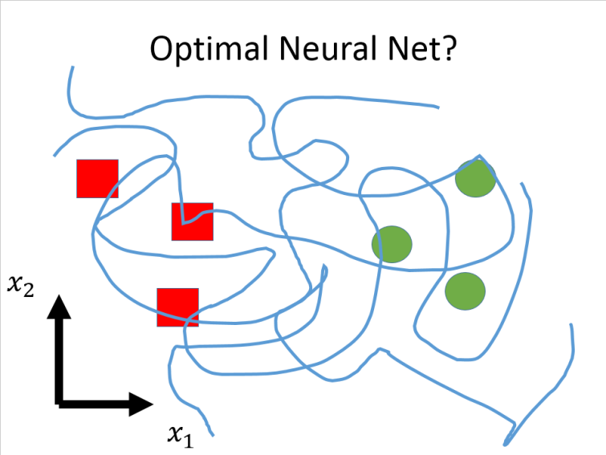
Regularization
How to select a good model?
How to regularize neural nets?
Notes:
These are two main problems regularization tries to address.

Slide 14
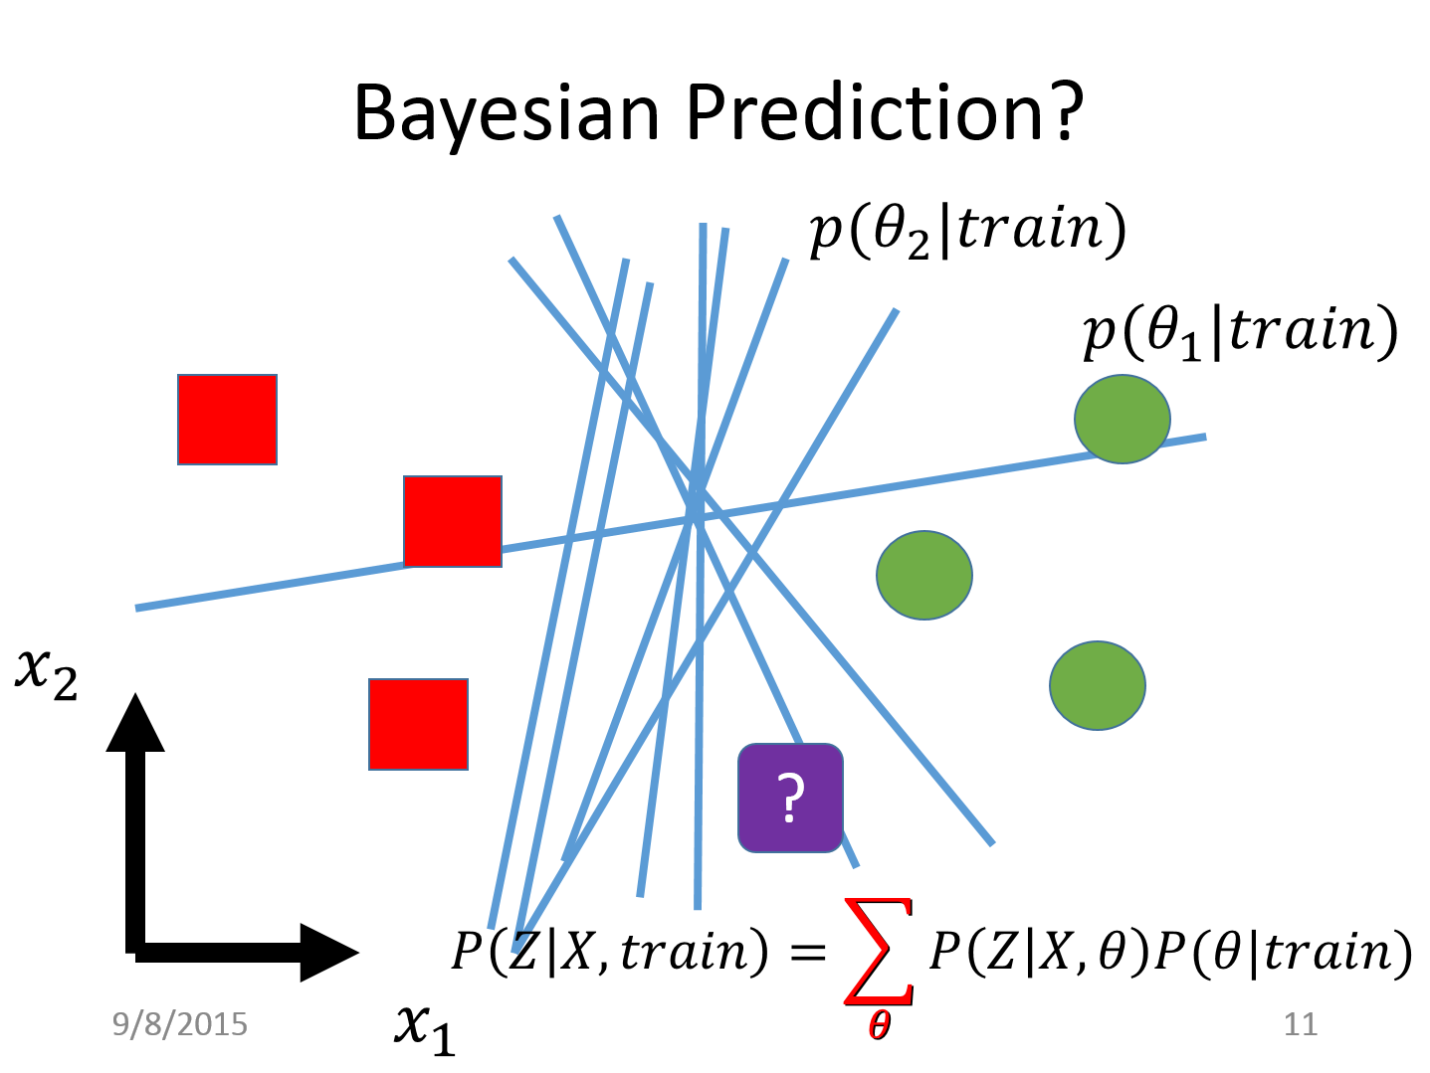
Regularization
How to select a good model?
How to regularize neural nets?
How to make a good prediction?
How to approximately vote over all models?
Notes:
These are two main problems regularization tries to address.

Slide 15
Regularization
How to select a good model?
How to regularize neural nets?
How to make a good prediction?
How to approximately vote over all models?
Dropout
Dropout
Notes:
The paper we read today, dropout provides solutions to both sides

Slide 16
Dropout in ILSVRC 2010
ImageNet Large Scale Visual Recognition Challenge (ILSVRC)
1.2 million images over 1000 categories
Report top-1 and top-5 error rate
Notes:
In the success of neural nets in ImageNet challenge
dropout plays an important role
We learned in the last class about the Imagenet challenge, and how alex krizhevsky beats previous approaches by 8%.

Slide 17
Dropout in ILSVRC 2010
ImageNet Large Scale Visual Recognition Challenge (ILSVRC)
1.2 million images over 1000 categories
Report top-1 and top-5 error rate
ILSVRC 2010
Notes:
In the success of neural nets in ImageNet challenge
dropout plays an important role
We learned in the last class about the Imagenet challenge, and how alex krizhevsky beats previous approaches by 8%.

Slide 18
Dropout in ILSVRC 2010
Notes:
In an 2012 youtube video Hinton reviewed how Alex Krizhevsky built that neural network.

Slide 19
Dropout in ILSVRC 2010
Notes:
A very interesting point is here, that before using dropout, Alex gets ~48% top 1 error which does not even beat the previous approaches. But with dropout in fully connected layers, he gets 39% error, a huge 9% improvement and 19% top-5 error rate, set the state of the art by 6%.

Slide 20
Dropout in ILSVRC 2010
Notes:
Then as we know, he later also uses dropout in convolutional layers. And his performance further improves by 2%

Slide 21
What is Dropout
$$x_{1}$$
$$w_{1}$$
$$y=w_{1}x_{1}+w_{2}x_{2}$$
$$+w_{3}x_{3}+w_{4}x_{4}+b$$
$$x_{2}$$
$$w_{2}$$
$$w_{3}$$
$$x_{3}$$
$$w_{4}$$
$$x_{4}$$
$$b$$
1
Notes:
Ok so what is the magic dropout?

Slide 22
What is Dropout
During training
For each data point
Randomly set input to 0 with probability 0.5 “dropout ratio”.
$$x_{1}$$
$$w_{1}$$
$$y=w_{1}x_{1}+w_{3}x_{3}+b$$
$$0$$
$$w_{2}$$
$$w_{3}$$
$$x_{3}$$
$$w_{4}$$
$$0$$
$$b$$
1

Slide 23
What is Dropout
During training
For each data point
Randomly set input to 0 with probability 0.5 “dropout ratio”.
$$0$$
$$w_{1}$$
$$y=w_{2}x_{2}+w_{3}x_{3}+b$$
$$x_{2}$$
$$w_{2}$$
$$w_{3}$$
$$x_{3}$$
$$w_{4}$$
$$0$$
$$b$$
1

Slide 24
What is Dropout
During training
For each data point
Randomly set input to 0 with probability 0.5 “dropout ratio”.
$$x_{1}$$
$$w_{1}$$
$$y=w_{1}x_{1}+b$$
$$0$$
$$w_{2}$$
$$w_{3}$$
$$0$$
$$w_{4}$$
$$0$$
$$b$$
1

Slide 25
What is Dropout
During training
For each data point
Randomly set input to 0 with probability 0.5 “dropout ratio”.
During testing
Halve weights
No dropout
$$x_{1}$$
$$w_{1}/2$$
$$y=(w_{1}x_{1}+w_{2}x_{2}$$
$$+w_{3}x_{3}+w_{4}x_{4})/2+b$$
$$x_{2}$$
$$w_{2}/2$$
$$w_{3}/2$$
$$x_{3}$$
$$w_{4}/2$$
$$x_{4}$$
$$b$$
1
Notes:
During testing there is no dropout, but according to a theory I’ll talk about later we need to halve all weights.
And that’s all dropout do. Surprisingly simple.

Slide 26
What is Dropout
During training
For each data point
Randomly set input to 0 with probability $p$ “dropout ratio”.
During testing
Multiply weights by $1−p$
No dropout
$$x_{1}$$
$$(1−p)w_{1}$$
$$y=(w_{1}x_{1}+w_{2}x_{2}$$
$$+w_{3}x_{3}+w_{4}x_{4})\left(1−p\right)$$
$$+b$$
$$x_{2}$$
$$(1−p)w_{2}$$
$$(1−p)w_{3}$$
$$x_{3}$$
$$(1−p)w_{4}$$
$$x_{4}$$
$$b$$
1
Notes:
The dropout rate is a parameter if we dropout with rate p, at test time we multiply the weights by 1-p.
This paper talks about multiplying weights,.

Slide 27
What is Dropout
During training
For each data point
Randomly set input to 0 with probability $p$ “dropout ratio”.
During testing
Multiply data by $1−p$
No dropout
$$(1−p)x_{1}$$
$$w_{1}$$
$$y=(w_{1}x_{1}+w_{2}x_{2}$$
$$+w_{3}x_{3}+w_{4}x_{4})\left(1−p\right)$$
$$+b$$
$$(1−p)x_{2}$$
$$w_{2}$$
$$(1−p)x_{3}$$
$$w_{3}$$
$$w_{4}$$
$$(1−p)x_{4}$$
$$b$$
1
Notes:
Another equivalent way to think about it is to multiplying data.
Now training and testing are all operations on data, so we can think of dropout as one layer in the neural net, as one function in a cascade.

Slide 28
What is Dropout
Inner
Product
Layer
Dropout
“Layer”
During training
For each data point
Randomly set input to 0 with probability $p$ “dropout ratio”.
During testing
Multiply data by $1−p$
No dropout
$$X$$
$$\tilde{X}$$
$$y$$
Notes:
Training…test…

Slide 29
What is Dropout
Inner
Product
Layer
Dropout
“Layer”
During training
For each data point
Randomly set input to 0 with probability $p$ “dropout ratio”.
During testing
Multiply data by $1−p$
No dropout
$$1−p$$
$$1−p$$
$$1−p$$
$$1−p$$
$$X$$
$$\tilde{X}$$
$$y$$

Slide 30
What is Dropout
During training
For each data point
Randomly set input to 0 with probability $p$ “dropout ratio”.
During testing
Multiply data by $1−p$
No dropout
Caffe
layer {
name: "drop6“
type: "dropout"
dropout_ratio: 0.5
}
Torch
nn.Dropout(0.5)
Notes:
Dropout is implemented as a layer in both Caffe and torch.

Slide 31
Dropout on MLP
Without dropout
Inner Product
ReLU
Inner Product
ReLU
Inner
Product
X
Scores
Notes:
This paper shows extensive experiments on many datasets.
Insert dropout right before every inner product layer
Input dropout is not common.

Slide 32
Dropout on MLP
Without dropout
Inner Product
ReLU
Inner Product
ReLU
Inner
Product
X
Scores
With dropout
Inner
Product
ReLU
Dropout
Inner
Product
ReLU
Dropout
Inner
Product
X
Scores
Notes:
This paper shows extensive experiments on many datasets.
Insert dropout right before every inner product layer
Input dropout is not common.

Slide 33
Dropout on MLP
MNIST
Classification of hand written digits
10 classes, 60k train

Slide 34
Dropout on MLP
MNIST
Classification of hand written digits
10 classes, 60k train
TIMIT
Classification of phones
39 classes*, ? train

Slide 35
Dropout on MLP
MNIST
Classification of hand written digits
10 classes, 60k train
TIMIT
Classification of phones
39 classes*, ? train
Reuters
Topic classification of documents as bags of words
50 classes, 800k train

Slide 36
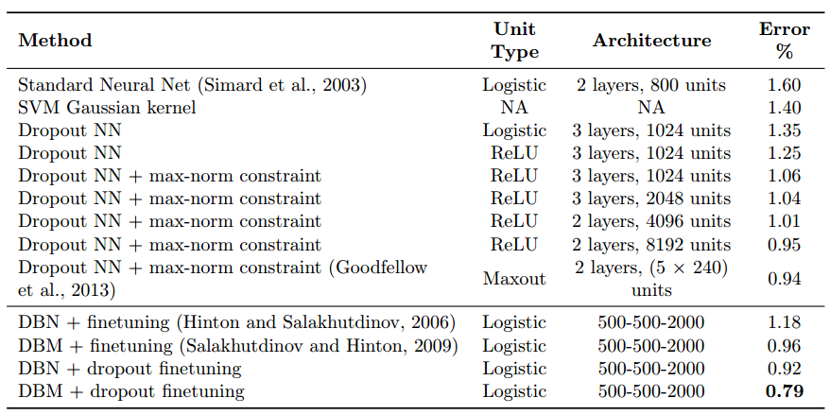
Dropout on MLP
MNIST

Slide 37
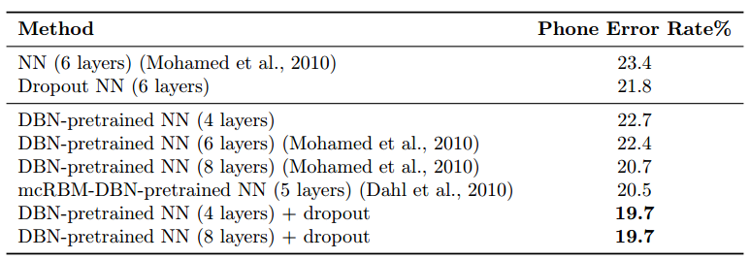
Dropout on MLP
TIMIT

Slide 38
Dropout on MLP
Reuters
3 layer NN: 31.05%
3 layer NN + Dropout 29.62%

Slide 39
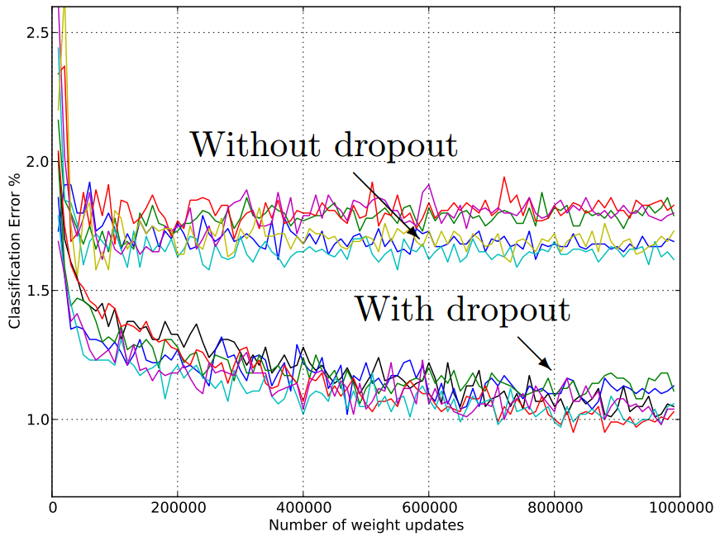
Dropout on MLP
MNIST

Slide 40
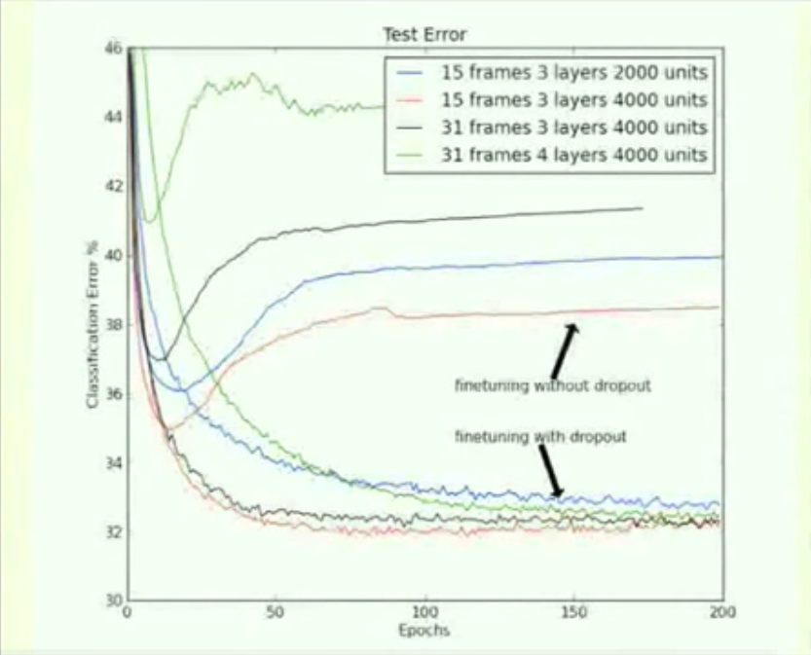
Dropout on MLP
TIMIT
Notes:
Severe overfitting starts ~10 epochs without dropout. Early stopping will stop there
But even then the performance is not as good as using dropout

Slide 41
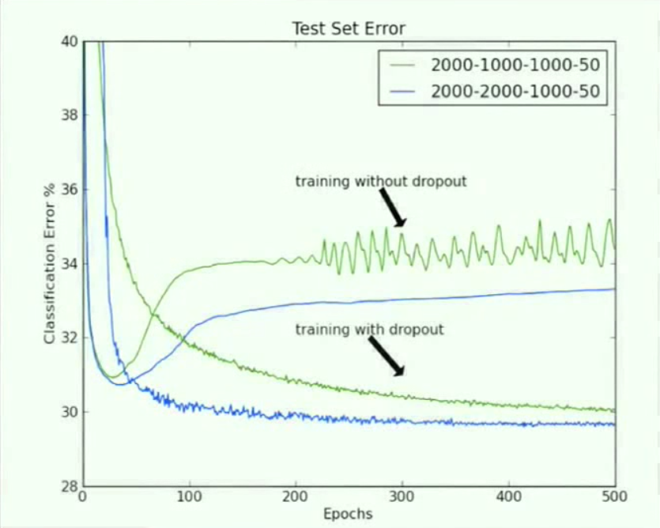
Dropout on MLP
Reuters

Slide 42
Dropout on ConvNets
Without dropout
Conv
ReLU
Conv
ReLU
Pool
Inner
Product
X
Scores

Slide 43
Dropout on ConvNets
Without dropout
Conv
ReLU
Conv
ReLU
Pool
Inner
Product
X
Scores
With dropout
Conv
ReLU
Dropout
Conv
ReLU
Pool
Dropout
Inner
Product
X
Scores

Slide 44
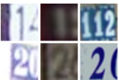
Dropout on ConvNets
Street View House Numbers (SVHN)
Color images of house numbers centered on 1 digit
10 classes, 73k train

Slide 45
Dropout on ConvNets
Street View House Numbers (SVHN)
Color images of house numbers centered on 1 digit
10 classes, 73k train
CIFAR-10 and CIFAR-100
Color images of object categories
10/100 classes, both 50k train

Slide 46
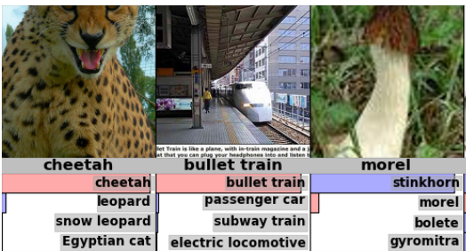
Dropout on ConvNets
Street View House Numbers (SVHN)
Color images of house numbers centered on 1 digit
10 classes, 73k train
CIFAR-10 and CIFAR-100
Color images of object categories
10/100 classes, both 50k train
ImageNet (ILSVRC series)
Color images of object categories
1000 classes, 1.2 MILLION train

Slide 47
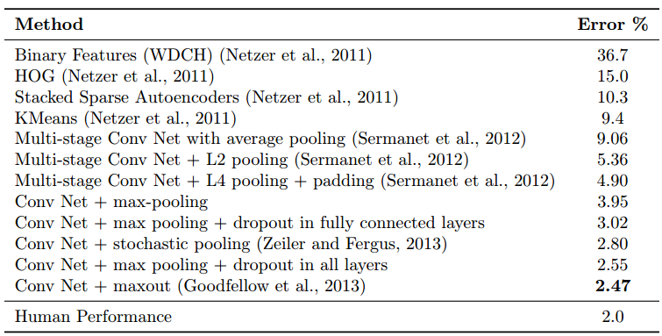
Dropout on ConvNets
Street View House Numbers (SVHN)

Slide 48
Dropout on ConvNets
CIFAR-10 and CIFAR-100

Slide 49
Dropout on ConvNets
ImageNet
ILSVRC 2010
ILSVRC 2012

Slide 50
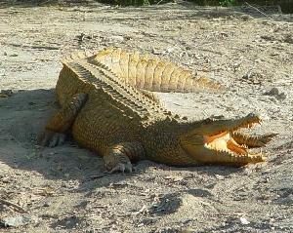
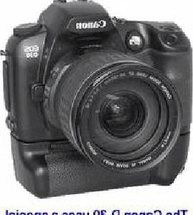
Dropout on Simple Classifiers
Caltech 101
Classifying objects into 101 categories

Slide 51
Dropout on Simple Classifiers
Caltech 101
Classifying objects into 101 categories
Deep Convolutional Activation Feature (DeCAF)
Activation of CNN (CaffeNet) layers as features

Slide 52
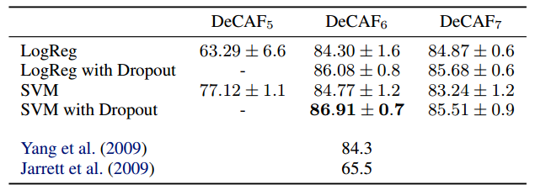
Dropout on Simple Classifiers
Caltech 101
Classifying objects into 101 categories
Deep Convolutional Activation Feature (DeCAF)
Activation of CNN (CaffeNet) layers as features
Logistic regression and SVM on DeCAF on Caltech 101

Slide 53
Why Does Dropout Work?
How to select a good model?
How to make a good prediction?
Notes:
Now we’ve seen what dropout is and how it helps deep neural networks. But why does it work so well, what’s the theory behind it.
On a side note a lot of deep learning research goes this way, you find something that works and try to explain it.
As a regularization technique dropout looks at both problems in regularization
Reach here in 15~20 mins

Slide 54
Why Does Dropout Work?
How to select a good model?
Prevent co-adaptation
Induce sparse activations
Data augmentation
How to make a good prediction?
Notes:
Now we’ve seen what dropout is and how it helps deep neural networks. But why does it work so well, what’s the theory behind it.
On a side note a lot of deep learning research goes this way, you find something that works and try to explain it.
As a regularization technique dropout looks at both problems in regularization
Reach here in 15~20 mins

Slide 55
Why Does Dropout Work?
How to select a good model?
Prevent co-adaptation
Induce sparse activations
Data augmentation
How to make a good prediction?
Bagging with shared weights
Efficient approximate averaging
Notes:
Now we’ve seen what dropout is and how it helps deep neural networks. But why does it work so well, what’s the theory behind it.
On a side note a lot of deep learning research goes this way, you find something that works and try to explain it.
As a regularization technique dropout looks at both problems in regularization
Reach here in 15~20 mins

Slide 56
Why Does Dropout Work?
Prevent co-adaptation
Notes:
Likely to fail

Slide 57
Why Does Dropout Work?
Prevent co-adaptation

Slide 58
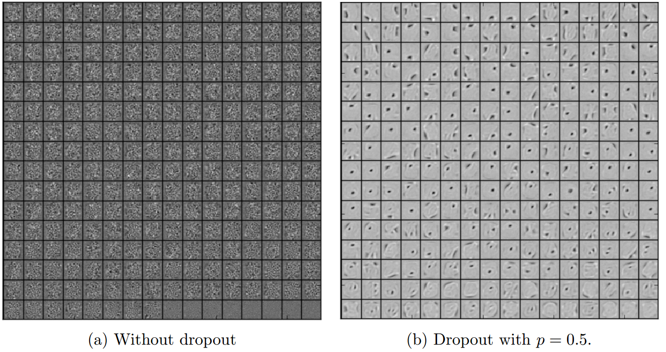
Why Does Dropout Work?
Prevent co-adaptation
Filters (autoencoder on MNIST)

Slide 59
Why Does Dropout Work?
Prevent co-adaptation

Slide 60
Why Does Dropout Work?
Prevent co-adaptation

Slide 61
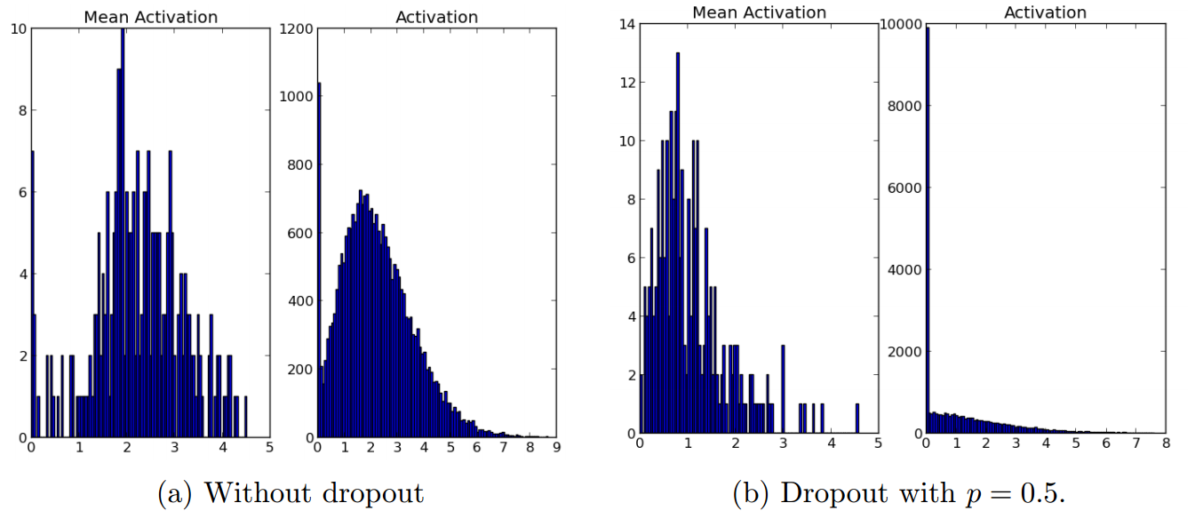
Why Does Dropout Work?
Induce sparse activations
Activations (autoencoder on MNIST)

Slide 62
Why Does Dropout Work?
Data augmentation
Dropout as adding “pepper” noise
Cheetah
Train
Morel

Slide 63
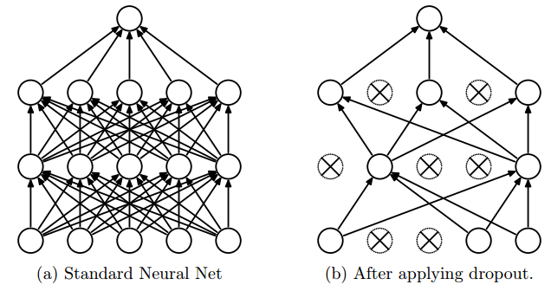
Why Does Dropout Work?
Bagging with shared weights
Exponentially many architectures
Forward
Notes:
When training, training exponentially many architectures with weights shared

Slide 64
Why Does Dropout Work?
Bagging with shared weights
Exponentially many architectures
Approximate geometric mean of all architectures
$$\tilde{x}$$
Dropout
Inner
Product
$$x$$
$$score=(w,\tilde{x})$$
$$θ$$
$$w$$
Notes:
When testing, it uses a simple approximation to compute the geometric mean of all the architectures.
With activation and more layers it’s approximate. One extension of dropout, dropconnect that peng will talk about tries to address this issue.

Slide 65
Why Does Dropout Work?
Bagging with shared weights
Exponentially many architectures
Approximate geometric mean of all architectures
$$\tilde{x}$$
Dropout
Inner
Product
$$x$$
$$score=(w,\tilde{x})$$
$$P(y|x,θ)\sim e^{(w,\tilde{x}) }$$
$$θ$$
$$w$$
Notes:
When testing, it uses a simple approximation to compute the geometric mean of all the architectures.
With activation and more layers it’s approximate. One extension of dropout, dropconnect that peng will talk about tries to address this issue.

Slide 66
Why Does Dropout Work?
Bagging with shared weights
Exponentially many architectures
Approximate geometric mean of all architectures
$$\tilde{x}$$
Dropout
Inner
Product
$$x$$
$$score=(w,\tilde{x})$$
$$P(y|x,θ)\sim e^{(w,\tilde{x}) }$$
$$θ$$
$$w$$
Geometric mean over $θ$
$$\sqrt[N]{\prod_{θ}{P(y|x,θ)}}=\sqrt[N]{\prod_{θ}{e^{(w,\tilde{x})}}}=e^{\frac{1}{N}\sum_{θ}{(w,\tilde{x})}}=e^{ ((1−p)w,x)}$$
Notes:
When testing, it uses a simple approximation to compute the geometric mean of all the architectures.
With activation and more layers it’s approximate. One extension of dropout, dropconnect that peng will talk about tries to address this issue.

Slide 67
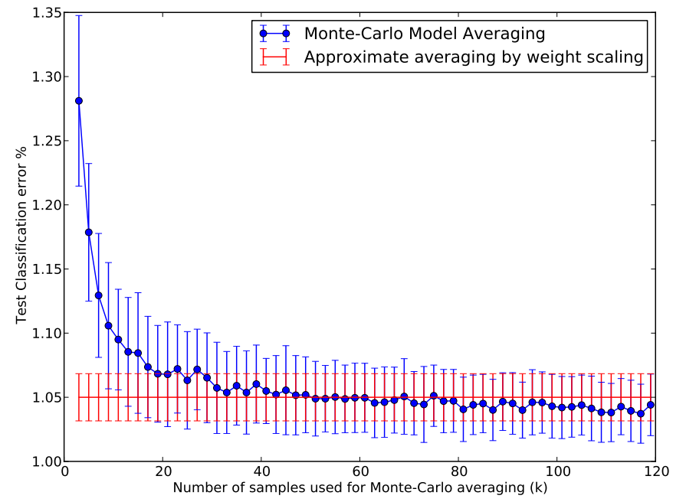
Why Does Dropout Work?
Bagging with shared weights
Exponentially many architectures
Approximate geometric mean of all architectures
Exact
Basic dropout
Notes:
But this paper also shows how well this approximation works. On MNIST they compare the (1-p) approximate averaging and sampling a bunch of architectures then average over the samples, and it shows that the dropout approximation performs well in terms of test errors.

Slide 68
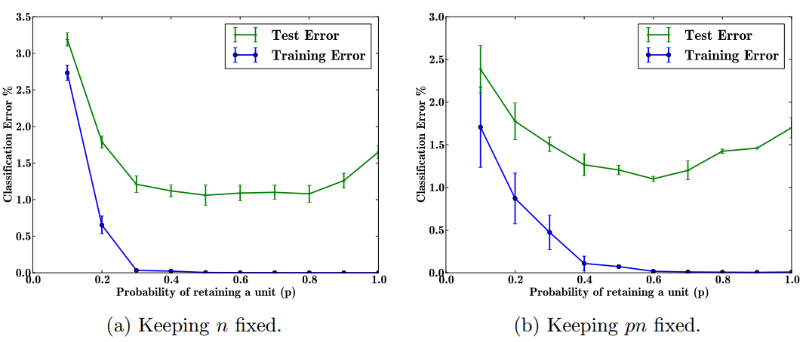
Effects of Dropout Parameters
Retaining probability (1-dropout ratio)
Notes:
For practical guidelines, this paper also studies the effect of dropout parameters.

Slide 69
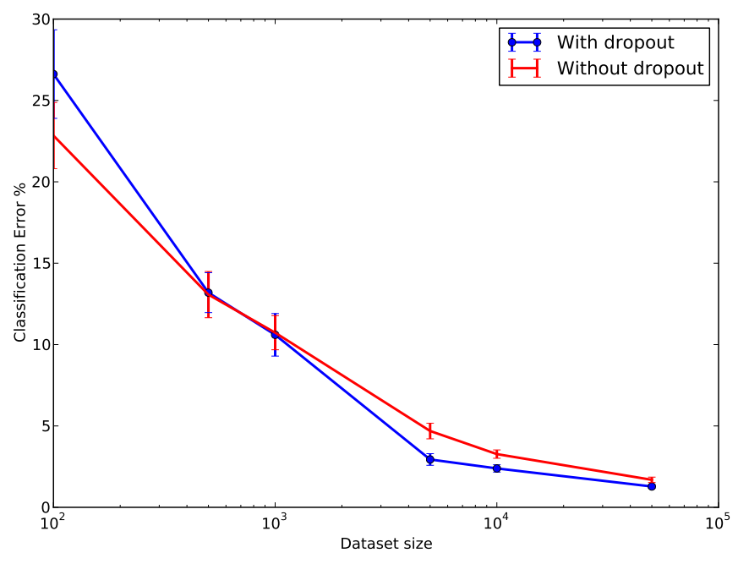
Effects of Dropout Parameters
Dataset size

Slide 70
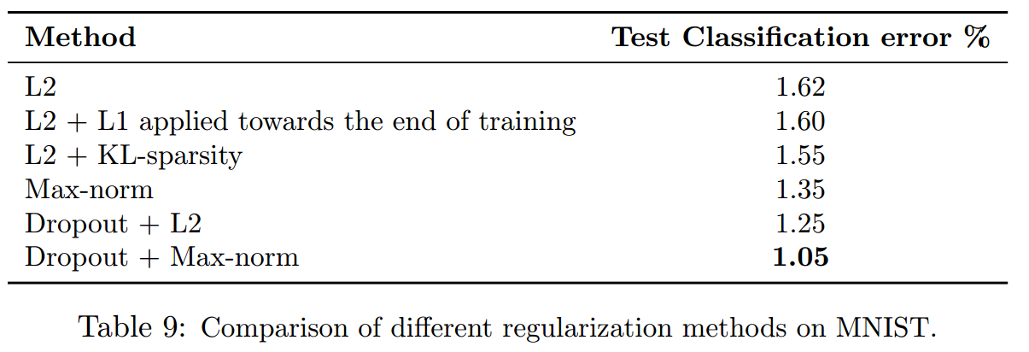
Effects of Dropout Parameters
Combining with other regularizers
Notes:
Dropout is often combined with other regularizers.
A commonly used setting is dropout + L2

Slide 71
Generalizations of Dropout
Gaussian dropout
Gaussian instead of 0/1 Bernoulli
DropConnect
Dropping connections instead of data: larger space for bagging
Averaging after the activation function: better approximation
Maxout
Dropout as cross channel pooling in ReLU
Using Maxout instead of ReLU
Notes:
Now I’ll hand over to Peng to talk about generalizations of dropout such as Gaussian dropout dropconnect and maxout

Slide 72
Generalizations of Dropout
Distribution
R.V. from other distribution
Dropout
Selection scheme
DropConnect
Maxout
Activation function

Slide 73
Generalizations of Dropout
Distribution
R.V. from other distribution
Dropout
Selection scheme
DropConnect
Maxout
Activation function

Slide 74
Multiplicative Gaussian Noise
Multiplying hidden activations by Bernoulli distributed variables
Random variables from other distribution
Each activation function can be:
or
Result credit: N. Srivastava et al. 2014

Slide 75
Generalizations of Dropout
Distribution
R.V. from other distribution
Dropout
Selection scheme
DropConnect
Maxout
Activation function

Slide 76
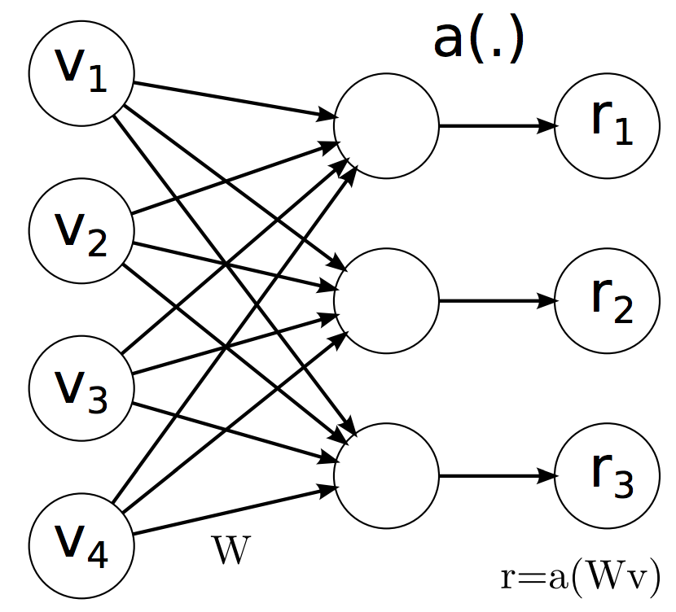
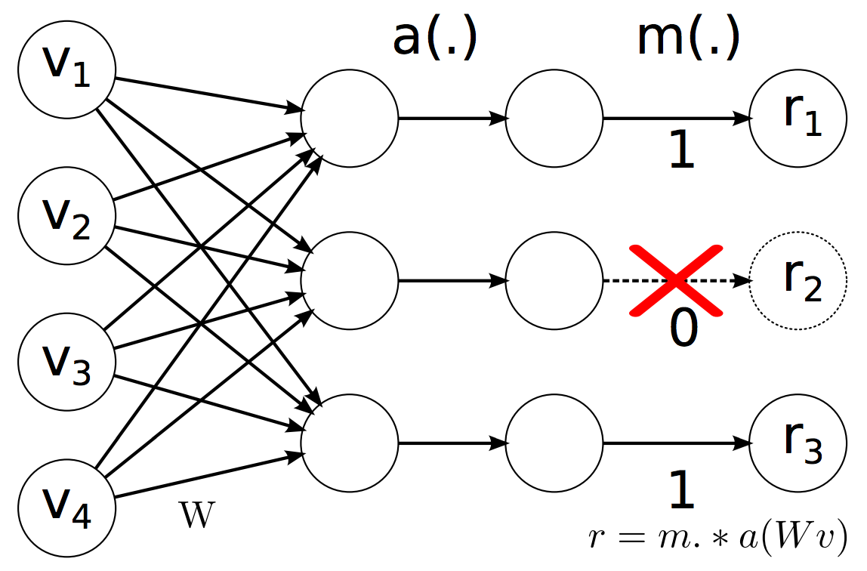
Dropout
No Dropout
Dropout
Keep the element of each layer’s output
with p, otherwise set to 0 with (1-p)
Figure credit: Wan et al. ICML 2013

Slide 77
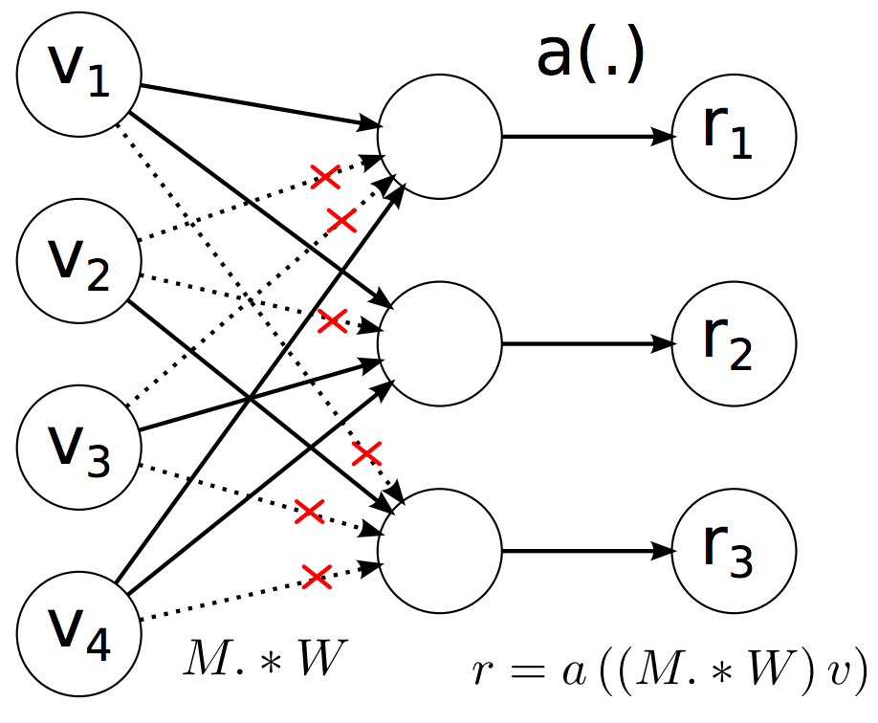
DropConnect
Dropout
Keep the element of each layer’s output
with p, otherwise set to 0 with (1-p)
DropConnect
Keep the connection of each layer’s output with p, otherwise set to 0 with (1-p)
Figure credit: Wan et al. ICML 2013
Notes:
equations

Slide 78
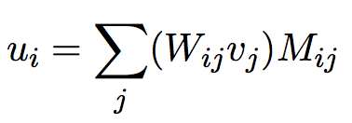
Inference step
Old approximation (dropout)
Better approximation
1-D Gaussian distribution
Figure credit: Wan et al. ICML 2013

Slide 79
Experiments
Dateset augmentation
5 Independent networks
Manually tune parameter, i.e. learning rate
Train with dropout, dropconnect and neither
Fix sample number at inference step
MNIST
SVHN
CIFAR-10

Slide 80
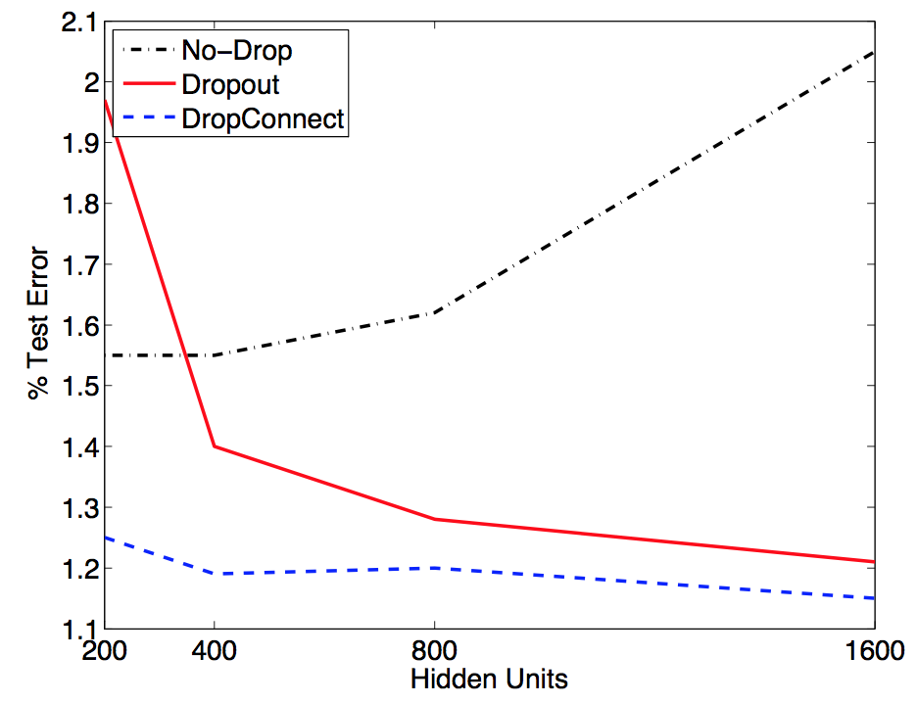
MNIST
Test error on MNIST dataset
with 2 hidden layers network
Figure credit: Wan et al. ICML 2013
Notes:
cite

Slide 81
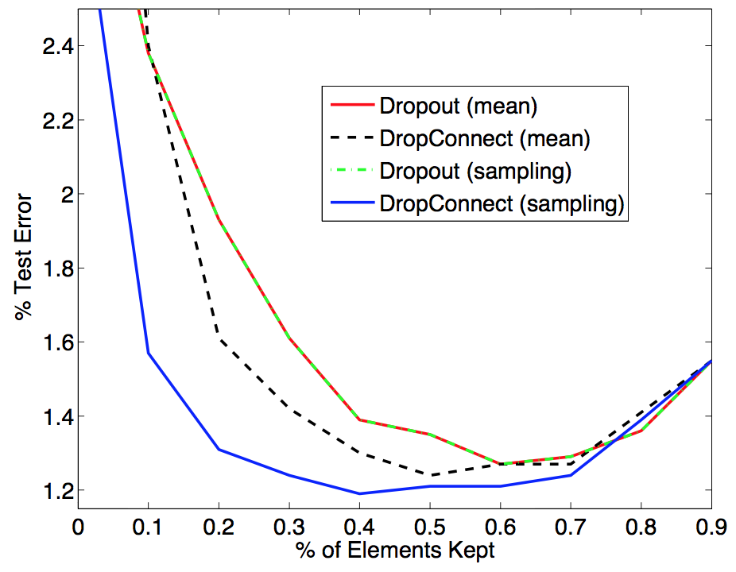
MNIST
Test error as drop out rate changes
Figure credit: Wan et al. ICML 2013

Slide 82
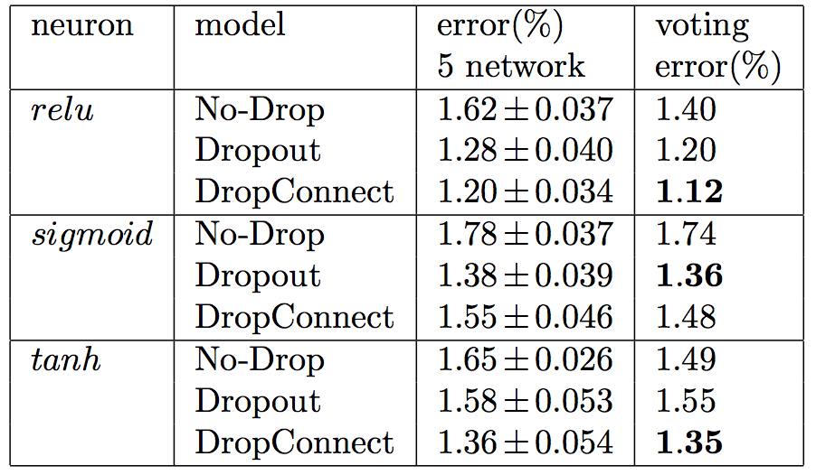
MNIST
Classification error rate without data augmentation
Figure credit: Wan et al. ICML 2013

Slide 83
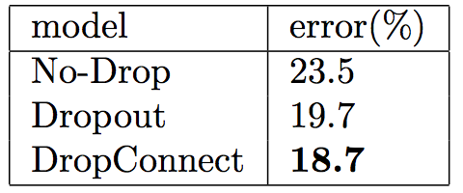
CIFAR-10
On top of 3-layer of AlexNet, perform no dropout, dropconnect and dropout
Figure credit: Wan et al. ICML 2013

Slide 84
CIFAR-10
On top of 2-conv layers and 2 fully connected layers
Figure credit: Wan et al. ICML 2013

Slide 85
SVHN
512 unit between feature extractor and softmax layer
Figure credit: Wan et al. ICML 2013

Slide 86
Generalizations of Dropout
Distribution
R.V. from other distribution
Dropout
Selection scheme
DropConnect
Maxout
Activation function

Slide 87
Maxout
Dropout suits well to train an ensemble of large models and approximate average model predictions
Maxout enhances dropout’s abilities as a model averaging technique

Slide 88
Maxout
f(x)
f(x)
x
x
ReLU
Piece-wise linear function

Slide 89
Maxout
Maxout uses the max unit:
k linear functions
Take the maximum value from k models
Maxout uses the max unit:
Where

Slide 90
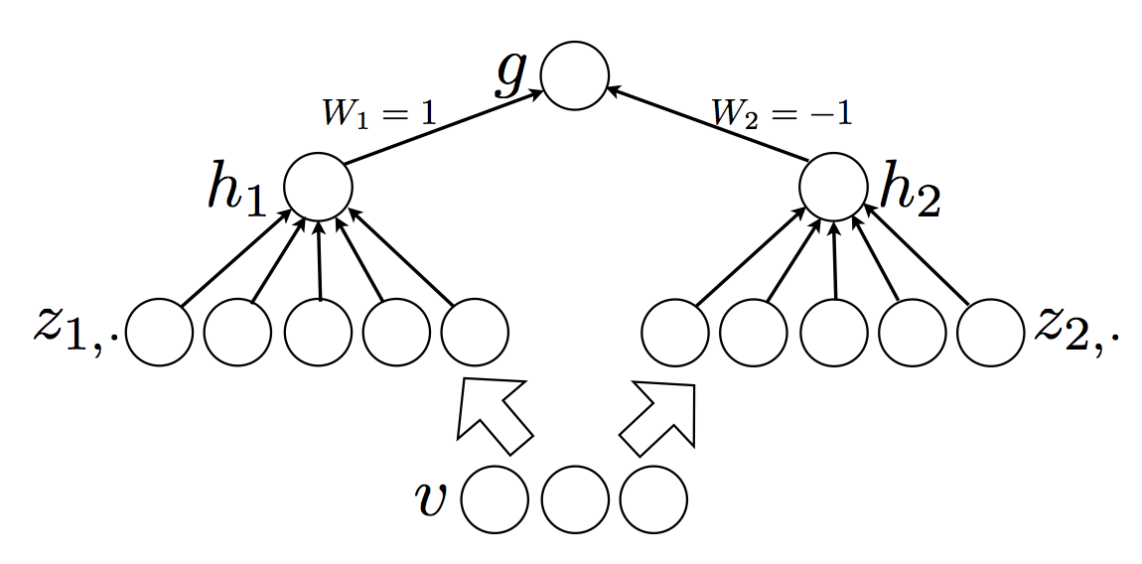
Universal approximator
Maxout is a universal approximator
A maxout model with just two hidden units can approximate any continuous function
Figure credit: Goodfellow et al. ICML 2013

Slide 91
Universal approximator
Any continuous piece wise linear function g(v) can be expressed as the difference between two convex piece wise linear functions
For any continuous function f(v), there exists a continuous piece wise linear function g(v), such that:

Slide 92
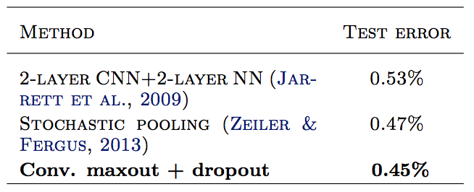
MNIST
3 convolution maxout hidden layers, with max pooling
Followed by a softmax layer
Figure credit: Goodfellow et al. ICML 2013

Slide 93
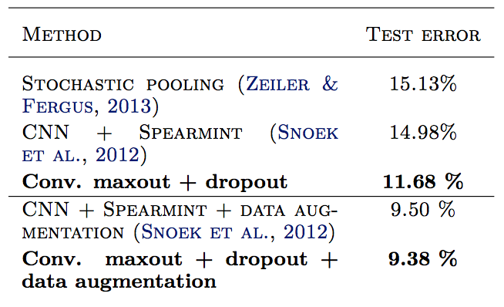
CIFAR-10
3 convolutional maxout layers
1 fully connected maxout layer
1 softmax layer
Figure credit: Goodfellow et al. ICML 2013

Slide 94
Why maxout performs better
Enhance dropout’s approximate model averaging technique
Maxout yields better optimization performance
Decrease saturation rate

Slide 95
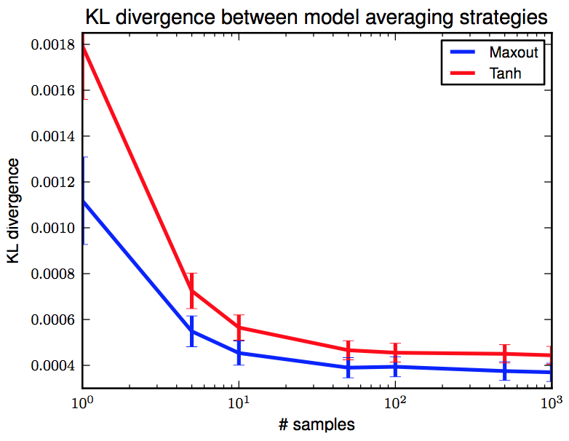
Better averaging model technique
Dropout training encourages maxout units to have larger linear regions around inputs
Figure credit: Goodfellow et al. ICML 2013

Slide 96
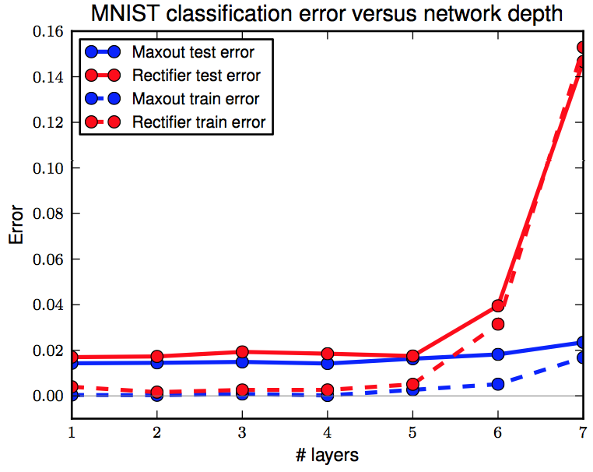
Better averaging model technique
Two experiments
2 convolutional layers on SVHN data
Rectifier units: 7.3% training error
Maxout units: 5.1% training error
Deep and narrow model on MNIST
Figure credit: Goodfellow et al. ICML 2013

Slide 97
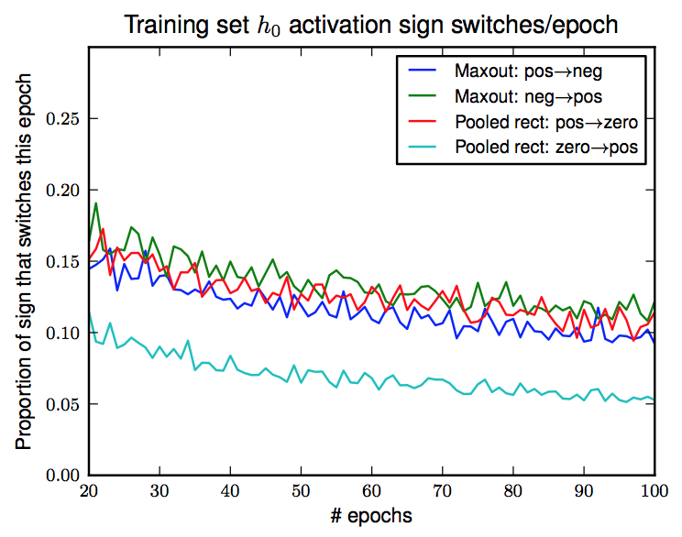
Saturation
Training with SGD: saturate at 0 less than 5% time
Training with dropout: saturate rate increases
Activation function is a constant on left
Maxout has gradient every where
Figure credit: Goodfellow et al. ICML 2013

Slide 98
Saturation
High proportion of zeros and the difficulty of escaping them impairs the optimization performance
Train two MLPs with 2 hidden layers
Fails to use 17.6% filters in first layer and 39.2% in second layer
Fails to use 0.1% filters

Slide 99
Conclusion remarks
“If your deep neural net is significantly overfitting, dropout will usually reduce the number of errors by a lot.
If your deep neural net is not overfitting you should be using a bigger one!”
Hinton, Lecture 6a, CSC2535, 2013

Slide 100
Marginalizing Dropout
Marginalizing dropout in regression
A special form of ridge regression
Marginalizing dropout on Deep Networks?

Slide 101
Conclusion Remarks
“If your deep neural net is significantly overfitting, dropout will usually reduce the number of errors by a lot.
If your deep neural net is not overfitting you should be using a bigger one!”

Slide 103
f(x)
f(x)
x
x

Slide 104
Inference Step

Slide 105
Regularization
Many approaches have been propose to do regularization in deep neural network,
Adding L1 or L2 penalty
Early stopping of training
Bayesian method
Dropout

Slide 106
Why DropConnect works
Averaging models
Rademacher complexity
where:
P = 0: model complexity is zero
P = 1: returns standard model complexity
P = 0.5: all sub-models have equal complexity
Notes:
complexity

