Slide 1
ECE 6504: Deep Learning for Perception
Topics:
Backprop in Conv Layers
Dhruv Batra
Virginia Tech

Slide 2
Administrativia
Presentations
https://docs.google.com/spreadsheets/d/1m76E4mC0wfRjc4HRBWFdAlXKPIzlEwfw1-u7rBw9TJ8/edit#gid=2045905312
HW1
Out today
Due in 2 weeks
Please please please please please start early
https://computing.ece.vt.edu/~f15ece6504/homework1/

Slide 3
Recap of last time

Slide 4
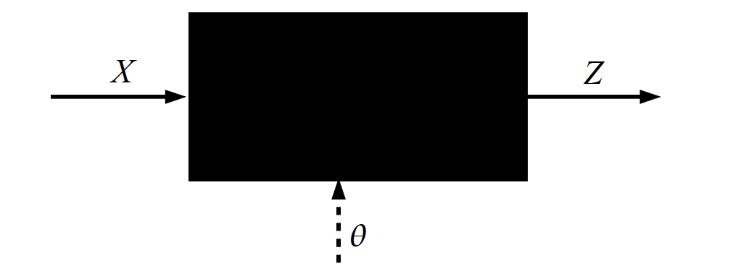
Key Computation: Forward-Prop
Slide Credit: Marc'Aurelio Ranzato, Yann LeCun

Slide 5
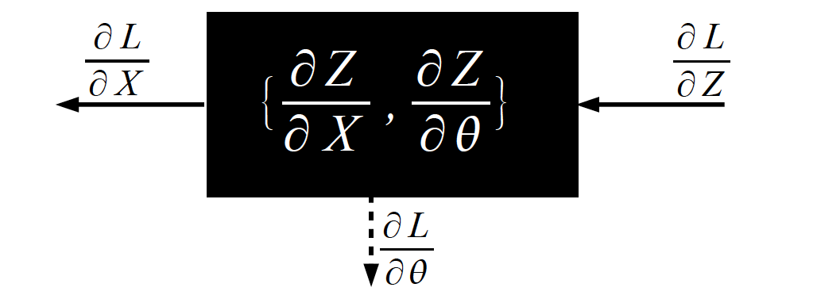
Key Computation: Back-Prop
Slide Credit: Marc'Aurelio Ranzato, Yann LeCun

Slide 6
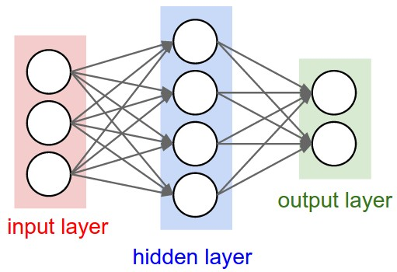
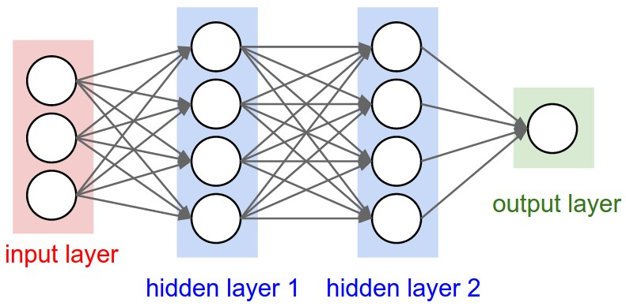
Multilayer Networks
Cascade Neurons together
The output from one layer is the input to the next
Each Layer has its own sets of weights
Image Credit: Andrej Karpathy, CS231n

Slide 7
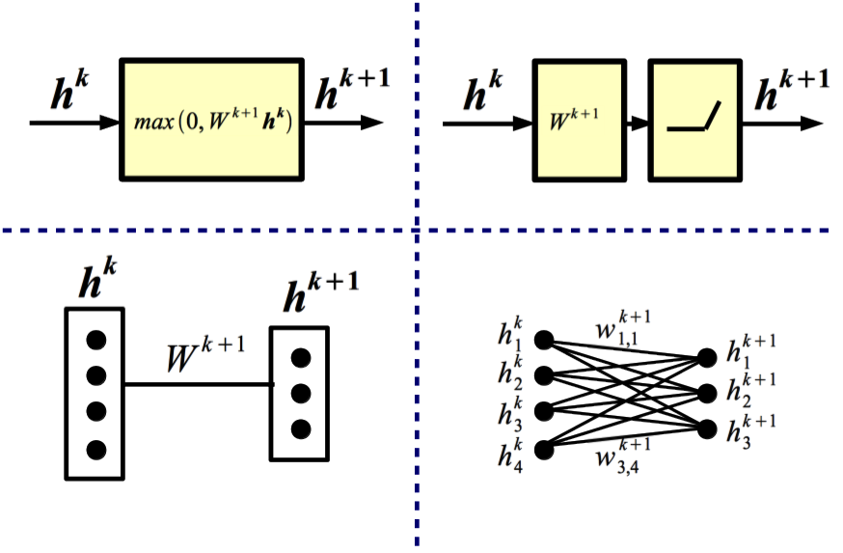
Equivalent Representations
Slide Credit: Marc'Aurelio Ranzato, Yann LeCun

Slide 8
Plan for Today
CNNs
Backward pass
Partial derivation on board
Full derivation in class

