Slide 1
ECE 6504: Deep Learning for Perception
Topics:
  (Finish) Backprop
  Convolutional Neural Nets
Dhruv Batra
Virginia Tech

Slide 2
Administrativia
Presentation Assignments
  https://docs.google.com/spreadsheets/d/1m76E4mC0wfRjc4HRBWFdAlXKPIzlEwfw1-u7rBw9TJ8/edit#gid=2045905312

Slide 3
Recap of last time

Slide 4
Last Time
Notation + Setup
Neural Networks
Chain Rule + Backprop

Slide 5
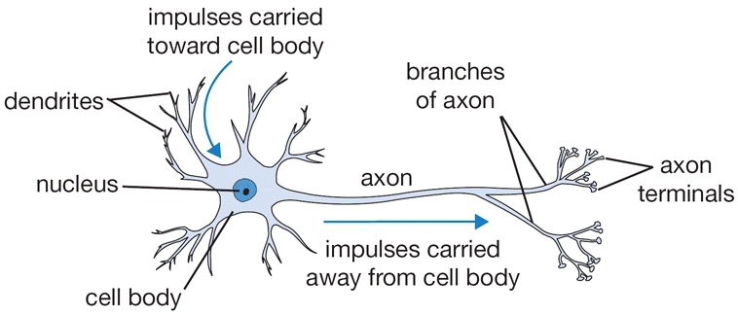
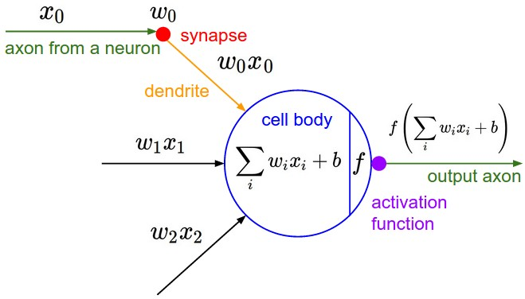
Recall: The Neuron Metaphor
Neurons
    accept information from multiple inputs,
    transmit information to other neurons.
Artificial neuron
    Multiply inputs by weights along edges
    Apply some function to the set of inputs at each node
Image Credit: Andrej Karpathy, CS231n

Slide 6
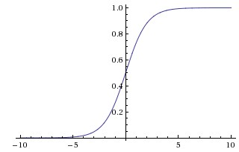
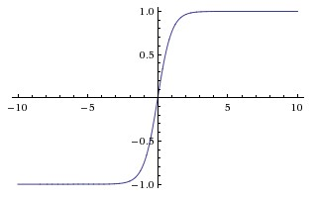
Activation Functions
sigmoid vs tanh

Slide 7
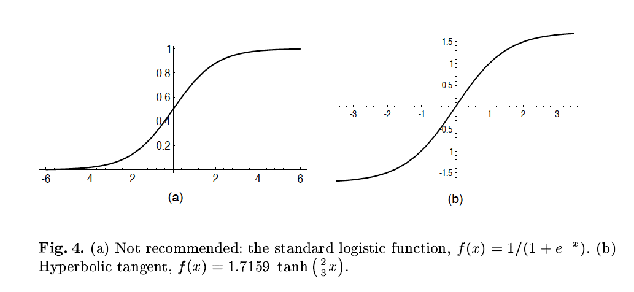
A quick note
Image Credit: LeCun et al. ‘98

Slide 8
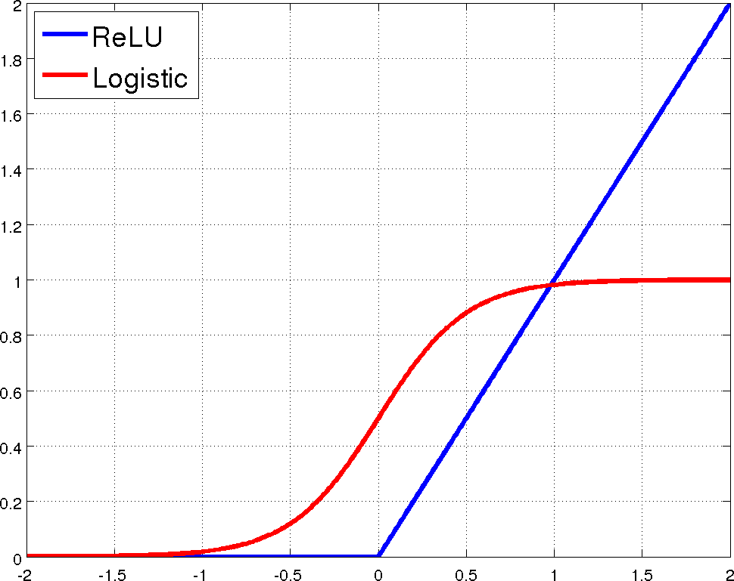
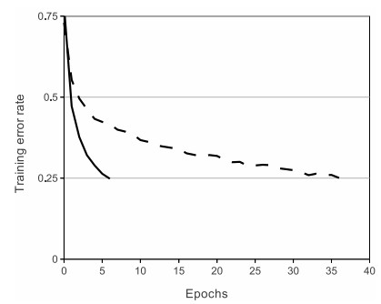
Rectified Linear Units (ReLU)

Slide 9
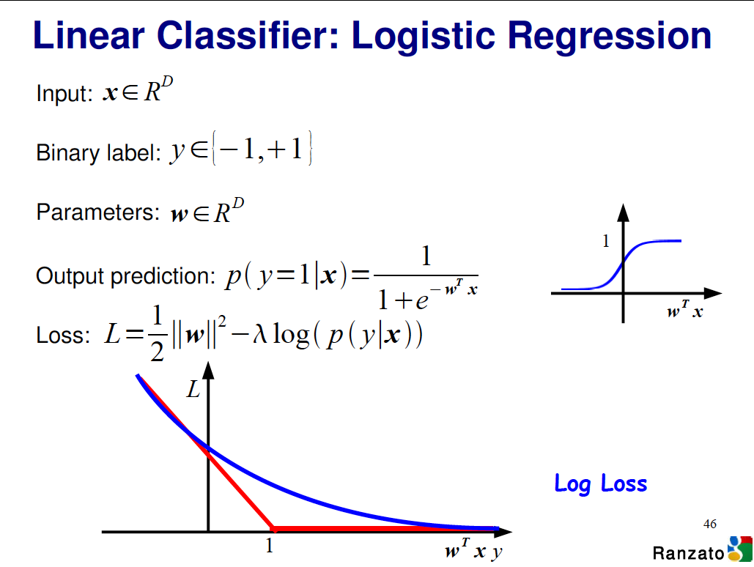

Slide 10
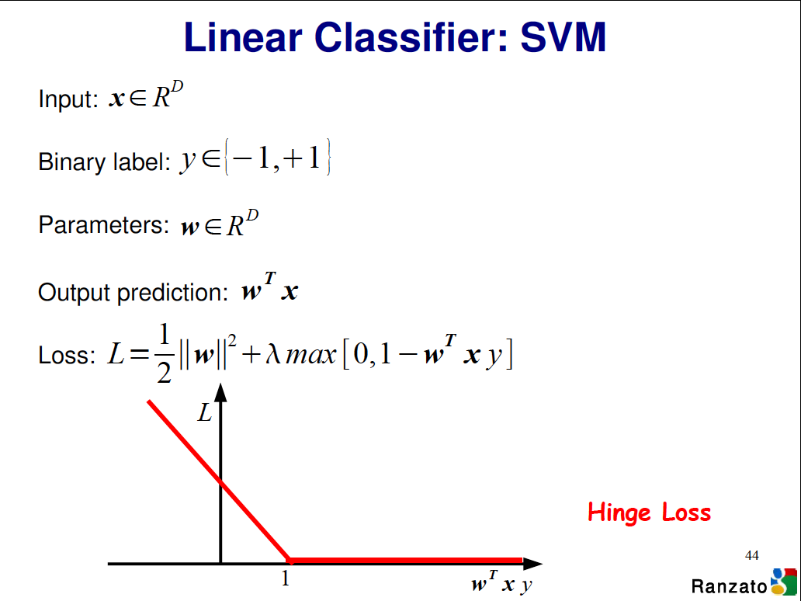

Slide 11
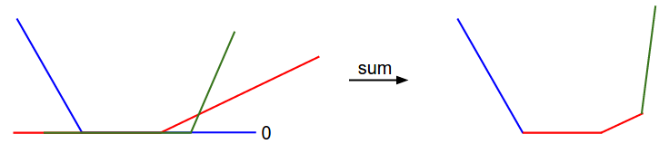
Visualizing Loss Functions
Sum of individual losses
Image Credit: Andrej Karpathy, CS231n

Slide 12
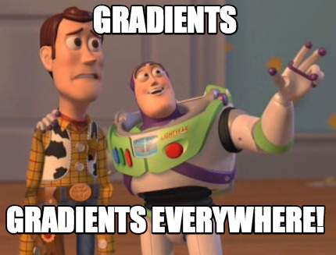
Detour

Slide 13
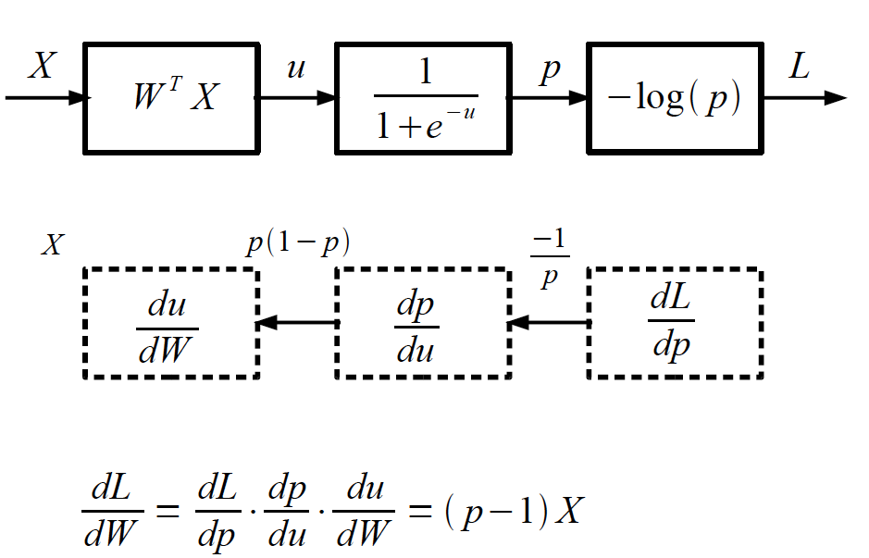
Logistic Regression as a Cascade
Slide Credit: Marc'Aurelio Ranzato, Yann LeCun

Slide 14
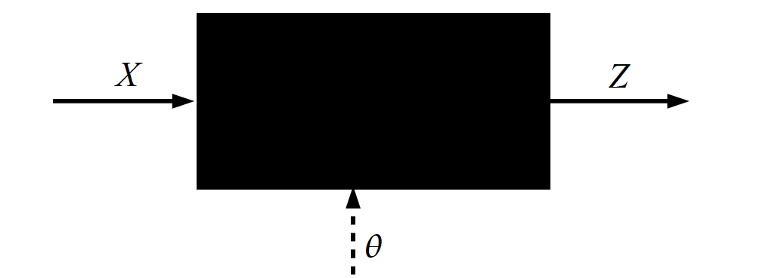
Key Computation: Forward-Prop
Slide Credit: Marc'Aurelio Ranzato, Yann LeCun

Slide 15
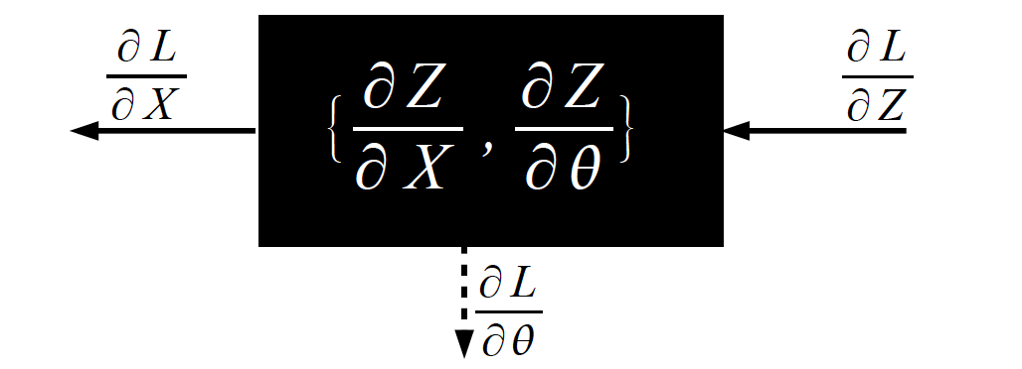
Key Computation: Back-Prop
Slide Credit: Marc'Aurelio Ranzato, Yann LeCun

Slide 16
Plan for Today
MLPs
  Notation
  Backprop
CNNs
  Notation
  Convolutions
  Forward pass
  Backward pass

Slide 17
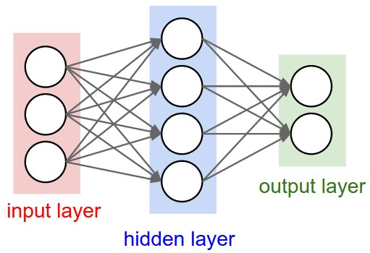

Multilayer Networks
Cascade Neurons together
The output from one layer is the input to the next
Each Layer has its own sets of weights
Image Credit: Andrej Karpathy, CS231n

Slide 18
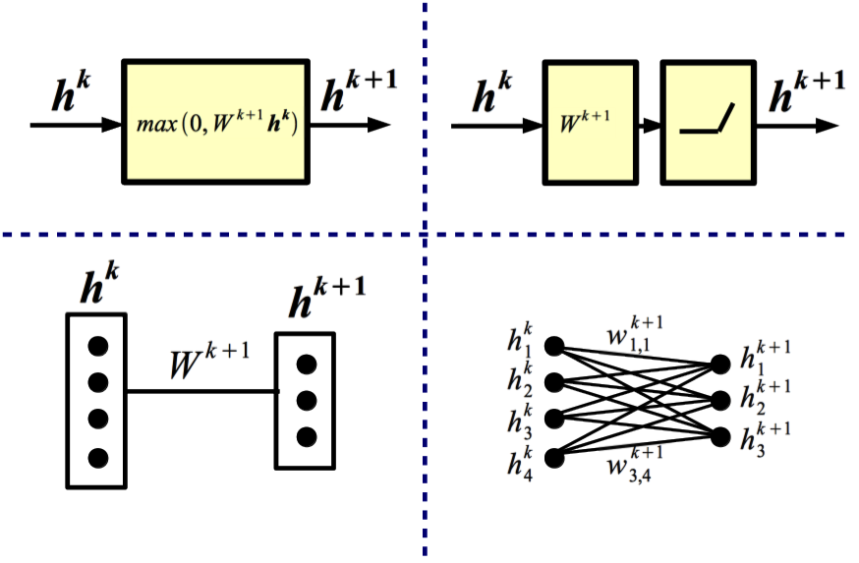
Equivalent Representations
Slide Credit: Marc'Aurelio Ranzato, Yann LeCun

Slide 19
Backward Propagation
Question: Does BPROP work with ReLU layers only?
Answer: Nope, any a.e. differentiable transformation works.
Question: What's the computational cost of BPROP?
Answer: About twice FPROP (need to compute gradients w.r.t. input and parameters at every layer).
Note: FPROP and BPROP are dual of each other. E.g.,:
FPROP
BPROP
SUM
+
COPY
+
Slide Credit: Marc'Aurelio Ranzato, Yann LeCun

Slide 20
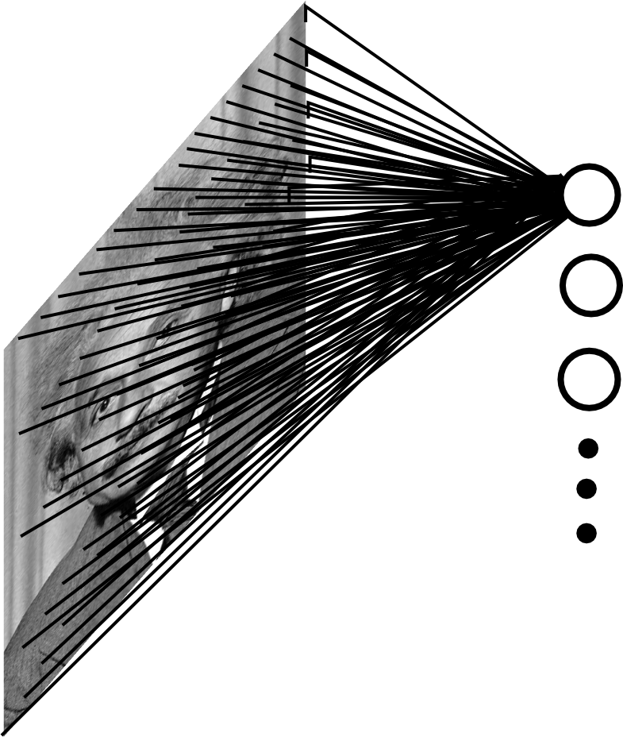
Fully Connected Layer
Example: 200x200 image
40K hidden units
~2B parameters!!!
- Spatial correlation is local
- Waste of resources + we have not enough training samples anyway..
Slide Credit: Marc'Aurelio Ranzato

Slide 21
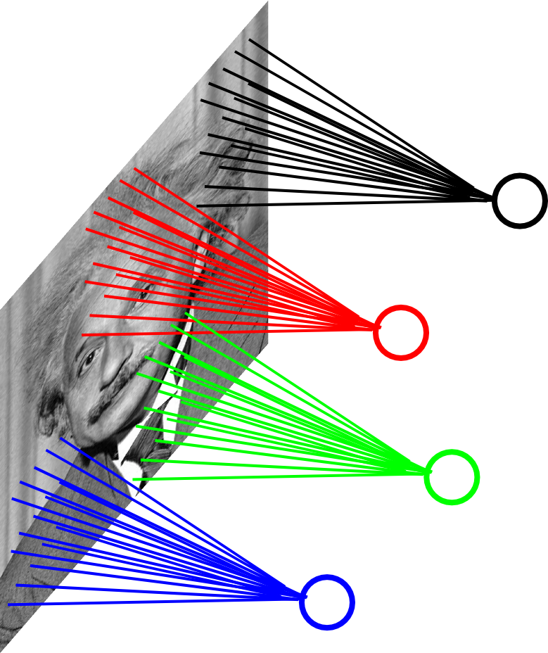
Locally Connected Layer
Example: 200x200 image
40K hidden units
Filter size: 10x10
4M parameters
Note: This parameterization is good when input image is registered (e.g., face recognition).
Slide Credit: Marc'Aurelio Ranzato

Slide 22
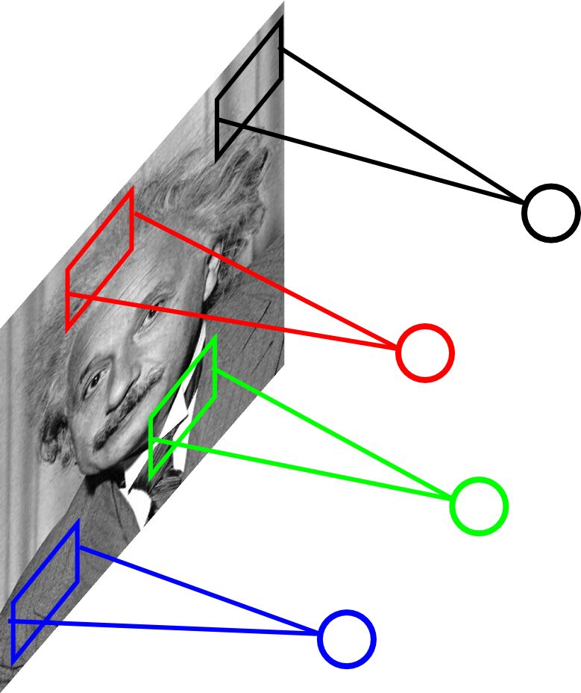
Locally Connected Layer
STATIONARITY? Statistics is similar at different locations
Example: 200x200 image
40K hidden units
Filter size: 10x10
4M parameters
Note: This parameterization is good when input image is registered (e.g., face recognition).
Slide Credit: Marc'Aurelio Ranzato

Slide 23
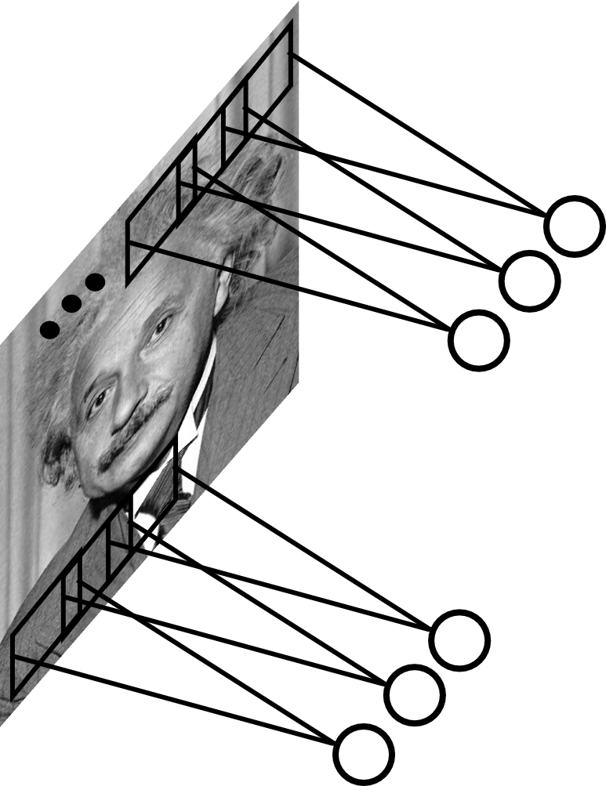
Convolutional Layer
Share the same parameters across different locations (assuming input is stationary):
Convolutions with learned kernels
Slide Credit: Marc'Aurelio Ranzato

Slide 24
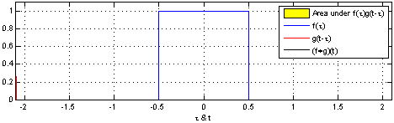
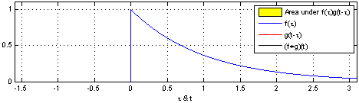
"Convolution of box signal with itself2" by Convolution_of_box_signal_with_itself.gif: Brian Ambergderivative work: Tinos (talk) - Convolution_of_box_signal_with_itself.gif. Licensed under CC BY-SA 3.0 via Commons - https://commons.wikimedia.org/wiki/File:Convolution_of_box_signal_with_itself2.gif#/media/File:Convolution_of_box_signal_with_itself2.gif

Slide 25
Convolution Explained
http://setosa.io/ev/image-kernels/
https://github.com/bruckner/deepViz

Slide 26
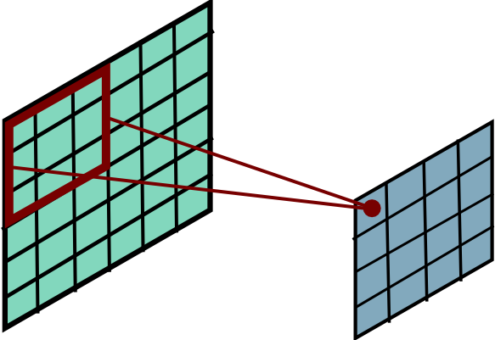
Convolutional Layer
Slide Credit: Marc'Aurelio Ranzato

Slide 27
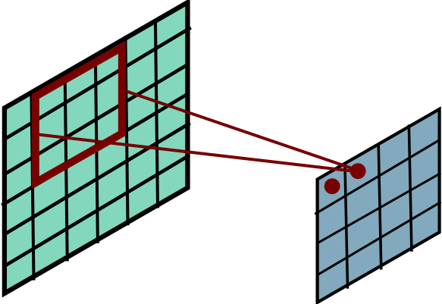
Convolutional Layer
Slide Credit: Marc'Aurelio Ranzato

Slide 28
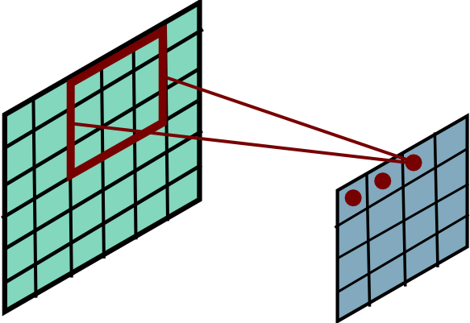
Convolutional Layer
Slide Credit: Marc'Aurelio Ranzato

Slide 29
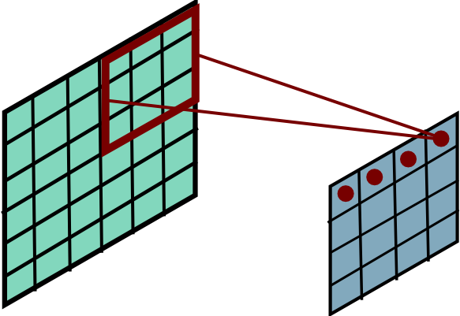
Convolutional Layer
Slide Credit: Marc'Aurelio Ranzato

Slide 30
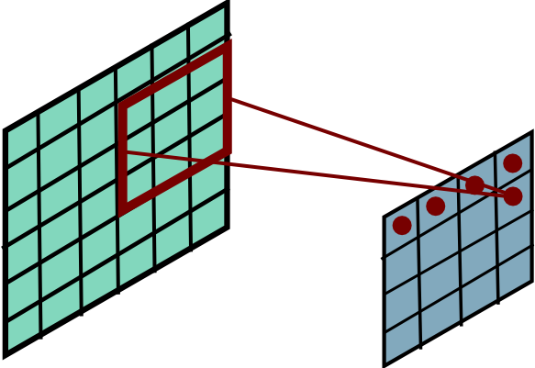
Convolutional Layer
Slide Credit: Marc'Aurelio Ranzato

Slide 31
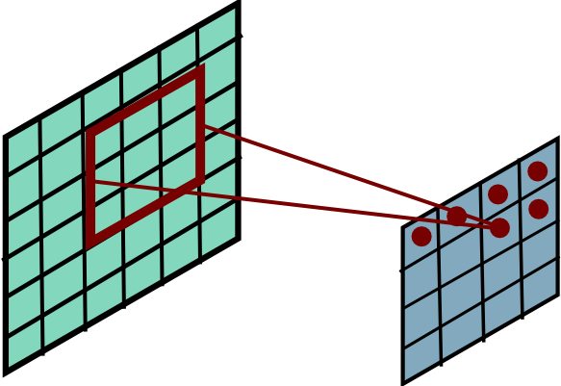
Convolutional Layer
Slide Credit: Marc'Aurelio Ranzato

Slide 32
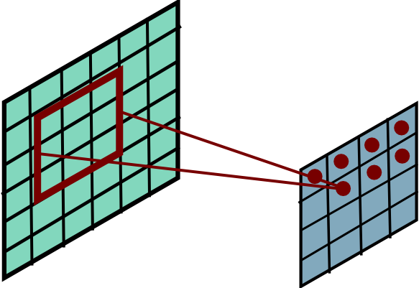
Convolutional Layer
Slide Credit: Marc'Aurelio Ranzato

Slide 33
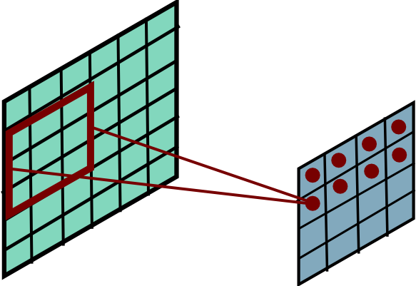
Convolutional Layer
Slide Credit: Marc'Aurelio Ranzato

Slide 34
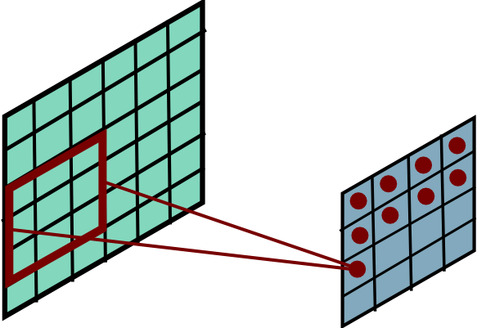
Convolutional Layer
Slide Credit: Marc'Aurelio Ranzato

Slide 35
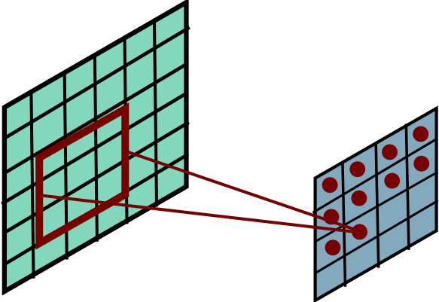
Convolutional Layer
Slide Credit: Marc'Aurelio Ranzato

Slide 36
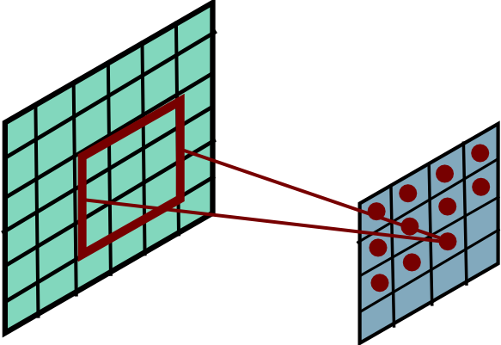
Convolutional Layer
Slide Credit: Marc'Aurelio Ranzato

Slide 37
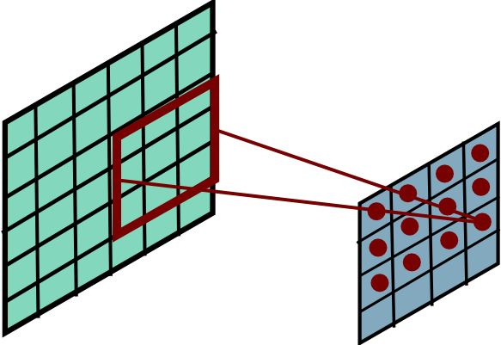
Convolutional Layer
Slide Credit: Marc'Aurelio Ranzato

Slide 38
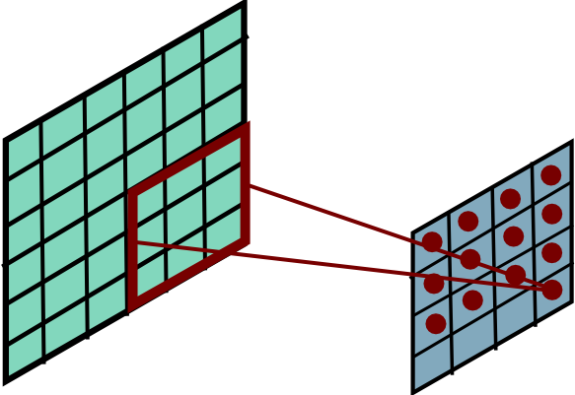
Convolutional Layer
Slide Credit: Marc'Aurelio Ranzato

Slide 39
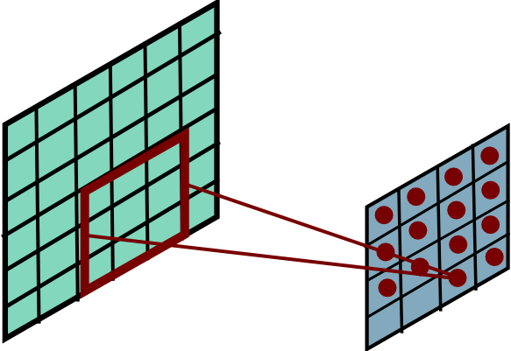
Convolutional Layer
Slide Credit: Marc'Aurelio Ranzato

Slide 40
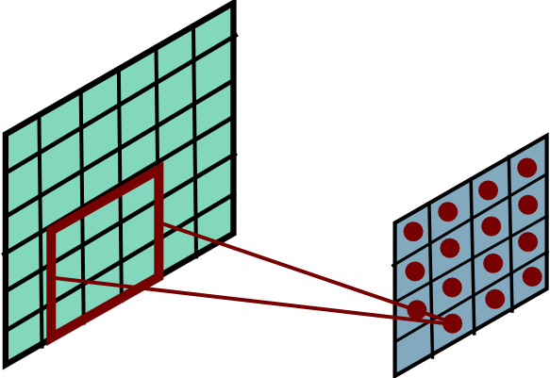
Convolutional Layer
Slide Credit: Marc'Aurelio Ranzato

Slide 41
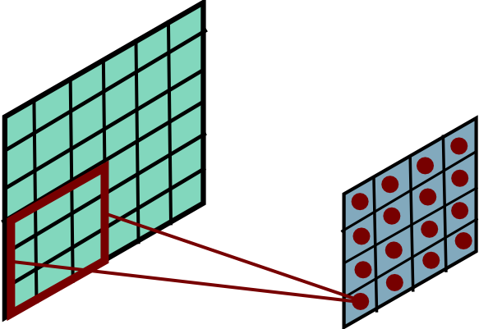
Convolutional Layer
Mathieu et al. “Fast training of CNNs through FFTs” ICLR 2014
Slide Credit: Marc'Aurelio Ranzato

Slide 42
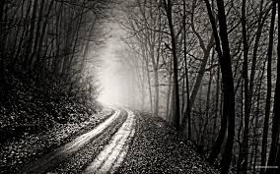
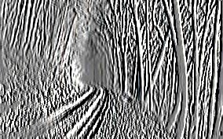
Convolutional Layer
-1 0 1
-1 0 1
-1 0 1
=
*
Slide Credit: Marc'Aurelio Ranzato

Slide 43
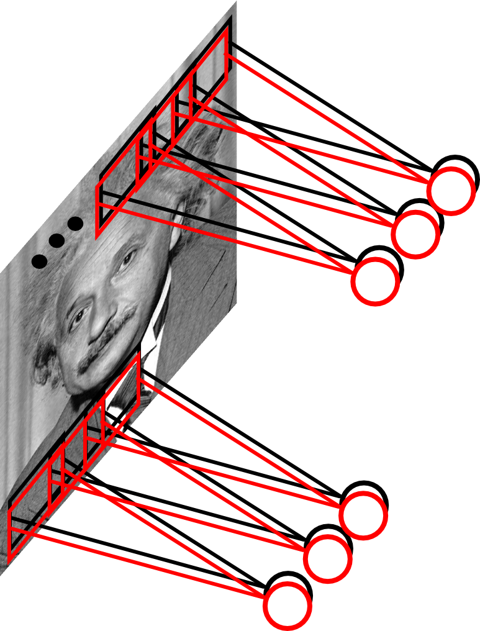
Convolutional Layer
Learn multiple filters.
E.g.: 200x200 image
100 Filters
Filter size: 10x10
10K parameters
Slide Credit: Marc'Aurelio Ranzato

Slide 44

Convolutional Nets
  a
Image Credit: Yann LeCun, Kevin Murphy

Slide 45
Convolutional Layer
output feature map
input feature map
kernel
Conv.
layer
Slide Credit: Marc'Aurelio Ranzato

Slide 46
Convolutional Layer
output feature map
input feature map
kernel
Slide Credit: Marc'Aurelio Ranzato

Slide 47
Convolutional Layer
output feature map
input feature map
kernel
Slide Credit: Marc'Aurelio Ranzato

Slide 48
Convolutional Layer
Question: What is the size of the output? What's the computational cost?
Answer: It is proportional to the number of filters and depends on the stride. If kernels have size KxK, input has size DxD, stride is 1, and there are M input feature maps and N output feature maps then:
- the input has size M@DxD
- the output has size N@(D-K+1)x(D-K+1)
- the kernels have MxNxKxK coefficients (which have to be learned)
- cost: M*K*K*N*(D-K+1)*(D-K+1)
Question: How many feature maps? What's the size of the filters?
Answer: Usually, there are more output feature maps than input feature maps. Convolutional layers can increase the number of hidden units by big factors (and are expensive to compute).
The size of the filters has to match the size/scale of the patterns we want to detect (task dependent).
Slide Credit: Marc'Aurelio Ranzato

Slide 49
Key Ideas
A standard neural net applied to images:
- scales quadratically with the size of the input
- does not leverage stationarity
Solution:
- connect each hidden unit to a small patch of the input
- share the weight across space
This is called: convolutional layer.
A network with convolutional layers is called convolutional network.
LeCun et al. “Gradient-based learning applied to document recognition” IEEE 1998
Slide Credit: Marc'Aurelio Ranzato

Slide 50
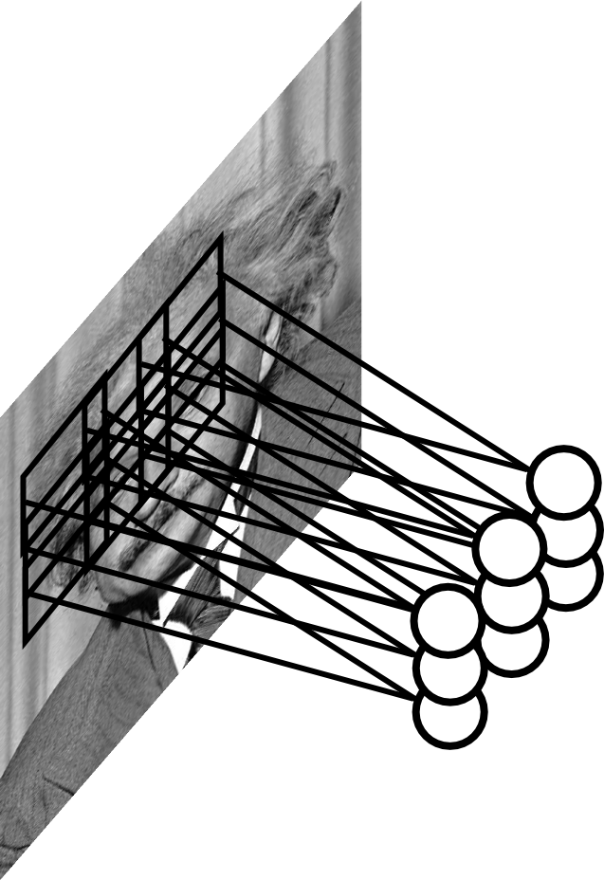
Pooling Layer
Let us assume filter is an “eye” detector.
Q.: how can we make the detection robust to the exact location of the eye?
Slide Credit: Marc'Aurelio Ranzato

Slide 51
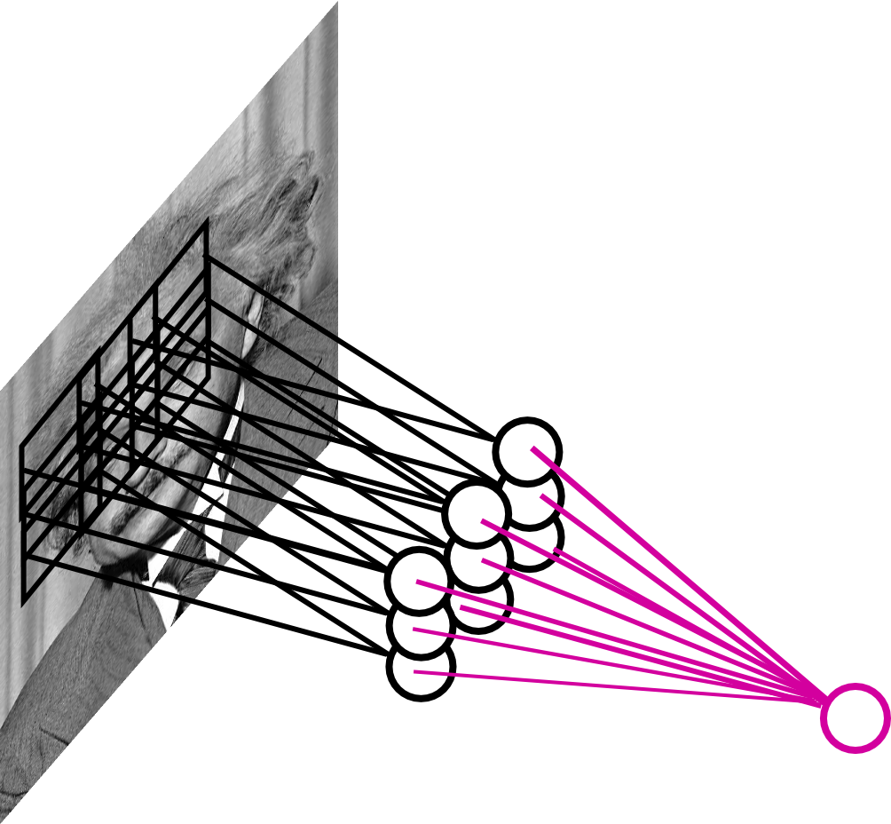
Pooling Layer
By “pooling” (e.g., taking max) filter
responses at different locations we gain robustness to the exact spatial location of features.
Slide Credit: Marc'Aurelio Ranzato

Slide 52
Pooling Layer: Examples
Max-pooling:
Average-pooling:
L2-pooling:
L2-pooling over features:
Slide Credit: Marc'Aurelio Ranzato

Slide 53
Pooling Layer
Question: What is the size of the output? What's the computational cost?
Answer: The size of the output depends on the stride between the pools. For instance, if pools do not overlap and have size KxK, and the input has size DxD with M input feature maps, then:
- output is M@(D/K)x(D/K)
- the computational cost is proportional to the size of the input (negligible compared to a convolutional layer)
Question: How should I set the size of the pools?
Answer: It depends on how much “invariant” or robust to distortions we want the representation to be. It is best to pool slowly (via a few stacks of conv-pooling layers).
Slide Credit: Marc'Aurelio Ranzato

Slide 54




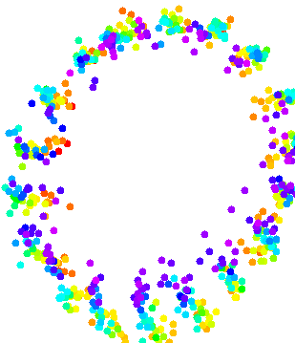













Pooling Layer: Interpretation
Task: detect orientation L/R
Conv layer: linearizes manifold
Slide Credit: Marc'Aurelio Ranzato

Slide 55
Pooling Layer: Interpretation
Task: detect orientation L/R
Conv layer: linearizes manifold
Pooling layer: collapses manifold
Slide Credit: Marc'Aurelio Ranzato

Slide 56
Pooling Layer: Receptive Field Size
Conv.
layer
Pool.
layer
If convolutional filters have size KxK and stride 1, and pooling layer has pools of size PxP, then each unit in the pooling layer depends upon a patch (at the input of the preceding conv. layer) of size: (P+K-1)x(P+K-1)
Slide Credit: Marc'Aurelio Ranzato

Slide 57
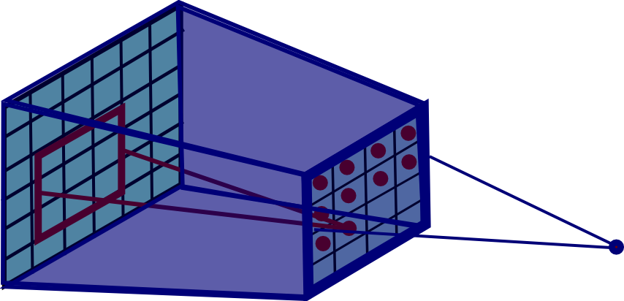
Pooling Layer: Receptive Field Size
Conv.
layer
Pool.
layer
If convolutional filters have size KxK and stride 1, and pooling layer has pools of size PxP, then each unit in the pooling layer depends upon a patch (at the input of the preceding conv. layer) of size: (P+K-1)x(P+K-1)
Slide Credit: Marc'Aurelio Ranzato

Slide 58
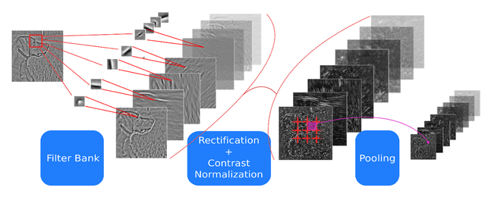
ConvNets: Typical Stage
One stage (zoom)
Convol.
Pooling
courtesy of
K. Kavukcuoglu
Slide Credit: Marc'Aurelio Ranzato

Slide 59
ConvNets: Typical Stage
One stage (zoom)
Convol.
Pooling
Conceptually similar to: SIFT, HoG, etc.
Slide Credit: Marc'Aurelio Ranzato

Slide 60
Note: after one stage the number of feature maps is usually increased (conv. layer) and the spatial resolution is usually decreased (stride in conv. and pooling layers). Receptive field gets bigger.
Reasons:
- gain invariance to spatial translation (pooling layer)
- increase specificity of features (approaching object specific units)
courtesy of
K. Kavukcuoglu
Slide Credit: Marc'Aurelio Ranzato

Slide 61
ConvNets: Typical Architecture
One stage (zoom)
Convol.
Pooling
Whole system
Input Image
Class
Labels
Fully Conn.
Layers
1st stage
2nd stage
3rd stage
Slide Credit: Marc'Aurelio Ranzato

Slide 62
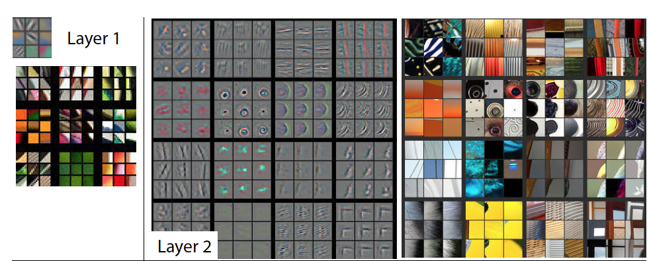
Visualizing Learned Filters
Figure Credit: [Zeiler & Fergus ECCV14]

Slide 63
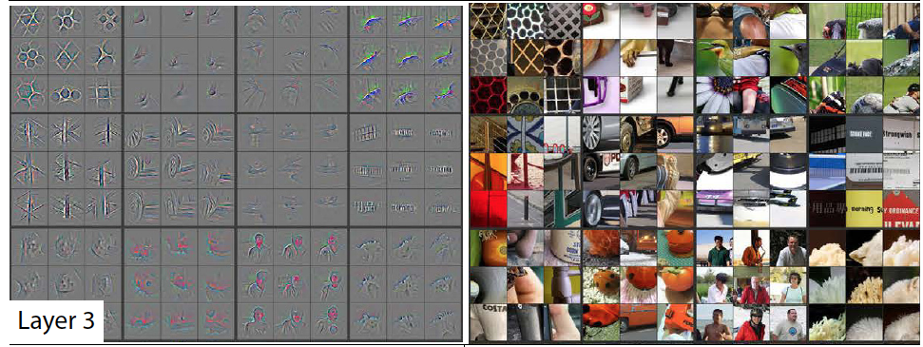
Visualizing Learned Filters
Figure Credit: [Zeiler & Fergus ECCV14]

Slide 64
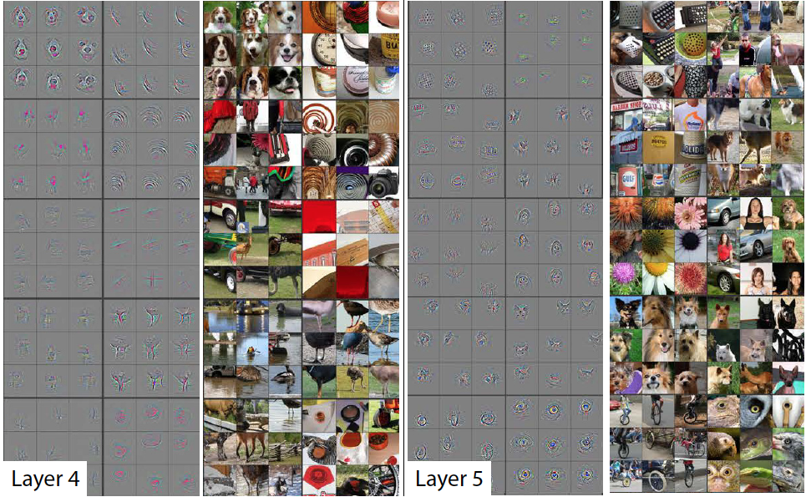
Visualizing Learned Filters
Figure Credit: [Zeiler & Fergus ECCV14]

Slide 65
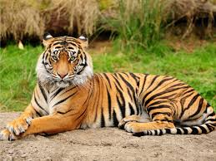
Fancier Architectures: Multi-Modal
Matching
shared representation
CNN
Text
Embedding
tiger
Frome et al. “Devise: a deep visual semantic embedding model” NIPS 2013
Slide Credit: Marc'Aurelio Ranzato

Slide 66
Fancier Architectures: Multi-Task
Fully
Conn.
Attr. 1
Fully
Conn.
Attr. 2
image
Conv
Norm
Pool
Conv
Norm
Pool
Conv
Norm
Pool
Conv
Norm
Pool
Fully
Conn.
...
Fully
Conn.
Attr. N
Zhang et al. “PANDA..” CVPR 2014
Slide Credit: Marc'Aurelio Ranzato

Slide 67
Fancier Architectures: Generic DAG
Any DAG of differentialble modules is allowed!
Slide Credit: Marc'Aurelio Ranzato

