Slide 1
ECE 6504: Deep Learning for Perception
Topics:
  Neural Networks
    Backprop
    Modular Design
Dhruv Batra
Virginia Tech

Slide 2
Administrativia
Scholar
  Anybody not have access?
  Please post questions on Scholar Forum.
  Please check scholar forums. You might not know you have a doubt.
Sign up for Presentations
  https://docs.google.com/spreadsheets/d/1m76E4mC0wfRjc4HRBWFdAlXKPIzlEwfw1-u7rBw9TJ8/edit#gid=2045905312

Slide 3
Plan for Today
Notation + Setup
Neural Networks
Chain Rule + Backprop

Slide 4
Supervised Learning
Input: x (images, text, emails…)
Output: y (spam or non-spam…)
(Unknown) Target Function
  f: X → Y (the “true” mapping / reality)
Data
  (x₁,y₁), (x₂,y₂), …, (x_{N},y_{N})
Model / Hypothesis Class
  g: X → Y
  y = g(x) = sign(w^{T}x)
Learning = Search in hypothesis space
  Find best g in model class.

Slide 5
Basic Steps of Supervised Learning
Set up a supervised learning problem
Data collection
  Start with training data for which we know the correct outcome provided by a teacher or oracle.
Representation
  Choose how to represent the data.
Modeling
  Choose a hypothesis class: H = {g: X → Y}
Learning/Estimation
  Find best hypothesis you can in the chosen class.
Model Selection
  Try different models. Picks the best one. (More on this later)
If happy stop
  Else refine one or more of the above

Slide 6
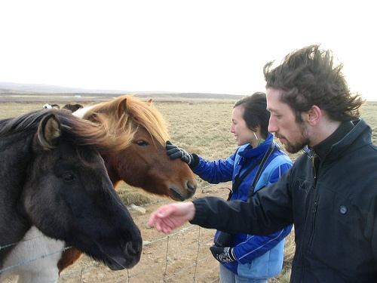

Error Decomposition
Reality
Modeling Error
model class
Estimation
Error
Optimization
Error

Slide 7
Error Decomposition
Reality
Modeling Error
Estimation
Error
Optimization
Error
model class

Slide 8
Error Decomposition
Modeling Error
Reality
model class
Higher-Order
Potentials
Estimation
Error
Optimization
Error

Slide 9
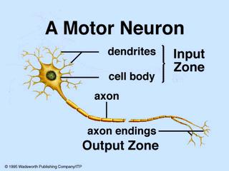
Biological Neuron

Slide 10
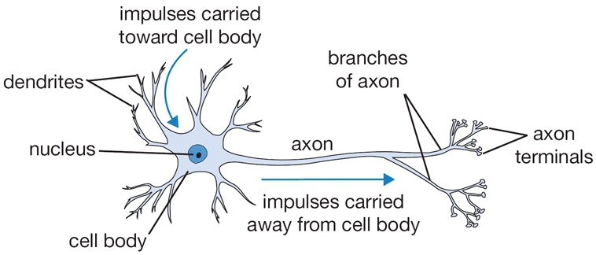
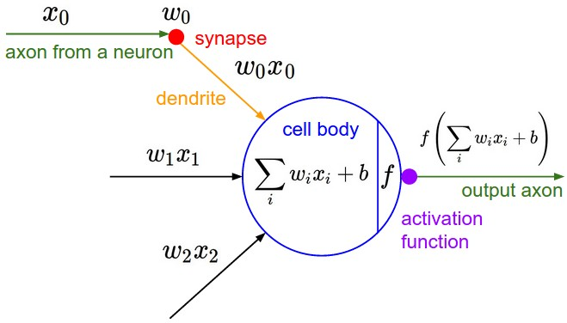
Recall: The Neuron Metaphor
Neurons
    accept information from multiple inputs,
    transmit information to other neurons.
Artificial neuron
    Multiply inputs by weights along edges
    Apply some function to the set of inputs at each node
Image Credit: Andrej Karpathy, CS231n

Slide 11
Types of Neurons
Linear Neuron
Logistic Neuron
Potentially more. Require a convex
loss function for gradient descent training.
Perceptron
Slide Credit: HKUST

Slide 12
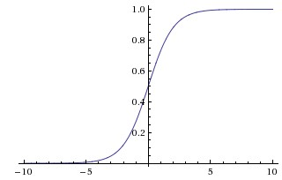
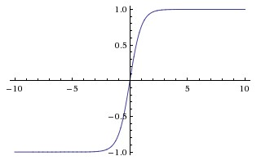
Activation Functions
sigmoid vs tanh

Slide 13
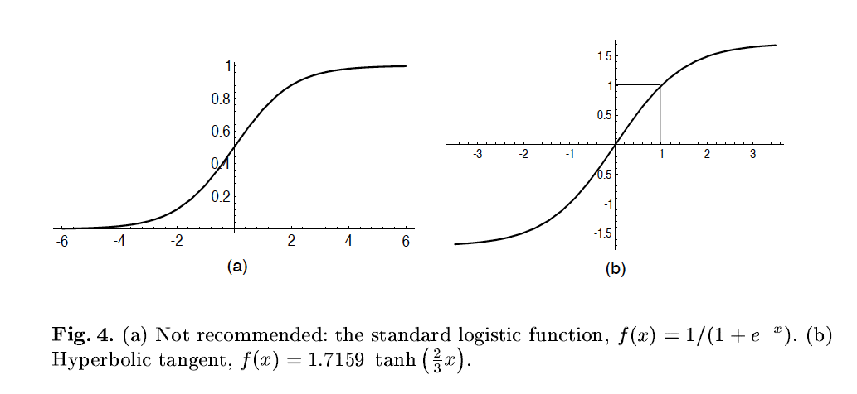
A quick note
Image Credit: LeCun et al. ‘98

Slide 14
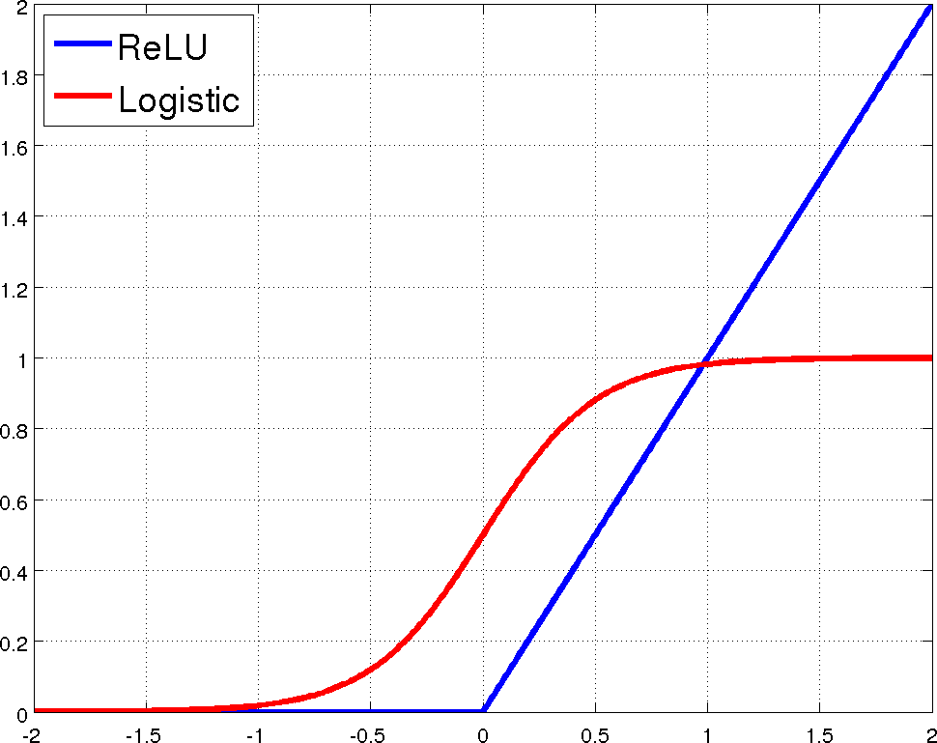
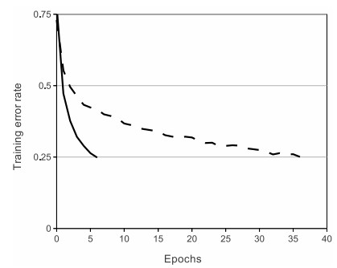
Rectified Linear Units (ReLU)
[Krizhevsky et al., NIPS12]

Slide 15
Limitation
A single “neuron” is still a linear decision boundary
What to do?
Idea: Stack a bunch of them together!

Slide 16
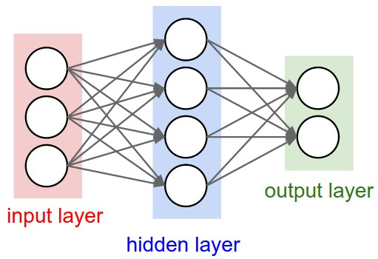

Multilayer Networks
Cascade Neurons together
The output from one layer is the input to the next
Each Layer has its own sets of weights
Image Credit: Andrej Karpathy, CS231n

Slide 17
Universal Function Approximators
Theorem
  3-layer network with linear outputs can uniformly approximate any continuous function to arbitrary accuracy, given enough hidden units [Funahashi ’89]

Slide 18
Neural Networks
Demo
  http://neuron.eng.wayne.edu/bpFunctionApprox/bpFunctionApprox.html

Slide 19
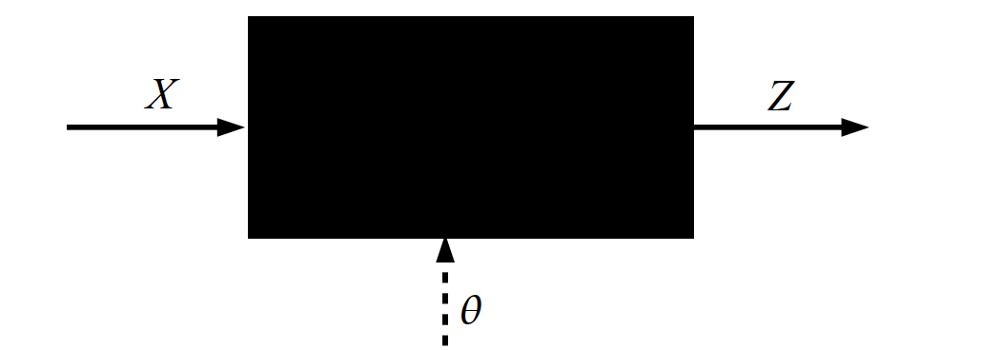
Key Computation: Forward-Prop
Slide Credit: Marc'Aurelio Ranzato, Yann LeCun

Slide 20
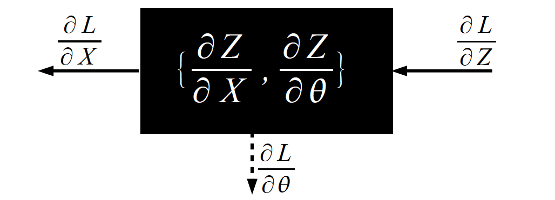
Key Computation: Back-Prop
Slide Credit: Marc'Aurelio Ranzato, Yann LeCun

Slide 21
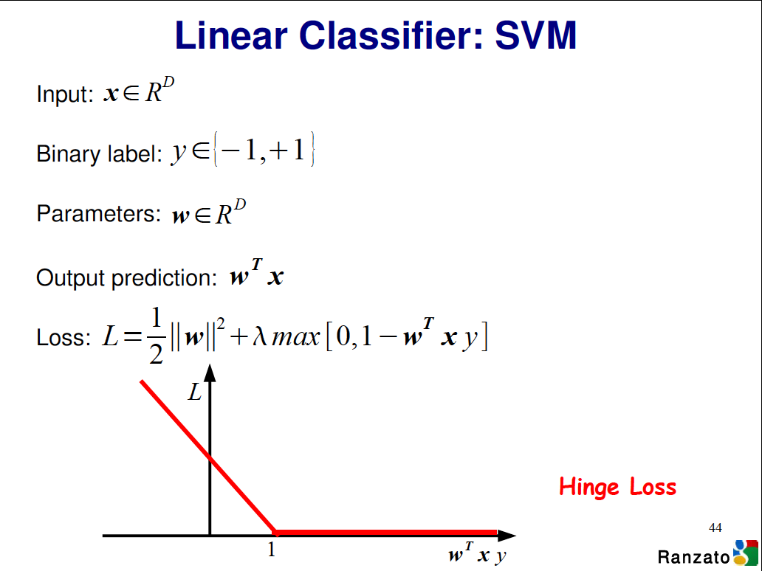

Slide 22
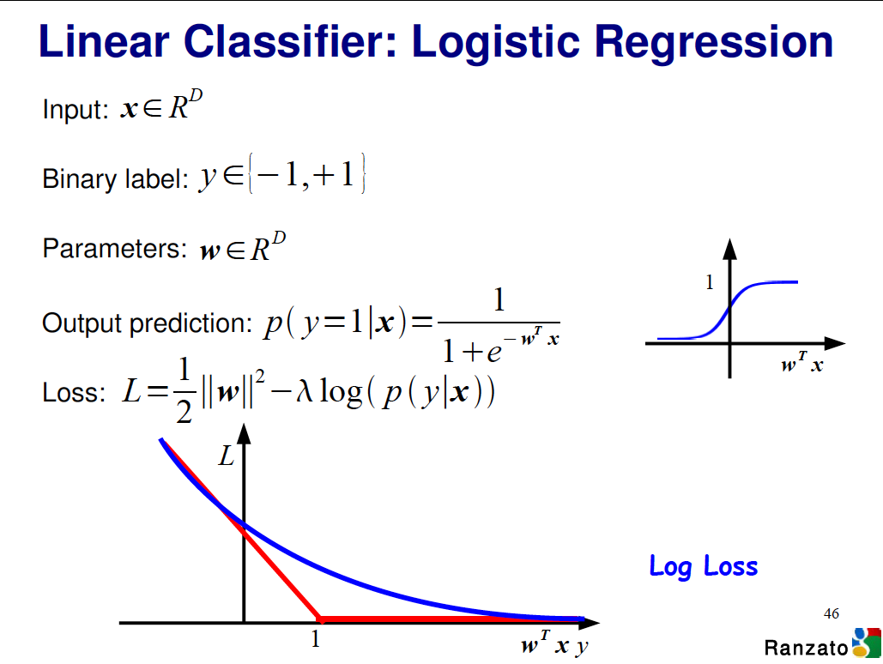

Slide 23
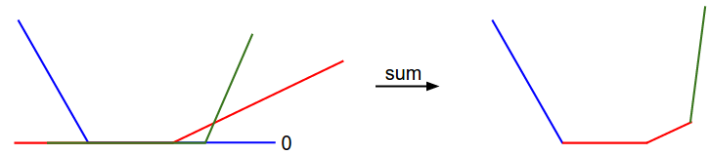
Visualizing Loss Functions
Sum of individual losses

Slide 24

Detour

Slide 25
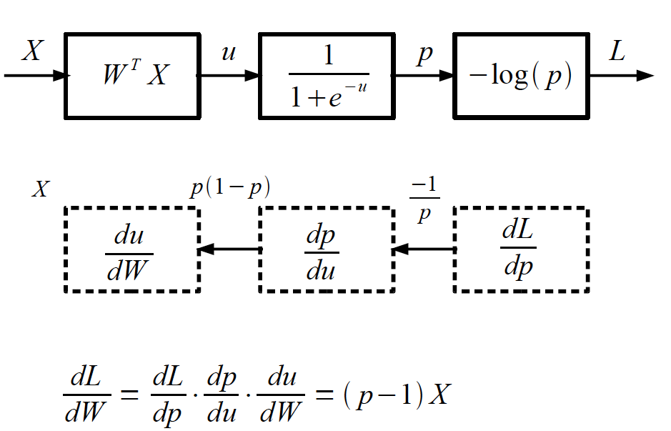
Logistic Regression as a Cascade
Slide Credit: Marc'Aurelio Ranzato, Yann LeCun

Slide 26
Forward Propagation
On board

