Slide 1
ECE6504 – Deep Learning for Perception
Introduction to CAFFE
Ashwin Kalyan V

Slide 2
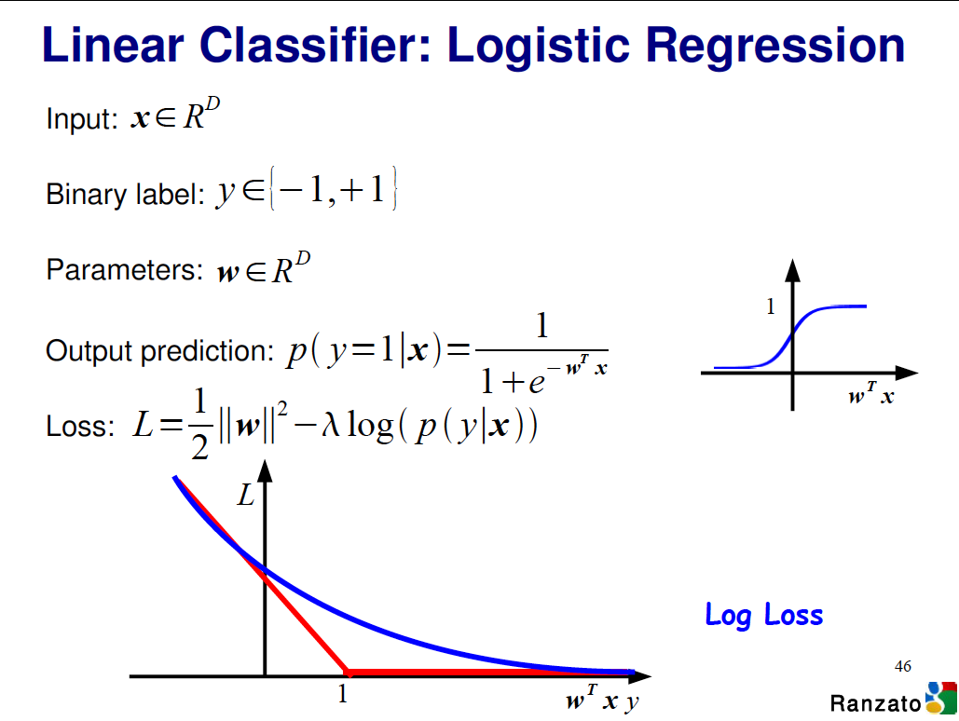

Slide 3
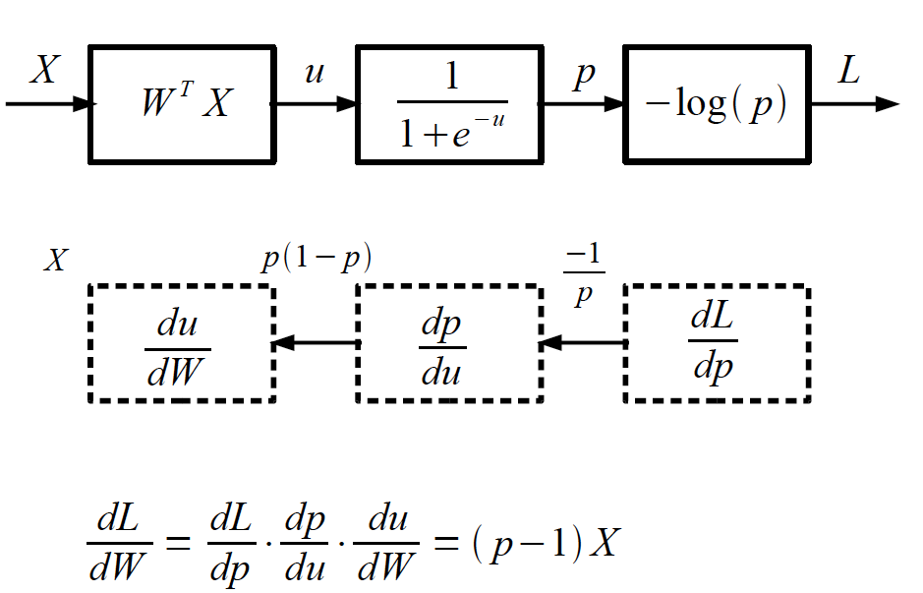
Logistic Regression as a Cascade
Slide Credit: Marc'Aurelio Ranzato, Yann LeCun

Slide 4
Logistic Regression as a Cascade
Slide Credit: Marc'Aurelio Ranzato, Yann LeCun

Slide 5
Logistic Regression as a Cascade
Slide Credit: Marc'Aurelio Ranzato, Yann LeCun

Slide 6
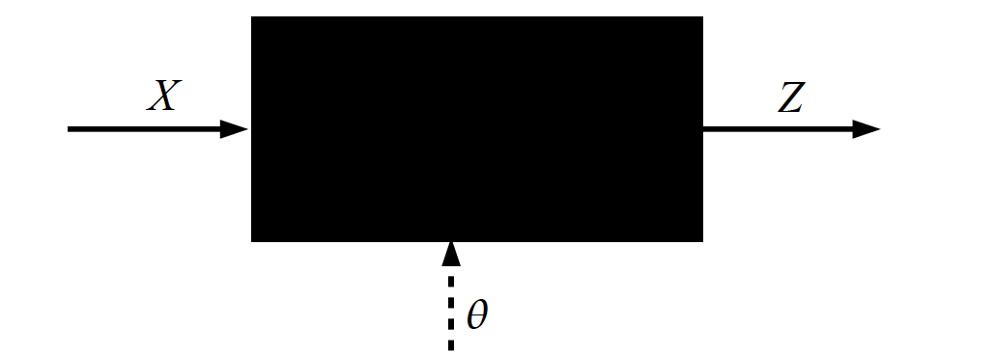
Key Computation: Forward-Prop
Slide Credit: Marc'Aurelio Ranzato, Yann LeCun

Slide 7
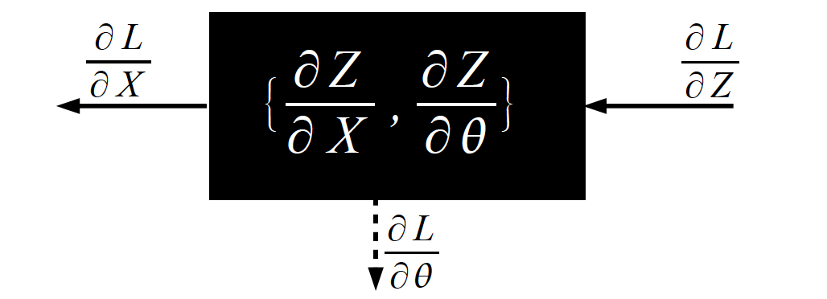
Key Computation: Back-Prop
Slide Credit: Marc'Aurelio Ranzato, Yann LeCun

Slide 8
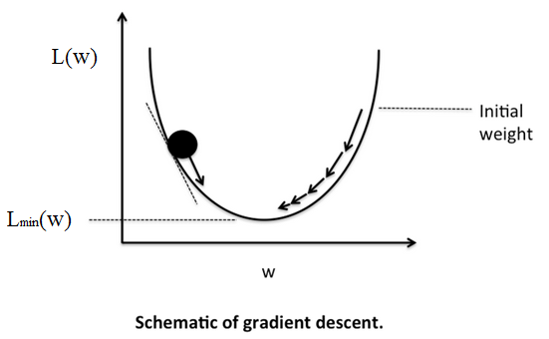

Training using Stochastic Gradient Descent
$$W≔W−μ∇L$$

Slide 9
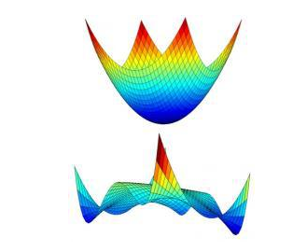

Training using Stochastic Gradient Descent
Loss functions of NN are almost always non-convex
$$W≔W−μ∇L$$

Slide 10
Training using Stochastic Gradient Descent
Loss functions of NN are almost always non-convex
which makes training a little tricky.
$$W≔W−μ∇L$$
Many methods to find the optimum, like momentum update, Nesterov momentum update, Adagrad, RMSPRop, etc

Slide 11
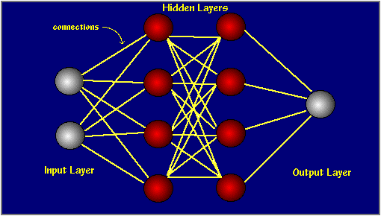
Network
A network is a set of layers and its connections.
Data and gradients move along the connections.
Feed forward networks are Directed Acyclic graphs (DAG) i.e. they do not have any recurrent connections.

Slide 12
Main types of deep architectures
Neural nets
Conv Nets
Hierar. Sparse Coding
Deconv Nets
feed-forward
Feed-back
input
input
Stacked
Auto-encoders
DBM
Recurrent Neural nets
Recursive Nets
LISTA
Bi-directional
Recurrent
input
input
Slide Credit: Marc'Aurelio Ranzato, Yann LeCun

Slide 13
Focus of this course
Neural nets
Conv Nets
Hierar. Sparse Coding
Deconv Nets
feed-forward
Feed-back
input
input
Stacked
Auto-encoders
DBM
Recurrent Neural nets
Recursive Nets
LISTA
Bi-directional
Recurrent
input
input
Slide Credit: Marc'Aurelio Ranzato, Yann LeCun

Slide 14
Focus of this class
Neural nets
Conv Nets
Hierar. Sparse Coding
Deconv Nets
feed-forward
Feed-back
input
input
Stacked
Auto-encoders
DBM
Recurrent Neural nets
Recursive Nets
LISTA
Bi-directional
Recurrent
input
input
Slide Credit: Marc'Aurelio Ranzato, Yann LeCun

Slide 15
Focus of this class
Neural nets
Conv Nets
Hierar. Sparse Coding
Deconv Nets
Why?
Because official
CAFFE release supports DAG
feed-forward
Feed-back
input
input
Stacked
Auto-encoders
DBM
Recurrent Neural nets
Recursive Nets
LISTA
Bi-directional
Recurrent
input
input
Slide Credit: Marc'Aurelio Ranzato, Yann LeCun

Slide 16
Outline
Caffe?
Installation
Key Ingredients
Example: Softmax Classifier
Pycaffe
Roasting
Resources
References

Slide 17

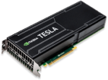
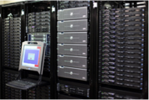
What is Caffe?
Open framework, models, and worked examples
for deep learning
1.5 years
450+ citations, 100+ contributors
2,500+ forks, >1 pull request / day average
focus has been vision, but branching out:
sequences, reinforcement learning, speech + text
Prototype
Train
Deploy

Slide 18
What is Caffe?
Open framework, models, and worked examples
for deep learning
Pure C++ / CUDA architecture for deep learning
Command line, Python, MATLAB interfaces
Fast, well-tested code
Tools, reference models, demos, and recipes
Seamless switch between CPU and GPU
Prototype
Train
Deploy

Slide 19
Installation

Slide 20
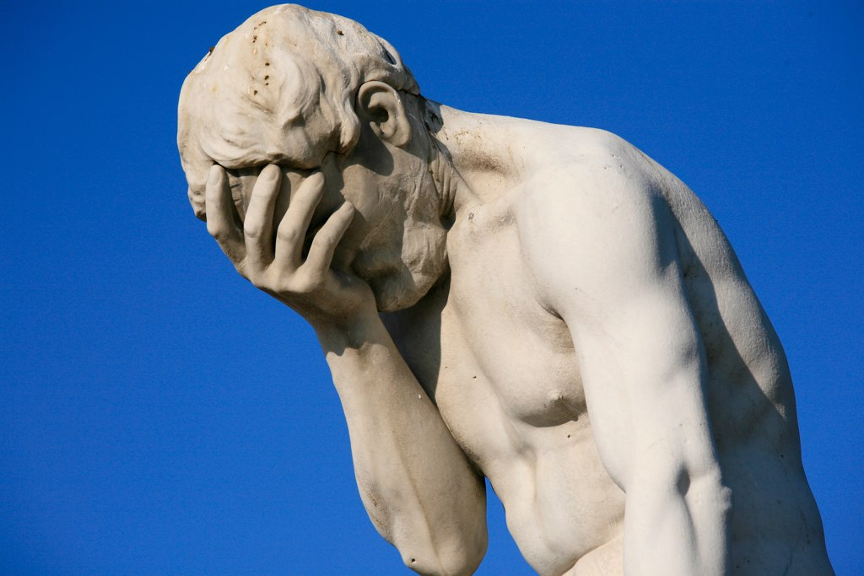
Installation

Slide 21
Installation
Strongly recommended that you use Linux (Ubuntu)/ OS X. Windows has some unofficial support though.
Prior to installing look at the installation page and the wiki
- the wiki has more info. But all support needs to be taken with a pinch of salt
- lots of dependencies
Suggested that you back up your data!

Slide 22
Installation
CUDA (Compute Unified Device Architecture) is a parallel computing platform and application programming interface (API) model created by NVIDIA
Installing CUDA
– check if you have a cuda supported Graphics Processing Unit (GPU).
If not, go for a cpu only installation of CAFFE.
- Do not install the nvidia driver if you do not have a supported
GPU

Slide 23
Installation
Clone the repo from here
Depending on the system configuration, make modifications to the Makefile.config file and proceed with the installation instructions.
We suggest that you use Anaconda python for the installation as it comes with the necessary python packages.

Slide 24
Quick Questions?

Slide 25
Key Ingredients

Slide 26
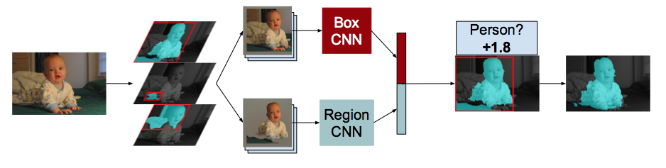
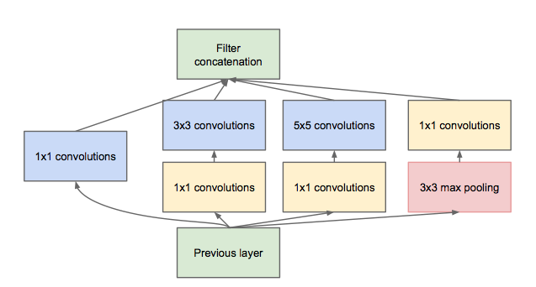
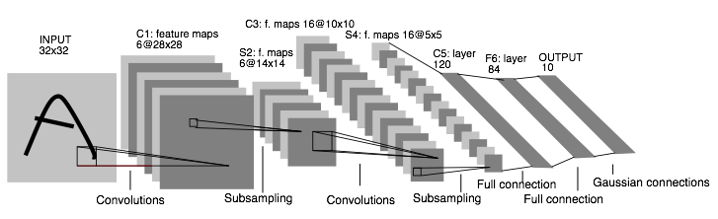
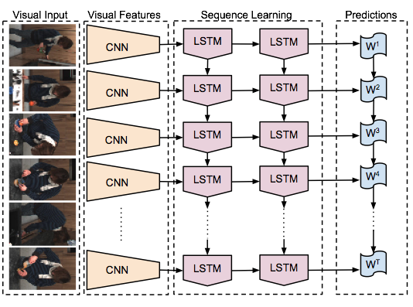
DAG
SDS two-stream net
Many current deep models
have linear structure
GoogLeNet Inception Module
Caffe nets can have any directed acyclic graph (DAG) structure.
LRCN joint vision-sequence model

Slide 27
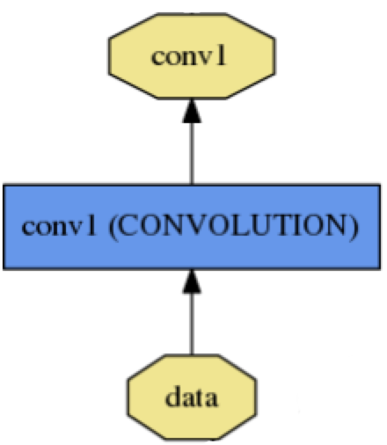
Blob
name: "conv1"
type: CONVOLUTION
bottom: "data"
top: "conv1"
… definition …
Blobs are N-D arrays for storing and communicating information.
hold data, derivatives, and parameters
lazily allocate memory
shuttle between CPU and GPU
top
blob
Data
Number x K Channel x Height x Width
256 x 3 x 227 x 227 for ImageNet train input
Parameter: Convolution Weight
N Output x K Input x Height x Width
96 x 3 x 11 x 11 for CaffeNet conv1
Parameter: Convolution Bias
96 x 1 x 1 x 1 for CaffeNet conv1
bottom blob

Slide 28
Layer Protocol
Setup: run once for initialization.
Forward: make output given input.
Backward: make gradient of output
- w.r.t. bottom
- w.r.t. parameters (if needed)
Reshape: set dimensions.
Compositional Modeling
The Net’s forward and backward passes are composed of the layers’ steps.
Layer Development Checklist

Slide 29
Layers
Caffe divides layers into
- neuron layers (eg: Inner product),
- Vision layers (Convolutional, pooling,etc)
- Data layers (to read in input)
- Loss layers
You can write your own layers. More development guidelines are here

Slide 30
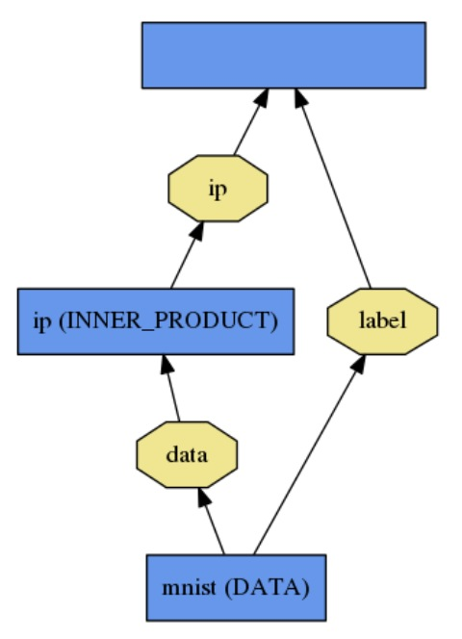
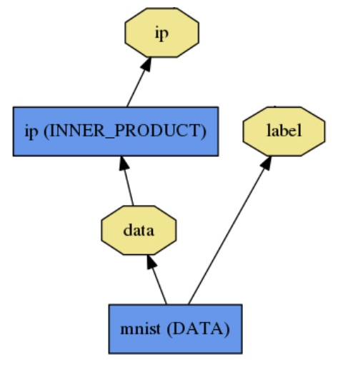
Loss
loss (LOSS_TYPE)
Classification
SoftmaxWithLoss
HingeLoss
Linear Regression
EuclideanLoss
Attributes / Multiclassification
SigmoidCrossEntropyLoss
Others…
New Task
NewLoss
What kind of model is this?
Define the task by the loss.

Slide 31
Protobuf Model Format
Strongly typed format
Auto-generates code
Developed by Google
Defines Net / Layer / Solver
schemas in caffe.proto
layer {
name: "ip"
type: "InnerProduct"
bottom: "data"
top: "ip"
inner_product_param {
num_output: 2
}
}
message ConvolutionParameter {
// The number of outputs for the layer
optional uint32 num_output = 1;
// whether to have bias terms
optional bool bias_term = 2 [default = true];
}

Slide 32
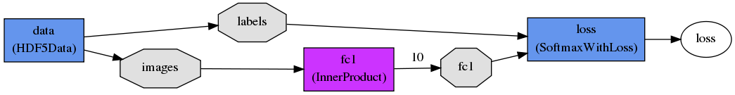





Softmax Classifier
$$y$$
$$Loss(p,y)$$
$$x$$
$$p$$
$$Wx+b$$

Slide 33
Neural Network

Slide 34
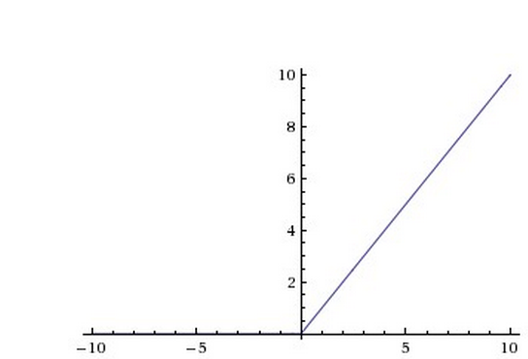
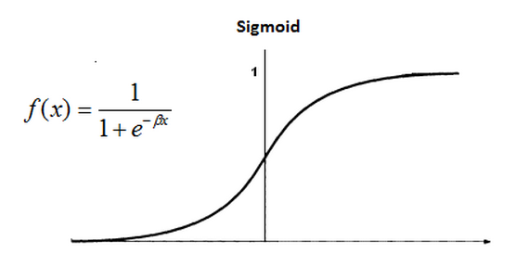
Activation function
Rectified Linear Unit (ReLU) Activation

Slide 35
Recipe for brewing a net
Convert the data to caffe-supported format
LMDB, HDF5, list of images
Define the net
Configure the solver
Start train from supported interface (command line, python, etc)

Slide 36
Layers – Data Layers
Data Layers : gets data into the net
- Data: LMDB/LEVELDB
efficient way to input data, only for 1-of-k classification tasks
- HDF5Data: takes in HDF5 format
- easy to create custom non-image datasets but supports only float32/float64
- Data can be written easily in the above formats using python support. ( using lmdb and h5py respectively). We will see how to write hdf5 data shortly
- Image Data: Reads in directly from images. Can be a little slow.
- All layers (except hdf5) support standard data augmentation tasks

Slide 37
Recipe for brewing a net
Convert the data to caffe-supported format
LMDB, HDF5, list of images
Define the network/architecture
Configure the solver
Start train from supported interface (command line, python, etc)

Slide 38
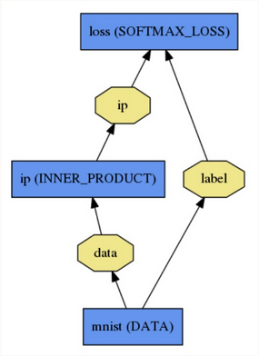
Example: Softmax Classifier
Architecture file
name: "LogReg"
layer {
name: "mnist"
type: "Data"
top: "data"
top: "label"
data_param {
source: "input_leveldb"
batch_size: 64
}
}

Slide 39
Example: Softmax Classifier
Architecture file
name: "LogReg"
layer {
name: "mnist"
type: "Data"
top: "data"
top: "label"
data_param {
source: "input_leveldb"
batch_size: 64
}
}
layer {
name: "ip"
type: "InnerProduct"
bottom: "data"
top: "ip"
inner_product_param {
num_output: 2
}
}

Slide 40
Example: Softmax Classifier
Architecture file
name: "LogReg"
layer {
name: "mnist"
type: "Data"
top: "data"
top: "label"
data_param {
source: "input_leveldb"
batch_size: 64
}
}
layer {
name: "ip"
type: "InnerProduct"
bottom: "data"
top: "ip"
inner_product_param {
num_output: 2
}
}
layer {
name: "loss"
type: "SoftmaxWithLoss"
bottom: "ip"
bottom: "label"
top: "loss"
}

Slide 41
Recipe for brewing a net
Convert the data to caffe-supported format
LMDB, HDF5, list of images
Define the net
Configure the solver
Start train from supported interface (command line, python, etc)

Slide 42
Example: Softmax Classifier
Solver file
net: "logreg_train_val.prototxt”
test_iter: 10
test_interval: 500
base_lr: 0.0000001
momentum: 0.0
weight_decay: 50000
lr_policy: "step”
stepsize: 2000
display: 100
max_iter: 2000
snapshot: 1000
snapshot_prefix: "logreg-snapshot/”
solver_mode: GPU

Slide 43
Example: Softmax Classifier
Solver file
net: "logreg_train_val.prototxt”
test_iter: 10
test_interval: 500
base_lr: 0.0000001
momentum: 0.0
weight_decay: 50000
lr_policy: "step”
stepsize: 2000
display: 100
max_iter: 2000
snapshot: 1000
snapshot_prefix: "logreg-snapshot/”
solver_mode: GPU
CAFFE has many common solver methods:
SGD
Adagrad
RMSProp
Nesterov Momentum, etc
More details in this page

Slide 44
Recipe for brewing a net
Convert the data to caffe-supported format
LMDB, HDF5, list of images
Define the net
Configure the solver
Train from supported interface (command line, python, etc)

Slide 45
Softmax Classifier Demo
Command line interface
< Ipython notebook>

Slide 46
Pycaffe Demo
Softmax Classifier example on pycaffe

Slide 47
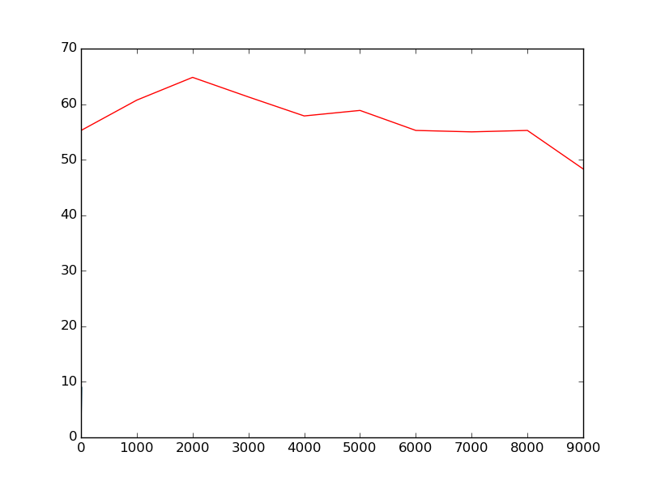
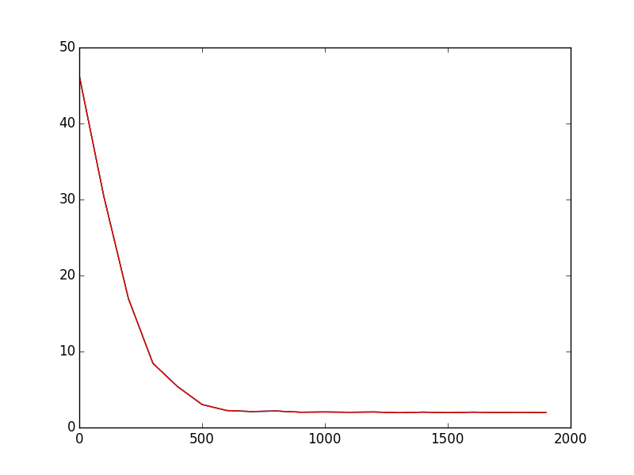
Need for tuning Hyper - parameters
Figure on the left has a high learning rate and the loss on the training set does not converge. When hyper-parameters like learning rate and weight-decay are tuned, the loss decreases rapidly as shown in the figure on the right.

Slide 48
Logging
It is use full to generate a log file where caffe dumps values like training loss, iteration number, norm of the weights of each blob, etc.
Parse log file to obtain useful hints about training process
- see caffe/tools/extra/parse_log.py
The above is a generic function. Custom log parsing can be created by you keeping the above as an example.

Slide 49
Log Parse Demo

Slide 50
Pycaffe Demo
pycaffe to visualize weights of a pre-trained model
Model Zoo has pretrained models of deep learning architectures like alexnet
Running a forward pass to
- predict class
Pycaffe documentation is sparse!
Looking at examples and reading code is inevitable if you want to make the best use of CAFFE!

Slide 51
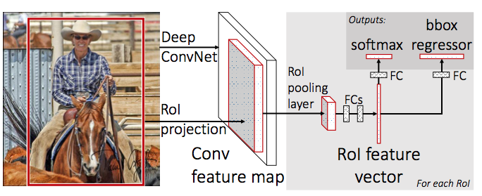
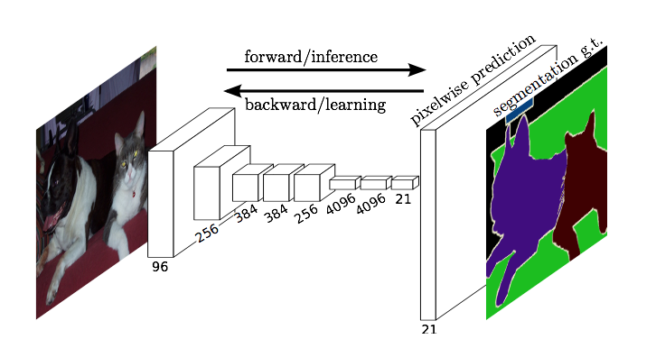

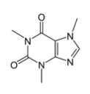
Up Next The Latest Roast
Detection
Pixelwise Prediction
Sequences
Framework Future

Slide 52
Resources
Many examples are provided in the caffe-master/examples directory
Ipython notebooks for common Neural network tasks like filter visualization, fine-tuning, etc
Caffe-tutorials
Caffe chat
Caffe-users group
Watch out for new features!

Slide 53
References
http://caffe.berkeleyvision.org/
DIY Deep Learning for Vision with Caffe

Slide 54
THANK YOU

