Slide 1
Dropout as a Bayesian Approximation
Yarin Gal and Zoubin Ghahramani
Presented by Qing Sun

Slide 2
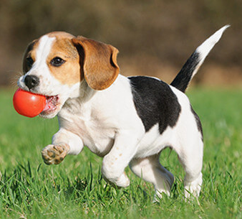

Why Care About Uncertainty
Cat or Dog?

Slide 3
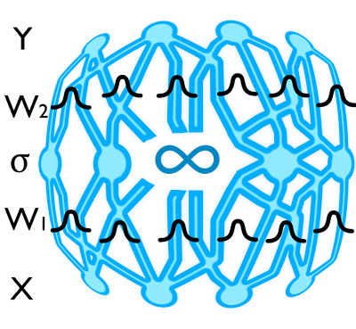
Bayesian Inference
Bayesian techniques
Posterior:
Prediction:
Challenge
Computational cost
More parameters to optimize

Slide 4
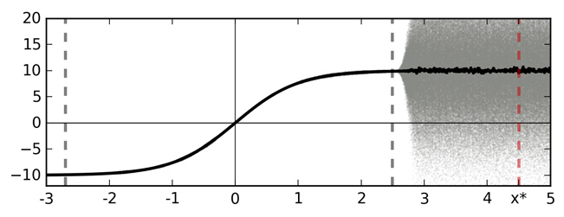
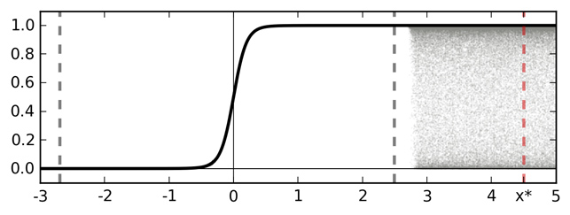
Softmax?
Softmax input as a function of data x
Softmax output as a function of data x

Slide 5
Softmax?
P(c|O): the density of points of category c at location O
Consider neighbors
Point estimate
Place a distribution over O
Softmax: Delta distribution centered at local minima
Softmax is not enough to reason uncertainty!
John S. Denker and Yann LeCun. Transforming Neural-Net Output Levels to Probability Distributions, 1995

Slide 6
Why Dropout works?
Ensemble, L2 regularizer, …
Variational approximation to Gaussian Process (GP)

Slide 7
Gaussian Process
A Gaussian Process is a generalization of a multivariate Gaussian distribution to infinitely many variables (i.e., function).
Definition: a Gaussian Process is a collection of random variables, any finite of which have (consistent) Gaussian distribution.
A Gaussian Process is fully specified by a mean function , and covariance function :

Slide 8
Prior and Posterior
Squared Exponential (SE) covariance function:

Slide 9
How Dropout works?
Demo.

Slide 10
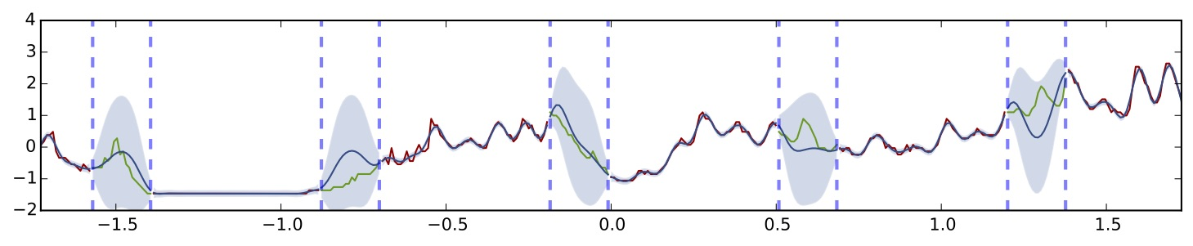
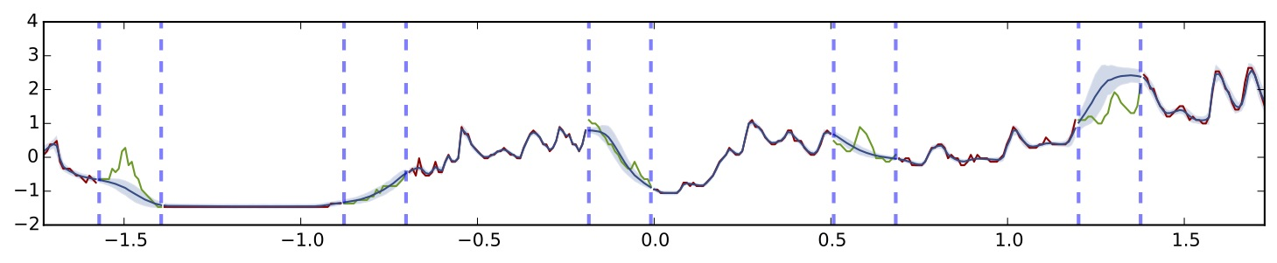
How Dropout works?
Gaussian process with SE covariance function
Dropout using uncertainty information (5 hidden layers, ReLU non-linearty)

Slide 11
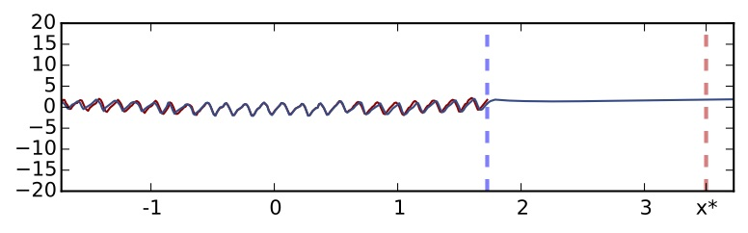
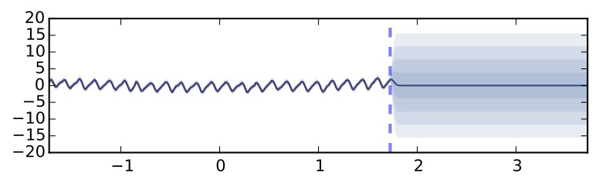
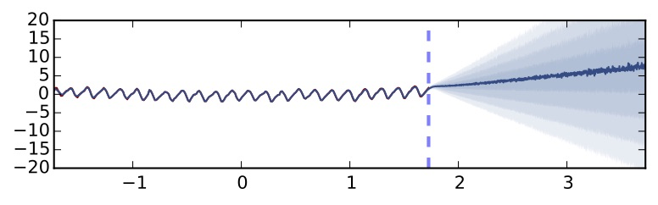
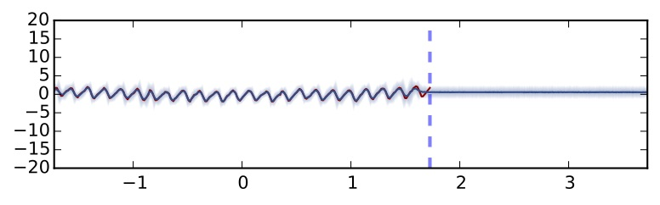
How Dropout works?
(a) Standard dropout
(b) Gaussian process with SE covariance function
(c) MC dropout ReLU non-linearity
(d) MC dropout TanH non-linearity
CO2 concentration dataset

Slide 12
Why Does It Make Sense?
Infinity wide (single hidden layer) NNs with distributions placed over
their weights converge to Gaussian Process [Neal’s thesis, 1995]
By the Central Limit Theorem, it will become Gaussian as N->∞, as long as
each term has finite variance. Since is bounded, this must be the case
The distribution will reach a limit if we make scale as
The joint distribution of the function at any number of input points converges to a
multivariate Gaussian, i.e., we have a Gaussian process.
The hidden-to-output weights go to zero as the number of hidden units goes to
infinity. [Please check Neal’s thesis for how they deal with this issue.]
R M Neal. Bayesian learning for neural networks. PhD thesis, University of Toronto, 1995.

Slide 13
Why Does It Make Sense?
Posterior distribution might have complex form
Define an “easier” variational distribution
Minimizing KL maximizing the log evidence lower bound
Fit training data
Similar to prior-> avoid over-fitting
Key problem: what kind of q(w) dropout provides?

Slide 14
Why Does It Make Sense?
Parameters: W₁, W₂ and b
No variance variable. Minimizing KL divergence from the full posterior
contains second-order moment
p₁=p₂=0, normal NN without dropout => no regularization on parameters
s->0, mixed Gaussian distribution approximates Bernoullis distribution

Slide 15
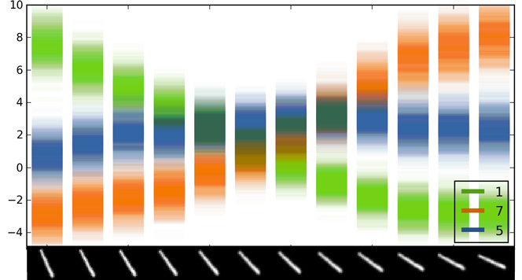
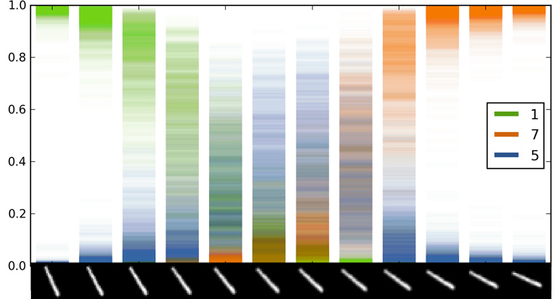
Experiments
(a) Softmax input scatter
(b) Softmax output scatter
MINIST digit classification

Slide 16
Experiments
Averaged test performance in RMSE and predictive log likelihood for variational inference (VI),
Probabilistic back-propagation (PBP) and dropout uncertainty (Dropout)

Slide 17
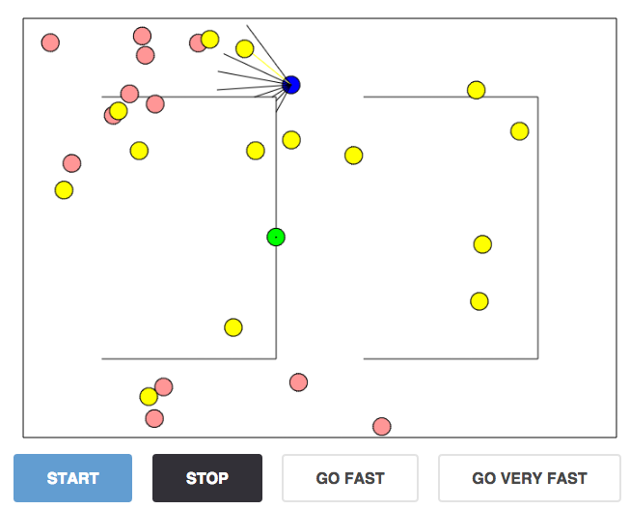
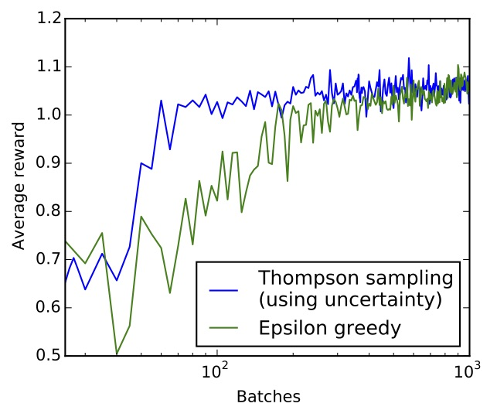
Experiments
(a) Agent in 2D world. Red circle: postive reward,
green circle: negative reward
(b) Log plot of average reward

Slide 18
The End!

