Slide 1
ECE6504: Deep Learning for Perception
Fall 2015
Presented by:
Jianwei Yang, Ph.D. Student
Stanislaw Antol, Ph.D. Student
Image credits: unless otherwise noted, images are from the corresponding papers
Notes:
Nowadays, unsupervised learning on images has draw much attentions from both academic and industrial fields. This is mainly triggered by the explosion of images we have. Without labels, these images cannot be directly feed into a supervised learning scheme. Instead, unsupervised learning is a good choice.

Slide 2
(Un)supervised Learning
Training data
Representation
Training labels
Magic box
Supervised Learning
Testing data
Predicted labels
Training data
Magic box
Small amount of training labels
Representation
Semi-Supervised Learning
Testing data
Predicted labels
Training data
Magic box
NO training labels
Representation
Unsupervised Learning
Testing data
Predicted labels
Notes:
Here, I would like to briefly list three machine learning pipelines. For the supervised learning, we are given a bunch of training data, and also labels , we want to learn some models that can fit well between them. In some other cases, we only have a small part of training labels for the training data. We can turn to semi-supervised learning. When we have no training labels for the data, we need unsupervised learning.

Slide 3
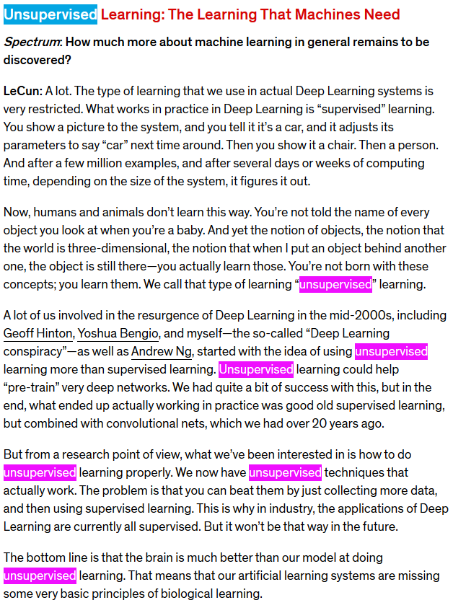
Left one: http://spectrum.ieee.org/automaton/robotics/artificial-intelligence/facebook-ai-director-yann-lecun-on-deep-learning#qaTopicFive
Right two: https://www.reddit.com/r/MachineLearning/comments/25lnbt/ama_yann_lecun
Notes:
Here, I posted some comments of Dr. Lecun Yann on supervised learning. He said much about unsupervised learning. At last, he talked about the main used of unsupervised learning,

Slide 4
Unsupervised Representation Learning
Sparse-Coding
Deep Belief Network
How about fabricating labels for training data?
and learning representations in discriminative way?
EM
auto-encoders
ICA
Training data
No training labels
Magic box
Fabricated training labels
PCA
Representation
Boltzmann machines
Manifold learning
Testing data
Predicted labels
……
[1] Bengio, Yoshua, Aaron Courville, and Pierre Vincent. "Representation learning: A review and new perspectives." Pattern Analysis and Machine Intelligence, IEEE Transactions on 35.8 (2013): 1798-1828.
Notes:
So what is the appropriate objectives for learning good representations? Considering that we have not labels, and thus we cannot formulate a loss function as conventional supervised learning. In this case, the learning procedure becomes much diverse. Traditionally, people used sparse coding, EM, PCA, ICA or some kind of manifold learning to capture the structure of the data. Then, because of the development of deep learning methods, more are focused on extracting deep representations using such as deep belief network, auto-encoders or Boltzmann machines and so on. In all this methods, they analyze directly and solely on the input X, but recently, some others attempted to fabricating labels

Slide 5
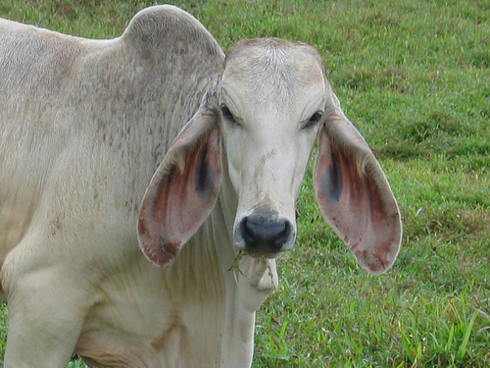
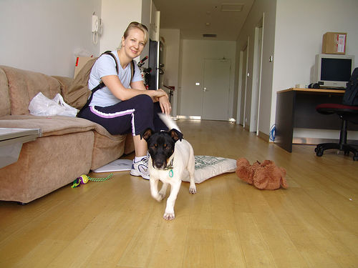
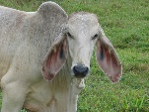
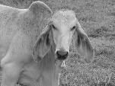
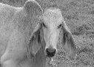
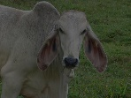
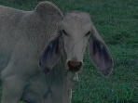
Fabricating Supervisory Signals
Spatial clues
1
2
3
4
5
6
7
8
Temporal clues
Ops, no labels at all!!!
Surrogate clues
Image source: Pascal VOC 2011

Slide 6
The papers involved
1. Doersch, Carl, Abhinav Gupta, and Alexei A. Efros. “Unsupervised Visual Representation Learning by Context Prediction.” ICCV 2015 oral & arXiv preprint arXiv:1505.05192 (2015).
2. Wang, Xiaolong, and Abhinav Gupta. "Unsupervised Learning of Visual Representations using Videos." ICCV 2015 & arXiv preprint arXiv:1505.00687 (2015).
3. Dosovitskiy, Alexey, Jost Tobias Springenberg, and Thomas Brox. "Unsupervised feature learning by augmenting single images." arXiv preprint arXiv:1312.5242 (2013).

Slide 7
1. Unsupervised Visual Representation Learning by Context Prediction: 1.1 Core idea
Context among words
Context among image patches
Unsupervised Visual Representation Learning
1
2
3
1
2
3
4
5
4
5
vector-1 vector-2 vector-3 vector-4
6
7
8
6
7
8
vector-1
vector-2
v0
v1
Top-left
v1
v2
v3
vector-1
vector-2
vector-3
v0
v2
Top
v4
v0
v5
vector-2
vector-3
vector-4
……
v6
v7
v8
vector-3
vector-4
v0
v8
Bottom-right
……

Slide 8
1. Unsupervised Visual Representation Learning by Context Prediction: 1.2 Learning paradigm
fc9 (8)
fc8 (4096)
1
fc7 (4096)
2
fc6 (4096)
fc6 (4096)
pool5 (3x3, 256, 2)
pool5 (3x3, 256, 2)
3
conv5 (3x3, 256, 1)
conv5 (3x3, 256, 1)
1
2
3
4
conv4 (3x3, 384, 1)
conv4 (3x3, 384, 1)
4
5
conv3 (3x3, 384, 1)
conv3 (3x3, 384, 1)
5
LRN2
LRN2
6
7
8
pool2 (3x3, 384, 2)
pool2 (3x3, 384, 2)
6
conv2 (5x5, 384, 1)
conv2 (5x5, 384, 1)
7
LRN1
LRN1
pool1 (3x3, 96, 2)
pool1 (3x3, 96, 2)
8
conv1 (11x11, 96, 4)
conv1 (11x11, 96, 4)
Notes:
Objective: learning a context prediction neural network.
Ultimate goal: this learning paradigm is to obtain representations such that patches which are visually similar across different images would be close in the embedding space.
(parameters shared across two sides)

Slide 9
1. Unsupervised Visual Representation Learning by Context Prediction: 1.3 Avoiding “trivial” solutions
Non-overlapping VS. overlapping
Chromatic aberration affects
Patch locations affects the separation of green and magenta
1) Color projection; 2) Color dropping;
1
2
3
1
2
3
4
5
4
5
6
7
8
6
7
8
Semantic info. VS. Low-level patterns
We do not need
Chromatic affects!!!
We need high-level semantics!!!
Right figure credit: Carl Doersch
Notes:
If there are overlapping between patches, it is very possible that the network will capture the low-level
How to recover layout?

Slide 10
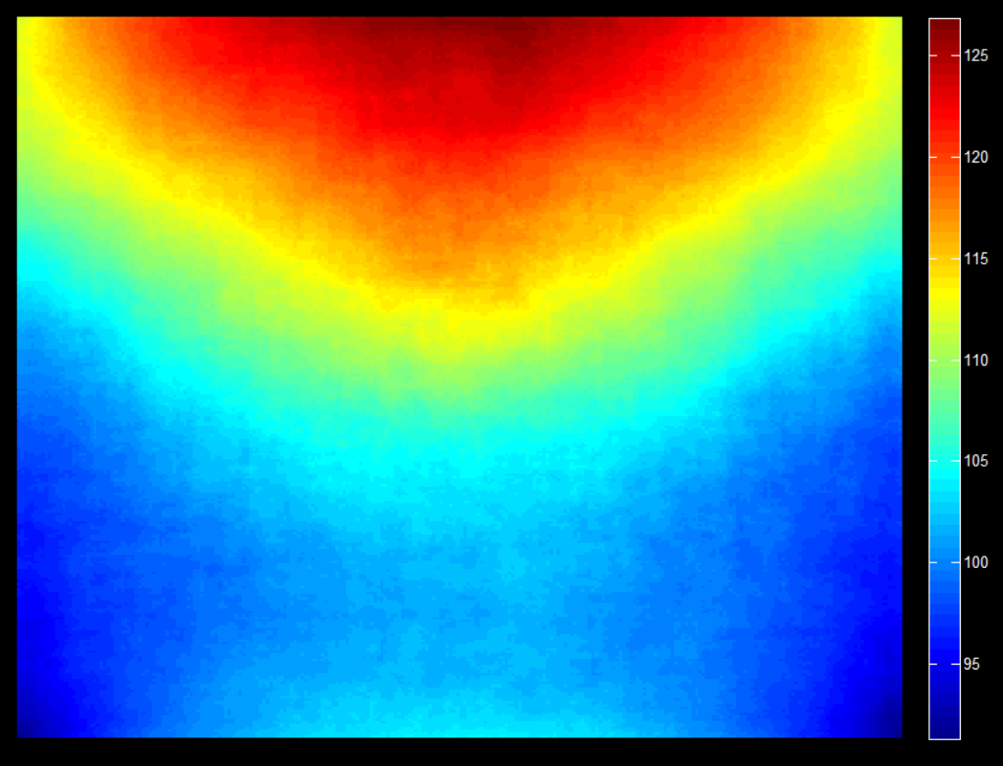
1. Unsupervised Visual Representation Learning by Context Prediction: 1.3.0 Chromatic aberration visualization
Mean of all images
Mean of all abs(g – (r + b))
Notes:
I am just curious about what the chromatic aberration looks like, so I myself conduct another experiments. I compute the separation of green and (red + blue)

Slide 11
1. Unsupervised Visual Representation Learning by Context Prediction: 1.4 Detailed setup
Setup | Values
Train data set | ImageNet 2012, 1.3M images
Patch size | 96x96
Gap between patches | 48 pixels
Jitter | ±7 pixels
Pre-processing | Mean subtraction; Color projecting or dropping; Down-sample and up-sampling
Training parameters | Values
momentum | 0.999
Notes:
If there are overlapping between patches, it is very possible that the network will capture the low-level

Slide 12
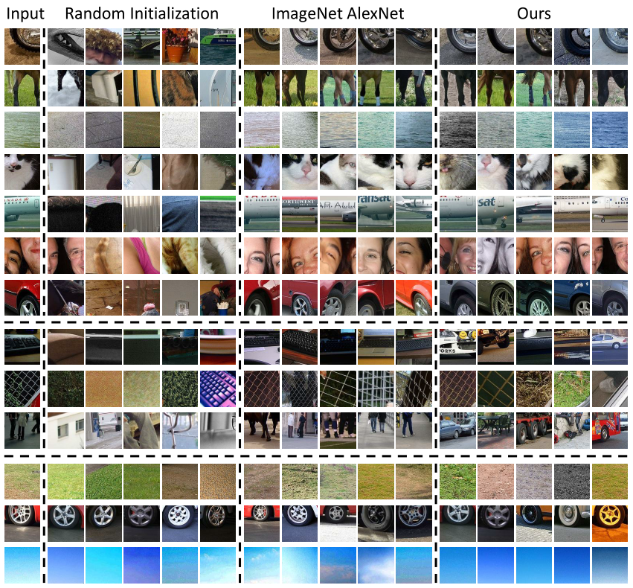
1. Unsupervised Visual Representation Learning by Context Prediction: 1.5 Experiment-Nearest Neighbors
The proposed
method performs
well
1. It seems that the proposed method
works well on objects, but worse on
Other patches;
2. In generally, alexnet outperforms other
Methods (from my point of view)
3. Random CNN also makes sense!!!
The AlexNet outperforms
All three work well
Notes:
If there are overlapping between patches, it is very possible that the network will capture the low-level

Slide 13
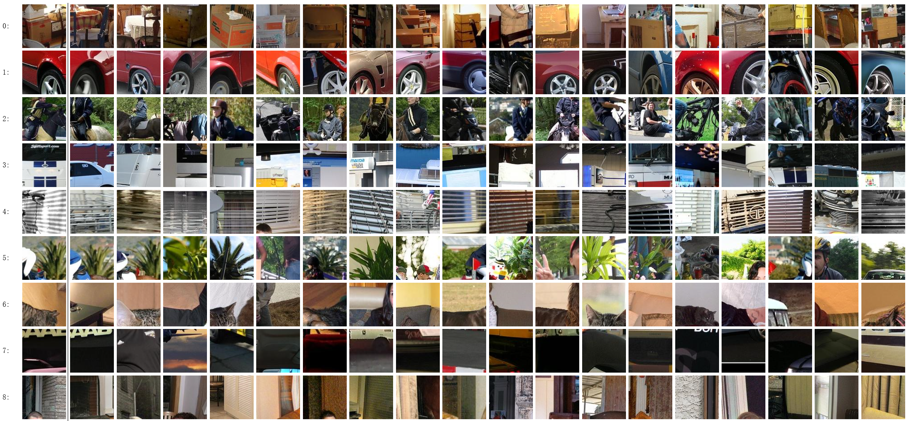
1. Unsupervised Visual Representation Learning by Context Prediction: 1.5 Experiment-Nearest Neighbors, more results
Notes:
If there are overlapping between patches, it is very possible that the network will capture the low-level

Slide 14
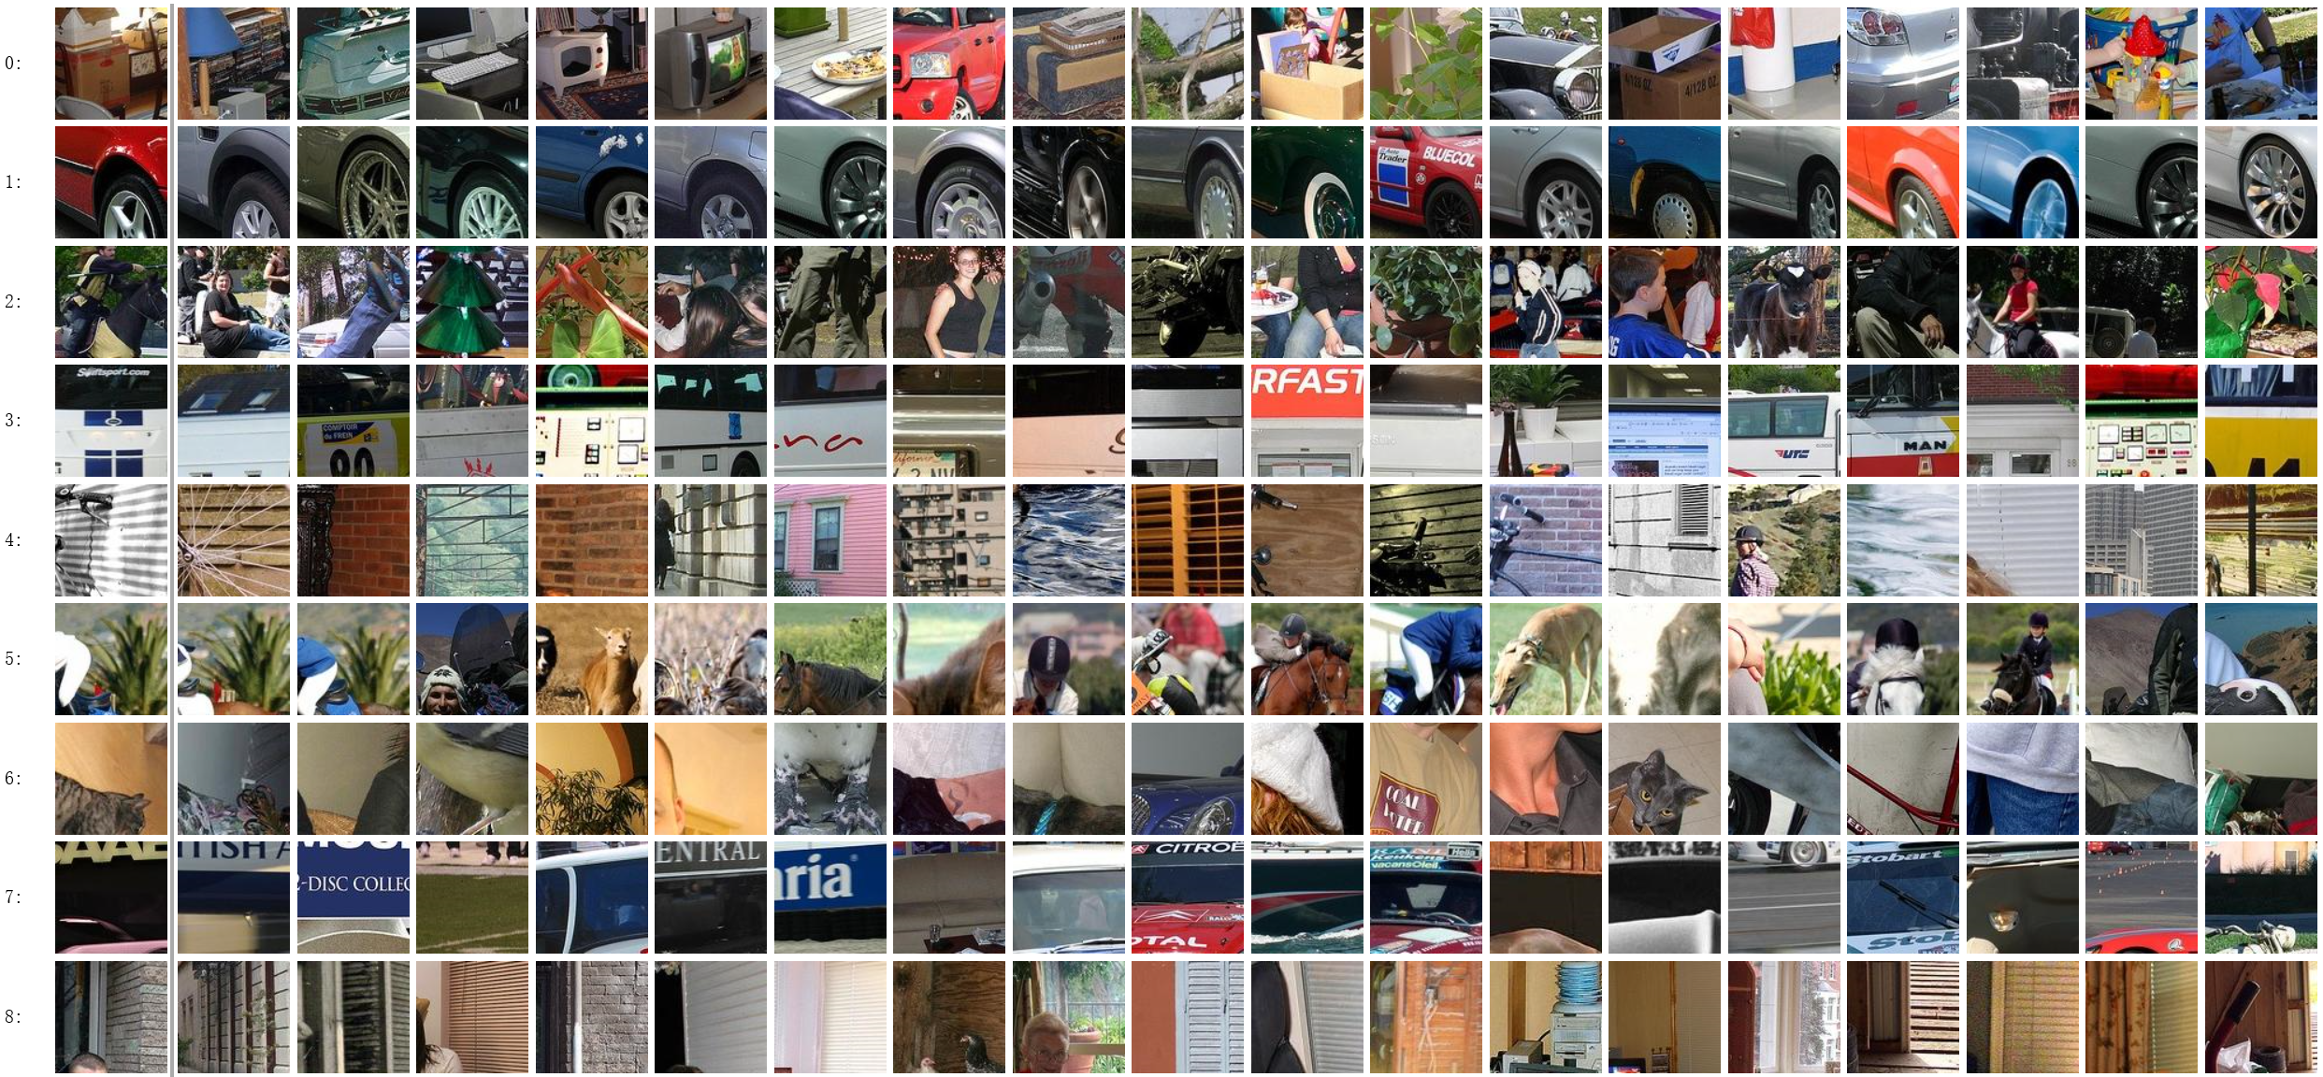
1. Unsupervised Visual Representation Learning by Context Prediction: 1.5 Experiment-Nearest Neighbors, more results
Notes:
If there are overlapping between patches, it is very possible that the network will capture the low-level

Slide 15
1. Unsupervised Visual Representation Learning by Context Prediction: 1.5 Experiment-Object detection
RCNN Revisiting
Figure credit: Ross Girshick
Notes:
If there are overlapping between patches, it is very possible that the network will capture the low-level

Slide 16
1. Unsupervised Visual Representation Learning by Context Prediction: 1.5 Experiment-Object detection
fc8 (21)
3x3
fc7 (4096)
7x7
pool6 (3x3, 1024, 2)
3x3
fc6 (4096)
7x7
conv6b (1x1, 1024, 1)
6x6
pool5 (3x3, 256, 2)
conv6 (3x3, 4096, 1)
RCNN
7x7
6x6
conv5 (3x3, 256, 1)
pool5 (3x3, 256, 2)
This paper
conv4 (3x3, 384, 1)
6x6
conv5 (3x3, 256, 1)
conv3 (3x3, 384, 1)
conv4 (3x3, 384, 1)
6x6
LRN2
conv3 (3x3, 384, 1)
12x12
pool2 (3x3, 384, 2)
LRN2
conv2 (5x5, 384, 1)
14x14
96 x 96
pool2 (3x3, 384, 2)
LRN1
14x14
12x12
conv2 (5x5, 384, 1)
227 x 227
pool1 (3x3, 96, 2)
LRN1
24x24
28x28
conv1 (11x11, 96, 4)
pool1 (3x3, 96, 2)
56x56
conv1 (11x11, 96, 4)
96 x 96
227 x 227
Notes:
If there are overlapping between patches, it is very possible that the network will capture the low-level

Slide 17
1. Unsupervised Visual Representation Learning by Context Prediction: 1.5 Experiment-Object detection results
Scratch means directly training on VOC training set without any pre-training
Notes:
If there are overlapping between patches, it is very possible that the network will capture the low-level

Slide 18
1. Unsupervised Visual Representation Learning by Context Prediction: 1.6 Experiment-Visual Data Mining
1
2
3
4
1
2
3
4
Step 1: find top 100 images which have strongest matches for all four patches;
Step 2: determine whether four patches geometrically verified
Step 3: rank constellations by counting the number of geometrically verified matches
Notes:
If there are overlapping between patches, it is very possible that the network will capture the low-level

Slide 19
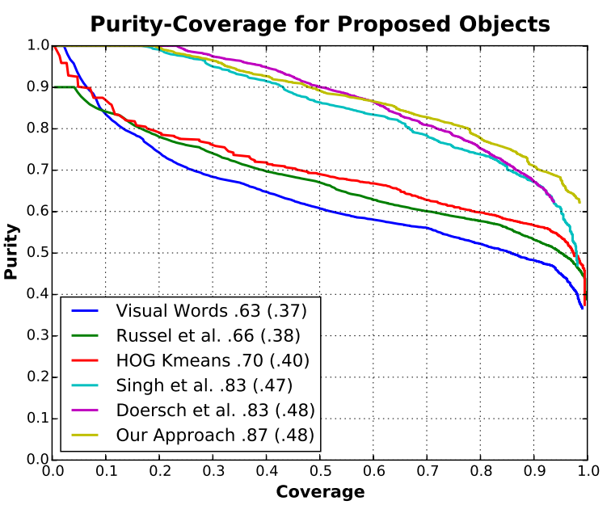
1. Unsupervised Visual Representation Learning by Context Prediction: 1.6 Experiment-Visual Data Mining-Quantitative results
Dataset | Subset of Pascal VOC 2007
With respect to AUC, the proposed
method is the best
[1] C. Doersch, A. Gupta, and A. A. Efros. Context as supervisory sig-nal: Discovering objects with predictable context. In ECCV. 2014.
Notes:
If there are overlapping between patches, it is very possible that the network will capture the low-level

Slide 20
1. Unsupervised Visual Representation Learning by Context Prediction: 1.7 Experiment-Relative Prediction Task
Dataset | 500 images from Pascal VOC 2007
Patch pairs | 256 pairs from each image
Classification accuracy | 38.4%
Classification accuracy on training set | 39.5%
Classification accuracy on validation set | 40.3%
Dataset | 500 images from Pascal VOC 2007
Patch pairs | Patches pairs from object regions (no occluded, no truncated, simple)
Classification accuracy | 39.2%
Classification accuracy on cars | 45.6%
Notes:
If there are overlapping between patches, it is very possible that the network will capture the low-level

Slide 21
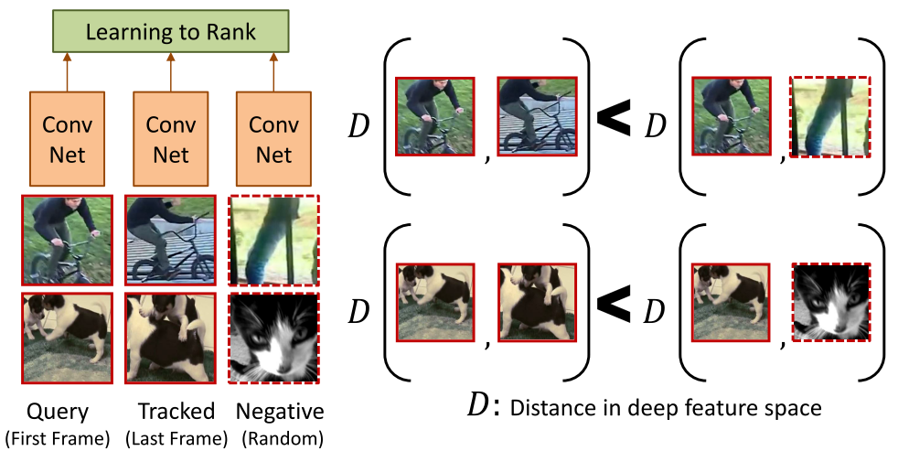
2. Unsupervised Learning of Visual Representations using Videos 2.1 Core idea
Tracking for correspondence
Triplet loss for representation learning
Then:
How to mine patches?
How to tracking patches?
How to select negative patches?
How to formulate the objective function?

Slide 22
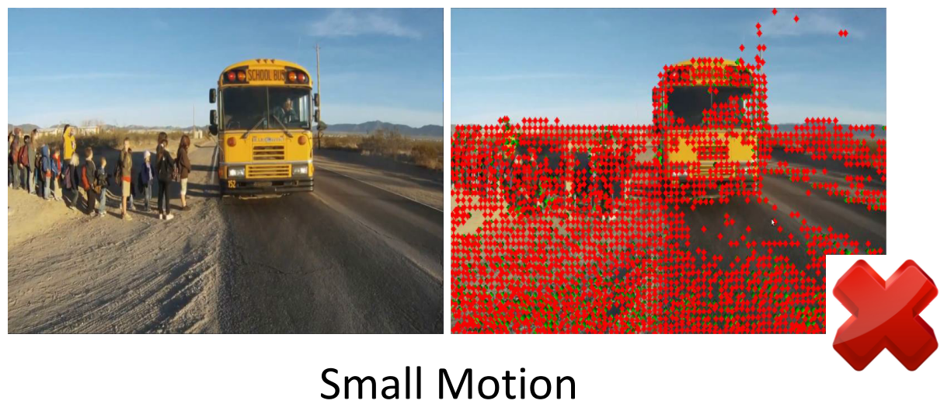
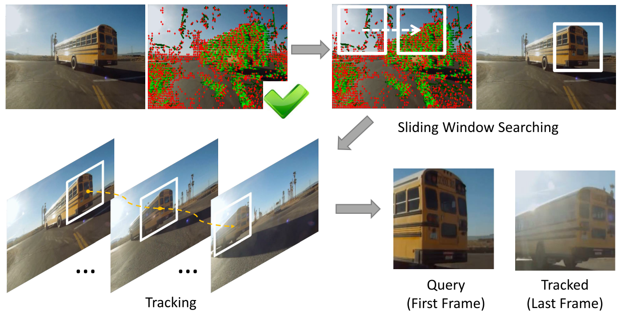
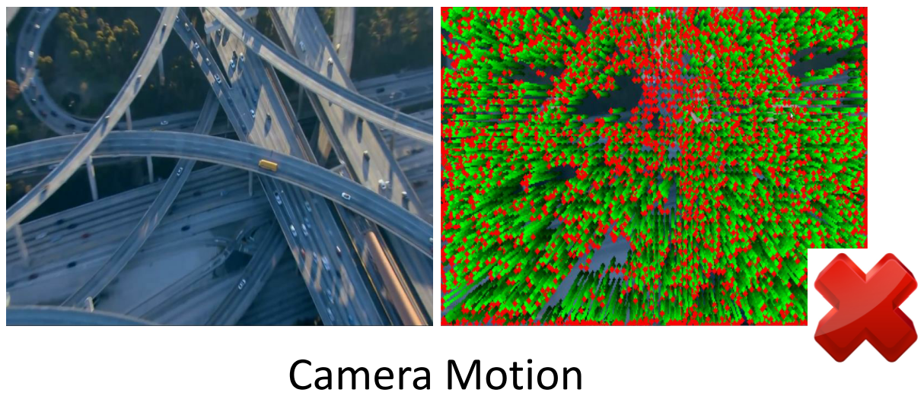
2. Unsupervised Learning of Visual Representations using Videos 2.1 Mining and tracking patches
SURF [1] + IDT [2]
Sliding Window + KCF [3]
Find 227x227 bounding box with most number of moving points
Tracking on bounding box
Moving points: motion > 0.5 pixels
Noisy frame: <25% moving points
Camera motion frame: >75% moving points
[1] H. Bay, T. Tuytelaars, and L. V. Gool. Surf: Speeded up robust features. In ECCV, 2006.
[2] H. Wang and C. Schmid. Action recognition with improved trajectories. In ICCV, 2013.
[3] J. F. Henriques, R. Caseiro, P. Martins, and J. Batista. High-speed tracking with kernelized correlation ﬁlters. TPAMI, 2015.

Slide 23
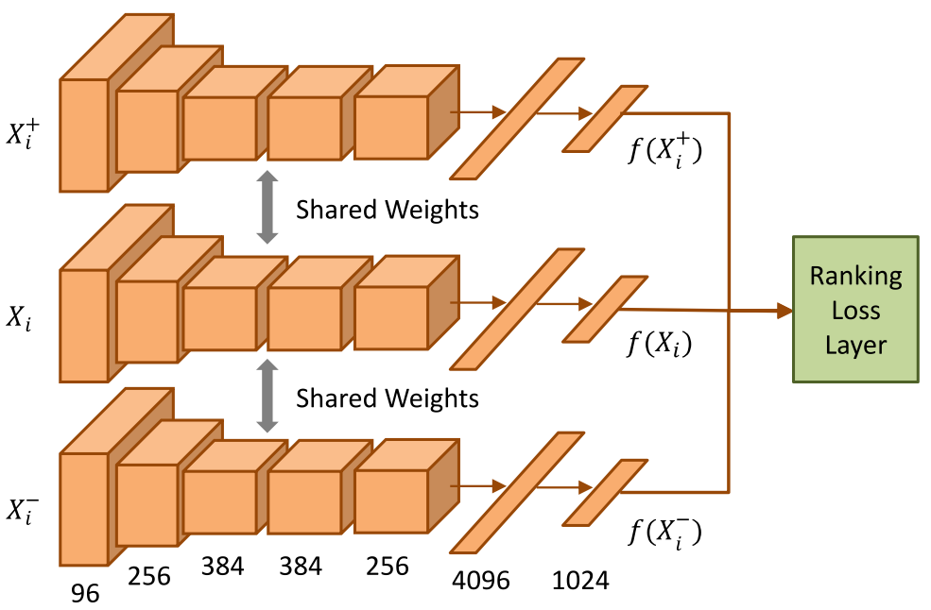
2. Unsupervised Learning of Visual Representations using Videos 2.2 Learning from videos-architecture
1. Metric: cosine distance
2. Loss function:
3. Objective function:

Slide 24
2. Unsupervised Learning of Visual Representations using Videos 2.2 Learning from videos-hard negative mining
For each positive pair, random select K=4
negative pairs with highest losses.
Random selection first
2. Hard negative sampling then
After 10 epochs, select K=4 negative pairs
with highest losses.

Slide 25
2. Unsupervised Learning of Visual Representations using Videos 2.3 Iterating the fine-tuning
Unsupervised training
Fine-tune on target domain
1. Improve the performance
2. Converge after two iterations

Slide 26
2. Unsupervised Learning of Visual Representations using Videos 2.4 Implementation details
Setups | value
#videos | 100k
#patches (discovered by proposed alg.) | 8M
Three different networks | 1.5M, 5M, 8M
Batch size | 100
Learning rate | 0.001
Training procedure | Random negative sampling first 150k iter. Hard negative sampling after that
Learning rate policy | For 1.5M patches, a factor of 10 at every 80k iterations, finish at 240k iterations For 5M, 8M, a factor of 10 at every 120 iterations, finish at 350k

Slide 27
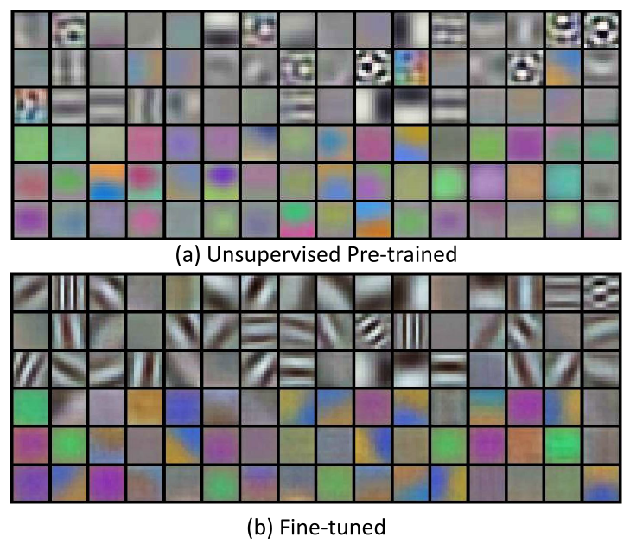
2. Unsupervised Learning of Visual Representations using Videos 2.5 Experimental results-filters
Filters training on unlabeled videos
Filters after fine-tuning on Pascal VOC 2012

Slide 28
2. Unsupervised Learning of Visual Representations using Videos 2.5 Experimental results-object retrieval
Configuration | Retrieval rate(top-20)
Pool5 + cosine metric | 40%
ELDA + HOG[1] | 24%
AlexNet + Random | 19%
AlexNet + Supervised training | 62%

Slide 29
2. Unsupervised Learning of Visual Representations using Videos 2.5 Experimental results-object detection
Dataset | Pascal VOC 2012
Set 4 fine-tuning | Trainval set (11540 images)
Set 4 testing | Test set (10991 images)
Leaning rate | 0.01, reduced by a factor of 10 each 80k iterations, finished at 200k iterations

Slide 30
2. Unsupervised Learning of Visual Representations using Videos 2.5 Experimental results-object detection
Dataset | Pascal VOC 2012
Set 4 fine-tuning | Trainval set (11540 images)
Set 4 testing | Test set (10991 images)
Leaning rate | 0.01, reduced by a factor of 10 each 80k iterations, finished at 200k iterations

Slide 31
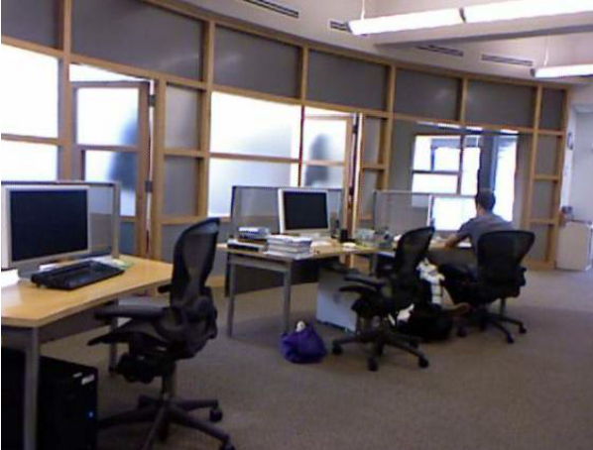
2. Unsupervised Learning of Visual Representations using Videos 2.5 Experimental results-surface normal estimation
Estimating surface normal from a RGB image
Dataset | NYUv2 dataset
Set 4 fine-tuning | Train set (795 images)
Set 4 testing | Test set (654 images)
Leaning rate | 1e-6, finished at 10k iterations
Output map: 20 x 20
#Surface normal categories: 20

Slide 32
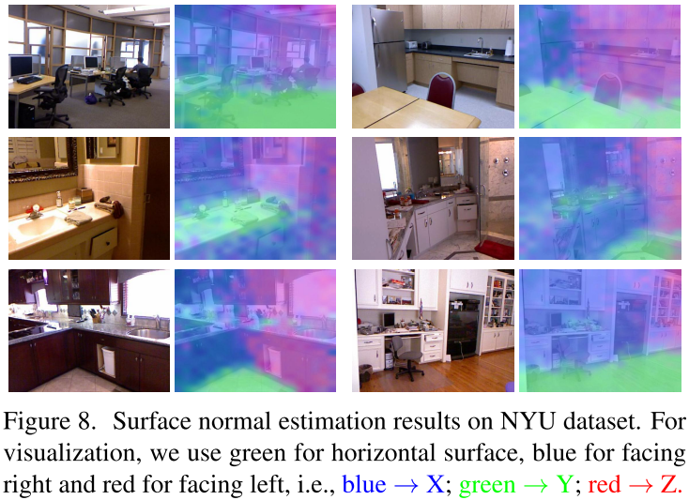
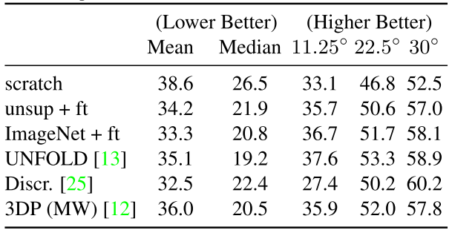
2. Unsupervised Learning of Visual Representations using Videos 2.5 Experimental results-object detection

Slide 33
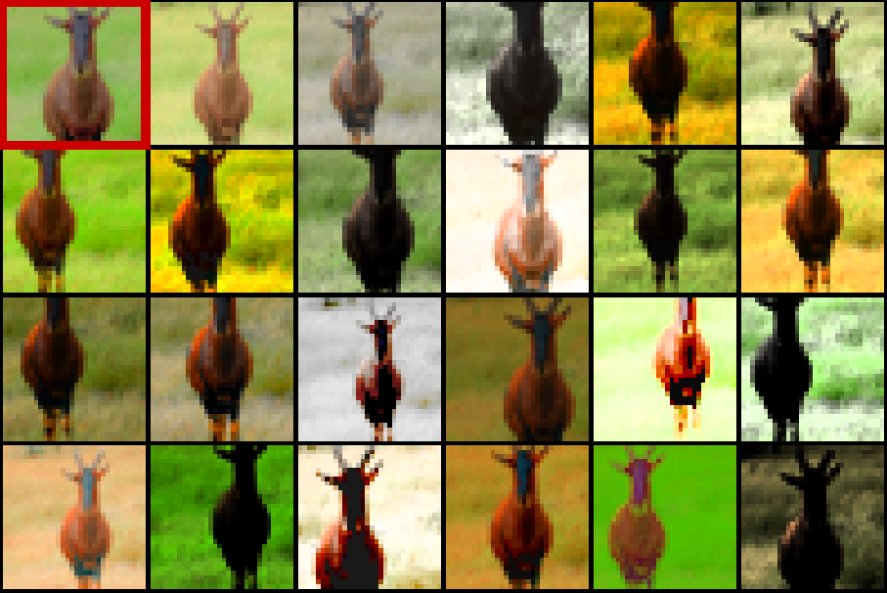
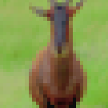
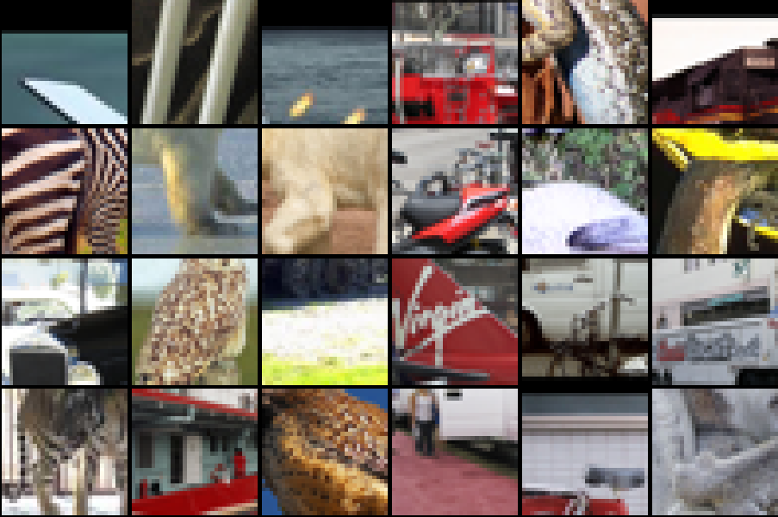
3. Unsupervised Feature Learning by Augmenting Single Images 3.1 Core Idea
Surrogate class
Sample patch
Transformations
w/ randomness
Other classes (patches + their surrogates)
Samples patches from dataset
Create surrogate classes by transforming patches
Train NN to discriminate between surrogate classes
Use NN as feature extractor (i.e., transfer learning)

Slide 34
3. Unsupervised Feature Learning by Augmenting Single Images 3.2 Patch Sampling
Get dataset of unlabeled images
Distribution should be similar to eventual classification images
Sample 32x32 patches
Different images
Different scales
Different positions
Must have sufficient gradient energy (avoid uniformly colored ones)

Slide 35
3. Unsupervised Feature Learning by Augmenting Single Images 3.3 Transformations
Sample patch
Transformations
w/ randomness
Each random transformation is a composition of:
x/y translation up to 0.25x(32,32)
Image scaling between 0.7x-1.4x
Adjust color
Get patch’s principal components
Select scaling factor between 0.5-2 for each component
Apply same transformation to all pixels in patch
Change saturation and value (i.e., in HSV space) by raising value to a power between 0.25-4
Only pre-processing is subtracting training set mean pixel value (at each pixel)

Slide 36
3. Unsupervised Feature Learning by Augmenting Single Images 3.4 Training the Neural Network Feature Extractor
Use AlexNet code to train a ConvNet with standard classification loss
2 convolution layers
64 filters
5x5 size
2x2 max pooling layers
1 fully connected layer
128 neurons
Added dropout
1 softmax layer
Pre-training sometimes necessary
Large number classes -> poor training
Pre-train w/ a smaller subset of classes
Add remaining classes back in

Slide 37
3. Unsupervised Feature Learning by Augmenting Single Images 3.4 Testing the Features
Feature extraction (learned on unlabeled dataset)
Convert NN to fully convolutional one (i.e., without softmax)
Create a 3-layer spatial pyramid of these features
Now have fixed-size, multi-scale feature representation
Train SVM using the train set of the labeled dataset
Parameters via cross-val
Test SVM on test set of the labeled dataset

Slide 38
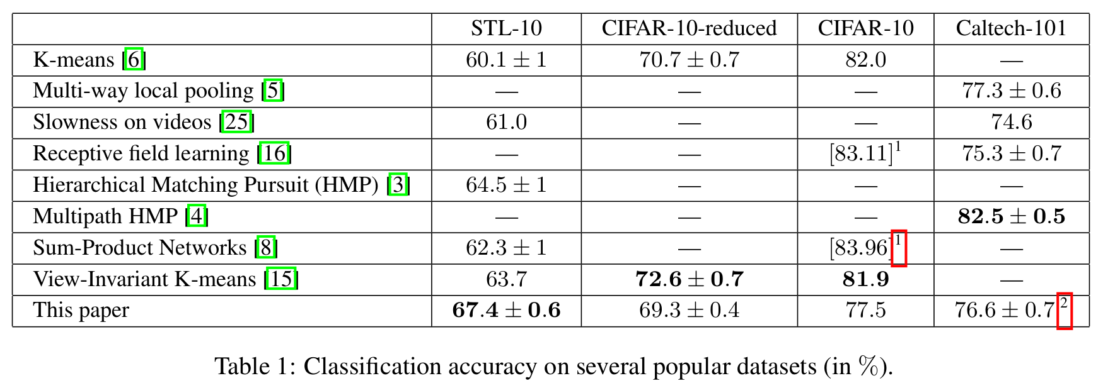
3. Unsupervised Feature Learning by Augmenting Single Images 3.5 Results
Competitive or better than other unsupervised methods

Slide 39
Unsupervised Learning with Receptive Fields

Slide 40
The Papers Involved
4. Quoc Le, Marc'Aurelio Ranzato, Rajat Monga, Matthieu Devin, Kai Chen, Greg Corrado, Jeff Dean, and Andrew Ng. “Building high-level features using large scale unsupervised learning.” ICML 2012 & arXiv preprint arXiv:1112.6209v5 (2012).
5. Bruno A . Olshausen and David J. Field. “Sparse coding with an overcomplete basis set: A strategy employed by V1?” Vision Research 1997.

Slide 41
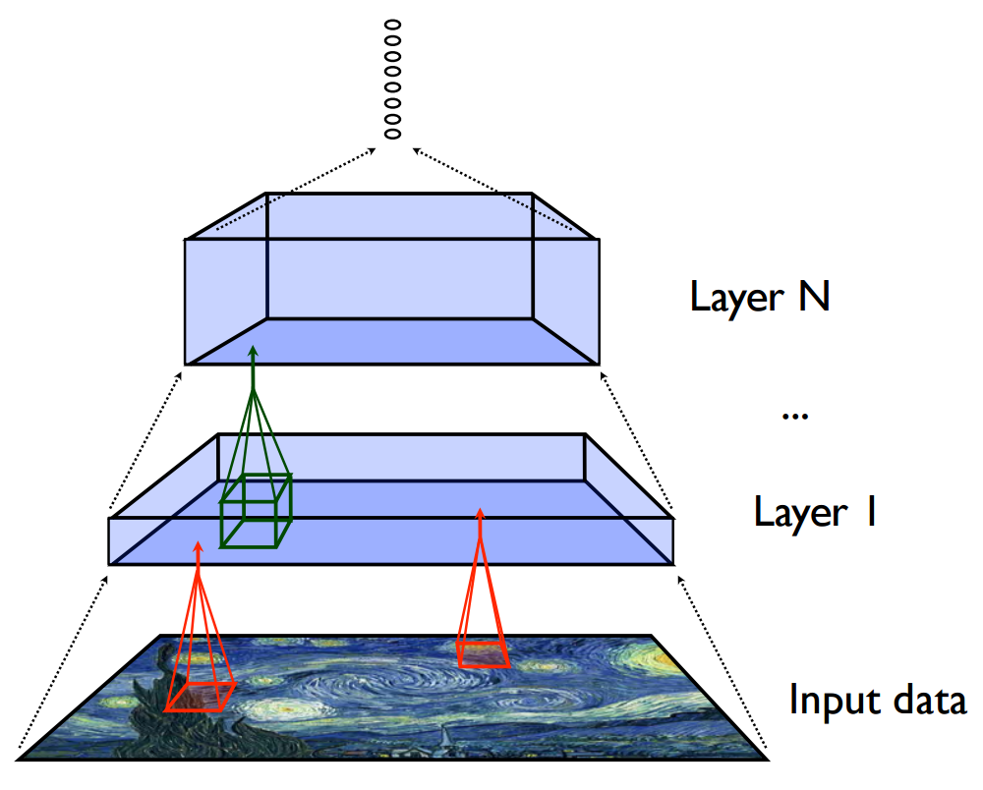
4. Building High-level Features Using Large Scale Unsupervised Learning 4.1 Core Idea
Responds most to:
Lots of unsupervised data exists (e.g., YouTube videos)
Given the right architecture (and sufficient computation), parts of the architecture will become high-level detectors (e.g., faces)
Image credit: http://beckman.cs.wisc.edu/invited-talks/dean.pdf
Notes:
http://beckman.cs.wisc.edu/invited-talks/dean.pdf

Slide 42
4. Building High-level Features Using Large Scale Unsupervised Learning 4.2 Training Data
10 million frames from YouTube videos
No details on how they sample videos
200x200 pixel images

Slide 43
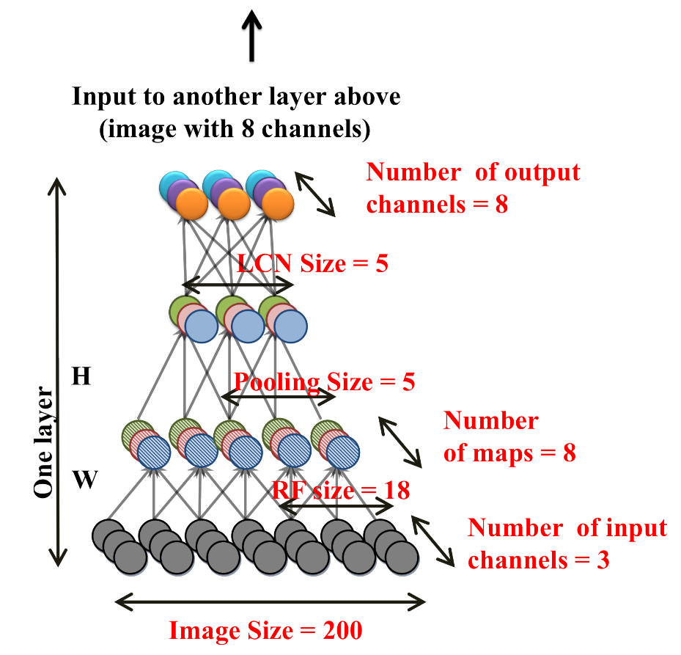
4. Building High-level Features Using Large Scale Unsupervised Learning 4.3 Architecture
Local Receptive Fields
Like CNN filters, but NOT shared across image locations
Can learn non-translation invariances
Each field looks at all channels
18x18x3/18x18x8/18x18x8
Overlapping
Likely, since 1st output map too small
3x

Slide 44
4. Building High-level Features Using Large Scale Unsupervised Learning 4.3 Architecture
Pooling Layer
L2-pooling
5x5 region on each map/channel
Overlapping
stride = ?
3x
Image credit: http://cs.nyu.edu/~fergus/tutorials/deep_learning_cvpr12/tutorial_p2_nnets_ranzato_short.pdf
Notes:
http://cs.nyu.edu/~fergus/tutorials/deep_learning_cvpr12/tutorial_p2_nnets_ranzato_short.pdf

Slide 45
4. Building High-level Features Using Large Scale Unsupervised Learning 4.3 Architecture
Local Contrast Normalization Layer
Subtracting and divisive normalization
5x5 region on each map/channel
Overlapping
stride = 1?
3x
Image credit: http://cs.nyu.edu/~fergus/tutorials/deep_learning_cvpr12/tutorial_p2_nnets_ranzato_short.pdf
Notes:
http://cs.nyu.edu/~fergus/tutorials/deep_learning_cvpr12/tutorial_p2_nnets_ranzato_short.pdf

Slide 46
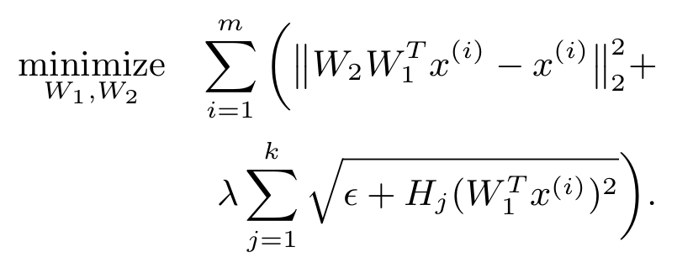
4. Building High-level Features Using Large Scale Unsupervised Learning 4.4 Training
Tries to reconstruct image
Optimization
W₁ is encoding/extraction matrix
W₂ is decoding/reconstruction matrix
H_{j} is “the vector of weights of the j-th pooling unit”
Minimize the equation on the right for sum of each of 3 layer groups
I.e., 3 sets of W₁ and W₂
Lots of code/work to distribute learning using asynchronous SGD and model parallelism
Training on 1k machines took 3 days
Called DistBelief
Google just released TensorFlow, its successor
Encourages sparsity and
“tries to group similar features”

Slide 47
4. Building High-level Features Using Large Scale Unsupervised Learning 4.5 Experiments on Human Faces/Human Bodies/Cat Faces
“Test” set
37,000 “test” images with equal positive:negative ratios
13,026/13,026/10,000 faces from Labeled Faces in the Wild / bodies from Keller et al. 2009 person dataset / cat faces from Zhang et al. 2008 dataset
23,974/23,974/18,409 from ImageNet as not-faces
Find the best neuron as detector (at best threshold)

Slide 48
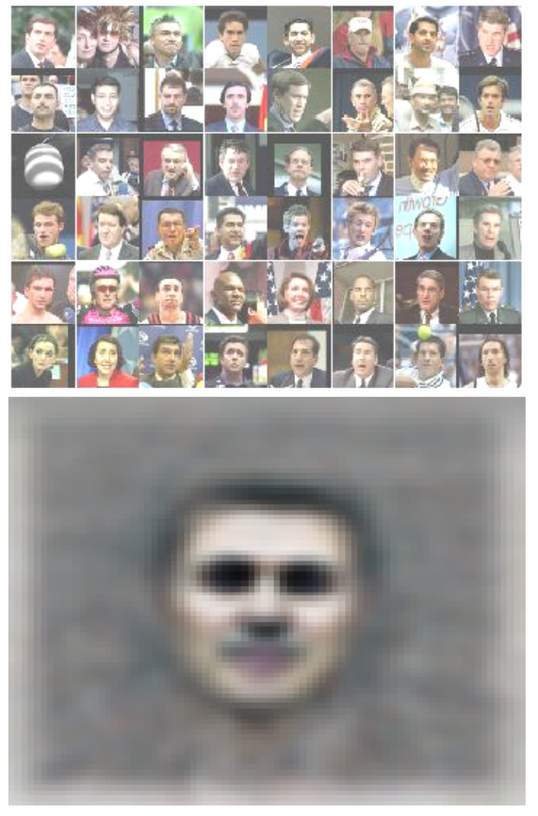
4. Building High-level Features Using Large Scale Unsupervised Learning 4.5 Experiments on Human Faces/Human Bodies/Cat Faces
Most activated images for faces
“Optimal” body image
“Optimal” face image
“Optimal” cat face image

Slide 49
4. Building High-level Features Using Large Scale Unsupervised Learning 4.6 Experiments on ImageNet Recognition
Add a logistic repressor classifier on top of their existing network and train using ImageNet protocol
Unsupervised pre-training gives them substantial classification accuracy boost

Slide 50
5. Sparse Coding with an Overcomplete Basis Set 5.1 Core Idea
Then-recent (circa 1996) neuroscience suggested that the first stage of the mammalian visual cortex (V1) have neurons that, like wavelets, are:
localized
oriented
bandpass
These properties, along with sparsity and linear superposition, can be shown to produce basis function qualitatively similar to the V1 neurons
Use a fairly simple neural network to learn a set of basis vectors to reconstruct images

Slide 51
5. Sparse Coding with an Overcomplete Basis Set 5.2 Image Representation with Basis Vectors
They will assume the image is represented as:
{φ_{i}} is some set of (to be learnt) basis vectors
Importantly, they want {φ_{i}} to be “overcomplete”
More basis vectors than needed for reconstruction
They will not be orthogonal and therefore multiple bases can be used to reconstruct part of the image
W/o overcompleteness, activations (i.e., a_{i}) will drastically change, even for slight translations in input
1.0*φ₁
0.3*φ₂
Image Credit: http://www.yorku.ca/eye/squarwav.gif

Slide 52
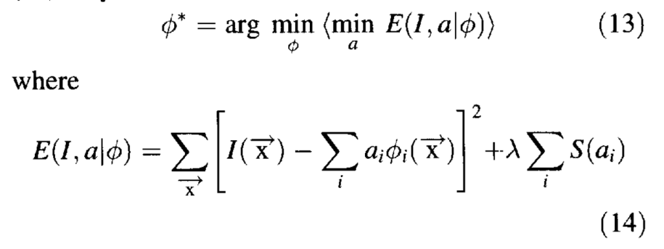
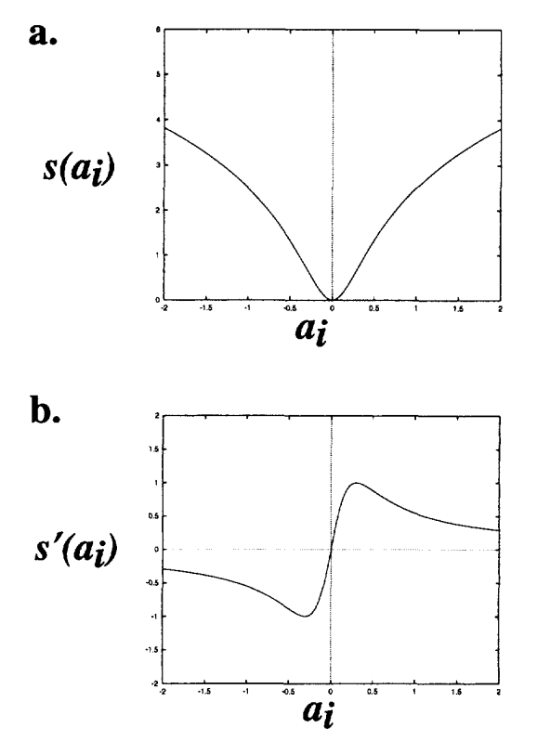
5. Sparse Coding with an Overcomplete Basis Set 5.3 Minimizing the Objective Function
Reconstruction error
Activation sparsity
First, loop this until equilibrium reached:

Slide 53
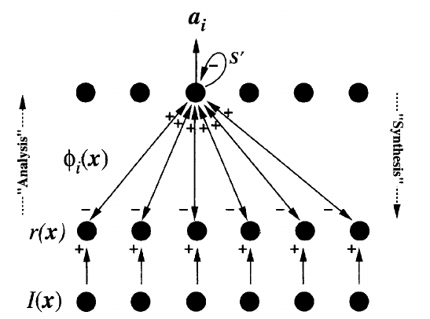
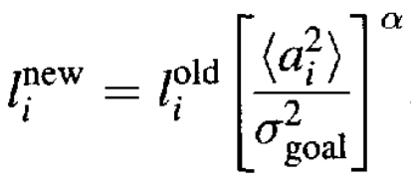
5. Sparse Coding with an Overcomplete Basis Set 5.3 Minimizing the Objective Function
Neural Network View
Then, update basis vectors via gradient:
)
while trying to force norm of basis vectors to have some target variance among their activations via:

Slide 54
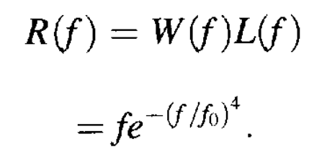
5. Sparse Coding with an Overcomplete Basis Set 5.4 Training Details
Dataset
10 512x512 images of natural scenes (e.g., trees, rocks)
Pre-processed by filtering (in frequency domain):
Randomly sample 12x12 patches
Skip ones with 4 pixels of border
Drop ones that have less than 10% of average variance
Little gradient info, same computation time
Neural Network
{φ_{i}} initialized randomly, then {a_{i}} initialized by them
Loop for {a_{i}} for sparsity
Batch size of 100 patches used to update {φ_{i}}

Slide 55
5. Sparse Coding with an Overcomplete Basis Set 5.5 Experimental Results
Learned Basis Vectors

Slide 56
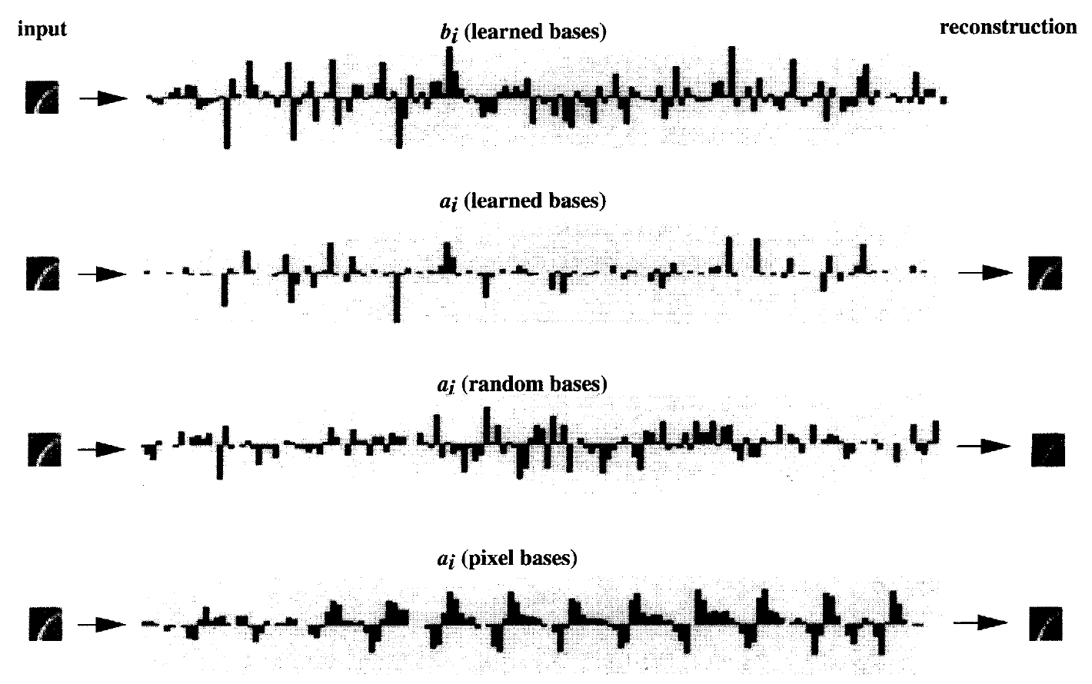
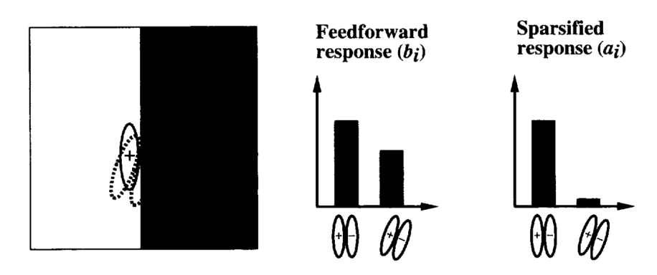
5. Sparse Coding with an Overcomplete Basis Set 5.5 Experimental Results
Making activations sparse:
forcing sparsity
learning bases

