Slide 1

ECE 6504:
Deep Learning for Perception
Dhruv Batra
Virginia Tech

Slide 2
What is this class about?
Some of the most exciting developments in
Machine Learning,
Vision, NLP, Speech, Robotics
& AI in general
in the last decade!

Slide 3
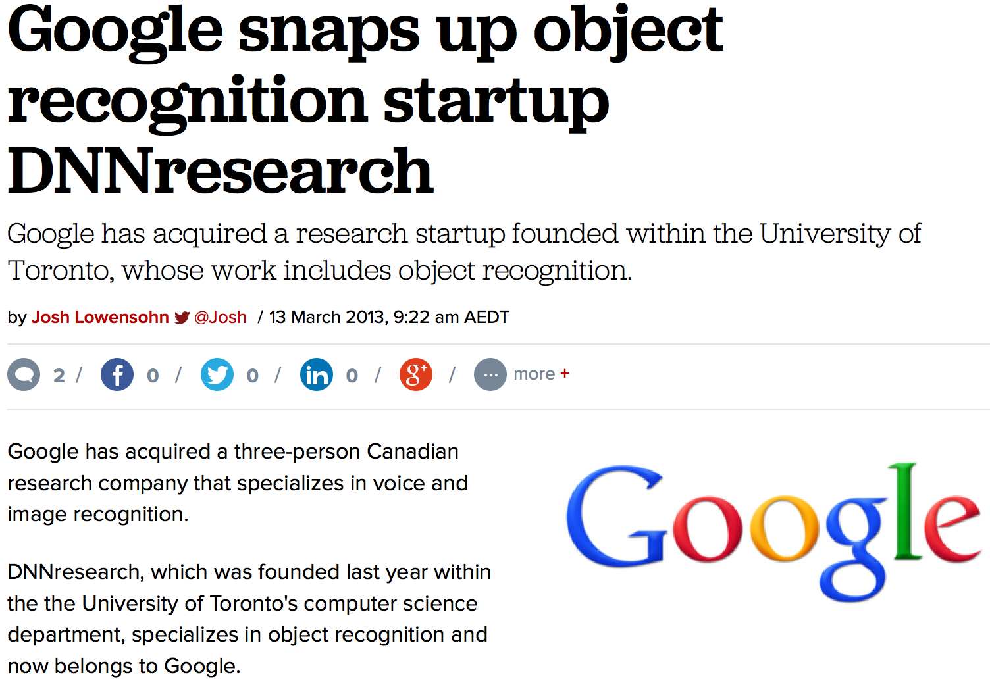
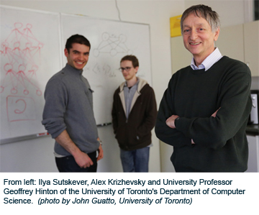
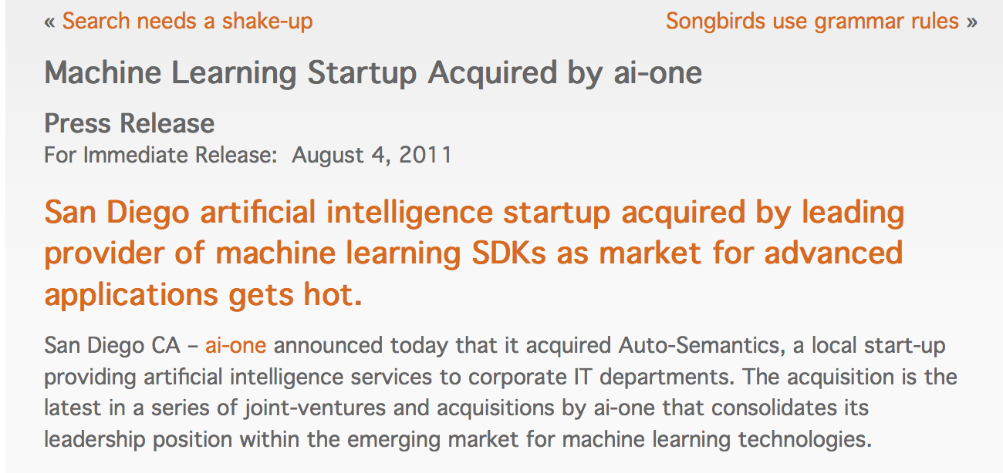
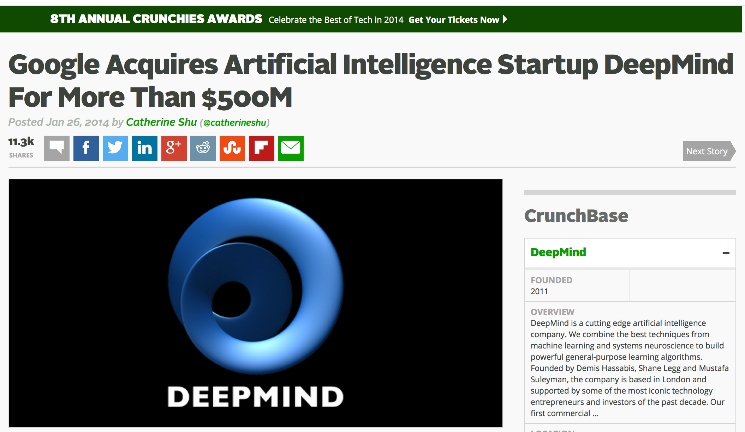
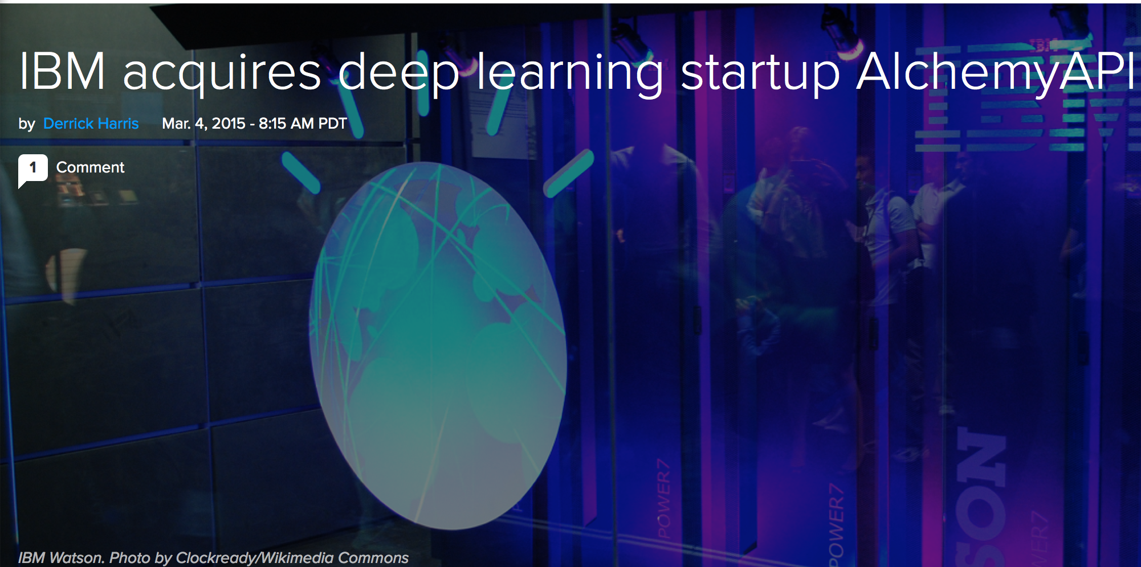
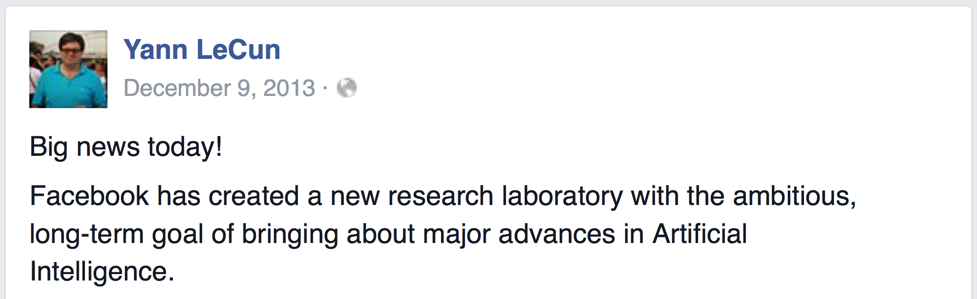
Acquisitions

Slide 4
First Caveat
This is an ADVANCED Machine Learning class
  This should NOT be your first introduction to ML
  You will need a formal class; not just self-reading/coursera
  If you took ECE 4984/5984 @VT, you’re in the right place
  If you took an equivalent class elsewhere, see list of topics taught in ECE 4984/5984 to be sure.

Slide 5
Topics Covered in Intro to ML
Basics of Statistical Learning
    Loss function, MLE, MAP, Bayesian estimation, bias-variance tradeoff, overfitting, regularization, cross-validation
Supervised Learning
    Nearest Neighbour, Naïve Bayes, Logistic Regression, Support Vector Machines, Kernels, Neural Networks, Decision Trees
    Ensemble Methods: Bagging, Boosting
Unsupervised Learning
    Clustering: k-means, Gaussian mixture models, EM
    Dimensionality reduction: PCA, SVD, LDA
Perception
    Applications to Vision, Natural Language Processing

Slide 6
What is Machine Learning?
“the acquisition of knowledge or skills through experience, study, or by being taught.”

Slide 7
What is Machine Learning?
[Arthur Samuel, 1959]
  Field of study that gives computers
  the ability to learn without being explicitly programmed
[Kevin Murphy] algorithms that
  automatically detect patterns in data
  use the uncovered patterns to predict future data or other outcomes of interest
[Tom Mitchell] algorithms that
  improve their performance (P)
  at some task (T)
  with experience (E)

Slide 8
What is Machine Learning?
Machine
Learning
Data
Understanding

Slide 9
ML in a Nutshell
Tens of thousands of machine learning algorithms
  Hundreds new every year
Decades of ML research oversimplified:
  All of Machine Learning:
  Learn a mapping from input to output f: X → Y
    e.g. X: emails, Y: {spam, notspam}
Slide Credit: Pedro Domingos

Slide 10
Types of Learning
Supervised learning
  Training data includes desired outputs
Unsupervised learning
  Training data does not include desired outputs
Weakly or Semi-supervised learning
  Training data includes a few desired outputs
Reinforcement learning
  Rewards from sequence of actions

Slide 11
Tasks
Supervised Learning
x
Classification
y
Discrete
x
Regression
y
Continuous
Unsupervised Learning
x
Clustering
y
Discrete ID
x
Dimensionality
Reduction
y
Continuous

Slide 12
Supervised Learning
Classification
x
Classification
y
Discrete

Slide 13

Vision: Image Classification
http://cloudcv.org/classify/
x
y
scuba diver
tiger shark
hammerhead
shark

Slide 14
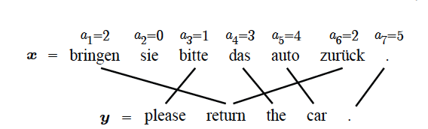
NLP: Machine Translation
Figure Credit: Kevin Gimpel

Slide 15
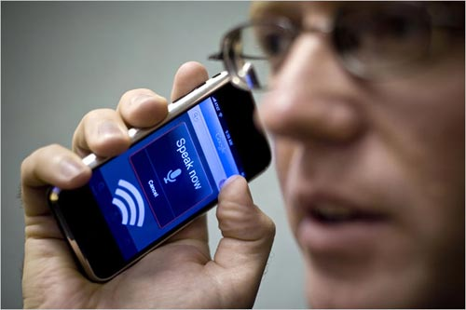
Speech: Speech2Text
Slide Credit: Carlos Guestrin

Slide 16
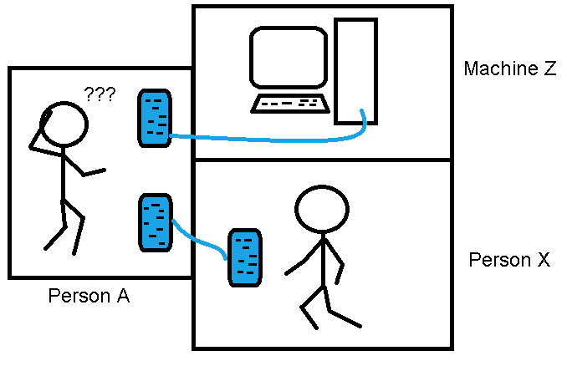
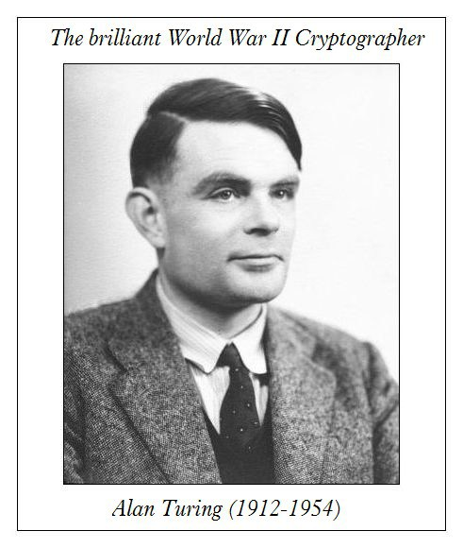
AI: Turing Test
“Can machines think”
Q: Please write me a sonnet on the subject of the Forth Bridge.
A: Count me out on this one. I never could write poetry.
Q: Add 34957 to 70764.
A: (Pause about 30 seconds and then give as answer) 105621.

Slide 17
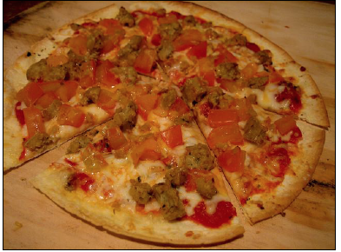
AI: Visual Turing Test
Q: How many slices
of pizza are there?
A: 6
x
y
http://cloudcv.org/vqa/

Slide 18
Supervised Learning
Input: x (images, text, emails…)
Output: y (spam or non-spam…)
(Unknown) Target Function
  f: X → Y (the “true” mapping / reality)
Data
  (x₁,y₁), (x₂,y₂), …, (x_{N},y_{N})
Model / Hypothesis Class
  g: X → Y
  y = g(x) = sign(w^{T}x)
Learning = Search in hypothesis space
  Find best g in model class.

Slide 19
Synonyms
Representation Learning
Deep (Machine) Learning
Deep Neural Networks
Deep Unsupervised Learning
Simply: Deep Learning

Slide 20
So what is Deep (Machine) Learning?
A few different ideas:
(Hierarchical) Compositionality
  Cascade of non-linear transformations
  Multiple layers of representations
End-to-End Learning
  Learning (goal-driven) representations
  Learning to feature extraction
Distributed Representations
  No single neuron “encodes” everything
  Groups of neurons work together

Slide 21
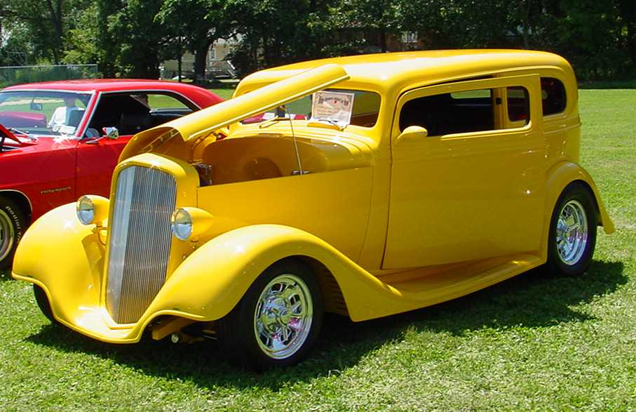
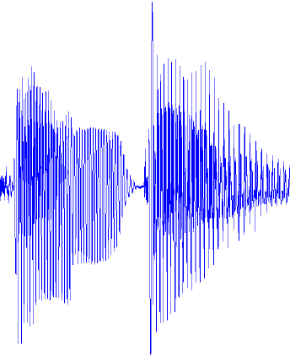
Traditional Machine Learning
VISION
hand-crafted
features
SIFT/HOG
your favorite
classifier
“car”
fixed
learned
SPEECH
hand-crafted
features
MFCC
your favorite
classifier
\ˈd ē p\
fixed
learned
NLP
hand-crafted
features
Bag-of-words
your favorite
classifier
This burrito place
is yummy and fun!
“+”
fixed
learned
Slide Credit: Marc'Aurelio Ranzato, Yann LeCun

Slide 22
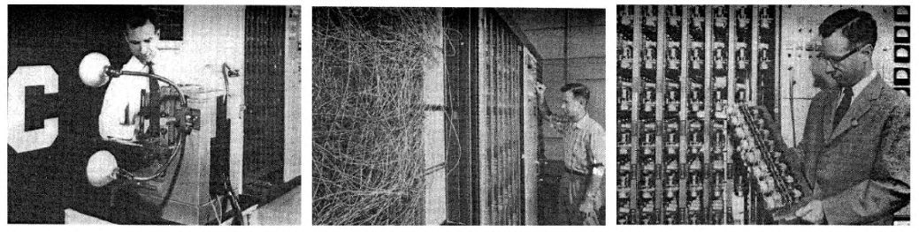
It’s an old paradigm
The first learning machine:
the Perceptron
  Built at Cornell in 1960
The Perceptron was a linear classifier on top of a simple feature extractor
The vast majority of practical applications of ML today use glorified linear classifiers or glorified template matching.
Designing a feature extractor requires considerable efforts by experts.
A
Feature Extractor
W_{i}
Slide Credit: Marc'Aurelio Ranzato, Yann LeCun

Slide 23
Hierarchical Compositionality
VISION
pixels
edge
texton
motif
part
object
SPEECH
sample
spectral band
formant
motif
phone
word
NLP
character
word
NP/VP/..
clause
sentence
story
Slide Credit: Marc'Aurelio Ranzato, Yann LeCun

Slide 24
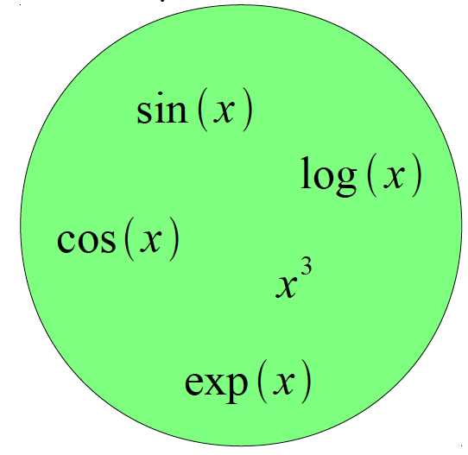
Building A Complicated Function
Given a library of simple functions
Compose into a
complicate function
Slide Credit: Marc'Aurelio Ranzato, Yann LeCun

Slide 25
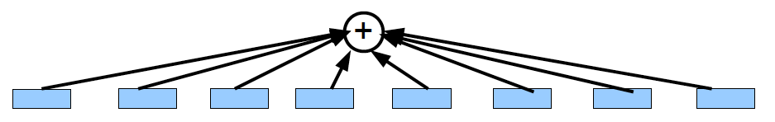
Building A Complicated Function
Given a library of simple functions
Idea 1: Linear Combinations
Boosting
Kernels
…
Compose into a
complicate function
Slide Credit: Marc'Aurelio Ranzato, Yann LeCun

Slide 26
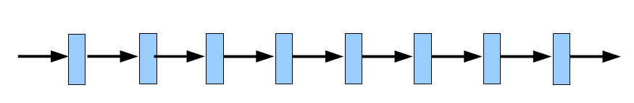
Building A Complicated Function
Given a library of simple functions
Idea 2: Compositions
Deep Learning
Grammar models
Scattering transforms…
Compose into a
complicate function
Slide Credit: Marc'Aurelio Ranzato, Yann LeCun

Slide 27
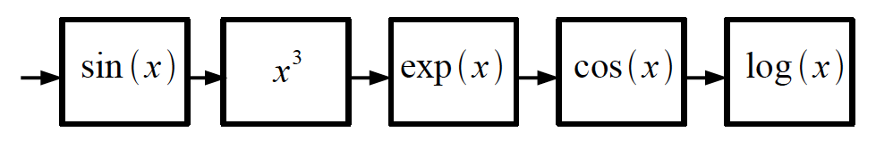
Building A Complicated Function
Given a library of simple functions
Idea 2: Compositions
Deep Learning
Grammar models
Scattering transforms…
Compose into a
complicate function
Slide Credit: Marc'Aurelio Ranzato, Yann LeCun

Slide 28
Deep Learning = Hierarchical Compositionality
“car”
Slide Credit: Marc'Aurelio Ranzato, Yann LeCun

Slide 29
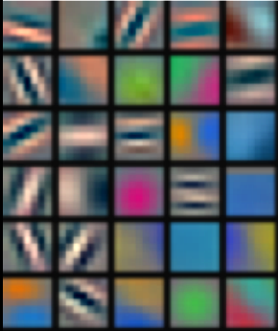
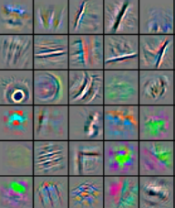
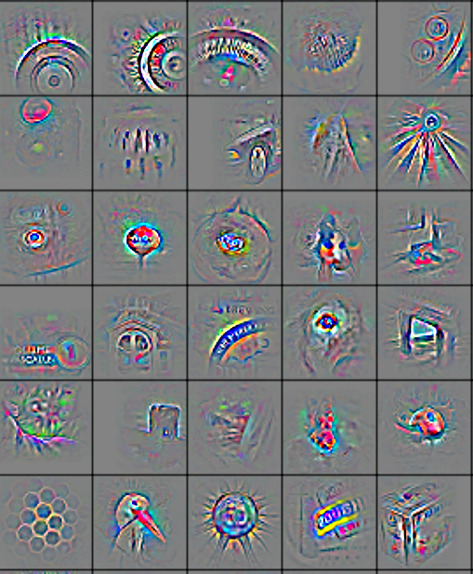
Deep Learning = Hierarchical Compositionality
Low-Level
Feature
Mid-Level
Feature
High-Level
Feature
Trainable
Classifier
“car”
Feature visualization of convolutional net trained on ImageNet from [Zeiler & Fergus 2013]
Slide Credit: Marc'Aurelio Ranzato, Yann LeCun

Slide 30
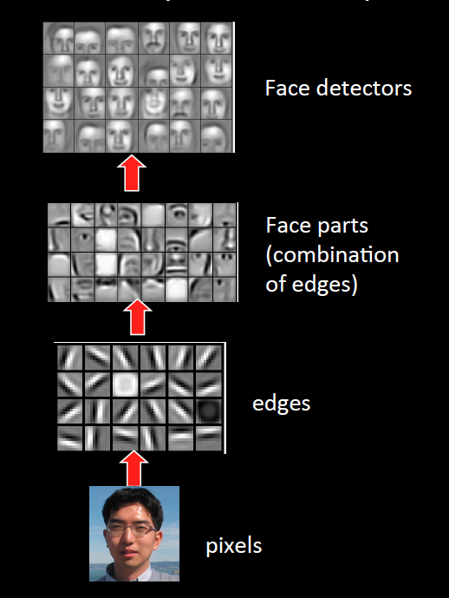
Sparse DBNs
[Lee et al. ICML ‘09]
Figure courtesy: Quoc Le

Slide 31
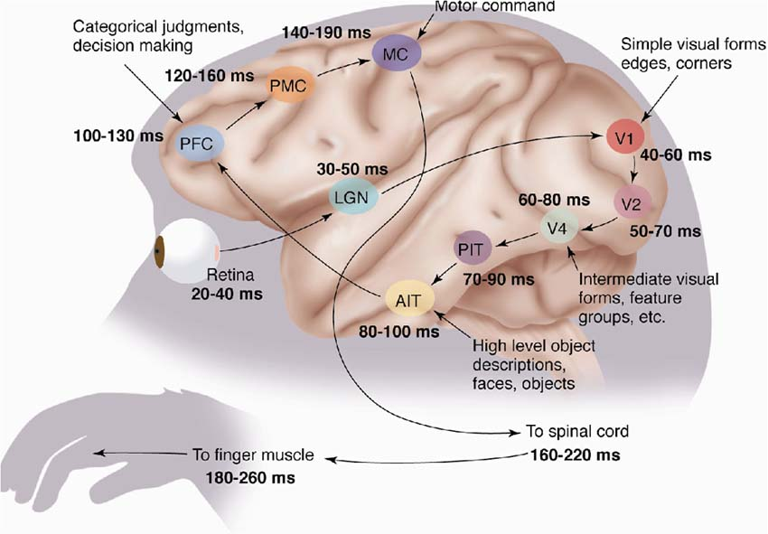
The Mammalian Visual Cortex is Hierarchical
The ventral (recognition) pathway in the visual cortex
[picture from Simon Thorpe]
Slide Credit: Marc'Aurelio Ranzato, Yann LeCun

Slide 32
So what is Deep (Machine) Learning?
A few different ideas:
(Hierarchical) Compositionality
  Cascade of non-linear transformations
  Multiple layers of representations
End-to-End Learning
  Learning (goal-driven) representations
  Learning to feature extraction
Distributed Representations
  No single neuron “encodes” everything
  Groups of neurons work together

Slide 33
Traditional Machine Learning
VISION
hand-crafted
features
SIFT/HOG
your favorite
classifier
“car”
fixed
learned
SPEECH
hand-crafted
features
MFCC
your favorite
classifier
\ˈd ē p\
fixed
learned
NLP
hand-crafted
features
Bag-of-words
your favorite
classifier
This burrito place
is yummy and fun!
“+”
fixed
learned
Slide Credit: Marc'Aurelio Ranzato, Yann LeCun

Slide 34
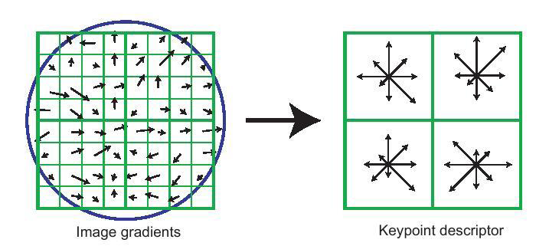
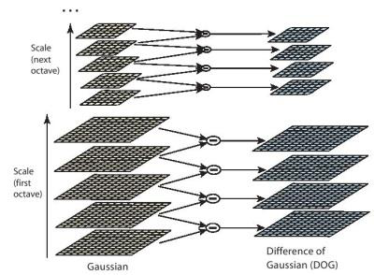
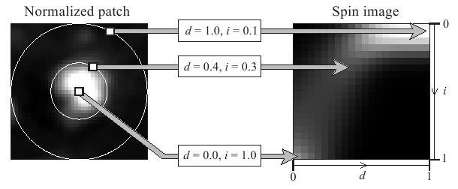
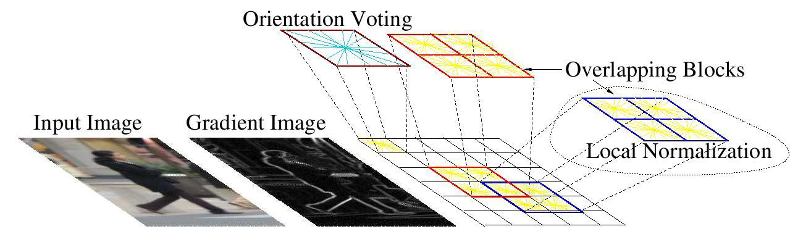
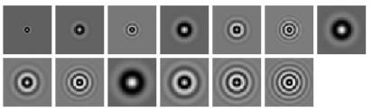
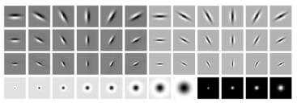
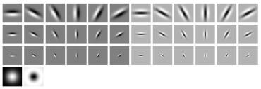
Feature Engineering
SIFT
Spin Images
HoG
Textons
and many many more….

Slide 35
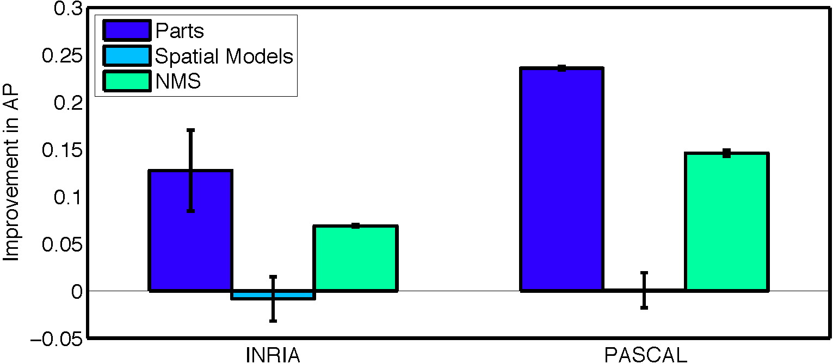
What are the current bottlenecks?
Ablation studies on DPM [Parikh & Zitnick, CVPR10]
  Replace every “part” in the model with a human
Key takeaway: “parts” or features are the most important!

Slide 36
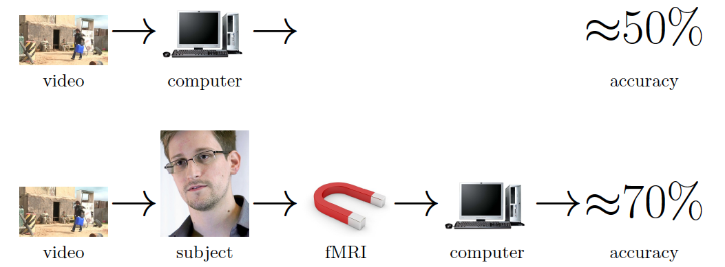
Seeing is worse than believing
[Barbu et al. ECCV14]
Image Credit: Barbu et al.

Slide 37
Traditional Machine Learning (more accurately)
“Learned”
VISION
SIFT/HOG
K-Means/
pooling
classifier
“car”
fixed
unsupervised
supervised
SPEECH
MFCC
Mixture of
Gaussians
classifier
\ˈd ē p\
fixed
unsupervised
supervised
NLP
Parse Tree
Syntactic
n-grams
classifier
This burrito place
is yummy and fun!
“+”
fixed
unsupervised
supervised
Slide Credit: Marc'Aurelio Ranzato, Yann LeCun

Slide 38
Deep Learning = End-to-End Learning
“Learned”
VISION
SIFT/HOG
K-Means/
pooling
classifier
“car”
fixed
unsupervised
supervised
SPEECH
MFCC
Mixture of
Gaussians
classifier
\ˈd ē p\
fixed
unsupervised
supervised
NLP
Parse Tree
Syntactic
n-grams
classifier
This burrito place
is yummy and fun!
“+”
fixed
unsupervised
supervised
Slide Credit: Marc'Aurelio Ranzato, Yann LeCun

Slide 39
Deep Learning = End-to-End Learning
A hierarchy of trainable feature transforms
  Each module transforms its input representation into a higher-level one.
  High-level features are more global and more invariant
  Low-level features are shared among categories
Trainable
Feature-Transform /
Classifier
Trainable
Feature-Transform /
Classifier
Trainable
Feature-Transform /
Classifier
Learned Internal Representations
Slide Credit: Marc'Aurelio Ranzato, Yann LeCun

Slide 40
“Shallow” vs Deep Learning
“Shallow” models
Deep models
hand-crafted
Feature Extractor
“Simple” Trainable
Classifier
fixed
learned
Trainable
Feature-Transform /
Classifier
Trainable
Feature-Transform /
Classifier
Trainable
Feature-Transform /
Classifier
Learned Internal Representations
Slide Credit: Marc'Aurelio Ranzato, Yann LeCun

Slide 41
Do we really need deep models?

Slide 42
So what is Deep (Machine) Learning?
A few different ideas:
(Hierarchical) Compositionality
  Cascade of non-linear transformations
  Multiple layers of representations
End-to-End Learning
  Learning (goal-driven) representations
  Learning to feature extraction
Distributed Representations
  No single neuron “encodes” everything
  Groups of neurons work together

Slide 43
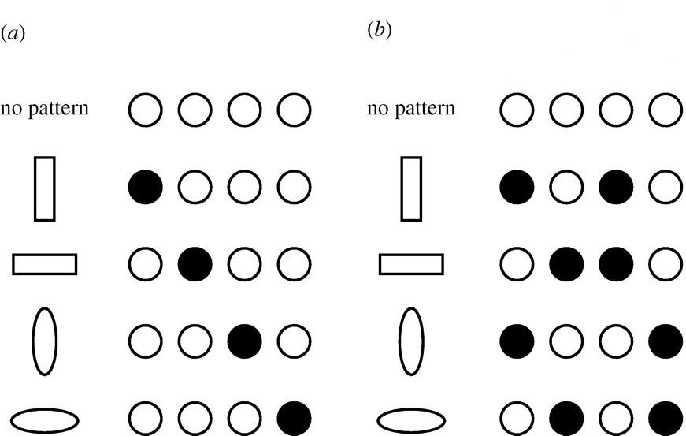
Distributed Representations Toy Example
Local vs Distributed
Slide Credit: Moontae Lee

Slide 44
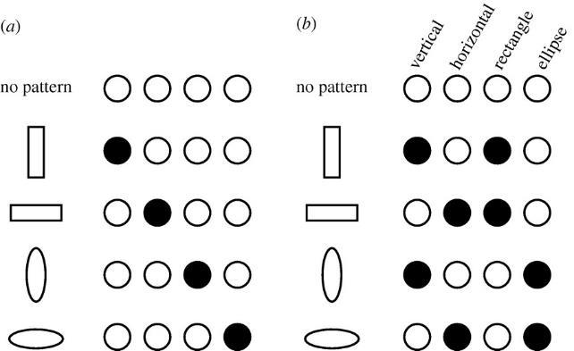
Distributed Representations Toy Example
Can we interpret each dimension?
Slide Credit: Moontae Lee

Slide 45
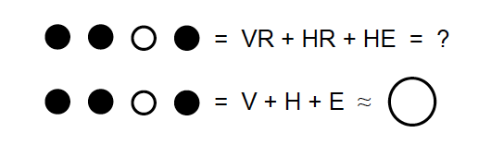
Power of distributed representations!
Local
Distributed
Slide Credit: Moontae Lee

Slide 46
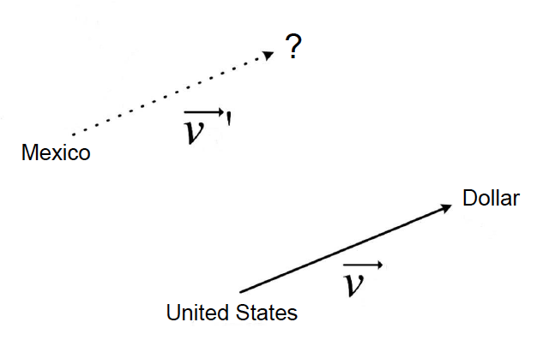
Power of distributed representations!
United States:Dollar :: Mexico:?
Slide Credit: Moontae Lee

Slide 47

Power of distributed representations!
Example: all face images of a person
  1000x1000 pixels = 1,000,000 dimensions
  But the face has 3 cartesian coordinates and 3 Euler angles
  And humans have less than about 50 muscles in the face
  Hence the manifold of face images for a person has <56 dimensions
The perfect representations of a face image:
  Its coordinates on the face manifold
  Its coordinates away from the manifold
Ideal
Feature
Extractor
Face/not face
Pose
Lighting
Expression
-----
Slide Credit: Marc'Aurelio Ranzato, Yann LeCun

Slide 48
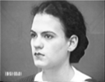
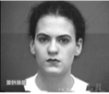

Power of distributed representations!
The Ideal Disentangling Feature Extractor
View
Pixel n
Ideal
Feature
Extractor
Pixel 2
Expression
Pixel 1
Slide Credit: Marc'Aurelio Ranzato, Yann LeCun

Slide 49
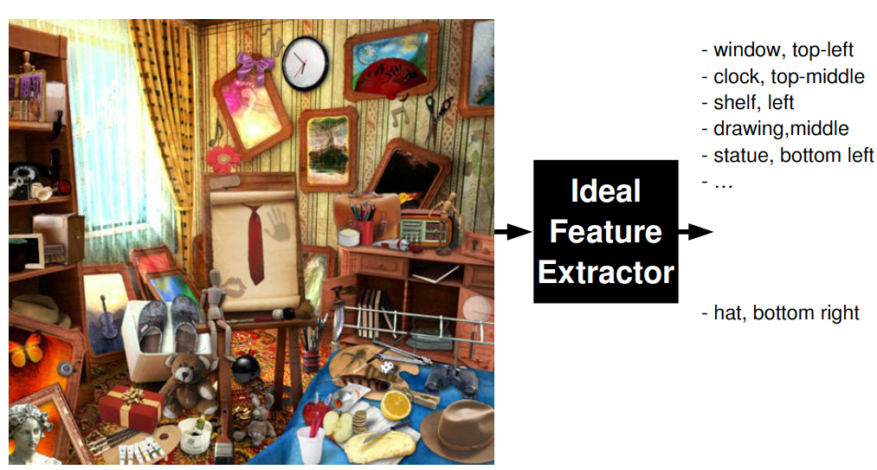
Distributed Representations
Q: What objects are in the image? Where?
Slide Credit: Marc'Aurelio Ranzato, Yann LeCun

Slide 50
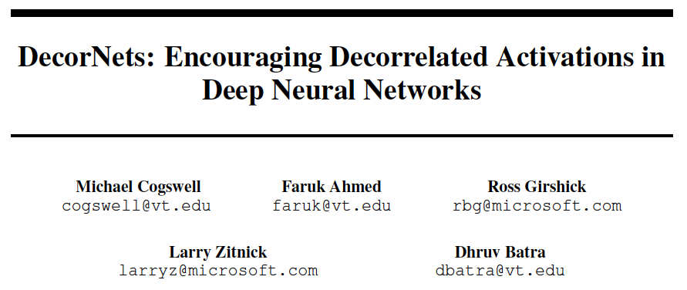
Power of distributed representations!

Slide 51
So what is Deep (Machine) Learning?
A few different ideas:
(Hierarchical) Compositionality
  Cascade of non-linear transformations
  Multiple layers of representations
End-to-End Learning
  Learning (goal-driven) representations
  Learning to feature extraction
Distributed Representations
  No single neuron “encodes” everything
  Groups of neurons work together

Slide 52
Benefits of Deep/Representation Learning
(Usually) Better Performance
  “Because gradient descent is better than you”
  Yann LeCun
New domains without “experts”
  RGBD
  Multi-spectral data
  Gene-expression data
  Unclear how to hand-engineer

Slide 53
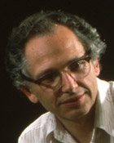
“Expert” intuitions can be misleading
“Every time I fire a linguist, the performance of our speech recognition system goes up”
  Fred Jelinik, IBM ’98
“Maybe the molecule didn’t go to graduate school”
  Will Welch defending the success of his approximate molecular screening algorithm, given that he’s a computer scientist, not a chemist
Database Screening for HIV Protease Ligands: The Influence of Binding-Site Conformation and Representation on Ligand Selectivity", Volker Schnecke, Leslie A. Kuhn, Proceedings of the Seventh International Conference on Intelligent Systems for Molecular Biology, Pages 242-251, AAAI Press, 1999.

Slide 54
Problems with Deep Learning
Problem#1: Non-Convex! Non-Convex! Non-Convex!
  Depth>=3: most losses non-convex in parameters
  Theoretically, all bets are off
  Leads to stochasticity
    different initializations → different local minima
Standard response #1
  “Yes, but all interesting learning problems are non-convex”
  For example, human learning
    Order matters → wave hands → non-convexity
Standard response #2
  “Yes, but it often works!”

Slide 55
Problems with Deep Learning
Problem#2: Hard to track down what’s failing
  Pipeline systems have “oracle” performances at each step
  In end-to-end systems, it’s hard to know why things are not working

Slide 56
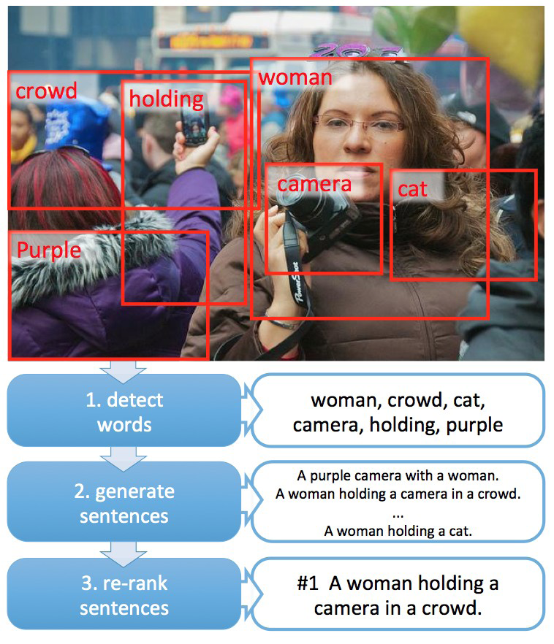
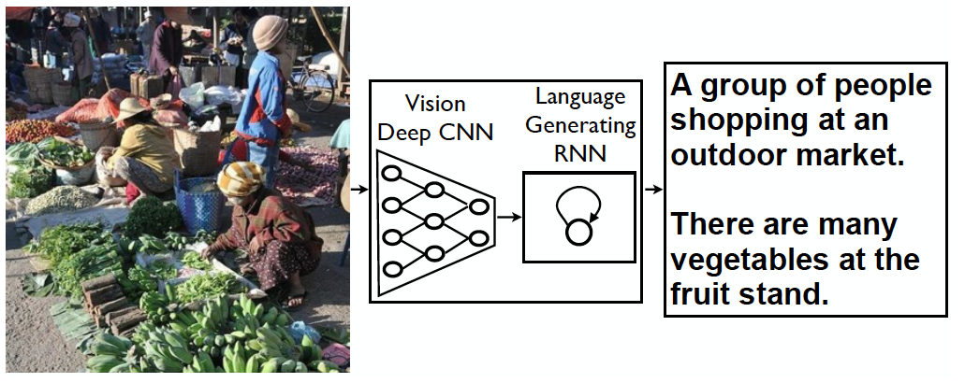
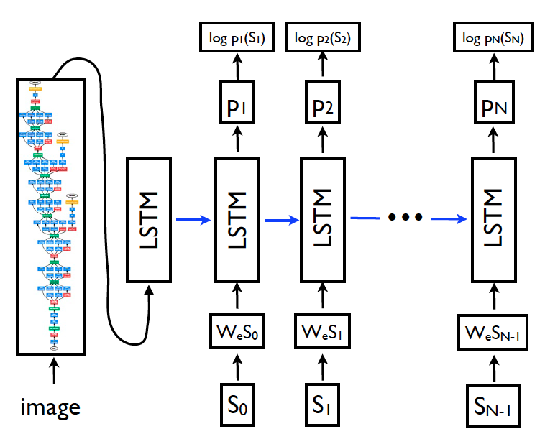
Problems with Deep Learning
Problem#2: Hard to track down what’s failing
[Fang et al. CVPR15]
[Vinyals et al. CVPR15]
Pipeline
End-to-End

Slide 57
Problems with Deep Learning
Problem#2: Hard to track down what’s failing
  Pipeline systems have “oracle” performances at each step
  In end-to-end systems, it’s hard to know why things are not working
Standard response #1
  Tricks of the trade: visualize features, add losses at different layers, pre-train to avoid degenerate initializations…
  “We’re working on it”
Standard response #2
  “Yes, but it often works!”

Slide 58
Problems with Deep Learning
Problem#3: Lack of easy reproducibility
  Direct consequence of stochasticity & non-convexity
Standard response #1
  It’s getting much better
  Standard toolkits/libraries/frameworks now available
  Caffe, Theano, Torch
Standard response #2
  “Yes, but it often works!”

Slide 59
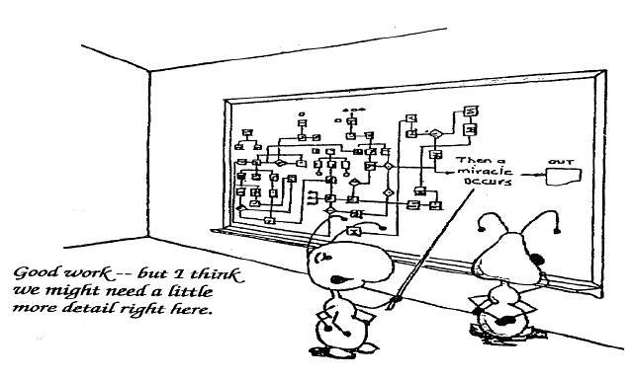
Yes it works, but how?

Slide 60
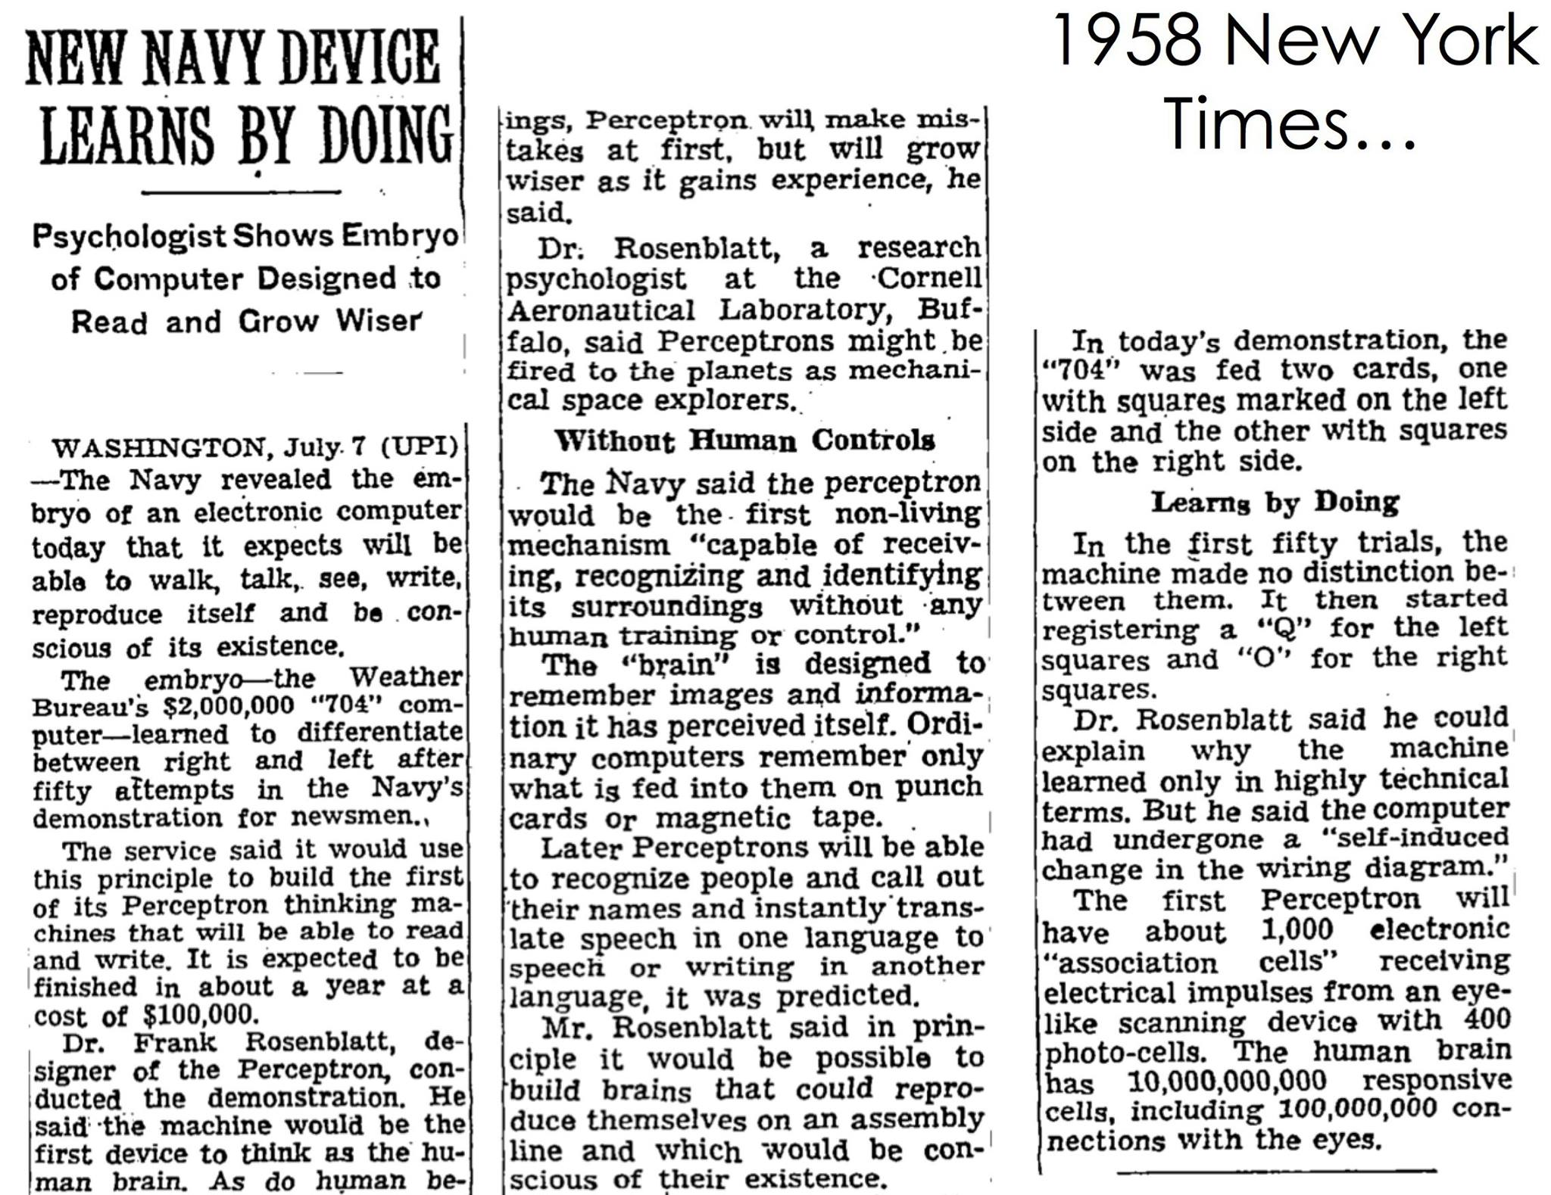

Slide 61
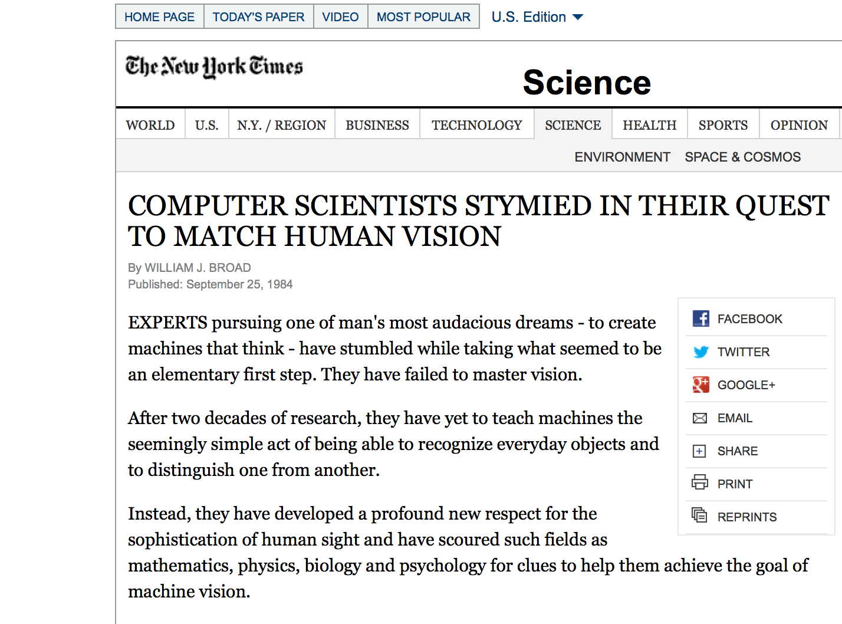

Slide 62
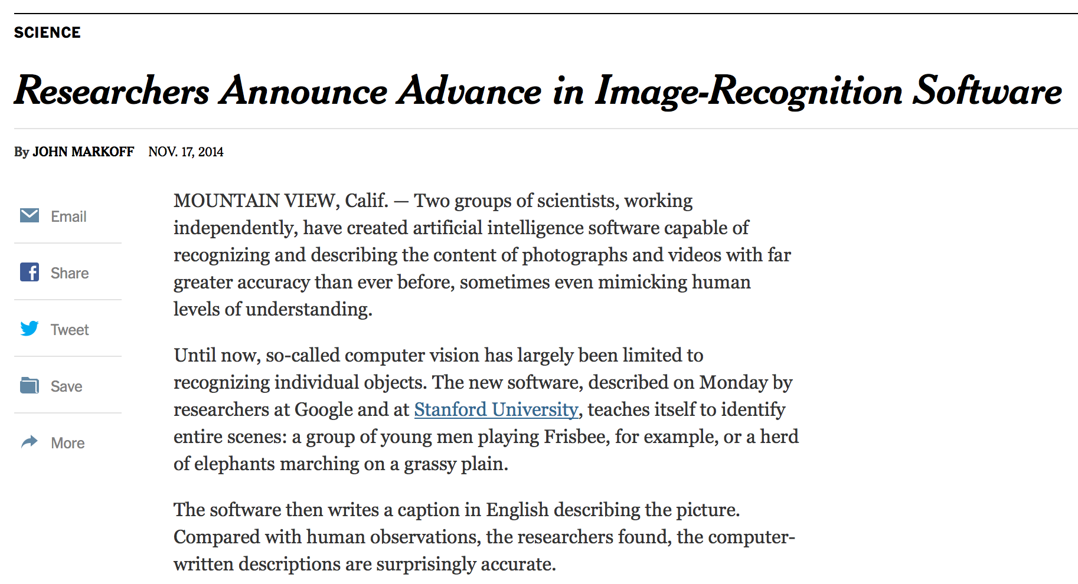

Slide 63
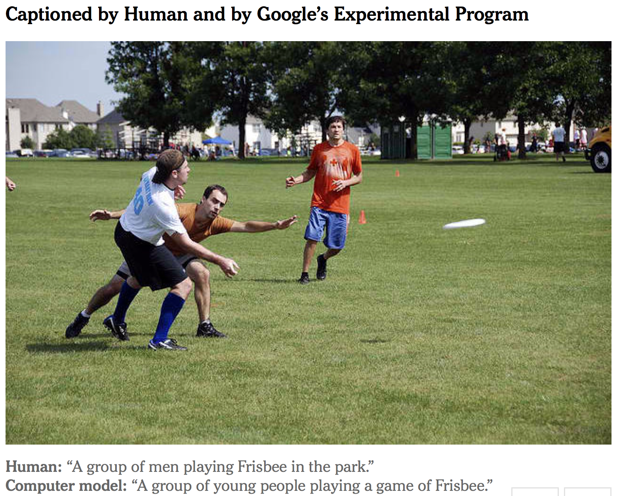

Slide 64
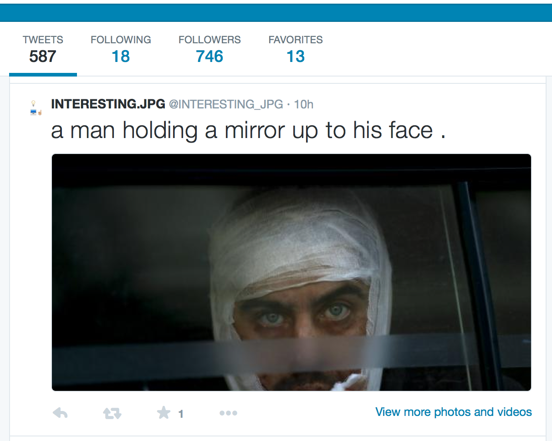
Results from @INTERESTING_JPG via http://deeplearning.cs.toronto.edu/i2t

Slide 65

Results from @INTERESTING_JPG via http://deeplearning.cs.toronto.edu/i2t

Slide 66

Results from @INTERESTING_JPG via http://deeplearning.cs.toronto.edu/i2t

Slide 67

Results from @INTERESTING_JPG via http://deeplearning.cs.toronto.edu/i2t

Slide 68

Results from @INTERESTING_JPG via http://deeplearning.cs.toronto.edu/i2t

Slide 69

ImageNet Large Scale Visual Recognition Challenge (ILSVRC)
Classification:
1000 object classes 1.4M/50k/100k images
Detection:
200 object classes 400k/20k/40k images
Dalmatian
http://image-net.org/challenges/LSVRC/{2010,…,2014}
Slide Credit: Li Fei-Fei

Slide 70



Data Enabling Richer Models
[Krizhevsky et al. NIPS12]
  54 million parameters; 8 layers (5 conv, 3 fully-connected)
  Trained on 1.4M images in ImageNet
  Better Regularization (Dropout)
Input Image
1k output
units
Convolution Layer
+ Non-Linearity
Pooling Layer
Convolution Layer
+ Non-Linearity
Pooling Layer
Fully-Connected MLP

Slide 71

ImageNet Classification 2012
[Krizhevsky et al. NIPS12]: 16.4% error
Next best team: 26.2% error

Slide 72

Other Domains & Applications
Vision
Natural Language Processing
Speech
Robotics
Game playing

Slide 73
Why are things working today?
More compute power
  GPUs are ~50x faster
More data
  10⁸ samples (compared to 10³ in 1990s)
Better algorithms/models/regularizers
  Dropout
  ReLu
  Batch-Normalization
  …

Slide 74
THE SPACE OF
MACHINE LEARNING METHODS
Slide Credit: Marc'Aurelio Ranzato, Yann LeCun

Slide 75
Recurrent Neural Net
Boosting
Convolutional Neural Net
Neural Net
Perceptron
SVM
Deep (sparse/denoising) Autoencoder
AutoencoderNeural Net
Sparse Coding
ΣΠ
GMM
Deep Belief Net
Restricted BM
BayesNP
Disclaimer: showing only a subset of the known methods
Slide Credit: Marc'Aurelio Ranzato, Yann LeCun

Slide 76
Recurrent Neural Net
SHALLOW
Boosting
Convolutional Neural Net
Neural Net
Perceptron
SVM
Deep (sparse/denoising) Autoencoder
AutoencoderNeural Net
Sparse Coding
ΣΠ
GMM
Deep Belief Net
Restricted BM
DEEP
BayesNP
Slide Credit: Marc'Aurelio Ranzato, Yann LeCun

Slide 77
Recurrent Neural Net
SHALLOW
Boosting
Convolutional Neural Net
Neural Net
Perceptron
SUPERVISED
SVM
UNSUPERVISED
Deep (sparse/denoising) Autoencoder
AutoencoderNeural Net
Sparse Coding
ΣΠ
GMM
Deep Belief Net
Restricted BM
DEEP
BayesNP
Slide Credit: Marc'Aurelio Ranzato, Yann LeCun

Slide 78
Recurrent Neural Net
SHALLOW
Boosting
Convolutional Neural Net
Neural Net
Perceptron
SUPERVISED
SVM
UNSUPERVISED
Deep (sparse/denoising) Autoencoder
AutoencoderNeural Net
PROBABILISTIC
Sparse Coding
ΣΠ
GMM
Deep Belief Net
Restricted BM
BayesNP
DEEP
Slide Credit: Marc'Aurelio Ranzato, Yann LeCun

Slide 79
Main types of deep architectures
Neural nets
Conv Nets
Hierar. Sparse Coding
Deconv Nets
feed-forward
Feed-back
input
input
Stacked
Auto-encoders
DBM
Recurrent Neural nets
Recursive Nets
LISTA
Bi-directional
Recurrent
input
input
Slide Credit: Marc'Aurelio Ranzato, Yann LeCun

Slide 80
Focus of this class
Neural nets
Conv Nets
Hierar. Sparse Coding
Deconv Nets
feed-forward
Feed-back
input
input
Stacked
Auto-encoders
DBM
Recurrent Neural nets
Recursive Nets
LISTA
Bi-directional
Recurrent
input
input
Slide Credit: Marc'Aurelio Ranzato, Yann LeCun

Slide 81
Main types of learning protocols
Purely supervised
    Backprop + SGD
  Good when there is lots of labeled data.
Layer-wise unsupervised + superv. linear classifier
    Train each layer in sequence using regularized auto-encoders or RBMs
    Hold fix the feature extractor, train linear classifier on features
  Good when labeled data is scarce but there is lots of unlabeled data.
Layer-wise unsupervised + supervised backprop
    Train each layer in sequence
    Backprop through the whole system
  Good when learning problem is very difficult.
Slide Credit: Marc'Aurelio Ranzato, Yann LeCun

Slide 82
Focus of this class
Purely supervised
    Backprop + SGD
  Good when there is lots of labeled data.
Layer-wise unsupervised + superv. linear classifier
    Train each layer in sequence using regularized auto-encoders or RBMs
    Hold fix the feature extractor, train linear classifier on features
  Good when labeled data is scarce but there is lots of unlabeled data.
Layer-wise unsupervised + supervised backprop
    Train each layer in sequence
    Backprop through the whole system
  Good when learning problem is very difficult.
Slide Credit: Marc'Aurelio Ranzato, Yann LeCun

Slide 83


Slide 84


Slide 85
Logistic Regression as a Cascade
Given a library of simple functions
Compose into a
complicate function
Slide Credit: Marc'Aurelio Ranzato, Yann LeCun

Slide 86

Logistic Regression as a Cascade
Given a library of simple functions
Compose into a
complicate function
Slide Credit: Marc'Aurelio Ranzato, Yann LeCun

Slide 87

Chain Rule
Slide Credit: Marc'Aurelio Ranzato, Yann LeCun

Slide 88
Chain Rule
Slide Credit: Marc'Aurelio Ranzato, Yann LeCun

Slide 89
Chain Rule: All local
Slide Credit: Marc'Aurelio Ranzato, Yann LeCun

Slide 90

Logistic Regression as a Cascade
Slide Credit: Marc'Aurelio Ranzato, Yann LeCun

Slide 91
Logistic Regression as a Cascade
Slide Credit: Marc'Aurelio Ranzato, Yann LeCun

Slide 92
Logistic Regression as a Cascade
Slide Credit: Marc'Aurelio Ranzato, Yann LeCun

Slide 93

Key Computation: Forward-Prop
Slide Credit: Marc'Aurelio Ranzato, Yann LeCun

Slide 94

Key Computation: Back-Prop
Slide Credit: Marc'Aurelio Ranzato, Yann LeCun

Slide 95

Neural Network Training
Step 1: Compute Loss on mini-batch [F-Pass]
Slide Credit: Marc'Aurelio Ranzato, Yann LeCun

Slide 96
Neural Network Training
Step 1: Compute Loss on mini-batch [F-Pass]
Slide Credit: Marc'Aurelio Ranzato, Yann LeCun

Slide 97
Neural Network Training
Step 1: Compute Loss on mini-batch [F-Pass]
Slide Credit: Marc'Aurelio Ranzato, Yann LeCun

Slide 98
Neural Network Training
Step 1: Compute Loss on mini-batch [F-Pass]
Step 2: Compute gradients wrt parameters [B-Pass]
Slide Credit: Marc'Aurelio Ranzato, Yann LeCun

Slide 99
Neural Network Training
Step 1: Compute Loss on mini-batch [F-Pass]
Step 2: Compute gradients wrt parameters [B-Pass]
Slide Credit: Marc'Aurelio Ranzato, Yann LeCun

Slide 100
Neural Network Training
Step 1: Compute Loss on mini-batch [F-Pass]
Step 2: Compute gradients wrt parameters [B-Pass]
Slide Credit: Marc'Aurelio Ranzato, Yann LeCun

Slide 101

Neural Network Training
Step 1: Compute Loss on mini-batch [F-Pass]
Step 2: Compute gradients wrt parameters [B-Pass]
Step 3: Use gradient to update parameters
Slide Credit: Marc'Aurelio Ranzato, Yann LeCun

Slide 102

Neural Network Training
Step 1: Compute Loss on mini-batch [F-Pass]
Step 2: Compute gradients wrt parameters [B-Pass]
Step 3: Use gradient to update parameters
  With momemtum
Slide Credit: Marc'Aurelio Ranzato, Yann LeCun

Slide 103
Course Information
Instructor: Dhruv Batra
  dbatra@vt
  Office Hours: Fri 3-4pm
  Location: 468 Whittemore

Slide 104


TAs
Ashwin Kalyan
B. Tech., NIT Surathkal
https://sites.google.com/site/ashwinkalyanv/
Abhishek Das
B. Tech., IIT Roorkee
http://abhishekdas.com/

Slide 105
Syllabus
Background & Basics
    Neural Networks, Backprop, Optimization (SGD)
Module 1: Convolutional Neural Networks (CNNs)
    Architectures, Pre-training, Fine-tuning
    Visualizations, Fooling ConvNets, Adversarial examples, Inverting Representations
    Different tasks: segmentation ConvNets
Module 2: Recurrent Neural Networks (RNNs)
    Difficulty of learning; “Vanilla” RNNs, LSTMs, GRU
    RNNs for Sequence-to-Sequence (machine translation & image captioning)
Module 3: Beyond RNNs
    CNNs + RNNs for Visual Question Answering (VQA)
    Learning to execute, Memory Networks
Module 4: Advanced Topics
    Bayesian Neural Networks, Hyper-parameter optimization
    Different regularizers

Slide 106
Syllabus
You will learn about the methods you heard about
But we are not teaching “how to use a toolbox”
You will understand algorithms, theory, applications, and implementations
It’s going to be FUN and HARD WORK ☺

Slide 107
Prerequisites
Intro Machine Learning
  Classifiers, regressors, loss functions, MLE, MAP
Linear Algebra
  Matrix multiplication, eigenvalues, positive semi-definiteness…
Calculus
  Multi-variate gradients, hessians, jacobians…

Slide 108

Prerequisites
Intro Machine Learning
  Classifiers, regressors, loss functions, MLE, MAP
Linear Algebra
  Matrix multiplication, eigenvalues, positive semi-definiteness…
Calculus
  Multi-variate gradients, hessians, jacobians…

Slide 109
Prerequisites
Intro Machine Learning
  Classifiers, regressors, loss functions, MLE, MAP
Linear Algebra
  Matrix multiplication, eigenvalues, positive semi-definiteness…
Calculus
  Multi-variate gradients, hessians, jacobians…
Programming!
  Homeworks will require Python, C++, and Lua!
  Libraries/Frameworks: Caffe and Torch
  HW0 (pure python), HW1 (python + Caffe),
  HW2 (Caffe), HW3+4 (Torch)
  Your language of choice for project

Slide 110

Prerequisites
Intro Machine Learning
  Classifiers, regressors, loss functions, MLE, MAP
Linear Algebra
  Matrix multiplication, eigenvalues, positive semi-definiteness…
Calculus
  Multi-variate gradients, hessians, jacobians…
Programming!
  Homeworks will require Python, C++, and Lua!
  Libraries/Frameworks: Caffe and Torch
  HW0 (pure python), HW1 (python + Caffe),
  HW2 (Caffe), HW3+4 (Torch)
  Your language of choice for project

Slide 111
Organization & Deliverables
4 homeworks (40%)
  First one goes out next week
    Start early, Start early, Start early, Start early, Start early, Start early, Start early, Start early, Start early, Start early
Paper Reviews (15%)
  Read 1 paper per class
  Submit reviews before class
Paper Presentations (15%)
  [Tentative] 1 presentation in the semester
  Practice run with a TA 3-4 days before scheduled date
Final project (25%)
  Projects done individually, or groups of two students
Class Participation (5%)
  Contribute to class discussions on Scholar
  Ask questions, answer questions

Slide 112
Homeworks
Homeworks are hard, start early!
  Due in 2 weeks via Scholar (Assignments tool)
  Pure Implementation
  Kaggle Competitions:
    https://inclass.kaggle.com/c/VT-ECE-Machine-Learning-HW1
“Free” Late Days
  5 late days for the semester
    Use for HW, project proposal/report
    Cannot use for HW0, reviews, or presentations
  After free late days are used up:
    25% penalty for each late day

Slide 113
HW0
Out today; due Monday (08/31)
  Available on class webpage + Scholar
Grading
  Does not count towards grade.
  BUT Pass/Fail.
  <=75% means that you might not be prepared for the class
Topics
  Implement a multi-class SVM and soft-max classifier
  SGD on two different losses
  Hyperparameter optimization with a standard package

Slide 114
Paper Reviews
Length
  <=1 page, 11 pt Times New Roman, 1 inch margins
Due: Midnight before class
Organization
  Summary:
    What is this paper about? What is the main contribution? Describe the main approach & results. Just facts, no opinions yet.
  List of positive points / Strengths:
    Is there a new theoretical insight? Or a significant empirical advance? Did they solve a standing open problem? Or is a good formulation for a new problem? Or a faster/better solution for an existing problem? Any good practical outcome (code, algorithm, etc)? Are the experiments well executed? Useful for the community in general?
  List of negative points / Weaknesses:
    What would you do differently? Any missing baselines? missing datasets? any odd design choices in the algorithm not explained well? quality of writing? Is there sufficient novelty in what they propose? Has it already been done? Minor variation of previous work? Why should anyone care? Is the problem interesting and significant?
  Reflections
    How does this relate to other papers we have read? What are the next research directions in this line of work?

Slide 115
Presentations
Frequency
  [Tentative] Once in the semester
Expectations
  Read all papers for that day
  Overview of that day’s theme (e.g. Visualizing ConvNets)
  Present details of at least 2 papers in detail
    Describe formulation, experiment, approaches, datasets
    Encouraged to present a broad picture
    Show results; demo code if possible
  How do different papers related to each other?
  Please clearly cite the source of each slide that is not your own.
  No review needed
  Meet with TA 3-4 days before class to dry run presentation
    Worth 40% of presentation grade

Slide 116
Project
Goal
  Chance to try Deep Learning
  Encouraged to apply to your research (computer vision, NLP, UAVs, computational biology…)
  Must be done this semester. No double counting.
  Can combine with other classes
    get permission from both instructors; delineate different parts
  Extra credit for shooting for a publication
Main categories
  Application/Survey
    Compare a bunch of existing algorithms on a new application domain of your interest
  Formulation/Development
    Formulate a new model or algorithm for a new or old problem
  Theory
    Theoretically analyze an existing algorithm

Slide 117

Spring 2013 Projects
Poster/Demo Session

Slide 118

Spring 2013 Projects
Gesture Activated Interactive Assistant
  Gordon Christie & Ujwal Krothpalli, Grad Students
  http://youtu.be/VFPAHY7th9A?t=42s

Slide 119


Spring 2013 Projects
American Sign Language Detection
  Vireshwar Kumar & Dhiraj Amuru, Grad Students

Slide 120
Re-grading Policy
Homework assignments
  Within 1 week of receiving grades: see the TAs
This is an advanced grad class.
  The goal is understanding the material and making progress towards our research.

Slide 121
Collaboration Policy
Collaboration
  Only on HWs and project (not allowed in HW0).
  You may discuss the questions
  Each student writes their own answers
  Write on your homework anyone with whom you collaborate
  Each student must write their own code for the programming part
Zero tolerance on plagiarism
  Neither ethical nor in your best interest
  Always credit your sources
  Don’t cheat. We will find out.

Slide 122
Waitlist / Audit / Sit in
Waitlist
  Do HW0. Come to first few classes.
  Let’s see how many people drop.
Audit
  Make presentation
Sitting in
  Talk to instructor.

Slide 123
Communication Channels
Primary means of communication -- Scholar Forum
  No direct emails to Instructor unless private information
  Instructor/TAs can provide answers to everyone on forum
  Class participation credit for answering questions!
  No posting answers. We will monitor.
Staff Mailing List
  f15ece6504-staff-g@vt.edu
Class websites:
  https://scholar.vt.edu/portal/site/f15ece6504
  https://computing.ece.vt.edu/~f15ece6504/
Office Hours

Slide 124
How to do well in class?
Come to class!
  Sit in front; ask question
  This is the most important thing you can do
One point
  No laptops or screens in class

Slide 125
Other Relevant Classes
https://filebox.ece.vt.edu/~dbatra/faq.html

Slide 126
Todo
HW0
  Due Monday 11:55pm
Paper Presentations
  Start looking at schedule
  Find papers you are interested in

Slide 127

Welcome

