Slide 1
Show and Tell: A Neural Image Caption Generator
Oriol Vinyals, Google
Alexander Toshev, Google
Samy Bengio, Google
Dumitru Erhan, Google

Slide 2
Example

Slide 3
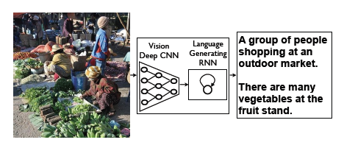
System flowchart

Slide 4
Introduction
Generative model
CNN (vision) + LSTM (language)
End-to-end system trained to maximize likelihood of target description given image
State-of-the-art results
PASCAL dataset: BLEU-1: 25 → 59
Flickr30k dataset: BLEU-1: 55 → 66
MS COCO: BLEU-4 score of 27.7

Slide 5
Introduction
Motivation from Machine Translation: encoder RNN and decoder RNN
Replace encoder RNN with deep CNN
Produces a rich representation of input image
Fully trainable network

Slide 6
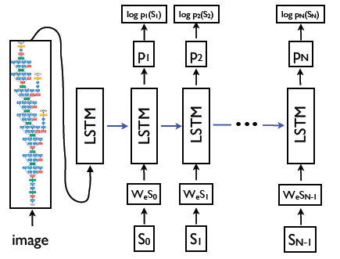
Model

Slide 7
Model
Objective: maximize probability of correct description given the image
Chain rule for joint probability over words of sentence S
Optimize sum of log probabilities over whole training set
Loss function: negative log likelihood of the correct word

Slide 8
Sentence generation
Two approaches
Sampling: sample one word from probability distribution p_{i} and feed the corresponding embedding as input at the next time step until an EOS token is sampled or till a maximum length
Beam search: keep k best sentences at each time
The paper used a beam size of 20
Beam size of 1 degrades results by 2 BLEU points

Slide 9
Training details
Datasets are smaller
Solution
Transfer learning
Dropout
Ensembling
Can initialize weights of CNN
trained for classification task on ImageNet

Slide 11
Evaluation
BLEU score for generation
Recall and mean rank for ranking
Mechanical Turk experiment: human subjects give a score on the usefulness of descriptions
Also use perplexity for hyperparameter tuning but not reported

Slide 12
Results – Sentence generation

Slide 13
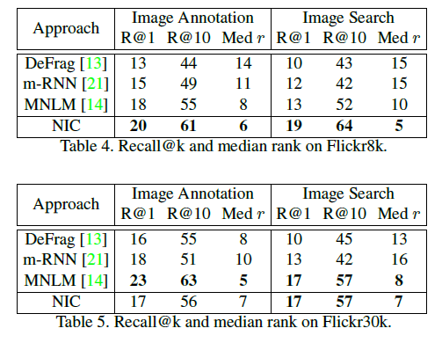
Results – Reranking

Slide 14
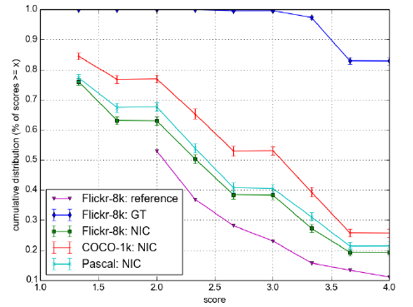
Results – Human Evaluation

Slide 15
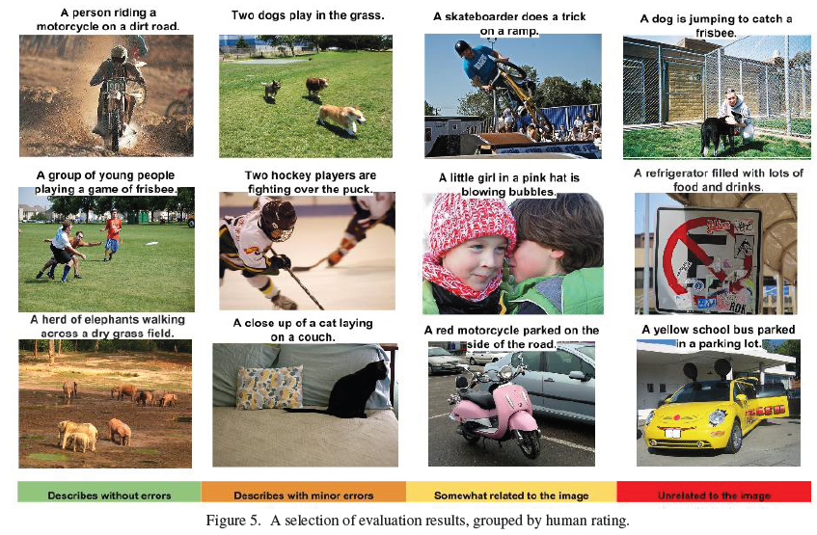

Slide 16
Other results
Transfer learning
Flickr30k to Flickr8k improves BLEU score by 4 points
Generation diversity
Best candidate sentence is present in training set 80% of the times.

Slide 17
Good example

Slide 18
Bad example

Slide 19
Mind’s Eye: A Recurrent Visual Representation for Image Caption Generation
Xinlei Chen, CMU
C. Lawrence Zitnick, MSR, Redmond

Slide 20
Introduction
Motivation: A good image description is often said to “paint a picture in your mind’s eye.”
Objective: To learn bi-directional representation that can generate
novel descriptions from images, and
visual representations from descriptions.

Slide 26
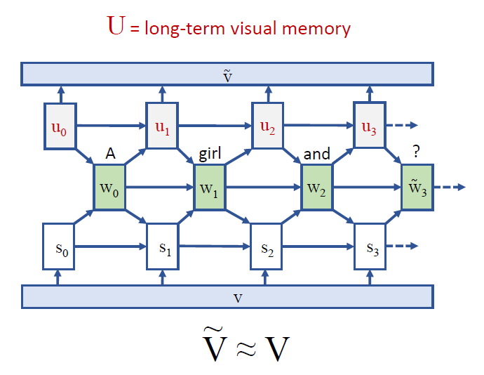
Model

Slide 27
Objective
Objective function consists of two components:
probability of a word $w_{t}$ being generated at time $t$given the set of previously generated words $W_{t−1}$ and the observed visual features $V$,
likelihood of visual features $V$ given a set of spoken or read words $W_{t}$ for generating visual representations of the scene or for performing image search
A set of latent variables $U_{t}$ encodes the visual interpretations of the previously seen words $W_{t}$
Objective function
$$\max{P\left(w_{t}, V\right| W_{t−1}, U_{t−1})=P\left(w_{t}\right| V, W_{t−1}, U_{t−1}) P\left(V\right| W_{t−1}, U_{t−1})}$$

Slide 28
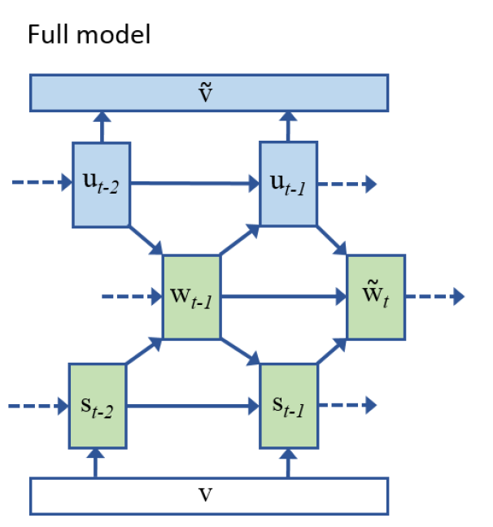
Model
Main contribution is the addition of recurrent visual hidden layer u
Recurrent layer u tries to reconstruct visual features v
Visual hidden layer u is also used to predict the next word

Slide 29
Hidden visual units u

Slide 30
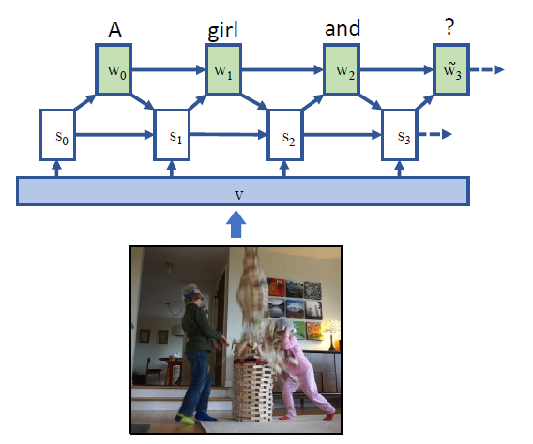
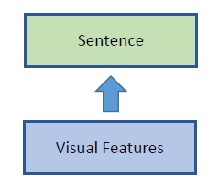
Recurrent Neural Networks

Slide 31
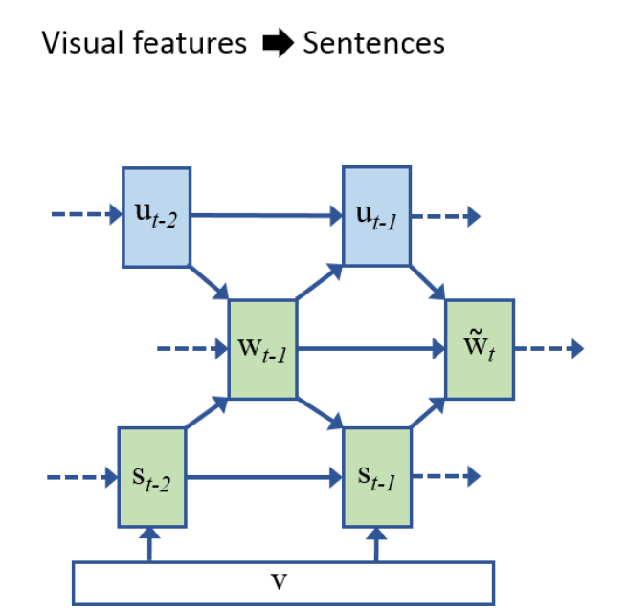
This model
For generating sentences,
v are known,
$ṽ$ are ignored.
Uses hidden representations s as well as visual interpretations u to predict words w

Slide 32
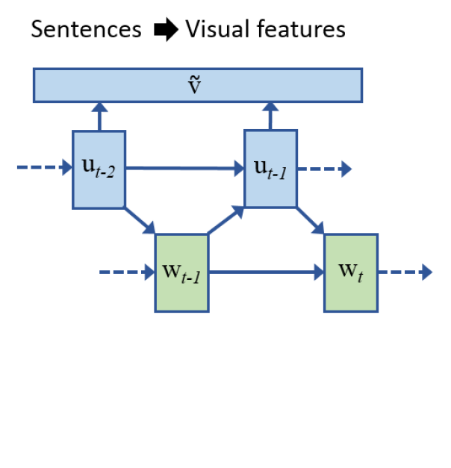
Model
While predicting visual features $ṽ$ from sentences,
w are known,
s and v are ignored.
Visual interpretations u are used to reconstruct visual features $ṽ$.

Slide 33
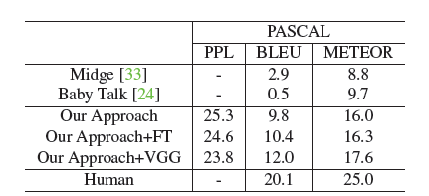
Results – Sentence generation

Slide 34
Results – Sentence generation

Slide 35
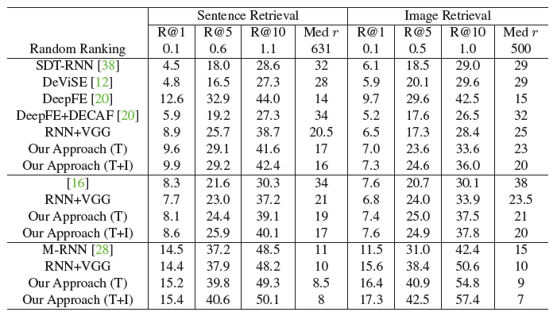
Results – Retrieval tasks

Slide 36
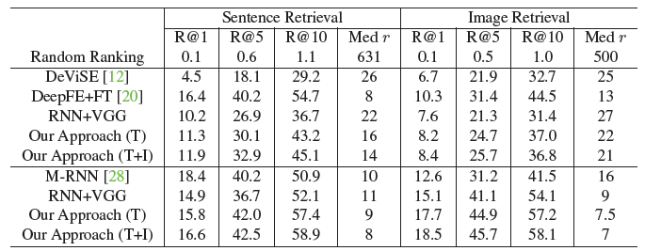
Results – Retrieval tasks

Slide 37
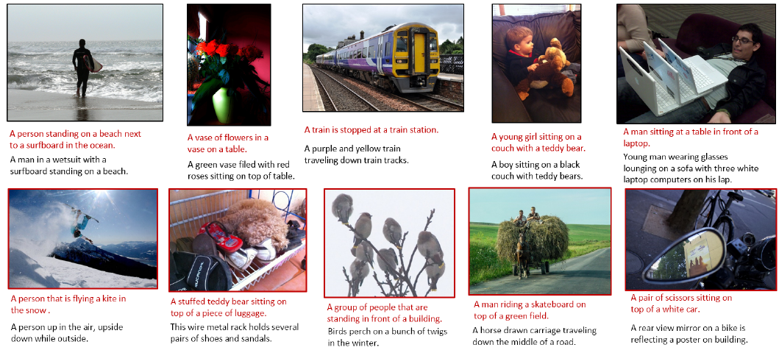
Qualitative results

Slide 38
Questions ?

